Slide 1
Annual Summary Report
And GIS Q&A 1/7/2016
w
Will start at 2 pm

Slide 2
Toggle Fullscreen
mode with this button
above
Use Chat box to ask Questions
Participant phone lines will be muted until after initial presentation
http://metrocount.com
Audio also available via phone: 866-823-7699
For assistance, call: 814-865-5355

Slide 3
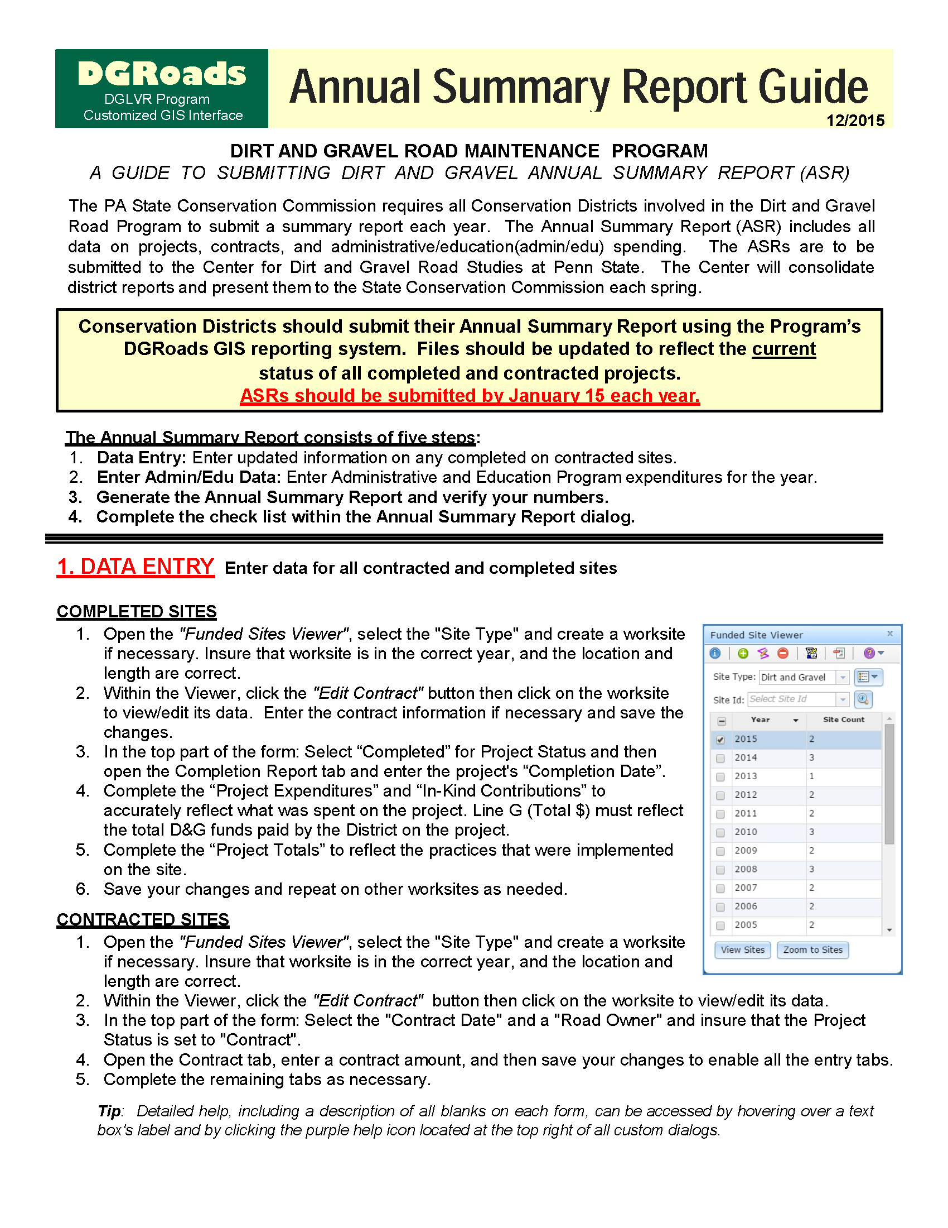

Slide 5
File Download
ASR Guide
http://www.dirtandgravel.psu.edu/pa-program-resources/program-specific-resources/reference-material

