Slide 1
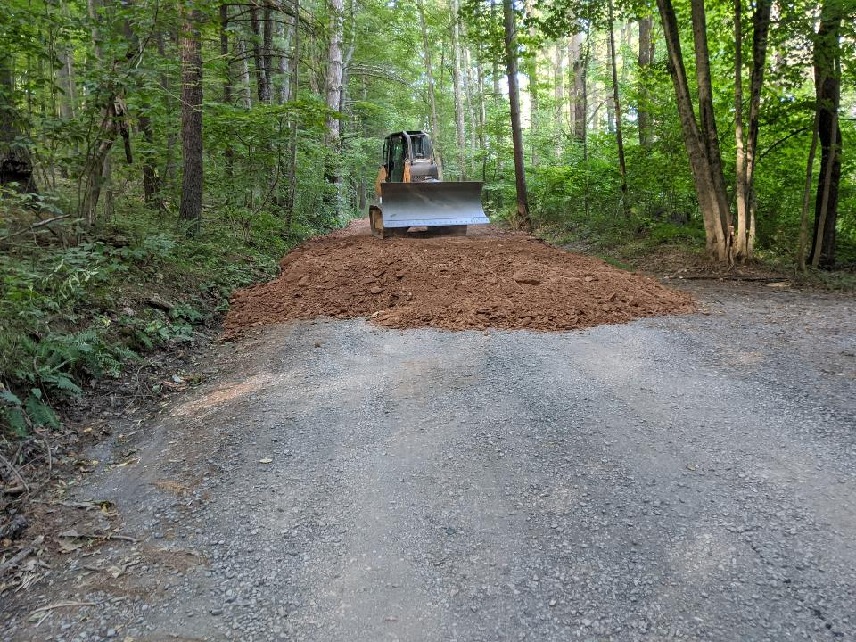
Dirt Gravel and Low Volume Road Program
Remote Training
Road Fill
Eric Nevel- CDGRS
Steve Bloser - CDGRS
www.dirtandgravelroads.org
5/20/2021 Starts at 9am
If you are reading this, then you are successfully seeing the webinar video. Webinar audio should be automatic through your computer (or click “join audio”), and options can be accessed in the “audio options” button on the bottom left. If your computer audio is not working, you can listen on your phone by dialing 312-626-6799.
Audio via Phone if needed: 312-626-6799
Webinar ID: 998 9453 7275

Slide 2
Road Fill
Filling Road Cross-Section
Purpose:
Review an expanded version (compared to ESM training) of road fill with additional examples.
Review available “Request for Quote” for road fill
Notes:
Helps With Drainage On Entrenched Roads
This technique can really help with drainage issues on entrenched roads.

Slide 3
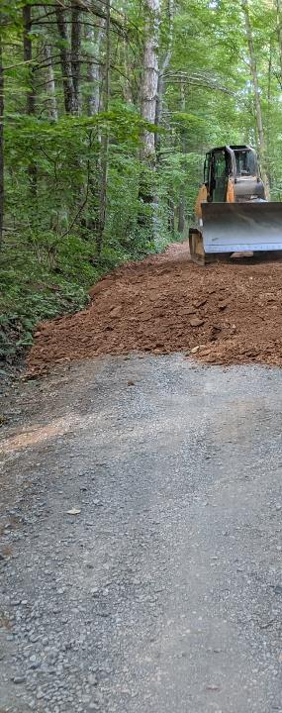
Road Fill
Road Fill
Background
Filling the Road Profile
Other Considerations
Types of Fill
Introduction to RFQ
Notes:
Helps With Drainage On Entrenched Roads
This technique can really help with drainage issues on entrenched roads.

Slide 4
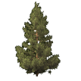
Natural Landscape
Introduction
How Roads Affect the Land
Surface drainage patterns
SUBSURFACE DRAINAGE PATTERNS
SUBSURFACE DRAINAGE PATTERNS
Sub-surface drainage patterns
Notes:
The effects of increased erosion are many, but the biggest are increased maintenance problems, as well as excess sediment and chemical runoff to the streams.

Slide 5
Roads Intercept Natural Drainage
Introduction
How Roads Affect the Land
Surface drainage patterns
Sub-surface drainage patterns
Notes:
The effects of increased erosion are many, but the biggest are increased maintenance problems, as well as excess sediment and chemical runoff to the streams.

Slide 6
Roads Intercept Natural Drainage
Surface drainage patterns
Sub-surface drainage patterns
Notes:
The effects of increased erosion are many, but the biggest are increased maintenance problems, as well as excess sediment and chemical runoff to the streams.

Slide 7
ESMP
Avoid Concentrating Drainage
Minimize Flow Volumes
Reduce Effects of Concentrated Drainage
Prevent Surface Erosion
Reduce Cost and Frequency of Road Maintenance
These are the goals of ALL of the practices in the DGLVR Program
Notes:
ALL ESMPs have these five goals
These five principles are the goals of ALL of the Environmentally Sensitive Maintenance Practices we will discuss in the next two days.

Slide 8
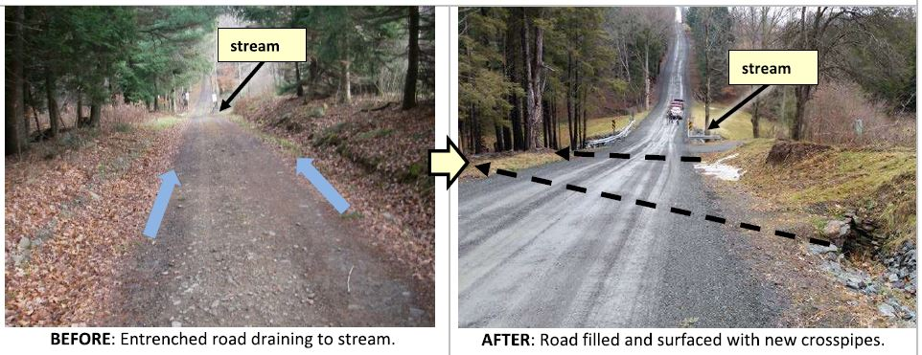
Road Fill
Drainage Disconnection and infiltration are the goals of the DGLVR Program
Hallmarks of the DGLVR program
Keeping sediment & excess runoff out of the stream
Getting water into the ground

Slide 9
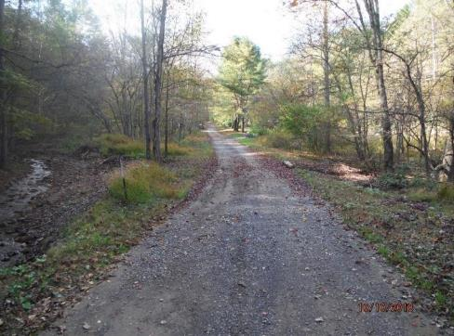
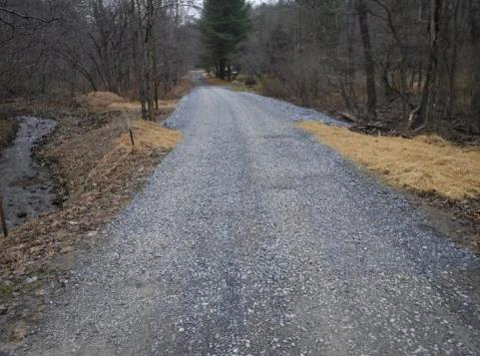
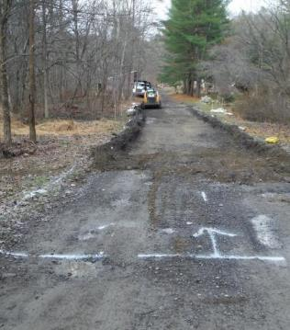
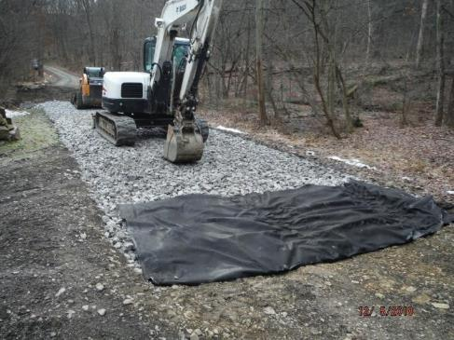
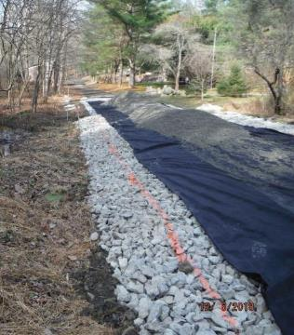
BEFORE
AFTER
2018 DnG 1/1
Centre County, Yeager Hollow Road
$35K Grant
Summary:
Frequently flooded and soft section of road
Large French Mattress and road fill
DURING
DURING
DURING

Slide 10
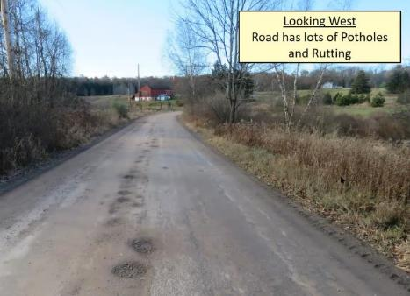
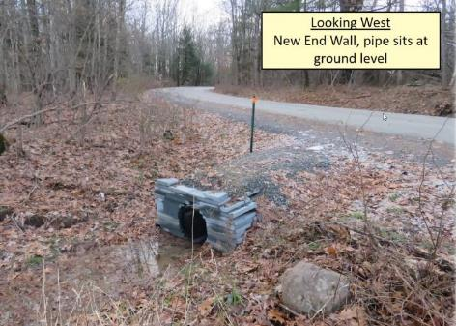
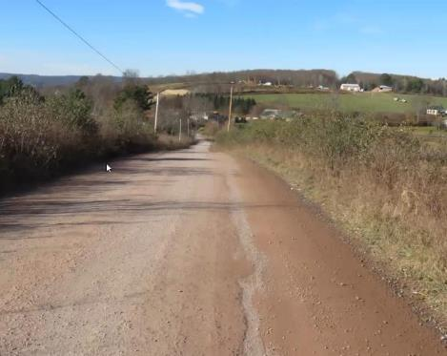
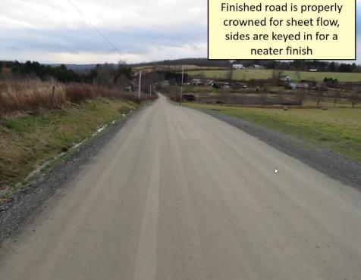
BEFORE
AFTER
2018 DnG 1/1
Wayne County, Adams Pond Road
$92K Grants, $17K In-kind
Summary:
Mile long site with poor base
9 New shallow crosspipes installed, ditches reshaped and stabilized
Base improvement and DSA
BEFORE
AFTER

Slide 11
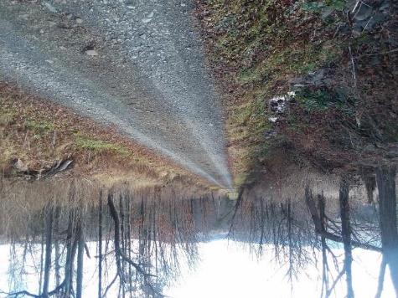
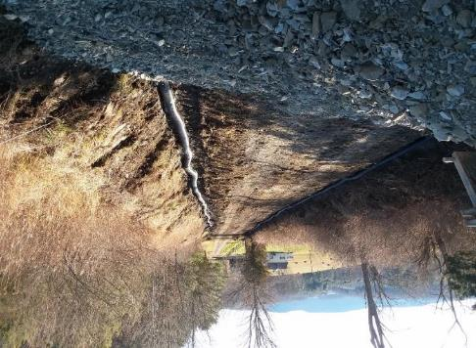
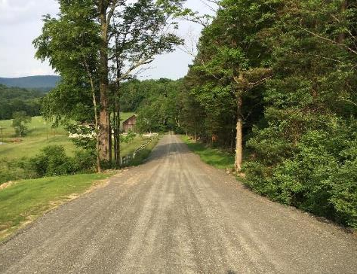
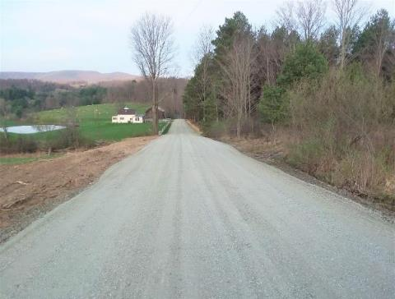
BEFORE
DURING
2018 DnG 1/1
Bradford County, Jung Road
$92K Grants, $15K In-kind
Summary:
Severely entrenched saturated road
~9,000 tons fill added to achieve sheet flow
1,300 feet of underdrain, new pipes, ditch stabilization
DURING
AFTER

Slide 12
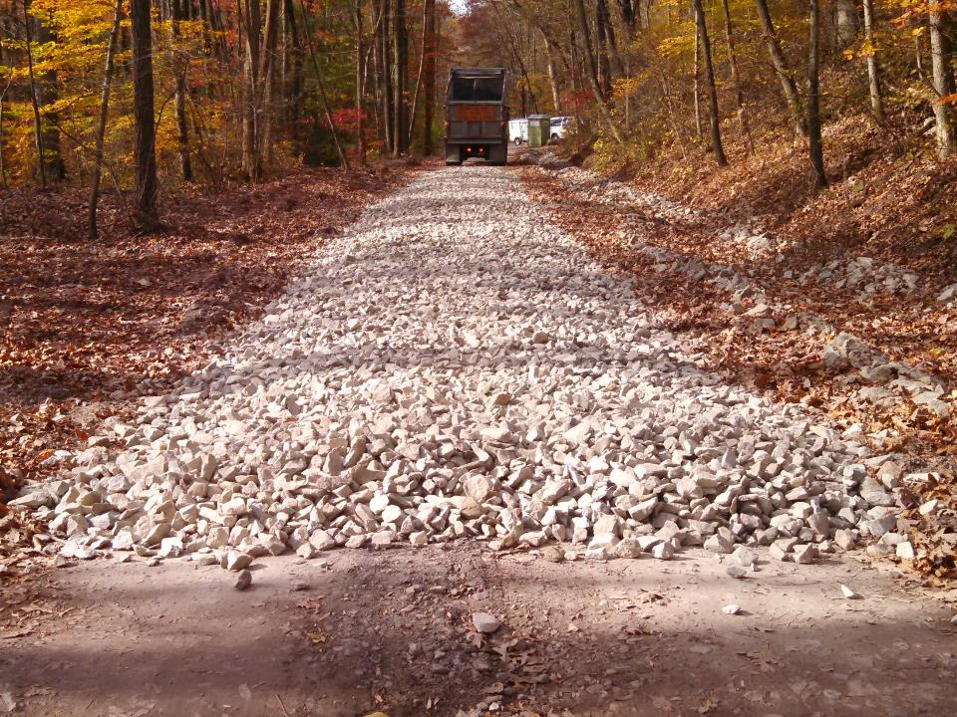
Environmentally Sensitive Maintenance for Dirt & Gravel Roads
Road Base

Slide 13
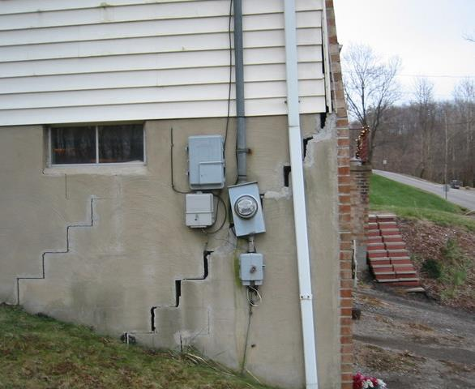
Road Base: Introduction
The most important part of a building is the part you can’t see. Roads are the same.
https://soilsmatter.wordpress.com/

Slide 14
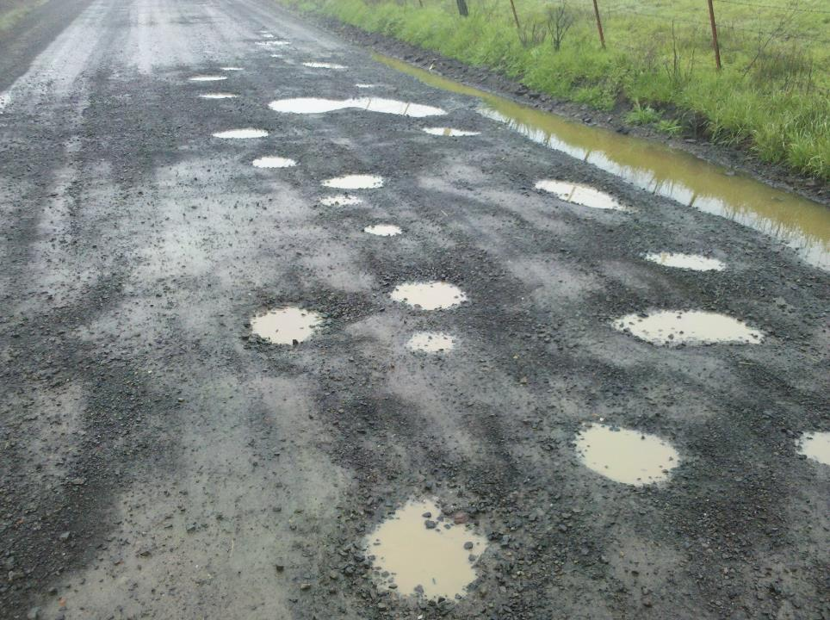
Road Base: Introduction
It’s impossible to properly maintain the road surface if underlying problems are the cause.
Surface irregularities will hold water, which will further degrade the surface and base and swallow tons of expensive aggregate.

Slide 15
Ideal Unpaved Road Cross Section
Road Base: Introduction
(often does not exist)
Base: free-draining base (2A, etc)
Sub-base: larger support rock
Surface: dense and compact
Subgrade: native earth

Slide 16
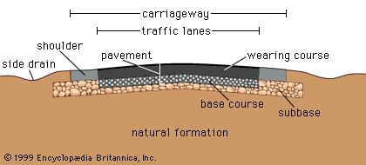
Ideal Paved Road Cross Section
Road Base: Introduction
(Subgrade)

Slide 17
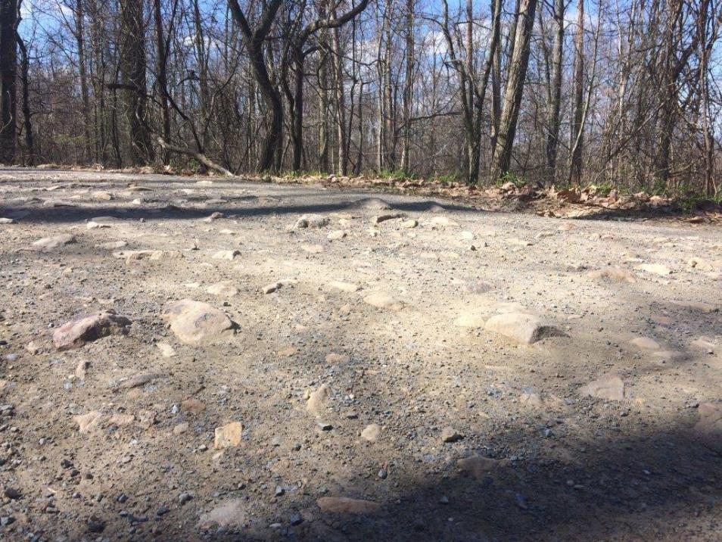
Road Base: Introduction
Geology
Geology
Soils
Soil Moisture
Freeze-thaw
Traffic Loads

Slide 18
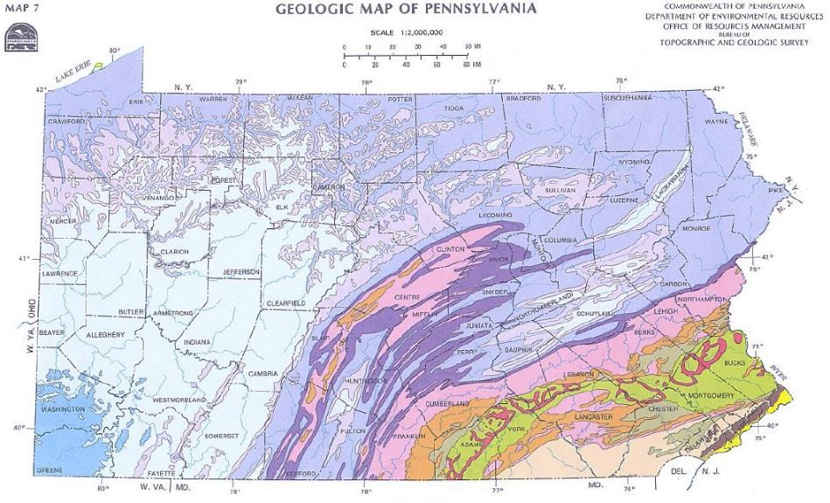
Road Base: Introduction
Geology
what do you have to work with?
18

Slide 19
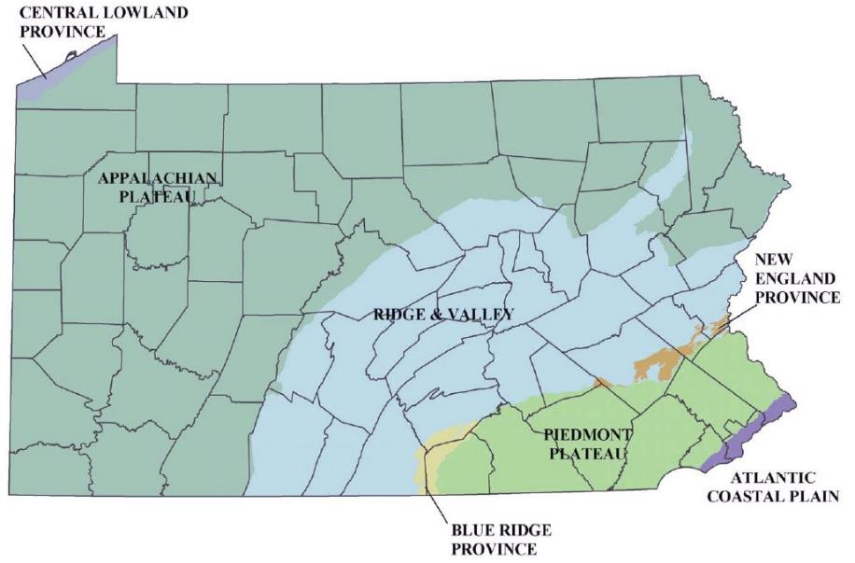
Road Base: Introduction
Geology
Physiographic Provinces
Glacial Soils
Glacial Soils
Glacial Soil Issues
- Water/frost susceptibility
- High clay/silt content
- Rounded gravel (lacks angularity)

Slide 20
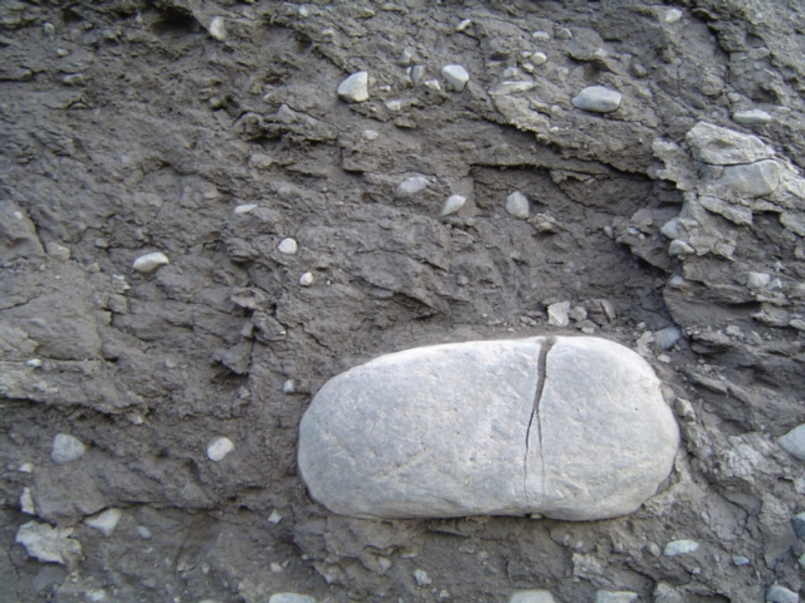
Road Base: Introduction
Geology
Glacial Soil Issues
- Water/frost susceptibility
- High clay/silt content
- Rounded gravel (lacks angularity)

Slide 21
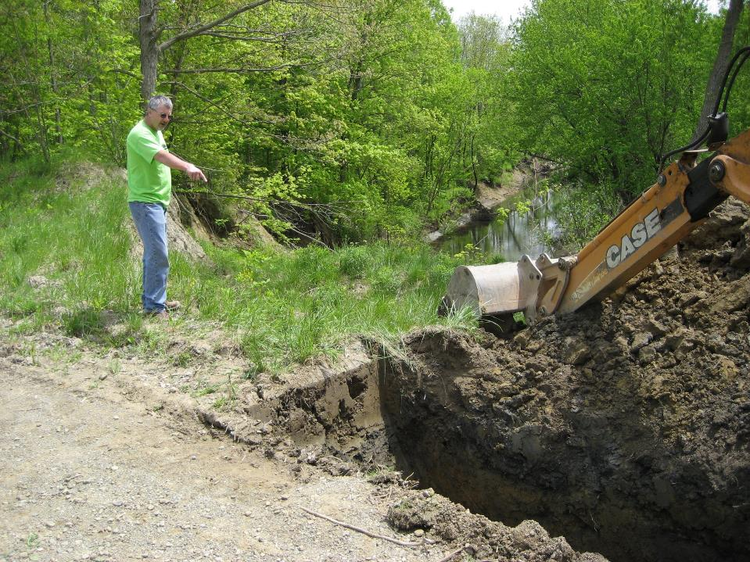
Road Base: Introduction
Soils
Geology
Soils
Soil Moisture
Freeze-thaw
Traffic Loads

Slide 22
Road Base: Introduction
Soils
TOPSOIL
Highly variable in depth
Home for plants and animals
Full of nutrients and organic matter
Makes a bad road
SUBSOIL
Little organic matter or nutrients
Little growth potential

Slide 23
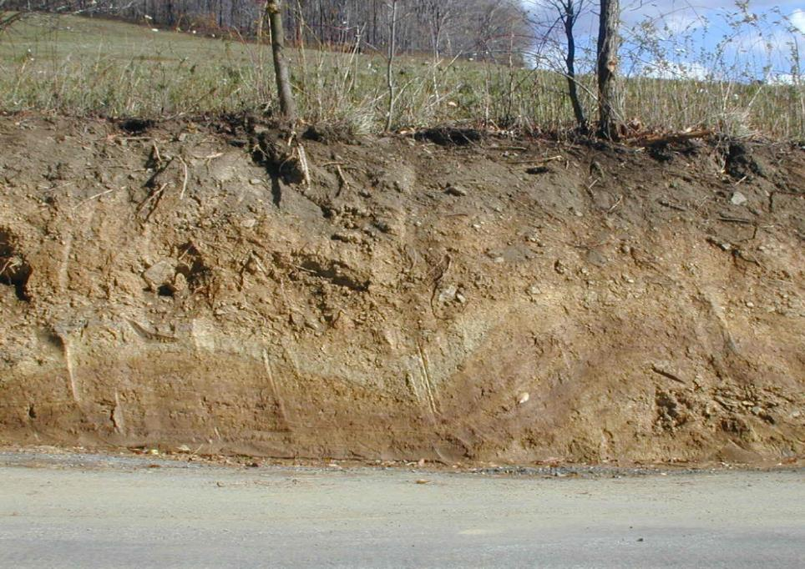
Road Base: Introduction
Soils
TOPSOIL
SUB-SOIL
23

Slide 24
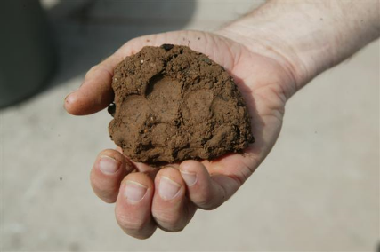
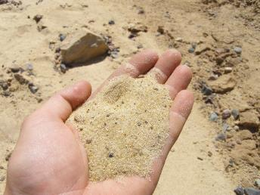
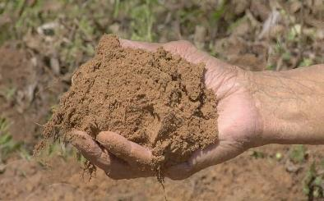
Road Base: Introduction
Soils
Soils are a mixture of :
Clay
Sand
Silt
Sand - Large
Silt - Small
Clay – Extremely small and FLAT!!!

Slide 25
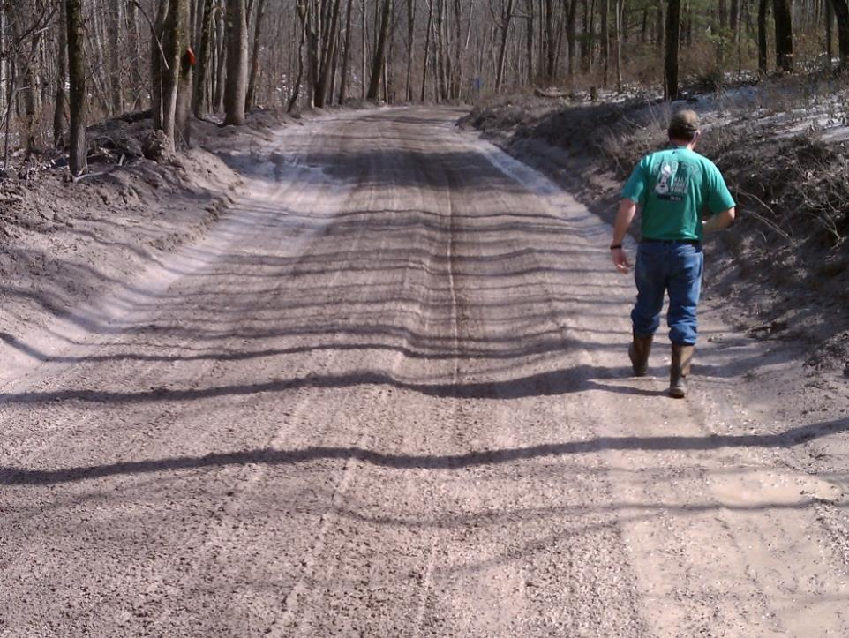
Road Base: Introduction
Soil Moisture
Geology
Soils
Soil Moisture
Freeze-thaw
Traffic Loads

Slide 26
Road Base: Introduction
Soil Moisture
How does
water move
underground?

Slide 27
Road Base: Introduction
Soil Moisture
VIDEO
Infiltration Schematic
0:53

Slide 28
28

Slide 29
Road Base: Introduction
Soil Moisture
Cracks in rock will channel subsurface water

Slide 30
Road Base: Introduction
Soil Moisture
Water runs downhill, right?
What about water underground?
Primary movement is downhill by gravity.
BUT……
Underground water can move sideways, and even UP!

Slide 31
Road Base: Introduction
Soil Moisture
How can water enter your road?
Through Permeable Surface
Seepage from High Ground
Lateral Flow from Roadside
Capillary Rise
Water Table
Water Table
31

Slide 32
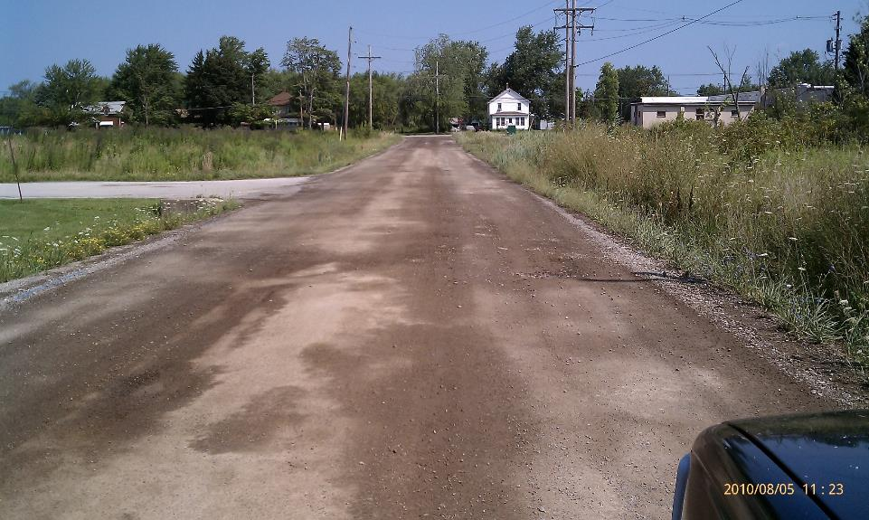
Road Base: Introduction
Soil Moisture
CAPILLARY RISE: Movement of water due to the forces of adhesion, cohesion, and surface tension
How can water enter your road?

Slide 33
Height of Capillary Rise
Road Base: Introduction
Soil Moisture
Soil Type Height of rise (ft)
Small Gravel < 0.4
Coarse Sand 0.5-1
Fine Sand 1-3
Silt 3-30
Clay 30-90

Slide 34
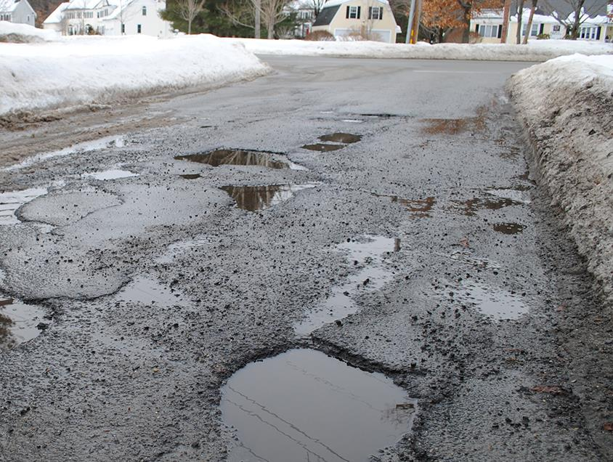
Road Base: Introduction
Freeze-Thaw
Geology
Soils
Soil Moisture
Freeze-thaw
Traffic Loads

Slide 35
Road Base: Introduction
Freeze-Thaw
FROST DAMAGE:
FREEZE/THAW
EXCESS WATER
FROST HEAVE
Why is there so much water in the spring?
Why do my fence posts rise every winter?
Why do large rocks rise up into my road?
Why does frost damage my road so much?
FROST
HEAVE
Notes:
I changed the slide to reduce words and highlight the concepts in the upcoming videos

Slide 36
Road Base: Introduction
Freeze-Thaw
Lets talk about FROST
Three Conditions Causing Frost Heave
Freezing Temperatures
Frost Susceptible Soil
Water Road Bed

Slide 37
The effect of frost on your roads
Road Base: Introduction
Freeze-Thaw
COLD AIR
COLD AIR
Snow
COLD AIR
Road
Frost Heave
Ice Lenses
Frost Table
Water Table

Slide 38
The effect of frost on your roads
Road Base: Introduction
Freeze-Thaw
WARM AIR
WARM AIR
Snow
WARM AIR
Road
Ice Lenses
Frost Table
Water Table

Slide 39
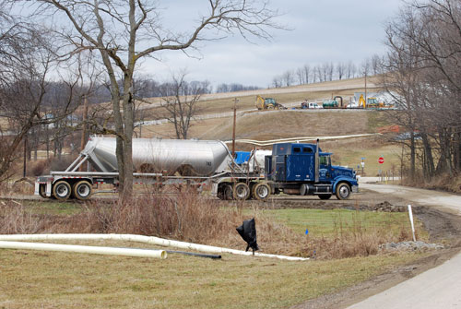
Road Base: Introduction
Traffic Loads
Geology
Soils
Soil Moisture
Freeze-thaw
Traffic Loads

Slide 40
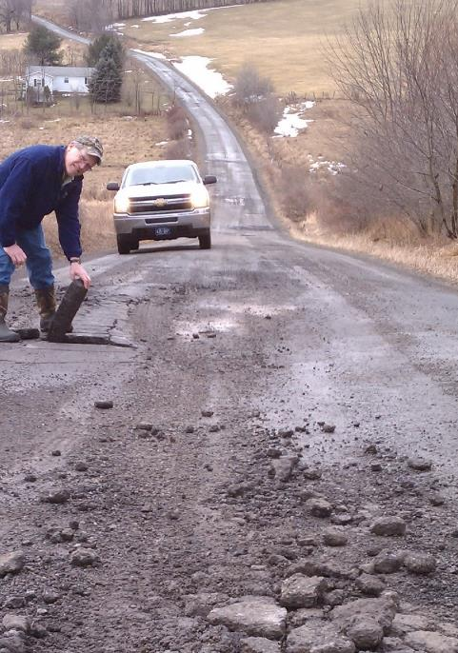
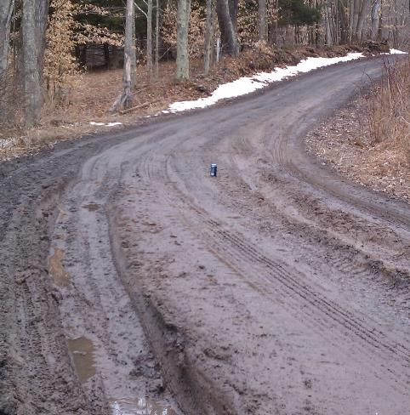
Road Base: Introduction
Traffic Loads
Traditionally we IGNORE Base Problems
Costs too much
Don’t understand the problem
Perceived as too big of a deal

Slide 41
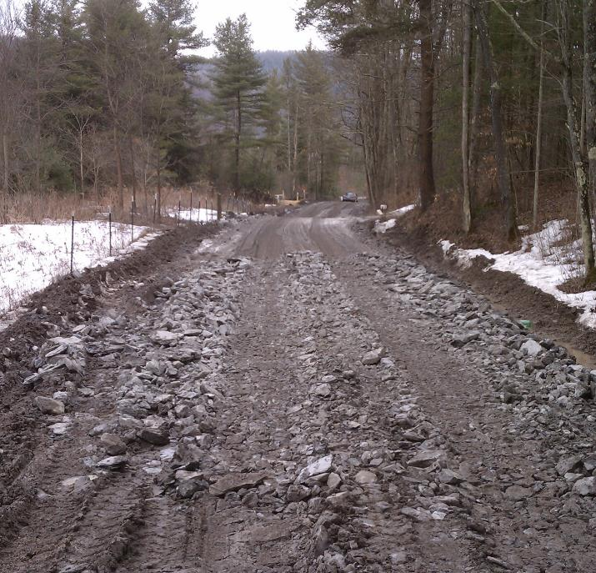
Base: Traditional Practices
Traditional “fix” is just to throw rock at the soft spots.
Spending money on symptoms, not fixing the problem
Road has “no bottom”

Slide 42
Road Fill
Road Fill
Background
Filling the Road Profile
Other Considerations
Types of Fill
Introduction to RFQ
Notes:
Helps With Drainage On Entrenched Roads
This technique can really help with drainage issues on entrenched roads.

Slide 43
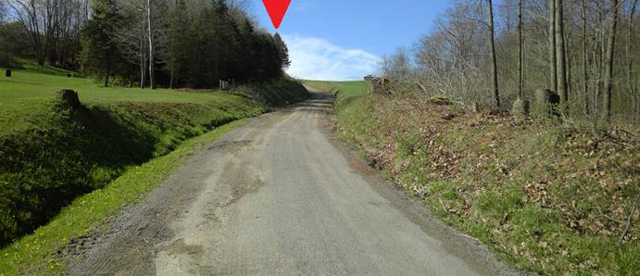
Road Base: ESMPs
Filling Road Cross-Section
Entrenched Roads
Lower than surrounding ground on both sides
Make it impossible to get water off the road
Notes:
Helps With Drainage On Entrenched Roads
This technique can really help with drainage issues on entrenched roads.

Slide 44
Road Base: ESMPs
Filling Road Cross-Section
Why are so many of our roads ENTRENCHED?
Notes:
Helps With Drainage On Entrenched Roads
This technique can really help with drainage issues on entrenched roads.

Slide 45
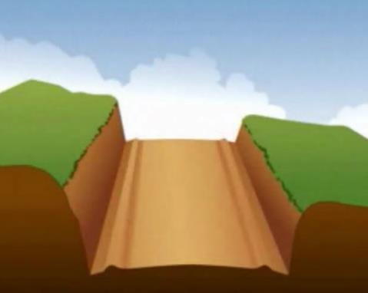
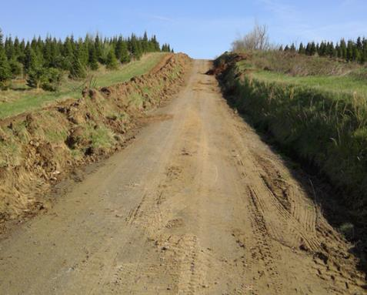
Road Base: ESMPs
Filling Road Cross-Section
A 100-year-old road that looses 1/2 inch of material that is not replaced each year will be entrenched 4’ today.
Notes:
Helps With Drainage On Entrenched Roads
This technique can really help with drainage issues on entrenched roads.

Slide 46
Road Base: ESMPs
Filling Road Cross-Section
When:
Where banks are higher on both sides of the road (entrenched roads)
When you want to improve base stability
When you want to shift the road up-slope
When you want to add road width
Page 52 in Field Guide
Notes:
Helps With Drainage On Entrenched Roads
This technique can really help with drainage issues on entrenched roads.

Slide 47
Road Base: ESMPs
Filling Road Cross-Section
How: Where banks are higher on both sides of the road
IDEAL CROSS-SECTION
TOP-SOIL
SUB-SOIL
ROADWAY
Page 52 in Field Guide
Notes:
Entrenched – Both Banks Higher – Water Trapped
An entrenched road is where both banks are higher than the road, and water on the road and ditches can’t escape.

Slide 48
Road Base: ESMPs
Filling Road Cross-Section
REDUCED BANK HEIGHT
ELIMINATED BANK
TOP-SOIL
FILL
SUB-SOIL
ROADWAY
Page 52 in Field Guide
Notes:
Fill To Eliminate Downslope Bank and Ditch – Can Sheet Flow ½ Road, and Create More Outlet Options For Pipes – Place To Put Snow
By filling the road high enough to eliminate the downslope bank and ditch, water can sheet flow off the downslope side, and pipes from the upslope ditch can be outletted without a high maintenance tail ditch. In addition, you now have some place to put the snow when you plow.

Slide 49
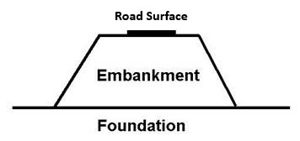
Road Base: ESMPs
Filling Road Cross-Section
Fill the hole, build a foundation, and elevate the road surface
Whenever possible or necessary we should strive to elevate the road surface by building an embankment
Often called “turnpiking”
Notes:
Fill To Eliminate Downslope Bank and Ditch – Can Sheet Flow ½ Road, and Create More Outlet Options For Pipes – Place To Put Snow
By filling the road high enough to eliminate the downslope bank and ditch, water can sheet flow off the downslope side, and pipes from the upslope ditch can be outletted without a high maintenance tail ditch. In addition, you now have some place to put the snow when you plow.

Slide 50
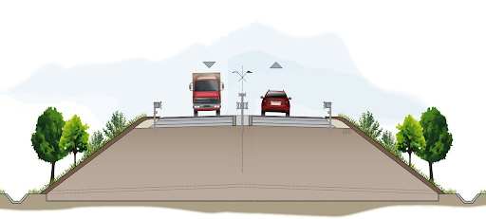
Road Base: ESMPs
Filling Road Cross-Section
surat-thani-thailand-oct-25-260nw-1095967559
http://www.envicom.eu/en/portfolio-posts/sizing-and-calculation-of-a-supporting-structure-necessary-to-ensure-stability-of-an-embankment-road-infrastructure-2/
Whenever possible or necessary we should strive to elevate the road surface by building an embankment
Often called “turnpiking”
Notes:
Fill To Eliminate Downslope Bank and Ditch – Can Sheet Flow ½ Road, and Create More Outlet Options For Pipes – Place To Put Snow
By filling the road high enough to eliminate the downslope bank and ditch, water can sheet flow off the downslope side, and pipes from the upslope ditch can be outletted without a high maintenance tail ditch. In addition, you now have some place to put the snow when you plow.

Slide 51
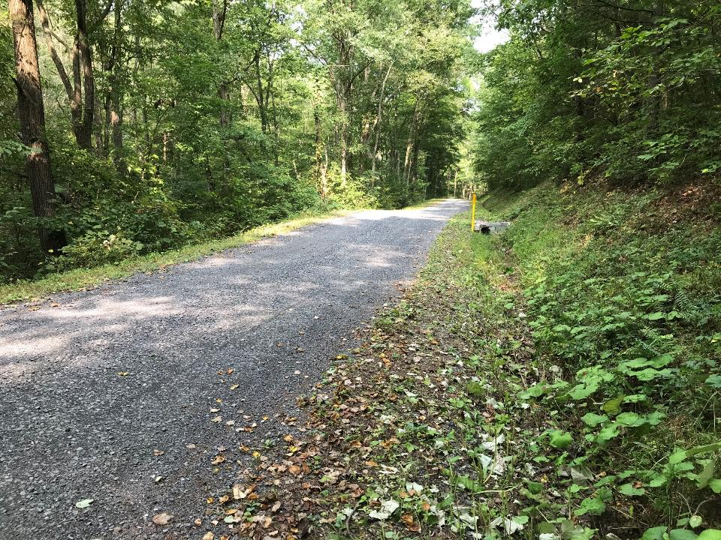
Road Base: ESMPs
Filling Road Cross-Section
surat-thani-thailand-oct-25-260nw-1095967559
Whenever possible or necessary we should strive to elevate the road surface by building an embankment
Often called “turnpiking”
Notes:
Fill To Eliminate Downslope Bank and Ditch – Can Sheet Flow ½ Road, and Create More Outlet Options For Pipes – Place To Put Snow
By filling the road high enough to eliminate the downslope bank and ditch, water can sheet flow off the downslope side, and pipes from the upslope ditch can be outletted without a high maintenance tail ditch. In addition, you now have some place to put the snow when you plow.

Slide 52
Ditch Outlets ESMPs
Filling Road Cross-Section
Entrenched Road
110
ditch
flow
ditch
flow
108
106
104
Figures not drawn to scale.
102
100

Slide 53
Ditch Outlets ESMPs
Filling Road Cross-Section
Entrenched Road
Complete Fill
110
ditch
flow
ditch
flow
108
106
Road
Fill
104
Figures not drawn to scale.
102
100

Slide 54
Ditch Outlets ESMPs
Filling Road Cross-Section
Entrenched Road
Complete Fill
110
ditch
flow
ditch
flow
New pipes
108
106
Sheet flow
Road
Fill
104
Figures not drawn to scale.
102
100

Slide 55
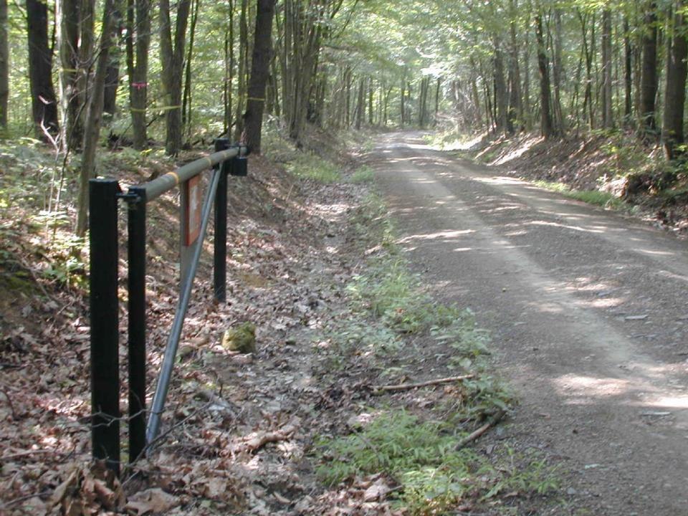
Road Base: ESMPs
Filling Road Cross-Section
BEFORE
Example 1: Huntingdon County
What to do?
Long ditch run
Ditch erosion
Ditch blows out stream
Unstable banks
Can’t get pipes or turnouts in
1400’ LONG ENTRENCHED ROAD
Huntingdon County – Red Rose Road – 1/9
Notes:
Red Rose Project – Entrenched – Filled Profile and Compared to Rip-Rap
This is Red Rose Road in Huntingdon County, a classic entrenched dirt road in Pennsylvania. The far end of this Road is fairly steep with deep eroded trenches. The Center thought the best fix here was to raise the road to the top of the banks. However, we wanted to compare the cost of raising the road to the cost of the traditional practice of rip-rapping the ditches with properly sized stone.

Slide 56
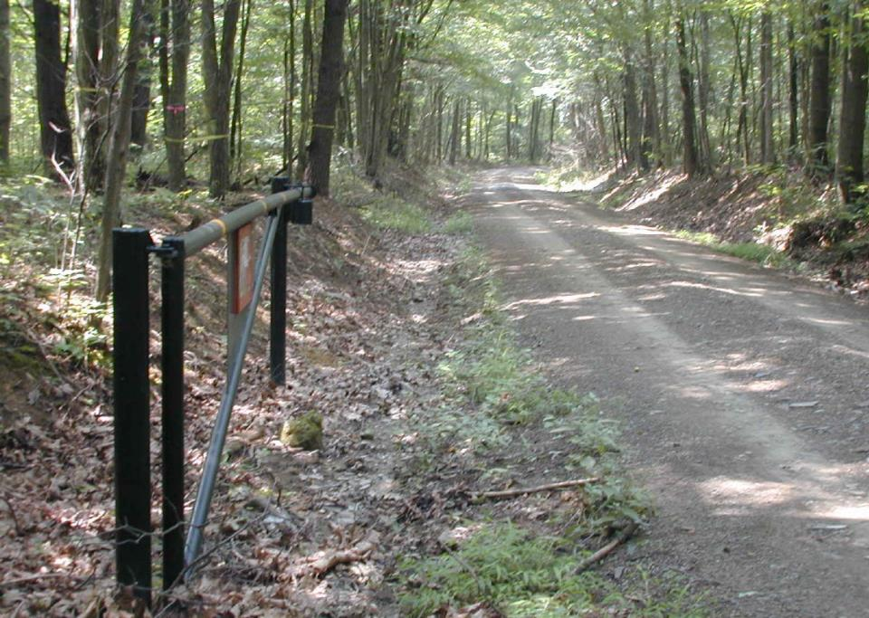
Road Base: ESMPs
Filling Road Cross-Section
BEFORE
IDEAL
ELEVATION
Huntingdon County – Red Rose Road – 3/9
Notes:
Red Rose Project – Entrenched – Filled Profile and Compared to Rip-Rap
This is Red Rose Road in Huntingdon County, a classic entrenched dirt road in Pennsylvania. The far end of this Road is fairly steep with deep eroded trenches. The Center thought the best fix here was to raise the road to the top of the banks. However, we wanted to compare the cost of raising the road to the cost of the traditional practice of rip-rapping the ditches with properly sized stone.

Slide 57
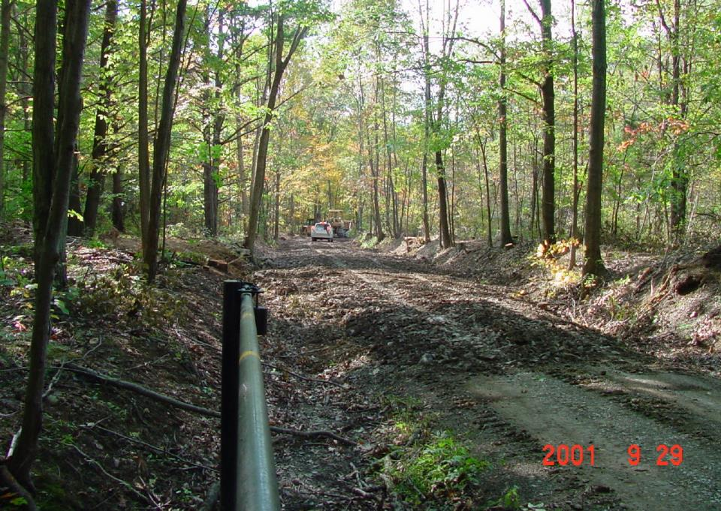
Road Base: ESMPs
Filling Road Cross-Section
Fill and Compact
Ideal
Elevation
Huntingdon County – Red Rose Road – 4/9
Notes:
Bid Project – Paid Contractor – Free Shale
We bid the job and got a price from a local contractor to fill the road, using material from an adjacent borrow area.

Slide 58
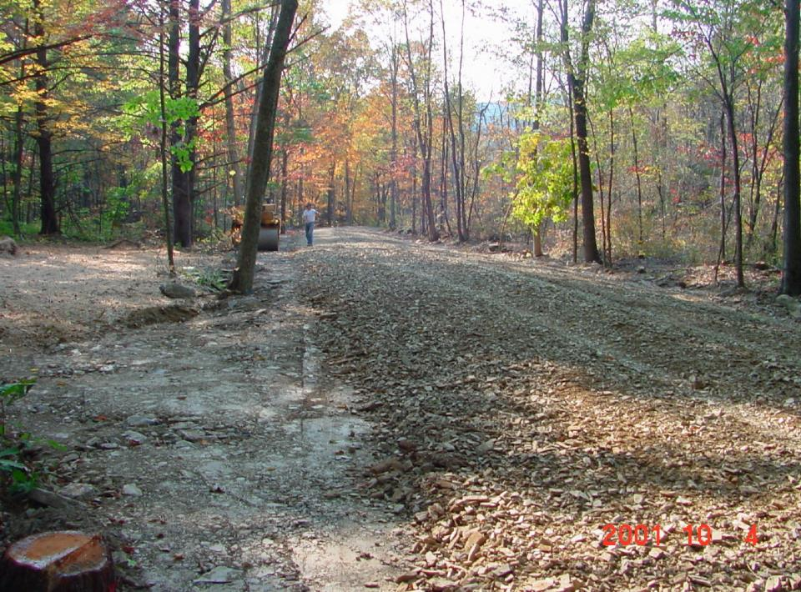
Road Banks: ESMPs
Filling Road Cross-Section
Fill and Compact
Ideal Elevation Achieved
Huntingdon County – Red Rose Road – 6/9
Huntingdon County – Red Rose Road (4 of 5)
Notes:
Finished Subgrade – Notice Crown – Road Can Sheet Flow – No Long Ditch Runs
Here is the finished subgrade. Notice we have built the proper crown into the subgrade before aggregate is placed. Now, the road is wider and can sheet flow off one side. The need for long ditch runs was also eliminated.

Slide 59
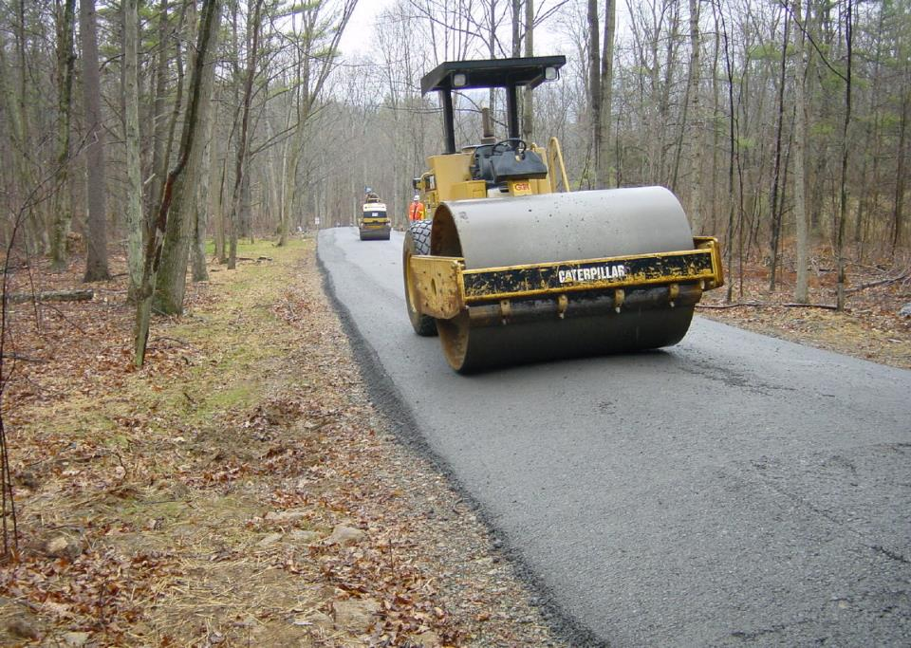
Road Base: ESMPs
Filling Road Cross-Section
PLACING AGGREGATE
2002
New pipe outlet
No ditch!
Huntingdon County – Red Rose Road – 7/9
Notes:
DSA Placed Next Year
A year later the DSA was applied to finish the project.

Slide 60
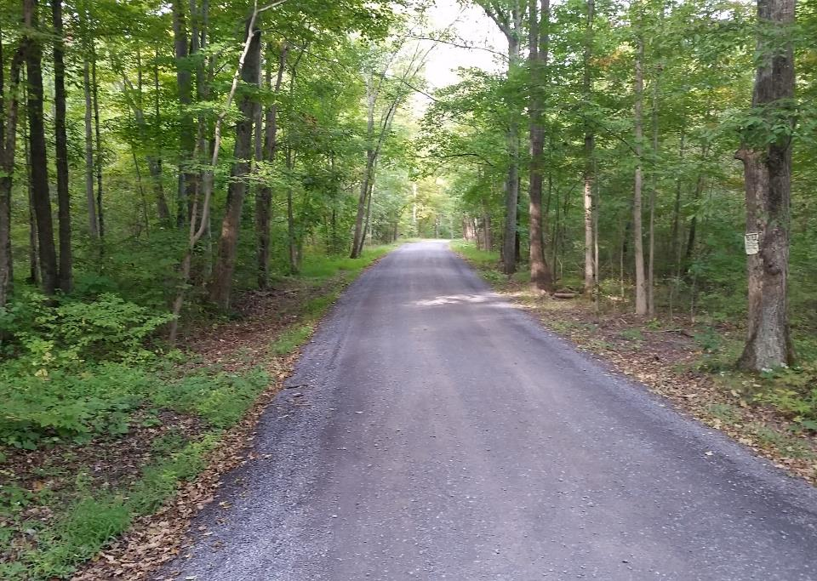
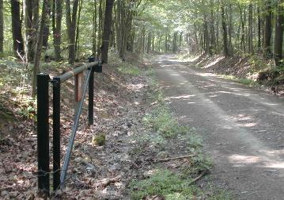
Road Base: ESMPs
Filling Road Cross-Section
2001
2020
long term improvement!
pipes
No ditch!
Huntingdon County – Red Rose Road – 8/9
Notes:
DSA Placed Next Year
A year later the DSA was applied to finish the project.

Slide 61
Road Fill
Red Rose Road – Huntingdon County - 2020
Good road base
Entrenched for over 1500 feet, few outlets availabe

Slide 62
Road Fill
Red Rose Road – Huntingdon County
8 cross-pipes (7 new!)
Over 4100 tons of total fill material (shale and 2A)
Shale Fill (average of 1 foot of fill over 3000 feet of road)
Paver placed 2A for surface (6” loose lift)
DSA to be placed (final phase in 2-phase project)

Slide 63
Road Fill
Red Rose Road – Huntingdon County
Before
After
No concentrated flow

Slide 64
Road Fill
Red Rose Road – Huntingdon County
Local shale was placed and compacted to promote sheet flow and ditch outlet opportunities

Slide 65
Road Fill
Red Rose Road – Huntingdon County
Shale has been placed and compacted

Slide 66
Road Fill
Red Rose Road – Huntingdon County
Downslope driveway accounted for:
Tie in (smooth transition)
Drainage
Sheet flow established on downslope ditch
New crosspipe outlets water below the driveway intersecion

Slide 67
Road Fill
Red Rose Road – Huntingdon County
Shallow cross-pipes were installed in the compacted shale before the 2A surface was placed.

Slide 68
Road Fill
Red Rose Road – Huntingdon County
Outlet of new cross-pipe at downslope driveway

Slide 69
Road Fill
Orwell Road – Bradford County

Slide 70
Road Fill
Orwell Road – Bradford County

Slide 71
Road Fill
Orwell Road – Bradford County

Slide 72
Road Fill
Robinson – Bradford County

Slide 73
Road Base: ESMPs
Filling Road Cross-Section
Jefferson County
BEFORE
AFTER

Slide 74
Road Base: ESMPs
Filling Road Cross-Section
BEFORE
Cambria County
Entrenchment doesn’t have to be deep to be a problem
BOF Dist 6, Cambria Cty – Stevenson Farm Road – 1/6
Notes:
The effects of increased erosion are many, but the biggest are increased maintenance problems, as well as excess sediment and chemical runoff to the streams.

Slide 75
Road Base: EMSPs
Filling Road Cross-Section
Placing Fill
BOF Dist 6, Cambria Cty – Stevenson Farm Road – 2/6
Notes:
The effects of increased erosion are many, but the biggest are increased maintenance problems, as well as excess sediment and chemical runoff to the streams.

Slide 76
Road Base: ESMPs
Filling Road Cross-Section
Fill and Compact
Compact fill in lifts of 1’ or less
BOF Dist 6, Cambria Cty – Stevenson Farm Road – 3/6
Notes:
The effects of increased erosion are many, but the biggest are increased maintenance problems, as well as excess sediment and chemical runoff to the streams.

Slide 77
Road Base: ESMPs
Filling Road Cross-Section
AFTER
BOF Dist 6, Cambria Cty – Stevenson Farm Road – 5/6
Notes:
The effects of increased erosion are many, but the biggest are increased maintenance problems, as well as excess sediment and chemical runoff to the streams.

Slide 78
Road Base: ESMPs
Filling Road Cross-Section
BEFORE
AFTER
more pipes
Fill allows for crosspipe
BOF Dist 6, Cambria Cty – Stevenson Farm Road – 6/6
Notes:
The effects of increased erosion are many, but the biggest are increased maintenance problems, as well as excess sediment and chemical runoff to the streams.

Slide 79
BEFORE
DURING
‘16 LVR Project - Complete
Venango County, Keister Rd
$144K Spent, $31K in kind
Massive fill job, underdrain and DSA
Crosspipes and through the bank pipes
BEFORE 1
AFTER

Slide 80
2017: DnG
Potter County, Cobb Hill Road
$75K Grant, $57K In-Kind
Summary:
Poor base and drainage: only 1 crosspipe total in a mile of road.
6,000+ tons of fill, 12 new pipes, 740’ underdrain, off ROW work
BEFORE
BEFORE
road = ditch
AFTER
New base allowed for multiple new pipes
AFTER
Roadway WILL FLOOD: Large mattress provides base support and pipes allow water to drain in both directions
Outlet swale through field

Slide 81
BEFORE
BEFORE 1
AFTER
Driveway pipe, grade break and 150’ of DSA
‘16 D&G Project - Complete
Snyder County, Mattern Rd
$40K Spent, $7K in kind
Driveway pipe and gradebreak
Base improvements
Fill, pipes, and DSA
Geotextile and fill

Slide 82
PROJECT SPOTLIGHT
2017 D&G Project
Armstrong County
Gibson School Road
$56K Spent
$56K in kind
Problems:
SEVERELY entrenched road
No drainage outlets
Practices Used:
Road fill and pipe
BEFORE
82

Slide 83
2017: D&G Project
Armstrong County, Gibson School Road
$56K Spent, $56K in kind
Summary:
Nearly 10,000 tons of fill
New pipes
BEFORE
SEVERELY entrenched roadway. Drainage improvements were impossible without fill. Entire road drained to headwater stream.
BEFORE

Slide 84
BEFORE
Township placed 9,800 tons of fill (6,300 tons of soil and shale, 3,500 tons of limestone.
AFTER
New pipe headwall
Shale fill
Limestone fill

Slide 85
2017: D&G Project
Armstrong County, Gibson School Road
$56K Spent, $56K in kind
Summary:
Nearly 10,000 tons of fill
New pipes
BEFORE
Township placed 9,800 tons of fill (6,300 tons of soil and shale, 3,500 tons of limestone).
AFTER
Worked with landowner to outlet some pipes on other side of hay field in woods.
3 New pipe headwall
Close-up

Slide 86
BEFORE
2017: D&G Project
Armstrong County, Gibson School Rd
$56K Spent, $56K in kind
Summary:
Nearly 10,000 tons of fill
New pipes
AFTER
Worked with landowner to outlet some pipes on other side of hay field into woods.
New pipe headwalls

Slide 87
Road Base: ESMPs
Filling Road Cross-Section
Sectional Fill:
When you can’t fill the road (either logistics or cost)
Transition into and out of road fill.
Short section of fill forces ditch turnout, and provides cover for a new crosspipe.
Notes:
Helps With Drainage On Entrenched Roads
This technique can really help with drainage issues on entrenched roads.

Slide 88
Ditch Outlets ESMPs
Filling Road Cross-Section
Entrenched Road
110
ditch
flow
ditch
flow
108
106
104
Figures not drawn to scale.
102
100

Slide 89
Ditch Outlets ESMPs
Filling Road Cross-Section
Entrenched Road
sectional Fill
110
ditch
flow
no fill
ditch
flow
108
106
104
Road
Fill
Figures not drawn to scale.
102
100
no fill

Slide 90
Road Base: ESMPs
Filling Road Cross-Section
BEFORE
Example 3: “sectional FILL” OPTION
McKean Cty – Prospect Rd – 1/7

Slide 91
Road Base: ESMPs
Filling Road Cross-Section
Example 3: “sectional FILL” OPTION
McKean Cty – Prospect Rd – 1/7

Slide 92
Road Base: ESMPs
Filling Road Cross-Section
BEFORE
sectional Fill Option
McKean Cty – Prospect Rd – 2/7

Slide 93
Road Base: ESMPs
Filling Road Cross-Section
Adding Fill
sectional Fill Option
Enough fill used to
build crown
reestablish ditch function
reduce the flow volume reaching stream.
McKean Cty – Prospect Rd – 3/7

Slide 94
Road Base: ESMPs
Filling Road Cross-Section
At a select location near the project midpoint enough fill is used to create ditch outlets.
sectional Fill Option
McKean Cty – Prospect Rd – 4/7

Slide 95
Road Base: ESMPs
Filling Road Cross-Section
A crosspipe and turn-out are installed in the elevated road section.
sectional Fill Option
AFTER
still entrenched here
elevated
McKean Cty – Prospect Rd – 5/7

Slide 96
Road Base: ESMPs
Filling Road Cross-Section
Elevated road and ditches relieves ditch flow volumes, reduces erosion and road problems.
sectional Fill Option
AFTER
still entrenched here
elevated
McKean Cty – Prospect Rd – 6/7

Slide 97
Road Base: ESMPs
Filling Road Cross-Section
Elevated road and ditches relieves ditch flow volumes, reduces erosion and road problems.
sectional Fill Option
AFTER
still entrenched here
elevated
McKean Cty – Prospect Rd – 7/7

Slide 98
Susquehanna County
Road Fill Overview
BEFORE
AFTER

Slide 99
To costly?
Road Base: ESMPs
Filling Road Cross-Section
Filling the road is a long-term solution that solves a host of problems
Eliminates ditches and need for rip-rap.
Reduces bank heights and constant resurfacing.
Creates drainage outlets.
Easier to plow snow off the roadway.
Notes:
Here Are The Numbers - $9,000 or 20% Cheaper Even If Have To Buy Fill
Here’s what the numbers told us. Because the shale was free and available on site, we needed to adjust our figures to reflect the true cost of material and hauling when shale was not free. But even after this adjustment, the cost of filling the road was $9,000, or 20%, cheaper than using rip-rap.

Slide 100
Road Base: ESMPs
Filling Road Cross-Section
Challenges of
wider roads:
Maintaining Crown
More re-graveling, grading, plowing, and money $$$
Increased site lines = faster speed
Faster surface degradation
More dust
Notes:
The purpose of effective surface drainage is to keep water off the road, and reduce problems for drivers and maintenance crews alike.

Slide 101
Road Base: ESMPs
Filling Road Cross-Section
Avoid over-widening the cartway when filling
Wider roads
Must pay
attention to
limits of ROW
Consider raising the road, but not over-widening the cartway.
NPDES Permit could apply.
If there is over 1.0 acre of disturbance outside of existing road “cross-section”
Road Fill
Road Fill
Final Road Width
Notes:
The purpose of effective surface drainage is to keep water off the road, and reduce problems for drivers and maintenance crews alike.

Slide 102
Road Base: ESMPs
Filling Road Cross-Section
Program has averaged 440,000 tons of fill per year the last 5 years
That’s enough material to fill a football field almost 1,000 feet over 5 years.
Notes:
Helps With Drainage On Entrenched Roads
This technique can really help with drainage issues on entrenched roads.

Slide 103
Road Fill
Road Fill
Background
Filling the Road Profile
Other Considerations
Types of Fill
Introduction to RFQ
Notes:
Helps With Drainage On Entrenched Roads
This technique can really help with drainage issues on entrenched roads.

Slide 104
Road Fill
Road Fill
Other Considerations
Geosynthetics
Structural Reinforcement
French Mattresses
Underdrains
Notes:
Helps With Drainage On Entrenched Roads
This technique can really help with drainage issues on entrenched roads.

Slide 105
Separation FABRIC
Geo-GRID
Notes:
Geo-Synthetics Can Be Used For Slope Reinforcement
Geo-synthetics, or “manmade earth”, have multiple applications, including slope reinforcement.

Slide 106
Separation Fabric
Separation Fabric: Plastic “cloth” used to separate different materials in soil.
Notes:
Geo-Synthetics Can Be Used For Slope Reinforcement
Geo-synthetics, or “manmade earth”, have multiple applications, including slope reinforcement.

Slide 107
Separation Fabric
Separation Fabric Uses:
Separates two types of material
Adds some strength
Distributes loads over larger area
Prevent clogging of underdrains
Separation Fabric
No Separation Fabric
stone
stone
sand
sand
Notes:
Geo-Synthetics Can Be Used For Slope Reinforcement
Geo-synthetics, or “manmade earth”, have multiple applications, including slope reinforcement.

Slide 108
Separation Fabric
Considerations:
Allows water to pass through
Not biodegradable
Should be buried 1 foot minimum
Many types, sizes, thicknesses, and uses
Some typical rolls: (600 sqyd) - $400
12.5’ wide x 432’ length
15’ wide x 360’ length
17.5’ wide x 309’ length
Notes:
Geo-Synthetics Can Be Used For Slope Reinforcement
Geo-synthetics, or “manmade earth”, have multiple applications, including slope reinforcement.

Slide 109
Separation Fabric
Types:
Two major classifications:
Woven
separation
Support
4-10 gpm/sqft
Non-woven
separation
filtering
95-140 gpm/sqft
Notes:
Geo-Synthetics Can Be Used For Slope Reinforcement
Geo-synthetics, or “manmade earth”, have multiple applications, including slope reinforcement.

Slide 110
Separation Fabric
Types:
Recommended uses for each class of fabric:
Woven
Base support for road in soft soils
Deadman anchors in stacked walls
Erosion control under rock armoring
Non-Woven
Sub-surface drainage – Underdrain
French Mattress
Consult manufacturer for intended use
Notes:
Geo-Synthetics Can Be Used For Slope Reinforcement
Geo-synthetics, or “manmade earth”, have multiple applications, including slope reinforcement.

Slide 111
Separation Fabric
Separation FABRIC
Geo-GRID
Notes:
Geo-Synthetics Can Be Used For Slope Reinforcement
Geo-synthetics, or “manmade earth”, have multiple applications, including slope reinforcement.

Slide 112
Geo-Grid
GEO-GRID: Plastic grid used to stabilize and strengthen soil.
Notes:
Geo-Synthetics Can Be Used For Slope Reinforcement
Geo-synthetics, or “manmade earth”, have multiple applications, including slope reinforcement.

Slide 113
Geo-Grid
Geo-Grid Uses:
Strengthen road base
Spreads weight (snowshoe effect)
Notes:
Geo-Synthetics Can Be Used For Slope Reinforcement
Geo-synthetics, or “manmade earth”, have multiple applications, including slope reinforcement.

Slide 114
Geo-Grid
Considerations:
Does not separate material like fabric
Adds more strength than fabric
Spreads weight better than fabric
Reduces depth of fill required.
Should be buried 1 foot minimum
Many types, sizes, patterns, and uses
Typical roll: 600 sqyd, $1,500
Notes:
Geo-Synthetics Can Be Used For Slope Reinforcement
Geo-synthetics, or “manmade earth”, have multiple applications, including slope reinforcement.

Slide 115
Geo-Grid
Common Uses Uses will be detailed throughout training
Notes:
Geo-Synthetics Can Be Used For Slope Reinforcement
Geo-synthetics, or “manmade earth”, have multiple applications, including slope reinforcement.

Slide 116
Road Fill
Road Fill
Other Considerations
Geosynthetics
Structural Reinforcement
French Mattresses
Underdrains
Notes:
Helps With Drainage On Entrenched Roads
This technique can really help with drainage issues on entrenched roads.

Slide 117
Road Base: ESMPs
Structural Reinforcement
Structural Reinforcement: Addition of rock and/or geo-synthetics to establish a solid road base
Notes:
The purpose of effective surface drainage is to keep water off the road, and reduce problems for drivers and maintenance crews alike.

Slide 118
Road Base: ESMPs
Structural Reinforcement
Importing new “bridge rock”
Structural support
Drainage
Notes:
The purpose of effective surface drainage is to keep water off the road, and reduce problems for drivers and maintenance crews alike.

Slide 119
Road Base: ESMPs
Geo-reinforced Roads
Separation:
Fabric keeps sub-base and sub-grade separate
(keeps mud below and stone on top)
Imported Base Course
Imported Sub-Base
FABRIC
Notes:
The purpose of effective surface drainage is to keep water off the road, and reduce problems for drivers and maintenance crews alike.

Slide 120
Road Base: ESMPs
Geo-reinforced Roads
Example 1: Huntingdon County
Low lying LVR
Saturated base soils
Huntingdon Cty – Miller Rd – 1/9
Notes:
The use of Fabric keeps the aggregate separate from the base material, reduces “pumping”, and spreads vehicle weight to minimize rutting.

Slide 121
Road Base: ESMPs
Geo-reinforced Roads
The “tar and chip” surface and underlying soil was excavated prior to placing fabric
Huntingdon Cty – Miller Rd – 2/9
Notes:
The use of Fabric keeps the aggregate separate from the base material, reduces “pumping”, and spreads vehicle weight to minimize rutting.

Slide 122
Road Base: ESMPs
Geo-reinforced Roads
The bridge rock was tailgated and spread with a loader
Huntingdon Cty – Miller Rd – 4/9
Notes:
The use of Fabric keeps the aggregate separate from the base material, reduces “pumping”, and spreads vehicle weight to minimize rutting.

Slide 123
Road Base: ESMPs
Geo-reinforced Roads
Another layer of fabric was added to keep the surface gravel on the surface.
This is very similar to a French mattress, which we’ll discuss next.
Huntingdon Cty – Miller Rd – 6/9
Notes:
The use of Fabric keeps the aggregate separate from the base material, reduces “pumping”, and spreads vehicle weight to minimize rutting.

Slide 124
Road Base: ESMPs
Geo-reinforced Roads
2RC was tailgated and will be “tarred and chipped”
Huntingdon Cty – Miller Rd – 7/9
Notes:
The use of Fabric keeps the aggregate separate from the base material, reduces “pumping”, and spreads vehicle weight to minimize rutting.

Slide 125
Road Base: ESMPs
Geo-reinforced Roads
“Bridge Rock”
Any water that comes out of the ground under the road surface will now migrate into the ditch instead of saturating the road base
Huntingdon Cty – Miller Rd – 8/9
Notes:
The use of Fabric keeps the aggregate separate from the base material, reduces “pumping”, and spreads vehicle weight to minimize rutting.

Slide 126
Road Base: ESMPs
Geo-reinforced Roads
Before
“Bridge Rock”
One year later
Huntingdon Cty – Miller Rd – 9/9
Notes:
The use of Fabric keeps the aggregate separate from the base material, reduces “pumping”, and spreads vehicle weight to minimize rutting.

Slide 127
Road Base: ESMPs
Geo-reinforced Roads
Geo-GRID
“snowshoe”
spreads load
strong support
ROUGH GUIDE:
The structural support added by geo-grid typically can produce a 40% reduction in fill height for the same strength.*
*Rule of thumb only: depends on fill material, kind of grid, moisture, etc.
Notes:
The purpose of effective surface drainage is to keep water off the road, and reduce problems for drivers and maintenance crews alike.

Slide 128
Road Base: ESMPs
Geo-reinforced Roads
Place Geo-synthetics between sub-grade and base coarse
Imported Base Course
GEO
Sub-grade
Notes:
The purpose of effective surface drainage is to keep water off the road, and reduce problems for drivers and maintenance crews alike.

Slide 129
Road Base: ESMPs
Geo-reinforced Roads
Geo-GRID
“snowshoe”
spreads load
strong support
Notes:
The purpose of effective surface drainage is to keep water off the road, and reduce problems for drivers and maintenance crews alike.

Slide 130
Road Fill
Road Fill
Other Considerations
Geosynthetics
Structural Reinforcement
French Mattresses
Underdrains
Notes:
Helps With Drainage On Entrenched Roads
This technique can really help with drainage issues on entrenched roads.

Slide 131
Road Base: ESMPs
French Mattress
French Mattress: A drainage structure under a road consisting of coarse rock wrapped in fabric through which water can freely pass.
Road
FABRIC
STONE
WATER FLOW

Slide 132
Road Base: ESMPs
French Mattress
When to use a French Mattress
To reconnect wetland hydrology divided by road
Very effective in:
sloped and lowland wetlands
areas with wet banks
areas with saturated road base
floodplains
Page 17 in Field Guide

Slide 133
Road Base: ESMPs
French Mattress
When to use a French Mattress

Slide 134
Road Base: ESMPs
French Mattress
A French Mattress is very flexible to fit your site!
short
long
with or without embedded pipes
Road

Slide 135
Road Base: ESMPs
French Mattress
A French Mattress is very flexible to fit your site!
short
long
with or without embedded pipes

Slide 136
Road Base: ESMPs
French Mattress
Mattresses are flexible, a few examples: Bedford County
Can use French Mattress to build up road over unstable wetland soils

Slide 137
Road Base: ESMPs
French Mattress
Mattresses are flexible, a few examples: Centre County
~200’ mattress used to bridge and drain a “perpetual aggregate-eating mudhole”
Long mattress with pipes due to wetland and backwatering from lake
Mattress outlets
Note drainage outlet

Slide 138
Road Base: ESMPs
French Mattress
Mattresses are flexible, a few examples: Pike County
Long mattress with pipes due to wetland and backwatering from lake

Slide 139
Road Base: ESMPs
French Mattress
Every situation is different, but you may need a 24’ wide mattress at the base to achieve a 18’ final road width!
Important Notes:
Make sure you make it wide enough to build road on top!
24 feet
20 feet
18 feet
18” x 20’ mattress

Slide 140
Road Fill
Road Fill
Other Considerations
Geosynthetics
Structural Reinforcement
French Mattresses
Underdrains
Notes:
Helps With Drainage On Entrenched Roads
This technique can really help with drainage issues on entrenched roads.

Slide 141
Road Base ESMPs
Underdrains
Underdrain : A buried drainpipe that collects subsurface water before it surfaces on the road and directs it to a stable outlet.
Page 12
in Field Guide
Notes:
Discussed in “Banks”
We talked about these buried drains in the “Banks” section.

Slide 142
Road Base: ESMPs
Underdrains
When TO USE:
Saturated road bases
Perpetually wet ditches and banks
ANY CONSISTENTLY
WET AREAS!
Notes:
Consider Underdrains When:
Wet Ditches, Banks, Spots in Road
Dry Bank and Remove Lubrication
Consider an Underdrain when you see perpetually wet ditches and banks along the road. They can even be installed under the cartway to dry out problem wet spots. When you dry out wet ditches and drain wet banks, you remove lubrication from the equation and make your banks more stable.

Slide 143
Road Base: ESMPs
Underdrains
Consider time of year, this is the same site in:
MARCH
MAY
Notes:
Cumberland County Project:
Drain Wet Ditch To Far Side
Dave and Dave
Now let’s look at an underdrain project the Center did a couple of years ago in Cumberland County, to drain a wet ditch through the road base and outlet the water to the far side of the road. If you pay attention, you’ll see my two ugly associates in these next slides.

Slide 144
Road Base: ESMPs
Underdrains
Constructed Stone Underdrain
1. Excavate Trench
2. Place Geo-textile
3. Add pipe and clean fill
4. Add clean fill
5. Wrap and overlap geo-textile
6. Cover geo-textile
FHWA Geosynthetic Design and Construction Guidelines (Berg, et. al., 1998)
Notes:
Constructed Underdrain:
Built Any Size – For Any Flow
Clean Filter Stone Also Carries Water
Slide of Steps of Construction
A constructed underdrain can be built to any size, to handle any anticipated flow. The clean stone surrounding the drain pipe will carry water as well. I’ve seen a lot of field drains made only of stone. This slide shows the steps of constructing an underdrain.

Slide 145
Road Base ESMPs
Underdrains
Jung Road – Bradford County
You can take advantage of deep ditches for underdrains. Much of the excavation is already done for you.
Notes:
Discussed in “Banks”
We talked about these buried drains in the “Banks” section.

Slide 146
Road Base: ESMPs
Underdrains
Before
Example 1
Underdrain excavation

Slide 147
Road Base: ESMPs
Underdrains
Have a plan to remove excavated material
Should have ~1% slope like a pipe

Slide 148
Road Base: ESMPs
Underdrains
Placing fabric in trench
Page 12 in Field Guide
Non-Woven Fabric
- separates
filters

Slide 149
Road Base: ESMPs
Underdrains
Page 12 in Field Guide
Clean Stone
Perforated Pipe
Constructing Underdrain
Notes:
Dig to Desired Width and Depth to Allow For Min. 12” Cover
Ensure Minimum 1% Slope
Line With Geo-Fab
Clean Stone Bedding
Lay Pipe
The trench was excavated to the desired width, and deep enough to allow for sufficient cover of the completed underdrain. The backhoe operator made sure their was at least 1% slope, so the drain would drain . The trench was then lined with enough geo-fabric to overlap on top. Clean stone was laid in the bottom as pipe bedding, and the perforated drain pipe was laid on top of the stone.

Slide 150
Road Base: ESMPs
Underdrains
Page 12 in Field Guide
Underdrain Outlet
Constructing Underdrain
Notes:
Dig to Desired Width and Depth to Allow For Min. 12” Cover
Ensure Minimum 1% Slope
Line With Geo-Fab
Clean Stone Bedding
Lay Pipe
The trench was excavated to the desired width, and deep enough to allow for sufficient cover of the completed underdrain. The backhoe operator made sure their was at least 1% slope, so the drain would drain . The trench was then lined with enough geo-fabric to overlap on top. Clean stone was laid in the bottom as pipe bedding, and the perforated drain pipe was laid on top of the stone.

Slide 151
Road Base: ESMPs
Underdrains
Page 12 in Field Guide
Underdrain Outlet
Constructing Underdrain
Notes:
Dig to Desired Width and Depth to Allow For Min. 12” Cover
Ensure Minimum 1% Slope
Line With Geo-Fab
Clean Stone Bedding
Lay Pipe
The trench was excavated to the desired width, and deep enough to allow for sufficient cover of the completed underdrain. The backhoe operator made sure their was at least 1% slope, so the drain would drain . The trench was then lined with enough geo-fabric to overlap on top. Clean stone was laid in the bottom as pipe bedding, and the perforated drain pipe was laid on top of the stone.

Slide 152
Road Base: ESMPs
Underdrains
Underdrain Notes:
Use clean gravel
AASHTO #1’s work well
“Fist-sized” stone
Page 12 in Field Guide
Notes:
Dig to Desired Width and Depth to Allow For Min. 12” Cover
Ensure Minimum 1% Slope
Line With Geo-Fab
Clean Stone Bedding
Lay Pipe
The trench was excavated to the desired width, and deep enough to allow for sufficient cover of the completed underdrain. The backhoe operator made sure their was at least 1% slope, so the drain would drain . The trench was then lined with enough geo-fabric to overlap on top. Clean stone was laid in the bottom as pipe bedding, and the perforated drain pipe was laid on top of the stone.

Slide 153
Road Base: ESMPs
Underdrains
Underdrain Notes:
Wrap all sides in fabric
Overlap all fabric seems 1’+
Non-Woven Fabric
- separates
filters
Notes:
Dig to Desired Width and Depth to Allow For Min. 12” Cover
Ensure Minimum 1% Slope
Line With Geo-Fab
Clean Stone Bedding
Lay Pipe
The trench was excavated to the desired width, and deep enough to allow for sufficient cover of the completed underdrain. The backhoe operator made sure their was at least 1% slope, so the drain would drain . The trench was then lined with enough geo-fabric to overlap on top. Clean stone was laid in the bottom as pipe bedding, and the perforated drain pipe was laid on top of the stone.

Slide 154
Road Base: ESMPs
Underdrains
Underdrain Notes:
Cover the fabric to hold it in place.
Try to build a ditch shape with the rock used to cover the fabric.
Notes:
Dig to Desired Width and Depth to Allow For Min. 12” Cover
Ensure Minimum 1% Slope
Line With Geo-Fab
Clean Stone Bedding
Lay Pipe
The trench was excavated to the desired width, and deep enough to allow for sufficient cover of the completed underdrain. The backhoe operator made sure their was at least 1% slope, so the drain would drain . The trench was then lined with enough geo-fabric to overlap on top. Clean stone was laid in the bottom as pipe bedding, and the perforated drain pipe was laid on top of the stone.

Slide 155
Road Base: ESMPs
Underdrains
1 year later
Notes:
Dig to Desired Width and Depth to Allow For Min. 12” Cover
Ensure Minimum 1% Slope
Line With Geo-Fab
Clean Stone Bedding
Lay Pipe
The trench was excavated to the desired width, and deep enough to allow for sufficient cover of the completed underdrain. The backhoe operator made sure their was at least 1% slope, so the drain would drain . The trench was then lined with enough geo-fabric to overlap on top. Clean stone was laid in the bottom as pipe bedding, and the perforated drain pipe was laid on top of the stone.

Slide 156
Road Fill
Road Fill
Background
Filling the Road Profile
Other Considerations
Types of Fill
Introduction to RFQ
Notes:
Helps With Drainage On Entrenched Roads
This technique can really help with drainage issues on entrenched roads.

Slide 157
Road Fill
What is fill?
-Fill is usually aggregate, rock, or subsoil (soil from beneath the topsoil) which has little soil organic matter or biological activity.
-Fill should be as free of organic matter as possible since organic matter will decompose creating pockets of empty space within the fill which could result in settling.
-Uneven or excessive settling of the fill can result in damage to any structures built on the fill.
-Fill is generally required to provide sufficient strength to hold form when compacted or placed.

Slide 158
Road Fill
Fill
Types of fill include:
- Select Fill
- General Fill
- Non-structural fill
- Rock Fill
- Permeable Fill

Slide 159
Road Fill
Select Fill
Select fill is superior quality material, used principally as capping, surface material, structural material and/or shoulder material. Select fill materials are commonly specified for use in the construction of:

Slide 160
Road Fill
Select Fill
Select fill is superior quality material, used principally as capping, surface material, structural material and/or shoulder material. Select fill materials are commonly specified for use in the construction of:
the earthworks layer immediately beneath the pavement layers
spill-through abutment fills and behind abutment areas of bridge approach embankments
reinforced soil embankments
fill placed adjacent to retaining walls
pipe and culvert backfill.

Slide 161
Road Fill
Select Fill
The maximum stone size for select fill used for roadwork's is 3 inches.
Select fill is required to be compacted; and when compacted, should be non-permeable (i.e water should not flow through it).

Slide 162
Road Fill
General Fill
General fill is a medium quality material which does not meet the requirements of select fill. General fill materials are usually used to:
Provide a stable platform during construction so that select fill and pavement layers can be satisfactorily placed.
Provide an elevated platform for a pavement such that adequate clearance is provided between the groundwater table or inundation level and the bottom of the pavement, and to protect the pavement from moisture infiltration.
Provide a more economical earthworks design than when using higher quality material for the whole of the fill embankment.

Slide 163
Road Fill
Non-Structural Fill
Non-structural fill is a lesser quality material which does not meet the requirements of select fill or general fill material, and which may be used in non-structural zones of embankments.

Slide 164
Road Fill
Rock Fill/Permeable Fill
Rock fill is a permeable material comprised of larger rock and rock fragments which may be used as drainage layers in areas subject to inundation or groundwater inflows or where general and non-structural fills are unsuitable, commonly due to the low strength of in situ soils.

Slide 165
Road Fill
Road Fill
Background
Filling the Road Profile
Other Considerations
Types of Fill
Introduction to RFQ
Notes:
Helps With Drainage On Entrenched Roads
This technique can really help with drainage issues on entrenched roads.

Slide 166
Road Fill
Introduction to RFQ
The CDGRS Road Fill Request for quote is very similar to the CDGRS Driving Surface Aggregate Request for quote.
both are optional
both are based on overcoming common problems encountered on projects by CDGRS staff and are not meant to be all-inclusive.
Conservation Districts (CDs) and others can tailor this RFQ to help them obtain quality fill to meet their needs.
The RFQ can allow for lower costs on deep fill projects by using lower quality fill deep in the profile where frost and abrasion are not an issue.
Using an RFQ gives the CD the ability to review and accept/reject material.
Since many CD’s already have identified suitable fill material, they would not necessarily need to use the RFQ for that purpose, but an RFQ is a good way to hold a contractor accountable for the quality of fill material.

Slide 167
Road Fill
Introduction to RFQ
Available online in Word format
You can tailor it to your needs
Has blanks for you to fill in data

Slide 168
Road Fill
Introduction to RFQ
Available online in Word format
Has optional information or information you choose based on project

Slide 169
Road Fill
Introduction to RFQ - Material
Red text = directly from RFQ
Section 4 – Road Fill Material
A. Any fill material used must be reviewed and approved by the Road Owner or their designee. This includes quarried materials with specifications. Acceptable and non-acceptable USCS designations are listed below. Any samples shall be obtained by the Owner or their designee (e.g. Conservation District (CD) Staff, Center for Dirt and Gravel Road Studies (CDGRS) staff, or person(s) otherwise approved by the SCC). Road fill material must meet the following minimum requirement
The following USCS soil types are acceptable as both deep and shallow fill materials.
a. GW – well-graded gravel (2A)
b. GM – silty gravel (low clay 2RC, DSA, 2A “modified”)
Shallow fill (select fill) – Material that is buried less and 30 inches below the finished road surface
Deep fill (general fill) – material that is buried greater than 30 inches below the finished road surface

Slide 170
Road Fill
Unified Soil Classification System (USCS)
The USCS is a soil classification system used in engineering and geology to describe the texture and grain size of a soil or aggregate. The classification system can be applied to most unconsolidated materials and is represented by a two-letter symbol. Each letter is described below (with the exception of Pt)

Slide 171
Road Fill
Unified Soil Classification System (USCS)

Slide 172
Road Fill
Introduction to RFQ - Material
Section 4A – Road Fill Material
b. Rock and gravel larger than 3 inches may be used as shallow fill as long it is clean.
Example: AASHTO #1 stone as a road base or in a French Mattress. The void spaces between the rocks keeps them from heaving to the surface.
2. The following USCS soil types (general fill) are acceptable only as deep fill:
GP – Poorly graded gravel (lacks fines for compaction, good for drainage)
GC – clayey gravel (use only as last resort)
SW – Well graded sand (sand is highly erosive if exposed)
SP – Poorly graded sand (highly erosive)
SM – Silty sand (excellent deep fill material)
SC – Clayey sand (use only as last resort)
ML – Silt (must be low plasticity and adequate density)
CL – Lean clay (must be low plasticity and adequate density),
Or a combination of these groups.
Red text = directly from RFQ

Slide 173
Road Fill
Additions to RFQ are encouraged
If you are going to use the RFQ, you may want to have an engineer make more specifications to the material, such as:
-Minimum acceptable dry density (proctor test needed)
- Maximum plasticity index
- Maximum liquid limit
- Select fill only
You can make the winning bidder or contractor prove the material meets any specifications by making sampling & testing part of the contract.
Material testing of fill should be a rare event, only needed when an unknown questionable source of fill becomes available, or when there is a history of issues with a particular fill source. Testing allows CDs to reject material in advance of a project (similar to DSA, it is better to identify problems before there are trucks lined up on the project). If testing is required, then Testing Requirements can be inserted into the RFQ in coordination with the Center for Dirt and Gravel Center staff and/or Municipal Engineer.

Slide 174
Road Fill
Introduction to RFQ - Material
Section 4A – Road Fill Material
3. PennDOT approved quarried aggregates and 4-inch minus are acceptable shallow and deep fill materials
4. Unsatisfactory fill material includes, but is not limited to, the following:
Unsatisfactory Soils/Aggregates: USCS Classifications per ASTM D 2487*
OL – Organic silt
CH – Fat clay (high plasticity)
MH – Elastic silt
OH – Organic clay
Pt – Peat
Or a combination of these groups

Slide 175
Road Fill
Introduction to RFQ - Material
Section 4B – Road Fill Material
Excavated Shale is an acceptable material. Shale material must be pre-approved by the Owner or their designee prior to use.
Shale fill may be used as deep fill, shallow fill and subbase fill if the finished driving surface will be stone aggregate.
Shale may not be used as the finished driving surface.
If shale is used for shallow fill then it must be capped with a minimum depth of 6-inches of stone aggregate (e.g. 2A, 2RC, etc.)
*****Not all shale is created equal!!!!
- It can contain clay or breakdown once excavated and rained on.
If you are unsure of the material, at least get someone out to look at it.

Slide 176
Road Fill
Introduction to RFQ - Material
Section 4B – Road Fill Material
Fill materials must be clean fill and be uncontaminated, non-water soluble, non-decomposable and inert.
Fill material shall be free of debris, waste, frozen materials, vegetation, and other deleterious matter.
This section is for alternative fill materials only. These materials often require extra testing to make sure they will not contaminate the environment. Use this section only if using alternative products such as dredged material, used asphalt, brick, or concrete, slag, bottle glass, foundry sand, coal combustion products, etc.
For more details, read the entire section in the RFQ…

Slide 177
Road Fill
Introduction to RFQ - Placement
Section 5 – Delivery and Placement.
Section I. Geotextile shall be installed on the sections of roads designated by the Owner or their designee.
Geotextile must be installed over designated deep fill materials listed in Section 4.4, prior to placement of shallow fill.
Total length of road to receive geotextile is ______ feet. Install geotextile a minimum width of ______ feet.
Geotextile shall be covered with a minimum of 12 inches (DESIGNATE MIN. DEPTH) of material.
Install class 2A woven geotextile, or approved equal.
This section can simply be deleted if no geotextile is used.

Slide 178
Road Fill
Introduction to RFQ - Placement
Section 5 – Delivery and Placement.
Section J. Geogrid shall be installed on the sections of roads designated by the Owner or their designee.
Where required install geogrid on the existing road surface and place fill material over geogrid. Geogrid shall be covered with a minimum of ____ inches of material.
Total length of road to receive geogrid is ______ feet. Install geogrid a minimum width of ______ feet.
Install (TYPE OF GEOGRID), or approved equal.
This section can simply be deleted if no geotextile is used.

Slide 179
Road Fill
Introduction to RFQ - Placement
Section 5 – Delivery and Placement
Choose section A or B.
Section A. (Turnpiking) Used on fill projects that are going to raise the finished surface above existing grade on both sides of the road/downslope side of road. Specify an average depth on the contract
Section B. Used on partial fill projects. “Install road fill at an average depth of ____ inches to elevate finished driving surface to allow for installation of drainage structures”.
- you may have varying fill heights on your project, be sure they are specified in the work plan and marked on-site if possible.

Slide 180
Road Fill
Introduction to RFQ - Placement
Section 5 – Delivery and Placement
Section C. Placement Method
Road fill is to be placed in 8-inch maximum lifts and compacted with a minimum 10-ton vibratory roller.
Soft rock materials like shale, sandstone, and cohesive soils like silts and lean clays can be placed in lifts up to 12 inches if a padfoot roller is used for compaction.
https://tuffmanequip.com/product/10-ton-roller
https://constructionor.com/sheepsfoot-rollers/
https://www.cat.com/en_AU/products/new/equipment/compactors/soil-compactors/106520.html

Slide 181
Road Fill
Introduction to RFQ - Placement
Section 5 – Delivery and Placement.
Section D. Road fill placements should be placed in an even lift the full width of the roadway.
- This allows for complete, even, and consistent compaction and will reduce any future settling of material
- Start thinking about building crown or cross-slope from the very first lift. This may require initial lift(s) that are slightly uneven.
- Deep ditches may need to be filled & compacted before the road can be raised.

Slide 182
Road Fill
Introduction to RFQ - Placement
Section 5 – Delivery and Placement.
Section E. The crown or cross slope of the roadway after fill placement must range from ½ to ¾ inch per foot (4-6%) for roads that will have a gravel driving surface.
Section F. The crown or cross slope of the roadway after fill placement must range from ¼ to ½ inch per foot (2-4%) for roads that will have a paved driving surface.
- Too often this is not done, and road surface ends up being too flat to drain.
- Putting this in the contract is the only to enforce that it is done. Will most likely require oversight to make it happen.

Slide 183
Road Fill
Introduction to RFQ - Placement
Section 5 – Delivery and Placement.
Section G. If freezing temperatures or precipitation are forecast that may cause the material to freeze, or prevent the material from drying out, placement may be postponed at the discretion of the road owner, Conservation District, or material supplier.
Section H. Any area(s) which do not meet minimum fill depths, minimum widths, road crown requirements shall be corrected in a manner acceptable to the Owner, at no expense to the Owner.

Slide 184
Road Fill
Road Fill
Background
Filling the Road Profile
Other Considerations
Types of Fill
Introduction to RFQ
Notes:
Helps With Drainage On Entrenched Roads
This technique can really help with drainage issues on entrenched roads.

Slide 185
Road Fill
Benefits of Road Fill
Provides cover for drainage
Eliminates downslope ditch
Promotes sheet flow
Improves road base
Reduces bank instabilities
Helps winter maintenance
Improves subsurface drainage
Widens road
LONG TERM solutions to many road issues

Slide 186
Road Base: ESMPs
Filling Road Cross-Section
Program has averaged 440,000 tons of fill per year the last 5 years
That’s enough material to fill a football field almost 1,000 feet over 5 years.
Notes:
Helps With Drainage On Entrenched Roads
This technique can really help with drainage issues on entrenched roads.

Slide 187
Environmentally Sensitive Maintenance for Dirt & Gravel Roads
Questions?
Discussion?
Notes:
This Section – Bank Management
In this section we will focus on the management of road banks.

