Slide 1
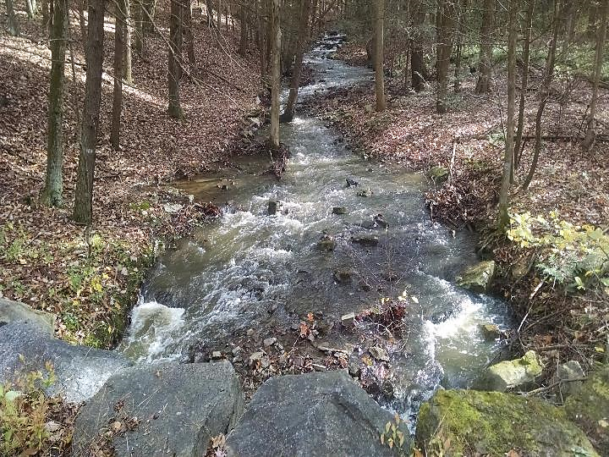
Stream Crossing Policy & Bankfull

Slide 2
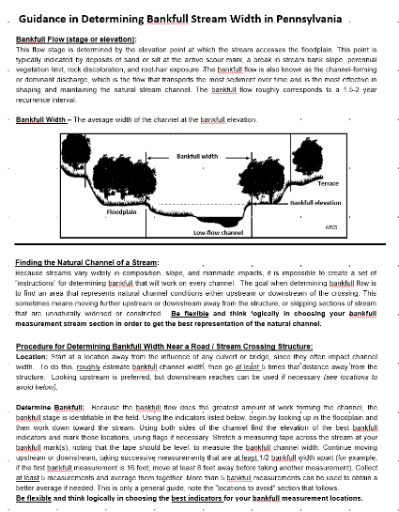
Stream Xing Replacement Policy
Bankfull guidance doc and webinar

Slide 3
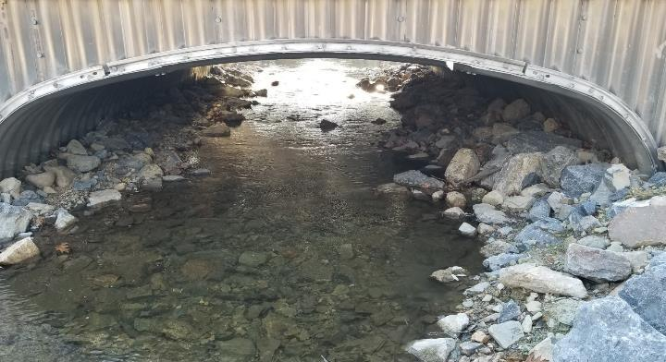
Stream Xing Replacement Policy
Stream Crossing Replacement Policy
Section 7.1 of the Administrative Manual

Slide 4
Stream Xing Replacement Policy
Policy for replacing culverts and bridges applies to both D&G and LVR projects.
Goal of the policy
Limits replacements to areas where structure is causing problem with stream.
Existing structures must be undersized and causing stream instabilities in relation to the bankfull width of the stream
New structures must be sized to properly accommodate stream flow, bed load, and aquatic organisms (bankfull width)

Slide 5
Stream Xing Replacement Policy
When does the Stream Crossing Policy Apply?
Applies to situations where streams, including intermittent channels, with identified bed and banks are flowing into the road or uphill ditch
Contact the Commission for questionable circumstances
In order for exemptions on “questionable stream” channels, Districts must obtain written approval from the Commission prior to contracting the project.
Use of Round Pipes
Round pipes over 3 feet in diameter are NOT permitted to be funded for use in stream crossing replacements.

Slide 6
Stream Xing Replacement Policy
Existing Stream crossing structures with an opening of more than 13 ft² ( equivalent to 48” diameter round pipe)
In order to be eligible for replacement, EXISTING structures must:
1. Have a structure to bankfull width ratio of 75% or less.
2. Show signs of streambank erosion.
3. Show signs of streambed erosion/aggradation.

Slide 7
Stream Xing Replacement Policy
Existing Stream crossing structures with an opening of more than 13 ft² ( equivalent to 48” diameter round pipe)
In order to be eligible for replacement, EXISTING structures must:
1. Have a structure to bankfull width ratio of 75 % or less.
2. Show signs of streambank erosion.
3. Show signs of streambed erosion/aggradation.
The NEW REPLACEMENT structure must (all four):
1. Have a structure width at least equal to bankfull width (100% ratio).
2. Be properly aligned with the channel.
3. Consider additional floodplain connectivity when possible.
4. Be designed and constructed to accommodate the passage of aquatic organisms through the structure.

Slide 8
Stream Xing Replacement Policy
Existing Stream crossing structures with an opening equal to or less than 13 ft² (equivalent to 48” diameter round pipe) automatically qualify
In order to be eligible for replacement, EXISTING structures must:
1. Have a structure to bankfull width ratio of 75% or less.
2. Show signs of streambank erosion.
3. Show signs of streambed erosion/aggradation.
The NEW REPLACEMENT structure must (all four):
1. Have a structure width at least equal to bankfull width (100% ratio).
2. Be properly aligned with the channel.
3. Consider additional floodplain connectivity when possible.
4. Be designed and constructed to accommodate the passage of aquatic organisms through the structure.

Slide 9
Stream Xing Replacement Policy
Multiple pipes
Existing stream crossings consisting of multiple pipes are eligible for replacement regardless of their relationship to the bankfull measurement (multiple pipes only, not multi-cell bridges)
Installation of multiple pipe structures is NOT permitted with Program funds
Must be replaced with a single opening structure of at least bankfull width.

Slide 10
Stream Xing Replacement Policy
Crossings that are not eligible for replacement
Program funds can NOT be used to replace the structure. This includes any materials, equipment, labor, engineering / consulting, etc.
Maintenance is not an eligible expense. Including lining of existing crossings, bridge deck repair, etc.
Can do work on road and stream around existing structure.
Divert ditches from directly impacting the stream
Drainage and base improvements on the road around the structure
Streambank Stabilization
Headwalls or endwalls on existing structure

Slide 11
Stream Xing Replacement Policy
All necessary permits must be obtained before work can begin.
Remember:
All permit conditions must be followed appropriately. DGLVR Projects are not exempt from any permits conditions or DEP regulations.

Slide 12
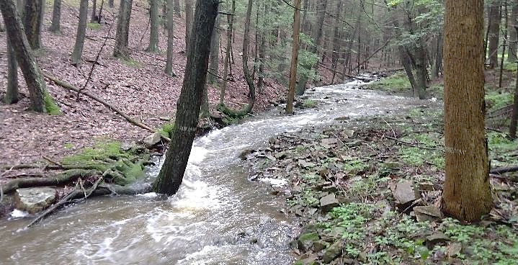
Definitions
In stable alluvial channels, bankfull discharge corresponds closely with effective discharge and channel-forming discharge.
Bankfull flow (stage or elevation) - defined as the point at which the flow just begins to enter the active floodplain.
Bankfull Width - Average stream width at bankfull elevation.
Channel-forming or dominant discharge - the discharge that is most effective in shaping and maintaining the natural stream channel.
Effective discharge - the single flow that is responsible for transporting the most sediment over time.

Slide 13
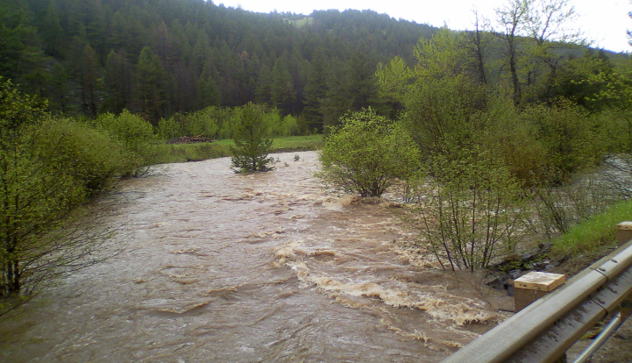
Bankfull flows transport the greatest amount of material over time.
Larger flow per event, but bankfull flow events occur more frequently.
But what about Floods??

Slide 14
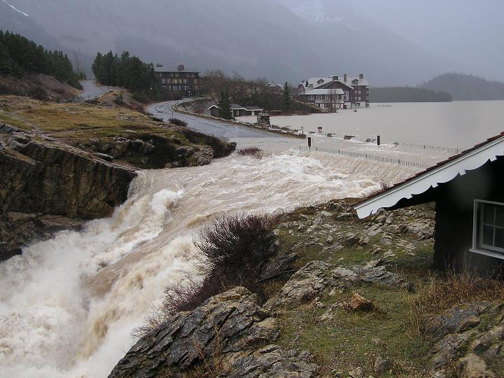
Hydrological Significance of Bankfull - Flow measurements show that the bankfull stage has a recurrence interval of 1.5 years on average.
This means that in any given year there is a 67% chance that the river will rise to or overtop the active floodplain.

Slide 15
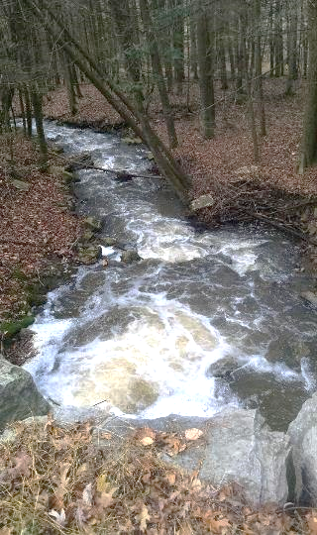
Bankfull flow sets many aquatic habitat characteristics such as pool dimensions, substrate size, width-depth ratio, etc.
Useful because it has hydrologic and morphologic significance which can be used for crossing design and will ensure sediment and aquatic passage.

Slide 16
Bankfull Determination
Because the bankfull flow does the greatest amount of work forming the channel, the bankfull stage is identifiable in the field.
There is no single universal indicator. You must look for clues and the combination of clues identifies bankfull.
Bankfull Elevation Indicators:
Elevation at the top of the highest depositional features such as point- and mid-channel bars
Changes in slope on banks
Changes in particle size on banks
Changes in vegetation on banks
Erosion and scour features (only when other features not present)

Slide 17
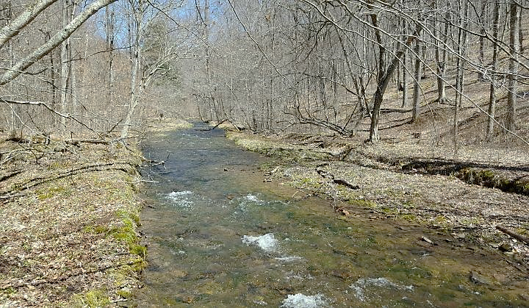
How would you approach measuring bankfull?

Slide 18
Bankfull Tips
Start by looking up in the floodplain then down to the channel
Use depositional features first then scour and vegetation
The transition between the channel and the floodplain can be grassed so it may be necessary to “weed” through vegetation to find the depositional area
Bases of trees can be below the floodplain elevation and are not always good indicators
Be aware of terraces and their difference from the floodplain

Slide 19
Stream Bed Width and Bankfull Width
floodplain
floodplain
bankfull width
stream bed width
Photos USFS

Slide 20
Additional Bankfull Determination Tips:
Bankfull flows will be LEVEL across the channel
Think logically!! Does it make sense that the points you are measuring as bankfull will see flow with that frequency?
Measuring bankfull is often easier during Spring and Fall when vegetation is dormant.
Be flexible in your measurement locations to find the best “Reference Reach” of a natural channel.
On entrenched streams, or streams with historically high sediment impacts (legacy sediments), bankfull elevation is often below the elevation of the “top of stream bank” due to many years of man-made impacts.

Slide 21
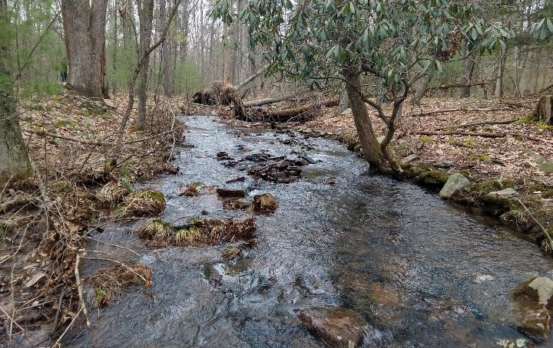
Locations to Avoid in Determining Bankfull
Logjams: These structures tend to increase the bankfull width temporarily in their immediate vicinity.
Manmade Impacts: Avoid locations with wall, weirs, dams, rip-rap, pipes. etc.
Bedrock Outcroppings: Bedrock can hide indicators of bankfull flow and alter channel width.
Braided Channels: Measure upstream or downstream of any braided channels if at all possible.
Tributaries/Springs: Measure bankfull between road crossing and any incoming flows that may increase width.
Hard Meander bends: Hard bends make it difficult to find good indicators since the stream is moving laterally.

Slide 22
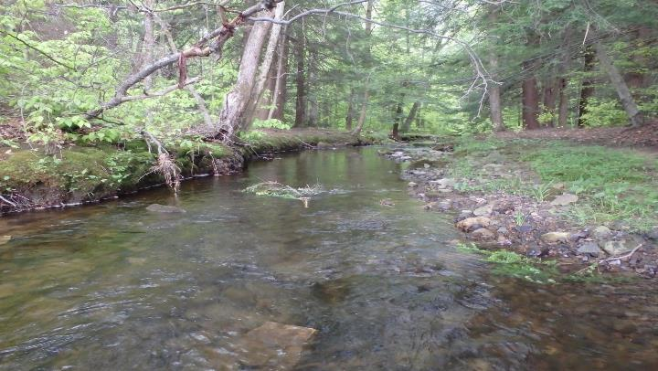
Bankfull Determination
Bankfull Width
Photos Trout Unlimited

Slide 23
^{Q}Bankfull
^{2/3 Q}bankfull
Small elevation changes can mean a large difference in Bankfull width.

Slide 24
Stream Bed Width and Bankfull Width
floodplain
floodplain
bankfull width stream bed width
Photos USFS

Slide 25
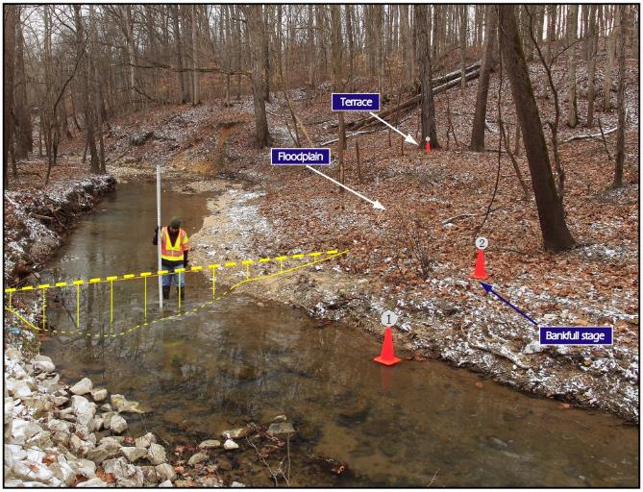
Photo – Indiana Fluvial Erosion Hazard Program

Slide 26
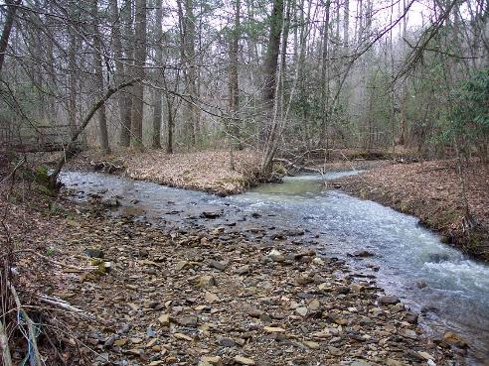
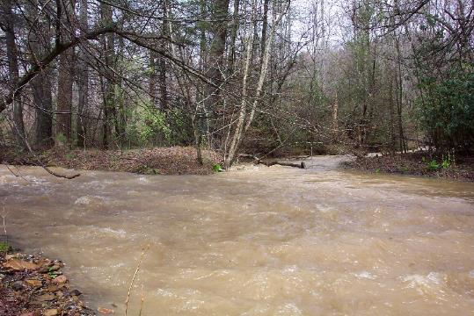
Photos - David Rosgen

Slide 27
Properly Designed Structures Sized to Bankfull Flow Width or Greater
Long-term ecological /geomorphic continuity
Minimal or no maintenance costs over structure life
Flood resiliency
Photos USFS

Slide 28
Bankfull width structure almost 2 decades old
Width ratio: 1.0, slope 4.5%
Johansen
Photos USFS

Slide 29
Beyond Bankfull
Going beyond bankfull allows you to build the stream bed AND banks.
Bankfull

Slide 30
Natural Stream Design – as big as your reference reach channel PLUS stable banks and/or roughness elements, capable of handling the vertical changes, hydraulic capacity, debris, and floodplain conveyance requirements with a structure wrapped around it!
How Big???
~1.25 x Bankfull
Photos USFS

Slide 31
Another good reason for banks
Corrosion rate increased due to abrasion from bedload

Slide 32
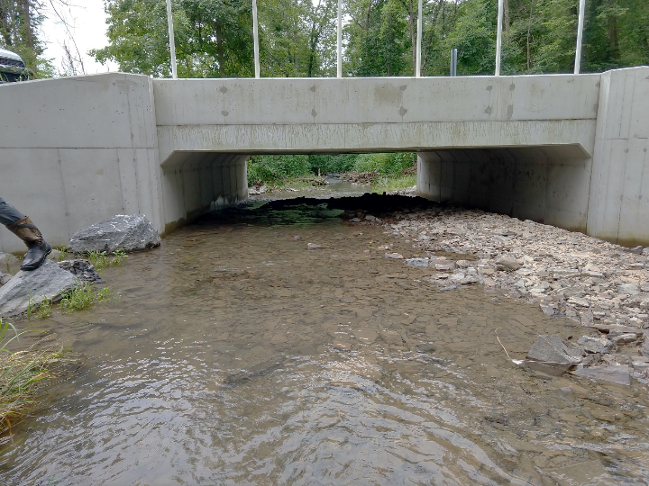
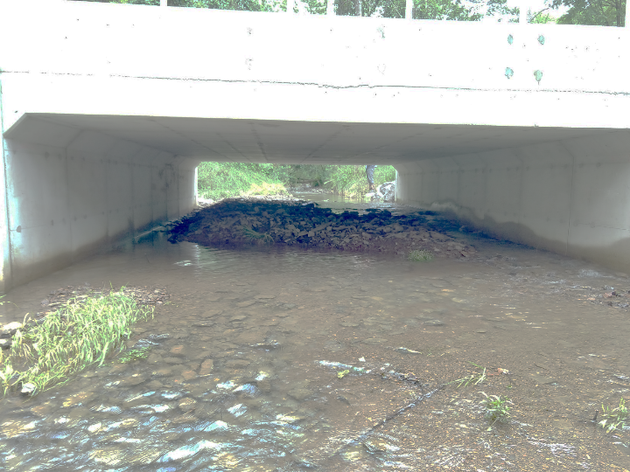
Beyond Bankfull Pitfalls

Slide 33
What is the Purpose/Significance of
Identifying Bankfull Flow Conditions?
^{Q}25 year
^{Q}bankfull
bankfull
2/3 Q
Transports more sediment over time than other discharges
Used to set structure size to ensure passage of sediment and aquatic organisms, and reduce flooding and maintenance.
Photos USFS

Slide 34
QUESTIONS??
https://www.fs.fed.us/biology/nsaec/products-videoswebinars.html

