Slide 1
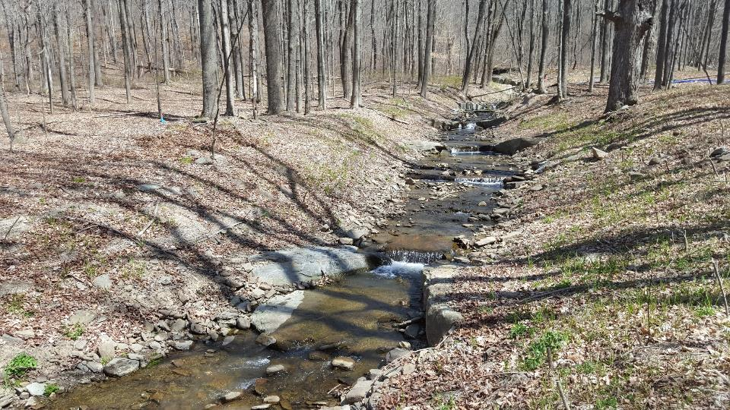



In-Stream Structures & Grade Control

Slide 2
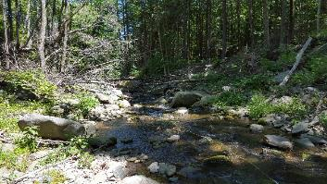
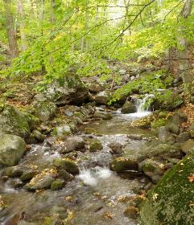
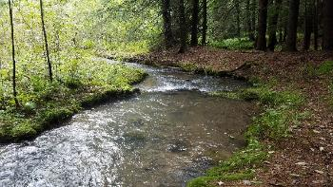
Overview….
slope dictates dominant bedforms
  length and spacing of bed features
‘pocket-water’
3.2 %
step / plunge pool
6.1 %
riffle / pool
1.2 %

Slide 3
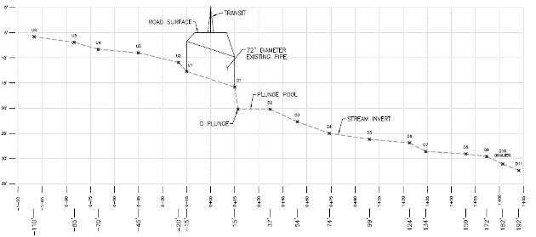
Connecting the dots…
Objective is to re-establish channel continuity
  minimize channel adjustment (erosion and sedimentation)
  increase longevity of the new crossing (flood resiliency)
  maintain AOP

Slide 4
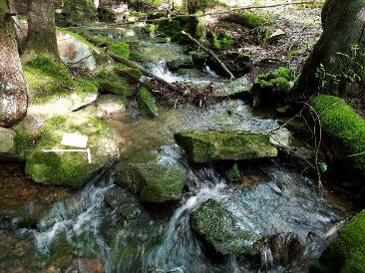
Slope is the key.
Channel Slope
  dictates dominant bedform & grade controls
      refugia / resting zones (pockets and pools) for AOP
  drives bed shear and entrainment
  As channel slope increases…
    channels become less sinuous
    energy dissipation more vertical
    grade control more frequent and robust

Slide 5
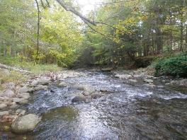
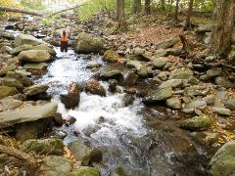
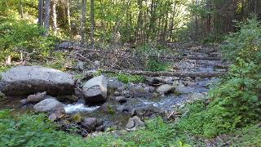
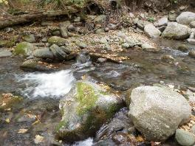
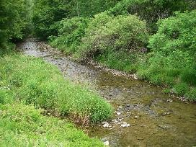
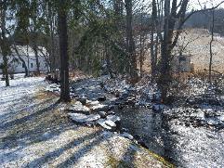
Grade control maintains channel slope and stability.

Slide 6
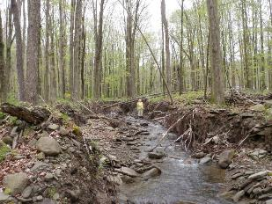
Instream structures
Primary functions
  replicate natural instream grade control elements
  keep substrate (streambed) within the culvert
    establish hydraulic control for upstream pool depth
    Define channel cross-section and low-flow channel
  maintain continuity through modified stream reach
Secondary functions
  Streambank protection / erosion control (thalweg maintenance)
    Instream habitat improvement

Slide 7
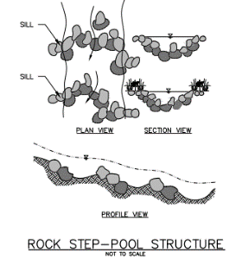
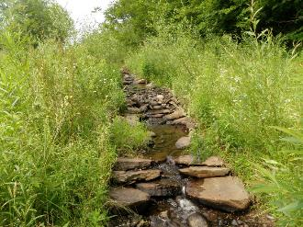
Instream rock structures
Rock clusters and cascades
  Mimic natural rock cascade / drop structures
  Size rock for higher-gradient / energy / sediment supply reaches
    Smaller channels and culverts (hand labor)

Slide 8
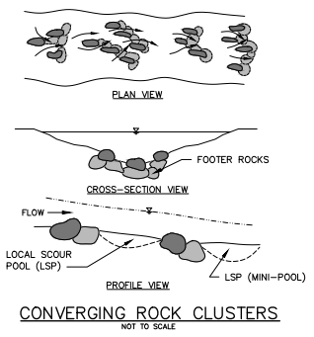
Instream rock structures
Rock clusters and cascades
  Can usually re-purpose native, onsite rock
  Minor-frequent grade control
  Built to defined cross-section (width & thalweg)
    Ribs and ‘key pieces’ for constructed riffle

Slide 9
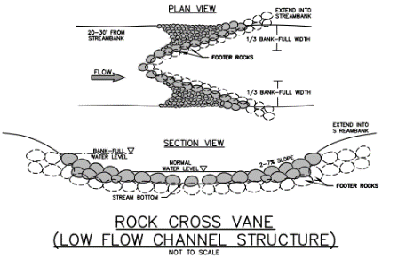
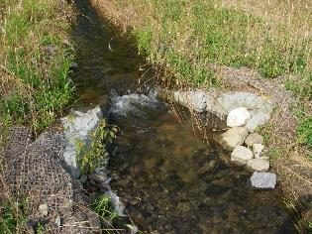
Instream rock structures
Rock cross vanes
  Mimic natural rock cascade / drop structures
  Suitable for higher-gradient / energy / sediment supply reaches
    Robust grade control

Slide 10
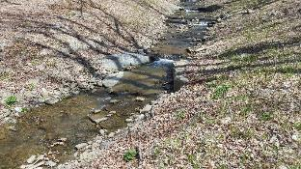
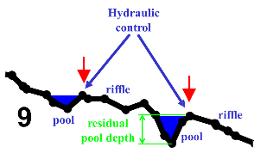
Instream rock structures
Rock cross vanes…
  Upstream ‘throat’ elevation sets the bed elevation
  Crest-to-crest slope sets channel slope
  Arm angle and slope is important
    Tie arms to bank at or near bankfull elevation and width
    Steeper channel more structures closer together (hydraulic control)

Slide 11
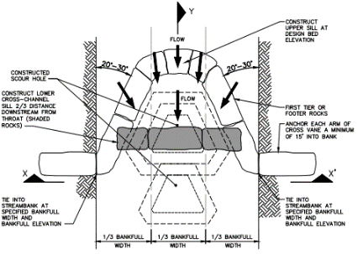
Instream rock structures
Rock cross vanes…
  Can be constructed inside culvert pipes
  Must be large enough to be stable in flood
    Gapped to allow for AOP

Slide 12
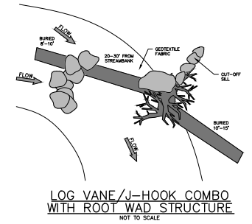
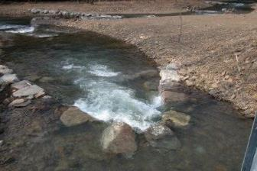
Instream rock structures
Rock cross vanes…
  Alternating sequence to restore over-widened channels
  Can promote erosion of opposite bank
    Can become undermined in steep channels
US Fish & Wildlife Service

Slide 13
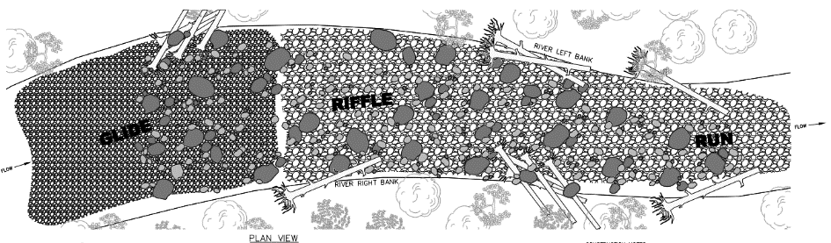
Instream rock structures
Constructed Riffles
  Relatively-easy to build (easier than it looks!) – especially inside a culvert…
  Relies on ribs and clusters of “key pieces” to hold grade in streambed

Slide 14
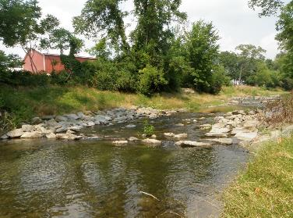
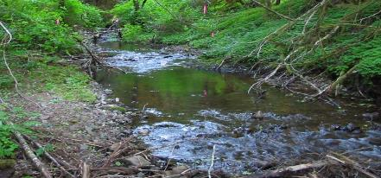
Instream rock structures
Constructed Riffles
  Dominant grade control element in riffle/pool bedform streams
  Suitable for low- to moderate-gradient / energy / sediment supply reaches

Slide 15
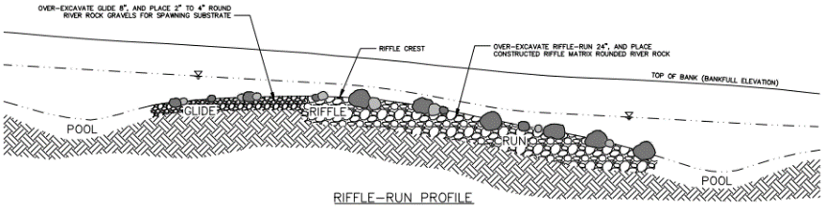
Instream rock structures
Constructed Riffles
  Think energy dissipation – floodplain instead of vertical plunge
  AOP and instream habitat means more than just fish…
  Important to maintain low-flow channel and cross-section shape
  Should not exceed typical bankfull width

Slide 16
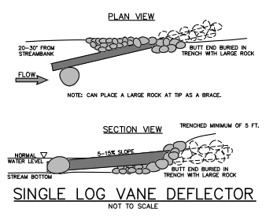
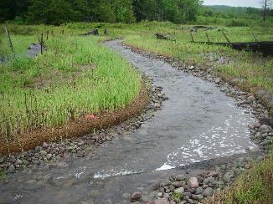
Instream log structures
Single log vanes
  Installed with upstream invert at bed elevation
  Low- to moderate-gradient / energy / sediment supply reaches
    Good for thalweg control

Slide 17
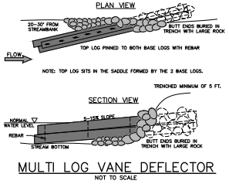
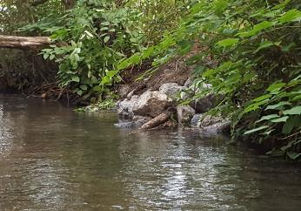
Instream log structures
Multi-log vanes
  Installed with upstream invert raised above bed elevation
  Low- to moderate-gradient / energy / sediment supply reaches
    Often used for thalweg control & bank protection

Slide 18
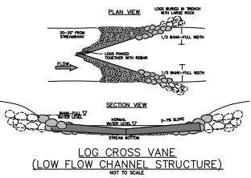
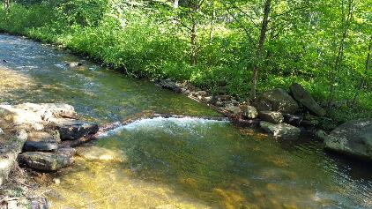
Instream log structures
Log cross vanes
  Similar in function to rock cross vanes
  Best in moderate-gradient / energy / sediment supply reaches
    Promote pool features

Slide 19
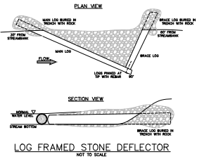
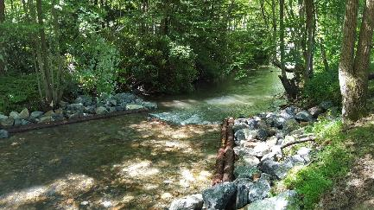
Instream log structures
Log cross vanes
  Can be built with upstream log-framed deflectors
  Arm angle and slope varies by channel slope
    Can withstand undermining better than rock cross vanes

Slide 20
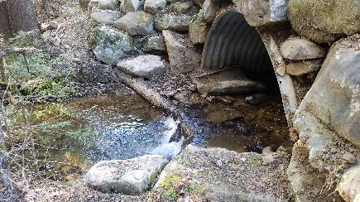
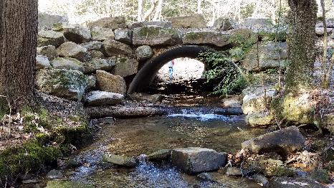
Log cross vanes as culvert grade control

Slide 21
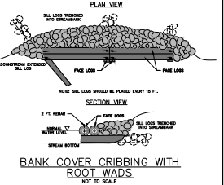
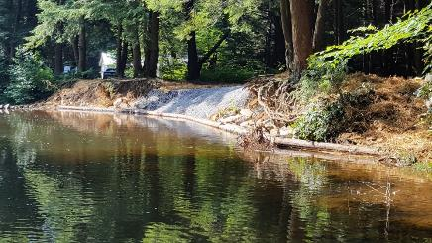
Instream log structures
Mud sills
  Primarily bank protection
  Can include log vane “arms” for grade / thalweg control
    Good for reclaiming scour pool width

Slide 22
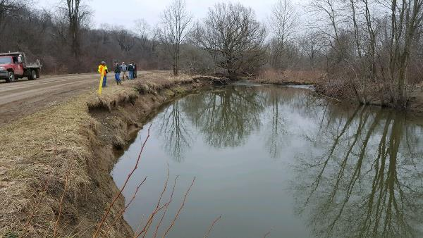
Instream log structures
Mud sill – before construction

Slide 23
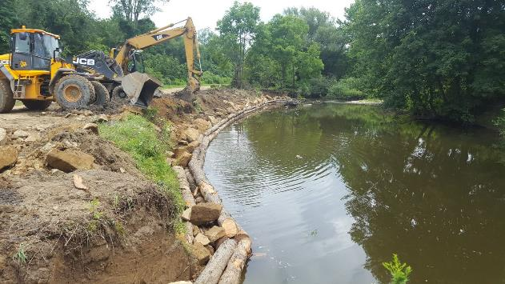
Instream log structures
Mud sill – during construction

Slide 24
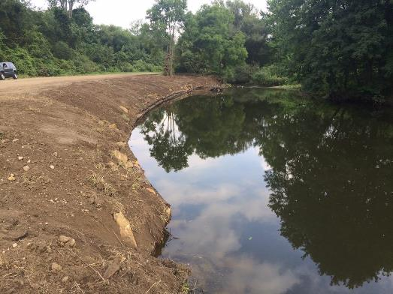
Instream log structures
Mud sill - completed

Slide 25
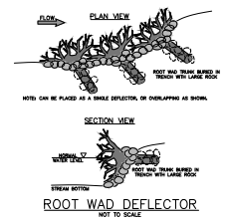
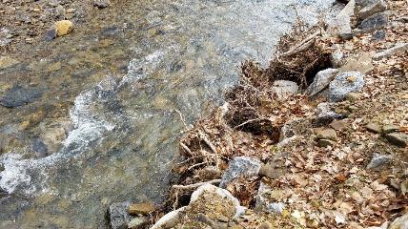
Instream log structures
Root wads
  Primarily bank protection / habitat improvement
    Good for reclaiming scour pool width
    Can be integrated with other structures

Slide 26
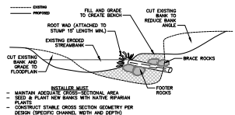
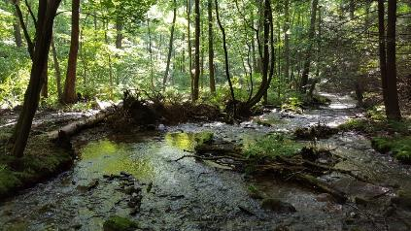
Instream log structures
Root wads
  Angle upstream and shingle/overlap for scour protection
    Usually require footer and brace logs/rock
    Place so they’re still effective at low-flow

Slide 27
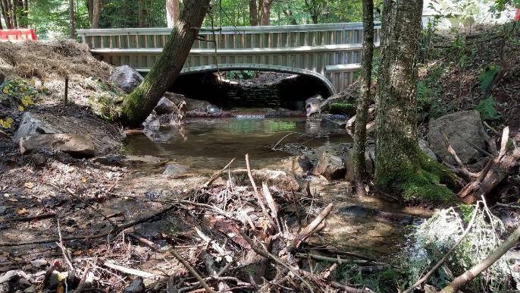
Questions ?

