Slide 1
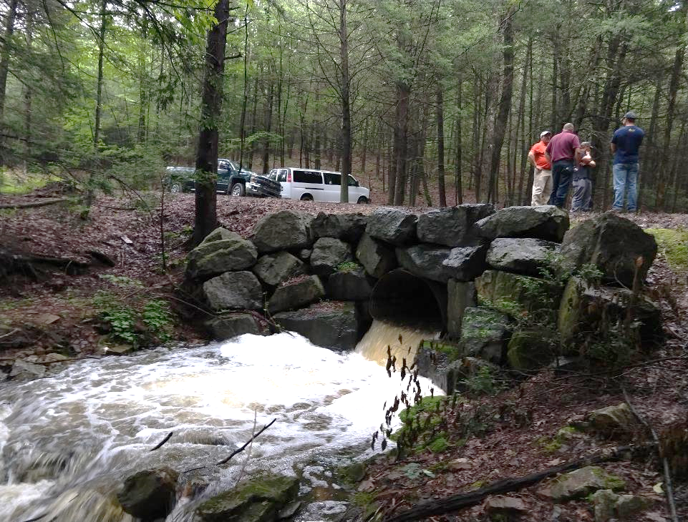
Permitting

Slide 2
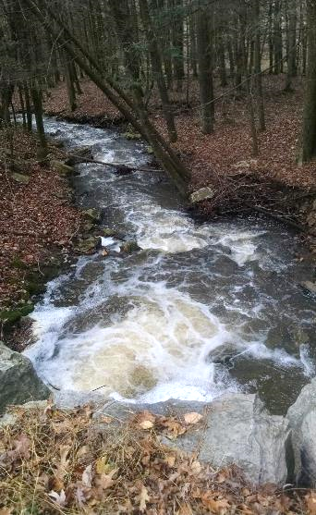
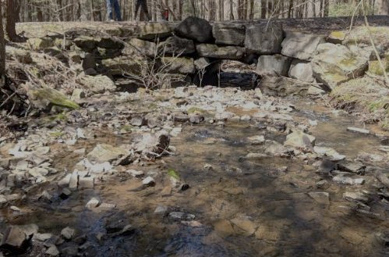
Details of 2019 replacement
Existing ~6’ squash pipe
Bankfull ~14 ft
Watershed area ~840 acres
~5% stream slope, ~3% pipe slope
Permit required??
Requires GP-11
Downstream scour pool
Upstream sediment wedge

Slide 3
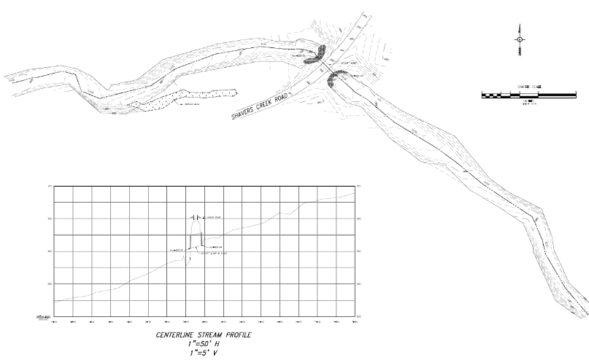
Initial Survey (May 2018)
Detailed engineering survey ~400’ downstream and 400’ upstream
Wetlands delineation completed

Slide 4
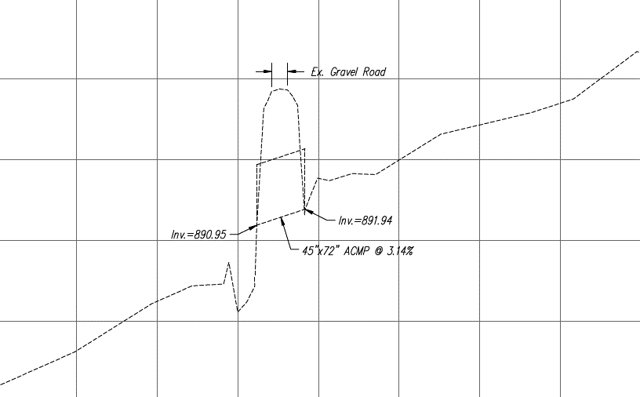
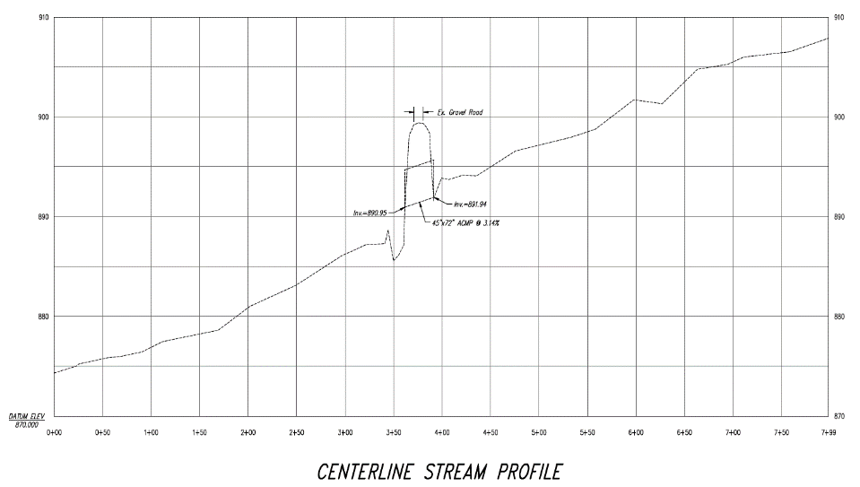

Slide 5
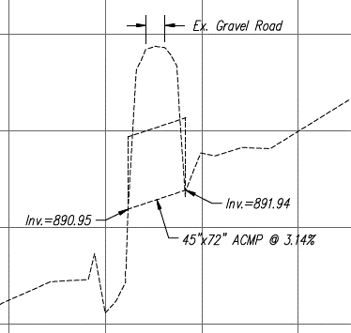
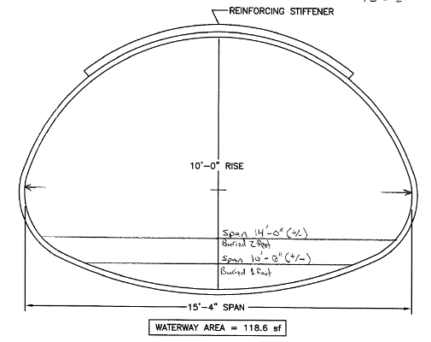
Structure Selection
Where will you do the work??
How to reconnect the stream bed?
Cover height?
Slope? Sour depth?
Bottom? No bottom?
Span ~15’ Buried 3 ft

Slide 6
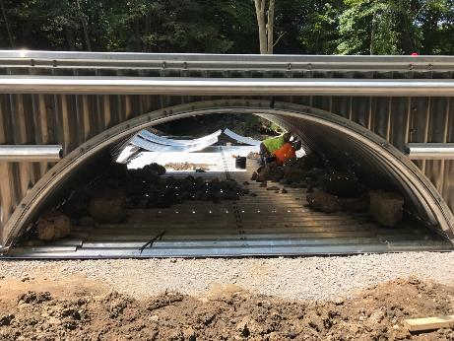
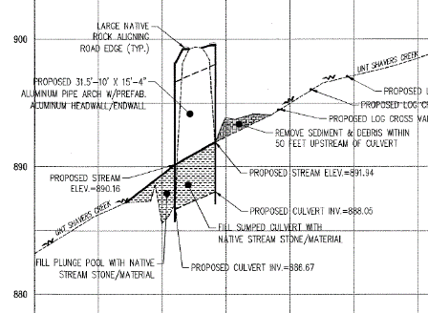
Span ~15’ Buried 3 ft

Slide 7
Upstream Work

Slide 8
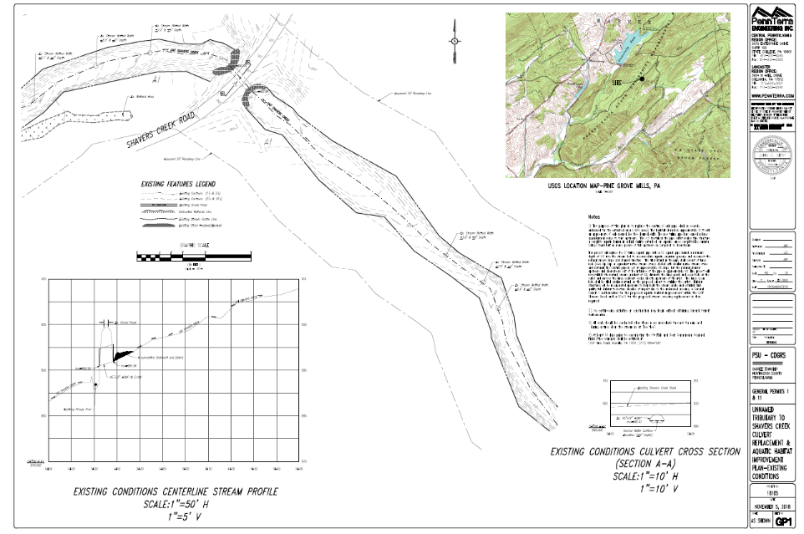

Slide 9
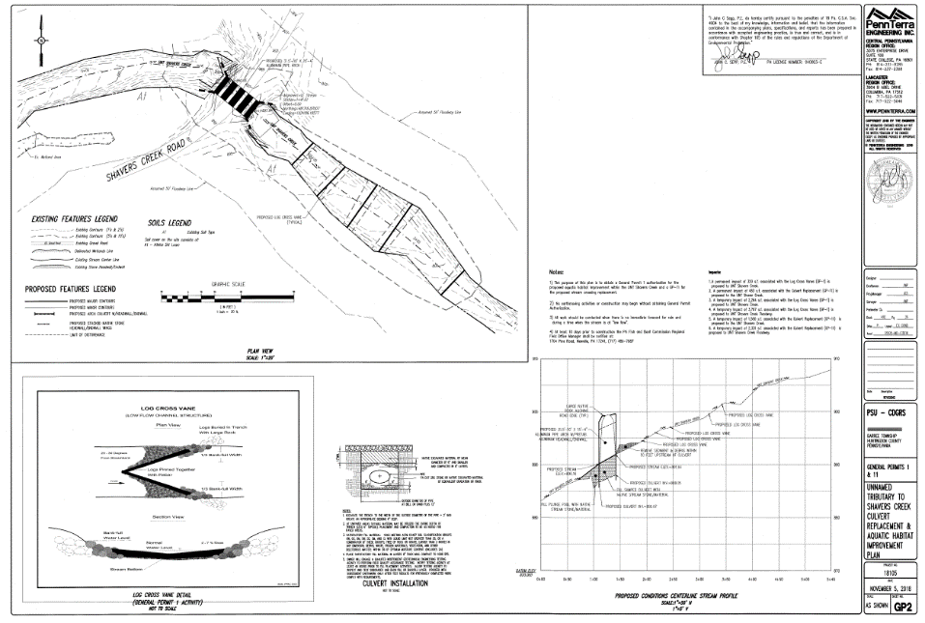

Slide 10
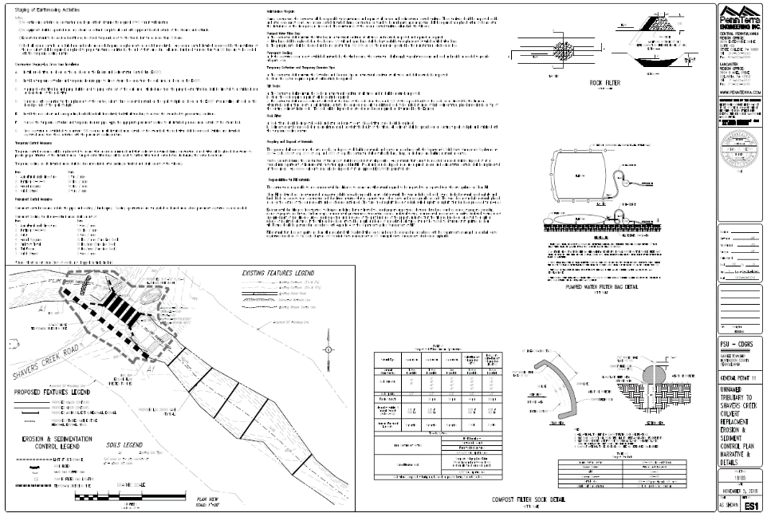

Slide 11
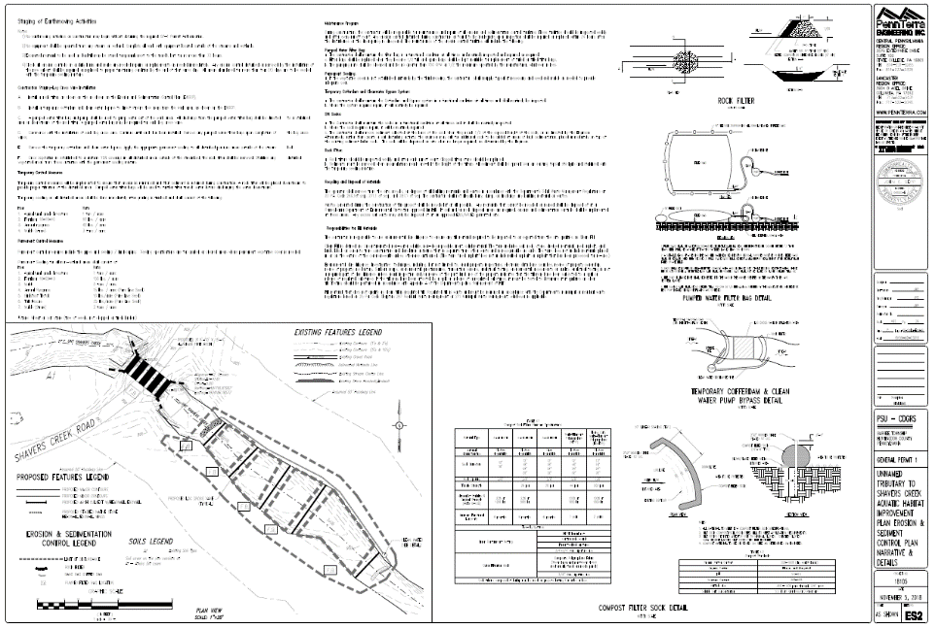

Slide 12
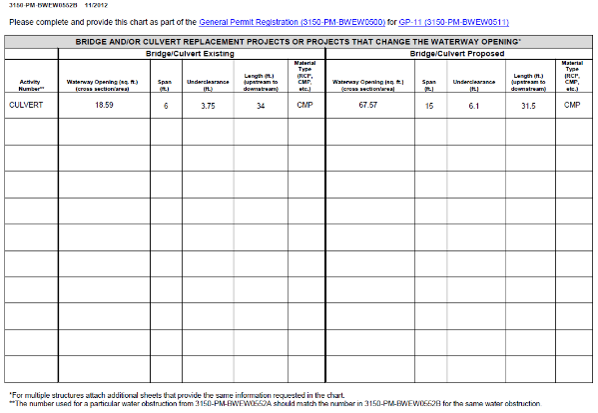
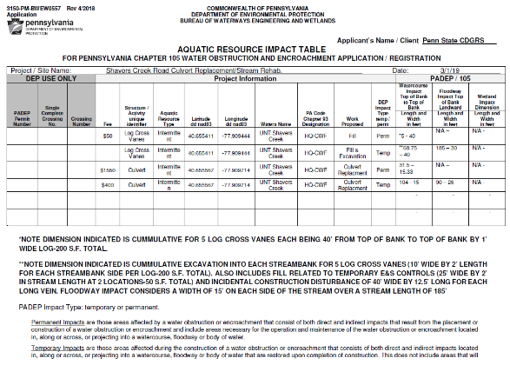
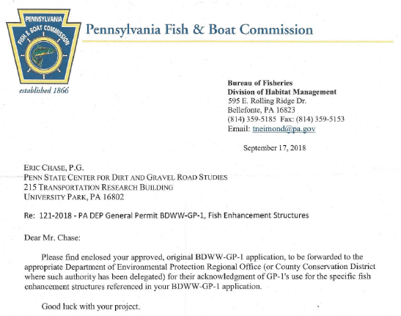
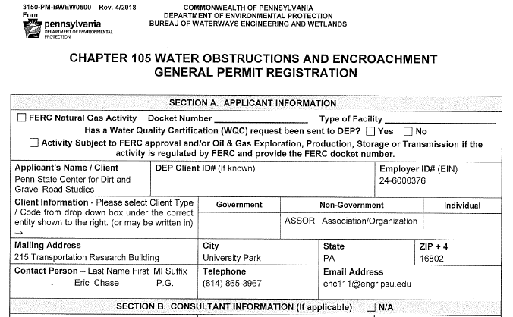
Other Documentation

Slide 13
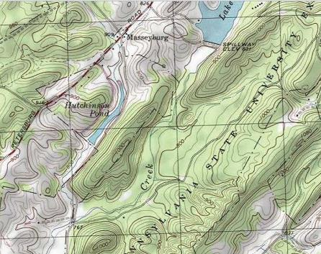
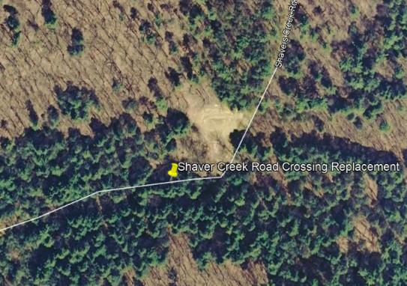
Other Documentation
Proposed Stream Crossing Replacement Location Map & Site Photographs
Shaver Creek Rd
Project Site
Photos 1, 2 & 3
Photos 4, 5 & 6

Slide 14
Then…
Submitted November 13, 2018
First DEP response February 25, 2019

Slide 15
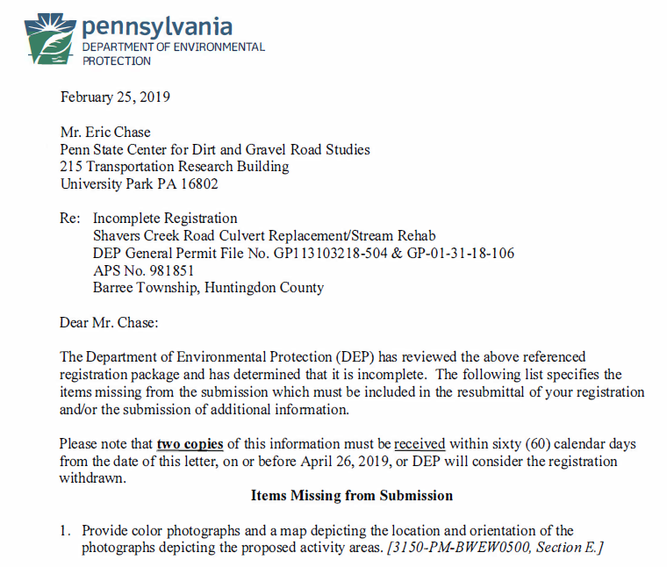
DEP Response

Slide 16
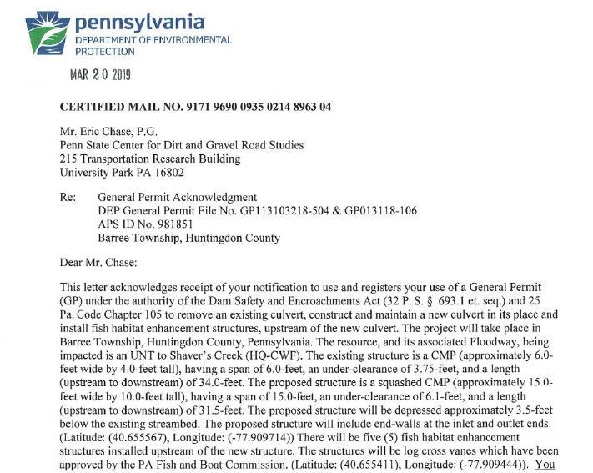
Permit approval

Slide 17
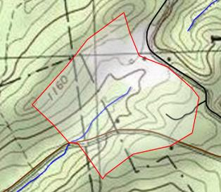
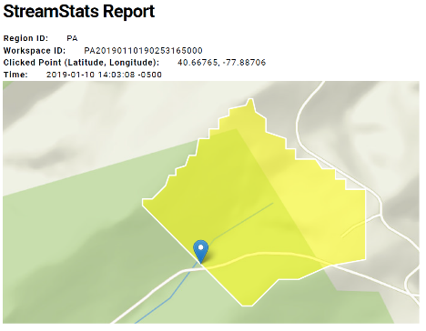
Permit Waivers
Watersheds <100 acres
No wetlands involved
Still must follow all GP provisions and do E&S
~60 acre watershed

Slide 18
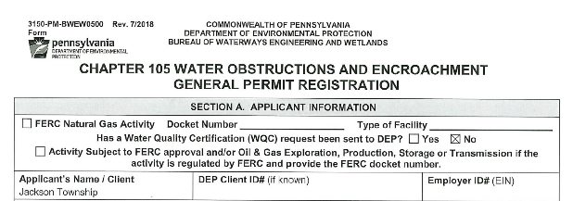
Want a Waiver Letter?
Filled out GP registration and signature page
PNDI – environmental review
Existing Conditions survey
Wetlands delineation
Watershed delineation and area
Photos – upstream and downstream

Slide 19
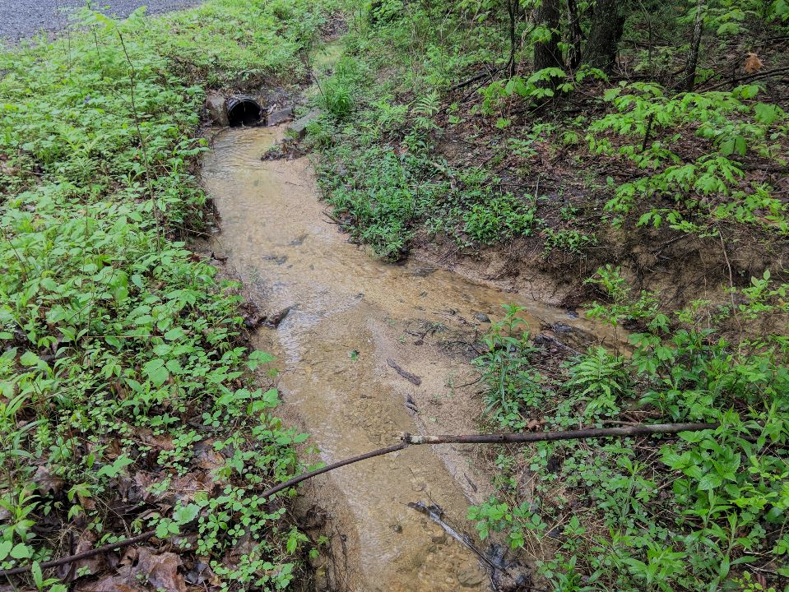
Questions?

