Slide 1
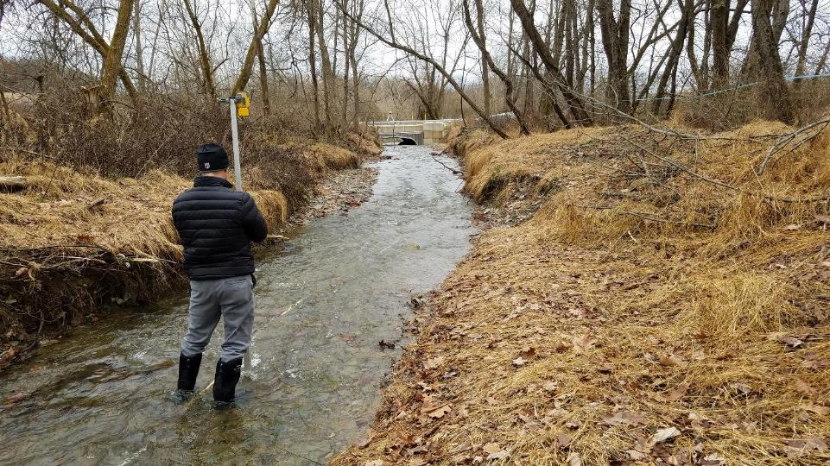
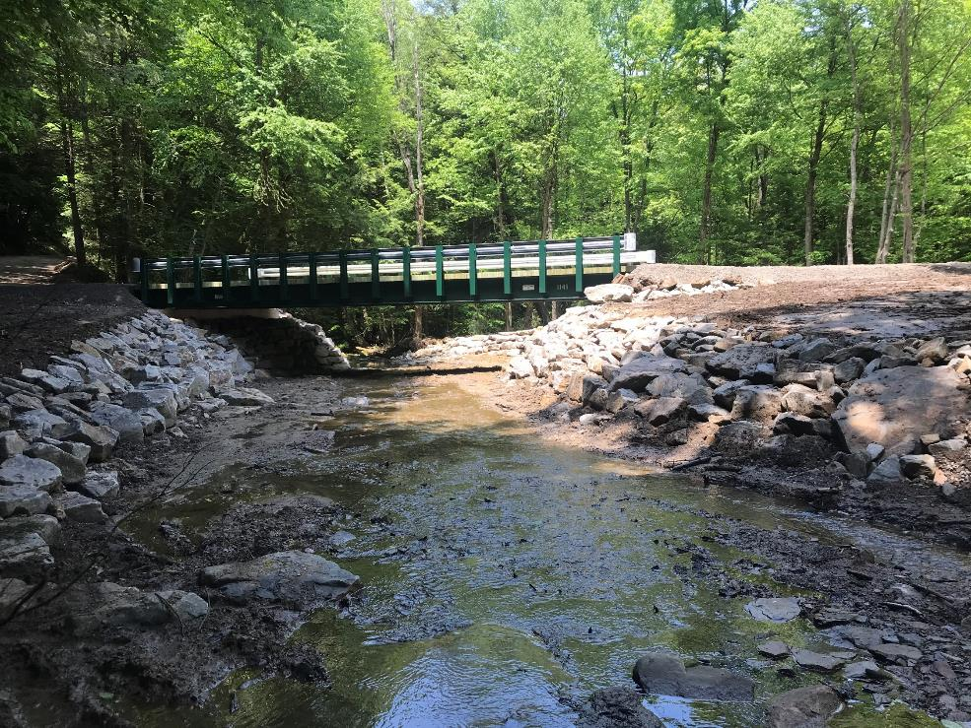



THE DISTRICT PROCESS
STREAM CROSSING REPLACEMENTS
Maria Dreese
CDGRS Extension Associate
maa241@psu.edu

Slide 2

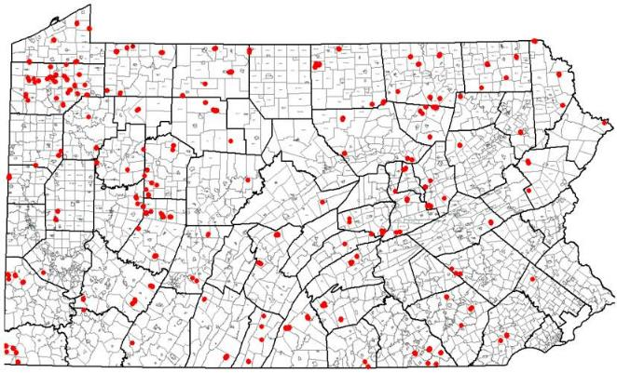
INTRO - DGLVR Program Completed Stream Crossings
Stream Crossings
~100 in 2017
~100 in 2018
~120 in 2019
2
Notes:
Introduce project partners

Slide 3
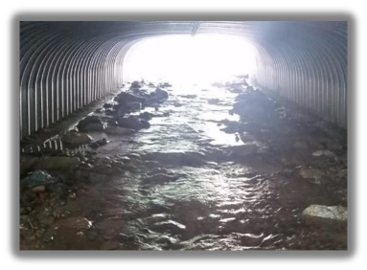
INTRO - Considerations
Stream Crossings with AOP (Stream Simulation)
Added layer of complexity
More time intensive process
Often requires projects to be planned ahead
Requires time for permitting
Requires consideration to timing for construction (waterway restrictions)
Grant application mostly developed w/out Engineer based on CDGRS, TU or CD’s recommendations.
3

Slide 4

INTRO - Considerations
Stream Crossings with AOP (Stream Simulation)
SCC Stream Crossing Notification Process
QAB Ranking Meeting(s) & District Board Contract Approval Process
CDGRS Stream Crossing Replacement Program is EVOLVING
Consider how your County can Evolve with us!
4
Notes:
Introduce project partners

Slide 5
INTRO – 10 Step Approach
#1 - Initial Site Assessment
#2 - Longitudinal Profile Survey
#3 - Grant Application – Material Selection & Cost Estimation
#4 - QAB Ranking & Review
#5 - Writing a Contract
#6 - Engineering, Design, Permitting
#7 - Bidding a Stream Crossing
#8 - Inspection
#9 - Final Inspection & As-built Notes
#10 - Completion Report
5
Notes:
Introduce project partners

Slide 6
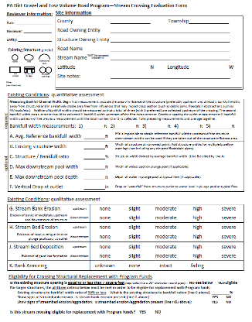

STEP 1 – Initial Site Assessment
SCC Stream Crossing Notification
Ideally applicant notifies you before they submit the grant application.
Meet on site and complete the Stream Crossing Evaluation Form
Honest, candid conversation about Applicant & District’s expectations for the project
Review site history
At least 100% Bankfull (BF)
  may consider 1.25 to 1.5 BF
Site Info
Site Evaluation: width considerations
Site Evaluation: erosion considerations
Eligibility Determination
6
Notes:
Introduce project partners

Slide 7
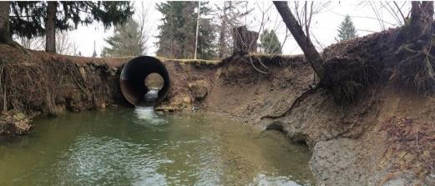
STEP 1 – Initial Site Assessment
Over 20’ Clear Span Opening – Considered a Bridge
  Federal inspection requirement every 2 years
8-20’ County Inspection Requirements May Apply
Is the Applicant committed to seeing this project through?
…Bankfull Determination…Survey Basics…Geomorphic Features…
7
Notes:
Introduce project partners

Slide 8
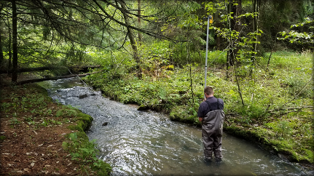
STEP 2 - Longitudinal Profile Survey
SCC Stream Crossing Notification
Slope of upstream and downstream channels
Existing invert elevations
Type, spacing, and length of bed features
Grade controls
  - Relative stability (tie-in points)
Pool depth
Road-surface elevations
  - Minimum coverage over new culvert
CONTACT CDGRS OR TU FOR ASSISTANCE

Slide 9
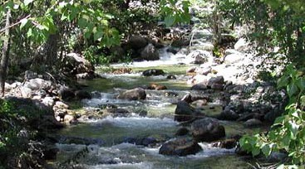
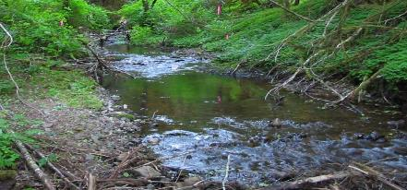
STEP 2 -Longitudinal Profile Survey
Beginning, end, and maximum depth of pools.
Crest and base of cobble, boulder, and LWD steps.
Beginning and end of riffles, runs, lag deposits.
Top and base of steps (LWD or rock), transverse ribs.
Bedrock exposures: Falls, ledges, etc.
Beginning and end of reach/channel types and other points of interest.
step
step
pool
step
pool
pool
pool
riffle
pool
riffle
riffle crest
pool
riffle

Slide 10
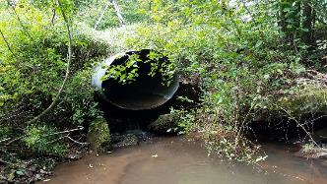
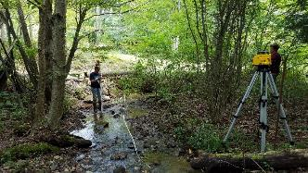
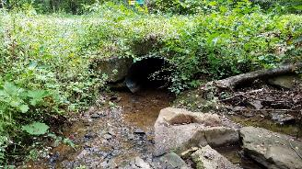
STEP 2 - Longitudinal Profile Survey
  Irish Hollow Run at Irish Hollow Road
Notes:
Introduce project partners

Slide 11
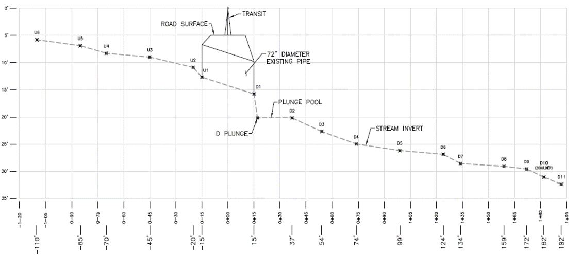
STEP 2 - Longitudinal Profile Survey

Slide 12
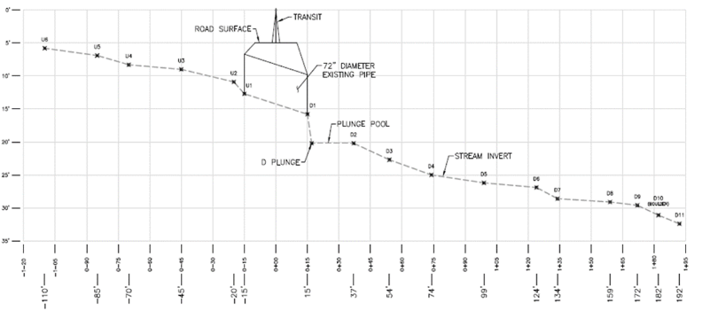
STEP 2 - Longitudinal Profile Survey

Slide 13
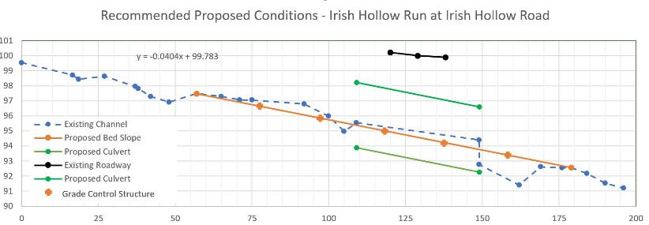
STEP 2 - Longitudinal Profile Survey
existing inlet invert
m
existing outlet invert
m
g
p
sediment wedge
g
  Reference slope (US of culvert) = 4.2 %
  Continuity (design) slope = 4.0 %
  Typical grade control (riffle crest) spacing = 28.5’
  Design riffle crest spacing = 21.5’
  Typical riffle length = 11’
  Typical pool length = 17.5’
  Typical pool depth = 0.8’ (below riffle crest)
  Design riffle length = 9’
  Design pool length = 12.5’
Notes:
Introduce project partners

Slide 14
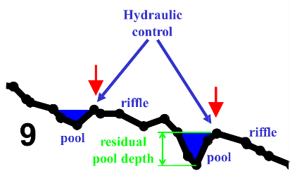
STEP 2 - Longitudinal Profile Survey

Slide 15
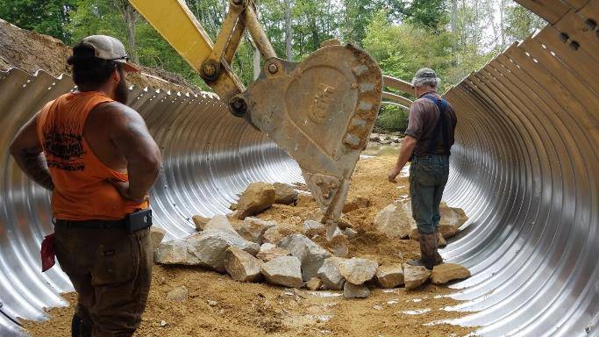
STEP 2 - Longitudinal Profile Survey

Slide 16
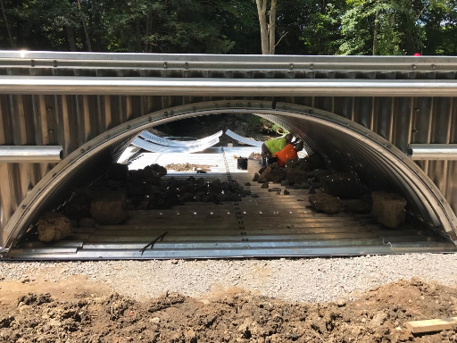
STEP 2 - Longitudinal Profile Survey

Slide 17
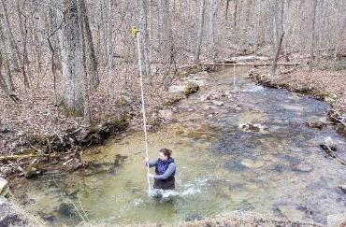
STEP 3 – Grant Application - Material Selection & Cost Estimation
SCC Stream Crossing Notification
Long Pro results inform the structure selection.
Depth of burial
Slope
Roadway cover
Grade control type & spacing
Accounts for maximum scour depth
Informs grade control and stream substrate aggregate size
Other Considerations
Applicant preferred material
Equipment & Labor requirements
Site access
Cost
Timing
CONTACT CDGRS OR TU FOR ASSISTANCE

Slide 18
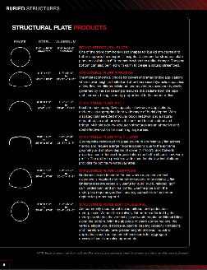
STEP 3 – Grant Application - Material Selection & Cost Estimation
  Materials: Structure, Headwalls, Wingwalls, Toe Plates
  Product catalogs from structure suppliers
  Utilize salesmen for structure estimates
  Provide span (width), rise (height), length, min & max cover
  Should be designed for HS20, HS25 or HL93.
  Include cost for Highway Loading calc. if inspections apply
  Consider manufacturer oversight for product assembly
  Consider manufacturer assembly
  Include headwalls, wingwalls or baffles if applicable
  Explore pre-assembly & delivery options

Slide 19
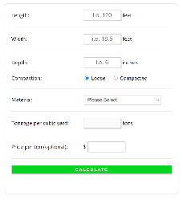
STEP 3 – Grant Application - Material Selection & Cost Estimation
  Materials Associated with Structure
  Structure Foundation Bedding Material (2A, 2RC, etc.)
  Structure Backfill Material (2A, 2RC, etc.)
    Assume all new controlled material
    Length x Width x Depth / 27 x 1.5 = Material in Tons
  Grade Control Material (Rock Rip Rap, Logs, Root Wads, Woody Additions)
  Material to fill plunge pools (Rock rip rap, run of bank fill, etc.)
  Stream substrate material
    Assume all new material. May reuse suitable excavation material
  Roadway surface material (DSA, 2A, asphalt, etc.)
  Cross pipes, underdrain, etc. for drainage near stream

Slide 20
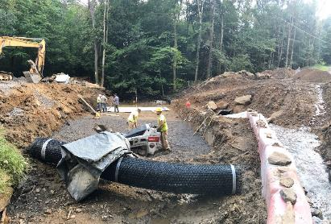
STEP 3 – Grant Application - Material Selection & Cost Estimation
  Materials: E&S Controls
  Flume Pipes
  Cofferdam Materials (sandbags, jersey barriers, plastic sheeting)
  Silt fence, compost filter sock, drop inlet bags, filter bags
  Topsoil
  Seed & Mulch, Hydroseeding

Slide 21
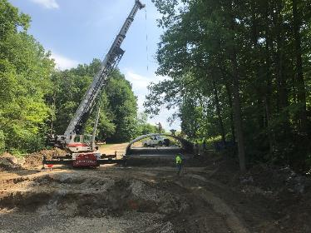
STEP 3 – Grant Application - Material Selection & Cost Estimation
  Equipment
  Excavator(s), Crane
  Compaction equipment (vibratory plates, jumping jacks, roller, etc.)
  Pumps (Bypass, Trash Pumps)
  Air Compressors or Generators for Hand Tools
  Trucking (Spoils materials, backfill, etc.)
  Equipment to place stream bed substrate (Motorize wheel barrel, skid steer, conveyor belt, etc.)

Slide 22
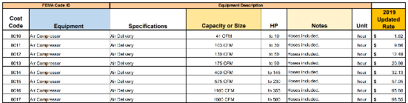
STEP 3 – Grant Application - Material Selection & Cost Estimation
  Equipment
  Contractor estimates (can group equipment & labor - estimated at prevailing wage)
  Equipment rental reimbursement
  Reimbursement of applicant equipment use at FEMA Rates
  REMINDER PROGRAM FUNDS CAN NOT BUY EQUIPMENT FOR APPLICANT

Slide 23
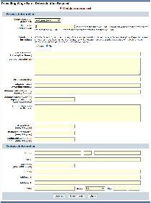
STEP 3 – Grant Application - Material Selection & Cost Estimation
  Labor
  Contractor estimates (can group equipment & labor - estimated at prevailing wage)
  Tree trimming or removal
  Utility relocation or temporary interruption of service
  Engineering
  Limited to 10% of grant requested funds
  New separate line item in grant application
  Engineering fees limited to those which occur after a contract is signed

Slide 24
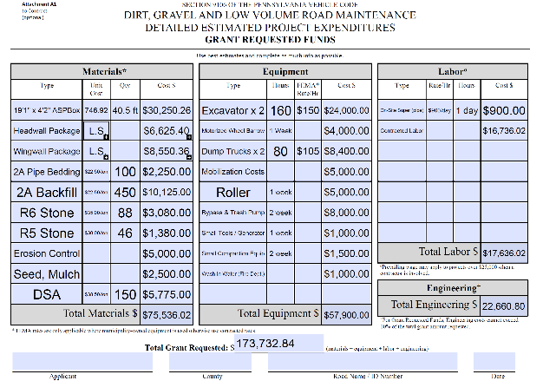
STEP 3 – Grant Application - Material Selection & Cost Estimation
13% of Total Grant Requested

Slide 25
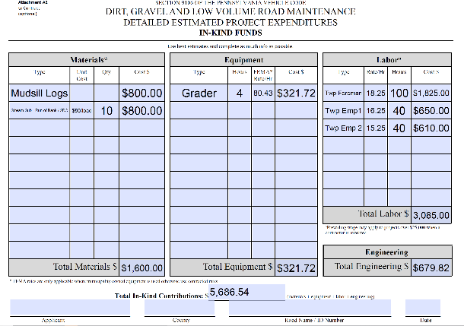
STEP 3 – Grant Application - Material Selection & Cost Estimation

Slide 26
STEP 4 – QAB Ranking & Review
SCC Stream Crossing Notification
  QAB reviews & ranks all grant applications
  QAB / CD consider application oversights
    Doesn’t meet program policy
      Less than BF Pipe
      Existing Structure not eligible for replacement ( more than 75% BF width)
    Insufficient materials estimated for stream simulation
    Labor rates without prevailing wages
    Inadequate equipment and time allocations
  After QAB ranking but before District Contracts, workplan can be revised.

Slide 27
STEP 5 – Writing a Contract
SCC Stream Crossing Notification
  Contract (grant request) + Inkind Needs to = Realistic Budget
  District Board approval of QAB Recommendations
  Attachment A – Grant Application
  Attachment B – Workplan
  Billable engineering work may begin after contract signed.
CONTRACT DELIVERABLES

Slide 28
STEP 6 – Engineering, Design, Permitting
Background
  P.E. seal required for permitted stream crossing replacements (GP #7, #11, Joint Permit)
  Limit engineering fees up to 10% of contract $ amount
  Applicant must cover remaining engineering fees above 10% threshold
Challenges
  Clients & Engineers lack understanding of program objectives, policy requirements & project needs
  “Traditional” approach to engineering design / permitting
  Non-competitive pricing
CONTACT CDGRS OR TU FOR ASSISTANCE

Slide 29
STEP 6 – Engineering, Design, Permitting
Engineering Request for Proposal (RFP)
What does it do?
  Establishes project expectations for client
  Defines scope and deliverables (design & permitting)
  Provides opportunity for Applicant/District review of engineering products
    Review prior to permit submittal
    Technically-sound & meets policy requirements
  Promotes competitive pricing environment
  Translates to development of good construction bid / SOW documents

Slide 30
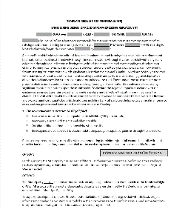
STEP 6 – Engineering, Design, Permitting
Engineering Request for Proposal (RFP)
Overview…
  Defines 8 Scope of Work Tasks for engineer
    Project Management (“office work”, meetings, etc.)
    Site survey and mapping
    Hydraulic analysis
    Geomorphic assessment / channel “design”
    Structural design
    Permitting
    Construction documents & construction cost estimate
    Construction inspection
Your project might require some or all of these, on a project-by-project basis

Slide 31
STEP 6 – Engineering, Design, Permitting
Engineering Request for Proposal (RFP)
Overview…
  Specifies project objectives to be met
    Permit type and minimum registration requirements (for GP projects)
      GP11 Permit Memo
    Replacement structure size, type and dimensions
    Channel continuity / grade control (substrate & aquatic organism passage)
    Grade control sizing (maintain substrate / AOP for lifespan of the structure)

Slide 32
STEP 6 – Engineering, Design, Permitting
Engineering Request for Proposal (RFP)
How does it work ?
User-defined (that means you…)
  Meant to be modified to fit your (municipality’s) project needs
  Municipality or District decides work done in house or delegated to engineer
    Geomorphic assessment / channel design data
    Size, type, and dimensions of replacement structure
    Applicable permit type
    Construction oversight
  Less engineering scope = lower engineering fee
  Consider technical assistance available through Center / TU when delegating scope to engineer.

Slide 33
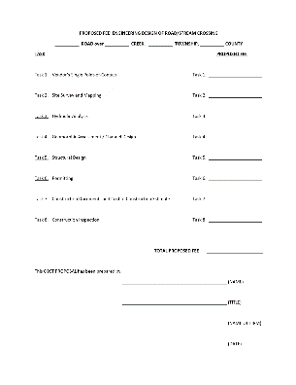
STEP 6 – Engineering, Design, Permitting
Engineering Request for Proposal (RFP)
Available online at:
https://www.dirtandgravel.psu.edu/pa-program-resources/program-specific-resources/blank-forms under “Example Forms”
Is there an engineer already “on retainer ?”
    Still defines Scope of Work for sole-sourced engineering

Slide 34
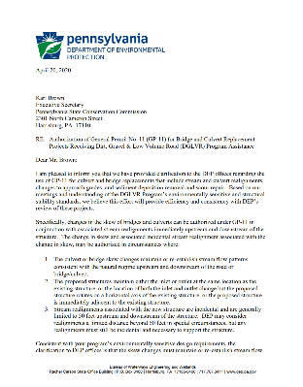
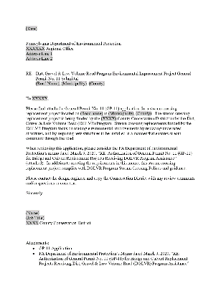
STEP 6 – Engineering, Design, Permitting
DEP GP11 Clarification Memo
Available online at:
https://www.dirtandgravel.psu.edu/sites/default/files/General%20Resources/Stream%20Crossings/DEP_GP11_memo_4_20_20.pdf
…2019 Stream Crossing Boot Camp Shaver’s Creek Permit Process…

Slide 35
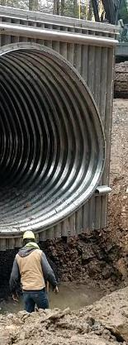
STEP 7 - Bidding Stream Crossings
Why is Project Bidding Important?
Quality documents vital to successful projects
Clear, concise plans required for contractor to understand project scope and goals.
Contractual agreement – needs to be well planned to avoid conflict, confusion, & delay during the construction process.
Bidding Requirements as of January 1, 2020 (PA Bulletin):
  Purchases & Contracts below $11,300 - No formal bidding or written/telephone quotes
  Purchases & Contracts from $11,300 & $21,000 - 3 written or telephone quotes
  Purchases & Contracts greater than >$21,000 - Formal Competitive Bidding Required
CONTACT CDGRS OR TU FOR ASSISTANCE

Slide 36
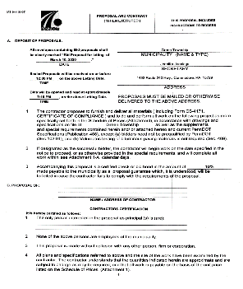
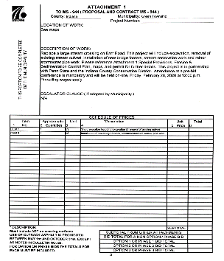
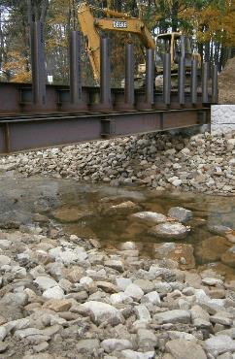
STEP 7 - Bidding Stream Crossings
PennDOT MS-944

Slide 37
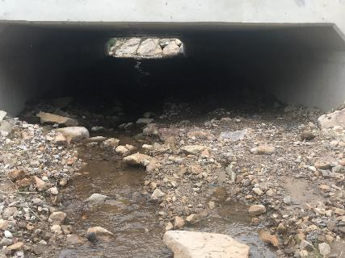
STEP 7 - Bidding Stream Crossings
MasterSpec
“Front End” Forms
Instructions to Bidders & Contract Forms
  Request for Bid
  Prevailing Wage Forms
  Bid Agreement Forms
  Non-Collusion Form
  Notice of Award
Construction Specifications
What & How to Install Crossing
Demolition
DSA Specification, Earthwork, etc.

Slide 38
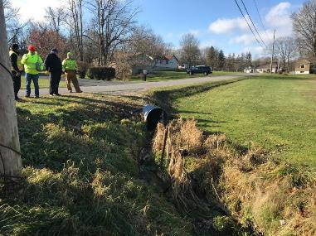
STEP 7 - Bidding Stream Crossings
Site Showing
A gathering of potential bidders to review bid packet details.
Often require attendance to submit bid.
Helps obtain accurate, competitive bids.
District attendance is recommended.
Addendums
Written information adding to, clarifying or modifying the bidding documents during bidding process.

Slide 39
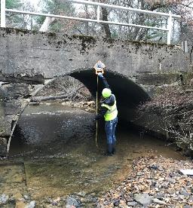
STEP 7 - Bidding Stream Crossings
Common Oversights & Issues
No Pre-Bid site showing.
No Pre-Construction meeting identified in bid packet.
No identification of inspectors (Township, Engineer, Conservation District).
No investigation of roadway restrictions, bonding requirements, construction limitations, utilities, etc.
Lack of specs. & details for pipe slope (Longitudinal Profile), stream & site restoration or survey requirements.
Clearly defined roles of Who is providing What to the job.
Request for product submittals.
Clearly defined timeframes.

Slide 40
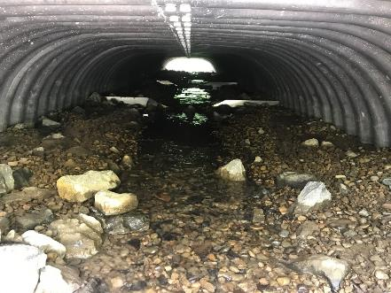
STEP 8 - Inspecting Stream Crossing Projects
Stream Crossing Projects Require Attention to Detail
Photo Documentation of Existing Site Conditions, Critical Stages During Construction & Post Completion of Project
Pre-Construction Meeting
Construction Survey – Benchmark Identification
Mobilization & Traffic Control
Stream Diversion & E&S BMPs
Site Clearing
Existing Structure Removal & Disposal
Foundation Prep for New Structure
Structure Assembly
Structure Placement (if applicable)
Structure Backfill
Stream Simulation Through Structure
Roadway Reconstruction
Site Cleanup, Restoration (Seed & Mulch)
Safety
CONTACT CDGRS OR TU FOR ASSISTANCE

Slide 41
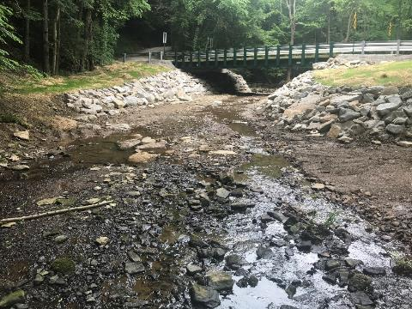
STEP 8 - Inspecting Stream Crossing Projects
Pre-Construction Meeting
Establishes “project team” & day to day working relationships
Discuss construction schedule
Establish required documentation
Review Permit Conditions and Special Site Features
Construction Survey – Benchmark Identification
Accuracy - correct stream slope, alignment, etc.
Identify benchmarks and control point locations.
  Ask for offsets if located within the excavation area.
Errors in foundation elevations severely affect the project
Mark areas not to be disturbed.
Check and re-check the work!

Slide 42
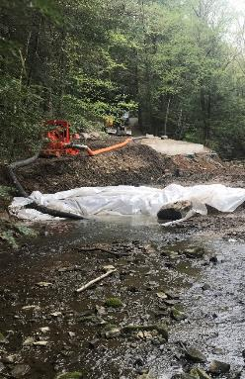
STEP 8 - Inspecting Stream Crossing Projects
Stream Diversion & E&S BMPs
Review E&S BMP materials are on site at start of project.
Make sure there is plan for bypass pump refueling.
Minimize clearing and disturbance to greatest extent possible.
Identify waste or stockpile areas and separate materials as applicable.
“Clean up” jobsite daily or before weather events.
Coffer dam materials provide tight seal to streambanks and bed.
Site Clearing, Existing Structure Removal, Foundation Prep for New Structure
OSHA soil categories & max. excavation slope angles – Excavation slope failure
Unsuitable foundation soils for structure foundation
Encounter bedrock
Sufficient space to operate (pipe assembly, backfill & compaction equipment, etc.)
Pipe bedding material

Slide 43
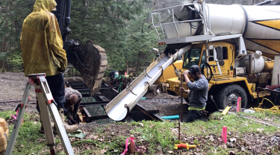
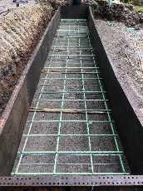
STEP 8 - Inspecting Stream Crossing Projects
Structure Assembly & Structure Placement (if applicable)
Consider manufacturer rep. on site to start assembly.
Review shop drawings & tools required for assembly.
Review access & aerial obstacles for concrete trucks, cranes, etc.
Forms, embedded bolts, reinforcing bars match shop drawings & manufacturer recommendations.
All hardware installed and torqued to spec.
Handle materials carefully.
Structure Backfill & Roadway Reconstruction
Place backfill at proper moisture content.
Backfill meets manufacture specs.
Use hand operated compaction equipment at haunches of structure and compact in lifts of 8 – 12”.
Provide compacted minimum cover over the structure.

Slide 44
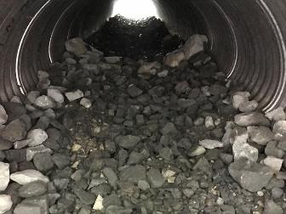
STEP 8 - Inspecting Stream Crossing Projects
Stream Simulation Through Structure
Review gradation, depth and linear extent of stream work.
Voids filled after each lift by washing filler material into voids and with hand tamping.
Fill elevation line is marked in the structure.
Equipment or labor suitable for structure size is provided to establish stream bed & channel features.
Don’t push material in structures with full invert & use rubber tire/tracked equipment when possible.
Site Cleanup, Restoration (Seed & Mulch)
Seed & mulch using natives suitable for shade conditions & reseed as needed.
Ensure E&S BMPs are removed when vegetation is established.

Slide 45
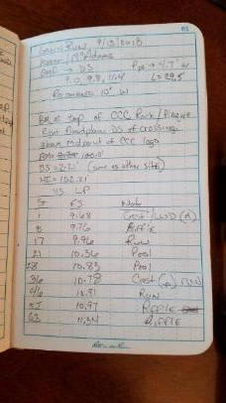
STEP 9 – Final Inspection & Asbuilt Notes
Final Inspection
Done before contract mobilizes out of job site
Review construction plan drawings & scope of work – everything completed?
All permanent E&S BMPs installed (seed, mulch, Turf Reinforcement Matting, Rip Rap, etc.)
As-built Notes
As built notes (work as executed survey)
Drawn over original grant workplan or construction drawings
Often done in red pen, initialed & dated
May differ from original workplan if agreed upon by all parties upfront
May require Engineer’s Input & Approval
Preparation for Completion Report Form

Slide 46
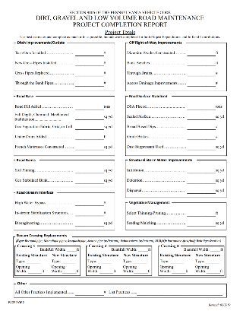
STEP 10 – Completion Reporting
Project Case File Must Have When Project is Completed
Contract, Grant Application, Workplan
Stream Crossing Evaluation Form
Traffic Count Validation Form (if applicable)
Evidence of all applicable permits and E&S plan
PA One Call serial #
Prevailing documentation (if applicable)

Slide 47
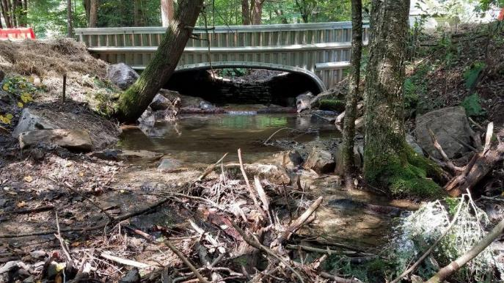
Questions ?
…2020 Shaver’s Creek Stream Crossing Replacement…

