Slide 1
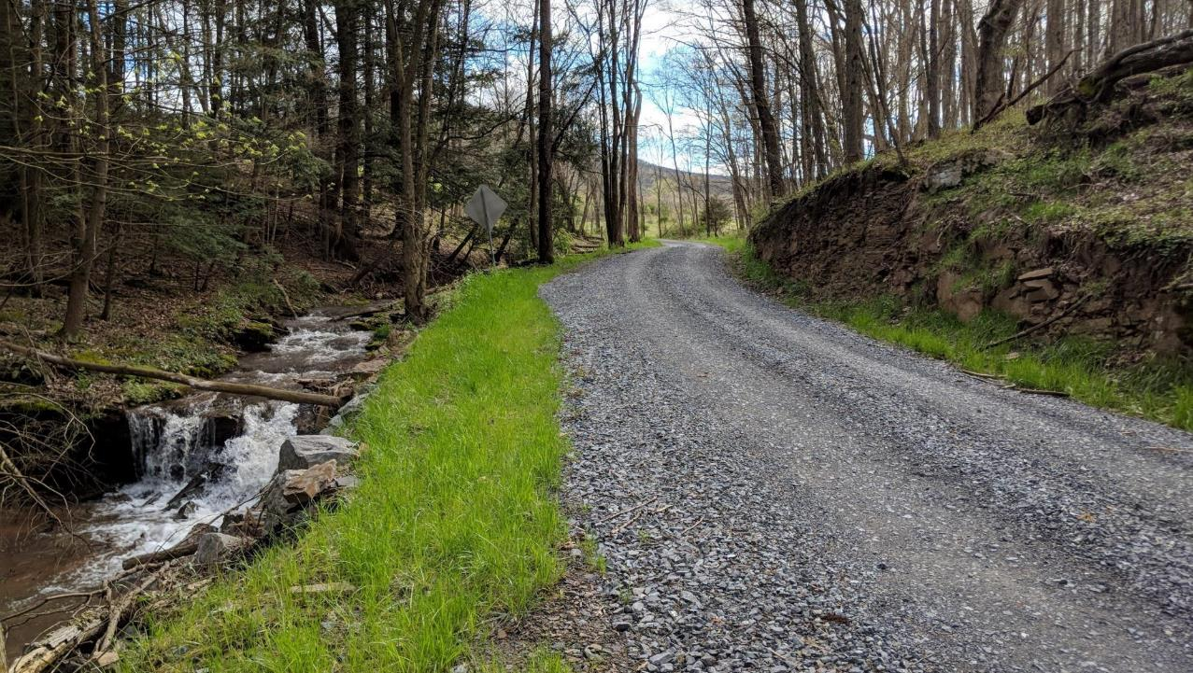
Dirt, Gravel, and Low Volume Road (DGLVR) Program
2/28/2023
How to Fill out the Grant Application
SCC
Sherri Law
shlaw@pa.gov
If you are reading this, then you are successfully seeing the webinar video. Webinar audio should be automatic through your computer (or click “join audio”), and options can be accessed in the “audio options” button on the bottom left. If your computer audio is not working, you can listen on your phone by dialing 646-876-9923.

Slide 2
Quality Assurance Boards
This webinar is being recorded
Please enter questions in the “Q&A” Feature
We will answer all questions at the end

Slide 3
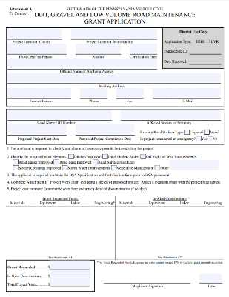
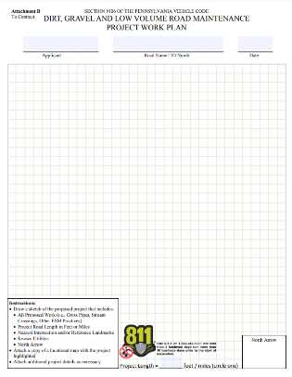
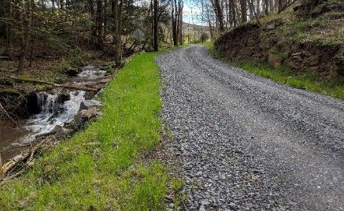
Outline
DGLVR Grant Applications
DGLVR Program Introduction
Eligibility for DGLVR Grant funds
Filling out the Grant Application
Page 1
Location map
Project sketch
Cost estimate
Attachments
What to do if you need help

Slide 4
Outline
DGLVR Grant Applications
DGLVR Program Introduction
Eligibility for DGLVR Grant funds
Filling out the Grant Application
Page 1
Location map
Project sketch
Cost estimate
Attachments
What to do if you need help

Slide 5
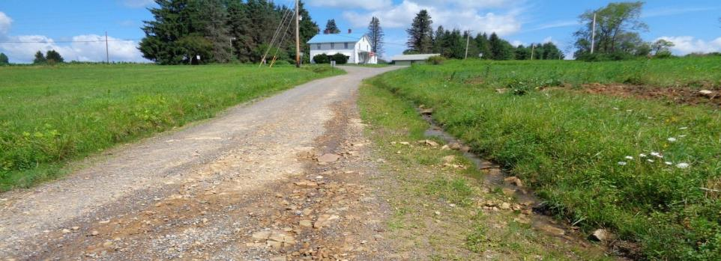
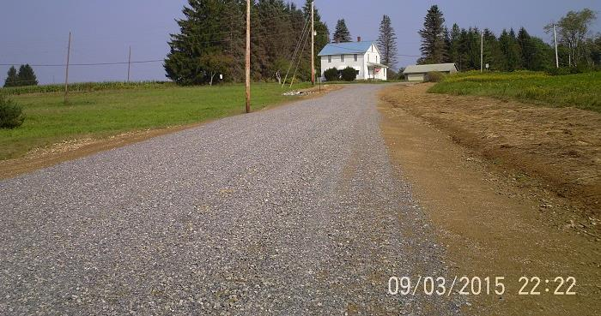
Before
Project Primer: Road Base and Fill
DGR Project in Jefferson County: $65K Spent, $5K in kind
After

Slide 6
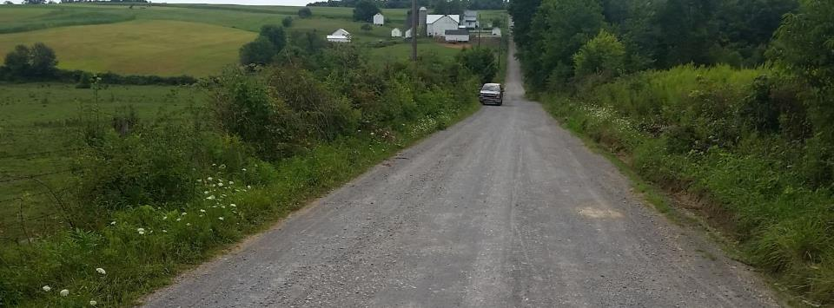
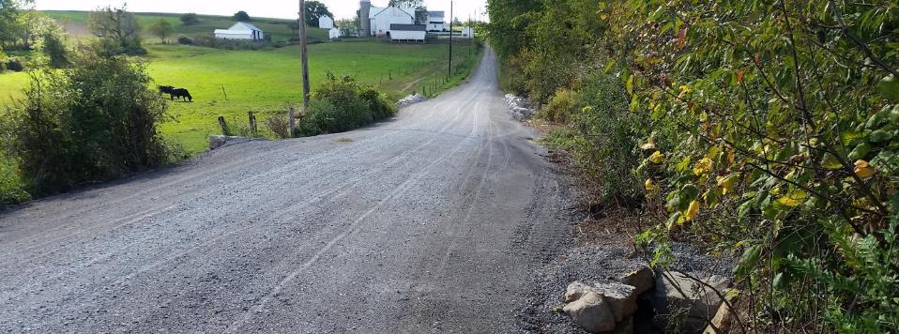
Before
Project Primer: Fill, pipes, surface
After
DGR Project in Mercer County: $100K Spent, $6K in kind

Slide 7
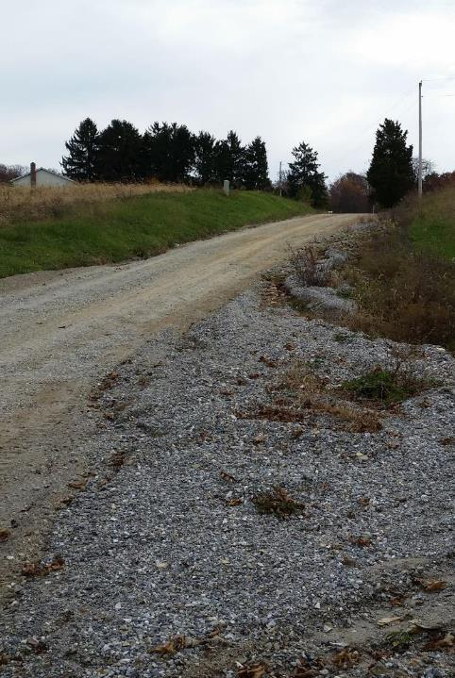
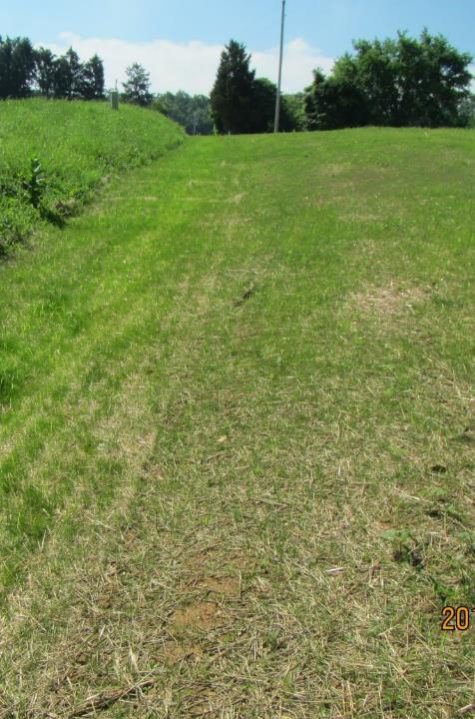
Before
Project Primer: Road Relocation
After
Before
DGR Project in York County: $63K Spent, $22K in kind
retired road
Road Relocated away from stream

Slide 8
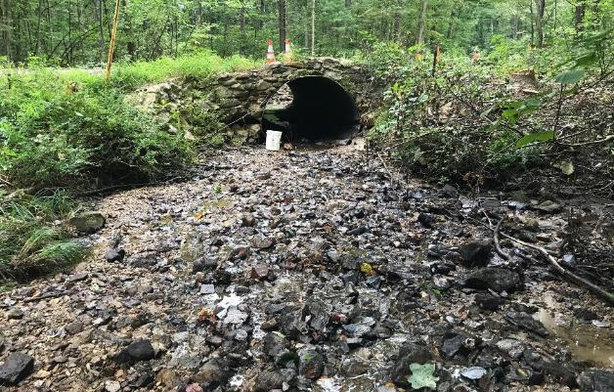
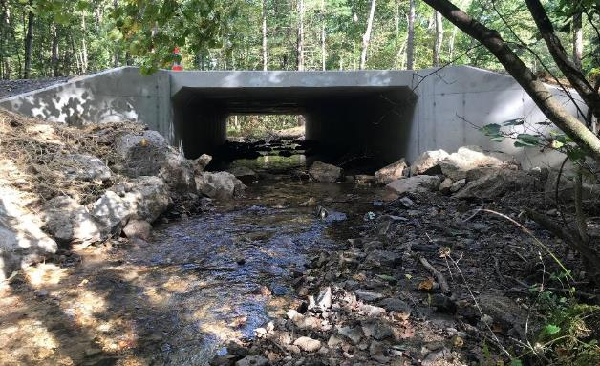
Project Primer: Stream Crossings
Inlet
Before
After

Slide 9
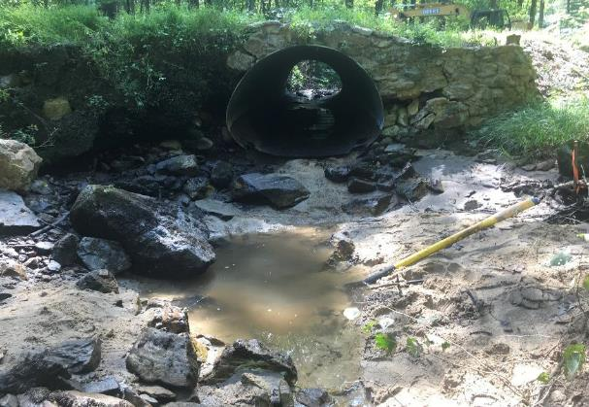
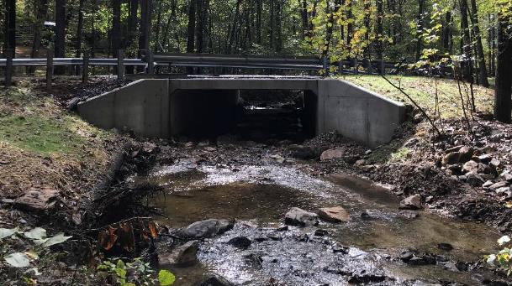
Project Primer: Stream Crossings
Outlet
Before
After

Slide 10
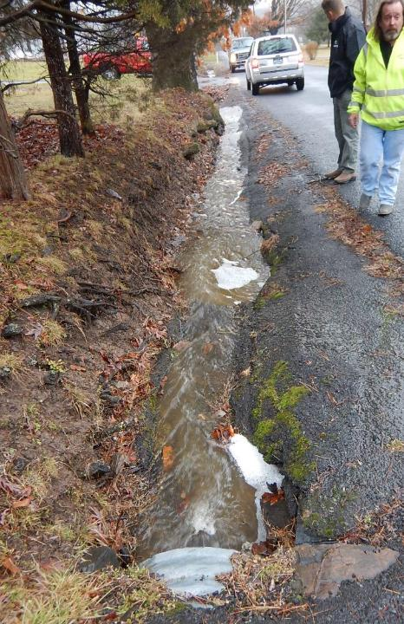
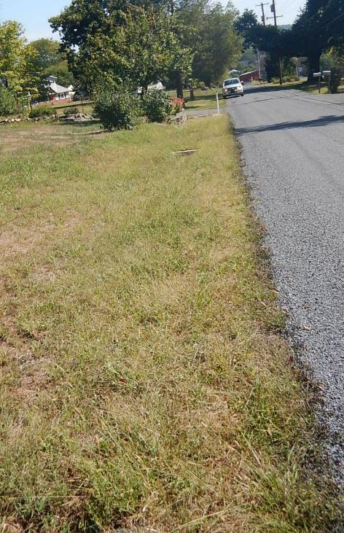
Before
Project Primer: LVR Issues
After
2016 LVR Project
Montgomery County, Webber Road
$24K Spent, $2K in kind
ESMs Used:
Small storm sewer
Widened grass-lined swale
Before
LVR Project in Montgomery County: $24K Spent, $2K in kind
Constant ditch washouts, erosion into yards

Slide 11
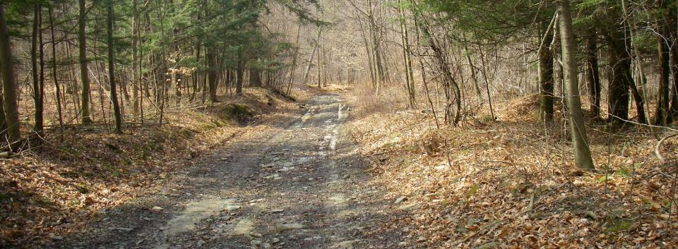
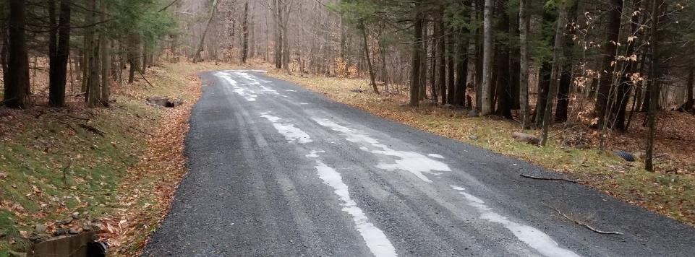
Before
Project Primer: Fill, pipes, surface
After
DGR Project in Bradford County: $107K Spent, $14K in kind

Slide 12
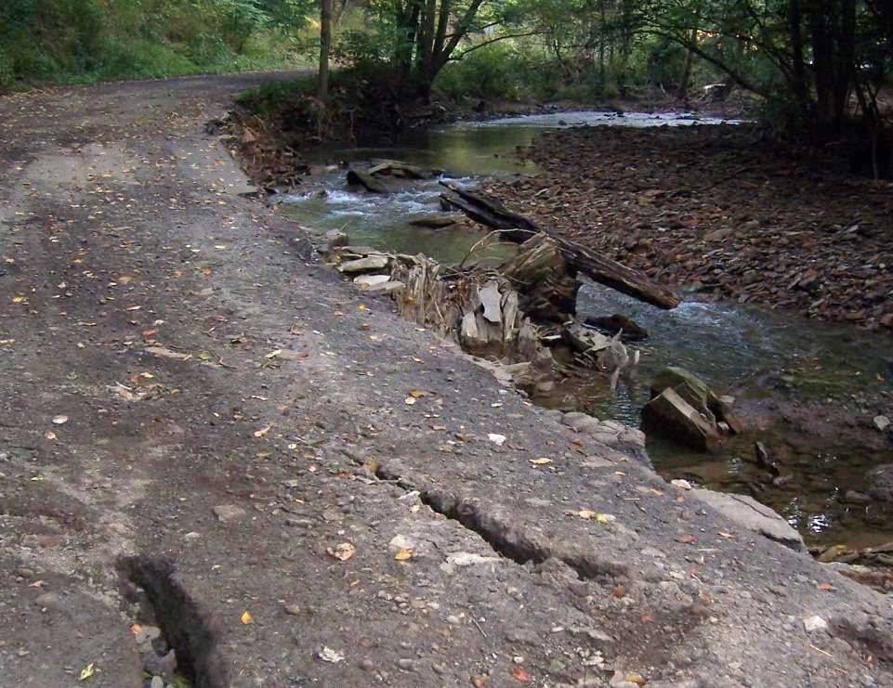
Introduction
Road / Stream Connection
Program focus is where the road and/or the stream negatively impacts the other
Notes:
Roads are often built along and across streams. Water can cause road damage and wash away road material into these nearby streams, causing issues for both the road and water quality.

Slide 13
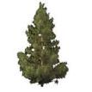
Surface drainage patterns
Tributary stream
Sub-surface drainage patterns
Notes:
Naturally, rain water soaks into the ground and runs over the land in “sheet flow” that doesn’t cause erosion.
Water collected in natural low spots on the landscape form streams.

Slide 14
Surface drainage patterns
Tributary stream
Sub-surface drainage patterns
DRAFT for comment 12/10/2021. This has not been approved by the SCC.
Notes:
This diagram shows how roads intercept water in the landscape and change drainage patterns
Traditional road drainage practices collect and concentrate water, which often causes erosion

Slide 15
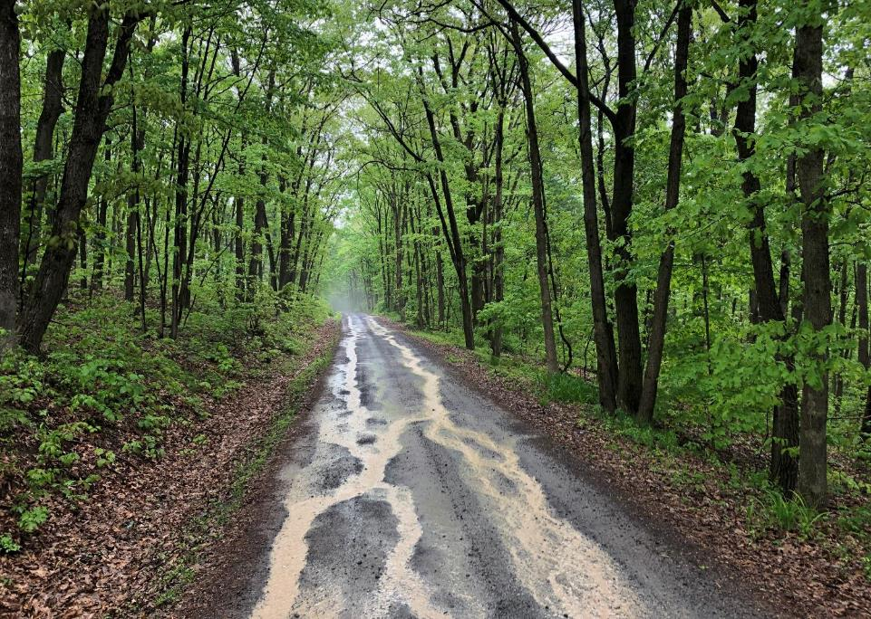
Introduction
Erosion
Effects of Roads
Generate Sediment
Deliver Sediment to Stream

Slide 16
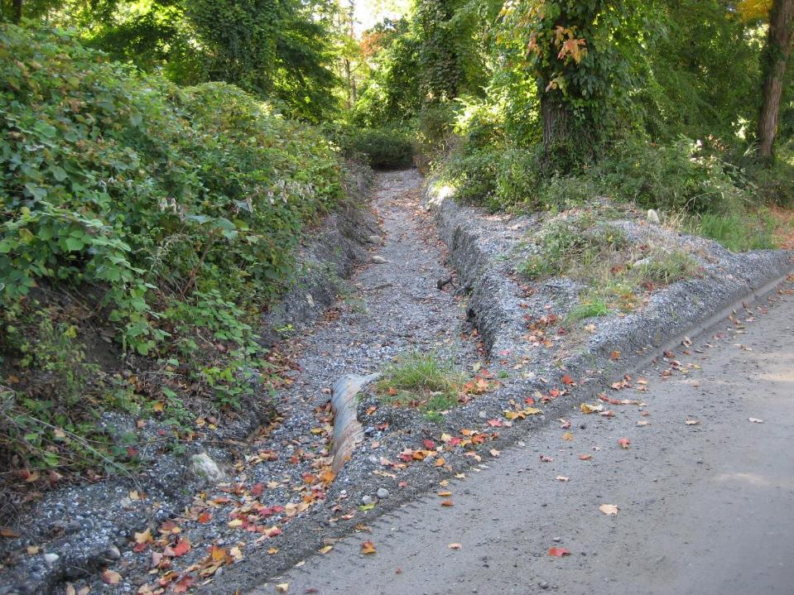
Introduction
Erosion
Effects of Roads
Generate Sediment

Slide 17
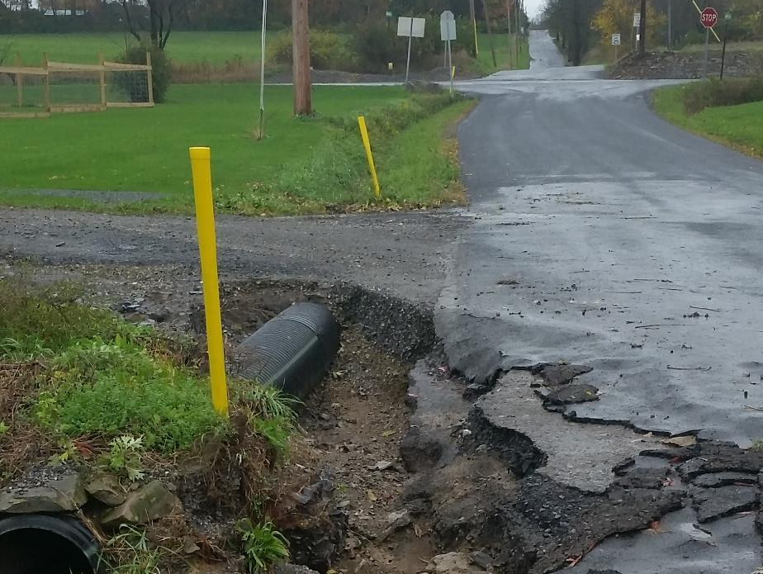
Introduction
Erosion
Effects of Roads
Even Paved Roads
Generate Sediment
NEW PIC

Slide 18
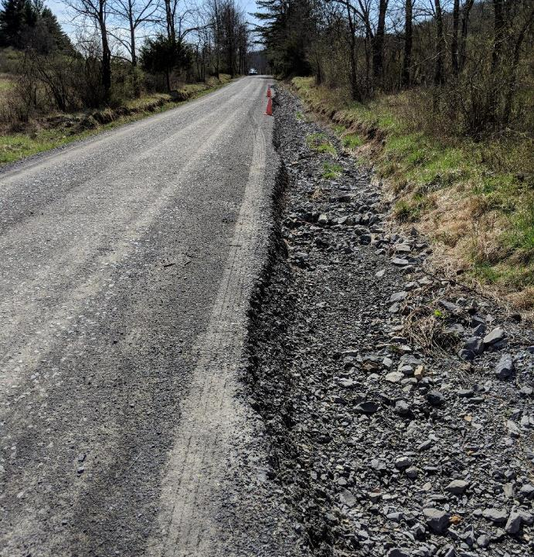
Road ditch with insufficient outlets
Notes:
Stormwater carried for long distances alongside roads create deep ditches, which are safety hazards.

Slide 19
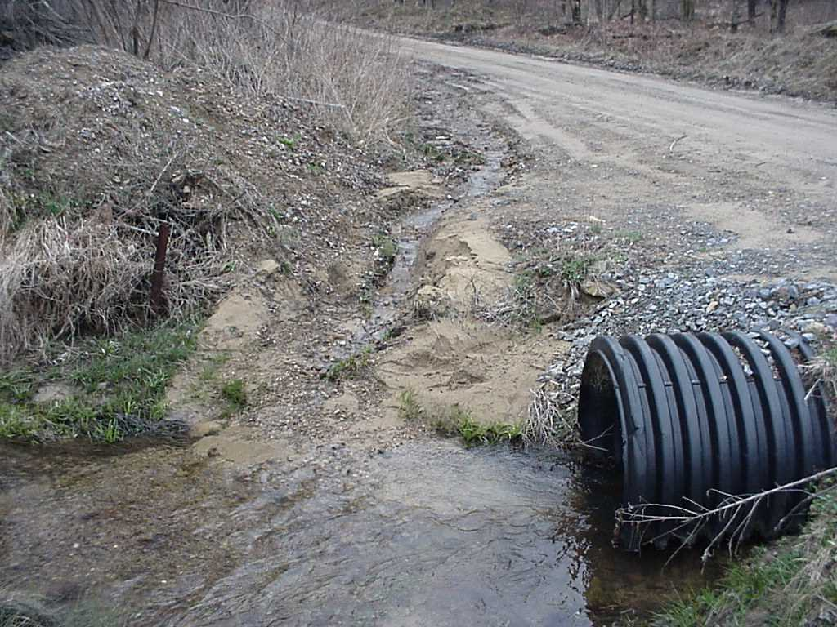
Introduction
Erosion
Effects of Roads
Deliver Sediment to Stream
Notes:
Good

Slide 20
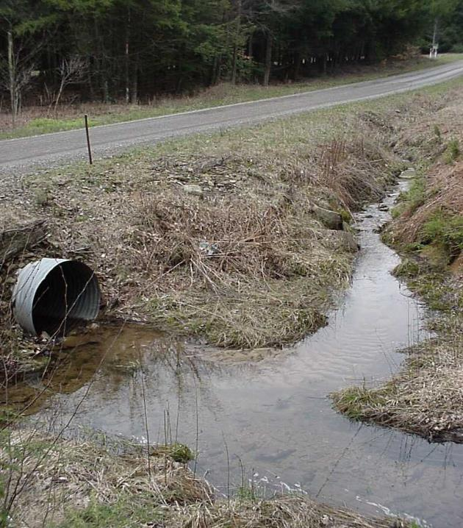
Effects of Roads
Deliver Sediment to Stream
ROAD DITCH FLOW
ROAD DITCH FLOW
STREAM FLOW
Notes:
Good

Slide 21
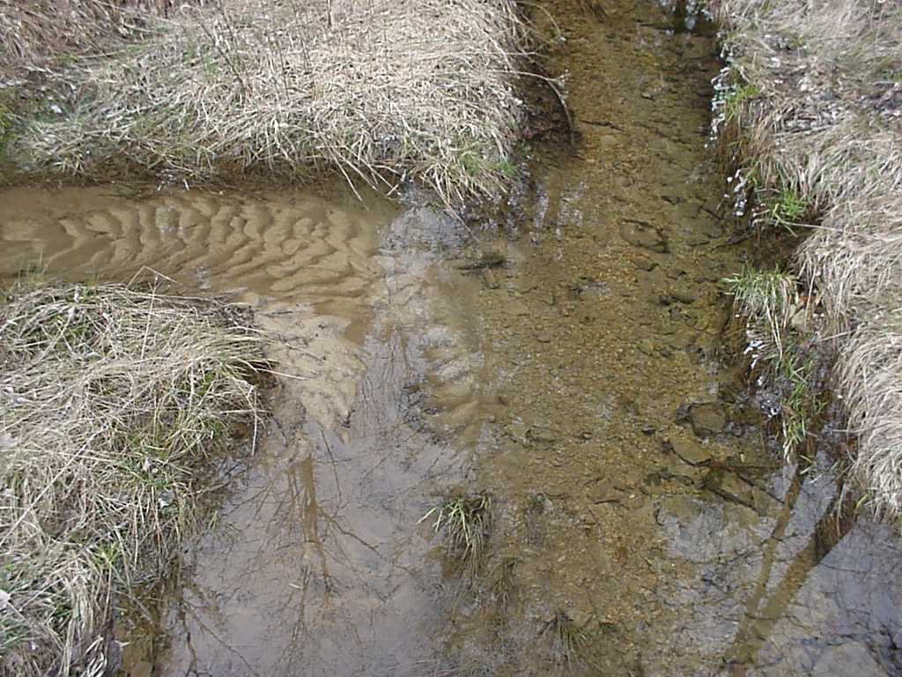
Introduction
Erosion
STREAM
FLOW
ROAD DITCH DRAINAGE
Road drainage is too often connected to a Stream
Notes:
Good.

Slide 22
Surface drainage patterns
Tributary stream
Sub-surface drainage patterns
DRAFT for comment 12/10/2021. This has not been approved by the SCC.
Notes:
This diagram shows how roads intercept water in the landscape and change drainage patterns
Traditional road drainage practices collect and concentrate water, which often causes erosion

Slide 23
Surface drainage patterns
Tributary stream
Sub-surface drainage patterns
DRAFT for comment 12/10/2021. This has not been approved by the SCC.
Notes:
Adding more storm water outlets spreads out and slows down stormwater, preventing erosion
Replacing undersized stream crossing structures can also protect roads and water quality

Slide 24
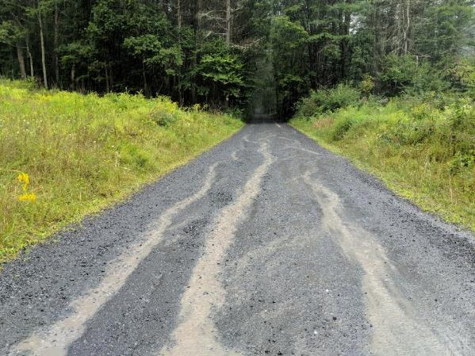
Example Dirt and Gravel Road Project
Stream
BEFORE
Water Flow
Notes:
An example DGR Project:

Slide 25
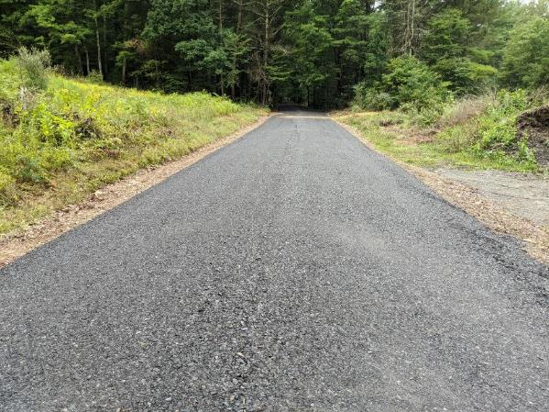
Example Dirt and Gravel Road Project
New Pipe
Stream
BEFORE
AFTER
Water Flow
Water Flow
Notes:
An example DGR Project:

Slide 26
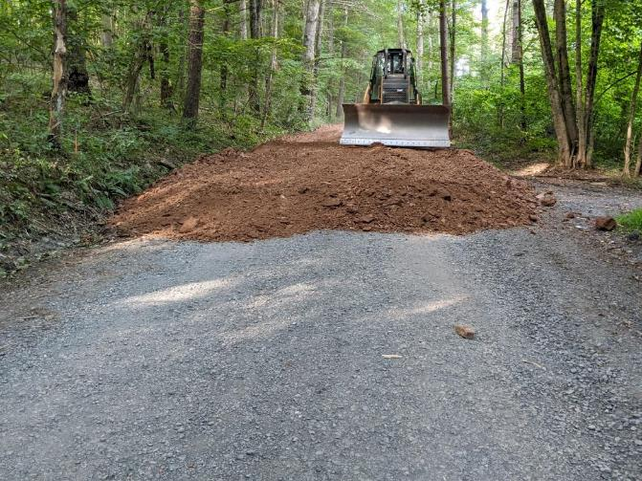
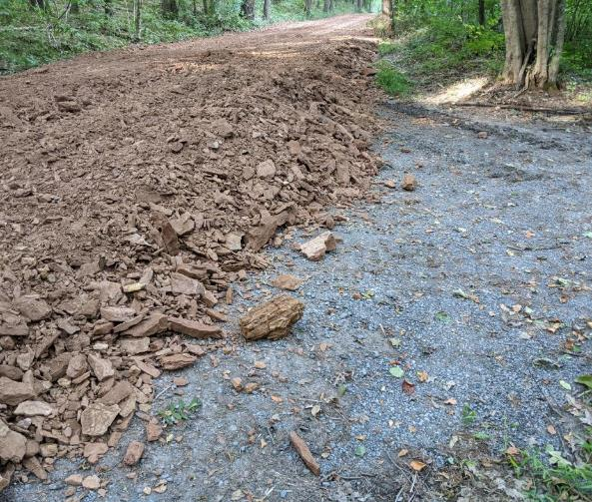
During construction – placing road fill
Notes:
Road fill raises the road and establishes appropriate shape (road crown) to allow water to drain from the road.

Slide 27
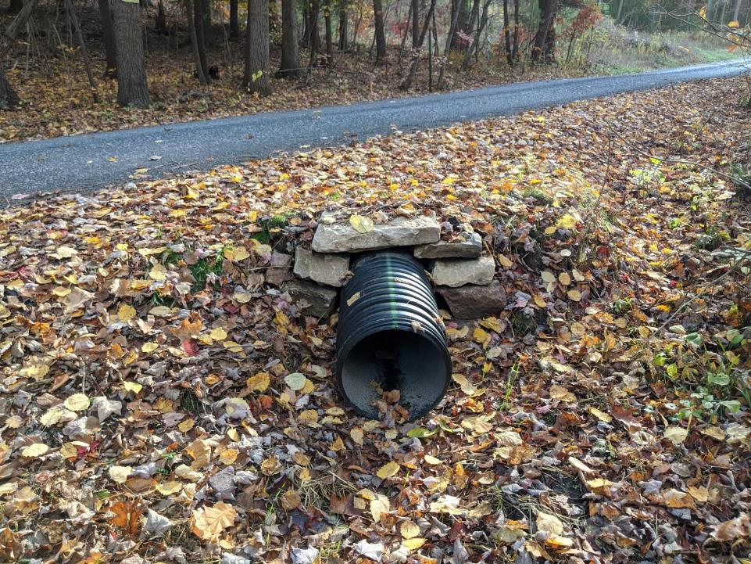
AFTER
Notes:
Shallow cross pipes do not cause erosion at the outlet of the pipe

Slide 28
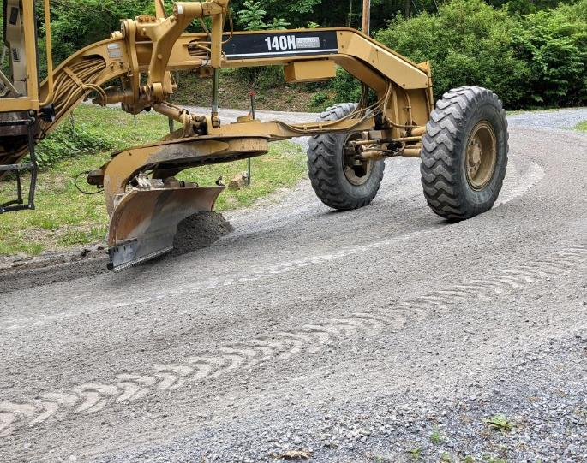
DGLVR Introduction
DGR
Two Types of Funding
Based on road surface
Dirt and Gravel Roads (DGR)
Unbound road surface
Can be shaped with a grader

Slide 29
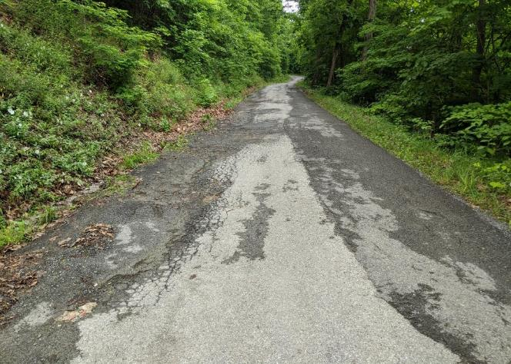
DGLVR Introduction
LVR
Low Volume Roads (LVR)
Paved or sealed (including tar and chip)
Low traffic volume (500 vehicles/day or less)

Slide 30
Outline
DGLVR Grant Applications
DGLVR Program Introduction
Eligibility for DGLVR Grant funds
Filling out the Grant Application
Page 1
Location map
Project sketch
Cost estimate
Attachments
What to do if you need help

Slide 31
Eligible Applicants
DGLVR Grant Applications
Eligibility
Public entities (local, county, and state) that own public roads in PA that are open to public vehicle travel
The person in charge of work plan development and project implementation from the entity must have attended Environmentally Sensitive Road Maintenance (ESM) Training within the past 5 calendar years

Slide 32
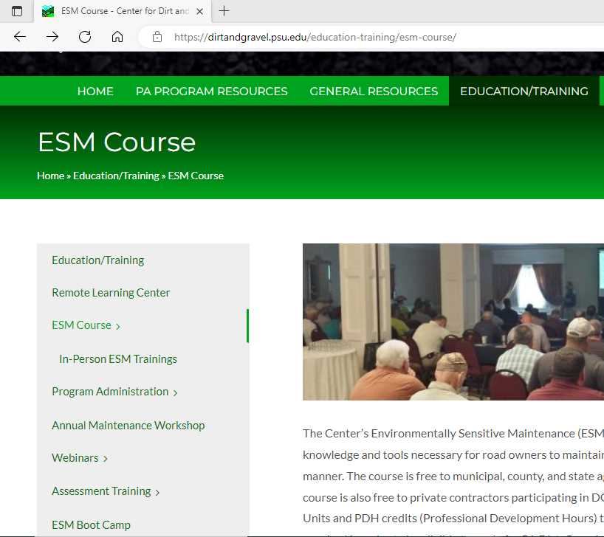
DGLVR Grant Applications
Eligibility
ESM Training
https://dirtandgravel.psu.edu/education-training/esm-course/
2 days, 8 AM – 4 PM
Breakfast, snacks, drinks, and lunch provided
No cost to attend
Must register online
12 sessions held in different locations around PA each year

Slide 33
Eligible Roads
DGLVR Grant Applications
Eligibility
Public Roads owned by an eligible applicant
Road must be open to public motor vehicle travel for a minimum of 2 consecutive weeks annually
The road must have a stream/water quality impact
Must be an unpaved or low volume road
LVR means sealed surface with ADT of 500 or less

Slide 34
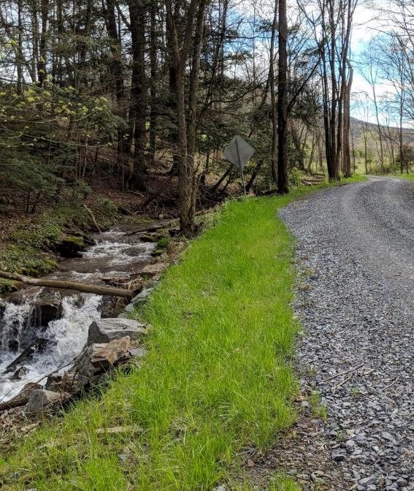
Project Eligibility
DGLVR Grant Applications
Eligibility
DGR and LVR projects must focus on both environmental and road improvements
Routine maintenance is not eligible for DGLVR funding
Focus on long-term benefit through use of Environmentally Sensitive Maintenance (ESM) practices
Project work must meet DGLVR policy, standards, and specifications

Slide 35
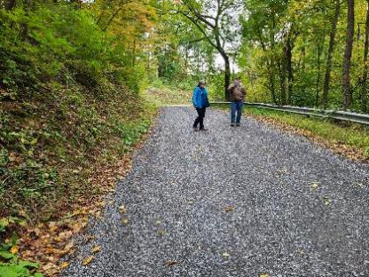
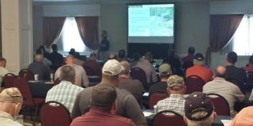
Questions about Eligibility?
DGLVR Grant Applications
Eligibility
Work with your local County Conservation District to make sure you, your roads, and your projects are eligible for DGLVR funding
Additional information at ESM training

Slide 36
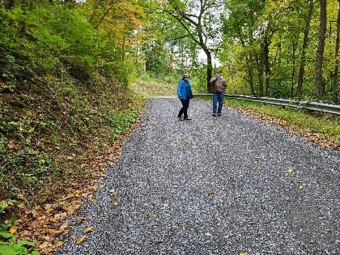
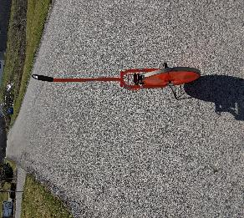
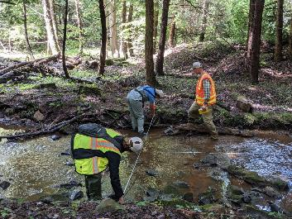
DGLVR Grant Applications
Eligibility
Pre-application meeting
review roads with conservation district
Make sure all eligibility requirements are met
Identify road problems
Come up with solutions
Take measurements
Make sure the project is a good fit for the grant program
Notes:
The largest task to prepare for the grant application is to design the project, including generating a sketch, materials list, and cost estimate
This is a very important topic and we only cover this briefly today
The ESM training will provide helpful information about designing your DGLVR Project
It is highly recommended that grant applicants work closely with the county conservation district on developing your project and grant application

Slide 37
Materials Estimation
DGLVR Grant Applications
Eligibility
Height or Depth
Width
Length

Slide 38
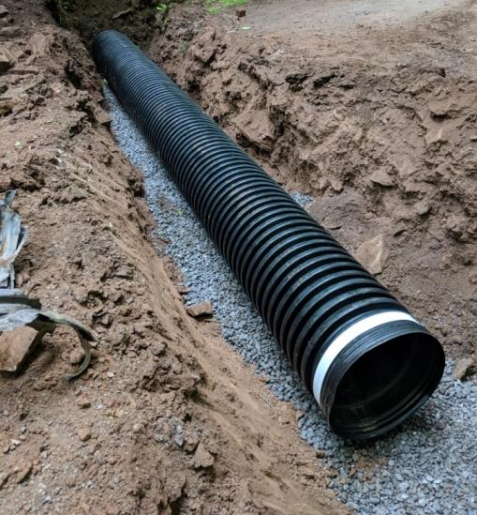
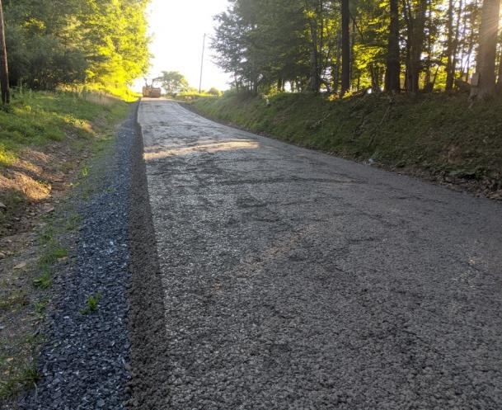
Materials Estimation
DGLVR Grant Applications
Eligibility
Depth
Depth
Width
Length
Width
Width
Length
Volume (ft³) = Length (ft) x Width (ft) x Height (ft)
Depth
Length

Slide 39
DGLVR Grant Applications
Eligibility
Materials Estimation Webinar
February 16, 2023
Recording available online
https://dirtandgravel.psu.edu/education-training/webinars/past-webinars/

Slide 40
Outline
DGLVR Grant Applications
DGLVR Program Introduction
Eligibility for DGLVR Grant funds
Filling out the Grant Application
Page 1
Location map
Project sketch
Cost estimate
Attachments
What to do if you need help

Slide 41
Why talk about grant applications?
DGLVR Grant Applications
It’s important that DGLVR grant applications are thorough, detailed, and filled out correctly.
To prevent misunderstandings
Notes:
This program focuses on simplicity and minimal paperwork, but we still want to write down enough to make sure everyone understands what the project is.

Slide 42
Why talk about grant applications?
DGLVR Grant Applications
The application becomes a DGLVR contract attachment
Defines the scope of work that the grant will pay for

Slide 43
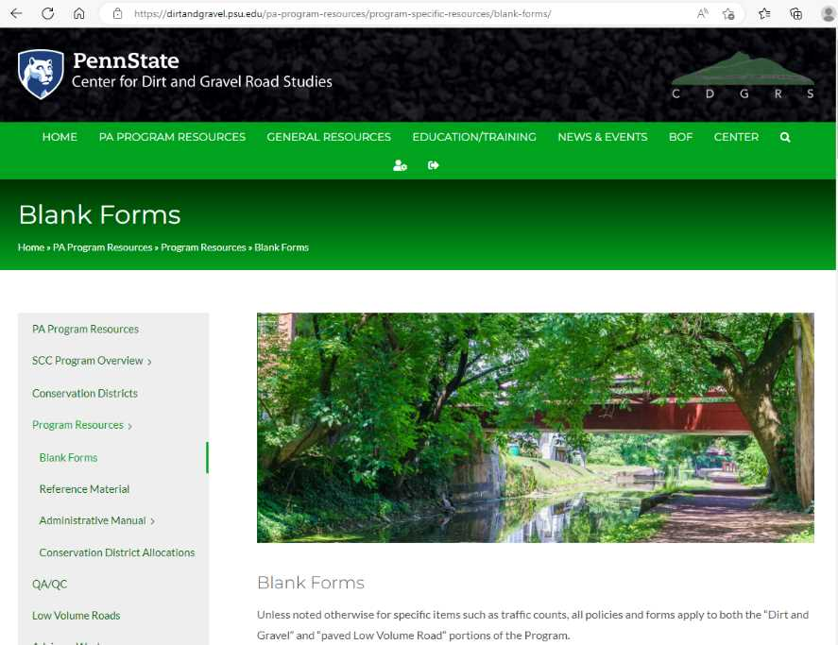
DGLVR Grant Applications
Filling out the Grant Application
Notes:
Most of the forms and paperwork mentioned in this presentation can be found on the Center’s website on the “Blank forms” Page

Slide 44
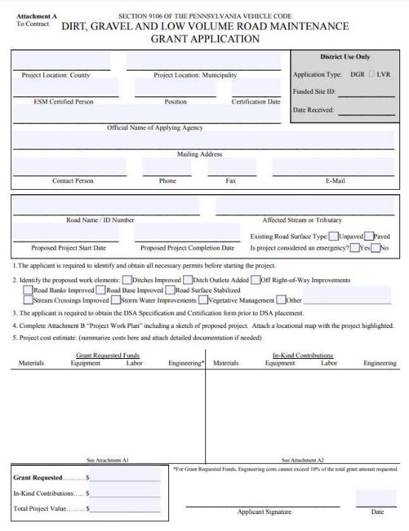
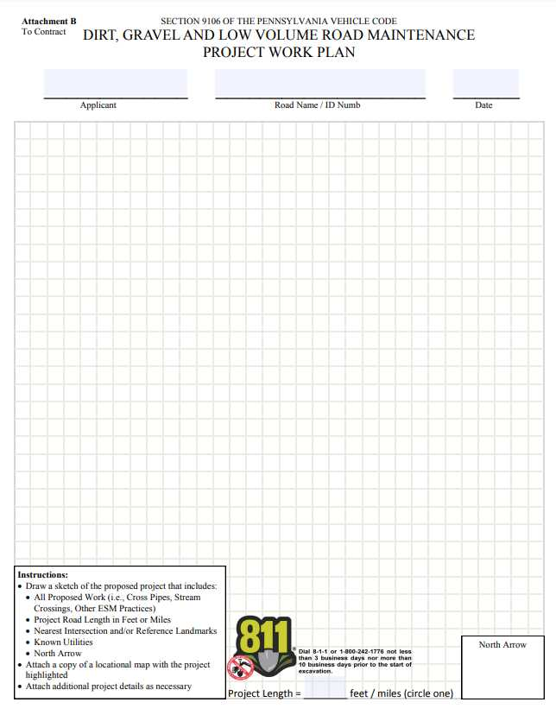
Application
Notes:
This is what the grant application looks like
Notice that the grant application is one page with a sketch on the back and attachments as needed

Slide 45
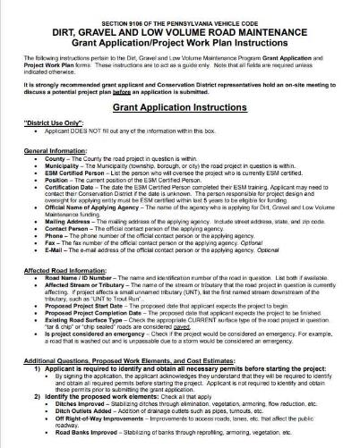
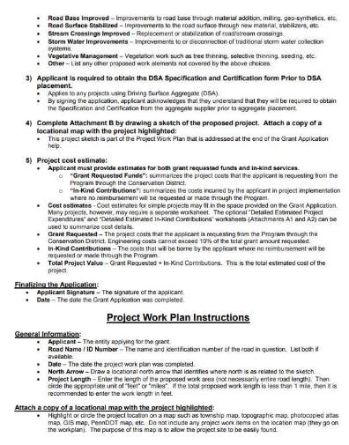
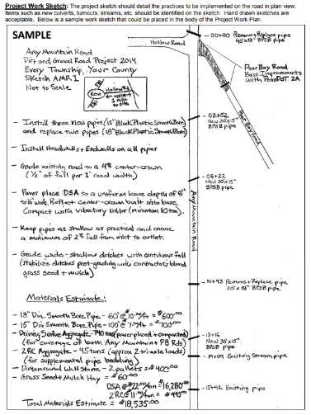
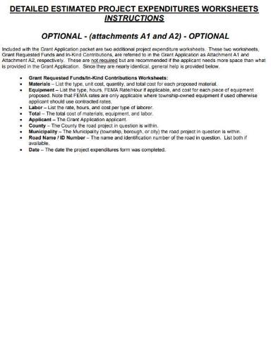
DGLVR Grant Applications
Filling out the Application
Instructions available on Blank Forms page of Center’s Website

Slide 46
Outline
DGLVR Grant Applications
DGLVR Program Introduction
Eligibility for DGLVR Grant funds
Filling out the Grant Application
Page 1
Location map
Project sketch
Cost estimate
Attachments
What to do if you need help

Slide 47
Filling out the Application
Any County
Example Township
John Doe
Roadmaster
8/25/2022
Example Township
123 Main Street, Example Town, PA 12345
John Doe
123-456-7890
123-789-4560
Johndoe@example.com
Any Mountain Road/ TR 123
Unnamed Tributary (UNT) to River
April 30, 2024
Sept 30, 2024
x
x
Notes:
Filling out the top of the grant application is pretty self explanatory.
Mostly filling out contact info and basic site info
Additional information on this available in application directions
Highlight a few items:
Contact info for multiple people can be listed if needed. For example, if the Twp roadmaster and supervisors are all very involved, or you might list a secretary as well as the person in charge of the road work.
Make sure the ESM Certification Date is within the last 5 years
If you don’t know the name of the affected stream or tributary, the conservation district can help you with that
Make sure the proposed project start date is within the time frame that funds are available (2-year spending requirement)

Slide 48
x
x
x
x
x
x
See attached sheets
$24,775.00
$3,590.00
2/1/2023
$28,365.00
Notes:
Similarly, the bottom of the grant application is pretty simple
Read the reminders about permits and DSA
Fill out the check boxes for project work. This is important
Attach a work plan and location map – we’ll talk about these soon
Summarize cost estimate and attach detailed documentation if needed – we’ll talk about this more as well in a few minutes
Note that the grant requested, in-kind contributions, and total project value is summarized on the bottom left of the grant application
Also notice that the ESM-Certified applicant signs the application

Slide 49
Outline
DGLVR Grant Applications
DGLVR Program Introduction
Eligibility for DGLVR Grant funds
Filling out the Grant Application
Page 1
Location map
Project sketch
Cost estimate
Attachments
What to do if you need help

Slide 50
Location Map
Work Area
Notes:
The location map shows where the project is in the world
This might not seem like an important part of the application because the applicant and conservation district usually both know where the project site is already, but this is helpful for QAB and Board members, for other conservation district staff if they are helping out or if there’s staff turnover, and for Center and SCC staff during tech assists and QAQCs

Slide 51
Location Map
Work Area
Notes:
It doesn’t matter what kind of map is used for the location map as long as it shows the location clearly, such as by labeling nearby main roads, towns, landmarks, etc.
First example was an aerial map and this is a road map from Google maps. USGS maps, municipal maps, and PennDOT maps are also commonly used

Slide 52
Outline
DGLVR Grant Applications
DGLVR Program Introduction
Eligibility for DGLVR Grant funds
Filling out the Grant Application
Page 1
Location map
Project sketch
Cost estimate
Attachments
What to do if you need help

Slide 53
DGLVR Grant Applications
Filling out the Application
Notes:
This application is meant to be simple so that even new municipal officials are able to complete it
However, the project sketch still needs to be detailed enough to define the scope of work

Slide 54
Notes:
The sketch on the right will be a lot more helpful than the one on the left
The sketch needs to communicate what the project is to someone who’s never seen the site or talked about it

Slide 55
Filling out the Application
Project Sketch Tips
Show approximate location, shape, and size of:
Road
Project features
cross pipes, French mattress, ditch reshaping, road fill, etc.
3 dimensions
Materials notes
Streams
Landmarks (big tree, fence, utility, mailbox, house, etc.)
Property lines
Notes:
Good sketches do not need to be to scale, but should show approximate location size and shape of important features
If there are intersections or noticeable turns in roads, including them in the sketch is helpful
Remember that all project features need to be included and described
3 dimensions are needed
This includes pipe length, not just diameter or width and height
This includes depth, widths, and heights
List what type of aggregates, pipes, geotextile fabrics, headwall/endwalls materials, etc.
Show location of stream or direction to the stream
Landmarks can be very helpful in determining where project features are supposed to be installed
If there’s off ROW work, it can also be helpful to show the right of way boundaries as well as which properties are included

Slide 56
Filling out the Application
GIS Project Sketch Tool
CDGRS has been working to develop updated project sketch capability in the GIS
Currently being tested and will be available to districts soon
Includes:
Draw on map to scale
Stationing
Standardized practices (pipe, underdrain, etc.)
Can print and attach to grant app
Notes:
The Center is working with a developer to update the drawing tools in the DGLVR GIS.
The updates are currently being tested and will be available to conservation districts soon
Eventually these drawing tools will be made available to grant applicants directly through the public GIS viewer as well

Slide 57
DGLVR Grant Applications
Filling out the Application
Engineered drawings are not required for the DGLVR grant application, but can be included
Notes:
Engineered drawings are not required for grant applications, but can be included if available
Remember that engineering costs incurred before DGLVR contracts are signed are not eligible for reimbursement with DGLVR funds

Slide 58
Outline
DGLVR Grant Applications
DGLVR Program Introduction
Eligibility for DGLVR Grant funds
Filling out the Grant Application
Page 1
Location map
Project sketch
Cost estimate
Attachments
What to do if you need help

Slide 59
x
x
x
x
x
x
DSA: $10,000
Pipes: $10,000
Etc.…
Township labor to install project: $3,590
$24,775.00
$3,590.00
2/1/2023
$28,365.00
Notes:
The grant application includes a spot for the cost estimate
This may be sufficient for small projects, but often additional space is needed and the cost estimate is attached

Slide 60
DGLVR Grant Applications
Filling out the Application
Developing a Cost Estimate
Start with a project plan
Sketch/draw your plan
Create materials list
Find out how much the materials costs
Find out how much installing the project will cost
Consider:
Do you have the labor and equipment to install the project yourself?
Will you hire a contractor?

Slide 61
DGLVR Grant Applications
Filling out the Application
Notes:
2 versions of this attachment are included to detail what the grant funds will pay for and what the applicant will pay for in-kind, or what the applicant plans to pay for with non-DGLVR funding
Both grant and in-kind expenses do need to be estimated for the application

Slide 62
Filling out the Application
Notes:
To put together a cost estimate using the provided attachments, each section is filled out similarly

Slide 63
DGLVR Grant Applications
Filling out the Application
x
=
DSA
$30/ton
800 tons
$24,000
Notes:
Start with quantities of material (or equipment or labor hours)
Determine the cost per unit and the quantity needed
Multiply and fill out the column

Slide 64
Up to 20% of the grant (max $25k) can be used for engineering costs incurred AFTER a contract is signed
Notes:
Add up the materials, equipment, labor, and engineering cost to determine the total grant requested (or total inkind)

Slide 65
x
x
x
x
x
x
See attached sheets
$24,775.00
$3,590.00
5/1/2021
$28,365.00
Notes:
Transfer the total grant, in-kind, and project costs from the attachments to the application

Slide 66
DGLVR Grant Applications
Filling out the Application
The PDF grant application on the Center’s website does the math for you!
https://dirtandgravel.psu.edu/pa-program-resources/program-specific-resources/blank-forms/
Notes:
The PDF on the blank forms page of the Center’s website will do the math for you

Slide 67
DGLVR Grant Applications
Filling out the Application
Notes:
It will even check if your engineering total exceeds 20% of the grant total

Slide 68
DGLVR Grant Applications
Filling out the Application
A cost estimate prepared by an engineer or contractor can be attached to the grant application
Make sure to specify which costs the grant will pay for and which will be in-kind
Notes:
The attachments we just talked about are not the only acceptable cost estimate format
A cost estimate prepared by an engineer or contractor can also be attached to the grant application
It’s okay if these estimates are not broken down into materials, equipment, and labor
Do specify what the grant will pay for vs what will be in-kind expenses

Slide 69
Anticipate cost increases by the time you go to construction
Don’t forget to budget for all project components, including Erosion & Sedimentation (E&S) Controls
Don’t forget to budget for Prevailing Wage

Slide 70
Make sure to budget for all project components
DGLVR Grant Applications
Filling out the Application
Example: What do you need to install a cross pipe?
Pipe
Connector/grease
Headwalls and endwalls
Back fill
Equipment and labor
Compaction equipment
Backhoe/excavator
Skid loader?
Truck to haul waste material?

Slide 71
Erosion and Sediment (E&S) Controls
DGLVR Grant Applications
Filling out the Application
Prevent loose earth disturbed during construction from washing away
Best management practices to reduce erosion can include free practices:
Don’t work in the rain
Don’t leave disturbed earth if it’s going to rain over night/the next day
Fill/cover any trenches the same day you dig them
Complete stream work when the water flow is low

Slide 72
E&S Controls to budget for
DGLVR Grant Applications
Filling out the Application
Erosion blanket
Water pump around system
Inlet Filter Bag
Grass seed and mulch

Slide 73
DGLVR Grant Applications
Filling out the Application
ALWAYS seed and mulch

Slide 74
Prevailing Wage
DGLVR Grant Applications
Filling out the Application
DGLVR projects totaling $25,000 or more must pay prevailing wage to contracted labor
See “Frequently Asked Questions about Prevailing Wage Document”
You can look up PW rate determinations in your area to estimate PW costs
Ask contractors for cost estimates at PW rates

Slide 75
Prevailing Wage
DGLVR Grant Applications
Filling out the Application
See recorded webinars from 2022
https://dirtandgravel.psu.edu/education-training/webinars/past-webinars/

Slide 76
Outline
DGLVR Grant Applications
DGLVR Program Introduction
Eligibility for DGLVR Grant funds
Filling out the Grant Application
Page 1
Location map
Project sketch
Cost estimate
Attachments
What to do if you need help

Slide 77
DGLVR Grant Applications
Potential Attachments to the Grant Application
Traffic count for LVR Projects
Notes:
“Applicant is responsible for providing traffic counts before a contract can be signed.” (Admin Manual 7.5)
It may be beneficial to obtain this early in project planning or before the QAB meeting to make sure the site is eligible
Some conservation districts may require this to be submitted with the application
Pay attention to time of year restrictions on when traffic counts can be completed

Slide 78
DGLVR Grant Applications
Potential Attachments to the Grant Application
Traffic count for LVR Projects
Landowner consent for
off right-of-way work
Notes:
Written, signed permission to work outside the ROW is required before starting work off ROW.
However, it is essential to be talking with landowners early in the project planning. Some QABs and CD Boards may require this before approving funding.
“Before working outside the right-of-way, the grant recipient must obtain written permission from the landowner. Landowner permission should be sought as early as possible in the funding process, ideally before contracting, to ensure the project can be implemented as planned.” (Admin Manual 3.7.4.8)

Slide 79
DGLVR Grant Applications
Potential Attachments to the Grant Application
Traffic count for LVR Projects
Landowner consent for off right-of-way work
Permits
Notes:
If a permit, such as a Chapter 105 permit, is required for your project, statewide DGLVR policy does not require that you obtain the permit during the application stage.
Policy requires that any required project permits must be obtained by the grant recipient before work can begin on the portion of the project related to the permit.
In some cases, it is recommended not to start your permit application until you know whether or not your project will receive DGLVR funds.
If you do have a project ready to go with a permit already approved, make sure you tell the conservation district and include the permitted design in your application.

Slide 80
DGLVR Grant Applications
Potential Attachments to the Grant Application
Traffic count for LVR Projects
Landowner consent for off right-of-way work
Permits
Project Narrative
Notes:
A few sentences explaining what the problem on the road is and how the project will fix it can be helpful for explaining the project to the QAB and district board.
This could be included on the project sketch or on a separate attachment.

Slide 81
DGLVR Grant Applications
Potential Attachments to the Grant Application
Traffic count for LVR Projects
Landowner consent for off right-of-way work
Permits
Project Narrative
Before Photos
Notes:
You know your road better than most. If you have photos of the road issues, especially during or after a rainstorm or snow melt, these can be helpful to illustrate the need for your proposed project.
The conservation district will likely take photos as well, but they are not always able to be at the road when it’s raining.

Slide 82
DGLVR Grant Applications
Potential Attachments to the Grant Application
Traffic count for LVR Projects
Landowner consent for off right-of-way work
Permits
Project Narrative
Before Photos
Additional Design Details
Technical assistance
Notes:
If the conservation district, Center for Dirt and Gravel Road Studies, or any other partners have provided design recommendations or guidance that you plan to follow, include it in your grant application.

Slide 83
DGLVR Grant Applications
Potential Attachments to the Grant Application
Traffic count for LVR Projects
Landowner consent for off right-of-way work
Permits
Project Narrative
Before Photos
Additional Design Details
Technical assistance
Stream crossing design
Notes:
Stream crossings are one type of DGLVR Project that might have additional design details or recommendations included as these can be difficult to represent in one sketch.

Slide 84
DGLVR Grant Applications
Potential Attachments to the Grant Application
Traffic count for LVR Projects
Landowner consent for off right-of-way work
Permits
Project Narrative
Before Photos
Additional Design Details
Technical assistance
Stream crossing design
Technical Bulletins
Notes:
Technical bulletins are an excellent addition to grant applications
These clearly explain how to construct ESM practices
Including these demonstrate that you understand ESM practices and are committed to installing them correctly

Slide 85
DGLVR Grant Applications
Potential Attachments to the Grant Application
Traffic count for LVR Projects
Landowner consent for off right-of-way work
Permits
Project Narrative
Before Photos
Additional Design Details
Technical assistance
Stream crossing design
Technical Bulletins
Standard ESM Details
Notes:
Standard details for ESM practices are available on the Center’s website as fillable PDFs and excel documents
These can be customized to individual projects and included in the grant application
like tech bulletins, these include helpful notes about how to install the practices
If you run out of space on the sketch page to include dimensions and notes about each practice, these are a great attachment

Slide 86
Outline
DGLVR Grant Applications
DGLVR Program Introduction
Eligibility for DGLVR Grant funds
Filling out the Grant Application
Page 1
Location map
Project sketch
Cost estimate
Attachments
What to do if you need help

Slide 87
DGLVR Grant Applications
What to do if you need help
Reach out to your local County Conservation District
The Center for Dirt and Gravel Road Studies Website also includes information on all PA County Conservation Districts

