Slide 1
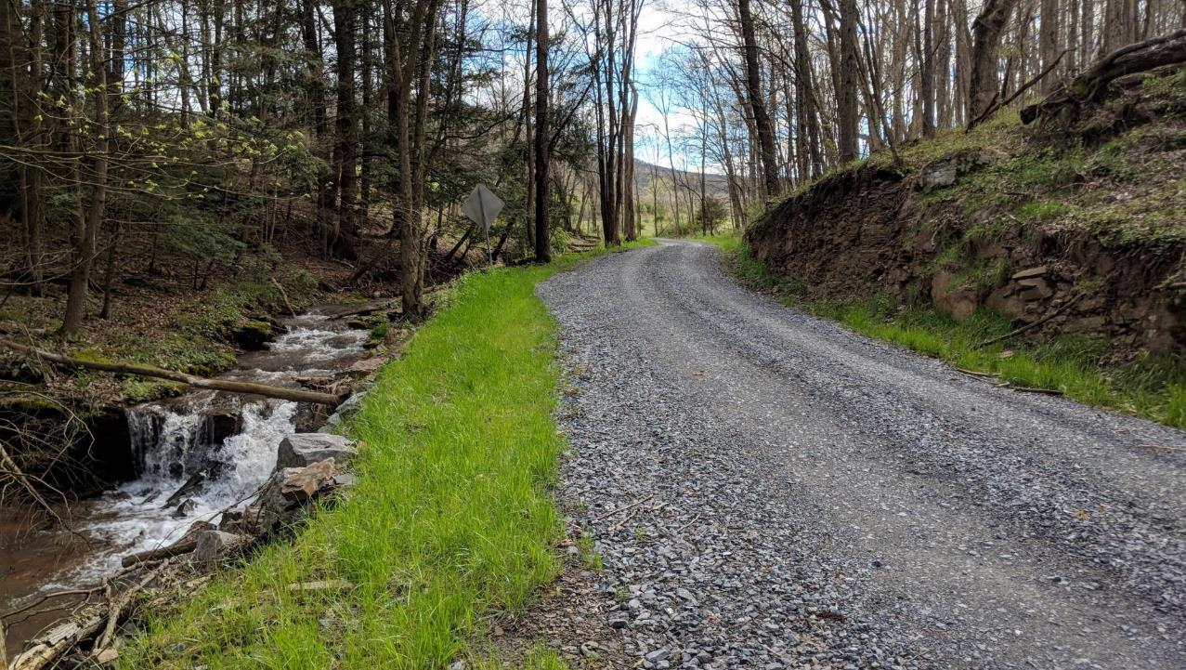
Dirt, Gravel, and Low Volume Road (DGLVR) Program
2/28/2023
Quality Assurance Board (QAB)
SCC
Sherri Law
shlaw@pa.gov
If you are reading this, then you are successfully seeing the webinar video. Webinar audio should be automatic through your computer (or click “join audio”), and options can be accessed in the “audio options” button on the bottom left. If your computer audio is not working, you can listen on your phone by dialing 646-876-9923.

Slide 2
Quality Assurance Boards
This webinar is being recorded
Please enter questions in the “Q&A” Feature
We will answer all questions at the end

Slide 3
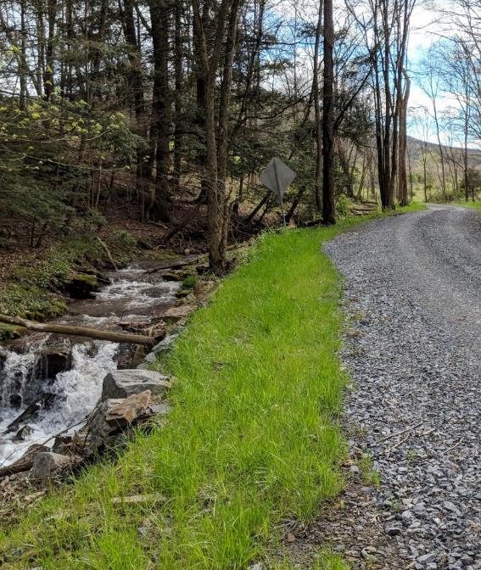
Outline
Quality Assurance Boards
DGLVR Program Introduction
QAB Policy review
QAB Structure and purpose
Meeting guidelines
Role in projects
Role in local policy
What to do if you’re a new QAB member

Slide 4
Outline
Quality Assurance Boards
DGLVR Program Introduction
QAB Policy review
QAB Structure and purpose
Meeting guidelines
Role in projects
Role in local policy
What to do if you’re a new QAB member

Slide 5
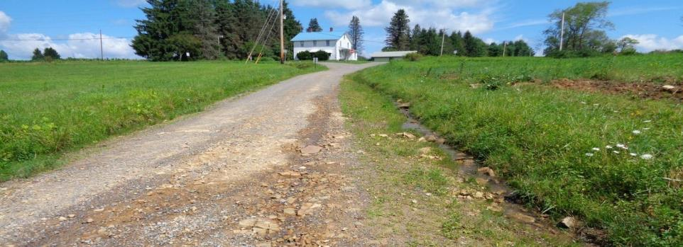
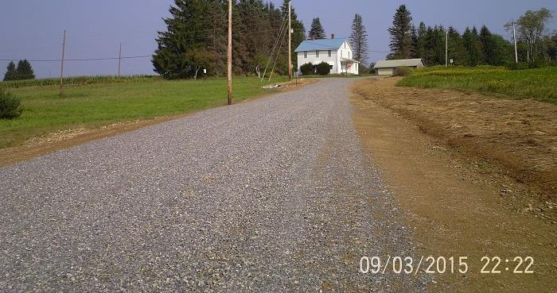
Before
Project Primer: Road Base and Fill
DGR Project in Jefferson County: $65K Spent, $5K in kind
After

Slide 6
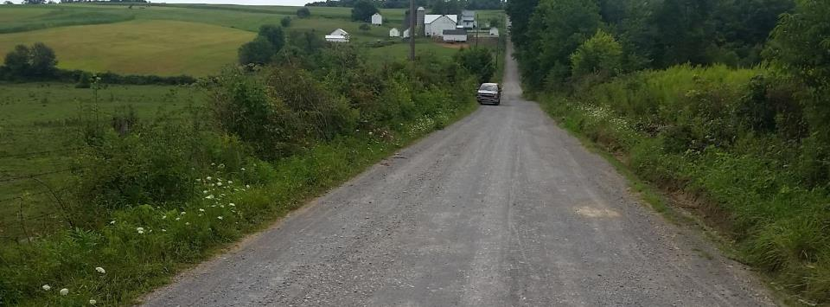
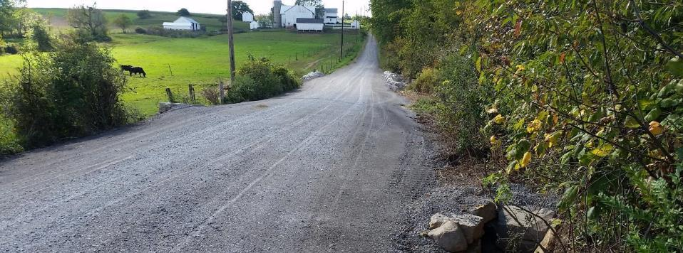
Before
Project Primer: Fill, pipes, surface
After
DGR Project in Mercer County: $100K Spent, $6K in kind

Slide 7
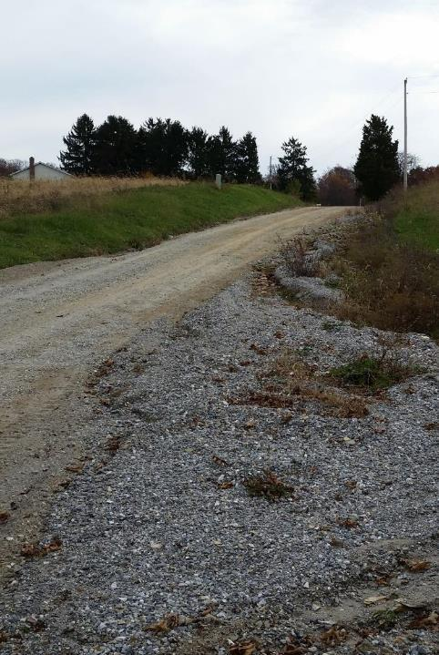
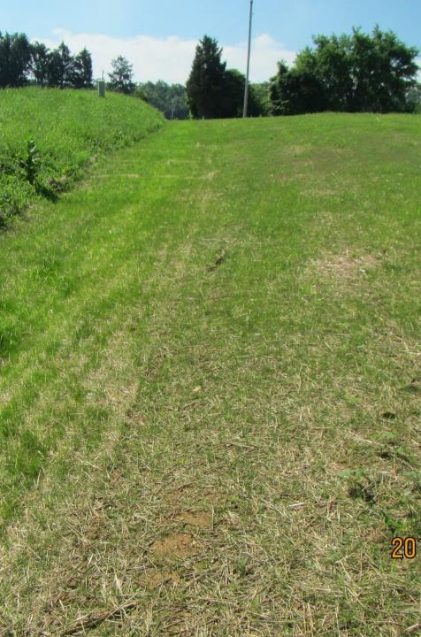
Before
Project Primer: Road Relocation
After
Before
DGR Project in York County: $63K Spent, $22K in kind
retired road
Road Relocated away from stream

Slide 8
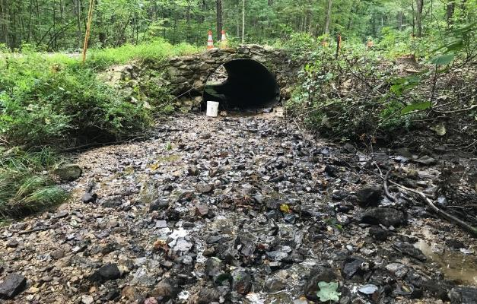
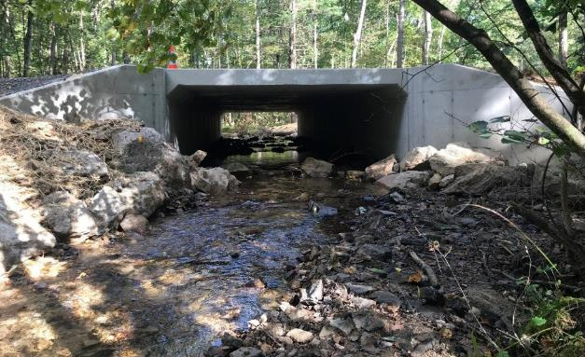
Project Primer: Stream Crossings
Inlet
Before
After

Slide 9
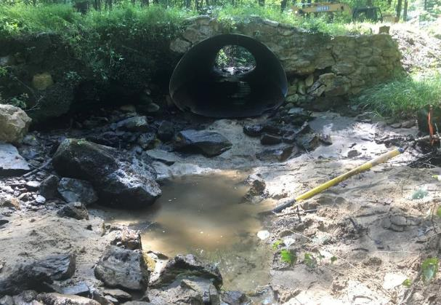
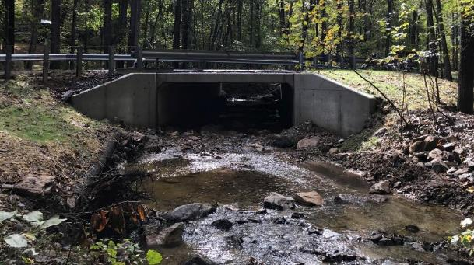
Project Primer: Stream Crossings
Outlet
Before
After

Slide 10
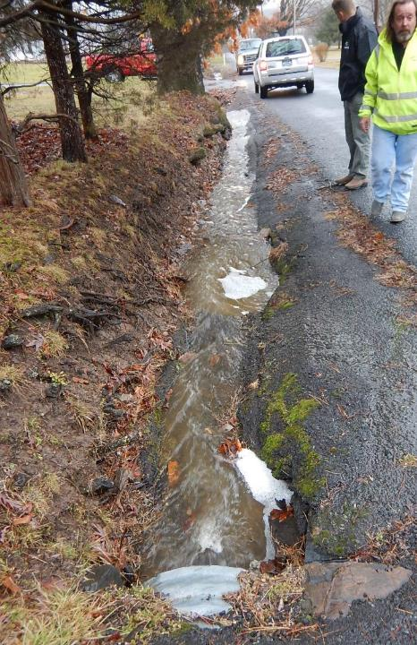
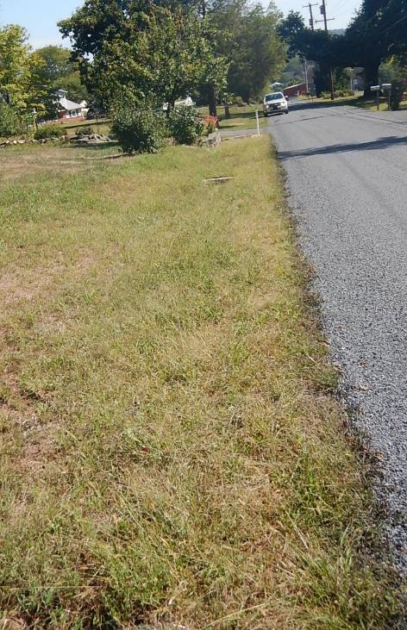
Before
Project Primer: LVR Issues
After
2016 LVR Project
Montgomery County, Webber Road
$24K Spent, $2K in kind
ESMs Used:
Small storm sewer
Widened grass-lined swale
Before
LVR Project in Montgomery County: $24K Spent, $2K in kind
Constant ditch washouts, erosion into yards

Slide 11
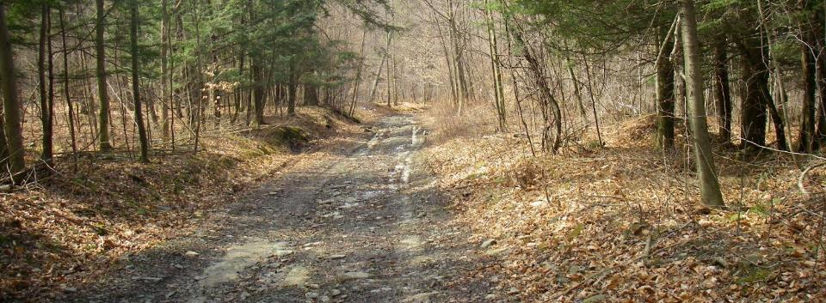
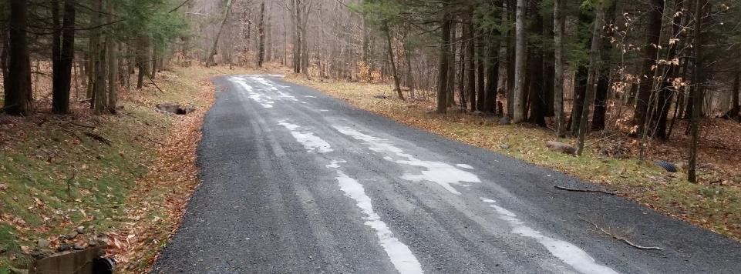
Before
Project Primer: Fill, pipes, surface
After
DGR Project in Bradford County: $107K Spent, $14K in kind

Slide 12
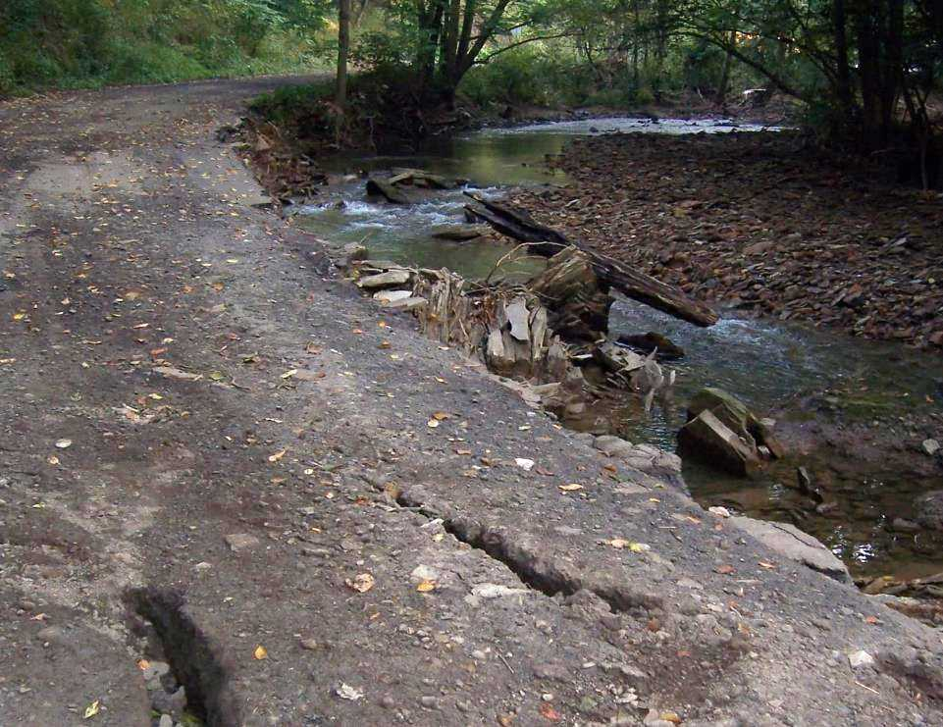
Introduction
Road / Stream Connection
Program focus is where the road and/or the stream negatively impacts the other
Notes:
Roads are often built along and across streams. Water can cause road damage and wash away road material into these nearby streams, causing issues for both the road and water quality.

Slide 13
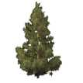
Surface drainage patterns
Tributary stream
Sub-surface drainage patterns
Notes:
Naturally, rain water soaks into the ground and runs over the land in “sheet flow” that doesn’t cause erosion.
Water collected in natural low spots on the landscape form streams.

Slide 14
Surface drainage patterns
Tributary stream
Sub-surface drainage patterns
DRAFT for comment 12/10/2021. This has not been approved by the SCC.
Notes:
This diagram shows how roads intercept water in the landscape and change drainage patterns
Traditional road drainage practices collect and concentrate water, which often causes erosion

Slide 15
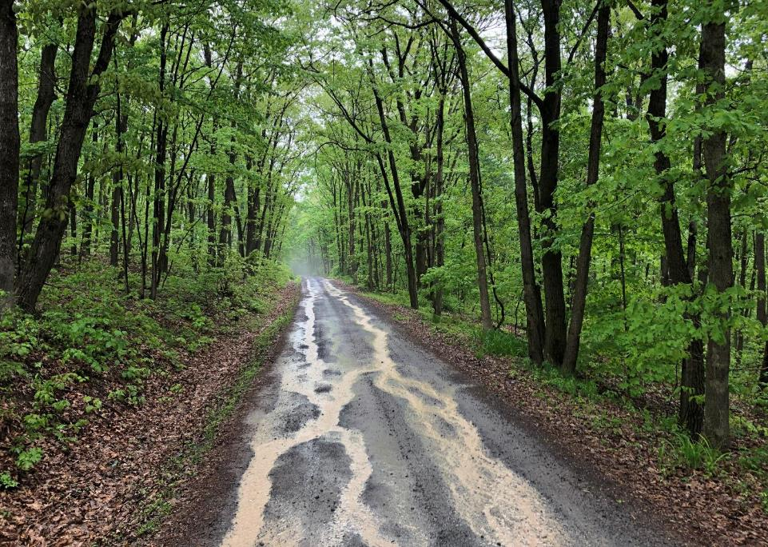
Introduction
Erosion
Effects of Roads
Generate Sediment
Deliver Sediment to Stream

Slide 16
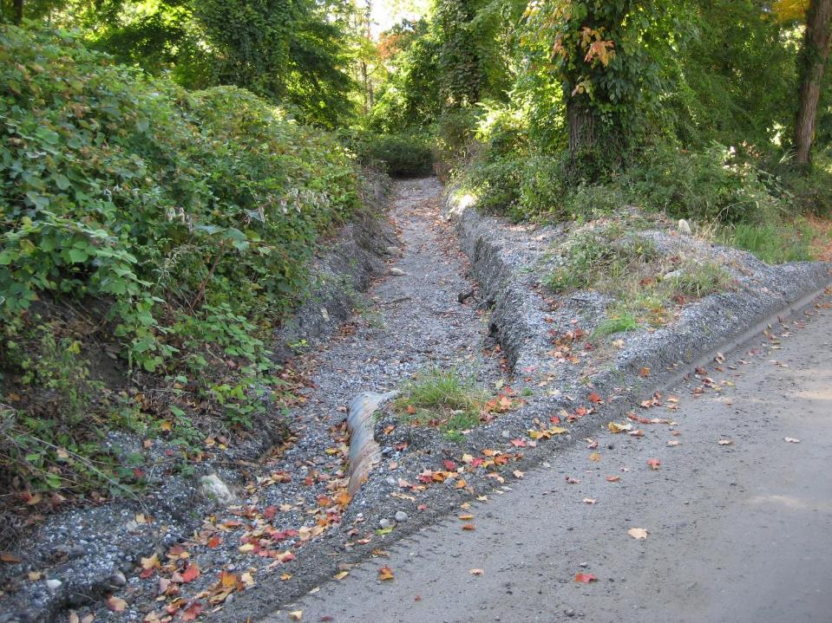
Introduction
Erosion
Effects of Roads
Generate Sediment

Slide 17
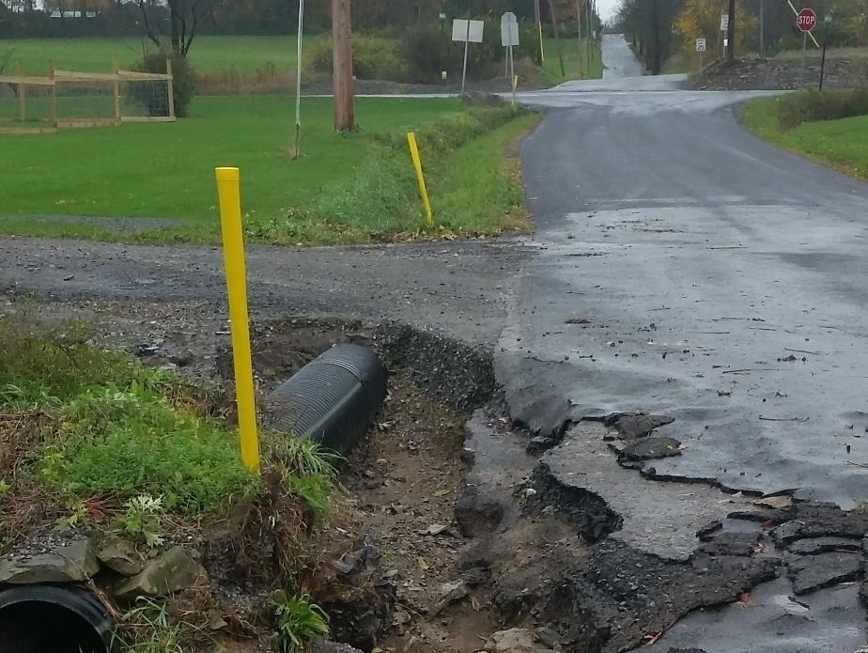
Introduction
Erosion
Effects of Roads
Even Paved Roads
Generate Sediment
NEW PIC

Slide 18
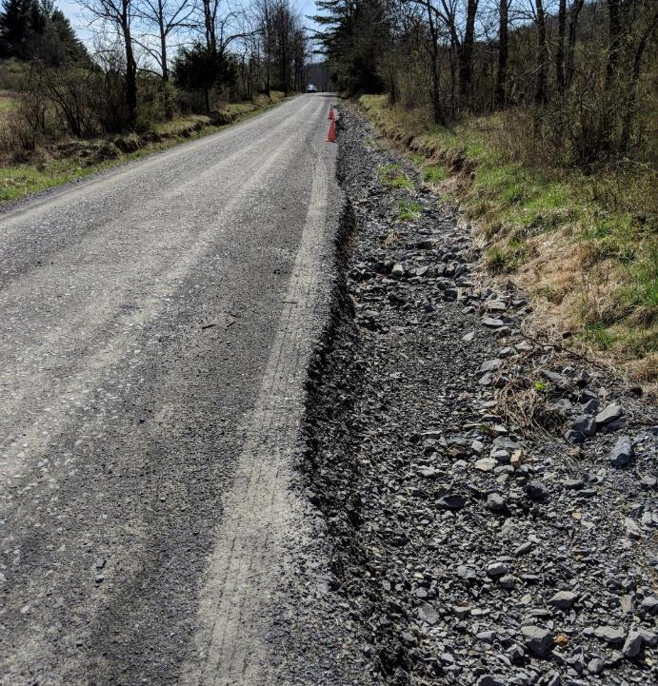
Road ditch with insufficient outlets
Notes:
Stormwater carried for long distances alongside roads create deep ditches, which are safety hazards.

Slide 19
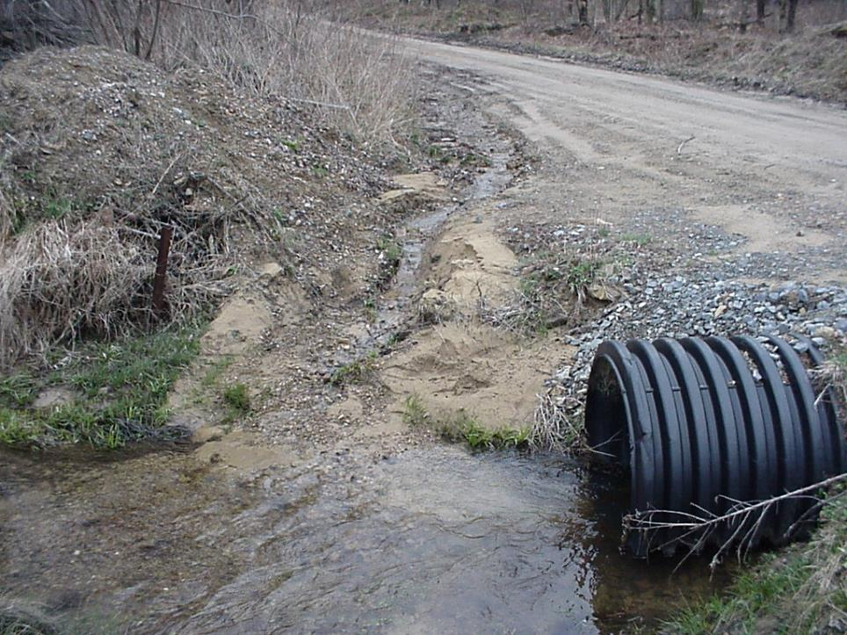
Introduction
Erosion
Effects of Roads
Deliver Sediment to Stream
Notes:
Good

Slide 20
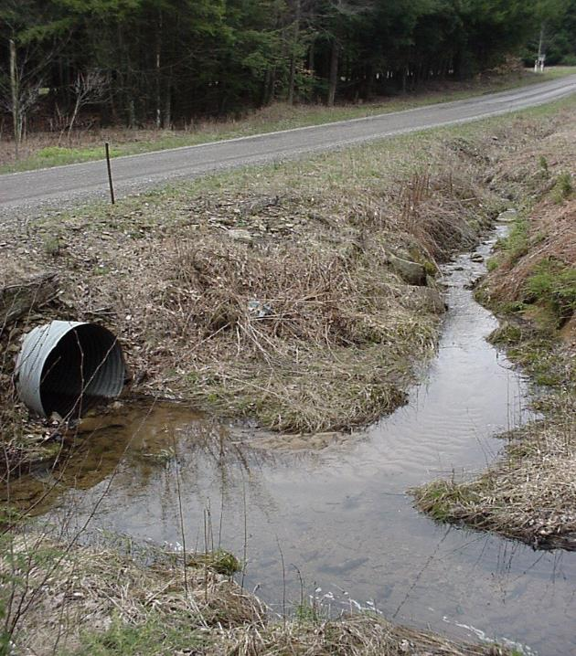
Effects of Roads
Deliver Sediment to Stream
ROAD DITCH FLOW
ROAD DITCH FLOW
STREAM FLOW
Notes:
Good

Slide 21
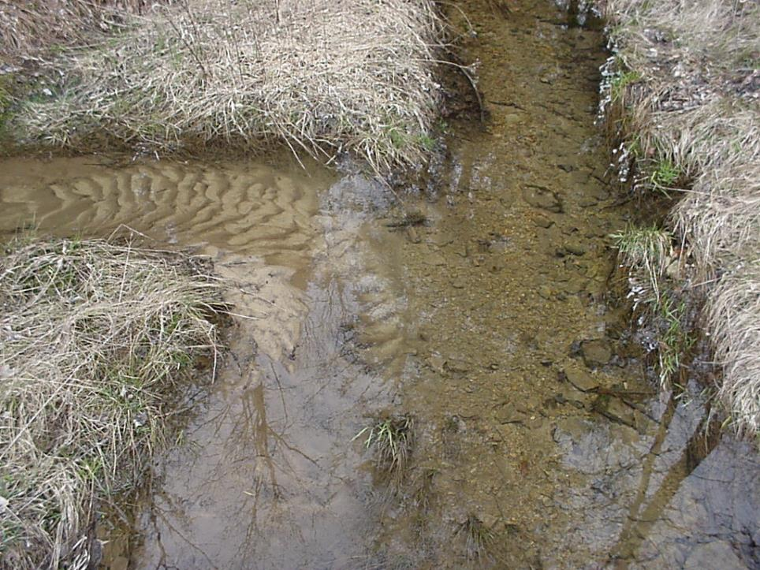
Introduction
Erosion
STREAM
FLOW
ROAD DITCH DRAINAGE
Road drainage is too often connected to a Stream
Notes:
Good.

Slide 22
Surface drainage patterns
Tributary stream
Sub-surface drainage patterns
DRAFT for comment 12/10/2021. This has not been approved by the SCC.
Notes:
This diagram shows how roads intercept water in the landscape and change drainage patterns
Traditional road drainage practices collect and concentrate water, which often causes erosion

Slide 23
Surface drainage patterns
Tributary stream
Sub-surface drainage patterns
DRAFT for comment 12/10/2021. This has not been approved by the SCC.
Notes:
Adding more storm water outlets spreads out and slows down stormwater, preventing erosion
Replacing undersized stream crossing structures can also protect roads and water quality

Slide 24
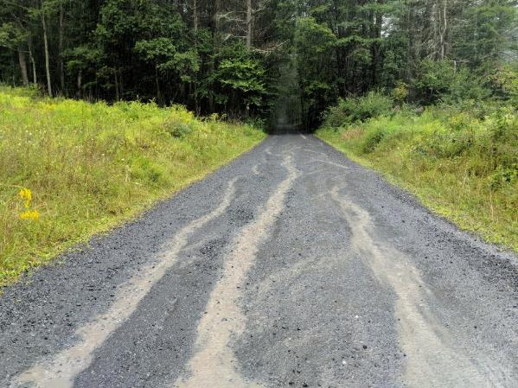
Example Dirt and Gravel Road Project
Stream
BEFORE
Water Flow
Notes:
An example DGR Project:

Slide 25
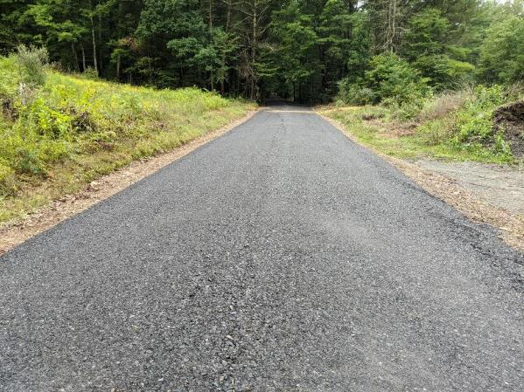
Example Dirt and Gravel Road Project
New Pipe
Stream
BEFORE
AFTER
Water Flow
Water Flow
Notes:
An example DGR Project:

Slide 26
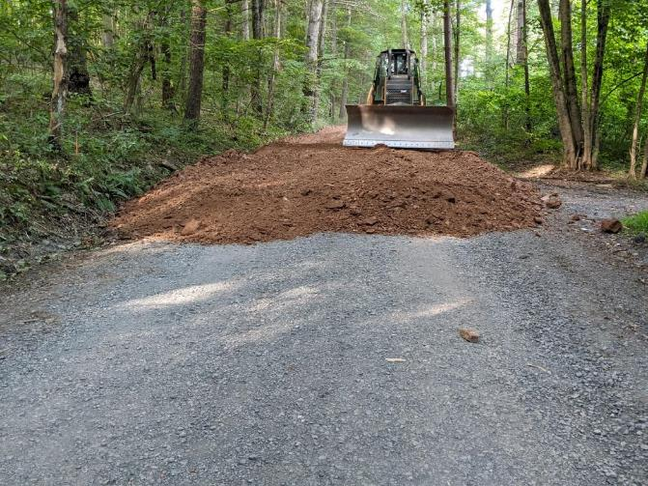
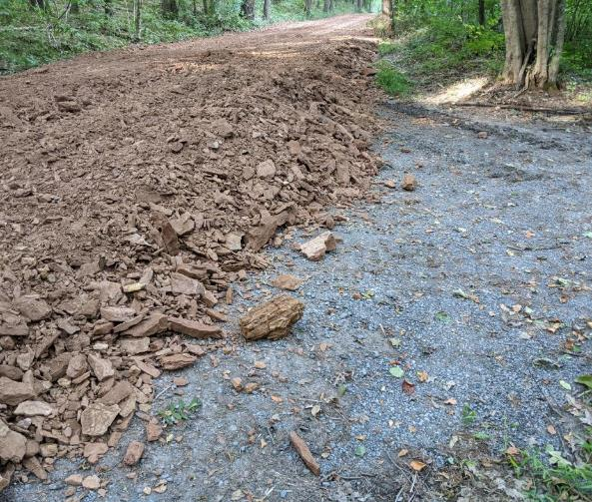
During construction – placing road fill
Notes:
Road fill raises the road and establishes appropriate shape (road crown) to allow water to drain from the road.

Slide 27
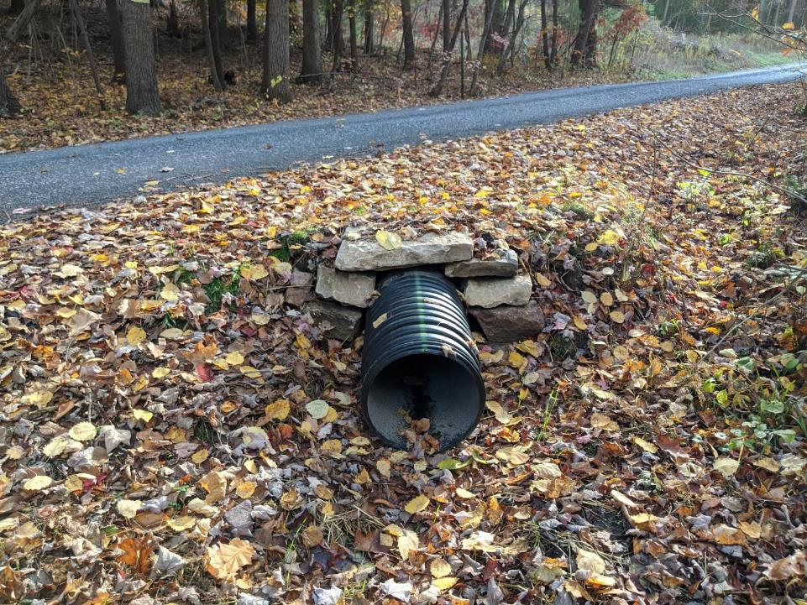
AFTER
Notes:
Shallow cross pipes do not cause erosion at the outlet of the pipe

Slide 28
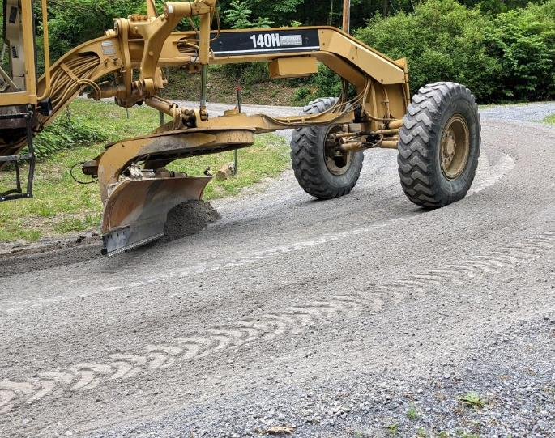
DGLVR Introduction
DGR
Two Types of Funding
Based on road surface
Dirt and Gravel Roads (DGR)
Unbound road surface
Can be shaped with a grader

Slide 29
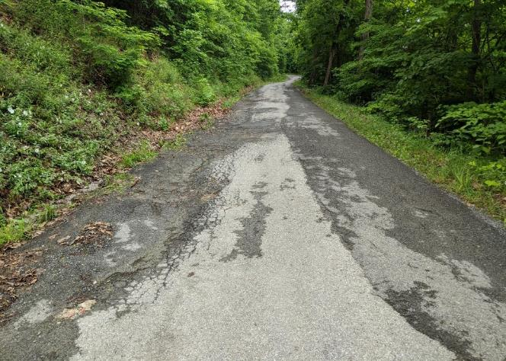
DGLVR Introduction
LVR
Low Volume Roads (LVR)
Paved or sealed (including tar and chip)
Low traffic volume (500 vehicles/day or less)

Slide 30
DGLVR Introduction
DGLVR Fundamentals
DGLVR Program Fundamentals
Focus on environmental and road improvement projects
Local control
Conservation district runs local Program
Quality Assurance Boards at county
Recommend project allocations
Recommend local policies
State guidance and local policies
Public Road owners apply for grants from conservation districts
90%+ of applicants are townships

Slide 31
Administrative Training
Introduction
What do we mean by “Local Control”?

Slide 32
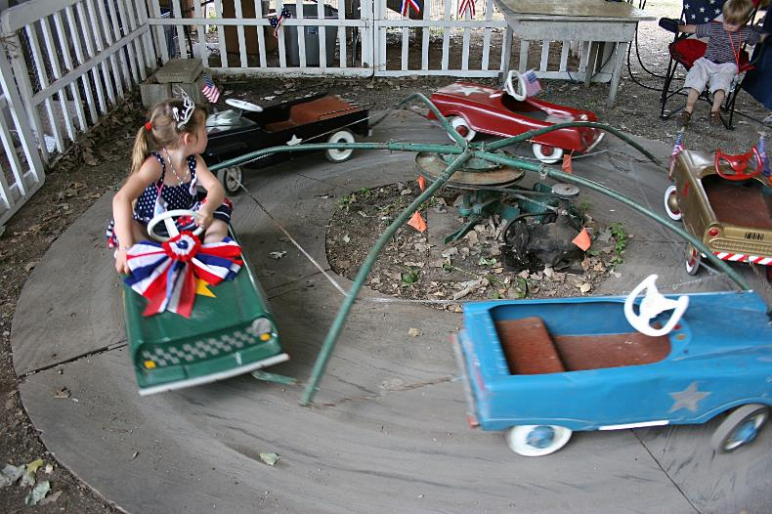
DGLVR Quality Assurance Board
DGLVR introduction
What do we mean by “Local Control”?
0% Local Control

Slide 33
DGLVR Quality Assurance Board
DGLVR introduction
What do we mean by “Local Control”?
100% Local Control

Slide 34
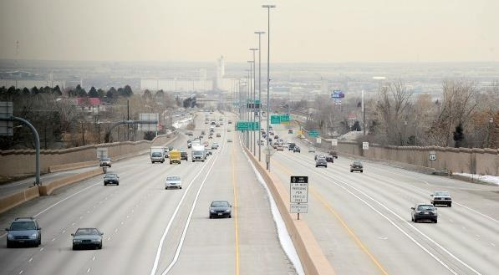
DGLVR Quality Assurance Board
DGLVR introduction
What do we mean by “Local Control”?
Effective local control
“lanes and guiderails”

Slide 35
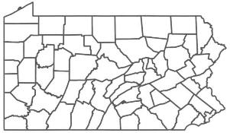
DGLVR Quality Assurance Board
DGLVR introduction
SCC provides funding to county conservation districts
&
Establishes statewide DGLVR policy
County conservation district runs local DGLVR Program
&
Establishes local DGLVR policy

Slide 36
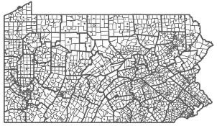
DGLVR Quality Assurance Board
DGLVR introduction
SCC provides funding to county conservation districts
&
Establishes statewide DGLVR policy
County QAB provides recommendations to conservation district board
Which projects to fund
Local policies
Local road owners apply to
conservation district for DGLVR grants

Slide 37
DGLVR Quality Assurance Board
DGLVR introduction
Penn State CDGRS receives funding and guidance from SCC

Slide 38
DGLVR Quality Assurance Board
DGLVR introduction
training
Penn State CDGRS provides education and technical assistance to conservation districts and grant applicants
training

Slide 39
DGLVR Financial Workshop
DGLVR Policies
Dirt and Gravel Road PROGRAM
Education
2 day ESM training
Annual Workshops
Demonstration Days
Outreach
- Technical Documentation
- Website
Newsletter
Interagency cooperation
Program Support
Advisory Groups
Technical Assistance to Districts
Quality Assurance effort
Geographic Information Systems
Funding Support
Guidance
Make Policy
“Administer” Program
QAQC
Coordinate with legislatures and other agencies

Slide 40
DGLVR Financial Workshop
DGLVR Policies
Dirt and Gravel Road PROGRAM
Got a Question? Who to ask:
Policy
Legal
Allocation/replenishment
QAQC
General Questions
Trainings
Technical Assistance
Outreach
GIS/Reporting
General Questions

Slide 41
Outline
Quality Assurance Boards
DGLVR Program Introduction
QAB Policy review
QAB Structure and purpose
Meeting guidelines
Role in projects
Role in local policy
What to do if you’re a new QAB member

Slide 42
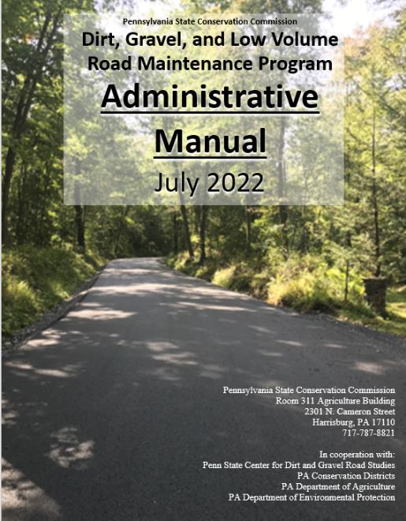
Administrative Manual
Introduction
DGLVR Administrative Manual
Approved by SCC 5/10/22
Introduction
SCC Role
Conservation District Role
Quality Assurance Board Role
Applicant Role
Center for Dirt and Gravel Roads
Additional Policies
Permits and Other Requirements
Appendices
Available online.
Hard copies sent on request.

Slide 43
Administrative Manual
Introduction
DGLVR Administrative Manual
Approved by SCC 5/10/22
Introduction
SCC Role
Conservation District Role
Quality Assurance Board Role (5 pages)
https://dirtandgravel.psu.edu/pa-program-resources/program-specific-resources/administrative-guidance-manual/4-quality-assurance-board-qab/
5) Applicant Role
6) Center for Dirt and Gravel Roads
7) Additional Policies
8) Permits and Other Requirements
Appendices
Available online.
Hard copies sent on request.
4) QAB Role
Defines composition and function of QAB
Composition
Meeting Requirements
QAB Role in Projects
QAB Role in Policy

Slide 44
4.0 Quality Assurance Board
Chap 4. QAB Role
Quality Assurance Board -§ 9106 of the PA Motor Vehicle Code, (E)
Within the conservation district a Quality Assurance Board shall be impaneled to establish and administer the grant program. The four-member QAB is to be comprised of a nonvoting chairman appointed by the conservation district directors and one local representative appointed by each of the following entities:
(1) The Federal Natural Resource Conservation Service
(2) The Pennsylvania Fish and Boat Commission
(3) The county conservation district
If circumstances require, the chairman may vote to decide a tie vote.

Slide 45
4.0 Quality Assurance Board
Chap 4. QAB Role
Quality Assurance Board Why?

Slide 46
4.0 Quality Assurance Board
Chap 4. QAB Role
Quality Assurance Board Why?
Local Involvement and Control
NRCS – Federal: conservation and erosion
PAFBC – State: aquatics and hydrology
District – County: conservation multi-discipline
Who knows best for the County?
People in the County!

Slide 47
4.0 Quality Assurance Board
Chap 4. QAB Role
Quality Assurance Board
Local control within guidelines established by the SCC.
QAB’s purpose is to advise and assist the conservation district board.
QAB is advisory only
District Board has the final say

Slide 48
4.1 QAB Composition
Chap 4. QAB Role
Composition of the QAB is established by law:
Only 4 members
Non-voting chair appointed by district board
One voting member appointed by the district board
One voting member appointed by Fish and Boat commission
One voting member appointed by NRCS

Slide 49
4.1 QAB Composition
Chap 4. QAB Role
Composition of the QAB is established by law:
Only 4 members
Non-voting chair appointed by district board
One voting member appointed by the district board
One voting member appointed by Fish and Boat commission
One voting member appointed by NRCS
Chairman may only vote to decide a tie

Slide 50
4.1 QAB Composition
Chap 4. QAB Role
Composition of the QAB is established by law:
Only 4 members
Non-voting chair appointed by district board
One voting member appointed by the district board
One voting member appointed by Fish and Boat commission
One voting member appointed by NRCS
Chairman may only vote to decide a tie
Voting members appointed by the agencies do not have to be employees

Slide 51
4.1 QAB Composition
Chap 4. QAB Role
Composition of the QAB is established by law:
Only 4 members
Non-voting chair appointed by district board
One voting member appointed by the district board
One voting member appointed by Fish and Boat commission
One voting member appointed by NRCS
Chairman may only vote to decide a tie
Voting members appointed by the agencies do not have to be employees
QAB can have as many advisors as they deem necessary, but advisors are non-voting

Slide 52
Structure and Purpose
Chap 4. QAB Role
NRCS and PAFBC designate their QAB appointees
Does not have to be NRCS/PAFBC employee.
Can also designate an alternate.
Should have appointment in writing
Appointments need to be agreed upon by the agency and conservation district
Sample appointment letter:

Slide 53
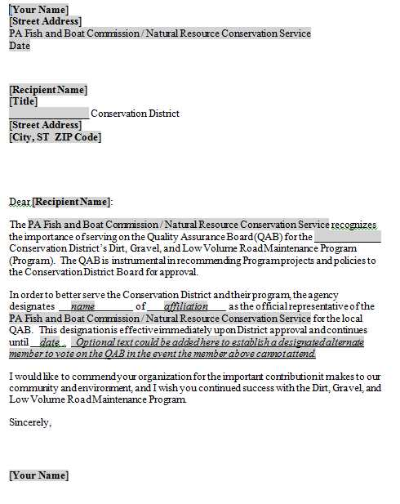
Structure and Purpose
Chap 4. QAB Role
Sample appointment letter:
Voting members appointed by the agencies do not have to be employees
Word Version Available online

Slide 54
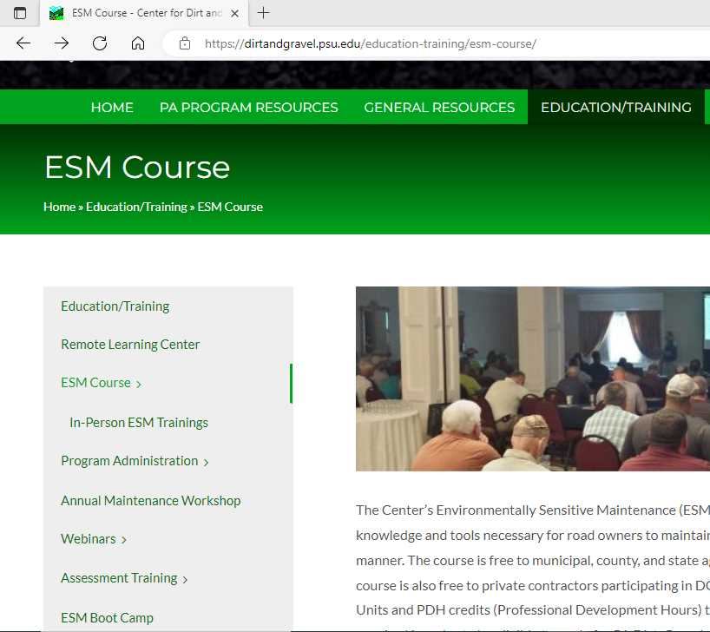
4.1 QAB Composition
Chap 4. QAB Role
All QAB members are strongly encouraged to take ESM training
At least one district member must take ESM training
https://dirtandgravel.psu.edu/education-training/esm-course/
No cost, must register online

Slide 55
Outline
Quality Assurance Boards
DGLVR Program Introduction
QAB Policy review
QAB Structure and purpose
Meeting guidelines
Role in projects
Role in local policy
What to do if you’re a new QAB member

Slide 56
4.2 QAB Meetings
Chap 4. QAB Role
QAB Meetings
On a regular schedule or as needed
Common action items at a QAB:
Review grant applications
Recommend projects for funding to the district board
Review completed projects
Recommend local policies to district board
At least 2 of the 3 voting members (quorum) needed to make recommendations to the district board

Slide 57
4.2 QAB Meetings
Chap 4. QAB Role
QAB Meetings must meet Sunshine Act Requirements
The Pennsylvania Sunshine Act requires all public agencies to take all official actions and conduct all deliberations leading up to official actions at public meetings. The Act covers all such actions by municipal governing bodies, committees of these governing bodies and municipal boards and commissions.
-Open Meetings, the Sunshine Act (Pennsylvania)

Slide 58
4.2 QAB Meetings
Chap 4. QAB Role
Sunshine Act Highlights
Notice of meetings are posted in a local paper and at the location of the meeting
Keep meeting minutes
Must have a quorum to vote
Meeting must be public
Cannot vote via email
Can vote in a virtual meeting or conference call if the public has access to join
Note that this list is not all-inclusive. Additional information online at https://www.agriculture.pa.gov/Pages/Sunshine-Act.aspx

Slide 59
4.2 QAB Meetings
Chap 4. QAB Role
Sunshine Act Highlights
Agenda posting requirements added in 2021
Post agenda at meeting location at least 24 hours in advance of the meeting
Post agenda on social media, website, and at the agency’s office
Copies of the agenda must be available for the public at the meeting
Include all issues to be deliberated on and any planned official action (votes)
Frequently Asked Questions at https://www.openrecords.pa.gov/SunshineAct.cfm
Note that this list is not all-inclusive. Additional information online at https://www.agriculture.pa.gov/Pages/Sunshine-Act.aspx

Slide 60
Chap 4. QAB Role
4.3 QAB role in projects
DGLVR Administrative Manual update 7/1/2022
4.3.1 Project Ranking / Sunshine Act
Field visits by the QAB are not subject to Sunshine Act requirements as long as no deliberations of QAB business occurs and no official actions or recommendations are made during the visit.

Slide 61
Outline
Quality Assurance Boards
DGLVR Program Introduction
QAB Policy review
QAB Structure and purpose
Meeting guidelines
Role in projects
Role in local policy
What to do if you’re a new QAB member

Slide 62
4.3 QAB role in projects
Chap 4. QAB Role
4.3.1 QAB Role: Project Ranking
QAB members should become familiar with applicant’s worksites:
Site visits as a group
Site visits individually
Photo tour from District staff
Paper application review only
Throw darts at “application dartboard”
Best option
Not recommended

Slide 63
4.3 QAB role in projects
Chap 4. QAB Role
4.3.1 QAB Role: Project Ranking
Each County must have written Project Ranking Criteria
Based on local priorities.
Can have separate DGR and LVR or combined.
Must provide for equal access.
Example template available on Center’s website.

Slide 64
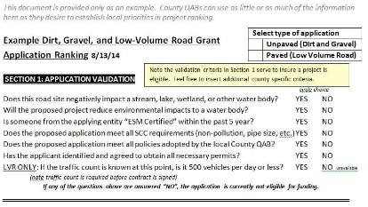
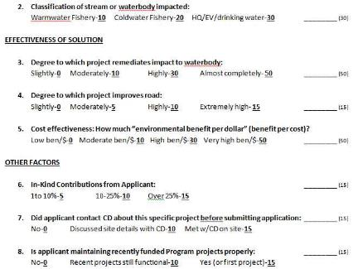
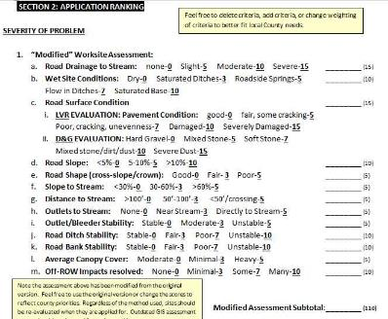
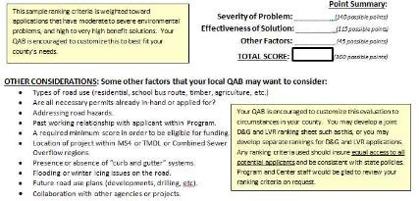
4.3 QAB role in projects
Chap 4. QAB Role
Solution
Application Validation
Misc
Problem
Other thoughts
Ranking Criteria Webinar Recorded 12/11/14
Recording and PowerPoint available online
www.dirtandgravelroads.org

Slide 65
Surface drainage patterns
Tributary stream
Sub-surface drainage patterns
DRAFT for comment 12/10/2021. This has not been approved by the SCC.
Notes:
Don’t forget that the goal of the DGLVR Program is to provide both road and environmental benefits

Slide 66
Surface drainage patterns
Tributary stream
Sub-surface drainage patterns
DRAFT for comment 12/10/2021. This has not been approved by the SCC.
Notes:
Projects should implement ESM practices to spread out and slow down stormwater, as well as disconnect road drainage from streams and other bodies of water.

Slide 67
The QAB can make changes to a grant application
Can add a cross pipe, underdrain, attach a technical bulletin, etc.
Notes:
Don’t forget that the law establishing the DGLVR Program allows QABs to add requirements to applications – see excerpt of Section 9106 of the PA Motor Vehicle code

Slide 68
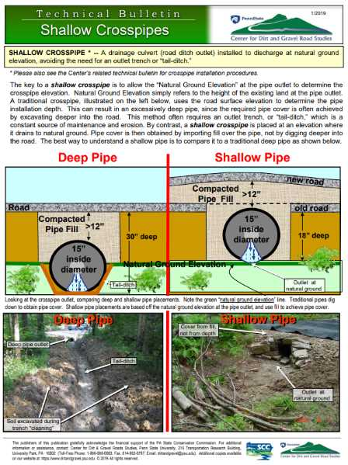
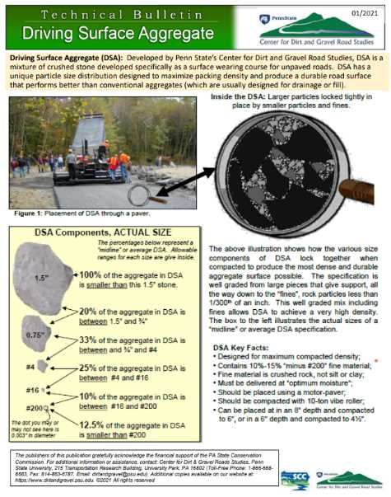
https://dirtandgravel.psu.edu/general-resources/technical-bulletins/
Notes:
Technical bulletins can be added to a grant application

Slide 69
Recorded webinar on Better Grant Applications is available at https://dirtandgravel.psu.edu/education-training/webinars/past-webinars/
2023

Slide 70
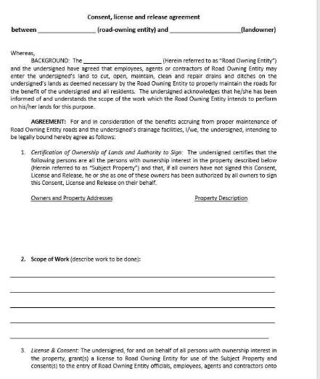
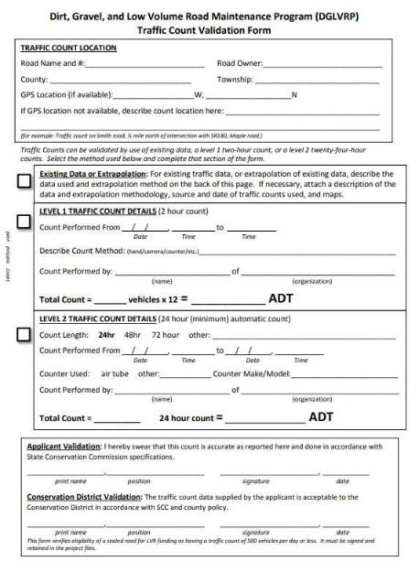
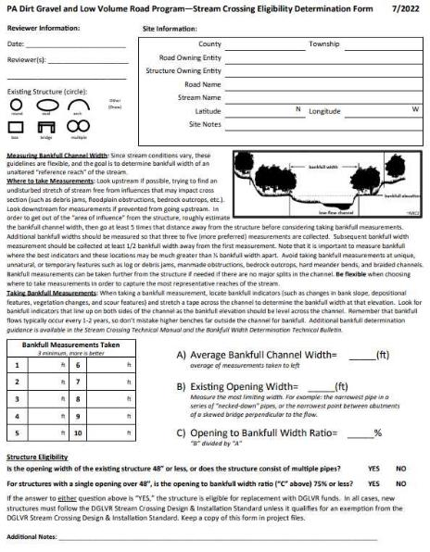
Supplements to the Grant Application
Some districts and QABs may want to review required paperwork during the application stage:
Traffic count for LVR Projects
Landowner consent for off right-of-way work
Steam crossing forms
Note: significant policy updates in 2022, including Stream Crossing Design and Installation Standard

Slide 71
4.3 QAB role in projects
Chap 4. QAB Role
4.3.2 QAB Role: Funding Recommendations
QAB makes funding recommendations based on the ranking criteria it establishes
District board then considers QAB recommendations
When the district board approves an application, district staff may then develop and secure a contract.

Slide 72
4.3 QAB role in projects
Chap 4. QAB Role
4.3.3 QAB Role: Project Implementation
After contract is secured, district staff is responsible for project administration, oversight, and inspection.
Future funding decisions for the project may be made by the CD Board with minimal QAB involvement.
i.e. District board could approve a contract amendment without QAB involvement
It’s a local decision on how much the QAB is involved after projects are funded

Slide 73
Outline
Quality Assurance Boards
DGLVR Program Introduction
QAB Policy review
QAB Structure and purpose
Meeting guidelines
Role in projects
Role in local policy
What to do if you’re a new QAB member

Slide 74
4.4 QAB Role in Policy
Chap 4. QAB Role
QAB Role in Policy
Developing local policy is a major function of the QAB:
QABs develop policy
District board adopts policy

Slide 75
4.4.1 Required Policies
Chap 4. QAB Role
Required Local Policies
Equal Access
Conflict of Interest
Project Ranking
Incentives for training
Non-pollution standards

Slide 76
4.4.1 Required Policies
Chap 4. QAB Role
Conflict of Interest
Note that in the event a QAB voting member has a conflict of interest, they cannot temporarily switch places with the non-voting chair for that vote

Slide 77
4.4.2 Optional Local Policies
Chap 4. QAB Role
Optional Local Policies
QAB can recommend policies for use within County Program.
Can be “more stringent” than Statewide policy.
Cannot conflict with Statewide policy.
Examples:
Deadlines for applications
Limiting use of DSA
Limiting number of stream crossings
Ongoing maintenance requirements

Slide 78
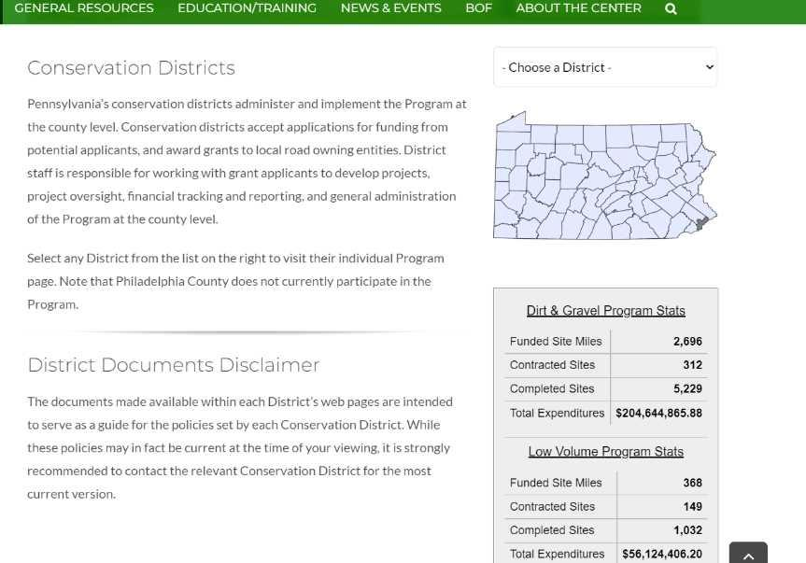
4.4 QAB Role in Policy
Chap 4. QAB Role
Individual County pages have contact info and policies
http://www.dirtandgravel.psu.edu/pa-program-resources/conservation-districts
Notes:
When QAB policies or ranking criteria are updated, please make sure to share the updated version with the Center so the updated documents can be added to the Center’s website.

Slide 79
Outline
Quality Assurance Boards
DGLVR Program Introduction
QAB Policy review
QAB Structure and purpose
Meeting guidelines
Role in projects
Role in local policy
What to do if you’re a new QAB member

Slide 80
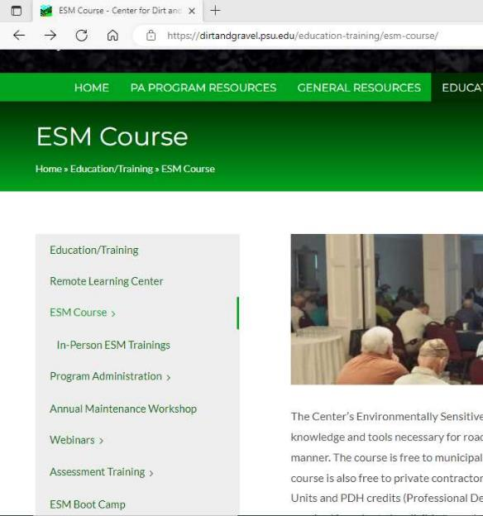
New Members
Quality Assurance Board
New QAB Members
Connect with the conservation district staff who administer the DGLVR Program
Review local policy and ranking criteria
Attend ESM training
Watch this presentation
Visit DGLVR project sites
Proposed
Under construction
Completed

Slide 81
Summary
Quality Assurance Board
QABs recommend local DGLVR policy and project funding
Local control is an important part of the DGLVR Program
QABs are encouraged to be active and involved in your local DGLVR Program
Being on the QAB does not have to be a huge time commitment
Questions?
Reach out to your county conservation district
Sherri Law
State Conservation Commission
shlaw@pa.gov
223-666-2567 or 717-787-4357

