Slide 1
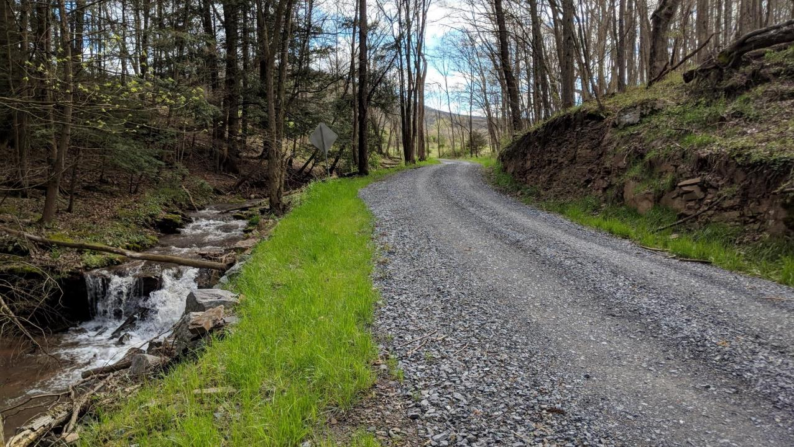
Dirt, Gravel, and Low Volume Road (DGLVR) Program
2/28/2023
Reviewing Grant Applications
SCC
Sherri Law
shlaw@pa.gov
If you are reading this, then you are successfully seeing the webinar video. Webinar audio should be automatic through your computer (or click “join audio”), and options can be accessed in the “audio options” button on the bottom left. If your computer audio is not working, you can listen on your phone by dialing 646-876-9923.

Slide 2
Quality Assurance Boards
This webinar is being recorded
Please enter questions in the “Q&A” Feature
We will answer all questions at the end

Slide 3
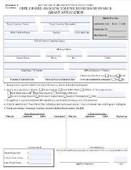
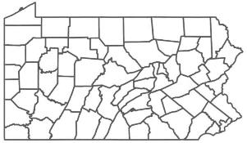
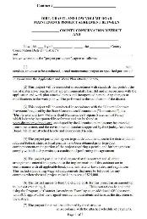
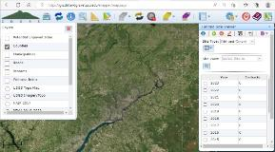
Reviewing Grant Applications
Submitted Applications
County Conservation District
Quality Assurance Board
Grant Application
Conservation District Board
County Conservation District
Contract
Notes:
Road owners submit grant applications to the county conservation district
The CD meets with their QAB to rank applications. The QAB recommends which projects should be funded.
The CD Board of Directors reviews the QAB recommendations and takes action on how to allocate DGLVR project funds
Once the Board has approved funding, the conservation district can generate DGLVR contracts in the GIS
Then the district and grant recipient sign the contract and the project can begin

Slide 4
Reviewing Grant Applications
Submitted Applications
County Conservation District
Quality Assurance Board
Grant Application
Conservation District Board
County Conservation District
Contract
Notes:
Today’s presentation is about what conservation districts do with grant applications before going to the QAB
Some of what we discuss can also have QAB involvement or can happen after a QAB meeting, but it’s most likely to happen before the QAB meeting

Slide 5
Why talk about grant applications?
Reviewing Grant Applications
It’s important that DGLVR grant applications are thorough, detailed, and filled out correctly.
To prevent misunderstandings
Notes:
This program focuses on simplicity and minimal paperwork, but we still want to write down enough to make sure everyone understands what the project is

Slide 6
Why talk about grant applications?
Reviewing Grant Applications
Recorded 2023 webinar on “Better Grant Applications” is available online
https://dirtandgravel.psu.edu/education-training/webinars/past-webinars/
Notes:
This program focuses on simplicity and minimal paperwork, but we still want to write down enough to make sure everyone understands what the project is

Slide 7
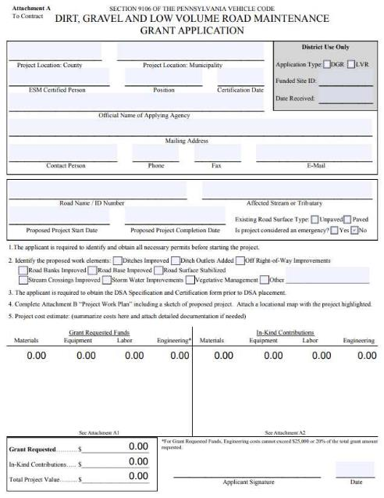
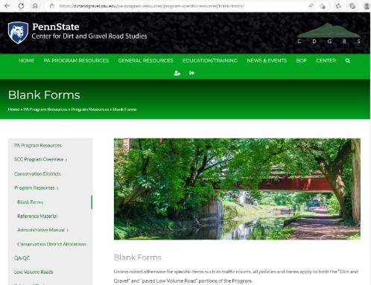
Reviewing Grant Applications
Required Form
Must be on the “DGLVR Program Grant Application” form
Available on the Blank Forms page of the Center for Dirt and Gravel Road Studies Website

Slide 8
Reviewing Grant Applications
Submitted Applications
When a conservation district receives an application:
Are you familiar with the site?
Are all required sections included?
Are the applicant, road, and project eligible?
Are all required sections filled out correctly?
Do you have all of the information needed to rank the application?
Is it a good project?
If any changes or clarifications are needed, reach out to the applicant ASAP

Slide 9
Reviewing Grant Applications
Submitted Applications
When a conservation district receives an application:
Are you familiar with the site?
Are all required sections included?
Are the applicant, road, and project eligible?
Are all required sections filled out correctly?
Do you have all of the information needed to rank the application?
Is it a good project?
If any changes or clarifications are needed, reach out to the applicant ASAP

Slide 10
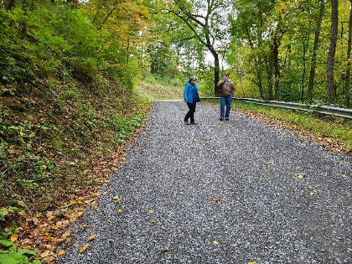
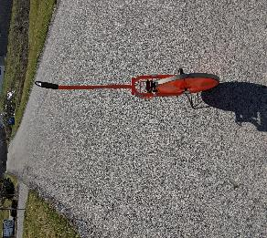
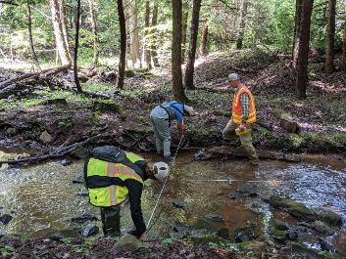
Reviewing Grant Applications
Familiarity with the site
Were you expecting the application?
Was there a pre-application meeting?
Has the applicant discussed the project with you?
If the answer is no, it is highly recommended that you consider meeting with the applicant on site to review the application together

Slide 11
Reviewing Grant Applications
Submitted Applications
When a conservation district receives an application:
Are you familiar with the site?
Are all required sections included?
Are the applicant, road, and project eligible?
Are all required sections filled out correctly?
Do you have all of the information needed to rank the application?
Is it a good project?
If any changes or clarifications are needed, reach out to the applicant ASAP

Slide 12
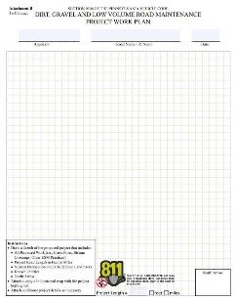
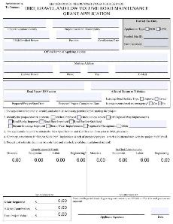
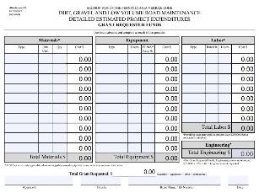
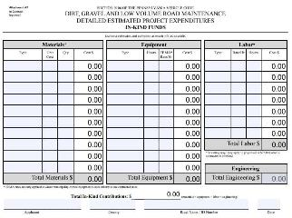
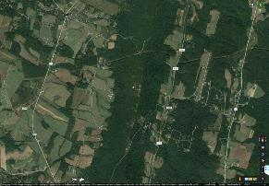
Reviewing Grant Applications
Required Application Sections
DGLVR Program Grant Application Form
Project Sketch
Local Requirements?
In Kind
Traffic count submitted with App
Etc.
Cost Estimate
Location Map
Work Area

Slide 13
Reviewing Grant Applications
Submitted Applications
When a conservation district receives an application:
Are you familiar with the site?
Are all required sections included?
Are the applicant, road, and project eligible?
Are all required sections filled out correctly?
Do you have all of the information needed to rank the application?
Is it a good project?
If any changes or clarifications are needed, reach out to the applicant ASAP

Slide 14
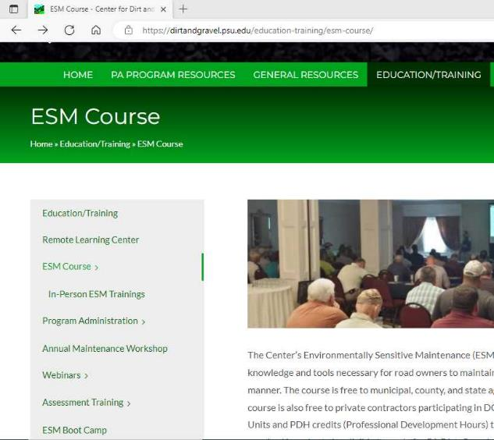
Eligible Applicants
Reviewing Grant Applications
Eligibility
Public entities (local, county, and state) that own public roads in PA
Federal and private road owners are not eligible
Must be ESM Certified
Employee of Road Owner
Person in charge of road work
Within 5 years

Slide 15
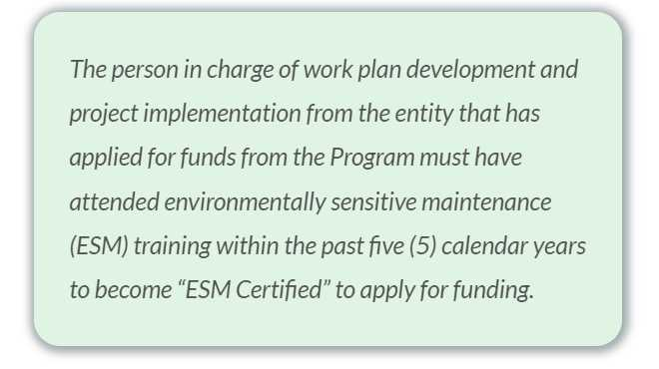
Reviewing Grant Applications
Eligibility
Typical roles who are ESM Certified:
Township supervisor
Roadmaster
Borough manager
Gamelands Land Manager
Roles whose ESM Cert. does NOT make the entity eligible:
ESM certified engineers
Unless they are an employee of the entity instead of on retainer/contracted
Anyone not in charge of the road work
Secretary, road crew member, intern, etc.
Note these people are still encouraged to attend ESM training!

Slide 16
Eligible Roads
Reviewing Grant Applications
Eligibility
Public Roads owned by an eligible applicant
Road must be open to public motor vehicle travel for a minimum of 2 consecutive weeks annually
The road must have a stream/water quality impact
Must be an unpaved or low volume road
LVR means sealed surface with ADT of 500 or less

Slide 17
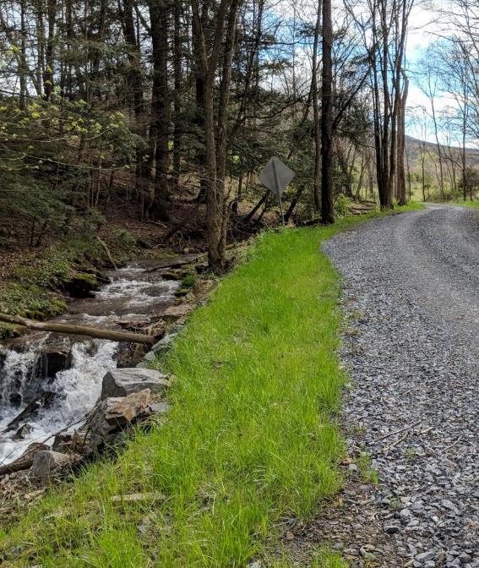
Project Eligibility
Reviewing Grant Applications
Eligibility
DGR and LVR projects must focus on both environmental and road improvements
Routine maintenance is not eligible for DGLVR funding
Focus on long-term benefit through use of Environmentally Sensitive Maintenance (ESM) practices
Project work must meet DGLVR policy, standards, and specifications

Slide 18
Reviewing Grant Applications
Submitted Applications
When a conservation district receives an application:
Are you familiar with the site?
Are all required sections included?
Are the applicant, road, and project eligible?
Are all required sections filled out correctly?
Do you have all of the information needed to rank the application?
Is it a good project?
If any changes or clarifications are needed, reach out to the applicant ASAP

Slide 19
Reviewing Grant Applications
Check that App is Filled Out Correctly
DGLVR Program Grant Application Form
Project Sketch
Local Requirements?
In Kind
Traffic count submitted with App
Etc.
Make sure the Grant Application is filled out correctly
Cost Estimate
Location Map
Work Area

Slide 20
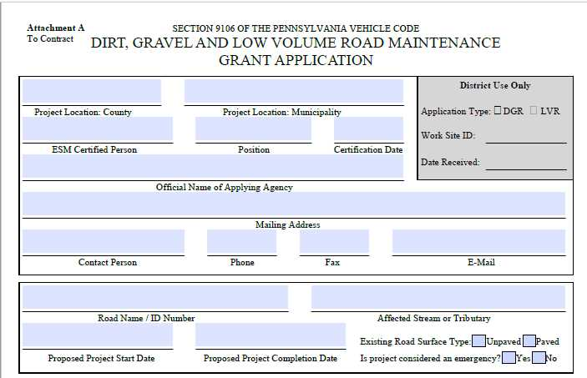
Filling out the Application
Any County
Example Township
X
John Doe
Roadmaster
8/25/2022
2/28/2023
Example Township
123 Main Street, Example Town, PA 12345
John Doe
123-456-7890
123-789-4560
Johndoe@example.com
Any Mountain Road/ TR 123
Unnamed Tributary (UNT) to River
April 30, 2023
Sept 30, 2023
x
x
Notes:
Make sure all of the contact site info and contact info are filled out and matches what you are expecting, if you have worked with the applicant on the proposed project
Pay particular attention to
Make sure the ESM Certification Date is within the last 5 years
Some applicants don’t know how to find the correct stream name and I recommend you double check that the correct affected stream or tributary is listed
Make sure the proposed project start date is within the time frame that funds are available (2-year spending requirement)
Note DSA can only be placed 4/1 – 9/30 and there are restrictions on in-stream work in trout streams
Record the date that the application was received and whether it’s for DGR or LVR funds

Slide 21
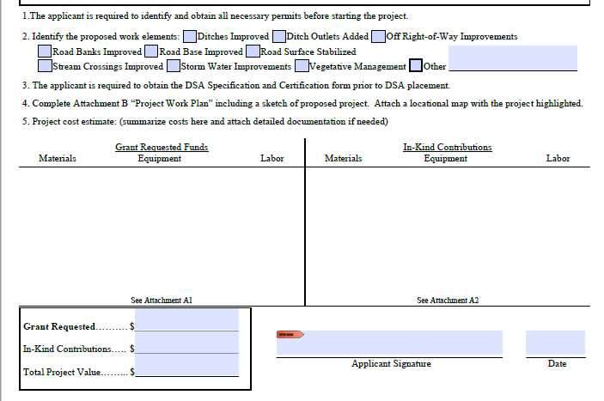
x
x
x
x
x
x
See attached sheets
$24,775.00
$3,590.00
2/1/2023
$28,365.00
Notes:
Similarly, the bottom of the grant application is pretty simple
Make sure the correct “proposed work elements” boxes are checked
Make sure the cost estimate is in the boxes or attached (usually attached)
Check that the grant request box in the lower left hand corner is filled out and matches the cost estimate
Make sure the ESM Certified applicant signed the application
Some applicants like to have multiple signatures from multiple township supervisors, board members, etc. Multiple signatures is fine but not required by state-wide policy.

Slide 22
Reviewing Grant Applications
Check that App is Filled Out Correctly
DGLVR Program Grant Application Form
Project Sketch
Local Requirements?
In Kind
Traffic count submitted with App
Etc.
Is the location map accurate and clear?
Cost Estimate
Location Map
Work Area

Slide 23
Location Map
Work Area
Notes:
The location map shows where the project is in the world
This might not seem like an important part of the application because the applicant and conservation district usually both know where the project site is already, but this is helpful for QAB and Board members, for other conservation district staff if they are helping out or if there’s staff turnover, and for Center and SCC staff during tech assists and QAQCs
Make sure there is some kind of reference point like a main road, town, etc. And that the correct section of the correct road is marked

Slide 24
Location Map
Work Area
Notes:
It doesn’t matter what kind of map is used for the location map as long as it shows the location clearly, such as by labeling nearby main roads, towns, landmarks, etc.
First example was an aerial map and this is a road map from Google maps. USGS maps, municipal maps, and PennDOT maps are also commonly used

Slide 25
Reviewing Grant Applications
Check that App is Filled Out Correctly
DGLVR Program Grant Application Form
Project Sketch
Local Requirements?
In Kind
Traffic count submitted with App
Etc.
Does the Project Sketch include adequate detail on what the project will include?
Cost Estimate
Location Map
Work Area

Slide 26
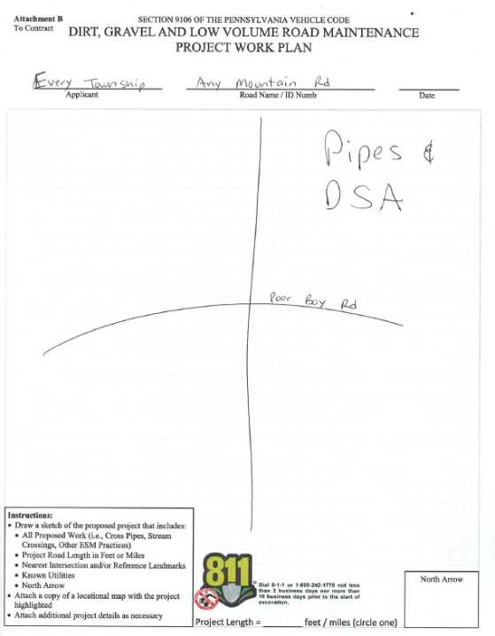
Reviewing Grant Applications
Notes:
This application is meant to be simple so that even new municipal officials are able to complete it
However, the project sketch still needs to be detailed enough to define the scope of work

Slide 27
Notes:
The sketch on the right will be a lot more helpful than the one on the left
The sketch needs to communicate what the project is to someone who’s never seen the site or talked about it

Slide 28
Check that App is Filled Out Correctly
Does the project sketch adequate detail to convey the project?
Length and width of proposed project
Correct location on the road
Project features
cross pipes, French mattress, ditch reshaping, road fill, etc.
3 dimensions for all project features
Materials notes
Streams
Landmarks (big tree, fence, utility, mailbox, house, etc.)
Property lines
Notes:
Good sketches do not need to be to scale, but should show approximate location size and shape of important features
If there are intersections or noticeable turns in roads, including them in the sketch is helpful
Remember that all project features need to be included and described
3 dimensions are needed
This includes pipe length, not just diameter or width and height
This includes depth, widths, and heights
List what type of aggregates, pipes, geotextile fabrics, headwall/endwalls materials, etc.
Show location of stream or direction to the stream
Landmarks can be very helpful in determining where project features are supposed to be installed
If there’s off ROW work, it can also be helpful to show the right of way boundaries as well as which properties are included
Make sure enough information is included so that you can check that their quantities are reasonable and that the sketch provides clear direction to whoever is building the project
Remember, the grant application is the only part of the DGLVR contract that specifies what the grant will be spent on

Slide 29
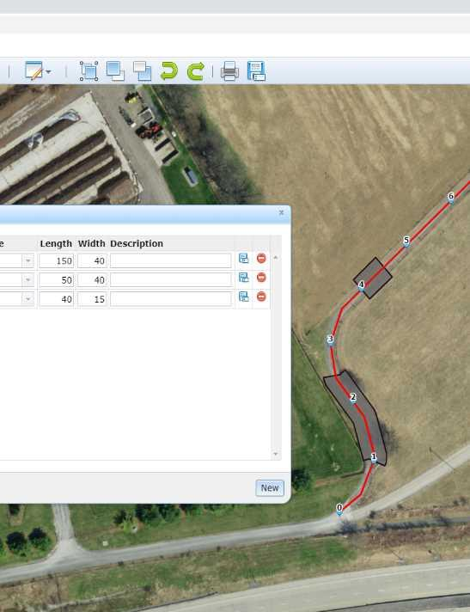
Check that App is Filled Out Correctly
GIS Project Sketch Tool
CDGRS has been working to develop updated project sketch capability in the GIS
Currently being tested and will be available to districts soon
Includes:
Draw on map to scale
Stationing
Standardized practices (pipe, underdrain, etc.)
Can print and attach to grant app
Notes:
The Center is working with a developer to update the drawing tools in the DGLVR GIS.
The updates are currently being tested and will be available to conservation districts soon
Eventually these drawing tools will be made available to grant applicants directly through the public GIS viewer as well

Slide 30
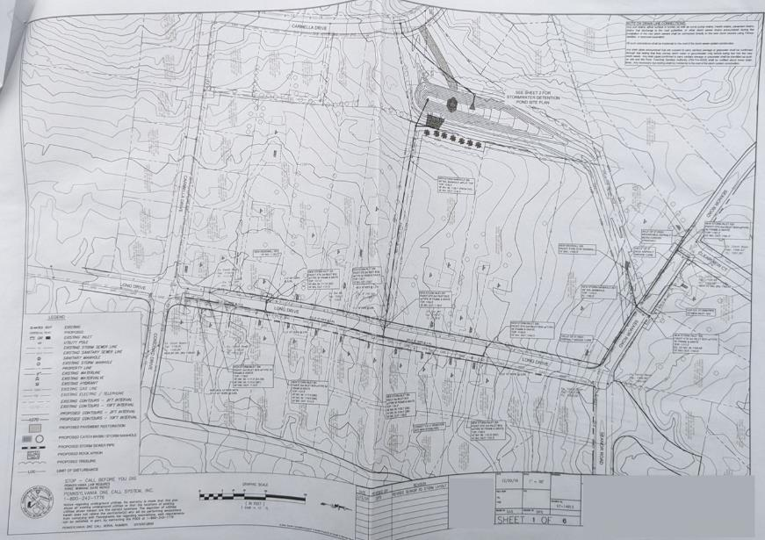
Reviewing Grant Applications
Check that App is Filled Out Correctly
Engineered drawings are not required for the DGLVR grant application, but can be included
Notes:
Engineered drawings are not required for grant applications, but can be included if available
Remember that engineering costs incurred before DGLVR contracts are signed are not eligible for reimbursement with DGLVR funds

Slide 31
Reviewing Grant Applications
Check that App is Filled Out Correctly
DGLVR Program Grant Application Form
Project Sketch
Local Requirements?
In Kind
Traffic count submitted with App
Etc.
Cost Estimate
Location Map
Was anything left out of the cost estimate?
Is the math correct?
Work Area

Slide 32
x
x
x
x
x
x
DSA: $10,000
Pipes: $20,000
Etc.…
Township labor to install project: $3,590
$24,775.00
$3,590.00
2/1/2023
$28,365.00
Notes:
The grant application includes a spot for the cost estimate
This may be sufficient for small projects, but often additional space is needed and the cost estimate is attached

Slide 33
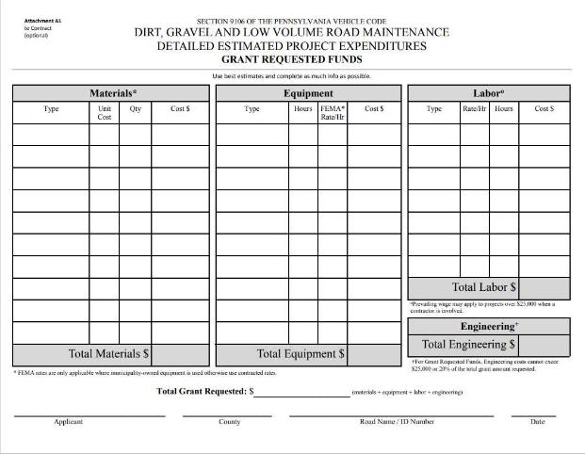
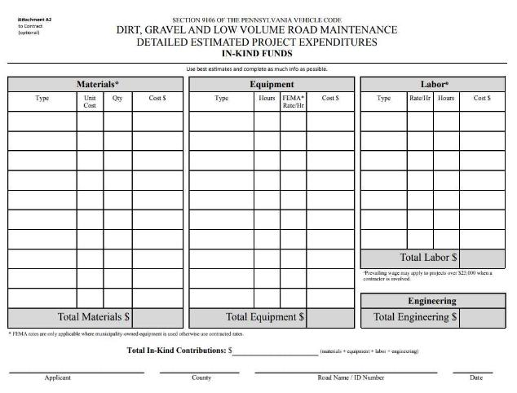
Reviewing Grant Applications
Check that App is Filled Out Correctly
Notes:
2 versions of this attachment are included to detail what the grant funds will pay for and what the applicant will pay for in-kind, or what the applicant plans to pay for with non-DGLVR funding
Both grant and in-kind expenses do need to be estimated for the application

Slide 34
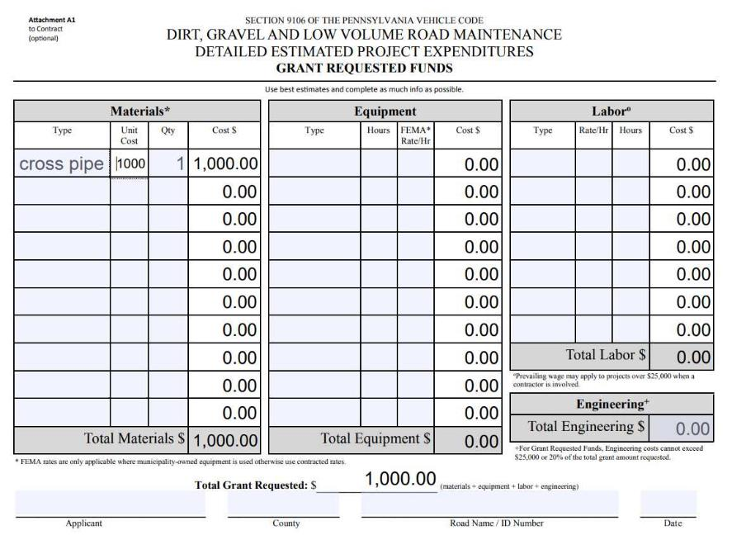
Check that App is Filled Out Correctly
Reviewing Grant Applications
Do the cost estimate and project sketch match?
Is anything that you discussed with the applicant missing from the application?
Notes:
Some of these details might be on the project sketch, which is okay. There’s limited room on the grant estimate for those details.
If the details are not on the sketch, cost estimate, or any other part of the grant application, make sure it gets added.

Slide 35
Check that App is Filled Out Correctly
If the sketch doesn’t match the cost estimate, then something is wrong!
Example: Sketch shows 3 cross pipes and cost estimate shows 1 cross pipe.
Did the applicant forget 2 of the pipes on the cost estimate?
Is the sketch wrong and only 1 pipe is part of the project?
Are both correct and a note is missing?
Maybe 2 of the pipes are existing and 1 new pipe is being installed being replaced?
Mark on the sketch which pipes are which

Slide 36
Reviewing Grant Applications
Check that App is Filled Out Correctly
Does the project plan include enough detail?
Notes:
Some of these details might be on the project sketch, which is okay. There’s limited room on the grant estimate for those details.
If the details are not on the sketch, cost estimate, or any other part of the grant application, make sure it gets added.

Slide 37
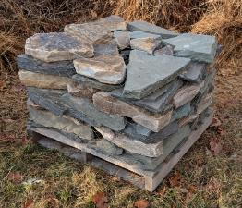
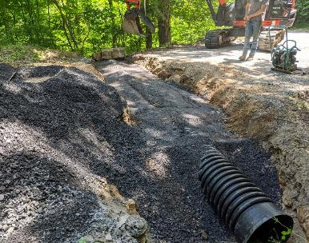
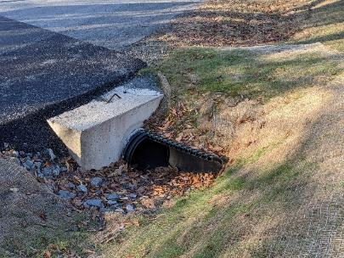
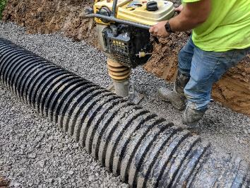
Make sure to budget for all project components
Reviewing Grant Applications
Check that App is Filled Out Correctly
Example: What do you need to install a cross pipe?
Pipe
Connector/grease
Headwalls and endwalls
Back fill
Equipment and labor
Compaction equipment
Backhoe/excavator
Skid loader?
Truck to haul waste material?
Notes:
Use ESM training materials and Tech Bulletins to help

Slide 38
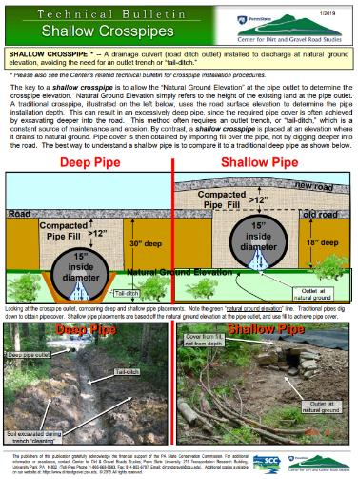
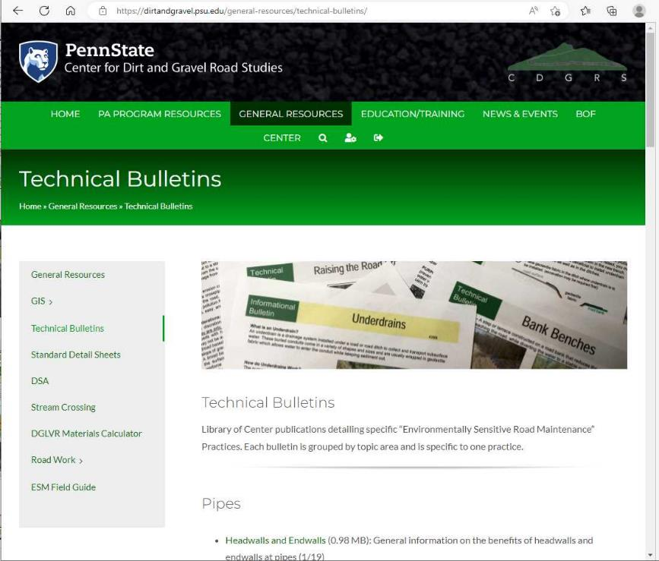
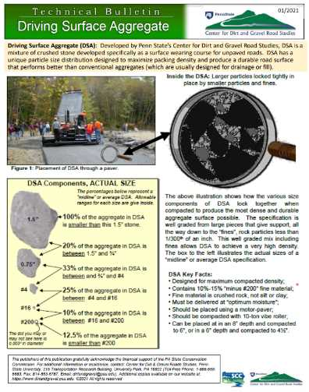
Reviewing Grant Applications
Check that App is Filled Out Correctly

Slide 39
Reviewing Grant Applications
Check that App is Filled Out Correctly
How long is the pipe?
What diameter is the pipe?
What is the pipe made out of?
Are backfill, headwalls, and endwalls budgeted for?
How much backfill is needed?
Who is installing the pipe?
What equipment is needed to install the pipe?
Are any of these in-kind?
Notes:
Some of these details might be on the project sketch, which is okay. There’s limited room on the grant estimate for those details.
If the details are not on the sketch, cost estimate, or any other part of the grant application, make sure it gets added.

Slide 40
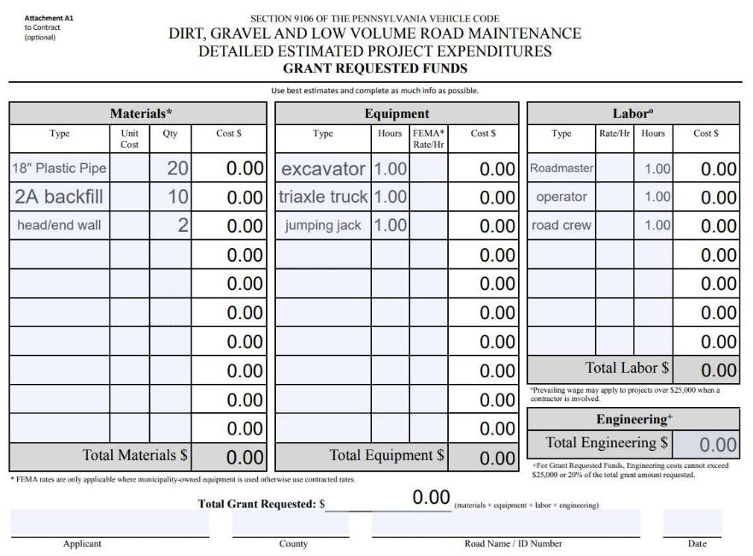
Reviewing Grant Applications
Check that App is Filled Out Correctly
Use your ESM, DGLVR, and construction knowledge to evaluate.
Most cross pipes are longer than 20 ft when installed on an angle
Is 1 hour enough time to install a cross pipe?
E&S Controls?
Check quantities using math

Slide 41
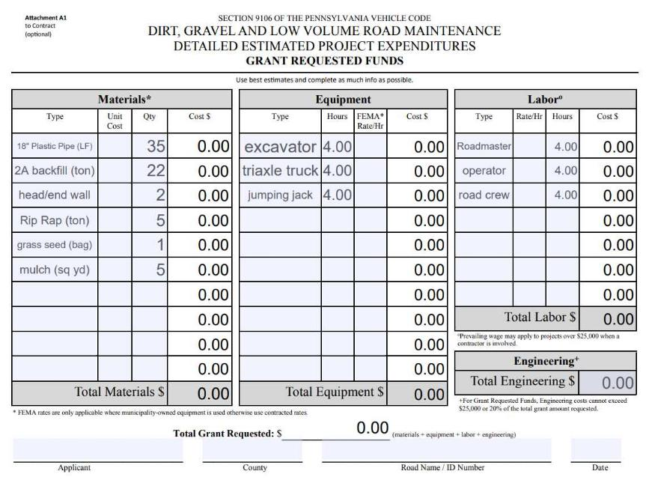
Don’t be afraid to ask for clarification or request updates to the grant application. Make a list of questions as you review and then call, email, and/or meet with the grant applicant.
Reviewing Grant Applications
Check that App is Filled Out Correctly

Slide 42
Materials Estimation
Reviewing Grant Applications
Check that App is Filled Out Correctly
Height or Depth
Width
Length

Slide 43
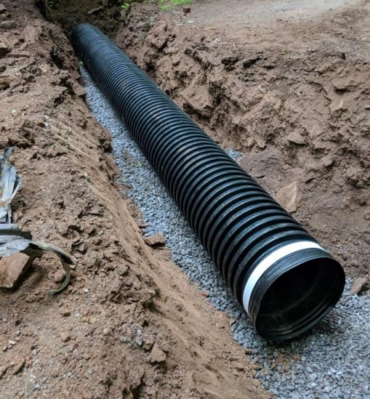
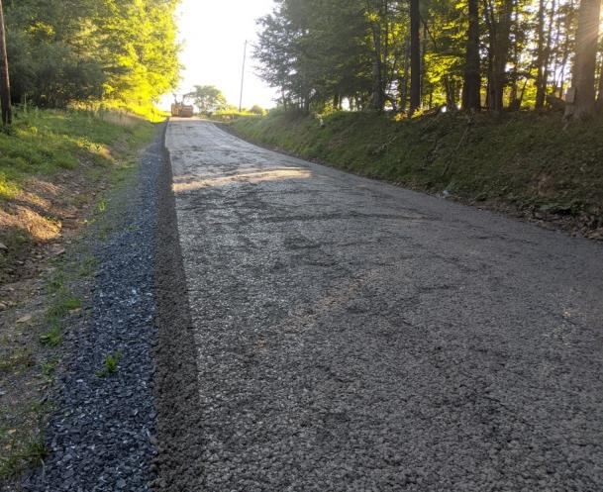
Materials Estimation
Reviewing Grant Applications
Check that App is Filled Out Correctly
Depth
Depth
Width
Length
Width
Width
Length
Volume (ft³) = Length (ft) x Width (ft) x Height (ft)
Depth
Length

Slide 44
DGLVR Grant Applications
Project Design
Materials Estimation Webinar
February 16, 2023
Recording available online
https://dirtandgravel.psu.edu/education-training/webinars/past-webinars/

Slide 45
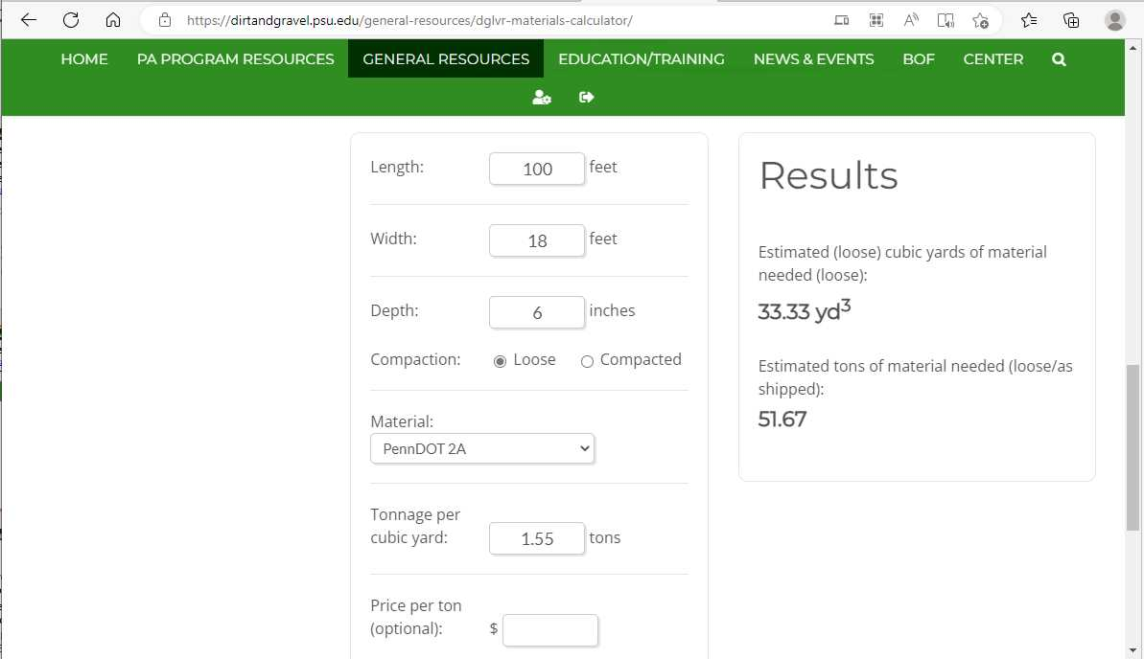
DGLVR Grant Applications
Project Design
Materials Calculator
https://dirtandgravel.psu.edu/general-resources/dglvr-materials-calculator/

Slide 46
Erosion and Sediment (E&S) Controls
Reviewing Grant Applications
Check that App is Filled Out Correctly
Prevent loose earth that is disturbed during construction from washing away
Best management practices to reduce erosion can include free practices:
Don’t work in the rain
Don’t leave disturbed earth if it’s going to rain over night/the next day
Fill/cover any trenches the same day you dig them
Complete stream work when the water flow is low

Slide 47
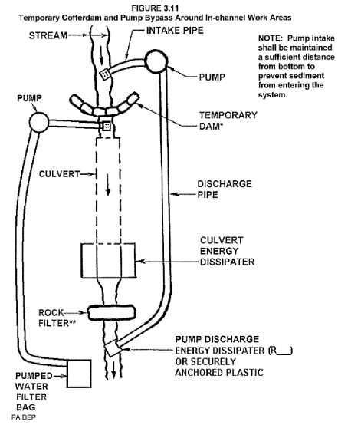
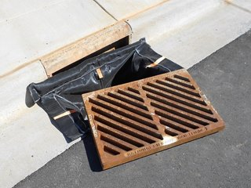
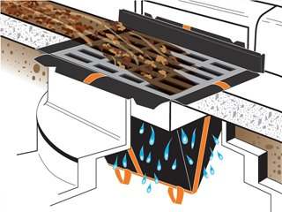
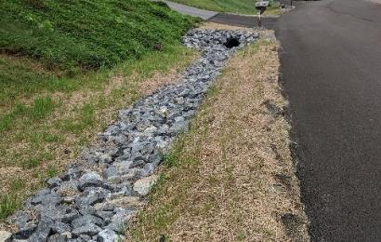
E&S Controls to budget for
Reviewing Grant Applications
Check that App is Filled Out Correctly
Erosion blanket
Water pump around system
Inlet Filter Bag
Grass seed and mulch

Slide 48
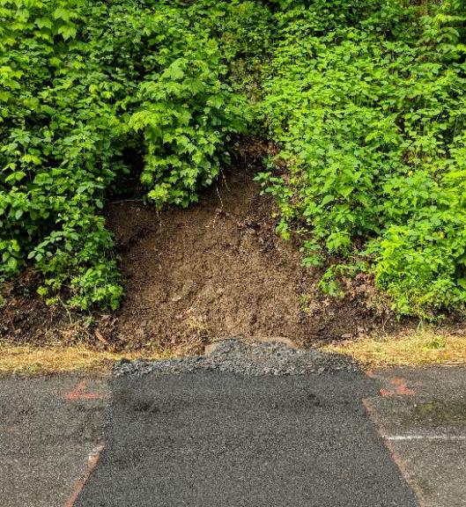
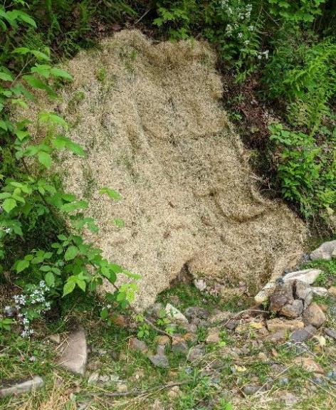
Reviewing Grant Applications
Check that App is Filled Out Correctly
ALWAYS seed and mulch

Slide 49
Check the Math
Reviewing Grant Applications
Check that App is Filled Out Correctly
Notes:
Even if all of the project components are included, the cost estimate could still be wrong if the math is done incorrectly.

Slide 50
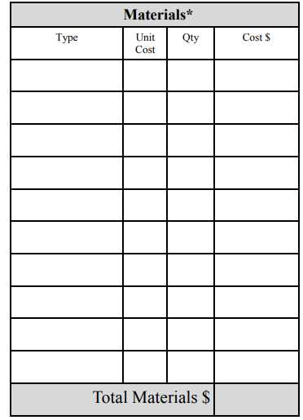
Reviewing Grant Applications
Check that App is Filled Out Correctly
x
=
DSA
$30/ton
800 tons
$240
$24,000
Notes:
Check the math
Multiple unit cost by quantity to make sure the cost is correct
Add up costs to make sure totals match

Slide 51
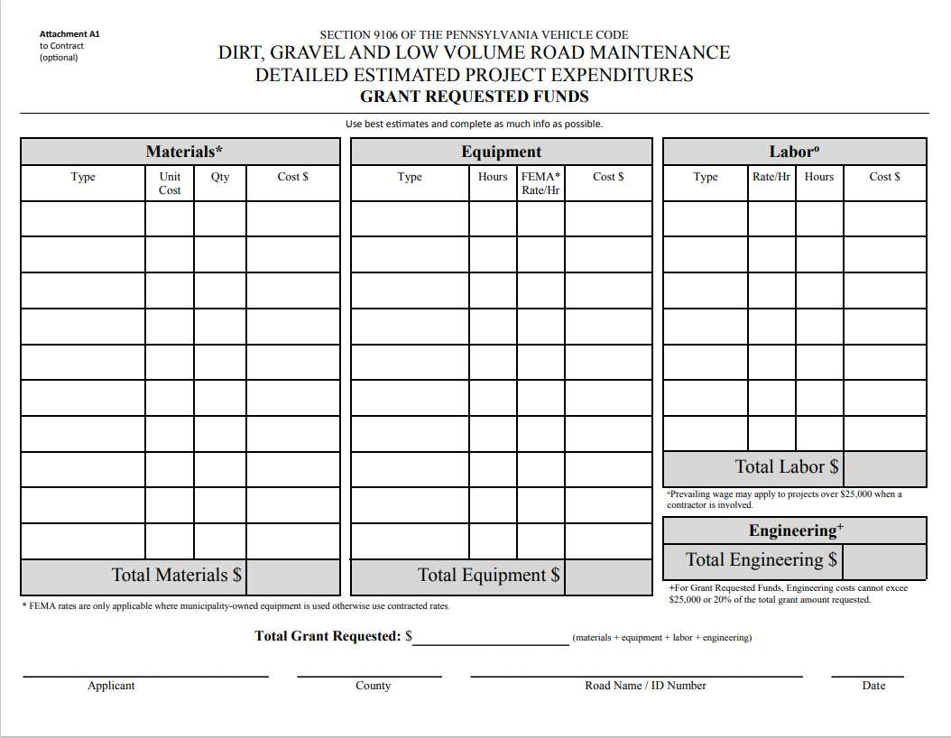
Notes:
Add up the materials, equipment, labor, and engineering cost to check that the total grant requested (or total in kind) is correct
Check this on the individual cost estimate sheets as well as the front of the grant application

Slide 52
x
x
x
x
x
x
See attached sheets
$24,775.00
$3,590.00
5/1/2021
$28,365.00
Notes:
Transfer the total grant, in-kind, and project costs from the attachments to the application

Slide 53
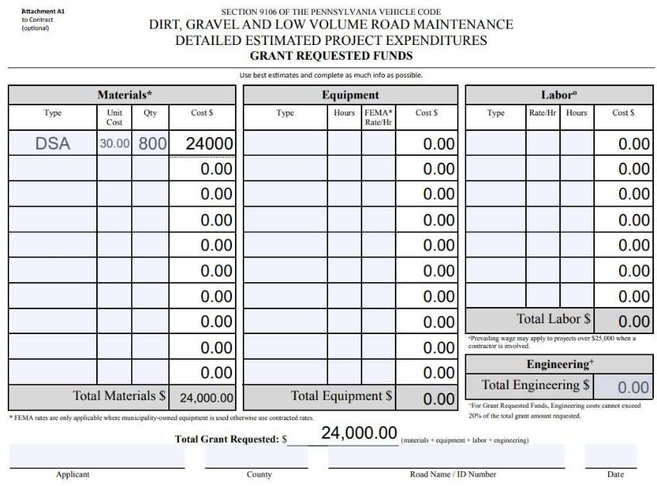
Reviewing Grant Applications
Check that App is Filled Out Correctly
The PDF grant application on the Center’s website does the math for you!
https://dirtandgravel.psu.edu/pa-program-resources/program-specific-resources/blank-forms/
Notes:
Checking math can be as simple as mental math or using a calculator
You can use a spreadsheet if you want
If you want to type something to document that you checked the math, consider using the fillable PDF from the Center’s website that is set up to do the math

Slide 54
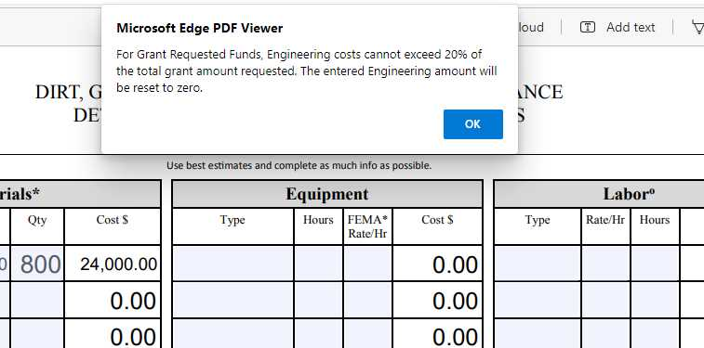
Reviewing Grant Applications
Check that App is Filled Out Correctly
Notes:
It will even check if your engineering total exceeds 20% of the grant total

Slide 55
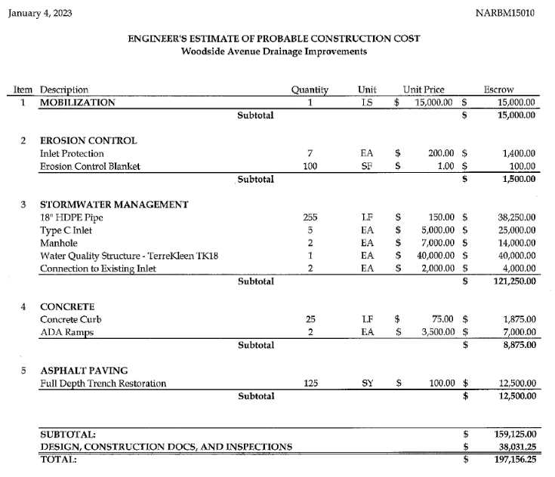
Reviewing Grant Applications
Check that App is Filled Out Correctly
A cost estimate prepared by an engineer or contractor can be attached to the grant application
Check that the grant applicant specified which costs the grant will pay for and which will be in-kind
Notes:
The attachments we just talked about are not the only acceptable cost estimate format
A cost estimate prepared by an engineer or contractor can also be attached to the grant application
It’s okay if these estimates are not broken down into materials, equipment, and labor
It’s not a bad idea to still check the math on these
Check to see if the grant applicant specified what the grant will pay for vs what will be in-kind expenses

Slide 56
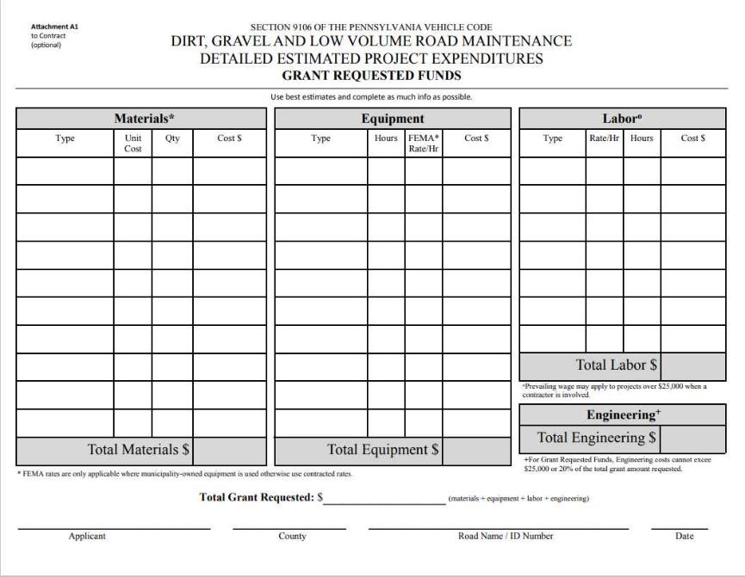
Reviewing Grant Applications
Check that App is Filled Out Correctly
Up to 20% of the grant (max $25k) can be used for engineering costs incurred AFTER a contract is signed
Anticipate cost increases by the time you go to construction
Don’t forget to budget for Prevailing Wage
Notes:
Check that labor costs account for prevailing wage rates if a contractor will be hired

Slide 57
Prevailing Wage
Reviewing Grant Applications
Check that App is Filled Out Correctly
DGLVR projects totaling $25,000 or more must pay prevailing wage to contracted labor

Slide 58
x
x
x
x
x
x
See attached sheets
$24,775.00
$3,590.00
5/1/2021
$28,365.00
Notes:
Transfer the total grant, in-kind, and project costs from the attachments to the application

Slide 59
How much does Prevailing Wage Cost?
Reviewing Grant Applications
Check that App is Filled Out Correctly
You can look up PW rate determinations in your area to estimate PW costs
Ask contractors for cost estimates at PW rates

Slide 60
Reviewing Grant Applications
Check that App is Filled Out Correctly
See “Frequently Asked Questions about Prevailing Wage Document” and recorded webinars
See recorded webinars from 2022
https://dirtandgravel.psu.edu/education-training/webinars/past-webinars/

Slide 61
Reviewing Grant Applications
Check that App is Filled Out Correctly
DGLVR Program Grant Application Form
Project Sketch
Local Requirements?
In Kind
Traffic count submitted with App
Etc.
Cost Estimate
Location Map
Work Area

Slide 62
DGLVR Grant Applications
Check that App is Filled Out Correctly
Additional requirements
Stream crossing eligibility form
Traffic count (before contract is signed)
Landowner permission (before working off ROW)
SCC permission for off ROW over 35% of total project cost or 500+ ft away from road
In-kind local requirement?
Notes:
These 3 documents are required at different points in project lifecycles
Districts can locally require these to be submitted with a grant application
Even if you don’t require the paperwork at the time a grant is submitted, these are things you should be thinking about for each grant application

Slide 63
DGLVR Grant Applications
Check that App is Filled Out Correctly
Traffic count for LVR Projects
Required before a contract is signed
Districts can require this during the application phase
Make sure it is filled out correctly
Make sure traffic count meets Admin Manual
March 1 – week before Thanksgiving
Avoid holidays
Level 1:Tues, Wed, or Thurs for 2 consecutive hours between 3-6 pm
Level 2: must be conducted for a minimum of 24 consecutive hours between 12 am Tues and 12 am Fri
Notes:
“Applicant is responsible for providing traffic counts before a contract can be signed.” (Admin Manual 7.5)
It may be beneficial to obtain this early in project planning or before the QAB meeting to make sure the site is eligible
Some conservation districts may require this to be submitted with the application
Pay attention to time restrictions on when traffic counts can be completed

Slide 64
Reviewing Grant Applications
Submitted Applications
When a conservation district receives an application:
Are you familiar with the site?
Are all required sections included?
Are the applicant, road, and project eligible?
Are all required sections filled out correctly?
Do you have all of the information needed to rank the application?
Is it a good project?
If any changes or clarifications are needed, reach out to the applicant ASAP

Slide 65
DGLVR Grant Applications
Ranking
Local ranking criteria:
Varies in each district, but may include:
environmental assessment that requires a site visit
Photos if the QAB cannot all visit the site
Watershed quality or impairment
Trout stream status (wild trout, naturally reproducing, etc.)
Amount or % of in-kind contribution
maintenance of applicant’s past DGLVR projects
Notes:
Every district has a unique ranking system
It is helpful to make sure before the QAB meeting that you have all of the information needed to rank each project
Review your local ranking criteria for more details

Slide 66
Reviewing Grant Applications
Submitted Applications
When a conservation district receives an application:
Are you familiar with the site?
Are all required sections included?
Are the applicant, road, and project eligible?
Are all required sections filled out correctly?
Do you have all of the information needed to rank the application?
Is it a good project?
If any changes or clarifications are needed, reach out to the applicant ASAP

Slide 67
Evaluate the Project
Does the project plan fix the road issues AND erosion/water quality issues?
Are ESM practices used?
Spread out water
Slow down water
Infiltrate water
Disconnect road drainage from stream
Are new outlets being added?
Is sheet flow being achieved?
Are all outlets and conveyances (ditch, swale, etc.) proposed to be stabilized?
Vegetation
Rock lining

Slide 68
Reviewing Grant Applications
Evaluate the Project
Surface drainage patterns
Tributary stream
Sub-surface drainage patterns
DRAFT for comment 12/10/2021. This has not been approved by the SCC.
Notes:
Remember DGLVR Program goals when looking at potential projects

Slide 69
Reviewing Grant Applications
Evaluate the Project
Surface drainage patterns
Tributary stream
Sub-surface drainage patterns
DRAFT for comment 12/10/2021. This has not been approved by the SCC.
Notes:
Make sure the proposed project uses ESM practices to improve the road and water quality

Slide 70
Reviewing Grant Applications
Evaluate the Project
Does the project meet DGLVR Policy?
All drainage and base issues addressed before placing DSA?
Do cross pipes have headwalls and endwalls?
Full Depth Reclamation design done by 3rd party and CDGRS notified?
Channels with bed and banks flowing into the road or uphill ditch treated as streams?
Stream crossings follow Design and Installation Standard or Exemption form completed?
Notes:
In addition to making sure the project meets DGLVR Program goals, it must meet all policies
We already discussed eligibility requirements
Also consider any specific policies that apply to individual practices

Slide 71
Evaluate the Project
Just because you can do a project, doesn’t mean you should
If ESM practices are not proposed
Minimal environmental benefits
If landowner restraints prevent an effective project
Project size/scope is too large
Do you have better projects?
It’s okay to walk away from projects that are not a good fit for the DGLVR Program – even if they are eligible
Local policies and ranking criteria can help you prioritize good projects

Slide 72
Road ditch with insufficient outlets
Notes:
If insufficient ditch outlets are proposed, walk away from the project

Slide 73
Road ditch with insufficient outlets
Notes:
If insufficient ditch outlets are proposed, walk away from the project

Slide 74
Reviewing Grant Applications
Evaluate the Project
The QAB can make changes to a grant application
Districts can work with grant applicants to update application before it goes to the QAB

Slide 75
Reviewing Grant Applications
Evaluate the Project
Additions to the grant application?
Technical Bulletins
Standard ESM Practice sketches
Technical Assistance Write Ups
Additional Design Details
See recorded webinar for more ideas!

Slide 76
Why talk about grant applications?
DGLVR Grant Applications
It’s important that DGLVR grant applications are thorough, detailed, and filled out correctly.
To prevent misunderstandings
Notes:
This program focuses on simplicity and minimal paperwork, but we still want to write down enough to make sure everyone understands what the project is

Slide 77
Reviewing Grant Applications
Submitted Applications
Sherri Law
shlaw@pa.gov
223-666-25767 or
717-480-2303
County Conservation District
Quality Assurance Board
Grant Application
Project Implementation
Engineering, Permitting, Bidding, Construction, completion paperwork, final payment
Conservation District Board
County Conservation District
Contract
Notes:
A good grant application and project plan will make project implementation go more smoothly
Project implementation can include engineering, permitting, and bidding
Projects always include construction, completion paperwork, and final payment
Despite the variety in project implementation, one constant is that there will be multiple parties to work with and get on the same page. A clear project plan helps prevent miscommunications

