Slide 1
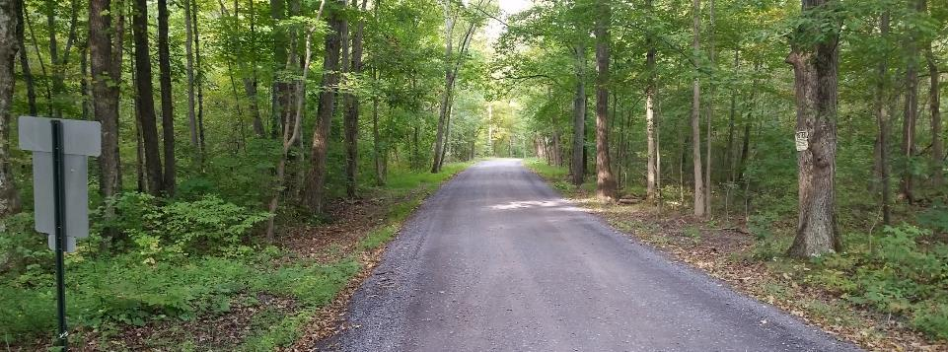
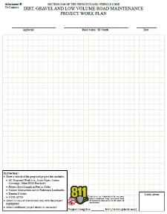
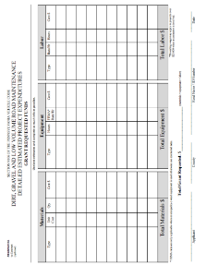
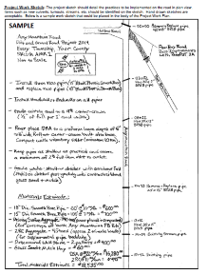
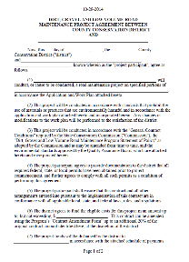
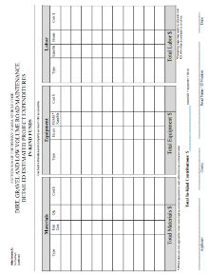
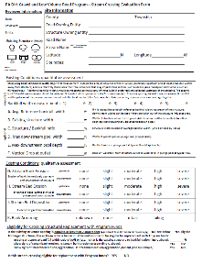
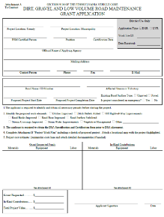
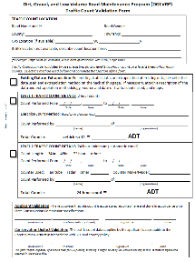
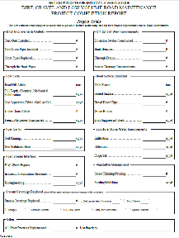
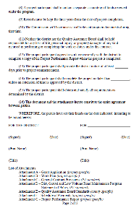
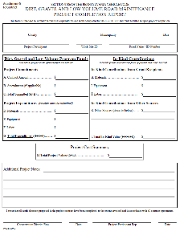
Dirt, Gravel, and Low Volume Road Maintenance Program
Administrative Training
January 2021
If you are reading this, then you are successfully seeing the meeting video. Meeting audio should be automatic through your computer, and options can be accessed in the “audio options” button on the bottom left. If your computer audio is not working, you can listen on your phone by dialing 312-626-6799 (only needed if computer audio is not possible).
Audio via Phone if needed: 312-626-6799
Webinar ID: 952 8609 6347

Slide 2
Logistics and Introductions
Roy Richardson - SCC
Justin Challenger – SCC
Sherri Law - SCC
Steve Bloser - PSU
www.dirtandgravelroads.org
Audio via Phone if needed: 312-626-6799
Webinar ID: 952 8609 6347
Audio via Phone: 669-900-6833
2
Audio via Phone: 669-900-6833

Slide 3
Zoom Logistics
Top of your screen:
Viewing options
Get out of full screen mode, etc.
Your buttons will look different, just look for the lime green tab
Audio via Phone if needed: 312-626-6799
Webinar ID: 952 8609 6347

Slide 4
Zoom Logistics
Bottom of your screen:
Zoom Controls
Your buttons will look different, just look for the lime green tab
Audio via Phone if needed: 312-626-6799
Webinar ID: 952 8609 6347

Slide 5
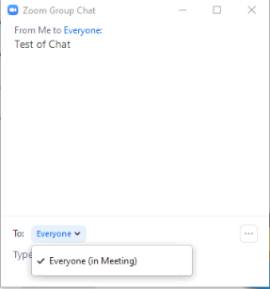
Zoom Logistics
You are muted by default.
Three options to communicate:
Chat: text chat with panelists and/or attendees
Roy\Justin\Steve

Slide 6
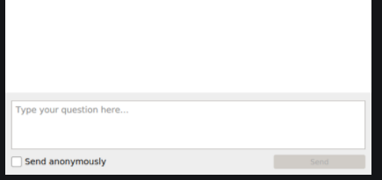
Zoom Logistics
You are muted by default.
Three options to communicate:
Chat: text chat with panelists and/or attendees
Q&A: Ask questions to panelists (can be anonymous)
Roy\Justin\Steve
Audio via Phone if needed: 312-626-6799
Webinar ID: 952 8609 6347

Slide 7
Zoom Logistics
You are muted by default.
Three options to communicate:
Chat: text chat with panelists and/or attendees
Q&A: Ask questions to panelists
Raise Hand: We will assume you wish to speak and unmute you
Audio via Phone if needed: 312-626-6799
Webinar ID: 952 8609 6347

Slide 8
Polls
We will be using Zoom polls to ask various questions during the training.
Will share all results live
All polls are set to allow anonymous answers
You must answer poll questions – you don’t have to answer correctly, but if you don’t answer 70%, you don’t get a certification
Audio via Phone if needed: 312-626-6799
Webinar ID: 952 8609 6347

Slide 9
Admin Training Schedule
Today
Will take 1-2 breaks
This is the full DGLVR admin training, not a shortened refresher.
Logistical questions?
Let’s Get Started
PLEASE ASK QUESTIONS
Audio via Phone if needed: 312-626-6799
Webinar ID: 952 8609 6347

Slide 10
Dirt, Gravel, and Low Volume Road Maintenance Program
Administrative Training
January 2022
RECORD

Slide 11
Roy

Slide 12
Dirt, Gravel, and Low Volume Road Maintenance Program
Administrative Training
January 2022

Slide 13
Administrative Training
Introduction
Steve Bloser
CENTER Director
PSU Center for Dirt and Gravel Roads
smb201@psu.edu
814-865-5355
Roy Richardson
PROGRAM Coordinator
State Conservation Commission
Pa Department of Agriculture
rrichardso@pa.gov
717-787-2013
Justin Challenger
State Conservation Commission
Pa Department of Agriculture
jchallenge@pa.gov
717-787-4187
Sherri Law
State Conservation Commission
Pa Department of Agriculture
shlaw@pa.gov
223 – 666 – 2567 / Cell: 717-480-2303

Slide 14
Administrative Training
Introduction
Goals today:
Provide guidance for Districts to run their Program.
Clear up “grey areas” in existing Program.
Outline new topics.

Slide 15
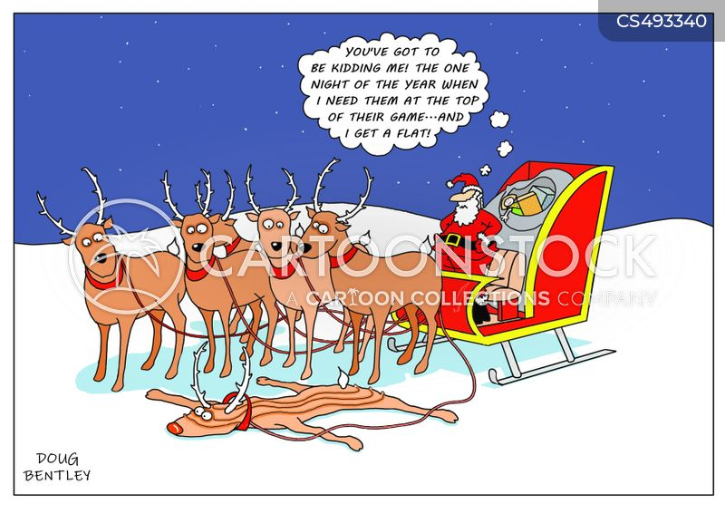
Funny Slide
Sleigh Cartoons and Comics - funny pictures from CartoonStock
https://www.cartoonstock.com/directory/s/sleigh.asp

Slide 16
Administrative Training
Introduction
Program Fundamentals
Focus on environmental and road improvement projects
Local control
Conservation District runs local Program
Quality Assurance Boards at County
State guidance and local policies
Application and Grant Process, 90%+ of applicants are townships.

Slide 17
Administrative Training
Introduction
What do we mean by “Local Control”?

Slide 18
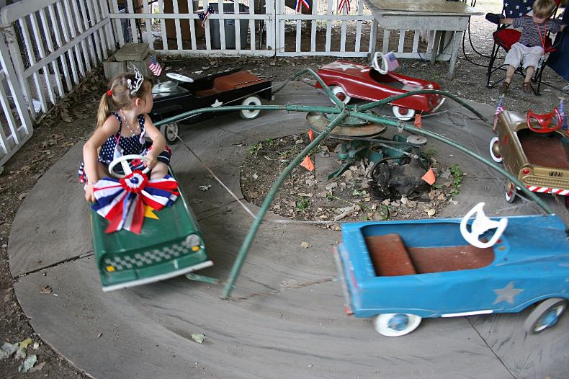
Administrative Training
Introduction
What do we mean by “Local Control”?
0% Local Control
Administrative Training

Slide 19
Administrative Training
Introduction
What do we mean by “Local Control”?
100% Local Control

Slide 20
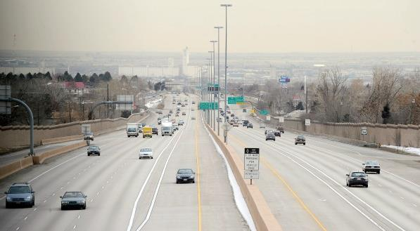
Administrative Training
Introduction
What do we mean by “Local Control”?
Effective local control
“lanes and guiderails”

Slide 21
Administrative Training
Introduction
Overall balancing act
Need for Increased Accountability
Simplicity and Local Control
D&G

Slide 22
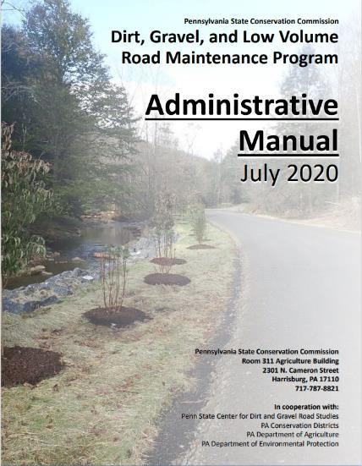
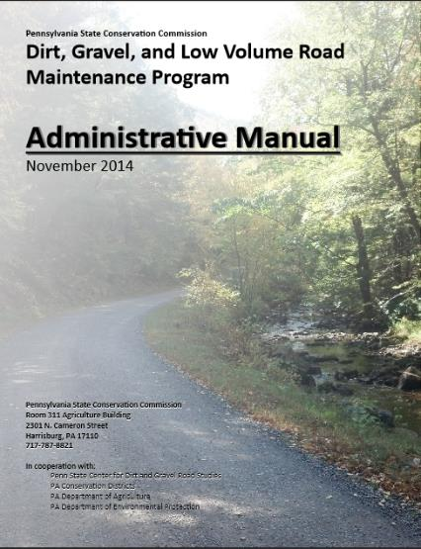
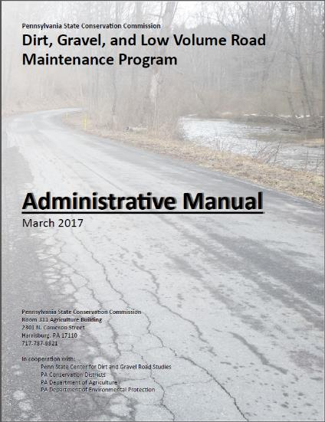
Administrative Manual
Introduction
DG&LVR Administrative Manual
Approved by SCC 3/14/17
Introduction
SCC Role
Conservation District Role
Quality Assurance Board Role
Applicant Role
Center for Dirt and Gravel Roads
Additional Policies
Permits and Other Requirements
Appendices
Available online.
Hard copies sent on request.
Training Follows Manual!

Slide 23
Administrative Manual
Introduction
DG&LVR Administrative Manual
Approved by SCC 3/14/17
Introduction
SCC Role
Conservation District Role
Quality Assurance Board Role
Applicant Role
Center for Dirt and Gravel Roads
Additional Policies
Permits and Other Requirements
Appendices
Available online.
Hard copies sent on request.
Introduction
6-page “Abstract” of the Program and the rest of the manual.
Program Structure
Program History
ESM Overview
Training Follows Manual!

Slide 24
Administrative Manual
Introduction
DG&LVR Administrative Manual
Approved by SCC 3/14/17
Introduction
SCC Role
Conservation District Role
Quality Assurance Board Role
Applicant Role
Center for Dirt and Gravel Roads
Additional Policies
Permits and Other Requirements
Appendices
Available online.
Hard copies sent on request.
SCC Role
4-page summary of SCC role
SCC Structure
Program Administration
QAQC
Training Follows Manual!

Slide 25
Administrative Manual
Introduction
DG&LVR Administrative Manual
Approved by SCC 3/14/17
Introduction
SCC Role
Conservation District Role
Quality Assurance Board Role
Applicant Role
Center for Dirt and Gravel Roads
Additional Policies
Permits and Other Requirements
Appendices
Available online.
Hard copies sent on request.
3) District Role
Over ½ of manual
Receiving Funds
Accounting for Funds
Dispersing Funds to Grantees
CD Educational Opportunities
Program Eligibility
3.8 Administering Projects
GIS system
Annual Reports
Training Follows Manual!

Slide 26
Administrative Manual
Introduction
DG&LVR Administrative Manual
Approved by SCC 3/14/17
Introduction
SCC Role
Conservation District Role
Quality Assurance Board Role
Applicant Role
Center for Dirt and Gravel Roads
Additional Policies
Permits and Other Requirements
Appendices
Available online.
Hard copies sent on request.
4) QAB Role
Defines composition and function of QAB
Composition
Meeting Requirements
QAB Role in Projects
QAB Role in Policy
Training Follows Manual!

Slide 27
Administrative Manual
Introduction
DG&LVR Administrative Manual
Approved by SCC 3/14/17
Introduction
SCC Role
Conservation District Role
Quality Assurance Board Role
Applicant Role
Center for Dirt and Gravel Roads
Additional Policies
Permits and Other Requirements
Appendices
Available online.
Hard copies sent on request.
5) Applicant Role
Intentionally repeats previous material
Written “to” the applicant audience
Intended to be standalone to give to applicants.
Training Follows Manual!

Slide 28
Administrative Manual
Introduction
DG&LVR Administrative Manual
Approved by SCC 3/14/17
Introduction
SCC Role
Conservation District Role
Quality Assurance Board Role
Applicant Role
Center for Dirt and Gravel Roads
Additional Policies
Permits and Other Requirements
Appendices
Available online.
Hard copies sent on request.
6) Center Role
3-page overview of Center role and available services
Education
Outreach
Technical Assistance
Documentation
Training Follows Manual!

Slide 29
Administrative Manual
Introduction
DG&LVR Administrative Manual
Approved by SCC 3/14/17
Introduction
SCC Role
Conservation District Role
Quality Assurance Board Role
Applicant Role
Center for Dirt and Gravel Roads
Additional Policies
Permits and Other Requirements
Appendices
Available online.
Hard copies sent on request.
7) Additional Policies
Policies that apply to certain circumstances:
Stream Crossing Replacement
Driving Surface Aggregate
Paved LVR-Specific Policies
Full Depth Reclamation
Training Follows Manual!

Slide 30
Administrative Manual
Introduction
DG&LVR Administrative Manual
Approved by SCC 3/14/17
Introduction
SCC Role
Conservation District Role
Quality Assurance Board Role
Applicant Role
Center for Dirt and Gravel Roads
Additional Policies
Permits and Other Requirements
Appendices
Available online.
Hard copies sent on request.
8) Permits
Brief overview of permit issues related to Program projects.
Training Follows Manual!

Slide 31
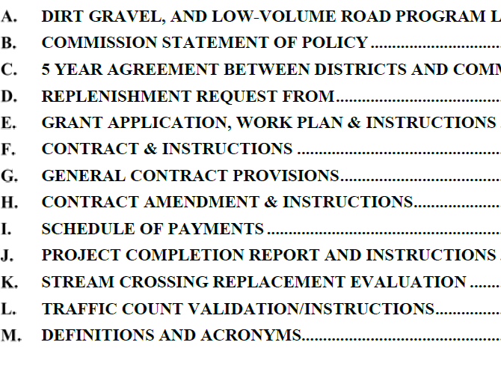
Administrative Manual
Introduction
DG&LVR Administrative Manual
Approved by SCC 3/14/17
Introduction
SCC Role
Conservation District Role
Quality Assurance Board Role
Applicant Role
Center for Dirt and Gravel Roads
Additional Policies
Permits and Other Requirements
Appendices
Available online.
Hard copies sent on request.
Appendices
Program forms and policies…
Training Follows Manual!

Slide 32
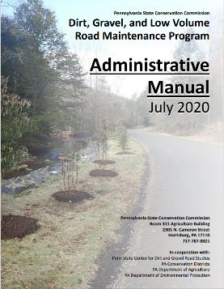
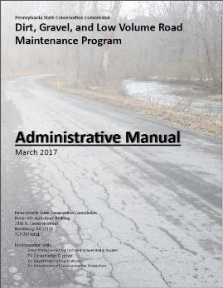
Administrative Manual
Introduction
SCC Role
Conservation District Role
Quality Assurance Board
Applicant Role
Center for Dirt and Gravel Roads
Additional Policies
Permits and Other Requirements
Appendices

Slide 33
Introduction
Chap 1. Intro
Introduction Contents
Overview of Program and rest of manual
Brief Program history
Explanation of Worksites
Brief Explanation of Environmentally Sensitive Maintenance practices

Slide 34
Introduction
Chap 1. Intro
Introduction Contents
Overview of Program and rest of manual
Brief Program history
Explanation of Worksites
Explanation of ESM practices
Note manual section and title on top of slide. Follow along or take notes in manual.

Slide 35
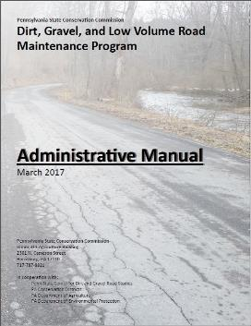
Administrative Manual
Introduction
SCC Role
Conservation District Role
Quality Assurance Board
Applicant Role
Center for Dirt and Gravel Roads
Additional Policies
Permits and Other Requirements
Appendices

Slide 36
2) State Conservation Commission
Chap 2. SCC
SCC
14-member board in PA Department of Agriculture
Karl Brown: Executive Secretary
Roy Richardson: DGLVR Program Coordinator
Justin Challenger: DGLVR Staff
Sherri Law: DGLVR Staff

Slide 37
2) State Conservation Commission
Chap 2. SCC
SCC Role
SCC Structure
Program Coordinator
Allocations
Replenishments
Establishing Policy
Quality Assurance / Quality Control

Slide 38
2) State Conservation Commission
Chap 2. SCC
Quality Assurance / Quality Control (QAQC)
2-3 day visit to review county Program.
Administration, Functionality, Projects.
Involves SCC, Center, and Field Reps.
Planning to visit ~22 districts annually.
Complete details on website www.dirtandgravelroads.org

Slide 39
2) State Conservation Commission
Chap 2. SCC
QAQC Round 1:
Every County visited 2003-2011
QAQC Round 2:
Every County visited 2015-2017
QAQC Round 3:
Every County visited 2018-2020
QAQC Round 4:
Began 2021
22 completed

Slide 40
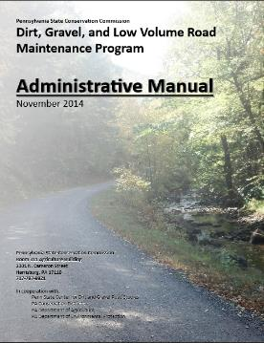
Administrative Manual
Introduction
SCC Role
Conservation District Role
Quality Assurance Board
Applicant Role
Center for Dirt and Gravel Roads
Additional Policies
Permits and Other Requirements
Appendices

Slide 41
3) Conservation District Role
Chap 3. CD Role
District Role:
Run the Program within each County.
Receive $ from SCC
Provide grants to applicants

Slide 42
SHERRI

Slide 43
3) CD Role
Chap 3. CD Role
3.1 CD Structure
3.2 Overview
3.3 Receiving Funds from SCC
3.4 Accounting of funds at CD
3.5 Dispersing funds to Grant Recipients
3.6 CD Educational opportunities
3.7 Program Eligibility
3.8 Administering Projects
3.9 GIS System
3.10Annual Summary Reports
Topic List:
follow the money

Slide 44
3) CD Role
Chap 3. CD Role
3.1 CD Structure
3.2 Overview
3.3 Receiving Funds from SCC
3.4 Accounting of funds at CD
3.5 Dispersing funds to Grant Recipients
3.6 CD Educational opportunities
3.7 Program Eligibility
3.8 Administering Projects
3.9 GIS System
3.10Annual Summary Reports

Slide 45
3.3 Receiving Funds from SCC
Chap 3. CD Role
Receiving Funds from SCC
5-year agreement (FY 2018-19 is year 1)
Timeline for allocations
Approved by SCC in May
Approved in State Budget for July 1
Advances received by CDs in September
Allocations are formula based on:
DGR: miles of unpaved roads and worksites and proximity to streams
LVR: miles of urban and non-urban roads and proximity to streams
Complete details: www.dirtandgravelroads.org

Slide 46
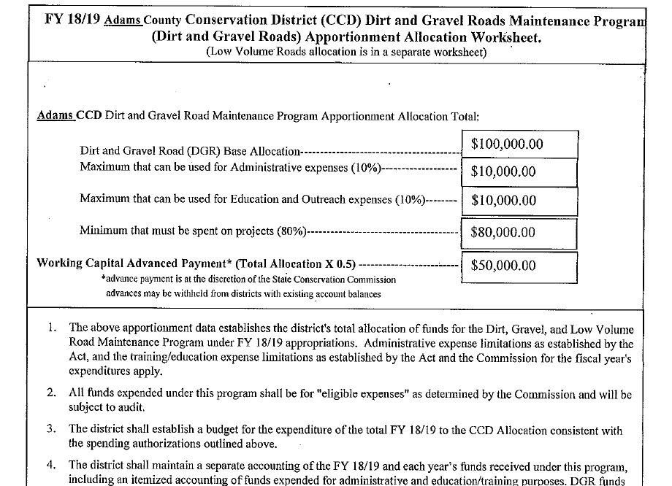
3.3.2-3: Advanced Working Capital
Chap 3. CD Role
Advanced Working Capital
50% of allocations advanced to districts
Will come as separate deposits (DGR and LVR)
Allocation worksheet explains breakdowns

Slide 47
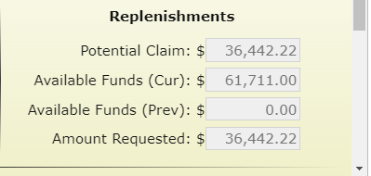
Replenishment
Chap 3. CD Role
Districts receive replenishments of remaining 50% of funds based on actual spending
Replenishments handled in GIS quarterly reporting system
Automatically generated each quarter
DGR and LVR replenishment will come in separate deposits

Slide 48
Chap 3. CD Role
DGLVR funds will be direct deposited into each conservation district’s account
Required by PA State Treasury
Separate deposits for DGR and LVR
SCC is sharing district feedback on this change with Vendor Services

Slide 49
3.3.4: Spending Requirements
Chap 3. CD Role
Spending Requirements
DGR and LVR spending tracked separately.
All funds must be spent within two years of state budget approval to be eligible for future allocations.
If a District misses a year, can be eligible in future years if they meet future requirements.

Slide 50
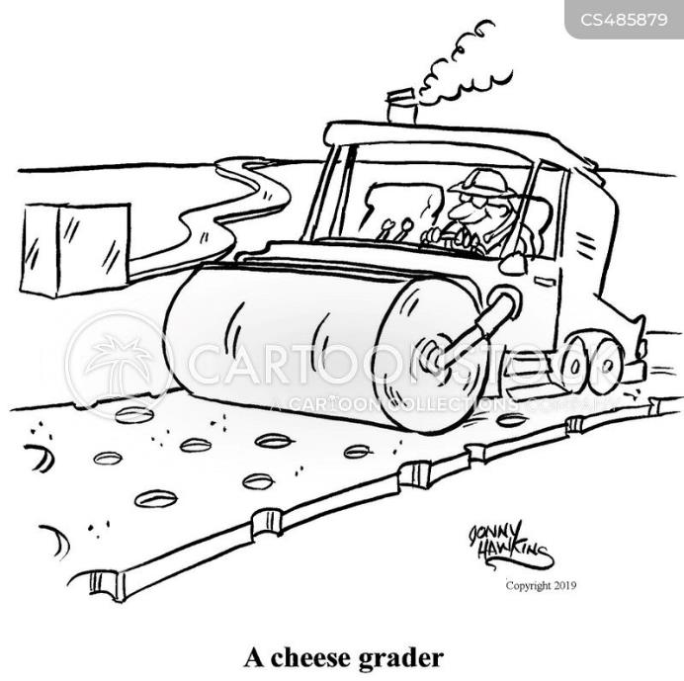
Funny Slide
https://www.cartoonstock.com/directory/c/cheese_grader.asp

Slide 51
3) CD Role
Chap 3. CD Role
3.1 CD Structure
3.2 Overview
3.3 Receiving Funds from SCC
3.4 Accounting of funds at CD
3.5 Dispersing funds to Grant Recipients
3.6 CD Educational opportunities
3.7 Program Eligibility
3.8 Administering Projects
3.9 GIS System
3.10Annual Summary Reports

Slide 52
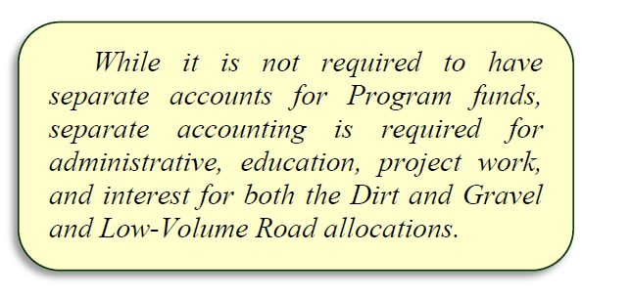
3.4.1: Separate Accounting
Chap 3. CD Role

Slide 53
3.4.1: Separate Accounting
Chap 3. CD Role
Separate Accounting:
Districts are required to track funding based on the following categories:
DGR
Administration
Education / Training
Projects
Interest
LVR
Administration
Education / Training
Projects
Interest
District records relating to the DGLVR Program must be kept for a minimum of 7 years from the date of final payment on a project

Slide 54
3.4.2-4 CD Spending Categories
Chap 3. CD Role
District May Utilize:
Up to 10% for administration.
Up to 10% for education/training
At least 80% must be spent on projects.

Slide 55
3.4.2-4 CD Spending Categories
Chap 3. CD Role
Spending Deadlines:
Project funds must be spent within 2 years of state budget approval
2 year limit
Administration and Education Funds must be spent within the allotted fiscal year
1 year limit
Administration and Education/Training funds are automatically “rolled” into project funds after 1 year

Slide 56
3.4.2-4 CD Spending Categories
Chap 3. CD Role
DGLVR Allocation
Must be spent in 2 years
100% can be used for Projects

Slide 57
3.4.2-4 CD Spending Categories
Chap 3. CD Role
DGLVR Allocation
Available in the first year of an allocation
Max 10% can be Admin
Max 10% can be Edu
Minimum 80% Project funds

Slide 58
3.4.2-4 CD Spending Categories
Chap 3. CD Role
Can use less than 10% of allocation for admin and 10% for edu
DGLVR Allocation
Admin
Edu
Minimum 80% Project funds

Slide 59
3.4.2-4 CD Spending Categories
Chap 3. CD Role
DGLVR Allocation
Unused admin & edu allowance become project funds
Admin
Edu
Minimum 80% Project funds

Slide 60
3.4.2-4 CD Spending Categories
Chap 3. CD Role
All funds must be spent in 2 years
DGLVR Allocation
Admin
Edu
Minimum 80% Project funds

Slide 61
3.4.2-4: Separate Accounting
Chap 3. CD Role
Proper Utilization of Program Funds
Funds can be used for Projects, Admin, and Education/Training of the DGLVR Program only
Using program funds for equipment or expenses for another program is not permitted
Must use an appropriate cost allocation method for shared expenses

Slide 62
3.4.2-4 CD Spending Categories
Chap 3. CD Role
Cost Allocation Method:
Method for splitting shared costs proportionately between multiple programs
Must be utilized for shared district expenses, such as:
Vehicles
Rent
Office Supplies
Phone/Internet
Etc.
Must be available to the SCC upon request

Slide 63
3.4.2-4 CD Spending Categories
Chap 3. CD Role
Cost Allocation Method Example 1:
Using Full Time Equivalents (FTE)
Defined by the Federal Government Accountability office as:
“number of total hours worked divided by the maximum number of compensable hours in a full-time schedule”
Example
District has 10 Staff
1 staff spends 100% of their time on DGLVR and 1 staff spends 50% of their time on DGLVR
1.5 of the 10 FTE’s are funded by and actually spend that amount of time working on the program
Then 15% of general overhead expenses (utilities, rent, etc.) are eligible DGLVR Program expenses

Slide 64
3.4.2-4 CD Spending Categories
Chap 3. CD Role
Cost Allocation Method Example 1:
1.5 out of 10 FTEs spent on DGLVR
15% of overall staff time spent on DGLVR
How shared expenses are paid:
15% of shared expenses are eligible DGLVR expenses
85% of shared expenses are NOT eligible DGLVR expenses
85% of overall staff time NOT spent on DGLVR

Slide 65
3.4.2-4 CD Spending Categories
Chap 3. CD Role
Cost Allocation Method Example 1:
Example (continued)
1.5 out of 10 FTEs spent on DGLVR Program
Then 15% of general overhead expenses (utilities, rent, etc.) can be charged to DGLVR Program
Should be further sub-divided into DGR and LVR
75% of DGLVR time is spent on DGR
25% of DGLVR time is spent on LVR
So,
15% x 0.75 = 11.25% of shared expenses are eligible DGR expenses
15% x 0.25 = 3.75% of shared expenses are eligible LVR expenses

Slide 66
3.4.2-4 CD Spending Categories
Chap 3. CD Role
Cost Allocation Method Example 1:
1.5 out of 10 FTEs spent on DGLVR
15% of overall staff time spent on DGLVR
85% of overall staff time NOT spent on DGLVR

Slide 67
3.4.2-4 CD Spending Categories
Chap 3. CD Role
Cost Allocation Method Example 1:
1.5 out of 10 FTEs spent on DGLVR
¾ of DGLVR time is spent on DGR
11.25%
¼ of DGLVR time is spent on LVR
3.75%
How shared expenses are paid:
11.25% are eligible DGR expenses
3.75% are eligible LVR expenses
85% are NOT eligible DGLVR expenses
85% of overall staff time NOT spent on DGLVR

Slide 68
3.4.2-4 CD Spending Categories
Chap 3. CD Role
Cost Allocation Method Example 2:
Vehicle that is utilized equally by 4 programs
Total number of programs
District has 4 main programs
DGLVR
Watershed Specialist
E&S
Nutrient Management
Costs are shared equally among programs
Each program pays 25% of shared expenses

Slide 69
3.4.2-4 CD Spending Categories
Chap 3. CD Role
Cost Allocation Method Example 2:
Vehicle shared equally by 4 Programs
25% of use is for DGLVR activities
25% of use is for Other Program A
25% of use is for Other Program B
25% of use is for Other Program C

Slide 70
3.4.2-4 CD Spending Categories
Chap 3. CD Role
Cost Allocation Method Example 2 (FTE):
Vehicle shared equally by 4 Programs
How shared expenses are paid:
12.5% are eligible DGR expenses
12.5% are eligible LVR expenses
75% are NOT eligible DGLVR expenses
12.5% of use is for DGR
25% of use is for Other Program A
12.5% of use is for LVR
25% of use is for Other Program B
25% of use is for Other Program C

Slide 71
3.4.2-4 CD Spending Categories
Chap 3. CD Role
Cost Allocation Method Example 3:
Expenses used unequally by multiple programs.
District has a truck that is used primarily for E&S, but also used for DGLVR
In this case, vehicle expenses must be based on actual usage for each program

Slide 72
3.4.2-4 CD Spending Categories
Chap 3. CD Role
Cost Allocation Method Example 2 (FTE):
Vehicle shared unequally by multiple programs
5% of use is for DGR
8% of use is for LVR
How shared expenses are paid:
5% are eligible DGR expenses
8% are eligible LVR expenses
88% are NOT eligible DGLVR expenses
87% of use is for Other Program(s)

Slide 73
3.4.2-4 CD Spending Categories
Chap 3. CD Role
Unacceptable Expenses / Cost Allocation Methods:
District utilizes only DGLVR program funds to purchase a vehicle and pay for vehicle expenses, but the vehicle is shared by all district programs
District technician spends 5% of their time on DGR and 3% of their time on LVR, but 50% of their salary and overhead expenses are paid for with DGLVR funds
District utilizes solely DGLVR funds to pay for their newsletter about all district programs

Slide 74
3.4.2-4 CD Spending Categories
Chap 3. CD Role
Spending Policies
https://www.istockphoto.com/illustrations/money-falling

Slide 75
3.4.2: Administrative Funds
Chap 3. CD Role
Guidelines for Administrative Funds
Up to 10% of allocations of Both DGR and LVR
Up to 100% of funds can be used on projects!
Primary purpose of Admin Funds is:
Assure adequate funding for technical staff who work on the Program
Must be spent on eligible expenses as they are incurred.
Must be incurred within the allotted fiscal year (1 year spending limit)
“Banking” of funds is not permitted

Slide 76
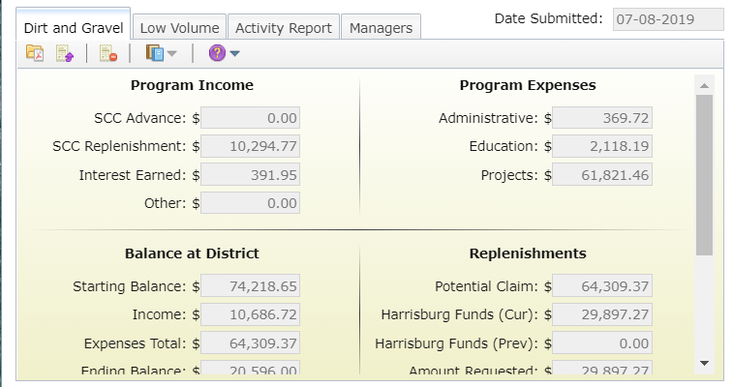
3.4.2: Administrative Funds
Chap 3. CD Role
Administration Funds

Slide 77
3.4.3 Education Funds
Chap 3. CD Role
Guidelines for Education / Training Funds
Up to 10% of allocations of Both DGR and LVR
Up to 100% of funds can be used on projects!
Primary purpose of education funds:
Allow District to attend trainings and events for their own education
Provide training and events for potential program participants
Must be spent on eligible expenses as they are incurred.
Must be incurred within the allotted fiscal year
“Banking” of funds is not permitted

Slide 78
3.4.3: Education Funds
Chap 3. CD Role
Education/Training Funds

Slide 79
3.4.2 & 3.4.3: Admin / Education Funds
Chap 3. CD Role
Admin and Edu funds are not the same
Admin
Edu
Salary and Benefits for administering the Program
Travel for administering the Program
Office Expenses
Field Equipment
Aggregate testing
Consulting services
Overhead costs (insurance, utilities, rent)
Salary and Benefits for time spent attending educational events
Travel for educational purposes
Costs to attend trainings
Costs to host trainings
Promotional materials
Participation incentives
- Equipment for rental to applicants
- Demonstration Projects
- Cost Allocation Method must be used for shared expenses

Slide 80
3.4.2 & 3.4.3: Admin / Education Funds
Chap 3. CD Role
Salary:
Salary can only be claimed for time spent working directly on administration or education/training efforts for the DGLVR program.
Tracking can be done using an appropriate allocation method.
Track exact hours
Percent effort
Other method approved by the Commission
Includes technical staff, support staff, and management
Difference between time spent on admin vs edu

Slide 81
3.4.2 & 3.4.3: Admin / Education Funds
Chap 3. CD Role
Admin and Edu funds are not the same
Salary and Benefits
Admin
Edu
Salary and Benefits for time spent attending educational events
Salary and Benefits for time spent hosting educational events
Salary and Benefits for administering the program
Program paperwork
Emails and phone calls
Project meetings (pre-app, pre-design, pre-construction, etc.)
Inspections of DGLVR-funded projects
→ Educational events include trainings, conferences, field days, workshops, technical assistance, or other outreach activities

Slide 82
3.4.2 & 3.4.3: Admin / Education Funds
Chap 3. CD Role
Admin and Edu funds are not the same
Travel
Admin
Edu
Travel to:
field sites & meetings
vehicle costs
per-diems
Parking
Etc.
Travel to:
set up trainings, workshops, and demonstrations for local stakeholders
Travel to:
Trainings and workshops

Slide 83
3.4.2 & 3.4.3: Admin / Education Funds
Chap 3. CD Role
Admin and Edu funds are not the same
Field Equipment
Equipment for applicants
(NOT eligible)
Admin
Edu
Equipment for loan/rental to applicants
Leaf blowers
traffic counters
grader blades
etc.
Cost Allocation Method must be used for shared expenses
Equipment for CD use:
Levels
Tapes
survey equipment
safety equipment
etc.

Slide 84
3.4.2 & 3.4.3: Admin / Education Funds
Chap 3. CD Role
Admin and Edu funds are not the same
Other
Admin
Edu
Providing training:
Staff time, supplies, location rental, etc.
Promotional Materials
Advertisements, reports, websites, project signage, and promotional items
Limited to $1,000/yr
Participation Incentives
Paying travel costs related to education activities for applicants or QAB members
Office Expenses
Includes:
Computers
Printers
internet service
office supplies like paper, etc.
Aggregate testing
Consultant services
Overhead costs (insurance, utilities, rent, etc.)
Cost Allocation Method must be used for shared expenses

Slide 85
3.4.2 & 3.4.3: Admin / Education Funds
Chap 3. CD Role
The SCC is there to help you understand and follow policy
Contact the SCC with questions about eligible administrative or education expenses or appropriate cost allocation methods

Slide 86
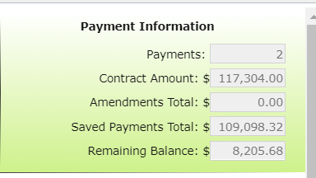
3.4.4: Project Funds
Chap 3. CD Role
Project Funds
At least 80% of funds must go to projects.
Project funds are totaled by the GIS system from the information a District submits for each project
Eligible project expenses outlined in Section 3.7

Slide 87
3.4.4: Project Funds
Chap 3. CD Role
Project Funds

Slide 88
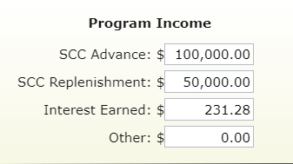
3.4.5: Interest Funds
Chap 3. CD Role
Interest Funds
ALL interest accrued on ALL categories of DGLVR funds (even admin and edu) must be spent on DGLVR projects.
DGR interest must go to DGR projects, LVR interest must go to LVR projects.
Interest tracked in quarterly reporting

Slide 89
3.4.6 Demonstration projects
Chap 3. CD Role
Demonstration Projects
District-funded outside of ranking system.
Showcase new technology, education site, etc.
Only education or administrative funds can be used.
Must follow existing Program policies: be on an eligible public road; have off ROW permissions; have environmental benefit; meet LVR traffic counts; etc.
Must have QAB and district board Approval.
Must have a contract, MOU, or other agreement with the road-owning entity.
Contact Center or Commission staff before contracting a Demo project.

Slide 90
3.4.6 Demonstration projects
Chap 3. CD Role
Demonstration Projects
Do not use to circumvent standard training requirements and normal project agreements.
Regular project (application, ranking) - any funds
Demo Project – admin/edu funds only
You can do “education and outreach” efforts on any project.

Slide 91
Chap 3. CD Role
3.4 Accounting of Funds
Verifying Funds
QAQC team will request itemized documentation of interest accrued and how funds for Administration, Education & Training, and Projects were utilized.
DGR and LVR will both be checked
These funds will be cross referenced with figures entered (by the District) into the GIS system.
District will be asked to provide sufficient evidence of actual expenditures (QuickBooks, Copy of checks, invoices, etc.)

Slide 92
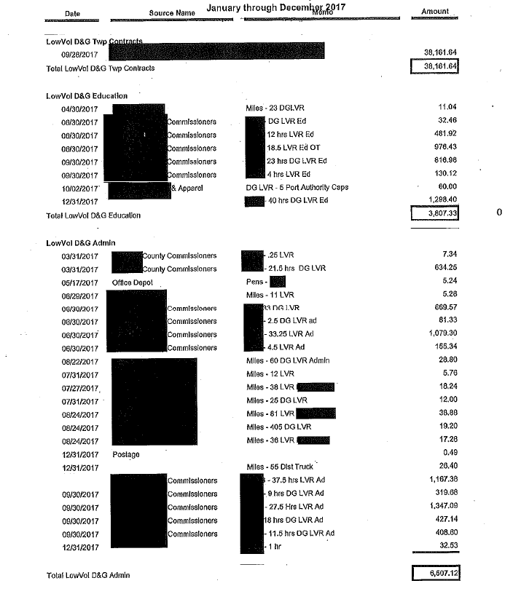
3.4 Accounting of Funds
Chap 3. CD Role
Verifying Funds
Have documentation to back up

Slide 93
Chap 3. CD Role
3.5 Dispersing Funds to Grant Recipients
Dispersing Funds to Grant Recipients
Districts can advance up to 50% of funds to grant recipients
Up to 70% of grant can be paid on a cash-expended basis
At least 30% of grant must be retained until project completion
Conservation districts should develop individual policies regarding payment to grantees
Written schedule of payments is included in contract

Slide 94
JUSTIN

Slide 95
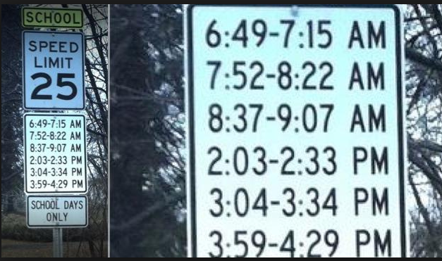
Funny Slide
Has to be a lawyer involved…
http://www.rd.com/slideshows/funny-road-signs/

Slide 96
3) CD Role
Chap 3. CD Role
3.1 CD Structure
3.2 Overview
3.3 Receiving Funds from SCC
3.4 Accounting of funds at CD
3.5 Dispersing funds to Grant Recipients
3.6 CD Educational opportunities
3.7 Program Eligibility
3.8 Administering Projects
3.9 GIS System
3.10Annual Summary Reports

Slide 97
3.6.1 Education FOR Districts
Chap 3. CD Role
ESM Training
Training course that covers road maintenance principals
Mandatory for district staff involved with the program
Mandatory for at least one district QAB member
Highly recommended for everyone involved in the program
Remote Trainings being held this winter

Slide 98
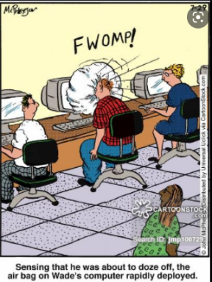
3.6.1 Education FOR Districts
Chap 3. CD Role
Admin Training (ZZZzzzzz…)
Covers administrative policies and guidance provided in the admin manual
Required for staff persons most involved with the program
http://anintrospectiveworld.blogspot.com/2012/08/sleeping-in-class.html

Slide 99
3.6.1 Education FOR Districts
Chap 3. CD Role
Annual Maintenance Workshop
More in depth training than ESM
ESM certified individual may attend annual workshop at least once every 5 yrs in lieu of ESM training, provided their certification is not expired.

Slide 100
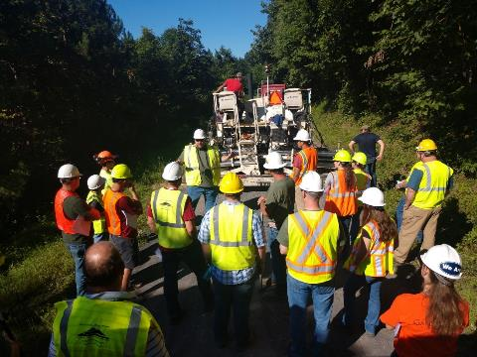
3.6.1 Education FOR Districts
Chap 3. CD Role
Boot Camps
ESM: Program basics for new-hires, with demos of pipe installation, underdrain, DSA
Stream Crossing: In-depth trainings planned for 2022

Slide 101
3.6.1 Education FOR Districts
Chap 3. CD Role
Technical Assistance
Conducted primarily by Center staff
Initiated by districts
Small group training for districts and municipalities
Help with:
Project design / layout
Meet with applicants
Aggregate placement
Project implementation
Whatever you need!

Slide 102
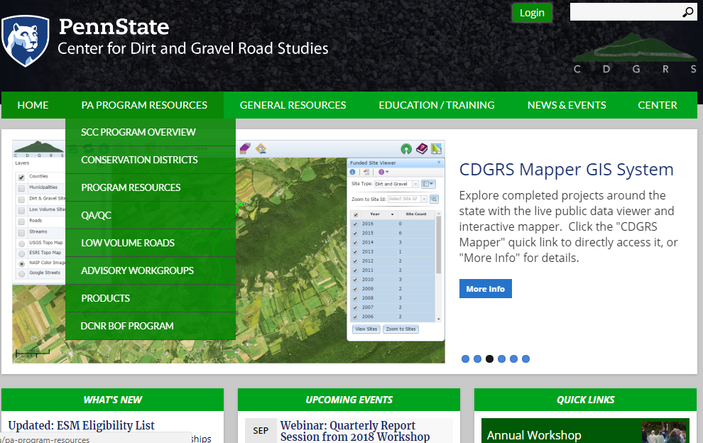
3.6.1 Education FOR Districts
Chap 3. CD Role
www.dirtandgravel.psu.edu

Slide 103
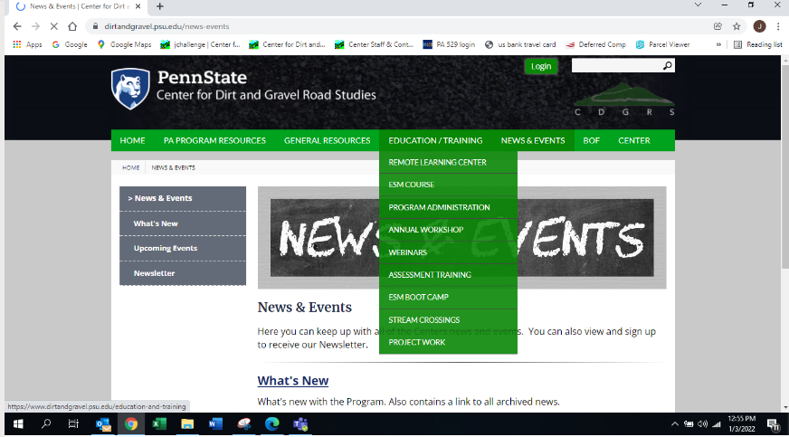
3.6.1 Education FOR Districts
Chap 3. CD Role
Remote Learning Center

Slide 104
3.6.1 Education FOR Districts
Chap 3. CD Role
Remote Learning Center

Slide 105
3.6.1 Education FOR Districts
Chap 3. CD Role
www.dirtandgravel.psu.edu

Slide 106
3.6.1 Education FOR Districts
Chap 3. CD Role
www.dirtandgravelroads.org
Standard forms
Blank forms
Example/sample forms
Webinars
Recording
Powerpoints
Materials and Cost Calculator
GIS system

Slide 107
Other Documentation
Chap 3. CD Role
Other Documentation
www.dirtandgravelroads.org
Technical bulletins
Sample forms and policies
Blank forms
Aggregate guidance
GIS help
Reference material
70+ webinars and other recorded trainings

Slide 108
3.6.2 Education BY Districts
Chap 3. CD Role
Education by Districts for applicants:
Participate in existing events
Municipal Conventions
Contractor Workshops
Legislative Breakfasts
Municipal Visits
Hold new events
Demo Days
Program Update Sessions
Project tours
Promotion: press releases, signs, emails
Jan 2017 Webinar
CD Education and Outreach Ideas

Slide 109
Funny Slide
http://www.shiply.com/blog/uploaded_images/funny_road_signs_21-746380.jpg

Slide 110
3) CD Role
Chap 3. CD Role
3.1 CD Structure
3.2 Overview
3.3 Receiving Funds from SCC
3.4 Accounting of funds at CD
3.5 Dispersing funds to Grant Recipients
3.6 CD Educational opportunities
3.7 Program Eligibility
3.8 Administering Projects
3.9 GIS System
3.10Annual Summary Reports

Slide 111
3.7.1 Eligible Applicants
Chap 3. CD Role
Eligible Applicants
Public entities that own roads
Person in charge of the project must be ESM certified to apply
Municipalities (1400+ twps, 800+ boroughs, 50+ cities)
State entities such as:
PennDOT, Game Commission, Fish & Boat
County and other Government entities
Federal roads and private roads are NOT eligible
All public roads are “born” in legislation

Slide 112
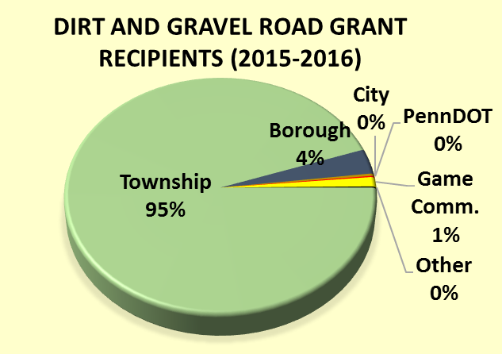
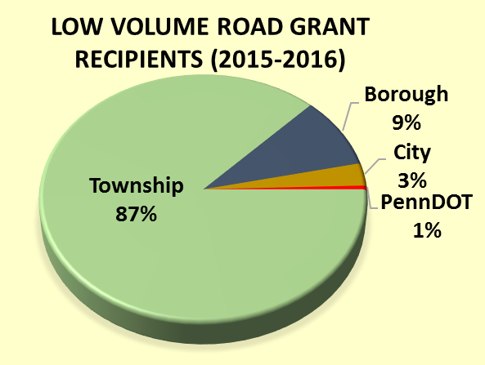
3.7.1 Eligible Applicants
Chap 3. CD Role
Eligible Applicants
Public entities that own roads
Grant recipients: 2019-2020:

Slide 113
3.7.1.3 Determining Road Ownership
Chap 3. CD Role
Road Ownership
The entity that owns the “right of way” is the determining factor, not who owns the adjacent land
Contracts and payments can only be made with the entity that owns the road
Questionable situations?
Check for liquid fuels funding
Courthouse records
Responsibility of the applicant to prove ownership

Slide 114
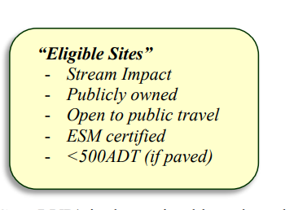
3.7.2 Eligible Roads
Chap 3. CD Role
Dirt and Gravel Road
“Unbound” surfaces.
“gradable”
Paved Low Volume Road
Surface bound with asphalt, oil, or other binder
Includes “tar and chip”
500 vehicles a day or less – traffic count required
Surface Conservations
Converting poorly constructed LVR into a DGR may utilize either LVR or DGR funding

Slide 115
3.7.3 Eligible Projects
Chap 3. CD Role
Eligible Projects
Focus on environmental and road improvements
Use ESM practices as described in section 1.4
Reduce sediment
Reduce concentrated drainage
Program focus is on long-term environmtneal and road improvements
“routine maintenance” is not eligible for funding
Crack sealing
Grading roads
Bridge repairs

Slide 116
3.7.4 Eligible Project Expenses
Chap 3. CD Role
Eligible Project Expenses
No program specific purchase requirements (use applicant’s established procedures for bidding and purchasing)
Records of purchases must be kept (by the grant recipient) for 7 years from project completion
Applicants can apply for the full cost of all materials, equipment, and labor

Slide 117
3.7.4.1 Eligible Expenses - Materials.
Chap 3. CD Role
Materials
Typical materials include pipe, stone, fabric, etc
Products with leaching potential must meet SCC standards for non-pollution. Approved products list on www.dirtandgravelroads.org.

Slide 118
3.7.4.2 Eligible Expenses - Equipment
Chap 3. CD Role
Equipment
Reimbursement of applicant owned equipment is eligible (@ FEMA rates)
Equipment can be rented, FEMA rates do not apply.
DGLVR funds, including project, administrative, or education, cannot be used to purchase, cost share, or maintain equipment for an applicant.
It is acceptable for a Conservation District to purchase equipment for loan/rent to applicants.

Slide 119
Funny Slide
Does this go under equipment, or labor???

Slide 120
3.7.3 Eligible Expenses - Labor
Chap 3. CD Role
Labor
Reimbursement of labor and equipment operators is an eligible expense.
Labor rates may include wage and benefits.

Slide 121
3.7.3 Eligible Expenses - Labor
Chap 3. CD Role
Municipal Labor
Reimbursement of labor and equipment operators is an eligible expense
Labor rates may include wage and benefits.
PREVAILING WAGE: Does not apply to projects done with Municipal labor force.

Slide 122
3.7.4.4 Contractor Costs
Chap 3. CD Role
Contractors
Projects may be completed in whole or in part by contractors
Grant recipients use their standard bidding procedures
Districts must make payments to the grant recipient, not the contractors
PREVAILING WAGE:

Slide 123
3.7.4.5 Prevailing Wage
Chap 3. CD Role
PREVAILING WAGE: Projects where the estimated total project cost exceeds $25,000 (NOT $100,000) are subject to the prevailing wage act for contracted labor.
It is the responsibility of the grant recipient to obtain the Prevailing Wage Act scale for the area and include it in any proposal to solicit bids for the contract. The Prevailing Wage scale can be obtained from the Prevailing Wage Division of the Pennsylvania Department of Labor and Industry. If the Prevailing Wage Act applies, the advertisement shall also note this fact.

Slide 124
3.7.4.5 Prevailing Wage
Chap 3. CD Role
PREVAILING WAGE: Projects where the estimated total project cost exceeds $25,000 (NOT $100,000) are subject to the prevailing wage act for contracted labor.
Total Project Costs: include other grant sources in-kind material (not equipment/labor).
Cannot “split” projects to avoid PW.
PW does not apply to municipal labor.
PW must be documented in project file

Slide 125
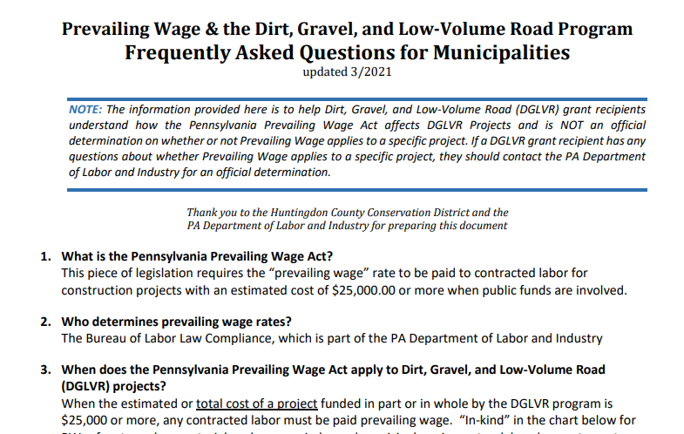
3.7.4.2 Prevailing Wage
Chap 3. CD Role
PREVAILING WAGE FAQ: 16 Q&As

Slide 126
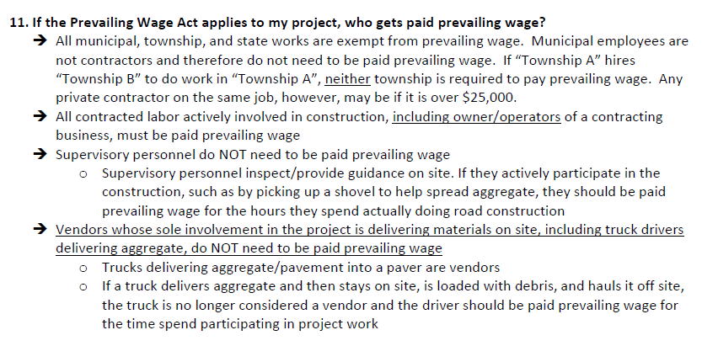
3.7.4.4 Prevailing Wage
Chap 3. CD Role
PREVAILING WAGE FAQ: 15 Q&As

Slide 127
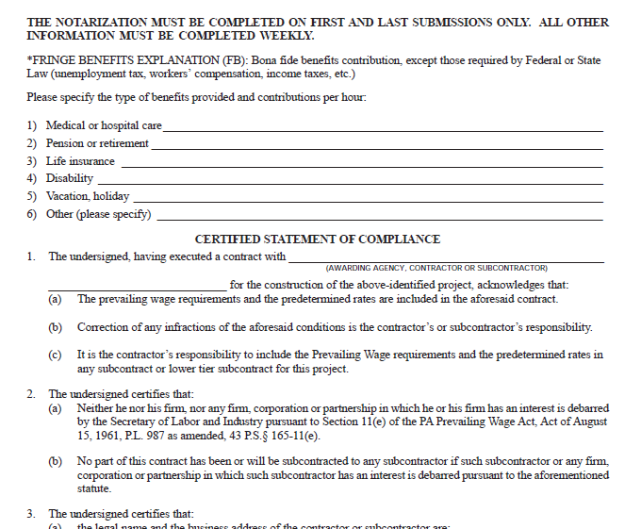
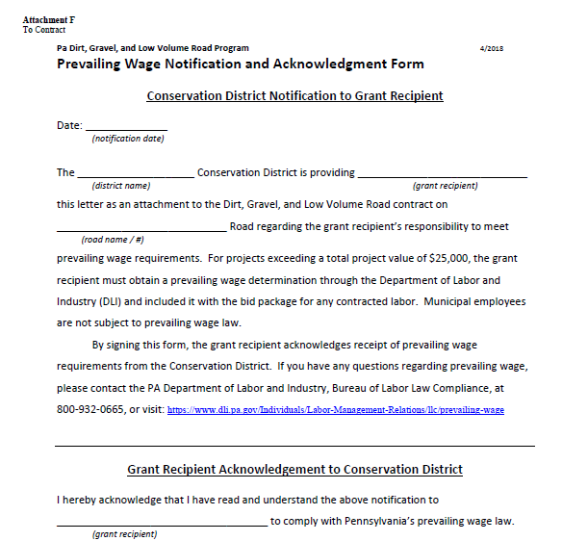
3.7.4.5 Prevailing Wage
Chap 3. CD Role
PREVAILING WAGE DGLVR Documents
PW Certification (G) two pages
Required for all projects where PW applies
Required before making final payment
PW Notification Letter (F)
Required for all projects
Ensures grant recipient knows PW requirements
Attachments F and G to Contract
(Contract and attachments are in appendix C in admin manual)

Slide 128
3.7.4.5 Prevailing Wage
Chap 3. CD Role
Additional Information:
Brian Smolock, Labor Law Investigator
PA Department of Labor and Industry
717-787-0606
bsmolock@pa.gov

Slide 129
3.7.4.6 In-Kind
Chap 3. CD Role
In Kind Contributions
In-Kind: materials, equipment, and labor funded by other sources, typically the applicant
No Statewide requirement for inkind amounts
Only contributions that meet all Program policies may be counted as in-kind contributions.
Stream crossings, DSA, FDR are most common

Slide 130
3.7.4.7 Engineering and Permitting Costs
Chap 3. CD Role
Engineering, permitting, or similar consultant costs are limited to a maximum of 10% of the total contract between the District and the grant recipient.
Example a district enters into a contract for a pipe replacement. Contract amount is $30,000, but with in-kind match, etc, the total cost is $50,000. What is the maximum amount that can be reimbursed for engineering?

Slide 131
3.7.4.7 Engineering and Permitting Costs
Chap 3. CD Role
Engineering, permitting, or similar consultant costs are limited to a maximum of 10% of the total contract between the District and the grant recipient.
Example a district enters into a contract for a pipe replacement. Contract amount is $30,000, but with in-kind match, etc, the total cost is $50,000. What is the maximum amount that can be reimbursed for engineering?
$3,000

Slide 132
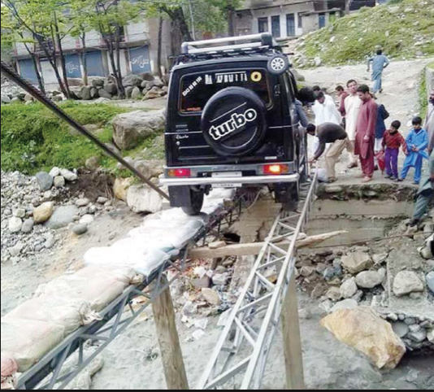
Funny Slide
Speaking of Engineering…
http://www.rd.com/slideshows/funny-road-signs/

Slide 133
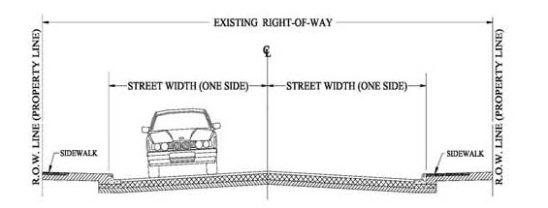
3.7.4.8 Working off the Right of way
Chap 3. CD Role
Right-of-way:
Publicly owned road corridor.
Typically 33’ width (16.5’ from road Centerline) for municipal roads.
Exceptions do apply, sometime up to 50’.
http://old.mcallen.net/landingpages/lp_engineering/roa_permits.aspx

Slide 134
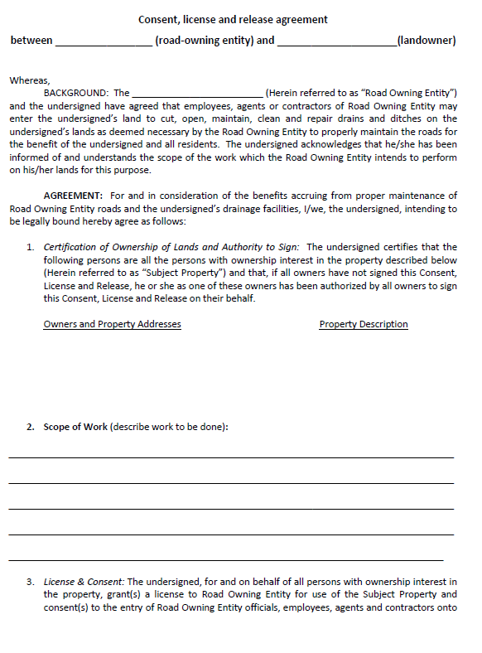
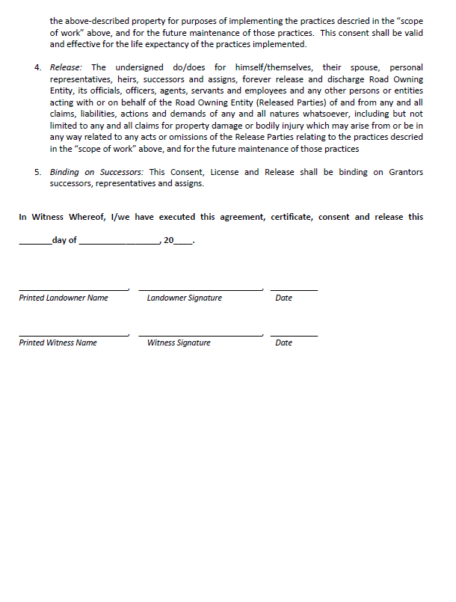
3.7.4.8 Working off the Right of way
Chap 3. CD Role
Written permission from landowners is required when working outside the right-of-way.
Districts can use their own form, or the example provided in manual, but must use something!
Word Version Available Online
www.dirtandgravelroads.org

Slide 135
3.7.4.8 Working off the Right of way
Chap 3. CD Role
Working outside the right-of-way is permissible with DGLVR funds only under certain conditions:
Must be directly necessary to the successful completion of the project on a public road.
Limited in scope to cost effective practices that directly reduce road impacts
Grant recipient MUST obtain written permission before starting the project
Districts must keep a copy of written permission in the project file

Slide 136
3.7.4.8 Working off the Right of way
Chap 3. CD Role
In certain situations, off-right-of-way work requires the prior written approval from the SCC before a contract can be signed:
Where off-right-of-way work is more than 35% of the total project costs (including program funds and in-kind contributions)
Where work extends more than 500 feet off of the right-of-way.

Slide 137
3.7.4.8 Working off the Right of way
Chap 3. CD Role
Landowner permission is suggested when off-right-of-way impacts are expected, even if work is done within wright-of-way.
New pipes and turnouts.
Subsurface drainage
French mattress
Driveway issues.
Road fill jobs.

Slide 138
3.7.4.9 Combined Funds
Chap 3. CD Role
Program funds may be combined with other funds to pay for a project.
Detailed accounting of which funds were spent on which portions of the project must be maintained
Other funding sources may be used as matching funds, provided the program funds are used on eligible projects
Must still adhere to non-pollution standards and ESM practices

Slide 139
Steve

Slide 140
3) CD Role
Chap 3. CD Role
3.1 CD Structure
3.2 Overview
3.3 Receiving Funds from SCC
3.4 Accounting of funds at CD
3.5 Dispersing funds to Grant Recipients
3.6 CD Educational opportunities
3.7 Program Eligibility
3.8 Administering Projects
3.9 GIS System
3.10Annual Summary Reports

Slide 141
3) CD Role
Chap 3. CD Role
3.8 Administering Projects
3.8.1 Notification to Applicants
3.8.2 Pre-Application Site Visit
3.8.3 Pre-Design Site Visit
3.8.4 Receiving Grant Applications
3.8.5 Contracting
3.8.6 Pre-Project Logistics
3.8.7 Project Oversight
3.8.8 Contract Amendments
3.8.9 Project Completion
3.8.10 Project File Retention

Slide 142
3.8.1 Notifying applicants
Chap 3. CD Role
Notifying Applicants
Districts must inform all potential applicants of funding availability (equal access).
QAB equal access policy.

Slide 143
3.8.2 Pre-Application site visit
Chap 3. CD Role
Pre-app site visit
Districts should meet with potential applicants on site BEFORE an application is submitted
Early discussion of potential problems (permitting, funding availability, etc)
Best interest of both parties.
Look at potential landowner or off-ROW issues
Checklist available

Slide 144
Checklists & Tools
Pre-application Checklist
Pre-construction Checklist
Project Hard Files Checklist
Project Narrative
Project Timeline
NOT REQUIRED, for your benefit

Slide 145
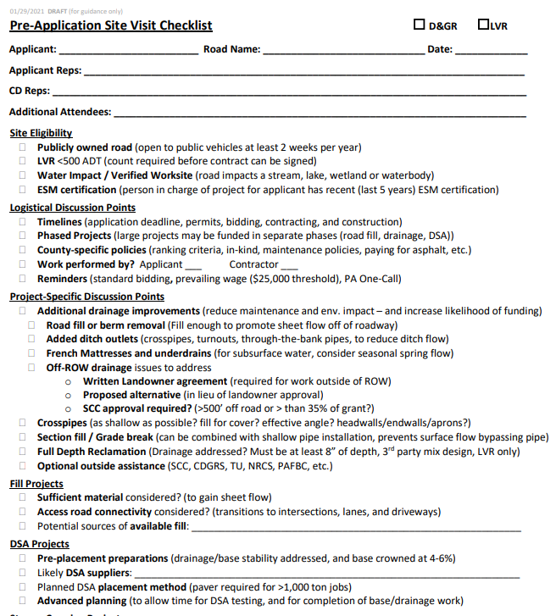
Checklists & Tools
Pre-application Checklist
Pre-construction Checklist
Project Hard Files Checklist
Project Narrative
Project Timeline
NOT REQUIRED, for your benefit

Slide 146
Checklists & Tools
Pre-application Checklist
Pre-construction Checklist
Project Hard Files Checklist
Project Narrative
Project Timeline
NOT REQUIRED, for your benefit

Slide 147
Checklists & Tools
Pre-application Checklist
Pre-construction Checklist
Project Hard Files Checklist
Project Narrative
Project Timeline
NOT REQUIRED, for your benefit

Slide 148
Checklists & Tools
Pre-application Checklist
Pre-construction Checklist
Project Hard Files Checklist
Project Narrative
Project Timeline
NOT REQUIRED, for your benefit

Slide 149
Checklists & Tools
Pre-application Checklist
Pre-construction Checklist
Project Hard Files Checklist
Project Narrative
Project Timeline
NOT REQUIRED, for your benefit

Slide 150
3.8.3 Pre-Design site visit
Chap 3. CD Role
Pre-design site visit
If a project requires engineering
It is highly recommended that districts meet with the grant recipient and engineer on site BEFORE design work is started
Make sure the engineer understands DGLVR requirements
Early discussion of potential problems (permitting, funding availability, etc)
Best interest of both parties.
Keep in mind that engineering expenses incurred before a contract is signed are NOT eligible for reimbursement with DGLVR funds

Slide 151
3) CD Role
Chap 3. CD Role
3.8 Administering Projects
3.8.1 Notification to Applicants
3.8.2 Pre-Application Site Visit
3.8.3 Pre-Design Site Visit
3.8.4 Receiving Grant Applications
3.8.5 Contracting
3.8.6 Pre-Project Logistics
3.8.7 Project Oversight
3.8.8 Contract Amendments
3.8.9 Project Completion
3.8.10 Project File Retention

Slide 152
3.8.4 Receiving Grant Applications 1/2
Chap 3. CD Role
Receiving Grant Apps: Timeline
Receive Applications
Work with applicants to revise if needed.
Review for completeness and accuracy.
Completed applications get forwarded to QAB for review and ranking.
QAB recommendations taken to District Board for action
Contract can then be made with grant recipient.

Slide 153
3.8.4 Receiving Grant Applications 2/2
Chap 3. CD Role
Receiving Grant Apps
Districts may set application periods, or they may have an open application period
One page application
Districts may develop their own policy for unfunded applications
Disapprove
Retain
Resubmit

Slide 154
Grant App, Work plan, Instructions
Chap 3. CD Role
Grant app and forms used to apply to CD
Project-specific Grant Application
Optional cost summary forms
Project Sketch (back of grant app)
Instructions for all forms

Slide 155
Grant App, Work plan, Instructions
Chap 3. CD Role
Grant Application (front)
Project Sketch
(back)
Attachment A to Contract
(Contract and attachments are in appendix C in admin manual)

Slide 156
Grant App, Work plan, Instructions
Chap 3. CD Role
Grant App - Top
District Use Only Box
2 page “cheat sheet” for new CD hires.
Applicant Info
Project Info

Slide 157
E. Grant App, Work plan, Instructions
Forms Update
Grant App - Bottom
2 page “cheat sheet” for new CD hires.
Grant Request $
In-Kind $
Additional Cost Sheets Available

Slide 158
Grant App, Work plan, Instructions
Chap 3. CD Role
OPTIONAL cost details
Attachment A to Contract
(Contract and attachments are in appendix C in admin manual)

Slide 159
Grant App, Work plan, Instructions
Chap 3. CD Role
Bottom of Grant Application
2 page “cheat sheet” for new CD hires.

Slide 160
Grant App, Work plan, Instructions
Chap 3. CD Role
OPTIONAL cost details
2 page “cheat sheet” for new CD hires.
Attachment A to Contract
(Contract and attachments are in appendix C in admin manual)

Slide 161
Grant App, Work plan, Instructions
Chap 3. CD Role
Bottom of Grant Application
2 page “cheat sheet” for new CD hires.

Slide 162
Grant App, Work plan, Instructions
Chap 3. CD Role
Project Sketch
(back of grant app)
Attachment A to Contract
(Contract and attachments are in appendix C in admin manual)
2 page “cheat sheet” for new CD hires.

Slide 163
Grant App, Work plan, Instructions
Chap 3. CD Role
2 page “cheat sheet” for new CD hires.

Slide 164
Grant App, Work plan, Instructions
Chap 3. CD Role

Slide 165
Grant App, Work plan, Instructions
Chap 3. CD Role
Grant App Instructions, Sample Sketch
2 page “cheat sheet” for new CD hires.
Attachment A to Contract
(Contract and attachments are in appendix C in admin manual)

Slide 166
E. Grant App, Work plan, Instructions
Chap 3. CD Role
Grant forms available online
With or without instructions

Slide 167
Funny Slide
No Thanks.
http://www.shiply.com/blog/uploaded_images/funny_road_signs_21-746380.jpg

Slide 168
3) CD Role
Chap 3. CD Role
3.8 Administering Projects
3.8.1 Notification to Applicants
3.8.2 Pre-Application Site Visit
3.8.3 Pre-Design Site Visit
3.8.4 Receiving Grant Applications
3.8.5 Contracting
3.8.6 Pre-Project Logistics
3.8.7 Project Oversight
3.8.8 Contract Amendments
3.8.9 Project Completion
3.8.10 Project File Retention

Slide 169
ROY

Slide 170
3.8.5 Contracting
Chap 3. CD Role
Contracting
Contract must be in place before anything happens
No fund advances can take place without a contract
No work can begin without a contract
No expenses, such as engineering costs, can be incurred before a contract is signed

Slide 171
Contract
Grant App Instructions, Sample Sketch
Chap 3. CD Role
2 page “cheat sheet” for new CD hires.
Appendix C
in manual – with attachments

Slide 172
Contract
Chap 3. CD Role
2-page contract between CD and grantee
Other documents attached to contract:
Appendix C
in manual – with attachments

Slide 173
Contract
Chap 3. CD Role
2-page contract between CD and grantee
CDs can add provisions to contract
Need to be approved by your solicitor.
Need to notify SCC.

Slide 174
Contract
Chap 3. CD Role
Cancelling a contract
If a contract cannot be completed in a reasonable timeframe (2+ years), the district should consider closing out or canceling the contract.
Districts who maintain open contracts for multiple years may see reduced allocations in future years at the discretion of the State Conservation Commission.

Slide 175
Schedule of Payments
Chap 3. CD Role
50% max
30% min
Available Online
www.dirtandgravelroads.org
NEW: Can Generate Automatically in GIS

Slide 176
Contract Amendment
Chap 3. CD Role
If needed, a simple one-page amendment form can be used to:
increase contract by up to 20% (total of original contract)***change proposed
extend completion date
Increase both funds and time
Appendix D
in manual

Slide 177
Contract Amendment
Chap 3. CD Role
Limited to 20% of contract
Can be used to extend completion date.
Appendix D
in manual

Slide 178
Contract Amendment
Chap 3. CD Role
Amendment Instructions
Can now be used to extend completion date.
Appendix D
in manual

Slide 179
Contract
Chap 3. CD Role
2-page contract between CD and grantee
Other documents attached to contract:
NEW: Can Generate Automatically in GIS
GIS now prints out entire application packet with all attachments except Grant App / Workplan

Slide 180
3) CD Role
Chap 3. CD Role
3.8 Administering Projects
3.8.1 Notification to Applicants
3.8.2 Pre-Application Site Visit
3.8.3 Pre-Design Site Visit
3.8.4 Receiving Grant Applications
3.8.5 Contracting
3.8.6 Pre-Project Logistics
3.8.7 Project Oversight
3.8.8 Contract Amendments
3.8.9 Project Completion
3.8.10 Project File Retention

Slide 181
3.8.6 Pre-project logistics
Chap 3. CD Role
Pre project logistics
Permits, Pa 1-call
It is the responsibility of the grant recipient to insure that all necessary permits are obtained and any other pre-project requirements are met (1-call, PNDI, etc)
It is the responsibility of the district to verify that permits have been obtained before work can begin on the portion of the project that requires a permit.

Slide 182
3.8.6 Pre-project logistics
Chap 3. CD Role
Pre project logistics
Pre-project meeting (separate from pre-application meeting)
Grant recipients MUST notify the conservation district before beginning work on a project.
The amount of notice is spelled out in the contract with the district.
Contractors and sub-contractors are strongly encouraged to attend.
Notify Center of planned DSA placements.
Checklist available

Slide 183
3) CD Role
Chap 3. CD Role
3.8 Administering Projects
3.8.1 Notification to Applicants
3.8.2 Pre-Application Site Visit
3.8.3 Pre-Design Site Visit
3.8.4 Receiving Grant Applications
3.8.5 Contracting
3.8.6 Pre-Project Logistics
3.8.7 Project Oversight
3.8.8 Contract Amendments
3.8.9 Project Completion
3.8.10 Project File Retention

Slide 184
3.8.7 Project Oversight
Chap 3. CD Role
Project Oversight
District must ensure that project work is performed in accordance with contract and attachments, including subcontractors.
Stay involved
Have an on-site presence
Pay attention
Call Center/SCC for help if needed
No excuses!
When it comes to project oversight, remember…

Slide 185
3.8.7 Project Oversight
Chap 3. CD Role
“You get what you inspect, not what you expect”
more involvement = better projects

Slide 186
3.8.7 Project Oversight
Chap 3. CD Role
Project Oversight
Make sure you are on site:
First day(s) of project work
When project moves to a new phase or practice
When critical practices or practices new to the applicant are being installed
For regular check-ins

Slide 187
3.8.7 Project Oversight
Chap 3. CD Role
Project Oversight
“The twp wanted to do it that way” is not an excuse
The CD holds the purse strings
Ensure work is done properly
Require remediations where necessary
Don’t pay for subpar work

Slide 188
Funny Slide

Slide 189
3) CD Role
Chap 3. CD Role
3.8 Administering Projects
3.8.1 Notification to Applicants
3.8.2 Pre-Application Site Visit
3.8.3 Pre-Design Site Visit
3.8.4 Receiving Grant Applications
3.8.5 Contracting
3.8.6 Pre-Project Logistics
3.8.7 Project Oversight
3.8.8 Contract Amendments
3.8.9 Project Completion
3.8.10 Project File Retention

Slide 190
3.8.9 Project Completion
Chap 3. CD Role
Project Completion Report
Closeout summary of individual project
Encourage joint CD/grantee completion at final inspection.
Summarizes funding
Summarizes work
Signed by CD and grantee
Must be signed and retained with project files.

Slide 191
3.8.9 Project Completion
Chap 3. CD Role
Expanded to front and back
Project Info
ESM Practice Summary
Financial Summary
Appendix G
in manual
Notes and Signatures

Slide 192
3.8.9 Project Completion
Chap 3. CD Role
Front Top
Financial Summary
Appendix G
in manual

Slide 193
3.8.9 Project Completion
Chap 3. CD Role
Front Bottom
Space for notes
CD and Grantee Signatures
Appendix G
in manual

Slide 194
3.8.9 Project Completion
Chap 3. CD Role
Back Top
Appendix G
in manual

Slide 195
3.8.9 Project Completion
Chap 3. CD Role
Back Bottom

Slide 196
3.8.9 Project Completion
Chap 3. CD Role
Project Completion Report Instructions
Appendix G
in manual

Slide 197
Program Forms Update Webinar Recorded 12/17/14
Recording and PowerPoint available online
www.dirtandgravelroads.org

Slide 198
3) CD Role
Chap 3. CD Role
3.8 Administering Projects
3.8.1 Notification to Applicants
3.8.2 Pre-Application Site Visit
3.8.3 Pre-Design Site Visit
3.8.4 Receiving Grant Applications
3.8.5 Contracting
3.8.6 Pre-Project Logistics
3.8.7 Project Oversight
3.8.8 Contract Amendments
3.8.9 Project Completion
3.8.10 Project File Retention

Slide 199
3.8.10 Project File Retention
Chap 3. CD Role
All records relating to the Program must be kept for a minimum of 7 years from the date of final payment on a project
see “Hard File” Project Checklist for paperwork required to be in hard file
It is recommended to keep additional relevant documentation beyond the minimum required to be in the hard file
Communications with project participants, photos, bid documents if applicable, etc.

Slide 200
STEVE

Slide 201
3) CD Role
Chap 3. CD Role
3.1 CD Structure
3.2 Overview
3.3 Receiving Funds from SCC
3.4 Accounting of funds at CD
3.5 Dispersing funds to Grant Recipients
3.6 CD Educational opportunities
3.7 Program Eligibility
3.8 Administering Projects
3.9 GIS System
3.10Annual Summary Reports

Slide 202
3.9 GIS reporting
Chap 3. CD Role
GIS reporting
CDs use customized GIS system to track all project location, deliverables and spending.
Use system to generate quarterly reports to SCC.

Slide 203
3.9 GIS reporting
Chap 3. CD Role
GIS Reporting
ALL Program reporting done in GIS
Please attend a GIS training if you are responsible for record keeping and reporting for Program.
District Managers have to take abbreviated GIS training

Slide 204
3.9 GIS reporting
Chap 3. CD Role
Annual Summary Reports

Slide 205
Funny Slide
This place has to be in California...
http://media-cache-cd0.pinimg.com/736x/4d/b5/ff/4db5ff34b780ec0332c261fa91954030.jpg

Slide 206
Justin

Slide 207
Administrative Manual
Introduction
SCC Role
Conservation District Role
Quality Assurance Board
Applicant Role
Center for Dirt and Gravel Roads
Additional Policies
Permits and Other Requirements
Appendices

Slide 208
4.0 Quality Assurance Board
Chap 4. QAB Role
Quality Assurance Board -§ 9106, (E)
Within the conservation district a Quality Assurance Board shall be impaneled to establish and administer the grant program. The four-member QAB is to be comprised of a nonvoting chairman appointed by the conservation district directors and one local representative appointed by each of the following entities:
(1) The Federal Natural Resource Conservation Service
(2) The Pennsylvania Fish and Boat Commission
(3) The county conservation district
If circumstances require, the chairman may vote to decide a tie vote.

Slide 209
4.0 Quality Assurance Board
Chap 4. QAB Role
Quality Assurance Board Why?

Slide 210
4.0 Quality Assurance Board
Chap 4. QAB Role
Quality Assurance Board Why?
Local Involvement and Control
NRCS – Federal: conservation and erosion
PAFBC – State: aquatics and hydrology
District – County: conservation multi-discipline
Who knows best for the County?
People in the County!

Slide 211
4.0 Quality Assurance Board
Chap 4. QAB Role
Quality Assurance Board
Local control within guidelines established by the commission.
QAB’s purpose is to advise and assist the conservation district board.
QAB is advisory only
District Board has the final say

Slide 212
4.1 QAB Composition
Chap 4. QAB Role
Composition of the QAB is established by law:
Only 4 members
Non-voting chair appointed by district board
One voting member appointed by the district board
One voting member appointed by Fish and Boat commission
One voting member appointed by NRCS
Chairman may only vote to decide a tie
Voting members appointed by the agencies do not have to be employees
All QAB members are strongly encouraged to take ESM training
At least one district member must take ESM training
QAB can have as many advisors as they deem necessary, but advisors are non voting

Slide 213
Structure and Purpose
Chap 4. QAB Role
NRCS and PAFBC (not CD) designate their QAB appointees
Does not have to be NRCS/PAFBC employee.
Can also designate an alternate.
Should have appointment in writing
Sample appointment letter:

Slide 214
Structure and Purpose
Chap 4. QAB Role
Sample appointment letter:
Voting members appointed by the agencies do not have to be employees
Word Version Available online

Slide 215
4.2 QAB Meetings
Chap 4. QAB Role
QAB Meetings
On a regular schedule or as needed
Common action items at a QAB:
Review grant applications
Recommend projects for funding to the district board
Review completed projects
Recommend local policies to district board
At least 2 of the 3 voting members (quorum) on any recommendations to the district board

Slide 216
4.2 QAB Meetings
Chap 4. QAB Role
QAB Meetings must be Sunshined
The Pennsylvania Sunshine Act requires all public agencies to take all official actions and conduct all deliberations leading up to official actions at public meetings. The Act covers all such actions by municipal governing bodies, committees of these governing bodies and municipal boards and commissions.
-Open Meetings, the Sunshine Act (Pennsylvania)

Slide 217
4.2 QAB Meetings
Chap 4. QAB Role
QAB Meetings
Regular meetings must follow sunshine act requirements.
Must have quorum of voting members (2 of three voting members).
Meeting minutes must be kept.
QAB chairmain may only vote to break a tie

Slide 218
4.3 QAB role in projects
Chap 4. QAB Role
4.3.1 QAB Role: Project Ranking
QAB members should become familiar with applicant’s worksites:
Site visits as a group
Site visits individually
Photo tour from District staff
Paper application review only
Throw darts at “application dartboard”
Best option
Not recommended

Slide 219
4.3 QAB role in projects
Chap 4. QAB Role
4.3.1 QAB Role: Project Ranking
Each County must have written Project Ranking Criteria
Based on local priorities.
Can have separate D&G and LVR or combined.
Must provide for equal access.
Example template available on Center’s website.

Slide 220
4.3 QAB role in projects
Chap 4. QAB Role
Solution
Application Validation
Misc
Problem
Other thoughts
Ranking Criteria Webinar Recorded 12/11/14
Recording and PowerPoint available online
www.dirtandgravelroads.org

Slide 221
4.3 QAB role in projects
Chap 4. QAB Role
4.3.2 QAB Role: Funding Recommendations
QAB makes funding recommendations based on the ranking criteria it establishes
District board then considers QAB recommendations
When the district board approves an application, district staff may then develop and secure a contract.

Slide 222
4.3 QAB role in projects
Chap 4. QAB Role
4.3.3 QAB Role: Project Implementation
After contract is secured, district staff is responsible for project administration, oversight, and inspection.
Future funding decisions for the project may be made by the board with minimal QAB involvement.
i.e. District board could approve a contract amendment without QAB involvement

Slide 223
4.4 QAB Role in Policy
Chap 4. QAB Role
QAB Role in Policy
Developing local policy is a major function of the QAB:
QABs develop policy
District board adopts policy

Slide 224
4.4.1 Required Policies
Chap 4. QAB Role
Required Local Policies
Equal Access
Conflict of Interest
Project Ranking
Incentives for training
Non-pollution standards

Slide 225
4.4.2 Optional Local Policies
Chap 4. QAB Role
Optional Local Policies
QAB can recommend policies for use within County Program.
Can be “more stringent” than Statewide policy.
Cannot conflict with Statewide policy.
Examples:
Deadlines for applications
Limiting use of DSA
Ongoing maintenance requirements

Slide 226
4.4 QAB Role in Policy
Chap 4. QAB Role
Individual County pages have contact info and policies
http://www.dirtandgravel.psu.edu/pa-program-resources/conservation-districts

Slide 227
Funny Slide
https://www.flickr.com/photos/halfbyte/2649002573

Slide 228
Administrative Manual
Introduction
SCC Role
Conservation District Role
Quality Assurance Board
Applicant Role
Center for Dirt and Gravel Roads
Additional Policies
Permits and Other Requirements
Appendices

Slide 229
5 Applicant Role
Chap 5. Applicants
5. Applicant Role
Designed as standalone section you can copy and give to new potential applicants.
Most information is repetitive from SCC and District section, just written with applicants in mind.

Slide 230
Steve

Slide 231
Administrative Manual
Introduction
SCC Role
Conservation District Role
Quality Assurance Board
Applicant Role
Center for Dirt and Gravel Roads
Additional Policies
Permits and Other Requirements
Appendices

Slide 232
Center Role
Chap 6. CDGRS
Dirt and Gravel Road PROGRAM
Education
2 day ESM training
Annual Workshops
Demonstration Days
Outreach
- Technical Documentation
- Website
Newsletter
Interagency cooperation
Program Support
Advisory Groups
Technical Assistance to Districts
Quality Assurance effort
Geographic Information Systems
Funding Support
Guidance
Make Policy
“Administer” Program
QAQC
Coordinate with legislatures and other agencies

Slide 233
Center Role
Chap 6. CDGRS
Dirt and Gravel Road PROGRAM
Got a Question? Who to ask:
Policy
Legal
Allocation/replenishment
QAQC
General Questions
Trainings
Technical Assistance
Outreach
GIS/Reporting
General Questions

Slide 234
Administrative Manual
Introduction
SCC Role
Conservation District Role
Quality Assurance Board
Applicant Role
Center for Dirt and Gravel Roads
Additional Policies
Permits and Other Requirements
Appendices

Slide 235
7 Additional Program Policies
Chap 7. Add. Policies
Some policies that don’t necessarily apply to every project:
7.1 Stream Crossing Replacement Policy
7.2 Driving Surface Aggregate
7.3 Full Depth Reclamation
7.4 LVR Policies
7.5 Traffic Counts

Slide 236
7.1 Stream Crossings
Chap 7. Add. Policies
Policy for replacing culverts and bridges.
Applies to both D&G and LVR projects.
Limits replacements to areas where structure is causing problem with stream.
Existing structures must be undersized and causing stream instabilities.
New structures must be sized to properly accommodate stream flow, bed load, and aquatic organisms.

Slide 237
7.1 Stream Crossings
Chap 7. Add. Policies
Undersized Structures cause stream instability
Gravel deposition upstream (constant “cleaning”)
“Firehose effect” erosion downstream
Often barriers to aquatic life
-Trout Unlimited

Slide 238
7.1 Stream Crossings
Chap 7. Add. Policies
BANKFULL
WIDTH
Bankfull Width: Width of channel at bankfull flow: typically when water begins to access floodplain and characterized by a 1-2 year event.

Slide 239
7.1 Stream Crossings
Chap 7. Add. Policies
Stream crossings OVER 12.5 ft² opening (4’ diameter)
In order to be eligible for replacement, EXISTING structures must:
1. Have a structure to bankfull width ratio of 75% or less.
2. Show signs of streambank erosion.
3. Show signs of streambed erosion/aggradation.

Slide 240
7.1 Stream Crossings
Chap 7. Add. Policies
Stream crossings OVER 12.5 ft² opening (4’diameter)
In order to be eligible for replacement, EXISTING structures must:
1. Have a structure to bankfull width ratio of 75 % or less.
2. Show signs of streambank erosion.
3. Show signs of streambed erosion/aggradation.
The NEW REPLACEMENT structure must (all four):
1. Have a structure width at least equal to bankfull width (100% ratio).
2. Be properly aligned with the channel.
3. Consider additional floodplain connectivity when possible.
4. Be designed and constructed to accommodate the passage of aquatic organisms through the structure.

Slide 241
7.1 Stream Crossings
Chap 7. Add. Policies
Stream crossings UNDER 12.5 ft² opening (4’ diameter)
In order to be eligible for replacement, EXISTING structures must:
1. Have a structure to bankfull width ratio of 75% or less.
2. Show signs of streambank erosion.
3. Show signs of streambed erosion/aggradation.
The NEW REPLACEMENT structure must (all four):
1. Have a structure width at least equal to bankfull width (100% ratio).
2. Be properly aligned with the channel.
3. Consider additional floodplain connectivity when possible.
4. Be designed and constructed to accommodate the passage of aquatic organisms through the structure.

Slide 242
7.1 Stream Crossings
Chap 7. Add. Policies
Where does stream crossing policy apply?
Applies to situations where streams, including intermittent channels, with identified bed and banks are flowing into the road or the uphill ditch.

Slide 243
7.1 Stream Crossings
Chap 7. Add. Policies
Policy for replacing culverts and bridges.
Can always do work on road and stream around bridge.
Bridge or culvert maintenance is not an eligible expense.

Slide 244
7.1 Stream Crossings
Chap 7. Add. Policies
Multiple pipes
Existing multiple pipes are automatically eligible for replacement
Installation of new multiple pipe structures is NOT permitted with Program funds
Must be replaced with a single opening structure of at least bankfull width.

Slide 245
7.1 Stream Crossings
Chap 7. Add. Policies
Round pipes
No new round pipes over 36”.
Difficult or impossible to maintain streambed
Still restricts flow since bankfull width is halfway up pipe

Slide 246
7.1 Stream Crossings
Chap 7. Add. Policies
Details in manual, and recorded Webinar.
Photo documentation
Recommended!
Site Info
Site Evaluation: width considerations
Site Evaluation: erosion considerations
Appendix E
in manual
Eligibility Determination

Slide 247
7.1 Stream Crossings
Chap 7. Add. Policies
CDs are required to notify SCC of planned stream crossing replacement before signing a contract
Access notification by logging into CDGS website:

Slide 248
7.1 Stream Crossings
Chap 7. Add. Policies
Stream Crossing Resources

Slide 249
7.1 Stream Crossings
Chap 7. Add. Policies
Stream Crossing Resources
Recorded Stream Crossing Boot Camp presentations

Slide 250
Funny Slide
Not eligible…

Slide 251
Sherri

Slide 252
7 Additional Program Policies
Chap 7. Add. Policies
Some policies that don’t necessarily apply to every project:
7.1 Stream Crossing Replacement Policy
7.2 Driving Surface Aggregate
7.3 Full Depth Reclamation
7.4 LVR Policies
7.5 Traffic Counts

Slide 253
Funny Slide
https://en.thefunpost.com/40-funny-things-we-found-on-the-road

Slide 254
7.2 Driving Surface Aggregate
Chap 7. Add. Policies
Driving Surface Aggregate
Specific mixture of stone designed as a wearing course for unpaved roads.

Slide 255
7.2 Driving Surface Aggregate
Chap 7. Add. Policies
Driving Surface Aggregate
Only approved aggregate for surfacing unpaved roads with DGLVR funds
Aggregate is not a project requirement
Other aggregates may be used to cap fill projects (>1’ depth)
All drainage and road base issues must be addressed before DSA is paid for/placed with DGLVR funds
DSA placement Season April 1 – Sep 30.

Slide 256
7.2 Driving Surface Aggregate
Chap 7. Add. Policies
DSA Details and Resources at www.dirtandgravelroads.org

Slide 257
7.2 Driving Surface Aggregate
Chap 7. Add. Policies
DSA Resources: DSA Handbook

Slide 258
7.2 Driving Surface Aggregate
Chap 7. Add. Policies
DSA is major Program expense
Center’s “DSA Clearinghouse” designed to improve aggregate and job quality.

Slide 259
7.2 Driving Surface Aggregate
Chap 7. Add. Policies
What conservation districts must do:
1. Ensure DSA is tested by independent lab and meets specification
If a CD would like the CDGRS to do this:
contact CDGRS once the DSA supplier is chosen and at least 30 days before proposed placement date
Fill out the DSA Notification Form on the CDGRS website and email to CDGRS
Keep test results in project file

Slide 260
7.2 Driving Surface Aggregate
Chap 7. Add. Policies

Slide 261
7.2 Driving Surface Aggregate
Chap 7. Add. Policies
What conservation districts must do:
2. Collect DSA Certification Form from first load delivered to the work site
Needs to match pre-construction testing

Slide 262
7.2 Driving Surface Aggregate
Chap 7. Add. Policies
What conservation districts must do:
2. Collect DSA Certification Form from first load delivered to the work site
Needs to match pre-construction testing

Slide 263
7.2 Driving Surface Aggregate
Chap 7. Add. Policies
What conservation districts must do:
3. Ensure the DSA placement meets DGLVR Program requirements
See CDGRS Website and DSA Handbook for additional guidance
DSA Technical Bulletin →

Slide 264
7.2 Driving Surface Aggregate
Chap 7. Add. Policies
What Center will do varies case-by case
“DSA Clearinghouse”
If you are having the Center test DSA, notify 30 days before placement
If you are testing DSA, let the Center know and share test results
Normal tech assists
Help planning projects
Help inspecting placements
Help troubleshoot if you have questions
Don’t hesitate to reach out

Slide 265
7 Additional Program Policies
Chap 7. Add. Policies
Some policies that don’t necessarily apply to every project:
7.1 Stream Crossing Replacement Policy
7.2 Driving Surface Aggregate
7.3 Full Depth Reclamation
7.4 LVR Policies
7.5 Traffic Counts

Slide 266
7.4 Full Depth Reclamation
Chap 7. Add. Policies
Full Depth Reclamation
FDR is a major rehabilitation technique in which the full depth (minimum 6") of the surface and predetermined portion of the underlying base is uniformly pulverized and blended to provide a stronger, homogeneous road base

Slide 267
7.4 Full Depth Reclamation
Chap 7. Add. Policies
Full Depth Reclamation
Shallow surface grinds for the purpose of road resurfacing are not considered FDR projects.
FDR is a base stabilization technique and does not provide a final driving surface.
FDR is an eligible expense in the DGLVR Program, at the discretion of individual Conservation Districts, for use on paved Low Volume Road (LVR) projects.
FDR is not an eligible expense on unpaved roads

Slide 268
7.4 Full Depth Reclamation
Chap 7. Add. Policies
Full Depth Reclamation
The Center must be made aware of any proposed FDR project before a contract is signed.
FDR must follow specifications in PennDOT Publication 447 (Approved Projects for Lower Volume Local Roads)
The mix design for FDR projects must be determined by an independent third-party.
Any additives or binding agents used in chemical stabilization must be on the Program’s “Approved Products” list (detailed on the Center’s website)

Slide 269
7 Additional Program Policies
Chap 7. Add. Policies
Some policies that don’t necessarily apply to every project:
7.1 Stream Crossing Replacement Policy
7.2 Driving Surface Aggregate
7.3 Full Depth Reclamation
7.4 LVR Policies
7.5 Traffic Counts

Slide 270
7.4 Low Volume Road Issues
Chap 7. Add. Policies
Low Volume Road (LVR) Issues
Paved or sealed with <500 vehicles per day.
Note “tar and chip” or “chip-sealed” = paved
More on traffic counts in a minute

Slide 271
7.4.1 LVR Project Focus
Chap 7. Add. Policies
LVR Project Focus
ESM Principals
Benefit to both road and environment
Focus on long term improvements
Not for routine maintenance such as cleaning inlets, street sweeping, etc.
Not for neglected maintenance with no road improvements
Must provide a long-term benefit to the road and to the environment

Slide 272
7.4.2 LVR Project Guidelines
Chap 7. Add. Policies
Paying for re-paving
Drainage issues must be addressed first
Base instability issues must be addressed first
Other necessary ESM principals must be addressed first (Bank stability, road entrenchment, etc.)
At discretion of individual CDs if and to what extent you will pay for paving.

Slide 273
Funny Slide
For example, paying for patchwork only…
http://www.pinterest.com/pin/569072102885936345/

Slide 274
7.4.2 LVR Project Guidelines
Chap 7. Add. Policies
Paving Gravel Roads:
Program funds may not be used to convert unpaved roads to paved
If you have steep or high traffic roads that would benefit from being sealed, contact SCC for potential pilot project.

Slide 275
7.4.2 LVR Project Guidelines
Chap 7. Add. Policies
Reclaiming paved roads
Districts, at their discretion, may fund a project to convert a paved road back to D&G.
Either funding source may be used

Slide 276
7.4.4 LVRs in Urban areas
Chap 7. Add. Policies
Projects in Urban Areas
Many ESM practices that work on DGR Projects will work on rural LVRs, but there will be some new and innovative ideas for urban areas

Slide 277
7.4.4 LVRs in Urban areas
Chap 7. Add. Policies
Projects in Urban Areas
Many ESM practices that work on DGR Projects will work on rural LVRs, but there will be some new and innovative ideas for urban areas
Please contact the Center when you are working on new and innovative projects for Urban areas
Projects must strike a balance between environmental improvements and road improvements

Slide 278
7 Additional Program Policies
Chap 7. Add. Policies
Some policies that don’t necessarily apply to every project:
7.1 Stream Crossing Replacement Policy
7.2 Driving Surface Aggregate
7.3 Full Depth Reclamation
7.4 LVR Policies
7.5 Traffic Counts

Slide 279
7.5 Traffic Counts on LVRs
Chap 7. Add. Policies
DGLVR Law:
“ To fund safe, efficient, and environmentally sound maintenance of sections of low volume roads that are sealed or paved with an average daily traffic count of 500 vehicles or less.”
(Unpaved road do not need traffic counts!)

Slide 280
7.5 Traffic Counts on LVRs
Chap 7. Add. Policies
Responsibility
Applicant is responsible for providing traffic counts before a contract can be signed.
Conservation District is responsible for verifying that a count exists, and that the count meets the criteria established in state and local policy.

Slide 281
7.5 Traffic Counts on LVRs
Chap 7. Add. Policies
Traffic Count Methods
Use existing data.
Level 1 count (2 hour).
Level 2 count (24 hour).
This policy sets the minimum statewide Program standard. Your County can enact stricter count standards.

Slide 282
7.5 Traffic Counts on LVRs
Chap 7. Add. Policies
Existing Data
200
150
250
600
300
250
850
< 500
2000
“skytop”
99/220/322
P. Matilda
St. College

Slide 283
7.5 Traffic Counts on LVRs
Chap 7. Add. Policies
Existing Data
200
150
250
600
300
250
850
2000
“skytop”
99/220/322
P. Matilda
St. College

Slide 284
7.5 Traffic Counts on LVRs
Chap 7. Add. Policies
Existing Data
200
150
???
250
600
300
<500
250
850
>500
2000
“skytop”
99/220/322
P. Matilda
St. College

Slide 285
7.5 Traffic Counts on LVRs
Chap 7. Add. Policies
Level 1 Counts
2-hour Manual, video, or counter.
Seasonal, day of week, and time constraints.
Provides an overestimate, so may not necessarily eliminate a site.
(March 1 through Thanksgiving)

Slide 286
7.5 Traffic Counts on LVRs
Chap 7. Add. Policies
Level 2 Counts
24-hour automatic counter.
Seasonal, day of week, and time constraints.
~$100-$300 each contracted
(March 1 through Thanksgiving)

Slide 287
Traffic Count Validation Form:
Standard form
Keep with project files.
Road Information
Use Existing Traffic Data
Level 1 Count
Appendix F
in manual
Level 2 Count
Validation

Slide 288
7.5 Traffic Counts on LVRs
Chap 7. Add. Policies
Conservation Districts may, at their discretion, use administrative and education funding to facilitate or support traffic counts for applicants.
Buying and loaning counters.
Paying for third party counts.
Districts should ensure that all potential applicants have equal access to any traffic count facilitation measures they may employ.

Slide 289
ROY

Slide 290
Administrative Manual
Introduction
SCC Role
Conservation District Role
Quality Assurance Board
Applicant Role
Center for Dirt and Gravel Roads
Additional Policies
Permits and Other Requirements
Appendices

Slide 291
Funny Slide
As clear as the permit process…
http://www.shiply.com/blog/uploaded_images
http://www.shiply.com/blog/uploaded_images/funny_road_signs_21-746380.jpg

Slide 292
8 Permits
Chap 8. Permits
All necessary permits must be obtained before work can begin on the portion of the project requiring a permit.
Can for example, do drainage work while waiting on a permit to replace stream crossing.

Slide 293
8 Permits
Chap 8. Permits
DEP GP11 Clarification Memo
Streamlined reviews
Crossing realignments
Raising road elevation
More…
April 2, 2020 Webinar

Slide 294
Administrative Manual
Introduction
SCC Role
Conservation District Role
Quality Assurance Board
Applicant Role
Center for Dirt and Gravel Roads
Additional Policies
Permits and Other Requirements
Appendices

Slide 295
Program Forms Update Webinar Recorded 12/17/14
Recording and PowerPoint available online
www.dirtandgravelroads.org

Slide 296
Funny Slide
http://www.demoties.com/wp-content/uploads/2011/10/Road-signs-Demotivational-poster.jpg

Slide 297
Contact Info
www.dirtandgravelroads.org
Roy Richardson
PROGRAM Coordinator
State Conservation Commission
Pa Department of Agriculture
rrichardso@pa.gov
717-787-2013
Steve Bloser
CENTER Director
PSU Center for Dirt and Gravel Roads
smb201@psu.edu
814-865-5355
Have a Question? Who to ask:
Policy
Legal
Allocation/replenishment
QAQC
General Questions
Trainings
Technical Assistance
Outreach
GIS/Reporting
General Questions

