Slide 1
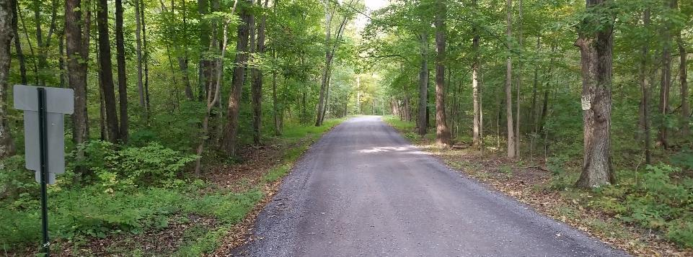
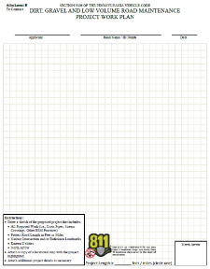
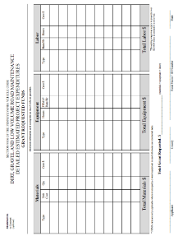
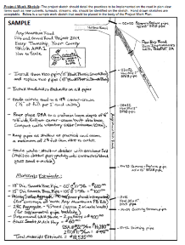
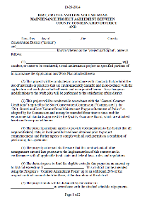
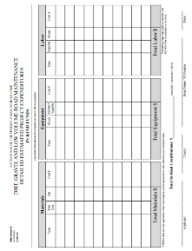
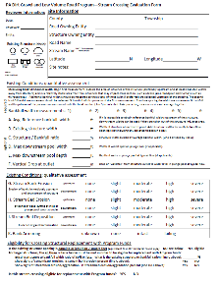
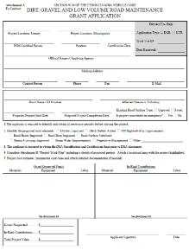
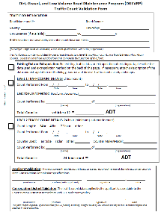
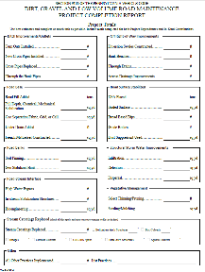
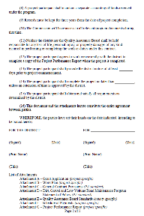
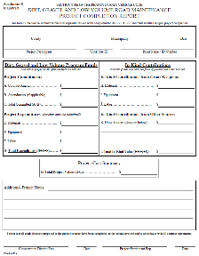
Dirt, Gravel, and Low Volume Road Maintenance Program
Administrative Training
January 2023
If you are reading this, then you are successfully seeing the meeting video. Meeting audio should be automatic through your computer, and options can be accessed in the “audio options” button on the bottom left. If your computer audio is not working, you can listen on your phone by dialing 312-626-6799 (only needed if computer audio is not possible).
Audio via Phone if needed: 312-626-6799
Webinar ID: 952 8609 6347

Slide 2
Logistics and Introductions
Roy Richardson – SCC
Sherri Law – SCC
Steve Bloser - PSU
www.dirtandgravelroads.org
Audio via Phone if needed: 312-626-6799
Webinar ID: 952 8609 6347
Audio via Phone: 669-900-6833
2
Audio via Phone: 669-900-6833

Slide 3
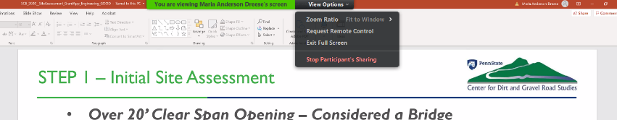
Zoom Logistics
  Top of your screen:
    Viewing options
    Get out of full screen mode, etc.
Your buttons will look different, just look for the lime green tab
Audio via Phone if needed: 312-626-6799
Webinar ID: 952 8609 6347

Slide 4
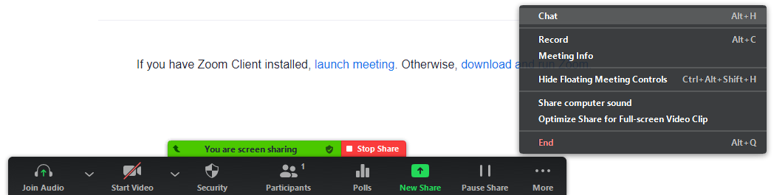

Zoom Logistics
  Bottom of your screen:
    Zoom Controls
Your buttons will look different, just look for the lime green tab
Audio via Phone if needed: 312-626-6799
Webinar ID: 952 8609 6347

Slide 5

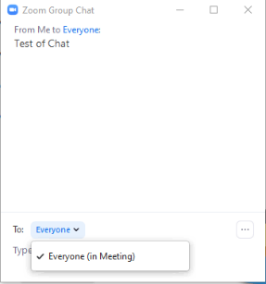
Zoom Logistics
  You are muted by default.
  Three options to communicate:
    Chat: text chat with panelists and/or attendees
Roy\Justin\Steve

Slide 6

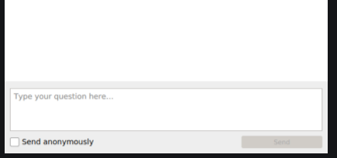
Zoom Logistics
  You are muted by default.
  Three options to communicate:
    Chat: text chat with panelists and/or attendees
    Q&A: Ask questions to panelists (can be anonymous)
Roy\Justin\Steve
Audio via Phone if needed: 312-626-6799
Webinar ID: 952 8609 6347

Slide 7

Zoom Logistics
  You are muted by default.
  Three options to communicate:
    Chat: text chat with panelists and/or attendees
    Q&A: Ask questions to panelists
    Raise Hand: We will assume you wish to speak and unmute you
Audio via Phone if needed: 312-626-6799
Webinar ID: 952 8609 6347

Slide 8
Admin Training Schedule
Today
Will take 1-2 breaks
This is the full (directors cut) DGLVR admin training, not a shortened refresher.
Logistical questions?
Let’s Get Started
PLEASE ASK QUESTIONS
Audio via Phone if needed: 312-626-6799
Webinar ID: 952 8609 6347

Slide 9
Dirt, Gravel, and Low Volume Road Maintenance Program
Administrative Training
January 2023
RECORD

Slide 10
Dirt, Gravel, and Low Volume Road Maintenance Program
Administrative Training
January 2023

Slide 11
Administrative Training
Introduction
Steve Bloser
  CENTER Director
  PSU Center for Dirt and Gravel Roads
  smb201@psu.edu
  814-865-5355
Roy Richardson
  PROGRAM Coordinator
  State Conservation Commission
  Pa Department of Agriculture
  rrichardso@pa.gov
  717-787-2013
Sherri Law
  State Conservation Commission
  Pa Department of Agriculture
  shlaw@pa.gov
  223 – 666 – 2567 / Cell: 717-480-2303
Vacant

Slide 12
Administrative Training
Introduction
Goals today:
Provide guidance for Districts to run their Program.
Clear up “grey areas” in existing Program.
Outline new topics.

Slide 13
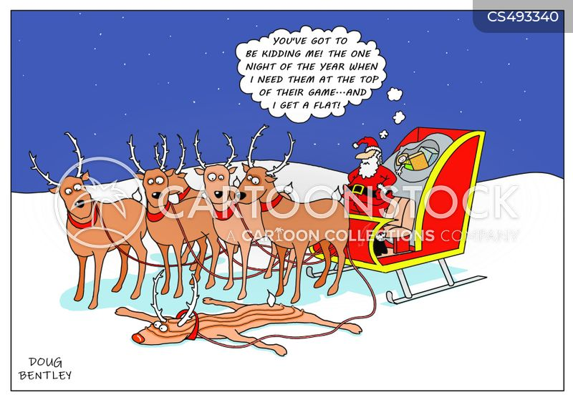
Funny Slide
Sleigh Cartoons and Comics - funny pictures from CartoonStock
https://www.cartoonstock.com/directory/s/sleigh.asp

Slide 14
Administrative Training
Introduction
Program Fundamentals
  Focus on environmental and road improvement projects
  Local control
    Conservation District runs local Program
    Quality Assurance Boards at County
    State guidance and local policies
  Application and Grant Process, 90%+ of applicants are townships.

Slide 15
Administrative Training
Introduction
What do we mean by “Local Control”?

Slide 16
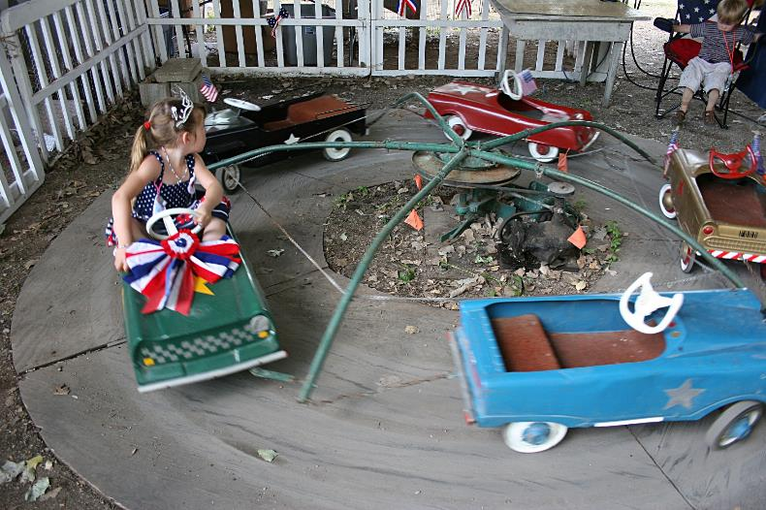
Administrative Training
Introduction
What do we mean by “Local Control”?
0% Local Control
Administrative Training

Slide 17

Administrative Training
Introduction
What do we mean by “Local Control”?
100% Local Control

Slide 18
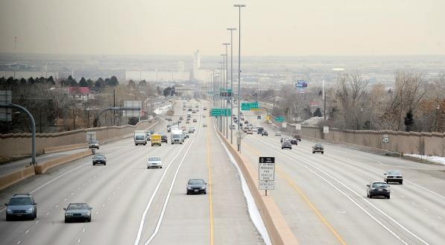
Administrative Training
Introduction
What do we mean by “Local Control”?
Effective local control
“lanes and guiderails”

Slide 19

Administrative Training
Introduction
Overall balancing act
Need for Increased Accountability
Simplicity and Local Control
D&G

Slide 20
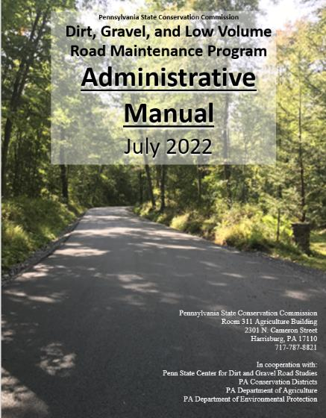
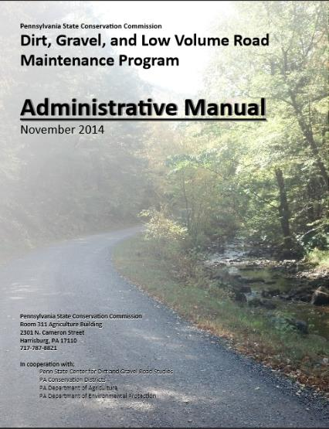
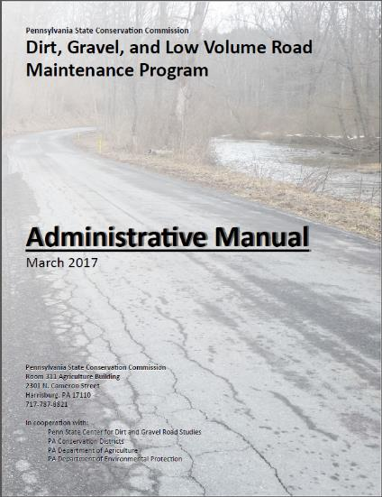
Administrative Manual
Introduction
DG&LVR Administrative Manual
Approved by SCC 5/10/22
Introduction
SCC Role
Conservation District Role
Quality Assurance Board Role
Applicant Role
Center for Dirt and Gravel Roads
Additional Policies
Permits and Other Requirements
Appendices
Available online.
Hard copies sent on request.
Training Follows Manual!

Slide 21
Administrative Manual
Introduction
DG&LVR Administrative Manual
Approved by SCC 5/10/22
Introduction
SCC Role
Conservation District Role
Quality Assurance Board Role
Applicant Role
Center for Dirt and Gravel Roads
Additional Policies
Permits and Other Requirements
Appendices
Available online.
Hard copies sent on request.
Introduction
6-page “Abstract” of the Program and the rest of the manual.
Program Structure
Program History
ESM Overview
Training Follows Manual!

Slide 22
Administrative Manual
Introduction
DG&LVR Administrative Manual
Approved by SCC 5/10/22
Introduction
SCC Role
Conservation District Role
Quality Assurance Board Role
Applicant Role
Center for Dirt and Gravel Roads
Additional Policies
Permits and Other Requirements
Appendices
Available online.
Hard copies sent on request.
SCC Role
4-page summary of SCC role
SCC Structure
Program Administration
QAQC
Training Follows Manual!

Slide 23
Administrative Manual
Introduction
DG&LVR Administrative Manual
Approved by SCC 5/10/22
Introduction
SCC Role
Conservation District Role
Quality Assurance Board Role
Applicant Role
Center for Dirt and Gravel Roads
Additional Policies
Permits and Other Requirements
Appendices
Available online.
Hard copies sent on request.
3) District Role
Over ½ of manual
Receiving Funds
Accounting for Funds
Dispersing Funds to Grantees
CD Educational Opportunities
Education/Training by CDs
Program Eligibility
Administering Projects
GIS system
Quarterly Reports
Annual Reports
Training Follows Manual!

Slide 24
Administrative Manual
Introduction
DG&LVR Administrative Manual
Approved by SCC 5/10/22
Introduction
SCC Role
Conservation District Role
Quality Assurance Board Role
Applicant Role
Center for Dirt and Gravel Roads
Additional Policies
Permits and Other Requirements
Appendices
Available online.
Hard copies sent on request.
4) QAB Role
Defines composition and function of QAB
Composition
Meeting Requirements
QAB Role in Projects
QAB Role in Policy
Training Follows Manual!

Slide 25
Administrative Manual
Introduction
DG&LVR Administrative Manual
Approved by SCC 5/10/22
Introduction
SCC Role
Conservation District Role
Quality Assurance Board Role
Applicant Role
Center for Dirt and Gravel Roads
Additional Policies
Permits and Other Requirements
Appendices
Available online.
Hard copies sent on request.
5) Applicant Role
Intentionally repeats previous material
Written “to” the applicant audience
Intended to be standalone to give to applicants.
Training Follows Manual!

Slide 26
Administrative Manual
Introduction
DG&LVR Administrative Manual
Approved by SCC 5/10/22
Introduction
SCC Role
Conservation District Role
Quality Assurance Board Role
Applicant Role
Center for Dirt and Gravel Roads
Additional Policies
Permits and Other Requirements
Appendices
Available online.
Hard copies sent on request.
6) Center Role
3-page overview of Center role and available services
Education
Outreach
Technical Assistance
Documentation
Training Follows Manual!

Slide 27
Administrative Manual
Introduction
DG&LVR Administrative Manual
Approved by SCC 5/10/22
Introduction
SCC Role
Conservation District Role
Quality Assurance Board Role
Applicant Role
Center for Dirt and Gravel Roads
Additional Policies
Permits and Other Requirements
Appendices
Available online.
Hard copies sent on request.
7) Additional Policies
Policies that apply to certain circumstances:
Stream Crossing Replacement
Driving Surface Aggregate
Paved LVR-Specific Policies
Full Depth Reclamation
Training Follows Manual!

Slide 28
Administrative Manual
Introduction
DG&LVR Administrative Manual
Approved by SCC 5/10/22
Introduction
SCC Role
Conservation District Role
Quality Assurance Board Role
Applicant Role
Center for Dirt and Gravel Roads
Additional Policies
Permits and Other Requirements
Appendices
Available online.
Hard copies sent on request.
8) Permits
Brief overview of permit issues related to Program projects.
Training Follows Manual!

Slide 29
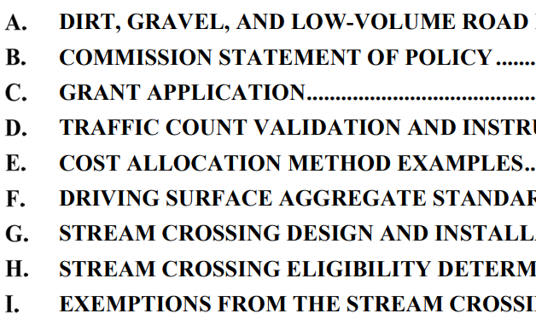

Administrative Manual
Introduction
DG&LVR Administrative Manual
Approved by SCC 5/10/22
Introduction
SCC Role
Conservation District Role
Quality Assurance Board Role
Applicant Role
Center for Dirt and Gravel Roads
Additional Policies
Permits and Other Requirements
Appendices
Available online.
Hard copies sent on request.
Appendices
Program forms and policies…
Training Follows Manual!

Slide 30

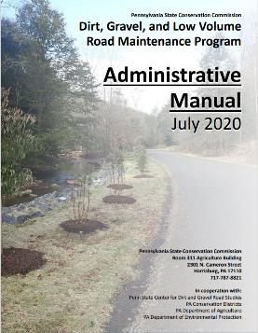
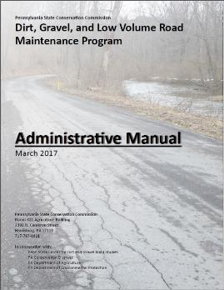
Administrative Manual
Introduction
SCC Role
Conservation District Role
Quality Assurance Board
Applicant Role
Center for Dirt and Gravel Roads
Additional Policies
Permits and Other Requirements
Appendices

Slide 31
1) Introduction
Chap 3. CD Role
1.1 Program Purpose
1.2 Program Structure
1.3 Program History
1.4 Worksites
Topic List:
Program Overview

Slide 32
Introduction
Chap 1. Intro
Introduction Contents
Overview of Program and rest of manual
Brief Program history
Explanation of Worksites
Brief Explanation of Environmentally Sensitive Maintenance practices

Slide 33
Introduction
Chap 1. Intro
Introduction Contents
Overview of Program and rest of manual
Brief Program history
Explanation of Worksites
Explanation of ESM practices
Note manual section and title on top of slide. Follow along or take notes in manual.

Slide 34
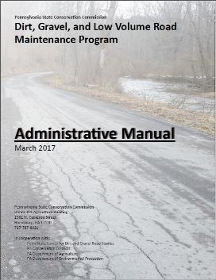
Administrative Manual
Introduction
SCC Role
Conservation District Role
Quality Assurance Board
Applicant Role
Center for Dirt and Gravel Roads
Additional Policies
Permits and Other Requirements
Appendices

Slide 35
2) State Conservation Commission
Chap 2. SCC
State Conservation Commission (SCC)
14-member board in PA Department of Agriculture
Doug M. Wolfgang: Executive Secretary
Roy Richardson: DGLVR Program Coordinator
Sherri Law: DGLVR Staff
vacant: DGLVR Staff

Slide 36
2) State Conservation Commission
Chap 2. SCC
SCC Role
SCC Structure
Program Coordinator
Allocations
Replenishments
Establishing Policy
Quality Assurance / Quality Control

Slide 37
2) State Conservation Commission
Chap 2. SCC
Quality Assurance / Quality Control (QAQC)
1-2 day visit to review county Program.
Financial, Administration & Functionality, Projects.
Involves SCC, Center, and Field Reps.
Planning to visit ~22 districts annually.
Complete details on website www.dirtandgravelroads.org

Slide 38
2) State Conservation Commission
Chap 2. SCC
QAQC Round 1:
Every County visited 2003-2011
QAQC Round 2:
Every County visited 2015-2017
QAQC Round 3:
Every County visited 2018-2020
QAQC Round 4:
2021 to 2023
48 completed so far

Slide 39
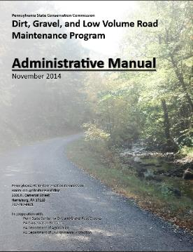
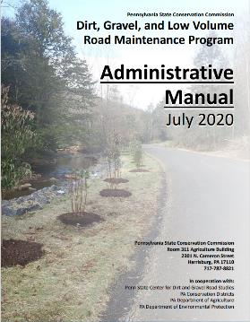
Administrative Manual
Introduction
SCC Role
Conservation District Role
Quality Assurance Board
Applicant Role
Center for Dirt and Gravel Roads
Additional Policies
Permits and Other Requirements
Appendices

Slide 40
3) Conservation District Role
Chap 3. CD Role
District Role:
  Run the Program within each County.
  Receive $ from SCC
  Provide grants to applicants

Slide 41
SHERRI

Slide 42
3) CD Role
Chap 3. CD Role
3.1 CD Structure
3.2 Overview
3.3 Receiving Funds from SCC
3.4 Accounting of funds at CD
3.5 Dispersing funds to Grant Recipients
3.6 CD Educational opportunities
3.7 Program Eligibility
3.8 Administering Projects
3.9 GIS System
3.10Annual Summary Reports
Topic List:
follow the money

Slide 43
3) CD Role
Chap 3. CD Role
3.1 CD Structure
3.2 Overview
3.3 Receiving Funds from SCC
3.4 Accounting of funds at CD
3.5 Dispersing funds to Grant Recipients
3.6 CD Educational opportunities
3.7 Program Eligibility
3.8 Administering Projects
3.9 GIS System
3.10Annual Summary Reports

Slide 44
3.3 Receiving Funds from SCC
Chap 3. CD Role
Receiving Funds from SCC
5-year agreement (FY 2022-23 is year 5)
Timeline for allocations
  Approved by SCC in May
  Approved in State Budget for July 1
  Advances received by CDs by September
Allocations are formula-based:
  DGR: miles of unpaved roads and worksites and proximity to streams
  LVR: miles of urban and non-urban roads and proximity to streams
  Complete details: www.dirtandgravelroads.org

Slide 45
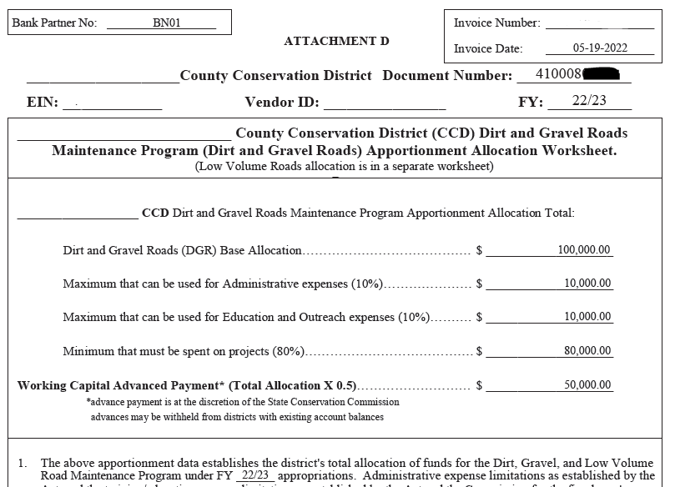
3.3.2-3: Advanced Working Capital
Chap 3. CD Role
Advanced Working Capital
50% of allocations advanced to districts
  Will come as separate deposits (DGR and LVR)
  Allocation worksheet explains breakdowns

Slide 46
Chap 3. CD Role
DGLVR funds will be direct deposited into each conservation district’s account
Required by PA State Treasury
Separate deposits for DGR and LVR

Slide 47
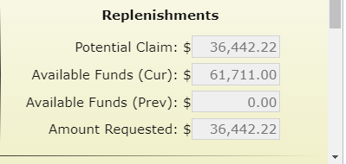
Replenishment
Chap 3. CD Role
Districts receive replenishments of remaining 50% of funds based on actual spending
  Replenishments handled in GIS quarterly reporting system
    Automatically generated each quarter
    DGR and LVR replenishment will come in separate deposits

Slide 48
3.3.4: Spending Requirements
Chap 3. CD Role
Spending Requirements
DGR and LVR spending tracked separately.
All funds must be spent within two years of state budget approval to be eligible for future allocations.
  Administration and Education funds must be utilized within the fiscal year they are allotted
  At the end of the fiscal year, unspent admin and edu funds become project funds (which still must be spent by the end of the 2-year time frame)
If a District misses a year, can be eligible in future years if they meet future requirements.

Slide 49
3.3.4: Spending Requirements
Chap 3. CD Role
Spending Requirements
Tracked in the GIS
Contact the SCC for assistance with meeting spending requirements

Slide 50
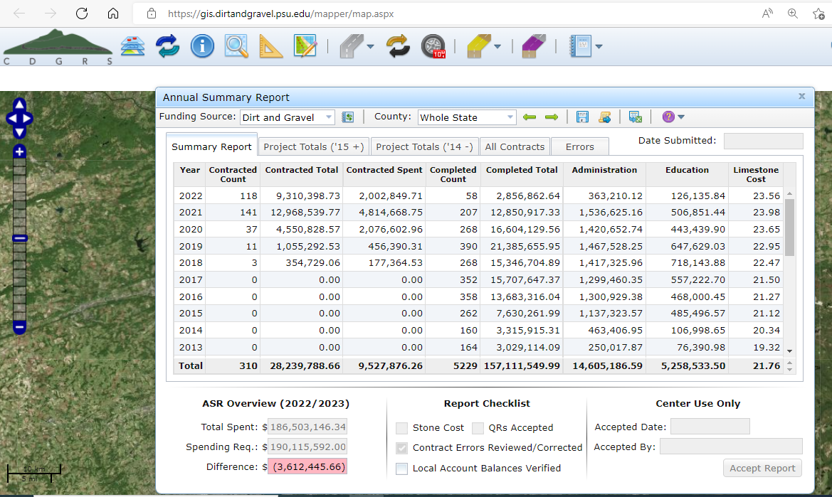
3.3.4: Spending Requirements
Chap 3. CD Role
Annual Summary Report

Slide 51
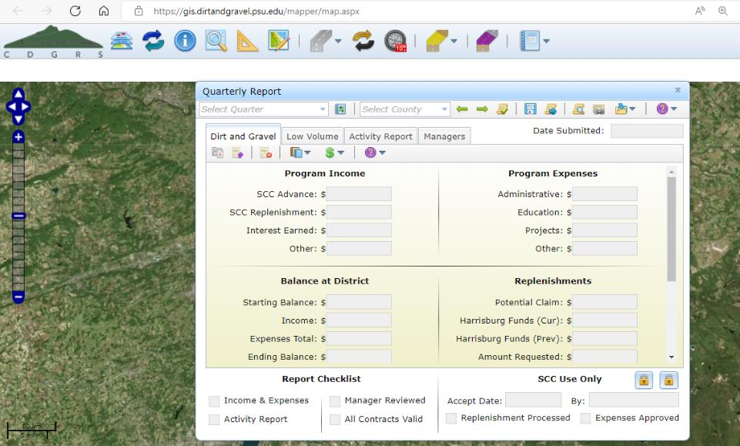
3.3.4: Spending Requirements
Chap 3. CD Role
Quarterly Report
Claimable Admin/Edu Tool
Budget Tool

Slide 52
3.3.4: Spending Requirements
Chap 3. CD Role
NOTE: This ONLY accounts for administrative and education spending reported in quarterly reports
(Does not include budgeted/planned admin or edu spending)

Slide 53
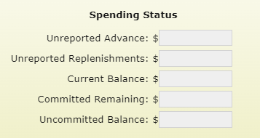
3.3.4: Spending Requirements
Chap 3. CD Role
Updated based on quarterly reports
100,000.00
Funds committed but not paid to contracts in GIS
60,000.00
40,000.00
Funds available for future spending
(project, admin, and edu)
NOTE: Does not include budgeted/planned admin or edu spending

Slide 54
3.3.4: Spending Requirements
Chap 3. CD Role
NOTE: This tool resets every quarter
Make sure quarterly report is up to date before starting
See 7/7/22 webinar recording for details

Slide 55
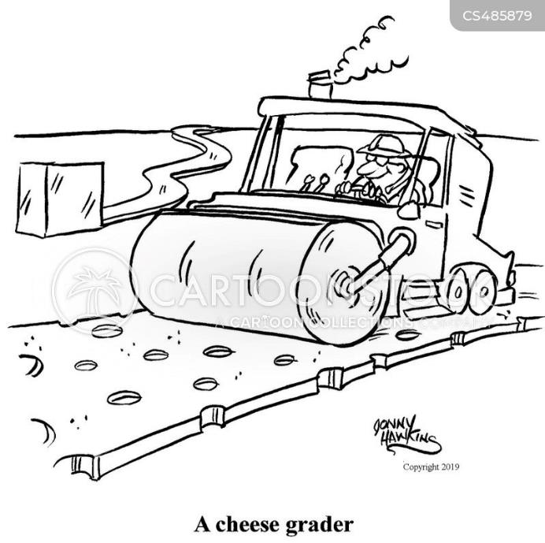
Funny Slide
https://www.cartoonstock.com/directory/c/cheese_grader.asp

Slide 56
3) CD Role
Chap 3. CD Role
3.1 CD Structure
3.2 Overview
3.3 Receiving Funds from SCC
3.4 Accounting of funds at CD
3.5 Dispersing funds to Grant Recipients
3.6 CD Educational opportunities
3.7 Program Eligibility
3.8 Administering Projects
3.9 GIS System
3.10Annual Summary Reports

Slide 57
3.4.1 Separate Accounting
Chap 3. CD Role
DGLVR funds must be in an interest-bearing Federal Deposit Insurance Corporation or equivalent insured account
Districts must ensure that account balances in excess of $250,000 are also insured or otherwise collateralized
District records relating to the DGLVR Program must be kept for a minimum of 7 years

Slide 58
3.4.1: Separate Accounting
Chap 3. CD Role
Separate Accounting:
Dirt and Gravel Roads funds (Project, Admin, and Edu)
  to be used solely for Dirt and Gravel Road Program expenses
  must be accounted for separate from the Low Volume Roads funds
Low Volume Roads funds (Project, Admin, and Edu)
  to be used solely for Low Volume Road Program expenses
  must be accounted for separate from the Low Volume Roads funds

Slide 59
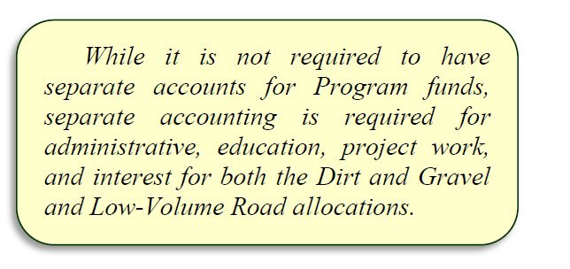
3.4.1: Separate Accounting
Chap 3. CD Role

Slide 60
3.4.1: Separate Accounting
Chap 3. CD Role
Separate Accounting:
Districts are required to track funding based on the following categories:
DGR
Income
  Advances
  Replenishments
  Interest earned
Expenses
  Administration
  Education / Training
  Projects
LVR
Income
  Advances
  Replenishments
  Interest earned
Expenses
  Administration
  Education / Training
  Projects
These categories are in the quarterly report

Slide 61
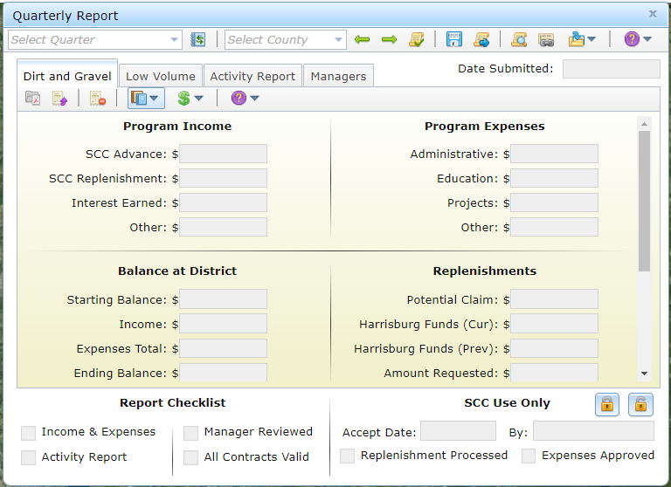
3.4.1: Separate Accounting
Chap 3. CD Role
“Other”
Should be rare

Slide 62
3.4.2-7 CD Spending Categories
Chap 3. CD Role
District May Utilize:
Up to 10% for administration.
Up to 10% for education/training
At least 80% must be spent on projects.

Slide 63
3.4.2-7 CD Spending Categories
Chap 3. CD Role
DGLVR Allocation
Must be spent in 2 years
100% can be used for Projects

Slide 64
3.4.2-7 CD Spending Categories
Chap 3. CD Role
DGLVR Allocation
Available in the first year of an allocation
Max 10% can be Admin
Max 10% can be Edu
Minimum 80% Project funds

Slide 65
3.4.2-7 CD Spending Categories
Chap 3. CD Role
Can use less than
10% of allocation for admin and 10% of allocation for edu
DGLVR Allocation
Admin
Edu
Minimum 80% Project funds

Slide 66
3.4.2-7 CD Spending Categories
Chap 3. CD Role
DGLVR Allocation
Unused admin & edu allowance become project funds
Admin
Edu
Minimum 80% Project funds

Slide 67
3.4.2-7 CD Spending Categories
Chap 3. CD Role
All funds must be spent in 2 years
DGLVR Allocation
Admin
Edu
Minimum 80% Project funds

Slide 68

3.4.2-4 CD Spending Categories
Chap 3. CD Role
Spending Policies
https://www.istockphoto.com/illustrations/money-falling

Slide 69
3.4.3: Administrative Funds
Chap 3. CD Role
Guidelines for Administrative Funds
Up to 10% of allocations of both DGR and LVR
  Up to 100% of funds can be used on projects
Primary purpose of Admin Funds is:
  Ensure adequate funding for technical staff who work on the Program
Must be spent on eligible expenses as they are incurred.
Must be incurred within the allotted fiscal year (1 year spending limit)
“Banking” of funds is not permitted

Slide 70
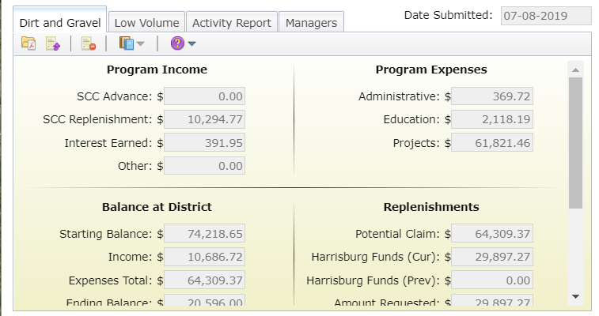
3.4.3: Administrative Funds
Chap 3. CD Role
Administration Funds

Slide 71
3.4.4 Education Funds
Chap 3. CD Role
Guidelines for Education / Training Funds
Up to 10% of allocations of both DGR and LVR
  Up to 100% of funds can be used on projects
Primary purpose of education funds:
  Allow District to attend trainings and events for their own education
  Provide training and events for potential program participants
Must be spent on eligible expenses as they are incurred.
Must be incurred within the allotted fiscal year
“Banking” of funds is not permitted

Slide 72
3.4.4: Education Funds
Chap 3. CD Role
Education/Training Funds

Slide 73
3.4.3 & 3.4.4: Admin / Education Funds
Chap 3. CD Role
Admin and Edu funds are not the same
Admin
Edu
Salary and Benefits for administering the Program
Travel for administering the Program
Office Expenses
Field Equipment
Aggregate testing
Consulting services
Overhead costs (insurance, utilities, rent)
Salary and Benefits for time related to DGLVR educational activities
Travel for educational purposes
Costs to attend trainings
Costs to host trainings
Promotional materials
Participation incentives
- Equipment for rental to applicants
- Demonstration Projects
- Cost Allocation Method must be used for shared expenses

Slide 74
3.4.3 & 3.4.4: Admin / Education Funds
Chap 3. CD Role
Admin and Edu funds are not the same
Salary and Benefits
Admin
Edu
Salary and Benefits for administering the DGLVR Program
Salary and Benefits related to DGLVR educational activities
Cost Allocation Method must be used for shared expenses
Salary and Benefits for technical staff, support staff, and management salaries

Slide 75
3.4.3 Administrative Funds
Chap 3. CD Role
Example administration activities include:
    site inspections, meetings, completing paperwork, communications, etc. related to DGLVR Projects.
    QAB meetings and Conservation District Board of Director meetings
    Reviewing DGLVR applications
Red Text shows wording changes to the DGLVR Admin Manual (effective 7/1/2022)

Slide 76
3.4.4 Education Funds
Chap 3. CD Role
DGLVR educational activities include:
  attending or hosting trainings, conferences, field days, workshops, technical assistance, or other outreach activities.
  Teaching individuals or small groups about the DGLVR Program in regard to potential DGLVR Project sites without a current contract for DGLVR funds. This includes working with potential grant applicants to develop an application for DGLVR funds, such as pre-application meetings.
DGLVR educational activities do NOT include:
  Administering DGLVR Projects with a current DGLVR Contract
  Administering the DGLVR Program, including QAB meetings, Conservation District Board of Director meetings, and reviewing DGLVR applications
Red Text shows wording changes to the DGLVR Admin Manual (effective 7/1/2022)

Slide 77
3.4.3 & 3.4.4: Admin / Education Funds
Chap 3. CD Role
Salary and Benefits:
  Salary can only be claimed for time spent working directly on administration or education/training efforts for the DGLVR program.
Tracking can be done on an hourly basis, a percent effort basis, or some other method that allocates salary in accordance with time spent on the Program.
Conservation districts must be able to document that staff time claimed as administrative time is spent on eligible administrative activities and staff time claimed as education time is spent on eligible education activities.
Red Text shows wording changes to the DGLVR Admin Manual (effective 7/1/2022)

Slide 78
3.4.3 & 3.4.4: Admin / Education Funds
Chap 3. CD Role
Staff time tracking:
  This should be a time sheet and/or report that includes details of the activity, including:
    the date
    activity description
    staff member(s)
    amount of time
    road name & road owner
    how the activity qualifies as a DGLVR admin or edu activity
  or some other method that documents that admin or edu time is spent on eligible admin or edu activities, respectively.
Red Text shows wording changes to the DGLVR Admin Manual (effective 7/1/2022)

Slide 79
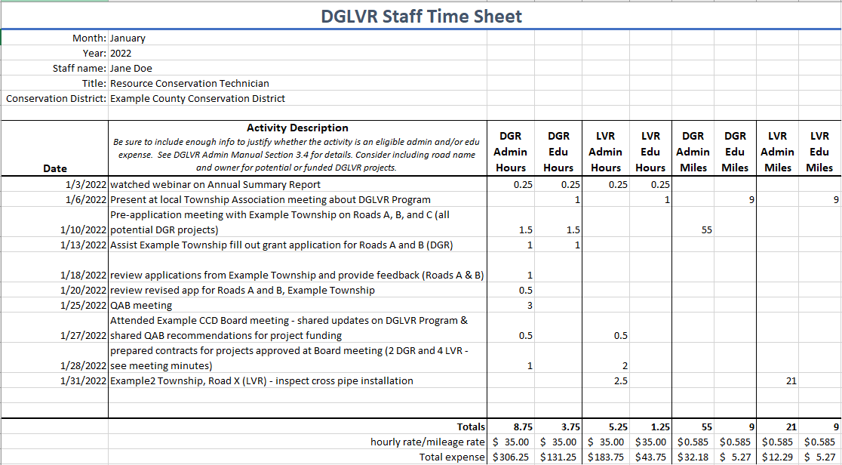
Example Time Tracking Method

Slide 80
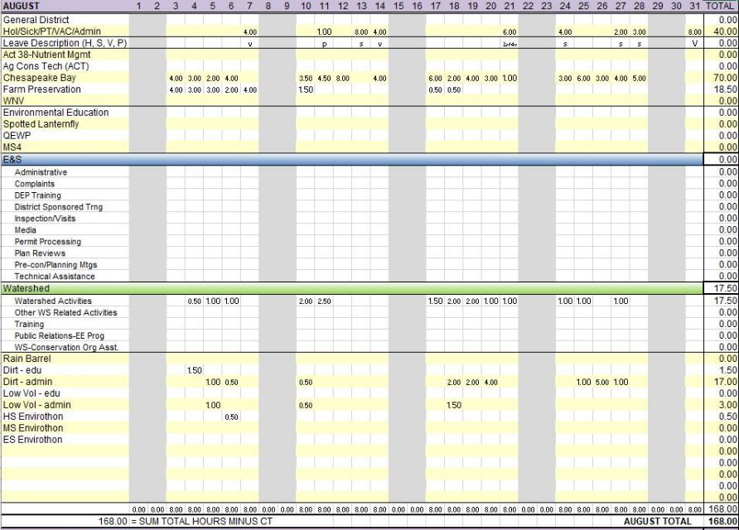
Example Time Tracking Method

Slide 81
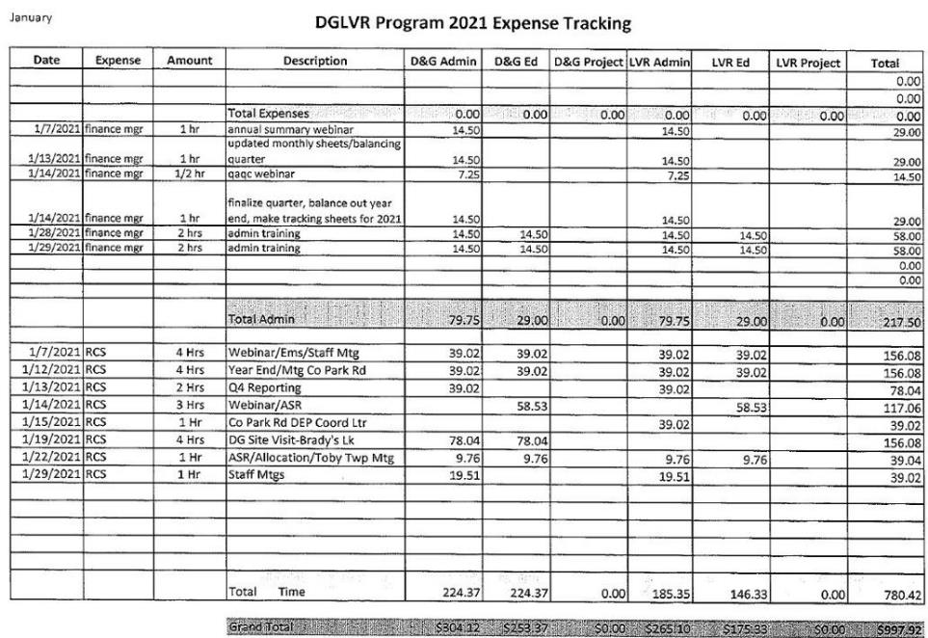
Example Time Tracking Method

Slide 82
3.4.3& 3.4.4: Admin / Education Funds
Chap 3. CD Role
Admin and Edu funds are not the same
Travel
Edu
Admin
Travel to:
field sites & meetings
vehicle costs
per-diems
Parking
Etc.
  Travel to:
  set up trainings, workshops, and demonstrations for local stakeholders
  Attend trainings/workshops
  Provide trainings/workshops

Slide 83
3.4.3 & 3.4.4: Admin / Education Funds
Chap 3. CD Role
Admin and Edu funds are not the same
Field Equipment
Equipment for applicants
(NOT eligible)
Admin
Edu
Equipment for loan/rental to applicants
  Leaf blowers
  traffic counters
  grader blades
  etc.
Cost Allocation Method must be used for shared expenses
Equipment for CD use:
  Levels
  Tapes
  survey equipment
  safety equipment
  etc.
Some districts may choose to use drones to take project pictures, video, and create educational materials. Note that districts using drones for any program are subject to the SCC’s “Conservation District Drone Utilization Policy”.
Red Text shows wording changes to the DGLVR Admin Manual (effective 7/1/2022)

Slide 84
3.4.3 & 3.4.4: Admin / Education Funds
Chap 3. CD Role
Admin and Edu funds are not the same
Other
Admin
Edu
Providing training:
  Staff time, supplies, location rental, etc.
Promotional Materials
  Advertisements, reports, websites, project signage
Promotional items
  limited to $1,000/yr
Participation Incentives
  Paying travel costs related to education activities for applicants or QAB members
Office Expenses
  Includes:
  Computers
  Printers
  internet service
  office supplies like paper, etc.
  Aggregate testing
  Consultant services
  Overhead costs (insurance, utilities, rent, etc.)
Cost Allocation Method must be used for shared expenses

Slide 85
3.4.2 Cost Allocation Method
Chap 3. CD Role
Some expenses will be 100% eligible DGLVR expenses:
  folders for DGLVR files
  mileage to a DGLVR project site
  QAB newspaper ad
  Etc.
Some expenses will be shared with other programs:
  File folders for any district staff to use
  Vehicle maintenance for a shared district vehicle
  Newsletter that covers all district programs
  Etc.

Slide 86
3.4.2 Cost Allocation Method
Chap 3. CD Role
Only a portion of shared expenses are eligible DGLVR expenses
Why?
  DGR funds can only be used for DGR expenses
  LVR funds can only be used for LVR expenses
Separate accounting is required
DGR Expenses
Administration
Education / Training
Projects
LVR Expenses
Administration
Education / Training
Projects

Slide 87

3.4.2 Cost Allocation Method
Chap 3. CD Role
How do we determine what portion of shared expenses are eligible DGR and LVR expenses?
Cost Allocation Method (CAM):
  Method for splitting shared costs proportionately between multiple programs
Splitting a dinner bill with friends is a cost allocation method
  You only pay for what you ate

Slide 88
3.4.2 Cost Allocation Method
Chap 3. CD Role
Cost Allocation Method (CAM):
Must be utilized for shared district expenses, such as:
  Vehicles
  Rent
  Office Supplies
  Phone/Internet
  Etc.
Must be available to the SCC upon request

Slide 89
3.4.2 Cost Allocation Method
Chap 3. CD Role
Cost Allocation Method Policy
The percent of shared expenses that are eligible DGR expenses are equal to the percent of staff time spent on DGR activities.
  The percent of staff time spent on DGR activities must be calculated compared to the total staff time spent on all programs/activities sharing the expense.
The percent of shared expenses that are eligible LVR expenses are equal to the percent of staff time spent on LVR activities.
  The percent of staff time spent on LVR activities must be calculated compared to the total staff time spent on all programs/activities sharing the expense.
Red Text shows wording changes to the DGLVR Admin Manual (effective 7/1/2022)

Slide 90
3.4.2 Cost Allocation Method
Chap 3. CD Role
Justin ate ½ slice of pizza
How much of the pizza does Justin pay for?
Justin pays for 1/16 of the pizza

Slide 91
3.4.2 Cost Allocation Method
Chap 3. CD Role
Pizza = shared expense
How much pizza you eat = how much of the expense is used for DGR or LVR

Slide 92
3.4.2 Cost Allocation Method
Chap 3. CD Role
The percent of shared expenses that are eligible DGR expenses are equal to the percent of staff time spent on DGR activities.
  The percent of staff time spent on DGR activities must be calculated compared to the total staff time spent on all programs/activities sharing the expense.

Slide 93
3.4.2 Cost Allocation Method
Chap 3. CD Role
Cost Allocation Method for Salaries
Salaries and associated benefits can only be paid for with DGLVR funds for time spent working directly on the DGLVR Program.
Tracking can be done on an hourly basis, a percent effort basis, or some other method that allocates salary in accordance with time spent on the DGLVR Program.

Slide 94
3.4.2 Cost Allocation Method
Chap 3. CD Role
Cost Allocation Method for Salaries
  Salary and benefits for time spent on DGR activities are to be paid for with DGR funds.
  If a conservation district chooses to divide salaries on a percent basis, then:
    the percent of a staff member’s salaries and benefits paid for with DGR funds must be proportionate to the amount of time that staff member spends on DGR activities out of the staff member’s total hours in a given time period.
Red Text shows wording changes to the DGLVR Admin Manual (effective 7/1/2022)

Slide 95
3.4.2 Cost Allocation Method
Chap 3. CD Role
Cost Allocation Method for Salaries CONTINUED
  Salary and benefits for time spent on LVR activities are to be paid for with LVR funds.
  If a conservation district chooses to divide salaries on a percent basis, then:
    The percent of a staff member’s salaries and benefits paid for with LVR funds must be proportionate to the amount of time that staff member spends on LVR activities out of the staff member’s total hours in a given time period.
Red Text shows wording changes to the DGLVR Admin Manual (effective 7/1/2022)

Slide 96
3.4.2 Cost Allocation Method
Chap 3. CD Role
The percent of a staff member’s salaries and benefits paid for with LVR funds
  must be proportionate to the amount of time that staff member spends on LVR activities out of the staff member’s total hours in a given time period.

Slide 97
3.4.2 Cost Allocation Method
Chap 3. CD Role
Examples of cost allocation methods that meet the policy outlined above are available in appendix E.
  These are not the only acceptable cost allocation methods.
For assistance in developing a cost allocation method, contact the SCC.
Red Text shows wording changes to the DGLVR Admin Manual (effective 7/1/2022)

Slide 98
Appendix E
Cost Allocation Method examples
CAM Example 3: If a district has a vehicle that is shared unequally by several programs, vehicle expenses or charges must be based on actual usage for each Program.

Slide 99
3.4.2-4 CD Spending Categories
Chap 3. CD Role
Cost Allocation Method Example3:
Vehicle shared unequally by multiple programs
5% of use is for DGR
8% of use is for LVR
How shared expenses are paid:
5% are eligible DGR expenses
8% are eligible LVR expenses
87% are NOT eligible DGLVR expenses
87% of use is for Other Program(s)

Slide 100
Appendix E
Cost Allocation Method examples
Example 3:
Vehicle is used for 500 miles in a quarter. 52 of those miles were for DGR activities, and 110 were for LVR activities.
Eligible DGR mileage expense =
52 x $0.58 (or other acceptable mileage rate) = $30.16
Eligible LVR mileage expense =
110 x $0.58 (or other acceptable mileage rate) = $63.80
OR
How much of a $50 oil change is eligible for reimbursement with DGR and LVR funds?
DGR: 52 = 0.104 $50 x 0.104 =$5.20 of the oil change
500 is an eligible DGR expense
LVR: 110 = 0.22 $50 x 0.22 = $11.00 of the oil change
500 is an eligible LVR expense

Slide 101
Appendix E
Cost Allocation Method examples
CAM Example 2: If a district has a vehicle that is shared equally by 4 programs, vehicle expenses could be divided equally among the 4 Programs.
DGLVR is one of the 4 programs, and the vehicle is used for equal amounts on DGR and LVR activities.
1/8 (12.5%) of the vehicle expenses are eligible DGR expenses, and
1/8 (12.5%) of the vehicle expenses are eligible LVR expenses.
Note: In this scenario, vehicle logs would document the equal usage of the vehicle for different programs, and the logs must be retained and provided upon request per section 3.4.1.

Slide 102
Appendix E
Cost Allocation Method examples
Cost Allocation Method Example 2:
Vehicle shared equally by 4 Programs
25% of use is for DGLVR activities
25% of use is for Other Program A
25% of use is for Other Program B
25% of use is for Other Program C

Slide 103
3.4.2-4 CD Spending Categories
Chap 3. CD Role
Cost Allocation Method Example 2:
Vehicle shared equally by 4 Programs
How shared expenses are paid:
12.5% are eligible DGR expenses
12.5% are eligible LVR expenses
75% are NOT eligible DGLVR expenses
12.5% of use is for DGR
25% of use is for Other Program A
12.5% of use is for LVR
25% of use is for Other Program B
25% of use is for Other Program C

Slide 104
Appendix E
Cost Allocation Method examples
Example 2:
100% = 12.5%
8
Example Expense: $1,000.00
1/8 (12.5%) of vehicle use is DGR
$1,000 x 12.5% = $125.00 is an eligible DGR expense
1/8 (12.5%) of vehicle use is LVR
$1,000 x 12.5% = $125.00 is an eligible LVR expense
$1,000 – $125 – $125 = $750 is not an eligible DGR or LVR expense

Slide 105
Appendix E
Cost Allocation Method examples
Cost Allocation Method Example 1:
Using Full Time Equivalents (FTE)
  Defined by the Federal Government Accountability office as:
    “number of total hours worked divided by the maximum number of compensable hours in a full-time schedule”

Slide 106
Appendix E
Cost Allocation Method examples
Cost Allocation Method Example 1:
1.5 out of 10 FTEs spent on DGLVR
District has 10 Staff
  1 staff spends 100% of their time on DGLVR and 1 staff spends 50% of their time on DGLVR
  1.5 of the 10 FTE’s are funded by and actually spend that amount of time working on the Program
  Then 15% of general overhead expenses (utilities, rent, etc.) are eligible DGLVR Program expenses

Slide 107
Appendix E
Cost Allocation Method examples
Cost Allocation Method Example 1:
1.5 out of 10 FTEs spent on DGLVR
15% of overall staff time spent on DGLVR
How shared expenses are paid:
15% of shared expenses are eligible DGLVR expenses
85% of shared expenses are NOT eligible DGLVR expenses
85% of overall staff time NOT spent on DGLVR

Slide 108
Appendix E
Cost Allocation Method examples
Cost Allocation Method Example 1:
1.5 out of 10 FTEs spent on DGLVR Program
  Then 15% of general overhead expenses (utilities, rent, etc.) can be charged to DGLVR Program
  Should be further sub-divided into DGR and LVR
    75% of DGLVR time is spent on DGR
    25% of DGLVR time is spent on LVR
  Therefore,
    15% x 0.75 = 11.25% of shared expenses are eligible DGR expenses
    15% x 0.25 = 3.75% of shared expenses are eligible LVR expenses

Slide 109
Appendix E
Cost Allocation Method examples
Cost Allocation Method Example 1:
1.5 out of 10 FTEs spent on DGLVR
15% of overall staff time spent on DGLVR
85% of overall staff time NOT spent on DGLVR

Slide 110
Appendix E
Cost Allocation Method examples
Cost Allocation Method Example 1:
1.5 out of 10 FTEs spent on DGLVR
¾ of DGLVR time is spent on DGR
11.25%
¼ of DGLVR time is spent on LVR
3.75%
How shared expenses are paid:
11.25% are eligible DGR expenses
3.75% are eligible LVR expenses
85% are NOT eligible DGLVR expenses
85% of overall staff time NOT spent on DGLVR

Slide 111
Appendix E
Cost Allocation Method examples
Example 1: 1.5 FTEs out of 10 FTEs are spent on DGLVR Activities. 75% of the 1.5 FTEs is spent on DGR activities, and 25% is spent on LVR activities.
Two ways to calculate percentages:
15% ÷ 4 = 3.75%
¾ of DGLVR time is DGR
3.75% x 3 = 11.25% is DGR
¼ of DGLVR time is LVR
3.75% x 1 = 3.75% is LVR
OR
75% of 15% = 0.75 x 0.15 = 0.1125
25% of 15% = 0.25 x 0.15 = 0.0375

Slide 112
Appendix E
Cost Allocation Method examples
Example 1: 1.5 FTEs out of 10 FTEs are spent on DGLVR Activities. 75% of the 1.5 FTEs is spent on DGR activities, and 25% is spent on LVR activities.
Remember, this means:
11.25% of overall staff time is DGR
3.75% of overall staff time is LVR
Example Expense: How much of a $1,000.00 expense is an eligible DGR and LVR expense?
$1,000 x 0.1125 = $112.50 is an eligible DGR expense
$1,000 x 0.0375 = $37.50 is an eligible LVR expense
$1,000 – $112.50 – $37.50 = $850 is not an eligible DGR or LVR expense

Slide 113
3.4.2-4 CD Spending Categories
Chap 3. CD Role
Unacceptable Expense / Cost Allocation Method Examples:
District utilizes only DGLVR program funds to purchase a vehicle and pay for vehicle expenses, but the vehicle is shared by all district programs
District technician spends 5% of their time on DGR and 3% of their time on LVR, but 50% of their salary and benefits are paid for with DGLVR funds
A District spends 15% of their total staff time on DGR activities. 15% of a new backhoe for an applicant is paid for with DGR funds. (DGLVR funds cannot be used to buy equipment for applicants)

Slide 114
3.4.2 Cost Allocation Method
Chap 3. CD Role
Examples of cost allocation methods that meet the policy outlined above are available in appendix E.
  These are not the only acceptable cost allocation methods.
Contact the SCC for assistance in developing a cost allocation method or with any other policy questions/assistance needs.
The SCC is there to help you understand and follow policy
Red Text shows wording changes to the DGLVR Admin Manual (effective 7/1/2022)

Slide 115

Funny Slide
https://sayingimages.com/funny-math-memes/

Slide 116
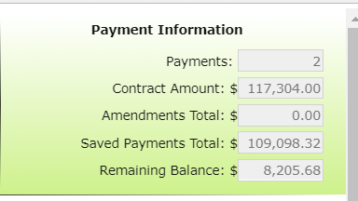
3.4.5: Project Funds
Chap 3. CD Role
Project Funds
At least 80% of funds must go to projects.
Project funds are totaled by the GIS system from the information a District submits for each project
Eligible project expenses outlined in Section 3.7

Slide 117
3.4.5: Project Funds
Chap 3. CD Role
Project Funds

Slide 118
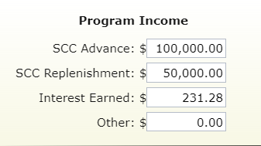
3.4.6: Interest Funds
Chap 3. CD Role
Interest Funds
ALL interest accrued on ALL categories of DGLVR funds (even admin and edu) must be spent on DGLVR projects.
DGR interest must go to DGR projects and
LVR interest must go to LVR projects.
Interest tracked in quarterly reporting

Slide 119
3.4.7 Demonstration projects
Chap 3. CD Role
Demonstration Projects
District-funded outside of ranking system.
Showcase new technology, education site, etc.
  Only education or administrative funds can be used.
  Must follow existing Program policies: be on an eligible public road; have off ROW permissions; have environmental benefit; meet LVR traffic counts; etc.
  Must have QAB and district board Approval.
  Must have a contract, MOU, or other agreement with the road-owning entity.
  Contact Center or Commission staff before contracting a Demo project.

Slide 120
3.4.7 Demonstration projects
Chap 3. CD Role
Demonstration Projects
Do not use to circumvent standard training requirements and normal project agreements.
  Regular project (application, ranking) - any funds
  Demo Project – admin/edu funds only
You can do “education and outreach” efforts on any project.

Slide 121
Chap 3. CD Role
3.4 Accounting of Funds
Verifying Funds
QAQC team will request itemized documentation of DGLVR income and expenses
  DGR and LVR will both be checked
These funds will be cross referenced with figures entered (by the District) into the GIS system.
  Check that quarterly report figures are accurate
District will be asked to provide sufficient evidence of actual expenditures (QuickBooks, Copy of checks, invoices, etc.)
  Check that expenses are eligible

Slide 122
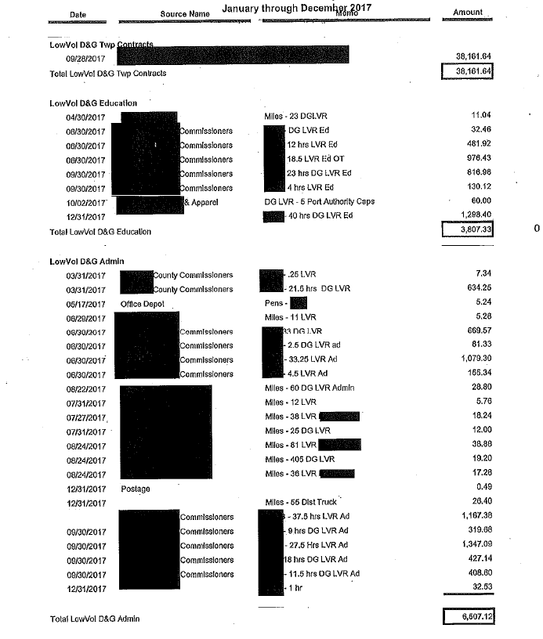
3.4 Accounting of Funds
Chap 3. CD Role
Verifying Funds
Have documentation to back up

Slide 123
Chap 3. CD Role
3.5 Dispersing Funds to Grant Recipients
Dispersing Funds to Grant Recipients
Districts can advance up to 50% of funds to grant recipients
Up to 70% of grant can be paid on a cash-expended basis
At least 30% of grant must be retained until project completion
Conservation districts should develop individual policies regarding payment to grantees
Written schedule of payments is included in contract

Slide 124
Administrative Manual
3.5.3 Contract Amendments
In some cases, the grant recipient may request additional time or addition funding above the contracted amount to complete a project. The approval of additional time or funding to a contract is at the discretion of the district board, based either on a case by case basis or by county policy. Districts may develop their own policies for handling cost overruns and time extensions, provided they are consistent with Commission policy. It is up to the discretion of the conservation district board if amendments to existing contracts must be recommended by the QAB. Options include but are not limited to: requiring district board approval; requiring QAB and district board approval; empowering CD staff to approve amendments, etc. There is no additional funding from the Commission to pay for cost overruns.

Slide 125
Administrative Manual
3.5.3 Contract Amendments
For cost overruns totaling 40 percent or less of the initial contract amount, a contract amendment must be completed and signed by both entities (available at www.dirtandgravelroads.org). Multiple amendments may be granted, provided the total of all amendments is not more than 40 percent of the initial contract amount. Amendments must be approved by the district board according to policies they establish. For contract amendments over 40 percent, written approval is required from the State Conservation Commission.
For cost overruns totaling more than 20 percent of the initial contract amount, a second separate contract must be made for the additional funds.

Slide 126
Roy

Slide 127
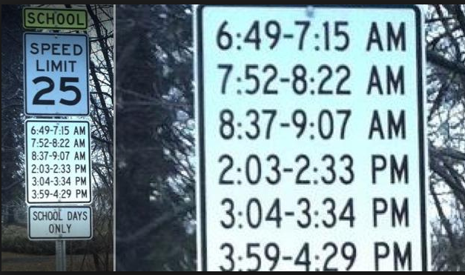
Funny Slide
Has to be a lawyer involved…
http://www.rd.com/slideshows/funny-road-signs/

Slide 128
3) CD Role
Chap 3. CD Role
3.1 CD Structure
3.2 Overview
3.3 Receiving Funds from SCC
3.4 Accounting of funds at CD
3.5 Dispersing funds to Grant Recipients
3.6 CD Educational opportunities
3.7 Program Eligibility
3.8 Administering Projects
3.9 GIS System
3.10Annual Summary Reports

Slide 129
3.6.1 Education FOR Districts
Chap 3. CD Role
ESM Training
Training course that covers road maintenance principals
Mandatory for district staff involved with the program
Mandatory for at least one district QAB member
Highly recommended for everyone involved in the program
Remote Trainings being held this winter

Slide 130
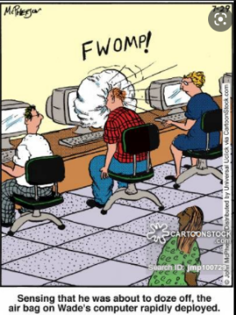
3.6.1 Education FOR Districts
Chap 3. CD Role
Admin Training (ZZZzzzzz…)
Covers administrative policies and guidance provided in the admin manual
Required for staff persons most involved with the program
Required Every 3 years
http://anintrospectiveworld.blogspot.com/2012/08/sleeping-in-class.html

Slide 131
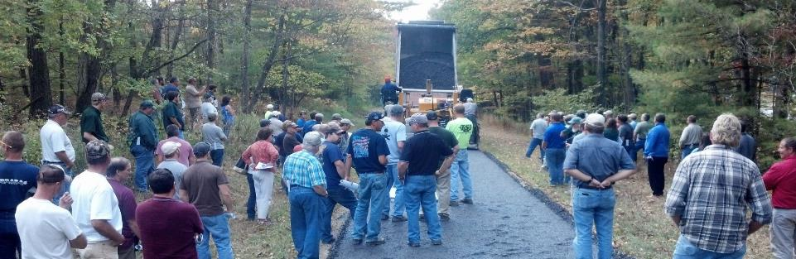
3.6.1 Education FOR Districts
Chap 3. CD Role
Annual Maintenance Workshop
More in depth training than ESM
ESM certified individual may attend annual workshop at least once every 5 yrs. in lieu of ESM training, provided their certification is not expired.

Slide 132
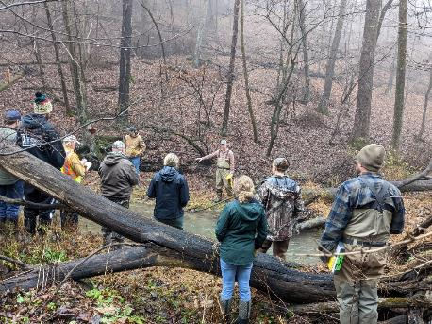
3.6.1 Education FOR Districts
Chap 3. CD Role
Stream Crossing Certification
CD staff must be certified to sign a contract for a stream crossing project on or after 7/1/2023
3 being planned before 7/1/2023
1 being planned for fall 2023
6 separate sessions
  Mostly virtual half day
  2 days in the field

Slide 133
3.6.1 Education FOR Districts
Chap 3. CD Role
Technical Assistance
Conducted primarily by Center staff
Initiated by districts
Small group training for districts and municipalities
Help with:
  Project design / layout
  Meet with applicants
  Aggregate placement
  Project implementation
  Whatever you need!

Slide 134
Administrative Manual
3.6.1.2 Stream Crossing Replacement Training
Effective July 1, 2023, at least one conservation district staff member must have completed the DGLVR Program’s “Stream Crossing Replacement Certification Training” and received a certificate of completion before the QAB can recommend or the conservation district can approve a contract for a project involving a stream crossing. A Stream Crossing Replacement Re-Certification Training must be taken once every three years to maintain staff certification. This training requirement does not apply to crossings that qualify for an automatic exemption from the DGLVR Stream Crossing Standard (see section 7.1.3.1).

Slide 135
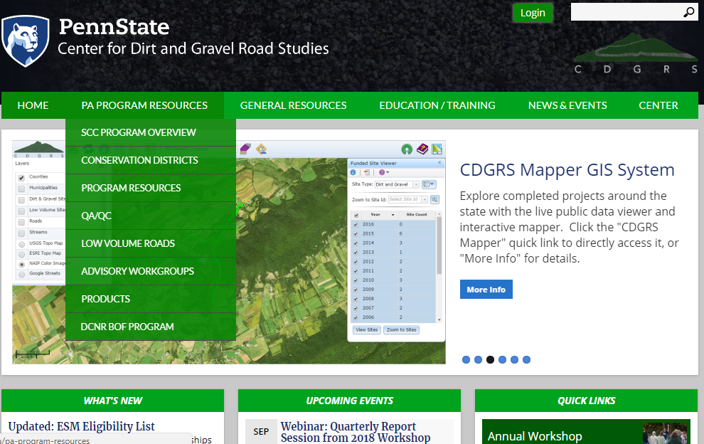
3.6.1 Education FOR Districts
Chap 3. CD Role
www.dirtandgravel.psu.edu

Slide 136
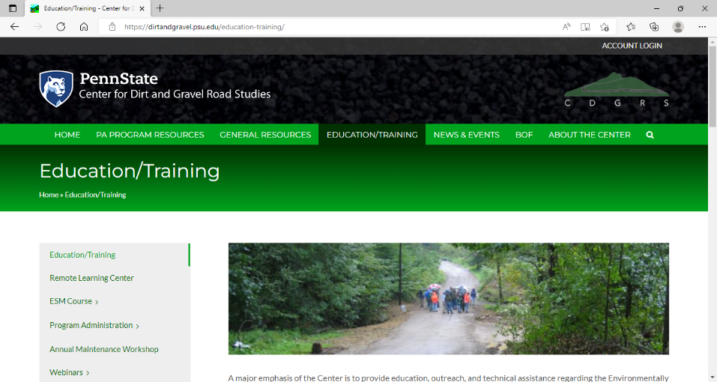
3.6.1 Education FOR Districts
Chap 3. CD Role
Remote Learning Center

Slide 137
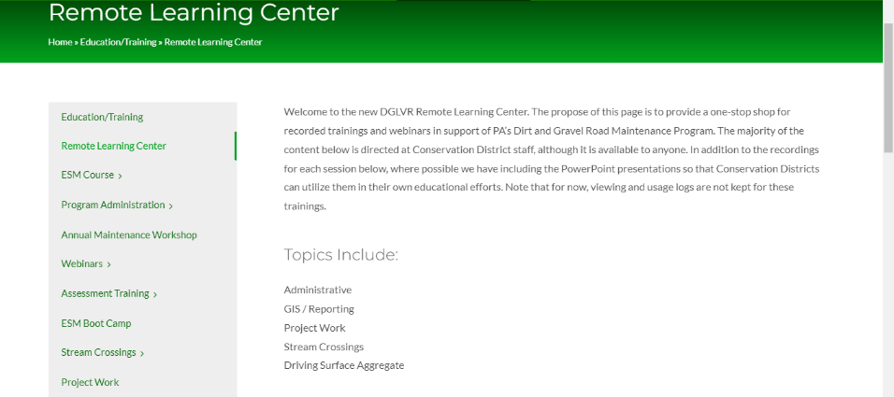
3.6.1 Education FOR Districts
Chap 3. CD Role
Remote Learning Center

Slide 138

3.6.1 Education FOR Districts
Chap 3. CD Role
www.dirtandgravel.psu.edu

Slide 139
3.6.1 Education FOR Districts
Chap 3. CD Role
www.dirtandgravel.psu.edu
Standard forms
Blank forms
Example/sample forms
Webinars
  Recording
  PowerPoints
Materials and Cost Calculator
GIS system

Slide 140
Other Documentation
Chap 3. CD Role
Other Documentation
www.dirtandgravelroads.org
Technical bulletins
Sample forms and policies
Blank forms
Aggregate guidance
GIS help
Reference material
70+ webinars and other recorded trainings

Slide 141

3.6.2 Education BY Districts
Chap 3. CD Role
Education by Districts for applicants:
  Participate in existing events
    Municipal Conventions
    Contractor Workshops
    Legislative Breakfasts
    Municipal Visits
  Hold new events
    Demo Days
    Program Update Sessions
    Project tours
  Promotion: press releases, signs, emails
Jan 2017 Webinar
CD Education and Outreach Ideas

Slide 142

Funny Slide
http://www.shiply.com/blog/uploaded_images/funny_road_signs_21-746380.jpg

Slide 143
3) CD Role
Chap 3. CD Role
3.1 CD Structure
3.2 Overview
3.3 Receiving Funds from SCC
3.4 Accounting of funds at CD
3.5 Dispersing funds to Grant Recipients
3.6 CD Educational opportunities
3.7 Program Eligibility
3.8 Administering Projects
3.9 GIS System
3.10Annual Summary Reports

Slide 144
3.7.1 Eligible Applicants
Chap 3. CD Role
Eligible Applicants
Public entities that own roads
Person in charge of the project must be ESM certified to apply
Municipalities (1400+ twps, 800+ boroughs, 50+ cities)
State entities such as:
  PennDOT, Game Commission, Fish & Boat
  County and other Government entities
Federal roads and private roads are NOT eligible
  All public roads are “born” in legislation

Slide 145


3.7.1 Eligible Applicants
Chap 3. CD Role
Eligible Applicants
Public entities that own roads
Grant recipients: 2019-2020:

Slide 146
3.7.1.3 Determining Road Ownership
Chap 3. CD Role
Road Ownership
The entity that owns the “right of way” is the determining factor, not who owns the adjacent land
Contracts and payments can only be made with the entity that owns the road
Questionable situations?
  Check for liquid fuels funding
  Courthouse records
  Responsibility of the applicant to prove ownership

Slide 147
3.7.1.4 Ineligible Entities
Chap 3. CD Role
Ineligible Entities
Federal Government
  National Parks and Forest Roads
  US ACOE Lands
Private Road Owners:
  Homeowners Associations
  Conservancies
  Non-Profits
  Etc.

Slide 148

3.7.2 Eligible Roads
Chap 3. CD Role
Dirt and Gravel Road
  “Unbound” surfaces.
  “gradable”
Paved Low Volume Road
  Surface bound with asphalt, oil, or other binder
  Includes “tar and chip”
  500 vehicles a day or less – traffic count required
Surface Conservations
  Converting poorly constructed LVR into a DGR may utilize either LVR or DGR funding

Slide 149
3.7.3 Eligible Projects
Chap 3. CD Role
Eligible Projects
Focus on environmental and road improvements
Use ESM practices as described in section 1.4
  Reduce sediment
  Reduce concentrated drainage
Program focus is on long-term environmental and road improvements
  “routine maintenance” is not eligible for funding
    Crack sealing
    Grading roads
    Bridge repairs

Slide 150
3.7.4 Eligible Project Expenses
Chap 3. CD Role
Eligible Project Expenses
No program specific purchase requirements (use applicant’s established procedures for bidding and purchasing)
Records of purchases must be kept (by the grant recipient) for 7 years from project completion
Applicants can apply for the full cost of all materials, equipment, and labor

Slide 151
3.7.4.1 Eligible Expenses - Materials.
Chap 3. CD Role
Materials
Typical materials include pipe, stone, fabric, etc.
Products with leaching potential must meet SCC standards for non-pollution. Approved products list on www.dirtandgravelroads.org.
Inlets and outlets of all cross pipes must have erosion protection, such as headwalls, endwalls, drop inlet boxes, and/or rip rap. All stream crossing structures must have a headwall and endwall.

Slide 152
3.7.4.2 Eligible Expenses - Equipment
Chap 3. CD Role
Equipment
Reimbursement of applicant owned equipment is eligible (@ FEMA rates)
Equipment can be rented, FEMA rates do not apply.
DGLVR funds, including project, administrative, or education, cannot be used to purchase, cost share, or maintain equipment for an applicant.
It is acceptable for a Conservation District to purchase equipment for loan/rent to applicants.

Slide 153
3.7.4.2 Equipement
Chap 3. CD Role
3.7.4.2 Equipment
Contact Commission or Center staff for questions about equipment without listed FEMA rates. Where FEMA rates do not accurately reflect local equipment costs, applicants may request approval to use other rates, if written documentation can be provided.
Red Text shows wording changes to the DGLVR Admin Manual (effective 7/1/2022)

Slide 154

Funny Slide
Does this go under equipment, or labor???

Slide 155
3.7.3 Eligible Expenses - Labor
Chap 3. CD Role
Labor
Reimbursement of labor and equipment operators is an eligible expense.
Labor rates may include wage and benefits.

Slide 156
3.7.3 Eligible Expenses - Labor
Chap 3. CD Role
Municipal Labor
Reimbursement of labor and equipment operators is an eligible expense
Labor rates may include wage and benefits.
PREVAILING WAGE: Does not apply to projects done with Municipal labor force.

Slide 157
3.7.4.4 Contractor Costs
Chap 3. CD Role
Contractors
Projects may be completed in whole or in part by contractors
Grant recipients use their standard bidding procedures
Districts must make payments to the grant recipient, not the contractors
PREVAILING WAGE:

Slide 158
Sherri

Slide 159
3.7.4.5 Prevailing Wage
Chap 3. CD Role
PREVAILING WAGE: Projects where the estimated total project cost exceeds $25,000 (NOT $100,000) are subject to the prevailing wage act for contracted labor.
  It is the responsibility of the grant recipient to obtain the Prevailing Wage Act scale for the area and include it in any proposal to solicit bids for the contract. The Prevailing Wage scale can be obtained from the Prevailing Wage Division of the Pennsylvania Department of Labor and Industry. If the Prevailing Wage Act applies, the advertisement shall also note this fact.

Slide 160
3.7.4.5 Prevailing Wage
Chap 3. CD Role
PREVAILING WAGE: Projects where the estimated total project cost exceeds $25,000 (NOT $100,000) are subject to the prevailing wage act for contracted labor.
  Total Project Costs: include other grant sources in-kind material (not equipment/labor).
  Cannot “split” projects to avoid PW.
  PW does not apply to municipal labor.
  PW must be documented in project file

Slide 161

3.7.4.5 Prevailing Wage
Chap 3. CD Role
PREVAILING WAGE FAQ: 19 Q&As

Slide 162

3.7.4.4 Prevailing Wage
Chap 3. CD Role
PREVAILING WAGE FAQ: 19 Q&As

Slide 163


3.7.4.5 Prevailing Wage
Chap 3. CD Role
PREVAILING WAGE DGLVR Documents
PW Certification (G) two pages
Required for all projects where PW applies
Required before making final payment
PW Notification Letter (F)
Required for all projects
Ensures grant recipient knows PW requirements
Attachments F and G to Contract
(Contract and attachments are automatically generated in GIS)

Slide 164
3.7.4.5 Prevailing Wage
Chapter 3
3.7.4.5 Prevailing Wage Documentation
If federal funds are involved in a project, federal prevailing wage requirements (Davis Bacon Act) often supersedes PA prevailing wage. Davis Bacon requirements are acceptable to the DGLVR program in this case, and Certified Payroll forms accepted by the US Department of Labor must be completed and kept in the project file.
Red Text shows wording changes to the DGLVR Admin Manual (effective 7/1/2022)

Slide 165


Recorded Webinars Available Online
https://www.dirtandgravel.psu.edu/education-and-training/webinars/past-webinars
2022
2022

Slide 166
3.7.4.5 Prevailing Wage
Chap 3. CD Role
  Additional Information:
  Brian Smolock,
  Labor Law Investigator
  PA Department of Labor and Industry
  717-787-0606
  bsmolock@pa.gov

Slide 167
3.7.4.6 In-Kind
Chap 3. CD Role
In Kind Contributions
  In-Kind: materials, equipment, and labor funded by other sources, typically the applicant
  No Statewide requirement for in kind amounts
  Only contributions that meet all Program policies may be counted as in-kind contributions.
    Stream crossings, DSA, FDR are most common

Slide 168
Administrative Manual
Chapter 3
3.7.4.7 Consultants, Engineering, and Permitting Costs
Program funds can be used to cover engineering, permitting, or similar consultant costs, but such costs are limited to a maximum of 10 20 percent of the total contract amount between the district and the grant recipient, with a maximum of $25,000 total for engineering, permitting, or similar consultant costs. Note this limit is defined as up to 10 20 percent of the contract amount (Program contracted funds), not 10 20 percent of the total project value (which could include in-kind or other funds).
Red Text shows wording changes to the DGLVR Admin Manual (effective 7/1/2022)

Slide 169
Administrative Manual
Chapter 3
3.7.4.7 Consultants, Engineering, and Permitting Costs
For example, a $30,000 contract on a project totaling $50,000 is limited to 20 percent of the contract, or $6,000, for engineering and permitting.
Another example, a $140,000 contract, 20 percent of the contract would be $28,000, but the program will only fund up to the maximum of $25,000. Preparation or design costs such as engineering or surveying that are incurred before the contract is signed are not eligible for grant reimbursement but can be counted as in-kind.
Red Text shows wording changes to the DGLVR Admin Manual (effective 7/1/2022)

Slide 170

Funny Slide
Speaking of Engineering…
http://www.rd.com/slideshows/funny-road-signs/

Slide 171
ROY

Slide 172

3.7.4.8 Working off the Right of way
Chap 3. CD Role
Right-of-way:
  Publicly owned road corridor.
  Typically 33’ width (16.5’ from road Centerline) for municipal roads.
  Exceptions do apply, sometime up to 50’.
http://old.mcallen.net/landingpages/lp_engineering/roa_permits.aspx

Slide 173


3.7.4.8 Working off the Right of way
Chap 3. CD Role
Written permission from landowners is required when working outside the right-of-way.
Districts can use their own form, or the example provided in manual, but must use something!
Word Version Available Online
www.dirtandgravelroads.org

Slide 174
3.7.4.8 Working off the Right of way
Chap 3. CD Role
Working outside the right-of-way is permissible with DGLVR funds only under certain conditions:
Must be directly necessary to the successful completion of the project on a public road.
Limited in scope to cost effective practices that directly reduce road impacts
Grant recipient MUST obtain written permission before starting the project
Districts must keep a copy of written permission in the project file

Slide 175
Administrative Manual
Chapter 3
3.7.4.8 Working Off Right-of-Way
Landowner permission should be sought as early as possible in the funding process, ideally before contracting, to ensure the project can be implemented as planned.
In some cases, landowner permission may be instrumental to implementing a successful DGLVR project (additional culvert outlets for example). In some cases, a viable alternative may exist to implement a successful plan without landowner permission, but in other cases sufficient water quality improvements cannot be made due to landowner constraints. In such cases, DGLVR funding may be better spent on a different project location. Contact the SCC in questionable circumstances where a lack of landowner permission may hinder successful project implementation.
Red Text shows wording changes to the DGLVR Admin Manual (effective 7/1/2022)

Slide 176
3.7.4.8 Working off the Right of way
Chap 3. CD Role
  In certain situations, off-right-of-way work requires the prior written approval from the SCC before a contract can be signed:
  Where off-right-of-way work is more than 35% of the total project costs (including program funds and in-kind contributions)
  Where work extends more than 500 feet off of the right-of-way.

Slide 177
3.7.4.8 Working off the Right of way
Chap 3. CD Role
Landowner permission is suggested when off-right-of-way impacts are expected, even if work is done within right-of-way.
New pipes and turnouts.
Subsurface drainage
  French mattress
Driveway issues.
Road fill jobs.

Slide 178
3.7.4.9 Combined Funds
Chap 3. CD Role
Program funds may be combined with other funds to pay for a project.
  Detailed accounting of which funds were spent on which portions of the project must be maintained
  Other funding sources may be used as matching funds, provided the program funds are used on eligible projects
  Must still adhere to non-pollution standards and ESM practices

Slide 179
3) CD Role
Chap 3. CD Role
3.1 CD Structure
3.2 Overview
3.3 Receiving Funds from SCC
3.4 Accounting of funds at CD
3.5 Dispersing funds to Grant Recipients
3.6 CD Educational opportunities
3.7 Program Eligibility
3.8 Administering Projects
3.9 GIS System
3.10Annual Summary Reports

Slide 180
3) CD Role
Chap 3. CD Role
3.8 Administering Projects
  3.8.1 Notification to Applicants
  3.8.2 Pre-Application Site Visit
  3.8.3 Pre-Design Site Visit
  3.8.4 Receiving Grant Applications
  3.8.5 Contracting
  3.8.6 Pre-Project Logistics
  3.8.7 Project Oversight
  3.8.8 Contract Amendments
  3.8.9 Project Completion
  3.8.10 Project File Retention

Slide 181
3.8.1 Notifying applicants
Chap 3. CD Role
Notifying Applicants
Districts are responsible for informing all potential applicants of:
  funding availability
  Application deadlines
  Other information necessary for Program Participation
Districts should work with their QAB to develop strategies for insuring equal access and notifications

Slide 182
3.8.2 Pre-Application site visit
Chap 3. CD Role
Pre-app site visit
Districts should meet with potential applicants on site BEFORE an application is submitted
Early discussion of potential problems (permitting, funding availability, etc)
Best interest of both parties.
Look at potential landowner or off-ROW issues
Checklist available

Slide 183
Checklists &
Tools
Pre-application
Checklist
Pre-construction
Checklist
Project Hard Files
Checklist
Project Narrative
Project Timeline
NOT REQUIRED, for
your benefit

Slide 184

Checklists &
Tools
Pre-application
Checklist
Pre-construction
Checklist
Project Hard Files
Checklist
Project Narrative
Project Timeline
NOT REQUIRED, for
your benefit

Slide 185

Checklists &
Tools
Pre-application
Checklist
Pre-construction
Checklist
Project Hard Files
Checklist
Project Narrative
Project Timeline
NOT REQUIRED, for
your benefit

Slide 186

Checklists &
Tools
Pre-application
Checklist
Pre-construction
Checklist
Project Hard Files
Checklist
Project Narrative
Project Timeline
NOT REQUIRED, for
your benefit

Slide 187

Checklists &
Tools
Pre-application
Checklist
Pre-construction
Checklist
Project Hard Files
Checklist
Project Narrative
Project Timeline
NOT REQUIRED, for
your benefit

Slide 188

Checklists &
Tools
Pre-application
Checklist
Pre-construction
Checklist
Project Hard Files
Checklist
Project Narrative
Project Timeline
NOT REQUIRED, for
your benefit

Slide 189
3.8.3 Pre-Design site visit
Chap 3. CD Role
Pre-design site visit
If a project requires engineering
It is highly recommended that districts meet with the grant recipient and engineer on site BEFORE design work is started
Make sure the engineer understands DGLVR requirements
Early discussion of potential problems (permitting, funding availability, etc.)
Best interest of both parties.
Keep in mind that engineering expenses incurred before a contract is signed are NOT eligible for reimbursement with DGLVR funds

Slide 190
3) CD Role
Chap 3. CD Role
3.8 Administering Projects
  3.8.1 Notification to Applicants
  3.8.2 Pre-Application Site Visit
  3.8.3 Pre-Design Site Visit
  3.8.4 Receiving Grant Applications
  3.8.5 Contracting
  3.8.6 Pre-Project Logistics
  3.8.7 Project Oversight
  3.8.8 Contract Amendments
  3.8.9 Project Completion
  3.8.10 Project File Retention

Slide 191
Sherri

Slide 192
3.8.4 Receiving Grant Applications 1/2
Chap 3. CD Role
Receiving Grant Apps: Timeline
  Receive Applications
  Work with applicants to revise if needed.
  Review for completeness and accuracy.
  Completed applications get forwarded to QAB for review and ranking.
  QAB recommendations taken to District Board for action
  Contract can then be made with grant recipient.

Slide 193
3.8.4 Receiving Grant Applications 2/2
Chap 3. CD Role
Receiving Grant Apps
Districts may set application periods, or they may have an open application period
One page application
Districts may develop their own policy for unfunded applications
  Disapprove
  Retain
  Resubmit

Slide 194
Grant App, Work plan, Instructions
Chap 3. CD Role
Grant app and forms used to apply to CD
Project-specific Grant Application
Optional cost summary forms
Project Sketch (back of grant app)
Instructions for all forms

Slide 195





Grant App, Work plan, Instructions
Chap 3. CD Role
Grant Application (front)
Project Sketch
(back)
Attachment A to Contract
(Grant application is appendix C in admin manual. Contract available at https://dirtandgravel.psu.edu/)

Slide 196


Grant App, Work plan, Instructions
Chap 3. CD Role
Grant App - Top
District Use Only Box
Applicant Info
Project Info

Slide 197
E. Grant App, Work plan, Instructions
Forms Update
Grant App - Bottom
Grant Request $
In-Kind $
Additional Cost Sheets Available

Slide 198

Grant App, Work plan, Instructions
Chap 3. CD Role
OPTIONAL cost details
Attachment A to Contract
(Grant application is appendix C in admin manual. Contract available at https://dirtandgravel.psu.edu/)

Slide 199


Grant App, Work plan, Instructions
Chap 3. CD Role
Bottom of Grant Application

Slide 200

Grant App, Work plan, Instructions
Chap 3. CD Role
OPTIONAL cost details
Attachment A to Contract
(Grant application is appendix C in admin manual. Contract available at https://dirtandgravel.psu.edu/)

Slide 201
Grant App, Work plan, Instructions
Chap 3. CD Role
Bottom of Grant Application

Slide 202

Grant App, Work plan, Instructions
Chap 3. CD Role
Project Sketch
(back of grant app)
Attachment A to Contract
(Grant application is appendix C in admin manual. Contract available at https://dirtandgravel.psu.edu/)

Slide 203


Grant App, Work plan, Instructions
Chap 3. CD Role

Slide 204

Grant App, Work plan, Instructions
Chap 3. CD Role

Slide 205



Grant App, Work plan, Instructions
Chap 3. CD Role
Grant App Instructions, Sample Sketch
Attachment A to Contract
(Grant application is appendix C in admin manual. Contract available at https://dirtandgravel.psu.edu/)

Slide 206

E. Grant App, Work plan, Instructions
Chap 3. CD Role
Grant forms available online
  With or without instructions

Slide 207

Funny Slide
No Thanks.
http://www.shiply.com/blog/uploaded_images/funny_road_signs_21-746380.jpg

Slide 208
3) CD Role
Chap 3. CD Role
3.8 Administering Projects
  3.8.1 Notification to Applicants
  3.8.2 Pre-Application Site Visit
  3.8.3 Pre-Design Site Visit
  3.8.4 Receiving Grant Applications
  3.8.5 Contracting
  3.8.6 Pre-Project Logistics
  3.8.7 Project Oversight
  3.8.8 Contract Amendments
  3.8.9 Project Completion
  3.8.10 Project File Retention

Slide 209
Roy

Slide 210
3.8.5 Contracting
Chap 3. CD Role
Contracting
Contract must be in place before anything happens
  No fund advances can take place without a contract
  No work can begin without a contract
  No expenses, such as engineering costs, can be incurred before a contract is signed

Slide 211
Administrative Manual
Chapter 3
3.8.5 Contracting
Preparation or design costs such as engineering or surveying that are incurred before the contract is signed are not eligible for grant reimbursement but can be counted as in-kind.
Red Text shows wording changes to the DGLVR Admin Manual (effective 7/1/2022)

Slide 212


Contract
Grant App Instructions, Sample Sketch
Chap 3. CD Role
Available at
https://dirtandgravel.psu.edu/
and generated in GIS

Slide 213

Contract
Chap 3. CD Role
2-page contract between CD and grantee
Other documents attached to contract:
Must Generate Contract using the GIS System

Slide 214
Contract
Chap 3. CD Role
2-page contract between CD and grantee
CDs can add provisions to contract
  Need to be approved by your solicitor.
  Need to notify SCC.

Slide 215
Contract
Chap 3. CD Role
Cancelling a contract
If a contract cannot be completed in a reasonable timeframe (2+ years), the district should consider closing out or canceling the contract.
Districts who maintain open contracts for multiple years may see reduced allocations in future years at the discretion of the State Conservation Commission.

Slide 216

Schedule of Payments
Chap 3. CD Role
50% max
30% min
Available Online
www.dirtandgravelroads.org
Must Generate in GIS

Slide 217

Contract Amendment
Chap 3. CD Role
If needed, a simple one-page amendment form can be used to:
  increase contract by up to 40% (total of original contract)
  extend completion date
  Increase both funds and time
Must Generate in GIS
Available at
https://dirtandgravel.psu.edu/
and generated in GIS

Slide 218

Contract Amendment
Chap 3. CD Role
Limited to 40% of contract
Can be used to extend completion date.
Available at
https://dirtandgravel.psu.edu/
and generated in GIS

Slide 219

Contract Amendment
Chap 3. CD Role
Amendment Instructions
Can now be used to extend completion date.
Available at
https://dirtandgravel.psu.edu/

Slide 220
Contract
Chap 3. CD Role
2-page contract between CD and grantee
Other documents attached to contract:
Automatically generated in GIS
GIS now prints out entire application packet with all attachments except Grant App / Workplan

Slide 221
3) CD Role
Chap 3. CD Role
3.8 Administering Projects
  3.8.1 Notification to Applicants
  3.8.2 Pre-Application Site Visit
  3.8.3 Pre-Design Site Visit
  3.8.4 Receiving Grant Applications
  3.8.5 Contracting
  3.8.6 Pre-Project Logistics
  3.8.7 Project Oversight
  3.8.8 Contract Amendments
  3.8.9 Project Completion
  3.8.10 Project File Retention

Slide 222
3.8.6 Pre-project logistics
Chap 3. CD Role
Pre project logistics
Permits, Pa 1-call
  It is the responsibility of the grant recipient to ensure that all necessary permits are obtained and any other pre-project requirements are met (1-call, PNDI, etc.)
  It is the responsibility of the district to verify that permits have been obtained before work can begin on the portion of the project that requires a permit.

Slide 223
3.8.6 Pre-project logistics
Chap 3. CD Role
Pre project logistics
Pre-project meeting (separate from pre-application meeting)
  Grant recipients MUST notify the conservation district before beginning work on a project.
  The amount of notice is spelled out in the contract with the district.
  Contractors and sub-contractors are strongly encouraged to attend.
  Notify Center of planned DSA placements.
  Checklist available

Slide 224
3) CD Role
Chap 3. CD Role
3.8 Administering Projects
  3.8.1 Notification to Applicants
  3.8.2 Pre-Application Site Visit
  3.8.3 Pre-Design Site Visit
  3.8.4 Receiving Grant Applications
  3.8.5 Contracting
  3.8.6 Pre-Project Logistics
  3.8.7 Project Oversight
  3.8.8 Contract Amendments
  3.8.9 Project Completion
  3.8.10 Project File Retention

Slide 225
3.8.7 Project Oversight
Chap 3. CD Role
Project Oversight
District must ensure that project work is performed in accordance with contract and attachments, as well as Program policy and standards:
    Stay involved
    Have an on-site presence
    Pay attention
    Call Center/SCC for help if needed
    No excuses!
When it comes to project oversight, remember…

Slide 226
3.8.7 Project Oversight
Chap 3. CD Role
“You get what you inspect, not what you expect”
more involvement = better projects

Slide 227
3.8.7 Project Oversight
Chap 3. CD Role
Project Oversight
Make sure you are on site:
  First day(s) of project work
  When project moves to a new phase or practice
  When critical practices or practices new to the applicant are being installed
  For regular check-ins

Slide 228
3.8.7 Project Oversight
Chap 3. CD Role
Project Oversight
“The twp wanted to do it that way” is not an excuse
The CD holds the purse strings
  Ensure work is done properly
  Require remediations where necessary
  Don’t pay for subpar work

Slide 229

Funny Slide

Slide 230
3) CD Role
Chap 3. CD Role
3.8 Administering Projects
  3.8.1 Notification to Applicants
  3.8.2 Pre-Application Site Visit
  3.8.3 Pre-Design Site Visit
  3.8.4 Receiving Grant Applications
  3.8.5 Contracting
  3.8.6 Pre-Project Logistics
  3.8.7 Project Oversight
  3.8.8 Contract Amendments
  3.8.9 Project Completion
  3.8.10 Project File Retention

Slide 231
3.8.9 Project Completion
Chap 3. CD Role
Prior to final payment, the following are required:
Final onsite inspection
Signed project completion report
  Summarizes funding
  Summarizes work
  Signed by CD and grantee
  Must be signed and retained with project files.
Receipts for all grant expenditures

Slide 232
3.8.9 Project Completion
Chap 3. CD Role
Other documentation may also be required:
DSA testing and certifications
Off ROW consent forms
Prevailing Wage documentation
“Hard file checklist” available

Slide 233
3.8.9 Project Completion
Chap 3. CD Role
3.8.9.1 Final Inspection
A final inspection must be completed onsite involving the district and grant recipient
Verify the project is completed in accordance with Program standards and to the satisfaction of the district.
Verify that all work elements classified as “in-kind services” are also completed in accordance with Program standards and to the satisfaction of the district.
Verify that work elements proposed in the work plan have been properly installed.
Allow the district to summarize the project work elements and costs on the project completion report.
Document any changes made from the grant application that have not already been documented.

Slide 234
3.8.9 Project Completion
Chap 3. CD Role
3.8.9.2 Final Project Remediation (if necessary)
Remediation work may be required before the project can be consider “complete”
The district should verify remediation work meets Program standards prior to making final payment

Slide 235




3.8.9 Project Completion
Chap 3. CD Role
Expanded to front and back
Project Info
ESM Practice Summary
Financial Summary
Available at
https://dirtandgravel.psu.edu/
and generated in GIS
Notes and Signatures

Slide 236

3.8.9 Project Completion
Chap 3. CD Role
Front Top
Financial Summary
Available at
https://dirtandgravel.psu.edu/
and generated in GIS

Slide 237

3.8.9 Project Completion
Chap 3. CD Role
Front Bottom
Space for notes
CD and Grantee Signatures
Available at
https://dirtandgravel.psu.edu/
and generated in GIS

Slide 238

3.8.9 Project Completion
Chap 3. CD Role
Back Top
Available at
https://dirtandgravel.psu.edu/
and generated in GIS

Slide 239

3.8.9 Project Completion
Chap 3. CD Role
Back Bottom

Slide 240


3.8.9 Project Completion
Chap 3. CD Role
Project Completion Report Instructions
Available at
https://dirtandgravel.psu.edu/

Slide 241
Administrative Manual
Chapter 3
3.8.9 Project completion & 3.8.10 Project File Retention
Required documentation as outlined on the “Hard File Checklist” is required to be kept in the project hard file and is needed prior to making final payment to the grant recipient

Slide 242
3) CD Role
Chap 3. CD Role
3.8 Administering Projects
  3.8.1 Notification to Applicants
  3.8.2 Pre-Application Site Visit
  3.8.3 Pre-Design Site Visit
  3.8.4 Receiving Grant Applications
  3.8.5 Contracting
  3.8.6 Pre-Project Logistics
  3.8.7 Project Oversight
  3.8.8 Contract Amendments
  3.8.9 Project Completion
  3.8.10 Project File Retention

Slide 243
3.8.10 Project File Retention
Chap 3. CD Role
All records relating to the Program must be kept for a minimum of 7 years from the date of final payment on a project
  see “Hard File” Project Checklist for paperwork required to be in hard file
  It is recommended to keep additional relevant documentation beyond the minimum required to be in the hard file
    Communications with project participants, photos, bid documents if applicable, etc.

Slide 244
STEVE

Slide 245
3) CD Role
Chap 3. CD Role
3.1 CD Structure
3.2 Overview
3.3 Receiving Funds from SCC
3.4 Accounting of funds at CD
3.5 Dispersing funds to Grant Recipients
3.6 CD Educational opportunities
3.7 Program Eligibility
3.8 Administering Projects
3.9 GIS System
3.10Annual Summary Reports

Slide 246

3.9 GIS reporting
Chap 3. CD Role
GIS reporting
CDs use customized GIS system to track all project location, deliverables and spending.
Use system to generate quarterly reports to SCC.

Slide 247
3.9 GIS reporting
Chap 3. CD Role
GIS Reporting
ALL Program reporting done in GIS
Please attend a GIS training if you are responsible for record keeping and reporting for Program.
District Managers have to take abbreviated GIS training

Slide 248
Administrative Manual
Chapter 3
3.9 GIS Reporting System
All contracts, amendments, and completion reports must be generated using the GIS system.
All funded projects are required to be filled out in the GIS to the extent practical including:
  Assessment (if applicable)
  Grant application
  Contract
  Amendments (if applicable)
  Payment(s)
  Completion report
  Photos (if applicable)
  Any additional supporting files
Red Text shows wording changes to the DGLVR Admin Manual (effective 7/1/2022)

Slide 249
Administrative Manual
Chapter 3
3.10 Quarterly Reports
Districts must keep documentation for all Program expenses and income according to section 3.4
Financial staff involved in the DGLVR Program must complete a quarterly report GIS training to gain access to the quarterly report system.
Red Text shows wording changes to the DGLVR Admin Manual (effective 7/1/2022)

Slide 250
Administrative Manual
Chapter 3
3.10 Quarterly Reports (continued)
In order to submit quarterly reports, the following must be completed:
  All income (advances, replenishments, interest) and expenses (project, administrative, and education/training) must be entered
  Local and GIS account balances must match before the quarterly report is submitted each quarter
  Information on funded projects is also required, including checking that all currently open contracts are in good standing and are not expired. The GIS includes a contract verifier tool that can be used during this process.
  Complete the summary of Program activities from district staff for the quarter.
  The Conservation District Manager, or its approved designee, is required to submit the report.
Red Text shows wording changes to the DGLVR Admin Manual (effective 7/1/2022)

Slide 251


3.10 Quarterly Reports
Chapter 3
2022

Slide 252

3.10 Quarterly Reports
Chapter 3
Contact the SCC and CDGRS for assistance with quarterly reports

Slide 253
Administrative Manual
Chapter 3
3.11 Annual Reports
Completing the Annual Summary Report includes ensuring all quarterly reports are submitted and accepted, entering average limestone DSA cost, and managing project errors. The average cost of limestone aggregate (DSA) delivered (not placed) is a small factor in District Allocations (in accordance with section 9106, the law that created the Dirt and Gravel Road Program).
Red Text shows wording changes to the DGLVR Admin Manual (effective 7/1/2022)

Slide 254


3.9 GIS reporting
Chap 3. CD Role
Annual Summary Reports

Slide 255

Funny Slide
This place has to be in California...
http://media-cache-cd0.pinimg.com/736x/4d/b5/ff/4db5ff34b780ec0332c261fa91954030.jpg

Slide 256
Sherri

Slide 257
Administrative Manual
Introduction
SCC Role
Conservation District Role
Quality Assurance Board
Applicant Role
Center for Dirt and Gravel Roads
Additional Policies
Permits and Other Requirements
Appendices

Slide 258
4.0 Quality Assurance Board
Chap 4. QAB Role
Quality Assurance Board -§ 9106, (E)
Within the conservation district a Quality Assurance Board shall be impaneled to establish and administer the grant program. The four-member QAB is to be comprised of a nonvoting chairman appointed by the conservation district directors and one local representative appointed by each of the following entities:
(1) The Federal Natural Resource Conservation Service
(2) The Pennsylvania Fish and Boat Commission
(3) The county conservation district
If circumstances require, the chairman may vote to decide a tie vote.

Slide 259
4.0 Quality Assurance Board
Chap 4. QAB Role
Quality Assurance Board Why?

Slide 260
4.0 Quality Assurance Board
Chap 4. QAB Role
Quality Assurance Board Why?
Local Involvement and Control
NRCS – Federal: conservation and erosion
PAFBC – State: aquatics and hydrology
District – County: conservation multi-discipline
Who knows best for the County?
People in the County!

Slide 261
4.0 Quality Assurance Board
Chap 4. QAB Role
Quality Assurance Board
Local control within guidelines established by the commission.
QAB’s purpose is to advise and assist the conservation district board.
  QAB is advisory only
  District Board has the final say

Slide 262
4.1 QAB Composition
Chap 4. QAB Role
Composition of the QAB is established by law:
  Only 4 members
    Non-voting chair appointed by district board
    One voting member appointed by the district board
    One voting member appointed by Fish and Boat commission
    One voting member appointed by NRCS
  Chairman may only vote to decide a tie
  Voting members appointed by the agencies do not have to be employees
  All QAB members are strongly encouraged to take ESM training
    At least one district member must take ESM training
  QAB can have as many advisors as they deem necessary, but advisors are non voting

Slide 263
Structure and Purpose
Chap 4. QAB Role
NRCS and PAFBC (not CD) designate their QAB appointees
Does not have to be NRCS/PAFBC employee.
Can also designate an alternate.
Should have appointment in writing
Sample appointment letter:

Slide 264

Structure and Purpose
Chap 4. QAB Role
Sample appointment letter:
  Voting members appointed by the agencies do not have to be employees
Word Version Available online

Slide 265
4.2 QAB Meetings
Chap 4. QAB Role
QAB Meetings
On a regular schedule or as needed
Common action items at a QAB:
  Review grant applications
  Recommend projects for funding to the district board
  Review completed projects
  Recommend local policies to district board
At least 2 of the 3 voting members (quorum) on any recommendations to the district board

Slide 266
4.2 QAB Meetings
Chap 4. QAB Role
QAB Meetings must be Sunshined
The Pennsylvania Sunshine Act requires all public agencies to take all official actions and conduct all deliberations leading up to official actions at public meetings. The Act covers all such actions by municipal governing bodies, committees of these governing bodies and municipal boards and commissions.
-Open Meetings, the Sunshine Act (Pennsylvania)
Agenda posting requirements added in 2021
Cannot vote via email
  Can vote in a virtual meeting or conference call if the public has access to join
https://www.agriculture.pa.gov/Pages/Sunshine-Act.aspx
https://www.openrecords.pa.gov/SunshineAct.cfm

Slide 267
Administrative Manual
Chapter 3
4.3.1 Project Ranking / Sunshine Act
Field visits by the QAB are not subject to Sunshine Act requirements as long as no deliberations of QAB business occurs and no official actions or recommendations are made during the visit.
Red Text shows wording changes to the DGLVR Admin Manual (effective 7/1/2022)

Slide 268
4.3 QAB role in projects
Chap 4. QAB Role
4.3.1 QAB Role: Project Ranking
QAB members should become familiar with applicant’s worksites:
  Site visits as a group
  Site visits individually
  Photo tour from District staff
  Paper application review only
  Throw darts at “application dartboard”
Best option
Not recommended

Slide 269
4.3 QAB role in projects
Chap 4. QAB Role
4.3.1 QAB Role: Project Ranking
Each County must have written Project Ranking Criteria
  Based on local priorities.
  Can have separate DGR and LVR or combined.
  Must provide for equal access.
  Example template available on Center’s website.

Slide 270




4.3 QAB role in projects
Chap 4. QAB Role
Solution
Application Validation
Misc
Problem
Other thoughts
Ranking Criteria Webinar Recorded 12/11/14
Recording and PowerPoint available online
www.dirtandgravelroads.org

Slide 271
4.3 QAB role in projects
Chap 4. QAB Role
4.3.2 QAB Role: Funding Recommendations
QAB makes funding recommendations based on the ranking criteria it establishes
District board then considers QAB recommendations
When the district board approves an application, district staff may then develop and secure a contract.

Slide 272
4.3 QAB role in projects
Chap 4. QAB Role
4.3.3 QAB Role: Project Implementation
After contract is secured, district staff is responsible for project administration, oversight, and inspection.
Future funding decisions for the project may be made by the board with minimal QAB involvement.
  i.e. District board could approve a contract amendment without QAB involvement

Slide 273
4.4 QAB Role in Policy
Chap 4. QAB Role
QAB Role in Policy
Developing local policy is a major function of the QAB:
QABs develop policy
District board adopts policy

Slide 274
4.4.1 Required Policies
Chap 4. QAB Role
Required Local Policies
Equal Access
Conflict of Interest
Project Ranking
Incentives for training
Non-pollution standards

Slide 275
4.4.2 Optional Local Policies
Chap 4. QAB Role
Optional Local Policies
QAB can recommend policies for use within County Program.
Can be “more stringent” than Statewide policy.
Cannot conflict with Statewide policy.
Examples:
  Deadlines for applications
  Limiting use of DSA
  Ongoing maintenance requirements

Slide 276

4.4 QAB Role in Policy
Chap 4. QAB Role
Individual County pages have contact info and policies
http://www.dirtandgravel.psu.edu/pa-program-resources/conservation-districts

Slide 277

Funny Slide
https://www.flickr.com/photos/halfbyte/2649002573

Slide 278
Administrative Manual
Introduction
SCC Role
Conservation District Role
Quality Assurance Board
Applicant Role
Center for Dirt and Gravel Roads
Additional Policies
Permits and Other Requirements
Appendices

Slide 279
5 Applicant Role
Chap 5. Applicants
5. Applicant Role
Designed as standalone section you can copy and give to new potential applicants.
Most information is repetitive from SCC and District section, just written with applicants in mind.

Slide 280
Steve

Slide 281
Administrative Manual
Introduction
SCC Role
Conservation District Role
Quality Assurance Board
Applicant Role
Center for Dirt and Gravel Roads
Additional Policies
Permits and Other Requirements
Appendices

Slide 282


Center Role
Chap 6. CDGRS
Dirt and Gravel Road PROGRAM
Education
2 day ESM training
Annual Workshops
Demonstration Days
Outreach
- Technical Documentation
- Website
Newsletter
Interagency cooperation
Program Support
Advisory Groups
Technical Assistance to Districts
Quality Assurance effort
Geographic Information Systems
Funding Support
Guidance
Make Policy
“Administer” Program
QAQC
Coordinate with legislatures and other agencies

Slide 283

Center Role
Chap 6. CDGRS
Dirt and Gravel Road PROGRAM
Got a Question? Who to ask:
Policy
Legal
Allocation/replenishment
QAQC
General Questions
Trainings
Technical Assistance
Outreach
GIS/Reporting
General Questions

Slide 284
Administrative Manual
Introduction
SCC Role
Conservation District Role
Quality Assurance Board
Applicant Role
Center for Dirt and Gravel Roads
Additional Policies
Permits and Other Requirements
Appendices

Slide 285
7 Additional Program Policies
Chap 7. Add. Policies
Some policies that don’t necessarily apply to every project:
7.1 Stream Crossing Replacement Policy
7.2 Driving Surface Aggregate
7.3 Full Depth Reclamation
7.4 LVR Policies
7.5 Traffic Counts

Slide 286
7.1.1 Background
Chap 7. Add. Policies
Policy for replacing culverts and bridges.
Applies to both DGR and LVR projects.
Limits replacements to areas where structure is causing problem with stream.
  Existing structures must be undersized and causing stream instabilities.
  New structures must be sized to properly accommodate stream flow, bed load, and achieve stream continuity through the roadway.

Slide 287
7.1.1 Background
Chap 7. Add. Policies
One of the Program’s major goals for stream crossings is to ensure the structures funded by the DGLVR Program are designed and implemented to achieve stream continuity
What is stream continuity?
  Connectivity and continuation of typical streambed features upstream, downstream and through the crossing
    Slope
    Width
    Bed composition
    Grade controls, pools
    profile

Slide 288
7.1.1 Background
Chap 7. Add. Policies
Replacement Structures
  Wide enough to allow for construction of a functional stream channel
  Including bank margins, low flow channel
  Grade controls
  Proper cross section
Bankfull width stream channel built through a wider than bankfull crossing
  Accommodates the hydraulic capacity of the stream
  Better stream function
    Flood resiliency
    Sediment and debris transport
    Full Aquatic Organism Passage

Slide 289

7.1 Stream Crossings
Chap 7. Add. Policies
Undersized Structures cause stream instability
Gravel deposition upstream (constant “cleaning”)
“Firehose effect” erosion downstream
Often barriers to aquatic life
-Trout Unlimited

Slide 290


7.1.2 Stream Crossing Replacement Policy
Chap 7. Add. Policies
7.1.2.1 Policy for Structure Installation
All stream crossing replacements funded in whole or in part with DGLVR funds, or listed as in-kind on a DGLVR Project, must follow the DGLVR Stream Crossing Design & Installation Standard
-unless an exemption is applicable (7.1.3)

Slide 291

7.1.2 Stream Crossing Replacement Policy
Chap 7. Add. Policies
Stream Crossing Replacement Technical Manual

Slide 292


7.1.2.1 Structure Installation
Chap 7. Add. Policies
Chapter 2 of the Stream Crossing Replacement Technical Manual
  Covers the Design and Installation Standard thoroughly

Slide 293

Recorded Webinars Available Online
https://www.dirtandgravel.psu.edu/education-and-training/webinars/past-webinars

Slide 294
7.1.2 Stream Crossing Replacement Policy
Chap 7. Add. Policies
7.1.2.2 Existing Structure Eligibility for Replacement
Small Pipes
  Existing crossing with an opening width less than or equal to 48” are automatically eligible for replacement
Multiple Pipes
  Existing crossing consisting of multiple (side by side) pipes are automatically eligible for replacement
    Only applies to pipes, not multiple cell bridges
All other structures
  Existing crossing with an opening width over 48” must have a “structure opening width to bankfull channel width” ratio of 75% or less
SCC notification
  Districts must notify the SCC of proposed stream crossing replacements as soon as practical before a contract is signed
  Available on the GIS system

Slide 295

7.1 Stream Crossings
Chap 7. Add. Policies
CDs are required to notify SCC of planned stream crossing replacement before signing a contract
  Access notification by logging into CDGS website:

Slide 296

7.1 Stream Crossings
Chap 7. Add. Policies
BANKFULL
WIDTH
Bankfull Width: Width of channel at bankfull elevation
Bankfull Elevation: the point at which the stream typically accesses the floodplain. Channel dimensions at this elevation convey the channel-forming or dominant discharge.

Slide 297

7.1.2.3 Stream Crossings
Chap 7. Add. Policies
Where does stream crossing policy apply?
Applies to situations where streams, including intermittent channels, with identified bed and banks are flowing into the road or the uphill ditch.

Slide 298


Chap 7. Add. Policies
7.1.2.3 Stream Crossings
Example 1
Looking upslope from road

Slide 299

Chap 7. Add. Policies
7.1.2.3 Stream Crossings
Example 2
Looking upslope from road

Slide 300

Chap 7. Add. Policies
7.1.2.3 Stream Crossings
Example 3
Looking upslope from road

Slide 301


Chap 7. Add. Policies
7.1.2.3 Stream Crossings
Example 4
Looking upslope from road

Slide 302
7.1 Stream Crossings
Chap 7. Add. Policies
7.1.2.4 Policy Limiting Engineering and Consulting Costs
Overviewed in 3.7.4.2
  Limited to 20% of the total contract amount
  Not to exceed $25,000

Slide 303
7.1 Stream Crossings
Chap 7. Add. Policies
7.1.2.5 Conservation District Education Requirements
Effective July 1, 2023
  At least one district staff member must have completed the stream crossing replacement certification training
  Must be completed prior to QAB recommending or District Board approving a project with a stream crossing
  Required every 3 years
  Does not apply to automatic exemptions

Slide 304
7.1 Stream Crossings
Chap 7. Add. Policies
7.1.2.6 Conservation District Requirements
Districts are required to hold meetings including:
  Pre-application meeting
    District and Grant Applicant
  Pre-design meeting
    Required if engineer is required
    District, grant recipient, and Design Engineer
  Pre-construction meeting
    District, grant recipient, engineer, and contractor

Slide 305


7.1 Stream Crossings
Chap 7. Add. Policies
7.1.2.6 Conservation District Requirements
Districts are required to attend a bid site showing if applicable
A stream crossing eligibility determination must be completed and kept in the project file

Slide 306
7.1 Stream Crossings
Chap 7. Add. Policies
7.1.2.6 Conservation District Requirements
Off Right-of-way
  Stream crossings nearly always extend outside the right-of-way
  Applicants are strongly encouraged to get permission from landowners prior to contracting the project
  If landowner permission is necessary to achieve continuity and meet the standard but cannot be obtained, the project cannot be completed.

Slide 307
7.1 Stream Crossings
Chap 7. Add. Policies
7.1.2.6 Conservation District Requirements
Site Assessment
  Must be completed for each stream crossing prior to the QAB recommending a project for funding.
  Used to support development of cost estimates and the grant application
  Includes obtaining a longitudinal profile and a minimum of 2 cross-sections of the existing stream
    Will be utilized for review of future surveys and project plans to ensure they meet the standard
  Must meet section IV.K of the Design and Installation Standard

Slide 308
7.1 Stream Crossings
Chap 7. Add. Policies
7.1.2.6 Conservation District Requirements
Site Assessment
  District must be onsite while the engineer/surveyor is completing their site assessment for the project
    Observe and assist with longitudinal profile and cross sections and ensure all important data points are obtained

Slide 309
7.1 Stream Crossings
Chap 7. Add. Policies
7.1.2.6 Conservation District Requirements
Plan Reviews
  All permit applications, site assessment, and design plans and specifications must be submitted to the conservation district
  The District must review the documents and provide written confirmation to the grant recipient or engineer that these document comply with DGLVR policy and Standards before they are submitted for permit review.
  Purpose is to verify consistency with Program policy and standards
    Not to review engineering calculations or permit completeness.
    Form letters available on the Center’s Website

Slide 310

7.1 Stream Crossings
Chap 7. Add. Policies

Slide 311
7.1 Stream Crossings
Chap 7. Add. Policies
7.1.2.6 Conservation District Requirements
Bid Review
  If a project is required to be bid out for construction:
    The grant recipient or engineer must provide all draft bid packages to the district
    The district must review the draft documents and provide written confirmation that the bid documents comply with DGLVR policy and standards prior to being put out to bid
    It is up to the grant recipient to ensure applicable bidding requirements are followed.

Slide 312

7.1 Stream Crossings
Chap 7. Add. Policies
7.1.2.6 Conservation District Requirements
Site inspections
  District must be onsite regularly during construction to ensure Program policies and standards are being met
    At minimum, must be onsite for the critical stages outlined in the Standard

Slide 313

7.1 Stream Crossings
Chap 7. Add. Policies
7.1.2.6 Conservation District Requirements
Districts must complete the “Project Lifecycle Checklist” (Appendix J), which must be kept in the project file

Slide 314
7.1 Stream Crossings
Chap 7. Add. Policies
7.1.3 Exemptions from the Standard
It is not always practical, cost effective, or biologically beneficial to complete a comprehensive stream continuity project
Stream crossings vary greatly across the state
Exemptions are designed to provide maximum leeway for the district and SCC to adapt to unique circumstances

Slide 315
7.1 Stream Crossings
Chap 7. Add. Policies
7.1.3 Exemptions from the Standard
It is not always practical, cost effective, or biologically beneficial t complete a comprehensive stream continuity project
Stream crossings vary greatly across the state
Exemptions designed to provide maximum leeway for the district and SCC to adapt to unique circumstances
Exemptions only apply to DGLVR Program Standards, and do not exempt any projects from applicable permit requirements

Slide 316
7.1 Stream Crossings
Chap 7. Add. Policies
7.1.3.1 Automatic Exemptions
Automatic Exemptions can be granted at the discretion of the conservation district
Must have a bankfull width of 4’ or less and:
  Defined bed and bank no more than 500’ upslope of the road
  Drainage area of 20 acres or less
Complete the Automatic Exemption form (Appendix I) and keep it in the project file

Slide 317
7.1 Stream Crossings
Chap 7. Add. Policies
7.1.3.2 SCC Approval for Exemptions
Used for projects that do not qualify for an automatic exemption
  Small channels that fall outside the automatic exemption
  Extensive outlet drops that make connectivity impossible or prohibitively expensive
  Other crossings with special circumstances
SCC Exemption from the DGLVR Stream Crossing Standard form must be obtained from the SCC and kept in the project file

Slide 318
7.1 Stream Crossings
Chap 7. Add. Policies
7.1.3.3 What is waived with an Exemption
The need to follow the DGLVR Stream Crossing Design and Installation Standard
The need to achieve stream continuity as it relates to slope, streambed material depth, and establishing grade controls within the structure

Slide 319
7.1 Stream Crossings
Chap 7. Add. Policies
7.1.3.3 Requirements for projects covered by an exemption
Any local, state, and federal laws and all applicable permits are not waived
New structures must span a minimum of 1.25x (125%) of the bankfull width of the stream
Upstream: Grade controls required immediately upstream of the inlet
Outlet stabilization required in the form of grade controls, bank armoring, or filling scour holes.

Slide 320
7.1 Stream Crossings
Chap 7. Add. Policies
7.1.3.3 Requirements for projects covered by an exemption
New structures must be properly aligned with the channel
Consider floodplain connectivity
Districts are required to review permits and engineered plans if they are required for the project
Divert surface runoff and roadway drainage away from the stream and structure
Other site-specific requirements may apply as identified by the SCC on a project-specific basis

Slide 321
7.1 Stream Crossings
Chap 7. Add. Policies
Recorded webinar from January 2023 about stream crossing exemptions
https://dirtandgravel.psu.edu/education-training/webinars/past-webinars/

Slide 322

7.1 Stream Crossings
Chap 7. Add. Policies
Stream Crossing Resources

Slide 323

Funny Slide
Not eligible…

Slide 324
Sherri

Slide 325
7 Additional Program Policies
Chap 7. Add. Policies
Some policies that don’t necessarily apply to every project:
7.1 Stream Crossing Replacement Policy
7.2 Driving Surface Aggregate
7.3 Full Depth Reclamation
7.4 LVR Policies
7.5 Traffic Counts

Slide 326

Funny Slide
https://en.thefunpost.com/40-funny-things-we-found-on-the-road

Slide 327

7.2 Driving Surface Aggregate
Chap 7. Add. Policies
Driving Surface Aggregate
Specific mixture of stone designed as a wearing course for unpaved roads.

Slide 328
7.2 Driving Surface Aggregate
Chap 7. Add. Policies
Driving Surface Aggregate
Only approved aggregate for surfacing unpaved roads with DGLVR funds
All drainage and road base issues must be addressed before DSA is paid for/placed with DGLVR funds
DSA placement required to be April 1 – Sep 30.
Paver Placement is required for contracts including over 500 tons of DSA
Red Text shows wording changes to the DGLVR SCC DSA Standard and Specification (effective 7/1/2022)

Slide 329
Administrative Manual
Chapter 7
Paver must be in good working order and be of sufficient horsepower to be capable of pushing loaded trucks uphill while placing material in a full width pass at the required minimum depth stipulated in the contract.
If the total tonnage is less than 500 tons, the DSA must be paver placed or placed by tailgating and groomed with a road grader equipped with a carbide-tipped grader blade. A track mounted paver is preferred.
Red Text shows wording changes to the DGLVR SCC DSA Standard and Specification (effective 7/1/2022)

Slide 330

Administrative Manual
Chapter 7
7.2.3 Exception to using DSA on Fill Projects
Driving surface aggregate meeting the Commission’s specification is the only approved road surface material that may be purchased (for DGR projects) with Program funds. The only exception to this is on road fill projects.

Slide 331

Administrative Manual
Chapter 7
7.2.3 Exception to using DSA on Fill Projects (continued)
Road fill projects are defined as projects which install an average compacted thickness of 12-inches or more of fill material, not including the driving surface, to allow for proper drainage and/or strengthen the existing road base.
Red Text shows wording changes to the DGLVR SCC DSA Standard and Specification (effective 7/1/2022)

Slide 332

Administrative Manual
Chapter 7
7.2.3 Exception to using DSA on Fill Projects (continued)
Road fill projects must be capped with DSA or an alternative aggregate at a minimum depth of 6-inches. Shale or bank-run gravel may not be used as the final driving surface. This exception is not meant to replace DSA with fill.
Shale is not an eligible driving surface
Red Text shows wording changes to the DGLVR SCC DSA Standard and Specification (effective 7/1/2022)

Slide 333

7.2 Driving Surface Aggregate
Chap 7. Add. Policies
DSA Details and Resources at www.dirtandgravelroads.org

Slide 334

7.2 Driving Surface Aggregate
Chap 7. Add. Policies
DSA Resources: DSA Handbook

Slide 335

7.2 Driving Surface Aggregate
Chap 7. Add. Policies
DSA is major Program expense
Center’s “DSA Clearinghouse” designed to improve aggregate and job quality.

Slide 336
7.2 Driving Surface Aggregate
Chap 7. Add. Policies
What conservation districts must do:
  1. Ensure DSA is tested by independent lab and meets specification
    If a CD would like the CDGRS to do this:
      contact CDGRS once the DSA supplier is chosen and at least 30 days before proposed placement date
      Fill out the DSA Notification Form on the CDGRS website and email to CDGRS
      Keep test results in project file

Slide 337

7.2 Driving Surface Aggregate
Chap 7. Add. Policies

Slide 338
7.2 Driving Surface Aggregate
Chap 7. Add. Policies
What conservation districts must do:
  2. Collect DSA Certification Form from first load delivered to the work site
    Needs to match pre-construction testing

Slide 339

7.2 Driving Surface Aggregate
Chap 7. Add. Policies
What conservation districts must do:
  2. Collect DSA Certification Form from first load delivered to the work site
    Needs to match pre-construction testing

Slide 340

7.2 Driving Surface Aggregate
Chap 7. Add. Policies
What conservation districts must do:
  3. Ensure the DSA placement meets DGLVR Program requirements
    See CDGRS Website and DSA Handbook for additional guidance
    DSA Technical Bulletin →

Slide 341
7.2 Driving Surface Aggregate
Chap 7. Add. Policies
What Center will do varies case-by case
“DSA Clearinghouse”
  If you are having the Center test DSA, notify 30 days before placement
  If you are testing DSA, let the Center know and share test results
Normal tech assists
  Help planning projects
  Help inspecting placements
  Help troubleshoot if you have questions
  Don’t hesitate to reach out

Slide 342
7 Additional Program Policies
Chap 7. Add. Policies
Some policies that don’t necessarily apply to every project:
7.1 Stream Crossing Replacement Policy
7.2 Driving Surface Aggregate
7.3 Full Depth Reclamation
7.4 LVR Policies
7.5 Traffic Counts

Slide 343

7.4 Full Depth Reclamation
Chap 7. Add. Policies
Full Depth Reclamation
  FDR is a major rehabilitation technique in which the full depth (minimum 6") of the surface and predetermined portion of the underlying base is uniformly pulverized and blended to provide a stronger, homogeneous road base

Slide 344
7.4 Full Depth Reclamation
Chap 7. Add. Policies
Full Depth Reclamation
  Shallow surface grinds for the purpose of road resurfacing are not considered FDR projects.
  FDR is a base stabilization technique and does not provide a final driving surface.
  FDR is an eligible expense in the DGLVR Program, at the discretion of individual Conservation Districts, for use on paved Low Volume Road (LVR) projects.
  FDR is not an eligible expense on unpaved roads

Slide 345
7.4 Full Depth Reclamation
Chap 7. Add. Policies
Full Depth Reclamation
The Center must be made aware of any proposed FDR project before a contract is signed.
FDR must follow specifications in PennDOT Publication 447 (Approved Projects for Lower Volume Local Roads)
The mix design for FDR projects must be determined by an independent third-party.
Any additives or binding agents used in chemical stabilization must be on the Program’s “Approved Products” list (detailed on the Center’s website)

Slide 346
7 Additional Program Policies
Chap 7. Add. Policies
Some policies that don’t necessarily apply to every project:
7.1 Stream Crossing Replacement Policy
7.2 Driving Surface Aggregate
7.3 Full Depth Reclamation
7.4 LVR Policies
7.5 Traffic Counts

Slide 347
7.4 Low Volume Road Issues
Chap 7. Add. Policies
Low Volume Road (LVR) Issues
Paved or sealed with <500 vehicles per day.
  Note “tar and chip” or “chip-sealed” = paved
  More on traffic counts in a minute

Slide 348
7.4.1 LVR Project Focus
Chap 7. Add. Policies
LVR Project Focus
ESM Principals
Benefit to both road and environment
Focus on long term improvements
  Not for routine maintenance such as cleaning inlets, street sweeping, etc.
  Not for neglected maintenance with no road improvements
  Must provide a long-term benefit to the road and to the environment

Slide 349
7.4.2 LVR Project Guidelines
Chap 7. Add. Policies
Paying for re-paving
Drainage issues must be addressed first
Base instability issues must be addressed first
Other necessary ESM principals must be addressed first (Bank stability, road entrenchment, etc.)
At discretion of individual CDs if and to what extent you will pay for paving.

Slide 350


Administrative Manual
Chapter 7
7.4 LVR Project Guidelines
Asphalt and Chipseal must confirm to PennDOT Pub 408 or Pub 447.
Note that the use of petroleum solvent based “cutback asphalts” such as MC-30 and MC-70 and NOT allowed for use in the Program.
Chip Seal placement
Chip Seal placement

Slide 351

Funny Slide
For example, paying for patchwork only…
http://www.pinterest.com/pin/569072102885936345/

Slide 352
7.4.2 LVR Project Guidelines
Chap 7. Add. Policies
Paving Gravel Roads:
Program funds may not be used to convert unpaved roads to paved
If you have steep or high traffic roads that would benefit from being sealed, contact SCC for potential pilot project.

Slide 353

7.4.2 LVR Project Guidelines
Chap 7. Add. Policies
Reclaiming paved roads
Districts, at their discretion, may fund a project to convert a paved road back to DGR.
Either funding source may be used

Slide 354


7.4.4 LVRs in Urban areas
Chap 7. Add. Policies
Projects in Urban Areas
Many ESM practices that work on DGR Projects will work on rural LVRs, but there will be some new and innovative ideas for urban areas

Slide 355
7.4.4 LVRs in Urban areas
Chap 7. Add. Policies
Projects in Urban Areas
Many ESM practices that work on DGR Projects will work on rural LVRs, but there will be some new and innovative ideas for urban areas
Please contact the Center when you are working on new and innovative projects for Urban areas
Projects must strike a balance between environmental improvements and road improvements

Slide 356
7 Additional Program Policies
Chap 7. Add. Policies
Some policies that don’t necessarily apply to every project:
7.1 Stream Crossing Replacement Policy
7.2 Driving Surface Aggregate
7.3 Full Depth Reclamation
7.4 LVR Policies
7.5 Traffic Counts

Slide 357
7.5 Traffic Counts on LVRs
Chap 7. Add. Policies
DGLVR Law:
“ To fund safe, efficient, and environmentally sound maintenance of sections of low volume roads that are sealed or paved with an average daily traffic count of 500 vehicles or less.”
(Unpaved road do not need traffic counts!)

Slide 358
7.5 Traffic Counts on LVRs
Chap 7. Add. Policies
Responsibility
Applicant is responsible for providing traffic counts before a contract can be signed.
Conservation District is responsible for verifying that a count exists, and that the count meets the criteria established in state and local policy.

Slide 359
7.5 Traffic Counts on LVRs
Chap 7. Add. Policies
Traffic Count Methods
Use existing data.
Level 1 count (2 hour).
Level 2 count (24 hour).
This policy sets the minimum statewide Program standard. Your County can enact stricter count standards.

Slide 360

7.5 Traffic Counts on LVRs
Chap 7. Add. Policies
Existing Data
200
150
250
600
300
250
850
< 500
2000
“skytop”
99/220/322
P. Matilda
St. College

Slide 361
7.5 Traffic Counts on LVRs
Chap 7. Add. Policies
Existing Data
200
150
250
600
300
250
850
2000
“skytop”
99/220/322
P. Matilda
St. College

Slide 362
7.5 Traffic Counts on LVRs
Chap 7. Add. Policies
Existing Data
200
150
???
250
600
300
<500
250
850
>500
2000
“skytop”
99/220/322
P. Matilda
St. College

Slide 363
7.5 Traffic Counts on LVRs
Chap 7. Add. Policies
Level 1 Counts
2-hour Manual, video, or counter.
Seasonal, day of week, and time constraints.
Provides an overestimate, so may not necessarily eliminate a site.
(March 1 through Thanksgiving)

Slide 364
7.5 Traffic Counts on LVRs
Chap 7. Add. Policies
Level 2 Counts
24-hour automatic counter.
Seasonal, day of week, and time constraints.
~$100-$300 each contracted
(March 1 through Thanksgiving)

Slide 365

Traffic Count
Validation Form:
  Standard form
  Keep with project files.
Road Information
Use Existing Traffic Data
Level 1 Count
Appendix F
in manual
Level 2 Count
Validation

Slide 366
7.5 Traffic Counts on LVRs
Chap 7. Add. Policies
Conservation Districts may, at their discretion, use administrative and education funding to facilitate or support traffic counts for applicants.
Buying and loaning counters.
Paying for third party counts.
Districts should ensure that all potential applicants have equal access to any traffic count facilitation measures they may employ.

Slide 367
Roy

Slide 368
Administrative Manual
Introduction
SCC Role
Conservation District Role
Quality Assurance Board
Applicant Role
Center for Dirt and Gravel Roads
Additional Policies
Permits and Other Requirements
Appendices

Slide 369

Funny Slide
As clear as the permit process…
http://www.shiply.com/blog/uploaded_images
http://www.shiply.com/blog/uploaded_images/funny_road_signs_21-746380.jpg

Slide 370
8 Permits
Chap 8. Permits
All necessary permits must be obtained before work can begin on the portion of the project requiring a permit.
Can for example, do drainage work while waiting on a permit to replace stream crossing.

Slide 371


8 Permits
Chap 8. Permits
SCC GP-11 Clarification Memo
Streamlined reviews
Crossing realignments
Raising road elevation
More…

Slide 372
Administrative Manual
Introduction
SCC Role
Conservation District Role
Quality Assurance Board
Applicant Role
Center for Dirt and Gravel Roads
Additional Policies
Permits and Other Requirements
Appendices

Slide 373


Slide 374

Funny Slide
http://www.demoties.com/wp-content/uploads/2011/10/Road-signs-Demotivational-poster.jpg

Slide 375

Contact Info
www.dirtandgravelroads.org
Roy Richardson
  PROGRAM Coordinator
  State Conservation Commission
  Pa Department of Agriculture
  rrichardso@pa.gov
  717-787-2013
Steve Bloser
  CENTER Director
  PSU Center for Dirt and Gravel Roads
  smb201@psu.edu
  814-865-5355
Have a Question? Who to ask:
Policy
Legal
Allocation/replenishment
QAQC
General Questions
Trainings
Technical Assistance
Outreach
GIS/Reporting
General Questions

