Slide 1
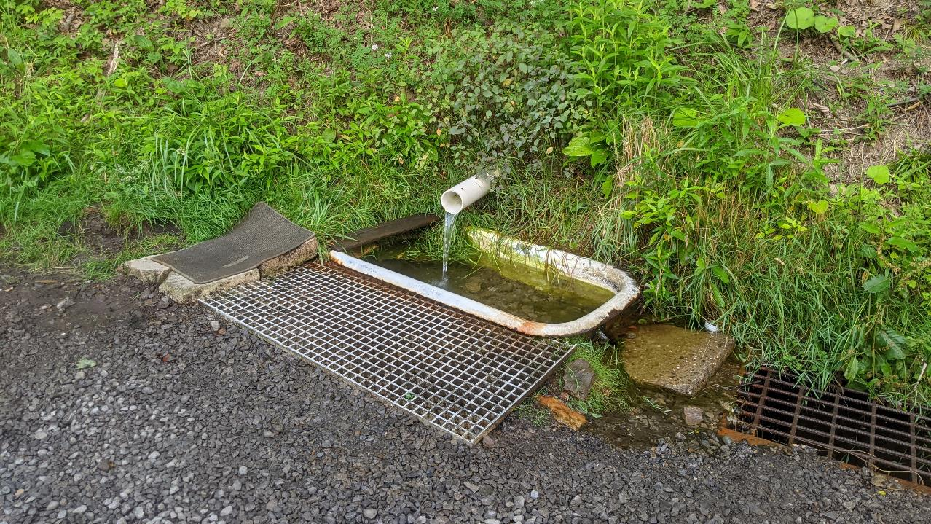
Dirt, Gravel, and Low Volume Road Program
WEBINAR
1/25/24
Starts 9am
2023 Project Showcase
SCC
Roy Richardson
rrichardso@pa.gov
Sherri Law
shlaw@pa.gov
Andy Mickey
anmickey@pa.gov
CDGRS
Steve Bloser
smb201@psu.edu
If you are reading this, then you are successfully seeing the webinar video. Webinar audio should be automatic through your computer (or click “join audio”), and options can be accessed in the “audio options” button on the bottom left. If your computer audio is not working, you can listen on your phone by dialing 312-626-6799.

Slide 2
2024 ESM Training – Registration Open Now!
https://dirtandgravel.psu.edu/education-training/esm-course/in-person-esm-trainings/
Cambria County – March 20-21, 2024
Johnstown, PA 15906
Schuylkill County – April 2 – 3, 2024
Ashland, PA 17921
Armstrong County – April 24 – 25, 2024
Kittanning, PA 16201
McKean County – May 15 – 16, 2024
Port Allegany Veteran Memorial Social Hall
Port Allegany, PA 16743
Wayne County – June 5 – 6, 2024
Honesdale, PA 18431
Clinton County – July – 10 – 11, 2024
Lock Haven University – Durrwachter Conference Center
Lock Haven, PA 17745
Beaver County – July 31 & August 1, 2024
Beaver Station Cultural & Event Center/Penn Bistro Catering
Beaver, PA 15009
Perry County – August 14 – 15, 2024
Central Penn College
Summerdale, PA 17093
Crawford County – September 11 & 12, 2024
Cross Creek Resort, Inc.
Titusville, PA 16354
Bradford County – September 25 – 26, 2024
Best Western Grand Victorian Inn
Sayre, PA 18840
Fulton County – October 23 & 24, 2024
Forbes Road Conference Center/ Holiday Inn & Express
Breezewood, PA 15533
Lancaster County – November 6 – 7, 2024
DoubleTree Resort by Hilton Hotel Lancaster
Lancaster, PA 17602

Slide 3
2024 Admin and Financial Trainings – Registration Open Now!
Admin Training
9-3:30 PM
Required for CD staff involved in the DGLVR Program at least once every 3 years
Online registration required
Financial Training
9-3:30 PM
Recommended for any CD staff involved in tracking/spending DGLVR funds
3-year certification
https://dirtandgravel.psu.edu/education-training/program-administration/admin-training/
https://dirtandgravel.psu.edu/education-training/program-administration/financial-training-registration/
Dates and Locations
March 13 (Berks County)
May 21 (Westmoreland County)
July 23 (Centre County) – Tentative
October 15 (Luzerne County)
December 3 (Venango County)
Dates and Locations
March 14 (Berks County)
May 22 (Westmoreland County)
July 24 (Centre County) – Tentative
October 16 (Luzerne County)
December 4 (Venango County)

Slide 4
2023 QAQC Project Showcase
Examples include:
“Classic” Drainage and Fill
French Mattress
Stream Crossing Replacement
Stormwater Basin
Permeable Pavement
DSA
Combining Funding Sources
Highwater Bypass
Underdrain
Drainage Disconnection
Off Right-Of-Way

Slide 5
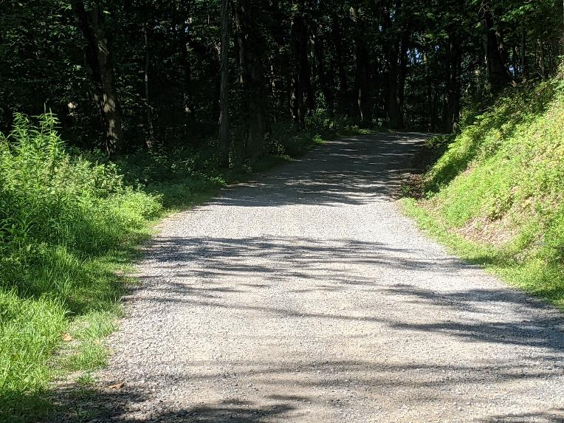
Rader School Road, Butler CCD
Before
DGR funds: $95,000.00
In-kind: $16,792.99
Problem being addressed:
The road was entrenched with insufficient stormwater drainage outlets.

Slide 6
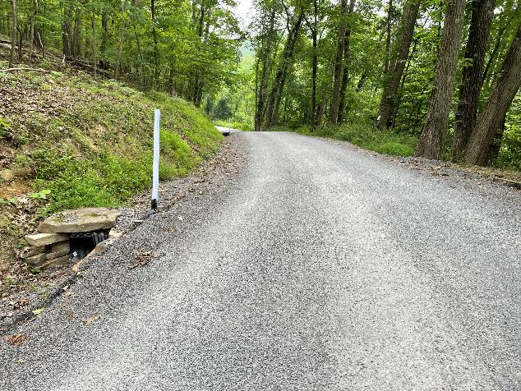
Rader School Road, Butler CCD
Project Description: (Site Length: 1,196 ft) “classic” fill and drainage project
7 new cross pipes and 1 cross pipe replaced
3,050 tons of road fill was placed to raise the road out of entrenchment and provide downslope sheet flow off the road.
The project site was chip sealed by the township following completion of the project.

Slide 7
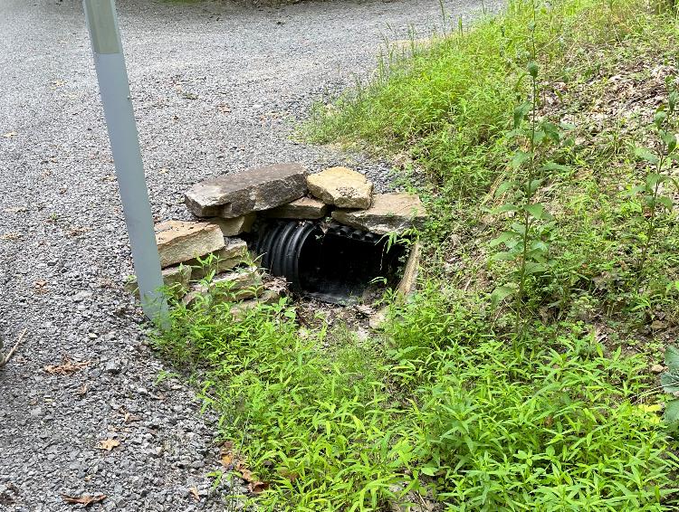
Rader School Road, Butler CCD
After
Stable inlets
No bank gouging
Solid headwall material stacked well
Inlet of pipe cut to help direct water into it
Frequent, stable outlets
Road fill elevates surface high enough to achieve sheet flow

Slide 8
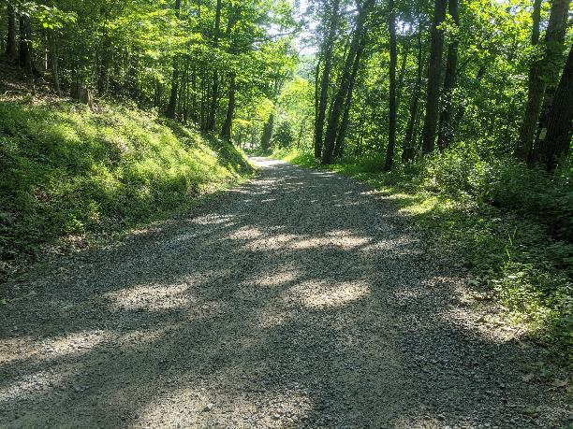
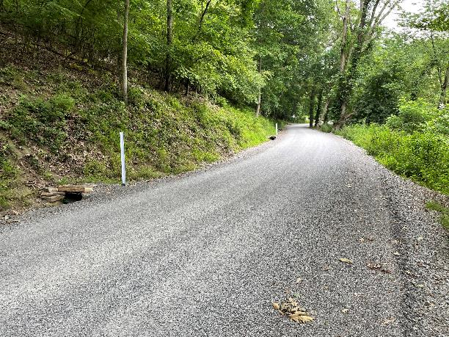
Rader School Road, Butler CCD
Before
After

Slide 9
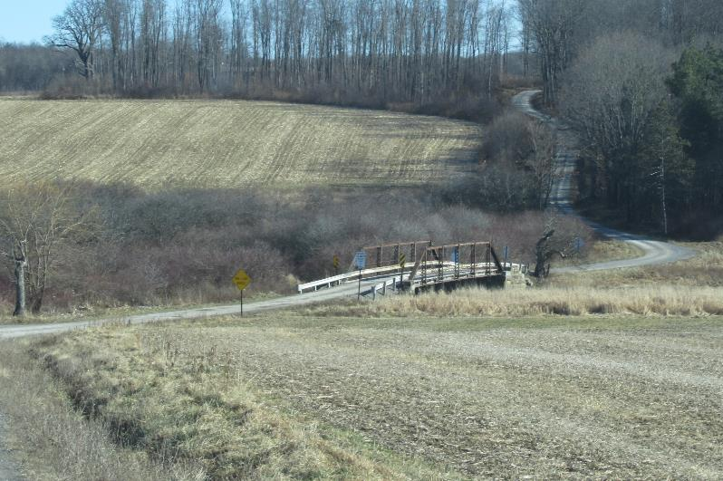
Yonai Road, Somerset CCD
Before
DGR funds: $160,692
In-kind: $35,970
Problem being addressed:
Yonai Road traverses an expansive floodplain in the head waters region of the Stonycreek River.
During even modest rain events and snow melts, the floodplain fills with water, ponding on the road.

Slide 10
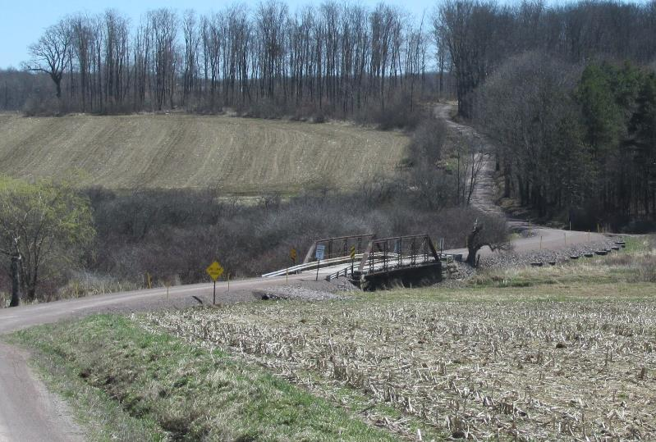
Yonai Road, Somerset CCD
After
DGR funds: $160,692
In-kind: $35,970
Project Description:
The Township installed a 500' x 24' x 3' thick French Mattress with twelve (12") relief pipes through the mattress.
Roadside ditches turned out to discharge away from the stream and mattress

Slide 11
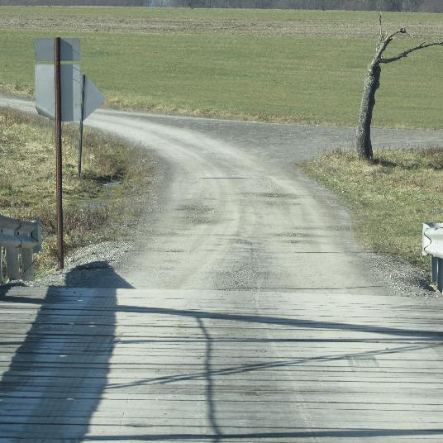
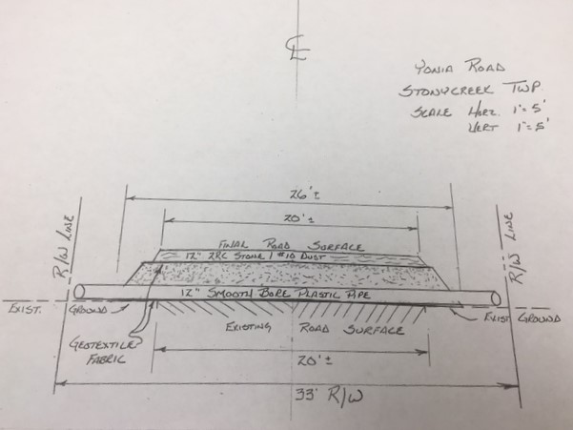
Yonai Road, Somerset CCD
Before

Slide 12
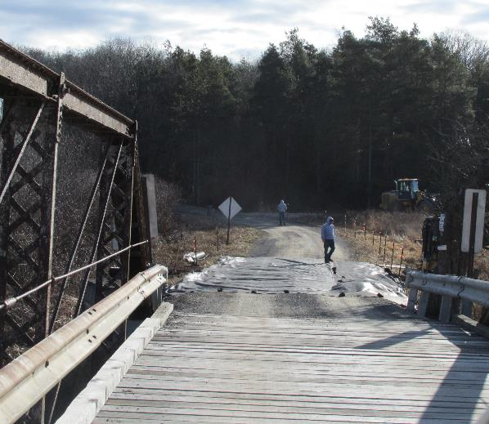
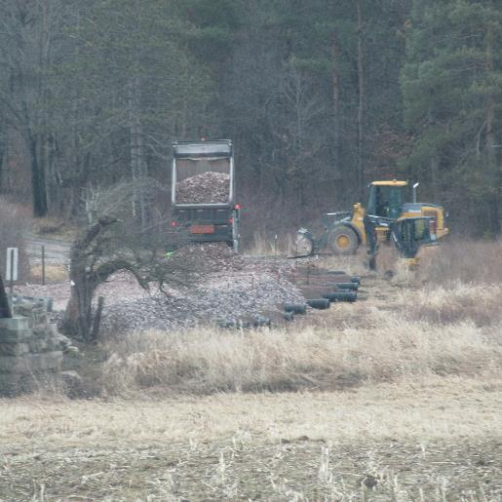
Yonai Road, Somerset CCD
During
During

Slide 13
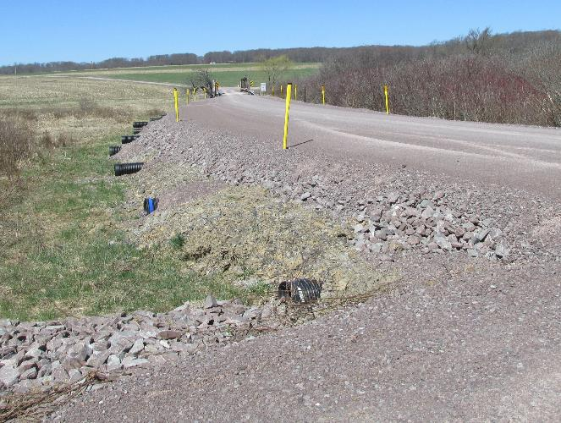
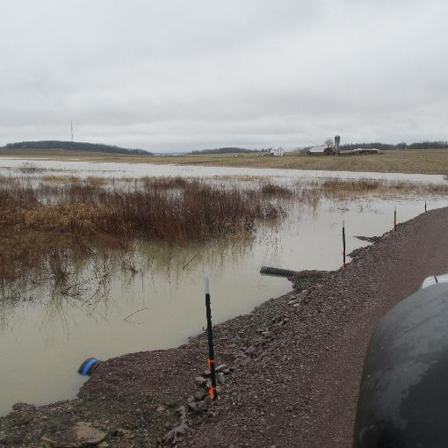
Yonai Road, Somerset CCD
After
After

Slide 14
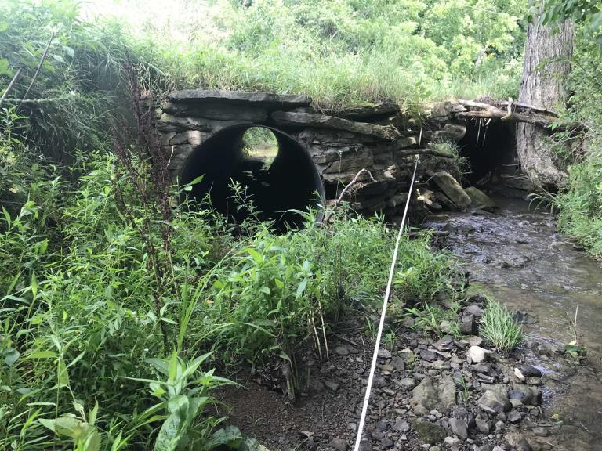
Wilhelm Road, Washington CCD
Before
DGR funds: $106,600.00
In-kind: $19,405.79
Problem being addressed:
The existing stream crossing was multiple pipes
the stream’s bankfull width is 12.9 ft

Slide 15
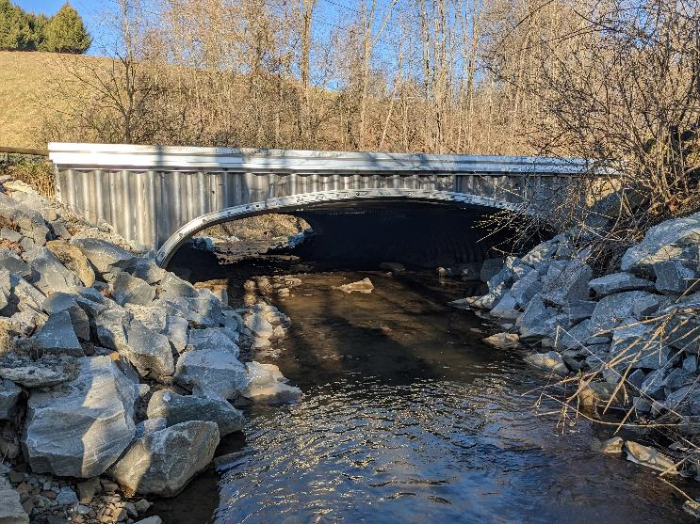
Wilhelm Road, Washington CCD
After
Project details:
A 16’ W x 4’3” H aluminum bottomless box culvert on express foundations was installed.
Road ditch turnouts were also installed to disconnect road drainage from the stream crossing.

Slide 16
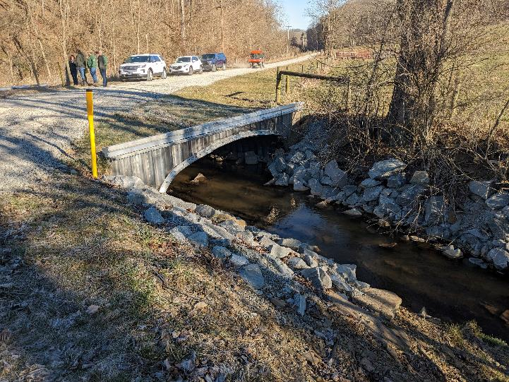
Wilhelm Road, Washington CCD
After
Project details:
The district worked closely with the CDGRS to incorporate updated guidance into the stream crossing design.
Bank margins, a low flow channel, and 3 riffles were constructed to establish a stable, continuous stream channel upstream, through, and downstream of the road crossing.

Slide 17
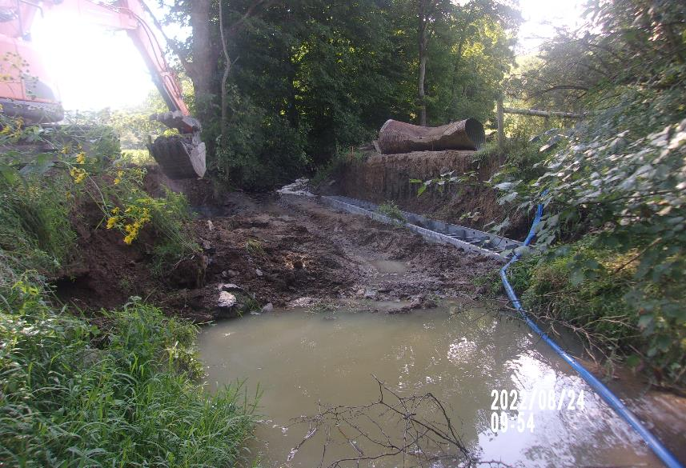
Wilhelm Road, Washington CCD
During
Excavation, pump around, and setting footings

Slide 18
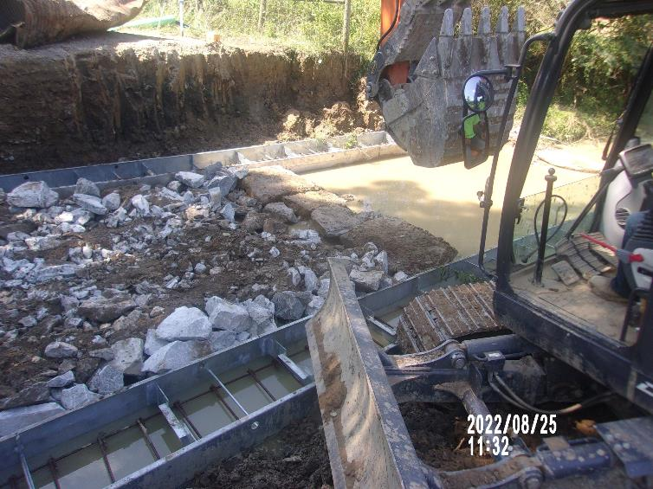
Wilhelm Road, Washington CCD
During
Stream bed reconstructed between footers
Note:
Large rock is used to build riffles (grade control) and is intended to be stable during storms
The rest of the stream bed is a mix of big stone/rip rap and fine material
Mixed before being placed
Fines help “glue” the bed material

Slide 19
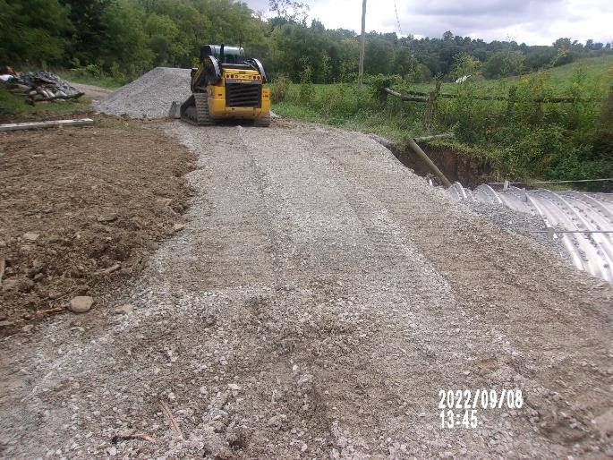
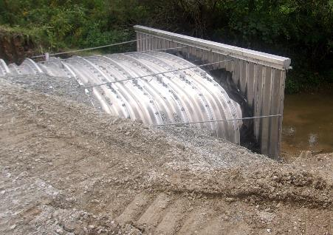
Wilhelm Road, Washington CCD
During
Back fill being placed and compacted
~6-10” thick layers (“lifts”)
Fill both sides of structure evenly
Headwall tie-backs

Slide 20
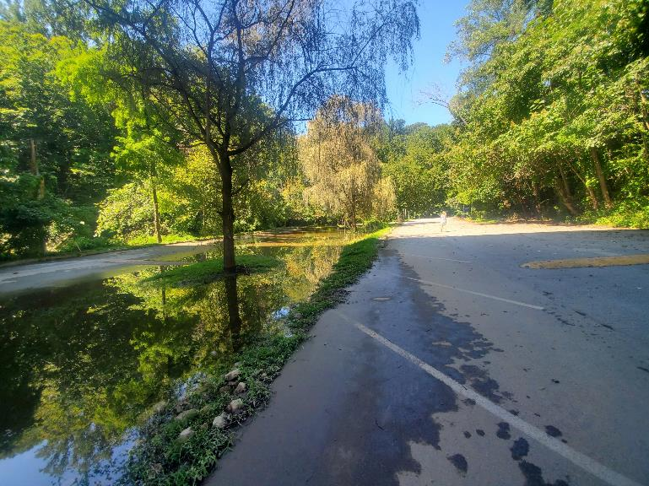
Paper Mill Road, Delaware CCD
Before
LVR funds: $69,280.05
In-kind: $83,387.95
Problem being addressed:
An existing stormwater basin collected water from a looped road but was not functioning properly.
Before photos show Sept 2021 flooding
Notes:
The 4” drainpipe that was supposed to allow water to exit the water quality basin was buried in sediment and debris and/or crushed.
The trench drain did not drain as it was filled with sediment and debris.
When the adjacent Crum Creek would flood into the water quality basin, the water drained extremely slowly, resulting in standing water in the road between the basin and Crum Creek.

Slide 21
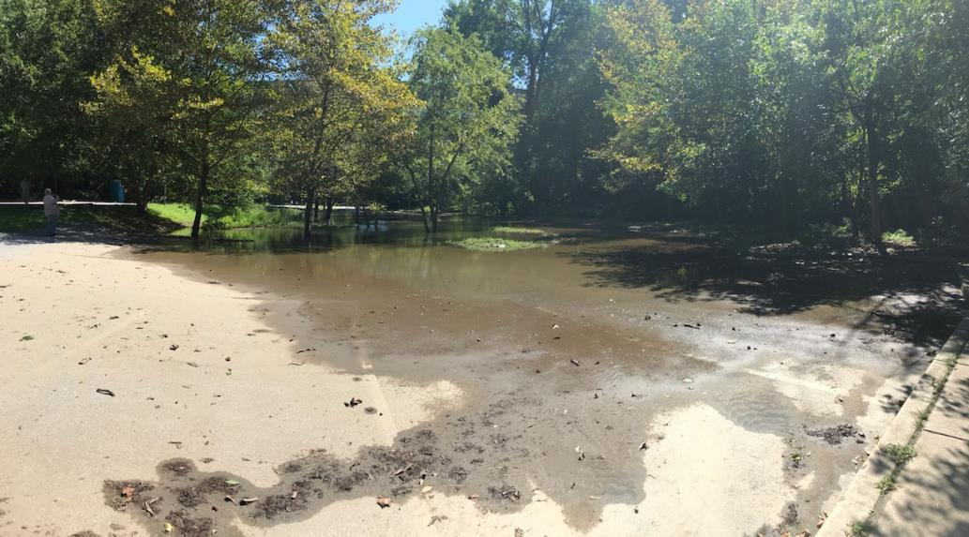
Paper Mill Road, Delaware CCD
Before
Notes:
The 4” drainpipe that was supposed to allow water to exit the water quality basin was buried in sediment and debris and/or crushed.
The trench drain did not drain as it was filled with sediment and debris.
When the adjacent Crum Creek would flood into the water quality basin, the water drained extremely slowly, resulting in standing water in the road between the basin and Crum Creek.

Slide 22
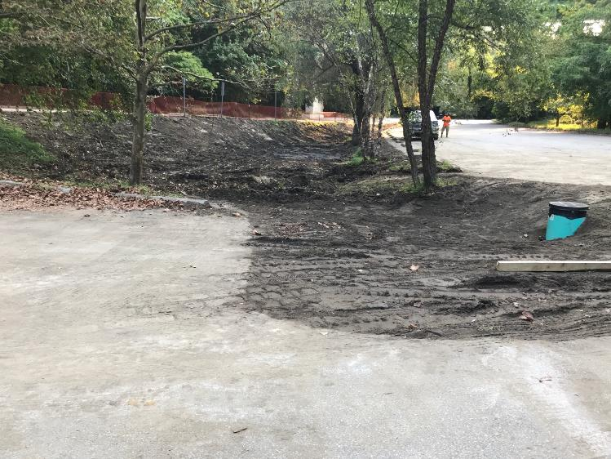
Paper Mill Road, Delaware CCD
During
Excavated basin (Sept 2022)
Re-graded the existing basin back to the original contours
installed a 24” outlet riser with trash rack
installed an 18” drainpipe with a backflow preventer valve and riprap apron at the outlet
re-vegetated the basin.
Guiderail was installed around the basin to prevent vehicle traffic from entering the basin.

Slide 23
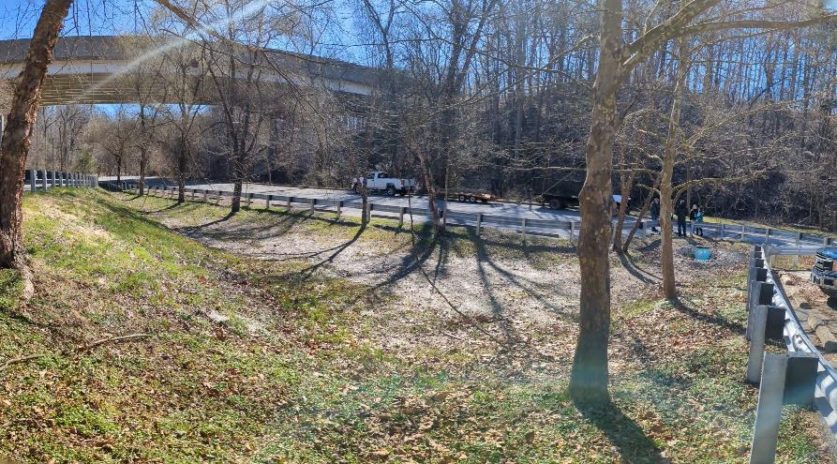
Paper Mill Road, Delaware CCD
After
The basin now functions
Promotes water infiltration
Captures sediment
Provides water detention
filters out pollutants before water enters Crum Creek

Slide 24
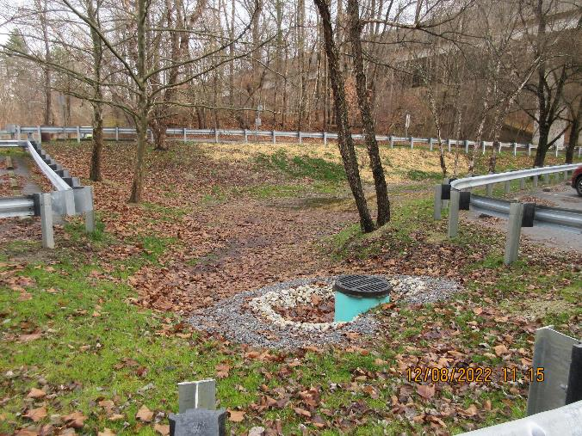
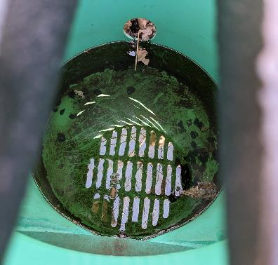
Paper Mill Road, Delaware CCD
After
24” outlet riser with trash rack

Slide 25
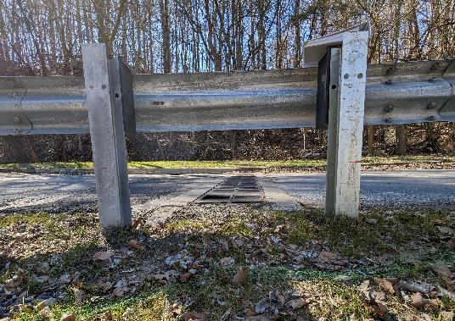
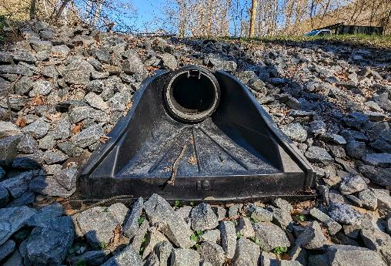
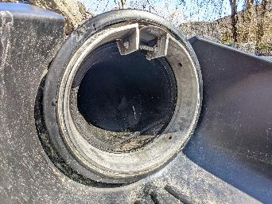
Paper Mill Road, Delaware CCD
After
installed an 18” drainpipe with a backflow preventer valve and riprap apron at the outlet

Slide 26
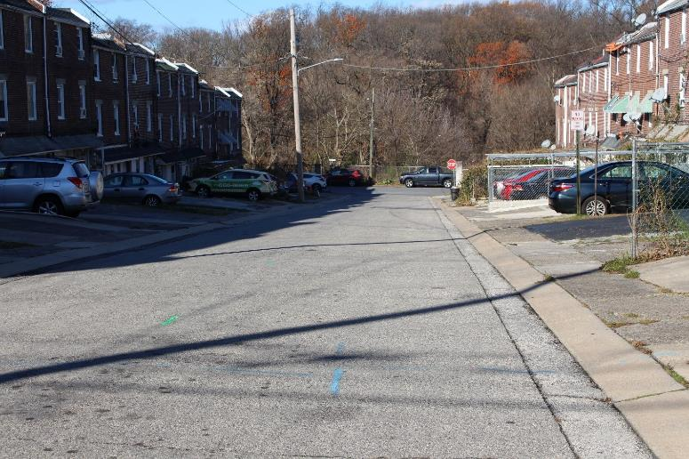
Aster Road and Wister Drive, Delaware CCD
Before
LVR funds: $44,750
In-kind: $64,010
Problem being addressed:
Stormwater flowed down Aster Road along the curb line to city inlets in Wister Drive.
The storm sewer system outfalls directly to Cobbs Creek.

Slide 27
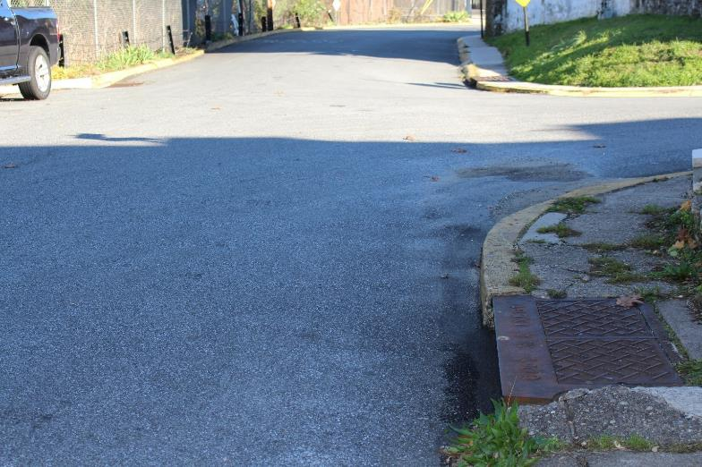
Aster Road and Wister Drive, Delaware CCD
Before
LVR funds: $44,750
In-kind: $64,010
Problem being addressed:
Due to the slope of Aster Road, much of the stormwater did not follow the curb line to the inlet, but rather crossed Wister Drive and ponded along the curb.

Slide 28
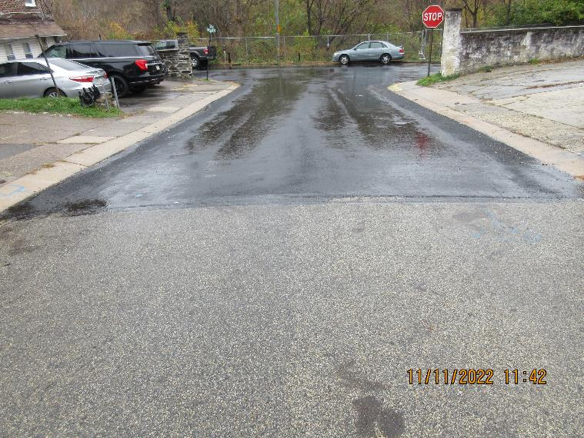
Aster Road and Wister Drive, Delaware CCD
After
Improvements:
Replaced 2 city inlets with type "C" inlets
replaced 65 LF of reinforced concrete class 3 pipe
Permeable pavement on both road edges
Proper road crown directs stormwater to permeable pavement and storm sewer inlets

Slide 29
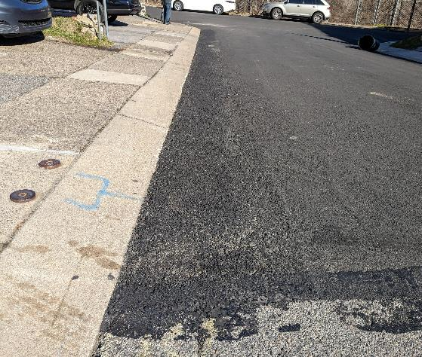
Aster Road and Wister Drive, Delaware CCD
After
Improvements:
Permeable pavement strips along the curb line on each side of the street capture stormwater flowing along the curb (25 sq yd total)
installed 100 LF of perforated pipe in a stone bed underneath the porous paving

Slide 30
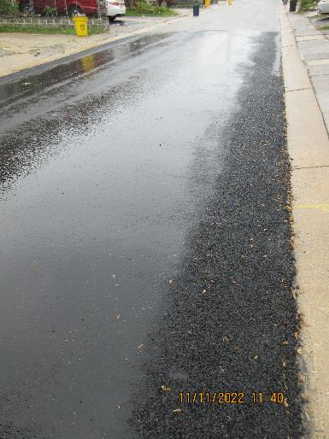
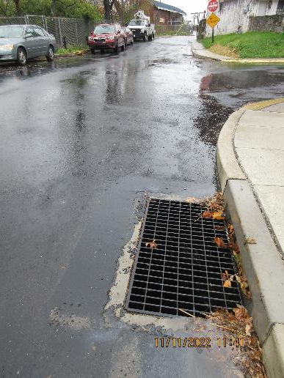
Aster Road and Wister Drive, Delaware CCD
After
Benefits:
Slows stormwater velocity
Sediment and debris captured in in the debris sumps of the new inlets
Stormwater carried through the stone bed is cooled before reaching the stream
Regular maintenance of the permeable pavement strips removes sediment and fines

Slide 31
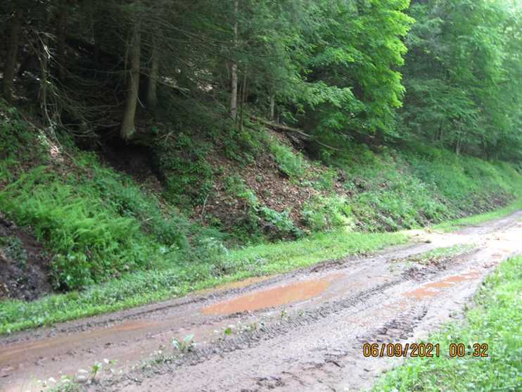
(2 Contracts)
DGR Funds: $238,828
In-Kind: $183,208
Bear Run Road, Lycoming CCD
Before
Background:
PGC-owned dead-end road opened seasonally
13,203’ site length
Adjacent to HQ, Class A Wild Trout Stream (Bear Run)
Problem Being Addressed:
Traditional drainage issues:
Lack of ditch outlets, groundwater influences, entrenchment, erosive outlets
Stream overtopping the road

Slide 32
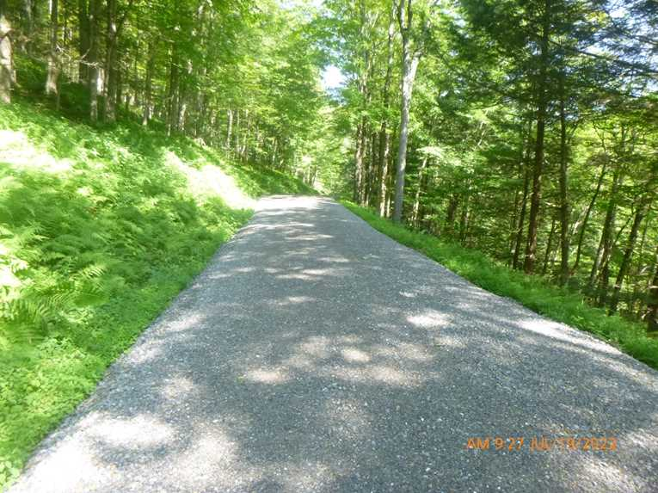
Bear Run Road, Lycoming CCD
After
Scope of Work
20 new cross pipes, 13 replacement cross pipes
Stacked stone end treatments
Solid outlet protection
1,544’ of underdrain
15,770 tons of road fill
2,040 SY of geo-fabric
Highwater bypass

Slide 33
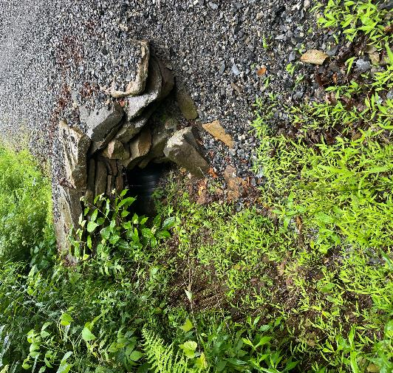
Bear Run Road, Lycoming CCD
After
Highlights:
Elimination of ditch erosion
Stabilization of erosion channels
Protection of new road base from groundwater influences
Alleviation from entrenchment (sheet slow)
Relief from flooding
Overall large reduction of sediment to Bear Run

Slide 34
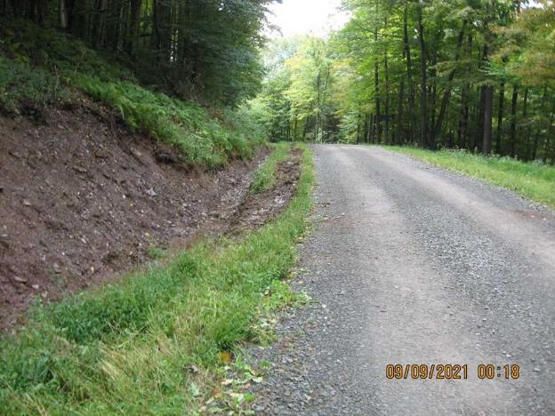
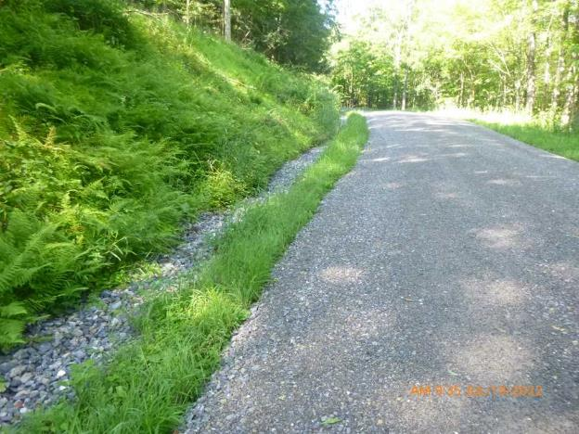
Bear Run Road, Lycoming CCD
After

Slide 35
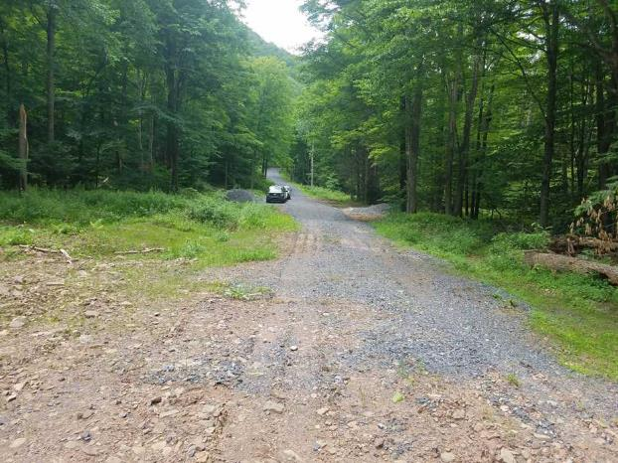
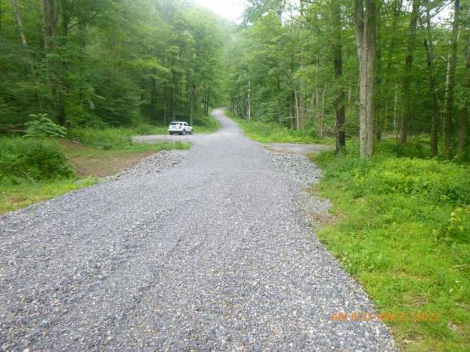
Bear Run Road, Lycoming CCD
After

Slide 36
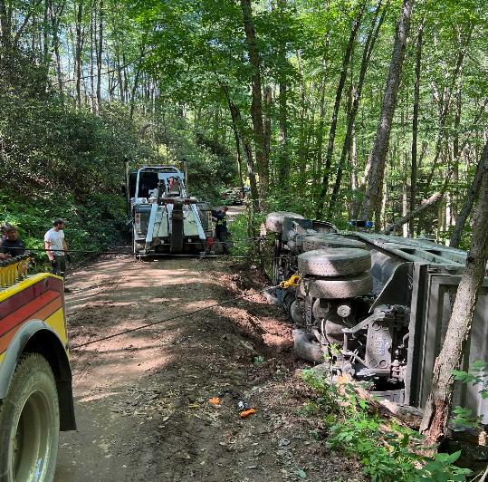
(4 Contracts)
DGR Funds: $533,484
In-Kind: $392,788
Jerry Run Road, Cameron CCD
During (Whoops)
Background:
Road owned by 2 townships through State Forest Land
26,986’ (5.1 mi) site length
Immediately adjacent to HQ, Class A Wild Trout Stream (Upper Jerry Run)
Problem Being Addressed:
Unavoidable road/stream interaction, surface drainage issues, sediment-heavy road surface material

Slide 37
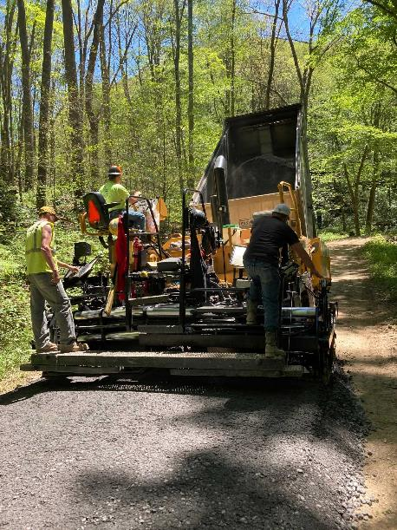
Jerry Run Road, Cameron CCD
During
Scope of Work
2 new cross pipes
most drainage improvements completed through previous projects
2,000 tons of road fill
10,000 tons of DSA placed

Slide 38
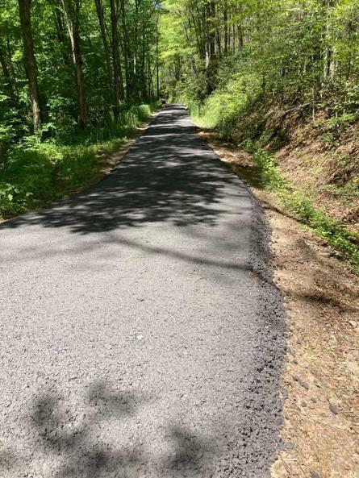
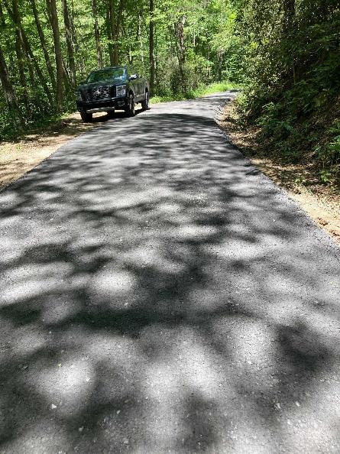
Jerry Run Road, Cameron CCD
After Placement
After Compaction
Highlights:
2 townships
Utilized 4 different funding sources
Overcame site challenges
bridge postings, road width, location
Excellent location for DSA use

Slide 39
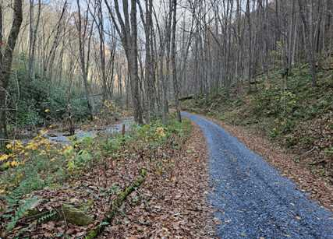
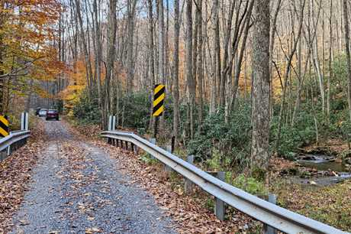
Jerry Run Road, Cameron CCD

Slide 40
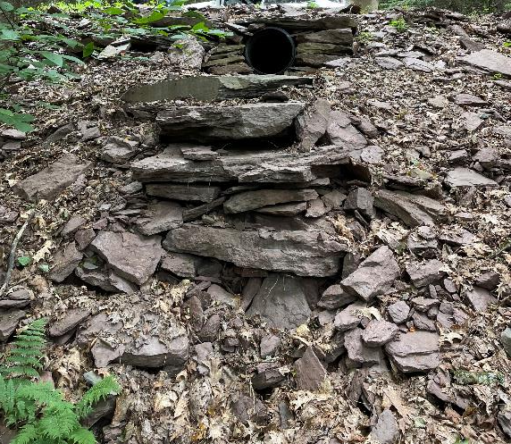
(2 Contracts)
DGR Funds: $140,482
In-Kind: $57,572
Pine Creek Road, Luzerne CCD
After
Background:
Fairmount Township unpaved road
Stream crosses road twice
3,600’ site length
Direct ditch connection to Pine Creek at base of slope
Problem Being Addressed:
Lack of ditch outlets, eroded ditches, saturated/flowing ditches, entrenchment, poor road base

Slide 41
Pine Creek Road, Luzerne CCD
Before

Slide 42
Pine Creek Road, Luzerne CCD
Scope of Work
7 new cross pipes, 3 replacement pipes
Solid outlet protection
640’ of underdrain
700 tons of road fill
2,000 tons of DSA
Before
After

Slide 43
Pine Creek Road, Luzerne CCD
Before
After

Slide 44
Pine Creek Road, Luzerne CCD
After
Highlights
Comprehensive project
drainage>fill>surface
Drainage disconnection
Great outlet stabilization
Simple, effective solution to erosion and drainage issues

Slide 45
Burrell Road, Clinton CCD
(2 Contracts)
DGR Funds: $45,355
In-Kind: $3,211
Before
Background:
Steep section of road with township line ¾ of the way up hill
991’ site length
Problem Being Addressed:
Steep, entrenched road
No drainage outlets with entire road and driveway draining to stream crossing
Off-ROW drainage issues
Groundwater issues

Slide 46
Burell Road, Clinton CCD
After
Scope of Work
1 new cross pipe
305’ of underdrain
1 diversion swale
390 tons of road fill
623 tons of DSA
Work completed by a combination of township and contractor work

Slide 47
Burell Road, Clinton CCD
After
Highlights
Fantastic drainage disconnection from stream
Utilized existing topography/terrain features
Durable wearing surface
Protection of investment through grade break
Cost effective, long-term solution
CDGRS involvement
Staffing changes

Slide 48
Burrell Road, Clinton CCD
Before
After

Slide 49
Burrell Road, Clinton CCD
Before
After

Slide 50
Washington Road, Berks CCD
LVR Funds: $47,010
In-Kind: $60,337
Before
Background:
Existing asphalt LVR road
722’ site length
Affected Stream: Schuylkill River
Problem Being Addressed:
The roadway and the adjacent fields and driveway would flood in larger storm events due to the area being a low point in the topography
No drainage

Slide 51
Washington Road, Berks CCD
Aerial View

Slide 52
Washington Road, Berks CCD
During
Scope of Work
1 infiltration/bioswale
2 inlet boxes
800’ of off-ROW 18” HDPE pipe
360’ underdrain
Rock sump/energy dissipation
Repaving

Slide 53
Washington Road, Berks CCD
After
Highlights
Innovative solution to unique problem
Landowner cooperation
Outlet protection

Slide 54
Washington Road, Berks CCD
1 Year After

Slide 55
And Remember…
Have a nice day!
…Save DSA and LEAVE THE RATTLESNAKES BE!

Slide 56
THANK YOU
Conservation Districts for doing great work!

