Slide 1
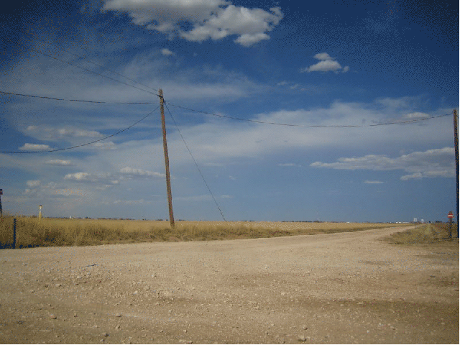


DGLVR Webinar
5-Year SCC/CD Agreements, Spending Requirements, and Annual Reports
12/15/22
Starts at 9am
If you are reading this, then you are successfully seeing the webinar video. Webinar audio should be automatic through your computer, and options can be accessed in the “audio options” button on the bottom left. If you are having audio issues, or are in a location where listening via phone is preferable, audio is also available on the CDGRS conference line at: 312-626-6799
For technical assistance, call: 814-865-5355

Slide 2
DGLVR Program
5-Year Agreements & Spending
Agenda
  5-year contact and spending requirements
  Review of draft new 5-year
  Annual Summary Report Refresher (including looking up spending status)

Slide 3
DGLVR Program
5-Year Agreements & Spending
DGLVR 5-Year Agreements (between SCC and CDs)
  Agreement that establishes DGLVR Program in individual CDs, allowing funding transfer to CDs.
  66 CDs currently have agreement
  Current Agreement ends 6/30/23
  All funding from agreement must be spent out by 6/30/24

Slide 4
DGLVR Program
5-Year Agreements & Spending
2018 2019 2020 2021 2022 2023 2024 2025 2025 2027 2028
Current 5-year
Extra Year
New 5-year
today
  Current 5-year:
    Began 7/1/2018, scheduled to end 6/30/2023
    Extra year written into contract to spend funds. All funds must be spent by 6/30/2024.
    New Agreement to begin 7/1/2023.

Slide 5
DGLVR Program
5-Year Agreements & Spending
ALL FUNDS: funds in Harrisburg, AND in Conservation District Accounts
Current 5-year
1-year Extension
today
  What this means:
    6/30/2024: ALL funds from FY 18-19 through FY 22-23 must be SPENT.

Slide 6
DGLVR Program
5-Year Agreements & Spending
  Question:
  What do you consider “spent”?
    Answer:
  Spent:
  A check has been written to the grant recipient
  An admin/edu expense has been paid with Program funds.

Slide 7
DGLVR Program
5-Year Agreements & Spending
  Question:
  How should I handle projects that may be delayed by engineering, permits, or other issues?
    Answer:
  Keep these projects moving along as best as you can
  Reach out to the SCC and Center early if you would like assistance or have specific questions
    SCC/Center will also reach out to “red” counties
  Remember that you can still meet your spending requirement even if individual projects are delayed

Slide 8
DGLVR Program
5-Year Agreements & Spending
  Question:
  When do admin/edu funds need to be spent by?
    Answer:
  Admin/edu funds must now be spent annually.
  FY 2022-23 admin edu funds must be spent by 6/30/23
  Unspent admin and edu funds roll over into project funds after 1 year, and they must be spent on projects by 6/30/24.

Slide 9
DGLVR Program
5-Year Agreements & Spending
  Question:
  Can I sign a contract for more money than I need to spend for FY 2022-23 funding, and finish payment with FY 2023-24 funding through the new 5-year agreement?
    Answer:
  Yes. This may require delaying payment in some cases. An alternative is to consider funding the contract in phases.

Slide 10
DGLVR Program
5-Year Agreements & Spending
  Question:
  How can I increase committing and spending quickly and effectively?
    Answer:
  Be proactive NOW in finding new contracts
  Consider assigning additional staff time to Program
  Contact municipalities that have good record of quality projects to see if anything is “shovel ready”.
  May require additional QAB meeting, or temporary change of grant application submittal deadline to get contracts signed.
  Consider larger, more comprehensive projects that can be completed in a timely fashion.

Slide 11
DGLVR Program
5-Year Agreements & Spending
  Question:
  What if funds are not spent by 6/30/24?
    Answer:
  Per conditions of the existing 5-year agreement (section 1.3): “…the funds will revert back to the control of the Commission for future apportionments, or the District may, at the discretion of the Commission, be ineligible for future allocations, or the amount of such funds may be deducted from any future apportionment to the District.”

Slide 12
DGLVR Program
5-Year Agreements & Spending
  Question:
  How do I know how much I need to spend to meet my spending requirements?
    Answer:
  This information is available in the GIS.
  The GIS demo at the end of this webinar will walk through how to determine these numbers.

Slide 13
DGLVR Program
5-Year Agreements & Spending
  Eligibility for FY 2023-24 Allocations
  DGR
    18 Red (still need to spend money to be eligible)
    47 Green (eligible for FY 2023-24 allocation)
  LVR
    23 Red
    43 Green
  Counties with 100% of current 5-year agreement spent:
    66 Red
    0 Green

Slide 14
DGLVR Program
5-Year Agreements & Spending
  When is the best time to start planning and asking for assistance?
  NOW!
  Winter is easier to get technical assistance quickly

Slide 15
DGLVR Program
5-Year Agreements & Spending
Agenda
  5-year contact and spending requirements
  Review of draft new 5-year
  Annual Summary Report Refresher (including looking up spending status)

Slide 16
DGLVR Program
5-Year Agreements & Spending
  Review of proposed changes in new 5-year agreement

Slide 17
DGLVR Program
5-Year Agreements & Spending
  New 5-year Agreement Timeline:
  Districts received draft agreement on 12/14/2022 to review
  District comments due to SCC by 1/20/2022
  SCC will review agreement at their Jan 2022 meeting
  Approved 5-year agreement will be sent to districts for signatures
    Please return as soon as practical
  Then the SCC will send the agreement to the 8 other parties that need to sign it

Slide 18
DGLVR Program
5-Year Agreements & Spending
Agenda
  5-year contact and spending requirements
  Review of draft new 5-year
  Annual Summary Report Refresher (including looking up spending status)

Slide 19

DGLVR Program
5-Year Agreements & Spending
  The Ken Show!

Slide 20
DGLVR Program
5-Year Agreements & Spending
Annual Summary Report
Due January 15th
Any CD employee with a GIS login can submit
Can be viewed at any point throughout the year to help keep track of spending requirements
New Budgeting tool to help meet spending requirements
5 Required Steps to submit
  All quarters for the previous calendar year submitted and accepted
  Enter the Limestone Cost for the previous year
  Check and fix any contract errors
  Verify all financial and project information in the ASR
  Check all boxes and submit the report

Slide 21
DGLVR Program
5-Year Agreements & Spending
Required Steps
Submit the October – December Quarter
  Verify that balances match
  Address any expired contracts
  SCC must accept the report before the ASR can be submitted

Slide 22
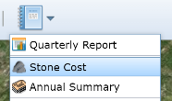
DGLVR Program
5-Year Agreements & Spending
Required Steps
Enter the Limestone Cost for 2022
  The average cost of limestone aggregate (DSA) delivered (not placed)

Slide 23
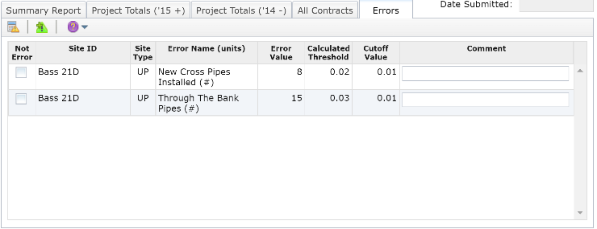
DGLVR Program
5-Year Agreements & Spending
Required Steps
Check and fix any contract Errors
  Review errors and, if valid, fix each within their respective contract to permanently remove the error from the list.
  If a marked error is not an error, check the respective box, enter comments, then click the "Save Changes" button.
Note that all errors must be fixed before the ASR can be submitted.

Slide 24
DGLVR Program
5-Year Agreements & Spending
Required Steps
Verify the information present in the ASR
  Financials for each Program
  Project totals for each completed Funded Site

Slide 25
DGLVR Program
5-Year Agreements & Spending
Required Steps
Submit the Annual Summary Report
  All check boxes need to be checked before you can submit
  Emails will be sent upon Submit and Accept

Slide 26
DGLVR Program
5-Year Agreements & Spending
Am I eligible for an allocation?
Depends on your Spending Requirement Status
Spending Requirement is the total of all allocations received minus the most recent 2 fiscal years
  If Total Spent >= Spending Requirement, then you are eligible for an allocation. The difference will be green.
  If Total Spent < Spending Requirement, then you are not eligible for an allocation. The difference will be red. That amount must be spent by the time the next allocation is determined. This is typically March 31.

Slide 27
DGLVR Program
5-Year Agreements & Spending
ASR Budgeting Tool
Useful to help meet Spending Requirements
Be sure that all income and expenses are up to date
The information saved in the ASR budget tool is reset when the next allocation has been entered into the GIS

Slide 28
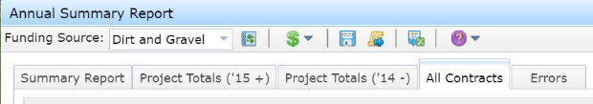
DGLVR Program
5-Year Agreements & Spending
Downloadable Data
Each of the five tabs in the ASR can be downloaded in a comma delimited format.
To download data for a particular tab, choose the appropriate tab and then click the Export Reports button.
Select the “Combined” funding source for both DGR and LVR data.

Slide 29
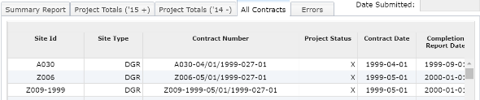
DGLVR Program
5-Year Agreements & Spending
Downloadable Data
The “All Contracts” tab is useful to view data for individual contracts.
The March 29, 2019 webinar “Detailed GIS Data Analysis Demo in Excel” provides a comprehensive GIS data analysis focusing on sorts, summarizations, formulas, and graphs, and other functions in excel. (located in Past Webinars)

Slide 30
DGLVR Program
5-Year Agreements & Spending
Report Due January 15

