Slide 1
Audio test underway:
You should here audio now via either phone or computer.
If you are having audio issues, or are in a location where listening via phone is preferable, audio is also available on the CDGRS conference line at: 866-823-7699.
For audio via phone: 866-823-7699
For technical assistance: 814-865-5355

Slide 2
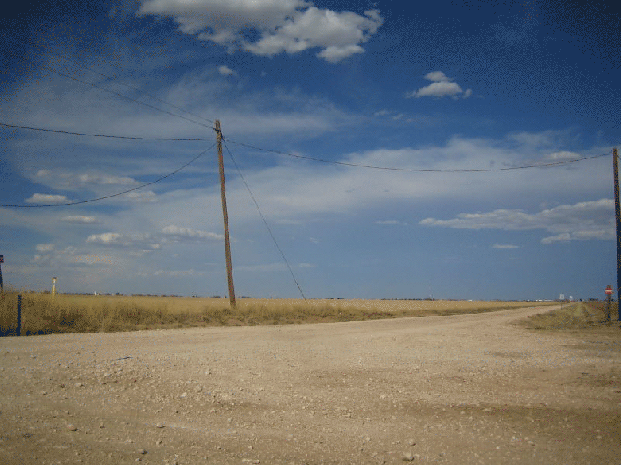
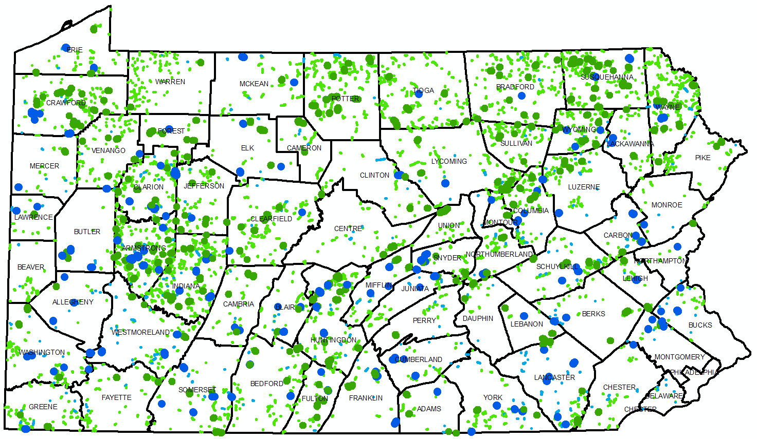
DGLVR Webinar
2017
Annual Summary
2/13/2018
Starts at 10am
If you are reading this, then you are successfully seeing the webinar video. Webinar audio should be automatic through your computer, and options can be accessed in the “audio options” button on the bottom left. If you are having audio issues, or are in a location where listening via phone is preferable, audio is also available on the CDGRS conference line at:
866-823-7699.
For technical assistance, call: 814-865-5355

Slide 3
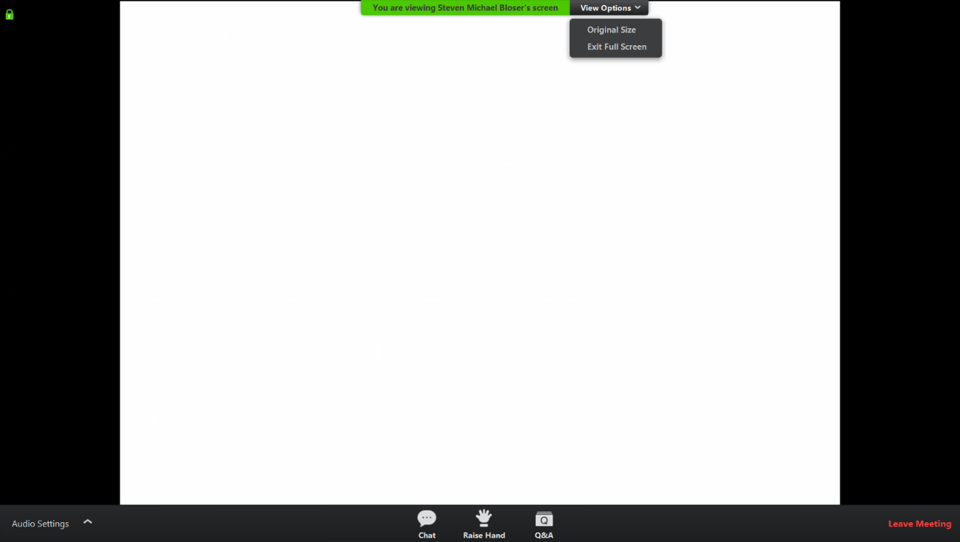
Q&A
Note you can ask a question anonymously
Q&A
For audio via phone: 866-823-7699
For technical assistance: 814-865-5355
Slide #

Slide 4
Annual Summary Report Details
Purpose:
Pause a minute, step back, and look at the big picture of what is being done by the Program.
A lot of figures and stats coming up fast:
Webinar recording and ppt slides available at www.dirtandgravelroads.org
Printed Annual Summary Report available soon.

Slide 5
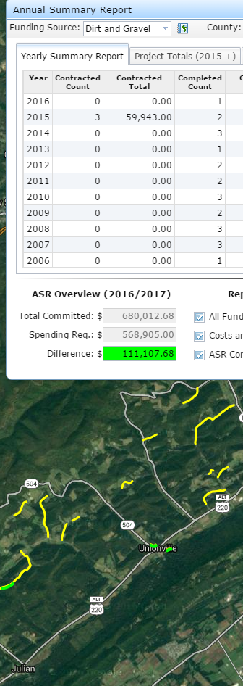
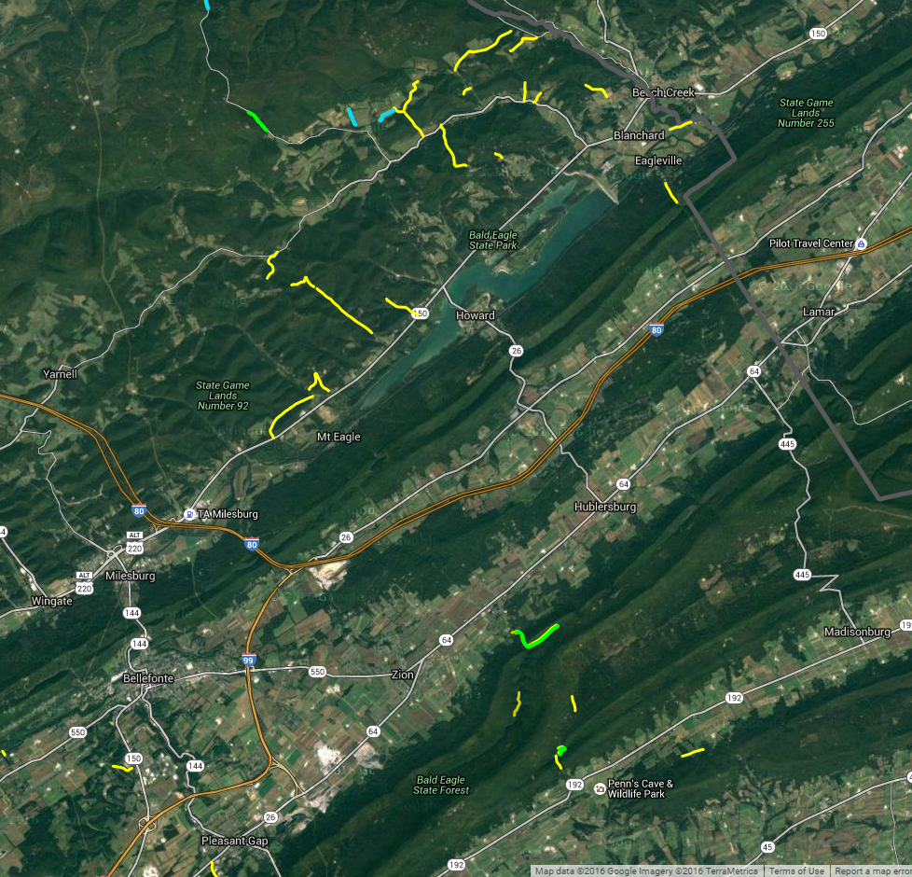
Annual Summary Report Details
ESM Trainings
Project Spending
Project Deliverables
Audio also available via phone: 866-823-7699
For assistance, call: 814-865-5355

Slide 6
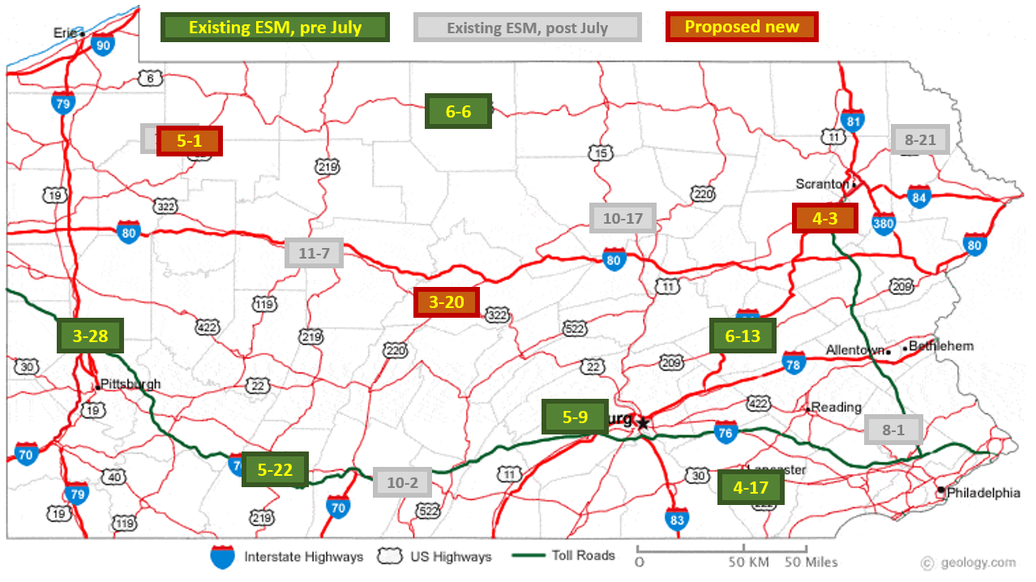
DGLVR Program
ESM Trainings
Note Added and Moved ESM Trainings:
For audio via phone: 866-823-7699
For technical assistance: 814-865-5355
ESM Training Schedule Changes:
Venango County: rescheduled from July to April 10 & 11, 2018 (all current registrations for this course have been notified and switched to the new dates)
Cross Creek Golf Course & Conference Center, 3815 PA 8, Titusville, PA 16354
814-827-9611 – Room Block: Center for Dirt and Gravel Roads, $65/night
Centre County: NEW added training – April 3 & 4, 2018 (Tuesday/Wednesday)
Ramada State College Hotel & Conference Center, 1450 S. Atherton Street, State College, PA
814-238-3001 -- Room Block: Center for Dirt and Gravel Roads, $73/night || valid until March 15, 2018
Luzerne County: NEW added training – May 1 & 2, 2018 (Tuesday/Wednesday)
Woodlands Inn & Resort, 1073 Highway 315, Wilkes-Barre, PA 18702
570-824-9834, Room Block: Dirt & Gravel Roads Training, $83/night || valid until Apr. 15, 2018

Slide 7
DGLVR Program
ESM Trainings
ESM Trainings:
3/28-29: Butler
4/3-4: Centre
4/10-11: Venango
4/17-18: Lancaster
5/1-2: Luzerne
5/9-10: Cumberland
5/22-23: Somerset
6/6-7: Potter
6/13-14: Schuylkill
7/11-12: Venango
8/1-2: Montgomery
8/21-22: Wayne
10/2-3: Bedford
10/17-18: Lycoming
11/7-8: Clearfield
Schedule is updated and registration is open for all courses at www.dirtandgravelroads.org

Slide 8
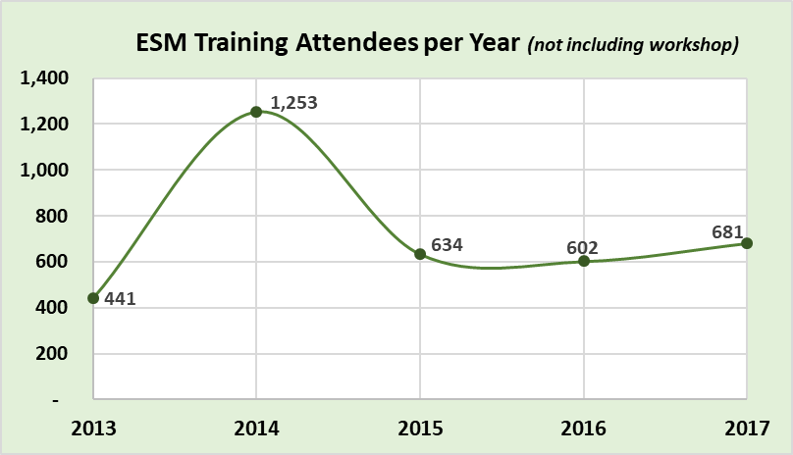
ASR Details
ESM Trainings
1997-2011 annual average
ESM Attendees per year
~50% increase over “old funding levels”
Potential additional surge with spending requirements and 5-year expirations?

Slide 9
ASR Details
ESM Trainings
ESM Changes for 2018
Only minor tweaks, no major changes
Vegetation Management Module
For audio via phone: 866-823-7699
For technical assistance: 814-865-5355

Slide 10
ASR Details
ESM Trainings
ESM “Boot Camp” for CDs
Initial planning for 2 sessions this summer
Aimed at relatively new technicians
~2.5 days, 75% in the field
Includes:
Construction basics
Survey basics
Complete crosspipe installation
Comprehensive site diagnostic and plan development
Stay Tuned!
For audio via phone: 866-823-7699
For technical assistance: 814-865-5355

Slide 11
Annual Summary Report Details
ESM Trainings
Project Spending
Project Deliverables
Audio also available via phone: 866-823-7699
For assistance, call: 814-865-5355

Slide 12
ASR Details
GIS
GIS
All Annual Reports done by Jan 31st
Currently in System: $100 $128 million spent/committed
$77 $98 Million in completed projects (DnG & LVR combined)
$24 $30 Million in contracted projects (DnG & LVR combined)
Audio also available via phone: 866-823-7699
For assistance, call: 814-865-5355

Slide 13
ASR Details
Spending
Big Picture: FY 2018-19 Allocations
2-year spending requirements: currently ~10 counties at risk of not being eligible for FY 2018-19 allocations, working through March to reduce that number.
FY 18-19 allocation Timeline:
May: SCC Approval
June: PA Budget Approval? (hopefully)
July-Sept: CDs receive advances
For audio via phone: 866-823-7699
For technical assistance: 814-865-5355

Slide 14
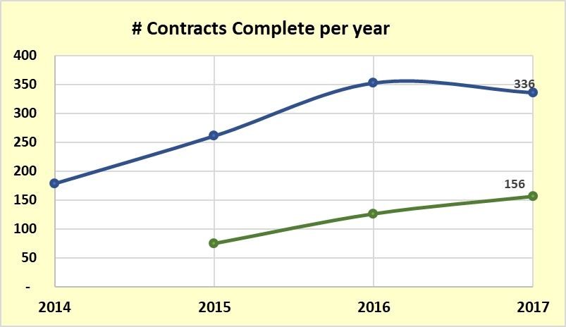
ASR Details
Spending
Dirt and Gravel
Low Volume
‘97-’14 average/yr
# DnG completed contracts decreased in 2017
# LVR completed contracts continued to increase in 2017

Slide 15
ASR Details
Spending
1997-2014 annual average
Dirt and Gravel
Low Volume
$4 million
$28 million
‘97-’14 average/yr
# DnG completed contracts decreased in 2017
# LVR completed contracts continued to increase in 2017

Slide 16
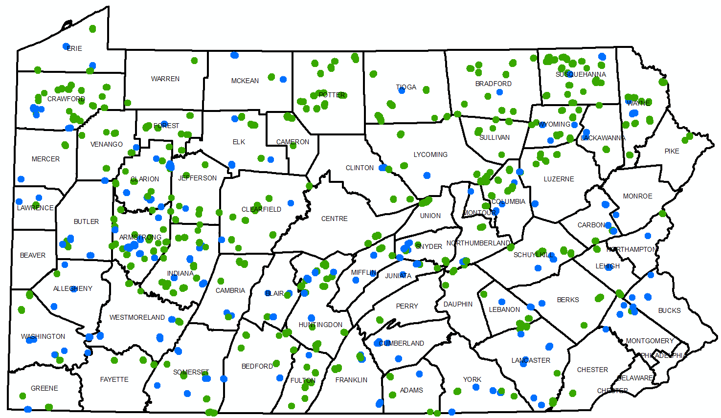
Contracts Completed in 2017:
336 Dirt and Gravel
156 Paved LVR
LVR
DnG

Slide 17
Contracts Completed since 1998:
3,991 Dirt and Gravel
360 Paved LVR
LVR
DnG

Slide 18
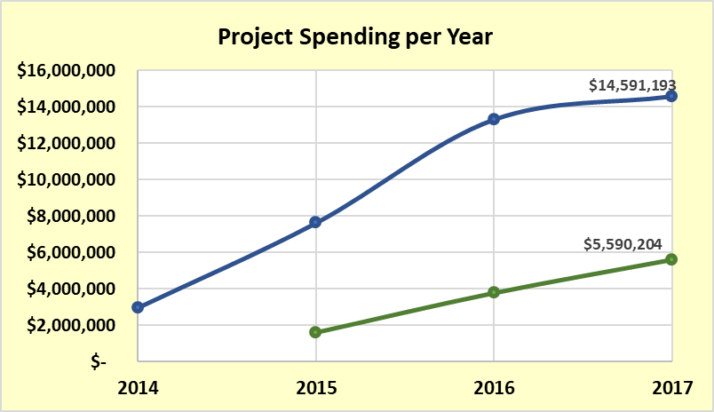
ASR Details
Spending
Dirt and Gravel
Low Volume
‘97-’14 average/yr
DnG spending lower than expected
LVR spending increasing linearly, still low

Slide 19
ASR Details
Spending
Dirt and Gravel
Low Volume
‘97-’14 average/yr
Both still short of expected “equilibrium”
For audio via phone: 866-823-7699
For technical assistance: 814-865-5355

Slide 20
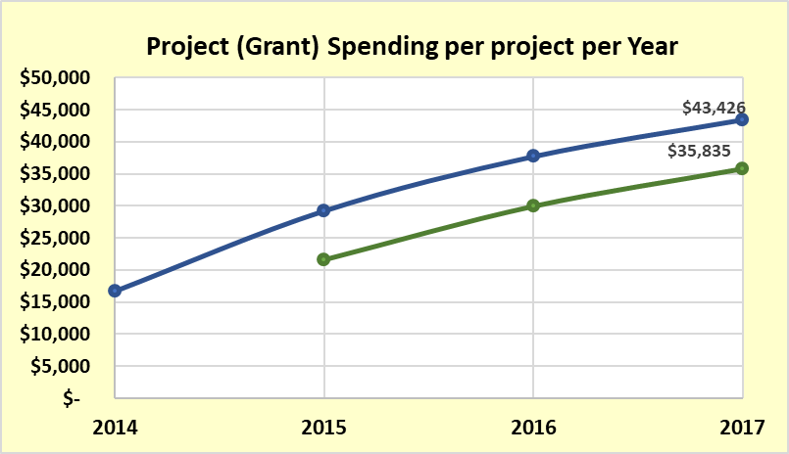
ASR Details
Spending
Dirt and Gravel
Low Volume
‘97-’14 average/yr
Average grant value is increasing:
$43K for DnG
$35K for LVR

Slide 21
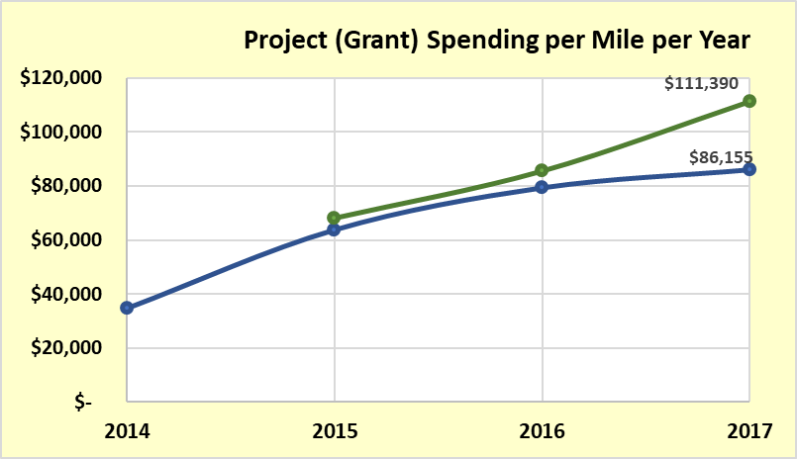
ASR Details
Spending
Low Volume
Dirt and Gravel
‘97-’14 average/yr
Program $ spent per mile increasing: (no in-kind)
$86K for DnG
$111K for LVR

Slide 22
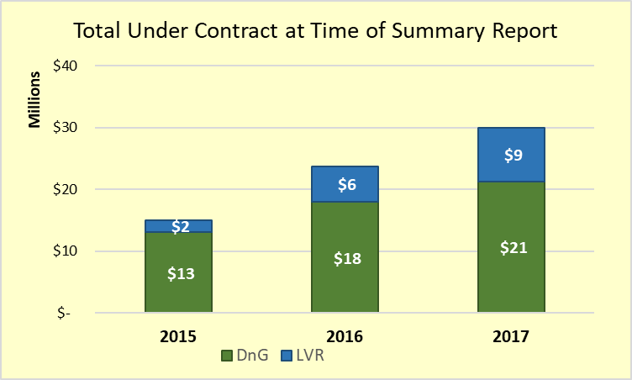
ASR Details
Spending
Currently Contracted: $30,000,000 (2/5/2018)
Dirt and Gravel: 336 Contracts, $21.3 million committed
Low Volume: 188 Contracts, $8.7 million committed
$15 million
$24 million
$30 million
LVR
DnG

Slide 23
ASR Details
Spending
Currently Contracted (2/5/2018)
Dirt and Gravel: 336 Contracts, $17.9 million committed
Low Volume: 188 Contracts, $5.8 million committed
137 Days
left to make contracts before June 30th
$15 million
$24 million
$30 million

Slide 24
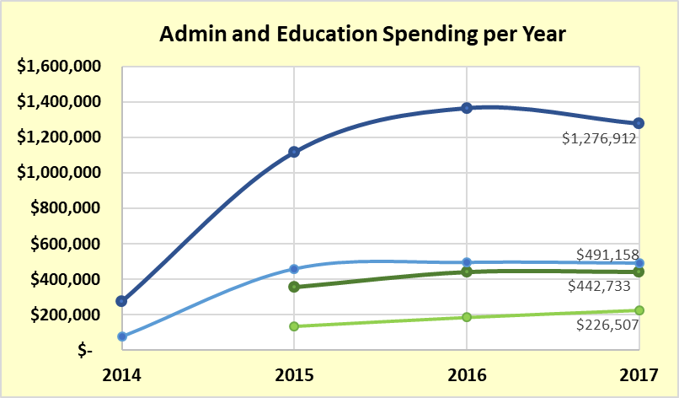
ASR Details
Spending
DnG Admin
DnG Edu
LVR Admin
LVR Edu
‘97-’14 average/yr
Overall Admin/Edu spending decreased 2% in 2017

Slide 25
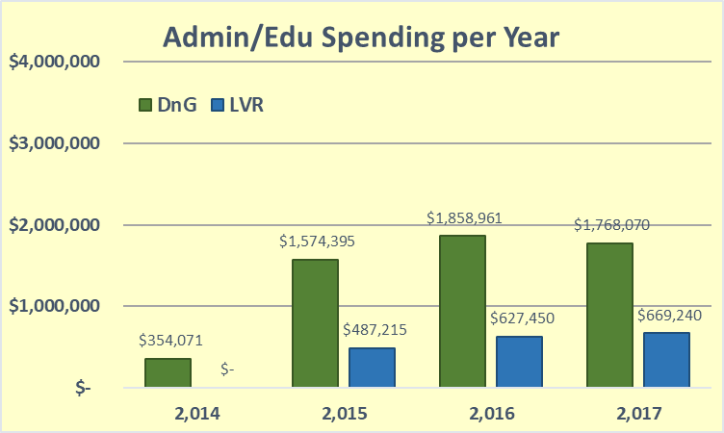
ASR Details
Spending
Overall Admin/Edu spending decreased 2% in 2017

Slide 26
ASR Details
Spending
$1.9M
LVR limit (20%)
$0.8M
Overall Admin/Edu spending decreased 2% in 2017
Potential for additional $2.7 million to be used

Slide 27
ASR Details
Spending
Overall Admin/Edu spending decreased 2% in 2017
Potential for additional $2.7 million to be used
If you are putting extra “potential admin edu” money towards good projects: Great, keep it up!!!
But many CD’s first complaint is “not enough people, not enough time”. Make sure you use the admin/edu you need to get good projects in a timely manner.
More education and outreach: currently at 2.5% for 2017

Slide 28
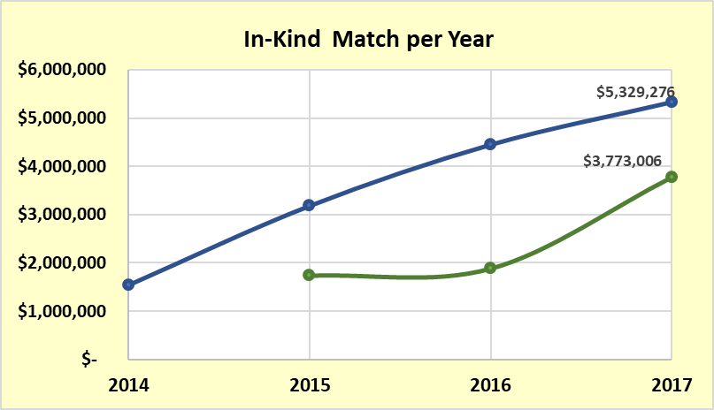
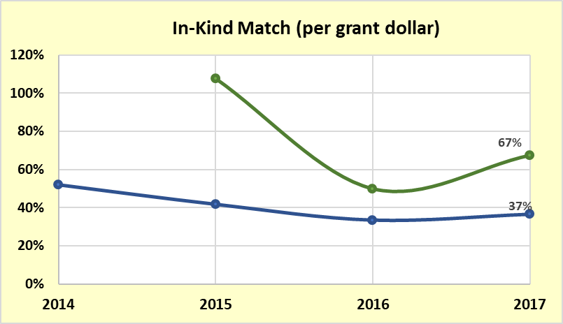
ASR Details
Spending
In-Kind
Total contributions increasing: $9M in 2017 is largest ever
Percentage match starting to increase
2017 averaged $0.45 in-kind for each Program Dollar.
Dirt and Gravel
Low Volume
Dirt and Gravel
Low Volume
45% avg

Slide 29
ASR Details
Spending
SPENDING Take home points
DnG spending increasing, but slowed in 2017
LVR spending increasing lineally, but still low
$30 million currently under contract
137 days left to make contracts before June 30th
Statewide, only using 9.6% of potential 20% admin/edu.
Get busy!
Call for assistance!

Slide 30
Annual Summary Report Details
ESM Trainings
Project Spending
Project Deliverables
Audio also available via phone: 866-823-7699
For assistance, call: 814-865-5355

Slide 31
ASR Details
Deliverables
Project Deliverables:
Purpose: To provide a “quick summary” of some of the major deliverables reported by CDs
More details will be included in written Annual Report.

Slide 32
ASR Details
Deliverables
Accuracy note:
Corrections are made each year, and some assumptions have to be made, so figures for many items may change over time.
We will be contacting CDs about updating errors, about 80 in all:
For example:
One project reported 60 pipes installed. Was likely 2 pipes totaling 60 feet.
One project reported 14 stream crossings installed. Was likely one 14’ diameter opening.
Also: deliverables include in-kind

Slide 33
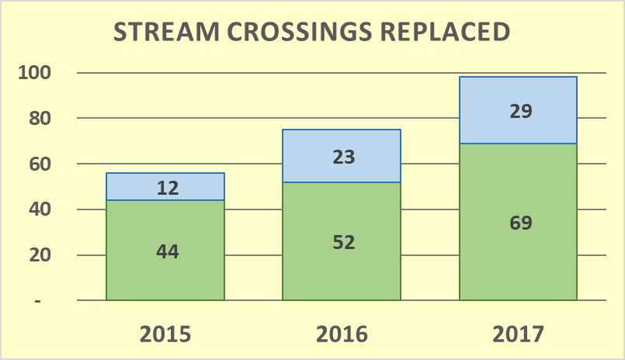
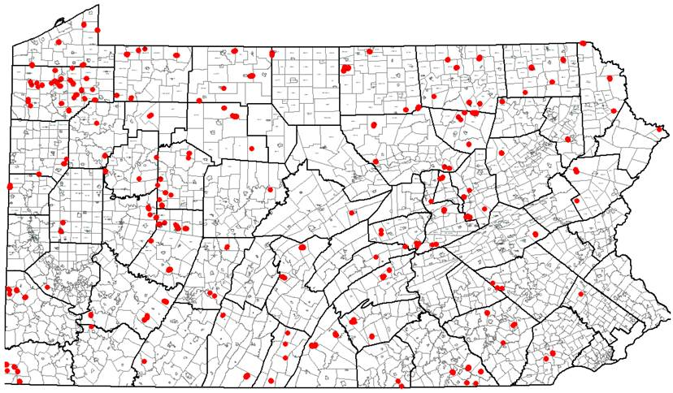
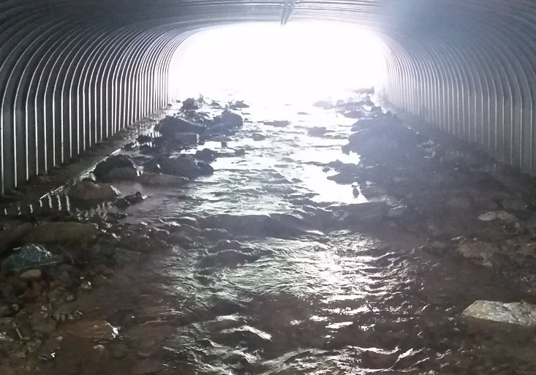
ASR Details
Deliverables
LVR
Stream Crossings
Still increasing
~100 in 2017
DnG
Replaced Crossings in 2016 or 2017

Slide 34
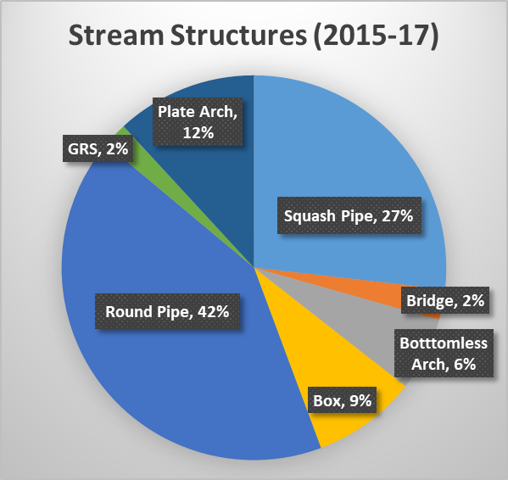
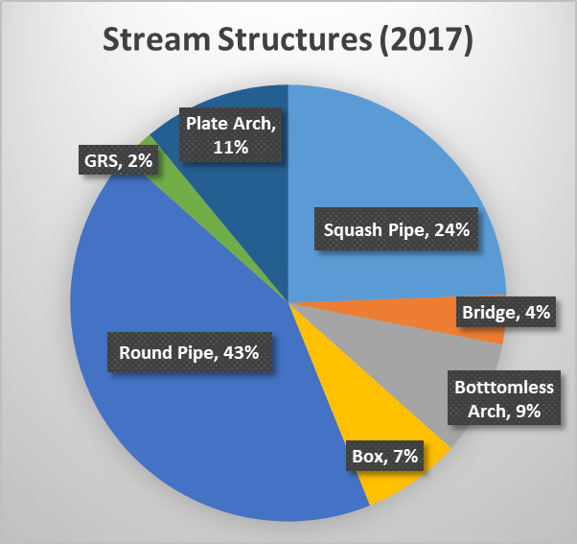
ASR Details
Deliverables
Stream Crossings
Still to many round pipes (35 in 2017)

Slide 35
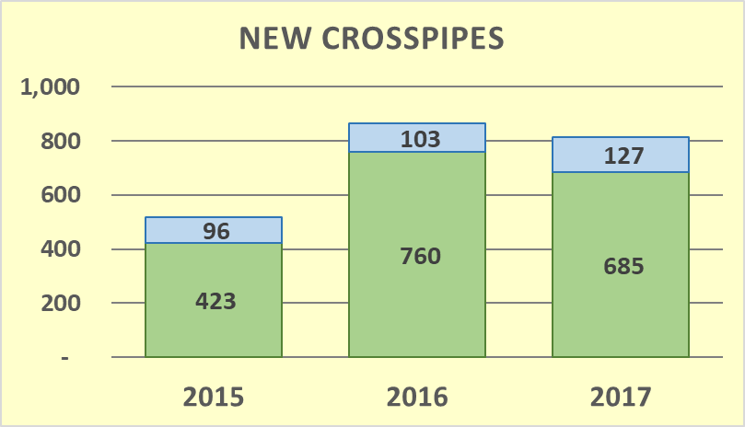
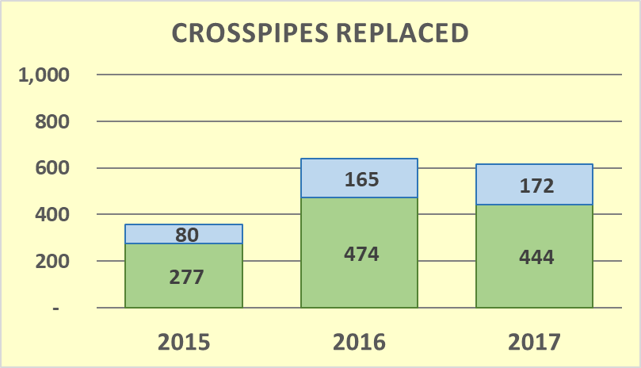
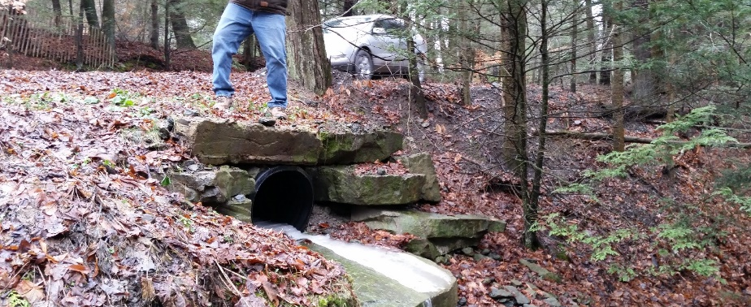
ASR Details
Deliverables
Drainage Crosspipes:
Similar to 2016 numbers
More replacements than new on LVRs
812
LVR
DnG
In 2017 alone:
~4.6 miles of new pipe
~ 3.5 miles of pipe replaced
(assuming 30’ avg length)
616

Slide 36
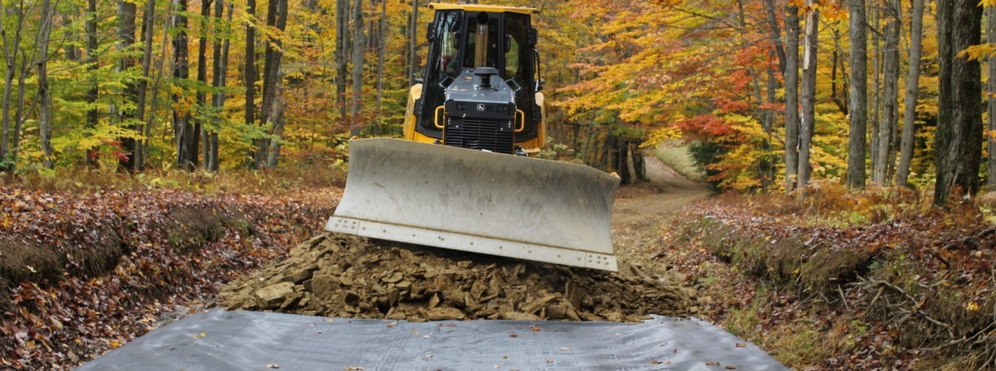
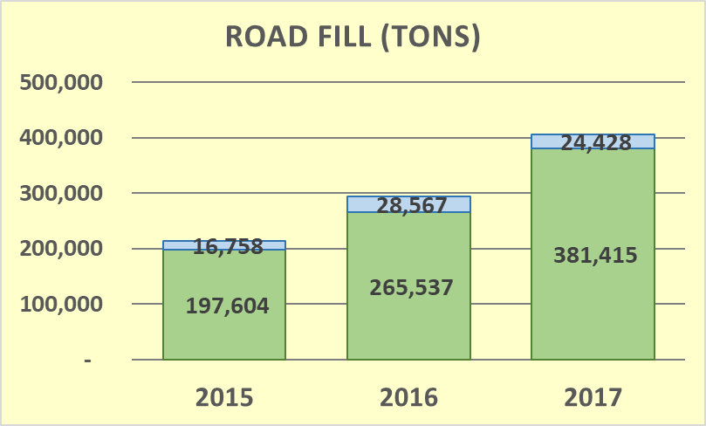
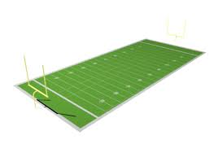
ASR Details
Deliverables
Road Fill Added:
In 2017 alone:
Would cover the playing surface of a football field 154’ deep
154’
LVR
DnG

Slide 37
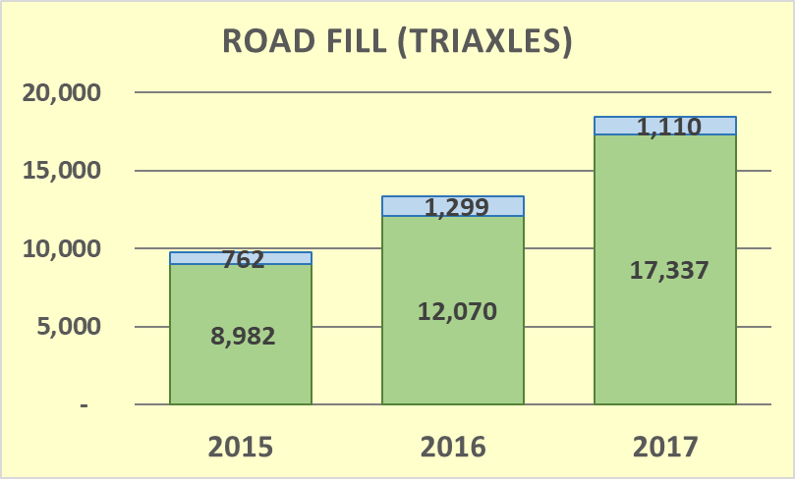
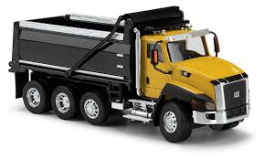
ASR Details
Deliverables
Road Fill Added:
38% increase from 2016 to 2017!
Under-used in LVR
18,447
+38%
In 2017 alone:
87 miles of triaxle trucks, bumper to bumper

Slide 38
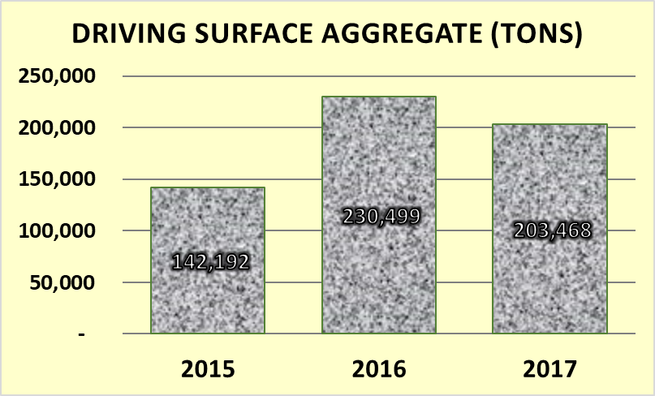
ASR Details
Deliverables
Driving Surface Aggregate:
Decrease in 2017
In 2017:
~80 Miles of road
In 2017 alone:
203,468 tons @ $25-$30 a ton =
$5-$6 million on DSA

Slide 39
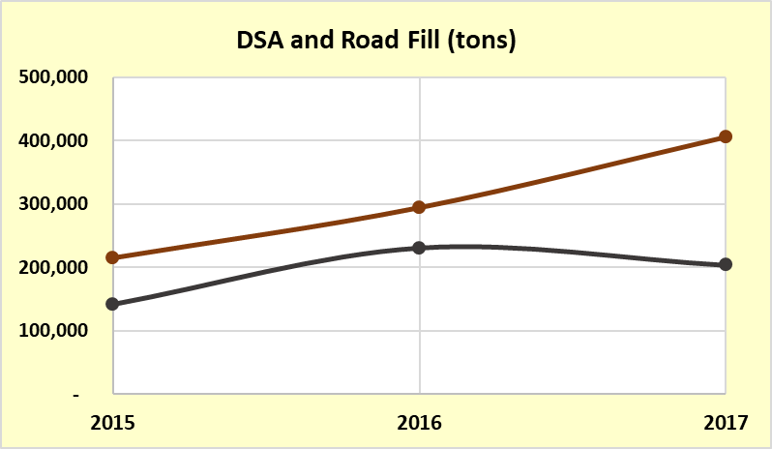
ASR Details
Deliverables
Trends
Road Fill increasing
DSA decreasing
Road Fill
DSA

Slide 40
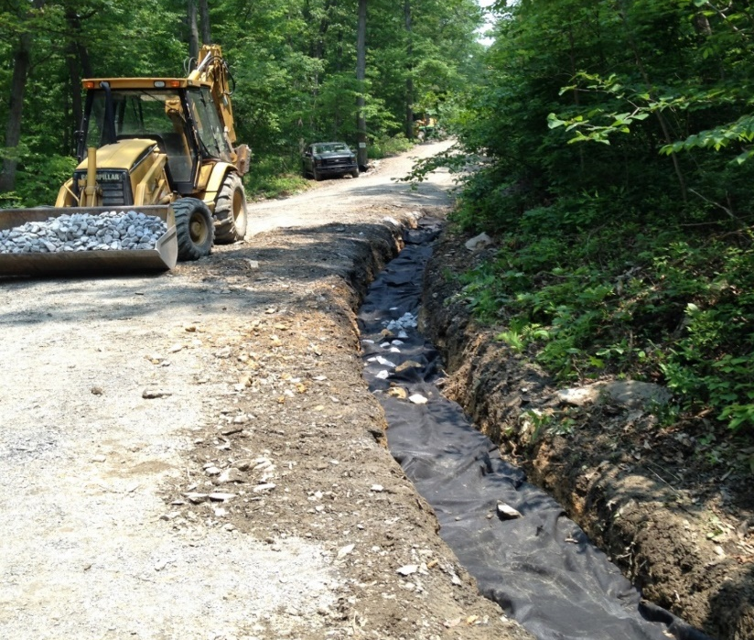
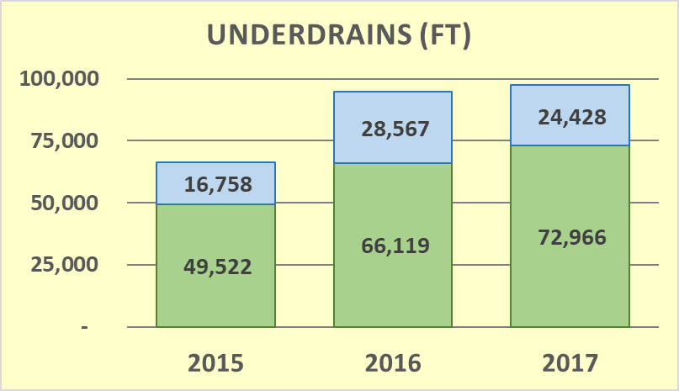
ASR Details
Deliverables
Underdrains
Similar to 2016
In 2017 alone: ~18.5 miles
(~4.6 miles LVR, 13.9 miles DnG)
Note some of this was funded as in-kind
LVR
DnG

Slide 41
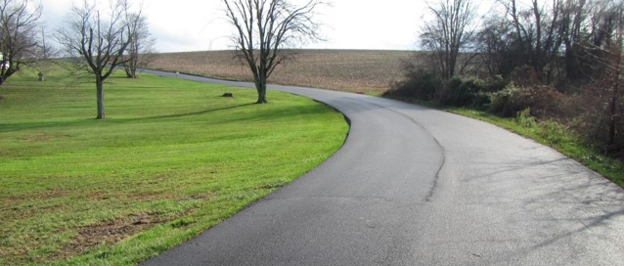
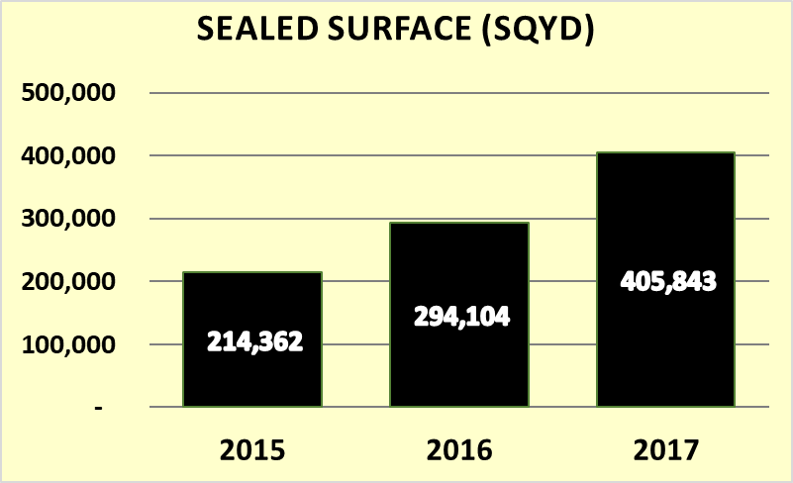
ASR Details
Deliverables
Paving (LVR Only):
Increasing steadily
In 2017 alone: ~12 miles of road
Note some of this was funded as in-kind

Slide 42
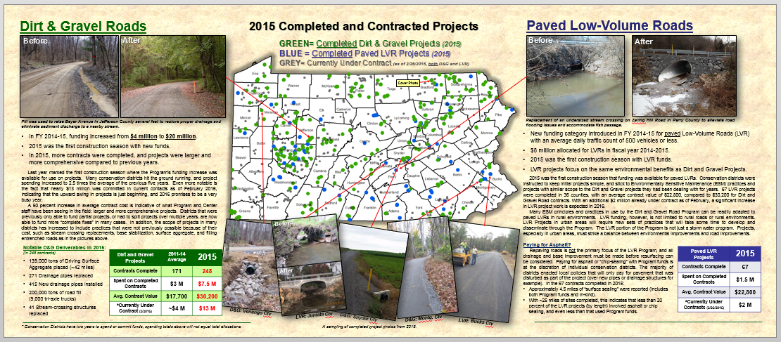
ASR Details
Deliverables
More details in 2017 annual report,
available this Spring.
Let us know if you have any questions or suggestions for analysis of spending or deliverables.

Slide 43
You can generate excel table for your county and do similar summaries:
Remind them of how to get stats for their county from GIS

Slide 44
Upcoming Events
February 20th PRJ SHARING: Westmoreland, Courtyard Marriott Monroeville
February 21st PRJ SHARING: Clarion, Park Inn by Radisson Clarion
February 27th PRJ SHARING: Lancaster, Lancaster CD Office
February 28th PRJ SHARING: Luzerne, Woodlands Inn & Resort
March 6th PRJ SHARING: Centre, CDGRS Office
Project Sharing Sessions: CDs share project photos and stories with each other and CDGRS/Program staff
Start next week
No charge, but must register
May have to cancel or combine unless more people register
Will send reminder today, and make final call on Thursday

Slide 45
Upcoming Events
February 20th PRJ SHARING: Westmoreland, Courtyard Marriott Monroeville
February 21st PRJ SHARING: Clarion, Park Inn by Radisson Clarion
February 27th PRJ SHARING: Lancaster, Lancaster CD Office
February 28th PRJ SHARING: Luzerne, Woodlands Inn & Resort
March 6th PRJ SHARING: Centre, CDGRS Office
March 7th WEBINAR: GIS and Quarterly Reporting Update
March 27th WEBINAR: Project Sharing Session Highlights
April 3rd WEBINAR: Taking better project photos (from workshop)
Summer TBD Stream Crossing Trainings (4 regional)
July TBD ESM Boot Camp for CDs (2 in State College)
TBD:
Admin Trainings
GIS Beginner Training
4-5 Quarterly Report Trainings
Sharing Sessions:
- Start next week
- Please register
Annual Workshop
Indiana, PA
September 18-20
ESM Trainings:
3/28-29: Butler 4/3-4: Centre 4/10-11: Venango
4/17-18: Lancaster 5/1-2: Luzerne 5/9-10: Cumberland
5/22-23: Somerset 6/6-7: Potter 6/13-14: Schuylkill
7/11-12: Venango 8/1-2: Montgomery 8/21-22: Wayne
10/2-3: Bedford 10/17-18: Lycoming 11/7-8: Clearfield

