Slide 1
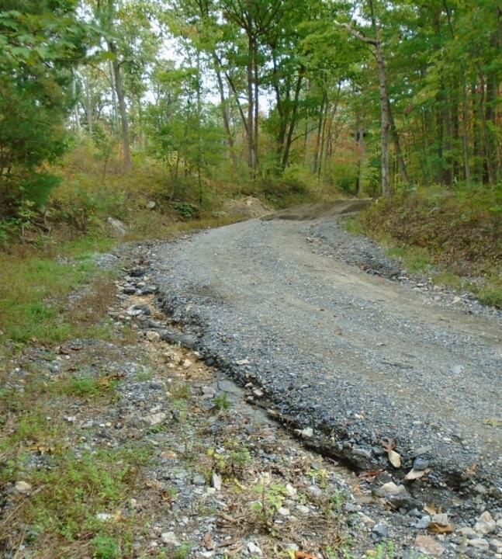
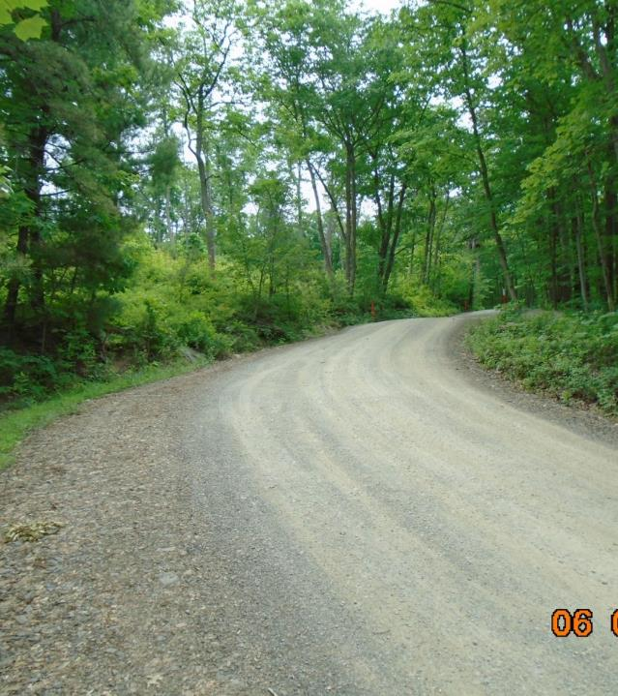
Dirt Gravel and Low Volume Road Program
WEBINAR
2/23/23, 9am
2022 Annual Summary Report
CDGRS
Steve Bloser
smb201@psu.edu
Photos: Cumberland CD
If you are reading this, then you are successfully seeing the webinar video. Webinar audio should be automatic through your computer (or click “join audio”), and options can be accessed in the “audio options” button on the bottom left. If your computer audio is not working, you can listen on your phone by dialing 646-876-9923.

Slide 2
Purpose
Summarize 2022 Program Status
Stop, step back, and look at the “Big Picture” Program overview of spending and deliverables

Slide 3
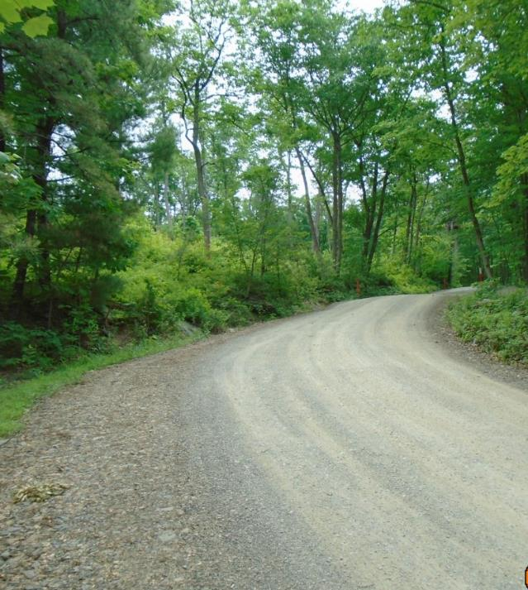
2022 Annual Summary Report
Annual Report: Financial
Annual Report: Deliverables
CD Financial Status
Warning: lots of graphs and info ahead. Recording and ppt will be available online.

Slide 4
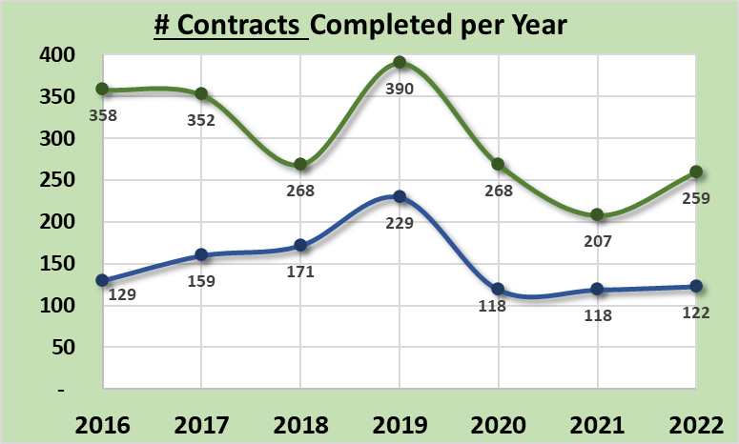
Annual Summary Report: Financial
381 Projects Completed
Up from 319 in 2021
430/yr past 5-year average
Completed based on closeout date:
Does not include partial payment on active contracts
Note:
2019: spending push at end of 5-year agreement
2020 and 2021: COVID impacts
Dirt and Gravel
Paved Low-Volume
ASR data as of 12/31/2022
www.dirtandgravelroads.org

Slide 5
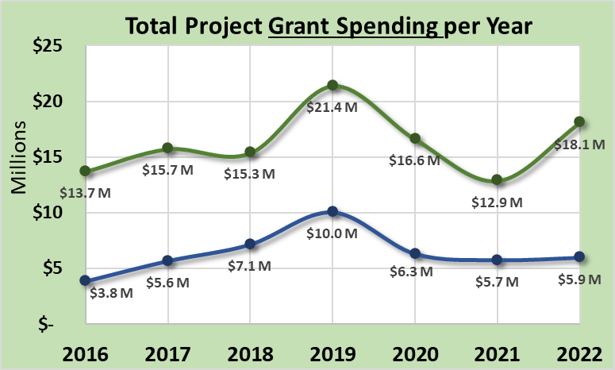
Annual Summary Report: Financial
$24M Spent on Completed Projects
Up from $18.6M in 2021
$23.8M past 5-year average
Completed based on closeout date:
Does not include partial payment on active contracts
Note:
2019: spending push at end of 5-year agreement
2020 and 2021: COVID impacts
Dirt and Gravel
Paved Low-Volume
ASR data as of 12/31/2022
www.dirtandgravelroads.org

Slide 6
Annual Summary Report: Financial
$24M Spent on Completed Projects
Up from $18.6M in 2021
$23.8M past 5-year average
Completed based on closeout date:
Does not include partial payment on active contracts
Dirt and Gravel
Likely Spending Equilibrium
Paved Low-Volume
ASR data as of 12/31/2022
www.dirtandgravelroads.org

Slide 7
Annual Summary Report: Financial
$24M Spent on Completed Projects
Up from $18.6M in 2021
$23.8M past 5-year average
In Addition, as of 2/23/2022:
24 contracts reported complete so far in 2023 for $2M
377 current contacts totaling $31.4M (120% of annual allocation)
$11M advanced on those contracts
$20.4M encumbered on those contracts
ASR data as of 12/31/2022
www.dirtandgravelroads.org

Slide 8
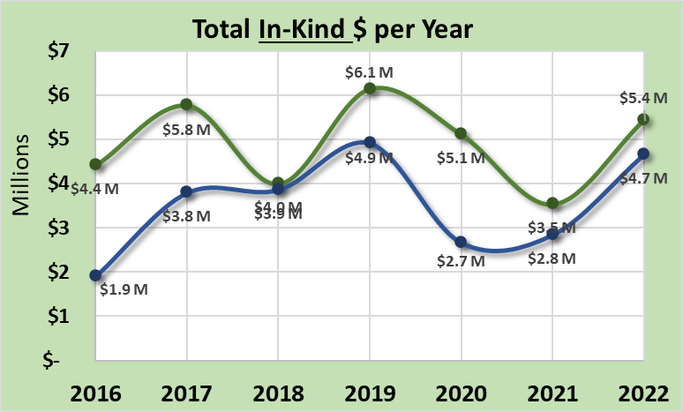
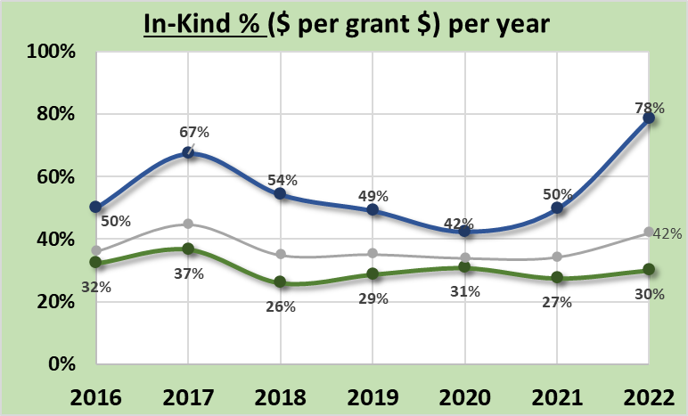
Annual Summary Report: Financial
In-Kind: goods or services incurred by participant but not reimbursed through DGLVR funds
$10.1M In-Kind Spent on Completed Projects
Up from $6.3M in 2021
$8.6M past 5-year average
42% In-Kind per Project Dollar
Up from 34% in 2021
36% past 5-year average
Dirt and Gravel
Paved Low-Volume
Paved Low-Volume
Dirt and Gravel
ASR data as of 12/31/2022
www.dirtandgravelroads.org

Slide 9
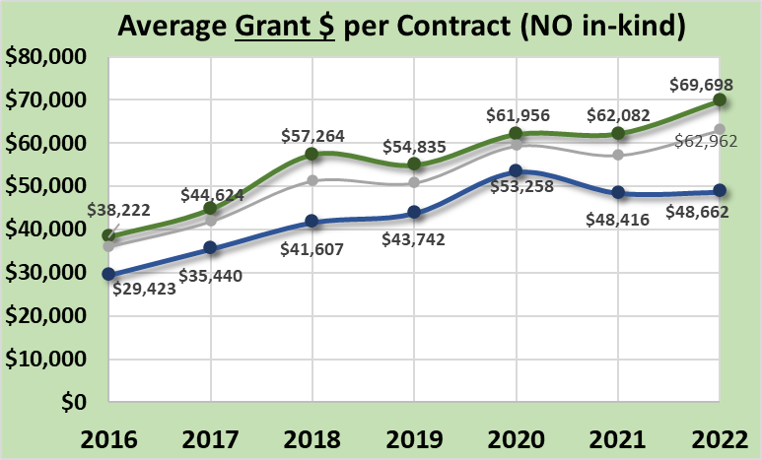
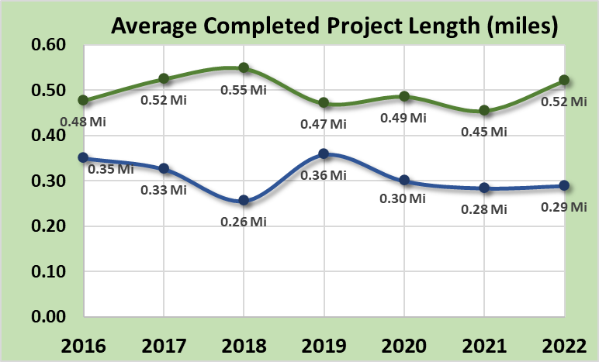
Annual Summary Report: Financial
Average Project Size:
Average per completed contract in 2022:
~$63,000 grant funds
~$26,000 in-kind
~0.45 or 2,400’ long
Steadily rising since 2014 increase:
Larger scale projects
More complex and costly projects
Increase in material cost
Dirt and Gravel
Paved Low-Volume
DGR:
2,700’ and $69,000 (+$21,000 in-kind)
Paved LVR:
1,500’ and $48,000 (+$38,000 in-kind)
Paved Low-Volume
Dirt and Gravel
* Note we no longer look at cost per mile, largely due to stream crossings skewing the costs
ASR data as of 12/31/2022
www.dirtandgravelroads.org

Slide 10
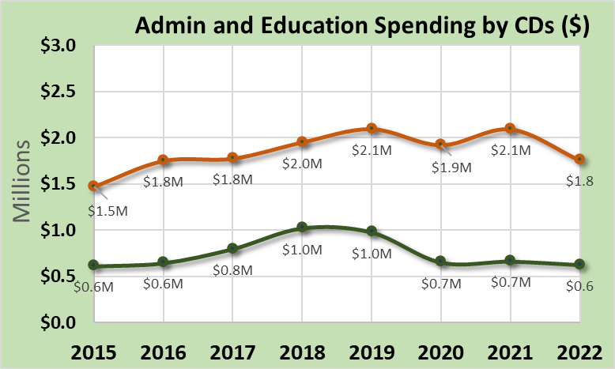
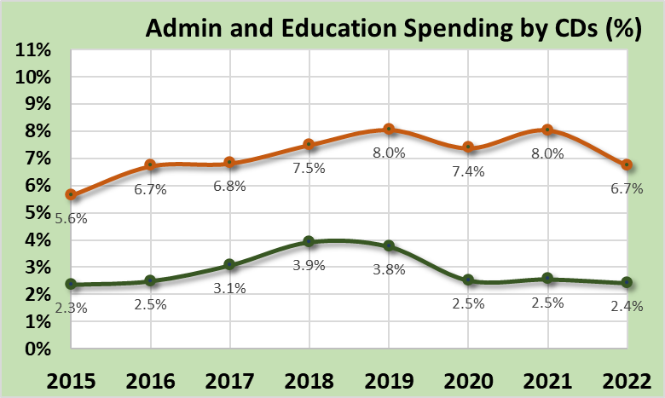
Annual Summary Report: Financial
Admin / Education Spending by CDs
Administration
10% maximum Allowable (of CD allocations)
6.7% in 2022
7.5% over 5-year average
Education
10% maximum Allowable (of CD allocations)
2.4% in 2022
3% over 5-year average
10% limit for each
CD administration
CD education
10% limit for each
CD administration
CD education
ASR data as of 12/31/2022
www.dirtandgravelroads.org

Slide 11
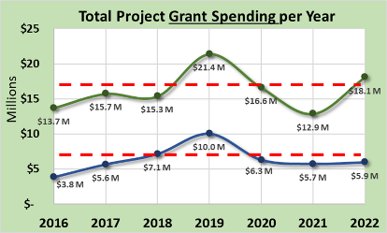
Annual Summary Report: Financial
Financial Summary
381 sites completed in 2021 with $24M spent on them
DGR up from last year, LVR steady
Supply chain issues and cost increases remain
Currently Contracted: 377 current contacts totaling $31.4M (120% of annual allocation)
Average contract in 2022:
Paved LVR: 1,500’ and $48,000 (+$38,000 in-kind)
DGR: 2,500’ and $69,000 (+$21,000 in-kind)
In-Kind: DGR steady ~30%, LVR increasing 50% in 2021, 78% in 2022
ASR data as of 12/31/2022
www.dirtandgravelroads.org

Slide 12
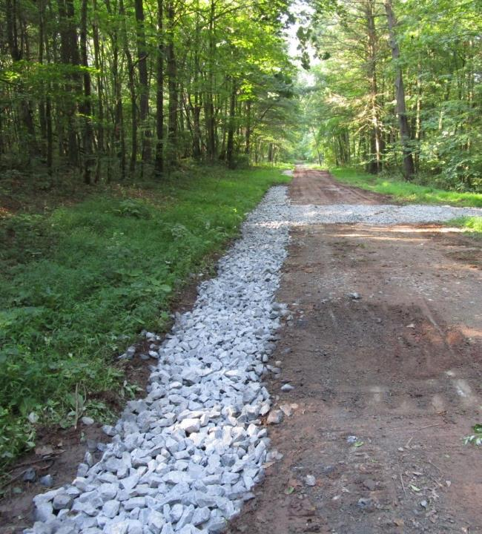
2022 Annual Summary Report
Annual Report: Financial
Annual Report: Deliverables
CD Financial Status

Slide 13
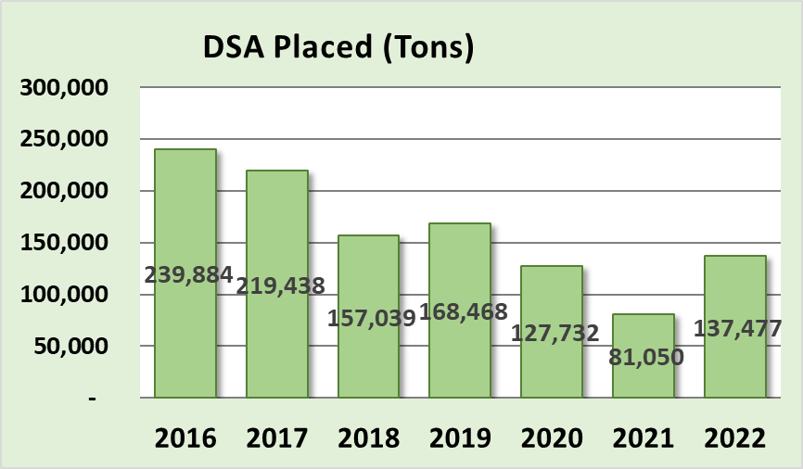
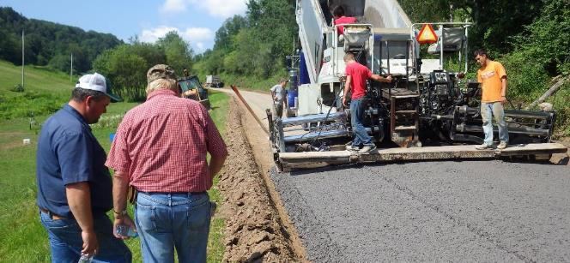
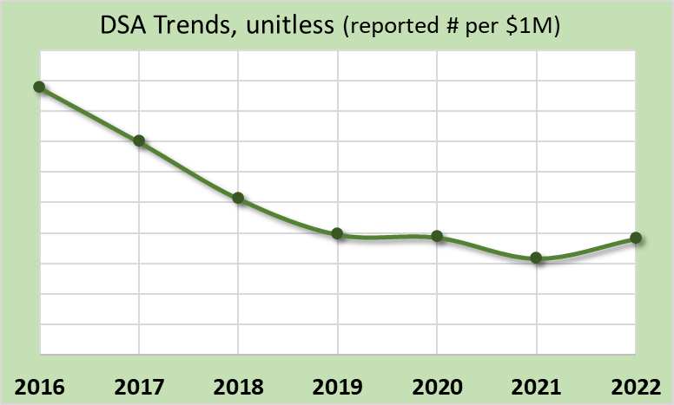
Annual Summary Report: Deliverables
Driving Surface Aggregate
Only approved surface w/ DGLVR funds
Only to be used only after drainage and base improvement are made
Decreasing 5-year trend, may be stabilizing at “new normal”
ASR data as of 12/31/2022
www.dirtandgravelroads.org

Slide 14
Annual Summary Report: Deliverables
Driving Surface Aggregate
Only approved surface w/ DGLVR funds
Only to be used only after drainage and base improvement are made
Decreasing 5-year trend, focus is shifting and costs are increasing
Actual Totals in Tons
$18.5M $24M
in in
2021 2021
But that does not account for annual spending variability
www.dirtandgravelroads.org

Slide 15
Annual Summary Report: Deliverables
Driving Surface Aggregate
Only approved surface w/ DGLVR funds
Only to be used only after drainage and base improvement are made
Decreasing 5-year trend, may be stabilizing at “new normal”
Actual Totals in Tons
But that does not account for annual spending variability
Dirt and Gravel
Normalized by annual spending
www.dirtandgravelroads.org

Slide 16
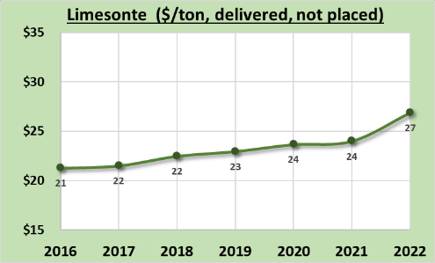
Annual Summary Report: Deliverables
Driving Surface Aggregate
Only approved surface w/ DGLVR funds
Only to be used only after drainage and base improvement are made
Decreasing 5-year trend, may be stabilizing at “new normal”
ASR data as of 12/31/2022
www.dirtandgravelroads.org

Slide 17
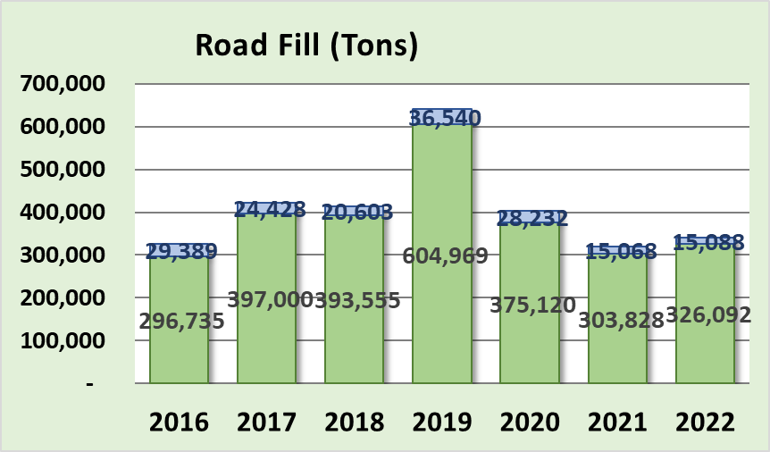
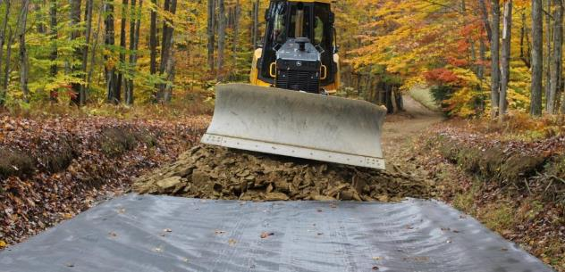
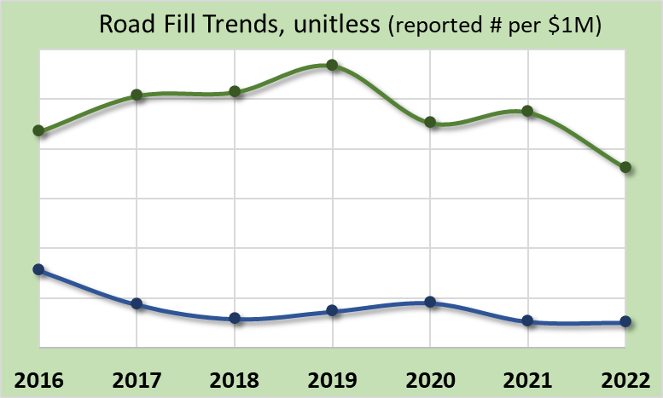
Annual Summary Report: Deliverables
Road Fill
Used to elevate entrenched roads
Continual point of emphasis as it fixes many drainage and base issues
Very consistent 5-year trends
Dirt and Gravel
Paved Low-Volume
Dirt and Gravel
Indicates 4-5X more emphasis on road fill in DGR vs LVR
Paved Low-Volume
www.dirtandgravelroads.org

Slide 18
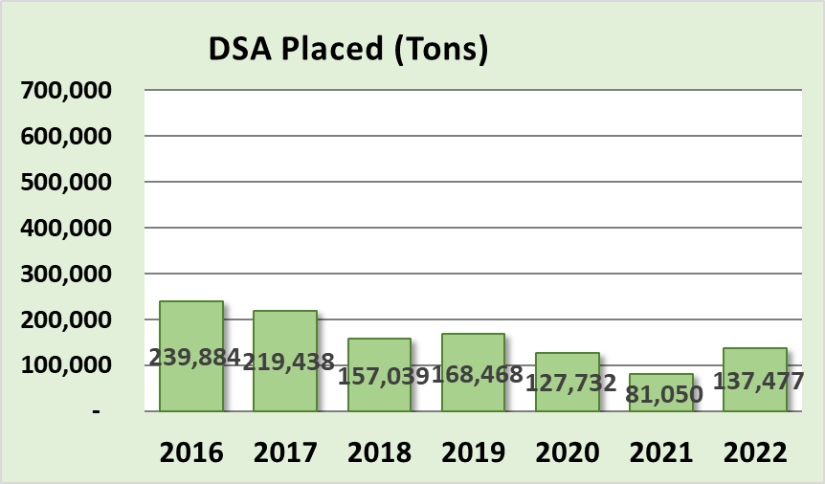
Annual Summary Report: Deliverables
5-year total: 3 tons of fill for every ton of DSA
Road Fill – vs- DSA
www.dirtandgravelroads.org

Slide 19
Annual Summary Report: Deliverables
5-year total: 3 tons of fill for every ton of DSA
Road Fill – vs- DSA
Past 5 years:
2.1 M tons road fill
0.7 M tons of DSA
What does that actually look like?

Slide 20
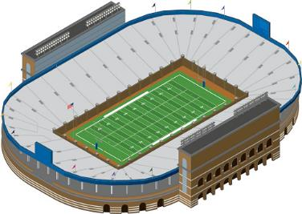
Annual Summary Report: Deliverables
5-year total: 3 tons of fill for every ton of DSA
Road Fill – vs- DSA
Past 5 years:
2.1 M tons road fill
0.7 M tons of DSA
What does that actually look like?
Football Field Playing Surface: 300’x160’
www.dirtandgravelroads.org

Slide 21
Annual Summary Report: Deliverables
5-year total: 3 tons of fill for every ton of DSA
850’ tall
(300’x160’)
Road Fill – vs- DSA
Past 5 years:
2.1 M tons road fill
0.7 M tons of DSA
What does that actually look like?
275’ tall
(300’x160’)
FILL
DSA
www.dirtandgravelroads.org

Slide 22
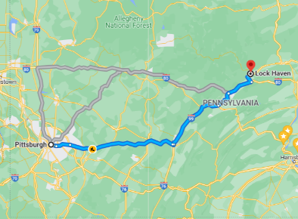
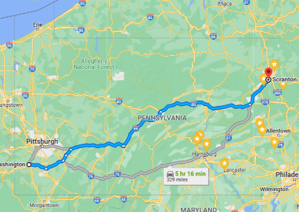
Annual Summary Report: Deliverables
5-year total: 3 tons of fill for every ton of DSA
Road Fill – vs- DSA
Past 5 years:
2.1 M tons road fill
0.7 M tons of DSA
What does that actually look like?
DSA:
Compacted 6” deep x 18’ wide
177 miles long
Pittsburgh to Lock Haven 6” deep
Fill:
Compacted 1’ deep x 18’ wide
322 miles long
Washington PA to Scranton 1’ deep

Slide 23
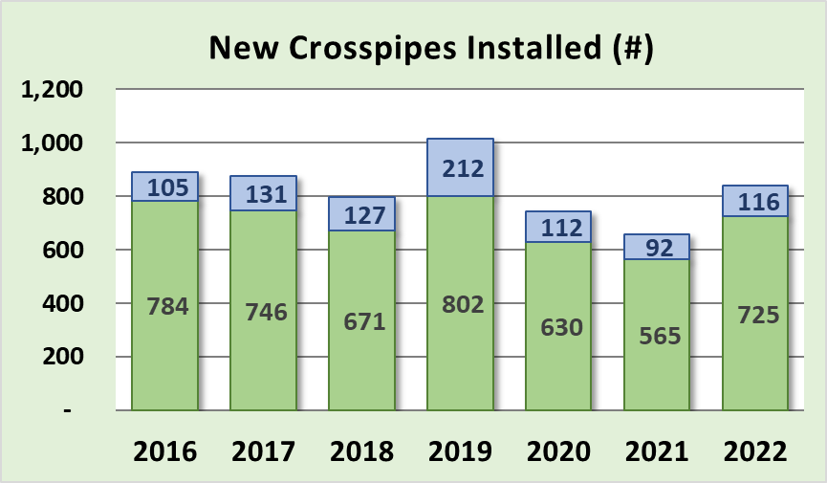
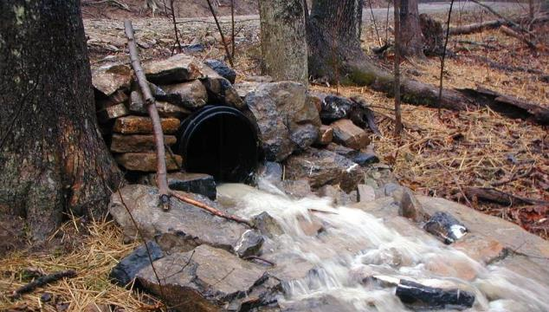
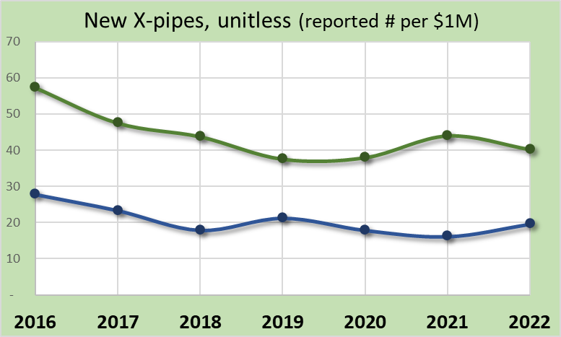
Annual Summary Report: Deliverables
NEW Crosspipes Installed
Fundamental drainage disconnection
Relatively steady trend
4,000+ new pipes installed in last 5 yrs
Dirt and Gravel
Paved Low-Volume
Dirt and Gravel
Paved Low-Volume
www.dirtandgravelroads.org

Slide 24
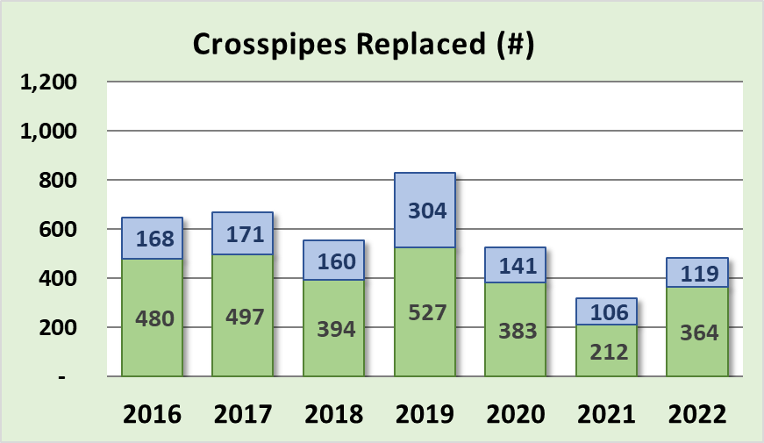
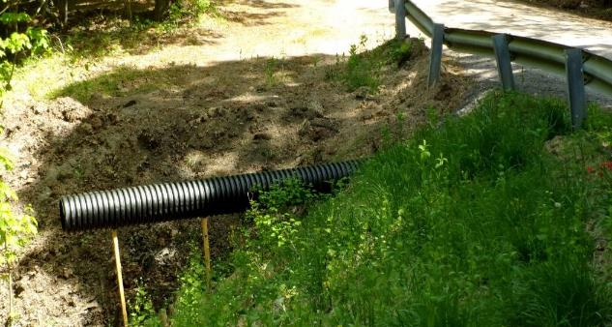
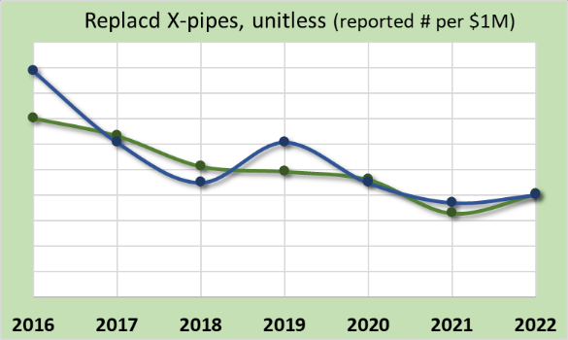
Annual Summary Report: Deliverables
Crosspipes REPLACED
Replacement of existing drainage crosspipes
Dirt and Gravel
Paved Low-Volume
Paved Low-Volume
Dirt and Gravel
www.dirtandgravelroads.org

Slide 25
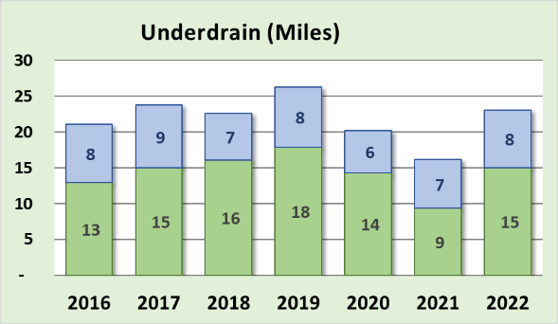
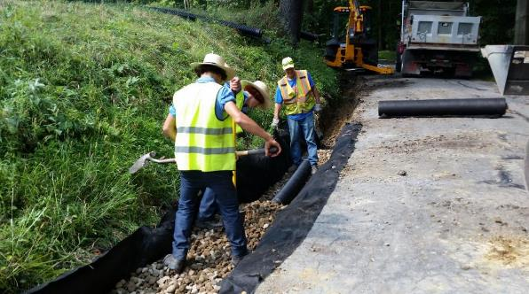
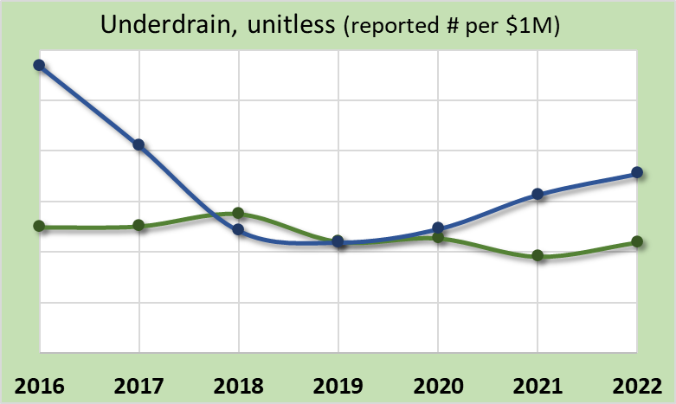
Annual Summary Report: Deliverables
Dirt and Gravel
Subsurface Drainage: Underdrains
Underdrains used to address subsurface drainage, mostly in ditchlines
Generally stable trend
Paved Low-Volume
Paved Low-Volume
Dirt and Gravel
www.dirtandgravelroads.org

Slide 26
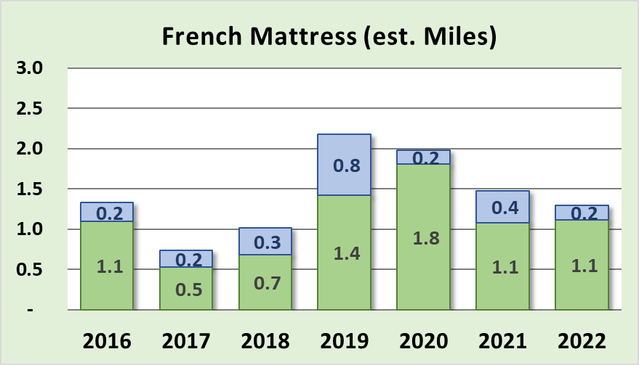
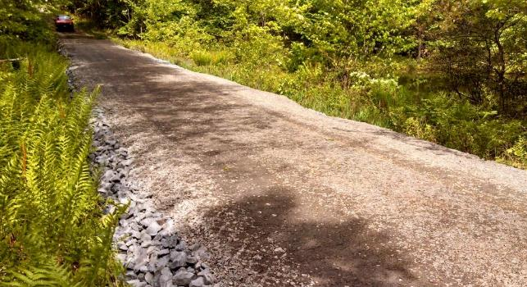
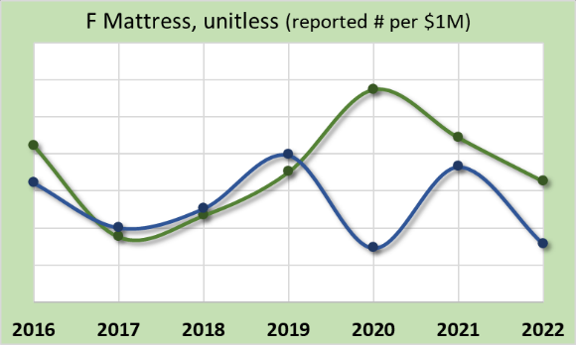
Annual Summary Report: Deliverables
Subsurface Drainage: French Mattress
Used to allow water to drain through road and provide base support
Generally increasing trend
Dirt and Gravel
Paved Low-Volume
Dirt and Gravel
Paved Low-Volume
www.dirtandgravelroads.org

Slide 27
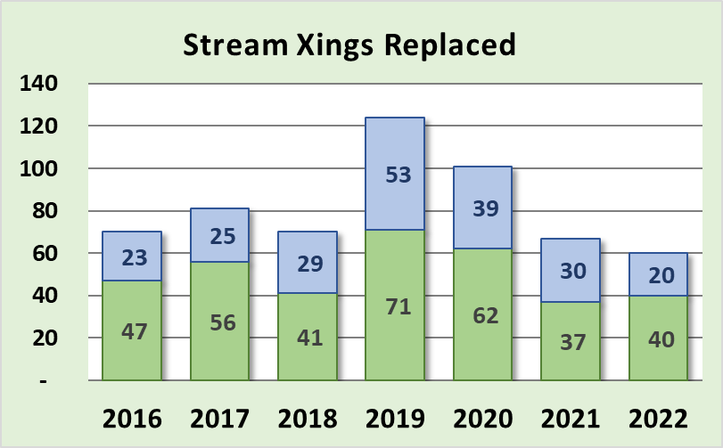
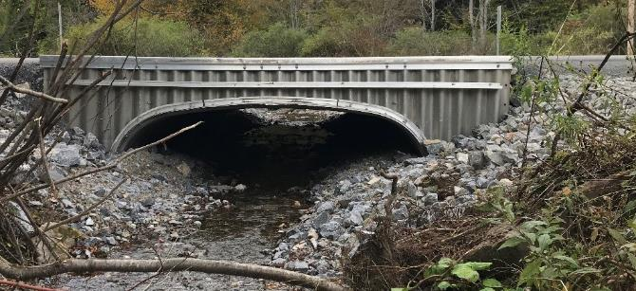
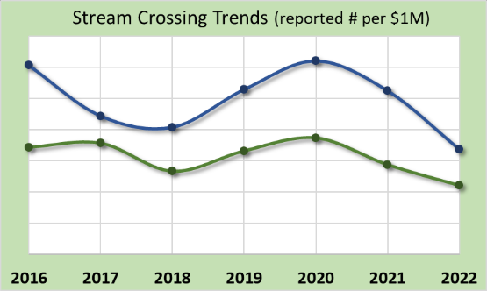
Annual Summary Report: Deliverables
Dirt and Gravel
Stream Crossing Replacements
Currently replacing ~60 per year
Decreasing 5-year trend
More prevalent on LVRs
Improved data collected starting July ‘19
Paved Low-Volume
Paved Low-Volume
Dirt and Gravel
www.dirtandgravelroads.org

Slide 28
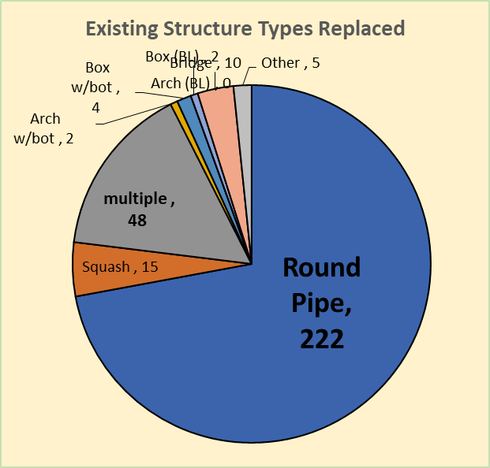
Annual Summary Report: Deliverables
Stream Crossing Replacements
308 replacements since July 2019
Old Structures: 72% were round pipes
www.dirtandgravelroads.org

Slide 29
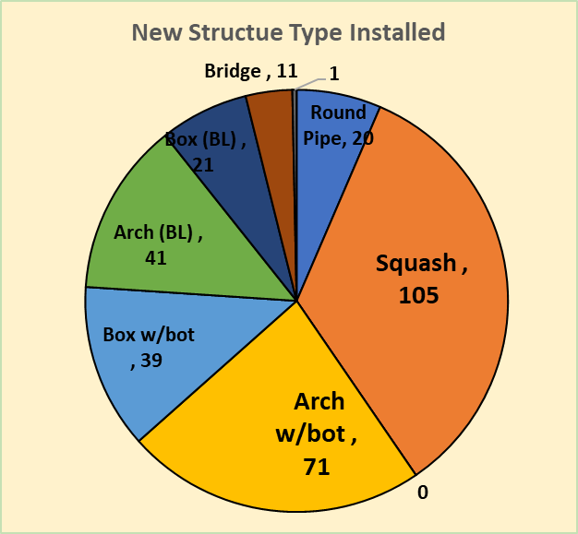
Annual Summary Report: Deliverables
Stream Crossing Replacements
308 replacements since July 2019
Old Structures: 72% were round pipes
New Structures:
Type
57% were squash or pipe arch (w/bottom)
25% were bottomless (arch/box/bridge)
www.dirtandgravelroads.org

Slide 30
Annual Summary Report: Deliverables
Stream Crossing Replacements
308 replacements since July 2019
Old Structures: 72% were round pipes
New Structures:
Type
57% were squash or pipe arch (w/bottom)
25% were bottomless (arch/box/bridge)
Size:
6% over 20’ opening
Average BF reported= 9.3’
Average new structure width = 11’
www.dirtandgravelroads.org

Slide 31
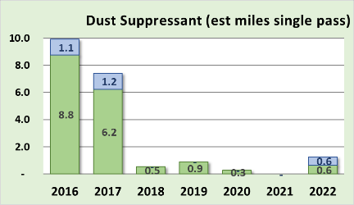
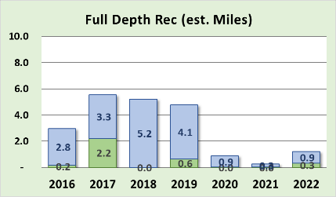
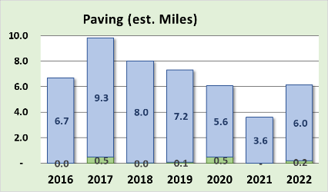
Annual Summary Report: Deliverables
Very Minor Players (even with in-kind)
Dust Suppressants: decreased to almost no use
Full Depth Reclamation: additional requirements in 2019 decreased use
Paving: most CDs only pay for what they disturb in fixing drainage. Note much of paving in graph below was in-kind.
Dirt and Gravel
Paved Low-Volume
www.dirtandgravelroads.org

Slide 32
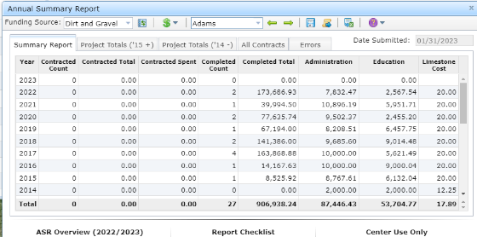
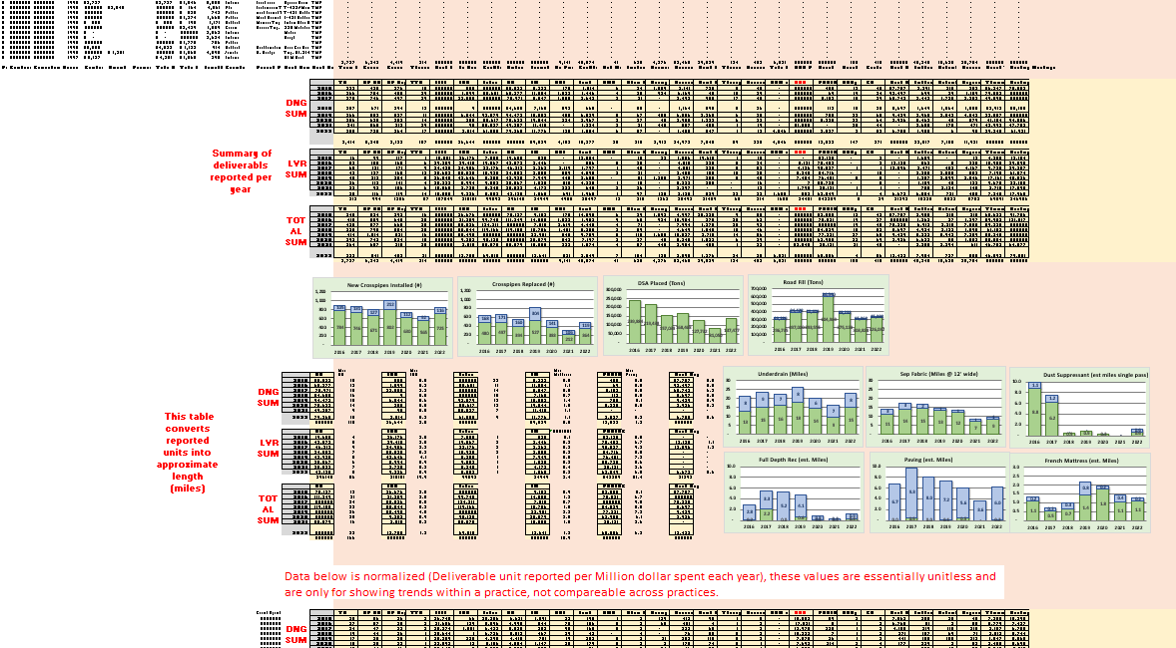
Annual Summary Report: Deliverables
Where did these numbers come from, and can I do this for my county?
www.dirtandgravelroads.org

Slide 33
Annual Summary Report: Deliverables
Where did these numbers come from, and can I do this for my county?
Numbers came straight from GIS
YES, you can do the same thing and more for your county
Two 2019 Webinars recorded
March 7, 2019
March 21, 2019
CDGRS – education and training – webinars – past webinars
www.dirtandgravelroads.org

Slide 34
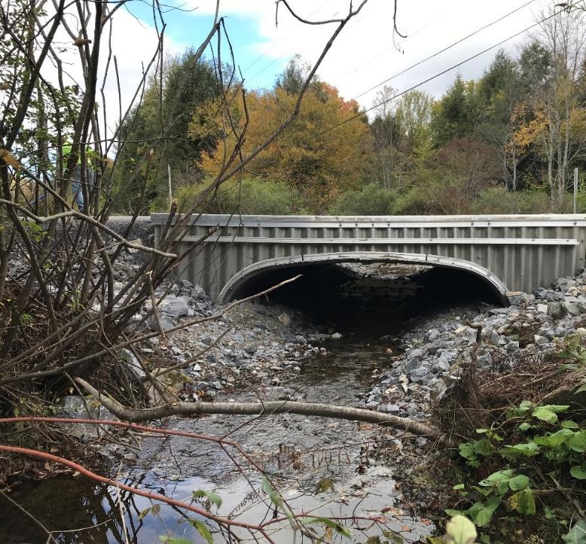
2022 Annual Summary Report
Annual Report: Financial
Annual Report: Deliverables
CD Financial Status

Slide 35
Annual Summary Report: CD Financial Status
Reminders / Overview
Allocations to CDs
$26.1 Million Annually
$130 through this 5-year agreement
At least 80% required to go to projects, ~90% does
CDs get ½ their allocation up front, other ½ remains in Hbg for replenishment
CDs have two years to spend funding
Currently in FY 2022-23, year 5 of 5-year agreement between SCC and CDs
www.dirtandgravelroads.org

Slide 36
Annual Summary Report: Allocation Eligibility
Data as of 2/11/23
Current Allocation Eligibility Status (2-year spending)
DGR Green: requirements already met, OK for FY 2023-24 DGR Allocations
57 Counties
DGR Red: requirements not yet met
8 Counties currently – will likely get lower
LVR Green: requirements already met, OK for FY 2023-24 LVR Allocations
56 Counties
LVR Red: requirements not yet met
9 Counties – will likely get lower
CDs have through March 31 to meet spending deadlines
This allows allocations to be taken to SCC at May Meeting
www.dirtandgravelroads.org

Slide 37
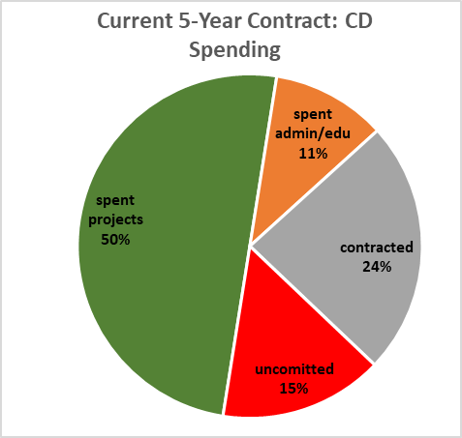
Annual Summary Report: CD Financial Status
Data as of 2/21/23
Of the 130 million allocated under current 5-year agreement:
$2.4M remaining in Hbg (9% of one annual allocation)
$37.1M remaining in CD Local Accounts (142% of one annual allocation)
$19.3M committed but not paid to current contracts (74% of one annual allocation)
$20.2M uncommitted funds (77% of one annual allocation)
www.dirtandgravelroads.org

Slide 38
Annual Summary Report: Allocation Eligibility
Reminder for next year
2-year spending: like normal year, CDs not spending enough will not be eligible for allocation
5-year contract ending:
CDs have until 6/30/24 to expend ALL funding from current 5-year agreement that ends 6/30/2023.
Funding remaining 6/30/24 will “revert to the control of the SCC”
Currently ~20M uncommitted
Contact Roy, Sherri, and Ken to discuss
www.dirtandgravelroads.org

Slide 39
Let’s zoom out some more and look at the BIG BIG BIG picture…

Slide 40
Annual Summary Report: Big Big Big Picture
Data as of 2/21/23
Overall Program Lifetime Spending Summary (Since 1997)
$296M Total Allocated to CDs ($60M before 2014 funding increase, $236M since)
www.dirtandgravelroads.org

Slide 41
Annual Summary Report: Big Big Big Picture
Data as of 2/21/23
Overall Program Lifetime Spending Summary (Since 1997)
$298M Total Allocated to CDs ($60M before 2014 funding increase, $238M since)
$220M Spent on 6,574 Completed Projects
$20M Spent on Administration at CDs
$7M Spent on Education at CDs
$31M contracted to projects (377) with $11M of that $31M spent
$278M of funding Spent and Committed ($234M spent and $21M committed)
www.dirtandgravelroads.org

Slide 42
Annual Summary Report: Big Big Big Picture
Data as of 2/21/23
Overall Program Lifetime Spending Summary (Since 1997)
$298M Total Allocated to CDs ($60M before 2014 funding increase, $238M since)
$220M Spent on 6,574 Completed Projects
$20M Spent on Administration at CDs
$7M Spent on Education at CDs
$31M contracted to projects (377) with $11M of that $31M spent
$278M of funding Spent and Committed ($234M spent and $21M committed)
Plus $90M total in-kind!
Over a quarter of a billion dollars
www.dirtandgravelroads.org

Slide 43
Annual Summary Report: Big Big Big Picture
Data as of 2/21/23
Overall Program Lifetime Spending Summary (Since 1997)
$298M Total Allocated to CDs ($60M before 2014 funding increase, $238M since)
$220M Spent on 6,574 Completed Projects
$20M Spent on Administration at CDs
$7M Spent on Education at CDs
$31M contracted to projects (377) with $11M of that $31M spent
$278M of funding Spent and Committed ($234M spent and $21M committed)
Plus $90M total in-kind!
www.dirtandgravelroads.org

Slide 44
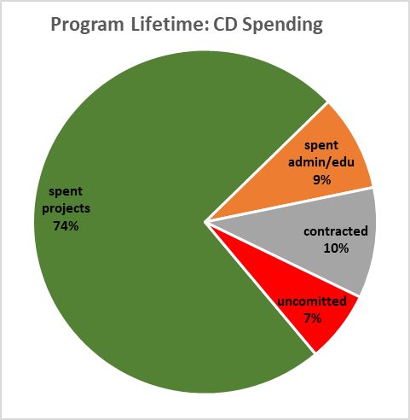
Annual Summary Report: Big Big Big Picture
Overall Program Lifetime Spending Summary (Since 1997)
$298M Total Allocated to CDs ($60M before 2014 funding increase, $238M since)
$220M Spent on 6,574 Completed Projects
$20M Spent on Administration at CDs
$7M Spent on Education at CDs
$31M contracted to projects (377) with $11M of that $31M spent
$278M of funding Spent and Committed ($234M spent and $21M committed)
$20.2M
www.dirtandgravelroads.org

Slide 45
Annual Summary Report: Big Big Big Picture
Plus $90M total in-kind!
www.dirtandgravelroads.org

Slide 46
Annual Summary Report: Big Big Big Picture
Thank you
PA Conservation Districts
Administering efficient programs
Meeting spending deadlines
Submitting timely reports
Putting good projects on the ground
Answering the phone even when you see Ken’s name!
www.dirtandgravelroads.org

