Slide 1
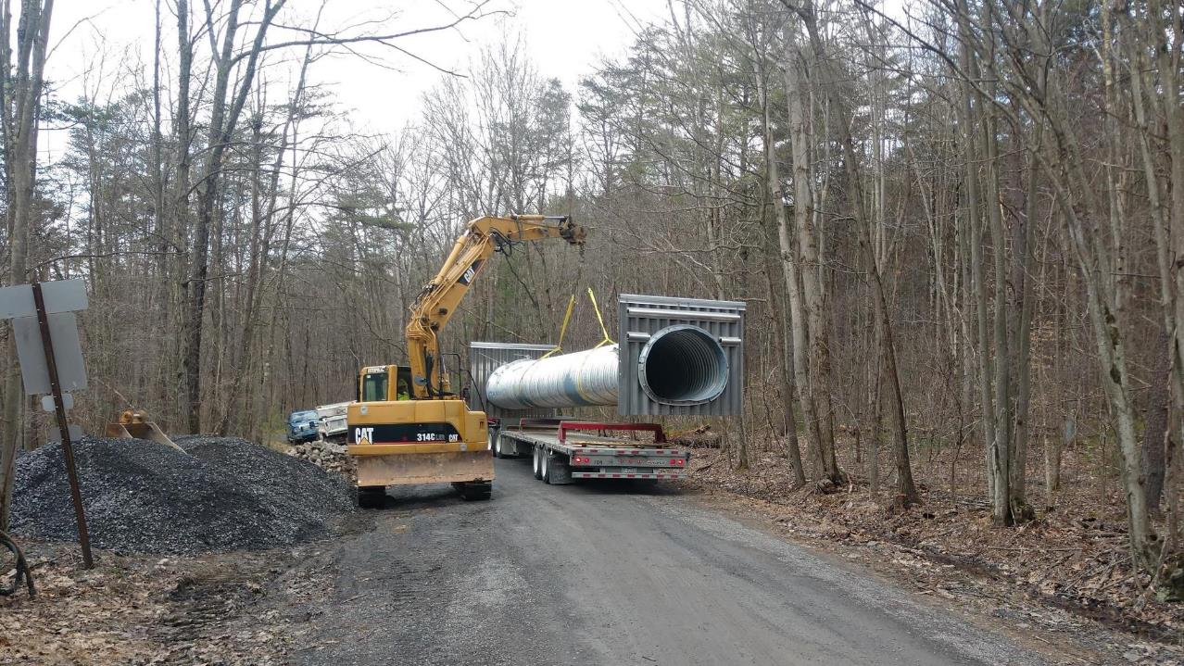
Dirt Gravel and Low Volume Road Program
WEBINAR
3/24/22
Starts 9am
2021 Annual Summary Report
CDGRS
Steve Bloser
smb201@psu.edu
SCC
Roy Richardson
rrichardso@ps.gov
Justin Challenger
jchallenge@pa.gov
Sherri Law
shlaw@pa.gov
If you are reading this, then you are successfully seeing the webinar video. Webinar audio should be automatic through your computer (or click “join audio”), and options can be accessed in the “audio options” button on the bottom left. If your computer audio is not working, you can listen on your phone by dialing 646-876-9923.

Slide 2
Purpose
Summarize 2021 Program Status
Stop, step back, and look at the “Big Picture” Program overview of spending and deliverables

Slide 3
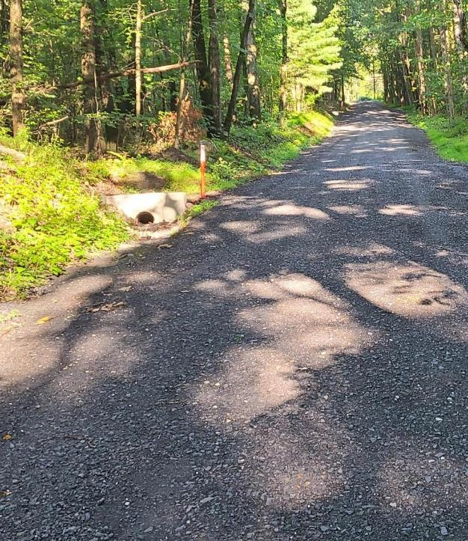
2021 Annual Summary Report
Annual Report: Financial
Annual Report: Deliverables
CD Financial Status
CD Allocation Eligibility

Slide 4
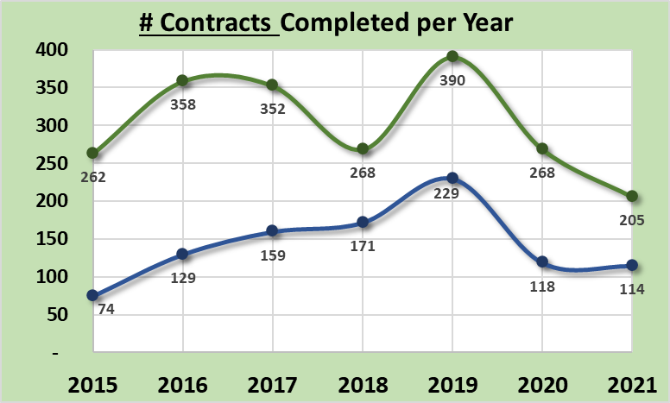
Annual Summary Report: Financial
319 Projects Completed
Down from 386 in 2020
455/yr past 5-year average
Completed based on closeout date:
Does not include partial payment on active contracts
Note:
2019: spending push at end of 5-year agreement
2020 and 2021: COVID impacts
Dirt and Gravel
Paved Low-Volume
ASR data as of 12/31/2021
www.dirtandgravelroads.org

Slide 5
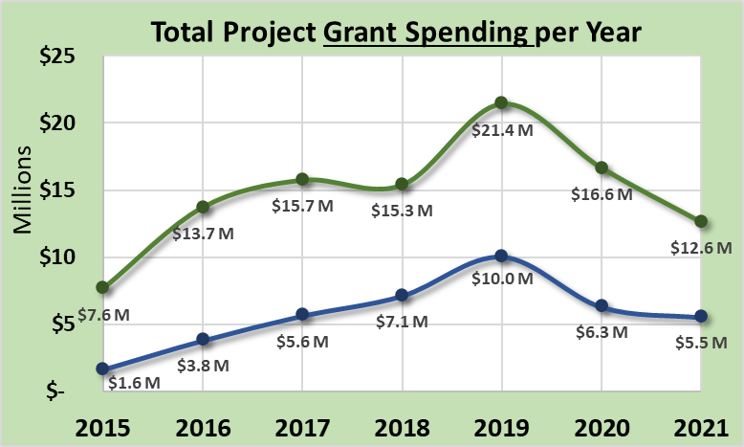
Annual Summary Report: Financial
$18.1 M Spent on Completed Projects
Down from $22.9M in 2020
$23.2M past 5-year average
Completed based on closeout date:
Does not include partial payment on active contracts
Note:
2019: spending push at end of 5-year agreement
2020 and 2021: COVID impacts
Dirt and Gravel
Paved Low-Volume
ASR data as of 12/31/2021
www.dirtandgravelroads.org

Slide 6
Annual Summary Report: Financial
$18.1 M Spent on Completed Projects
Down from $22.9M in 2020
$23.2M past 5-year average
Where should spending be?
Completed based on closeout date:
Does not include partial payment on active contracts
Dirt and Gravel
Likely Spending Equilibrium
Paved Low-Volume
ASR data as of 12/31/2021
www.dirtandgravelroads.org

Slide 7
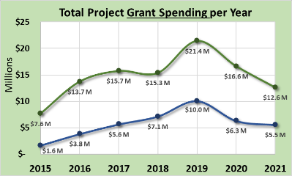
Annual Summary Report: Financial
$18.1 M Spent on Completed Projects
Down from $22.9M in 2020
$23.2M past 5-year average
In Addition, as of 3/22/2022:
89 contracts reported complete so far in 2022 for $6.2M
Completed based on closeout date:
Does not include partial payment on active contracts
ASR data as of 12/31/2021
www.dirtandgravelroads.org

Slide 8
Annual Summary Report: Financial
$18.1 M Spent on Completed Projects
Down from $22.9M in 2020
$23.2M past 5-year average
In Addition, as of 3/22/2022:
89 contracts reported complete so far in 2022 for $6.2M
410 current contacts totaling $33.3M
$12M advanced on those contracts
$21.3M encumbered on those contracts
ASR data as of 12/31/2021
www.dirtandgravelroads.org

Slide 9
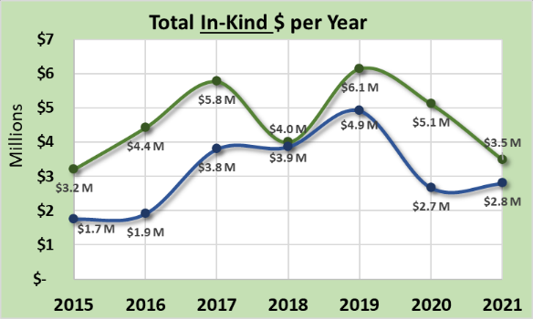
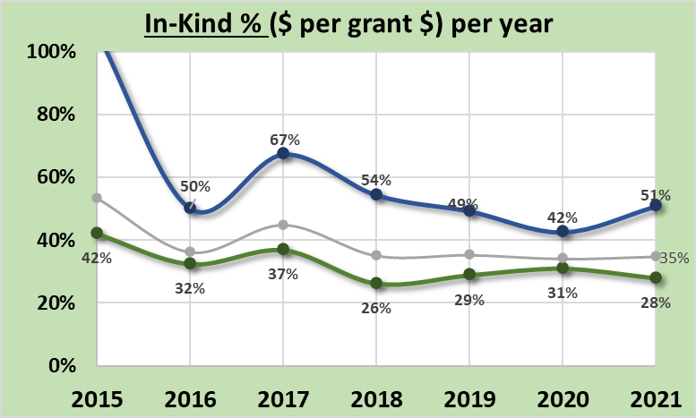
Annual Summary Report: Financial
Dirt and Gravel
In-Kind: goods or services incurred by participant but not reimbursed through DGLVR funds
$6.2M In-Kind Spent on Completed Projects
Down from $7.7M in 2020
$8.5M past 5-year average
35% In-Kind per Project Dollar
Compared to 34% in 2020
37% past 5-year average
Paved Low-Volume
Paved Low-Volume
Dirt and Gravel
ASR data as of 12/31/2021
www.dirtandgravelroads.org

Slide 10
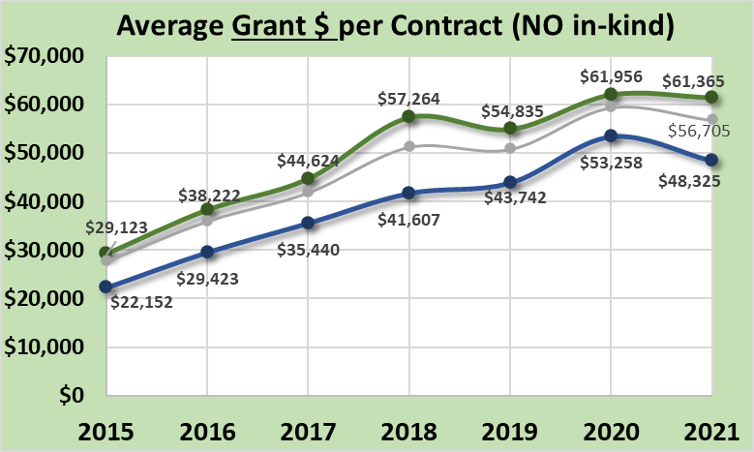
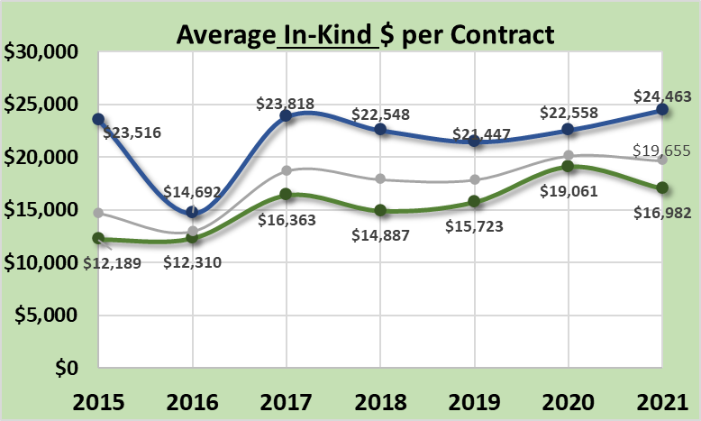
Annual Summary Report: Financial
Average Project Size:
Average per completed contract:
$57K in 2021 (DGLVR funds only)
$76K in 2021 (including in-kind)
Steadily rising since 2014 increase:
Larger scale projects
More complex and costly projects
Increase in material cost
Dirt and Gravel
Paved Low-Volume
Paved Low-Volume
Dirt and Gravel
ASR data as of 12/31/2021
www.dirtandgravelroads.org

Slide 11
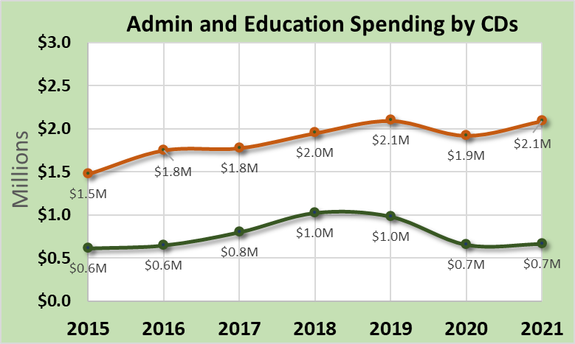
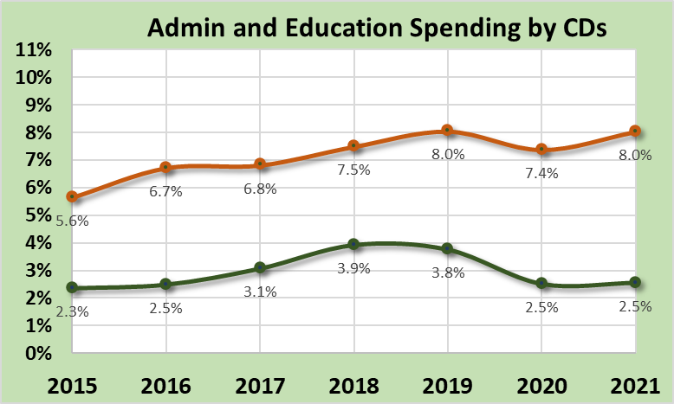
Annual Summary Report: Financial
Admin / Education Spending by CDs
Administration
10% maximum Allowable
8.0% in 2021
7.5% over 5-year average
Education
10% maximum Allowable
2.5% in 2021
3.2% over 5-year average
10% limit for each
CD administration
CD education
10% limit for each
CD administration
CD education
ASR data as of 12/31/2021
www.dirtandgravelroads.org

Slide 12
Annual Summary Report: Financial
Financial Summary
319 sites completed in 2021 with $18.1M spent on them
Down from last 2 years
Supply chain issues delayed some projects
Below long-term expected spending averages, expect busy year in 2022
Currently Contracted: 410 contracts for $33.3M (127% of one annual CD allocation)
Average grant values: holding steady, nearly $60,000 in 2020 and 2021
In-Kind: Steady at $0.35 to $0.37 per $1 of grant funds (no statewide in-kind requirement)
ASR data as of 12/31/2021
www.dirtandgravelroads.org

Slide 13
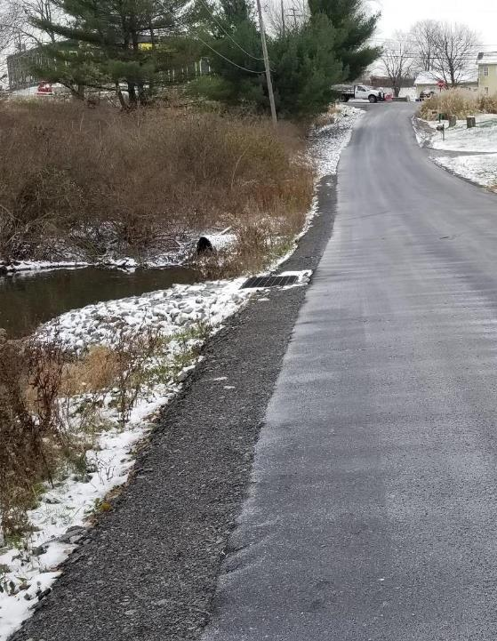
2021 Annual Summary Report
Annual Report: Financial
Annual Report: Deliverables
CD Financial Status
CD Allocation Eligibility

Slide 14
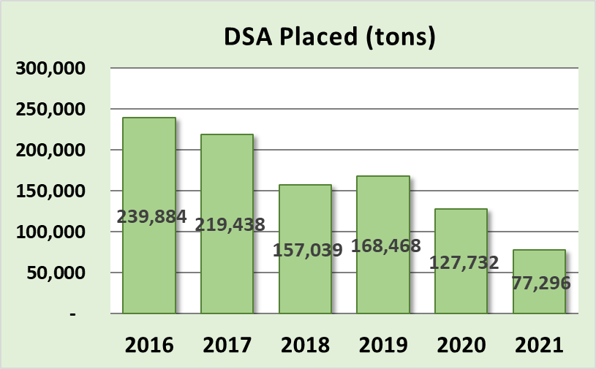
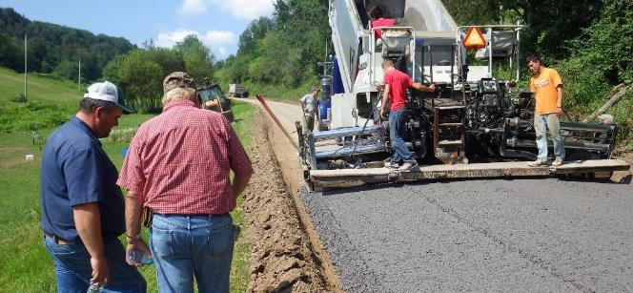
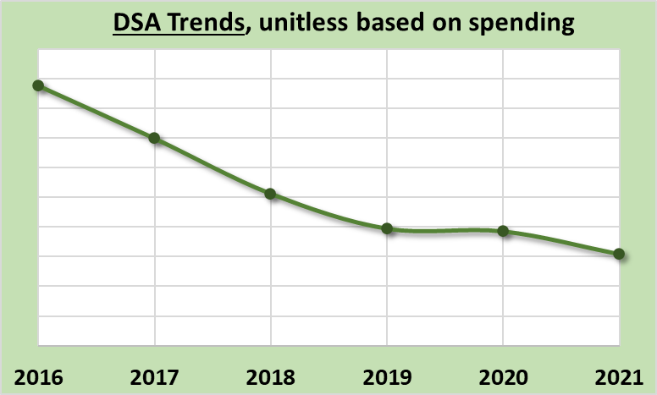
Annual Summary Report: Deliverables
Driving Surface Aggregate
Only approved surface w/ DGLVR funds
Should be used only after drainage and base improvement are made
Decreasing 5-year trend, focus is shifting and costs are increasing
ASR data as of 12/31/2021
www.dirtandgravelroads.org

Slide 15
Annual Summary Report: Deliverables
Driving Surface Aggregate
Only approved surface w/ DGLVR funds
Should be used only after drainage and base improvement are made
Decreasing 5-year trend, focus is shifting and costs are increasing
Actual Totals in Tons
$16.6M $12.6M
in in
2020 2021
But that does not account for annual spending variability
www.dirtandgravelroads.org

Slide 16
Annual Summary Report: Deliverables
Driving Surface Aggregate
Only approved surface w/ DGLVR funds
Should be used only after drainage and base improvement are made
Decreasing 5-year trend, focus is shifting and costs are increasing
Actual Totals in Tons
But that does not account for annual spending variability
Dirt and Gravel
Normalized by annual spending
www.dirtandgravelroads.org

Slide 17
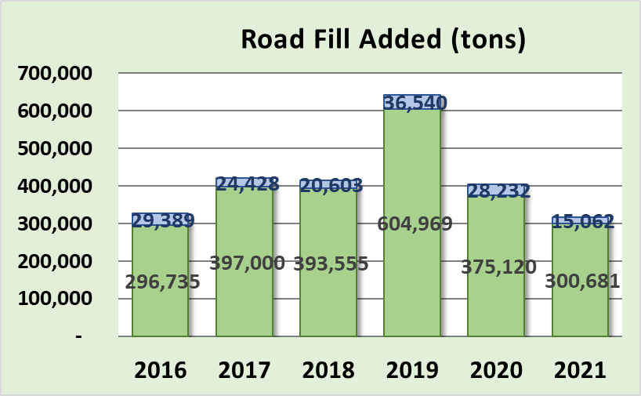
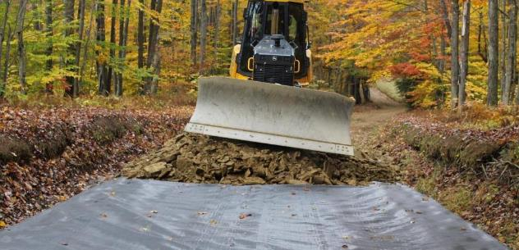
Annual Summary Report: Deliverables
Road Fill
Used to elevate entrenched roads
Continual point of emphasis as it fixes many drainage and base issues
Very consistent 5-year trends
Dirt and Gravel
Paved Low-Volume
Dirt and Gravel
Paved Low-Volume
www.dirtandgravelroads.org

Slide 18
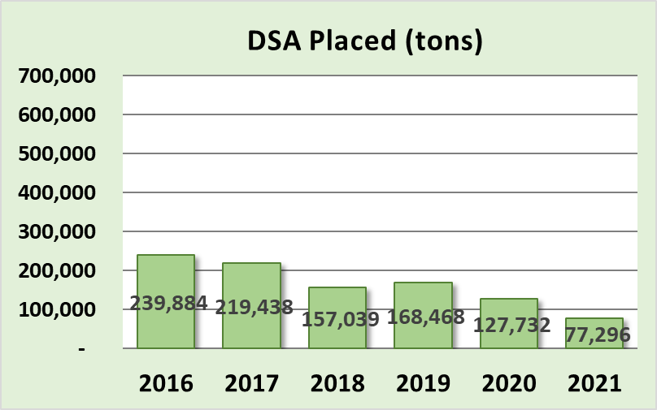
Annual Summary Report: Deliverables
Road Fill – vs- DSA
www.dirtandgravelroads.org

Slide 19
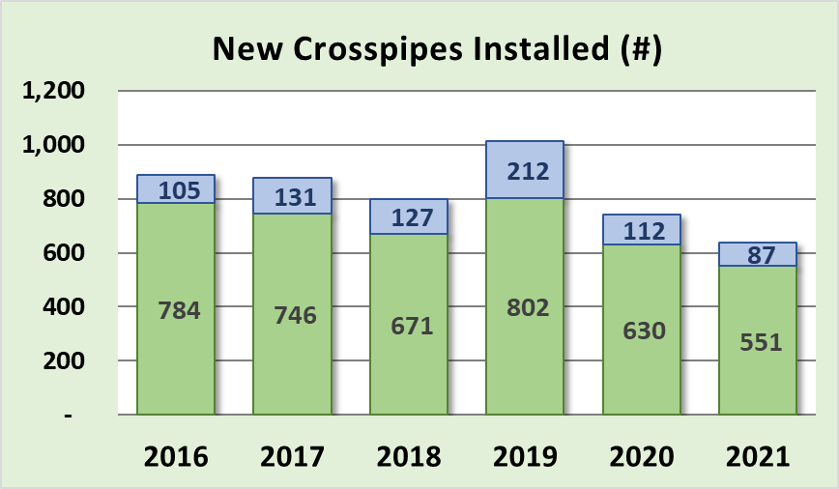
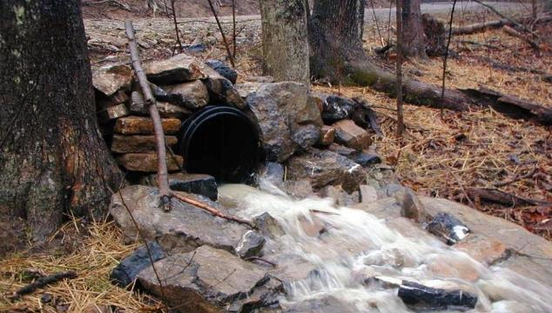
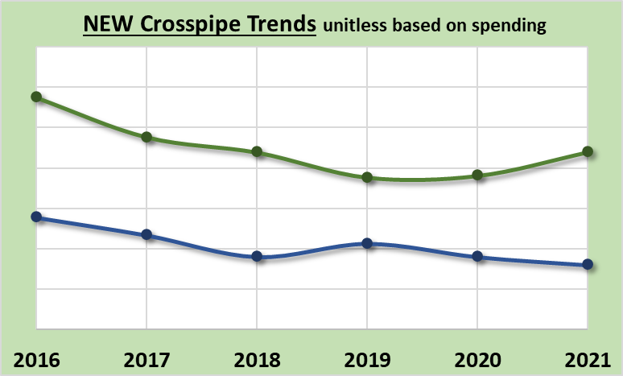
Annual Summary Report: Deliverables
NEW Crosspipes Installed
Most fundamental tool to disconnect road drainage
Relatively steady trend
Dirt and Gravel
Paved Low-Volume
Dirt and Gravel
Paved Low-Volume
www.dirtandgravelroads.org

Slide 20
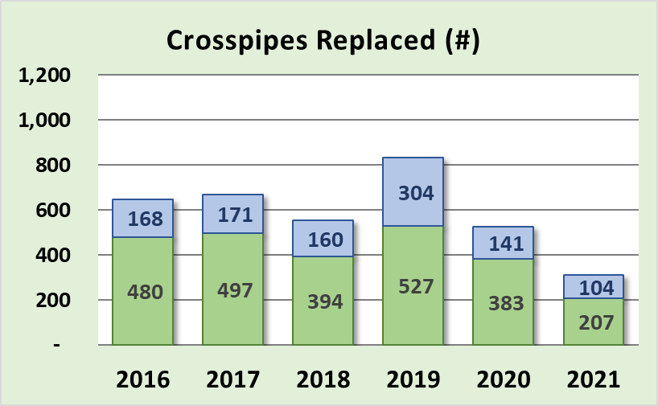
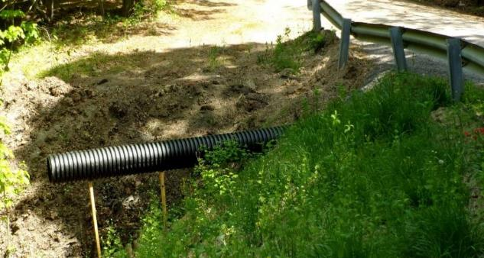
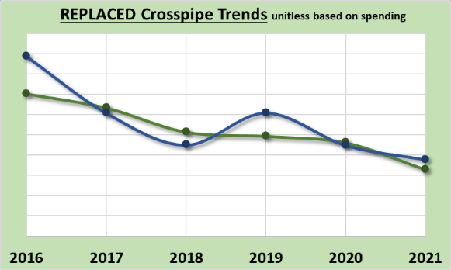
Annual Summary Report: Deliverables
Crosspipes REPLACED
Replacement of existing drainage crosspipes
General decreasing trend
Dirt and Gravel
Paved Low-Volume
Dirt and Gravel
Paved Low-Volume
Dirt and Gravel
Paved Low-Volume
www.dirtandgravelroads.org

Slide 21
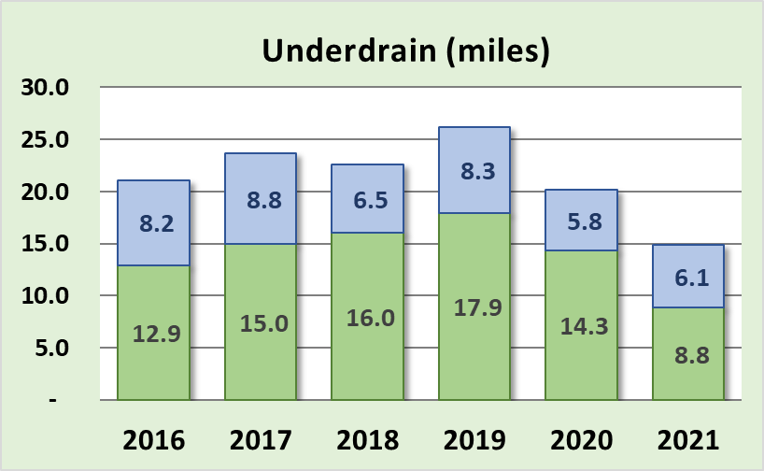
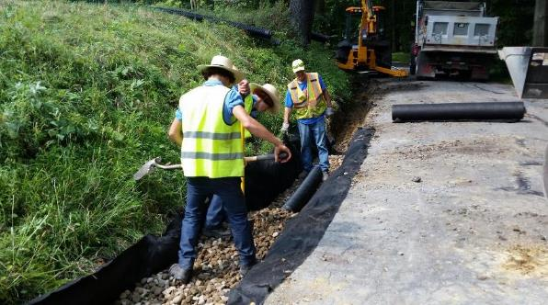
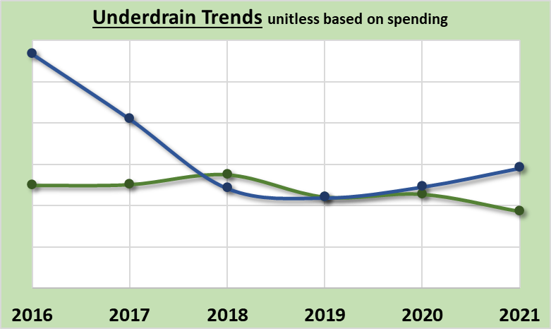
Annual Summary Report: Deliverables
Subsurface Drainage: Underdrains
Underdrains used to address subsurface drainage, mostly in ditchlines
Generally stable trend
Dirt and Gravel
Paved Low-Volume
Paved Low-Volume
Dirt and Gravel
www.dirtandgravelroads.org

Slide 22
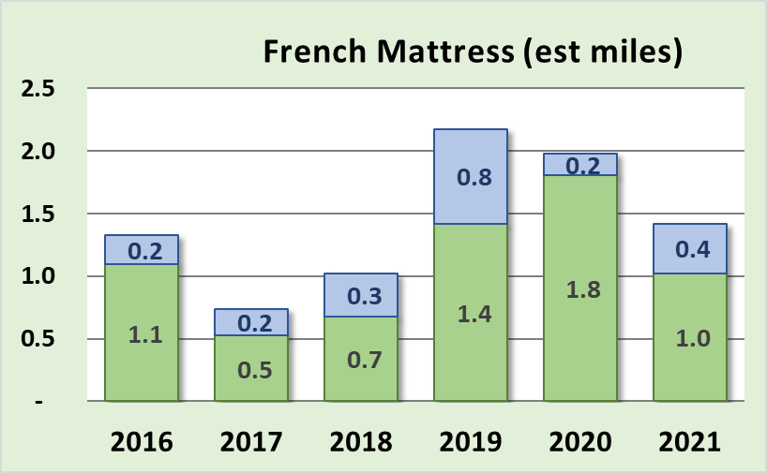
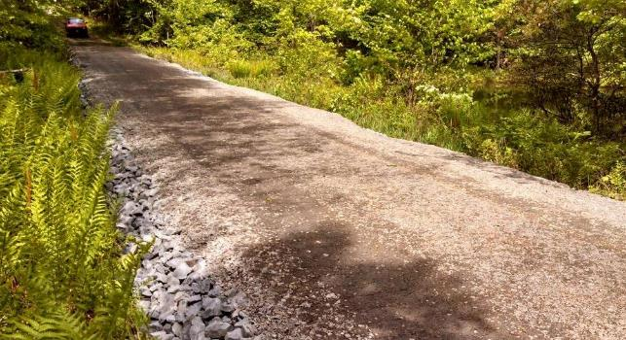
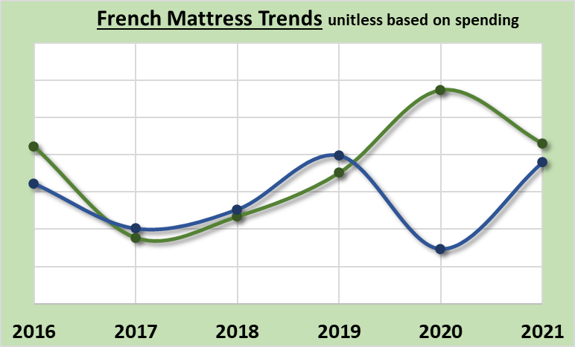
Annual Summary Report: Deliverables
Subsurface Drainage: French Mattress
Used to allow water to drain through road and provide base support
Generally increasing trend
Dirt and Gravel
Paved Low-Volume
Dirt and Gravel
Paved Low-Volume
www.dirtandgravelroads.org

Slide 23
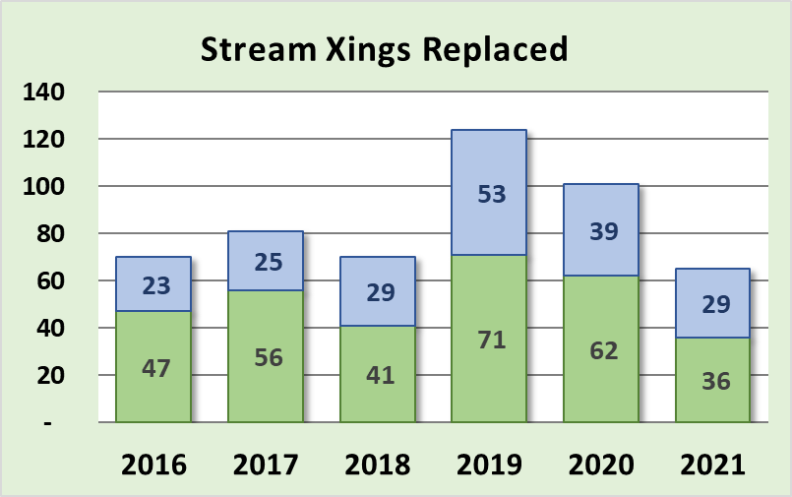
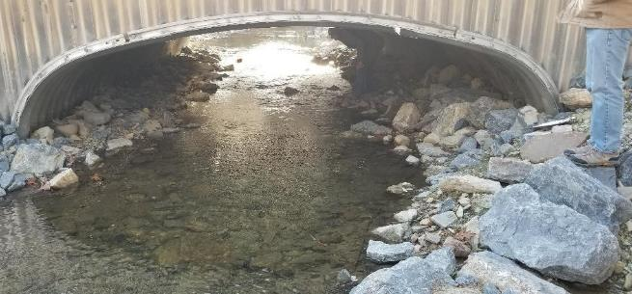
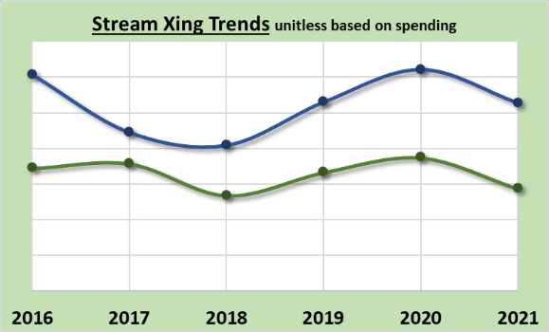
Annual Summary Report: Deliverables
Stream Crossing Replacements
Currently replacing ~85 per year
Fairly consistent 5-year trend
More prevalent on LVRs
Improved data collected starting July 2019…
Dirt and Gravel
Paved Low-Volume
Dirt and Gravel
Paved Low-Volume
Paved Low-Volume
Dirt and Gravel
www.dirtandgravelroads.org

Slide 24
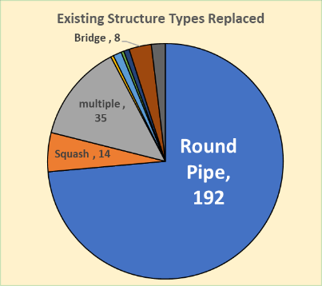
Annual Summary Report: Deliverables
Stream Crossing Replacements
260 replacements since July 2019
Old Structures: 74% were round pipes
www.dirtandgravelroads.org

Slide 25
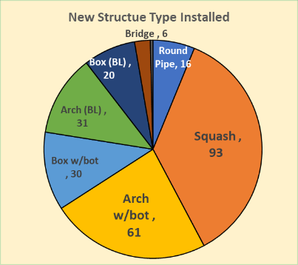
Annual Summary Report: Deliverables
Stream Crossing Replacements
260 replacements since July 2019
Old Structures: 74% were round pipes
New Structures:
Type
60% are squash or pipe arch (w/bottom)
Only 22% are bottomless (arch/box/bridge)
www.dirtandgravelroads.org

Slide 26
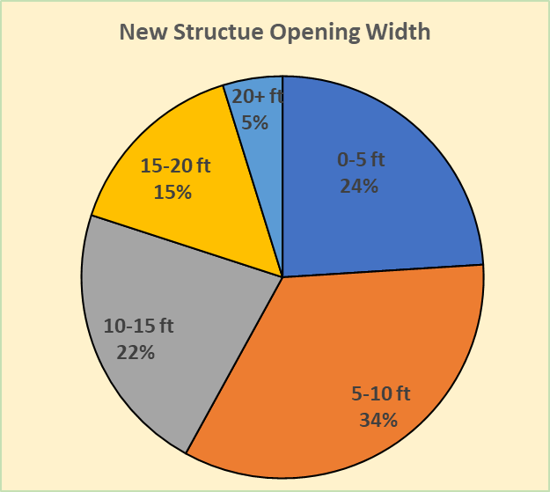
Annual Summary Report: Deliverables
Stream Crossing Replacements
260 replacements since July 2019
Old Structures: 74% were round pipes
New Structures:
Type
60% are squash or pipe arch (w/bottom)
Only 22% are bottomless (arch/box/bridge)
Size:
58% are under <10’ width
5% are over > 20’ in width
Avg existing structure width = 4.2’
Avg bankfull width = 9.1’
Avg new structure width = 10.2’ (112%)
www.dirtandgravelroads.org

Slide 27
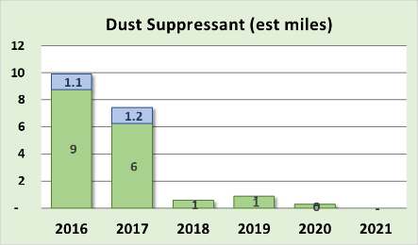
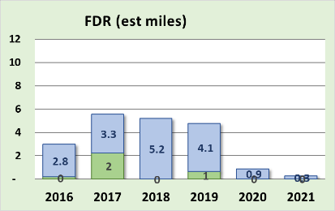
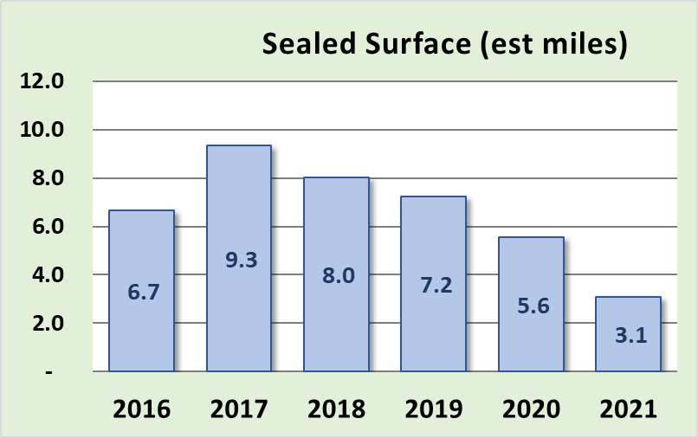
Annual Summary Report: Deliverables
Very Minor Players
Dust Suppressants: decreased to almost no use
Full Depth Reclamation: additional requirements in 2019 decreased use
Paving: most CDs only pay for what they disturb in fixing drainage. Note much of paving in graph below was in-kind.
Dirt and Gravel
Paved Low-Volume
www.dirtandgravelroads.org

Slide 28
Annual Summary Report: Deliverables
Overall Trends
Most deliverables fairly consistent since 2015 funding increase
Continued focus on drainage improvements with fill & pipes the main tools
Decreasing in emphasis on Driving Surface Aggregate
Spending on Paving, Dust Suppressants, and F.D.R. is very minor
More DGLVR funding going to stream crossings
www.dirtandgravelroads.org

Slide 29
Annual Summary Report: Deliverables
Where did these numbers come from, and can I do this for my county?
www.dirtandgravelroads.org

Slide 30
Annual Summary Report: Deliverables
Where did these numbers come from, and can I do this for my county?
Numbers came straight from GIS
YES, you can do the same thing and more for your county
Two 2019 Webinars recorded
March 7, 2019
March 21, 2019
CDGRS – education and training – webinars – past webinars
www.dirtandgravelroads.org

Slide 31
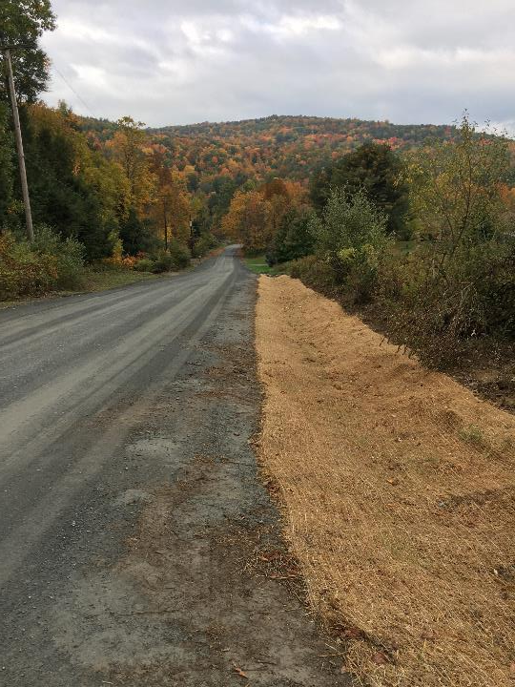
2021 Annual Summary Report
Annual Report: Financial
Annual Report: Deliverables
CD Financial Status
Allocation Eligibility

Slide 32
Annual Summary Report: CD Financial Status
Reminders / Overview
Currently in FY 2021-22, year 4 of 5-year agreement between SCC and CDs
CDs have two years to spend funding
Allocations to CDs
$ 26.1 Million Annually
$ 104.4 through first 4 years of this agreement
At least 80% required to go to projects, approx. ~90% does
CDs get ½ their allocation up front, other ½ remains in Hbg for replenishment
www.dirtandgravelroads.org

Slide 33
Annual Summary Report: CD Financial Status
Data as of 3/22/2022
Of the 104.4 million allocated under current 5-year agreement:
$3.8M remaining in Hbg (14.6% of one annual allocation)
+ $33.1M remaining in CD Local Accounts (127% of one annual allocation)
$36.9M remaining funds (CD&Hbg)(141.5% of one annual allocation)
- $21.2M committed but not paid to current contracts (81% of one annual allocation)
$15.7M uncommitted funds (60% of one annual allocation)
www.dirtandgravelroads.org

Slide 34
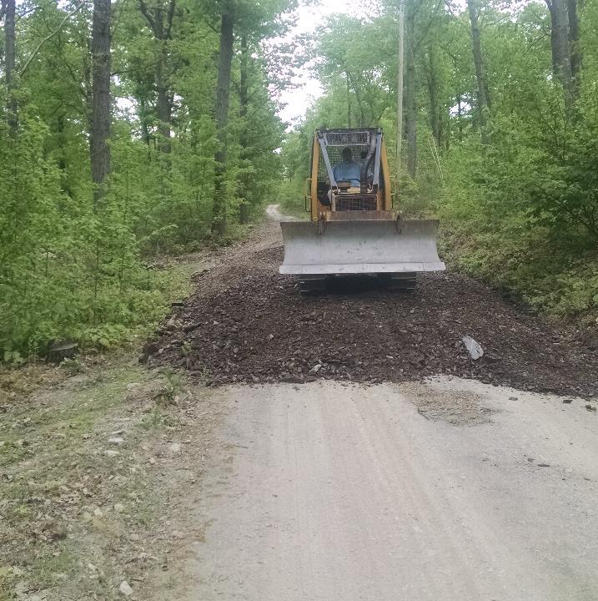
2021 Annual Summary Report
Annual Report: Financial
Annual Report: Deliverables
CD Financial Status
Allocation Eligibility

Slide 35
Annual Summary Report: Allocation Eligibility
Reminders / Overview
CDs have two years to spend funding
Otherwise not eligible for future allocations
Allocations from ineligible CDs distributed to other CDs
LVR and DGR calculated separately
Allocations can resume in future FYs once spending requirements are met
Data as of 3/22/2022
www.dirtandgravelroads.org

Slide 36
Annual Summary Report: Allocation Eligibility
Data as of 3/22/2022
Current Allocation Eligibility Status
DGR Green: requirements already met, OK for FY 2021-22 DGR Allocations
62 Counties
DGR Red: requirements not yet met
3 Counties currently – will likely get lower
LVR Green: requirements already met, OK for FY 2021-22 LVR Allocations
62 Counties
LVR Red: requirements not yet met
4 Counties – will likely get lower
CDs have through March 31 to meet spending deadlines
This allows allocations to be taken to SCC at May Meeting
www.dirtandgravelroads.org

Slide 37
Let’s zoom out some more and look at the BIG BIG BIG picture…

Slide 38
Annual Summary Report: Big Big Big Picture
Data as of 3/22/22
Overall Program Lifetime Spending Summary (Since 1997)
$271M Total Allocated to CDs ($60M before 2014 funding increase, $211M since)
www.dirtandgravelroads.org

Slide 39
Annual Summary Report: Big Big Big Picture
Data as of 3/22/22
Overall Program Lifetime Spending Summary (Since 1997)
$271M Total Allocated to CDs ($60M before 2014 funding increase, $211M since)
$197M Spent on 6,225 Completed Projects
$18M Spent on Administration at CDs
$7M Spent on Education at CDs
$33M contracted to projects (410) with $12M of that $33M spent
$255M of funding Spent and Committed ($234M spent and $21M committed)
Plus $80M total in-kind!
www.dirtandgravelroads.org

Slide 40
Annual Summary Report: Big Big Big Picture
Data as of 3/22/22
Overall Program Lifetime Spending Summary (Since 1997)
$271M Total Allocated to CDs ($60M before 2014 funding increase, $211M since)
$197M Spent on 6,225 Completed Projects
$18M Spent on Administration at CDs
$7M Spent on Education at CDs
$33M contracted to projects (410) with $12M of that $33M spent
$255M of funding Spent and Committed ($234M spent and $21M committed)
Plus $80M total in-kind!
Over a quarter of a billion dollars
www.dirtandgravelroads.org

Slide 41
Annual Summary Report: Big Big Big Picture
Data as of 3/22/22
Overall Program Lifetime Spending Summary (Since 1997)
$271M Total Allocated to CDs ($60M before 2014 funding increase, $211M since)
$197M Spent on 6,225 Completed Projects
$18M Spent on Administration at CDs
$7M Spent on Education at CDs
$33M contracted to projects (410) with $12M of that $33M spent
$255M of funding Spent and Committed ($234M spent and $21M committed)
Only $16M, or about 60% a year’s allocation, currently uncommitted
With $233M spent, and a “cumulative statewide spending requirement” of $216M: Statewide, spending is currently $17M “in the green”
Plus $80M total in-kind!
www.dirtandgravelroads.org

Slide 42
Annual Summary Report: Big Big Big Picture
Thank you
PA Conservation Districts
Adapting to funding increase and changing policies and reporting requirements
Administering efficient programs
Meeting spending deadlines
Submitting timely reports
Putting good projects on the ground
www.dirtandgravelroads.org

