Slide 1
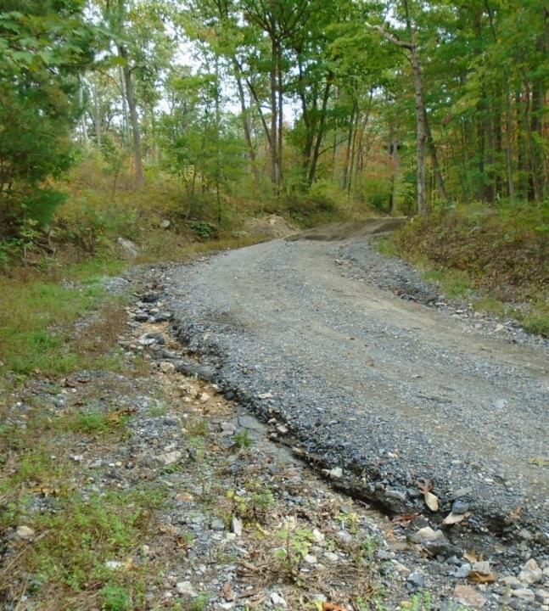
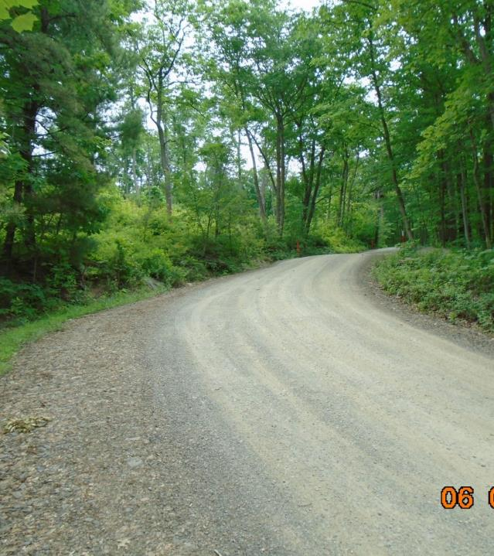
Dirt Gravel and Low Volume Road Program
WEBINAR
3/7/24, 9am
2023 Annual Summary Report
CDGRS
Steve Bloser
smb201@psu.edu
Photos: Cumberland CD
If you are reading this, then you are successfully seeing the webinar video. Webinar audio should be automatic through your computer (or click “join audio”), and options can be accessed in the “audio options” button on the bottom left. If your computer audio is not working, you can listen on your phone by dialing 646-876-9923.

Slide 2
Purpose
Summarize 2023 Program Status
Stop, step back, and look at the “Big Picture” Program overview of spending and deliverables

Slide 3
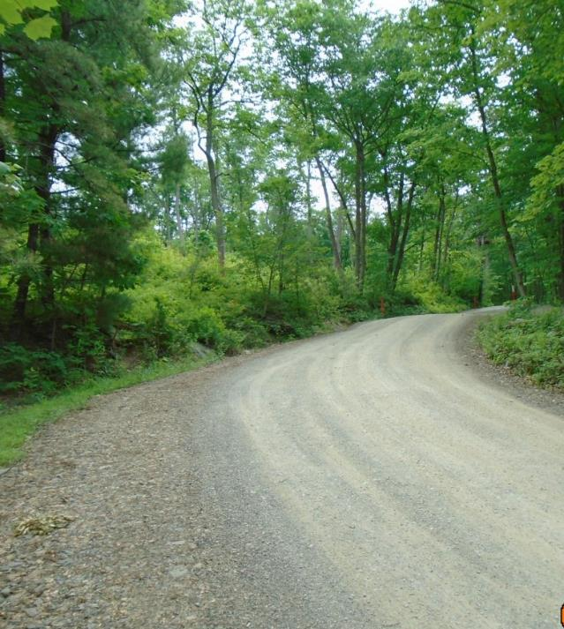
2023 Annual Summary Report
Annual Report: Financial
Annual Report: Deliverables
CD Financial Status
Warning: lots of graphs and info ahead. Recording and ppt will be available online.

Slide 4
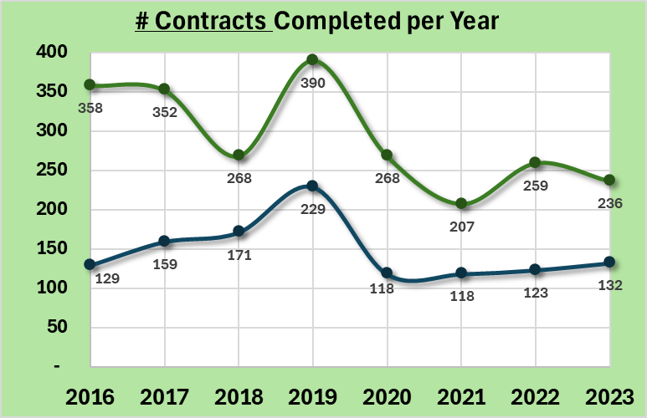
Annual Summary Report: Financial
368 Projects Completed
236 DGR, 132 LVR
416/yr past 5-year average
Completed based on closeout date:
Does not include partial payment on active contracts
Dirt and Gravel
Note:
2019: spending push at end of 5-year agreement
2020 and 2021: COVID impacts
Paved Low-Volume
ASR data as of 12/31/2023
www.dirtandgravelroads.org

Slide 5
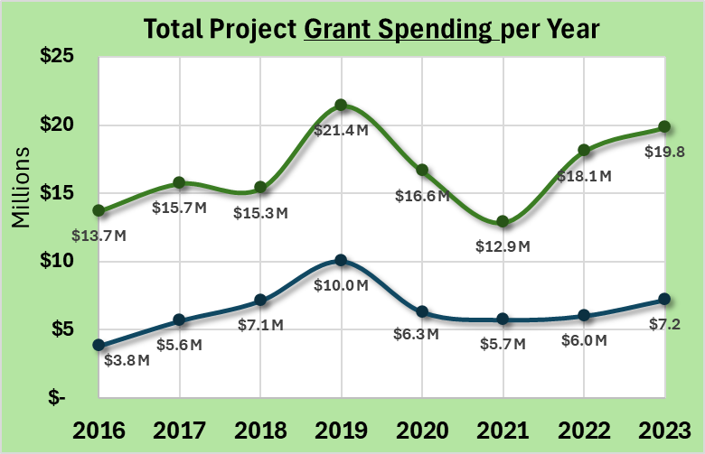
Annual Summary Report: Financial
$27M Spent on Completed Projects
Up $3M from 2022
$24.8M past 5-year average
Completed based on closeout date:
Does not include partial payment on active contracts
Dirt and Gravel
Note:
2019: spending push at end of 5-year agreement
2020 and 2021: COVID impacts
Paved Low-Volume
ASR data as of 12/31/2023
www.dirtandgravelroads.org

Slide 6
Annual Summary Report: Financial
$27M Spent on Completed Projects
Up $3M from 2022
$24.8M past 5-year average
Completed based on closeout date:
Does not include partial payment on active contracts
Dirt and Gravel
Likely Spending Equilibrium
Paved Low-Volume
ASR data as of 12/31/2023
www.dirtandgravelroads.org

Slide 7
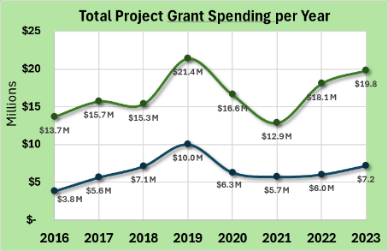
Annual Summary Report: Financial
$27M Spent on Completed Projects
Up $3M from 2022
$24.8M past 5-year average
In Addition, as of 3/4/2024:
30 contracts reported complete so far in 2024 for $2.1M
390 current contacts totaling $34.5M (133% of annual allocation)
$14M advanced on those contracts
$20.5M encumbered on those contracts
ASR data as of 12/31/2023
www.dirtandgravelroads.org

Slide 8
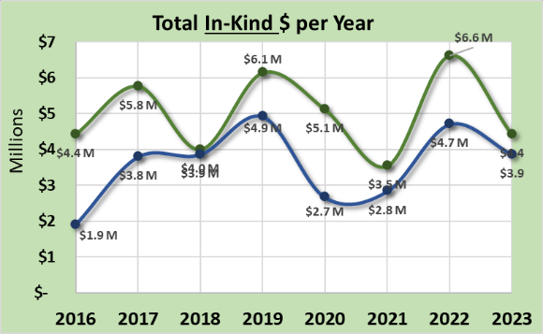
Annual Summary Report: Financial
Dirt and Gravel
In-Kind: goods or services incurred by participant but not reimbursed through DGLVR funds
$8.3M In-Kind Spent on Comp. Projects
Down $1.8M from 2022
$8.9M past 5-year average
Dirt and Gravel
Paved Low-Volume
Paved Low-Volume
ASR data as of 12/31/2023
www.dirtandgravelroads.org

Slide 9
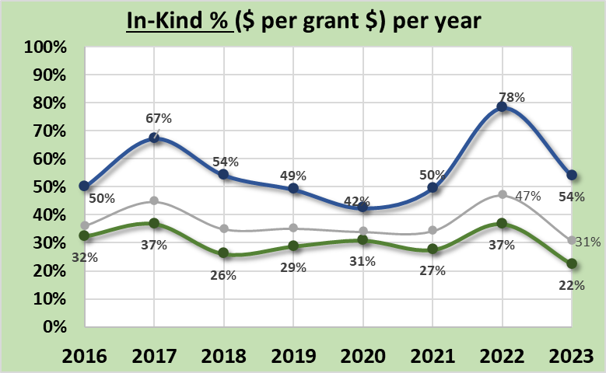
Annual Summary Report: Financial
Dirt and Gravel
In-Kind: goods or services incurred by participant but not reimbursed through DGLVR funds
$8.3M In-Kind Spent on Comp. Projects
Down $1.8M from 2022
$8.9M past 5-year average
31% In-Kind per Project Dollar
Down 11% from 2022
36% past 5-year average
Paved Low-Volume
Paved Low-Volume
Dirt and Gravel
ASR data as of 12/31/2023
www.dirtandgravelroads.org

Slide 10
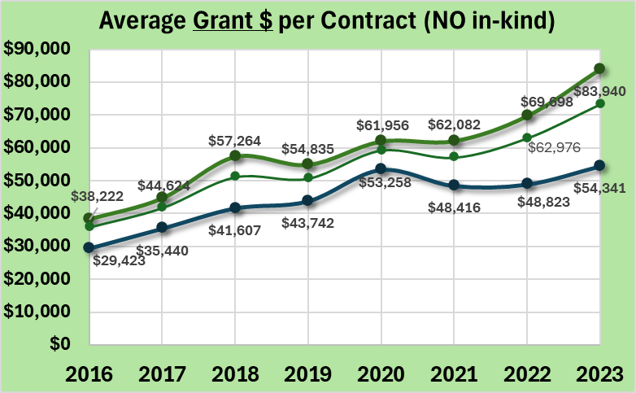
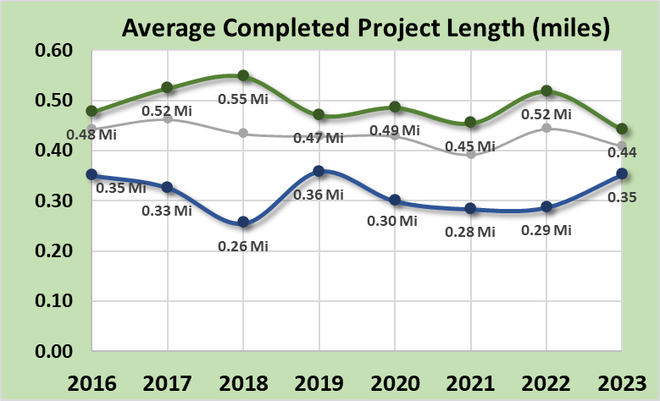
Annual Summary Report: Financial
Average Project Size:
Average Completed Site in 2023:
DGR: $84K grant, $19K in-kind, 0.44 miles
LVR: $54K grant, $26K in-kind, 0.35 miles
DGLVR: $73K grant, $23K in-kind, 0.41 miles
Steadily rising since costs:
Larger scale projects
More complex and costly projects
Increase in material cost
Dirt and Gravel
Paved Low-Volume
Dirt and Gravel
Paved Low-Volume
* Note we no longer look at cost per mile, largely due to stream crossings skewing the costs
ASR data as of 12/31/2023
www.dirtandgravelroads.org

Slide 11
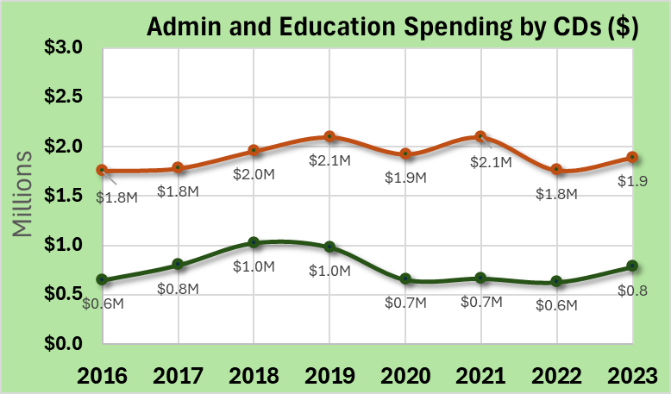
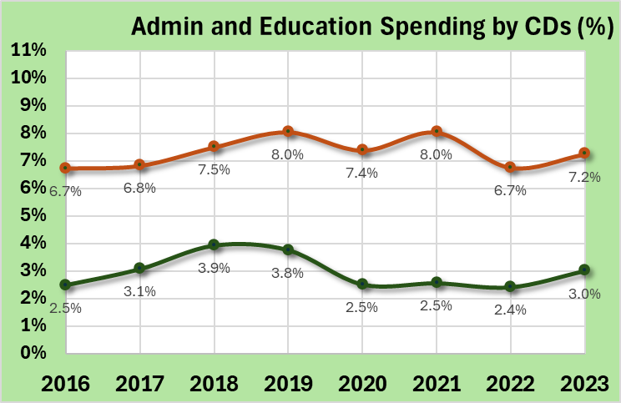
Annual Summary Report: Financial
Admin / Education Spending by CDs
Administration
10% maximum Allowable (of CD allocations)
7.2% in 2023
7.5% 5-year average
Education
10% maximum Allowable (of CD allocations)
3.0% in 2023
2.8% 5-year average
10% limit for each
CD administration
CD education
10% limit for each
CD administration
CD education
ASR data as of 12/31/2023
www.dirtandgravelroads.org

Slide 12
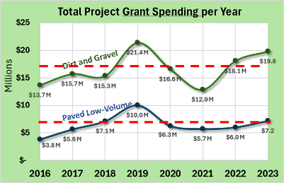
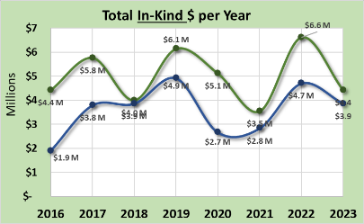
Annual Summary Report: Financial
Financial Summary
368 sites completed in 2021 with $27M spent
Spending up due to 5-year contract and spending push
Currently Contracted: 390 current contacts totaling $34.5M (133% of annual allocation)
Average completed contract in 2023: $73K grant, $23K in-kind, 0.41 miles long
In-Kind: dropped in 2023, still at $0.31 per grant $1
ASR data as of 12/31/2023
www.dirtandgravelroads.org

Slide 13
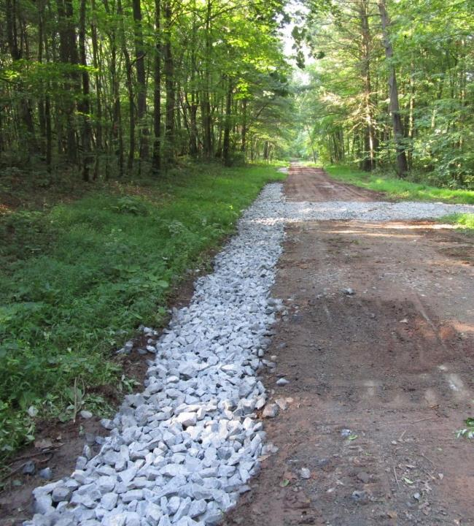
2022 Annual Summary Report
Annual Report: Financial
Annual Report: Deliverables
CD Financial Status

Slide 14
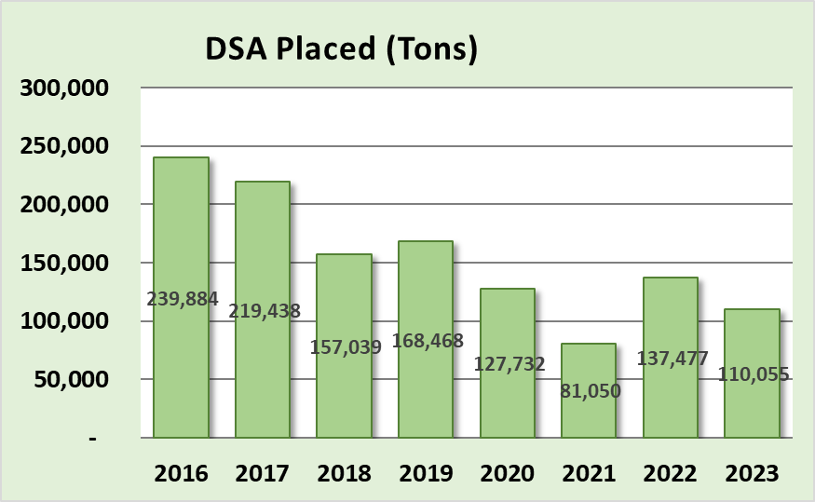
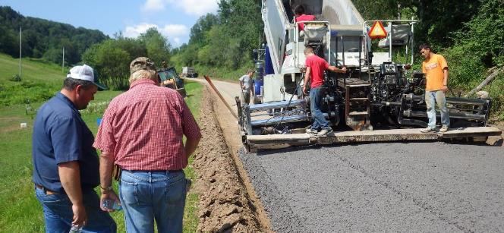
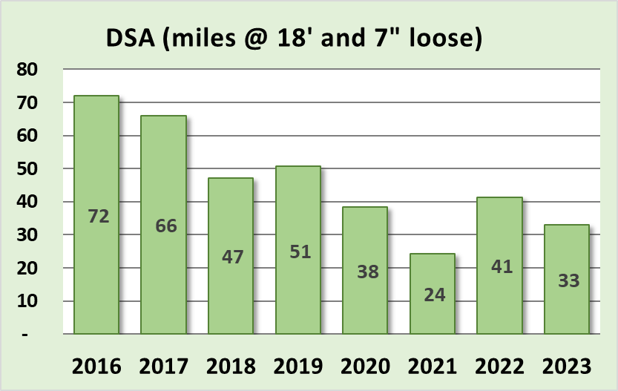
Annual Summary Report: Deliverables
Driving Surface Aggregate
Only approved surface w/ DGLVR funds
2023: 110,000 Tons, est 33 miles
Quantity placed each year slowly decreasing as costs go up.
ASR data as of 12/31/2023
www.dirtandgravelroads.org

Slide 15
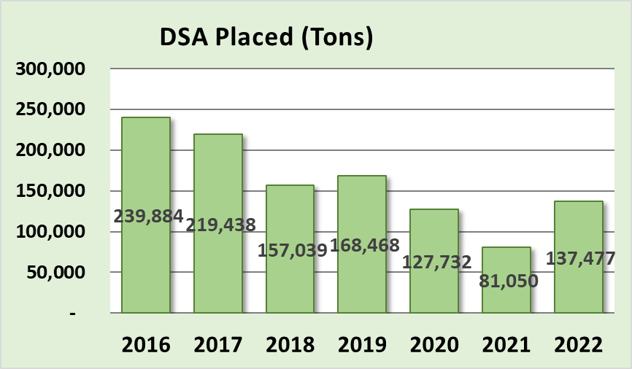
Annual Summary Report: Deliverables
Driving Surface Aggregate
Only approved surface w/ DGLVR funds
Only to be used only after drainage and base improvement are made
Decreasing 5-year trend, focus is shifting and costs are increasing
Actual Totals in Tons
$18.5M $24M
in in
2021 2021
But that does not account for annual spending variability
www.dirtandgravelroads.org

Slide 16
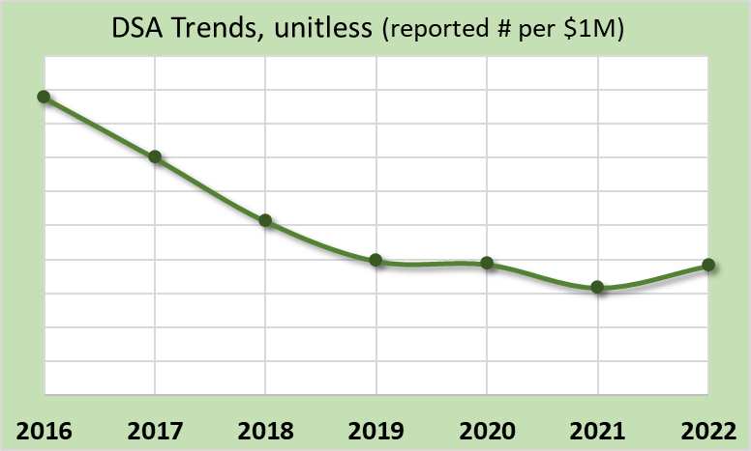
Annual Summary Report: Deliverables
Driving Surface Aggregate
Only approved surface w/ DGLVR funds
Only to be used only after drainage and base improvement are made
Decreasing 5-year trend, may be stabilizing at “new normal”
Actual Totals in Tons
But that does not account for annual spending variability
Dirt and Gravel
Normalized by annual spending
www.dirtandgravelroads.org

Slide 17
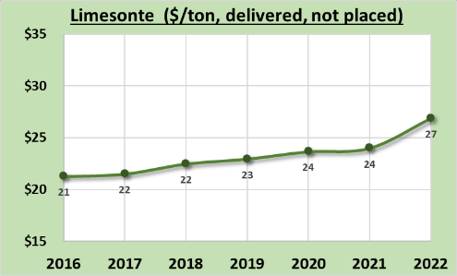
Annual Summary Report: Deliverables
Driving Surface Aggregate
Only approved surface w/ DGLVR funds
Only to be used only after drainage and base improvement are made
Decreasing 5-year trend, may be stabilizing at “new normal”
ASR data as of 12/31/2023
www.dirtandgravelroads.org

Slide 18
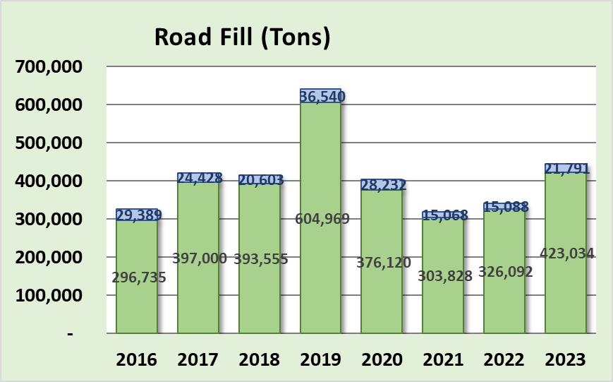
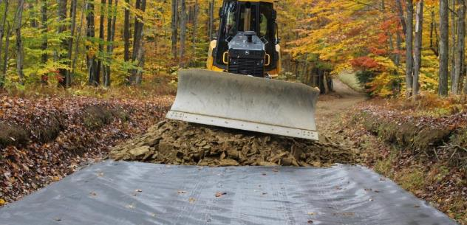
Annual Summary Report: Deliverables
Road Fill
Used to elevate entrenched roads
Continual point of emphasis as it fixes many drainage and base issues
Very consistent 5-year trends
Paved Low-Volume
Dirt and Gravel
60 miles @ 18’ wide
and 1’ deep compacted
www.dirtandgravelroads.org

Slide 19
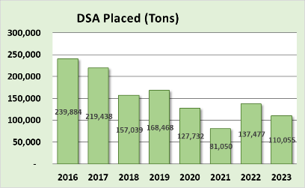
Annual Summary Report: Deliverables
Road Fill
Used to elevate entrenched roads
Continual point of emphasis as it fixes many drainage and base issues
Very consistent 5-year trends
Fill and DSA looks similar but different scales
Paved Low-Volume
Dirt and Gravel
www.dirtandgravelroads.org

Slide 20
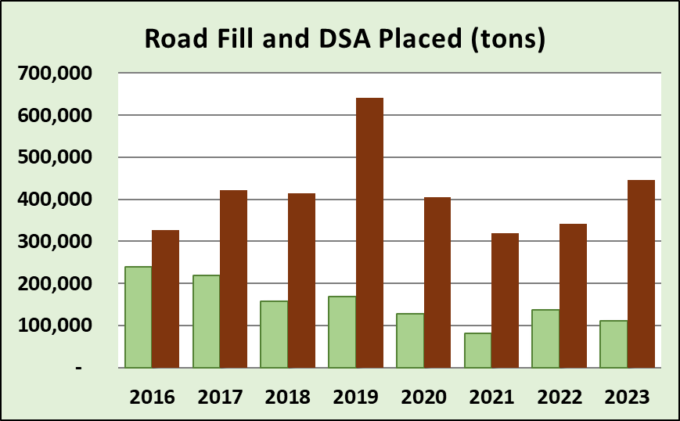
Annual Summary Report: Deliverables
Road Fill – vs- DSA
5-year total: 3-4 tons of fill for every ton of DSA
F
I
L
L
D
S
A
www.dirtandgravelroads.org

Slide 21
Annual Summary Report: Deliverables
5-year total: 3 tons of fill for every ton of DSA
Road Fill – vs- DSA
Past 5 years:
2.1 M tons road fill
0.7 M tons of DSA
What does that actually look like?

Slide 22
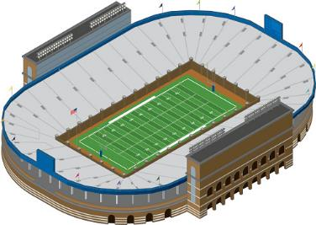
Annual Summary Report: Deliverables
5-year total: 3 tons of fill for every ton of DSA
Road Fill – vs- DSA
Past 5 years:
2.1 M tons road fill
0.7 M tons of DSA
What does that actually look like?
Football Field Playing Surface: 300’x160’
www.dirtandgravelroads.org

Slide 23
Annual Summary Report: Deliverables
5-year total: 3 tons of fill for every ton of DSA
850’ tall
(300’x160’)
Road Fill – vs- DSA
Past 5 years:
2.1 M tons road fill
0.7 M tons of DSA
What does that actually look like?
275’ tall
(300’x160’)
FILL
DSA
www.dirtandgravelroads.org

Slide 24
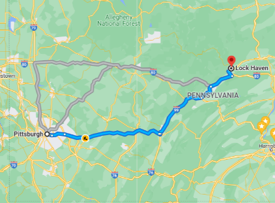
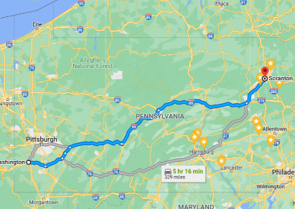
Annual Summary Report: Deliverables
5-year total: 3 tons of fill for every ton of DSA
Road Fill – vs- DSA
Past 5 years:
2.1 M tons road fill
0.7 M tons of DSA
What does that actually look like?
DSA:
Compacted 6” deep x 18’ wide
177 miles long
Pittsburgh to Lock Haven 6” deep
Fill:
Compacted 1’ deep x 18’ wide
322 miles long
Washington PA to Scranton 1’ deep

Slide 25
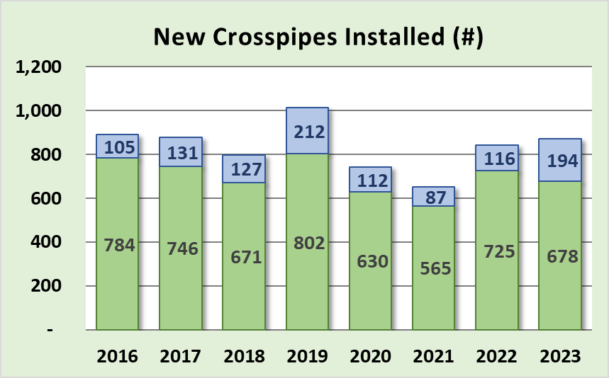
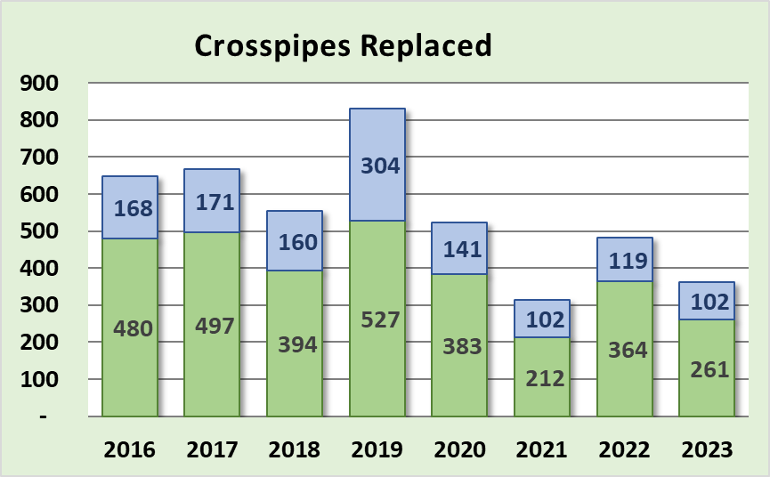
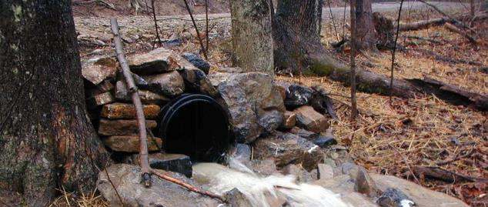
Annual Summary Report: Deliverables
Crosspipes Installed
Fundamental drainage disconnection
872 new pipes in 2023
Last 5 years:
4,121 new pipes installed
2,515 pipes replaced
Paved Low-Volume
Dirt and Gravel
www.dirtandgravelroads.org

Slide 26
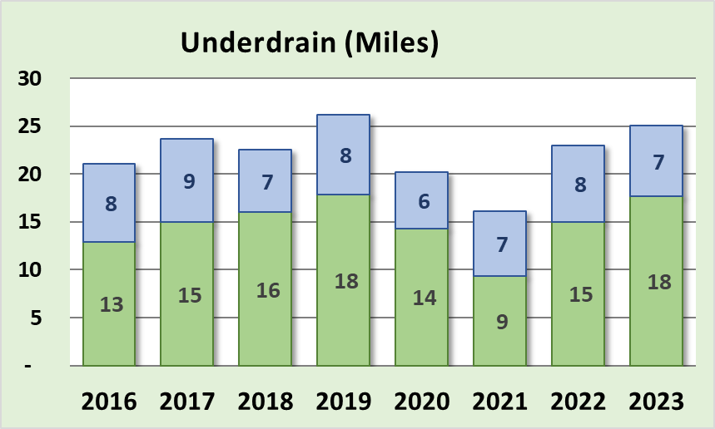
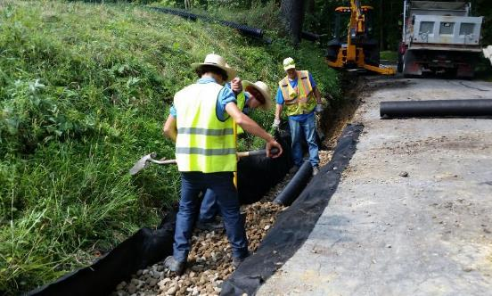
Annual Summary Report: Deliverables
Subsurface Drainage: Underdrains
Underdrains used to address subsurface drainage, mostly in ditch lines
Generally stable trend
Paved Low-Volume
Dirt and Gravel
www.dirtandgravelroads.org

Slide 27
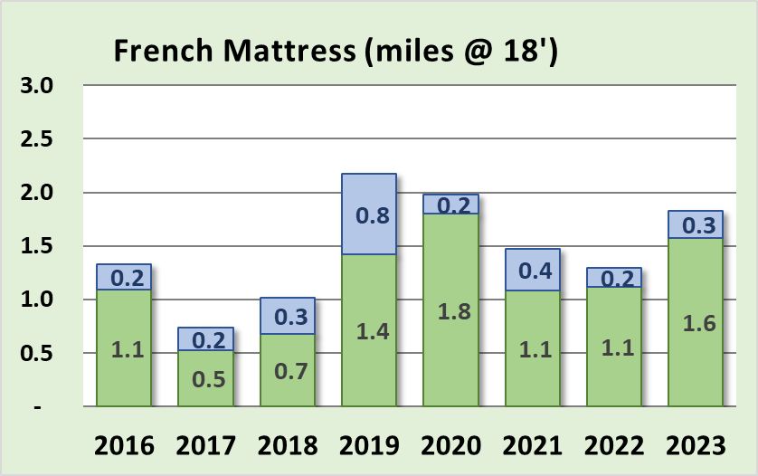
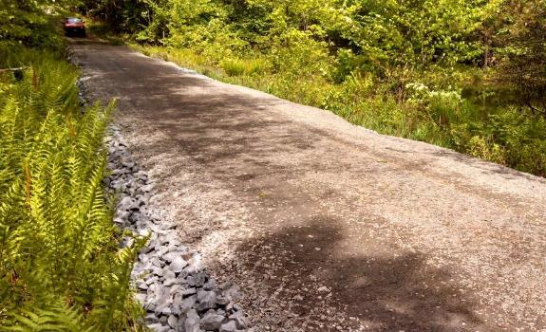
Annual Summary Report: Deliverables
Subsurface Drainage: French Mattress
Used to allow water to drain through road and provide base support
Generally increasing trend
Paved Low-Volume
Dirt and Gravel
www.dirtandgravelroads.org

Slide 28
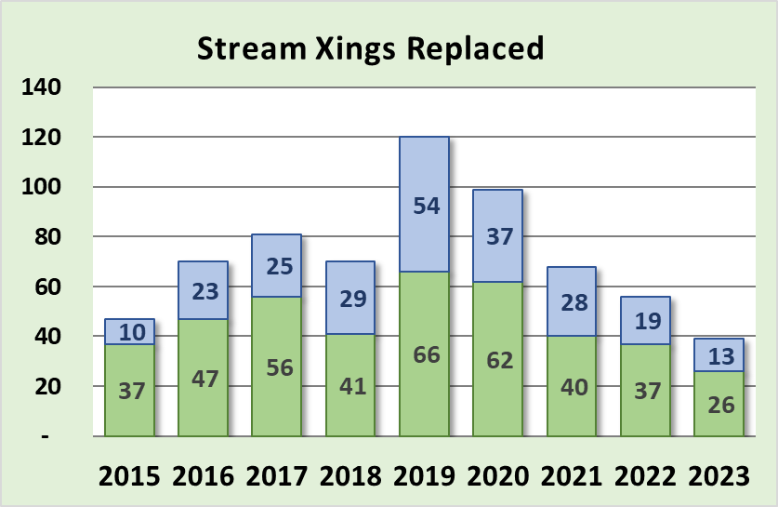
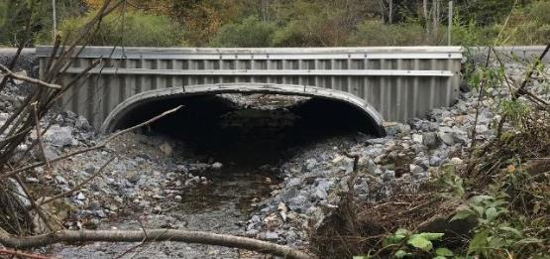
Annual Summary Report: Deliverables
Stream Crossing Replacements
Decreasing 5-year trend
39 replaced in 2023: all contracted pre-standard
More prevalent on LVRs
Improved data collected starting July ’19…
Paved Low-Volume
Dirt and Gravel
standard
www.dirtandgravelroads.org

Slide 29
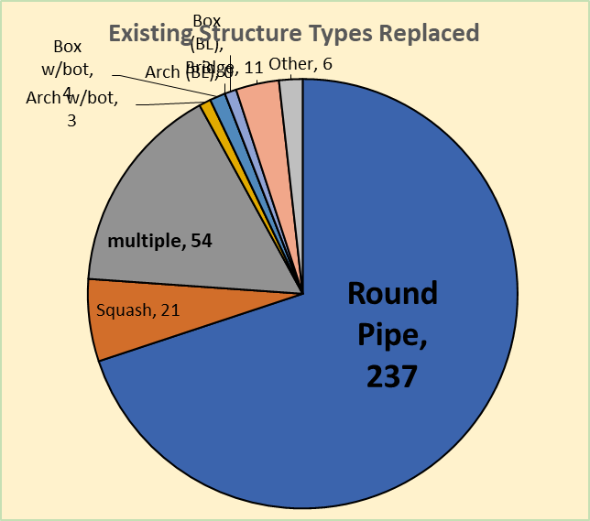
Annual Summary Report: Deliverables
Stream Crossing Replacements
339 replacements since July 2019
Old Structures: 70% were round pipes
www.dirtandgravelroads.org

Slide 30
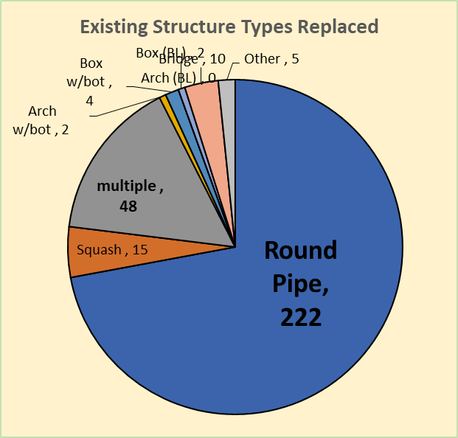
Annual Summary Report: Deliverables
Stream Crossing Replacements
339 replacements since July 2019
Old Structures: 70% were round pipes
New Structures:
Type
57% were squash or pipe arch (w/bottom)
27% were bottomless (arch/box/bridge)
www.dirtandgravelroads.org

Slide 31
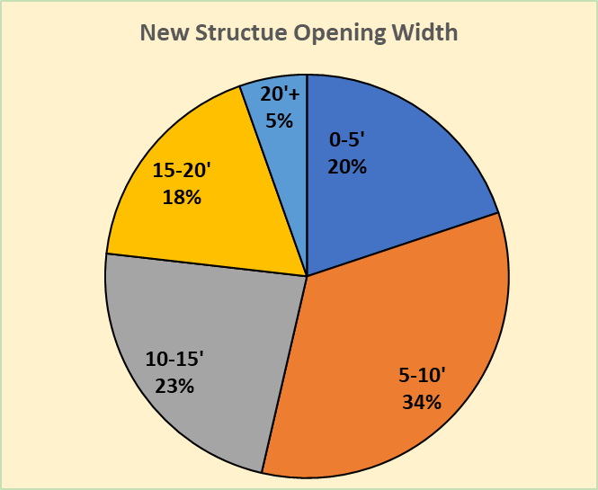
Annual Summary Report: Deliverables
Stream Crossing Replacements
339 replacements since July 2019
Old Structures: 70% were round pipes
New Structures:
Type
57% were squash or pipe arch (w/bottom)
27% were bottomless (arch/box/bridge)
Size:
54% less than 10’ opening
5% over 20’ opening
Average BF reported= 9.5’
Average new structure width = 11.2’ (118%)
www.dirtandgravelroads.org

Slide 32
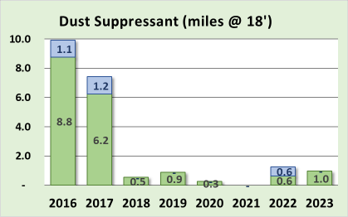
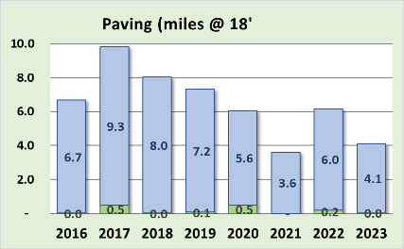
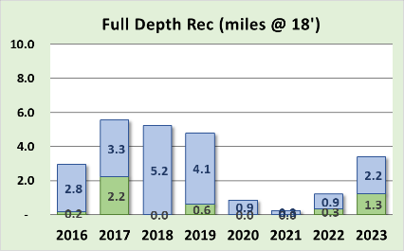
Annual Summary Report: Deliverables
Very Minor Players (even with in-kind)
Dust Suppressants: decreased to almost no use
Full Depth Reclamation: additional requirements in 2019 decreased use
Paving: most CDs only pay for what they disturb in fixing drainage. Note much of paving in graph below was in-kind.
Dirt and Gravel
Paved Low-Volume
www.dirtandgravelroads.org

Slide 33
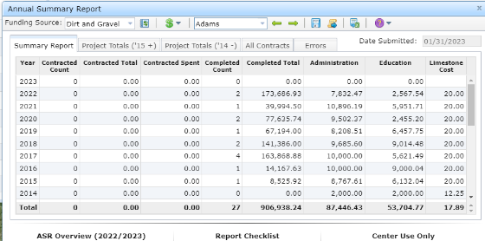
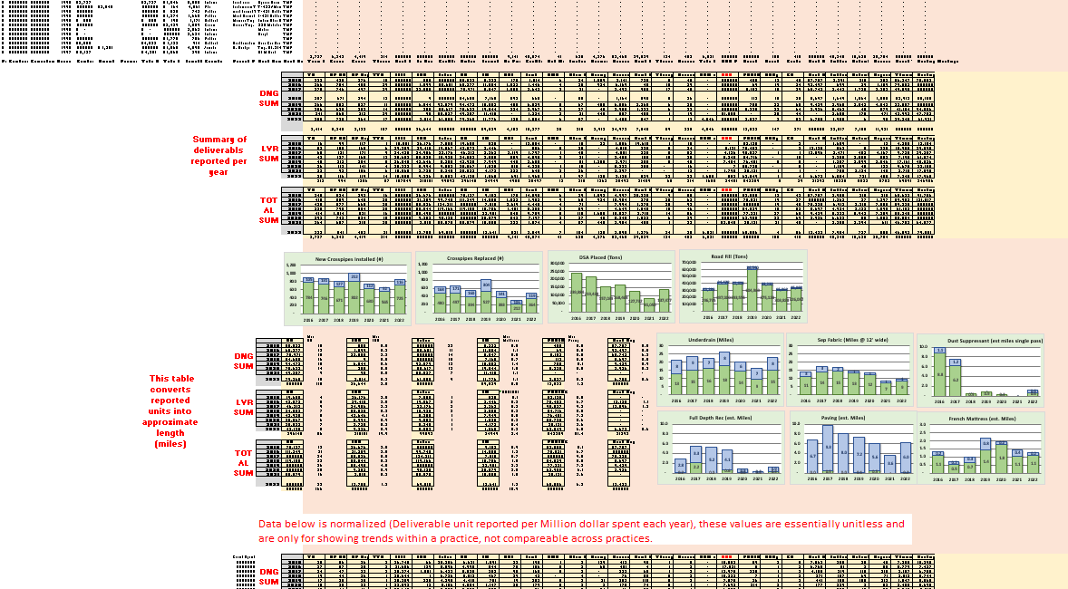
Annual Summary Report: Deliverables
Where did these numbers come from, and can I do this for my county?
www.dirtandgravelroads.org

Slide 34
Annual Summary Report: Deliverables
Where did these numbers come from, and can I do this for my county?
Numbers came straight from GIS
YES, you can do the same thing and more for your county
Two 2019 Webinars recorded
March 7, 2019
March 21, 2019
CDGRS – education and training – webinars – past webinars
www.dirtandgravelroads.org

Slide 35
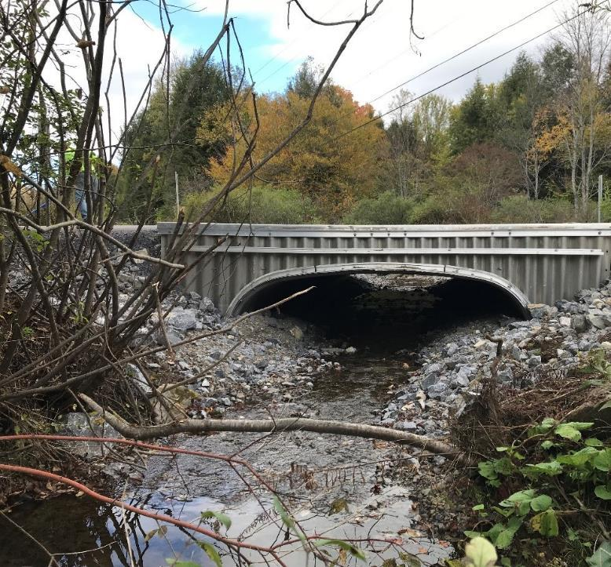
2023 Annual Summary Report
Annual Report: Financial
Annual Report: Deliverables
CD Financial Status

Slide 36
Annual Summary Report: CD Financial Status
Reminders / Overview
Allocations to CDs
$26.1 Million Annually
$130 Million through this 5-year agreement
At least 80% required to go to projects, ~90% does
CDs get ½ their allocation up front, other ½ remains in Hbg for replenishment
CDs receive DGLVR funds BEFORE they spend them
When spending is reported in quarterly reports, the 50% advance is replenished
Replenishments are different from reimbursements
www.dirtandgravelroads.org

Slide 37
Annual Summary Report: CD Financial Status
Reminders / Overview
CDs have two years to spend funding
Currently in FY 2023-24, year 1 of 5-year agreement between SCC and CDs
Funds from previous 5-year agreement must be spent by 6/30/2024
FY 2024-25 allocations will be taken to the SCC in July 2024 (after the spending deadline)
www.dirtandgravelroads.org

Slide 38
Annual Summary Report: Spending update (5-year)
Green: all funds from 2018-23 agreement have been spent
Yellow: all funds from 2018-23 agreement have been committed
Red: some funds from 2018-23 agreement have not been committed
(Committed = active contract in GIS)
If your “balance remaining” is more than your “committed remaining” in your GIS quarterly report, you are yellow or red
www.dirtandgravelroads.org

Slide 39
Annual Summary Report: Spending update (5-year)
Data as of 3/7/24
www.dirtandgravelroads.org

Slide 40
Annual Summary Report: Spending update (5-year)
Question:
What do you consider “spent”?
Answer:
Spent: when DGLVR Funds leave your Program account
An admin/edu expense has been paid with Program funds and reported in quarterly report
A check has been written to the grant recipient and entered in GIS
Advances, partial payments, final payments
www.dirtandgravelroads.org

Slide 41
Annual Summary Report: Spending update (5-year)
Question:
What if funds are not spent by 6/30/24?
Answer:
Per conditions of the existing 5-year agreement (section 1.3): “…the funds will revert back to the control of the Commission for future apportionments, or the District may, at the discretion of the Commission, be ineligible for future allocations, or the amount of such funds may be deducted from any future apportionment to the District.”
www.dirtandgravelroads.org

Slide 42
Annual Summary Report: Spending update (5-year)
Contact Roy, Sherri, Andy, and Ken to discuss
www.dirtandgravelroads.org
https://clipart-library.com/phone-call-cliparts.html

Slide 43
Annual Summary Report: Spending update (5-year)
Reminders:
No webinar next week (SE admin training)
Looking for comments on new hire guide
2024 Webinars
February 29: New Hire Guide for CD DGLVR Technicians
Staffing turnover at conservation districts can cause significant disruptions to CD projects and programs. The Center has worked with the SCC to develop a “New Hire Guide” for new Conservation District DGLVR Technicians to facilitate their orientation to the Program. This webinar reviewed the new guide which will be made available.
Webinar Download (99.8 MB): MP4 format (~45 minutes)
Presentation Downloads:
Adobe PDF (1.33 MB)
MS Powerpoint (1.28 MB)

Slide 44
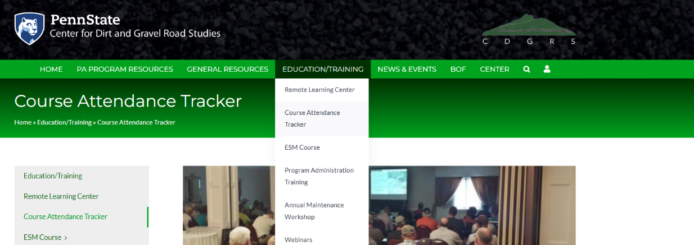
Annual Summary Report: Spending update (5-year)
Reminder: Course Attendance Tracker

Slide 45
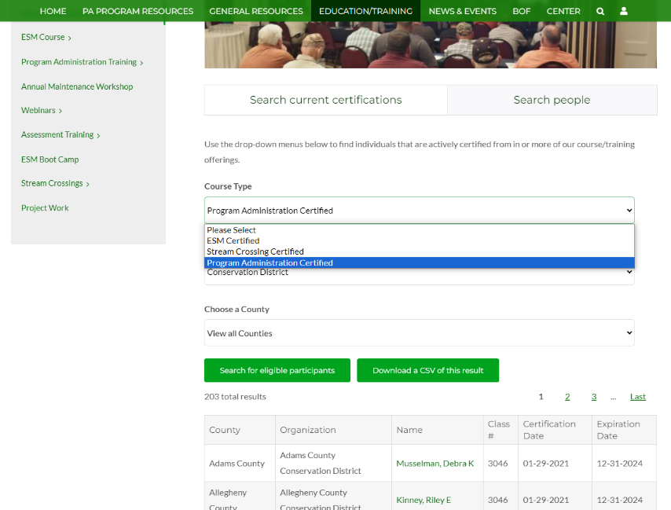
Annual Summary Report: Spending update (5-year)
Reminder:
Course Attendance
Tracker
Search Certifications:
ESM
Stream Training
Admin Training

Slide 46
Annual Summary Report: Spending update (5-year)
Reminders:
No webinar next week (SE admin training)
Looking for comments on new hire guide
2024 Webinars
February 29: New Hire Guide for CD DGLVR Technicians
Staffing turnover at conservation districts can cause significant disruptions to CD projects and programs. The Center has worked with the SCC to develop a “New Hire Guide” for new Conservation District DGLVR Technicians to facilitate their orientation to the Program. This webinar reviewed the new guide which will be made available.
Webinar Download (99.8 MB): MP4 format (~45 minutes)
Presentation Downloads:
Adobe PDF (1.33 MB)
MS Powerpoint (1.28 MB)

