Slide 1



Dirt Gravel and Low Volume Road Program
WEBINAR
CDGRS Annual Summary Report Training
Survey Results
ESM Trainings
Webinars
Longer Remote Trainings
Online training Center
Winter Tech Assists
1/7/21 Starts at 9am
If you are reading this, then you are successfully seeing the webinar video. Webinar audio should be automatic through your computer (or click “join audio”), and options can be accessed in the “audio options” button on the bottom left. If your computer audio is not working, you can listen on your phone by dialing 646-876-9923.

Slide 2
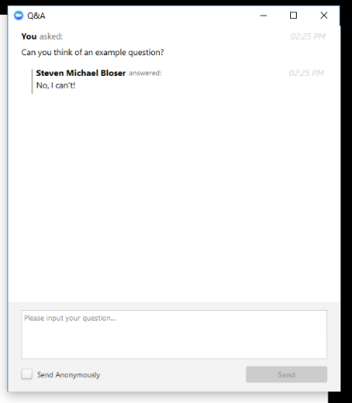
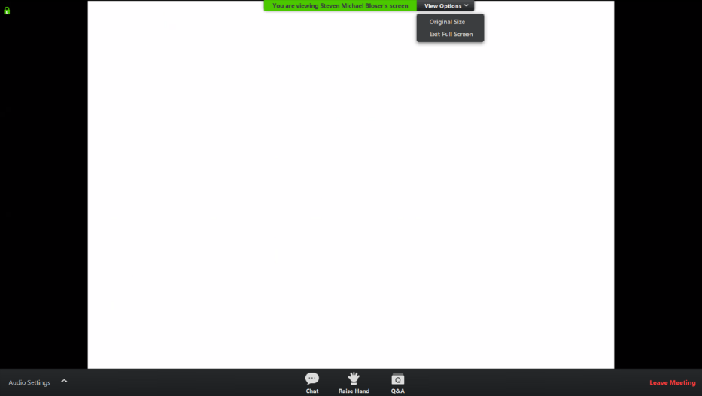
CDGRS Annual Summary Report Training
Note you can ask a question anonymously
Q&A
For audio via phone: 646-876-9923
2

Slide 3
CDGRS Annual Summary Report Training
Required Steps
Verify that the GIS and Local Balances match
  For both DGR and LVR
  They MUST match before moving to Step 2

Slide 4
CDGRS Annual Summary Report Training
Required Steps
Submit the October – December Quarter
  Roy must accept the report before the ASR can be submitted

Slide 5
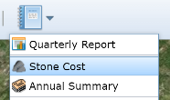
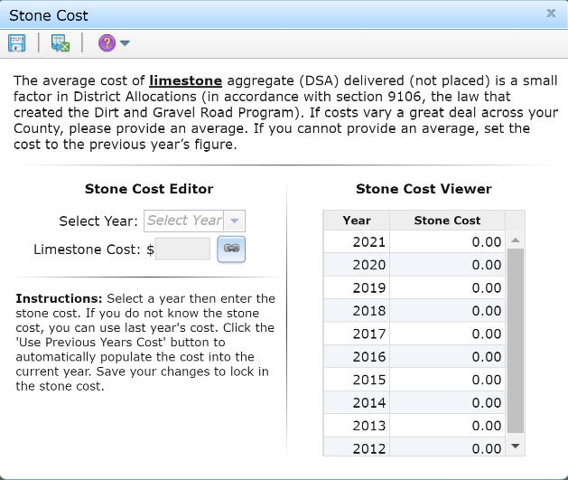
CDGRS Annual Summary Report Training
Required Steps
Enter the Limestone Cost for 2020
  The average cost of limestone aggregate (DSA) delivered (not placed)
Note that this slide was modified after the presentation’s conclusion to include DSA in the description of limestone aggregate.

Slide 6
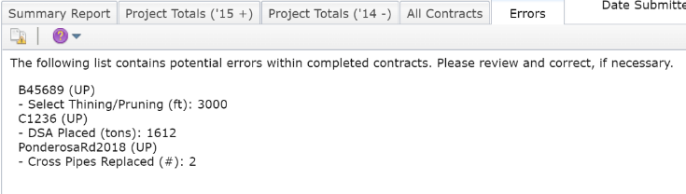
CDGRS Annual Summary Report Training
Required Steps
Check and fix any contract Errors

Slide 7
CDGRS Annual Summary Report Training
Required Steps
Verify the information present in the ASR
  Financials for each Program
  Project totals for each completed Funded Site

Slide 8
CDGRS Annual Summary Report Training
Required Steps
Submit the Annual Summary Report
  All check boxes need to be checked before you can submit
  Emails will be sent upon Submit and Accept

Slide 9
CDGRS Annual Summary Report Training
Report Due January 15

Slide 10
CDGRS Annual Summary Report Training
Photo Contest
  Typically held at annual workshop in fall.
  Planning to hold one over winter to create April 2021 to March 2022 DGLVR calendar
  Submit to Amy (alp90@psu.edu)
    Before Picture
    After Picture
    Project description, 200 word max

Slide 11
Dirt Gravel and Low Volume Road Program
WEBINAR
CDGRS Annual Summary Report Training
Survey Results
ESM Trainings
Webinars
Longer Remote Trainings
Online training Center
Winter Tech Assists
QUESTIONS ?

