Slide 1
DGLVR Webinar
CDGRS Annual Summary Report
Training
1/8/2020
Starts at 9am
If you are reading this, then you are successfully seeing the webinar video. Webinar audio should be automatic through your computer, and options can be accessed in the “audio options” button on the bottom left. If you are having audio issues, or are in a location where listening via phone is preferable, audio is also available on the CDGRS conference line at: 866-823-7699.
For technical assistance, call: 814-865-5355

Slide 2
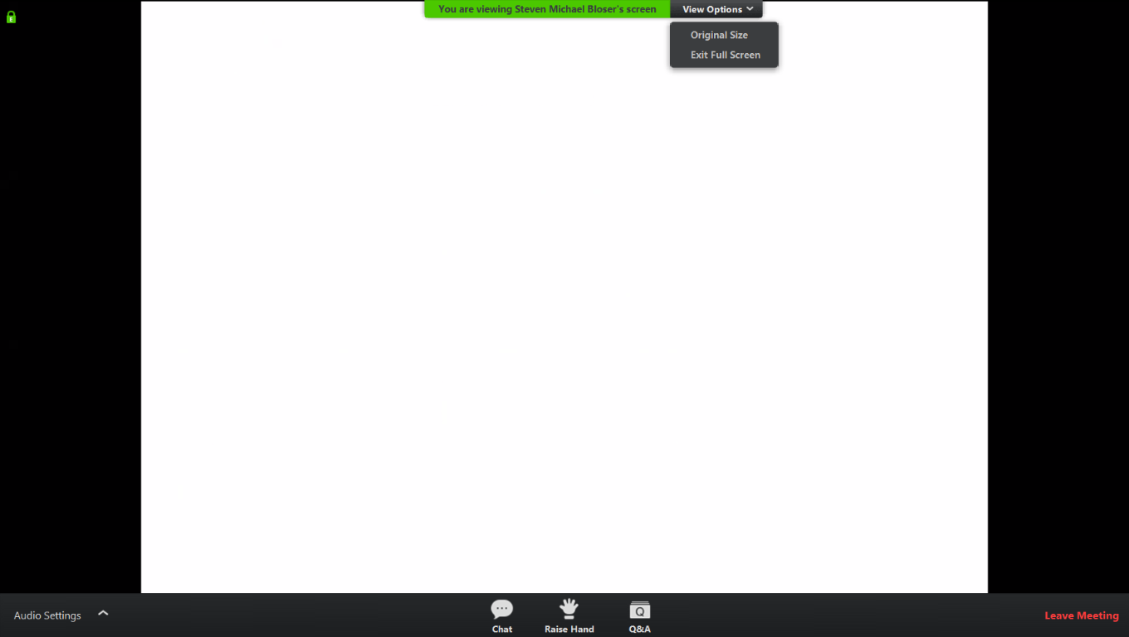
Q&A
Note you can ask a question anonymously
Q&A
For audio via phone: 866-823-7699
For technical assistance: 814-865-5355

Slide 3
Annual Summary Report Training
Required Steps
Submit the October – December Quarter
Roy must accept the report before the ASR can be submitted
Enter the Limestone Cost for 2019
Verify the information present in the ASR
Financials for each Program
Project totals for each completed Funded Site
New Stream Crossing data is included
Submit the Annual Summary Report
Once submitted, an email will be sent to Ken Corradini with the submitter cc’d
Once accepted, an email will be sent the submitter with the Ken Corradini cc’d
Report Due January 15

