Slide 1
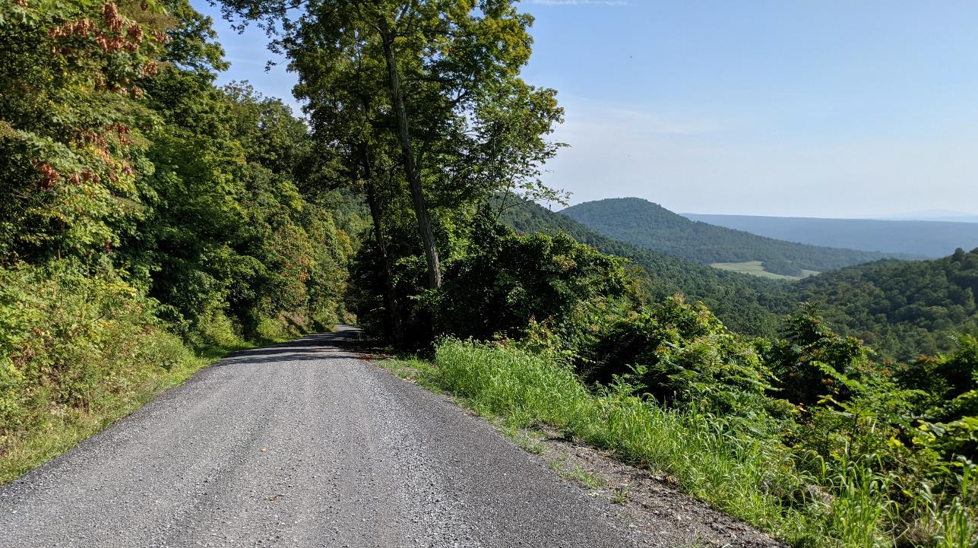
Dirt Gravel and Low Volume Road Program
Administrative Manual
Proposed Updates
3/10/2022
Roy Richardson: SCC
rrichardso@pa.gov
Justin Challenger: SCC
jchallenge@pa.gov
Sherri Law: SCC
shlaw@pa.gov
Steve Bloser: CDGRS
smb201@psu.edu
If you are reading this, then you are successfully seeing the webinar video. Webinar audio should be automatic through your computer (or click “join audio”), and options can be accessed in the “audio options” button on the bottom left. If your computer audio is not working, you can listen on your phone by dialing 646-876-9923.

Slide 2
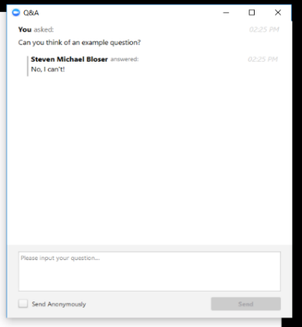
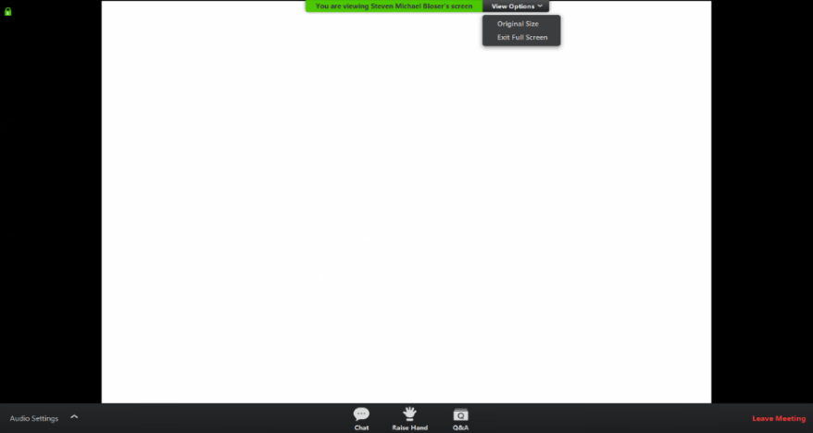
Webinar Logistics
WEBINAR IS BEING RECORDED
Note you can ask a question anonymously
Q&A
For audio via phone: 312-626-6799

Slide 3
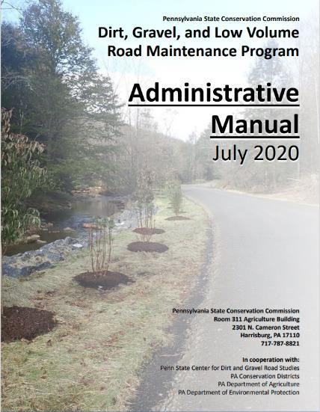
Administrative Manual
DGLVR Administrative Manual
Approved 7/2020
Introduction
SCC Role
Conservation District Role
Quality Assurance Board Role
Applicant Role
Center for Dirt and Gravel Roads
Additional Policies
Permits and Other Requirements
Appendices

Slide 4
Administrative Manual
DGLVR Administrative Manual
Introduction - unchanged
SCC Role
Conservation District Role
Quality Assurance Board Role
Applicant Role
Center for Dirt and Gravel Roads
Additional Policies
Permits and Other Requirements
Appendices
Introduction
6-page “Abstract” of the Program and the rest of the manual.
Program Structure
Program History
ESM Overview

Slide 5
Administrative Manual
DGLVR Administrative Manual
Introduction
SCC Role - updated QAQC description
Conservation District Role
Quality Assurance Board Role
Applicant Role
Center for Dirt and Gravel Roads
Additional Policies
Permits and Other Requirements
Appendices
2) SCC Role
4-page summary of SCC role
SCC Structure
Program Administration
QAQC

Slide 6
Administrative Manual
Chapter 2
DRAFT
Updated QAQC Description
Revised section to be consistent with updated QAQC process
1 or 2 day visit to the District
Interviews of staff and QAB can be held virtually prior to in person visit
Will send packet of information outlining process well ahead of your QAQC visit

Slide 7
Administrative Manual
DGLVR Administrative Manual
Introduction
SCC Role
Conservation District Role
Clearer wording in various places
Drone policy
Updated section on cost allocation methods
Contract amendments up to 40% of contract amount
clarification on training offerings, including stream crossing trainings
Update to consultant/engineering fees section (TBD)
Updates to GIS/reporting section
(partly covered in webinar 3/4/22)
3) Conservation District Role
Over ½ of manual
Receiving Funds
Accounting for Funds
Dispersing Funds to Grantees
CD Educational Opportunities
Program Eligibility
Administering Projects
GIS system
Annual Reports

Slide 8
Administrative Manual
Chapter 3
DRAFT
Guidelines for Administrative Expenditures
Salary is an eligible administrative expense.
This includes technical staff, support staff, and management salaries related to administering the Program.
Example administration activities include paperwork, communications, site inspections, meetings, etc. related to DGLVR Projects that have a contract for DGR or LVR project funding.

Slide 9
Administrative Manual
Chapter 3
DRAFT
Education funds can be used for drones
Some districts may choose to use drones to take project pictures, video, and create educational materials. Note that districts using drones for any program are subject to the SCC’s “Conservation District Drone Utilization Policy”.

Slide 10
Administrative Manual
Chapter 3
DRAFT
Cost allocation Method for Shared Expenses
Some conservation district expenses, such as vehicles, rent, and office expenses, are shared between the DGLVR Program and other programs or funding sources. A portion of shared expenses may be eligible DGLVR administrative and/or education expenses, as detailed below:
The percent of shared expenses that are eligible DGR expenses are equal to the percent of staff time spent on DGR activities.
The percent of staff time spent on DGR activities must be calculated compared to the total staff time spent on all programs/activities sharing the expense.
The percent of shared expenses that are eligible LVR expenses are equal to the percent of staff time spent on LVR activities.
The percent of staff time spent on LVR activities must be calculated compared to the total staff time spent on all programs/activities sharing the expense.

Slide 11
Administrative Manual
Chapter 3
DRAFT
Cost allocation Method for Shared Expenses CONTINUED
Salaries and associated benefits can only be paid for with DGLVR funds for time spent working directly on the DGLVR Program. Tracking can be done on an hourly basis, a percent effort basis, or some other method that allocates salary in accordance with time spent on the DGLVR Program.
Salary and benefits for time spent on DGR activities are to be paid for with DGR funds.
Salary and benefits for time spent on LVR activities are to be paid for with LVR funds.
If a conservation district chooses to divide salaries on a percent basis, then:
the percent of a staff member’s salaries and benefits paid for with DGR funds must be proportionate to the amount of time that staff member spends on DGR activities out of the staff member’s total hours in a given time period.
The percent of a staff member’s salaries and benefits paid for with LVR funds must be proportionate to the amount of time that staff member spends on b activities out of the staff member’s total hours in a given time period.

Slide 12
Administrative Manual
Chapter 3
Cost allocation Method for Shared Expenses CONTINUED
The conservation district must keep and be able to provide documentation to the SCC of time spent on DGR and LVR activities as part of the administration and education funding record-keeping. (7 years)
Examples of cost allocation methods that meet the policy outlined above are available in appendix TBD. These are not the only acceptable cost allocation methods. For assistance in developing a cost allocation method, contact the SCC.
DRAFT

Slide 13
CAM examples for Admin Manual
Proposed Appendix
DRAFT
Example 3: If a district has a vehicle that is shared unequally by several programs, vehicle expenses or charges must be based on actual usage for each Program.

Slide 14
CAM examples for Admin Manual
Proposed Appendix
DRAFT
Cost Allocation Method Example 3:
Vehicle shared unequally by multiple programs
5% of use is for DGR
8% of use is for LVR
How shared expenses are paid:
5% are eligible DGR expenses
8% are eligible LVR expenses
87% are NOT eligible DGLVR expenses
87% of use is for Other Program(s)

Slide 15
CAM examples for Admin Manual
Proposed Appendix
Example 3:
Vehicle is used for 500 miles in a quarter. 52 of those miles were for DGR activities, and 110 were for LVR activities.
Eligible DGR mileage expense = 52 x $0.58 (or other acceptable mileage rate) = $30.16
Eligible LVR mileage expense = 110 x $0.58 (or other acceptable mileage rate) = $63.80
How much of a $50 oil change is eligible for reimbursement with DGR and LVR funds?
DGR: 52 = 0.104 $50 x 0.104 =$5.20 of the oil change is an eligible DGR expense
500
LVR: 110 = 0.22 $50 x 0.22 = $11.00 of the oil change is an eligible LVR expense
500

Slide 16
Administrative Manual
Chapter 3
DRAFT
Contract Amendments
In some cases, the grant recipient may request additional time or addition funding above the contracted amount to complete a project. The approval of additional time or funding to a contract is at the discretion of the district board, based either on a case by case basis or by county policy. Districts may develop their own policies for handling cost overruns and time extensions, provided they are consistent with Commission policy. It is up to the discretion of the conservation district board if amendments to existing contracts must be recommended by the QAB. There is no additional funding from the Commission to pay for cost overruns.

Slide 17
Administrative Manual
Chapter 3
DRAFT
Contract Amendments
For cost overruns totaling 20 40 percent or less of the initial contract amount, a contract amendment must be completed and signed by both entities (available at www.dirtandgravelroads.org). Multiple amendments may be granted, provided the total of all amendments is not more than 20 40 percent of the initial contract amount. Amendments must be approved by the district board according to policies they establish. For cost overruns totaling more than 20 percent of the initial contract amount, a second separate contract must be made for the additional funds. For contract amendments over 40 percent, written approval is required from the State Conservation Commission.

Slide 18
Administrative Manual
Chapter 3
GIS
In order to submit quarterly reports, the following must be completed:
all income (advances, replenishments, interest) and expenses (project, administrative, and educational) for the quarter must be entered into the GIS system.
Local and GIS account balances must match before the quarterly report is submitted each quarter.
Information on contracted projects is also required, including checking that all open contracts are in good standing and are not expired. The GIS includes a contract verifier tool that can be used during this process. (topic of 3/4/2022 webinar)
Complete the summary of Program activities from district staff for the quarter.
The Conservation District Manager, or their approved designee, is required to submit the report.

Slide 19
Administrative Manual
DGLVR Administrative Manual
Introduction
SCC Role
Conservation District Role
Quality Assurance Board Role – minor clarification on Sunshine Act
Applicant Role
Center for Dirt and Gravel Roads
Additional Policies
Permits and Other Requirements
Appendices
4) QAB Role
Defines composition and function of QAB
Composition
Meeting Requirements
QAB Role in Projects
QAB Role in Policy

Slide 20
Administrative Manual
DGLVR Administrative Manual
Introduction
SCC Role
Conservation District Role
Quality Assurance Board Role
Applicant Role – will be updated to match other updates
Center for Dirt and Gravel Roads
Additional Policies
Permits and Other Requirements
Appendices
5) Applicant Role
Intentionally repeats previous material
Written “to” the applicant audience
Intended to be standalone to give to applicants.

Slide 21
Administrative Manual
DGLVR Administrative Manual
Introduction
SCC Role
Conservation District Role
Quality Assurance Board Role
Applicant Role
Center for Dirt and Gravel Roads – unchanged
Additional Policies
Permits and Other Requirements
Appendices
6) Center Role
3-page overview of Center role and available services
Education
Outreach
Technical Assistance
Documentation

Slide 22
Administrative Manual
DGLVR Administrative Manual
Introduction
SCC Role
Conservation District Role
Quality Assurance Board Role
Applicant Role
Center for Dirt and Gravel Roads
Additional Policies
Stream crossing updates
DSA updates
Fill Policy update
Sealed surface update
8) Permits and Other Requirements
Appendices
7) Additional Policies
Policies that apply to certain circumstances:
Stream Crossing Replacement
Driving Surface Aggregate
Paved LVR-Specific Policies
Full Depth Reclamation

Slide 23
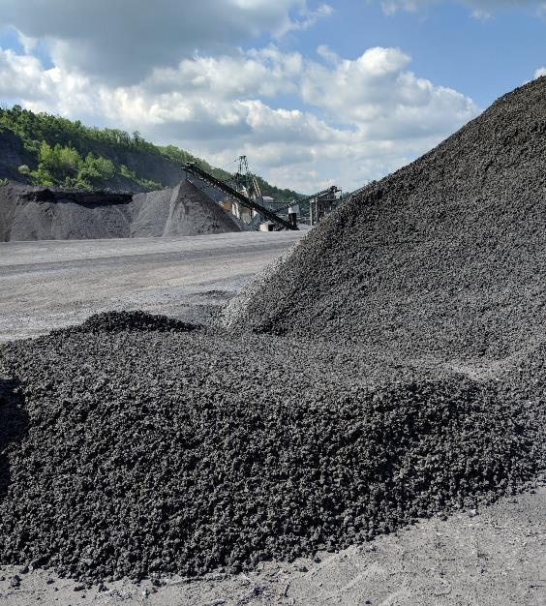
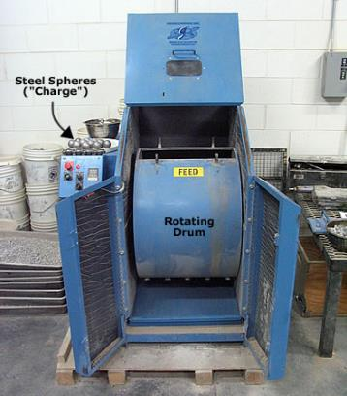
Administrative Manual
DSA Standard
DSA Standard updates
Abrasion Resistance: The loss of mass (LA Abrasion) shall be less than 40% 45%.
https://pavementinteractive.org/reference-desk/testing/aggregate-tests/los-angeles-abrasion/

Slide 24
Administrative Manual
DSA Request for Quote
RFQ updated (not policy)
updated DSA Specification language incorporated
Clarifications of which parts can be edited vs which parts are required/in the specification
added: Roller to be:
Double drum roller equipped with functional spray bars and scrapers.
Single drum dirt roller <single drum not preferred but may be needed on sites with steep banks or hills – edit RFQ to specify allowed rollers>).
Added: Equipment must be on-site to cut paving notches and/or repair damaged ditches or road sections (e.g., skid steer, backhoe).

Slide 25
Administrative Manual
Chapter 7
Fill Policy updated
Driving surface aggregate meeting the Commission’s specification is the only approved road surface material that may be purchased (for DGR projects) with Program funds. The only exception to this is on road fill projects. Road fill projects are defined as projects which install an average compacted thickness of 12-inches or more of fill material, not including the driving surface, to allow for proper drainage and/or strengthen the existing road base. Road fill projects must be capped with DSA or an alternative aggregate at a minimum depth of 6-inches. Shale or bank-run gravel may not be used as the final driving surface. This exception is not meant to replace DSA with fill.

Slide 26
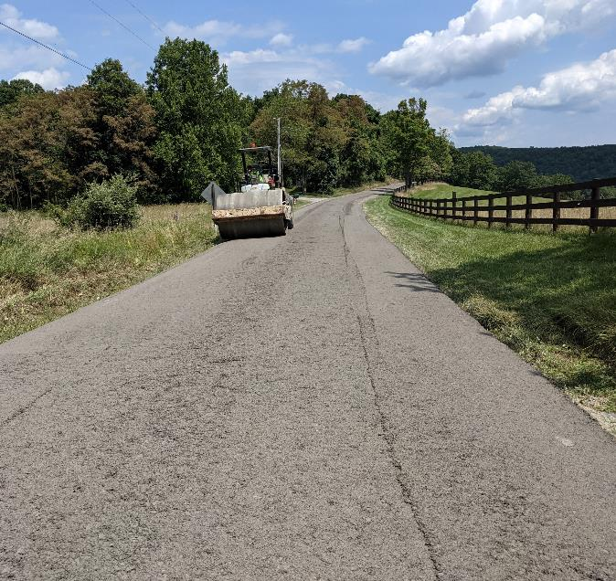
Administrative Manual
Chapter 7
Fill Policy updated
Unchanged:
Driving surface aggregate meeting the Commission’s specification is the only approved road surface material that may be purchased (for DGR projects) with Program funds.

Slide 27
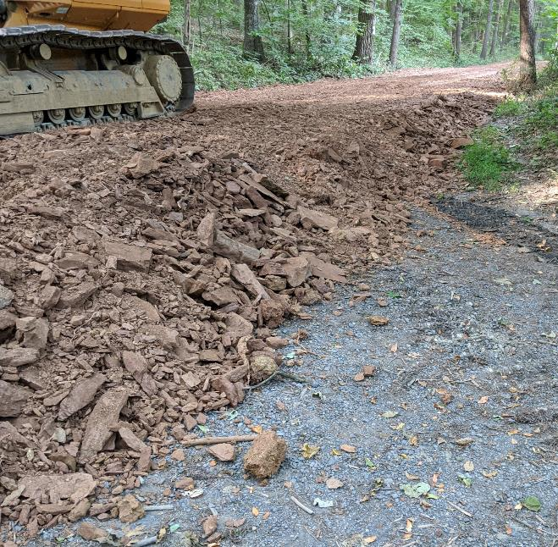
Administrative Manual
Chapter 7
Fill Policy updated
The only exception to this is on road fill projects. Road fill projects are defined as projects which install an average compacted thickness of 12-inches or more of fill material, not including the driving surface, to allow for proper drainage and/or strengthen the existing road base.

Slide 28
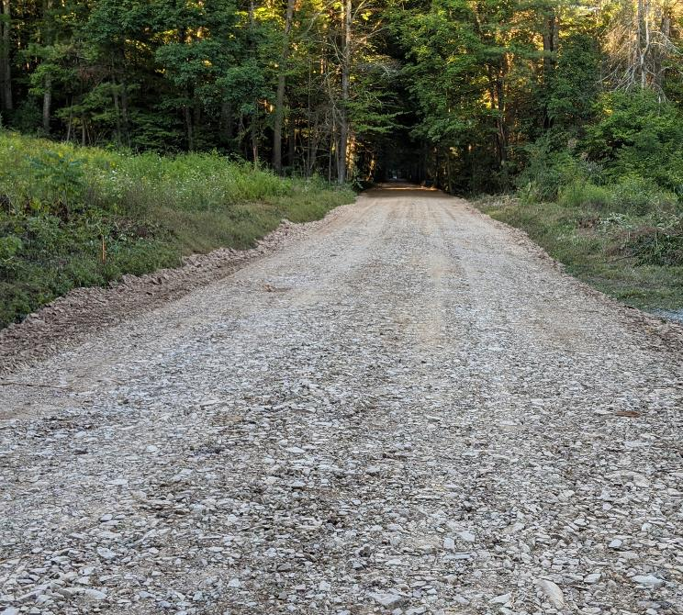
Administrative Manual
Chapter 7
Fill Policy updated
Road fill projects must be capped with DSA or an alternative aggregate at a minimum depth of 6-inches. Shale or bank-run gravel may not be used as the final driving surface. This exception is not meant to replace DSA with fill.
Shale is not an eligible driving surface

Slide 29
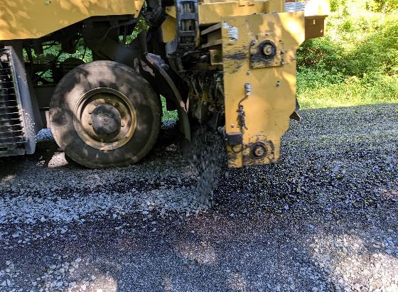
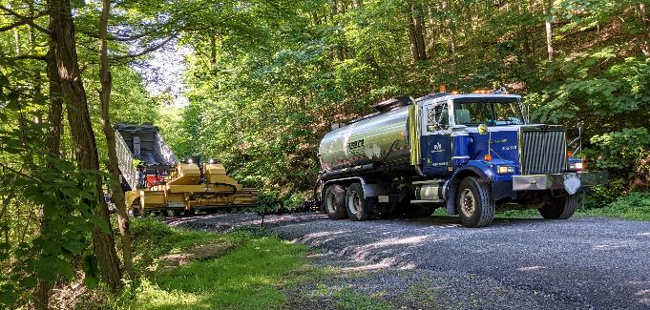
Administrative Manual
Chapter 7
Asphalt and Chip seal are the only paving or sealing materials approved for the use with Program funds and must conform to PennDOT Pub 408 or Pub 447. Note that the use of petroleum solvent based “cutback asphalts” such as MC-30 and MC-70 and NOT allowed for use in the Program.
Pictures of chip seal application

Slide 30
Administrative Manual
DGLVR Administrative Manual
Introduction
SCC Role
Conservation District Role
Quality Assurance Board Role
Applicant Role
Center for Dirt and Gravel Roads
Additional Policies
8) Permits and Other Requirements - unchanged
Appendices
8) Permits and Other Requirements
Brief overview of permit issues related to Program projects.

Slide 31
Administrative Manual
DGLVR Administrative Manual
Introduction
SCC Role
Conservation District Role
Quality Assurance Board Role
Applicant Role
Center for Dirt and Gravel Roads
Additional Policies
8) Permits and Other Requirements
Appendices - add Cost Allocation Method examples
Appendices
Appendix A: Dirt, Gravel, and Low-Volume Road Program Law 9106
Appendix B: Commission Statement of Policy
Appendix C: Contract and Attachments
Appendix D: Contract Amendment
Appendix E: Stream Crossing Replacement Evaluation
Appendix F: Traffic Count Validation and Instructions
Appendix G: Project Completion Report and Instructions
Appendix H: Definitions and Acronyms

Slide 32
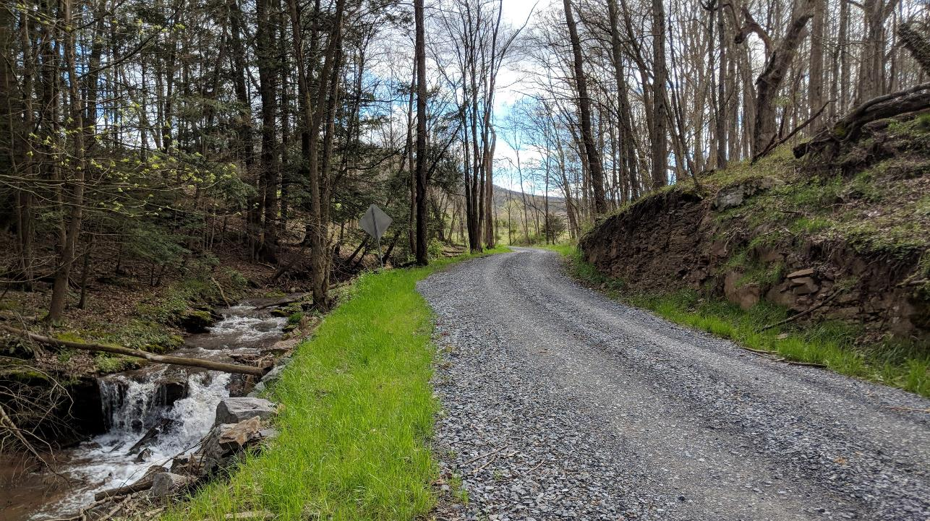
Questions?

