Slide 1
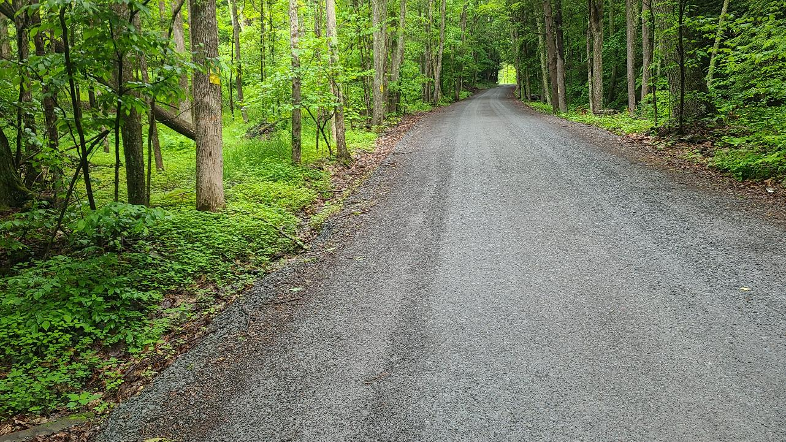
DGLVR Program
Administrative Manual Updates
June 02, 2022
Sherri Law
State Conservation Commission
Justin Challenger
State Conservation Commission
If you are reading this, then you are successfully seeing the webinar video. Webinar audio should be automatic through your computer (or click “join audio”), and options can be accessed in the “audio options” button on the bottom left. If your computer audio is not working, you can listen on your phone by dialing 646-876-9923.

Slide 2
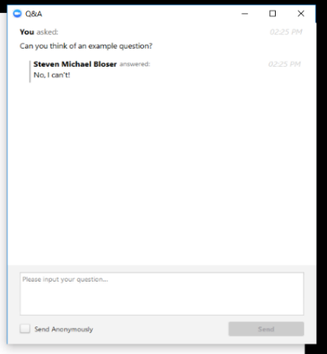
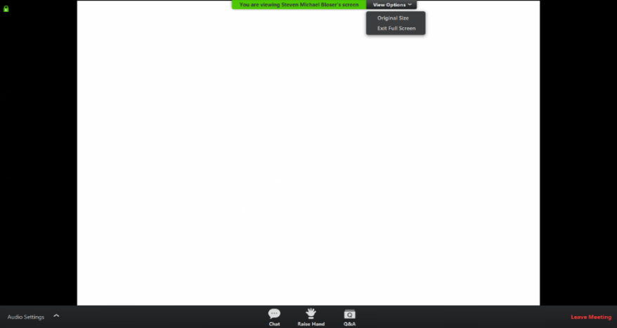
Webinar Logistics
WEBINAR IS BEING RECORDED
Note you can ask a question anonymously
Q&A
For audio via phone: 646-876-9923

Slide 3
Administrative Manual
Policy changes are effective for all contracts signed on or after
July 1st, 2022

Slide 4
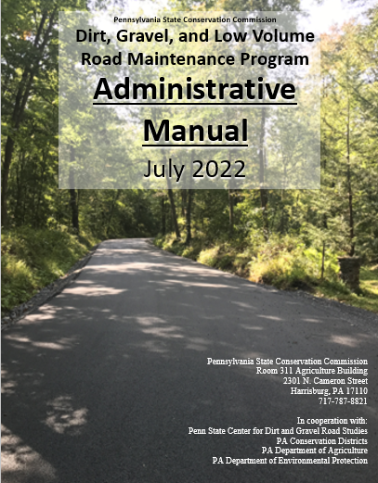
Administrative Manual
DGLVR Administrative Manual
Introduction
SCC Role
Conservation District Role
Quality Assurance Board Role
Applicant Role
Center for Dirt and Gravel Roads
Additional Policies
Permits and Other Requirements
Appendices

Slide 5
Administrative Manual
DGLVR Administrative Manual
Introduction - unchanged
SCC Role
Conservation District Role
Quality Assurance Board Role
Applicant Role
Center for Dirt and Gravel Roads
Additional Policies
Permits and Other Requirements
Appendices
Introduction
6-page “Abstract” of the Program and the rest of the manual.
Program Structure
Program History
ESM Overview

Slide 6
Administrative Manual
DGLVR Administrative Manual
Introduction
SCC Role - updated QAQC description
Conservation District Role
Quality Assurance Board Role
Applicant Role
Center for Dirt and Gravel Roads
Additional Policies
Permits and Other Requirements
Appendices
2) SCC Role
4-page summary of SCC role
SCC Structure
Program Administration
QAQC

Slide 7
Administrative Manual
Chapter 2
Updated QAQC Description
Revised section to be consistent with updated QAQC process
Generally, a 1- or 2-day visit to the District
Interviews of staff and QAB can be held virtually prior to in person visit
Site visit to review projects completed since previous QAQC visit (previous 3 years)
Will send packet of information outlining process well ahead of your QAQC visit

Slide 8
Administrative Manual
DGLVR Administrative Manual
Introduction
SCC Role
Conservation District Role
Clearer wording in various places
Drone policy
Updated section on cost allocation methods
Contract amendments up to 40% of contract amount
clarification on training offerings, including stream crossing trainings
Update to consultant/engineering fees section
Updates to GIS/reporting section
(partly covered in webinar 3/4/22)
3) Conservation District Role
Over ½ of manual
Receiving Funds
Accounting for Funds
Dispersing Funds to Grantees
CD Educational Opportunities
Education/Training by CDs
Program Eligibility
Administering Projects
GIS system
Quarterly Reports
Annual Reports

Slide 9
3.4.3 Administrative Funds
Chapter 3
Guidelines for Administrative Expenditures
Salary is an eligible administrative expense.
This includes technical staff, support staff, and management salaries related to administering the Program.
Example administration activities include:
site inspections, meetings, completing paperwork, communications, etc. related to DGLVR Projects.
QAB meetings and Conservation District Board of Director meetings
Reviewing DGLVR applications
Red Text shows wording changes to the DGLVR Admin Manual (effective 7/1/2022)

Slide 10
3.4.3 Administrative Funds
Chapter 3
Documenting Staff Time – Admin Funds
Salaries can only be claimed for time spent working directly on the DGLVR Program. Tracking can be done on an hourly basis, a percent effort basis, or some other method that allocates salary in accordance with time spent on the Program.
Conservation districts must be able to document that staff time claimed as administrative time is spent on eligible administrative activities. This should be a time sheet and/or report that includes details of the activity, including the date, activity description, staff member(s), amount of time, road name, road owner, and how the activity qualifies as a DLGVR educational activity, or some other method that documents that administrative time is spent on eligible administrative activities.
Red Text shows wording changes to the DGLVR Admin Manual (effective 7/1/2022)

Slide 11
3.4.4 Education Funds
Chapter 3
Salary is an eligible education expense.
This includes technical staff, support staff, and management salaries related to DGLVR educational activities.
DGLVR educational activities include:
attending or hosting trainings, conferences, field days, workshops, technical assistance, or other outreach activities.
Teaching individuals or small groups about the DGLVR Program in regard to potential DGLVR Project sites without a current contract for DGLVR funds. This includes working with potential grant applicants to develop an application for DGLVR funds, such as pre-application meetings.
DGLVR educational activities do NOT include:
Administering DGLVR Projects with a current DGLVR Contract
Administering the DGLVR Program, including QAB meetings, Conservation District Board of Director meetings, and reviewing DGLVR applications
Red Text shows wording changes to the DGLVR Admin Manual (effective 7/1/2022)

Slide 12
3.4.4 Education Funds
Chapter 3
Education funds can be used for drones
Some districts may choose to use drones to take project pictures, video, and create educational materials. Note that districts using drones for any program are subject to the SCC’s “Conservation District Drone Utilization Policy”.
Red Text shows wording changes to the DGLVR Admin Manual (effective 7/1/2022)

Slide 13
3.4.4 Education Funds
Chapter 3
Documenting Staff Time – Edu Funds
Salaries can only be claimed for time spent working directly on education efforts for the DGLVR Program. Tracking can be done on an hourly basis, a percent effort basis, or some other method that allocates salary in accordance with time spent on the Program.
Conservation districts must be able to document that staff time claimed as educational time is spent on eligible educational activities. This should be a time sheet and/or report that includes details of the activity, including the date, activity description, staff member(s), amount of time, road name, road owner, and how the activity qualifies as a DLGVR educational activity, or some other method that documents that educational time is spent on eligible educational activities.
Red Text shows wording changes to the DGLVR Admin Manual (effective 7/1/2022)

Slide 14
3.4.2 Cost Allocation Method for Shared Expenses
Chapter 3
Cost allocation Method for Shared Expenses
Some conservation district expenses, such as vehicles, rent, and office expenses, are shared between the DGLVR Program and other programs or funding sources. A portion of shared expenses may be eligible DGLVR administrative and/or education expenses, as detailed below:
The percent of shared expenses that are eligible DGR expenses are equal to the percent of staff time spent on DGR activities.
The percent of staff time spent on DGR activities must be calculated compared to the total staff time spent on all programs/activities sharing the expense.
The percent of shared expenses that are eligible LVR expenses are equal to the percent of staff time spent on LVR activities.
The percent of staff time spent on LVR activities must be calculated compared to the total staff time spent on all programs/activities sharing the expense.
Red Text shows wording changes to the DGLVR Admin Manual (effective 7/1/2022)

Slide 15
3.4.2 Cost Allocation Method for Shared Expenses
Chapter 3
Cost allocation Method for Shared Expenses CONTINUED
Salaries and associated benefits can only be paid for with DGLVR funds for time spent working directly on the DGLVR Program. Tracking can be done on an hourly basis, a percent effort basis, or some other method that allocates salary in accordance with time spent on the DGLVR Program.
Salary and benefits for time spent on DGR activities are to be paid for with DGR funds.
If a conservation district chooses to divide salaries on a percent basis, then:
the percent of a staff member’s salaries and benefits paid for with DGR funds must be proportionate to the amount of time that staff member spends on DGR activities out of the staff member’s total hours in a given time period.
Red Text shows wording changes to the DGLVR Admin Manual (effective 7/1/2022)

Slide 16
3.4.2 Cost Allocation Method for Shared Expenses
Chapter 3
Cost allocation Method for Shared Expenses CONTINUED
Salaries and associated benefits can only be paid for with DGLVR funds for time spent working directly on the DGLVR Program. Tracking can be done on an hourly basis, a percent effort basis, or some other method that allocates salary in accordance with time spent on the DGLVR Program.
Salary and benefits for time spent on LVR activities are to be paid for with LVR funds.
If a conservation district chooses to divide salaries on a percent basis, then:
The percent of a staff member’s salaries and benefits paid for with LVR funds must be proportionate to the amount of time that staff member spends on LVR activities out of the staff member’s total hours in a given time period.
Red Text shows wording changes to the DGLVR Admin Manual (effective 7/1/2022)

Slide 17
Administrative Manual
Chapter 3
Cost allocation Method for Shared Expenses CONTINUED
The conservation district must keep and be able to provide documentation to the SCC of time spent on DGR and LVR activities as part of the administration and education funding record-keeping. (7 years)
Examples of cost allocation methods that meet the policy outlined above are available in appendix E. These are not the only acceptable cost allocation methods. For assistance in developing a cost allocation method, contact the SCC.
Red Text shows wording changes to the DGLVR Admin Manual (effective 7/1/2022)

Slide 18
CAM examples for Admin Manual
Appendix E
Cost Allocation Method Example 1:
1.5 out of 10 FTEs spent on DGLVR

Slide 19
CAM examples for Admin Manual
Appendix E
Cost Allocation Method Example 1:
1.5 out of 10 FTEs spent on DGLVR
15% of overall staff time spent on DGLVR
How shared expenses are paid:
15% of shared expenses are eligible DGLVR expenses
85% of shared expenses are NOT eligible DGLVR expenses
85% of overall staff time NOT spent on DGLVR

Slide 20
CAM examples for Admin Manual
Appendix E
Cost Allocation Method Example 1:
Example (continued)
1.5 out of 10 FTEs spent on DGLVR Program
Then 15% of general overhead expenses (utilities, rent, etc.) can be charged to DGLVR Program
Should be further sub-divided into DGR and LVR
75% of DGLVR time is spent on DGR
25% of DGLVR time is spent on LVR
So,
15% x 0.75 = 11.25% of shared expenses are eligible DGR expenses
15% x 0.25 = 3.75% of shared expenses are eligible LVR expenses

Slide 21
CAM examples for Admin Manual
Appendix E
Cost Allocation Method Example 1:
1.5 out of 10 FTEs spent on DGLVR
15% of overall staff time spent on DGLVR
85% of overall staff time NOT spent on DGLVR

Slide 22
CAM examples for Admin Manual
Appendix E
Cost Allocation Method Example 1:
1.5 out of 10 FTEs spent on DGLVR
¾ of DGLVR time is spent on DGR
11.25%
¼ of DGLVR time is spent on LVR
3.75%
How shared expenses are paid:
11.25% are eligible DGR expenses
3.75% are eligible LVR expenses
85% are NOT eligible DGLVR expenses
85% of overall staff time NOT spent on DGLVR

Slide 23
CAM examples for Admin Manual
Appendix E
Example 1: 1.5 FTEs out of 10 FTEs are spent on DGLVR Activities. 75% of the 1.5 FTEs is spent on DGR activities, and 25% is spent on LVR activities.
Two ways to calculate percentages:
15% ÷ 4 = 3.75%
¾ of DGLVR time is DGR
3.75% x 3 = 11.25% is DGR
¼ of DGLVR time is LVR
3.75% x 1 = 3.75% is LVR
OR
75% of 15% = 0.75 x 0.15 = 0.1125
25% of 15% = 0.25 x 0.15 = 0.0375
Example Expense: $1,000.00
$1,000 x 11.25% = $112.50 is an eligible DGR expense
$1,000 x 3.75% = $37.50 is an eligible LVR expense
$1,000 – $112.50 – $37.50 = $850 is not an eligible DGR or LVR expense

Slide 24
CAM examples for Admin Manual
Appendix E
Example 2: If a district has a vehicle that is shared equally by 4 programs, vehicle expenses could be divided equally among the 4 Programs.
DGLVR is one of the 4 programs, and the vehicle is used for equal amounts on DGR and LVR activities. 1/8 or 12.5% of the vehicle expenses are eligible DGR expenses, and 1/8 or 12.5% of the vehicle expenses are eligible LVR expenses.
Note: In this scenario, vehicle logs would document the equal usage of the vehicle for different programs, and the logs must be retained and provided upon request per section 3.4.1.

Slide 25
CAM examples for Admin Manual
Appendix E
Cost Allocation Method Example 2:
Vehicle shared equally by 4 Programs
How shared expenses are paid:
12.5% are eligible DGR expenses
12.5% are eligible LVR expenses
75% are NOT eligible DGLVR expenses
12.5% of use is for DGR
25% of use is for Other Program A
12.5% of use is for LVR
25% of use is for Other Program B
25% of use is for Other Program C

Slide 26
CAM examples for Admin Manual
Appendix E
Example Expense: $1,000.00
Example 2:
100% = 12.5%
8
1/8 (12.5%) of vehicle use is DGR
$1,000 x 12.5% = $125.00 is an eligible DGR expense
1/8 (12.5%) of vehicle use is LVR
$1,000 x 12.5% = $125.00 is an eligible LVR expense
$1,000 – $125 – $125 = $750 is not an eligible DGR or LVR expense

Slide 27
CAM examples for Admin Manual
Appendix E
Example 3: If a district has a vehicle that is shared unequally by several programs, vehicle expenses or charges must be based on actual usage for each Program.

Slide 28
CAM examples for Admin Manual
Appendix E
Cost Allocation Method Example 3:
Vehicle shared unequally by multiple programs
5% of use is for DGR
8% of use is for LVR
How shared expenses are paid:
5% are eligible DGR expenses
8% are eligible LVR expenses
87% are NOT eligible DGLVR expenses
87% of use is for Other Program(s)

Slide 29
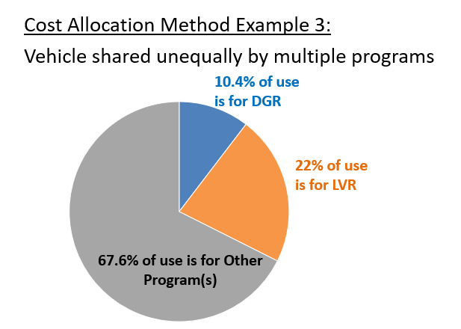
CAM examples for Admin Manual
Appendix E
How shared expenses are paid:
10.4% of each expense is an eligible DGR expense
22% of each expense is an eligible LVR expense
67.6% of each expense NOT an eligible DGLVR expense

Slide 30
CAM examples for Admin Manual
Appendix E
Example 3:
Vehicle is used for 500 miles in a quarter. 52 of those miles were for DGR activities, and 110 were for LVR activities.
Eligible DGR mileage expense = 52 x $0.58 (or other acceptable mileage rate) = $30.16
Eligible LVR mileage expense = 110 x $0.58 (or other acceptable mileage rate) = $63.80
How much of a $50 oil change is eligible for reimbursement with DGR and LVR funds?
DGR: 52 = 0.104 $50 x 0.104 =$5.20 of the oil change is an eligible DGR expense
500
LVR: 110 = 0.22 $50 x 0.22 = $11.00 of the oil change is an eligible LVR expense
500

Slide 31
Administrative Manual
Chapter 3
3.5.3 Contract Amendments
In some cases, the grant recipient may request additional time or addition funding above the contracted amount to complete a project. The approval of additional time or funding to a contract is at the discretion of the district board, based either on a case by case basis or by county policy. Districts may develop their own policies for handling cost overruns and time extensions, provided they are consistent with Commission policy. It is up to the discretion of the conservation district board if amendments to existing contracts must be recommended by the QAB. Options include but are not limited to: requiring district board approval; requiring QAB and district board approval; empowering CD staff to approve amendments, etc. There is no additional funding from the Commission to pay for cost overruns.
Red Text shows wording changes to the DGLVR Admin Manual (effective 7/1/2022)

Slide 32
Administrative Manual
Chapter 3
3.5.3 Contract Amendments
For cost overruns totaling 20 40 percent or less of the initial contract amount, a contract amendment must be completed and signed by both entities (available at www.dirtandgravelroads.org). Multiple amendments may be granted, provided the total of all amendments is not more than 20 40 percent of the initial contract amount. Amendments must be approved by the district board according to policies they establish. For cost overruns totaling more than 20 percent of the initial contract amount, a second separate contract must be made for the additional funds. For contract amendments over 40 percent, written approval is required from the State Conservation Commission.
Red Text shows wording changes in Admin Manual (effective 7/1/2022)

Slide 33
Administrative Manual
Chapter 3
3.6.1.2 Stream Crossing Replacement Training
Effective July 1, 2023, at least one conservation district staff member must have completed the DGLVR Program’s “Stream Crossing Replacement Certification Training” and received a certificate of completion before the QAB can recommend or the conservation district can approve a contract for a project involving a stream crossing. A Stream Crossing Replacement Re-Certification Training must be taken once every three years to maintain staff certification. This training requirement does not apply to crossings that qualify for an automatic exemption from the DGLVR Stream Crossing Standard (see section 7.1.3.1).
Red Text shows wording changes to the DGLVR Admin Manual (effective 7/1/2022)

Slide 34
Administrative Manual
Chapter 3
3.6.1.6 Remote Learning Center
The Center has established a “Remote Learning Center” on its website at: https://www.dirtandgravel.psu.edu/education-and-training/remote-learning-center. The Remote Learning Center contains a wide variety of recorded webinars and remote trainings that are available free of charge to anyone. The website contains not only recording of trainings, but also the PowerPoint files that were used for each training. Conservation Districts may find the PowerPoint slides useful in their own educational efforts within their county.
Red Text shows wording changes to the DGLVR Admin Manual (effective 7/1/2022)

Slide 35
Administrative Manual
Chapter 3
3.7.4.1 Materials
Inlets and outlets of all cross pipes must have erosion protection, such as headwalls, endwalls, drop inlet boxes, and/or rip rap. All stream crossing structures must have a headwall and endwall.
Red Text shows wording changes to the DGLVR Admin Manual (effective 7/1/2022)

Slide 36
Administrative Manual
Chapter 3
3.7.4.2 Equipment
Contact Commission or Center staff for questions about equipment without listed FEMA rates. Where FEMA rates do not accurately reflect local equipment costs, applicants may request approval to use other rates, if written documentation can be provided.
Red Text shows wording changes to the DGLVR Admin Manual (effective 7/1/2022)

Slide 37
Administrative Manual
Chapter 3
3.7.4.5 Prevailing Wage Documentation
If federal funds are involved in a project, federal prevailing wage requirements (Davis Bacon Act) often supersedes PA prevailing wage. Davis Bacon requirements are acceptable to the DGLVR program in this case, and Certified Payroll forms accepted by the US Department of Labor must be completed and kept in the project file.
Red Text shows wording changes to the DGLVR Admin Manual (effective 7/1/2022)

Slide 38
Recorded Webinars Available Online
https://www.dirtandgravel.psu.edu/education-and-training/webinars/past-webinars
2022
2022

Slide 39
Administrative Manual
Chapter 3
3.7.4.7 Consultants, Engineering, and Permitting Costs
Program funds can be used to cover engineering, permitting, or similar consultant costs, but such costs are limited to a maximum of 10 20 percent of the total contract amount between the district and the grant recipient, with a maximum of $25,000 total for engineering, permitting, or similar consultant costs. Note this limit is defined as up to 10 20 percent of the contract amount (Program contracted funds), not 10 20 percent of the total project value (which could include in-kind or other funds).
Red Text shows wording changes to the DGLVR Admin Manual (effective 7/1/2022)

Slide 40
Administrative Manual
Chapter 3
3.7.4.7 Consultants, Engineering, and Permitting Costs
For example, a $30,000 contract on a project totaling $50,000 is limited to 10 20 percent of the contract, or $3,000 $6,000, for engineering and permitting. Another example, a $140,000 contract, 20 percent of the contract would be $28,000, but the program will only fund up to the maximum of $25,000. Preparation or design costs such as engineering or surveying that are incurred before the contract is signed are not eligible for grant reimbursement but can be counted as in-kind.
Red Text shows wording changes to the DGLVR Admin Manual (effective 7/1/2022)

Slide 41
Administrative Manual
Chapter 3
3.7.4.8 Working Off Right-of-Way
Landowner permission should be sought as early as possible in the funding process, ideally before contracting, to ensure the project can be implemented as planned.
In some cases, landowner permission may be instrumental to implementing a successful DGLVR project (additional culvert outlets for example). In some cases, a viable alternative may exist to implement a successful plan without landowner permission, but in other cases sufficient water quality improvements cannot be made due to landowner constraints. In such cases, DGLVR funding may be better spent on a different project location. Contact the SCC in questionable circumstances where a lack of landowner permission may hinder successful project implementation.
Red Text shows wording changes to the DGLVR Admin Manual (effective 7/1/2022)

Slide 42
Administrative Manual
Chapter 3
3.8.5 Contracting
Preparation or design costs such as engineering or surveying that are incurred before the contract is signed are not eligible for grant reimbursement but can be counted as in-kind.
Red Text shows wording changes to the DGLVR Admin Manual (effective 7/1/2022)

Slide 43
Administrative Manual
Chapter 3
3.8.5.1 Contract Attachments
Grant Application and Workplan
When the scope of project work is changed, it is recommended to document this on an updated grant application that is signed or initialed by the conservation district and grant recipient. At a minimum, districts must keep records of changes such as in a project narrative, via letters, in a saved or printed email, or other documented communication.
Red Text shows wording changes to the DGLVR Admin Manual (effective 7/1/2022)

Slide 44
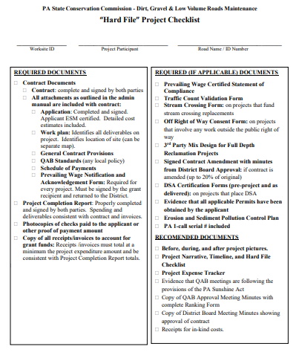
Administrative Manual
Chapter 3
3.8.9 Project completion & 3.8.10 Project File Retention
Required documentation as outlined on the “Hard File Checklist” is required to be kept in the project hard file and is needed prior to making final payment to the grant recipient
Available on the “Blank Forms” page of the CDGRS Website
https://www.dirtandgravel.psu.edu/pa-program-resources/program-specific-resources/blank-forms

Slide 45
Administrative Manual
Chapter 3
3.9 GIS Reporting System
All contracts, amendments, and completion reports must be generated using the GIS system.
All funded projects are required to be filled out in the GIS to the extent practical including:
Assessment (if applicable)
Grant application
Contract
Amendments (if applicable)
Payment(s)
Completion report
Photos (if applicable)
Any additional supporting files (file upload tool is currently under development)
Red Text shows wording changes to the DGLVR Admin Manual (effective 7/1/2022)

Slide 46
Administrative Manual
Chapter 3
3.10 Quarterly Reports
Districts must keep documentation for all Program expenses and income according to section 3.4
Financial staff involved in the DGLVR Program must complete a quarterly report GIS training to gain access to the quarterly report system.
Red Text shows wording changes to the DGLVR Admin Manual (effective 7/1/2022)

Slide 47
Administrative Manual
Chapter 3
3.10 Quarterly Reports (continued)
In order to submit quarterly reports, the following must be completed:
All income (advances, replenishments, interest) and expenses (project, administrative, and education/training) must be entered
Local and GIS account balances must match before the quarterly report is submitted each quarter
Information on funded projects is also required, including checking that all currently open contracts are in good standing and are not expired. The GIS includes a contract verifier tool that can be used during this process.
Complete the summary of Program activities from district staff for the quarter.
The Conservation District Manager, or its approved designee, is required to submit the report.
Red Text shows wording changes to the DGLVR Admin Manual (effective 7/1/2022)

Slide 48
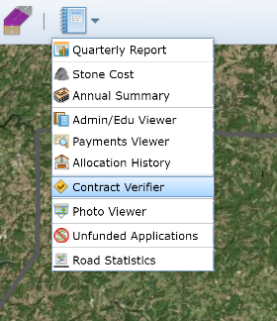
3.10 Quarterly Reports
Chapter 3
2022

Slide 49
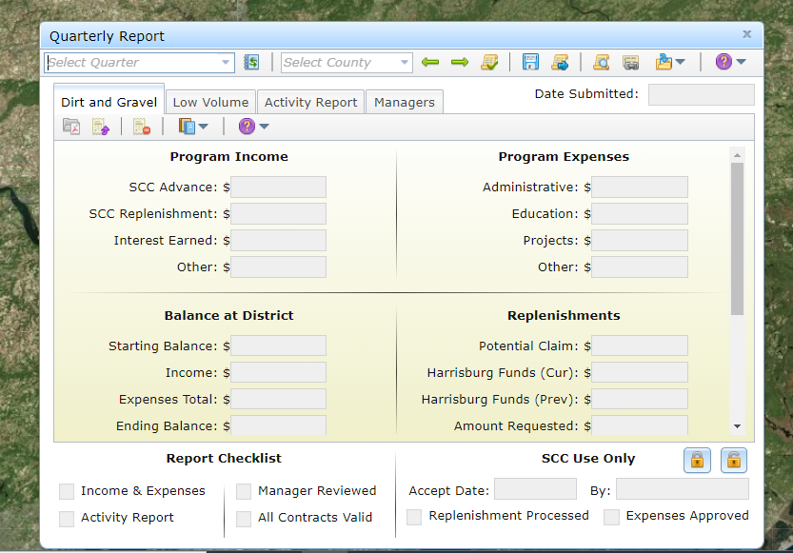
3.10 Quarterly Reports
Chapter 3
Contact the SCC and CDGRS for assistance with quarterly reports

Slide 50
Administrative Manual
Chapter 3
3.11 Annual Reports
Completing the Annual Summary Report includes ensuring all quarterly reports are submitted and accepted, entering average limestone DSA cost, and managing project errors. The average cost of limestone aggregate (DSA) delivered (not placed) is a small factor in District Allocations (in accordance with section 9106, the law that created the Dirt and Gravel Road Program).
Red Text shows wording changes to the DGLVR Admin Manual (effective 7/1/2022)

Slide 51
Administrative Manual
DGLVR Administrative Manual
Introduction
SCC Role
Conservation District Role
Quality Assurance Board Role – minor clarification on Sunshine Act
Applicant Role
Center for Dirt and Gravel Roads
Additional Policies
Permits and Other Requirements
Appendices
4) QAB Role
Defines composition and function of QAB
Composition
Meeting Requirements
QAB Role in Projects
QAB Role in Policy

Slide 52
Administrative Manual
Chapter 3
4.3.1 Project Ranking / Sunshine Act
Field visits by the QAB are not subject to Sunshine Act requirements as long as no deliberations of QAB business occurs and no official actions or recommendations are made during the visit.
Red Text shows wording changes to the DGLVR Admin Manual (effective 7/1/2022)

Slide 53
Administrative Manual
DGLVR Administrative Manual
Introduction
SCC Role
Conservation District Role
Quality Assurance Board Role
Applicant Role – updated to match other updates
Center for Dirt and Gravel Roads
Additional Policies
Permits and Other Requirements
Appendices
5) Applicant Role
Intentionally repeats previous material
Written “to” the applicant audience
Intended to be standalone to give to applicants.

Slide 54
Administrative Manual
DGLVR Administrative Manual
Introduction
SCC Role
Conservation District Role
Quality Assurance Board Role
Applicant Role
Center for Dirt and Gravel Roads – unchanged
Additional Policies
Permits and Other Requirements
Appendices
6) Center Role
3-page overview of Center role and available services
Education
Outreach
Technical Assistance
Documentation

Slide 55
Administrative Manual
DGLVR Administrative Manual
Introduction
SCC Role
Conservation District Role
Quality Assurance Board Role
Applicant Role
Center for Dirt and Gravel Roads
Additional Policies
Stream crossing updates
DSA updates
Exception to DSA on fill projects update
Sealed surface update
8) Permits and Other Requirements
Appendices
7) Additional Policies
Policies that apply to certain circumstances:
Stream Crossing Replacement
Driving Surface Aggregate
Paved LVR-Specific Policies
Full Depth Reclamation

Slide 56
Recorded Webinars Available Online
https://www.dirtandgravel.psu.edu/education-and-training/webinars/past-webinars

Slide 57
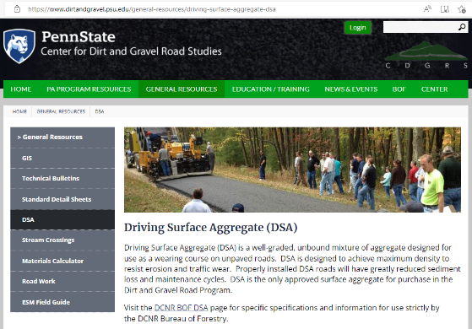
Administrative Manual
DSA Request for Quote
7.2 Driving Surface Aggregate
Only approved surface aggregate for use in DGLVR Program
Developed in 2000, last change made in 2019
Three changes for 2022:
Abrasion Resistance (LA Abrasion) (DSA Standard and Specification)
Paver placement requirement (DSA Standard and Specification)
Exception to using DSA on Fill Projects (Admin Manual Chapter 7)
Available on the “DSA” page of the CDGRS Website
https://www.dirtandgravel.psu.edu/general-resources/driving-surface-aggregate-dsa

Slide 58
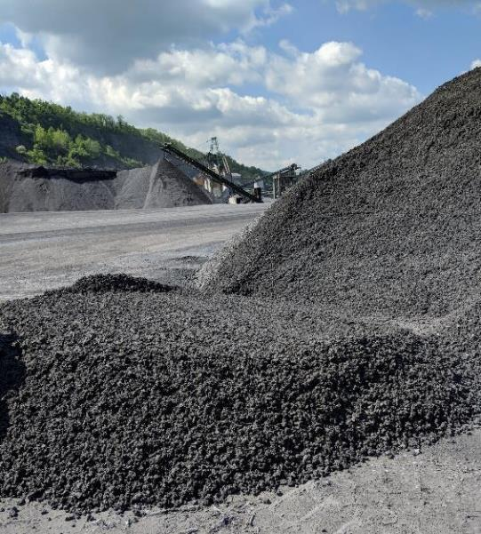
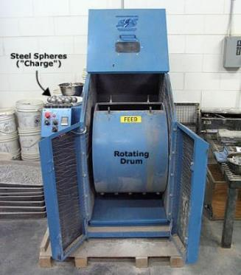
Administrative Manual
DSA Standard
III. Material
A. Abrasion Resistance: The loss of mass (LA Abrasion) shall be less than 40% 45%.
https://pavementinteractive.org/reference-desk/testing/aggregate-tests/los-angeles-abrasion/
Red Text shows wording changes to the DGLVR SCC DSA Standard and Specification (effective 7/1/2022)

Slide 59
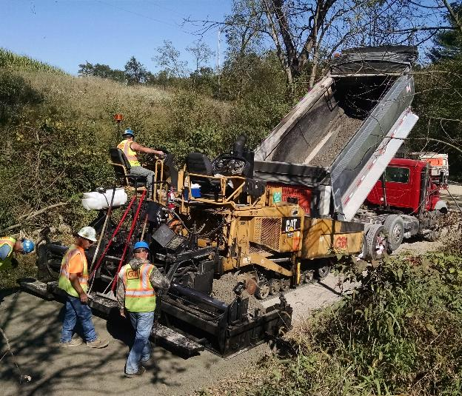
Administrative Manual
Chapter 7
IV. D. Placement
Placement: The use of a motorized paver is highly recommended for all DSA placements. For projects and/or contracts including over 1,000 500 tons of DSA, a motorized paver is required.
Red Text shows wording changes to the DGLVR SCC DSA Standard and Specification (effective 7/1/2022)

Slide 60
Administrative Manual
Chapter 7
IV. D. Placement
Placement: The use of a motorized paver is highly recommended for all DSA placements. For projects and/or contracts including over 1,000 500 tons of DSA, a motorized paver is required.
Paver must be in good working order and be of sufficient horsepower to be capable of pushing loaded trucks uphill while placing material in a full width pass at the required minimum depth stipulated in the contract. If the total tonnage is less than 500 tons, the DSA must be paver placed or placed by tailgating and groomed with a road grader equipped with a carbide-tipped grader blade. A track mounted paver is preferred.
Red Text shows wording changes to the DGLVR SCC DSA Standard and Specification (effective 7/1/2022)

Slide 61
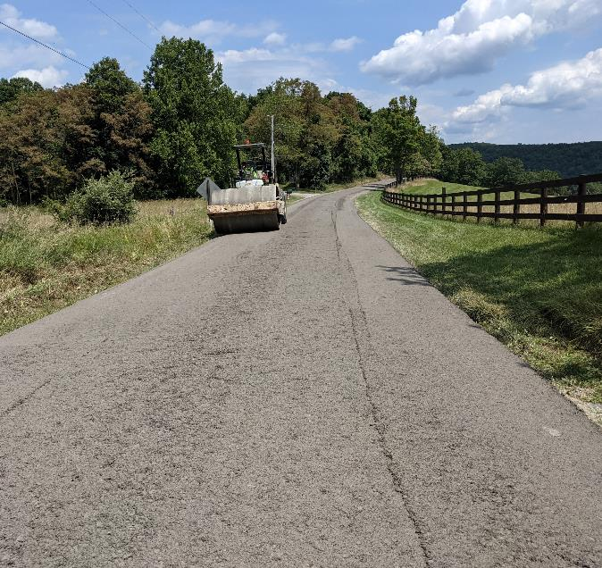
Administrative Manual
Chapter 7
7.2.3 Exception to using DSA on Fill Projects
Driving surface aggregate meeting the Commission’s specification is the only approved road surface material that may be purchased (for DGR projects) with Program funds. The only exception to this is on road fill projects.

Slide 62
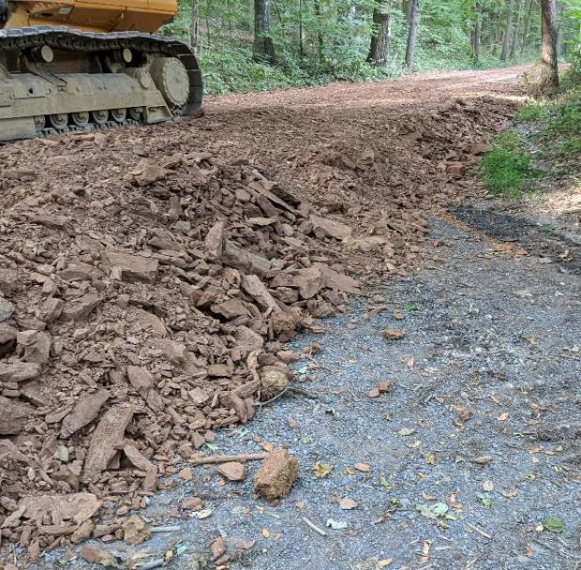
Administrative Manual
Chapter 7
7.2.3 Exception to using DSA on Fill Projects (continued)
Road fill projects are defined as projects which install an average compacted thickness of 12-inches or more of fill material, not including the driving surface, to allow for proper drainage and/or strengthen the existing road base.
Red Text shows wording changes to the DGLVR Admin Manual (effective 7/1/2022)

Slide 63
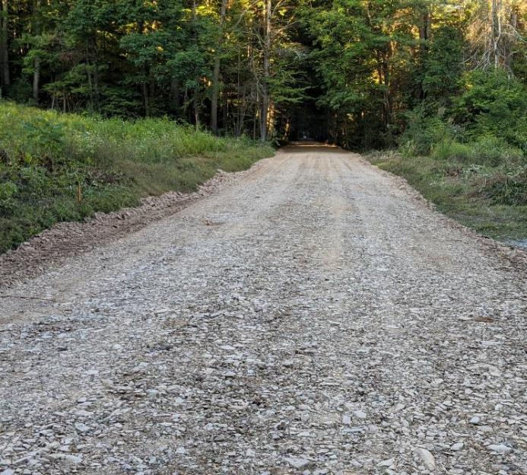
Administrative Manual
Chapter 7
7.2.3 Exception to using DSA on Fill Projects (continued)
Road fill projects must be capped with DSA or an alternative aggregate at a minimum depth of 6-inches. Shale or bank-run gravel may not be used as the final driving surface. This exception is not meant to replace DSA with fill.
Shale is not an eligible driving surface
Red Text shows wording changes to the DGLVR Admin Manual (effective 7/1/2022)

Slide 64
Administrative Manual
DSA Request for Quote
7.3 Full-Depth Reclamation
Unchanged

Slide 65
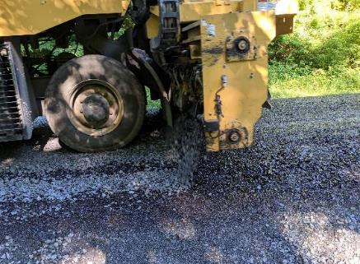
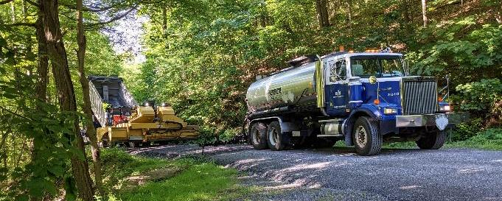
Administrative Manual
Chapter 7
7.4 LVR Project Guidelines
Asphalt and Chipseal must confirm to PennDOT Pub 408 or Pub 447.
Note that the use of petroleum solvent based “cutback asphalts” such as MC-30 and MC-70 and NOT allowed for use in the Program.
Chip Seal placement
Chip Seal placement
Red Text shows wording changes to the DGLVR Admin Manual (effective 7/1/2022)

Slide 66
Administrative Manual
DSA Request for Quote
7.5 Traffic Counts for Low Volume Roads
Unchanged

Slide 67
Administrative Manual
DGLVR Administrative Manual
Introduction
SCC Role
Conservation District Role
Quality Assurance Board Role
Applicant Role
Center for Dirt and Gravel Roads
Additional Policies
8) Permits and Other Requirements - unchanged
Appendices
8) Permits and Other Requirements
Brief overview of permit issues related to Program projects.

Slide 68
Administrative Manual
Appendicies
APPENDIX A. DIRT GRAVEL, AND LOW-VOLUME ROAD PROGRAM LAW 9106
APPENDIX B. COMMISSION STATEMENT OF POLICY
APPENDIX C. CONTRACT AND ATTACHMENTS not needed, since GIS now generates
APPENDIX C. BLANK GRANT APPLICATION was part of contract attachments, no changes
APPENDIX D. CONTRACT AMENDMENT not needed, since GIS now generates
APPENDIX D. TRAFFIC COUNTY VALIDATION AND INSTRUCTIONS
APPENDIX E. PROJECT COMPLETION REPORT not needed, since GIS now generates
APPENDIX E. COST ALLOCATION METHOD EXAMPLES
APPENDIX F. DSA STANDARD AND SPECIFICATION
APPENDIX G. STREAM CROSSING REPLACEMENT STANDARD
APPENDIX H. STREAM CROSSING REPLACEMENT EVALUATION
APPENDIX I. EXEMPTIONS FROM STREAM CROSSING STANDARD
APPENDIX J. STREAM CROSSING PROJECT LIFECYCLE CHECKLIST
APPENDIX K. DEFINITIONS AND ACRONYMS
Red Text shows wording changes to the DGLVR Admin Manual (effective 7/1/2022)

Slide 69
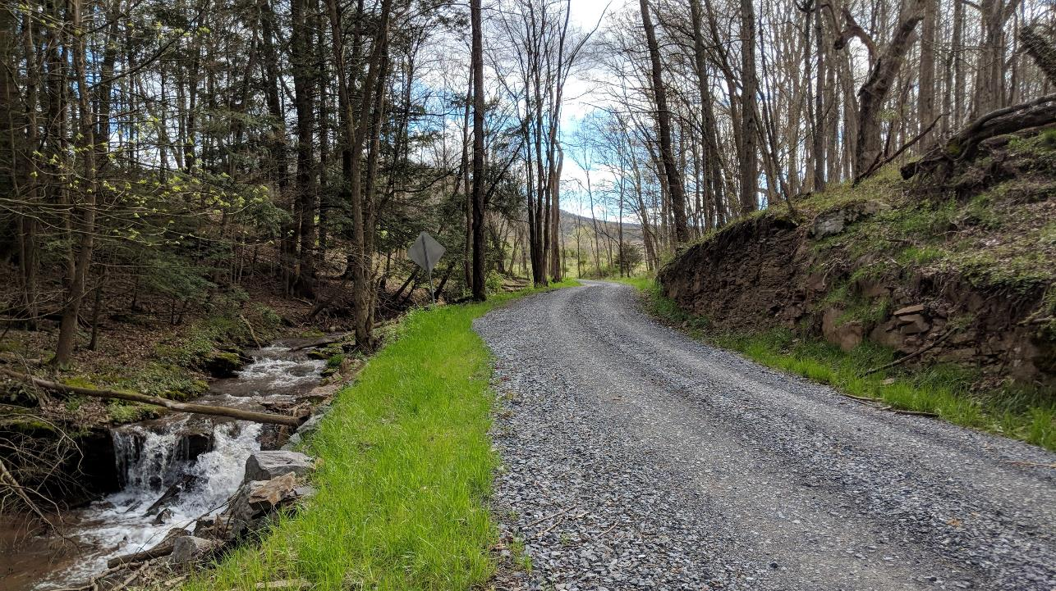
Questions?

