Slide 1



Dirt Gravel and Low Volume Road Program
WEBINAR
Admin/Edu Changes and GIS Updates
Survey Results
ESM Trainings
Webinars
Longer Remote Trainings
Online training Center
Winter Tech Assists
6/15/21 Starts at 9am
If you are reading this, then you are successfully seeing the webinar video. Webinar audio should be automatic through your computer (or click “join audio”), and options can be accessed in the “audio options” button on the bottom left. If your computer audio is not working, you can listen on your phone by dialing 646-876-9923.

Slide 2
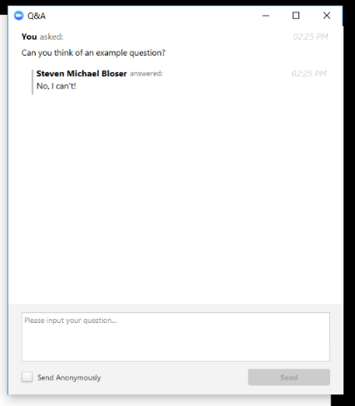
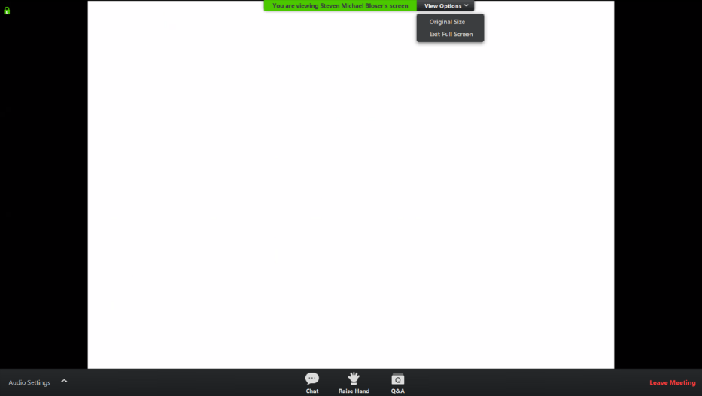
Admin/Edu Changes and GIS Updates
Note you can ask a question anonymously
Q&A
For audio via phone: 646-876-9923
2

Slide 3
Admin/Edu Changes and GIS Updates
Administrative and Education Changes
Approved at the July, 2020 SCC meeting, effective July 1, 2020, administrative and education expenses must be incurred within the allotted fiscal year.

Slide 4
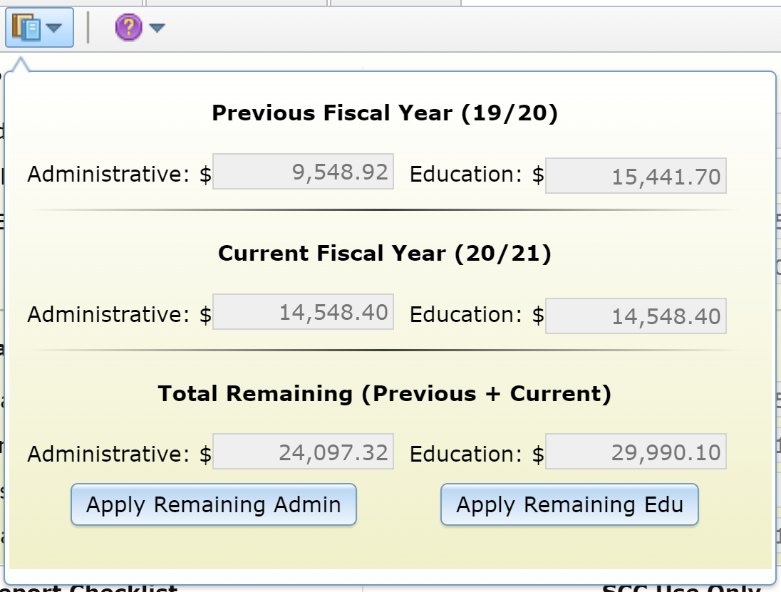
Admin/Edu Changes and GIS Updates
Administrative and Education Changes
What does this mean?
On July 1, 2021, all monies listed in the Claimable Admin/Edu for both DGR and LVR will be set to $0.
For the example on the right:
  FY 19/20 is removed because the
  2 years has past.
  FY 20/21 replaces FY 19/20 and the
  amounts are set to $0.
  FY 21/22 becomes the Current Fiscal
  Year and 10% of the Allocation is
  entered into the Administrative and
  Education categories.

Slide 5
Admin/Edu Changes and GIS Updates
Administrative and Education Changes
Typical Year
Before July 1, 2021
After July 1, 2021

Slide 6
Admin/Edu Changes and GIS Updates
Administrative and Education Changes
The “banking” of admin/edu funds for two fiscal years is only allowed with written permission from the Commission.
  Email containing how much they want, why they need the extra year
  Should be a rare occurrence
Permission to use these funds must be submitted by June 30 of the current fiscal year.

Slide 7
Admin/Edu Changes and GIS Updates
Administrative and Education Changes
If approved, the allotted amounts are posted in the Manager’s tab.
The approved amount will not be larger than the current cap.
If the actual amounts left at the end of the fiscal year are less than the approved amounts, the lesser amount will be applied to the allowable spending cap.

Slide 8
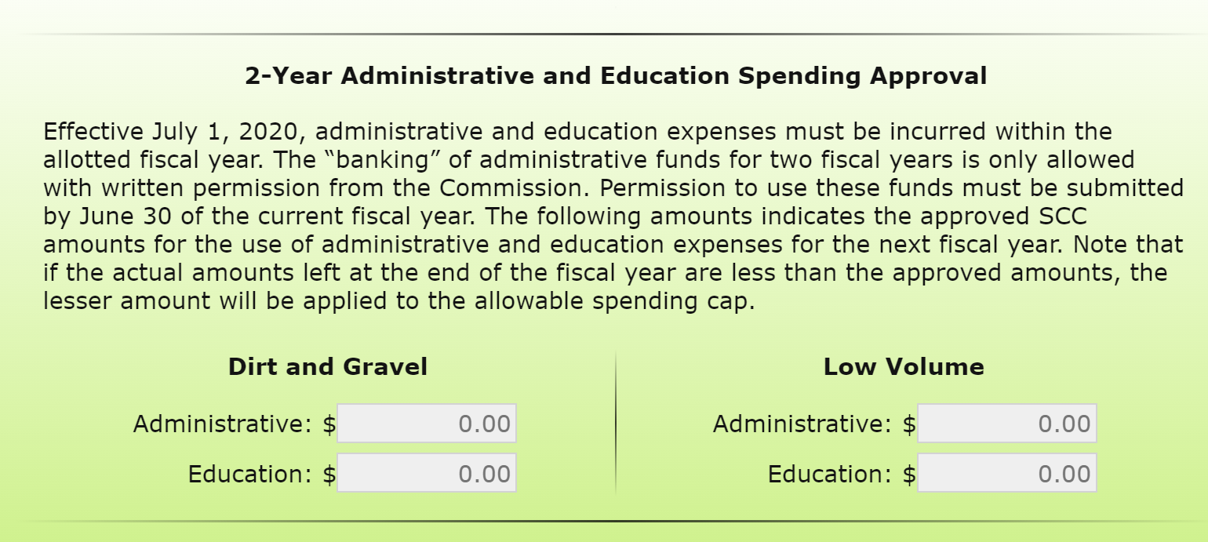
Admin/Edu Changes and GIS Updates
Administrative and Education Changes

Slide 9
Admin/Edu Changes and GIS Updates
Administrative and Education Changes
Year with 2-Year Approval
(Admin = $7,000; Edu = $0)
Before July 1, 2021
After July 1, 2021

Slide 10
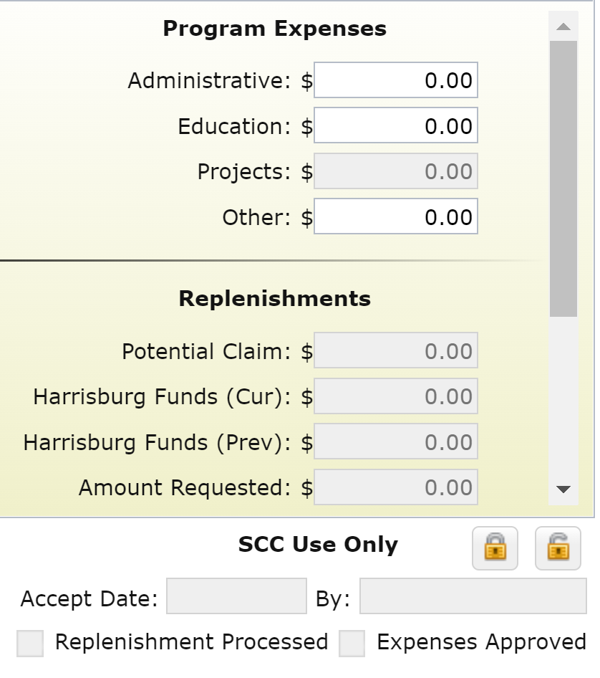
Admin/Edu Changes and GIS Updates
Program Expenses: Other
Program expenses that
are not admin/edu/
project related.
  Funds to be returned to
  another Program
The commission must
approve these expenses
prior to submitting the
Quarterly Report.
Explanation must be
recorded in activity report.

Slide 11
Admin/Edu Changes and GIS Updates
Quarterly Report Reminder
In order to have the SCC accept the April-June QR, Districts must:
Verify that both the Dirt and Gravel AND Low Volume ending balances match the local account balance
The verification must come from the District Manager/Appointed Representative
If the balances do NOT match, then the balances need to be fixed prior to the report being accepted

Slide 12
Admin/Edu Changes and GIS Updates
GIS Updates
Advances are now tracked
Site Length added to Add and Edit Funded Site tools.
Funded Site Move tool updated.
Annual Summary Report Error Checker updated.

Slide 13
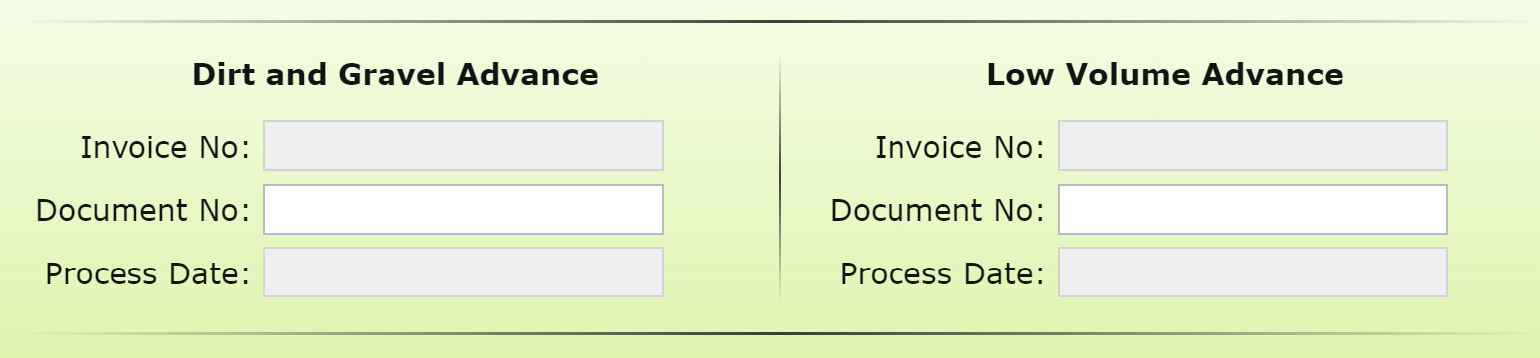
Admin/Edu Changes and GIS Updates
GIS Updates - Advances
Advances will be entered into the quarter they are mailed.
An alert email will be sent.
Info is located in Manager’s tab.

Slide 14
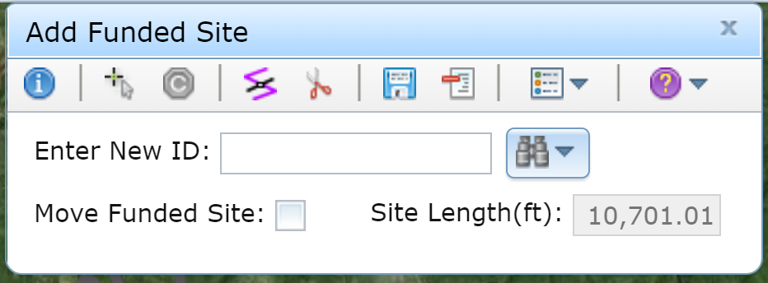
Admin/Edu Changes and GIS Updates
GIS Updates – Site Length
Site Length field added to Add and Edit Funded Site tools.
Length automatically updated in real time.
Site Tip: Make Funded Sites equal to/longer than actual site length

Slide 15
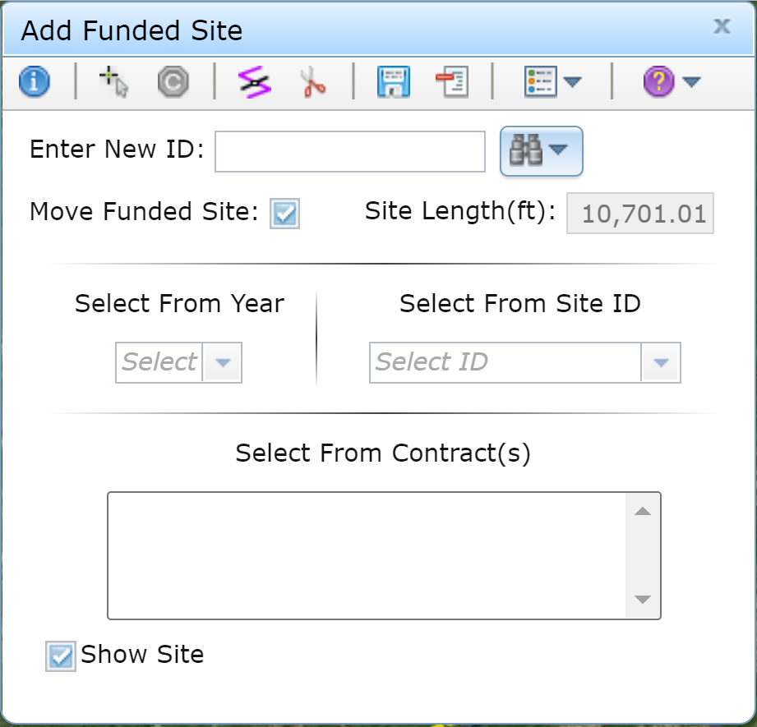
Admin/Edu Changes and GIS Updates
GIS Updates – Move Tool
The move tool has been updated visually.
The single contract bug has been fixed.

Slide 16
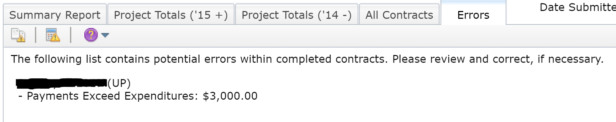
Admin/Edu Changes and GIS Updates
GIS Updates – ASR Error Checker
Payments that exceed expenditures have been added.
Open your Annual Summary Report then click the Errors tab.
These need to be addressed ASAP. Contact Ken for assistance.

Slide 17
Dirt Gravel and Low Volume Road Program
WEBINAR
Admin/Edu Changes and GIS Updates
Survey Results
ESM Trainings
Webinars
Longer Remote Trainings
Online training Center
Winter Tech Assists
QUESTIONS ?

