Slide 1
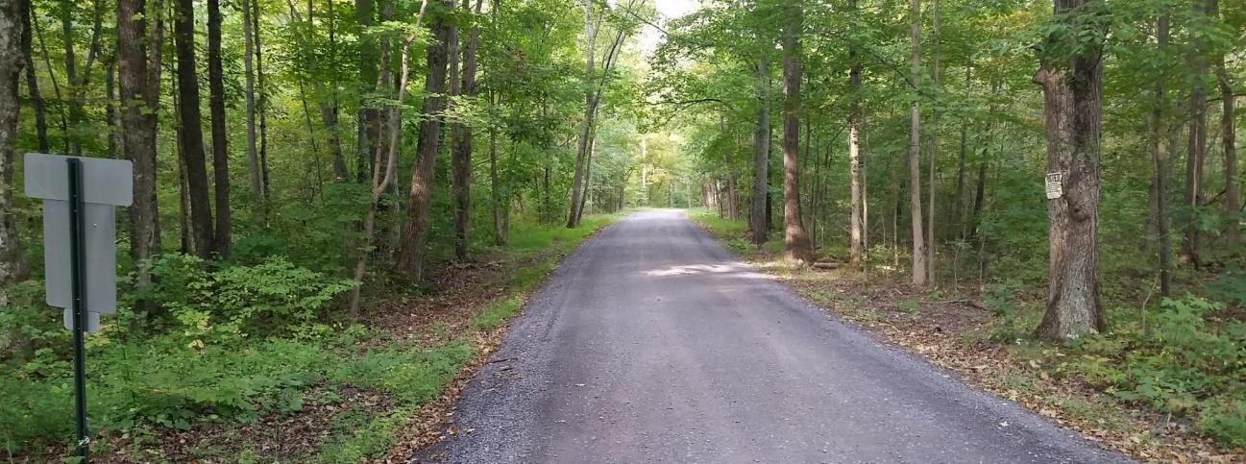
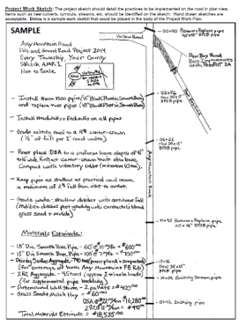
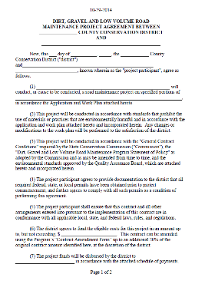
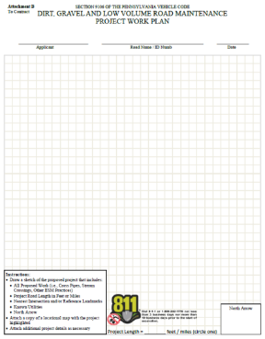
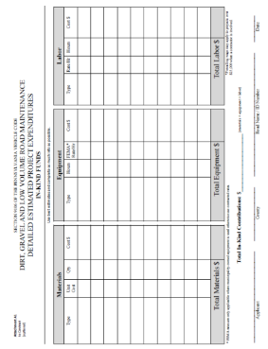
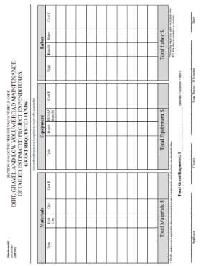
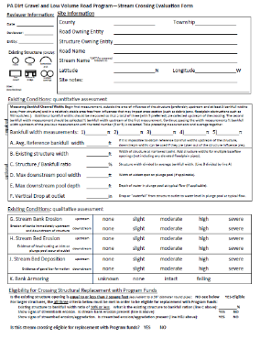
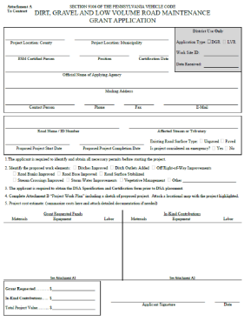
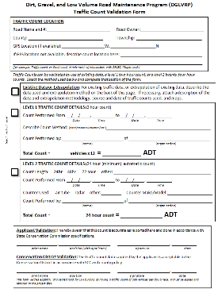
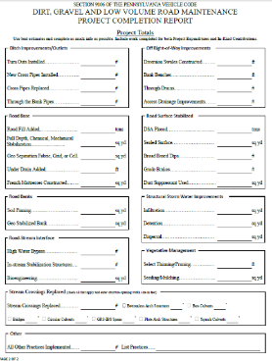
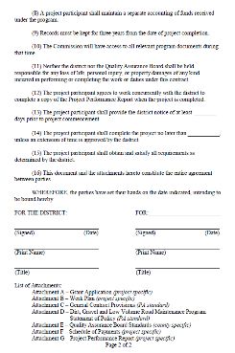
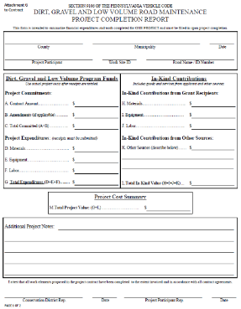


Dirt Gravel and Low Volume Road Program
WEBINAR
4/6/23, 9am
Administrative Q&A and
Policy Determinations
SCC
Sherri Law
shlaw@pa.gov
Roy Richardson
rrichardso@pa.gov
Photos: Cumberland CD
If you are reading this, then you are successfully seeing the webinar video. Webinar audio should be automatic through your computer (or click “join audio”), and options can be accessed in the “audio options” button on the bottom left. If your computer audio is not working, you can listen on your phone by dialing 646-876-9923.

Slide 2
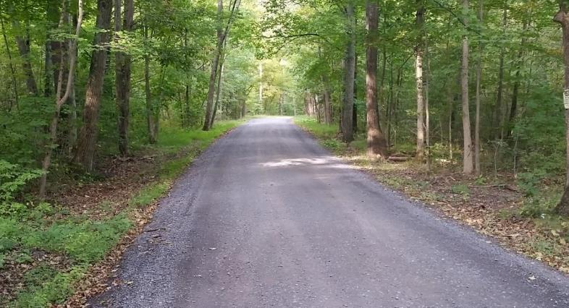
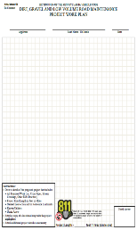
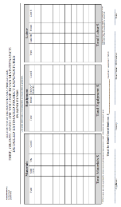
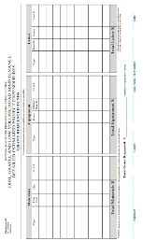
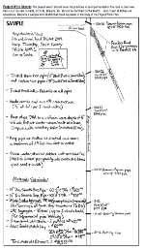
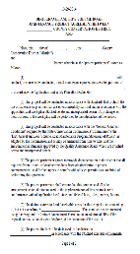
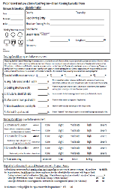
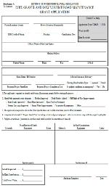
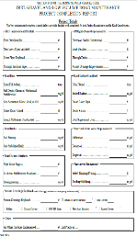
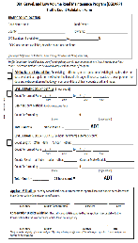
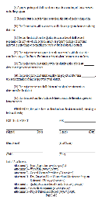
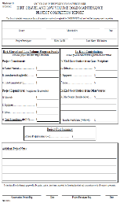



Purpose
Quick refresher on available resources
Share some recent questions and/or policy determinations received from CDs
Allow additional policy
questions.
Please put additional policy questions in Q&A anytime!

Slide 3
DGLVR Administrative Resources
Administrative Manual

Slide 4
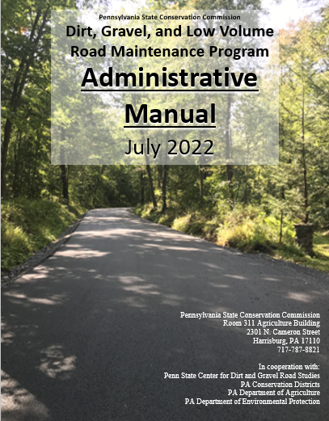
Administrative Manual
DGLVR Administrative Manual
Approved by SCC 5/10/22
Introduction
SCC Role
Conservation District Role
Quality Assurance Board Role
Applicant Role
Center for Dirt and Gravel Roads
Additional Policies
Permits and Other Requirements
Appendices
Available online.
Hard copies sent on request.

Slide 5
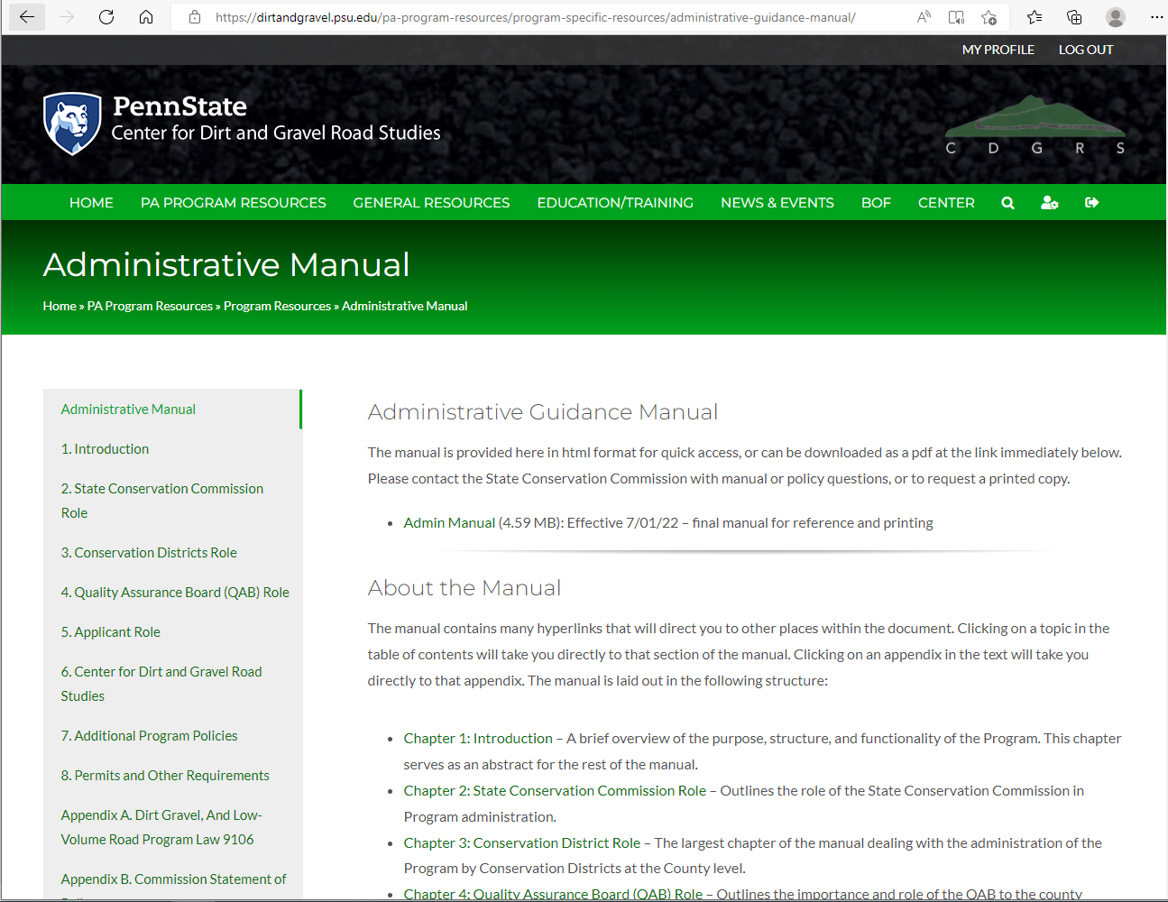

Slide 6
DGLVR Administrative Resources
Administrative Manual
Administrative Training

Slide 7
DGLVR Administrative Training
Available for district staff, QAB members, and others
Required for staff person(s) most directly responsible for administering the DGLVR Program at least every 3 years
Offered as needed multiple times a year
Traditionally in-person
Virtual option added during COVID-19 pandemic but now back to in-person
Recording available online

Slide 8
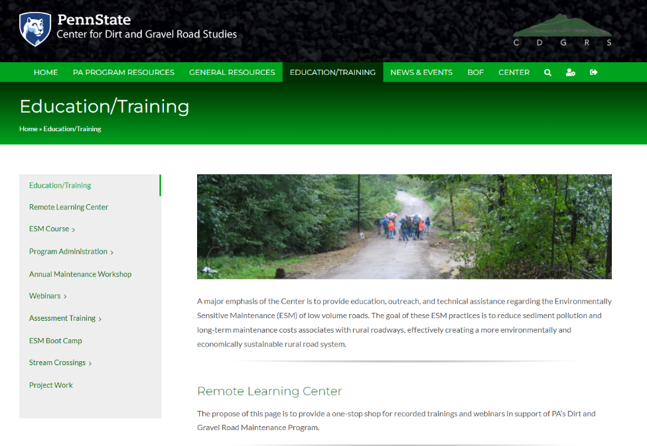

Slide 9
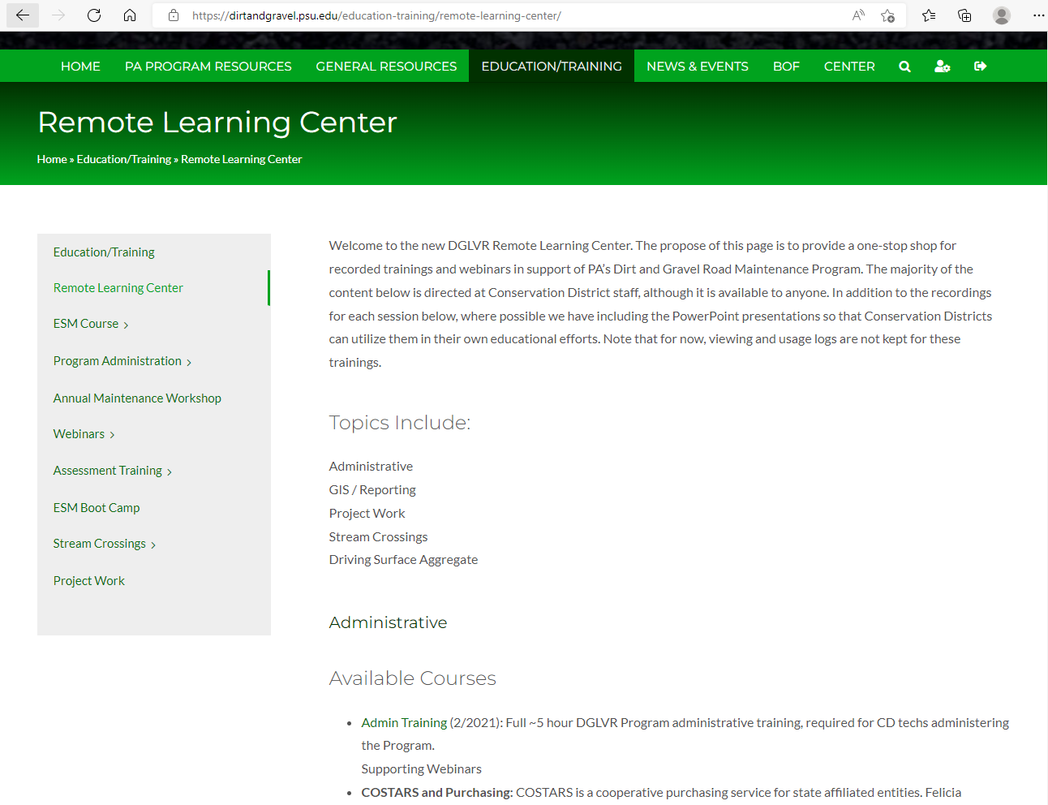

Slide 10
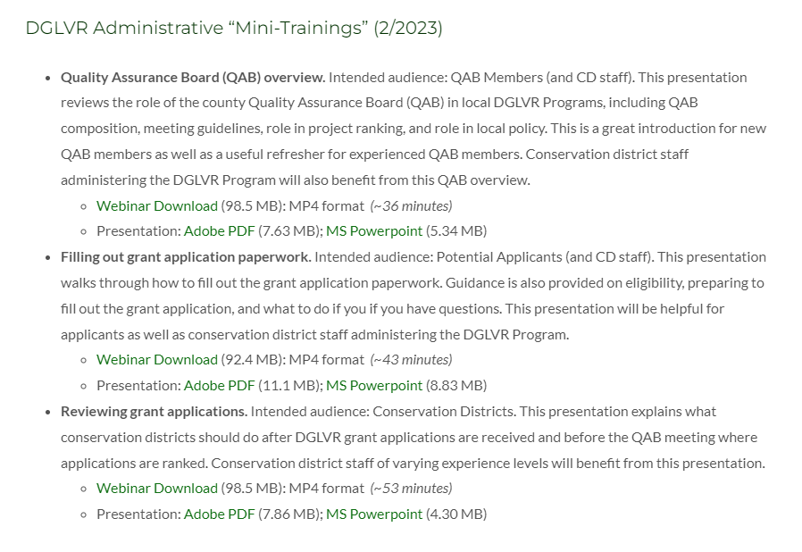

Slide 11
DGLVR Administrative Resources
Administrative Manual
Administrative Training
Webinars

Slide 12
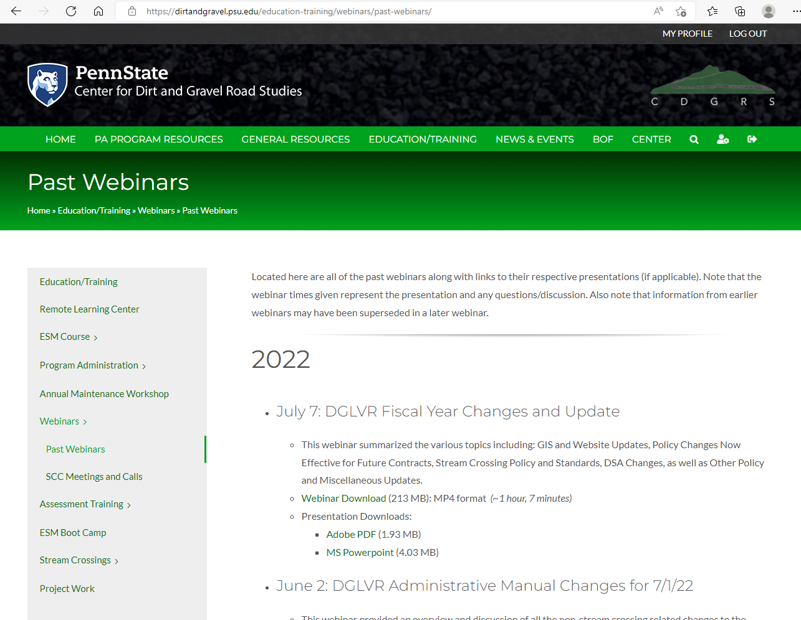

Slide 13
DGLVR Administrative Resources
Administrative Manual
Administrative Training
Webinars
State Conservation Commission

Slide 14

DGLVR State Conservation Commission Staff
Roy Richardson
  DGLVR Program Coordinator
  rrichardso@pa.gov
  717-787-2013
Sherri Law
  Financial
  shlaw@pa.gov
  Office: 223-666-2567
  Cell: 717-480-2303
Call Us!

Slide 15
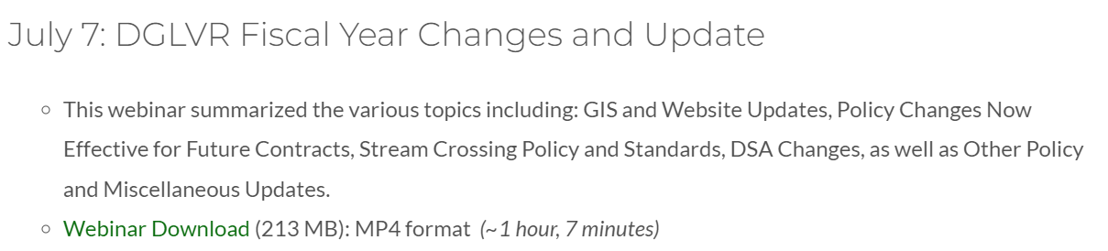
When do policy updates go into effect?
Administrative Manual was updated 7/1/2022
  All DGLVR contracts follow the Admin Manual effective when the contract was signed
  See recorded webinar for summary of updates:
  https://dirtandgravel.psu.edu/education-training/webinars/past-webinars/
2022

Slide 16
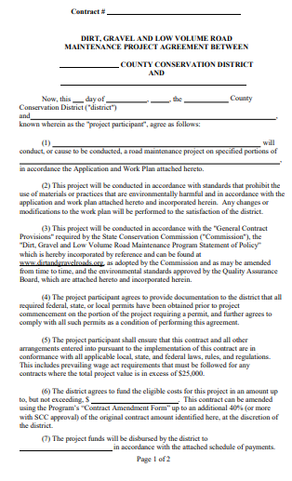
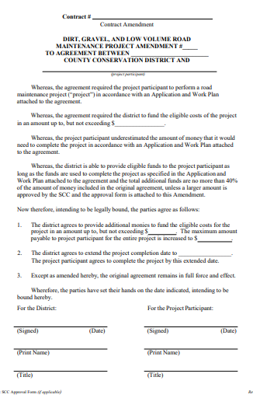
When do policy updates go into effect?
Contract amendment policy was updated 7/1/22
For cost overruns totaling 40% or less of the initial contract amount, the Contract Amendment form can be used
  Must be completed and signed by both parties
Multiple amendments can be granted, provided that the total of all amendments is not more than 40% of the initial contract amount

Slide 17
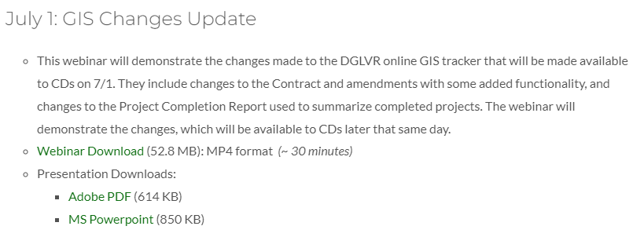
For contract amendments over 40% of the initial contract amount, written approval from the SCC is needed
  This is done through the GIS
2022

Slide 18
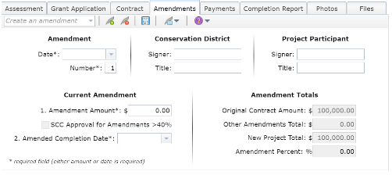
  If >40% the following steps must be followed to create the amendment
    Complete and submit the Approval Request form
      An email confirmation of the request will be sent
      Check the status by opening up the approval request
      Another amendment cannot be created while a request
      is pending. Withdraw the request if needed.
    A representative from the SCC will approve or reject the request
    Once approved, the amendment can be created
      The amount is fixed and cannot be changed
      The SCC Approval checkbox will automatically be checked
      An attachment document will be included with the printed amendment. This document must be signed by the Conservation District representative.

Slide 19
When do policy updates go into effect?
Contract amendment policy was updated 7/1/22
For open contracts signed before 7/1/22
  Contracts can still be amended up to 20% of the original contract amount
  Reach out to SCC to discuss contract amendments over 20%

Slide 20
When do policy updates go into effect?
Engineering limit was updated 7/1/2022
  A maximum of 20% of the total contract amount between the district and the grant recipient, with a maximum of $25,000 total, can be used for engineering, permitting, or similar consultant costs
    The contract amount between the district and the grant recipient refers to the amount of DGLVR funds that the district is providing to the grant recipient

Slide 21
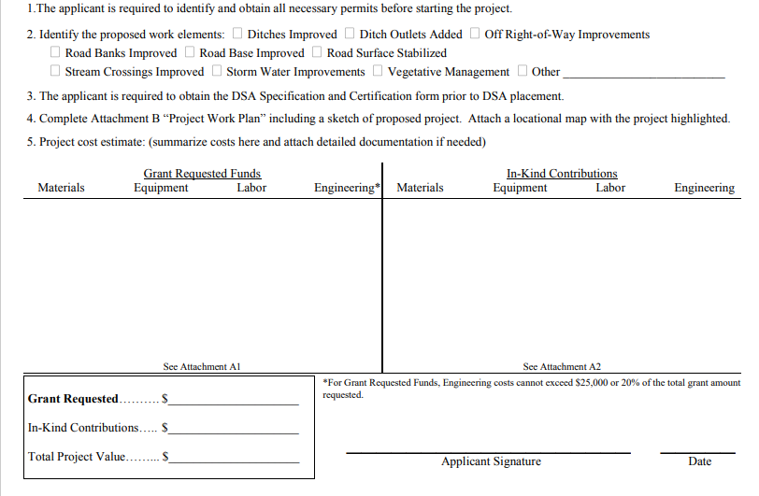

Slide 22
When do policy updates go into effect?
Engineering limit was updated 7/1/2022
  Contracts signed before 7/1/2022 are limited to a maximum of 10% of the total DGLVR contract amount

Slide 23
When do policy updates go into effect?
7.1.2.5 Conservation District Education Requirements for stream crossings
Effective 7/1/2023, at least one conservation district staff member must have completed the DGLVR Program’s “Stream Crossing Replacement Certification Training” and received a certificate of completion
before the QAB can recommend or the conservation district Board can approve a contract for a project involving a stream crossing replacement

Slide 24
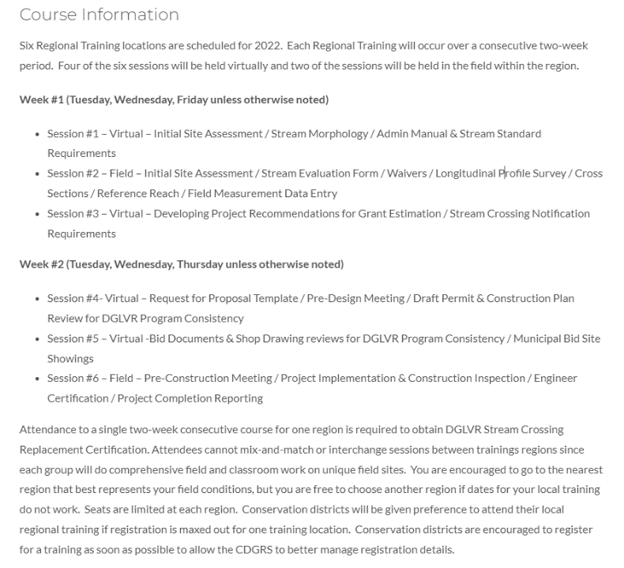
May 16-25, 2023
  Field days in State College area
June 20-29, 2023
  Field days in Clarion area
October 31- Nov 9
  Field days in State College area
Registration available
  https://dirtandgravel.psu.edu/education-training/stream-crossings/stream-crossing-replacement-certification-training/

Slide 25
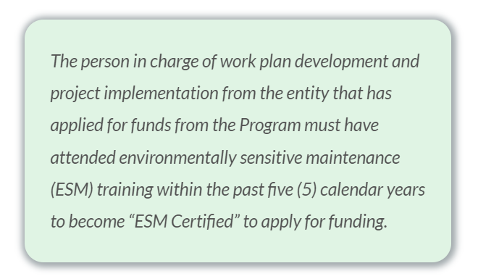
What happens if the grant recipient’s ESM Certification expires during the project or the ESM Certified person leaves the organization?
The grant recipient can continue and complete the project
Encourage them to attend ESM training as soon as possible

Slide 26
Road Eligibility – Road Ownership
Public Roads owned by an eligible applicant as described in Admin Manual Section 3.7.1
  municipalities and other local, county, or state public entities that own and maintain public roads
  ESM Certified
Determining Road ownership (3.7.1.3)
  Applying entity must own the road “right of way”
  Applicants are responsible to prove road ownership
  If a municipality receives “Liquid Fuels” funding for the road, it is eligible for DGLVR funds
  Most public roads will have courthouse records of ownership
  County/municipal solicitors may be helpful in determining road ownership

Slide 27
Road Eligibility – Open to public
Road must be open to public motor vehicle travel for a minimum of 2 consecutive weeks annually
What if the road is temporarily closed due to poor condition, failed bridge/stream culvert, etc.?
  Reach out to the SCC to discuss your specific situation

Slide 28
Road Eligibility – Low Volume Roads
Paved or sealed surface, including chip seal (tar and chip)
Average Daily Traffic (ADT) of 500 vehicles or less
  Make sure traffic count follows instructions in Admin Manual 7.5

Slide 29
Road Eligibility – Traffic Counts
Only apply to a segment of road between intersections
Valid for 5 years
Time restrictions
  March 1 – week before Thanksgiving
  Cannot be on a holiday, or the day before or after a holiday
  Must be conducted on a Tuesday, Wednesday, or Thursday
  Level 1: Must be conducted for a minimum of 2 consecutive hours between 3-6 pm
  Level 2: must be conducted for a minimum of 24 consecutive hours between 12 am Tues and 12 am Fri
Only the number of vehicle passes is counted, regardless of direction of travel or type of vehicle
Form requires signatures

Slide 30
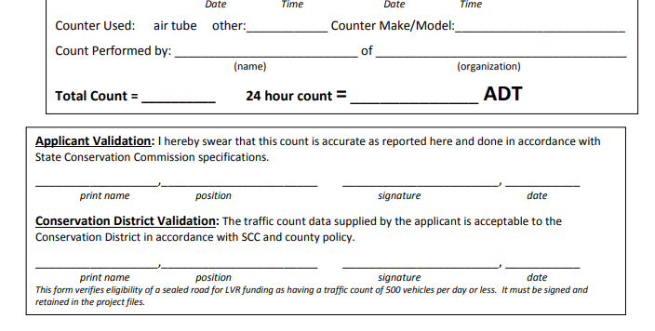
Road Eligibility – Traffic Counts
Conservation District must review and sign traffic counts to verify that they meet DGLVR Policy

Slide 31
Road Eligibility – Environmental Goals/Water Quality Impact
DGR and LVR projects must focus on both environmental and road improvements
Only consider projects that provide some form of environmental benefit
Focus on long-term benefit through use of Environmentally Sensitive Maintenance (ESM) practices
If you cannot obtain permission from the road owner (or adjacent landowners for off-ROW work) to complete adequate ESM practices, consider funding other projects
Most ranking criteria prioritize projects with greater environmental impact and the best solutions for the impacts

Slide 32
Paved aprons
Unpaved roads experience additional wear and tear at intersections with paved roads
DGR funds can be used to install a paved apron where the unpaved road intersects with a paved road
  These must be a reasonable length, such as long enough for the longest vehicle that utilizes the road (school bus, etc.).
  50' is probably long enough for most roads. 100' would be the maximum expected for a steeper road.

Slide 33
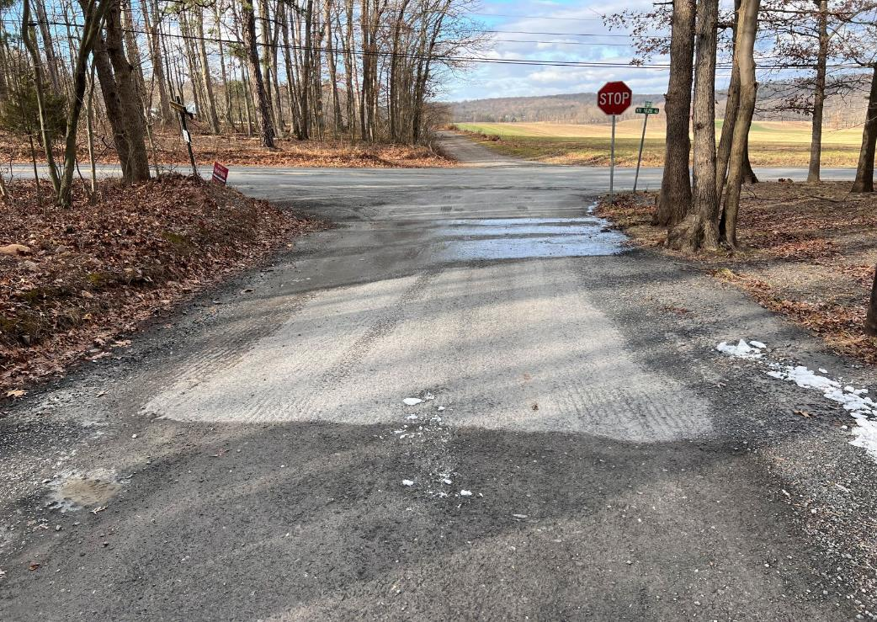

Slide 34
Can a grant recipient bid a DGLVR project with non-DGLVR funded road work?
Yes
All of the grant recipient’s bidding and other requirements still need to be met
The DGLVR project still has to meet DGLVR requirements
Typically includes:
  Making sure DGLVR work meets DGLVR policy, specifications, and standards
  Bid ad and documents must include prevailing wage (if the project is subject to PW)

Slide 35
The grant recipient has a contract for DGLVR funds but did not complete their project. What can I pay for?
DGLVR funds can only be used for eligible project expenses
Materials must be installed properly and meet all DGLVR policy, standards, and specifications
Application is the contract attachment that details what the grant funding is for
The SCC is available to review individual questions on eligible project expenses
Keep in mind: is the completed work stable and does it meet DGLVR goals?

Slide 36
Once a project is complete, can I fund additional work/another project on that site?
Yes and no depending on the proposed work
Routine Maintenance is not eligible for DGLVR funds
  Grading DSA, seasonal mowing, cleaning out ditches, cleaning pipes after storms, crack sealing asphalt, lining an existing culvert, bridge repair, etc.
  Some of these practices can be eligible as part of a larger DGLVR project, such as cleaning and reshaping ditches to make sure water can get into new cross pipes and grading the road base to prepare for DSA placement

Slide 37
Once a project is complete, can I fund additional work/another project on that site?
Additions, corrections, and repairs are eligible for DGLVR funds
  Add a cross pipe or underdrain that was missed
  complete a project in phases
  rebuild failed grade controls with a new design

Slide 38
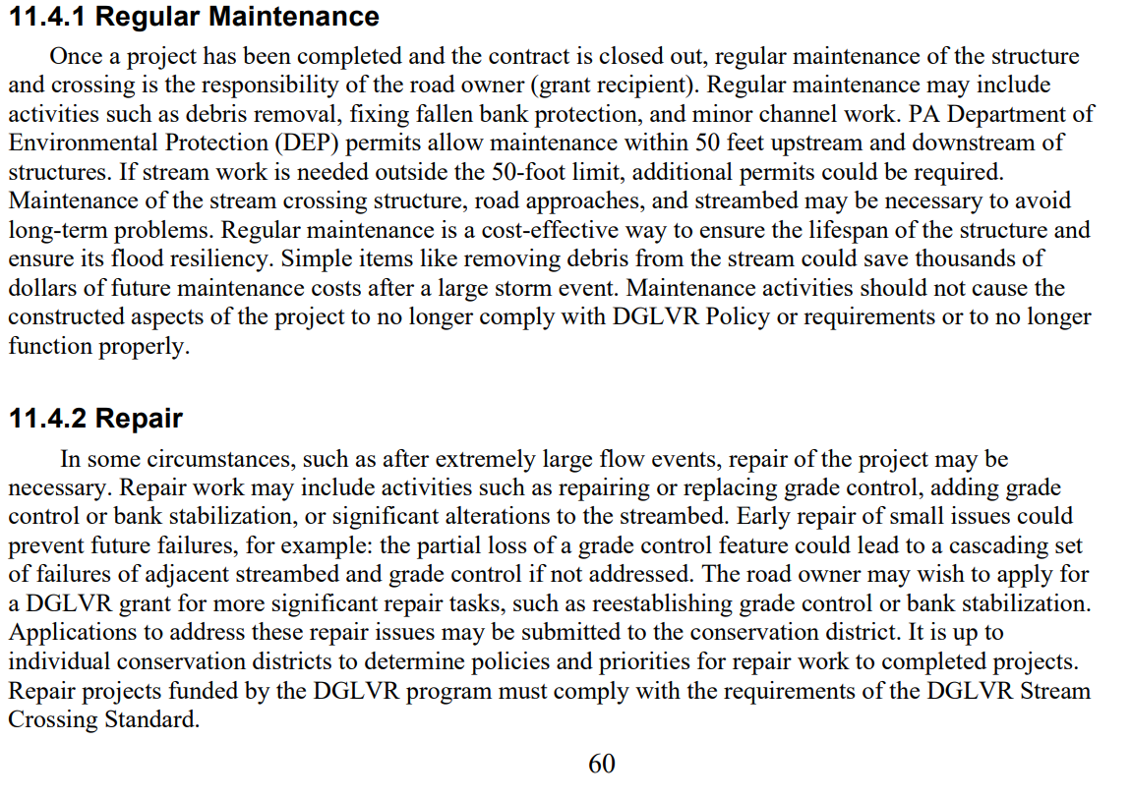
Stream Crossing Repair – Guidance in Tech Manual Chapter 11

Slide 39
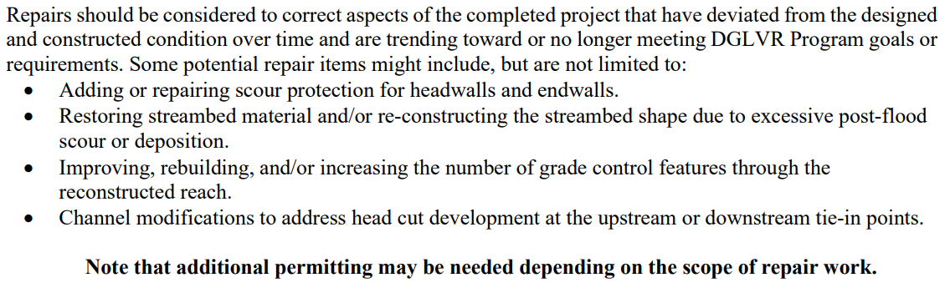
Stream Crossing Repair – Guidance in Tech Manual Chpt 11

Slide 40
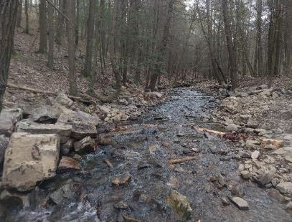
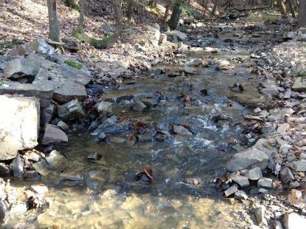
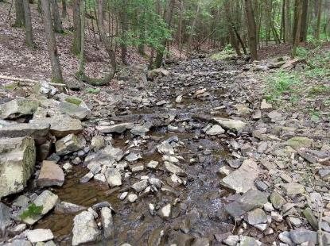
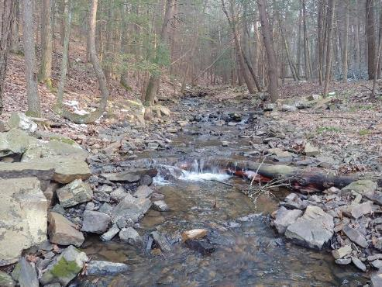
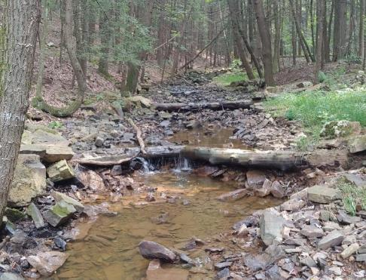
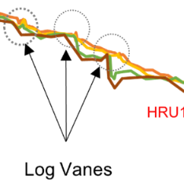
April 2019
October 2019
May 2020
January 2021
After 4 ~bankfull events
September 2021
After Hurricane Ida

Slide 41
Schedule of Payments
Conservation Districts can advance up 50% of the DGLVR contract amount to the grant recipient once the contract is signed
  Do not need to wait for permits before advancing funds
Conservation Districts can provide additional funding after the project is underway on a cash expended basis
  Up to 70% of the project funds (additional 20% if 50% was already advanced)
  Project components must be installed to the Program policy/standards and verified with receipts
  50% advance must be spent before paying the additional 20%

Slide 42
Schedule of Payments
The district shall withhold payment of at least 30% of the approved project expenses (contract plus amendments) until the satisfactory completion of the project
Before making final payment:
  Conduct a final inspection and determine that the work was performed consistent with the project application/workplan, DGLVR policy, and to the district’s satisfaction
  Review all invoices/receipts and fill out completion report
  Receive all other required paperwork, including but not limited to, Prevailing Wage documentation, PA One-Call serial number, DSA Certification forms, As-built drawings/Engineer’s Certification for stream crossings, etc. (see updated file checklist)

Slide 43
4.2 QAB Meetings
Chap 4. QAB Role
QAB Meetings must meet Sunshine Act Requirements
The Pennsylvania Sunshine Act requires all public agencies to take all official actions and conduct all deliberations leading up to official actions at public meetings. The Act covers all such actions by municipal governing bodies, committees of these governing bodies and municipal boards and commissions.
-Open Meetings, the Sunshine Act (Pennsylvania)

Slide 44
4.2 QAB Meetings
Chap 4. QAB Role
Sunshine Act Highlights
Notice of meetings are posted in a local paper and at the location of the meeting
Keep meeting minutes
Must have a quorum to vote
Meeting must be public
  Cannot vote via email
  Can vote in a virtual meeting or conference call if the public has access to join
Note that this list is not all-inclusive. Additional information online at https://www.agriculture.pa.gov/Pages/Sunshine-Act.aspx

Slide 45
4.2 QAB Meetings
Chap 4. QAB Role
Sunshine Act Highlights
Agenda posting requirements added in 2021
  Post agenda at meeting location at least 24 hours in advance of the meeting
  Post agenda on social media, website, and at the agency’s office
  Copies of the agenda must be available for the public at the meeting
  Include all issues to be deliberated on and any planned official action (votes)
  Frequently Asked Questions at https://www.openrecords.pa.gov/SunshineAct.cfm
Note that this list is not all-inclusive. Additional information online at https://www.agriculture.pa.gov/Pages/Sunshine-Act.aspx

Slide 46
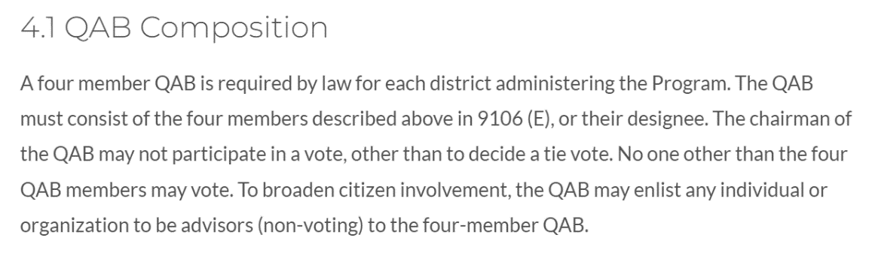
QAB Policy
Conflict of Interest
  Some QAB policies recently reviewed included that in the event of a conflict of interest, “the QAB member will temporarily assume the role of the non-voting Chairman, and the Chairman will vote in his or her stead.”
    This is not allowed

Slide 47
QAB Policy
Conflict of Interest
  Consider a policy that requires a QAB member to abstain from voting when they have a conflict of interest
  Note that there are 3 voting members, and a quorum of 2 voting members must be present in order for the QAB to vote. This means that if there is a conflict of interest, you need to have the other 2 voting members present for the QAB to vote.

Slide 48
DGLVR State Conservation Commission Staff
Roy Richardson
  DGLVR Program Coordinator
  rrichardso@pa.gov
  717-787-2013
Sherri Law
  Financial
  shlaw@pa.gov
  Office: 223-666-2567
  Cell: 717-480-2303
Call Us!

