Slide 1
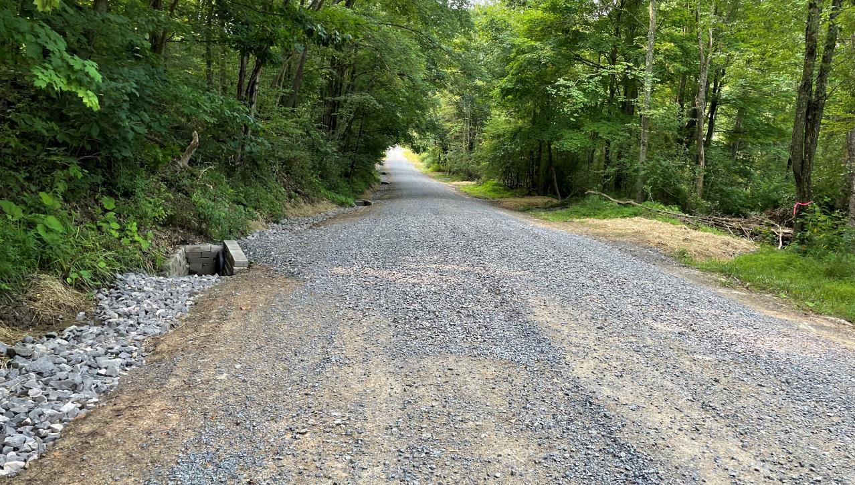
Dirt Gravel and Low Volume Road Program
WEBINAR
1/11/24
Starts 9am
DGLVR Admin Manual Proposed Updates
SCC
Sherri Law
shlaw@pa.gov
Andy Mickey
anmickey@pa.gov
CDGRS
Steve Bloser
smb201@psu.edu
If you are reading this, then you are successfully seeing the webinar video. Webinar audio should be automatic through your computer (or click “join audio”), and options can be accessed in the “audio options” button on the bottom left. If your computer audio is not working, you can listen on your phone by dialing 312-626-6799.

Slide 2
2024 ESM Training – Registration Open Today!
https://dirtandgravel.psu.edu/education-training/esm-course/in-person-esm-trainings/
Cambria County – March 20-21, 2024
Johnstown, PA 15906
Schuylkill County – April 2 – 3, 2024
Ashland, PA 17921
Armstrong County – April 24 – 25, 2024
Kittanning, PA 16201
McKean County – May 15 – 16, 2024
Port Allegany Veteran Memorial Social Hall
Port Allegany, PA 16743
Wayne County – June 5 – 6, 2024
Honesdale, PA 18431
Clinton County – July – 10 – 11, 2024
Lock Haven University – Durrwachter Conference Center
Lock Haven, PA 17745
Beaver County – July 31 & August 1, 2024
Beaver Station Cultural & Event Center/Penn Bistro Catering
Beaver, PA 15009
Perry County – August 14 – 15, 2024
Central Penn College
Summerdale, PA 17093
Crawford County – September 11 & 12, 2024
Cross Creek Resort, Inc.
Titusville, PA 16354
Bradford County – September 25 – 26, 2024
Best Western Grand Victorian Inn
Sayre, PA 18840
Fulton County – October 23 & 24, 2024
Forbes Road Conference Center/ Holiday Inn & Express
Breezewood, PA 15533
Lancaster County – November 6 – 7, 2024
DoubleTree Resort by Hilton Hotel Lancaster
Lancaster, PA 17602

Slide 3
2024 Admin and Financial Trainings – Registration Open Today!
Admin Training
9-3:30 PM
Required for CD staff involved in the DGLVR Program at least once every 3 years
Online registration required
Financial Training
9-3:30 PM
Recommended for any CD staff involved in tracking/spending DGLVR funds
3-year certification
https://dirtandgravel.psu.edu/education-training/program-administration/admin-training/
https://dirtandgravel.psu.edu/education-training/program-administration/financial-training-registration/
Dates and Locations
March 13 (Berks County)
May 21 (Westmoreland County)
July 23 (Centre County) – Tentative
October 15 (Luzerne County)
December 3 (Venango County)
Dates and Locations
March 14 (Berks County)
May 22 (Westmoreland County)
July 24 (Centre County) – Tentative
October 16 (Luzerne County)
December 4 (Venango County)

Slide 4
Proposed DGLVR Admin Manual updates for 7/1/2024
Webinar Outline
Why?
How to review and comment
Review of proposed Admin Manual Updates
Review of proposed Completion Report and Contract Attachment updates

Slide 5
Proposed DGLVR Admin Manual updates for 7/1/2024
Webinar Outline
Why?
How to review and comment
Review of proposed Admin Manual Updates
Review of proposed Completion Report and Contract Attachment updates

Slide 6
Proposed DGLVR Admin Manual updates for 7/1/2024
Why?
The purpose of the Administrative Manual is to clearly explain how the DGLVR Program works
Provide clear and accurate guidance to conservation districts
Be responsible with DGLVR funding and follow requirements in the law and SCC Statement of Policy

Slide 7
Proposed DGLVR Admin Manual updates for 7/1/2024
Why?
The Admin Manual is updated every 2 years to address observed needs
Common questions from conservation districts
Clarifications of existing policy
Policy determinations
Recurring themes observed on QAQCs

Slide 8
Proposed DGLVR Admin Manual updates for 7/1/2024
Admin Manual updates are not the only way the SCC and Center are responding to observed Program needs.
Policy and training are both important.
The SCC and Center continually discuss and offer other types of training and guidance as well:
Webinars
Updates to existing trainings
New trainings
Updated/new technical bulletins, checklists, etc.

Slide 9
Proposed DGLVR Admin Manual updates for 7/1/2024
See recorded webinar for more details on upcoming trainings
https://dirtandgravel.psu.edu/education-training/webinars/past-webinars/
December 7, 2023: Education Update & Course Registration System
This webinar discussed a 2023 summary and 2024 planning for various DGLVR education opportunities (ESM, Webinars, Stream Training, Admin training, Workshop etc.). We also reviewed the Center’s new online Course Registration System, which now includes the ability to search for active certifications for yourself, your county, or others.
Webinar Download (60.6 MB): MP4 format (~32 minutes)
Presentation Downloads:
Adobe PDF (1.97 MB)
MS Powerpoint (2.44 MB)

Slide 10
Proposed DGLVR Admin Manual updates for 7/1/2024
Webinar Outline
Why?
How to review and comment
Review of proposed Admin Manual Updates
Review of proposed Completion Report and Contract Attachment updates

Slide 11
Proposed DGLVR Admin Manual updates for 7/1/2024
Timeline
Fall 2023: SCC staff worked with Center staff to draft proposed changes
Nov-Dec 2023: DGLVR Policy & Planning workgroup reviewed proposed updates and provided feedback
Dec 2023: SCC and Center staff incorporates feedback from workgroup
Jan 3, 2024: Proposed updates emailed to conservation districts for review
Jan-Feb 9, 2024: CDs review and comment on proposed changes
Feb 9, 2024: CD comments due to SCC
March-April 2024: SCC legal and policy review
May or July 2024: Changes go to SCC meeting for approval
July 1, 2024: propose to make changes effective

Slide 12
Proposed DGLVR Admin Manual updates for 7/1/2024
How to review and comment on the proposed updates
Proposed document updates were emailed to conservation districts
on January 3, 2024
DGLVR Administrative Manual (proposed track changes version)
DGLVR Administrative Manual, Appendix E, Cost Allocation Methods (proposed updated examples)
Proposed new Project Completion Report and Scope of Work (with explanation)
Also available online at: https://dirtandgravel.psu.edu/news/proposed-policy-updates/
Feel free to reach out with questions or to discuss proposed updates
Comments must be emailed to Sherri Law at shlaw@pa.gov by Feb 9, 2024
When commenting on specific sections of the Admin Manual, please reference the section number your comment refers to.

Slide 13
Proposed DGLVR Admin Manual updates for 7/1/2024
Webinar Outline
Why?
How to review and comment
Review of proposed Admin Manual Updates
Review of proposed Completion Report and Contract Attachment updates

Slide 14
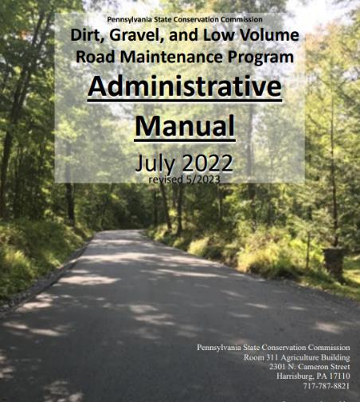
Proposed DGLVR Admin Manual updates for 7/1/2024
DGLVR Administrative Manual
Approved by SCC 5/10/22
Revised May 2023 (DSA spec update)
Introduction
SCC Role
Conservation District Role
Quality Assurance Board Role
Applicant Role
Center for Dirt and Gravel Roads
Additional Policies
Permits and Other Requirements
Appendices

Slide 15
Proposed DGLVR Admin Manual updates for 7/1/2024
DGLVR Administrative Manual Proposed 2024 updates
Introduction
SCC Role
Conservation District Role
Quality Assurance Board Role
Applicant Role
Center for Dirt and Gravel Roads
Additional Policies
Permits and Other Requirements
Appendices
Other documents
– minor clarifications
– minor clarifications
– updates and clarifications
– minor clarifications
– updated to match other chapters
– no change
– no change
– minor clarifications
– updated CAM examples
– completion report updates
– NEW contract attachment A “Project Scope of Work”

Slide 16
Proposed DGLVR Admin Manual updates for 7/1/2024
Review of proposed Admin Manual Updates
Main updates are reviewed in the following slides
To see every proposed change, see the track changes of the Admin Manual
Notes:
Examples of changes not included in this presentation:
Updating “Program Coordinator” title to “Program Manager” to accurately reflect the current title
Reiterating existing requirements in different sections of the admin manual
Listing Agricultural Conservation Assistance Program (ACAP) as something the SCC administers in the description of the SCC
Adding stream crossings to a list of example ESM practices
Clarifying that DGLVR allocations are posted on the Center’s website, not the PA Bulletin

Slide 17
Proposed DGLVR Admin Manual updates for 7/1/2024
Note: Black text is existing in the Admin Manual
Different colors are different people typing in “track changes”
hyperlinks appear as blue text
DRAFT for comment January 2024. This has not been approved by the SCC.

Slide 18
Proposed DGLVR Admin Manual updates for 7/1/2024
Section 3.7.1.2 Other Potential Applicants
Section 3.7.1.4 Ineligible Entities
DRAFT for comment January 2024. This has not been approved by the SCC.

Slide 19
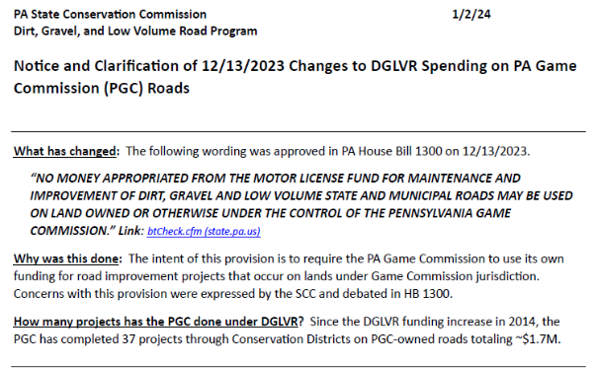
Proposed DGLVR Admin Manual updates for 7/1/2024
https://dirtandgravel.psu.edu/news/dglvr_update_on_pgc_roads/

Slide 20
Proposed DGLVR Admin Manual updates for 7/1/2024
Section 3.3.2 Advance Working Capital
DRAFT for comment January 2024. This has not been approved by the SCC.
Notes:
SCC may delay advance payments if there are outstanding quarterly reports, etc. from a district.

Slide 21
Proposed DGLVR Admin Manual updates for 7/1/2024
Section 3.3.4 Spending Requirements
DRAFT for comment January 2024. This has not been approved by the SCC.

Slide 22
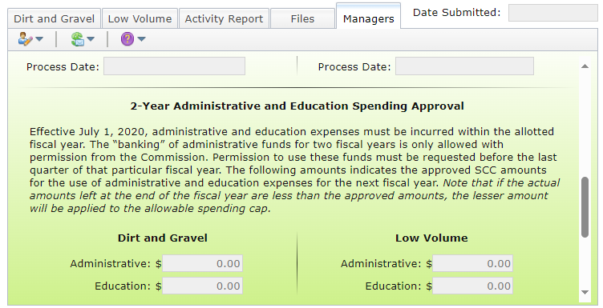
Proposed DGLVR Admin Manual updates for 7/1/2024

Slide 23
Proposed DGLVR Admin Manual updates for 7/1/2024
Section 3.4.2 Cost Allocation Method for Shared Expenses
Justin ate ½ slice of pizza
How much of the pizza does Justin pay for?
Justin pays for 1/16 of the pizza
DRAFT for comment January 2024. This has not been approved by the SCC.

Slide 24
Proposed DGLVR Admin Manual updates for 7/1/2024
Section 3.4.2 Cost Allocation Method for Shared Expenses
Similar clarifications throughout Section 3.4.2
DRAFT for comment January 2024. This has not been approved by the SCC.

Slide 25
Proposed DGLVR Admin Manual updates for 7/1/2024
Sections 3.4.3 Administration Funds & 3.4.4 Education Funds
Salary is an eligible administration and education expense
DGLVR administrative activities include:
Follow up visits to previously contracted DGLVR worksites for the purpose of ranking new grant applications or implementing local policies
DGLVR educational activities include:
Training new conservation district staff on DGLVR topics
Teaching individuals or small groups about the DGLVR Program on completed DGLVR sites
DGLVR education activities DO NOT include: ranking received applications
DRAFT for comment January 2024. This has not been approved by the SCC.

Slide 26
Proposed DGLVR Admin Manual updates for 7/1/2024
Section 3.4.3 Administrative Funds & 3.4.4 Education Funds
Note: The text in red is also proposed to be added to the education/training travel description as well.
DRAFT for comment January 2024. This has not been approved by the SCC.

Slide 27
Proposed DGLVR Admin Manual updates for 7/1/2024
Section 3.4.3 Administrative Funds
Section 3.4.4 Education Funds
DRAFT for comment January 2024. This has not been approved by the SCC.

Slide 28
Proposed DGLVR Admin Manual updates for 7/1/2024
Section 3.4.3 Administrative Funds
DRAFT for comment January 2024. This has not been approved by the SCC.

Slide 29
Proposed DGLVR Admin Manual updates for 7/1/2024
Section 3.4.4 Education Funds
DRAFT for comment January 2024. This has not been approved by the SCC.

Slide 30
Proposed DGLVR Admin Manual updates for 7/1/2024
Section 3.7.2 Eligible Roads
DRAFT for comment January 2024. This has not been approved by the SCC.

Slide 31
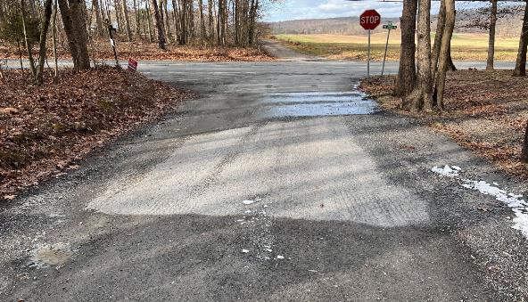
Proposed DGLVR Admin Manual updates for 7/1/2024
Section 3.7.2.3 Surface Conversions
Asphalt
Gravel
DRAFT for comment January 2024. This has not been approved by the SCC.
Notes:
Language on “approximately 50-100 ft max” will be updated.

Slide 32
Proposed DGLVR Admin Manual updates for 7/1/2024
Section 3.7.2.4 Retiring Roads
DRAFT for comment January 2024. This has not been approved by the SCC.

Slide 33
Proposed DGLVR Admin Manual updates for 7/1/2024
Section 3.7.2.5 Road Relocations
DRAFT for comment January 2024. This has not been approved by the SCC.

Slide 34
Proposed DGLVR Admin Manual updates for 7/1/2024
Section 3.7.2.6 Creating New Roads
DRAFT for comment January 2024. This has not been approved by the SCC.

Slide 35
Proposed DGLVR Admin Manual updates for 7/1/2024
Section 3.7.4.1 Materials
DRAFT for comment January 2024. This has not been approved by the SCC.

Slide 36
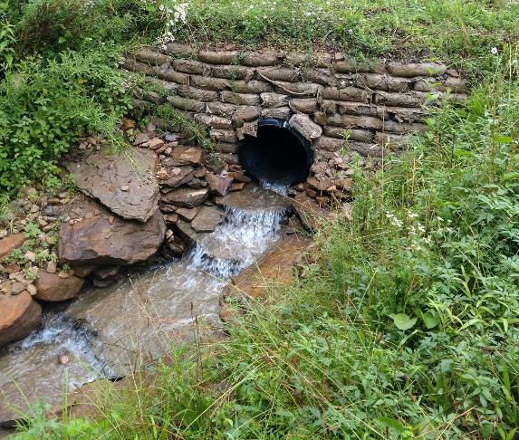
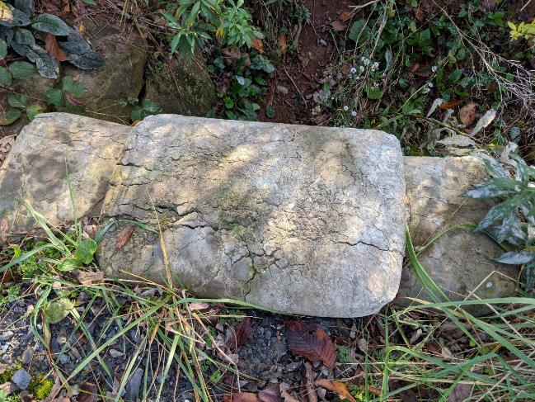
Proposed DGLVR Admin Manual updates for 7/1/2024
DRAFT for comment January 2024. This has not been approved by the SCC.

Slide 37
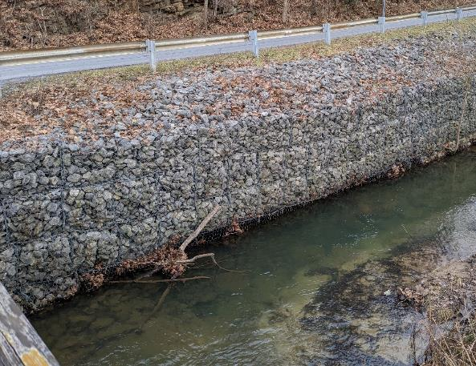
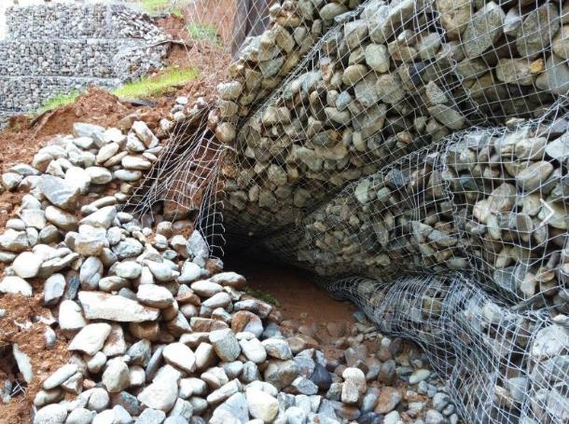
Proposed DGLVR Admin Manual updates for 7/1/2024
Note empty baskets on the bottom row
DRAFT for comment January 2024. This has not been approved by the SCC.

Slide 38
Proposed DGLVR Admin Manual updates for 7/1/2024
Section 3.8.6.1 Permits, PA One-Call
DRAFT for comment January 2024. This has not been approved by the SCC.

Slide 39
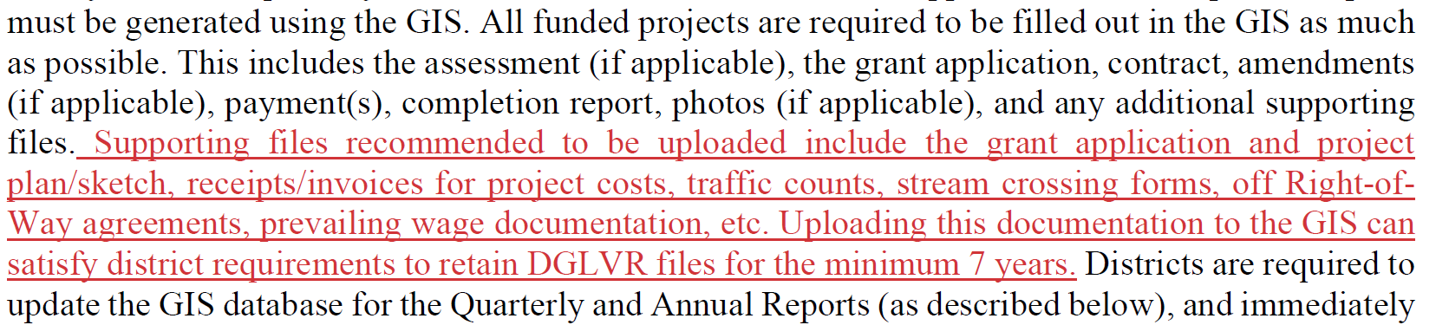
Proposed DGLVR Admin Manual updates for 7/1/2024
Section 3.9 GIS reporting System
DRAFT for comment January 2024. This has not been approved by the SCC.

Slide 40
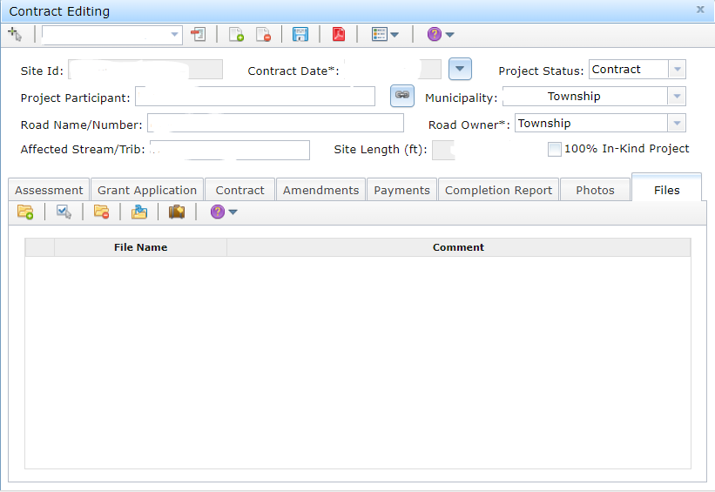
Proposed DGLVR Admin Manual updates for 7/1/2024

Slide 41
Proposed DGLVR Admin Manual updates for 7/1/2024
Section 4.1 QAB Composition
DRAFT for comment January 2024. This has not been approved by the SCC.

Slide 42
Proposed DGLVR Admin Manual updates for 7/1/2024
Section 4.3.1 Project Ranking
DRAFT for comment January 2024. This has not been approved by the SCC.

Slide 43
Proposed DGLVR Admin Manual updates for 7/1/2024
Appendix E: Cost Allocation Method Examples
Example 3 was moved to example 1 since this is the first one we discuss during Admin Training. Two updates are proposed:
Update the mileage rate from $0.58 to $0.67 per mile
Add clarification that either mileage reimbursement or direct vehicle expenses are eligible DGLVR expenses to match Admin Manual.
Example 1 from the previous version of the appendix was moved to example 2 and is unchanged.
A new example 3 was added with an example of a newsletter cost allocation method.
DRAFT for comment January 2024. This has not been approved by the SCC.

Slide 44
Proposed DGLVR Admin Manual updates for 7/1/2024
Webinar Outline
Why?
How to review and comment
Review of proposed Admin Manual Updates
Review of proposed Completion Report and Contract Attachment updates

Slide 45
Proposed Updates
Completion Report
Updates to make more effective.
Scope of Work
New form to identify what is “planned” to be done when contracting.
Will provide reason/background, then walk through forms.

Slide 46
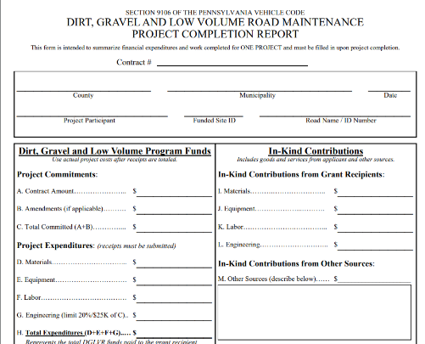
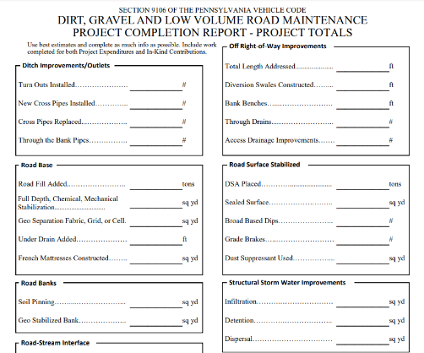
Proposed Updates to Completion Report
Problem
Financial: Difficult to break out materials/equipment/labor
Deliverables:
Many deliverables on form are seldom used (soil pinning, dispersal, etc.)
Some deliverables have no home on from or are difficult to fit (drop inlets, SS)
More information needed for stream crossings done under standard

Slide 47
Proposed Updates to Completion Report
Problem
Financial: Difficult to break out materials/equipment/labor
Deliverables:
Many deliverables on form are seldom used (soil pinning, dispersal, etc.)
Some deliverables have no home on from or are difficult to fit (drop inlets, SS)
More information needed for stream crossings done under standard
Proposed Changes
Financial: Change breakout to identify what goes to contractor and engineer
Deliverables:
Update to better quantify what is done in field
Create separate page to report on stream crossing

Slide 48
Proposed New Scope of Work
Problem
Grant Application is currently attached to Contract to describe project
Shortfalls:
Often what is funded is not exactly the same as what is applied for.
Lacks detail on deliverables.
Program does not know what any project includes until it is done!

Slide 49
Proposed New Scope of Work
Problem
Grant Application is currently attached to Contract to describe project
Shortfalls:
Often what is funded is not exactly the same as what is applied for.
Lacks detail on deliverables.
Program does not know what any project includes until it is done!
Proposed New “Scope of Work” form
Replaces Grant Application as contract attachment (GA still used by applicants)
Better identifies financial breakdown
Better identifies “Planned Deliverables”
“Planned Deliverables” will be read into completion report for confirmation/editing (e.g Planned 7 pipes, added 1 so actually installed 8)

Slide 50
Proposed DGLVR Admin Manual updates for 7/1/2024
Contract Attachments:
Attachment A: Grant Application Project Scope of work
Attachment B: General Contract Provisions
Attachment C: Statement of Policy
Attachment D: QAB/District Standards and Policies
Attachment E: Schedule of Payments
Attachment F: Prevailing Wage Notification Letter
Attachment G: Prevailing Wage Certified Statement of Compliance
Note that the PW Certified Weekly Payroll and Certified Statement of Compliance will still be required to be kept in project files
DRAFT for comment January 2024. This has not been approved by the SCC.

Slide 51
Proposed DGLVR Admin Manual updates for 7/1/2024
Section 3.8.5.1 Contract Attachments
Proposed “Project Scope of Work” attachment will be reviewed with the proposed updates to the completion report
DRAFT for comment January 2024. This has not been approved by the SCC.
Notes:
The Project Scope of Work proposed contract attachment is intended to provide a clearer explanation of the work funded by the contract as well as help the Center/SCC predict workload of upcoming projects statewide. The form includes parts of the grant application and a page based on the completion report to make this attachment as easy as possible.

Slide 52
Proposed Updates
Completion Report
Updates to make more effective.
Scope of Work
New form to identify what is “planned” to be done when contracting.
Walkthrough of forms (provided to CDs 1/3)

Slide 53
Proposed DGLVR Admin Manual updates for 7/1/2024
Upcoming Webinars
Thursdays at 9am
Topic list and webinar link available on Center’s website:
https://dirtandgravel.psu.edu/education-training/webinars/
Thurs 1/18/24: 2023 Project Showcase
Thurs 1/25/24: TBD

