Slide 1
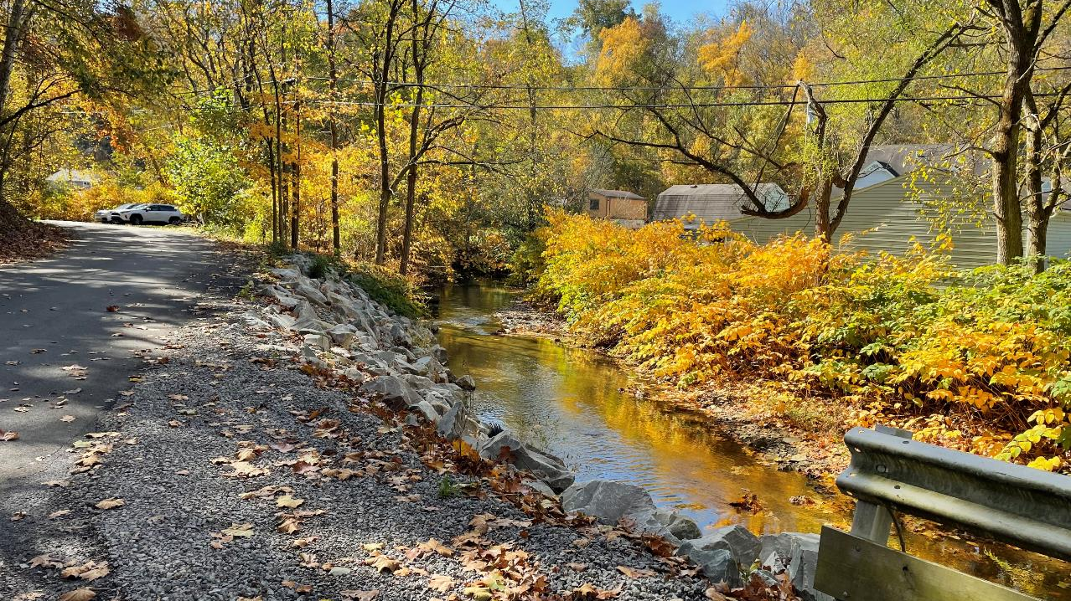


Dirt Gravel and Low Volume Road Program
WEBINAR
2/22/24
Starts 9am
DGLVR Admin Manual Revised Updates
SCC
Roy Richardson
rrichardso@pa.gov
Sherri Law
shlaw@pa.gov
Andy Mickey
anmickey@pa.gov
CDGRS
Steve Bloser
smb201@psu.edu
If you are reading this, then you are successfully seeing the webinar video. Webinar audio should be automatic through your computer (or click “join audio”), and options can be accessed in the “audio options” button on the bottom left. If your computer audio is not working, you can listen on your phone by dialing 312-626-6799.

Slide 2

Proposed DGLVR Admin Manual updates for 7/1/2024
Webinar Outline
Brief Introduction
Review of proposed Admin Manual Updates
Review of proposed Completion Report and Contract Attachment updates
Reminders and Updates

Slide 3
Proposed DGLVR Admin Manual updates for 7/1/2024
Why?
The purpose of the Administrative Manual is to clearly explain how the DGLVR Program works
Provide clear and accurate guidance to conservation districts
Be responsible with DGLVR funding and follow requirements in the law and SCC Statement of Policy

Slide 4
Proposed DGLVR Admin Manual updates for 7/1/2024
https://dirtandgravel.psu.edu/education-training/esm-course/in-person-esm-trainings/
Timeline
Fall 2023: SCC staff worked with Center staff to draft proposed changes
Nov-Dec 2023: DGLVR Policy & Planning workgroup reviewed proposed updates and provided feedback
Jan 3, 2024: Proposed updates emailed to conservation districts for review
Jan-Feb 9, 2024: CDs review and comment on proposed changes
Feb 9, 2024: CD comments due to SCC
Feb 13, 2023: P&P workgroup to discuss proposed revisions
March-April 2024: SCC legal and policy review
May or July 2024: Changes go to SCC meeting for approval
July 1, 2024: propose to make changes effective

Slide 5
Proposed DGLVR Admin Manual updates for 7/1/2024
Webinar Outline
Brief Introduction
Review of proposed Admin Manual Updates
Review of proposed Completion Report and Contract Attachment updates
Reminders and Updates

Slide 6
Proposed DGLVR Admin Manual updates for 7/1/2024
See previously recorded webinar for explanation of original changes
January 11, 2024: DGLVR Admin Manual Proposed Updates
  Review of the proposed DGLVR Admin Manual and Completion Report changes.
  Webinar Download (113 MB): MP4 format (~1 hour, 5 minutes)
  Presentation Downloads:
    Adobe PDF (3.33 MB)
    MS Powerpoint (3.25 MB)

Slide 7
Proposed DGLVR Admin Manual updates for 7/1/2024
Screenshare Admin Manual

Slide 8
Proposed DGLVR Admin Manual updates for 7/1/2024
Webinar Outline
Brief Introduction
Review of proposed Admin Manual Updates
Review of proposed Completion Report and Contract Attachment updates
Reminders and Updates

Slide 9
Proposed Updates
Completion Report
Updates to make more effective.
Scope of Work
New form to identify what is “planned” to be done when contracting.

Slide 10
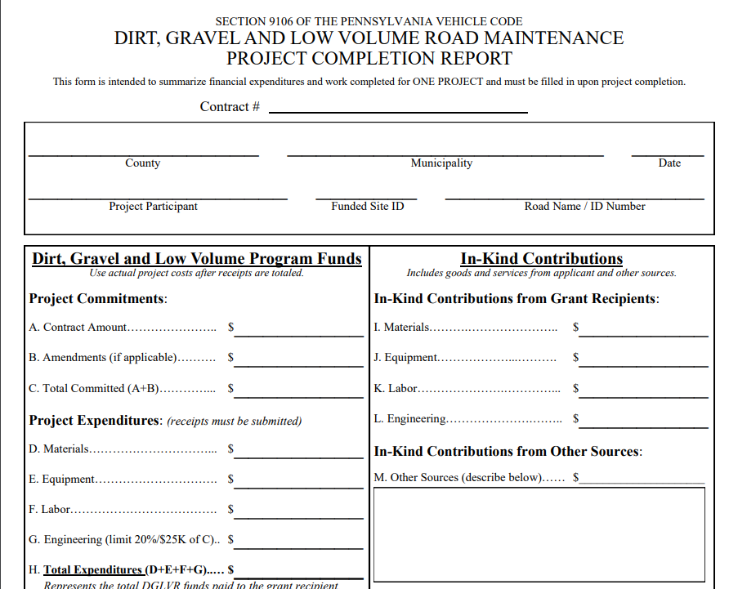
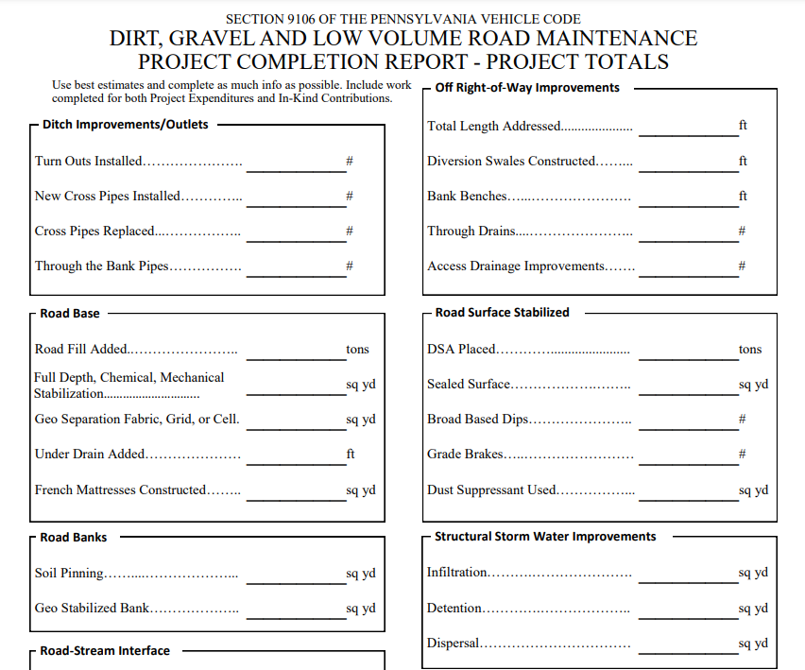
Proposed Updates to Completion Report
Problem
Financial: Difficult to break out materials/equipment/labor
Deliverables:
  Many deliverables on form are seldom used (soil pinning, dispersal, etc.)
  Some deliverables have no home on from or are difficult to fit (drop inlets, SS)
  More information needed for stream crossings done under standard

Slide 11
Proposed Updates to Completion Report
Problem
Financial: Difficult to break out materials/equipment/labor
Deliverables:
  Many deliverables on form are seldom used (soil pinning, dispersal, etc.)
  Some deliverables have no home on from or are difficult to fit (drop inlets, SS)
  More information needed for stream crossings done under standard
Proposed Changes
Financial: Change breakout to identify what goes to contractor and engineer
Deliverables:
  Update to better quantify what is done in field
  Create separate page to report on stream crossing

Slide 12
Proposed New Scope of Work
Problem
Grant Application is currently attached to Contract to describe project
Shortfalls:
  Often what is funded is not exactly the same as what is applied for.
  Lacks detail on deliverables.
  Program does not know what any project includes until it is done!

Slide 13
Proposed New Scope of Work
Problem
Grant Application is currently attached to Contract to describe project
Shortfalls:
  Often what is funded is not exactly the same as what is applied for.
  Lacks detail on deliverables.
  Program does not know what any project includes until it is done!
Proposed New “Scope of Work” form
Replaces Grant Application as contract attachment (GA still used by applicants)
Better identifies financial breakdown
Better identifies “Planned Deliverables”
“Planned Deliverables” will be read into completion report for confirmation/editing (e.g Planned 7 pipes, added 1 so actually installed 8)

Slide 14
Proposed Updates
Completion Report
Updates to make more effective.
Scope of Work
New form to identify what is “planned” to be done when contracting.
Walkthrough of form updates

Slide 15
Proposed DGLVR Admin Manual updates for 7/1/2024
Screenshare Comp report and Scope of Work

Slide 16
Proposed DGLVR Admin Manual updates for 7/1/2024
Webinar Outline
Brief Introduction
Review of proposed Admin Manual Updates
Review of proposed Completion Report and Contract Attachment updates
Reminders and Updates

Slide 17
Proposed DGLVR Admin Manual updates for 7/1/2024
https://dirtandgravel.psu.edu/education-training/esm-course/in-person-esm-trainings/
Timeline
Fall 2023: SCC staff worked with Center staff to draft proposed changes
Nov-Dec 2023: DGLVR Policy & Planning workgroup reviewed proposed updates and provided feedback
Jan 3, 2024: Proposed updates emailed to conservation districts for review
Jan-Feb 9, 2024: CDs review and comment on proposed changes
Feb 9, 2024: CD comments due to SCC
Feb 13, 2023: P&P workgroup to discuss proposed revisions
March-April 2024: SCC legal and policy review
May or July 2024: Changes go to SCC meeting for approval
July 1, 2024: propose to make changes effective

Slide 18
Training details and registration online at https://dirtandgravel.psu.edu/education-training/
ESM Training: Required for grant applicants and CD staff administering the DGLVR Program (5-year certification)
Admin Training: Required for CD staff involved in the DGLVR Program (3-year certification)
Financial Training: Recommended for any CD staff involved in tracking/spending DGLVR funds
Stream Crossing Training – for CDs
Required for conservation districts in order to fund stream crossing projects (3-year certification)
May 21 – 23, June 11 – 13, August 13 – 15 (all Centre County)
Registration open soon
Stream Crossing Training – for engineers
Recommended for any consultants working on DGLVR stream crossing projects
July 1 & 2 (Centre County), August 28 & 29 (McKean County), September 18 & 19 (Monroe County)
Registration open soon
ESM Bootcamps
Recommended for CD staff designing and overseeing DGLVR projects
2 in the works for 2024, Centre CCD. Details TBD

Slide 19
Proposed DGLVR Admin Manual updates for 7/1/2024
Upcoming Webinars
Thursdays at 9am: https://dirtandgravel.psu.edu/education-training/webinars/
February 29: New Hire Guide for CD DGLVR Technicians: Staffing turnover at conservation districts can cause significant disruptions to CD projects and programs. The Center has worked with the SCC to develop a “New Hire Guide” for new Conservation District DGLVR Technicians to facilitate their orientation to the Program. This webinar will review the new guide which will be made available.
March 7: DGLVR Annual Summary Report Overview: A “big-picture” review of spending and project data from the 2023 Annual Summary Report based on CD GIS data.
March 21: DSA Season Primer: With DSA season just around the corner, this webinar will provide a refresher on DSA testing, purchasing, and placement.

Slide 20

DGLVR Program
Spending Update
  5-Year Spending Update
    All funding from agreement must be spent out by 6/30/2024
    Current CD Status as of 2/21/2024
      Spent everything: 24 DGR, 20 LVR
      Committed everything: 24 DGR, 29 LVR
      Not committed: 16 DGR, 17 LVR

Slide 21
DGLVR Program
Spending Update
  5-Year Spending Update - Financials
    Dirt and Gravel
      Committed: $4,219,970.78
      Not Committed: $464,751.52
    Low Volume
      Committed: $2,689,685.79
      Not Committed: $867,122.70
    Total
      DGR: $4,684,772.30
      LVR: $3,556,808.49
      Total: $8,241,530.79

Slide 22
DGLVR Program
Spending Update
  Question:
  How do I know how much I need to spend to meet my spending requirements?
    Answer:
  This information is available in the GIS.

Slide 23
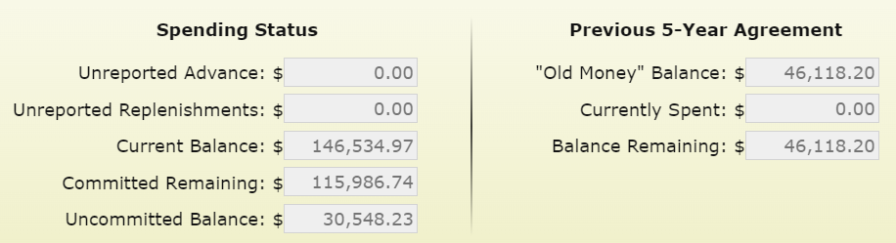
DGLVR Program
Spending Update
  Question:
  How do I know if I have all my “old money” contracted?
    Answer:
  If your Committed Remaining is greater than the Balance Remaining.

Slide 24
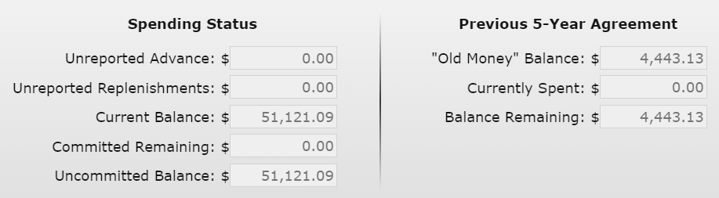
DGLVR Program
Spending Update
  Question:
  How do I know if I still have “old money” to contract?
    Answer:
  If your Committed Remaining is less than the Balance Remaining.

Slide 25
DGLVR Program
Spending Update
  5-Year Spending Update
    If you are Green in both DGR and LVR, great job!
    If you are Yellow or Red in DGR and/or LVR, expect follow-up status calls/emails.

