Slide 1




Dirt Gravel and Low Volume Road Program
WEBINAR
Stream Crossings: the good, the bad, and the
in-between
Survey Results
ESM Trainings
Webinars
Longer Remote Trainings
Online training Center
Winter Tech Assists
2/11/21 Starts at 9am
If you are reading this, then you are successfully seeing the webinar video. Webinar audio should be automatic through your computer (or click “join audio”), and options can be accessed in the “audio options” button on the bottom left. If your computer audio is not working, you can listen on your phone by dialing 646-876-9923.

Slide 2
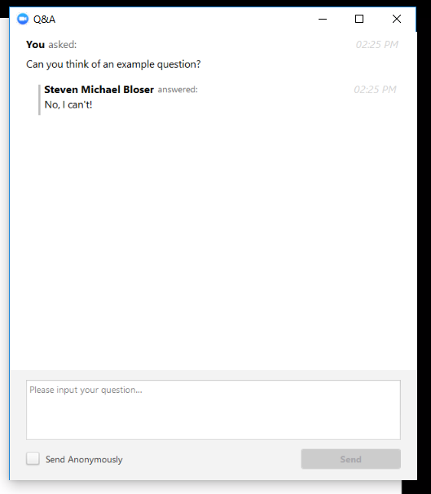
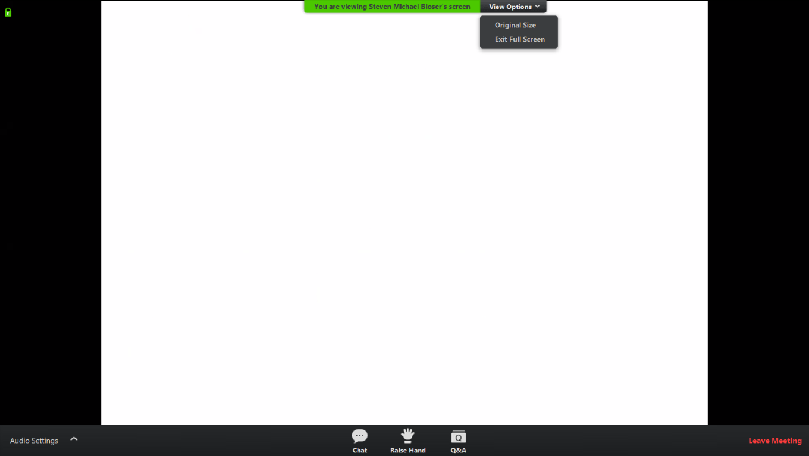
Road Aggregates 101
Note you can ask a question anonymously
Q&A
For audio via phone: 646-876-9923
2

Slide 3
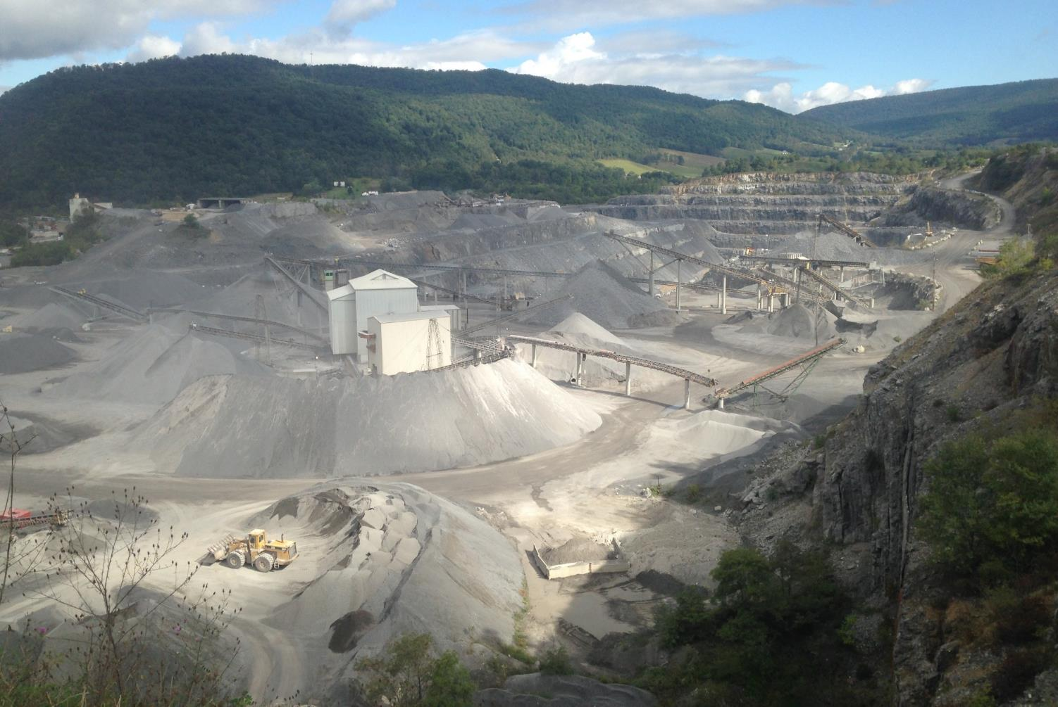
Road Aggregates 101

Slide 4
Road Aggregates 101
  Purpose
  Introduce the updated “Aggregates 101” technical bulletin.
  Provide an introduction to commonly used road aggregates, especially for new CD staff.

Slide 5
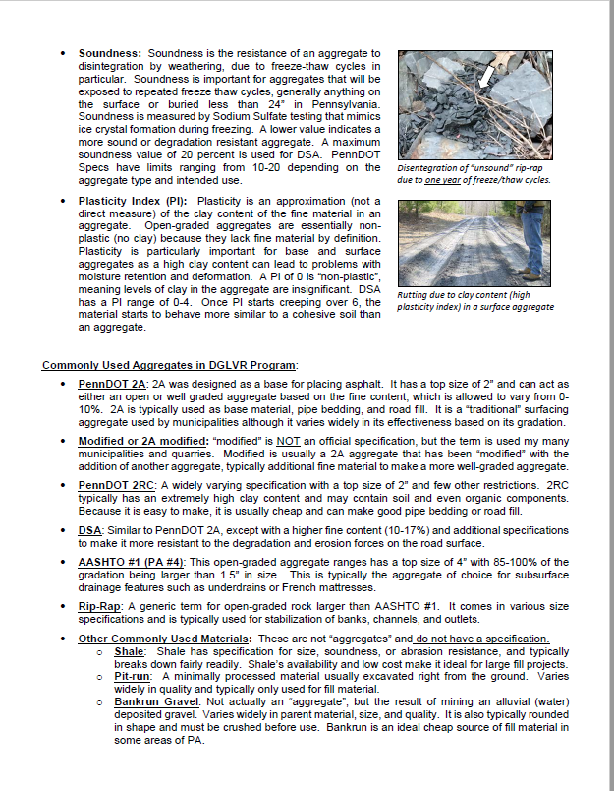
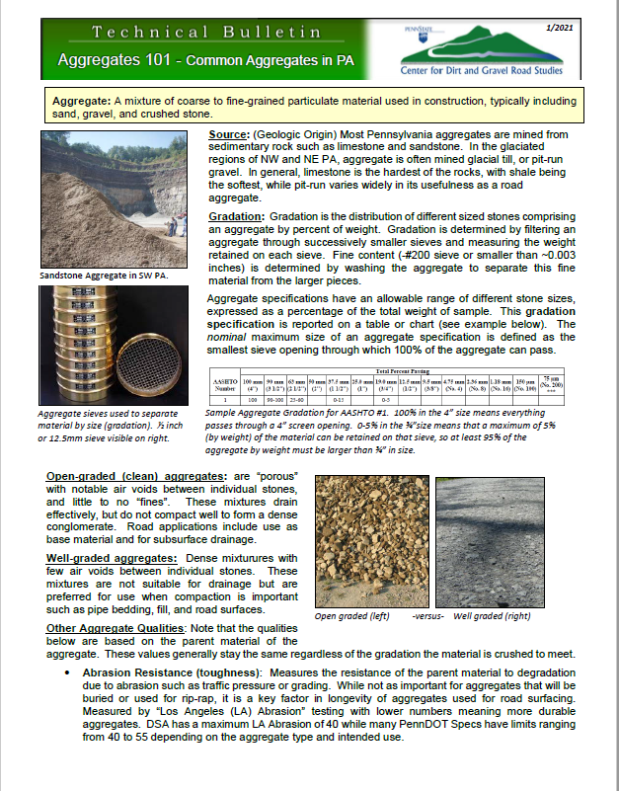
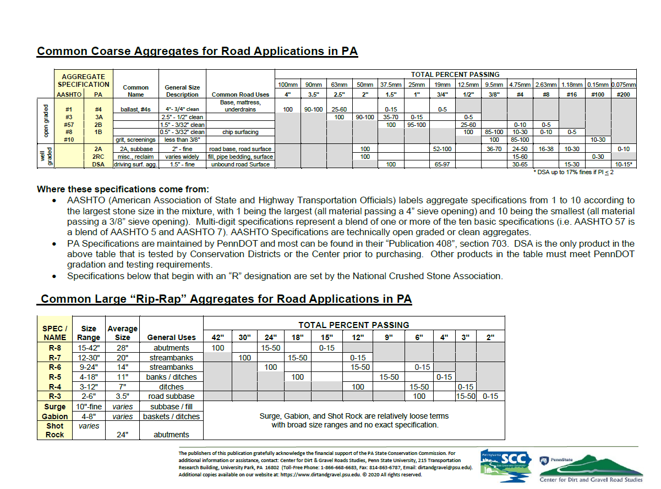
Road Aggregates 101
  Update and expanded “Aggregates 101” technical bulletin

Slide 6
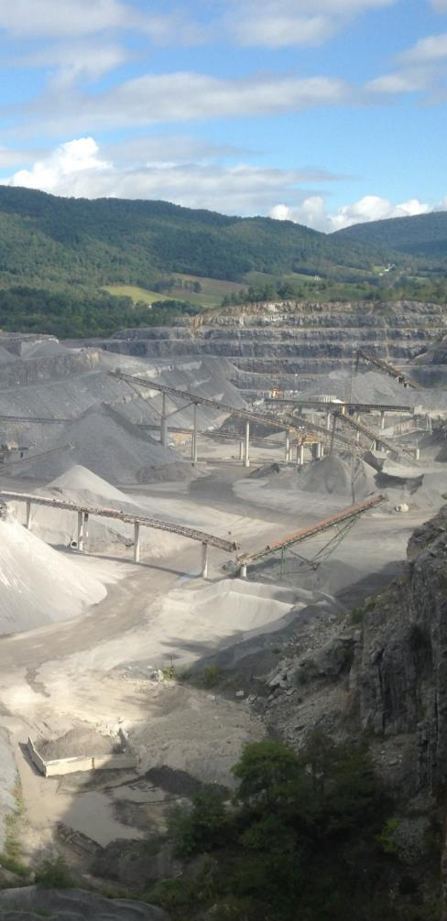
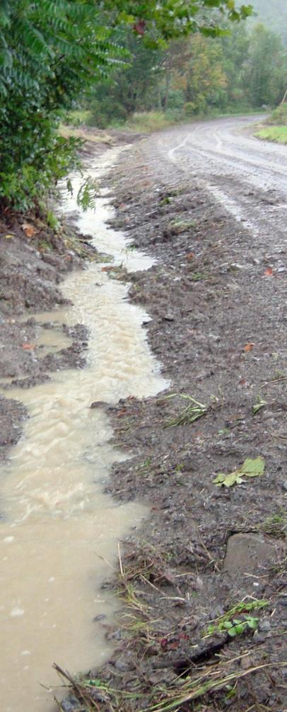
Road Aggregates 101
  Background
  Important Aggregate Properties
  Commonly Used Aggregates
    Coarse Aggregates
    Larger “rip-rap” aggregates

Slide 7
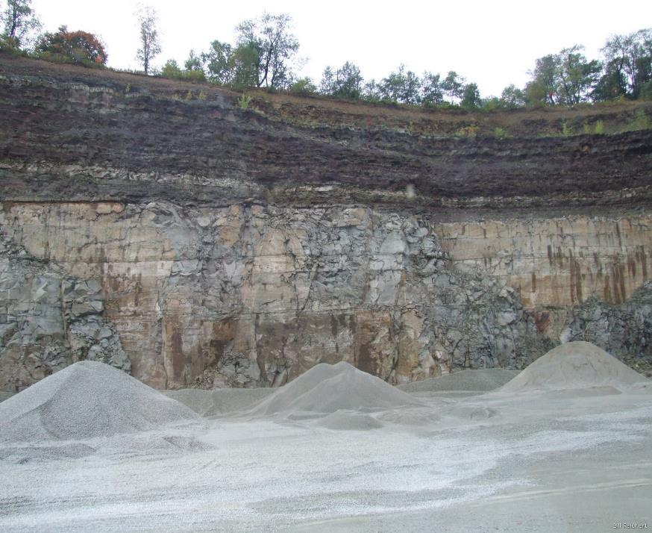
Road Aggregates 101
Background
  Aggregate: A mixture of coarse to fine-grained particulate material used in construction, typically including sand, gravel, and crushed stone.
  Sources:
    Limestone
    Sandstone

Slide 8
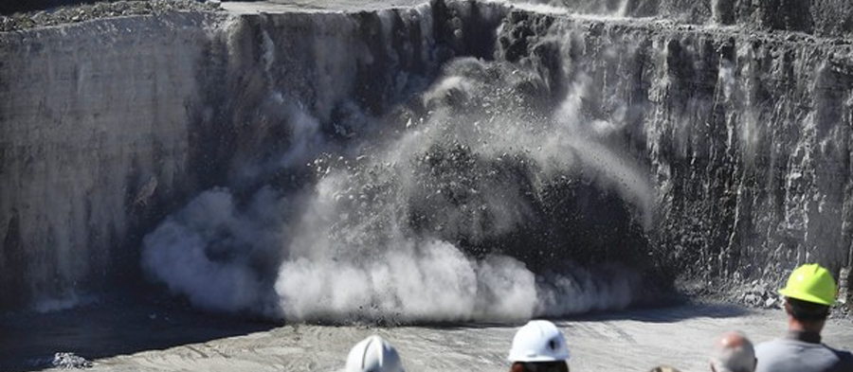
Road Aggregates 101
Background
  Making Aggregates:
    Blast
    Crush
    Sieve
https://www.geoengineer.org/news/last-blast-at-thornton-quarry-creates-a-new-reservoir

Slide 9
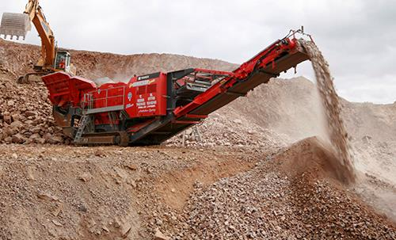
Road Aggregates 101
Background
  Making Aggregates:
    Blast
    Crush
    Sieve
https://www.terex.com/finlay/en/product/jaw-crushers/j-1480

Slide 10
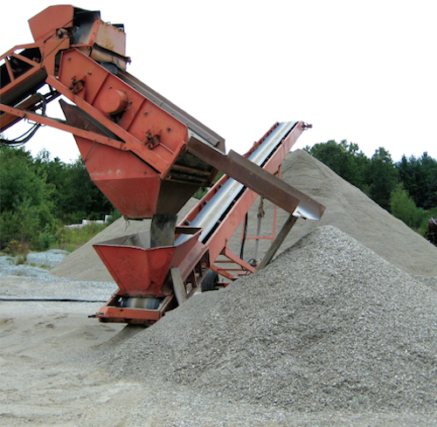
Road Aggregates 101
Background
  Making Aggregates:
    Blast
    Crush
    Sieve
https://www.quarrymagazine.com/2020/03/19/blending-of-recycled-glass-and-crushed-rock-in-road-pavements/
https://www.terex.com/finlay/en/product/jaw-crushers/j-1480
Small size
Large size

Slide 11
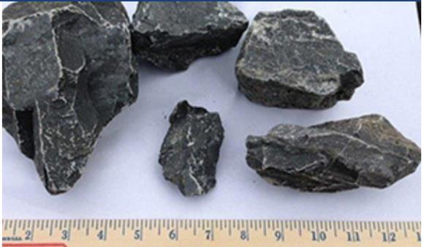
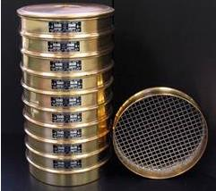
Road Aggregates 101
Background
  Gradation: Size distribution of particle in an aggregate by percent weight
  Example: AASHTO #1
    Mixture of 2-3 inch stones with
    no fine material
http://www.pennsysupply.com/construction-materials/aggregate.asp

Slide 12
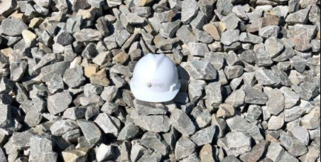

Road Aggregates 101
Background
  Gradation: Size distribution of particle in an aggregate by percent weight
  Example: AASHTO #1
    Mixture of 2–3 inch stones with
    no fine material
https://laurelaggregates.com/products/aashto-1/
Everything must pass a 4” opening
At least 85% of material larger than 1.5”
Max 5% by weight can pass ¾” opening

Slide 13
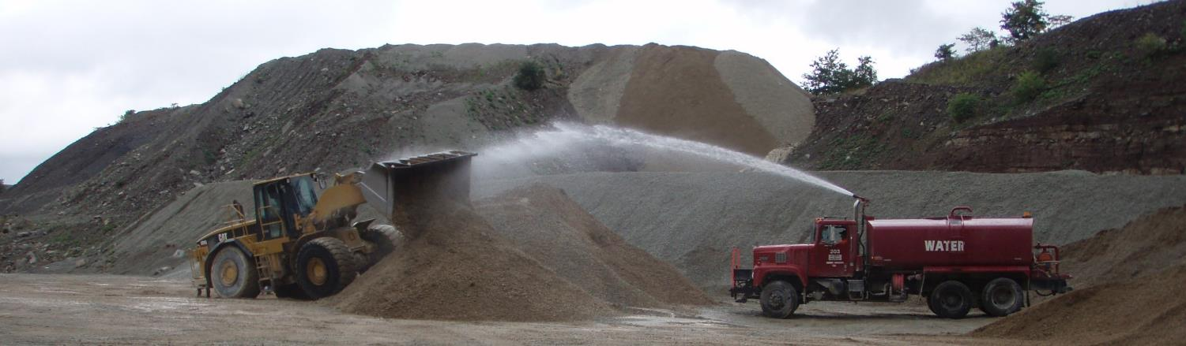
Road Aggregates 101
Background
  Gradation: Size distribution of particle in an aggregate by percent weight
    Some Gradations can be crushed directly
    Some may have to be mixed after crushing
    Gradation is about size, It is independent of aggregate quality. Both good and bad parent material can be crushed to the same gradation.
Mixing 2A and fines to make DSA

Slide 14
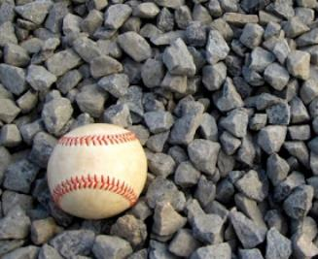
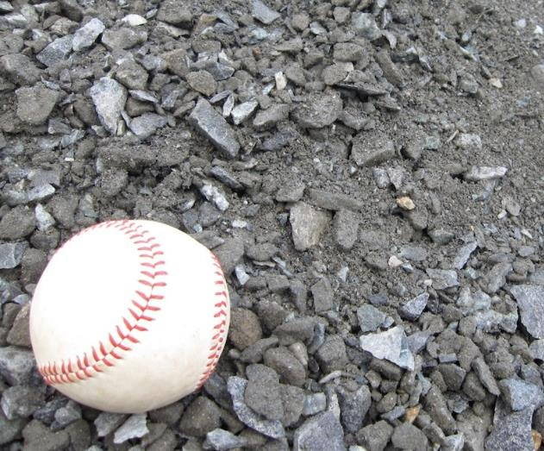
Road Aggregates 101
Background
  Gradation: Size distribution of particle in an aggregate by percent weight
  Open -vs- Well graded aggregates: drainage and compaction are mutually exclusive
Open-Graded (Clean)
Compaction? NO
Free draining? YES
Well-Graded
Compaction? YES
Free draining? NO
http://www.martinstone.com/products/stone-modified/

Slide 15
Road Aggregates 101
  Background
  Important Aggregate Properties
  Commonly Used Aggregates
    Coarse Aggregates
    Larger “rip-rap” aggregates

Slide 16
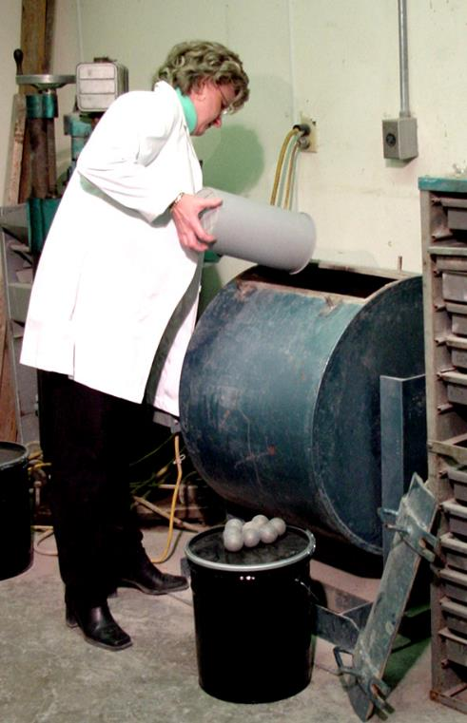
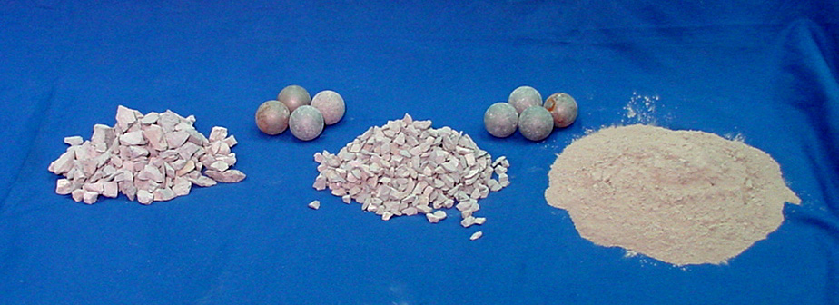
Road Aggregates 101
Aggregate Quality Properties
  Abrasion Resistance: Resistance to mechanical breakdown. Measured by “LA Abrasion”
Aggregate is placed in steel drum with steel spheres and rotated.
Results are expressed as % loss
Lower % = less crushing = harder aggregate

Slide 17
Road Aggregates 101
Aggregate Quality Properties
  Abrasion Resistance: Resistance to mechanical breakdown.
Abrasion resistance is most important for surface aggregates to resist traffic, grading, etc.
  Driving Surface Aggregate (DSA) (max LA Abrasion of 40)
  Anything used as a surface (most DOT aggregates range from 40-55)
Abrasion resistance less important if aggregate is to be buried or used off of the cartway.

Slide 18
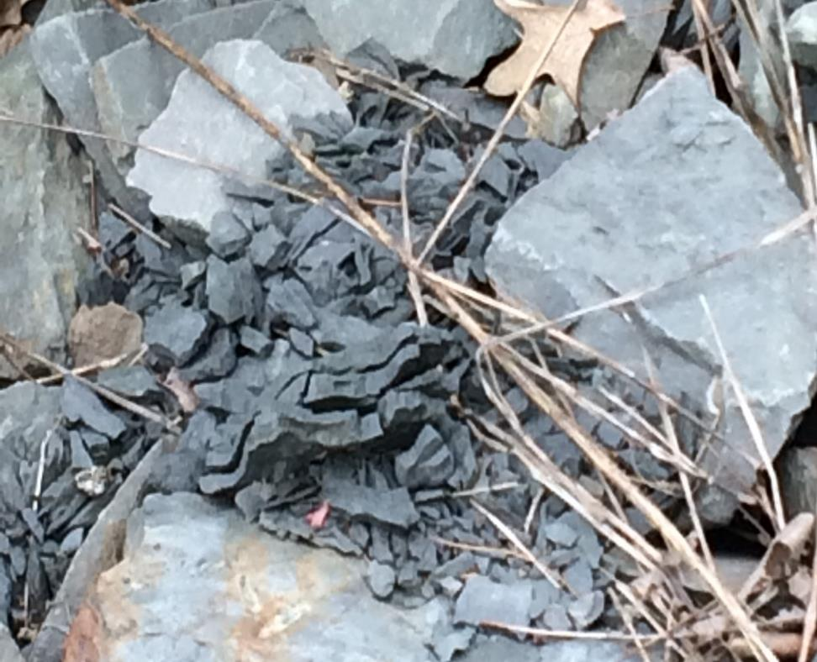
Road Aggregates 101
Aggregate Quality Properties
  Soundness: Resistance to weathering, specifically by freeze thaw cycles
Have you ever seen a rock do this is as little as one year?
That is poor soundness.

Slide 19
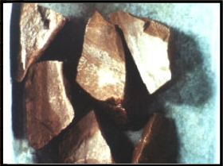
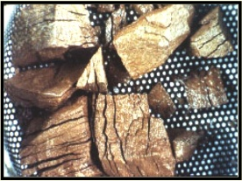
Road Aggregates 101
Aggregate Quality Properties
  Soundness: Measured by Sodium Sulfate test
Aggregate is soaked in sodium sulfate then dried 5 times, which mimic freeze thaw cycles.
Results are expressed as % loss
Lower % = less breakdown = more sound aggregate
BEFORE
AFTER

Slide 20
Road Aggregates 101
Aggregate Quality Properties
  Soundness: Measured by Sodium Sulfate test
Soundness is most important for anything exposed to freezing temperatures
  Surface aggregates
  Shallow bases
  Rip Rap
  Shallow or exposed subsurface drains
  Anything not buried at least 18-32 inches
Soundness is less important for material buried below frost depth such as large fill projects.

Slide 21
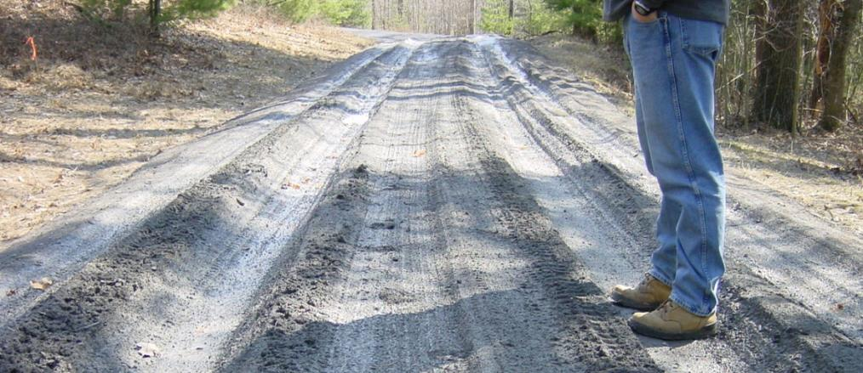
Road Aggregates 101
Aggregate Quality Properties
  Plasticity Index: PI is an approximation of clay in an aggregate
  Impacts of clay in aggregate
    Retain water
    Remains mobile (dust and sediment)
    Remain flexible (rutting)

Slide 22
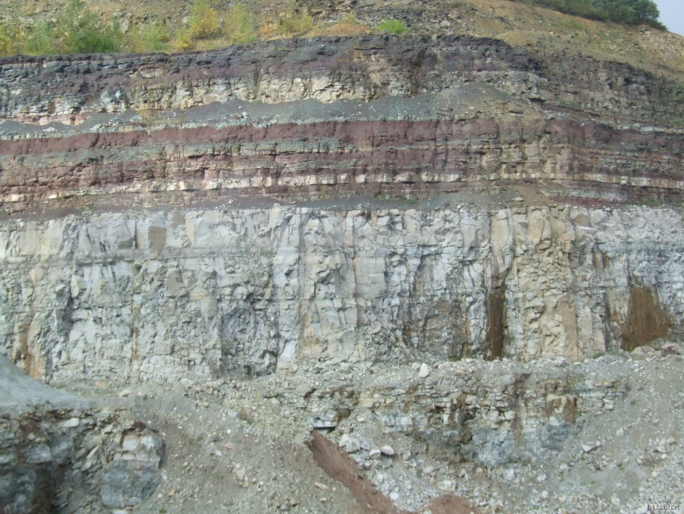
Road Aggregates 101
Aggregate Quality Properties
  Plasticity Index: PI is an approximation of clay in an aggregate
  Where does clay
  come from?
How much overburden may get mixed in?
Are there clay seems in this limestone?

Slide 23
Road Aggregates 101
Aggregate Quality Properties
  Plasticity Index: PI is an approximation of clay in an aggregate
Plasticity is only run on material passing the #40 (<1mm)
Open graded or clean aggregate are “non plastic” by default
  Plasticity index
    0 = “non-plastic” (negligible clay / silt content)
    1-4 = some clay / silt
    4-6 = clay content can make material “sticky”
    6+ = starts to behave more like soil than aggregate

Slide 24
Road Aggregates 101
IMPORTANT
  Abrasion Resistance, Soundness, and Plasticity are related to properties of the parent material.
    They can vary slightly from one rock face to another within the same quarry.
    They essentially remain the same regardless of the gradation or level of crushing done to the aggregate

Slide 25
Road Aggregates 101
  Background
  Important Aggregate Properties
  Commonly Used Aggregates
    Coarse Aggregates
    Larger “rip-rap” aggregates

Slide 26
Road Aggregates 101
Aggregates
  A word about specifications
AASHTO (American Association of State and Highway Transportation Officials) Federal spec on open-graded or clean stone
PA Specifications are maintained by PennDOT largely for well-graded aggregates (“Publication 408”, section 703).
note some redundancy, for example ASSHTO #1 = PA #4
Specifications that begin with an “R” designation are set by the National Crushed Stone Association.

Slide 27
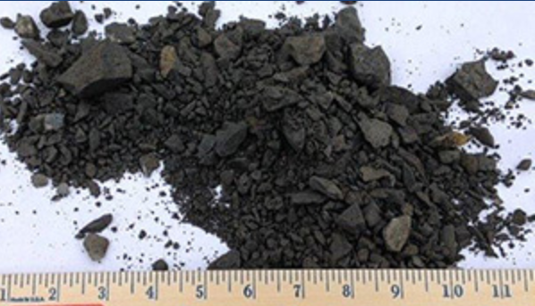
Road Aggregates 101
Common Coarse Aggregates
  PENNDOT 2A: well-graded
Designed as base for asphalt
Very common “standard” aggregate
2” top size
Fine content ranges from 0-10%
  Near 0, behaves almost as an open-graded aggregate
  Near 10, very well graded, approaching DSA
No plasticity specification
http://www.pennsysupply.com/construction-materials/aggregate.asp

Slide 28
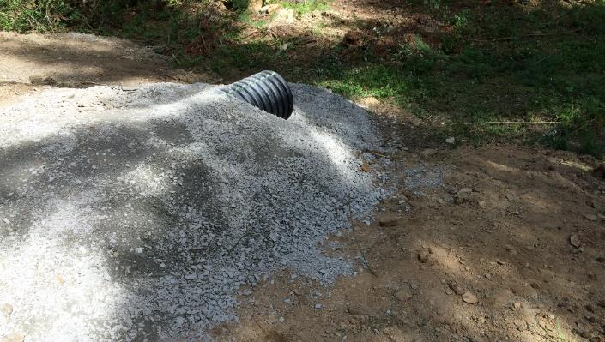
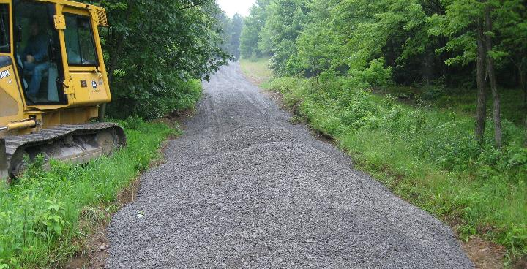
Road Aggregates 101
2A for crosspipe bedding
Common Coarse Aggregates
  PENNDOT 2A: well-graded
Uses
  Road base and subbase
  Pipe bedding
  Road fill (in areas where cost is low)
  Traditional road surface
  (not recommended due to variability of fines)
2A for road fill / base

Slide 29
Road Aggregates 101
Common Coarse Aggregates
  PENNDOT 2A “Modified”
“Modified” does NOT exist as a spec.
Some quarries and townships will still use the term.
What is it?
  2A with extra fines
Purchase at your own risk since there is no spec.

Slide 30
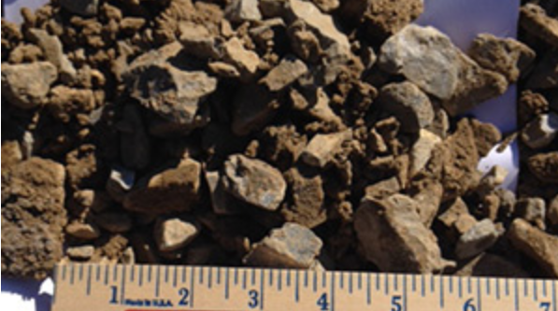
Road Aggregates 101
Common Coarse Aggregates
  PENNDOT 2RC: well-graded
Wide ranging in size and quality
Very common “standard” aggregate
2” top size
Fine content ranges from 0-30%
  Near 0, behaves almost as an open-graded aggregate
  Near 30…you just bought dirt
Can contain soil and even organics
Typically, high PI (lots of clay)
http://www.pennsysupply.com/construction-materials/aggregate.asp

Slide 31
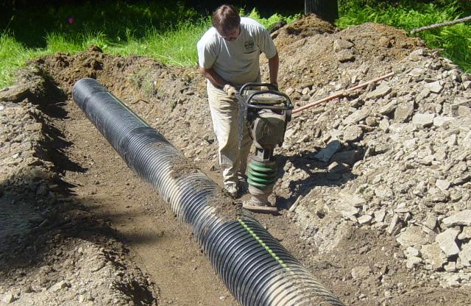
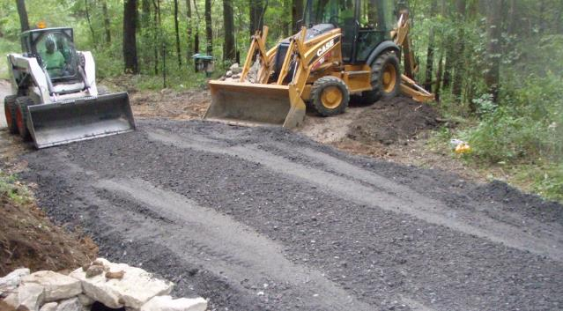
Road Aggregates 101
2RC for pipe bedding
Common Coarse Aggregates
  PENNDOT 2RC: well-graded
Uses
  Pipe bedding / backfill
  Road fill
  Traditional road surface
  (not recommended due to variability of fines and clay content)
2RC for road fill / base

Slide 32
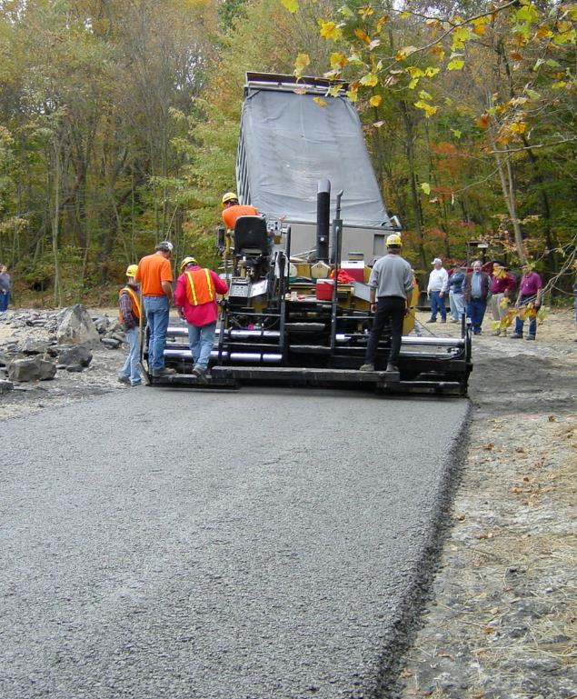
Road Aggregates 101
Common Coarse Aggregates
  Driving Surface Aggregate (DSA)
Like PennDOT 2A, BUT:
  Fine content is 10-17
  Stricter specs on abrasion resistance, soundness, and plasticity
  Additional specifications on placement
Designed for compaction and longevity as a wearing surface
2/4: Remote Training: “DSA Day”: Feb 4, 9am-noon

Slide 33
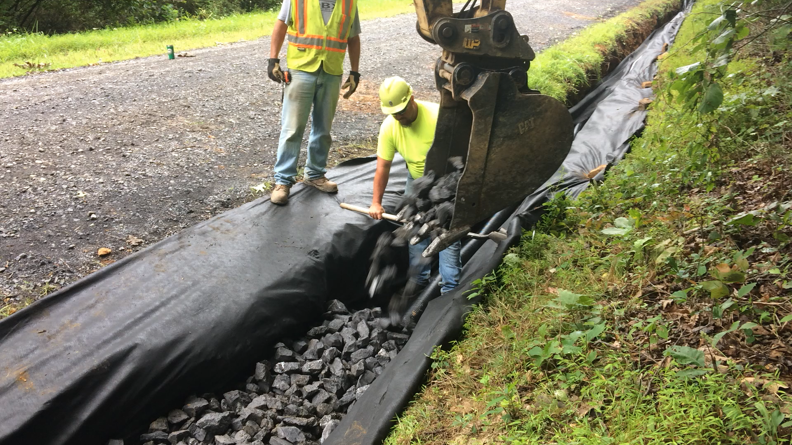
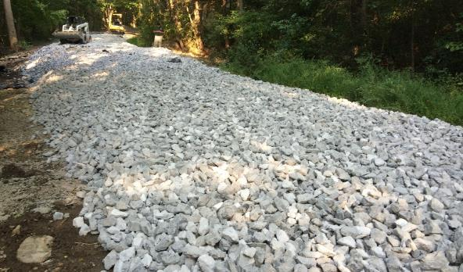
Road Aggregates 101
AASHTO # 1 for underdrain
Common Coarse Aggregates
  AASHTO #1 (PA#4)
Most used free-draining spec
Gradation
  Top size of 4”
  Only 15% can be smaller than 1.5”
  Only 5% can be smaller than ¾”
Uses
  Subsurface drainage
  Base stabilization
AASHTO # 1 for French Mattress

Slide 34
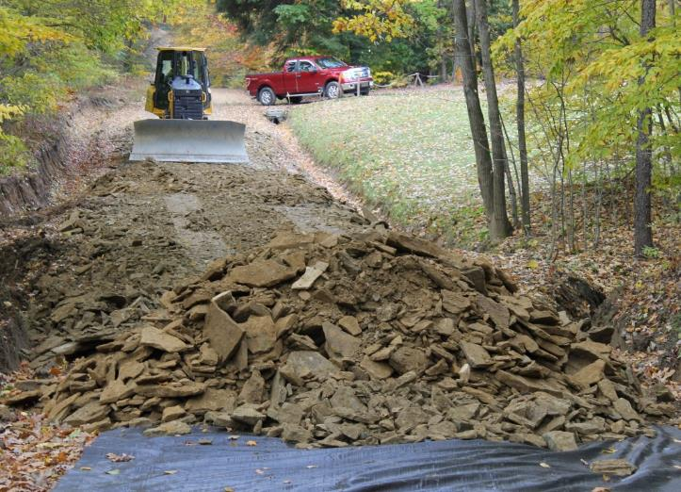
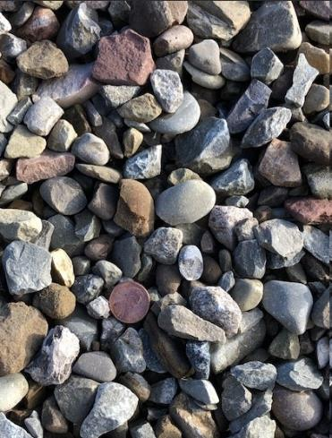
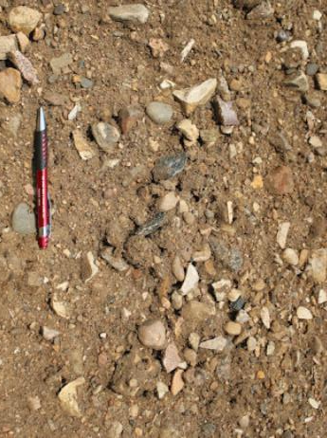
Road Aggregates 101
Shale as road fill
Common Coarse Aggregates
  Other Common Materials
Shale
Pit Run
Bankrun Gravel
These do NOT have a specification.
Typically excavated directly from ground with no processing.
They are highly variable in composition and quality
Primarily used as cheap sources of fill
Pit Run
Bankrun Gravel
Road Fill RFQ available on Center’s website
http://www.millcreeksandgravel.com/crush-gravel http://mccollumtrucking.com/gravel/

Slide 35
Road Aggregates 101
  Background
  Important Aggregate Properties
  Commonly Used Aggregates
    Coarse Aggregates
    Larger “rip-rap” aggregates

Slide 36
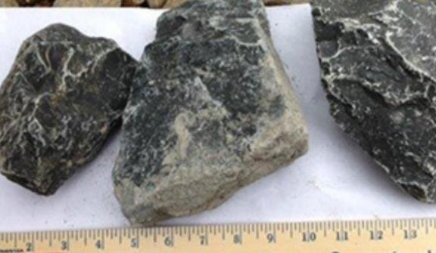
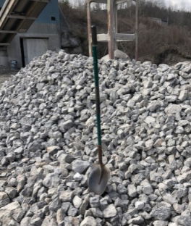
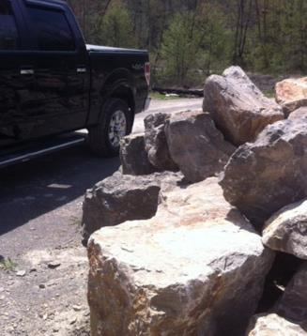
Road Aggregates 101
Common Coarse Aggregates
  Rip Rap
R-4
Generic Term for large clean stone
Used for stabilization (ditches, outlets, channels, banks, etc.)
R-3: (2" - 6")
R-4 (3" - 12")
R-5 (4" - 18")
R-6 (9" - 24")
R-7 (12" - 30")
R-8 (15" - 42")
http://www.pennsysupply.com/construction-materials/aggregate.asp
R-3
R-8
https://mmlime.com/materials/
https://mmlime.com/materials/

Slide 37
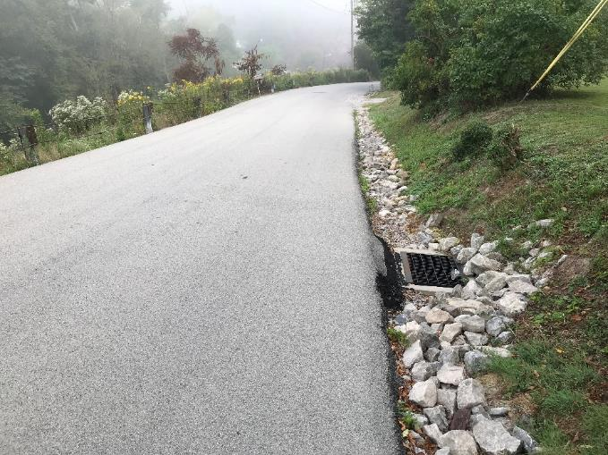
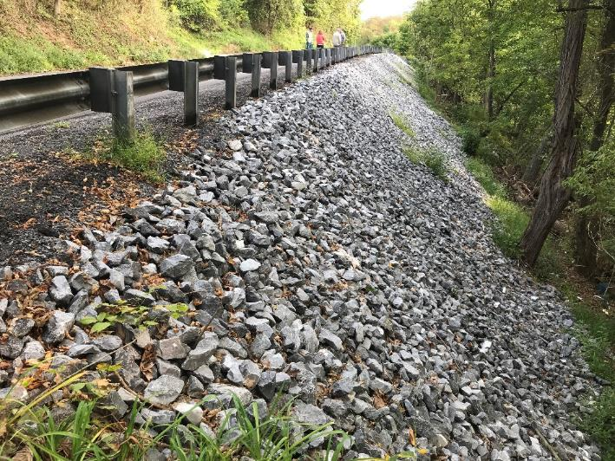
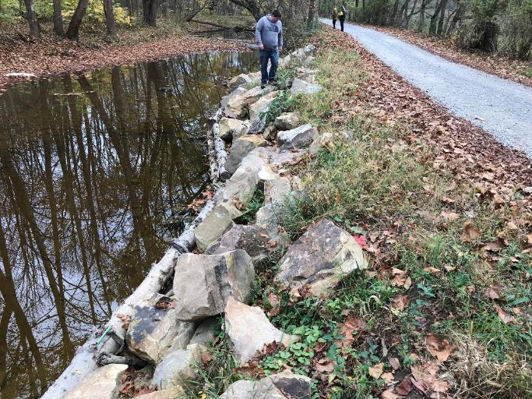
Road Aggregates 101
Common Coarse Aggregates
  Rip Rap
R-4
R-4 on bank slide stabilization
http://www.pennsysupply.com/construction-materials/aggregate.asp
R-5 on ditch stabilization
R-7 on streambank stabilization

Slide 38
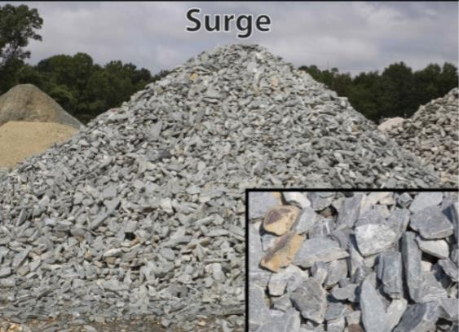
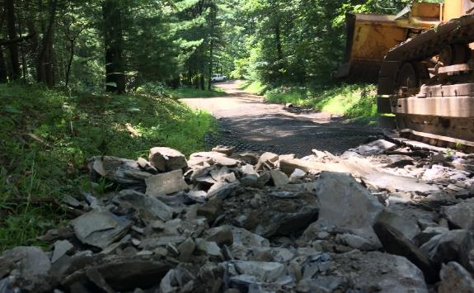
Road Aggregates 101
Common Coarse Aggregates
  Other terms for Large Aggregate
“Surge”
These do NOT have a specification
Very roughly graded and highly variable
Terms you might hear:
  Surge: ~10” and smaller
  Shot Rock: essential rip-rap without a specification
  Gabion: similar to AASSHTO #1 /#3
http://mccollumtrucking.com/gravel/
“Shot Rock” as road fill

Slide 39
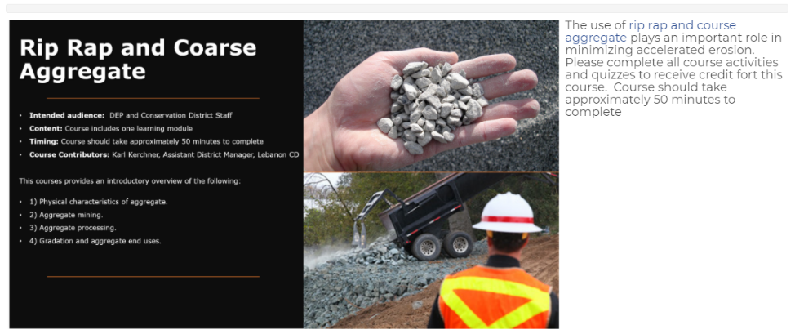
Road Aggregates 101
  Additional Information
  DEP Watershed Academy
  “Rip-Rap” and Coarse Aggregate

Slide 40
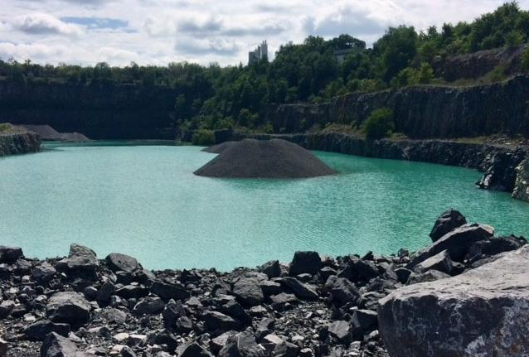
Road Aggregates 101
Crater Lake, Oregon

Slide 41
Road Aggregates 101
Crater Lake, Oregon
2A pile in a flooded quarry pit!

Slide 42
Dirt Gravel and Low Volume Road Program
WEBINAR
Road Aggregates 101
Survey Results
ESM Trainings
Webinars
Longer Remote Trainings
Online training Center
Winter Tech Assists
QUESTIONS ?
1/26-27: Remote ESM Training Jan 26 and 27, 8am-12:30 pm BOTH days:
1/28-29: Remote Administrative Training: 1/28 and 1/29, 9-11:30am BOTH days: Admin
2/4: Remote Training: “DSA Day”: Feb 4, 9am-noon: NEW
2/11: Webinar: Stream Crossings, the good, the bad, and the ugly: Feb 11, 9am: NEW
2/16-17: Remote ESM Training Feb 16 and 17, 8am-12:30 pm BOTH days:
2/18: Webinar: Annual Summary Report Overview: February 18, 9am: NEW
2/23: Remote Training: “Bookkeeper Bootcamp”: Feb 23, 9am-noon: NEW
2/25: Remote Training: “Streambank Stabilization”: Feb 25, 9am-noon: NEW

