Slide 1
Dirt Gravel and Low Volume Road Program
WEBINAR
Unpaved Road Assessments
Survey Results
ESM Trainings
Webinars
Longer Remote Trainings
Online training Center
Winter Tech Assists
12/22/20 Starts at 9am
If you are reading this, then you are successfully seeing the webinar video. Webinar audio should be automatic through your computer (or click “join audio”), and options can be accessed in the “audio options” button on the bottom left. If your computer audio is not working, you can listen on your phone by dialing 646-876-9923.

Slide 2
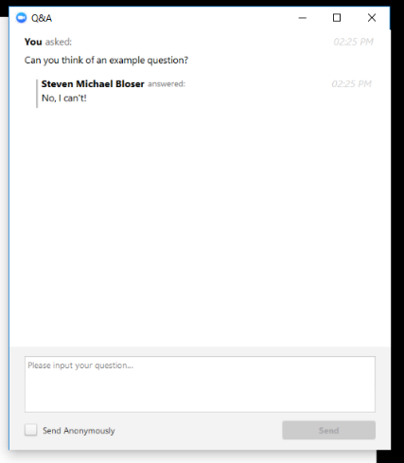
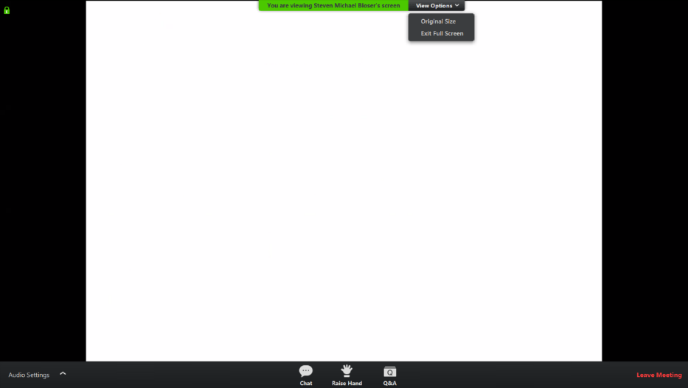
Assessment Refresher
Assessment Refresher
Note you can ask a question anonymously
Q&A
For audio via phone: 646-876-9923
2

Slide 3
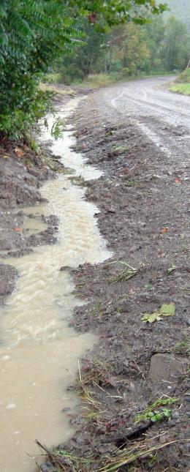
Assessment Refresher
Purpose
Refresher and overview of assessment process
Directed at new CD staff or someone considering starting an assessment for the first time

Slide 4
Assessment Refresher
Introduction and Purpose
History
Allocation impacts
Overview

Slide 5
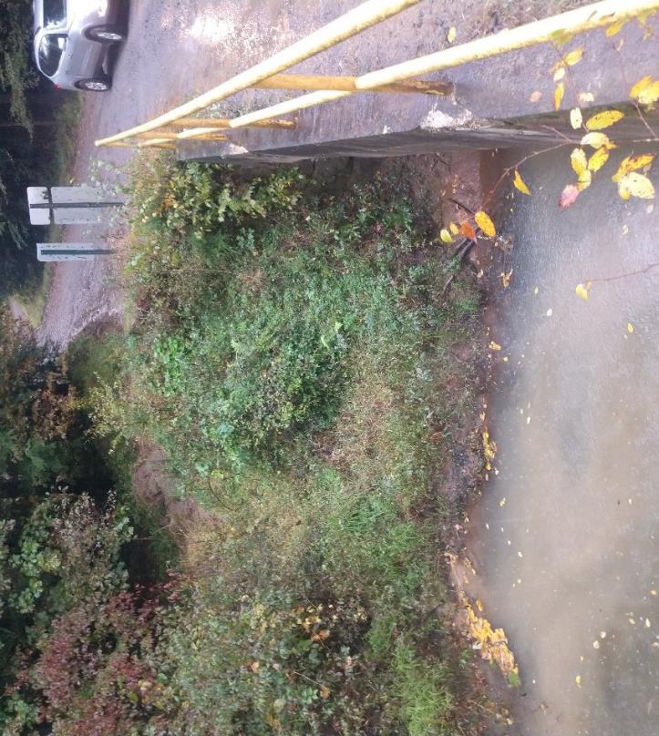
Assessment: Field identification of sections of public unpaved roads that impact water quality.

Slide 6
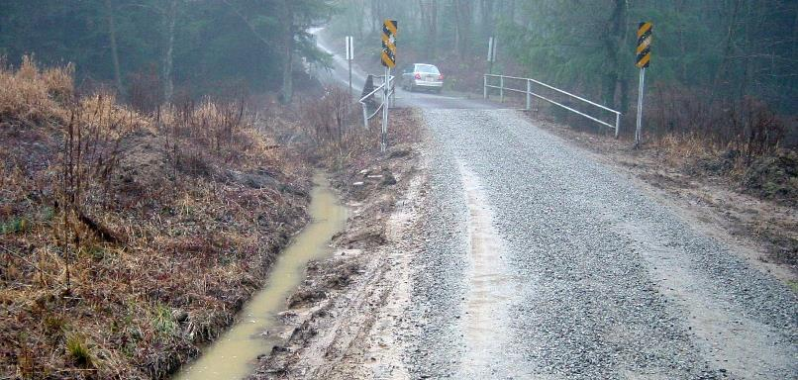
Worksite Assessments
Background
Unpaved Road Assessment:
Field identification of sections of public unpaved roads that impact water quality.
Creation of “potential Worksites” in GIS

Slide 7
Worksite Assessments
Background
Potential Worksite: Identified segment of unpaved road where drainage in impacting water quality.
Culverts
1
4
2
FIELD
3
FOREST
STREAM
Audio also available via phone: 866-823-7699
For assistance, call: 814-865-5355

Slide 8
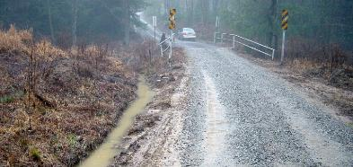
Worksite Assessments
Background
Potential Worksite: Identified segment of unpaved road where drainage in impacting water quality.
Culverts
BRIDGE
ditches drain to stream
1
4
2
FIELD
3
FOREST
STREAM
Audio also available via phone: 866-823-7699
For assistance, call: 814-865-5355

Slide 9
Worksite Assessments
Background
Potential Worksite: Identified segment of unpaved road where drainage in impacting water quality.
Culverts
BRIDGE
ditches drain to stream
1
4
2
FIELD
3
FOREST
STREAM
Audio also available via phone: 866-823-7699
For assistance, call: 814-865-5355

Slide 10
Worksite Assessments
Background
Potential Worksite: Identified segment of unpaved road where drainage in impacting water quality.
Culverts
BRIDGE
ditches drain to stream
1
WORKSITE
4
2
WORKSITE
FIELD
3
FOREST
STREAM
Audio also available via phone: 866-823-7699
For assistance, call: 814-865-5355

Slide 11
Worksite Assessments
Background
Unpaved Road Assessment:
Field identification of sections of public unpaved roads that impact water quality.
Creation of “potential Worksites” in GIS
Turning NON-POINT SOURCE
pollution into…
55
28
POINT SOURCES
streams
And providing quantification of pollution potential!
WORKSITES!
72
unpaved
road

Slide 12
Assessment Refresher
Introduction and Purpose
History
Allocation impacts
Overview

Slide 13
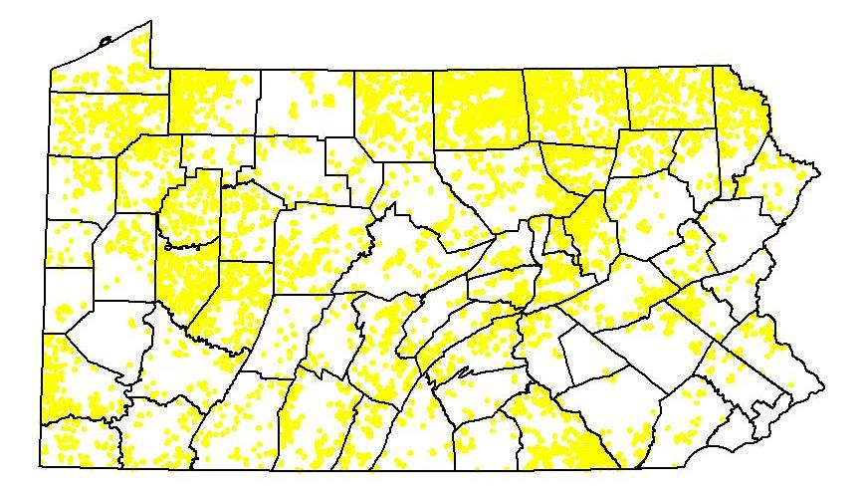
Worksite Assessments
Background
Ever wonder where all those “potential” worksites came from in your GIS?

Slide 14
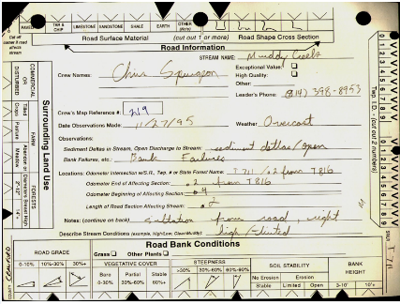
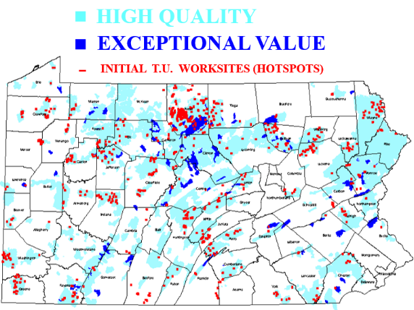
Worksite Assessments
Background
1996-1998 TU Volunteer Assessment
Protected Watersheds only
900 worksites statewide
Quantified problem
and established
DGLVR program
900 sites

Slide 15
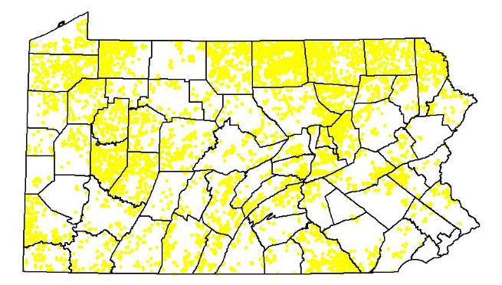
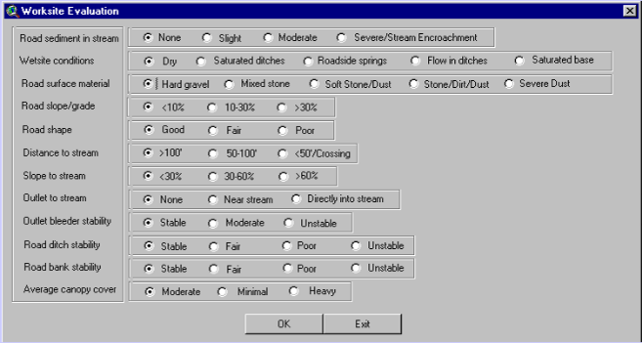
Worksite Assessments
Background
2000 CD Statewide Assessment
Used first version of GIS, introduced “dirty dozen”.
Had to ask twps. where unpaved roads were!
ALL watersheds assessed.
~3,000 miles of sites identified and assessed

Slide 16
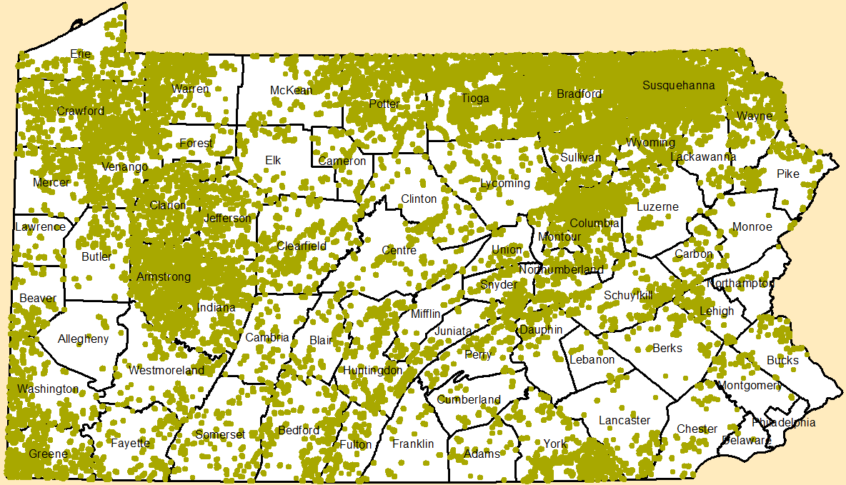
Worksite Assessments
Background
2007-08 CD Statewide Assessment
Voluntary assessment period.
6,200 miles of worksites.
The basis for those yellow sites you see in GIS today!
16,000 sites

Slide 17
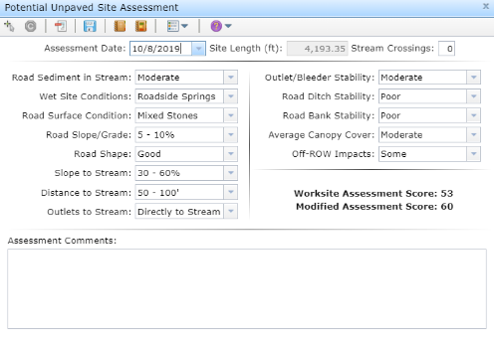
Worksite Assessments
Background
2018-19 CD Statewide Assessment
Voluntary assessment period.
Increased from 6,200 to 7,200 miles of worksites.

Slide 18
Worksite Assessments
Background
2018-19 CD Statewide Assessment
Voluntary assessment period.
Increased from 6,200 to 7,200 miles of worksites.
2021:
~7,700 miles of worksites
Continuous “Open Assessment”

Slide 19
Assessment Refresher
Introduction and Purpose
History
Allocation impacts
Overview

Slide 20
Worksite Assessments
Wrap-up
Why does it Matter?
Miles of worksite and unpaved roads are a major factor in CD allocations
PA Section 9106:
“(C)Apportionment Criteria. The apportionment criteria shall:
Be based on verified need to correct pollution problems related to the road.
Consider the total miles of dirt and gravel roads maintained by local municipalities or state agencies that are open to the public during any period of the year.”

Slide 21
Worksite Assessments
Wrap-up
Why does it Matter?
Miles of worksite are a major factor in CD allocations
Dirt and Gravel Allocation Formula:
50%
IDENTIFIED
WORKSITES
=
Miles Worksites in County
Miles Worksites in State
45%
UNPAVED
ROADS
=
Miles Unpaved Road in County
+
¼ Miles Unpaved Road within 1,000’ of HQ/EV Strem
5%
LIMESTONE
COST
=
$ Stone County – Min $ Stone in State
Min $ Stone in State

Slide 22
Worksite Assessments
Wrap-up
Why does it Matter?
Miles of worksite are a major factor in CD allocations
Dirt and Gravel Allocation Formula:
50%
IDENTIFIED
WORKSITES
=
Miles Worksites in County
Miles Worksites in State
More worksites statewide means each worksite is worth a little less in allocation formula.
45%
UNPAVED
ROADS
=
Miles Unpaved Road in County
+
¼ Miles Unpaved Road within 1,000’ of HQ/EV Strem
5%
LIMESTONE
COST
=
$ Stone County – Min $ Stone in State
Min $ Stone in State

Slide 23
Worksite Assessments
Wrap-up
Why does it Matter?
Assessment completeness was highly variable
County Average Worksite Length:
0.17 to 0.76 miles (.35 avg)

Slide 24
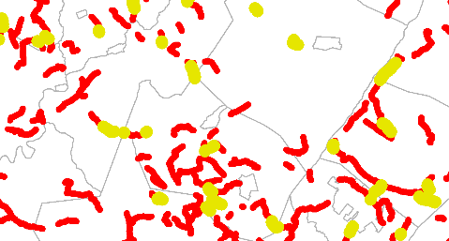
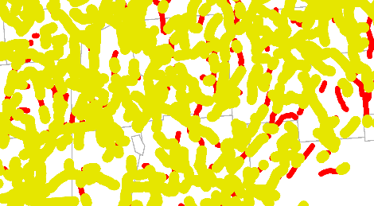
Worksite Assessments
Wrap-up
Why does it Matter?
Assessment completeness was highly variable
County Average Worksite Length:
0.17 to 0.76 miles (.35 avg)
County Unpaved to Worksite conversion:
11% to 79% (35% avg)
County A at 11% - example, at same scale - County B at 70%

Slide 25
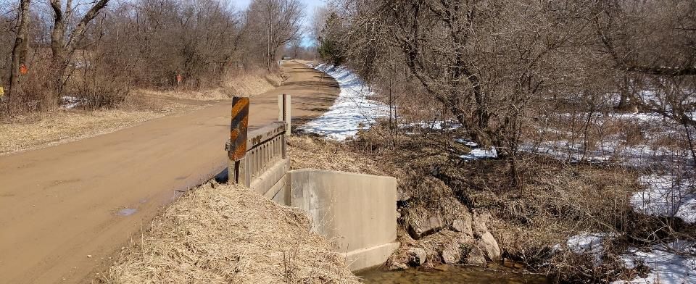
Worksite Assessments
Wrap-up
Venango County 2018 Reassessment Example
CD had questions about their assessment quality
SCC/CDGRS visited and helped assess 2 twps in 2018
Found sites were very short or completely missing
Approximately tripled total length of existing worksites

Slide 26
Worksite Assessments
Wrap-up
Should Your County Do a Reassessment???
Pros
Updated data: Current data may be 10-20 years old
Some roads have been paved
Some roads have been unpaved
Many sites are too short (created when Program was $4 Million)
Assessment is incomplete in many counties
May increase District allocation (could decrease though)
Would not increase maximum counties
MAY or MAY NOT increase minimum counties
Great way to get to know your county!
Cons
Time and expense.

Slide 27
Worksite Assessments
Wrap-up
Should Your County Do a Reassessment???
Considerations
How thorough, complete, and recent is your existing assessment?
Extent of changes or urbanization to county.
Time availability and cost.
Small counties may not have enough roads and worksites to increase above “minimum” status.
Some counties may actually decrease in allocation if a lot of paving has occurred.
Contact Steve Bloser or Ken Corradini at the CDGRS to discuss the circumstances of your particular county.

Slide 28
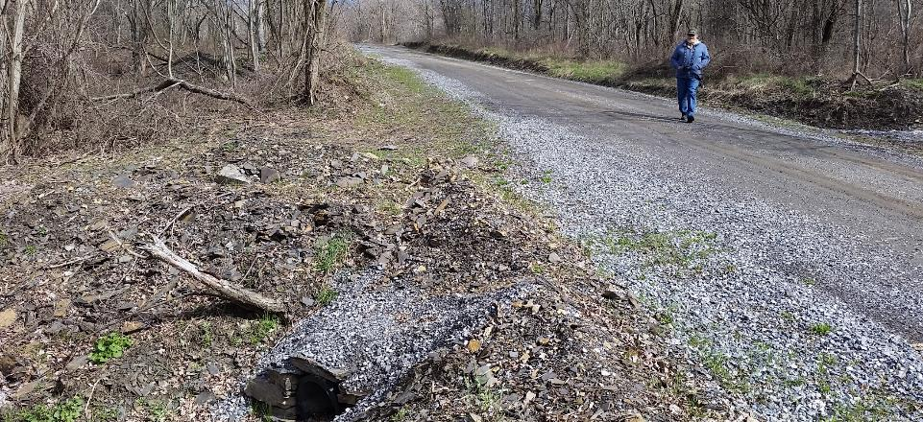
Worksite Assessments
Process Overview
Field identification of segment of road contributing to stream pollution
Assessments are a FIELD EXERCISE.
Can’t tell from topo maps or aerials:
Are there existing drainage structures? Do outlets reach stream? Are there non-blueline streams impacted?

Slide 29
Worksite Assessments
Process Overview
Find Stream Impact
Identify start and stop
Create Worksite
Evaluate Worksite

Slide 30
Worksite Assessments
Background
Potential Worksite: Identified segment of unpaved road where drainage in impacting water quality.
Culverts
BRIDGE
ditches drain to stream
1
WORKSITE
4
2
WORKSITE
FIELD
3
FOREST
STREAM
Audio also available via phone: 866-823-7699
For assistance, call: 814-865-5355

Slide 31
Worksite Assessments
Background
Potential Worksite: Identified segment of unpaved road where drainage in impacting water quality.
Culverts
BRIDGE
ditches drain to stream
1
WORKSITE
4
2
WORKSITE
FIELD
3
FOREST
STREAM
Added Small Tributary
Audio also available via phone: 866-823-7699
For assistance, call: 814-865-5355

Slide 32
Worksite Assessments
Background
Potential Worksite: Identified segment of unpaved road where drainage in impacting water quality.
Culverts
BRIDGE
ditches drain to stream
WORKSITE
1
4
2
WORKSITE
FIELD
3
FOREST
STREAM
Added Small Tributary
Audio also available via phone: 866-823-7699
For assistance, call: 814-865-5355

Slide 33
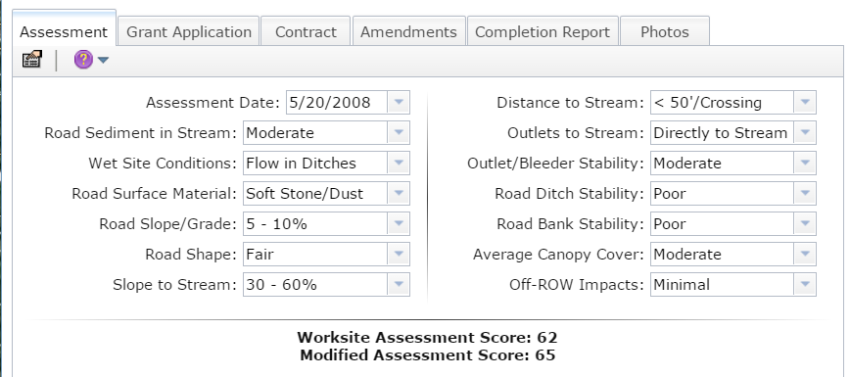
Worksite Assessments
Process Overview
The “Dirty Dozen”
- 12 factors – evaluate “pollution potential”
Assigns score from 0 to 100 (worst impact)
Scores no longer a factor in allocation formula
Audio also available via phone: 866-823-7699
For assistance, call: 814-865-5355

Slide 34
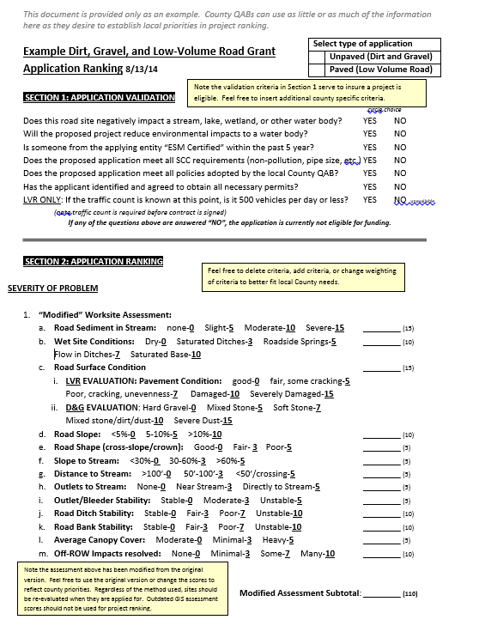
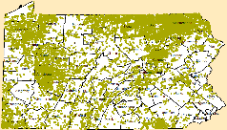
Worksite Assessments
Current Use
Assessments
~75% of sites have existing ranking, most are 8-16 years old.
Most CDs use “Dirty Dozen” in ranking criteria.
If you use assessment score in ranking, you may want to consider completing ranking

Slide 35
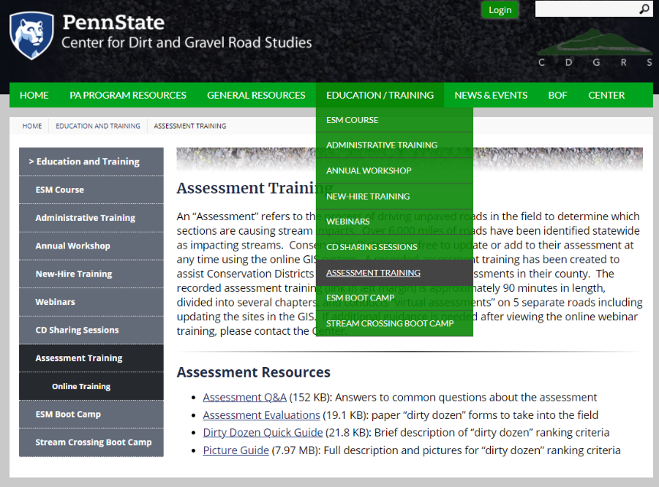
Assessment Refresher
Additional Resources

Slide 36
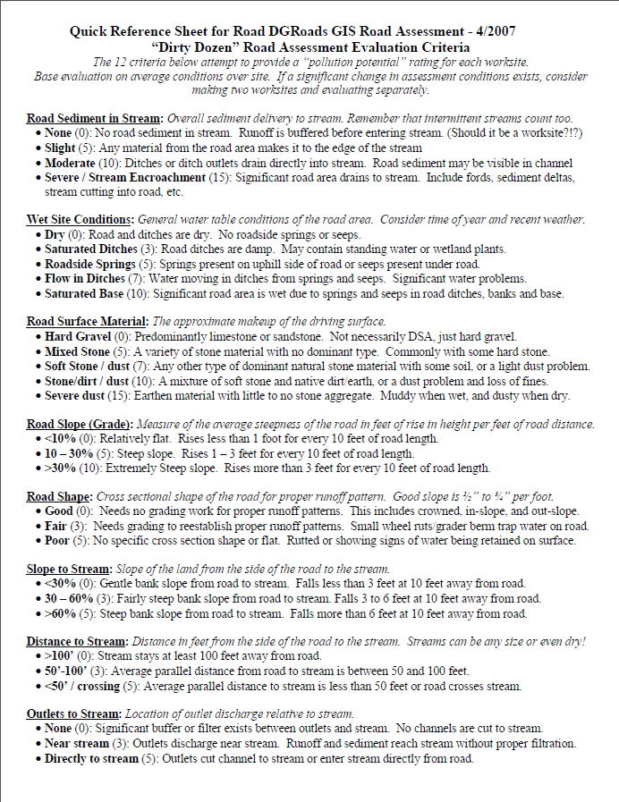
Assessment Refresher
Additional Resources
Quick Reference Guide
Field Guide
Q&A
Recorded Training

Slide 37
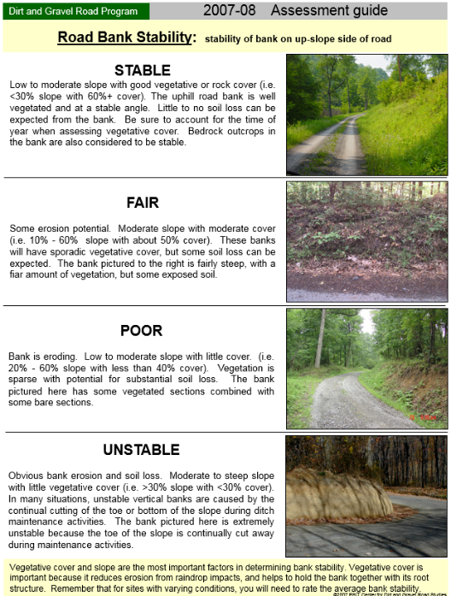
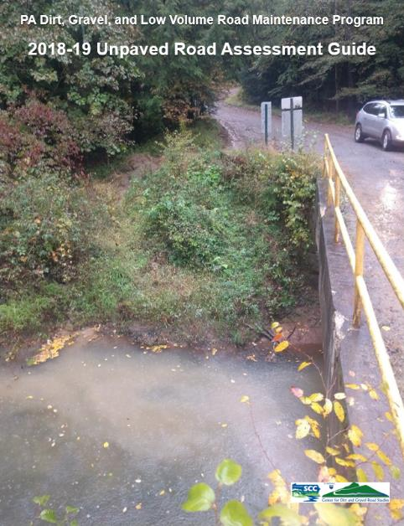
Assessment Refresher
Additional Resources
Quick Reference Guide
Field Guide
Q&A
Recorded Training

Slide 38
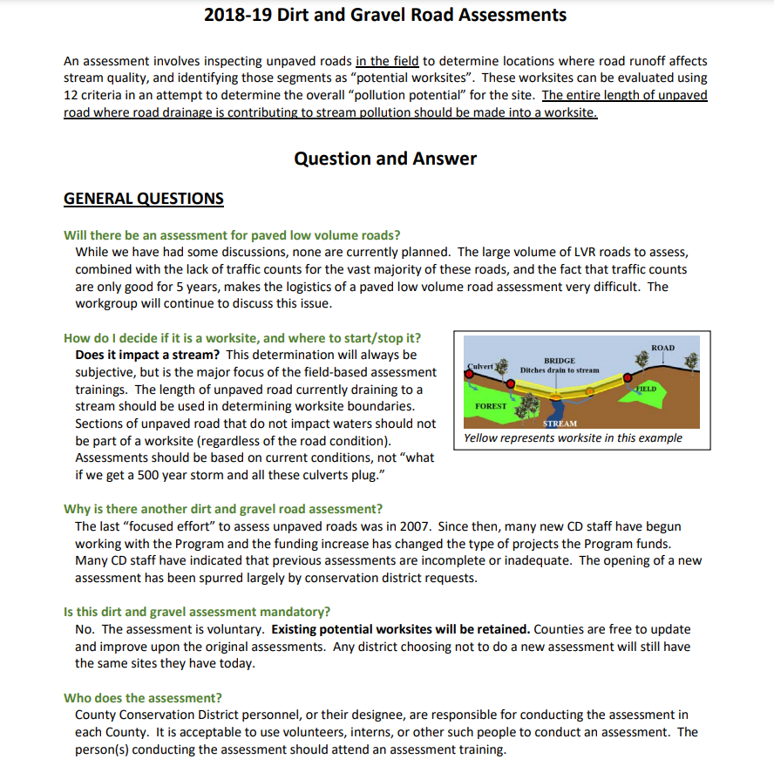
Assessment Refresher
Additional Resources
Quick Reference Guide
Field Guide
Q&A
Recorded Training

Slide 39
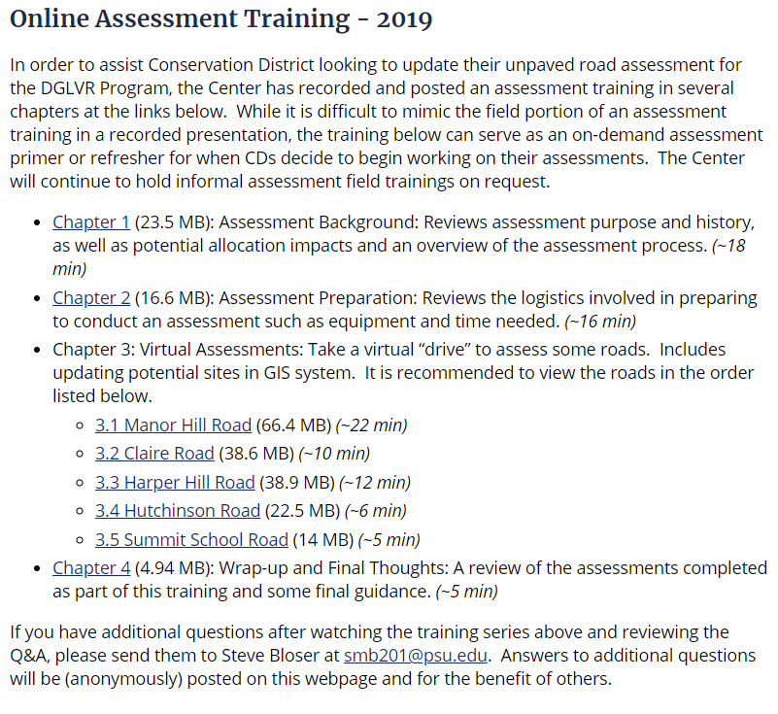
Assessment Refresher
Additional Resources
Quick Reference Guide
Field Guide
Q&A
Recorded Training
Background (18 min)
Preparation (16 min)
Virtual Assessments (55 min)
Wrap-up (5 min)

Slide 40
Assessment Refresher
Additional Resources
Quick Reference Guide
Field Guide
Q&A
Recorded Training
5/5/20 webinar: Assessment Perspectives and COVID Issues (w Juniata County)

Slide 41
Worksite Assessments
Assessment Details
When is the dirt and gravel assessment due?
There is currently no “due date” to complete assessments. Counties are always free to update their inventory of potential sites. Future district allocations will likely factor in all worksites for each county as of roughly April of each year in order to have allocations for SCC approval in May.
Should I assess paved LVRs too?
No. Identified worksites are not part of the allocation formula for LVRs. Why not?
Since PA does not have local traffic counts, we don’t know for sure what roads qualify as LV until a count is done.
There are potentially 3-4 times as many paved road miles to assess as unpaved.

Slide 42
Worksite Assessments
Assessment Details
COVID Considerations
Recommend that two people participate – this may not be possible without two vehicles – Consider handheld two-way radios if you decide to use two vehicles
Limits options to interact with townships or invite them along
More difficulty communicating and coordinating between staff and if you involve townships

Slide 43
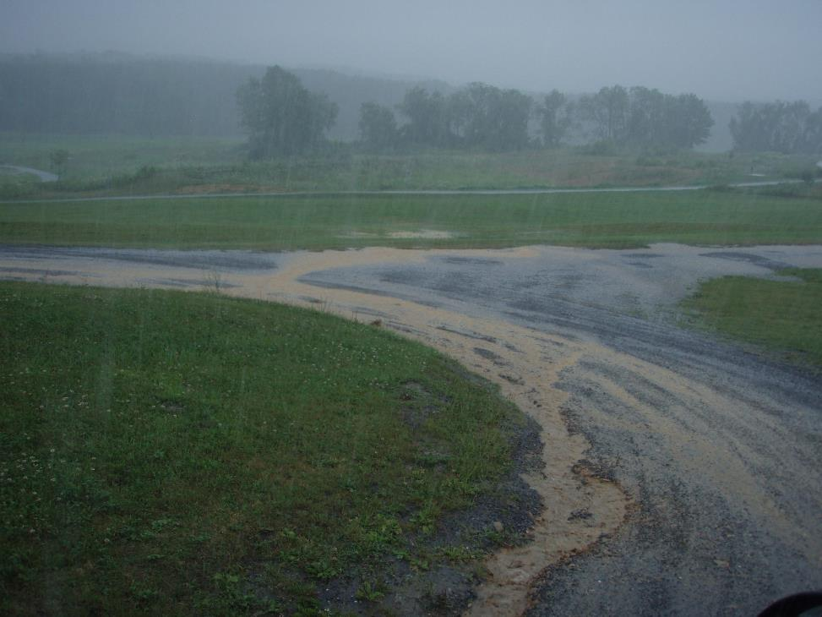
Worksite Assessments
Wrap-up
Buy a good umbrella!!!
Assess in the rain!!!
Contact Steve Bloser or Ken Corradini at the CDGRS to discuss the circumstances of your particular county.

Slide 44
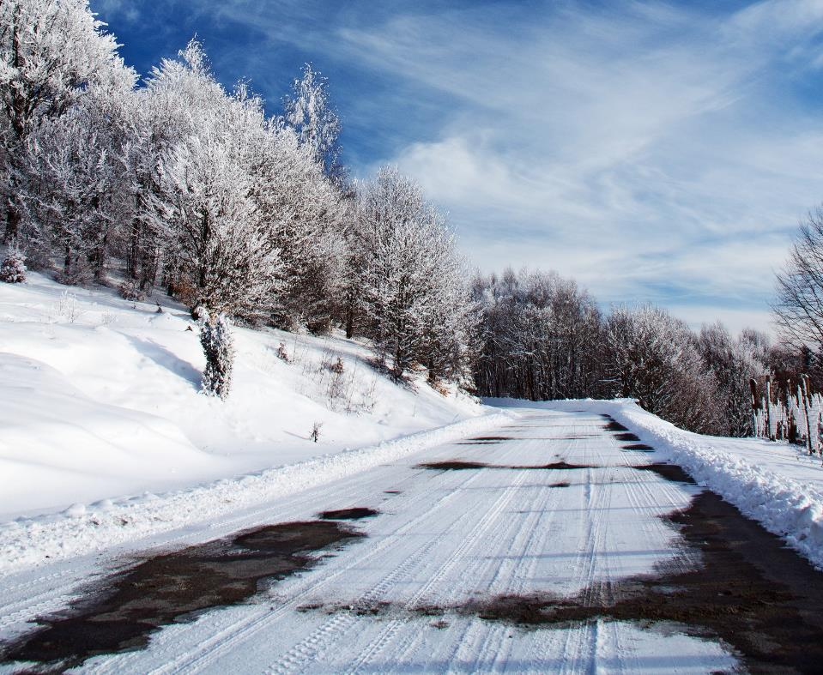
Happy Holidays!
Next Webinar:
January 7th
Annual Summary Refresher

