Slide 1
DGLVR Webinar
Bankfull Technical Bulletin Update
4/9/20
Starts at 9am
If you are reading this, then you are successfully seeing the webinar video. Webinar audio should be automatic through your computer, and options can be accessed in the “audio options” button on the bottom left. If your computer audio is not working, you can listen on your phone by dialing 646-876-9923.
For technical assistance use the chat box

Slide 2
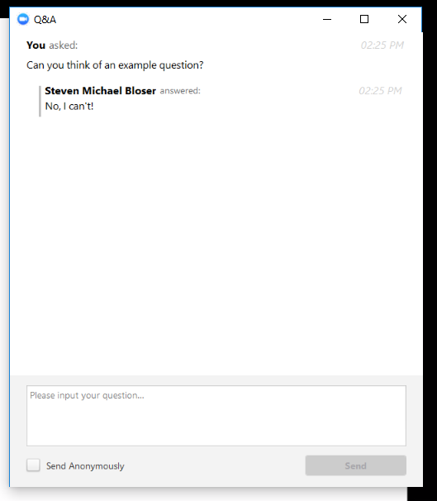
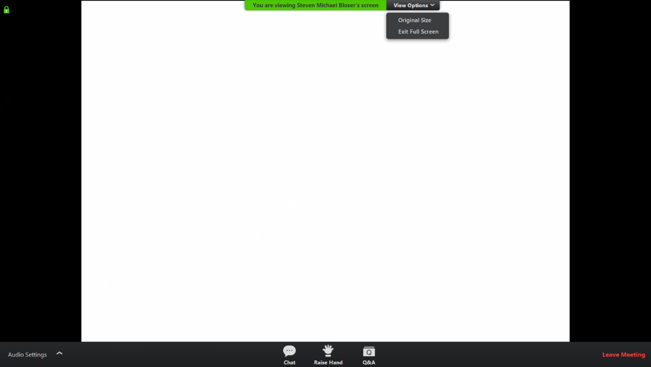
Q&A
Note you can ask a question anonymously
Q&A
For audio via phone: 646-876-9923
For technical assistance use chat box
Slide #

Slide 3
Bankfull Update
Big Picture
CDGRS/TU have started on a series of technical bulletins related to stream crossing replacements
This webinar is the first in an eventual series of webinars debuting new technical bulletins
For audio via phone: 646-876-9923
For technical assistance use chat box

Slide 4
Bankfull Update
Big Picture
Bankfull Guidance
Structure Selection
Slope and Longitudinal Profile
Grade Control
Substrate / Bed Material
DGLVR Grant App Procedure
Contracting, engineering, cost estimates
Design Requirements
Construction Oversight
For audio via phone: 646-876-9923
For technical assistance use chat box

Slide 5
Bankfull Update
Bankfull Technical Bulletin:
Expands on existing 1-page guide
Tries to clear up common misconceptions
Provides more picture examples of streams, bankfull indicators, and more.
Get final feedback
For audio via phone: 646-876-9923
For technical assistance use chat box

Slide 6
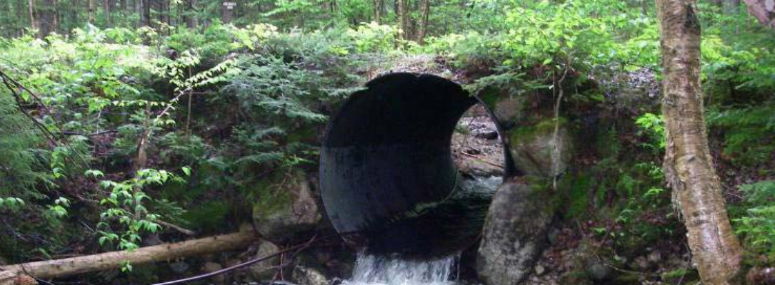
Bankfull Update
Special Thanks to Trout Unlimited for their work on the Bankfull Technical Bulletin and for many of the pictures and slides used in this webinar.
J. Tomlinson

Slide 7
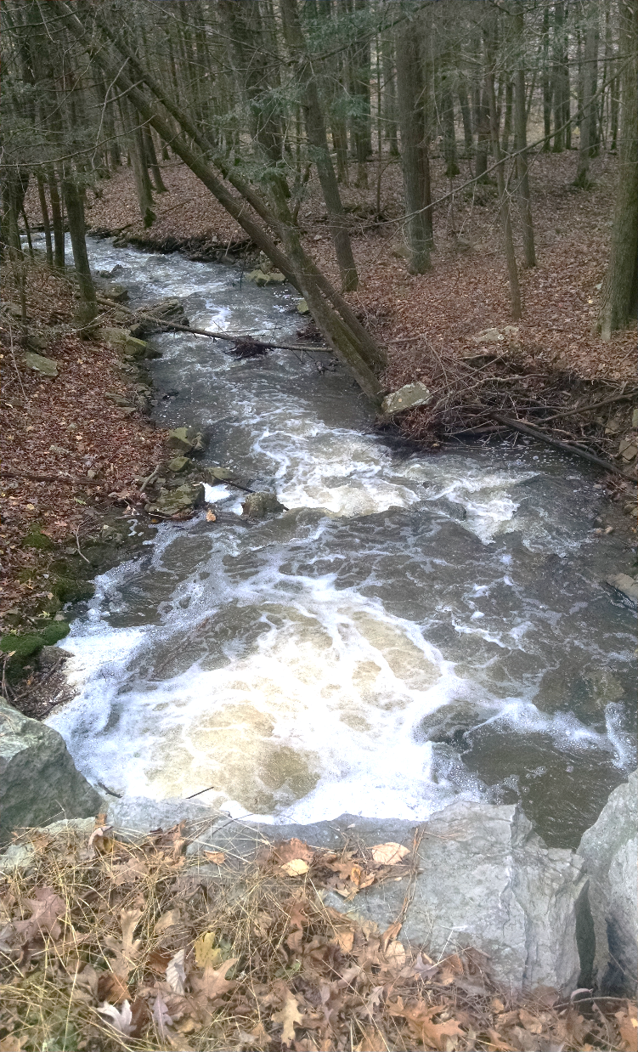
Bankfull Update
Bankfull flow sets stream characteristics:
-pool width and depth
-channel shape
-substrate size
-width-depth ratios
This is useful because it has hydrologic and morphologic significance which can be used for crossing design and will ensure sediment and aquatic passage.
For audio via phone: 646-876-9923
For technical assistance use chat box

Slide 8
Bankfull Update
Benefits of sizing structures for bankfull:
Hydraulic capacity for the 100-year storm (Q100)
Reduces flooding
Minimize maintenance needs
Maximize useful life of structure
Passage of aquatic species
Maintain channel processes
Meets DGLVR policy
For audio via phone: 646-876-9923
For technical assistance use chat box

Slide 9
Bankfull Update
Bankfull Determination
-Because the bankfull flow does the greatest amount of work forming the channel, the bankfull stage is identifiable in the field.
-There is no single universal indicator. You must look for clues and the combination of clues identifies bankfull.
^{Q}25 year
^{Q}bankfull
bankfull
2/3 Q

Slide 10
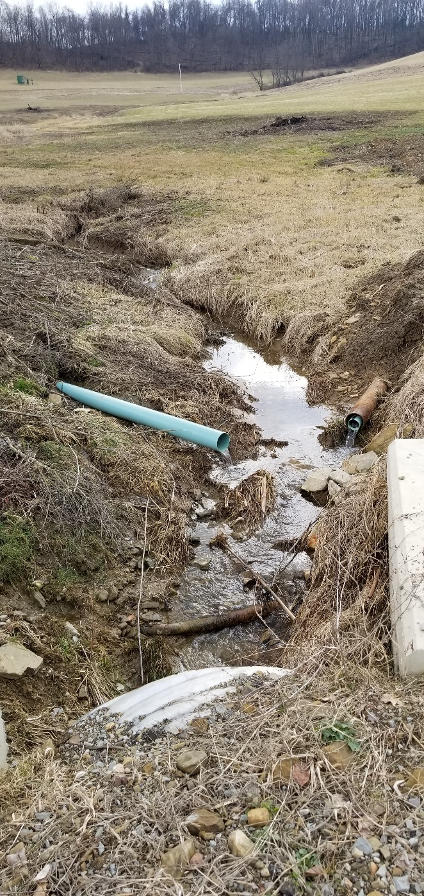
Bankfull Update
Bankfull Updates:
Policy Overview
Evaluation Form
Updated Technical Bulletin
For audio via phone: 646-876-9923
For technical assistance use chat box

Slide 11
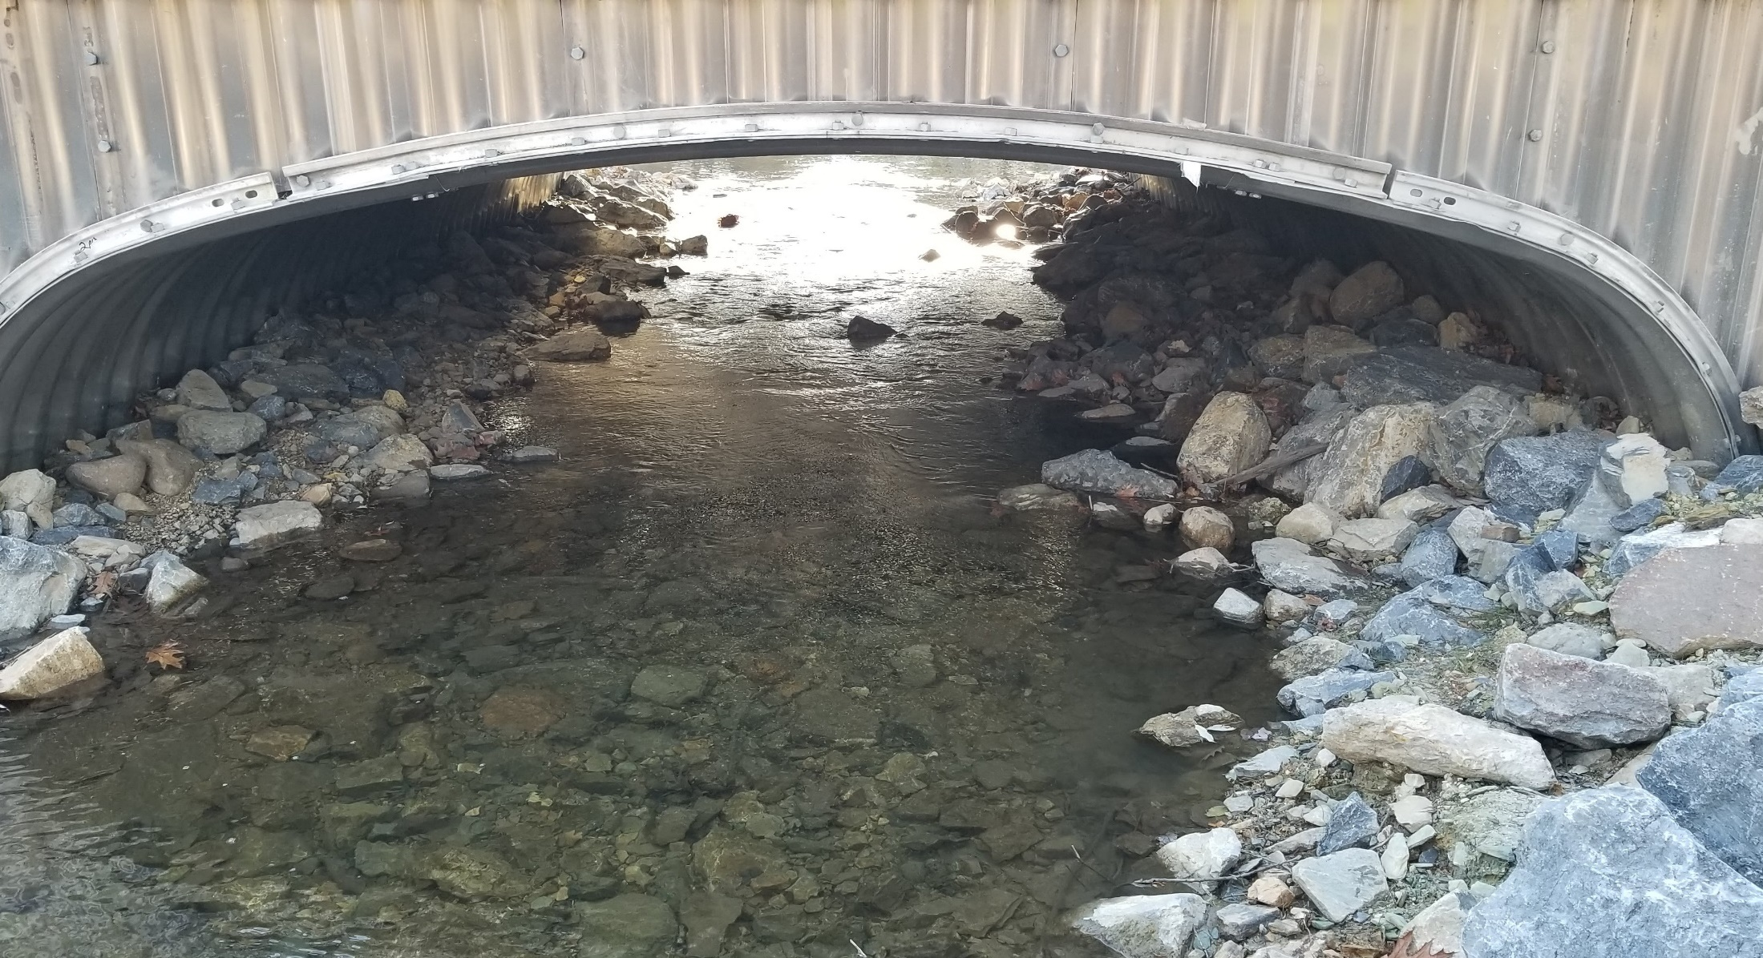
Stream Xing Replacement Policy
Stream Crossing Replacement Policy
Section 7.1 of the Administrative Manual
For audio via phone: 646-876-9923
For technical assistance use chat box

Slide 12
Stream Xing Replacement Policy
Policy for replacing culverts and bridges applies to both D&G and LVR projects.
Goal of the policy
Limits replacements to areas where structure is causing problem with stream.
Existing structures must be undersized and causing stream instabilities in relation to the bankfull width of the stream
New structures must be sized to properly accommodate stream flow, bed load, and aquatic organisms (bankfull width)
For audio via phone: 646-876-9923
For technical assistance use chat box

Slide 13
Stream Xing Replacement Policy
When does the Stream Crossing Policy Apply?
Applies to situations where streams, including intermittent channels, with identified bed and banks are flowing into the road or uphill ditch
Contact the Commission for questionable circumstances
In order for exemptions on “questionable stream” channels, Districts must obtain written approval from the Commission prior to contracting the project.
Use of Round Pipes
Round pipes over 3 feet in diameter are NOT permitted to be funded for use in stream crossing replacements.
For audio via phone: 646-876-9923
For technical assistance use chat box

Slide 14
Stream Xing Replacement Policy
Existing Stream crossing structures with an opening of more than 13 ft² ( equivalent to 48” diameter round pipe)
In order to be eligible for replacement, EXISTING structures must:
1. Have a structure to bankfull width ratio of 75% or less.
2. Show signs of streambank erosion.
3. Show signs of streambed erosion/aggradation.
For audio via phone: 646-876-9923
For technical assistance use chat box

Slide 15
Stream Xing Replacement Policy
Existing Stream crossing structures with an opening of more than 13 ft² ( equivalent to 48” diameter round pipe)
In order to be eligible for replacement, EXISTING structures must:
1. Have a structure to bankfull width ratio of 75 % or less.
2. Show signs of streambank erosion.
3. Show signs of streambed erosion/aggradation.
The NEW REPLACEMENT structure must (all four):
1. Have a structure width at least equal to bankfull width (100% ratio).
2. Be properly aligned with the channel.
3. Consider additional floodplain connectivity when possible.
4. Be designed and constructed to accommodate the passage of aquatic organisms through the structure.

Slide 16
Stream Xing Replacement Policy
Existing Stream crossing structures with an opening equal to or less than 13 ft² (equivalent to 48” diameter round pipe) automatically qualify
In order to be eligible for replacement, EXISTING structures must:
1. Have a structure to bankfull width ratio of 75% or less.
2. Show signs of streambank erosion.
3. Show signs of streambed erosion/aggradation.
The NEW REPLACEMENT structure must (all four):
1. Have a structure width at least equal to bankfull width (100% ratio).
2. Be properly aligned with the channel.
3. Consider additional floodplain connectivity when possible.
4. Be designed and constructed to accommodate the passage of aquatic organisms through the structure.

Slide 17
Stream Xing Replacement Policy
Multiple pipes
Existing stream crossings consisting of multiple pipes are eligible for replacement regardless of their relationship to the bankfull measurement (multiple pipes only, not multi-cell bridges)
Installation of multiple pipe structures is NOT permitted with Program funds
Must be replaced with a single opening structure of at least bankfull width.

Slide 18
Stream Xing Replacement Policy
Crossings that are not eligible for replacement
Program funds can NOT be used to replace the structure. This includes any materials, equipment, labor, engineering / consulting, etc.
Maintenance is not an eligible expense. Including lining of existing crossings, bridge deck repair, etc.
Can do work on road and stream around existing structure.
Divert ditches from directly impacting the stream
Drainage and base improvements on the road around the structure
Streambank Stabilization
Headwalls or endwalls on existing structure

Slide 19
Stream Xing Replacement Policy
All necessary permits must be obtained before work can begin.
Remember:
All permit conditions must be followed appropriately. DGLVR Projects are not exempt from any permits conditions or DEP regulations.

Slide 20
Bankfull Update
Bankfull Updates:
Policy Overview
Evaluation Form
Updated Technical Bulletin
For audio via phone: 646-876-9923
For technical assistance use chat box

Slide 21
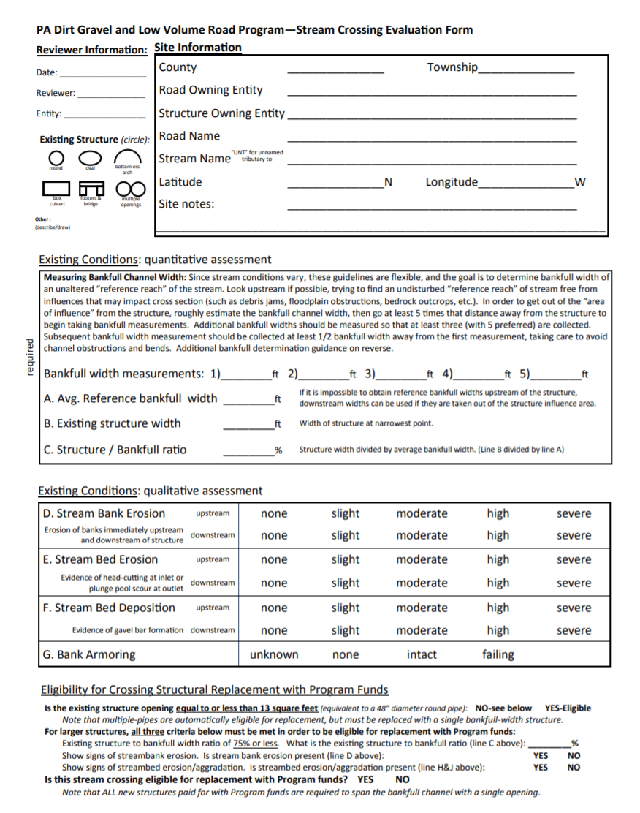
Stream Xing Replacement Policy
Evaluation Form
Site Info
Site Evaluation: width considerations
Site Evaluation: erosion considerations
Eligibility Determination

Slide 22
Stream Xing Replacement Policy
Evaluation Form
Site Info
Site Evaluation: width considerations
Site Evaluation: erosion considerations
Eligibility Determination

Slide 23
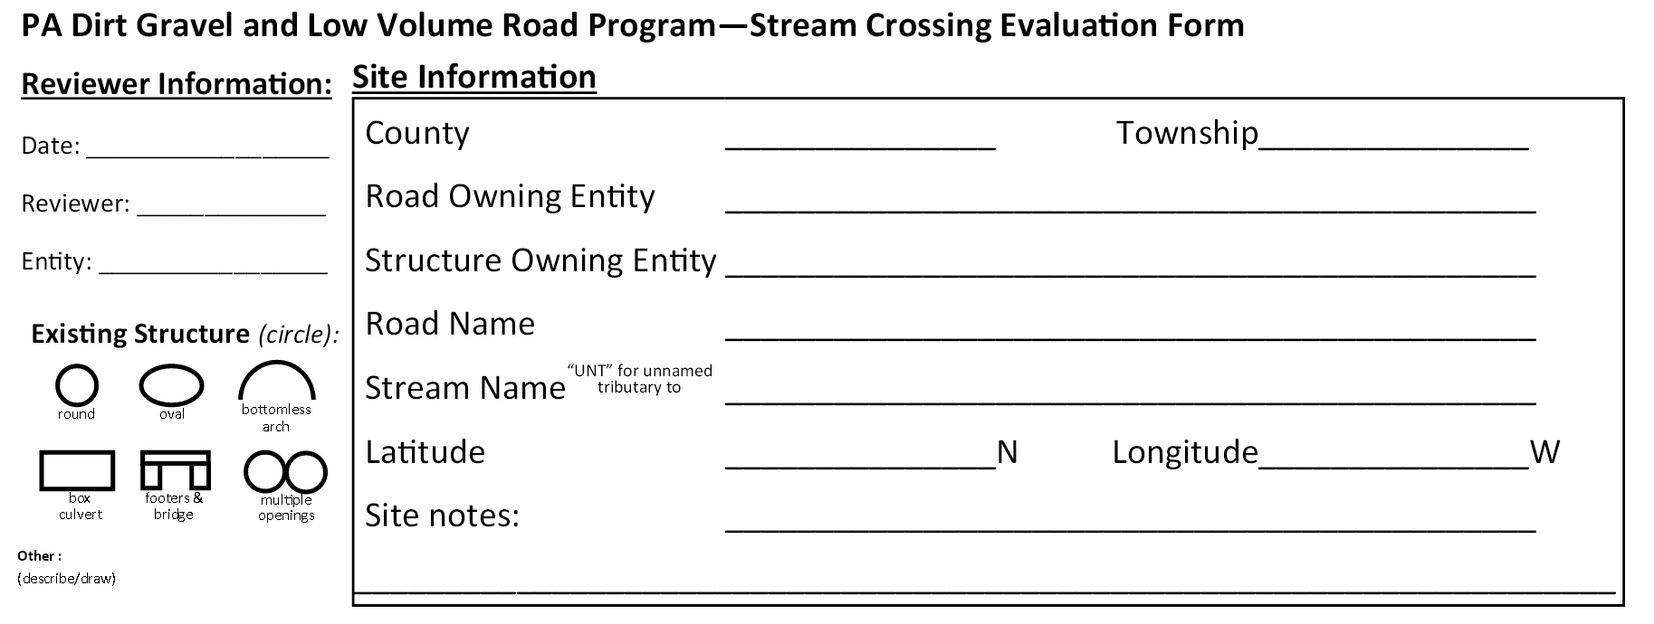
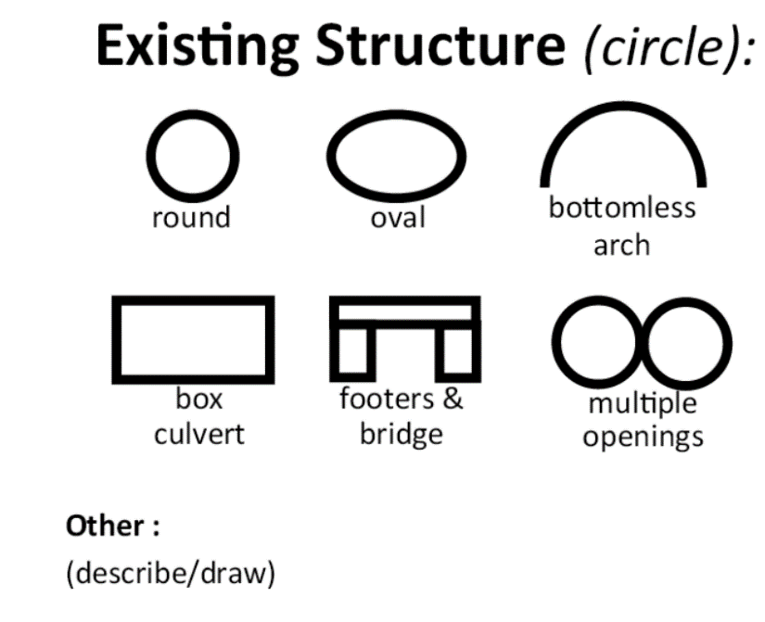
Stream Xing Replacement Policy
Evaluation Form

Slide 24
Stream Xing Replacement Policy
Evaluation Form
Site Info
Site Evaluation: Bankfull width considerations
Site Evaluation: erosion considerations
Eligibility Determination

Slide 25
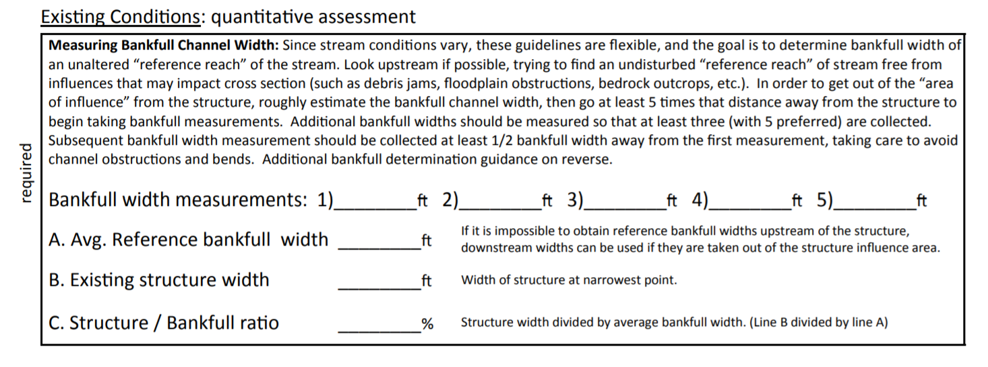
Stream Xing Replacement Policy
Evaluation Form
For audio via phone: 646-876-9923
For technical assistance use chat box

Slide 26
Stream Xing Replacement Policy
Evaluation Form
18
19
19.5
17
16.5
18
For audio via phone: 646-876-9923
For technical assistance use chat box

Slide 27
Stream Xing Replacement Policy
Evaluation Form
18
19
19.5
17
16.5
18
6
33
For audio via phone: 646-876-9923
For technical assistance use chat box

Slide 28
Stream Xing Replacement Policy
Evaluation Form
Stream Crossing Evaluation Form
Site Info
Site Evaluation: width considerations
Site Evaluation: erosion considerations
Eligibility Determination

Slide 29
Stream Xing Replacement Policy
Evaluation Form
For audio via phone: 646-876-9923
For technical assistance use chat box

Slide 30
Stream Xing Replacement Policy
Evaluation Form
For audio via phone: 646-876-9923
For technical assistance use chat box

Slide 31
Stream Xing Replacement Policy
Evaluation Form
Stream Crossing Evaluation Form
Site Info
Site Evaluation: width considerations
Site Evaluation: erosion considerations
Eligibility Determination

Slide 32
Stream Xing Replacement Policy
Evaluation Form
33
For audio via phone: 646-876-9923
For technical assistance use chat box

Slide 33
Bankfull Update
Bankfull Updates:
Policy Overview
Evaluation Form
Updated Technical Bulletin
For audio via phone: 646-876-9923
For technical assistance use chat box

Slide 34
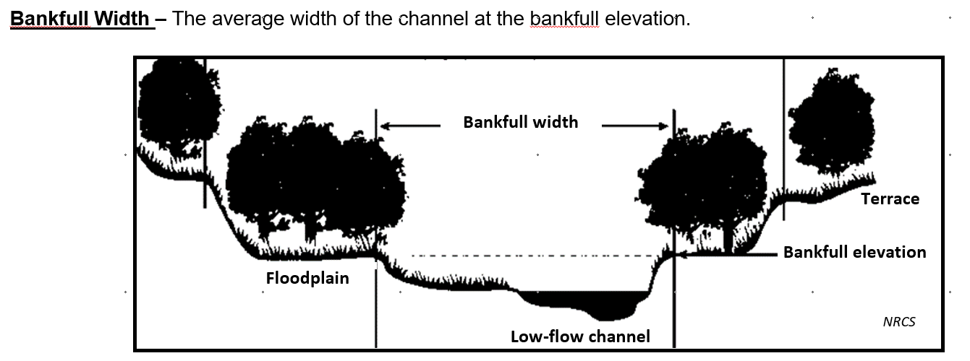
Bankfull Technical Bulletin
Updated Bankfull guidance to assist in completion of the Stream Crossing Replacement Evaluation

Slide 35
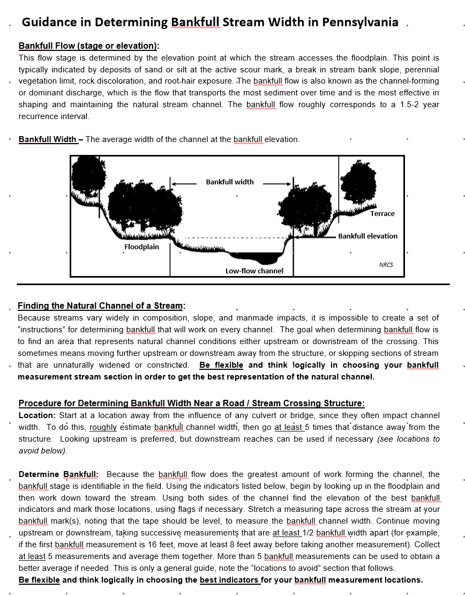
Bankfull Technical Bulletin
Bankfull Definition
Finding the Measurement Location
Procedure for determining Bankfull

Slide 36
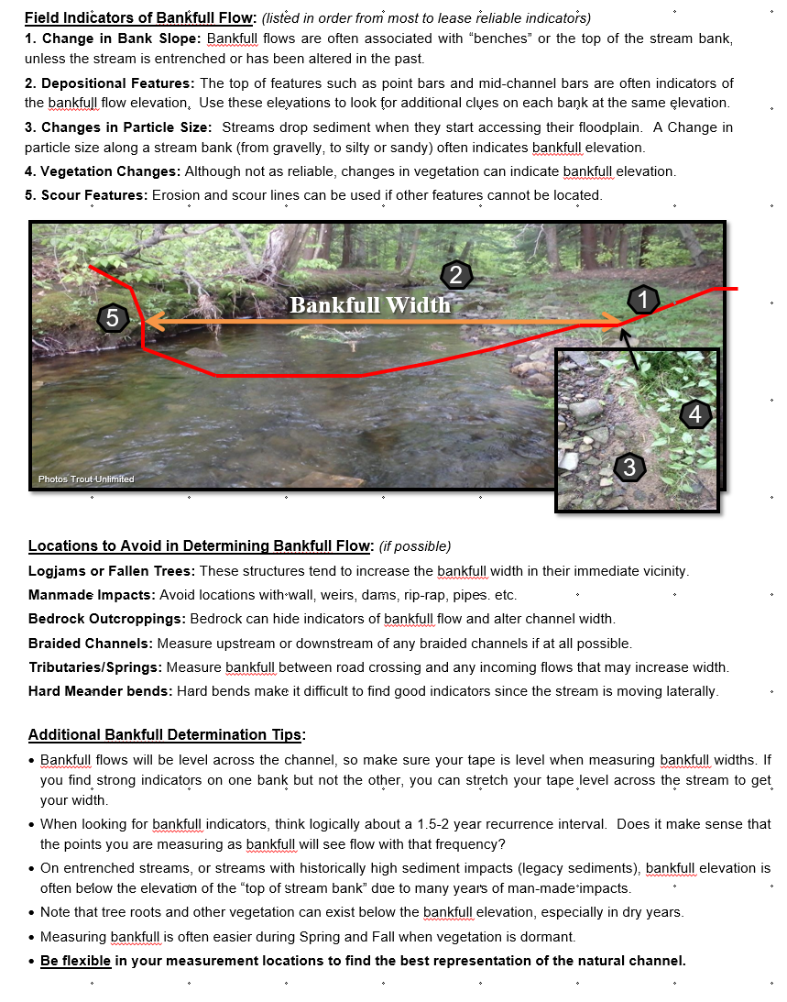
Bankfull Technical Bulletin
Bankfull Indicators
Locations to Avoid
Additional Tips

Slide 37
Bankfull Technical Bulletin
Floodplain
Floodplain
Bankfull width
Active channel width
Bankfull elevation: The elevation point where water fills the channel just before accessing floodplain.
Bankfull width: Average width of the channel at bankfull elevation.

Slide 38
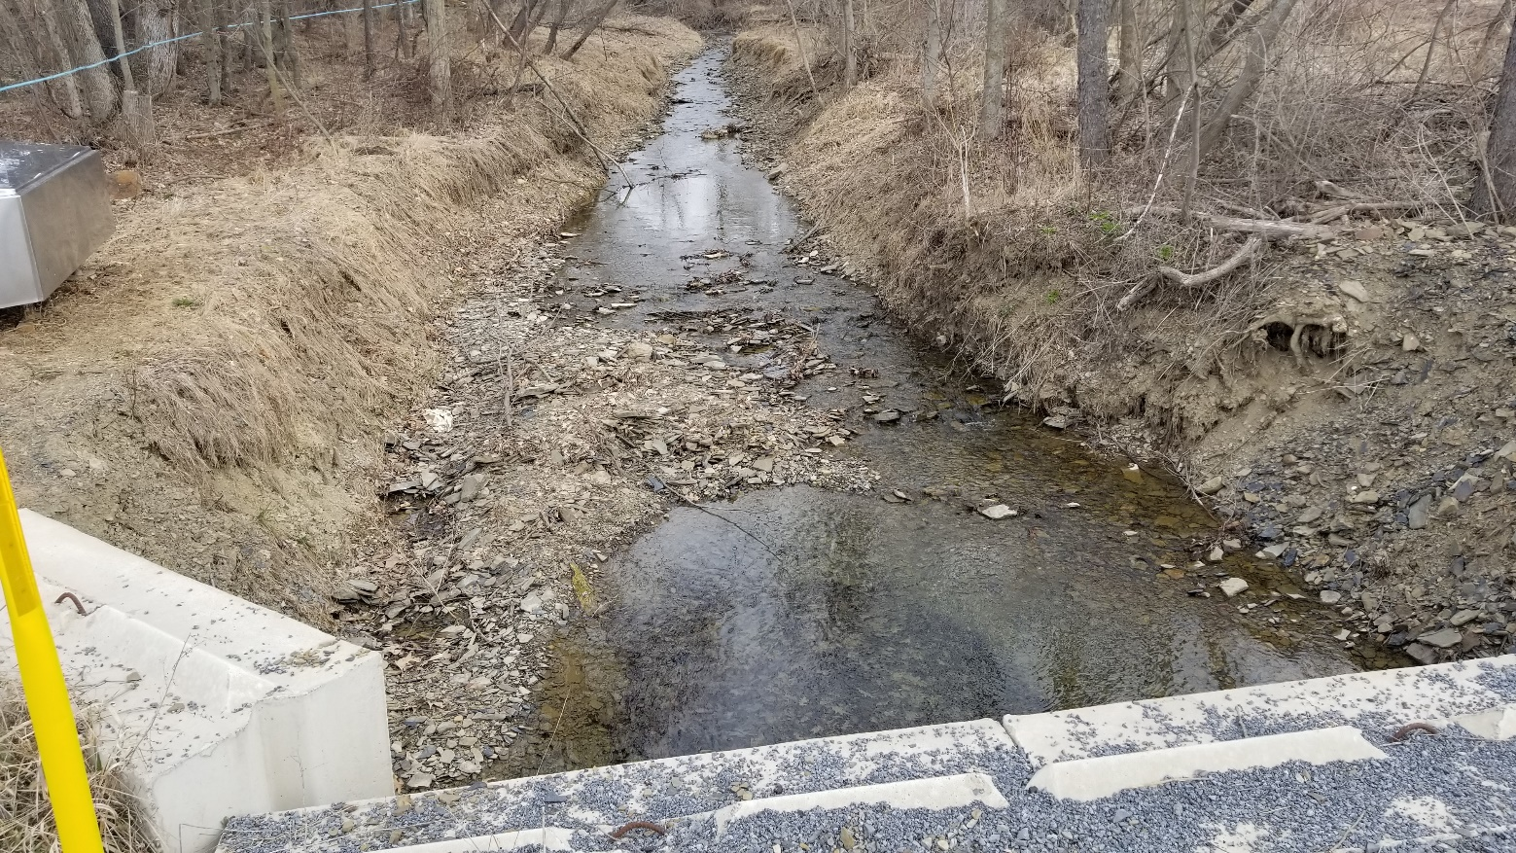
Bankfull Technical Bulletin
Procedure for Determining Bankfull Width Near a Road / Stream Crossing Structure:
Location: Start at a location away from the influence of any culvert or bridge, since they often impact channel width. To do this, roughly estimate bankfull channel width, then go at least 5 times that distance away from the structure. Looking upstream is preferred, but downstream reaches can be used if necessary (see locations to avoid below).

Slide 39
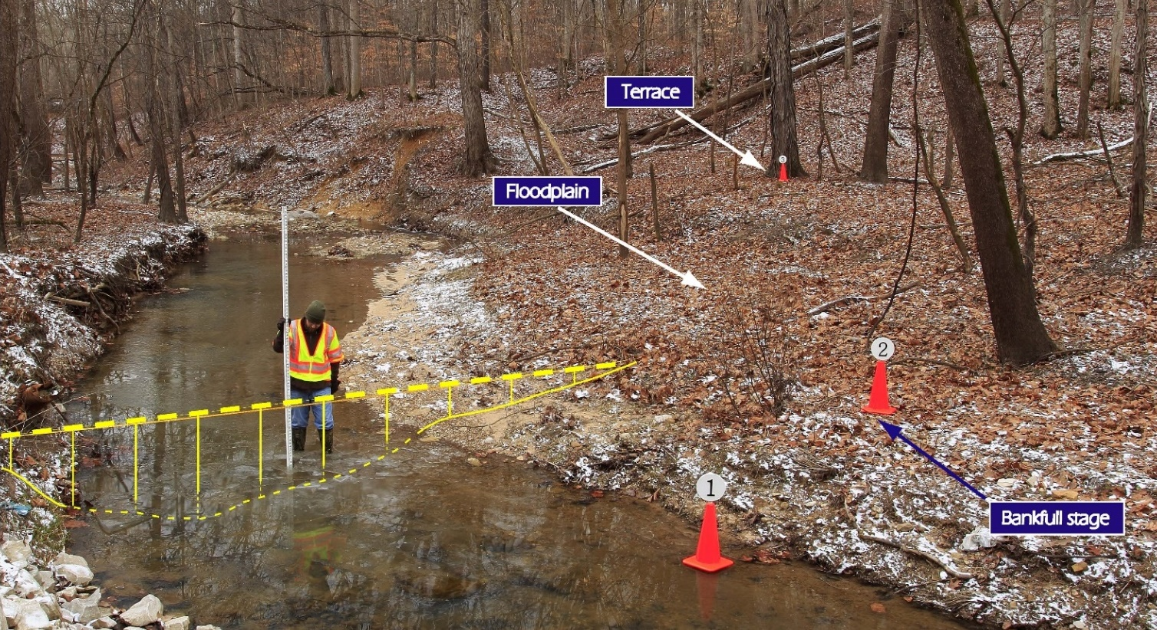
Bankfull Technical Bulletin
Determine Bankfull: Begin by looking up in the floodplain and then work down toward the stream. Using both sides of the channel find the elevation of the best bankfull indicators and mark those locations, using flags if necessary. Stretch a measuring tape across the stream at your bankfull mark(s), noting that the tape should be level, to measure the bankfull channel width. Continue moving upstream or downstream, taking successive measurements that are at least 1/2 bankfull width apart. Collect at least 5 measurements and average them together. Be flexible and think logically in choosing the best indicators for your bankfull measurement locations.
terrace
floodplain
bankfull width
bankfull stage
active channel
Photo – Indiana Fluvial Erosion Hazard program

Slide 40
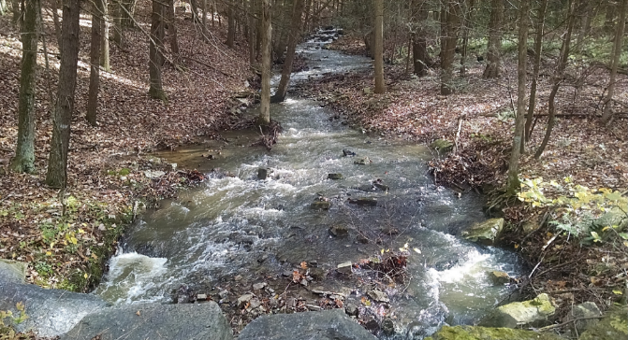
Bankfull Technical Bulletin
Finding the Natural Channel of a Stream:
Because streams vary widely in composition, slope, and manmade impacts, it is impossible to create a set of “instructions” for determining bankfull that will work on every channel. The goal when determining bankfull flow is to find an area that represents natural channel conditions either upstream or downstream of the crossing. This sometimes means moving further upstream or downstream away from the structure, or skipping sections of stream that are unnaturally widened or constricted.
Be flexible and think logically in choosing your bankfull measurement stream section in order to get the best representation of the natural channel.
go 200’+ upstream for natural channel and bankfull
sediment wedge
existing structure headwall

Slide 41
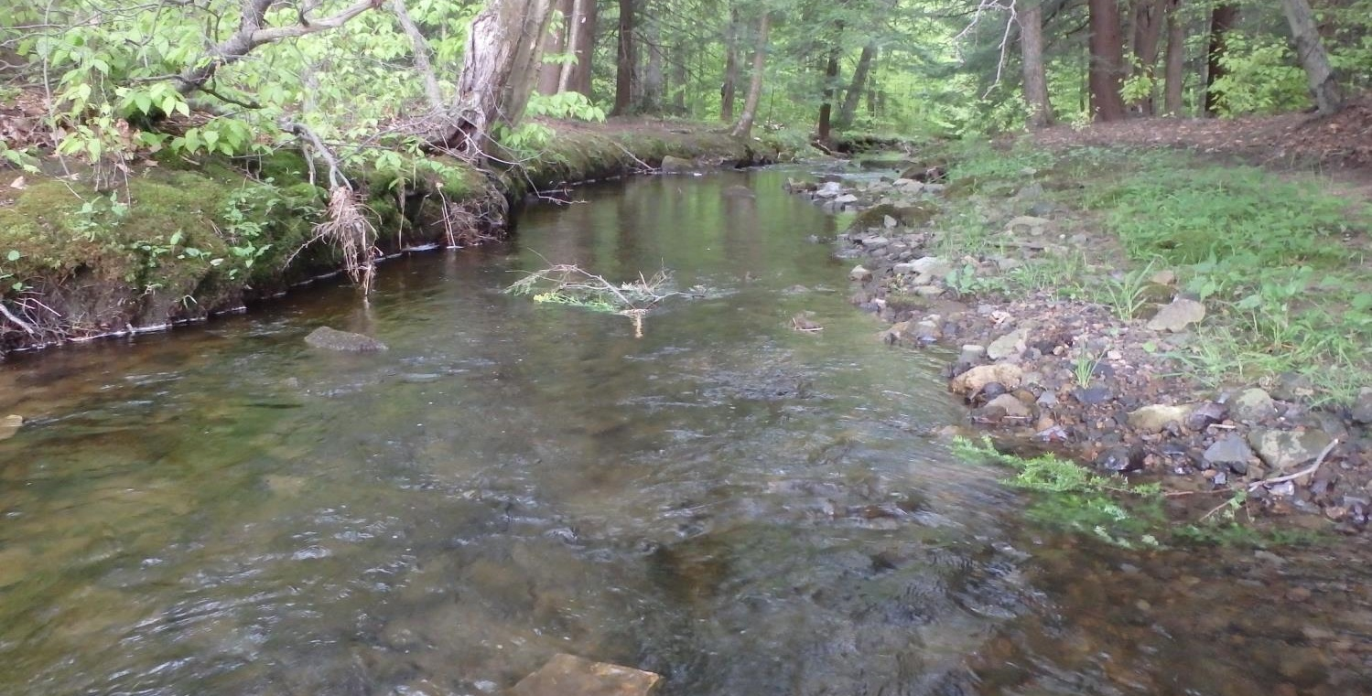
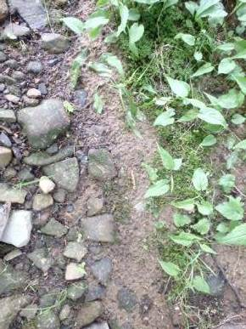
Bankfull Technical Bulletin
Field Indicators of Bankfull Flow: (listed in order from most to lease reliable indicators)
1. Change in Bank Slope: Bankfull flows are often associated with “benches” or the top of the stream bank, unless the stream is entrenched or has been altered in the past.
2. Depositional Features: The top of features such as point bars and mid-channel bars are often indicators of the bankfull flow elevation. Use these elevations to look for additional clues on each bank at the same elevation.
3. Changes in Particle Size: Streams drop sediment when they start accessing their floodplain. A Change in particle size along a stream bank (from gravelly, to silty or sandy) often indicates bankfull elevation.
4. Vegetation Changes: Although not as reliable, changes in vegetation can indicate bankfull elevation.
5. Scour Features: Erosion and scour lines can be used if other features cannot be located.
2
Bankfull Width
1
5
4
3
Photos Trout Unlimited
J. Tomlinson

Slide 42
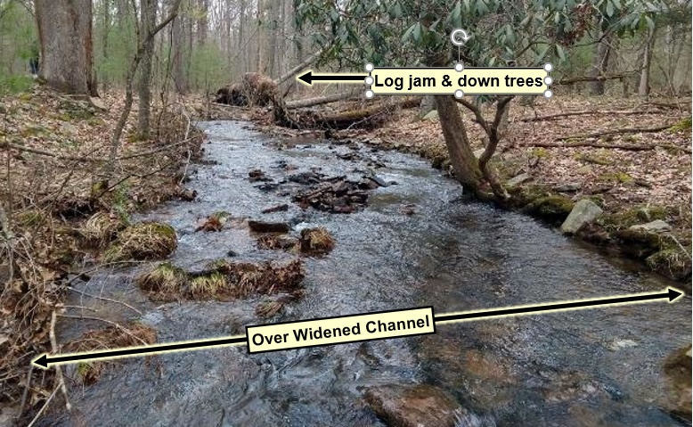
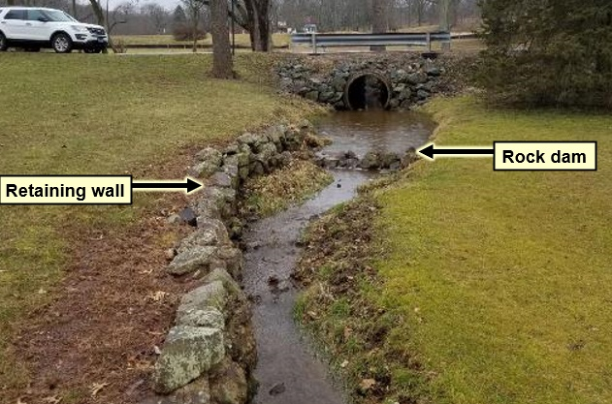
Bankfull Technical Bulletin
Locations to Avoid in Determining Bankfull Flow: (if possible)
Logjams or Fallen Trees: These structures tend to increase the bankfull width in their immediate vicinity.
Manmade Impacts: Avoid locations with wall, weirs, dams, rip-rap, pipes. etc.
Bedrock Outcroppings: Bedrock can hide indicators of bankfull flow and alter channel width.
Braided Channels: Measure upstream or downstream of any braided channels if at all possible.
Tributaries/Springs: Measure bankfull between road crossing and any incoming flows that may increase width.
Hard Meander bends: Hard bends make it difficult to find good indicators since the stream is moving laterally.

Slide 43
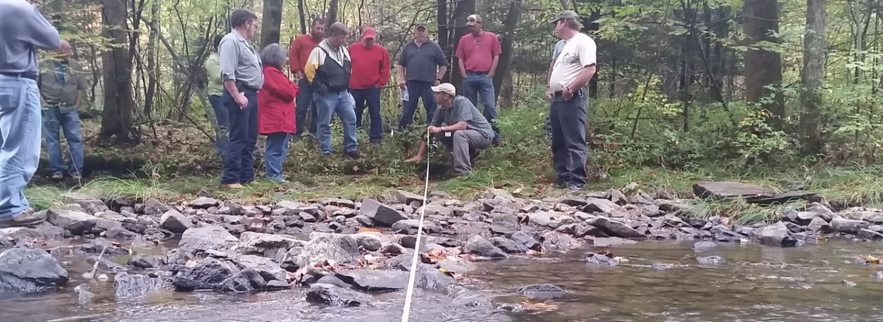
Bankfull Technical Bulletin
Additional Bankfull Determination Tips:
Bankfull flows will be level across the channel, so make sure your tape is level when measuring bankfull. If you find strong indicators on one bank, you can stretch the tape level across the stream to get bankfull.
When looking for bankfull indicators, think logically about a 1.5-2 year recurrence interval. Does it make sense that the points you are measuring as bankfull will see flow with that frequency?
Surveys of cross sections can be used to verify changes in slope as an indicator of bankfull.
On entrenched streams, or streams with historically high sediment impacts (legacy sediments), bankfull elevation can be below the elevation of the “top of stream bank” due to many years of impacts.
Note that tree roots and other vegetation can exist below the bankfull elevation, especially in dry years.
Measuring bankfull is often easier during Spring and Fall when vegetation is dormant.
Be flexible in your measurement locations to find the best representation of the natural channel.

Slide 44
Bankfull Update
Looking to finalize TB next week:
Comments, corrections, questions, additional clarifications needed, better pictures?
Eric Chase: ehc111@psu.edu
For audio via phone: 646-876-9923
For technical assistance use chat box

Slide 45
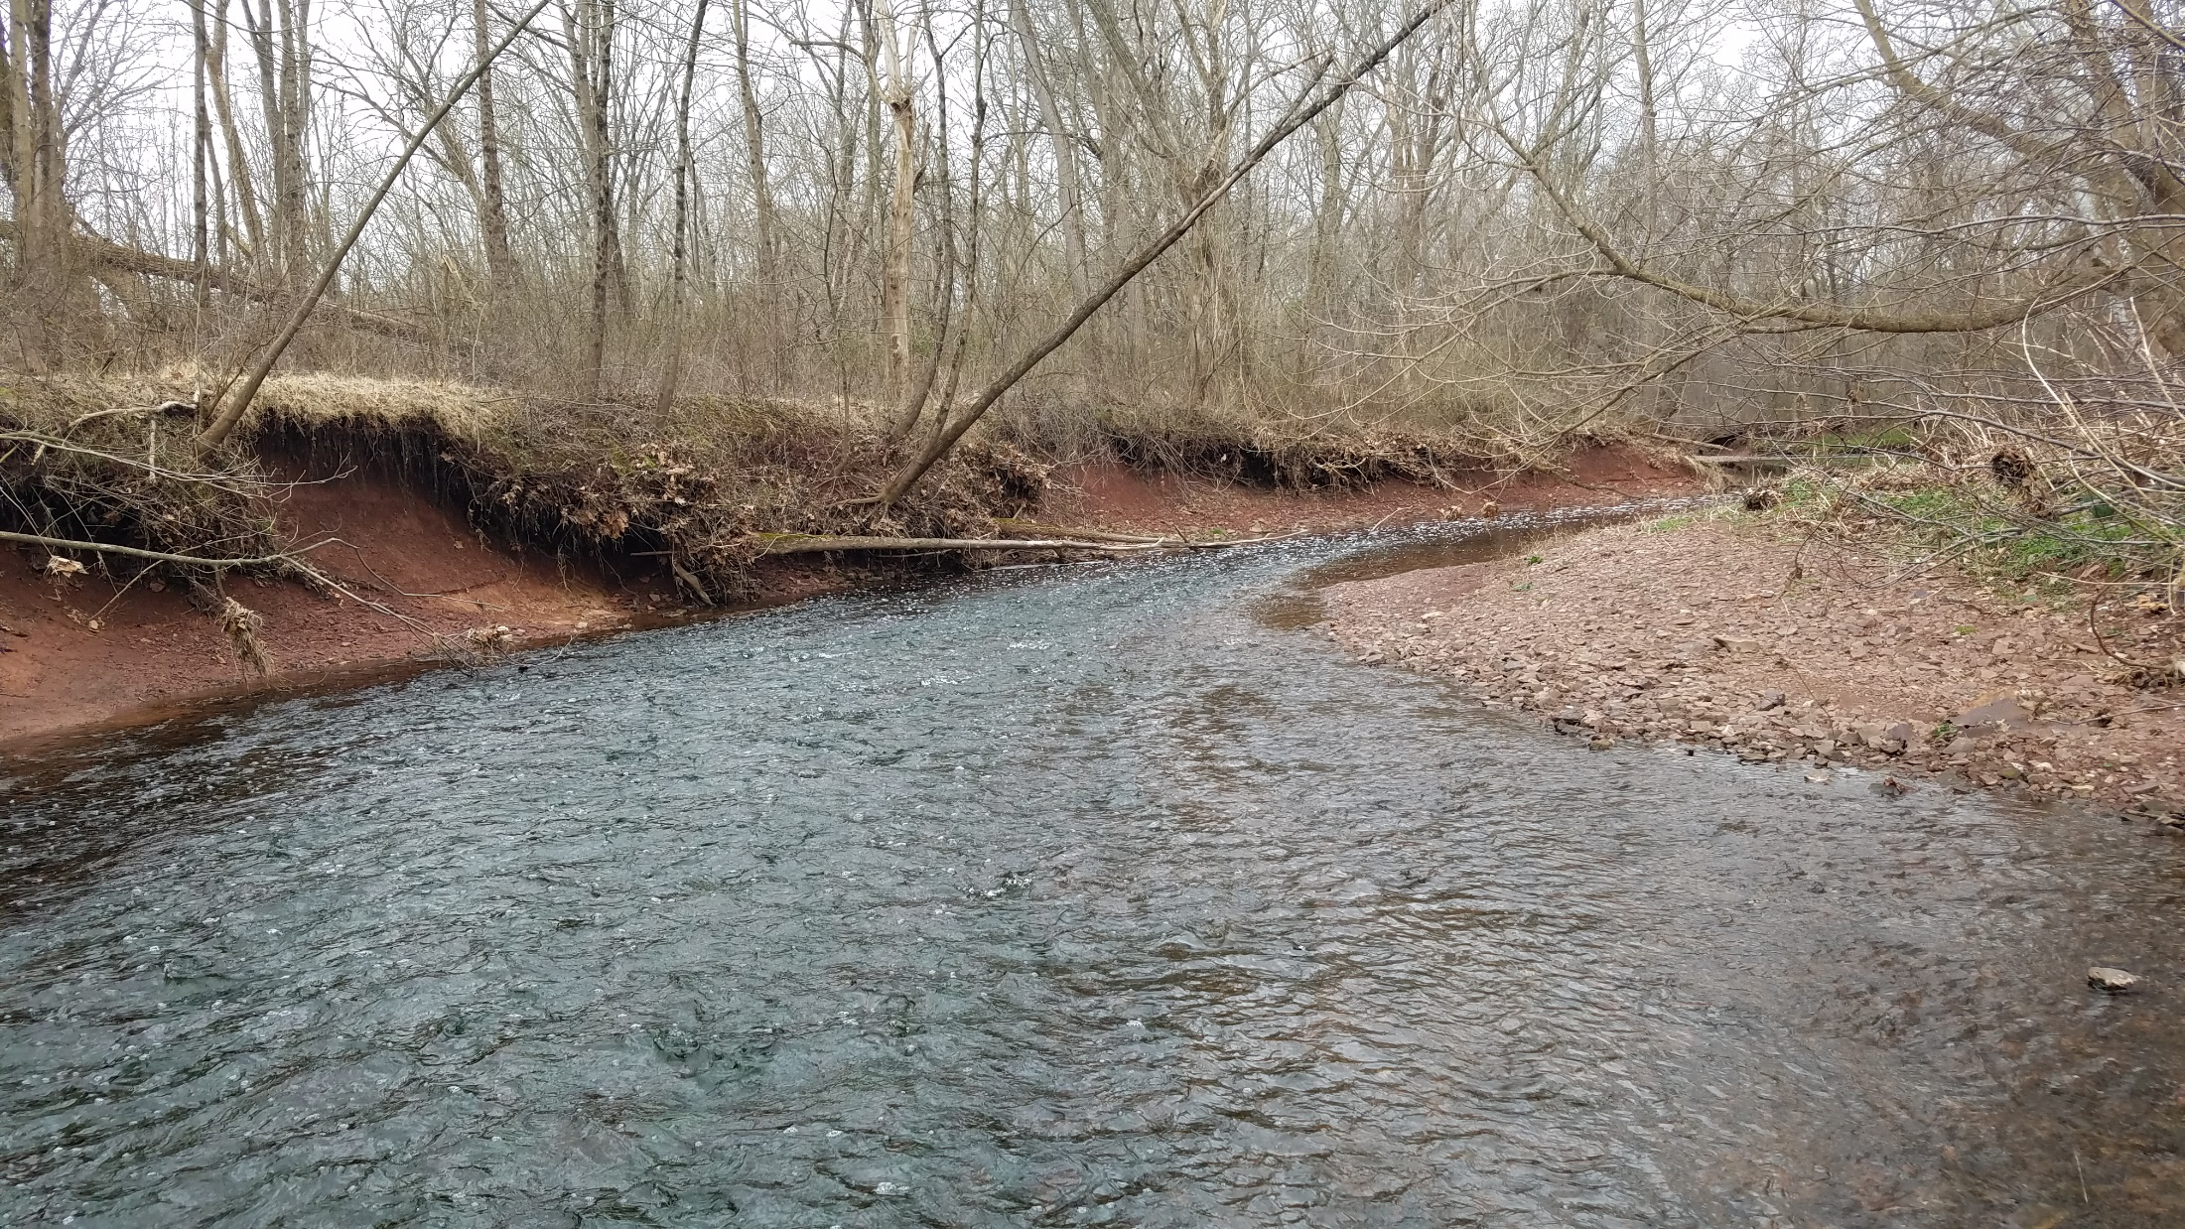
Bankfull Technical Bulletin
QUESTIONS?
Remnant Terrace
bankfull width
Shaun McAdams

