Slide 1
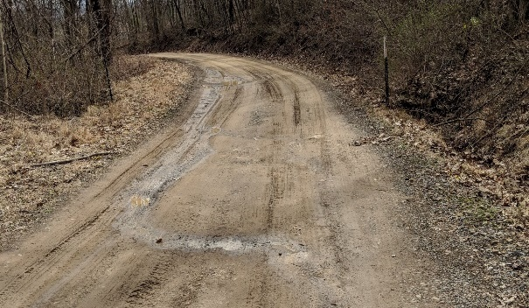
Better Grant Applications
Dirt, Gravel, and Low Volume Road Program
Webinar 1/12/2023
Sherri Law
shlaw@pa.gov
Roy Richardson: SCC
rrichardso@pa.gov
Ken Corradini: CDGRS
kjc139@psu.edu
Steve Bloser: CDGRS
smb201@psu.edu
If you are reading this, then you are successfully seeing the webinar video. Webinar audio should be automatic through your computer (or click “join audio”), and options can be accessed in the “audio options” button on the bottom left. If your computer audio is not working, you can listen on your phone by dialing 646-876-9923.

Slide 2
Why talk about grant applications?
It’s important that DGLVR grant applications are thorough, detailed, and filled out correctly.
To prevent misunderstandings
Notes:
This program focuses on simplicity and minimal paperwork, but we still want to write down enough to make sure everyone understands what the project is

Slide 3
Why talk about grant applications?
Need enough info to determine eligibility
Need enough info to determine if the project is a good use of DGLVR funds
Because the application becomes a DGLVR contract attachment
Defines the scope of work that the grant will pay for

Slide 4
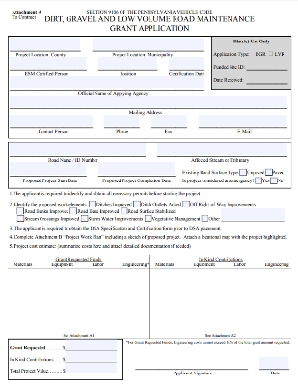
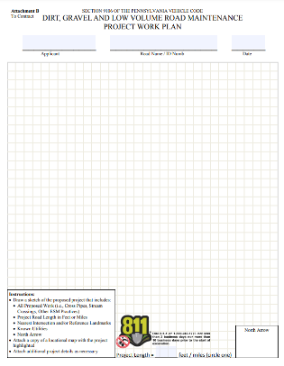
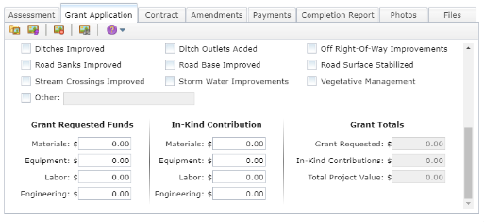
Outline
Preparing to fill out the grant application
Filling out the grant application
Supplements to the grant application
Documenting changes to the grant application
Adding the grant application to the GIS

Slide 5
Outline
Preparing to fill out the grant application
Filling out the grant application
Supplements to the grant application
Documenting changes to the grant application
Adding the grant application to the GIS

Slide 6
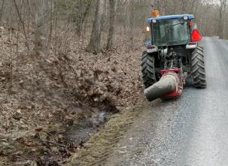
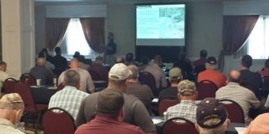
Preparing to fill out the Application
Outreach to potential grant applicants
Newsletter
Newspaper articles
Demonstrations
Local workshops
ESM Training
Notes:
Before working on a grant application, there are a variety of preliminary steps that districts and applicants often take
The grant application process usually begins with conservation districts doing outreach and education to potential applicants to make them aware of available funding and application deadlines
The applicants, in turn, attend ESM training to become eligible to apply for DGLVR funds

Slide 7
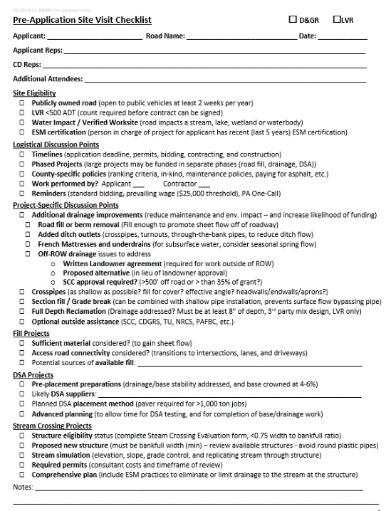
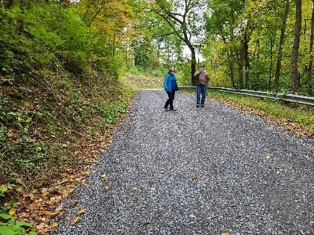
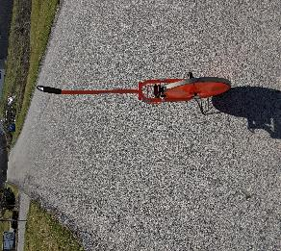
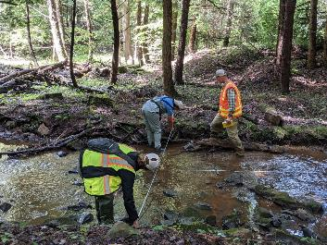
Preparing to fill out the Application
Outreach to potential grant applicants
Pre-application meeting
Notes:
One of the most common ways to prepare for submitting a grant application is for the grant applicant to meet with the conservation district on site to discuss and layout a project
Pre-application meetings are one of the best ways to make sure a project is eligible, meets policy, and is a good use of funding (i.e. it uses ESM practices, it makes and environmental improvement, etc.)
Sometimes districts will meet with the applicant to discuss these things after receiving an application and before the QAB ranks and recommends projects, which is also fine
Refer to the pre-app checklist for talking points when developing a project

Slide 8
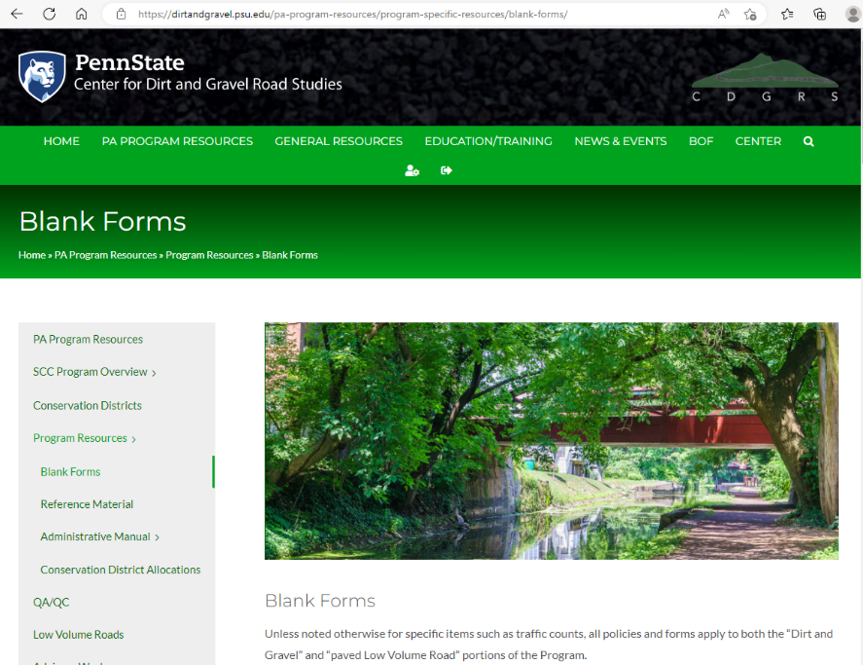
Preparing to Fill out the Grant Application
Notes:
A lot of the potential additions to grant applications that we’re about to discuss can be found on the Center’s website on the “Blank forms” Page

Slide 9
Preparing to fill out the Application
Outreach to potential grant applicants
Pre-application meeting
Project design
Materials list
Cost estimate
Notes:
Obviously the largest task to prepare for the grant application is to design the project, including generating a materials list and cost estimate
This is very important topic and we won’t go into details today about this process. We are planning a future webinar on project estimation to discuss this further.

Slide 10
Outline
Preparing to fill out the grant application
Filling out the grant application
Supplements to the grant application
Documenting changes to the grant application
Adding the grant application to the GIS

Slide 11
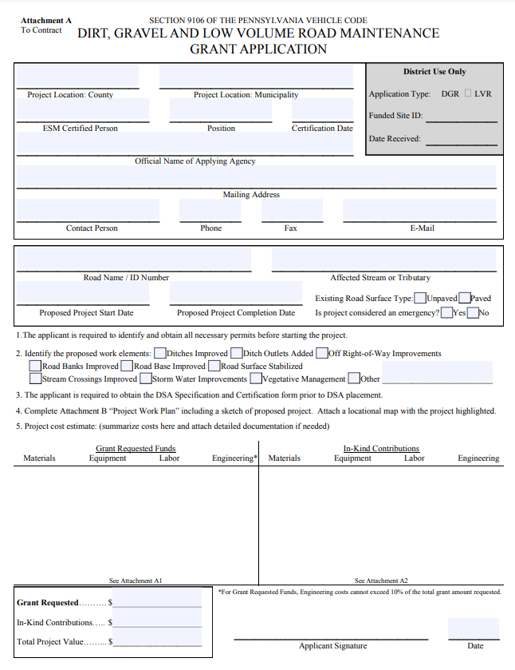
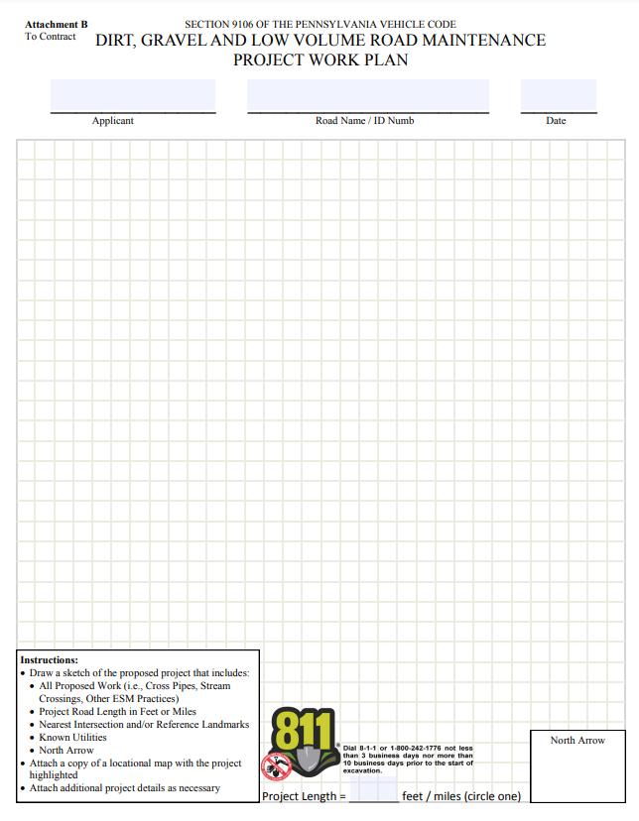
Application
Notes:
This is what the grant application looks like
Notice that the grant application is one page with a sketch on the back and attachments as needed

Slide 12
Application
Who fills out the Grant Application?
Road owner
Road owner with help from conservation district
The grant application is meant to be simple enough to be filled out by public road owners with minimal experience in road work.
The grant application must include enough detail to communicate the proposed project but does not need to have final design work complete.
Applicant can receive assistance from
Conservation District (recommended)
Center for Dirt and Gravel Road Studies (as needed)
Engineers (not required)
POLL QUESTIONS
Notes:
The grant application is meant to be simple enough to be filled out by even public road owners with minimal experience in road work.

Slide 13
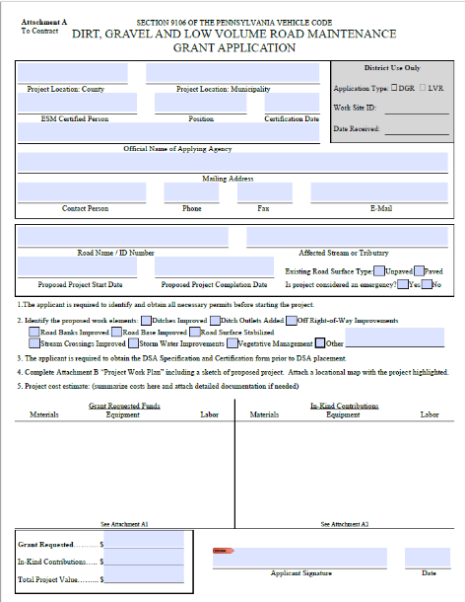
Filling out the Application
Fill out page 1 completely

Slide 14
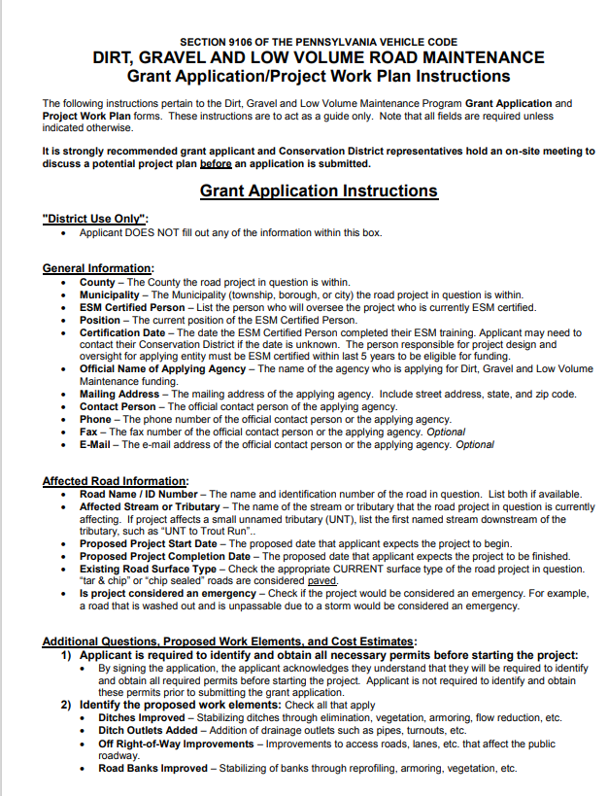
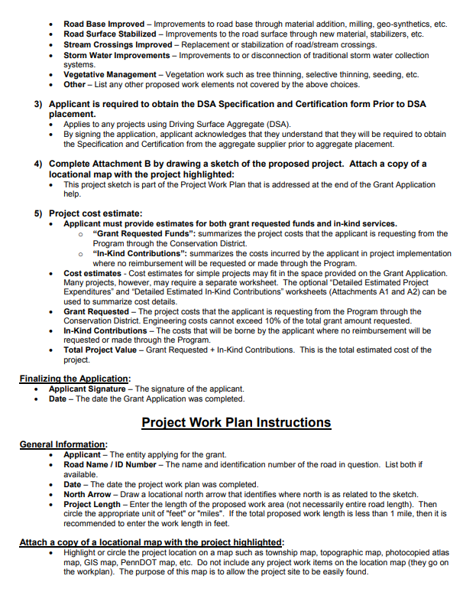
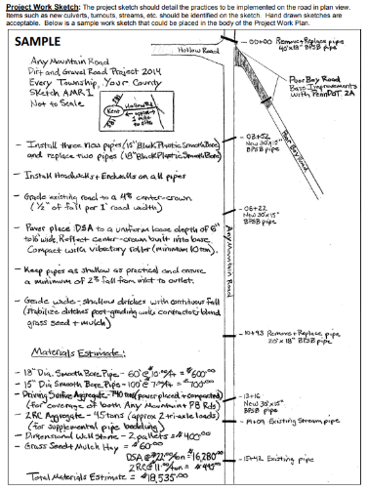
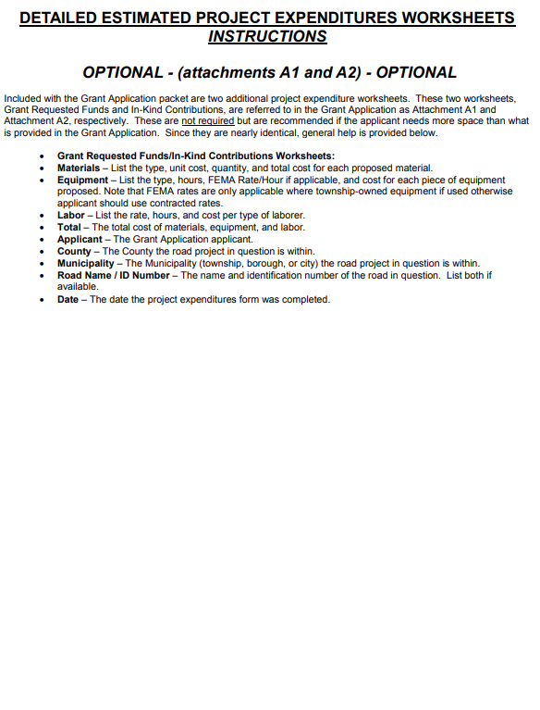
Filling out the Application
Instructions available on Blank Forms page of Center’s Website

Slide 15
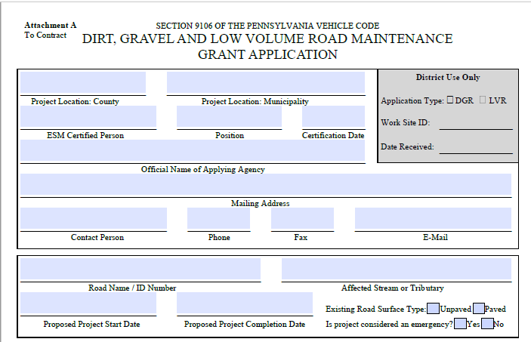
Filling out the Application
Any County
Example Township
John Doe
Roadmaster
8/25/2022
Example Township
123 Main Street, Example Town, PA 12345
John Doe
123-456-7890
123-789-4560
Johndoe@example.com
Any Mountain Road/ TR 123
Unnamed Tributary (UNT) to River
April 30, 2024
Sept 30, 2024
x
x
Notes:
Filling out the top of the grant application is pretty self explanatory.
Mostly filling out contact info and basic site info
Additional information on this available in application directions
I just want to highlight a few items:
Make sure the ESM Certification Date is within the last 5 years
Make sure the proposed project start date is within the time frame that funds are available (2-year spending requirement)

Slide 16
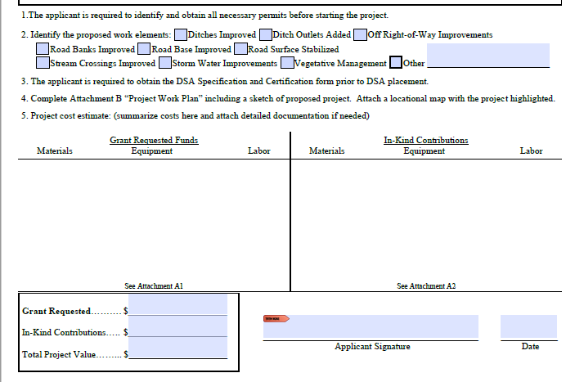
x
x
x
x
x
x
See attached sheets
$24,775.00
$3,590.00
2/1/2023
$28,365.00
Notes:
Similarly, the bottom of the grant application is pretty simple
Read the reminders about permits and DSA
Fill out the check boxes for project work. This is important
Attach a work plan and location map – we’ll talk about these soon
Summarize cost estimate and attach detailed documentation if needed – we’ll talk about this more as well in a few minutes
Notes that the grant requested, in-kind contributions, and total project value is summarized on the bottom left of the grant application
Also notice that the ESM-Certified applicant signs the application

Slide 17
Filling out the Application
Fill out page 1 completely
2. Location map

Slide 18
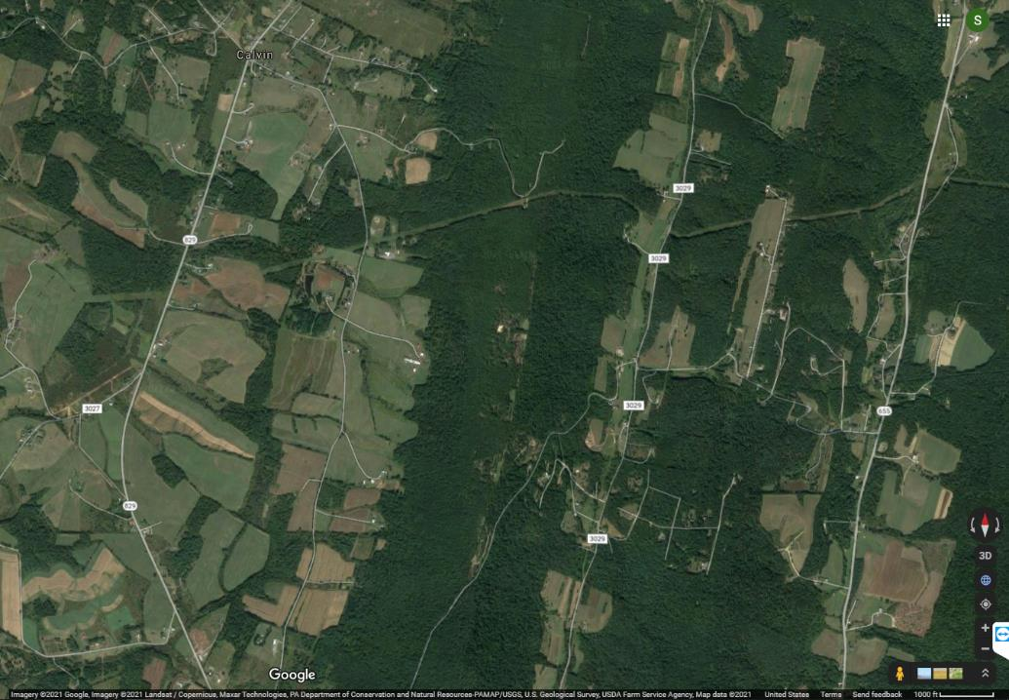
Location Map
Work Area
Notes:
The location map just where the project is in the world
This might not seem like an important part of the application because the applicant and conservation district usually both know where the project site is already, but this is helpful for QAB and Board members, for other conservation district staff if they are helping out or if there’s staff turnover, and for Center and SCC staff during tech assists and QAQCs

Slide 19
Location Map
Work Area
Notes:
It doesn’t matter what kind of map is used for the location map as long as it shows the location clearly, such as by labeling nearby main roads, towns, landmarks, etc.
First example was an aerial map and this is a road map from Google maps. USGS maps and municipal maps are also commonly used

Slide 20
Filling out the Application
Fill out page 1 completely
2. Location map
3. Sketch
Notes:
The project sketch is one of the most important parts of the application as it usually shows the proposed scope of work
Remember, this will be the attachment in the contract for DGLVR funds that specifies what the funding is going to be spent on

Slide 21
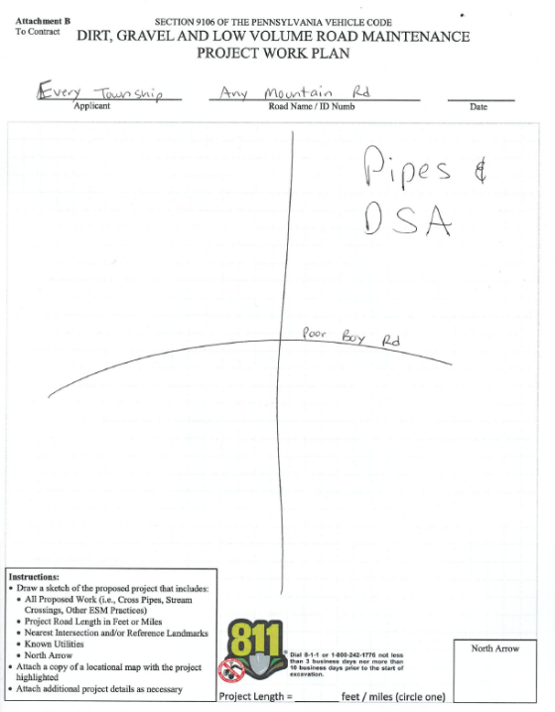
Filling out the Application
Notes:
This application is meant to be simple so that even new municipal officials are able to complete it
However, the project sketch still needs to be detailed enough to define the scope of work

Slide 22
Notes:
The sketch on the right will be a lot more helpful than the one on the left
The sketch needs to communicate what the project is to someone who’s never seen the site or talked about it

Slide 23
Filling out the Application
Project Sketch Tips
Show approximate location, shape, and size of:
Road
Project features
cross pipes, French mattress, ditch reshaping, road fill, etc.
3 dimensions
Materials notes
Streams
Landmarks (big tree, fence, utility, mailbox, house, etc.)
Property lines
Updated GIS drawing tools in development
Notes:
Good sketches do not need to be to scale, but should show approximate location size and shape of important features
If there are intersections or noticeable turns in roads, including them in the sketch is helpful
Remember that all project features need to be included and described
3 dimensions are needed
This includes pipe length, not just diameter or width and height
This includes depth, widths, and heights
List what type of aggregates, pipes, geotextile fabrics, headwall/endwalls materials, etc.
Show location of stream or direction to the stream
Landmarks can be very helpful in determining where project features are supposed to be installed
If there’s off ROW work, it can also be helpful to show the right of way boundaries as well as which properties are included

Slide 24
Filling out the Application
Recorded webinar on drawing tool updates in process
https://dirtandgravel.psu.edu/education-training/webinars/past-webinars/

Slide 25
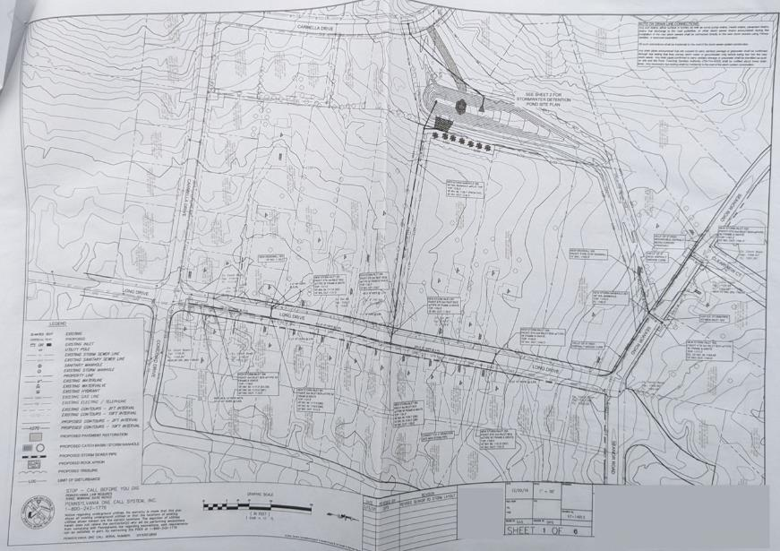
Filling out the Application
Engineered drawings are not required for the DGLVR grant application, but can be included
Notes:
Engineered drawings are not required for grant applications, but can be included if available
Remember that engineering costs incurred before DGLVR contracts are signed are not eligible for reimbursement with DGLVR funds

Slide 26
Filling out the Application
Fill out page 1 completely
2. Location map
3. Sketch
4. Cost estimate

Slide 27
x
x
x
x
x
x
DSA: $10,000
Pipes: $20,000
Etc.…
Township labor to install project: $3,590
$24,775.00
$3,590.00
2/1/2023
$28,365.00
Notes:
Similarly, the bottom of the grant application is pretty simple
Read the reminders about permits and DSA
Fill out the check boxes for project work. This is important
Attach a work plan and location map – we’ll talk about these soon
Summarize cost estimate and attach detailed documentation if needed – we’ll talk about this more as well in a few minutes
Notes that the grant requested, in-kind contributions, and total project value is summarized on the bottom left of the grant application
Also notice that the ESM-Certified applicant signs the application

Slide 28
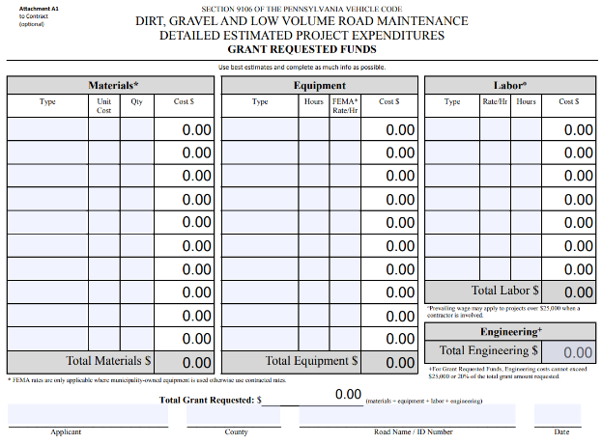
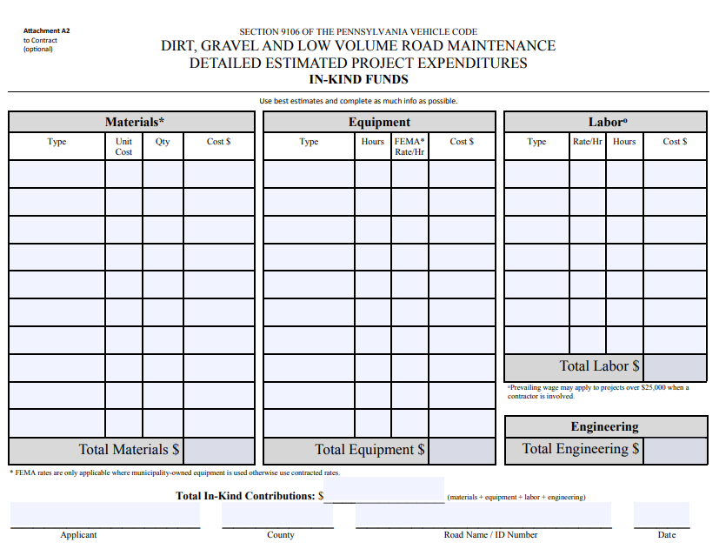
Application
Notes:
2 versions of this attachment are included to detail what the grant funds will pay for and what the applicant will pay for in-kind, or what the applicant plans to pay for with non-DGLVR funding
Both grant and in-kind expenses do need to be estimated for the application

Slide 29
Filling out the Application
Notes:
To put together a cost estimate using the provided attachments, each section is filled out similarly

Slide 30
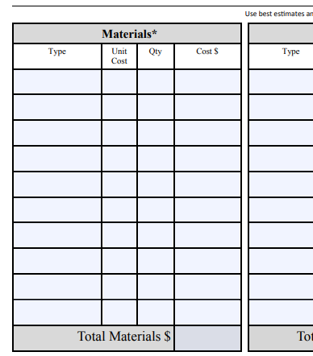
Filling out the Application
x
=
DSA
$30/ton
800 tons
$24,000
Notes:
Start with quantities of material (or equipment or labor hours)
Determine the cost per unit and the quantity needed
Multiply and fill out the column

Slide 31
Up to 20% of the grant (max $25k) can be used for engineering costs incurred AFTER a contract is signed

Slide 32
x
x
x
x
x
x
See attached sheets
$24,775.00
$3,590.00
5/1/2021
$28,365.00

Slide 33
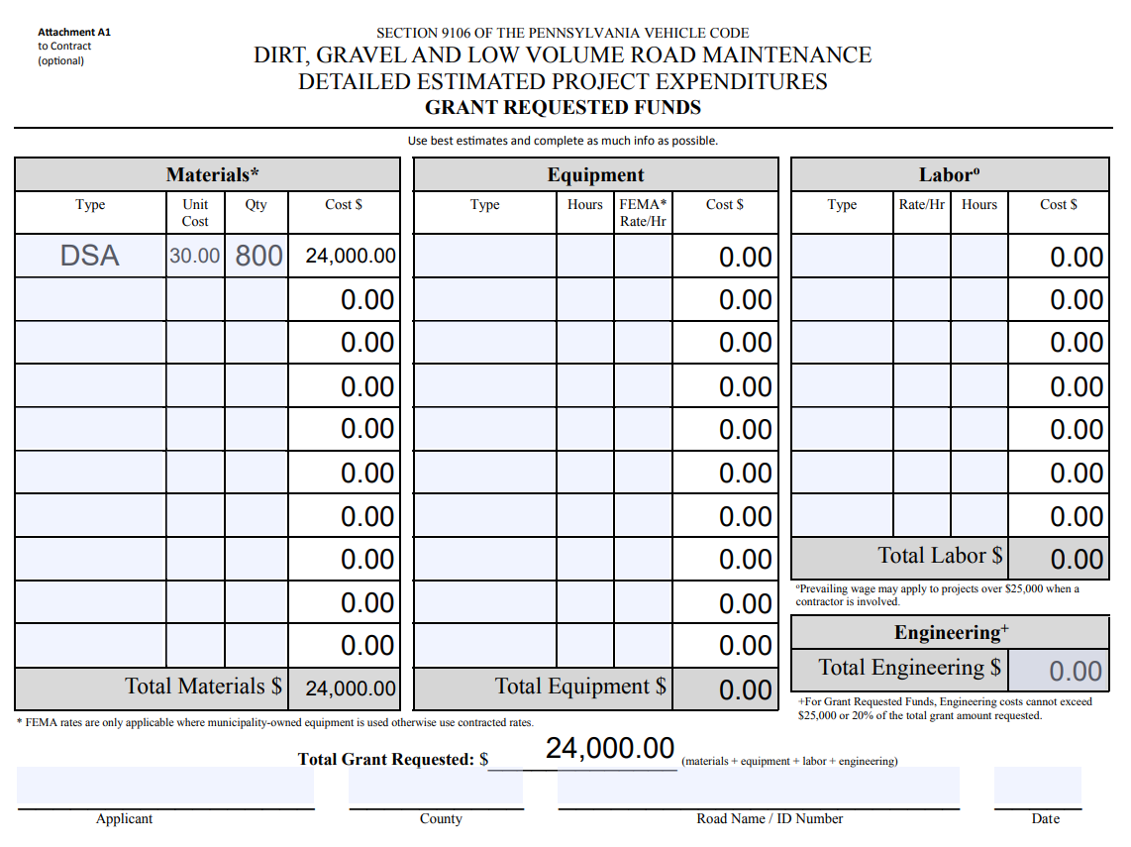
Filling out the Application
The PDF grant application on the Center’s website does the math for you!
https://dirtandgravel.psu.edu/pa-program-resources/program-specific-resources/blank-forms/
Notes:
The PDF on the blank forms page of the Center’s website will do the math for you

Slide 34
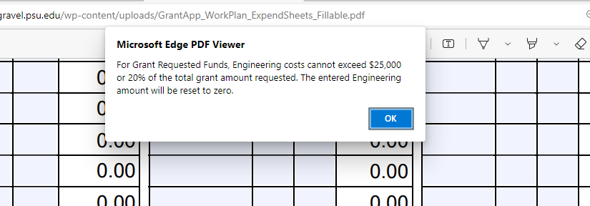
Filling out the Application
Notes:
It will even check if your engineering total exceeds 20% of the grant total

Slide 35
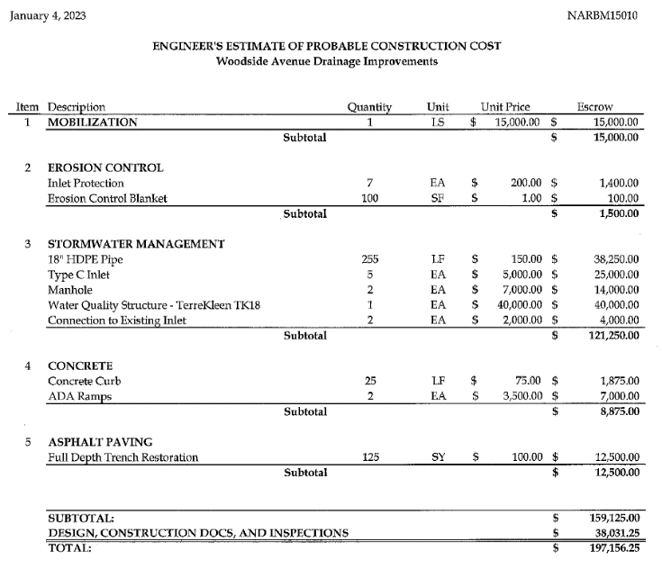
Filling out the Application
A cost estimate prepared by an engineer or contractor can be attached to the grant application
Make sure to specify which costs the grant will pay for and which will be in-kind
Notes:
The attachments we just talked about are not the only acceptable cost estimate format
A cost estimate prepared by an engineer or contractor can also be attached to the grant application

Slide 36
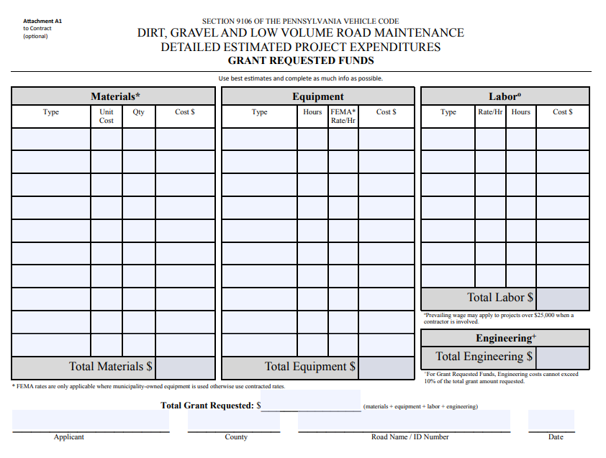
Anticipate cost increases by the time you go to construction
Don’t forget to budget for all project components, including Erosion & Sedimentation (E&S) Controls
Don’t forget to budget for Prevailing Wage

Slide 37
Prevailing Wage
Filling out the Application
DGLVR projects totaling $25,000 or more must pay prevailing wage to contracted labor
See “Frequently Asked Questions about Prevailing Wage Document”

Slide 38
Prevailing Wage
Filling out the Application
See recorded webinars from 2022
https://dirtandgravel.psu.edu/education-training/webinars/past-webinars/

Slide 39
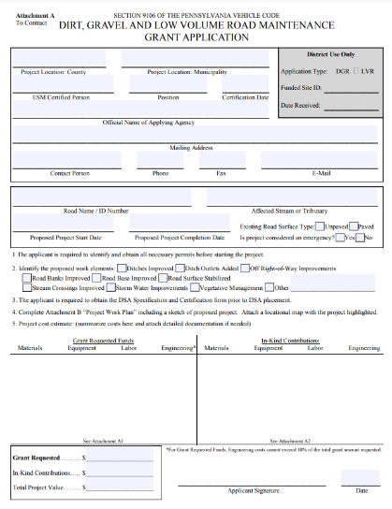
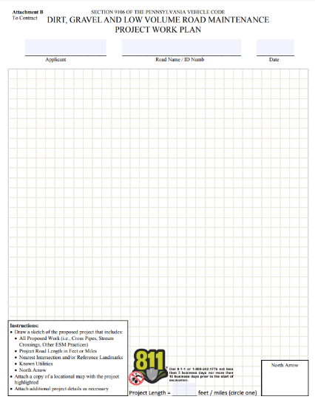
Filling out the Application
Fill out page 1 completely
Sketch
Location map
Cost estimate
Notes:
These 4 items are all that’s required for the grant application
However, the conservation district and grant applicant can add supplements to the application as needed

Slide 40
Outline
Preparing to fill out the grant application
Filling out the grant application
Supplements to the grant application
Documenting changes to the grant application
Adding the grant application to the GIS

Slide 41
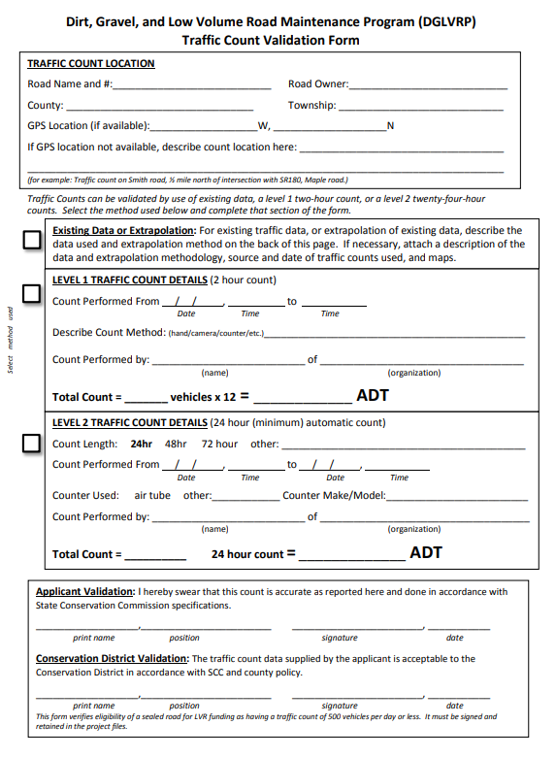
Supplements to the Grant Application
Traffic count for LVR Projects
Notes:
“Applicant is responsible for providing traffic counts before a contract can be signed.” (Admin Manual 7.5)
It may be beneficial to obtain this early in project planning or before the QAB meeting to make sure the site is eligible

Slide 42
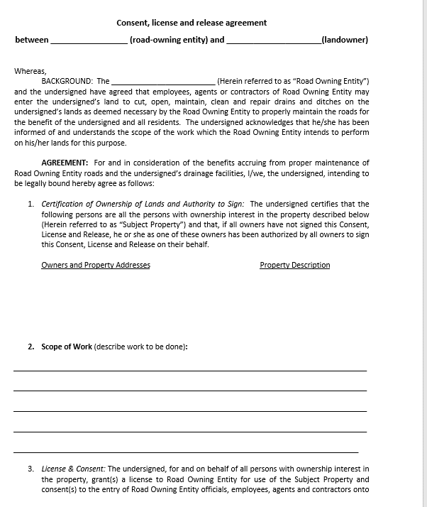
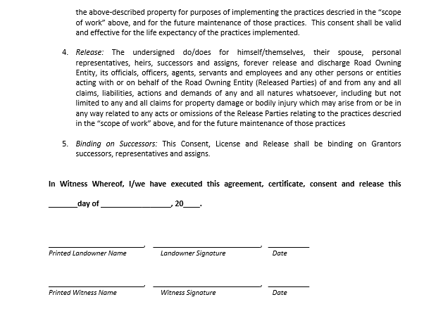
Supplements to the Grant Application
Traffic count for LVR Projects
Landowner consent for
off right-of-way work
Notes:
Required before starting work off ROW but it is essential to be talking with landowners early in the project planning. Some QABs and CD Boards may require this before approving funding.
“Before working outside the right-of-way, the grant recipient must obtain written permission from the landowner. Landowner permission should be sought as early as possible in the funding process, ideally before contracting, to ensure the project can be implemented as planned.” (Admin Manual 3.7.4.8)

Slide 43
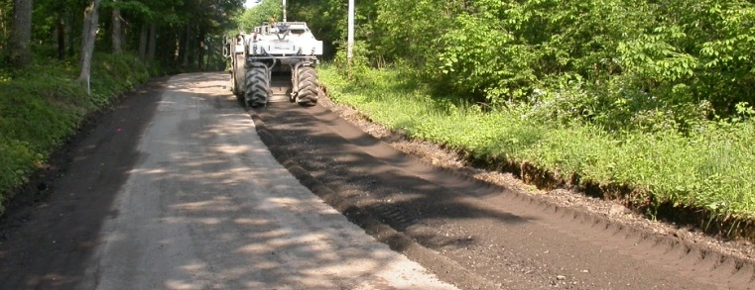
Supplements to the Grant Application
Traffic count for LVR Projects
Landowner consent for off right-of-way work
3rd party mix design for Full Depth Reclamation (FDR)
Notes:
There’s no timing requirement for when the 3rd party mix must be done, but be aware that if the mix design is done during the grant application phase, then you’ll want to ensure it was done by a third party
Admin Manual 7.3.3:
“The Center must be made aware of the proposed FDR project before a contract is signed. A site visit from Commission or Center staff may be requested.
FDR must follow specifications in PennDOT Publication 447 (Approved Products for Lower Volume Local Roads)
The mix design for FDR projects must be determined by an independent third-party.”

Slide 44
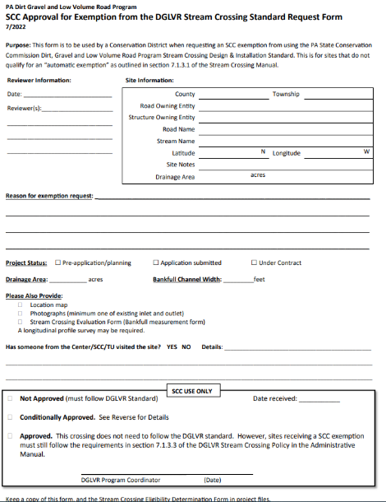
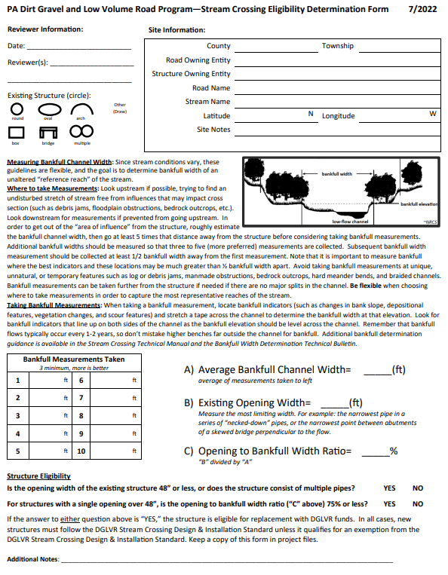
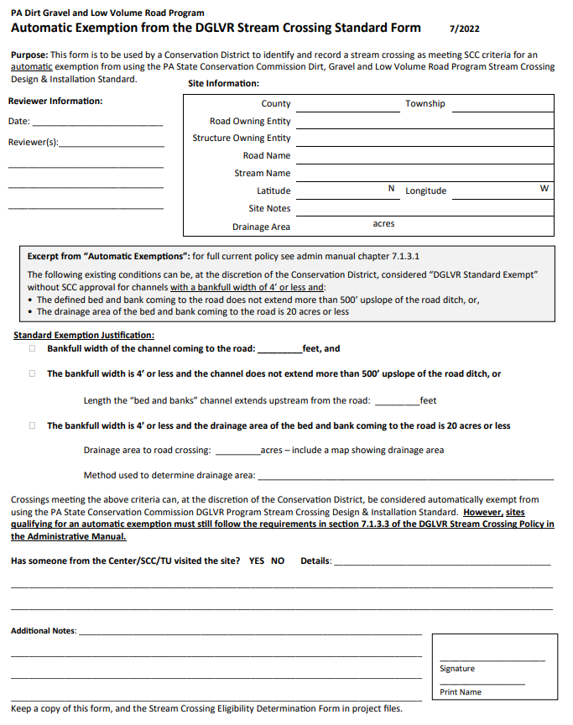
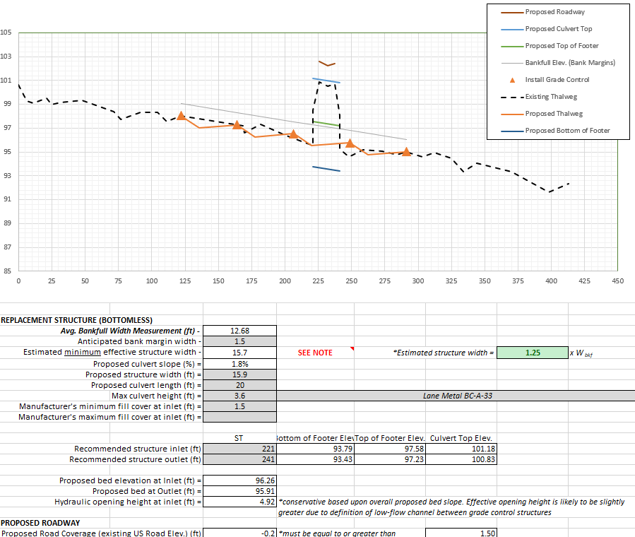
Supplements to the Grant Application
Traffic count for LVR Projects
Landowner consent for off right-of-way work
3rd party mix design for Full Depth Reclamation (FDR)
Steam crossing forms
Eligibility
long pro/site assessment
Exemption form

Slide 45
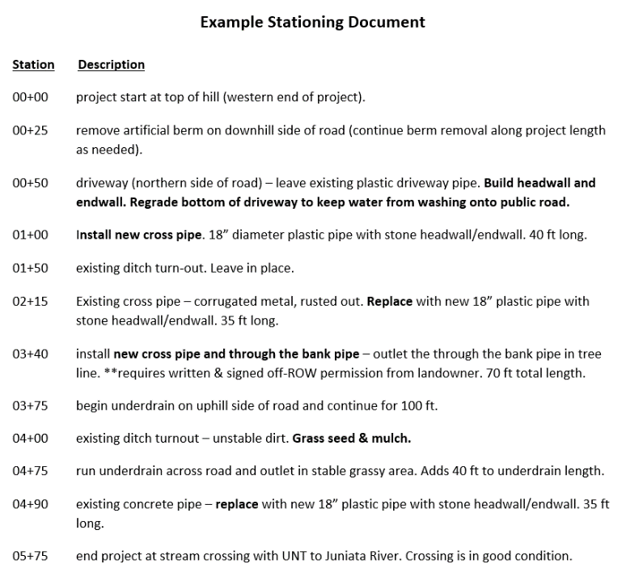
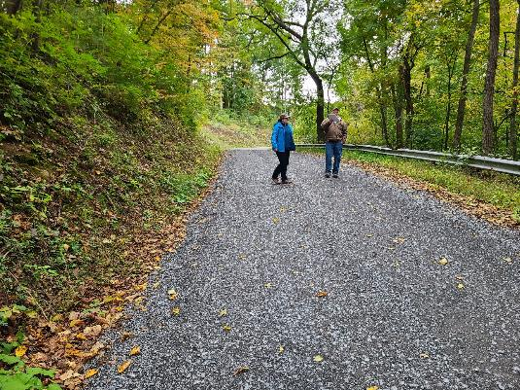
Supplements to the Grant Application
Traffic count for LVR Projects
Landowner consent for off right-of-way work
3rd party mix design for Full Depth Reclamation (FDR)
Steam crossing forms
Technical Assistance

Slide 46
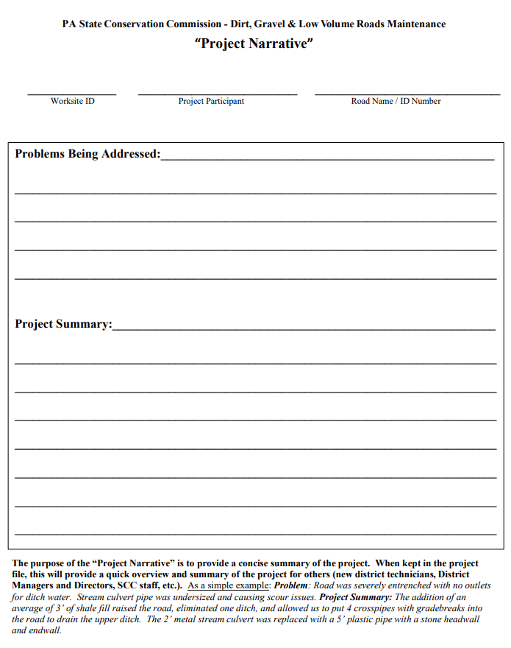
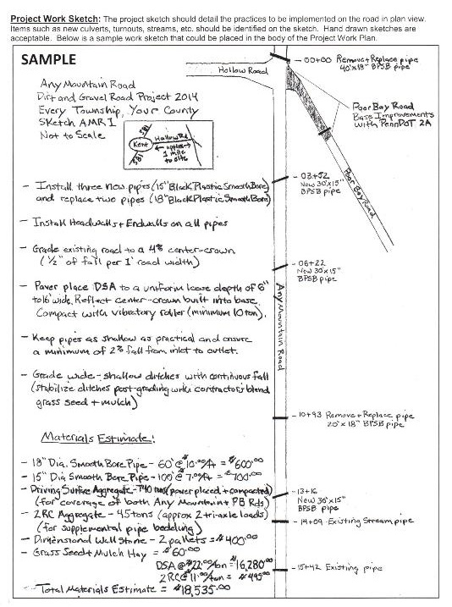
Supplements to the Grant Application
Traffic count for LVR Projects
Landowner consent for off right-of-way work
3rd party mix design for Full Depth Reclamation (FDR)
Steam crossing forms
Technical Assistance
Project narrative

Slide 47
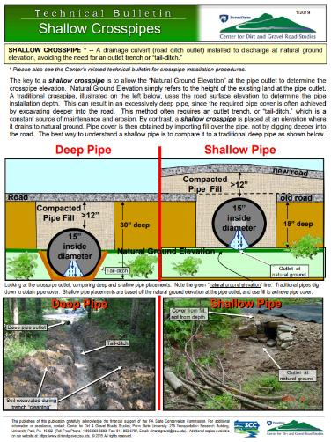
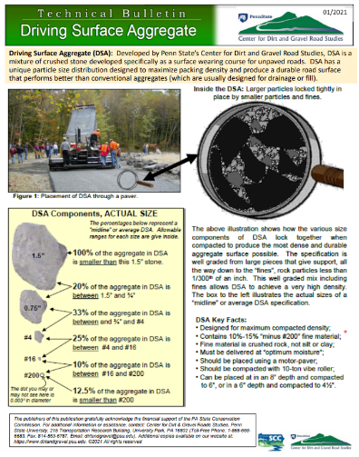
Supplements to the Grant Application
Traffic count for LVR Projects
Landowner consent for off right-of-way work
3rd party mix design for Full Depth Reclamation (FDR)
Steam crossing forms
Technical Assistance
Project narrative
Technical bulletins

Slide 48
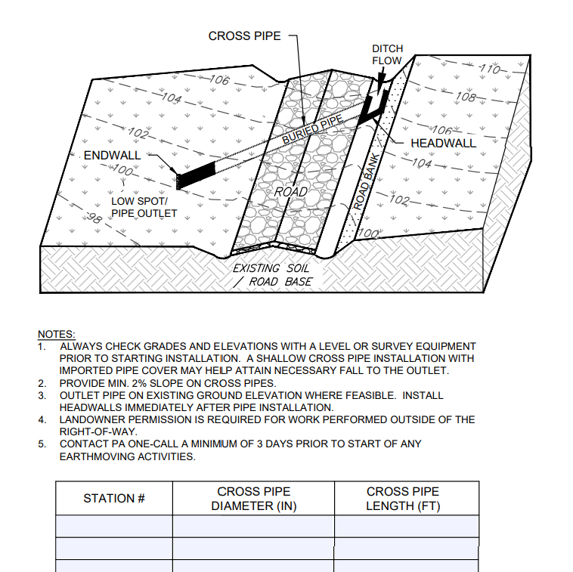
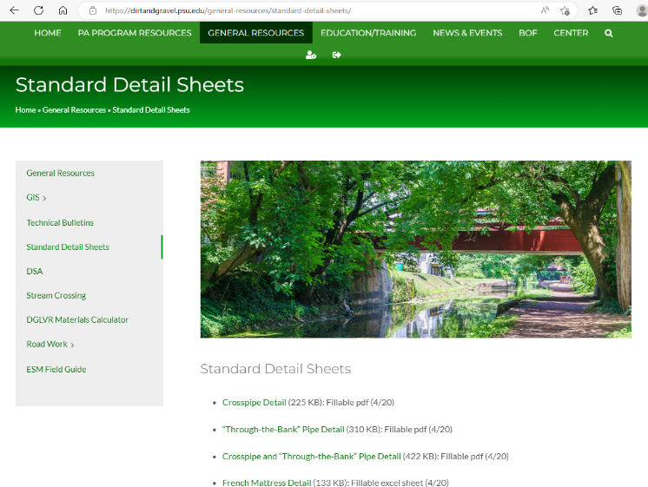
Supplements to the Grant Application
Traffic count for LVR Projects
Landowner consent for off right-of-way work
3rd party mix design for Full Depth Reclamation (FDR)
Steam crossing forms
Technical Assistance
Project narrative
Technical bulletins
Standard detail sheets

Slide 49
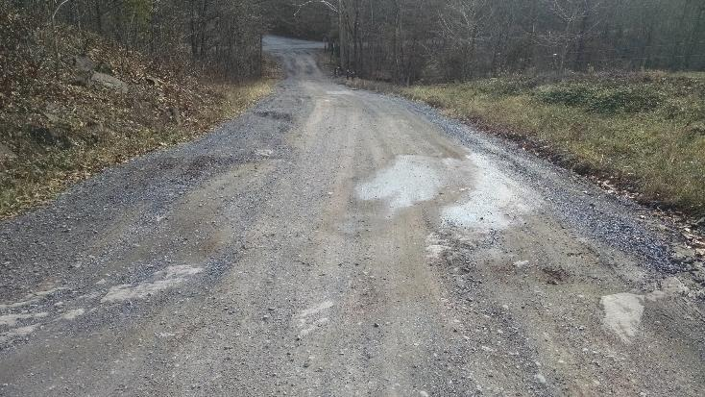
Supplements to the Grant Application
Traffic count for LVR Projects
Landowner consent for off right-of-way work
3rd party mix design for Full Depth Reclamation (FDR)
Steam crossing forms
Technical Assistance
Project narrative
Technical bulletins
Standard detail sheets
Before photos

Slide 50
Outline
Preparing to fill out the grant application
Filling out the grant application
Supplements to the grant application
Documenting changes to the grant application
Adding the grant application to the GIS

Slide 51
Documenting Changes to the Grant Application
The QAB can make changes to a grant application
Changes are often made during project implementation
Notes:
Changes can be made to grant applications at various times throughout a project’s lifecycle
Don’t forget that the law establishing the DGLVR Program allows QABs to add requirements to applications – see excerpt of Section 9106 of the PA Motor Vehicle code

Slide 52
Documenting Changes to the Grant Application
Why?
Because the application becomes a DGLVR contract attachment
Defines the scope of work covered by the contract
Notes:
It’s important to document changes to project scope because the grant application is the only thing documenting the scope of work that the grant funding can be spent on. As changes are made throughout the project lifecycle, districts should document this well and make sure the district and grant recipient both have documentation of the agreed upon changes.

Slide 53
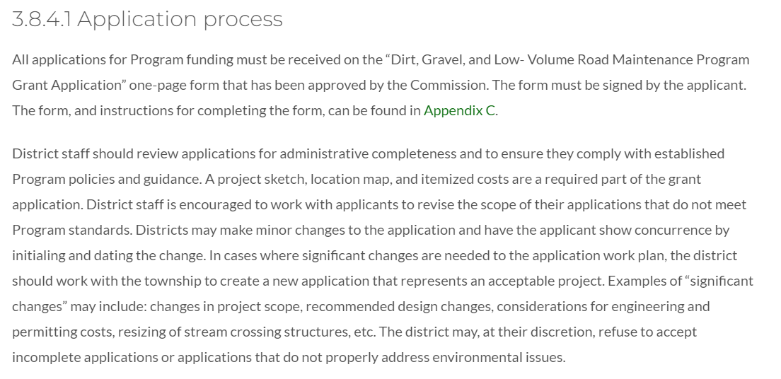
Documenting Changes to the Grant Application
Excerpt from Administrative Manual:
Notes:
Most districts are familiar with working with applicants to improve grant applications
Make sure that all changes are being documented in writing, preferably directly on the grant app
The Admin Manual provides some guidance on this

Slide 54
Documenting Changes to the Grant Application
5/5/2022
Notes:
Example of what an updated work plan could look like.
Clearly shows changes
Is initialed by the district and grant applicant/recipient
Include the date of changes
This could be accompanied by a letter(s), email(s), and/or notes in an activity log

Slide 55
Documenting Changes to the Grant Application
Notes:
Some conservation districts choose to sign a contract amendment when changes to the project scope are made
Can be for no additional funds and no additional time

Slide 56
Documenting Changes to the Grant Application
As-Built Documentation
Shows final project scope of work that was installed
Can still be as simple as red-line markups to the hand drawn sketch
GIS drawing tool updates in development
5/5/2022
Notes:
It’s recommended that district work with the grant recipient to do a final update to the project sketch to show what was installed

Slide 57
Outline
Preparing to fill out the grant application
Filling out the grant application
Supplements to the grant application
Documenting changes to the grant application
Adding the grant application to the GIS

Slide 58
Adding the Grant Application to GIS
GIS Questions? Reach out to Ken Corradini: kjc139@psu.edu
Notes:
Remember that one of the Admin Manual updates as of 7/1/2022 is that all funded projects need to be filled out in the GIS as much as possible, including the application

Slide 59
Adding the Grant Application to GIS
GIS Questions? Reach out to Ken Corradini: kjc139@psu.edu
Notes:
All of the same fields are the same as on the paper document
Should only take a few minutes to fill out
Please fill these out to the best of your ability, including the “Proposed work elements” check boxes

Slide 60
Adding the Grant Application to GIS
Various files can be uploaded
Project sketch
Other supporting files
GIS Questions? Reach out to Ken Corradini: kjc139@psu.edu

Slide 61
Summary
It’s important that DGLVR grant applications are thorough, detailed, and filled out correctly.
“Better” applications are detailed and updated
Additional documentation does not need to be very time consuming
5/5/2022

Slide 62
Summary
Reminders:
Quarterly Reports – Due 1/15/2023
Annual Summary Report – Due 1/15/2023
DGLVR Administrative Training 1/18 @ 9am
In person at Penn Stater in room 104: Contact Amy Lee Pifer (alp90@psu.edu) to register for in-person no later than Thursday, January 12, 2022.
Option to participate virtually
FUTURE WEBINARS AND TRAININGS: list will continue to evolve over time
Webinar: 1/19, 9am: Spread Footer Bridge Showcase
Webinar: 1/26, 9am: Small Slide Repair
POLL QUESTIONS

