Slide 1
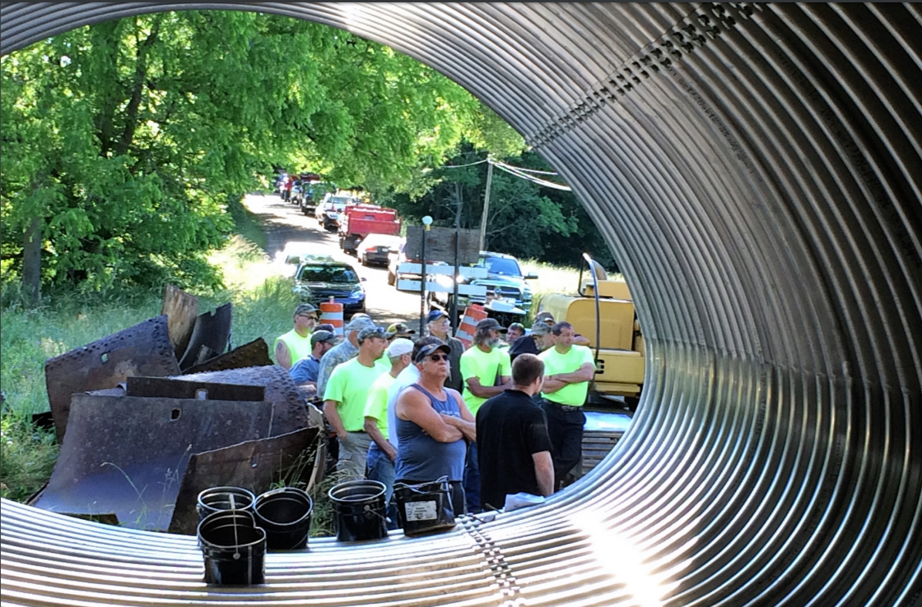
CD Education and Outreach
Toggle Fullscreen
mode with this button above
date
Starts at 9am
Use Chat box to ask Questions
Crawford CD
If you are reading this, then you are successfully seeing the webinar video. In addition to audio on the webinar, we have opened a phone conference line to allow attendees to listen and ask questions directly: 866-823-7699. Please use either the webinar audio or conference line, but not both (will produce feedback).
Audio also available via phone: 866-823-7699
For assistance, call: 814-865-5355

Slide 2
Toggle Fullscreen
mode with this button
above
Participant phone lines will be muted until after initial presentation
Thanks to Bradford, Crawford, and Jefferson Conservation Districts. Some of this is from their 2016 workshop presentation.
Use Chat box to ask Questions
http://metrocount.com
Audio also available via phone: 866-823-7699
For assistance, call: 814-865-5355

Slide 3
DGLVR
CD Education and Outreach
Purpose:
Share knowledge and experience from other CDs on education and outreach activities you can do to improve the Program in your County.
Participate in existing events
Host your own events
Improving communications
Audio also available via phone: 866-823-7699
For assistance, call: 814-865-5355

Slide 4
DGLVR
CD Education and Outreach
Participate in existing events
Host your own events
Improving communications
Crawford CD

Slide 5
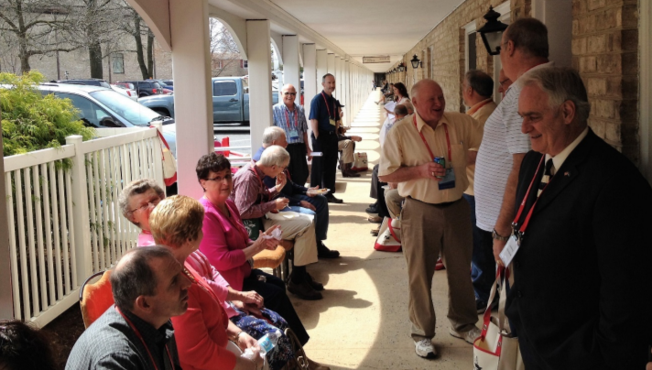
CD Education and Outreach
Participate in Existing Events
Municipal Events
Townships
47 Counties have Conventions (mostly fall)
Mostly one day, equipment demos, talks, vendors
Many have booth space available
PSATS State Convention (Hershey in April)
PA State Assn. of Twp. Supervisors: www.psats.org
Crawford County
Mixer at PSATS
in Hershey
Audio also available via phone: 866-823-7699
For assistance, call: 814-865-5355
Crawford CD

Slide 6
CD Education and Outreach
Participate in Existing Events
Municipal Events
Boroughs
PASB State Convention (Hershey in May)
PA State Assn. of Boroughs http://boroughs.org
Audio also available via phone: 866-823-7699
For assistance, call: 814-865-5355

Slide 7
CD Education and Outreach
Participate in Existing Events
Regional Events
Council of Governments (COGs)
COG: group of municipalities coordinating to act as one unit for common benefit
52 COGs exists in PA in various forms
PA Assn. of COGs: www.pacog.com
Audio also available via phone: 866-823-7699
For assistance, call: 814-865-5355

Slide 8
CD Education and Outreach
Participate in Existing Events
Regional Events
Contractor Workshops
Various sizes and sponsors
Typically focused on municipalities and contractors
Example: NEPA “Government Contracting Showcase” draws ~200 attendees every year. Includes vendors, presentations, demos, etc.
Audio also available via phone: 866-823-7699
For assistance, call: 814-865-5355

Slide 9
CD Education and Outreach
Participate in Existing Events
Regional Events
“Other” Applicants
Consider outreach to other potential applicants based on conditions in your county
PennDOT
PA Game Commission
PA Fish and Boat Commission
County Agencies
Audio also available via phone: 866-823-7699
For assistance, call: 814-865-5355

Slide 10
CD Education and Outreach
Participate in Existing Events
Legislative Breakfasts or Tours
Breakfasts
Typically short sessions with local legislators and municipalities
Excellent opportunities for presentations and project showcases
Tours
Many areas have occasional tours to allow legislators and municipalities to see activities in their region
Consider adding a DGLVR stop
Audio also available via phone: 866-823-7699
For assistance, call: 814-865-5355

Slide 11
CD Education and Outreach
Participate in Existing Events
Participate in Existing Events
Municipal Events
County conventions (twps, boroughs)
PSATS/PASB State Conventions (April and May)
Regional Events
COGs
Contractor Workshops
“Other” applicants (Game Commission, County, etc.)
Legislative Breakfasts or Tours
Audio also available via phone: 866-823-7699
For assistance, call: 814-865-5355

Slide 12
DGLVR
CD Education and Outreach
Participate in existing events
Host your own events
Improving communications
Crawford CD

Slide 13
CD Education and Outreach
Host Your Own Events
The most important thing to remember when planning to host your own event:
Audio also available via phone: 866-823-7699
For assistance, call: 814-865-5355

Slide 14
CD Education and Outreach
Host Your Own Events
The most important thing to remember when planning to host your own event:
If you feed them…they will come.
(can be as simple as coffee and doughnuts)
Audio also available via phone: 866-823-7699
For assistance, call: 814-865-5355

Slide 15
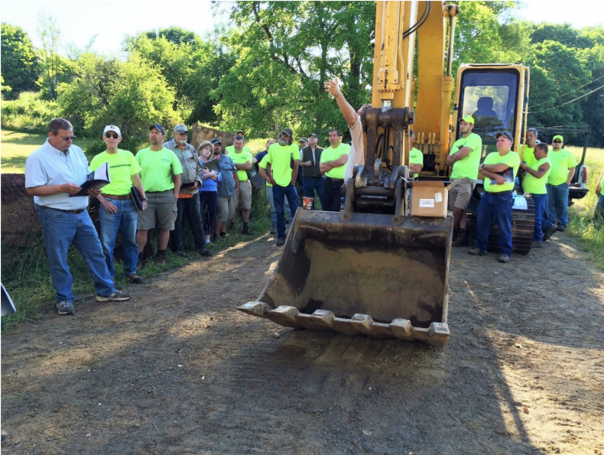
CD Education and Outreach
Host Your Own Events
Demo Days
Typically ½ day sessions with food on site
Keep it short, to the point, and hands-on
May include presentation indoors
Typically on active project site
Could do before / during / after demo days
Possibilities are endless: French mattress, underdrain, shallow pipe, headwalls, grading, equipment, road fill…
Crawford County
Pipe installation demo
Audio also available via phone: 866-823-7699
For assistance, call: 814-865-5355

Slide 16
CD Education and Outreach
Host Your Own Events
Tailgate Sessions
Less structured than a demo day
Invite potential applicants to “stop by”
Example:
“On ____date____, we will be installing _______esm practice________ on Smith Road in Jones Township. CD Staff will be on site from 7am to 3pm to talk and answer questions. Feel free to stop by. Coffee and doughnuts available”
Audio also available via phone: 866-823-7699
For assistance, call: 814-865-5355

Slide 17
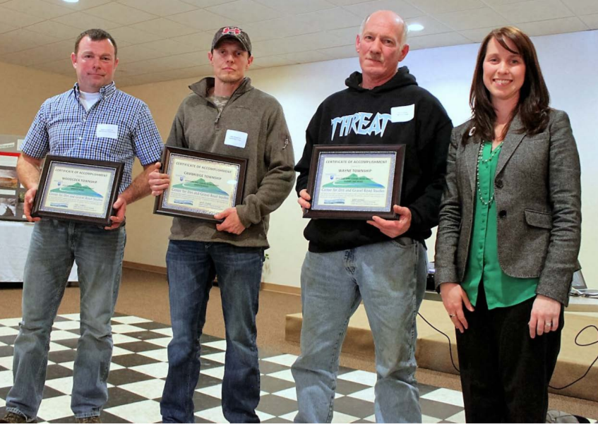
CD Education and Outreach
Host Your Own Events
Program Update Sessions
Invite potential applicants for short meeting
Review application deadlines, policy changes, local priorities, etc.
Review successful projects from last year
Recognize participants?
Crawford County
giving certificates for quality work completed
Audio also available via phone: 866-823-7699
For assistance, call: 814-865-5355

Slide 18
CD Education and Outreach
Host Your Own Events
Project Tours
Consider ½ day annual tour of completed projects
Provide transportation if needed
Invite legislators, municipalities, contractors and others
Could be DGLVR focused only, or part of a larger CD project tour.
Audio also available via phone: 866-823-7699
For assistance, call: 814-865-5355

Slide 19
CD Education and Outreach
Host Your Own Events
Pre-project site visits
HIGHLY ENCOURAGED
Work out kinks before they invest the time on the application and plan
Increases odds of a cooperative plan to address both environmental and maintenance concerns
Audio also available via phone: 866-823-7699
For assistance, call: 814-865-5355

Slide 20
CD Education and Outreach
Host Your Own Events
Other Ideas
Municipal Breakfasts: focus on projects
Municipal Secretary Breakfast: focus on admin
Audio also available via phone: 866-823-7699
For assistance, call: 814-865-5355

Slide 21
CD Education and Outreach
Host Your Own Events
Host Your Own Events
Demo Days
Tailgate Sessions
Program Update Sessions
Project Tours
Pre-application site visits
Municipal breakfasts
Municipal secretary breakfasts
Invite your neighboring CDs too!
Audio also available via phone: 866-823-7699
For assistance, call: 814-865-5355

Slide 22
DGLVR
CD Education and Outreach
Participate in existing events
Host your own events
Improving communications
Crawford CD

Slide 23
CD Education and Outreach
Improving Communications
Press Releases
Announce funding and application deadline
Announce grants awarded
Highlight successful project
Announce other outreach efforts
Audio also available via phone: 866-823-7699
For assistance, call: 814-865-5355

Slide 24
CD Education and Outreach
Improving Communications
Newsletters
DGLVR only, or as part of CD newsletter
Paper or digital
Bradford County printed DGLVR newsletter
Audio also available via phone: 866-823-7699
For assistance, call: 814-865-5355

Slide 25
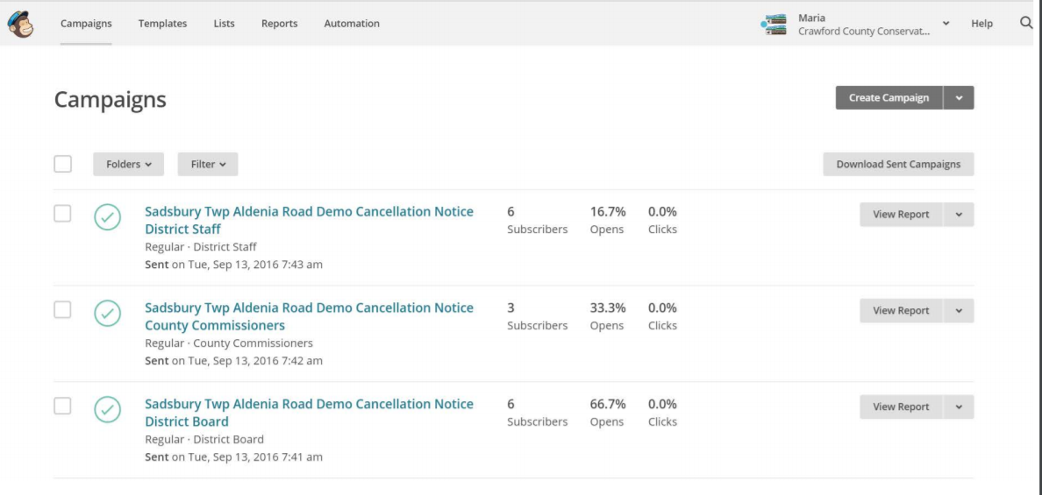
CD Education and Outreach
Improving Communications
Newsletters
DGLVR only, or as part of CD newsletter
Paper or digital
Digital newsletter and e-mail services can help: MailChimp, Constant Contact, etc.

Slide 26
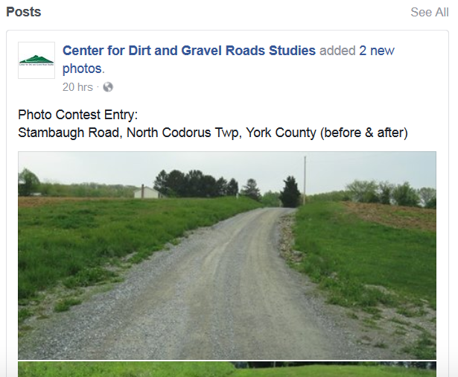
CD Education and Outreach
Improving Communications
Social Media
More municipalities are using, especially in more urban areas
Also lets municipalities communicate with each other.
Audio also available via phone: 866-823-7699
For assistance, call: 814-865-5355

Slide 27
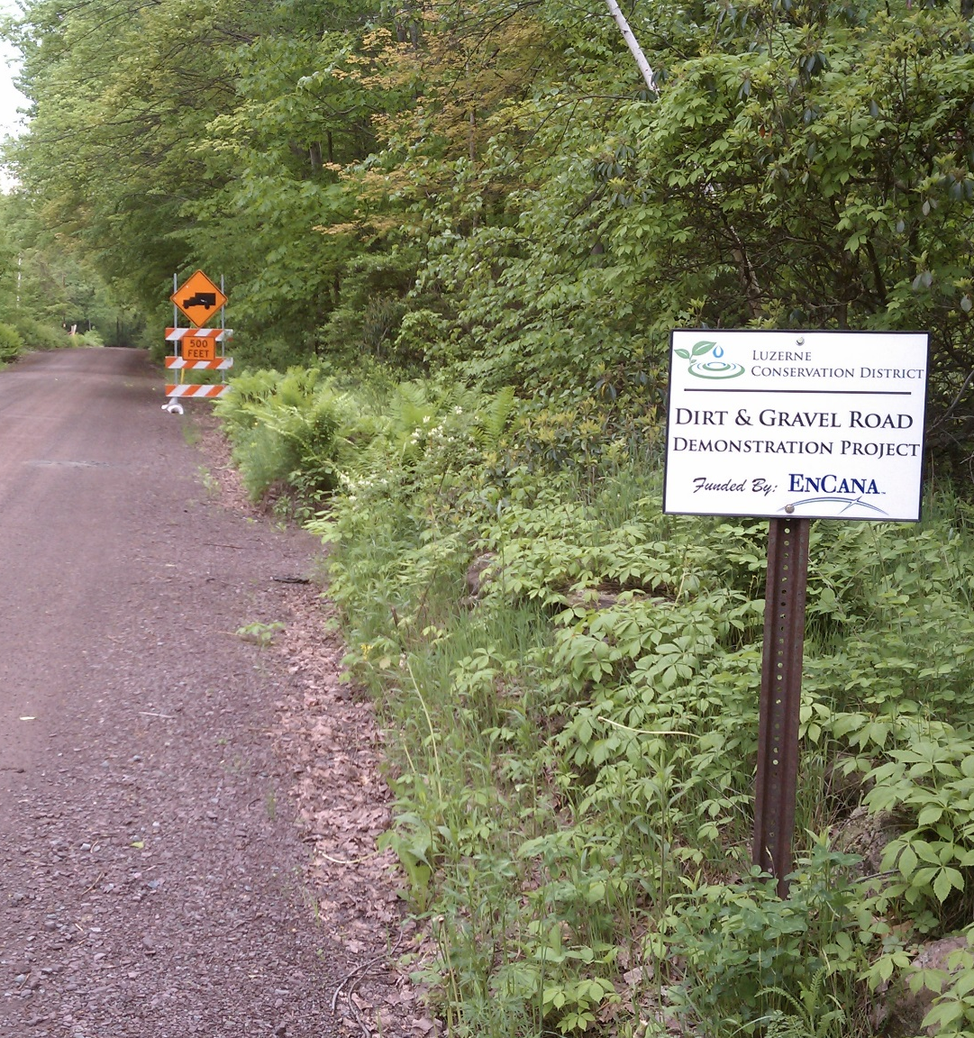
CD Education and Outreach
Improving Communications
Project Signs
Text
Logo
Contact Information
Audio also available via phone: 866-823-7699
For assistance, call: 814-865-5355

Slide 28
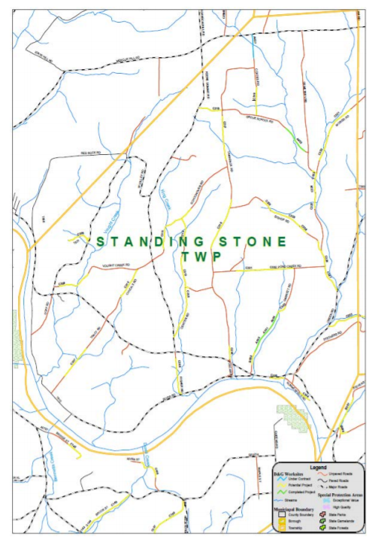
CD Education and Outreach
Improving Communications
Winter Visits
Scheduled or “pop in” visits to municipalities during winter or other slow times
Don’t need an agenda. Can talk application cycles, hunting stories, potential projects, etc.
Consider providing maps of potential projects
Don’t forget coffee and doughnuts
Bradford County twp project map
Audio also available via phone: 866-823-7699
For assistance, call: 814-865-5355

Slide 29
CD Education and Outreach
Improving Communications
Improving Communications
Press Releases
Newsletters – paper and digital
Social Media
Project Signs
Winter Visits

Slide 30
CD Education and Outreach
Participate in Existing Events
Municipal Events
County conventions (twps, boroughs)
PSATS/PASB State Convention (Hershey in April / May)
Regional Events
COGs
Contractor Workshops
“Other” applicants (Game Commission, County, etc.)
Legislative Breakfasts or Tours
Host Your Own Events
Demo Days
Tailgate Sessions
Program Update Sessions
Project Tours
Pre-application site visits
Municipal breakfasts
Municipal secretary breakfasts
QUESTIONS?
Improving Communications
Press Releases
Newsletters – paper and digital
Social Media
Project Signs
Winter Visits

Slide 31
Webinars:
January 17th CD Education and Outreach Ideas
January 31st Worksite Assessment “dirty dozen” overview
February 7th CD Replenishments and Direct Deposit
February 14th 2016 Annual Summary Report Review
March 17th Project Sharing Session Highlights
March 21st Overview of Admin Manual Changes
Brief ~30 minute sessions like this one

Slide 32
Webinars:
January 17th CD Education and Outreach Ideas
January 31st Worksite Assessment “dirty dozen” overview
February 7th CD Replenishments and Direct Deposit
February 14th 2016 Annual Summary Report Review
March 17th Project Sharing Session Highlights
March 21st Overview of Admin Manual Changes
DGLVR Project Sharing Sessions:
February 21st SouthWest PA, Greensburg
February 22nd NorthWest PA, Clarion
February 28th SouthEast PA, Lancaster
March 1st NorthEast PA, Wilkes-Barre
March 7th Central, State College
March 8&9 “Snow days” reserved for rescheduling a session if canceled for snow
One-day sessions like last summer. Focus on DnG and LVR project sharing and discussion. Details and registration available soon.

Slide 33
Webinars:
January 17th CD Education and Outreach Ideas
January 31st Worksite Assessment “dirty dozen” overview
February 7th CD Replenishments and Direct Deposit
February 14th 2016 Annual Summary Report Review
March 17th Project Sharing Session Highlights
March 21st Overview of Admin Manual Changes
DGLVR Project Sharing Sessions:
February 21st SouthWest PA, Greensburg
February 22nd NorthWest PA, Clarion
February 28th SouthEast PA, Lancaster
March 1st NorthEast PA, Wilkes-Barre
March 7th Central, State College
March 8&9 “Snow days” reserved for rescheduling a session if canceled for snow
Admin/GIS/Field Day New-Hire Training:
March 28 Admin, 29 GIS, 30 Field Day, in State College
Welcome to come to any or all days.

Slide 34
Webinars:
January 17th CD Education and Outreach Ideas
January 31st Worksite Assessment “dirty dozen” overview
February 7th CD Replenishments and Direct Deposit
February 14th 2016 Annual Summary Report Review
March 17th Project Sharing Session Highlights
March 21st Overview of Admin Manual Changes
DGLVR Project Sharing Sessions:
February 21st SouthWest PA, Greensburg
February 22nd NorthWest PA, Clarion
February 28th SouthEast PA, Lancaster
March 1st NorthEast PA, Wilkes-Barre
March 7th Central, State College
March 8&9 “Snow days” reserved for rescheduling a session if canceled for snow
Admin/GIS/Field Day New-Hire Training:
March 28 Admin, 29 GIS, 30 Field Day, in State College
Bankfull / Stream Crossing Trainings:
April 26th Cumberland County (tentative location)
May 10th Cameron/Elk County (tentative location)
May 11th Indiana County (tentative location)
June 6th Pike County (tentative location)
June 8th Centre County
June 13&14 “Flood days” reserved for rescheduling a session due to high stream flow
One-day sessions, mostly in field, focusing on bankfull and “common crossing installation issues”. Details and registration available soon. Space limited.

Slide 35
Webinars:
January 17th CD Education and Outreach Ideas
January 31st Worksite Assessment “dirty dozen” overview
February 7th CD Replenishments and Direct Deposit
February 14th 2016 Annual Summary Report Review
March 17th Project Sharing Session Highlights
March 21st Overview of Admin Manual Changes
DGLVR Project Sharing Sessions:
February 21st SouthWest PA, Greensburg
February 22nd NorthWest PA, Clarion
February 28th SouthEast PA, Lancaster
March 1st NorthEast PA, Wilkes-Barre
March 7th Central, State College
March 8&9 “Snow days” reserved for rescheduling a session if canceled for snow
Admin/GIS/Field Day New-Hire Training:
March 28 Admin, 29 GIS, 30 Field Day, in State College
Bankfull / Stream Crossing Trainings:
April 26th Cumberland County (tentative location)
May 10th Cameron/Elk County (tentative location)
May 11th Indiana County (tentative location)
June 6th Pike County (tentative location)
June 8th Centre County
June 13&14 “Flood days” reserved for rescheduling a session due to high stream flow
June 27-28 NAACC Culvert Assessment Training: www.streamcontinuity.org
Training on “culvert and bridge assessment for Aquatic Organism Passage”. Limited Space. Only attend if you plan to actively add to the inventory in the future.
Will discuss more details at project sharing sessions.
More info at www.streamcontinuity.org

Slide 36
Webinars:
January 17th CD Education and Outreach Ideas
January 31st Worksite Assessment “dirty dozen” overview
February 7th CD Replenishments and Direct Deposit
February 14th 2016 Annual Summary Report Review
March 17th Project Sharing Session Highlights
March 21st Overview of Admin Manual Changes
DGLVR Project Sharing Sessions:
February 21st SouthWest PA, Greensburg
February 22nd NorthWest PA, Clarion
February 28th SouthEast PA, Lancaster
March 1st NorthEast PA, Wilkes-Barre
March 7th Central, State College
March 8&9 “Snow days” reserved for rescheduling a session if canceled for snow
Admin/GIS/Field Day New-Hire Training:
March 28 Admin, 29 GIS, 30 Field Day, in State College
Bankfull / Stream Crossing Trainings:
April 26th Cumberland County (tentative location)
May 10th Cameron/Elk County (tentative location)
May 11th Indiana County (tentative location)
June 6th Pike County (tentative location)
June 8th Centre County
June 13&14 “Flood days” reserved for rescheduling a session due to high stream flow
June 27-28 NAACC Culvert Assessment Training: www.streamcontinuity.org

