Slide 1
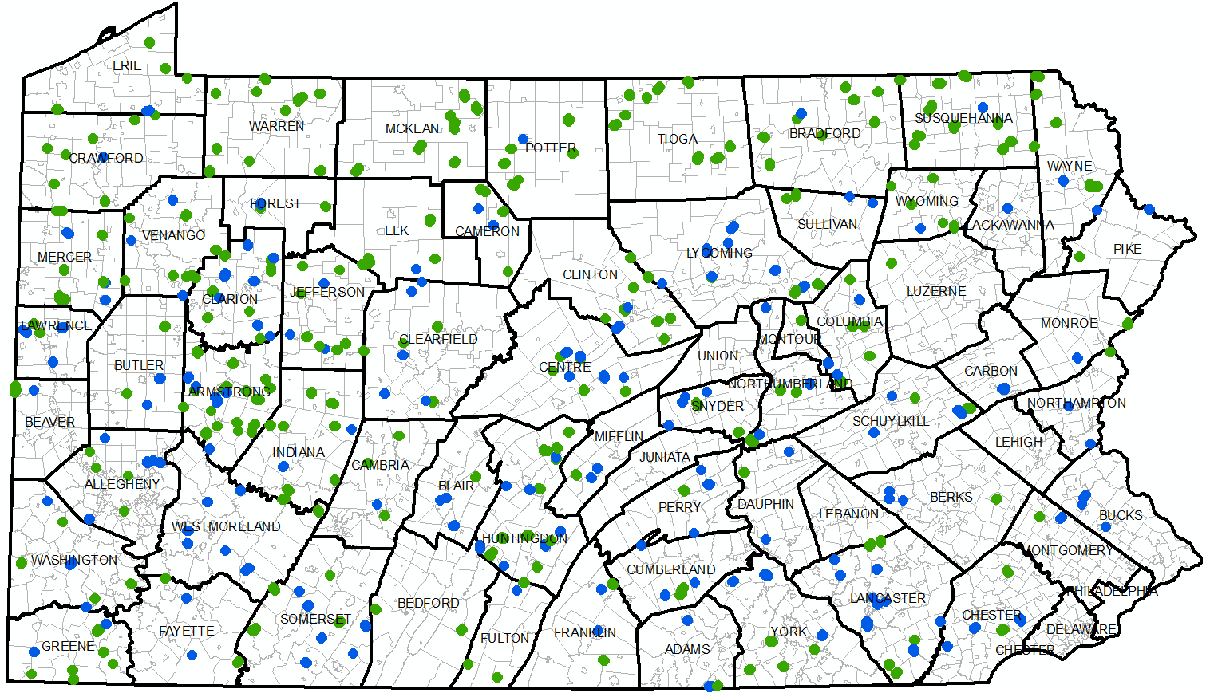
DGLVR Webinar
GIS Analysis
for CDs
3/21/2019
Starts at 9am
Session II – data analysis in Excel
If you are reading this, then you are successfully seeing the webinar video. Webinar audio should be automatic through your computer, and options can be accessed in the “audio options” button on the bottom left. If you are having audio issues, or are in a location where listening via phone is preferable, audio is also available on the CDGRS conference line at:
866-823-7699.
For technical assistance, call: 814-865-5355

Slide 2
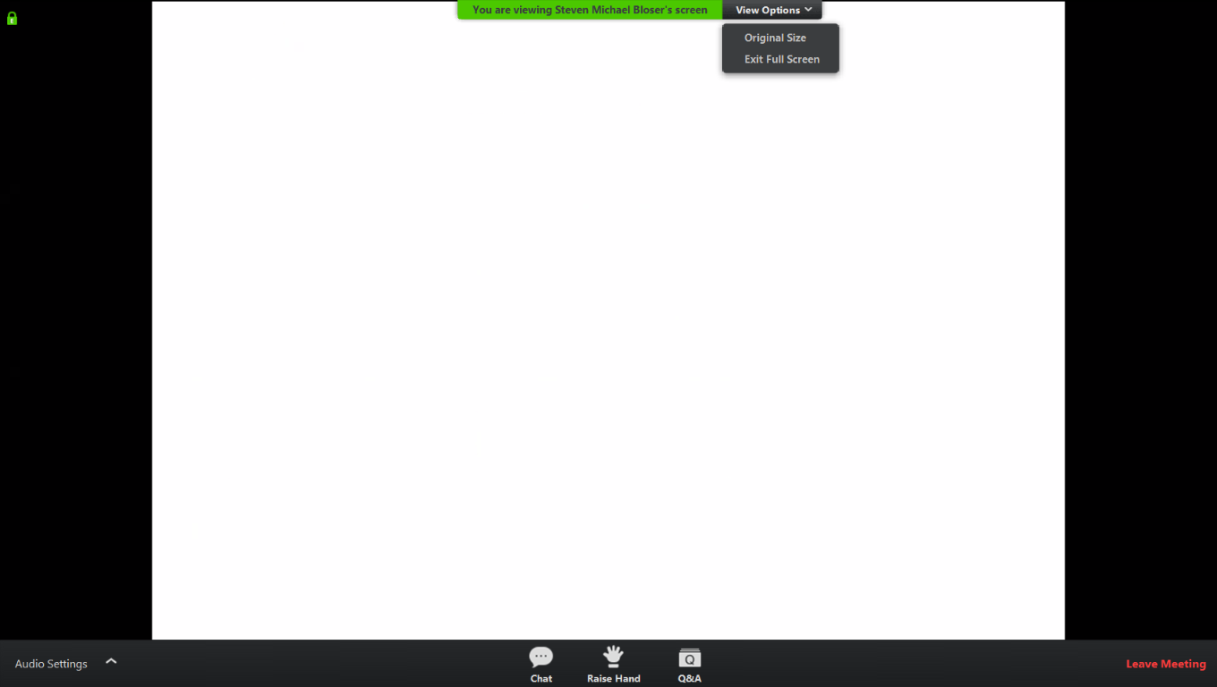
Q&A
Note you can ask a question anonymously
Q&A
For audio via phone: 866-823-7699
For technical assistance: 814-865-5355
Slide #

Slide 3
CD GIS Analysis
Previous webinar recorded on 3/7
In-GIS analysis
Creating excel project summary
Basics of looking at excel data

Slide 4
CD GIS Analysis
Today’s webinar is on more advanced data analysis in Excel
Thanks to Columbia County for letting us use their data for this demo
Most of this will be in Excel
You can follow along with your data if you are very comfortable with excel
Will be recorded so you can view again if needed.
What is your level of excel expertise?

Slide 5
CD GIS Analysis
Plan:
Internal in GIS
Allocation History, excel
Payments viewer, excel
Admin/Edu Viewer
Photo Viewer
Road Statistics
County - Municipality
Quarterly Report:
review 5-year spending
Activity new comments
Annual Summary Report
Highlight tabs, DnG vs LVR, etc
Exporting to CSV
External in Excel
Define rows and columns
Highlight important columns
Format $ and deliverables
Sort
Site type
Project status
Comp date (newest first)
Summarize columns
Basic stats
$ per mile
% in-kind match
Pull up statewide sheet as example of potential analysis

