Slide 1
Dirt Gravel and Low Volume Road Program
WEBINAR
CDGRS Contract Verifier / Quarterly Report Updates
Survey Results
ESM Overviews
Webinars
Longer Remote Overviews
Online training Center
Winter Tech Assists
3/4/22 Starts at 9am
If you are reading this, then you are successfully seeing the webinar video. Webinar audio should be automatic through your computer (or click “join audio”), and options can be accessed in the “audio options” button on the bottom left. If your computer audio is not working, you can listen on your phone by dialing 312-626-6799.

Slide 2
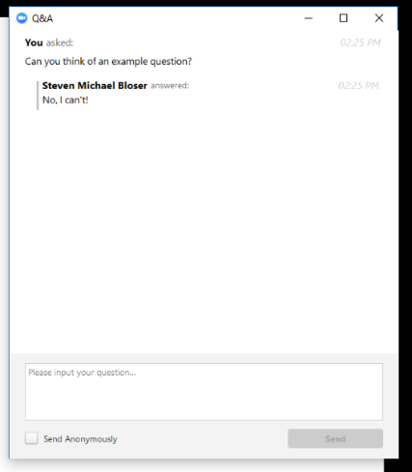
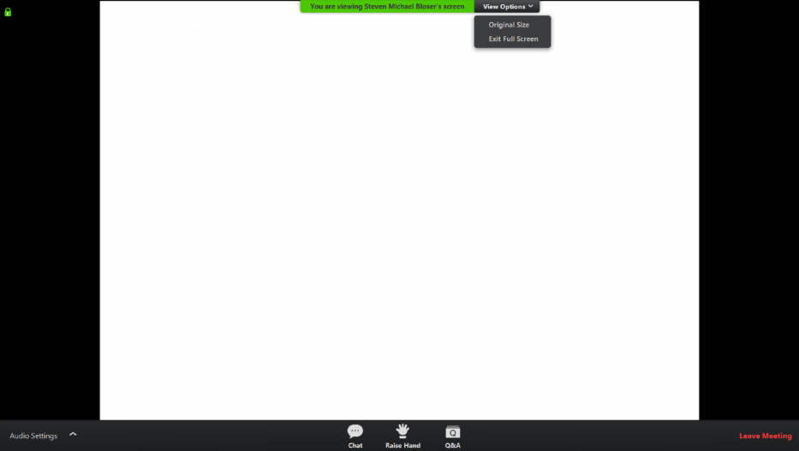
CDGRS Contract Verifier/QR Updates
Note you can ask a question anonymously
Q&A
For audio via phone: 312-626-6799
2

Slide 3
CDGRS Contract Verifier/QR Updates
Expired Contracts
What does this mean and why does it matter?
All DGLVR contracts have a date that the contract is required to be completed by, unless an extension of time is approved by the district.
This means that all construction, reports, and payments shall be completed by the completion date listed in the contract, unless an extension of time is approved by the district.
Keep in mind that final payment should be held until all required paperwork is obtained for the project file, including documentation of prevailing wage, DSA Certification, PA One-Call serial number, of- ROW consent forms, etc.​
A contract not completed as stated above by the completion/extension date is considered expired and void.

Slide 4
CDGRS Contract Verifier/QR Updates
Expired Contracts
Example 1: My contract hasn’t started yet or construction isn’t complete. Do I need to grant an extension?
YES!

Slide 5
CDGRS Contract Verifier/QR Updates
Expired Contracts
Example 2: My contract’s construction is finished and I am waiting on receipts or to make final payment. The contract is nearing or past the completion date. Do I need to grant an extension?
YES!

Slide 6
CDGRS Contract Verifier/QR Updates
Expired Contracts
How can I extend the contract?
All that is needed to extend a contract is a no-cost Amendment set to a later completion date.
How long can I extend the contract?
You can extend the contract as long as you deem required. It is recommended to give a reasonable amount of time so that you don’t have to issue additional amendments.
Keep your 2-year spending requirement in mind​.
Can I extend the contract multiple times?
Yes, but if you extend it too many times you may want to determine why and how to avoid future extensions.
Is there an easy way to determine which contracts are close to/already expired?
Yes, use the Contract Verifier report within the GIS Mapper.

Slide 7
CDGRS Contract Verifier/QR Updates
Contract Verifier
Purpose
Enables the CDs to easily determine the status of the completion date of an existing contract
Determination based on current date and the CDs “Watch-Days Notice”

Slide 8
CDGRS Contract Verifier/QR Updates
Contract Verifier
Why this is helpful?
Allows the CDs to ensure that the basic contract info has been entered and is correct
Allows the CDs to stay current with all ongoing contracts
Which contracts are nearing their agreed upon completion date
Which contracts are ongoing but have technically expired

Slide 9
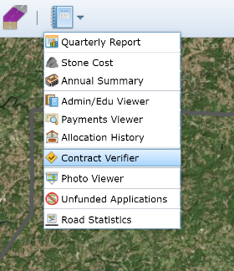
CDGRS Contract Verifier/QR Updates
Access the Contract Verifier through the Reports drop-down in the GIS Mapper

Slide 10
CDGRS Contract Verifier/QR Updates
Dirt & Gravel and Low Volume tabs
Site ID: The funded site’s ID
Contract Amount: Total amount awarded to date
Completion Date: The completion date on the contract
Extension Date: The latest amended completion date
Days Remaining: The total days before the end of the completion date or extension date, whichever is later
Color coded based on the Contract Watch-Days Notice

Slide 11
CDGRS Contract Verifier/QR Updates
Contract Watch-Days Notice
The days away from a contract completion/extension date to be identified as being in 'Watch’ status
The default is 180 days
Notice is editable but must be entered in days
Can return to the default by clicking “Reset Watch-Days”
Use the Save button to permanently apply edited days

Slide 12
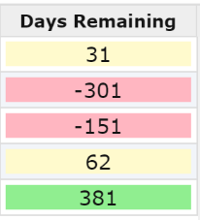
CDGRS Contract Verifier/QR Updates
Contract Watch-Days Notice cont.
3 Color Codes
Green: Days remaining exceeds notice
Yellow: Days remaining less than notice but not beyond the completion/extension date
Red: Completion/extension date earlier than current date
The days expired is displayed as negative number
If no completion date was saved in the contract, “no date” is displayed

Slide 13
CDGRS Contract Verifier/QR Updates
Additional Features
Export to CSV
Site Type, Site Id, Road Name, Project Participant
Contract Amount, Completion Date, Extension Date
Days Remaining
Totals provided for both Dirt & Gravel and Low Volume tabs

Slide 14
CDGRS Contract Verifier/QR Updates
Example based on 180 Watch-Days Notice
1 site’s contract exceeds the Watch-Days notice. It has 381 days before the contract expires.
2 sites are considered in ‘Watch’ status. One expires in 31 days and the other in 62 days.
1 site has no completion date. By default, this site is marked as expired. Add the contract’s completion date then open the Contract Verifier to view its status.
1 site’s contract has expired. If the contract is ongoing, then award a completion date amendment.

Slide 15
CDGRS Contract Verifier/QR Updates
Automated Email Notifications
CDs will have up to four email reminders per contract. Sent by Center with SCC Staff CC’d.
Reminder notices include:
On the same day as the District's Designated Watch-Days Notice.
Seven Days prior to the contract's expiration date.
The day the contract is set to expire. This date is still valid, so it serves as one last reminder to get the contract an extension before it becomes technically expired.
The first day the contract is expired.
Each email will include the contract’s Program Type, Site ID, Contract Amount, Completion and Extension Dates, Days Remaining, Project Participant, and Road Name.
If these notices are ignored, then the District will be unable to submit the next Quarterly Report.

Slide 16
CDGRS Contract Verifier/QR Updates
Quarterly Report Check
“All Contracts Valid” must be checked in order to be able to submit the Quarterly Report.
If it is unchecked, then there are expired contracts.

Slide 17
Dirt Gravel and Low Volume Road Program
WEBINAR
CDGRS Contract Verifier / Quarterly Report Updates
Survey Results
ESM Overviews
Webinars
Longer Remote Overviews
Online training Center
Winter Tech Assists
QUESTIONS ?

