Slide 1
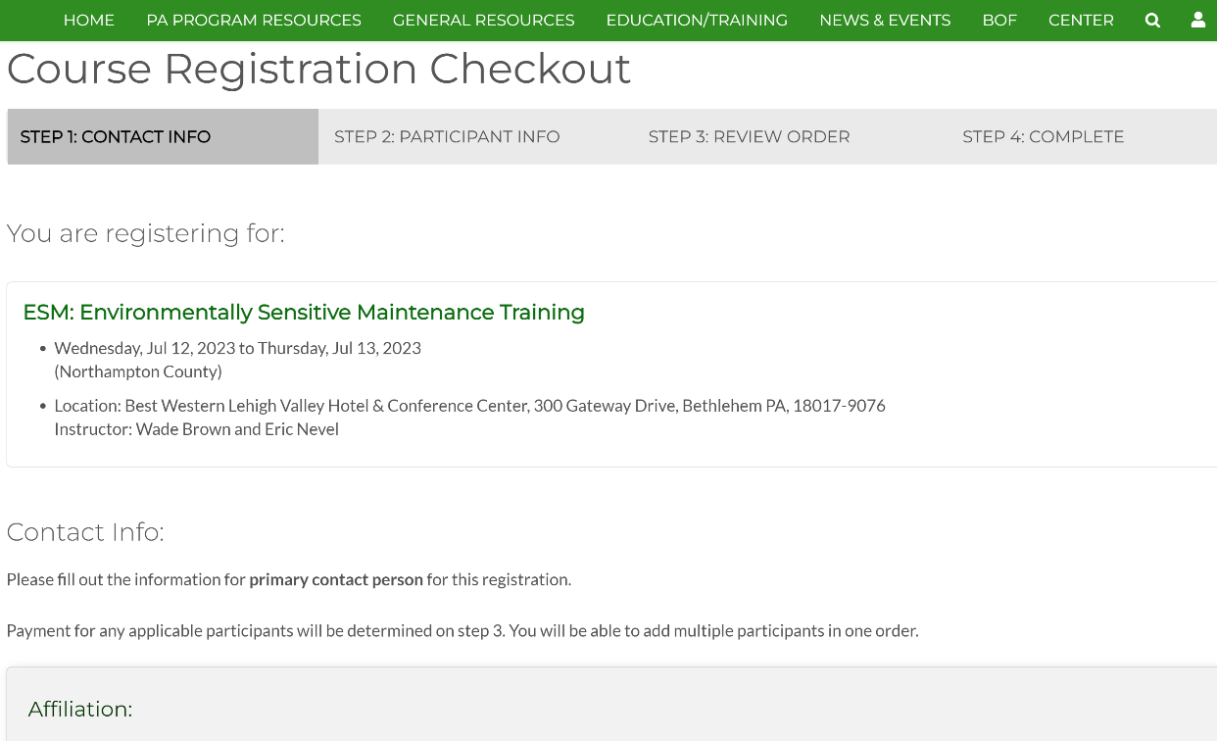
Course Registration Tool
Dirt Gravel and Low Volume Road Program
WEBINAR
6/22/23
Starts 9am
CDGRS
Amy Pifer
alp90@psu.edu
Mindi Suhy
mjs60@psu.edu
Ken Corradini
kjc139@psu.edu
If you are reading this, then you are successfully seeing the webinar video. Webinar audio should be automatic through your computer (or click “join audio”), and options can be accessed in the “audio options” button on the bottom left. If your computer audio is not working, you can listen on your phone by dialing 312-626-6799.

Slide 2
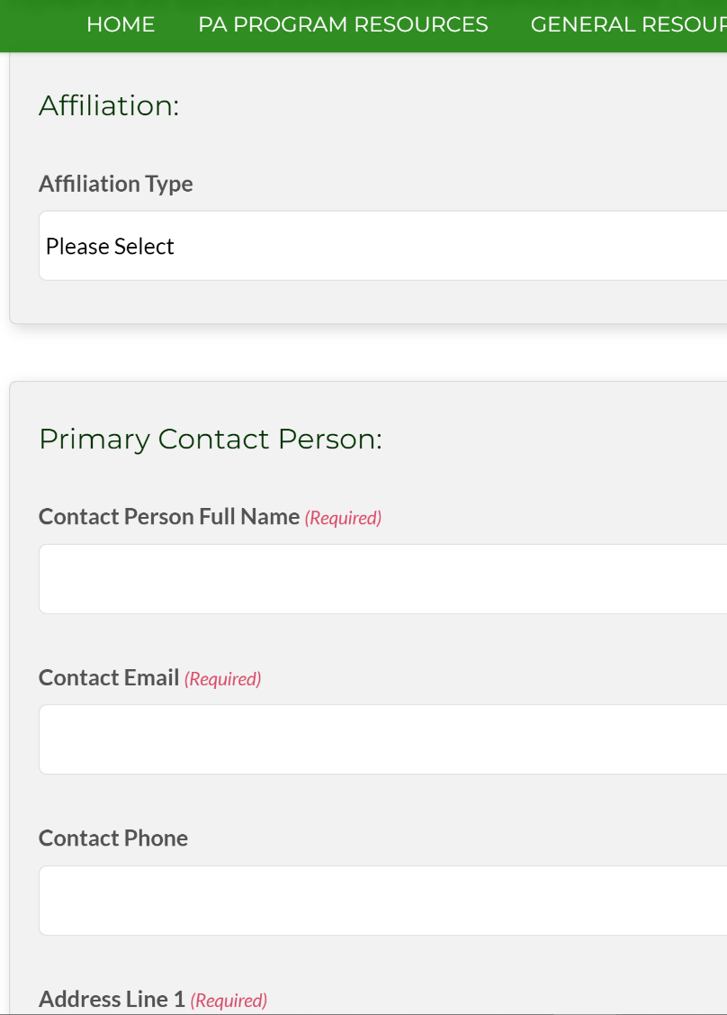
Course Registration Tool
Purpose
Create a simple registration tool for all courses the Center offers.
Can register multiple attendees at once.
No individual login required.
Future ESMs are available now.

Slide 3
Course Registration Tool
Background and Status
Demonstration
Moving Forward

Slide 4
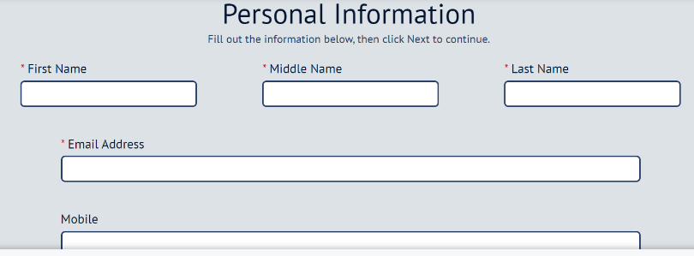
Course Registration Tool
Registrations before this tool:
CVENT used for Workshop and ESMs
Emails and phone for Admin trainings, etc
Zoom for Stream Crossing Trainings
www.dirtandgravelroads.org

Slide 5
Course Registration Tool
INCONSISTENT COURSE MANAGEMENT
Who took what?
No single database for course tracking
Am I still certified?
No reliable method to quickly determine who is certified
When am I getting my certificate?
No quick way to print certificates
Who is handling what registration for what course?
No dedicated course registration manager
www.dirtandgravelroads.org

Slide 6
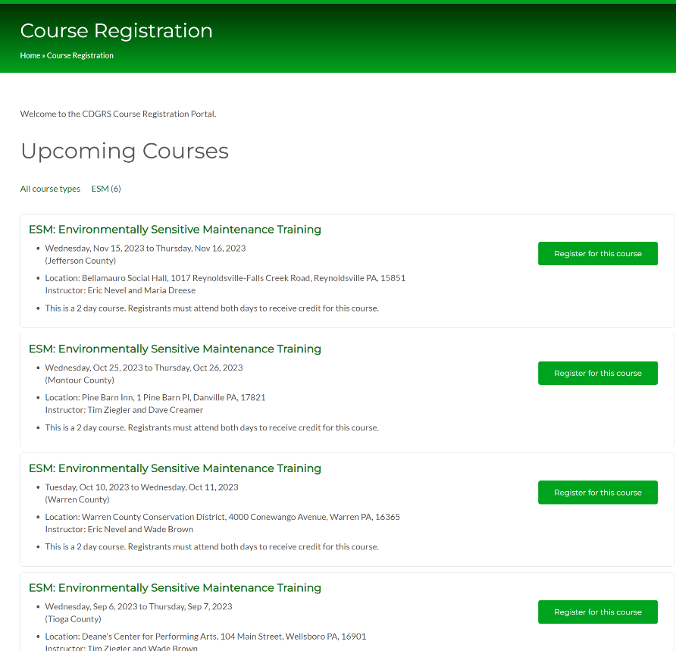
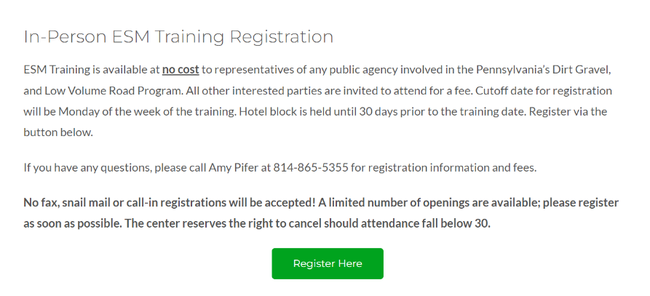
Course Registration Tool
ACCESS AVAILABLE COURSES:
Navigate to the class course page
Click the “Register Here” button
Find the course you want to register for and click its “Register for this course” button.
www.dirtandgravelroads.org

Slide 7
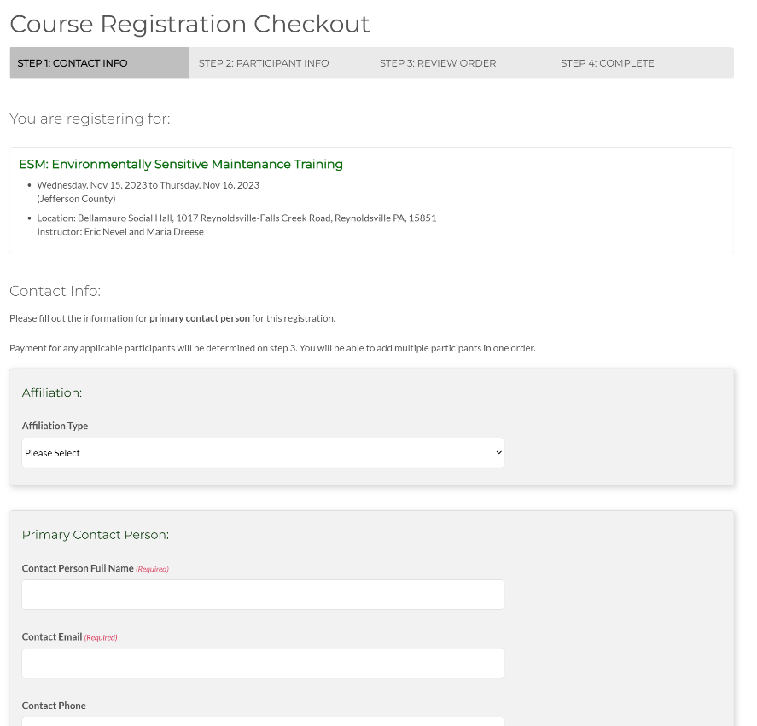
Course Registration Tool
COURSE REGISTRATION CHECKOUT:
Set the Affiliation and Contact Info
One person can register multiple people
Add the participants
Review your order
Complete the checkout
www.dirtandgravelroads.org

Slide 8
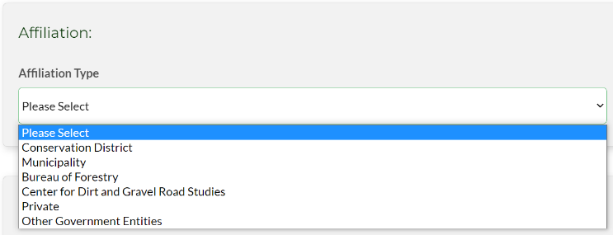
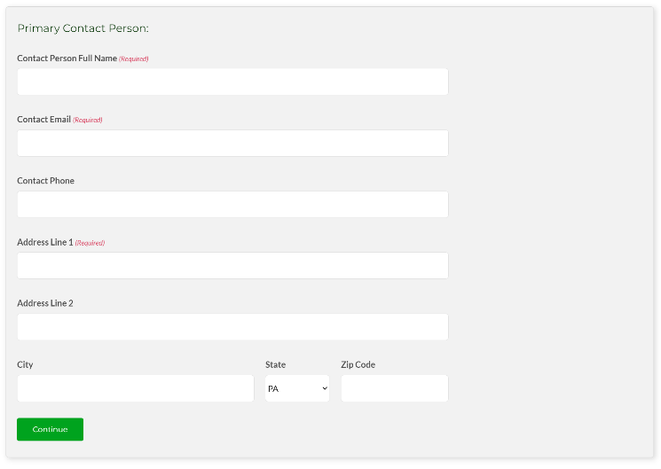
Course Registration Tool
STEP 1: CONTACT INFO
Select the Affiliation Type
If you are any other government entity other than what is provided, choose “Other Government Entity”
Complete information for the Primary Contact Person
This person will be the sole contact for all participants registered by that contact person
Note that all participants registered under the Contact Person will be assigned the same Affiliation as the Contact Person
Contact People registering multiple people from different Affiliations must place individual orders for each Affiliation
www.dirtandgravelroads.org

Slide 9
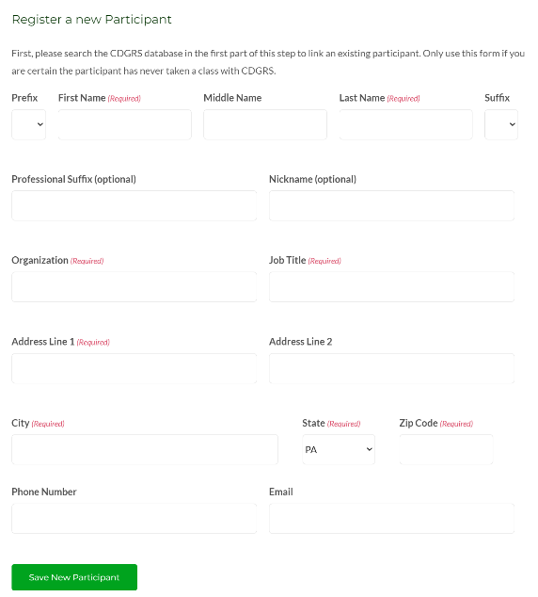
Course Registration Tool
STEP 2: PARTICIPANT INFO:
Search by name, email, registrant id
If the participant has ever taken a course through CDGRS, they should exist in this database.
Can also register new participants
Added participants will appear in the Current Participants list.
If you are the primary contact person, you still need to add yourself as a participant
www.dirtandgravelroads.org

Slide 10
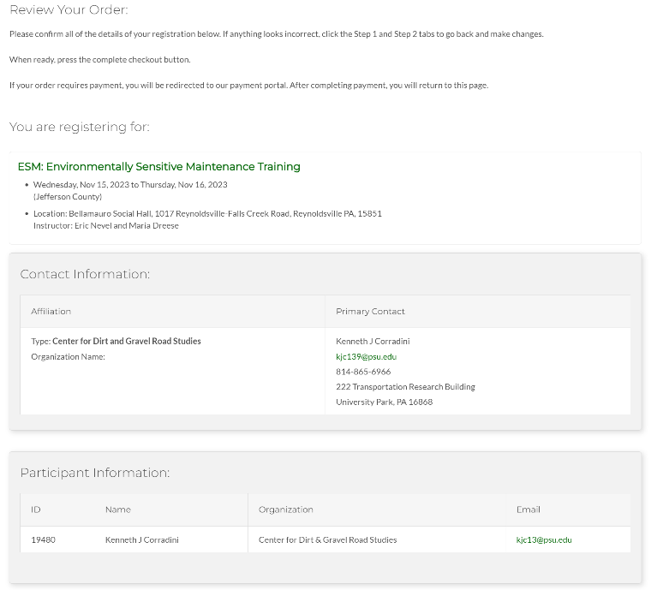
Course Registration Tool
STEP 3: Review Your Order:
Review all information and added participants for accuracy. Simply click browser’s “Back” button to go back and make any changes
Add any additional information/special accommodations then click “Complete Checkout”
www.dirtandgravelroads.org

Slide 11
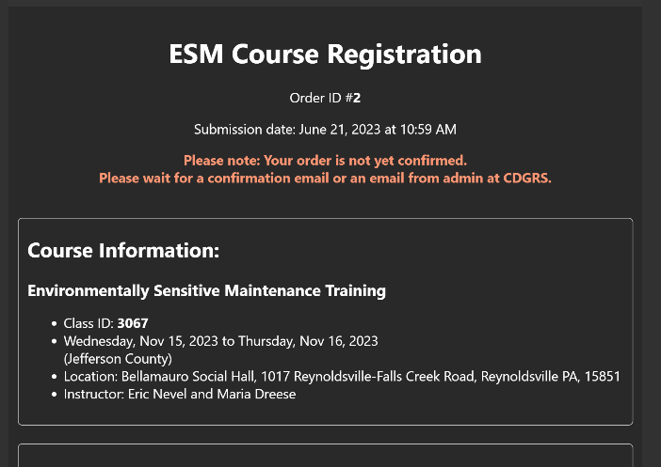
Course Registration Tool
STEP 4: Order Complete:
The Primary Contact will receive an email confirming their registration order
The order will remain in “Processing” until Amy or Mindi reviews and confirms the order
Once confirmed, the Primary Contact will receive a notification email
www.dirtandgravelroads.org

Slide 12
GIS Project Sketches
Background and Status
Demonstration
Moving Forward

Slide 13
GIS Project Sketches
Background and Status
Demonstration
Moving Forward

Slide 14
Course Registration Tool
Moving Forward
Addition of a search functionality to quickly determine ESM eligibility
Both on the website and in the GIS Mapper
Addition of a simple viewer to see what courses a user has taken
This already occurs with the ESM pdf
It will not contain information such as addresses, phone numbers, email, etc.
Future webinar will address this once this is enabled
All future course Certificates will have the Registrant ID printed.
Payment capabilities will be added for Workshop, ESM courses.
www.dirtandgravelroads.org

Slide 15
Course Registration Tool
Moving Forward: District Responsibilities
Reach out to your municipalities and inform them about the new registration system
Create a “quick guide” custom to your District with information/tips on how to register
This presentation will be available for download after the webinar
The Center will also have a “quick guide” available for download
Have your municipalities contact Amy and Mindi for registration assistance
www.dirtandgravelroads.org

Slide 16
Course Registration Tool
Moving Forward
Registration open Friday 6/23, but understand we are still refining. For help, please contact Amy and Mindi at DGregistration@psu.edu
If you have not emailed Amy and Mindi to register for an upcoming ESM, use the registration tool. Otherwise, you are already registered for that particular ESM course.
Give us feedback on glitches or suggestions
www.dirtandgravelroads.org

Slide 17
Course Registration Tool
Moving Forward
For the remainder of 2023, only the ESM and potential Admin courses will use this new registration system.
The Workshop and Municipality day will use CVENT because the payment system is still in development
The remaining Stream Crossing Trainings are just about full so they will continue with the Zoom registration
ALL courses will use the new registration system beginning 2024
www.dirtandgravelroads.org

