Slide 1
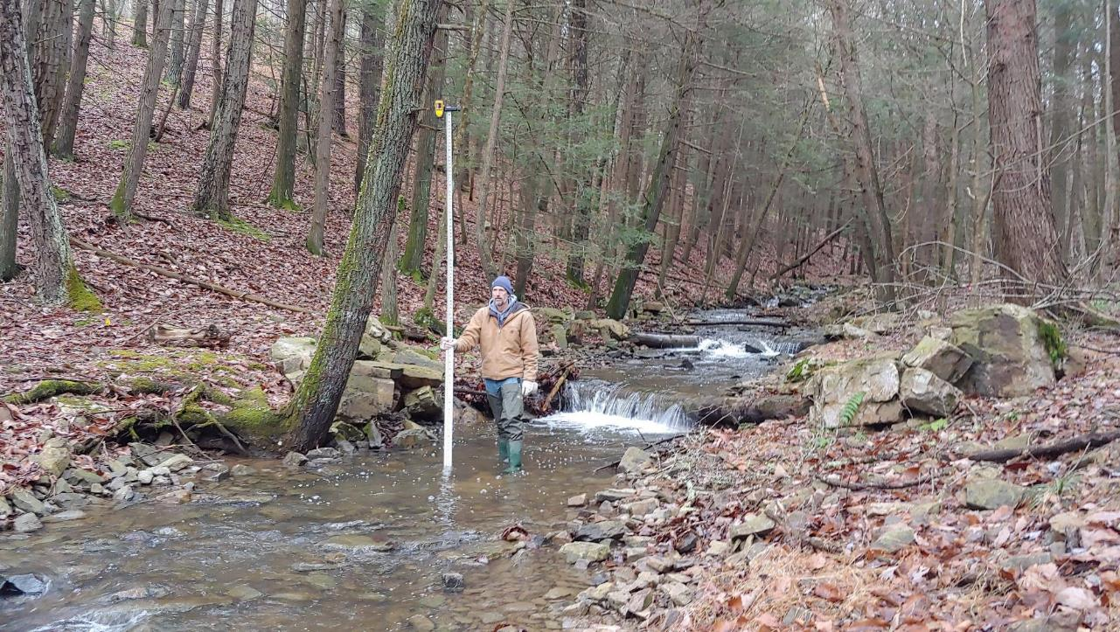
Dirt Gravel and Low Volume Road Program
WEBINAR
2/9/23
Starts 11am
Stream Crossing Replacement Monitoring
CDGRS
Eric Chase
ehc111@psu.edu
If you are reading this, then you are successfully seeing the webinar video. Webinar audio should be automatic through your computer (or click “join audio”), and options can be accessed in the “audio options” button on the bottom left. If your computer audio is not working, you can listen on your phone by dialing 312-626-6799.

Slide 2
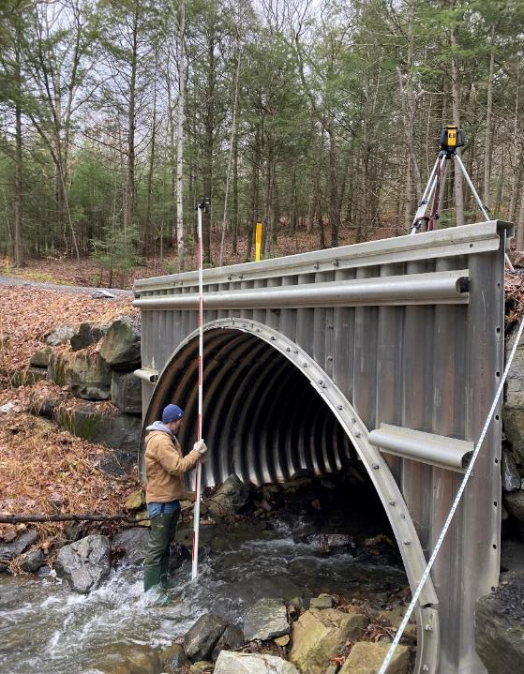
Stream Crossing Replacement Monitoring
Purpose
Provide an overview of monitoring of 2019 crossing replacement project
Provide information for CDs who might be interested in implementing monitoring of stream crossing replacement projects

Slide 3
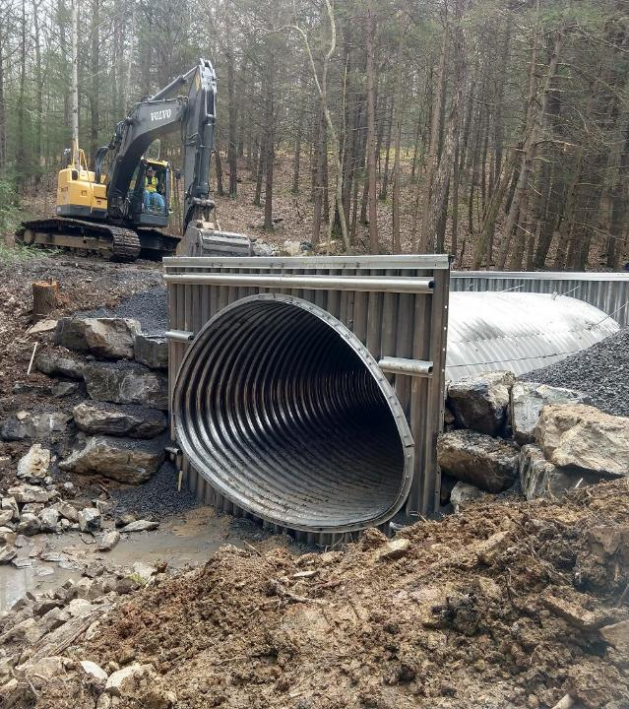
Stream Crossing Replacement Monitoring
Hammond Run Replacement
Hammond Run Monitoring
Monitoring opportunities for CDs

Slide 4
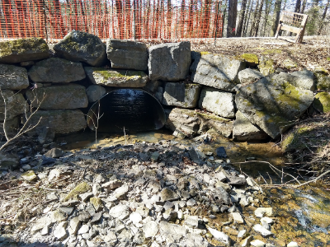
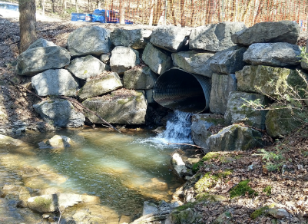
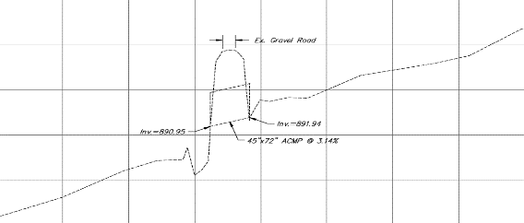
Hammond Run Replacement
Problem:
Failing 6’ squash pipe in a headwater stream with a 14’ bankfull channel.
Undersized crossing had created a significant upstream sediment wedge and downstream scour hole with a ~3’ outlet drop.
~5% Slope
Inlet
Outlet
www.dirtandgravelroads.org

Slide 5
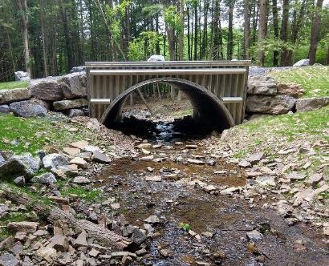
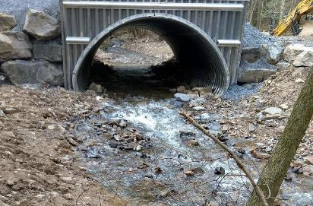
Hammond Run Replacement
Fix:
15’ x 10’ structural plate pipe arch was assembled and installed with headwall/endwall.
Streambed was re-established in the pipe.
3 log cross vanes were installed upstream to control the grade.
Inlet
Outlet
www.dirtandgravelroads.org

Slide 6
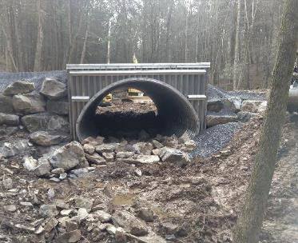
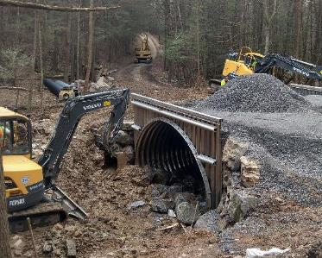
Hammond Run Replacement
Fix:
15’ x 10’ structural plate pipe arch was assembled and installed with headwall/endwall.
Streambed was re-established in the pipe.
3 log cross vanes were installed upstream to control the grade.
www.dirtandgravelroads.org

Slide 7
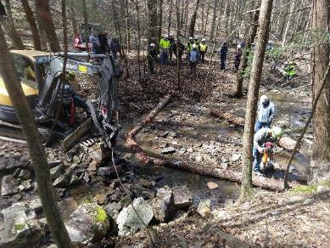
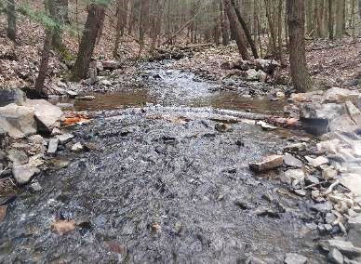
Hammond Run Replacement
Fix:
15’ x 10’ structural plate pipe arch was assembled and installed with headwall/endwall.
Streambed was re-established in the pipe.
3 log cross vanes were installed upstream to control the grade.
Timelapse videos:
https://dirtandgravel.psu.edu/education-training/stream-crossings/additional-education-resources/
www.dirtandgravelroads.org

Slide 8
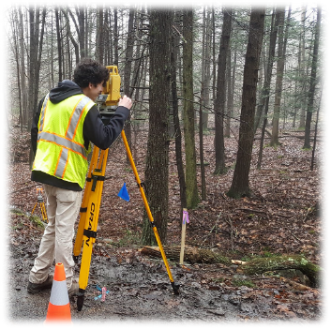
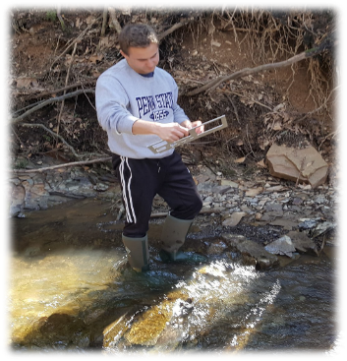
Stream Crossing Replacement Monitoring
Hammond Run Replacement
Hammond Run Monitoring
Monitoring opportunities for CDs

Slide 9
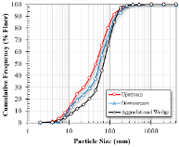
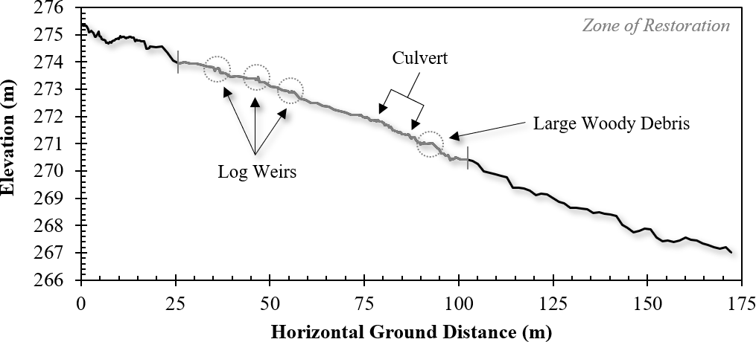
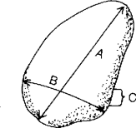
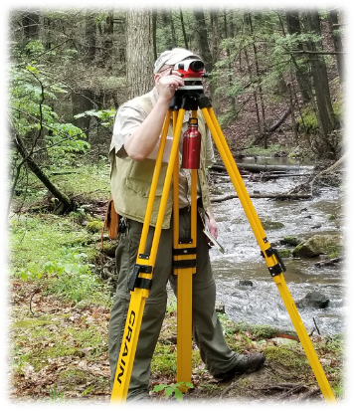
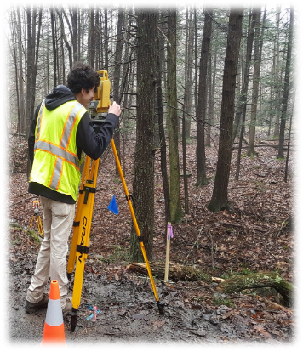
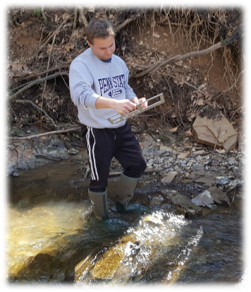
Hammond Run Monitoring
Cross Sections
Width
Depth
Longitudinal Profile
Change in elevation along downstream gradient
Particle-Size Distribution
Size of streambed sediment
www.dirtandgravelroads.org

Slide 10
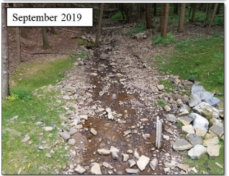
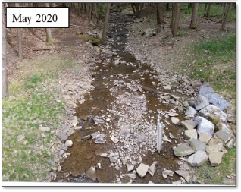
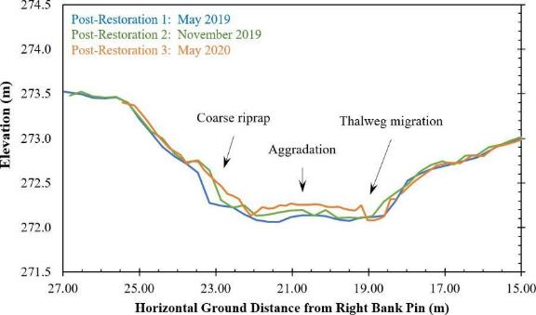
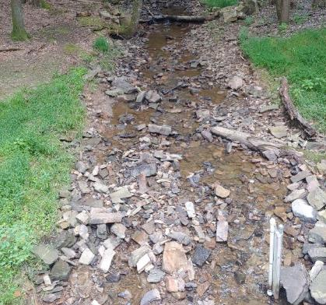
Hammond Run Results
Cross Sections
Channel adjustments through aggradation, degradation and thalweg migration.
September 2021
www.dirtandgravelroads.org

Slide 11
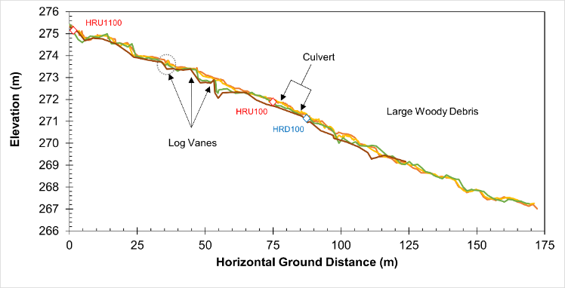
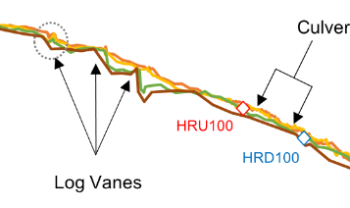
Hammond Run Results
Longitudinal Profiles
Significant changes at 1st upstream cross-vane
Some change at 2nd upstream cross-vane
Stable through crossing
Moving material larger than 12-18” diameter
Post-Restoration 2: November 2019
Post-Restoration 3: May 2020
Post-Restoration 4: May 2021
Post-Restoration 5: January 2023
Limestone Deposited 04/2019
Limestone Observed 05/2020
Restored Area
Limestone Observed 05/2021
www.dirtandgravelroads.org

Slide 12
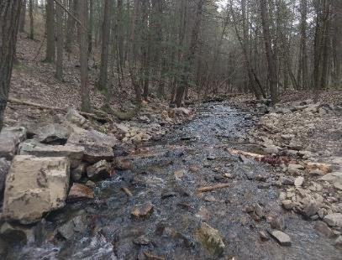
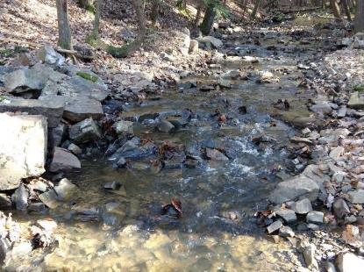
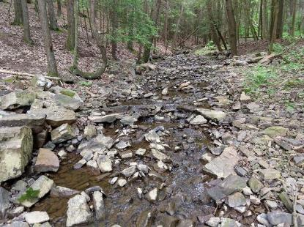
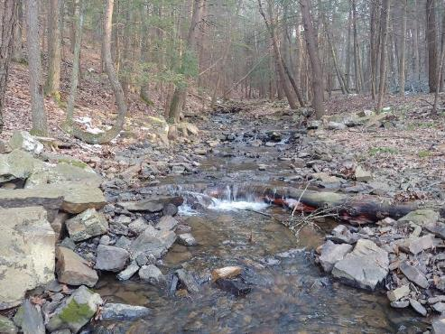
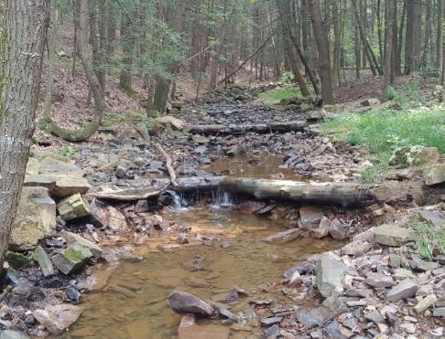
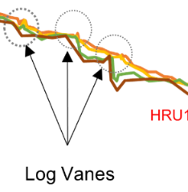
April 2019
October 2019
May 2020
January 2021
After 4 ~bankfull events
September 2021
After Hurricane Ida

Slide 13
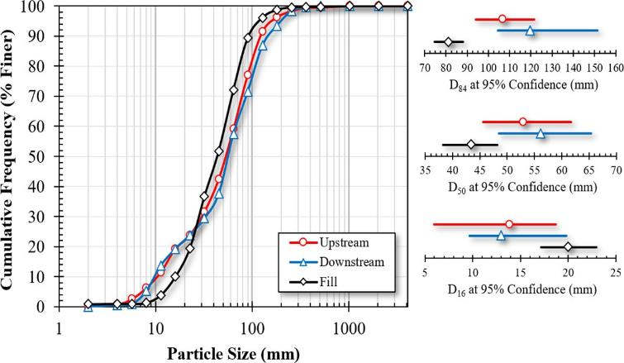
Hammond Run Results
Pebble Counts
Fill material has less fine material and is smaller on the upper end.
Upstream and downstream outside restored reach are similar.
Subsurface flow during summer low-flows around crossing.
“Perfect continuity” means particle sizes upstream, downstream and through structure would be the same
www.dirtandgravelroads.org

Slide 14
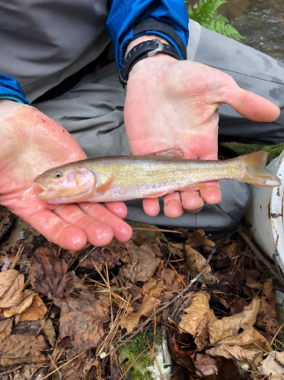
Hammond Run Monitoring
Ecological Assessment (Juniata College)
Conducted pre- and post-restoration
Fish assemblage analysis (electrofishing)
Benthic Macroinvertebrate community composition (kick-netting)
Stream water quality testing
Large creek chub caught 100m upstream post restoration
www.dirtandgravelroads.org

Slide 15
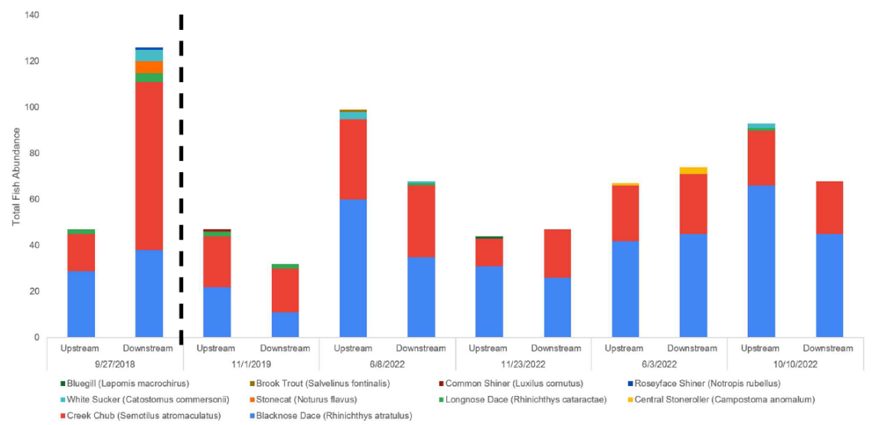
Hammond Run Results
Ecological Assessment (Juniata College)
Positive trends were observed within the local fish community post-restoration
Pre-restoration
Post-restoration
www.dirtandgravelroads.org

Slide 16
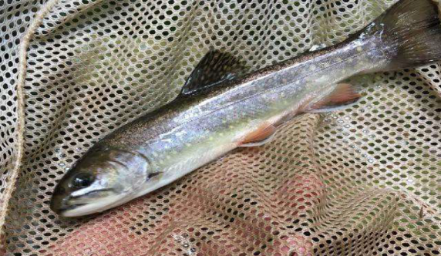
Hammond Run Results
Ecological Assessment (Juniata College)
Positive trends were observed within the local fish community post-restoration
Presence of a brook trout upstream of the culvert post-restoration
9-inch Brook trout caught 100m upstream post restoration
www.dirtandgravelroads.org

Slide 17
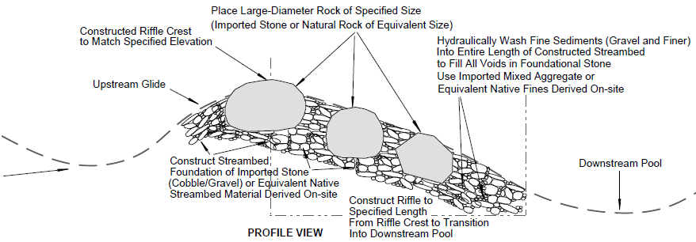
Hammond Run Results
Lessons Learned
Structure and inlet/outlet stable through multiple bankfull and greater events
Expect channel changes post replacement
Pebble counts would have better informed bed material as excavation spoils did not contain enough fine material
Grade controls need “length” associated with them – constructed riffle
www.dirtandgravelroads.org

Slide 18
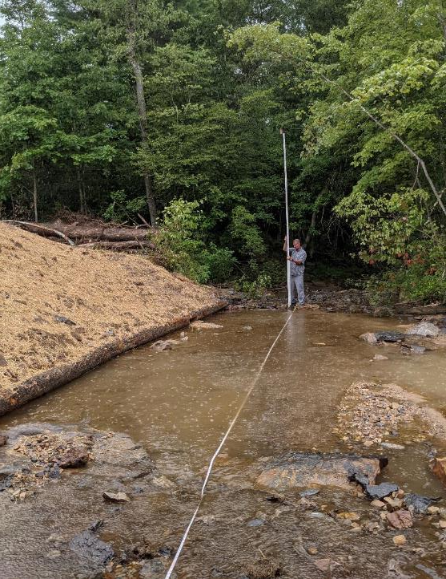
Stream Crossing Replacement Monitoring
Hammond Run Replacement
Hammond Run Monitoring
Monitoring opportunities for CDs

Slide 19
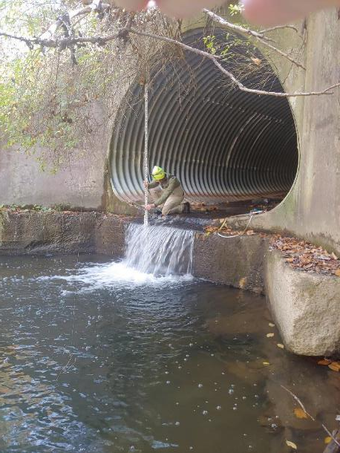
CD Monitoring opportunities
Implementing monitoring of stream crossing replacement projects
Conducted pre- and post-restoration monitoring
Longitudinal Profile
Cross sections
Pebble Counts
www.dirtandgravelroads.org

Slide 20
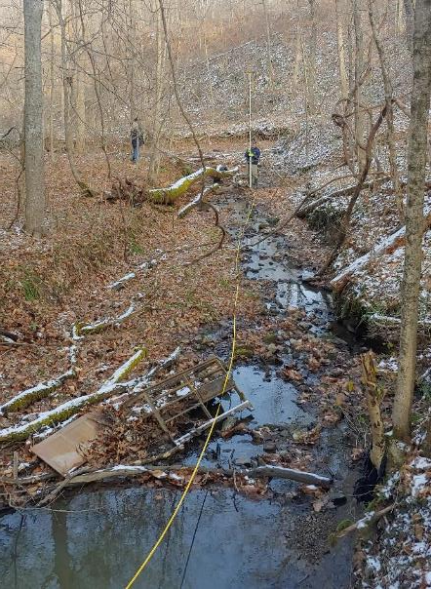
CD Monitoring opportunities
Longitudinal profile monitoring
Immediately survey post-restoration
Two surveys per year minimum
Survey after bankfull event
Use benchmarks established during stream crossing replacement project
Use geomorphic assessment form for survey data
www.dirtandgravelroads.org

Slide 21
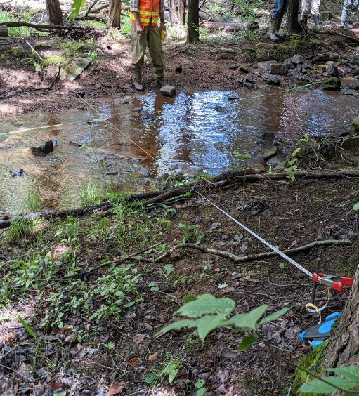
CD Monitoring opportunities
Cross section monitoring
Immediately survey post-restoration
3 cross sections - reference reach and upstream/downstream of crossing
Establish permanent cross section pins
Use geomorphic assessment form for survey data
www.dirtandgravelroads.org

Slide 22
CD Monitoring opportunities
Pebble Counts
Identify pool/riffle sequence in reference reach and reconstructed reach
Collect multiple transects and measure 100-400 particles
Use pebble count form for data
www.dirtandgravelroads.org

Slide 23
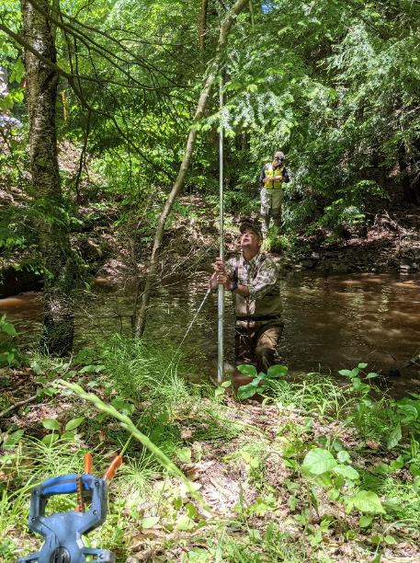
CD Monitoring opportunities
CD Time Investment:
Expect one full day for setup of long-pro, cross-sections and pebble counts
Subsequent monitoring ~1/2 day twice per year and after any bankfull event
Center staff will train first round of surveying and pebble counts – assist as needed after
www.dirtandgravelroads.org

Slide 24
CD Monitoring opportunities
Poll Question: Would you be interested in monitoring your stream crossing projects?
Polls are limited to multiple choice, so Please put in the Chat:
Any comments based on “rough” monitoring requirements
Your name and e-mail if you are interested in post-replacement monitoring
www.dirtandgravelroads.org

