Slide 1
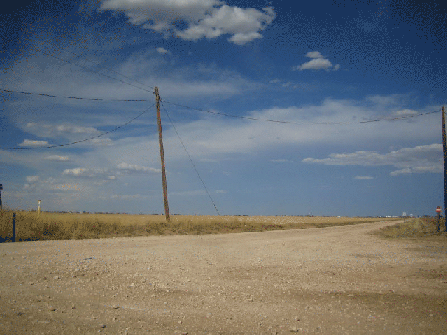
DGLVR Webinar
DEP GP-11 Clarification Memo
4/2/20
Starts at 9am
If you are reading this, then you are successfully seeing the webinar video. Webinar audio should be automatic through your computer, and options can be accessed in the “audio options” button on the bottom left. If your computer audio is not working, you can listen on your phone by dialing 312-626-6799.

Slide 2
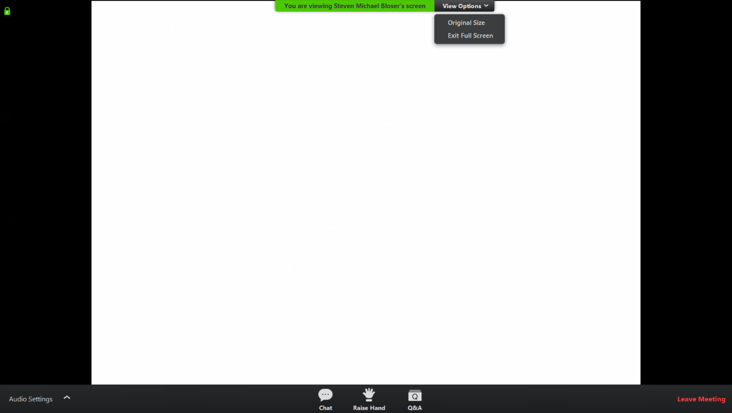
Q&A
Note you can ask a question anonymously
Q&A
For audio via phone: 312-626-6799
Slide #

Slide 3
DEP GP11 Clarification Memo
Background:
Historically some confusion on GP11s
Structure realignment
Raising the road over the crossing
How to achieve aquatic organism passage
Different interpretations in different regions
For audio via phone: 312-626-6799

Slide 4
DEP GP11 Clarification Memo
Background:
SCC and CDGRS started general discussions on permitting issues with DEP Central Office in 2018
Several meetings held 2018-2019
Discussed general challenges of permit process to DGLVR Projects
For audio via phone: 312-626-6799

Slide 5
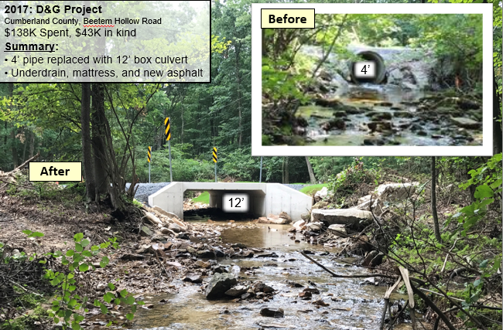
DEP GP11 Clarification Memo
Background:
SCC and CDGRS toured several sites with DEP staff
Completed site on Beetem Hollow in Cumberland County
For audio via phone: 312-626-6799

Slide 6
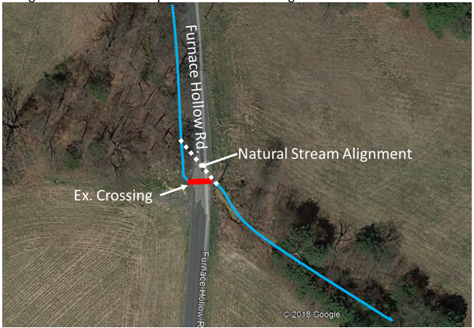
DEP GP11 Clarification Memo
Background:
SCC and CDGRS toured several sites with DEP staff
Pending site with alignment issues on Furnace Hollow in Cumberland County
For audio via phone: 312-626-6799

Slide 7
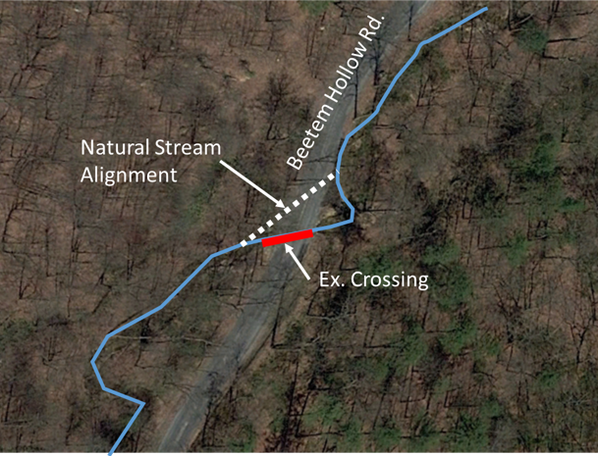
DEP GP11 Clarification Memo
Background:
SCC and CDGRS toured several sites with DEP staff
Potential site that may not be funded due to permit issues on Beetem Hollow in Cumberland County
For audio via phone: 312-626-6799

Slide 8
DEP GP11 Clarification Memo
Background:
Various other discussions and meetings with SCC/CDGRS and DEP in 2019. Results:
DEP GP-11 Clarification letter (will go through in detail next)
DGLVR applications will be assigned a “Tier 1 priority” for review.
For audio via phone: 312-626-6799

Slide 9
DEP GP11 Clarification Memo
Background:
Does this automatically apply to all DGLVR projects that need a GP11?
No. Since the letter outlines additional steps above and beyond normal permit requirements, it only applies to projects where these requirements can be met.
Otherwise permits will go through normal GP11 review process (no cover letter or Tier 1 review).
For audio via phone: 312-626-6799

Slide 10
DEP GP11 Clarification Memo
Background:
How do I ensure the clarification memo is considered for a permit application
Must notify DEP that the permit is a DGLVR Project
How? Notification Cover Letter
Draft Cover Letter (available from CDGRS)
Cover Letter to be prepared and signed by CD
Provide to applicant for permit submittal
For audio via phone: 312-626-6799

Slide 11
DEP GP11 Clarification Memo
Any questions on the background or logistics of implementation?
Will go through memo next

Slide 12
DEP GP11 Clarification Memo
Thank You!
Roger Adams: DEP Karl Brown: SCC
Ramez Ziadeh: DEP Justin Challenger: SCC
Andrew McDonald: DEP Wade Brown: CDGRS
Sid Freyermuth: DEP Lori Glace: Cumberland CD
Shelby Freyermuth : DEP

