Slide 1
DGLVR Webinar
DGLVR Impacts and Considerations from Coronavirus
3/26/20
Starts at 9am
If you are reading this, then you are successfully seeing the webinar video. Webinar audio should be automatic through your computer, and options can be accessed in the “audio options” button on the bottom left. If your computer audio is not working, you can listen on your phone by dialing 646-876-9923.
For technical assistance, call: 814-865-5355

Slide 2
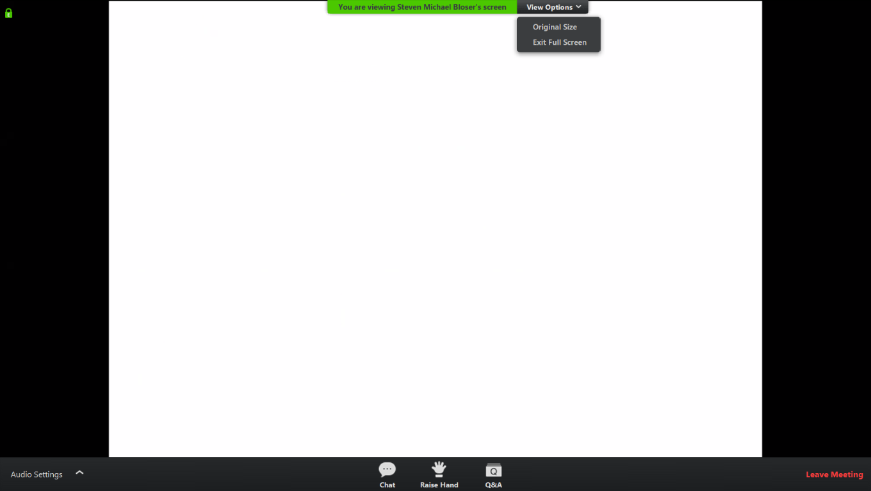
Q&A
Note you can ask a question anonymously
Q&A
For audio via phone: 646-876-9923
For technical assistance: 814-865-5355
Slide #

Slide 3
DGLVR Webinar
Impacts and Considerations from Coronavirus
Purpose:
Review DGLVR Program impacts from Coronavirus
Allow CDs to ask questions
For audio via phone: 646-876-9923
For technical assistance: 814-865-5355

Slide 4
DGLVR Impacts and Considerations from Coronavirus
Current Restrictions Overview:
PSU/CDGRS
Remote classes the rest of semester
Remote work until through April…
No county visits or tech assists until through April…
No trainings until May?
State/SCC
Remote work until indefinite
No QAQCs until indefinite
The Wolf Administration strongly encourages the suspension of large gatherings, events, conferences of more than 10 people, and per White House guidelines, ask that individuals and groups cancel any gatherings planned over the next eight weeks.
For audio via phone: 646-876-9923
For technical assistance: 814-865-5355

Slide 5
DGLVR Impacts and Considerations from Coronavirus
ESM Trainings:
Current Status
3/25-26, Huntingdon - POSTPONED
3/14-15, McKean - POSTPONED
4/22-23, Berks - POSTPONED
5/12-13, Somerset- unlikely
Remaining – TBD
Certifications:
Extension of certifications? TBD, maybe if “postponed” becomes “canceled”
Reminder: ESM certifications good until the end of the calendar year (anyone who took it in 2015 is certified through 12/31/2020)
For audio via phone: 646-876-9923
For technical assistance: 814-865-5355

Slide 6
DGLVR Impacts and Considerations from Coronavirus
QAQCs:
~22 scheduled for 2020
Current Status
March: 2 postponed
April: 3 scheduled TBD, earlier ones unlikely
May: 3 scheduled TBD
Contact Justin Challenger with questions

Slide 7
DGLVR Impacts and Considerations from Coronavirus
Spending Requirements:
Will SCC extend spending requirements for CDs to be eligible for allocation?
Likely will not be needed this year! Because of the rush last year with spending and the 5-year agreement ending, nearly all CDs should be eligible for FY 2020-21 allocations.
Could be a topic for next year if this continues?

Slide 8
DGLVR Impacts and Considerations from Coronavirus
CD Allocations:
Typical Schedule
Allocations to SCC in May
CDs get advance in August
Likely Schedule this year
Allocations to SCC in July
CDs get advance in August/September

Slide 9
DGLVR Impacts and Considerations from Coronavirus
Unpaved Road Assessments:
Allocation “snapshot” for FY 2020-21 DnG allocations extended to June 15th
WHAT BETTER TIME TO ASSESS?
GET OUT THERE!
Check with your county to make sure it is OK.
Recorded assessment training on CDGRS website (education – assessment training – online training)

Slide 10
DGLVR Impacts and Considerations from Coronavirus
State Budget:
Timing? Currently on schedule for July approval
Changes? None currently planned
Note any delays or changes in state budget could delay or alter allocations.

Slide 11
DGLVR Impacts and Considerations from Coronavirus
QAB and CD Board Meeting:
Held Remotely? allowable
Quorums?
Sunshine Requirements?
Must give notice of the date and time of call as best you can and provide call-in information on how the public can access the call. If possible, it should be recorded. As long as there is a quorum, any decisions made would be legal, provided all other requirements that would typically apply are met.

Slide 12
DGLVR Impacts and Considerations from Coronavirus
DEP Permitting:
Currently reviewing permit backlog
May be some delays
DEP is suspending the timeframes for providing permit decisions established in the Policy for Implementing the Department of Environmental Protection Permit Review Process and Permit Decision Guarantee due to the office closures related to COVID-19. Please note that DEP staff will continue to process received permit applications. However; due to operational conditions, applicants may experience delays receiving decisions. Applicants may also experience delays in receiving permit decisions where the applications are processed by County Conservation Districts. DEP will provide emergency authorizations for projects that are critical to public health and safety

Slide 13
DGLVR Impacts and Considerations from Coronavirus
Driving Surface Aggregate:
Quarries: many shut down now
Sampling and Testing:
CDGRS will continue to accept notifications, keep sending them ASAP
CDGRS will start to sample as soon as we are allowed
Please be patient! this will backlog the entire chain: quarries, contractors, CDGRS staff, testing labs,

Slide 14
DGLVR Impacts and Considerations from Coronavirus
Traffic Counts:
Can I continue to do traffic counts, given that traffic is likely to be lower than normal during this period?
YES. While the SCC recognizes counts may be lower than normal, they are required for grant eligibility. Counts can be completed as needed, as long as your county is OK with it

Slide 15
DGLVR Impacts and Considerations from Coronavirus
Other Potential Quarantine Tasks for CDs:
Assessments
Virtual meetings with CDGRS/SCC staff using screen sharing (site discussion using pictures, application review, pre-design talks, plan reviews, etc.)
Familiarize yourself with optional documents (bid documents, checklists, etc)
Review Bid packets, permits, etc
Review QAB policies
Professional development, outside trainings, certifications, LTAP Road Scholars: Some classes are now webinars
Develop a newsletter?
Plan new education and outreach events (recorded webinar)
Keep up contact to your municipalities!!

Slide 16
DGLVR Impacts and Considerations from Coronavirus
Additional Questions
Chat
Q&A
Send directly to Roy or myself later

Slide 17
DGLVR Impacts and Considerations from Coronavirus
Stay safe…and sane!
Next Webinar 4/2: DEP Permit Memo
Another “General DGLVR Coronavirus Impacts” update Webinar? In 2 weeks?

