Slide 1
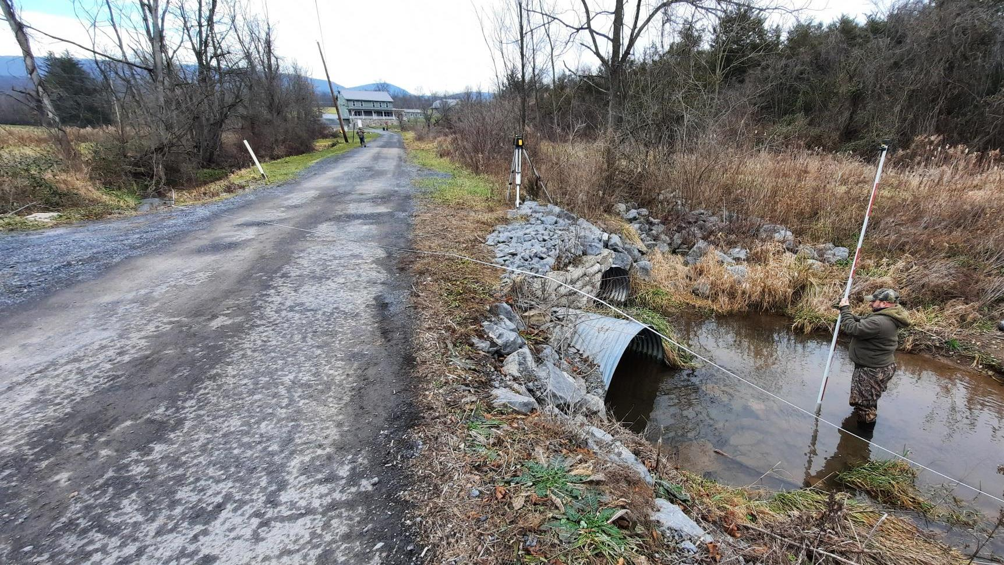
Dirt Gravel and Low Volume Road Program
Stream Crossing Documents Overview
Policy: 5/25 9am
Standard: 5/26 9am
Tech Manual: 5/27 9am
CDGRS
Steve Bloser
SCC
Roy Richardson
Justin Challenger
Sherri Law
If you are reading this, then you are successfully seeing the webinar video. Webinar audio should be automatic through your computer (or click “join audio”), and options can be accessed in the “audio options” button on the bottom left. If your computer audio is not working, you can listen on your phone by dialing 646-876-9923.

Slide 2
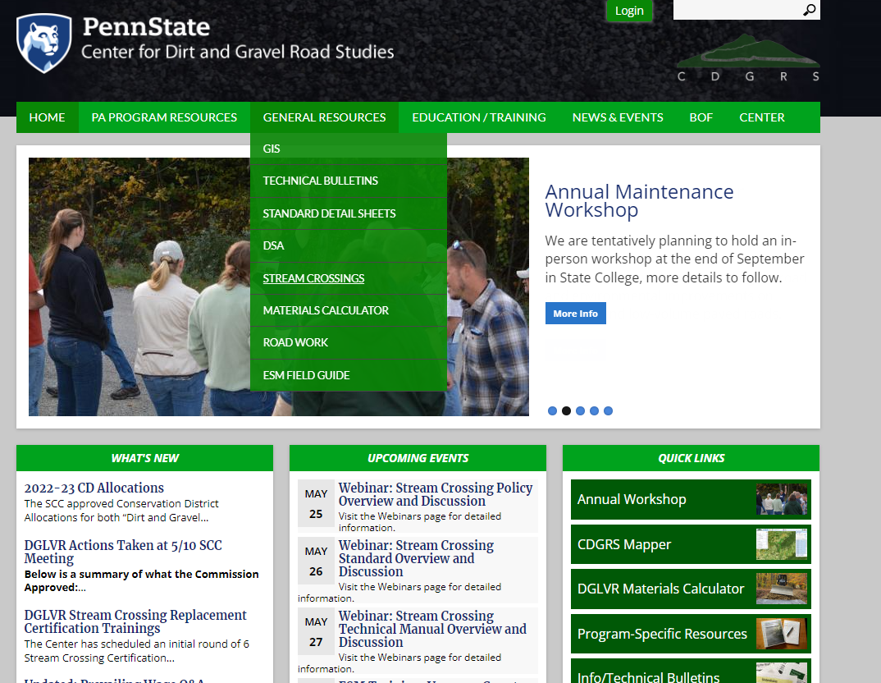
Stream Crossing Documents
Reminders:
Contracts signed before 7/1/22 must follow existing policy, not required to follow standard.
Documents available online (prelim format), will be printed and mailed to CDs
6 Regional trainings Scheduled June through December.
Each training consists of 4 virtual and 2 in-field sessions over two weeks.
Trainings taken this year WILL COUNT for certification requirement that goes into place 7/1/2023 (currently a 3-year certification).
Full Details online, registration is open, limited to 15 per session. as of 5/23:
Indiana: 3 spots remaining
Elk/Clarion: Full
Potter: 7 spots remaining
Monroe/Susq: 8 spots remaining
Cumberland: 6 spots remaining
Lehigh: 10 spots remaining
www.dirtandgravelroads.org

Slide 3
Stream Crossing Documents
Effective July 1, 2022
TECHNICAL MANUAL
Introduction
Understanding the standard
Initial Site Assessment
Longitudinal Profile Survey
Grant Application (Material Selection & Cost Estimation)
QAB Ranking & Review
Writing a Contract
From Contract to Construction
Installation and Constructions Inspection (active project oversight)
Final Inspection & As-built Notes
Maintenance
Engineering Design, Permitting, and Bidding a Stream Crossing
Chapters 1 & 2 are background and spec detail
Chapters 3-11 in chronological order and directed at CDs
Chapter 12 directed at engineers
www.dirtandgravelroads.org

Slide 4
Stream Crossing Documents
Effective July 1, 2022
Technical Manual
Intended as details on how to meet policy and standard
Does not contain additional requirements not already specified in Policy or Standard.
www.dirtandgravelroads.org

Slide 5
Tech Manual: Ch 1, Introduction
www.dirtandgravelroads.org

Slide 6
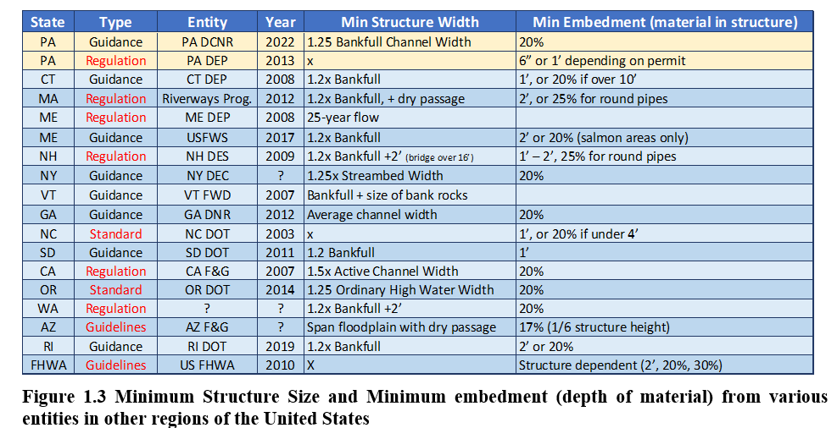
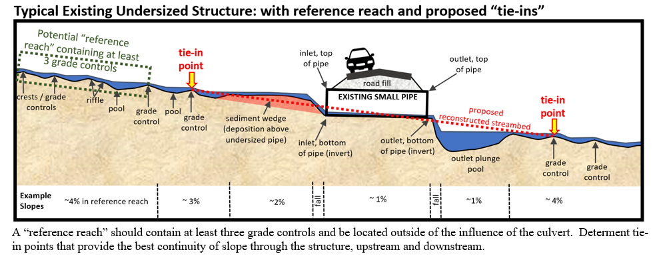
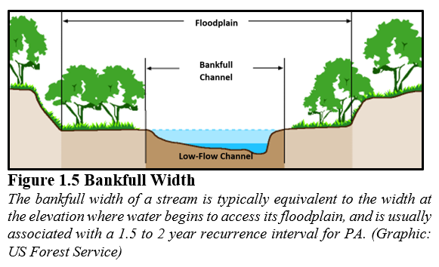
Tech Manual: Ch 1, Introduction
Ch 1 Highlights:
The “why”. Impacts of poor crossings and benefits of a different approach
Built on lessons from USFS and other states.
Focus on “Stream Continuity” over “Aquatic Organism Passage”. (and continuity will get you AOP)
Overview of roles and introduction of policy and standard, and bankfull.
www.dirtandgravelroads.org

Slide 7
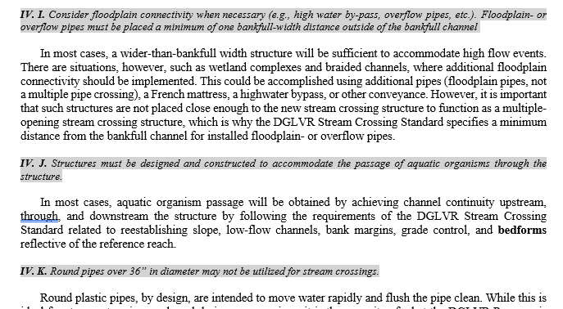
Tech Manual: Ch 2, DGLVR Stream Crossing Standard
Ch 2 Highlights:
Provides line-by-line explanation to the Standard.
This is what we used in yesterday’s webinar on the Standard.
www.dirtandgravelroads.org

Slide 8
Tech Manual: Ch 3, Initial Assessment and Planning
www.dirtandgravelroads.org

Slide 9
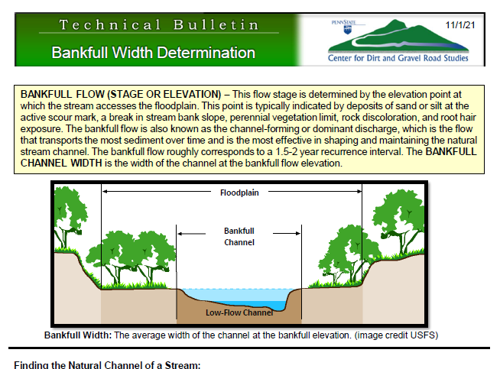
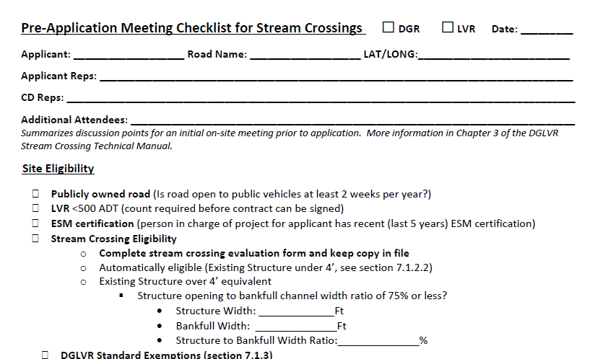
Tech Manual: Ch 3, Initial Assessment and Planning
Ch 3 Highlights:
Determining eligibility for replacement
Details on exemptions.
Pre project considerations
Realistic timelines
Off-ROW
Prevailing Wage
Potential project and engineering costs
Permitting
Likelihood of funding
SCC notification
Other Resources:
Checklist: Pre-App meeting
Tech Bulletin: Bankfull Width Determination
www.dirtandgravelroads.org

Slide 10
Tech Manual: Ch 4, Site Assessment
www.dirtandgravelroads.org

Slide 11
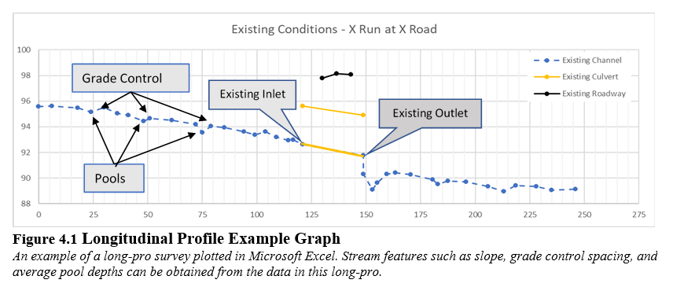
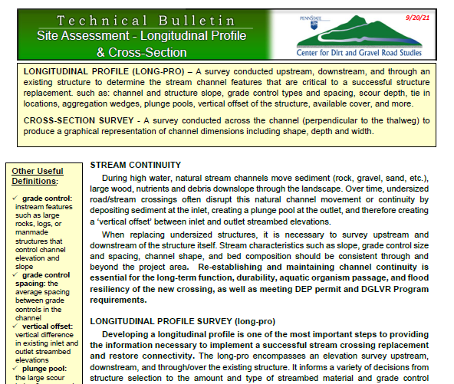
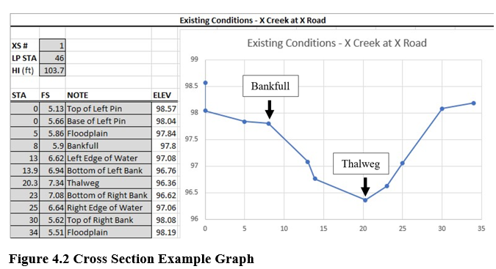
Tech Manual: Ch 4, Site Assessment
Ch 4 Highlights:
Longitudinal Profile
Cross Sections
Reference Reach
Data analysis
Other Resources:
Will be major focus of stream trainings
Tech Bulletin: Site Assessment: Long Pro and Cross Sections
www.dirtandgravelroads.org

Slide 12
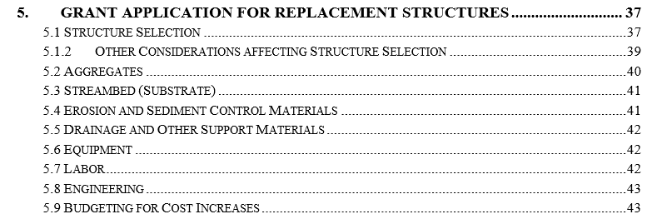
Tech Manual: Ch 5, Grant Application
www.dirtandgravelroads.org

Slide 13
Tech Manual: Ch 5, Grant Application
Ch 5 Highlights:
Estimating quantities and costs
Structure Selection: size, type
Grade controls
Streambed
Other materials
Labor (contracted vs muni)
Engineering
Other Resources:
Tech Bulletin: Structure Selection
Tech Bulletin: Grade Control
Tech Bulletin: Streambed Material
Goal is to get a good estimate of costs for contracting. Final design determined by engineer.
www.dirtandgravelroads.org

Slide 14
Tech Manual: Ch 6 & 7, Ranking and Contracting
Ch 6&7 Highlights:
Fairly “normal” DGLVR procedures
Ranking and evaluation considerations
Contracting and amendments
www.dirtandgravelroads.org

Slide 15
Tech Manual: Ch 8, From Contracting to Construction
www.dirtandgravelroads.org

Slide 16
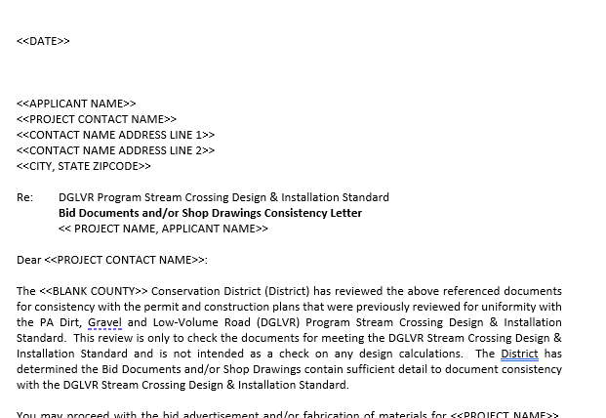
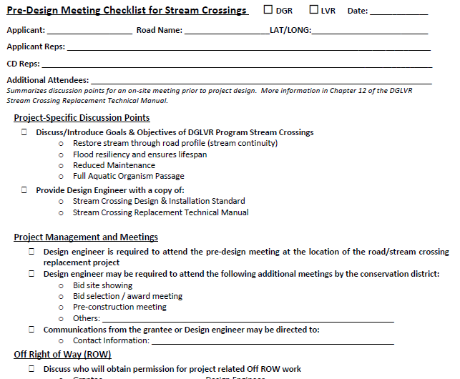
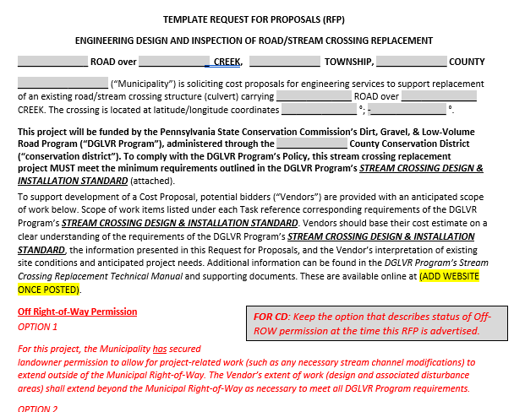
Tech Manual: Ch 8, From Contracting to Construction
Ch 8 Highlights:
Engineering and RFP(optional)
Engineering survey
CD review of plans
Bidding
CD review of bid
Site showing (required to attend if held)
Pre-design and pre-construction meetings (required)
Other Resources:
Templates:
RFP for engineering
CD permit review letter
CD bid package review letter
Checklists:
Pre-design Meeting
Permit review
Bid-package review
Pre-construction Meeting
www.dirtandgravelroads.org

Slide 17
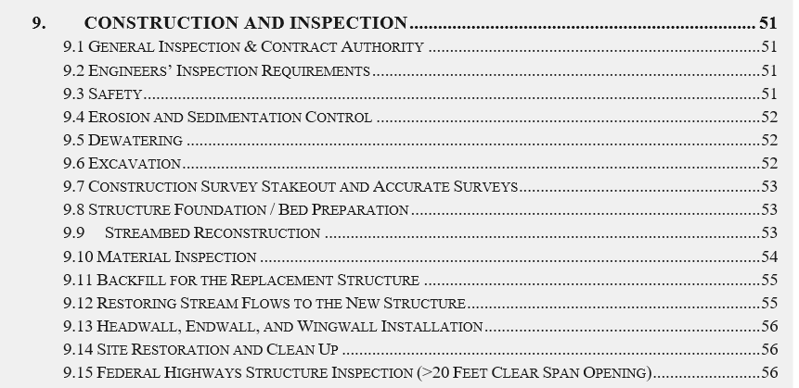
Tech Manual: Ch 9, Construction and Inspection
www.dirtandgravelroads.org

Slide 18
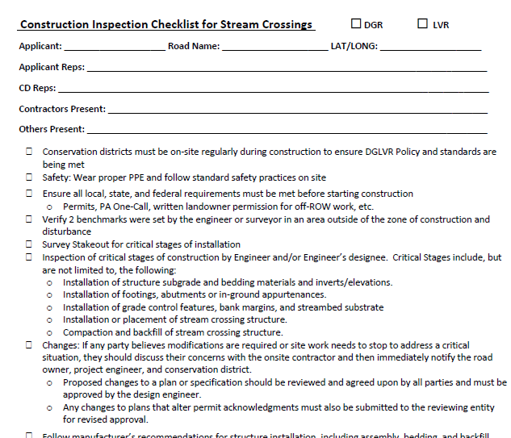
Tech Manual: Ch 9, Construction and Inspection
Ch 9 Highlights:
Inspection Requirements (engineer and CD)
Logistics: safety, E&S, dewatering etc
Structure placement
Re-establishing stream
Grade Control
Bank Margins
Streambed substrate
Backfill and cleanup
Other Resources:
Tech Bulletin: Grade Control
Tech Bulletin: Streambed Material
Checklist: Construction Inspection
www.dirtandgravelroads.org

Slide 19
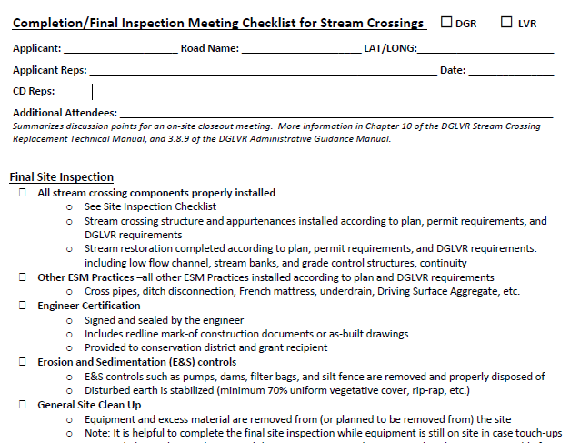
Tech Manual: Ch 10, Final Inspection and “As Built” Notes
Ch 10 Highlights:
Final inspection and completion report
Documentation and payment
Other Resources:
Checklist: Final Inspection
www.dirtandgravelroads.org

Slide 20
Tech Manual: Ch 11, Monitoring and Maintenance
Ch 11 Highlights:
Site monitoring encouraged but NOT required
Regular Maintenance: up to road owner
Larger “repairs”: May be funded at discretion of individual CDs
www.dirtandgravelroads.org

Slide 21
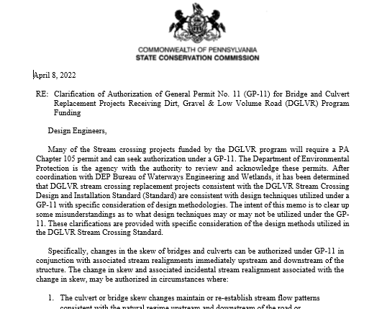
Tech Manual: Ch 12, Engineering Design Considerations
Other Resources:
GP-11 Permit Memo
Raising the Road
Crossing realignment
Ch 12 Highlights:
This chapter is intentionally repetitious of previous Chapters.
Written with an engineer audience in mind
More technical and design oriented
Can give to design engineer
This is where a lot of the “nitty gritty” lives
www.dirtandgravelroads.org

Slide 22
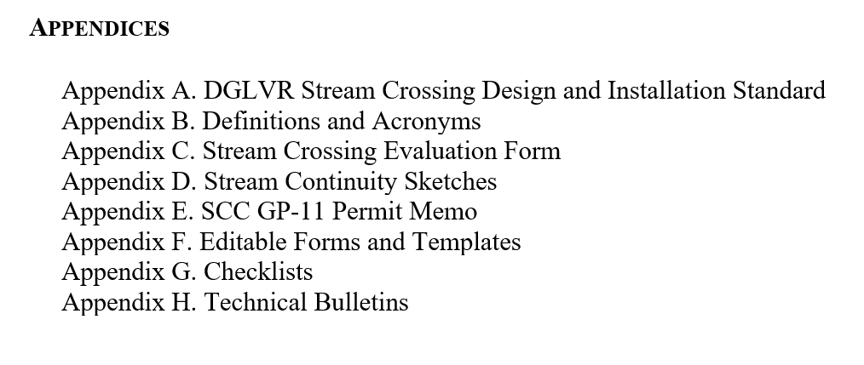
Tech Manual: Ch 12, Engineering Design Considerations
www.dirtandgravelroads.org

Slide 23
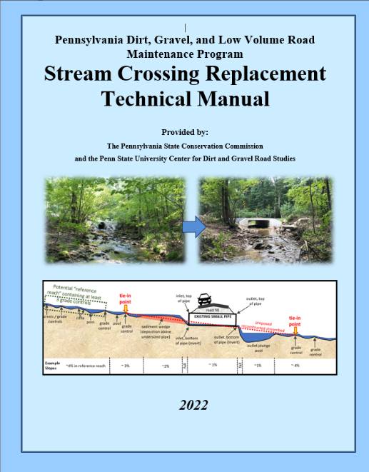
Stream Crossing Documents
Effective July 1, 2022
TECHNICAL MANUAL
Additional
Questions?
Introduction
Understanding the standard
Initial Site Assessment
Longitudinal Profile Survey
Grant Application (Material Selection & Cost Estimation)
QAB Ranking & Review
Writing a Contract
From Contract to Construction
Installation and Constructions Inspection (active project oversight)
Final Inspection & As-built Notes
Maintenance
Engineering Design, Permitting, and Bidding a Stream Crossing
Technical Manual does not contain additional requirements not already specified in Policy or Standard.
www.dirtandgravelroads.org

