Slide 1
DSA
Administrative
Webinar
Toggle full screen mode
with this button above
5/19/16
Starts at 9am
Use Chat box to ask Questions
http://metrocount.com
If you are reading this, then you are successfully seeing the webinar video. In addition to audio on the webinar, we have opened a phone conference line to allow attendees to listen and ask questions directly: 866-823-7699. Please use either the webinar audio or conference line, but not both (will produce feedback).
Audio also available via phone: 866-823-7699
For assistance, call: 814-865-5355

Slide 2
Toggle Fullscreen
mode with this button
above
RECORD
Use Chat box to ask Questions
Participant phone lines will be muted until after initial presentation
http://metrocount.com
Audio also available via phone: 866-823-7699
For assistance, call: 814-865-5355

Slide 3
Note:
Today is brief “administrative” DSA Overview to highlight changes
June 15th will be a Longer “technical” DSA webinar.

Slide 4
Driving Surface Aggregate
Background
Evolution of DSA spec
Walkthrough of new spec and changes
Overview of Handbook
Implementation

Slide 5
Driving Surface Aggregate
Background
Evolution of DSA spec
Walkthrough of new spec and changes
Overview of Handbook
Implementation

Slide 6
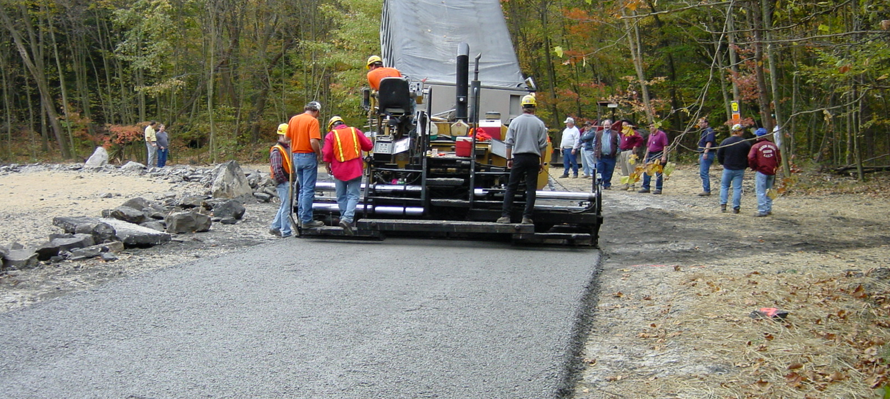
Driving Surface Aggregate
Background
What is it?
Specific blend of unbound aggregate designed as a wearing course for unpaved roads.
Only approved surface aggregate in the Program.
DSA is designed for maximum compaction.
Reduces breakdown under traffic.
Reduces erosion and runoff.

Slide 7
Driving Surface Aggregate
Background
DSA History
Historically, ~ 50% of funding has been spent on DSA

Slide 8
Driving Surface Aggregate
Background
DSA History
Historically, ~ 50% of funding has been spent on DSA
In 2015 Annual Report:
139,000 tons of DSA reported
Equivalent to 42 miles of road (@18’ width)
Equivalent to ~3.5million (@ $25/ton)
That is ~47% of the $7.5million spent on 248 completed projects in 2015

Slide 9
Driving Surface Aggregate
Background
A word about DSA use:
Originally intended to be used near streams where drainage to stream was unavoidable.
Has evolved into the “standard solution”.
Drainage must be addressed first!
We realize it is a “carrot” for municipalities, but DSA is not required on every project.
DSA and the spending game…

Slide 10
Driving Surface Aggregate
Background
Evolution of DSA spec
Walkthrough of new spec and changes
Overview of Handbook
Implementation

Slide 11
Driving Surface Aggregate
Evolution
DSA History
Center developed DSA in 2000.
PennDOT adopted DSA spec in 2006.
Program adopted PennDOT spec for use in 2006.

Slide 12
Driving Surface Aggregate
Evolution
DSA History
Center developed DSA in 2000.
PennDOT adopted DSA spec in 2006.
Program adopted PennDOT spec for use in 2006.
DSA Clearinghouse at Center in 2015.
SCC DSA Spec approved 5/10/2016 (separate from PennDOT spec)

Slide 13
Driving Surface Aggregate
Evolution
Reason for new Spec
Several DOT requirements that did not fit Program:
DOT approved quarry
Required paver
Required sub-grade compaction and density testing
Required in-place density testing
Flexibility to make changes
Local Control

Slide 14
Driving Surface Aggregate
Evolution
Timeline on new Spec
Program’s “Policy and Planning” advisory workgroup met several times last winter to provide input.
All Conservation Districts were given comment opportunity on spec in Feb 2016.
Met twice and received comments from PACA.
Final specification approved by SCC 5/10/16.
PA Aggregate and Concrete Association

Slide 15
Driving Surface Aggregate
Evolution
Purpose of new Spec
Make DSA more available (more suppliers)
Insure you get what you pay for
Improve overall quality of placements
Allow more Program control by not being tied to DOT spec.

Slide 16
Driving Surface Aggregate
Background
Evolution of DSA spec
Walkthrough of new spec and changes
Overview of Handbook
Implementation

Slide 17
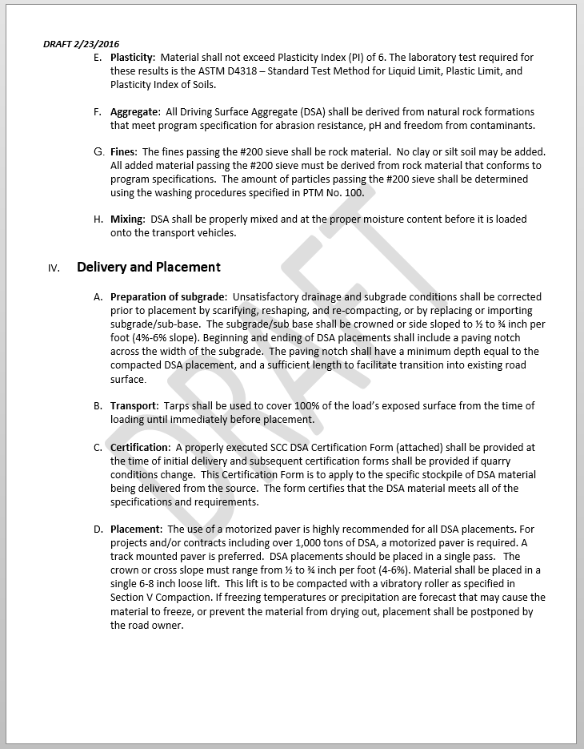
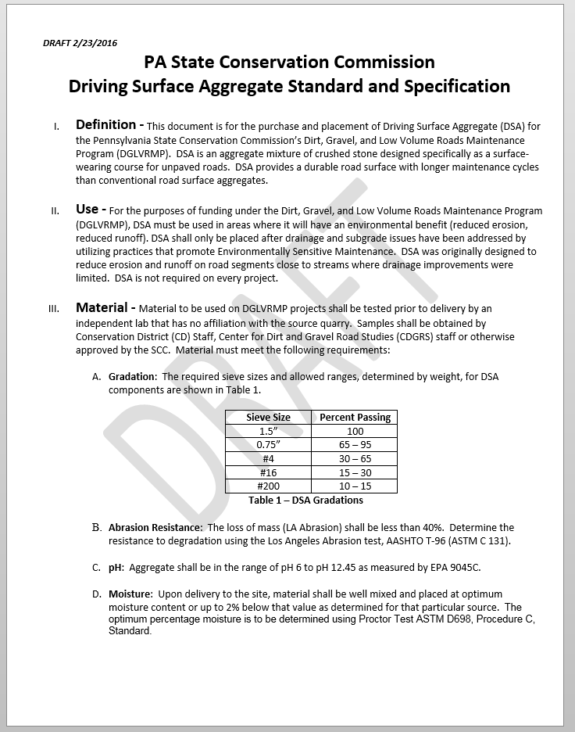
Driving Surface Aggregate
New Spec
Draft SCC Spec Walkthrough
2 pages
Walkthrough of changes

Slide 18
Driving Surface Aggregate
New Spec
Use of Bulletin 14 (DOT approved Quarry)
In DOT spec, not in SCC draft
Restricts availability
Non-DOT approved quarries can make good DSA

Slide 19
Driving Surface Aggregate
New Spec
DSA Use:
SCC Spec defines use in Program: only after drainage and base issues are addressed, etc.

Slide 20
Driving Surface Aggregate
New Spec
Material: Gradation
NEW: Material must be tested prior to delivery.

Slide 21
Driving Surface Aggregate
New Spec
Material: Gradation
NEW: Material must be tested prior to delivery.
Easier to fix problems before you have aggregate on the road.
Since Clearinghouse began in 2015: through 4/2016
118 samples tested (72 met DSA spec, 46 did NOT)
39% of samples tested did NOT meet spec

Slide 22
Driving Surface Aggregate
New Spec
Material: Gradation
Gradation itself did not change

Slide 23
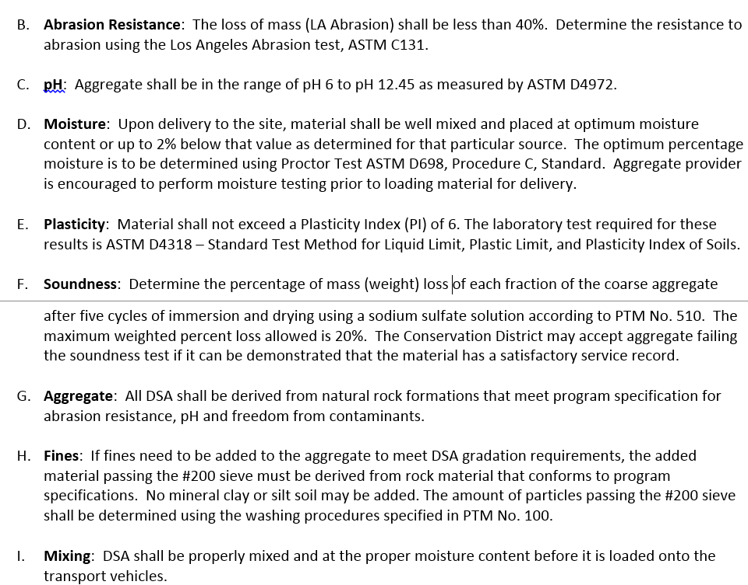
Driving Surface Aggregate
New Spec
Material: Details
Minor re-wording
Soundness
Measures resistance to freeze/thaw weathering
Already done for DOT approved Quarries

Slide 24
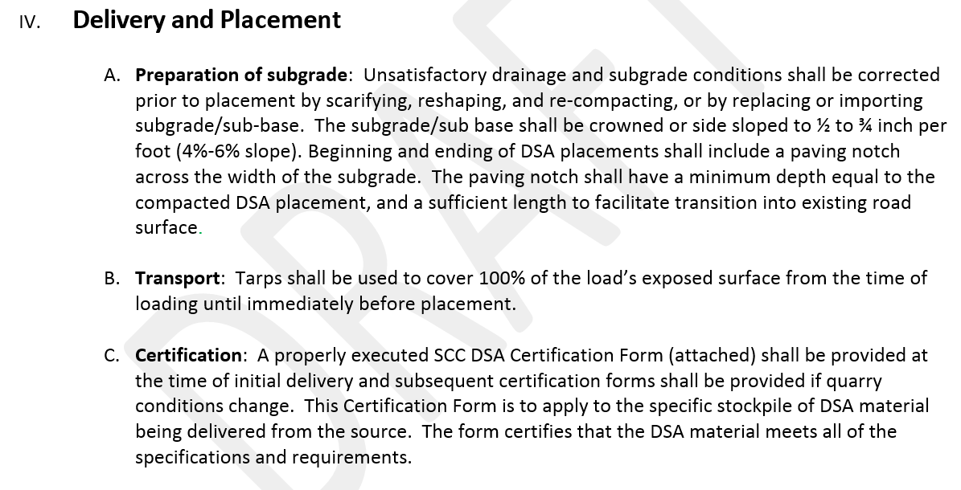
Driving Surface Aggregate
New Spec
Delivery and Placement
Removed subgrade testing (required in DOT)
SCC Spec has more details on subgrade prep

Slide 25
Driving Surface Aggregate
New Spec
Delivery and Placement
Use of paver to place DSA
DOT spec is unclear
SCC spec requires pavers on jobs >1,000 tons
SCC spec includes weather limitations on placement
PennDOT DSA MS-0450-0004:

Slide 26
Driving Surface Aggregate
New Spec
Compaction
In-place density testing
DOT requires for every 3,000 sqyd (~1,500’ of road)
SCC spec recommends density testing (local control)

Slide 27
Driving Surface Aggregate
Background
Evolution of DSA spec
Walkthrough of new spec and changes
Overview of Handbook
Implementation

Slide 28
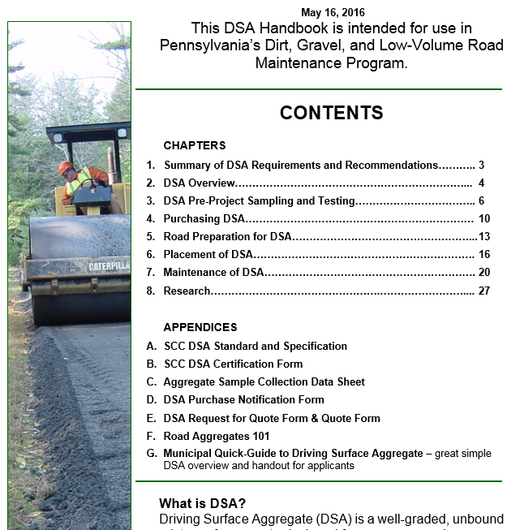
open

Slide 29
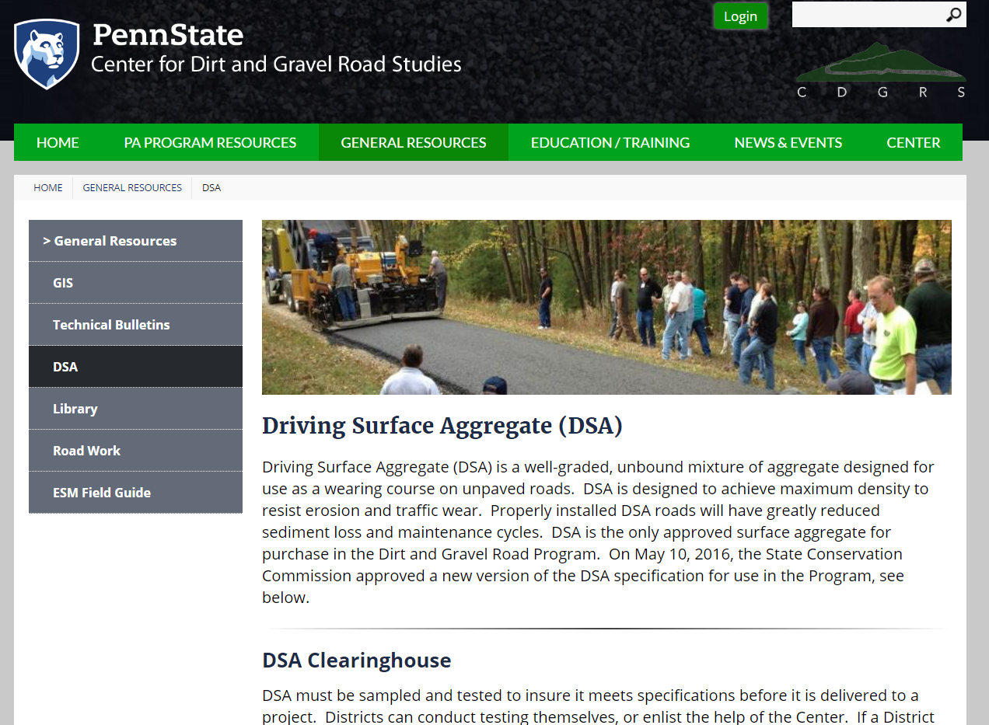
www.dirtandgravelroads.org: Resources: DSA
http://www.dirtandgravel.psu.edu/general-resources/driving-surface-aggregate-dsa

Slide 30
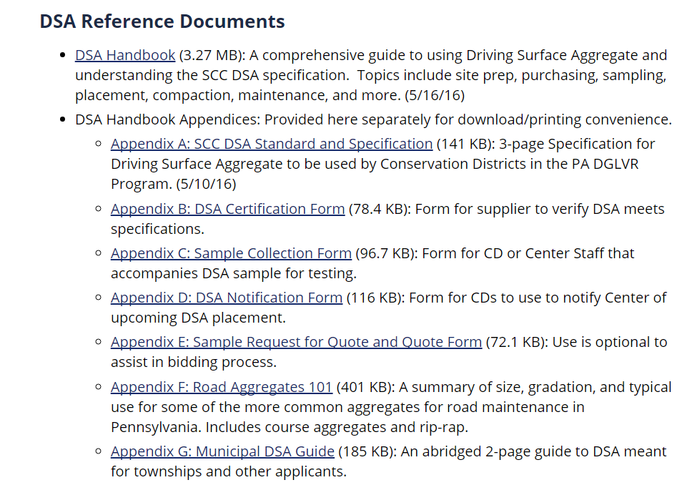
www.dirtandgravelroads.org: Resources: DSA
http://www.dirtandgravel.psu.edu/general-resources/driving-surface-aggregate-dsa

Slide 31
Driving Surface Aggregate
DSA “Technical” Webinar
June 15th, 2016, 9am
Time for you to review handbook.
Webinar will walk through handbook sections, discuss technical details.
Webinar may be longer than normal.
Contact Center or SCC with immediate questions

Slide 32
Driving Surface Aggregate
Background
Evolution of DSA spec
Walkthrough of new spec and changes
Overview of Handbook
Implementation

Slide 33
Driving Surface Aggregate
Implementation
What do I do now?
When does the new spec take effect?
Immediately (5/10/2016)

Slide 34
Driving Surface Aggregate
Implementation
What do I do now?
What about current contracts and bids?
Current signed contracts: may continue to use old specification (could also be re-bid).
Project that have been bid, but do not have a signed contract: Districts can accept bids under old spec, or re-bid under new spec.
Projects that have not been bid yet: use new SCC spec

Slide 35
Driving Surface Aggregate
Implementation
What do I do now?
So DSA needs to be sampled before my project?
Yes, pre-delivery testing is now required.
Will take more planning and lead time with placements.
Center, District, or third party can perform sampling.
Testing of samples must be done by independent lab.
Contact Center with questions.

Slide 36
Driving Surface Aggregate
Implementation
What do I do now?
Can I sample the DSA myself?
Yes
Sampling guidance in handbook
Must follow AASHTO spec.
Center will assist in training you
Please share result with Center

Slide 37
Driving Surface Aggregate
Implementation
What do I do now?
Do I still need the DSA Certification from the quarry?
Yes, it must still be delivered with the first load of DSA.
Required for legal reasons: quarry attesting DSA meets spec and is same material that was tested pre-delivery.

Slide 38
Driving Surface Aggregate
Evolution
Purpose of new Spec
Make DSA more available (more suppliers)
Insure you get what you pay for
Improve overall quality of placements
Allow more Program control by not being tied to DOT spec.

