Slide 1
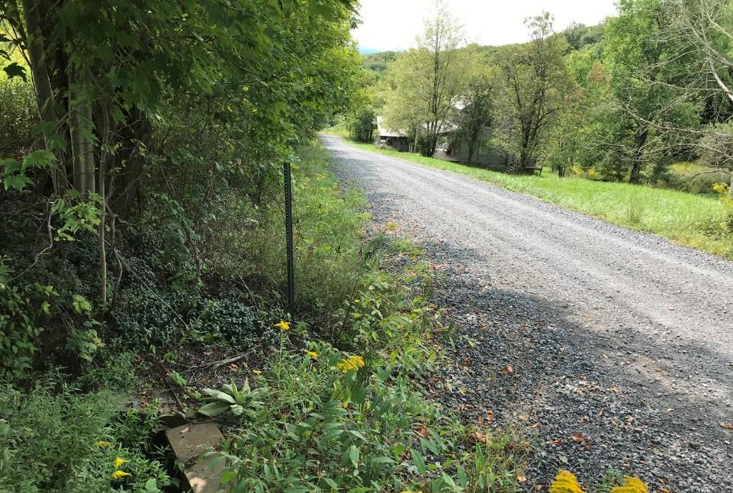
Dirt Gravel and Low Volume Road Program
WEBINAR
DSA Season
Dave Morrison- CDGRS
Steve Bloser - CDGRS
www.dirtandgravelroads.org
3/16/23 Starts at 9am
If you are reading this, then you are successfully seeing the webinar video. Webinar audio should be automatic through your computer (or click “join audio”), and options can be accessed in the “audio options” button on the bottom left. If your computer audio is not working, you can listen on your phone by dialing 646-876-9923.
Audio via Phone if needed: 646-876-9923

Slide 2
DSA Season Prep
Purpose
Primer and reminder for DSA placement season starting April 1

Slide 3
DSA Season Prep
RESOURCES:
DSA Certification: 2 page DSA certification form
DSA Specification: Material & Placement specs
DSA Handbook: More in depth DSA explanation
- Includes Request for Quote
- more details to come
All can be found on the CDGRS website including this webinar.
Notes:
In your course book are the resources noted here (on screen). There is also an Aggregate Handbook available which thoroughly covers DSA.

Slide 4
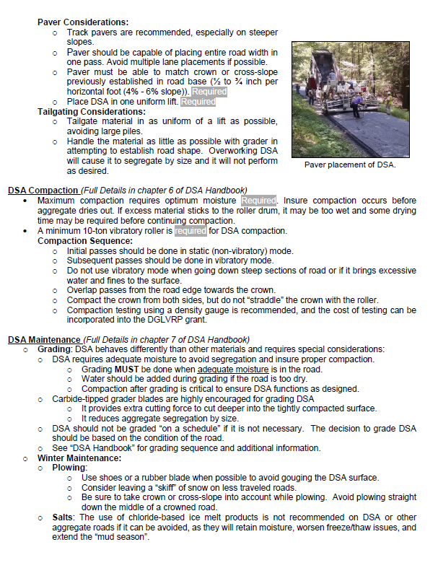
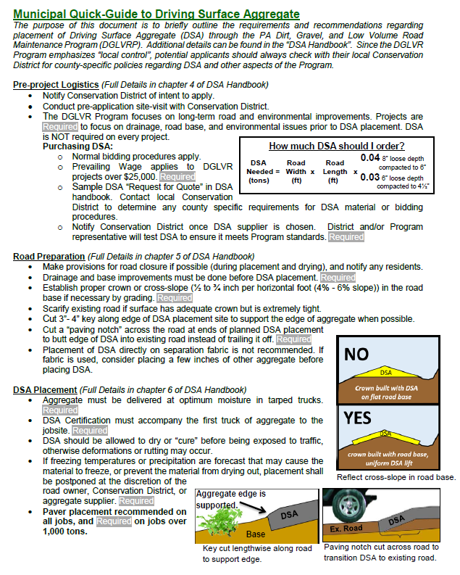
DSA Season Prep
Resources
DSA RESOURCES:
DSA Handbook: More in depth DSA information
includes Request for Quote
www.dirtandgravelroads.org
Municipal DSA Quick Guide:
Questions?
Notes:
In your course book are the resources noted here (on screen). There is also an Aggregate Handbook available which thoroughly covers DSA.

Slide 5
Reminder: Aggregates 101 Webinar Available
Recorded January 2021
Summary of general aggregate properties
Summary of commonly used aggregates in PA
Recording and powerpoint available on CDGRS website

Slide 6
Reminder: “DSA Day” Course Webinar Available
Recorded February 2021
In depth DSA course intended for CD’s
Recording and powerpoint available on CDGRS website

Slide 7
DSA Season Preparation
Reminder: 2020 DSA Changes:
Material
Slight gradation change to make DSA easier to produce.
Maximum plasticity index reduced from 6 to 4.
Placement
Placement Season April through September unless approved by SCC.
Paver must place DSA in single pass (paver still not required for jobs less than 500 tons)

Slide 8
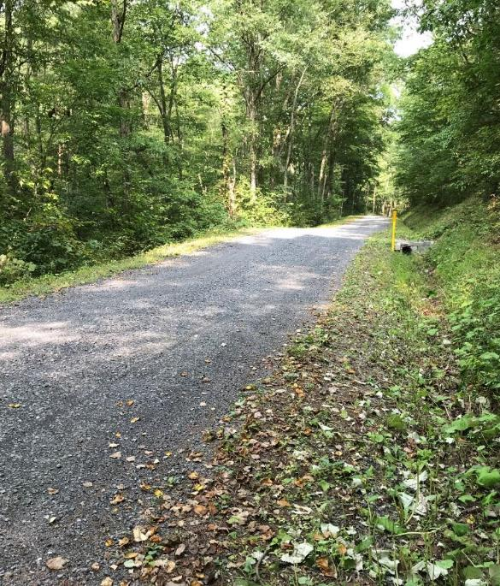
DSA Season Preparation
DSA Use
DSA Use and Overuse
When DSA is used as part of a project, it should be the very last phase of the project.
DSA alone does not constitute a comprehensive DGLVR Program project.

Slide 9
DSA Season Preparation
Sampling & Testing
Purchasing DSA with DGLVR Funds:
DSA must be independently sampled and tested
30-day notice time required for testing if CDGRS is doing the sampling.
Help from Center is also available for testing or placement on request.
30 day notice is a minimum
Notify as soon as supplier is known
Supplier needs time to make entire pile
Time for sampling
Time for testing
Potential time for failures

Slide 10
DSA Season Preparation
Sampling & Testing
Purchasing DSA with DGLVR Funds:
DSA must be independently sampled and tested
30-day notice time required for testing if CDGRS is doing the sampling.
Help from Center is also available for testing or placement on request.

Slide 11
DSA Season Preparation
Sampling & Testing
How to sample a DSA pile
Sampling and testing must be done on the (entire) specific pile that is supplying your project

Slide 12
DSA Season Preparation
Sampling & Testing
How to sample a DSA pile
Sampling and testing must be done on the (entire) specific pile that is supplying your project
Sample the full pile required for your project, if your project requires 5,000 tons, it must be a 5,000-ton pile.

Slide 13
DSA Season Preparation
Sampling & Testing
How to sample a DSA pile
Sampling and testing must be done on the (entire) specific pile that is supplying your project
Sample the full pile required for your project, if your project requires 5,000 tons, it must be a 5,000-ton pile.
Quarries must produce DSA piles in advance of delivery in order to allow time for sampling and testing (2 weeks recommended)

Slide 14
DSA Season Preparation
Sampling & Testing
How to sample a DSA pile
Sampling and testing must be done on the (entire) specific pile that is supplying your project
Sample the full pile required for your project, if your project requires 5,000 tons, it must be a 5,000-ton pile.
Quarries must produce DSA piles in advance of delivery in order to allow time for sampling and testing
Labs can get backlogged in construction season

Slide 15
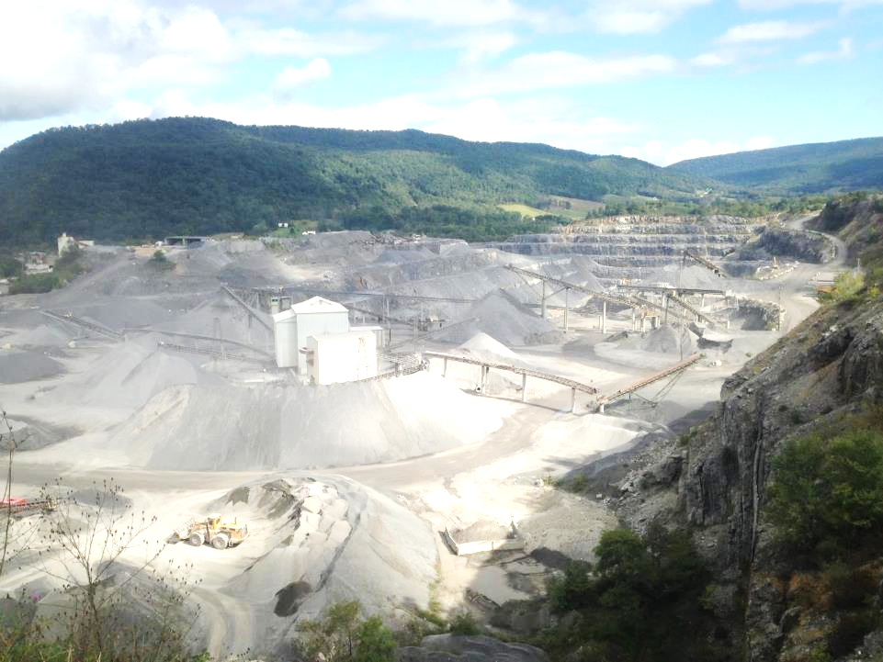
DSA Season Preparation
Sampling & Testing
Can a conservation district pull their own sample?
Yes. If a CD pulls their own sample, they must also pay for the lab testing.

Slide 16
DSA Season Preparation
Sampling & Testing
Can a conservation district pull their own sample?
Yes. If a CD pulls their own sample, they must also pay for the lab testing.
The costs of testing can be incorporated into the project cost or paid out of admin/education funds

Slide 17
DSA Season Preparation
Sampling & Testing
Can a conservation district pull their own sample?
Yes. If a CD pulls their own sample, they must also pay for the lab testing.
The costs of testing can be incorporated into the project cost or paid out of admin/education funds
Sampling and testing can also be done, free of charge, by the Center’s DSA Clearinghouse (more details on that later)

Slide 18
DSA Season Preparation
Sampling & Testing
How to collect a DSA sample…
Sampling from a stockpile should always be done using a loader to separate out small sampling pile(s).

Slide 19
DSA Season Preparation
Sampling & Testing
How to collect a DSA sample…
Sampling from a stockpile should always be done using a loader to separate out small sampling pile(s).
As the sampler, it is your job to witness the sample pile(s) being created from the DSA stockpile that will be used on the job.

Slide 20
DSA Season Preparation
Sampling & Testing
How to collect a DSA sample…
Sampling from a stockpile should always be done using a loader to separate out small sampling pile(s).
As the sampler, it is your job to witness the sample pile(s) being created from the DSA stockpile that will be used on the job.
Sampling is equally as important as the testing, and the sampler shall use every precaution to obtain samples that will show the nature and condition of the materials which they represent. A “representative” sample.

Slide 21
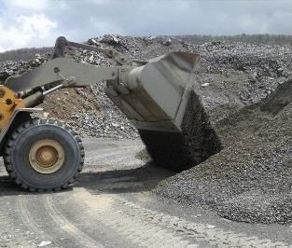
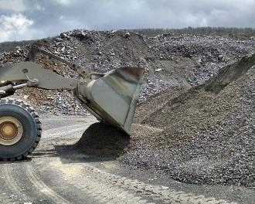
DSA Season Preparation
Sampling & Testing
How to collect a DSA sample…
Use loader to re-blend the segregated material on the outside of the pile.

Slide 22
DSA Season Preparation
Sampling & Testing
How to collect a DSA sample…
Use loader to re-blend the segregated material on the outside of the pile.
After blending, reenter the pile with the Loader and obtain a fully loaded bucket.

Slide 23
DSA Season Preparation
Sampling & Testing
How to collect a DSA sample…
Use loader to re-blend the segregated material on the outside of the pile.
After blending, reenter the pile with the Loader and obtain a fully loaded bucket.
Exit the pile and empty the bucket to form a small sampling pile at the base of the stockpile

Slide 24
DSA Season Preparation
Sampling & Testing
How to collect a DSA sample…
Use loader to re-blend the segregated material on the outside of the pile.
After blending, reenter the pile with the Loader and obtain a fully loaded bucket.
Exit the pile and empty the bucket to form a small sampling pile at the base of the stockpile
Using the loader, create a flat surface (sampling pad) by dragging the bucket back across the small pile.

Slide 25
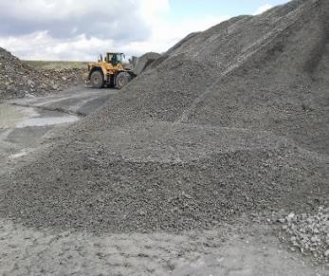
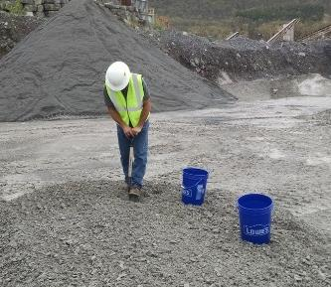
DSA Season Preparation
Sampling & Testing
How to collect a DSA sample…
Mentally divide the flat sampling pad into four quadrants and sample equally from each quadrant. Avoid sampling within 1 foot of the pad edge and take care to avoid previous shovel holes.

Slide 26
DSA Season Preparation
Sampling & Testing
How to collect a DSA sample…
Mentally divide the flat sampling pad into four quadrants and sample equally from each quadrant. Avoid sampling within 1 foot of the pad edge and take care to avoid previous shovel holes.
Collect the samples by fully inserting a square shovel into the flat pile as vertically as possible. Roll back the shovel and lift the material off the pile slowly to avoid material rolling off the shovel.

Slide 27
DSA Season Preparation
Sampling & Testing
How to collect a DSA sample…
Mentally divide the flat sampling pad into four quadrants and sample equally from each quadrant. Avoid sampling within 1 foot of the pad edge and take care to avoid previous shovel holes.
Collect the samples by fully inserting a square shovel into the flat pile as vertically as possible. Roll back the shovel and lift the material off the pile slowly to avoid material rolling off the shovel.
After collection, confirm with the quarry that the sampling met their requirements before leaving.

Slide 28
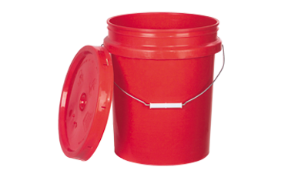
DSA Season Preparation
Sampling & Testing
How much do I need for a sample?
Proctor, gradation, plasticity
(2) ¾ full 5-gallon buckets (Minimum)
More buckets necessary depending on pile size and required tests
Too much sample is always better than not enough

Slide 29
DSA Season Preparation
Sampling & Testing
How much do I need for a sample?
One additional bucket each for Soundness
And LA Abrasion if needed
pH testing is rare and can be run with minimal material

Slide 30
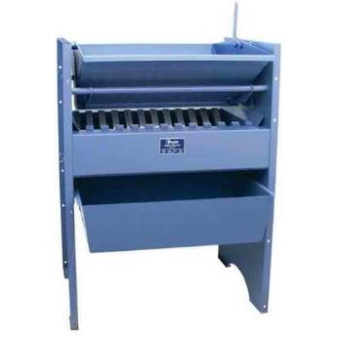
DSA Season Preparation
Sampling & Testing
How much do I need for a sample?
On large piles, there will be an extremely large sample.
Most quarries have a sample splitter in their lab
Use this to reduce the sample size to just what is needed for the testing
https://www.certifiedmtp.com/gilson-sp-1-universal-sample-splitter/?gclid=CjwKCAiAsOmABhAwEiwAEBR0ZvyrEzdrzsq8ZTSIluh2pwaglMEoDoD046GxAOYXnfkiOVTVDfTgaRoCzSEQAvD_BwE

Slide 31
DSA Season Preparation
Sampling & Testing
How much do I need for a sample?
Sometimes the lab technician will want to pull their own companion sample. (common)
They may or may not want to run the combined sample through the splitter. That is their choice. (rare)
https://www.certifiedmtp.com/gilson-sp-1-universal-sample-splitter/?gclid=CjwKCAiAsOmABhAwEiwAEBR0ZvyrEzdrzsq8ZTSIluh2pwaglMEoDoD046GxAOYXnfkiOVTVDfTgaRoCzSEQAvD_BwE

Slide 32
DSA Season Preparation
Sampling & Testing
Lab Testing
Interested in sampling your own DSA?
Let us know. We can share logistics of sample delivery or shipping, testing, etc.

Slide 33
DSA Season Preparation
Sampling & Testing
Lab Testing
Material must be tested by an independent lab (with no affiliation with the quarry or placement contractor) before delivery
The testing lab must be currently certified by AASHTO, USACE, or PennDOT
Per the SCC specification, DSA shall not be placed without pre-delivery sampling and testing. This testing is key to catching any potential problems with the aggregate BEFORE it is placed.

Slide 34
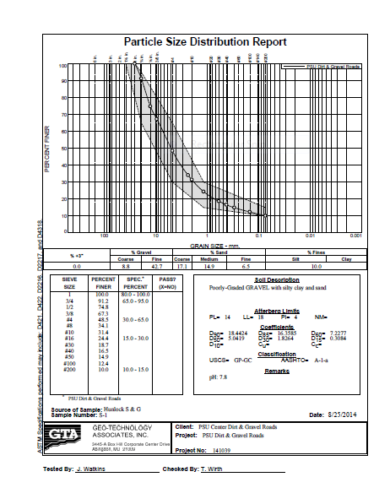
Plasticity
DSA Season Preparation
Sampling & Testing
Lab Testing
Example of lab results
The lab looks at more sieves than just those in the specification
This gives us a very clear snapshot of what is in the pile

Slide 35
Plasticity
DSA Season Preparation
Sampling & Testing
Lab Testing
Lot-dependent tests: run on every pile
Gradation (size distribution)
Plasticity (clay content)
Periodic test: Proctor (gives optimum moisture and max dry density)
Source-dependent tests: rarely needed
Toughness (LA Abrasion)
pH
Soundness (resistance to freeze/thaw)

Slide 36
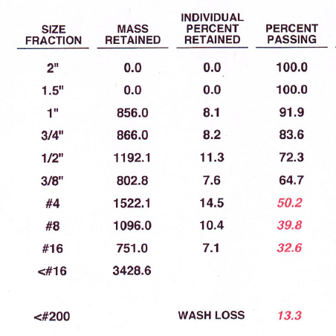
DSA Season Preparation
Sampling & Testing
What happens if a sample fails?
Gradation
If it’s close to meeting the spec., re-sample and re-test. This is a common practice.
If it fails a second time, a new pile will have to be made
50.2
39.8
The DSA spec:
Passing Sieve | Lower % | Higher %
1½ inch | 100 | -
³/4 inch | 65 | 97
#4 (¹/4 ") | 30 | 65
#16 (¹/16 ") | 15 | 30
#200(¹/200 ") | 10 | 15*
Spec: 15-30
13.3
Gradation run on every pile

Slide 37
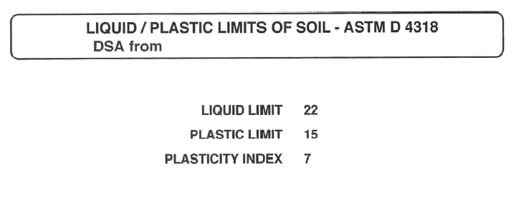
DSA Season Preparation
Sampling & Testing
What happens if a sample fails?
Plasticity
If plasticity fails, a new pile needs to be made after discussion of production methods
Some quarries may never meet this part of the spec.
Plasticity run on every pile
Maximum allowable PI is 4 (or 2 if fines are 15-17%)

Slide 38
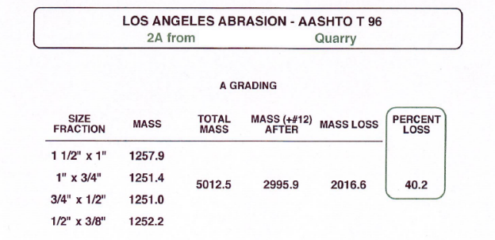
DSA Season Preparation
Sampling & Testing
What happens if a sample fails?
LA Abrasion
Find a new supplier. This property is a quality of the rock formation.
Its possible a new seam of rock at the quarry may perform better. Let quarry test it first.
Maximum allowable abrasion loss is 45%
Toughness rarely run

Slide 39
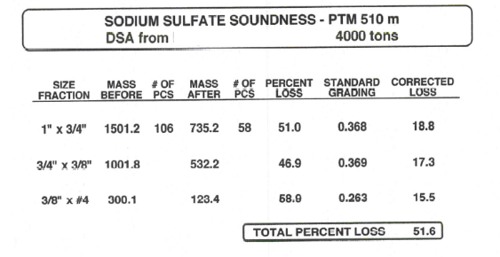
DSA Season Preparation
Sampling & Testing
What happens if a sample fails?
Soundness:
Find a new supplier. This property is a quality of the rock formation.
Its possible a new seam of rock at the quarry may perform better. Let quarry test it first.
Maximum allowable soundness loss is 20%
Soundness rarely run

Slide 40
DSA Season Preparation
Sampling & Testing
What happens if a sample fails?
pH- Find a new supplier (one and done in most cases).
DSA SPEC: pH between 6 and 12.45
pH rarely run

Slide 41
DSA Season Preparation
DSA Clearinghouse
DSA Clearinghouse
PURPOSE
Provide a central point of contact between conservation districts and DSA suppliers.
Provide DSA testing services when needed.
Provide DSA education to conservation districts.
Provide a central repository of DSA testing and placement data for the state to serve as a reference and avoid duplication of testing.

Slide 42
DSA Season Preparation
DSA Clearinghouse
DSA Clearinghouse
DISTRICT RESPONSIBILITY
Contact the Center for Dirt and Gravel Road Studies when a potential DSA supplier is chosen, at least 30 days before desired placement date.
Notification can be made utilizing the DSA Purchase Notification Form, provided in Appendix D in the DSA Handbook, or on the Center’s website.
If districts choose to sample their own DSA, they should share testing results with the Center in order to provide a more comprehensive statewide database and avoid duplicate testing.
30 day notice is a minimum
Notify as soon as supplier is known
Supplier needs time to make entire pile
Time for sampling
Time for testing
Potential time for failures

Slide 43
DSA Season Preparation
DSA Clearinghouse
DSA Clearinghouse
DISTRICT RESPONSIBILITY
Contact the Center for Dirt and Gravel Road Studies when a potential DSA supplier is chosen, at least 30 days before desired placement date.
Notification can be made utilizing the DSA Purchase Notification Form, provided in Appendix D in the DSA Handbook, or on the Center’s website.
If districts choose to sample their own DSA, they should share testing results with the Center in order to provide a more comprehensive statewide database and avoid duplicate testing.

Slide 44
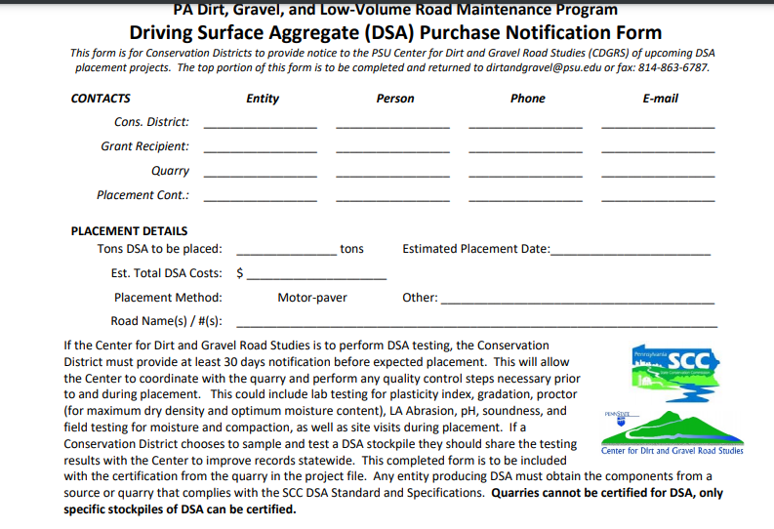
DSA Season Preparation
DSA Clearinghouse
DSA Notification: CD portion
dcm35@psu.edu
Notes:
New email coming…DO NOT Fax until further notice
Email Dave Morrison dcm35@psu.edu

Slide 45
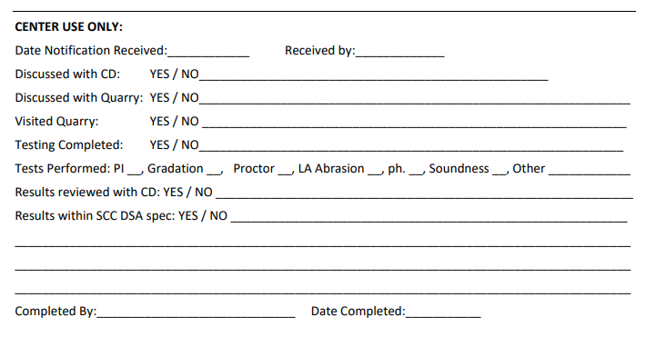
DSA Season Preparation
DSA Clearinghouse
DSA Notification: CDGRS portion
Notes:
You should share these results with the quarry or tell us to share them. As far as we are concerned these lab tests are property of the CD/SCC and are privileged info

Slide 46
DSA Season Preparation
DSA Clearinghouse
DSA Clearinghouse
POTENTIAL SERVICES PROVIDED
Visiting and talking with quarries and CD to ensure they understand the DSA requirements.
Collecting samples from the quarry and performing testing to ensure DSA meets all material requirements before delivery and placement.
Providing contractor education on DSA.
Providing on-site assistance during DSA placement.
Education of Conservation District staff on DSA sampling, testing, and placement.
Troubleshooting.
Identifying potential DSA suppliers if you are having trouble finding DSA in your area
Get on the schedule as far out as possible.

Slide 47
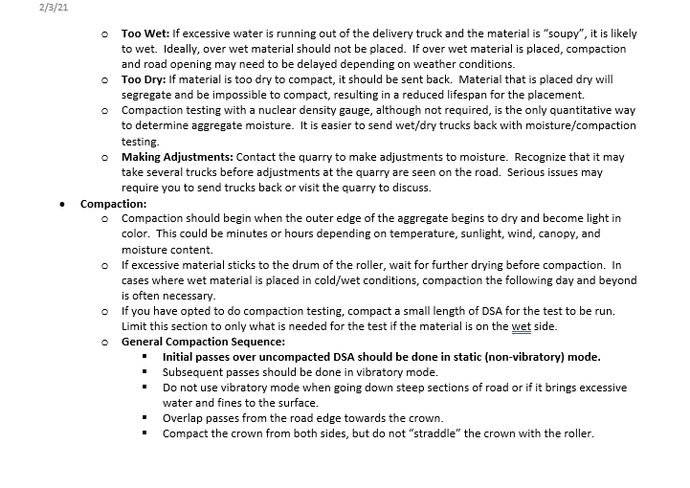
NEW DSA Project Checklist/Walkthrough for CDs
3-pages
Posted online

Slide 48
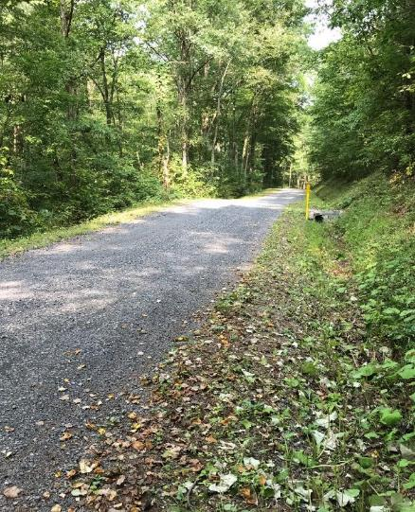
DSA Season Preparation
DSA Season Prep
What is the DSA Project Checklist?
Pre-application
Pre-Project logistics
~30 days prior to placement
Final Preparations
DSA Placement

Slide 49
DSA Season Preparation
DSA Project Checklist
What is the DSA Project Checklist?
A guide for CD’s to plan and implement successful DSA placements as part of a DGLVR project
Informational only: no NEW required actions.
Any existing required actions are noted as such

Slide 50
DSA Season Preparation
DSA Season Prep
What is the DSA Project Checklist?
Pre-application
Pre-Project logistics
~30 days prior to placement
Final Preparations
DSA Placement

Slide 51
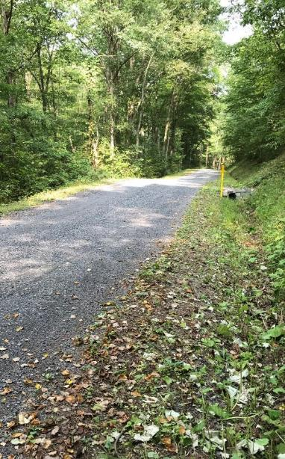
DSA Season Preparation
DSA Project Checklist – Pre-application
Drainage and base first!!
DSA is not required on every project
Program focus is on long-term road and environmental improvements
Projects are required to address any drainage, road base, and environmental issues prior to DSA placement

Slide 52
DSA Season Preparation
DSA Project Checklist – Pre-application
Meet with the municipality
Suggested An on-site pre-application meeting with the municipality helps to ensure a quality application
Discussing Topics:
Timing: Application, drainage work, placement date(s), placement season, time for production and testing, etc
Details: Project length, DSA depth, width, tonnage, available budget, paver, etc
Potential suppliers & placement contractors
Road preparation: Drainage, surface prep (fill/grading), etc
Compaction: Will compaction testing be utilized?

Slide 53
DSA Season Preparation
DSA Project Checklist – Pre-application
Material Calculation
The formula below is a general guide to the amount of DSA needed based on width, depth, and length of placement.
How much DSA should I order?
DSA Road Road
Needed = Width x Length x
(tons) (ft) (ft)
0.04 for 8” loose
compacted to 6”
0.03 for 6” loose
compacted to 4½”
Notes:
DSA is the icing on the cake.

Slide 54
DSA Season Preparation
DSA Season Prep
What is the DSA Project Checklist?
Pre-application
Pre-Project logistics
~30 days prior to placement
Final Preparations
DSA Placement

Slide 55
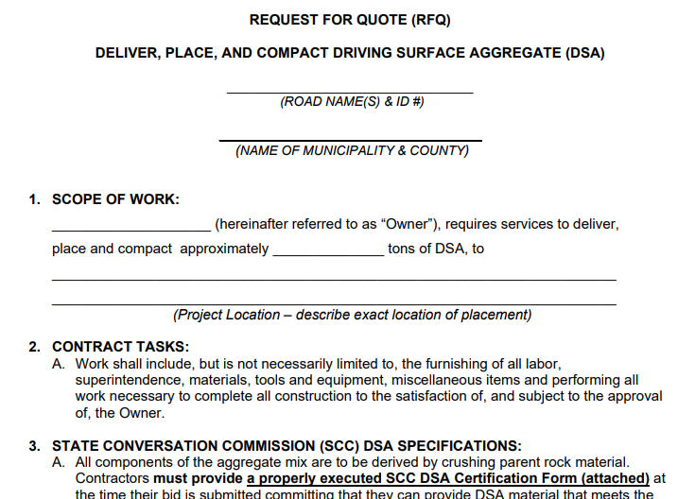
DSA Season Preparation
DSA Checklist – Pre-project logistics
Bidding
Municipalities should follow their standard purchasing, bidding, and payment procedures.
Prevailing wage applies to contracted labor when the total value of the project exceeds $25,000
An editable DSA Request for Quote is available on the Center’s website if needed

Slide 56
DSA Season Preparation
RFQ
RFQ: use is optional: editable version on CDGRS website

Slide 57
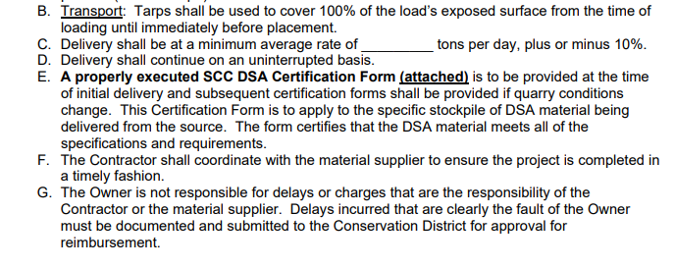
DSA Season Preparation
RFQ
RFQ: use is optional: editable version on CDGRS website
Can specify daily tonnage
Check with local suppliers and haulers to see what is reasonable in your locale.
You don’t want to create a situation where you receive zero bids because of your contract specs.

Slide 58
DSA Season Preparation
RFQ
RFQ
The form can be used to specify paver placement or tailgating jobs.
You could even specify preferred paver type (track-mounted, minimum horsepower, width, etc.)
Check with local contractors for equipment availability to make sure you get bids!
You could also add provisions to this RFQ (For example – Paving crew must consist of 4 crew members; three to operate the paver and one for the roller)

Slide 59
DSA Season Preparation
RFQ
RFQ
Specify contract term to lock in prices
Consider including roads signs and flaggers if needed
Specify acceptable time frame for completion of work. (Contractors often want to place DSA too early or too late in the year to avoid “asphalt season”)

Slide 60
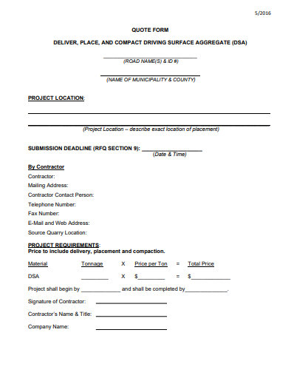
DSA Season Preparation
RFQ
RFQ
The RFQ ends with a simple 1-page quote form for the contractor to return

Slide 61
DSA Season Preparation
DSA Checklist – Pre-project logistics
Once placement contractor and supplier are determined…
Schedule target placement date, and a potential back-up date in case of delays. Allow as much time as possible for quarry to make material, sampling and testing. (Sampling delays, lab back-ups/failures)
DSA Sampling: Quarries do not have blanket approval to supply DSA. The full pile of DSA to be used on the job is required to be sampled and tested by a third-party lab prior to placement
The pile is approved once passing lab results are obtained

Slide 62
DSA Season Preparation
DSA Checklist – Pre-project logistics
DSA Sampling
CD Sampling:
CD’s may sample DSA for their projects
Contact CDGRS for information, training, or details on how to sample, where to send it, or how to interpret results
Other entities may also be contracted for sampling
Admin/Edu funds can be used to cover these costs, or the municipality can pay and be reimbursed through the grant
CDGRS Sampling:
Contact the CDGRS DSA Clearinghouse to schedule required sampling and testing of pile at least 30 days prior to desired placement date.
Cost of initial sampling and testing services will be covered by CDGRS
Notes:
Already covered, but mention engineer sampling

Slide 63
DSA Season Preparation
DSA Season Prep
What is the DSA Project Checklist?
Pre-application
Pre-Project logistics
~30 days prior to placement
Final Preparations
DSA Placement

Slide 64
DSA Season Preparation
DSA Checklist – 30 Days Out
Pre-Construction Meeting
Highly Recommended An on-site pre-construction meeting with the placement contractor and the municipality helps to ensure a quality project by getting everyone on the same page

Slide 65
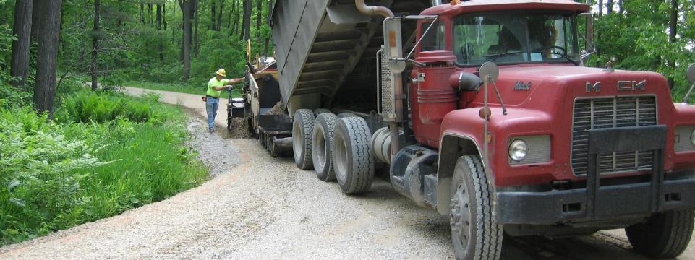
DSA Season Preparation
DSA Checklist – 30 Days Out
Pre-Construction Meeting Discussion Points
Trucking Logistics:
Truck routes
Number of trucks
Staging areas (material & equipment)
Turnaround for trucks to reduce backup length.

Slide 66
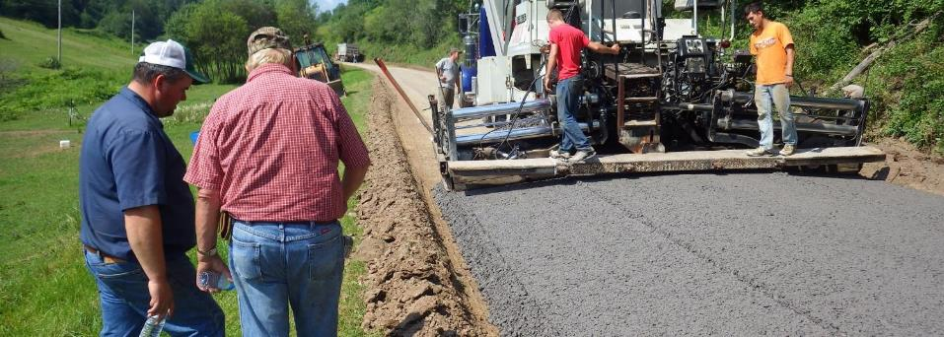
DSA Season Preparation
DSA Checklist – 30 Days Out
Pre-Construction Meeting Discussion Points
Final Road Preparation
Grading and establishing crown cross-slope (week of placement)
Establishment of paving notches and keys (just prior to placement)

Slide 67
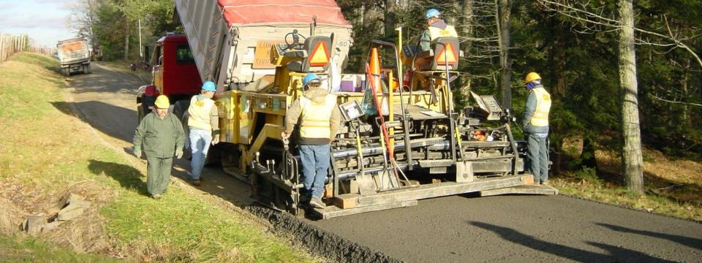
DSA Season Preparation
DSA Checklist – 30 Days Out
Pre-Construction Meeting Discussion Points
Equipment
Ensure paver and roller to be used meet Program and contract requirements
Paving must be done in one pass (full road width) and compacted with a minimum 10-ton vibratory roller

Slide 68
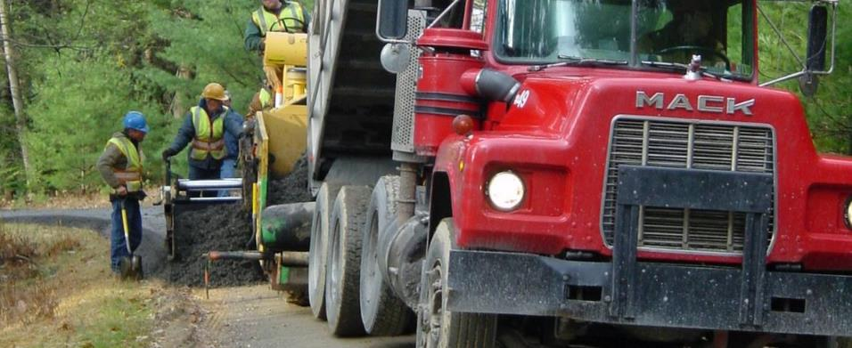
DSA Season Preparation
DSA Checklist – 30 Days Out
Pre-Construction Meeting Discussion Points
Material Slips
Define who will be collecting material slips from delivery trucks
Material slips should be retained in project file

Slide 69
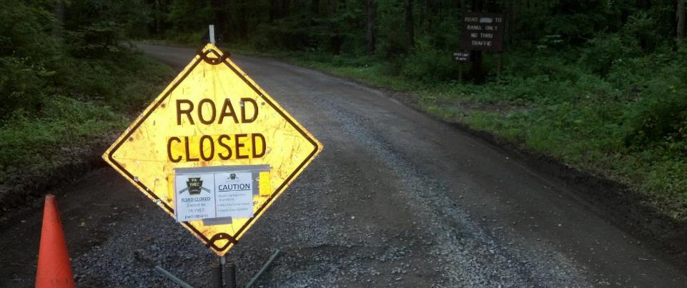
DSA Season Preparation
DSA Checklist – 30 Days Out
Pre-Construction Meeting Discussion Points
Road Logistics
Potential road closures
Need for road construction/safety signs?
Need for flaggers?

Slide 70
DSA Season Preparation
DSA Checklist – 30 Days Out
Pre-Construction Meeting Discussion Points
Compaction Testing (optional)
Discuss use of third party or contractor compaction testing if desired
Measures actual moisture content of material
helps for sending wet/dry trucks back
Also measures percent compaction

Slide 71
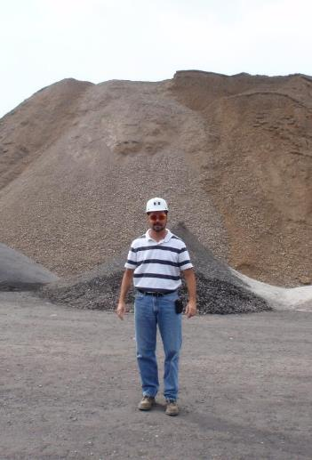
DSA Season Preparation
DSA Checklist – 30 Days Out
Quarry/Supplier Meeting
Highly Recommended Consider meeting with quarry or supplier during production and just before placement
Make sure production is on schedule and amount is adequate for sampling/completion of project
Ensure quarry understanding of..
SCC DSA specification
Importance of adequate mixing
Importance of proper moisture
Consider talking to loader operator as well as QC technician

Slide 72
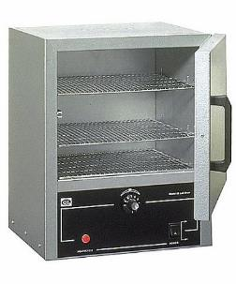
DSA Season Preparation
DSA Checklist – 30 Days Out
Quarry/Supplier Meeting
Highly Recommended Consider meeting with quarry or supplier during production and just before placement
Make sure production is on schedule and amount is adequate for sampling/completion of project
Ensure quarry understanding of..
SCC DSA specification
Importance of adequate mixing
Importance of proper moisture
Consider talking to loader operator as well as QC technician
Make sure quarry is doing moisture testing to monitor pile
Reminder about material cert. on first load delivered

Slide 73
DSA Season Preparation
DSA Season Prep
What is the DSA Project Checklist?
Pre-application
Pre-Project logistics
~30 days prior to placement
Final Preparations
DSA Placement

Slide 74
DSA Season Preparation
DSA Checklist – Final Preparations
Week of Placement
Review final logistics with municipality, contractor, supplier, trucking provider to make sure all are on the same page
Road prep (crown, base, drainage)
Truck routes (power lines)
Staging areas
Availability of equipment and personnel

Slide 75
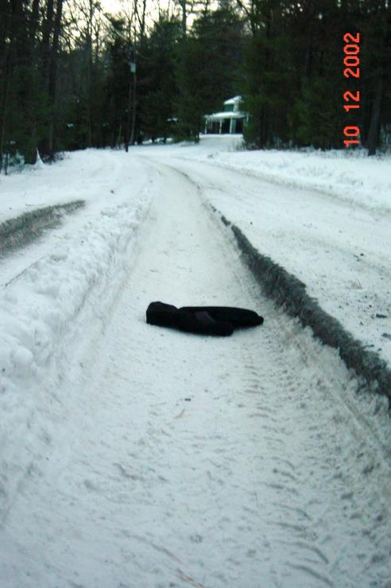
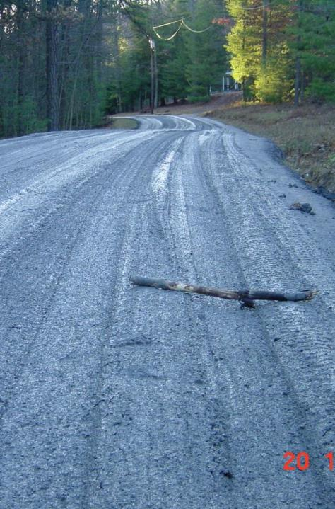
DSA Season Preparation
DSA Checklist – Final Preparations
Week of Placement: Check the Weather
Weather and Cancellations:
The DSA specification states: “If freezing temperatures or precipitation are forecast that may cause the material to freeze, or prevent the material from drying out, placement shall be postponed at the discretion of the road owner, Conservation District, or aggregate supplier.”.
It will often be up to the Conservation District to make calls to postpone due to weather.

Slide 76
DSA Season Preparation
DSA Checklist – Final Preparations
Day before and Day of Placement
Contact municipality, contractor, & quarry to verify placement plan
Include engineering tech performing compaction testing (if done). Their experience level can vary.
One last check in can eliminate problems
Use discussion points from above to tie up any loose ends
Check road for crown, keys, notches, etc.
Irregularities in the road base will reflect to the surface

Slide 77
DSA Season Preparation
DSA Season Prep
What is the DSA Project Checklist?
Pre-application
Pre-Project logistics
~30 days prior to placement
Final Preparations
DSA Placement

Slide 78
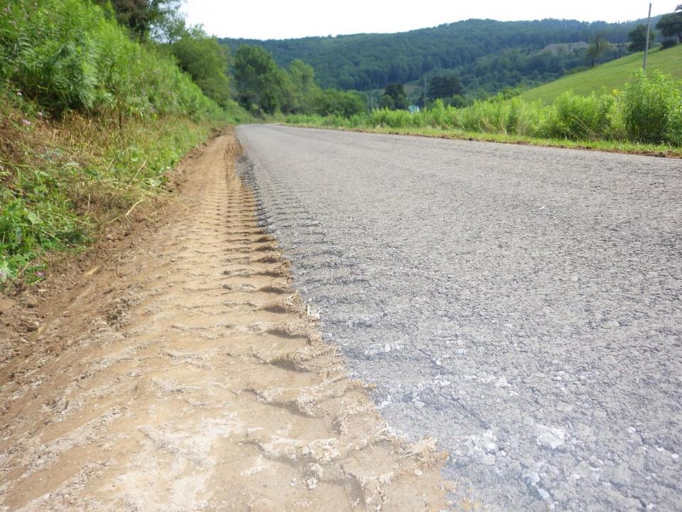
DSA Season Preparation
DSA Checklist – Placement
Day of Placement
Are transport trucks tarped as required?
Did the first load come with a certification?
Required
Who is collecting load slips?

Slide 79
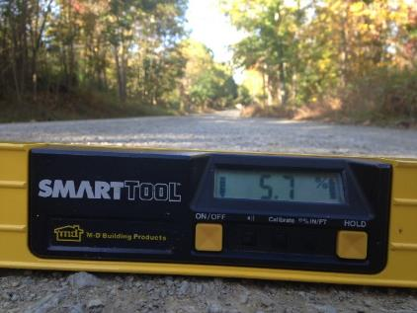
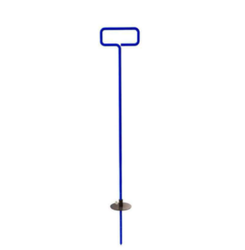
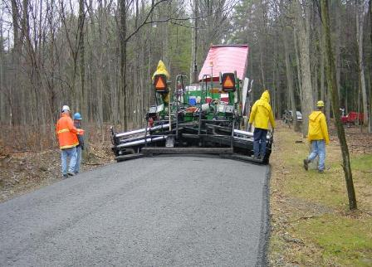
DSA Season Preparation
DSA Checklist – Placement
During placement
Continuously monitor…
Placement depth, width, & crown/cross-slope
It may take several hundred feet to get the paver “dialed in”
Yield?

Slide 80
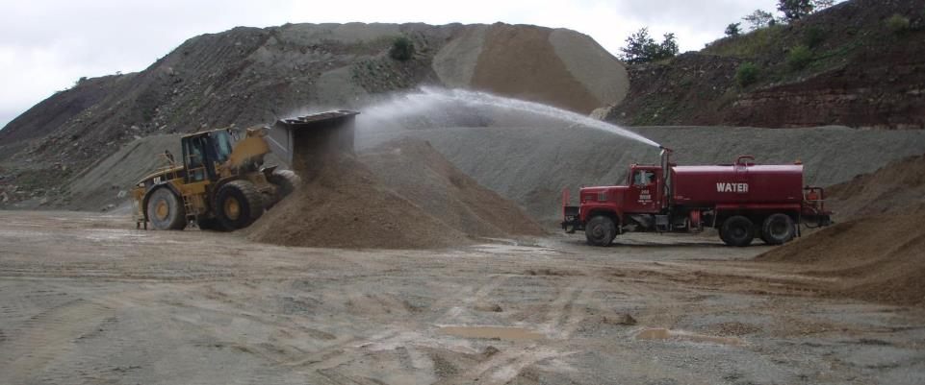
DSA Season Preparation
DSA Checklist – Placement
During placement
Continuously monitor…
Moisture, adequate mixing of material
Be alert for changes in consistency
Variations can happen throughout the day

Slide 81
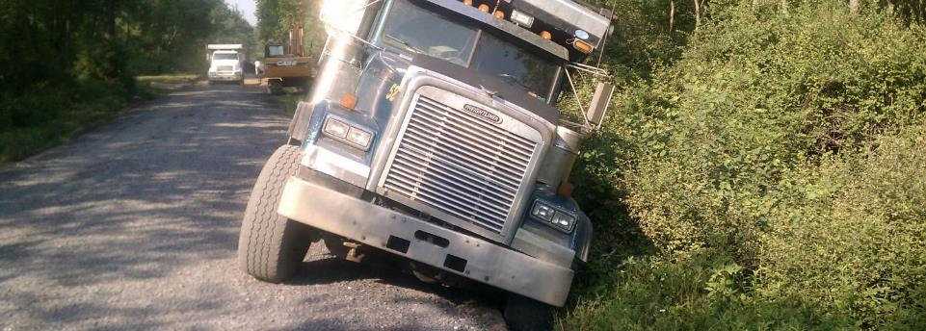
DSA Season Preparation
DSA Checklist – Placement
During placement
Continuously monitor…
Trucking logistics
# of trucks
Power lines
Turnarounds, routes, flaggers, etc.

Slide 82
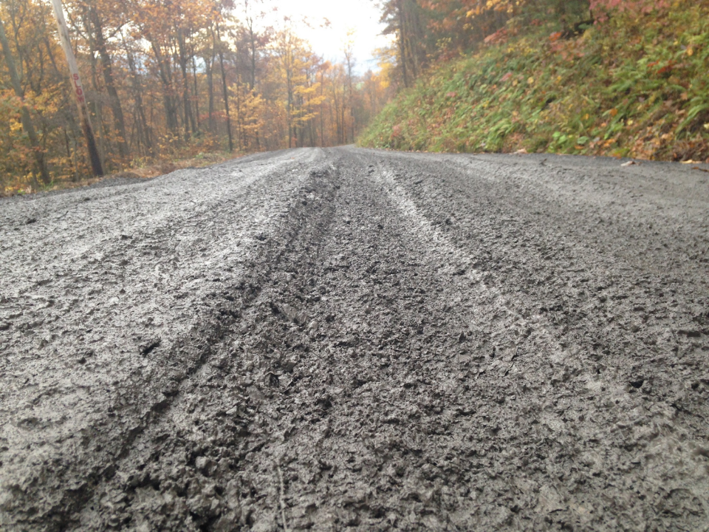
DSA Season Preparation
DSA Checklist – Placement
Water pouring from truck beds
In its wettest state, DSA should look like very low-slump concrete, better if it’s a bit drier than that
Too wet

Slide 83
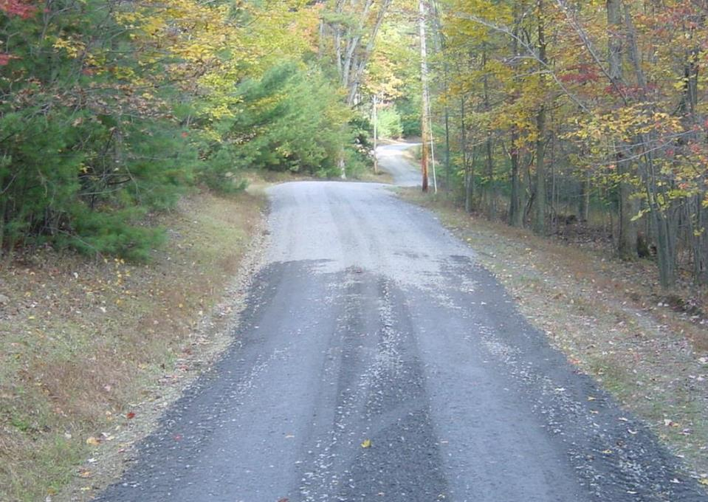
DSA Season Preparation
DSA Checklist – Placement
Too dry
Will not compact
Will come apart quickly

Slide 84
DSA Season Preparation
DSA Checklist – Placement
During placement
Making adjustments…
Contact quarry to make adjustments.
Use dump truck radios in remote areas
Note time of change request and compare to load time on tickets
Send back trucks if necessary
Once its down on the road surface, its more difficult to fix
Visit quarry if necessary
Unforeseen problems like personnel/equipment/moisture issues

Slide 85
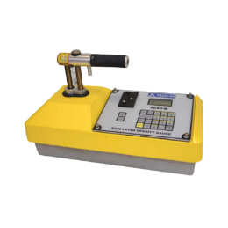
DSA Season Preparation
DSA Checklist – Placement
During placement
Compaction testing…
Utilizing a nuclear density gauge
Not required by Program
Quantitative way to quickly determine
Density (% compaction)
Moisture content – to compare to target moisture
Having this data can make it easier to send unacceptable loads back to the source
https://www.measur.ca/product/4640-b-surface-thin-layer-density-gauge/

Slide 86
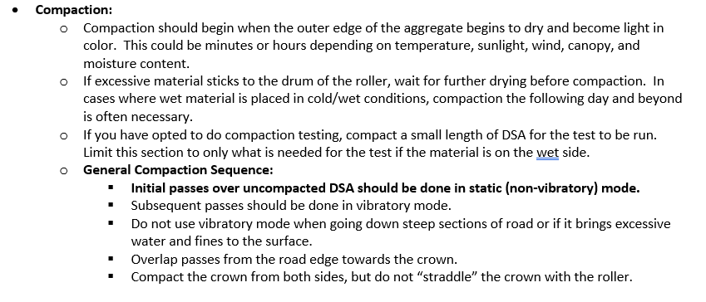
See DSA Handbook or Full DSA Webinar for details
COMPACTION

Slide 87
DSA Season Preparation
DSA Checklist – Placement
Proposed DSA Spec Changes
Planning to increase fine spec from “10-15” to “11-15”.
Details and reasons presented in 2/2/23 webinar.
Met with PA Aggregate and Concrete Association and presented at their regional meeting.
Potential approval at May SCC meeting.

Slide 88
Thank You! Questions?
Reminder: NEW DSA Project Checklist for CDs
3-pages
Posted online
30 day notice is a minimum
Notify as soon as supplier is known
Supplier needs time to make entire pile
Time for sampling
Time for testing
Potential time for failures
Notes:
Add contact info

Slide 89
7) Additional Policies
Policies that apply to certain circumstances:
Stream Crossing Replacement
Driving Surface Aggregate
Paved LVR-Specific Policies
Full Depth Reclamation
DGLVR Administrative Manual
Introduction
SCC Role
Conservation District Role
Quality Assurance Board Role
Applicant Role
Center for Dirt and Gravel Roads
Additional Policies
Stream crossing updates
DSA updates
Fill Policy update
Sealed surface update
8) Permits and Other Requirements
Appendices

Slide 90
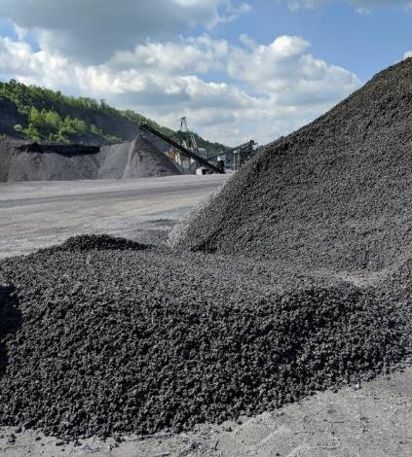
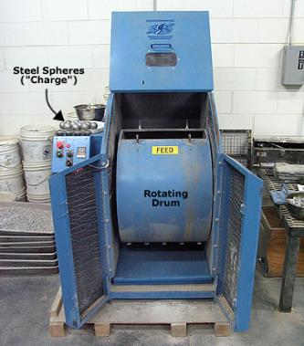
Proposed Spec. Changes
DSA Standard updates
Abrasion Resistance: The loss of mass (LA Abrasion) shall be less than 40% 45%.

Slide 91
DSA Standard updates
Placement: The use of a motorized paver is highly recommended for all DSA placements. For projects and/or contracts including over 1,000 500 tons of DSA, a motorized paver is required. Paver must be in good working order and be of sufficient horsepower to be capable of pushing loaded trucks uphill while placing material in a full width pass at the required minimum depth stipulated in the contract. If the total tonnage is less than 500 tons the DSA must be paver placed or placed by tailgating and groomed with a road grader equipped with a carbide tipped grader blade. A track mounted paver is preferred. DSA shall be placed in a single pass across the width of the road. The crown or cross slope must range from ½ to ¾ inch per foot (4-6%). Material shall be placed in a single 6-8 inch loose lift or layer. This lift is to be compacted with a vibratory roller as specified in Section V - Compaction. If freezing temperatures or precipitation are forecast that may cause the material to freeze, or prevent the material from drying out, placement shall be postponed at the discretion of the road owner, Conservation District, or aggregate supplier. DSA shall not be placed before April 1st or after September 30th unless otherwise approved by the SCC.

Slide 92
RFQ updated (not policy)
updated DSA Specification language incorporated
Clarifications of which parts can be edited vs which parts are required/in the specification
added: Roller to be:
Double drum roller equipped with functional spray bars and scrapers.
Single drum dirt roller <single drum not preferred but may be needed on sites with steep banks or hills – edit RFQ to specify allowed rollers>).
Added: Equipment must be on-site to cut paving notches and/or repair damaged ditches or road sections (e.g., skid steer, backhoe).

Slide 93
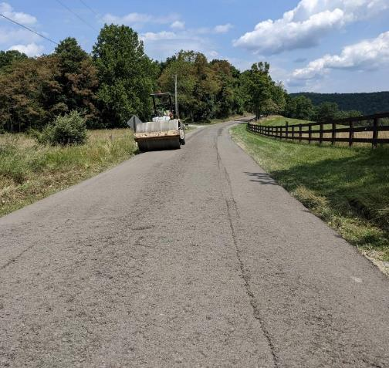
Fill Policy update
Unchanged:
Driving surface aggregate meeting the Commission’s specification is the only approved road surface material that may be purchased (for DGR projects) with Program funds.

Slide 94
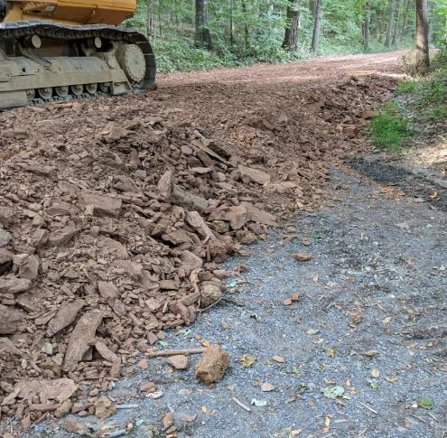
Potential Fill Policy update
The only exception to this is on road fill projects. Road fill projects are defined as projects which install an average compacted thickness of 12-inches or more of fill material, not including the driving surface, to allow for proper drainage and/or strengthen the existing road base.

Slide 95
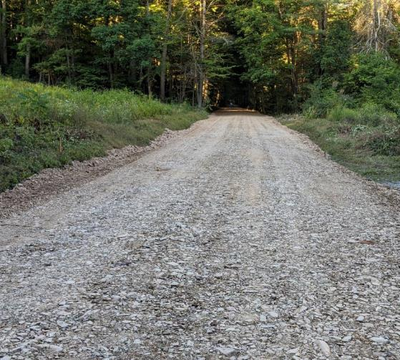
Potential Fill Policy update
Road fill projects must be capped with DSA or an alternative aggregate at a minimum depth of 6-inches. Shale or bank-run gravel may not be used as the final driving surface. This exception is not meant to replace DSA with fill.
Shale is not an eligible driving surface

Slide 96
Potential Fill Policy update
Driving surface aggregate meeting the Commission’s specification is the only approved road surface material that may be purchased (for DGR projects) with Program funds. The only exception to this is on road fill projects. Road fill projects are defined as projects which install an average compacted thickness of 12-inches or more of fill material, not including the driving surface, to allow for proper drainage and/or strengthen the existing road base. Road fill projects must be capped with DSA or an alternative aggregate at a minimum depth of 6-inches. Shale or bank-run gravel may not be used as the final driving surface. This exception is not meant to replace DSA with fill.

