Slide 1
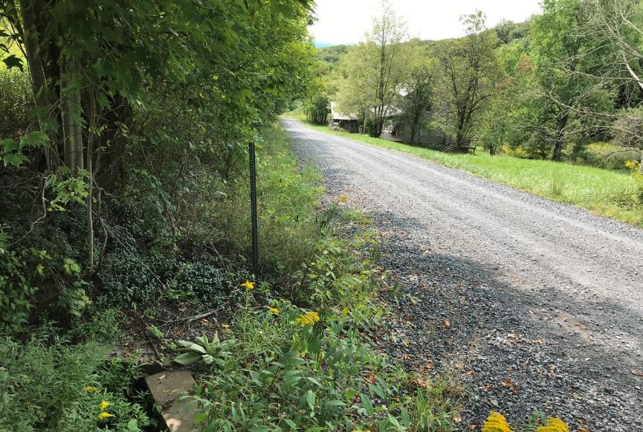
Dirt Gravel and Low Volume Road Program
WEBINAR
DSA Season
Dave Morrison- CDGRS
Steve Bloser - CDGRS
www.dirtandgravelroads.org
3/21/24 Starts at 9am
If you are reading this, then you are successfully seeing the webinar video. Webinar audio should be automatic through your computer (or click “join audio”), and options can be accessed in the “audio options” button on the bottom left. If your computer audio is not working, you can listen on your phone by dialing 646-876-9923.
Audio via Phone if needed: 646-876-9923
Webinar ID: 987 5482 6192

Slide 2
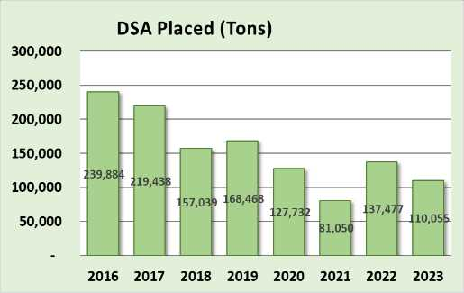
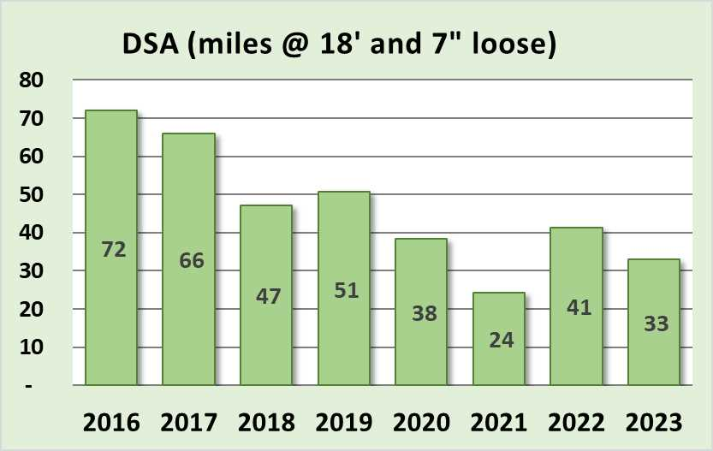
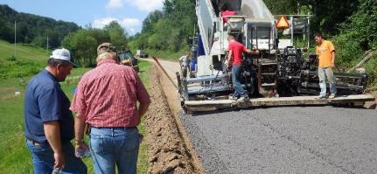
Driving Surface Aggregate
Placement Season April through September
110,000 tons placed in 2023 (SCC funds only)
@ $40 a ton, that’s $4.4 Million or roughly 25% of overall DGR roject spending

Slide 3
DSA Season Prep
Purpose
Primer and reminder for DSA placement season starting April 1
Discussion of new DSA Project Checklist

Slide 4
DSA Season Prep
RESOURCES:
DSA Certification: 2 page DSA certification form
DSA Specification: Material & Placement specs
DSA Handbook: More in depth DSA explanation
- Includes Request for Quote
- more details to come
All can be found on the CDGRS website including this webinar.
Notes:
In your course book are the resources noted here (on screen). There is also an Aggregate Handbook available which thoroughly covers DSA.

Slide 5
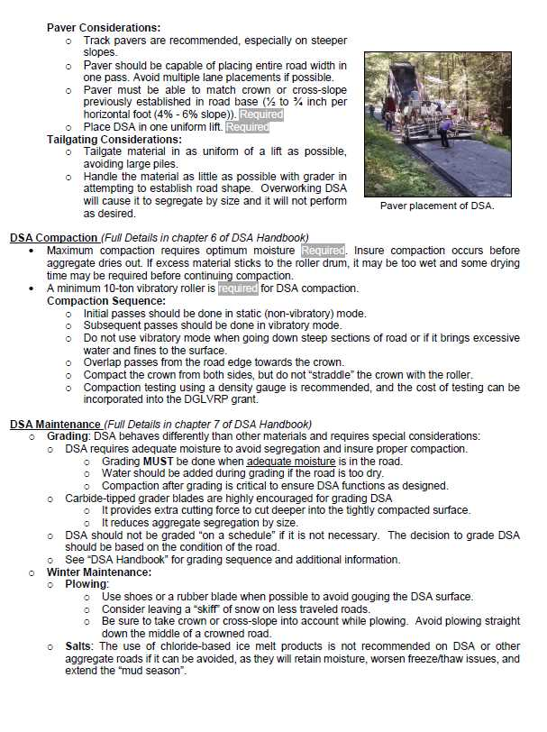
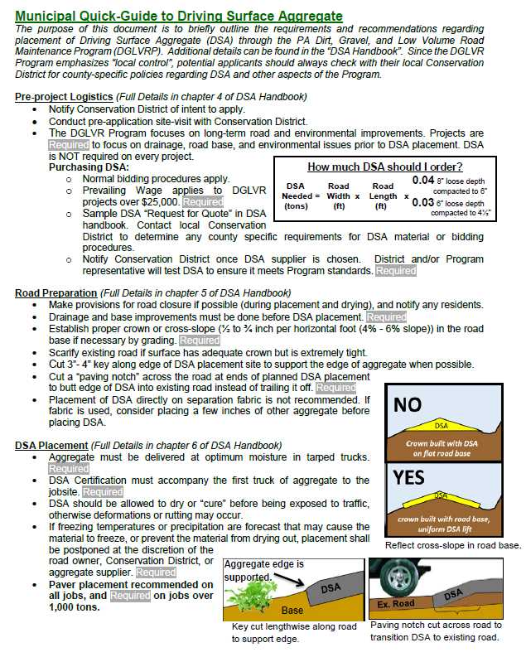
DSA Season Prep
Resources
DSA RESOURCES:
DSA Handbook: More in depth DSA information
includes Request for Quote
www.dirtandgravelroads.org
Municipal DSA Quick Guide:
Questions?
Notes:
In your course book are the resources noted here (on screen). There is also an Aggregate Handbook available which thoroughly covers DSA.

Slide 6
DSA Season Preparation
Reminder: 2023 DSA Changes:
Material
Slight gradation change. #200 11%-15% (17% if PI <2)
Placement
Placement Season April 1 through September 30 unless approved by SCC – NO GUARANTEE!
Paver must place DSA in single pass (paver still not required for jobs less than 500 tons)

Slide 7
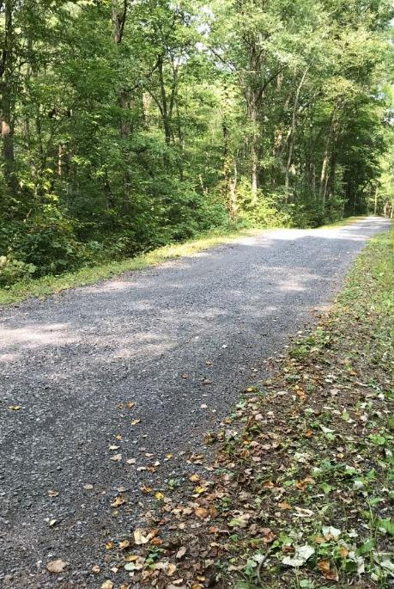
DSA Season Preparation
DSA Use
DSA Use and Overuse
When DSA is used as part of a project, it should be the very last phase of the project.
DSA alone does not constitute a comprehensive DGLVR Program project.

Slide 8
DSA Season Preparation
Sampling & Testing
Purchasing DSA with DGLVR Funds:
DSA must be independently sampled and tested
30-day notice time required for testing if CDGRS is doing the sampling.
Help from Center is also available for testing or placement on request.

Slide 9
DSA Season Preparation
Sampling & Testing
Purchasing DSA with DGLVR Funds:
DSA must be independently sampled and tested
30-day notice time required for testing if CDGRS is doing the sampling.
Help from Center is also available for testing or placement on request.
30 day notice is a minimum
Notify as soon as supplier is known
Supplier needs time to make entire pile
Time for sampling
Time for testing
Potential time for failures

Slide 10
DSA Season Preparation
Sampling & Testing
How to sample a DSA pile
Sampling and testing must be done on the (entire) specific pile that is supplying your project

Slide 11
DSA Season Preparation
Sampling & Testing
How to sample a DSA pile
Sampling and testing must be done on the (entire) specific pile that is supplying your project
Sample the full pile required for your project, if your project requires 5,000 tons, it must be a 5,000-ton pile.
Quarries must produce DSA piles in advance of delivery in order to allow time for sampling and testing
Labs can get backlogged in construction season

Slide 12
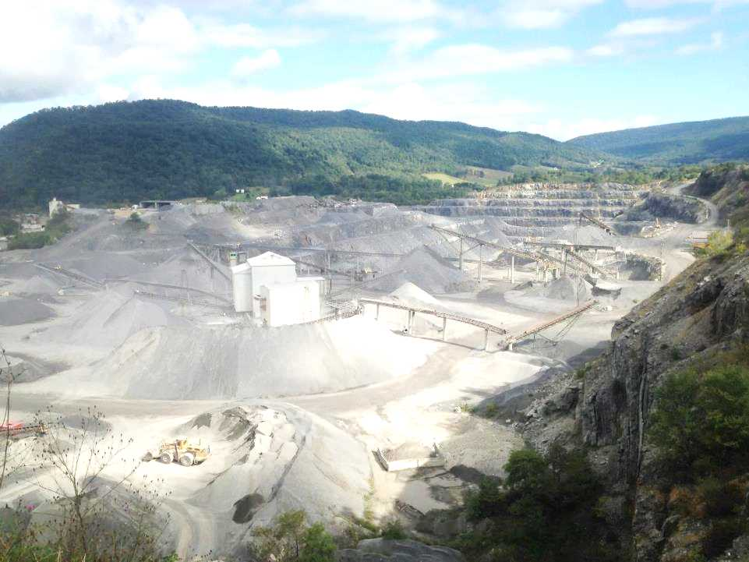
DSA Season Preparation
Sampling & Testing
Can a conservation district pull their own sample?
Yes. If a CD pulls their own sample, they must also pay for the lab testing.
The costs of testing can be incorporated into the project cost or paid out of admin/education funds
Sampling and testing can also be done, free of charge, by the Center’s DSA Clearinghouse (more details on that later)

Slide 13
DSA Season Preparation
Sampling & Testing
How to collect a DSA sample…
Contact the Center and we will train at the quarry on how to properly pull a sample.
Not as simple as just putting material in a bucket!!!

Slide 14
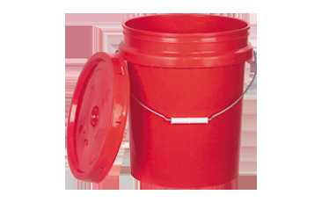
DSA Season Preparation
Sampling & Testing
How much do I need for a sample?
Proctor, gradation, plasticity
(2) ¾ full 5-gallon buckets (Minimum)
More buckets necessary depending on pile size and required tests
Too much sample is always better than not enough

Slide 15
DSA Season Preparation
Sampling & Testing
How much do I need for a sample?
One additional bucket each for Soundness
And LA Abrasion if needed
pH testing is rare and can be run with minimal material

Slide 16
DSA Season Preparation
Sampling & Testing
Lab Testing
Interested in sampling your own DSA?
Let us know. We can share logistics of sample delivery or shipping, testing, etc.

Slide 17
DSA Season Preparation
Sampling & Testing
Lab Testing
Material must be tested by an independent lab (with no affiliation with the quarry or placement contractor) before delivery
The testing lab must be currently certified by AASHTO or PennDOT
Per the SCC specification, DSA shall not be placed without pre-delivery sampling and testing. This testing is key to catching any potential problems with the aggregate BEFORE it is placed.

Slide 18
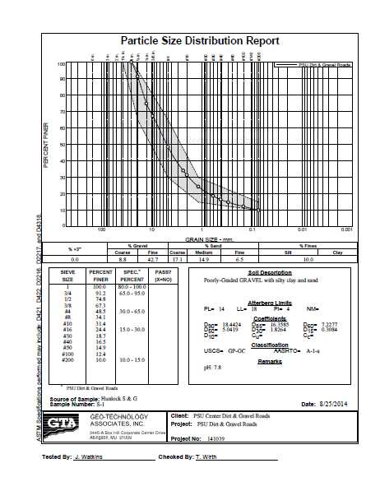
Plasticity
DSA Season Preparation
Sampling & Testing
Lab Testing
Example of lab results
The lab looks at more sieves than just those in the specification
This gives us a very clear snapshot of what is in the pile

Slide 19
DSA Season Preparation
Sampling & Testing
Lab Testing
Lot-dependent tests: run on every pile
Gradation (size distribution)
Plasticity (clay content)
Periodic test: Proctor (gives optimum moisture and max dry density)
Source-dependent tests: rarely needed
Toughness (LA Abrasion)
pH
Soundness (resistance to freeze/thaw)

Slide 20
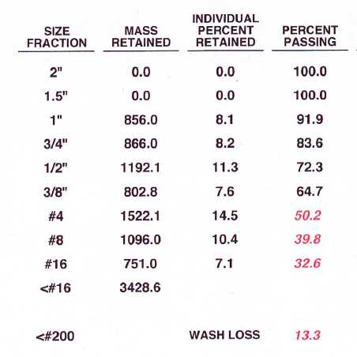
DSA Season Preparation
Sampling & Testing
What happens if a sample fails?
Gradation
If it’s close to meeting the spec., re-sample and re-test. This is a common practice.
If it fails a second time, a new pile will have to be made
50.2
39.8
The DSA spec:
Passing Sieve | Lower % | Higher %
1½ inch | 100 | -
³/4 inch | 65 | 97
#4 (¹/4 ") | 30 | 65
#16 (¹/16 ") | 15 | 30
#200(¹/200 ") | 11 | 15*
Spec: 15-30
13.3
Gradation run on every pile

Slide 21
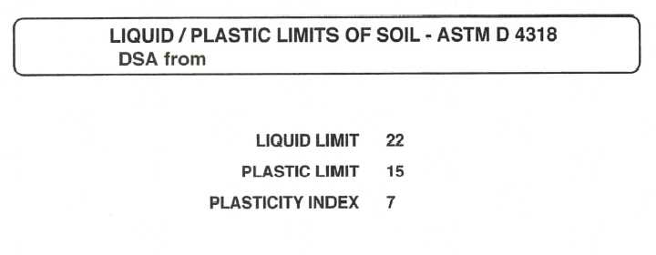
DSA Season Preparation
Sampling & Testing
What happens if a sample fails?
Plasticity
If plasticity fails, a new pile needs to be made after discussion of production methods
Some quarries may never meet this part of the spec.
Plasticity run on every pile
Maximum allowable PI is 4 (or 2 if fines are 15-17%)

Slide 22
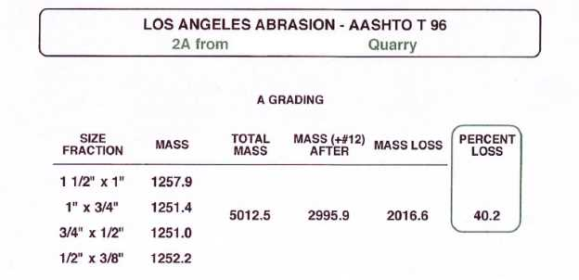
DSA Season Preparation
Sampling & Testing
What happens if a sample fails?
LA Abrasion
Find a new supplier. This property is a quality of the rock formation.
Its possible a new seam of rock at the quarry may perform better. Let quarry test it first.
Maximum allowable abrasion loss is 45%
Toughness rarely run

Slide 23
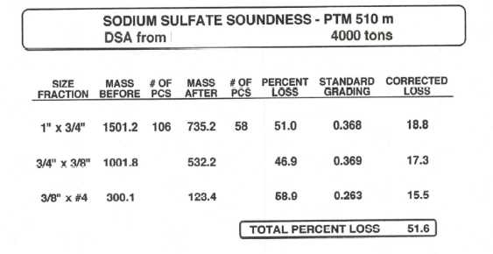
DSA Season Preparation
Sampling & Testing
What happens if a sample fails?
Soundness:
Find a new supplier. This property is a quality of the rock formation.
Its possible a new seam of rock at the quarry may perform better. Let quarry test it first.
Maximum allowable soundness loss is 20%
Soundness rarely run

Slide 24
DSA Season Preparation
Sampling & Testing
What happens if a sample fails?
pH- Find a new supplier (one and done in most cases).
DSA SPEC: pH between 6 and 12.45
pH rarely run

Slide 25
DSA Season Preparation
DSA Clearinghouse
DSA Clearinghouse
PURPOSE
Provide a central point of contact between conservation districts and DSA suppliers.
Provide DSA testing services when needed.
Provide DSA education to conservation districts.
Provide a central repository of DSA testing and placement data for the state to serve as a reference and avoid duplication of testing.

Slide 26
DSA Season Preparation
DSA Clearinghouse
DSA Clearinghouse
DISTRICT RESPONSIBILITY
Contact the Center for Dirt and Gravel Road Studies when a potential DSA supplier is chosen, at least 30 days before desired placement date.
Notification can be made utilizing the DSA Purchase Notification Form, provided in Appendix D in the DSA Handbook, or on the Center’s website.
If districts choose to sample their own DSA, they should share testing results with the Center in order to provide a more comprehensive statewide database and avoid duplicate testing.

Slide 27
DSA Season Preparation
DSA Clearinghouse
DSA Clearinghouse
DISTRICT RESPONSIBILITY
Contact the Center for Dirt and Gravel Road Studies when a potential DSA supplier is chosen, at least 30 days before desired placement date.
Notification can be made utilizing the DSA Purchase Notification Form, provided in Appendix D in the DSA Handbook, or on the Center’s website.
If districts choose to sample their own DSA, they should share testing results with the Center in order to provide a more comprehensive statewide database and avoid duplicate testing.
30 day notice is a minimum
Notify as soon as supplier is known
Supplier needs time to make entire pile
Time for sampling
Time for testing
Potential time for failures

Slide 28
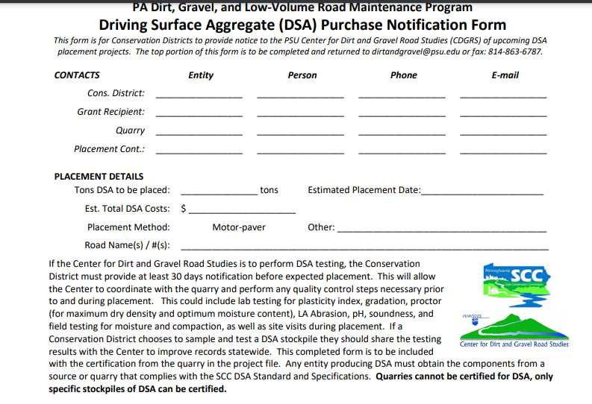
DSA Season Preparation
DSA Clearinghouse
DSA Notification: CD portion
dcm35@psu.edu
Notes:
New email coming…DO NOT Fax until further notice
Email Dave Morrison dcm35@psu.edu

Slide 29
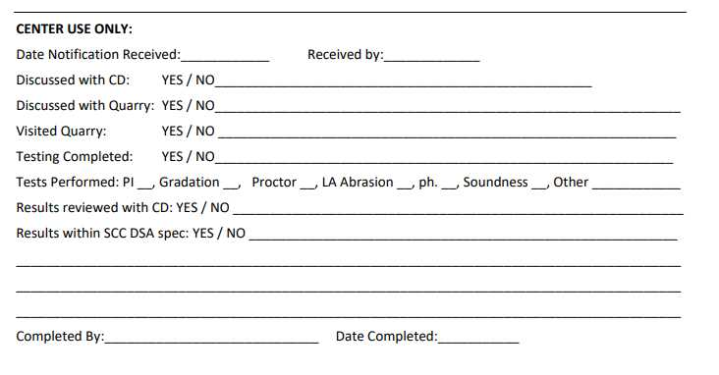
DSA Season Preparation
DSA Clearinghouse
DSA Notification: CDGRS portion
Notes:
You should share these results with the quarry or tell us to share them. As far as we are concerned these lab tests are property of the CD/SCC and are privileged info

Slide 30
DSA Season Preparation
DSA Clearinghouse
DSA Clearinghouse
POTENTIAL SERVICES PROVIDED
Visiting and talking with quarries and CD to ensure they understand the DSA requirements.
Collecting samples from the quarry and performing testing to ensure DSA meets all material requirements before delivery and placement.
Providing contractor education on DSA.
Providing on-site assistance during DSA placement.
Education of Conservation District staff on DSA sampling, testing, and placement.
Troubleshooting.
Identifying potential DSA suppliers if you are having trouble finding DSA in your area
Get on the schedule as far out as possible.

Slide 31
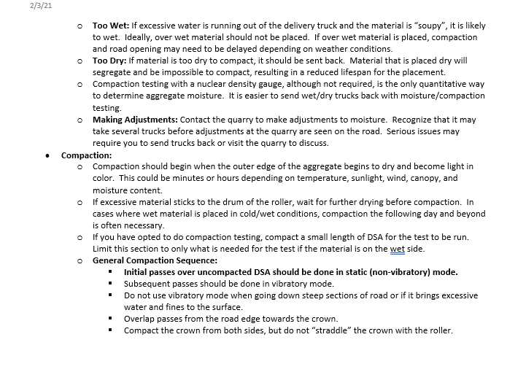
NEW DSA Project Checklist/Walkthrough for CDs
3-pages
Sent in webinar reminder
Posted online

Slide 32
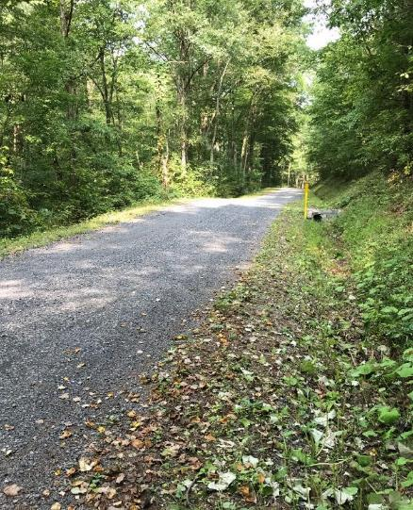
DSA Season Preparation
DSA Season Prep
What is the DSA Project Checklist?
Pre-application
Pre-Project logistics
~30 days prior to placement
Final Preparations
DSA Placement

Slide 33
DSA Season Preparation
DSA Project Checklist
What is the DSA Project Checklist?
A guide for CD’s to plan and implement successful DSA placements as part of a DGLVR project
Informational only: no NEW required actions.
Any existing required actions are noted as such

Slide 34
DSA Season Preparation
DSA Season Prep
What is the DSA Project Checklist?
Pre-application
Pre-Project logistics
~30 days prior to placement
Final Preparations
DSA Placement

Slide 35
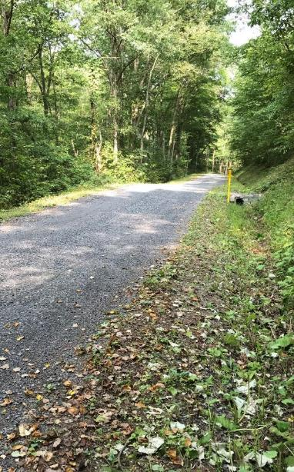
DSA Season Preparation
DSA Project Checklist – Pre-application
Drainage and base first!!
DSA is not required on every project
Program focus is on long-term road and environmental improvements
Projects are required to address any drainage, road base, and environmental issues prior to DSA placement

Slide 36
DSA Season Preparation
DSA Project Checklist – Pre-application
Meet with the municipality
Suggested An on-site pre-application meeting with the municipality helps to ensure a quality application
Discussing Topics:
Timing: Application, drainage work, placement date(s), placement season, time for production and testing, etc
Details: Project length, DSA depth, width, tonnage, available budget, paver, etc
Potential suppliers & placement contractors
Road preparation: Drainage, surface prep (fill/grading), etc
Compaction: Will compaction testing be utilized?

Slide 37
DSA Season Preparation
DSA Project Checklist – Pre-application
Material Calculation
The formula below is a general guide to the amount of DSA needed based on width, depth, and length of placement.
How much DSA should I order?
DSA Road Road
Needed = Width x Length x
(tons) (ft) (ft)
0.04 for 8” loose
compacted to 6”
0.03 for 6” loose
compacted to 4½”
Notes:
DSA is the icing on the cake.

Slide 38
DSA Season Preparation
DSA Season Prep
What is the DSA Project Checklist?
Pre-application
Pre-Project logistics
~30 days prior to placement
Final Preparations
DSA Placement

Slide 39
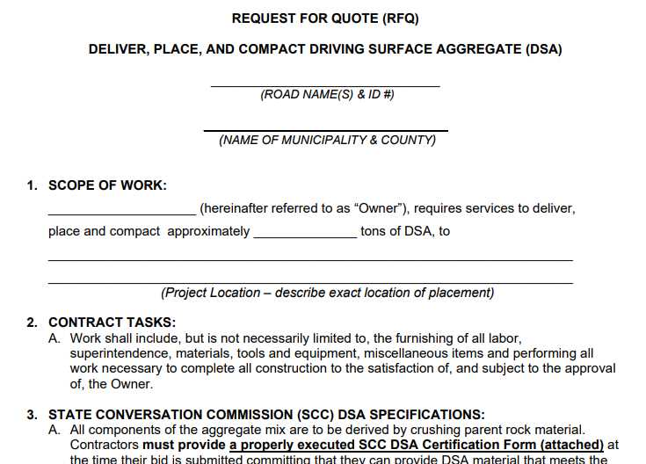
DSA Season Preparation
DSA Checklist – Pre-project logistics
Bidding
Municipalities should follow their standard purchasing, bidding, and payment procedures.
Prevailing wage applies to contracted labor when the total value of the project exceeds $25,000
An editable DSA Request for Quote is available on the Center’s website if needed

Slide 40
DSA Season Preparation
RFQ
RFQ: use is optional: editable version on CDGRS website

Slide 41
DSA Season Preparation
DSA Checklist – Pre-project logistics
Once placement contractor and supplier are determined…
Schedule target placement date, and a potential back-up date in case of delays. Allow as much time as possible for quarry to make material, sampling and testing. (Sampling delays, lab back-ups/failures)
DSA Sampling: Quarries do not have blanket approval to supply DSA. The full pile of DSA to be used on the job is required to be sampled and tested by a third-party lab prior to placement
The pile is approved once passing lab results are obtained

Slide 42
DSA Season Preparation
DSA Season Prep
What is the DSA Project Checklist?
Pre-application
Pre-Project logistics
~30 days prior to placement
Final Preparations
DSA Placement

Slide 43
DSA Placement
Dirt Gravel and Low Volume Road Program
Dave Morrison- CDGRS
www.dirtandgravelroads.org
4/10/24

Slide 44
DSA Season Preparation
DSA Checklist – 30 Days Out
Pre-Construction Meeting
Highly Recommended An on-site pre-construction meeting with the placement contractor and the municipality helps to ensure a quality project by getting everyone on the same page

Slide 45
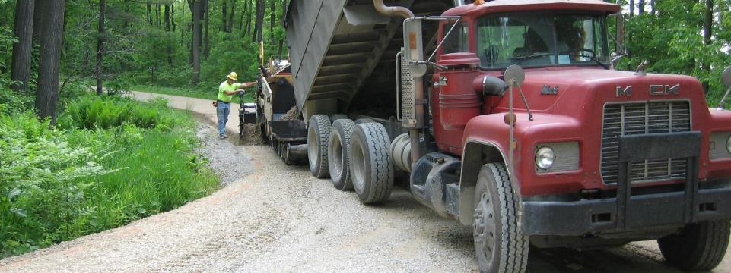
DSA Season Preparation
DSA Checklist – 30 Days Out
Pre-Construction Meeting Discussion Points
Trucking Logistics:
Truck routes
Number of trucks
Staging areas (material & equipment)
Turnaround for trucks to reduce backup length.

Slide 46
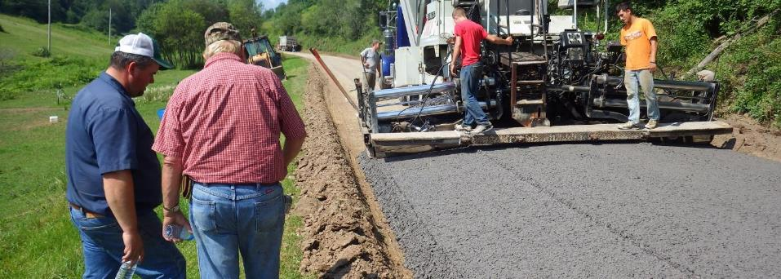
DSA Season Preparation
DSA Checklist – 30 Days Out
Pre-Construction Meeting Discussion Points
Final Road Preparation
Grading and establishing crown cross-slope (week of placement)
Establishment of paving notches and keys (just prior to placement)

Slide 47
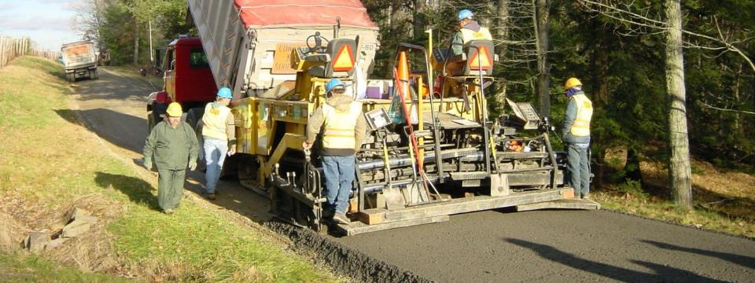
DSA Season Preparation
DSA Checklist – 30 Days Out
Pre-Construction Meeting Discussion Points
Equipment
Ensure paver and roller to be used meet Program and contract requirements
Paving must be done in one pass (full road width) and compacted with a minimum 10-ton vibratory roller

Slide 48
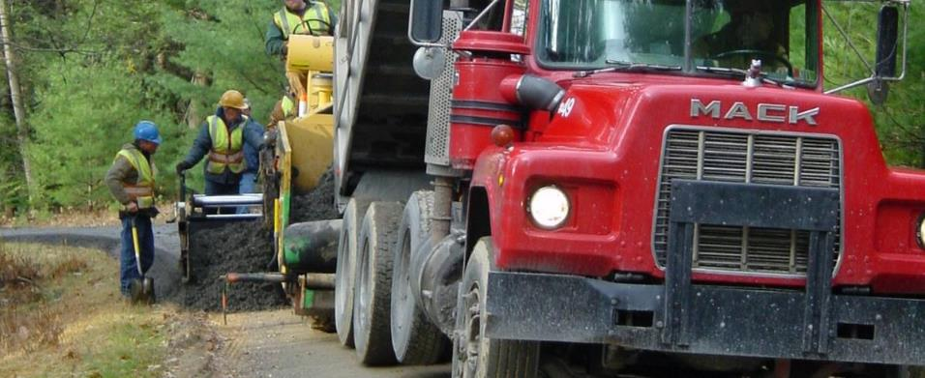
DSA Season Preparation
DSA Checklist – 30 Days Out
Pre-Construction Meeting Discussion Points
Material Slips
Define who will be collecting material slips from delivery trucks
Material slips should be retained in project file

Slide 49
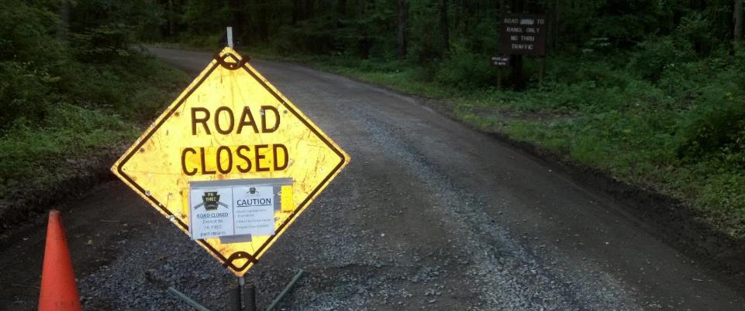
DSA Season Preparation
DSA Checklist – 30 Days Out
Pre-Construction Meeting Discussion Points
Road Logistics
Potential road closures
Need for road construction/safety signs?
Need for flaggers?

Slide 50
DSA Season Preparation
DSA Checklist – 30 Days Out
Pre-Construction Meeting Discussion Points
Compaction Testing (optional)
Discuss use of third party or contractor compaction testing if desired
Measures actual moisture content of material
helps for sending wet/dry trucks back
Also measures percent compaction

Slide 51
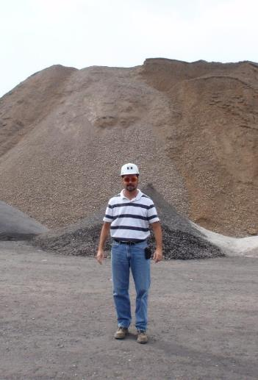
DSA Season Preparation
DSA Checklist – 30 Days Out
Quarry/Supplier Meeting
Highly Recommended Consider meeting with quarry or supplier during production and just before placement
Make sure production is on schedule and amount is adequate for sampling/completion of project
Ensure quarry understanding of..
SCC DSA specification
Importance of adequate mixing
Importance of proper moisture
Consider talking to loader operator as well as QC technician

Slide 52
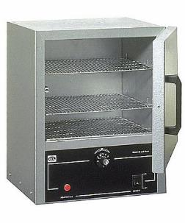
DSA Season Preparation
DSA Checklist – 30 Days Out
Quarry/Supplier Meeting
Highly Recommended Consider meeting with quarry or supplier during production and just before placement
Make sure production is on schedule and amount is adequate for sampling/completion of project
Ensure quarry understanding of..
SCC DSA specification
Importance of adequate mixing
Importance of proper moisture
Consider talking to loader operator as well as QC technician
Make sure quarry is doing moisture testing to monitor pile
Reminder about material cert. on first load delivered

Slide 53
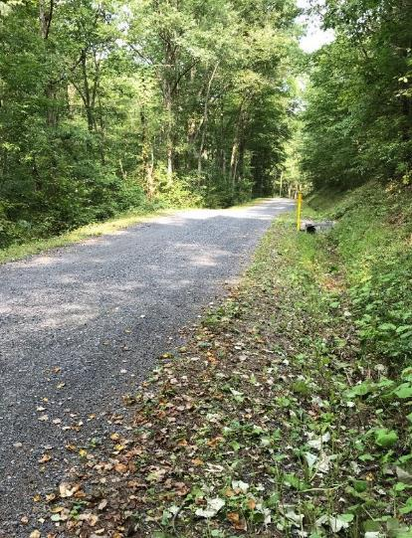
DSA Season Preparation
DSA Season Prep
What is the DSA Project Checklist?
Pre-application
Pre-Project logistics
~30 days prior to placement
Final Preparations
DSA Placement

Slide 54
DSA Season Preparation
DSA Checklist – Final Preparations
Week of Placement
Review final logistics with municipality, contractor, supplier, trucking provider to make sure all are on the same page
Road prep (crown, base, drainage)
Truck routes (power lines)
Staging areas
Availability of equipment and personnel

Slide 55
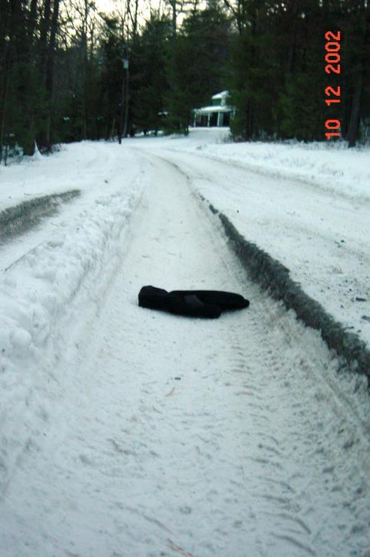
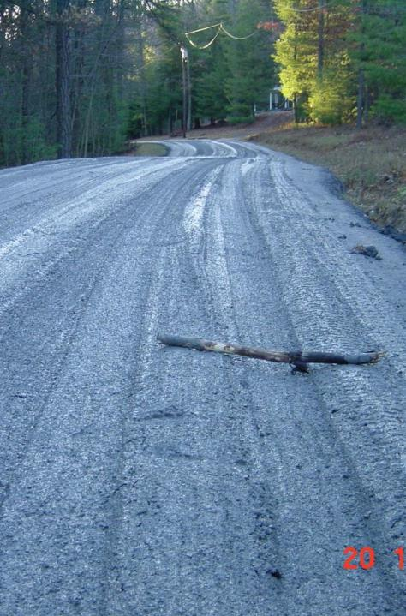
DSA Season Preparation
DSA Checklist – Final Preparations
Week of Placement: Check the Weather
Weather and Cancellations:
The DSA specification states: “If freezing temperatures or precipitation are forecast that may cause the material to freeze, or prevent the material from drying out, placement shall be postponed at the discretion of the road owner, Conservation District, or aggregate supplier.”.
It will often be up to the Conservation District to make calls to postpone due to weather.

Slide 56
DSA Season Preparation
DSA Checklist – Final Preparations
Day before and Day of Placement
Contact municipality, contractor, & quarry to verify placement plan
Include engineering tech performing compaction testing (if done). Their experience level can vary.
One last check in can eliminate problems
Use discussion points from above to tie up any loose ends
Check road for crown, keys, notches, etc.
Irregularities in the road base will reflect to the surface

Slide 57
DSA Season Preparation
DSA Season Prep
What is the DSA Project Checklist?
Pre-application
Pre-Project logistics
~30 days prior to placement
Final Preparations
DSA Placement

Slide 58
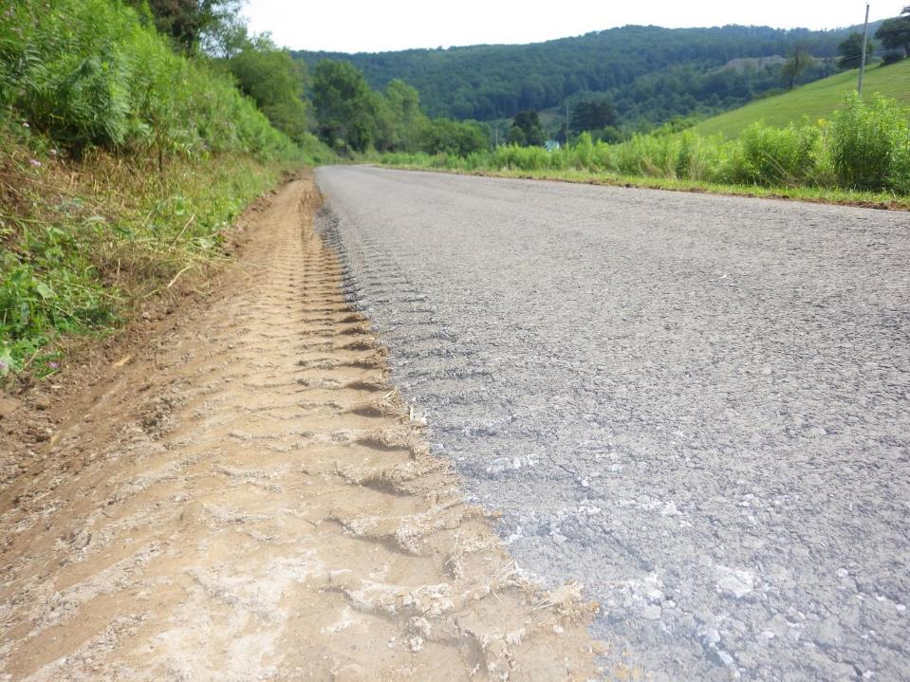
DSA Season Preparation
DSA Checklist – Placement
Day of Placement
Are transport trucks tarped as required?
Did the first load come with a certification?
Required
Who is collecting load slips?

Slide 59
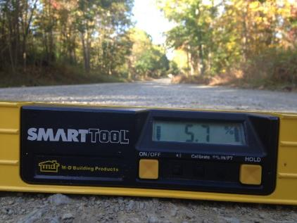
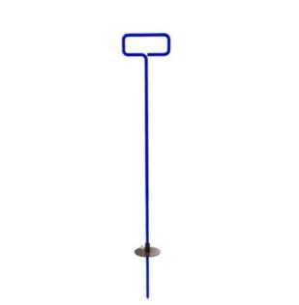
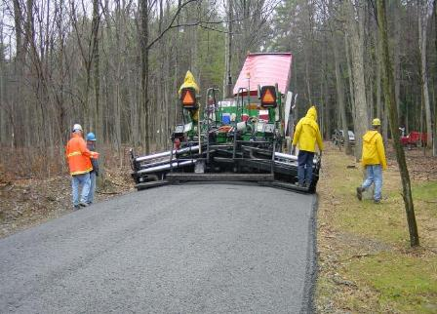
DSA Season Preparation
DSA Checklist – Placement
During placement
Continuously monitor…
Placement depth, width, & crown/cross-slope
It may take several hundred feet to get the paver “dialed in”
Yield?

Slide 60
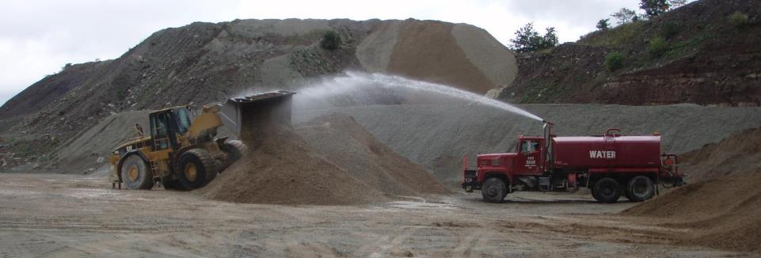
DSA Season Preparation
DSA Checklist – Placement
During placement
Continuously monitor…
Moisture, adequate mixing of material
Be alert for changes in consistency
Variations can happen throughout the day

Slide 61
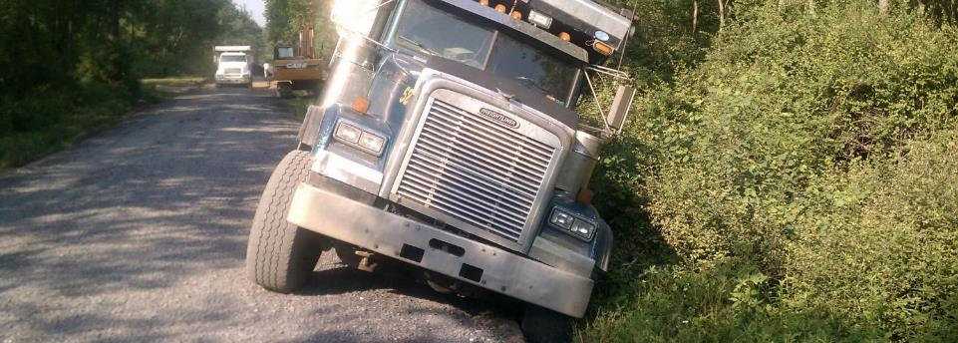
DSA Season Preparation
DSA Checklist – Placement
During placement
Continuously monitor…
Trucking logistics
# of trucks
Power lines
Turnarounds, routes, flaggers, etc.

Slide 62
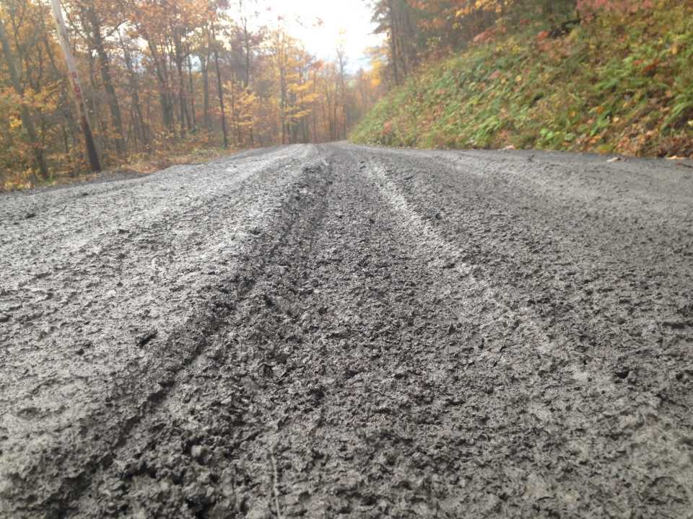
DSA Season Preparation
DSA Checklist – Placement
Water pouring from truck beds…
In its wettest state, DSA should look like very low-slump concrete, better if it’s a bit drier than that
Too wet

Slide 63
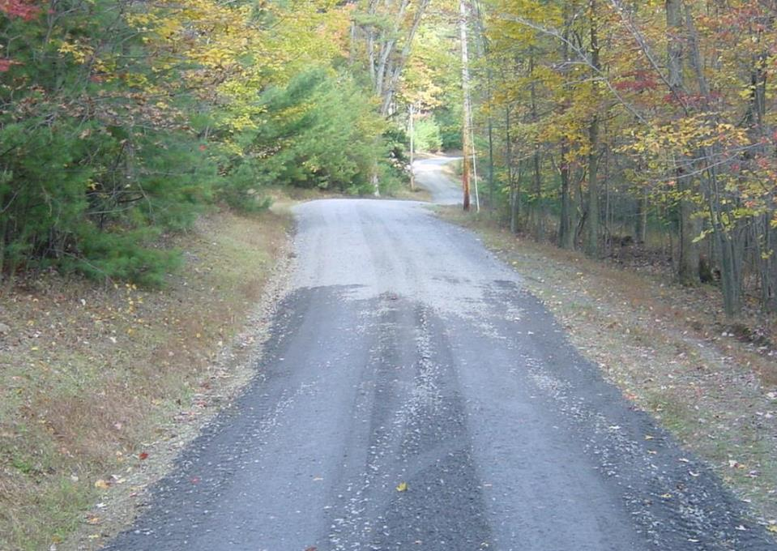
DSA Season Preparation
DSA Checklist – Placement
Too dry
Will not compact
Will come apart quickly

Slide 64
DSA Season Preparation
DSA Checklist – Placement
During placement
Making adjustments…
Contact quarry to make adjustments.
Use dump truck radios in remote areas
Note time of change request and compare to load time on tickets
Send trucks back if necessary!
Once its down on the road surface, its more difficult to fix
Visit quarry if necessary
Unforeseen problems like personnel/equipment/moisture issues

Slide 65
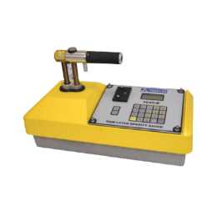
DSA Season Preparation
DSA Checklist – Placement
During placement
Compaction testing…
Utilizing a nuclear density gauge
Not required by Program
Quantitative way to quickly determine
Density (% compaction)
Moisture content – to compare to target moisture
Having this data can make it easier to send unacceptable loads back to the source
https://www.measur.ca/product/4640-b-surface-thin-layer-density-gauge/

Slide 66
See DSA Handbook or Full DSA Webinar for details
COMPACTION

Slide 67
Thank You! Questions?
Reminder: NEW DSA Project Checklist for CDs
3-pages
Sent in webinar reminder
Posted online
30 day notice is a minimum
Notify as soon as supplier is known
Supplier needs time to make entire pile
Time for sampling
Time for testing
Potential time for failures
Notes:
Add contact info

Slide 68
ESM Trainings: 12 scheduled statewide with the first one this week in Johnstown.
Stream Crossing Trainings: Conservation Districts
May 21-23
June 11-13
Aug 13-15
Stream Crossing Trainings: Design Engineers
July 1-2 Centre
Aug 28-29 McKean
Sep 18-19 Monroe
Administrative and Financial Trainings
Mar 13 (Admin), Mar 14 (financial), Berks
May 21 (Admin), May 22 (financial), Westmoreland
July 23 (Admin), July 24 (financial), Centre
Oct 16 (Admin), Oct 17 (financial), Luzerne
Dec 3 (Admin), Dec 4 (financial), Venango
Other Training Notes:
Workshop: Mark your calendars for October 8-10 in Dubois.
ESM Boot Camps: Working on finalizing dates for “new hire boot camps” not held since before COVID. Currently planning for two session in September, details to come.
DEP Stream Trainings: Building off the two completed last year, the Center is holding three 1.5 day stream crossing trainings for DEP permit review staff this spring.
Course Tracker: Don’t forget the new course attendance tracker allows you to look up your, or anyone else’s, current certifications and expiration dates. https://dirtandgravel.psu.edu/education-training/course-attendance-tracker/

Slide 69
DGLVR Program
Spending Update
5-Year Spending Update
All funding from agreement must be spent out by 6/30/2024
Current CD Status as of 3/20/2024
Spent everything: 27 DGR, 23 LVR
Committed everything: 25 DGR, 31 LVR
Not committed: 12 DGR, 12 LVR

Slide 70
DGLVR Program
Spending Update
5-Year Spending Update - Financials
Dirt and Gravel
Committed: $3,859,654.33
Not Committed: $379,227.69
Low Volume
Committed: $2,694,288.49
Not Committed: $564,217.31
Total that still needs to be spent
DGR: $4,238,882.02
LVR: $3,258,505.80
Total: $7,497,387.82

Slide 71
DGLVR Program
Spending Update
5-Year Spending Update
If you are Green in both DGR and LVR, great job!
If you are Red in DGR and/or LVR, you have already been contacted for a status update.
If you are Yellow in DGR and/or LVR, expect follow-up status calls/emails.

Slide 72
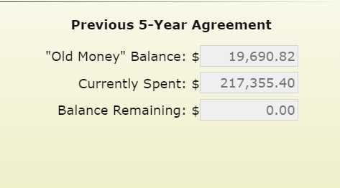
DGLVR Program
Spending Update
Question:
How do I know if I’m red, yellow, or green?
Answer:
If your “balance remaining” is $0 in your GIS quarterly report, you are green

Slide 73
DGLVR Program
Spending Update
Question:
How do I know if I’m red, yellow, or green?
Answer:
If you have a “balance remaining,” and it is less than the committed remaining, you are yellow

Slide 74
DGLVR Program
Spending Update
Question:
How do I know if I’m red, yellow, or green?
Answer:
If you have a “balance remaining” and it is greater than the committed remaining, you are red

Slide 75
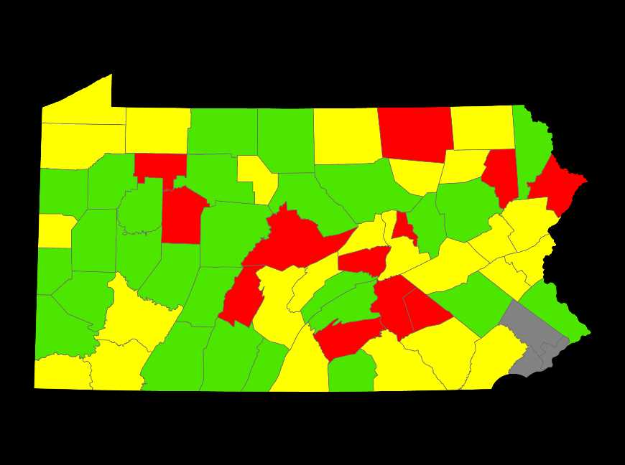
DGLVR Program
Spending Update
5-Year Spending Status – DGR
As of 3/20/2024

Slide 76
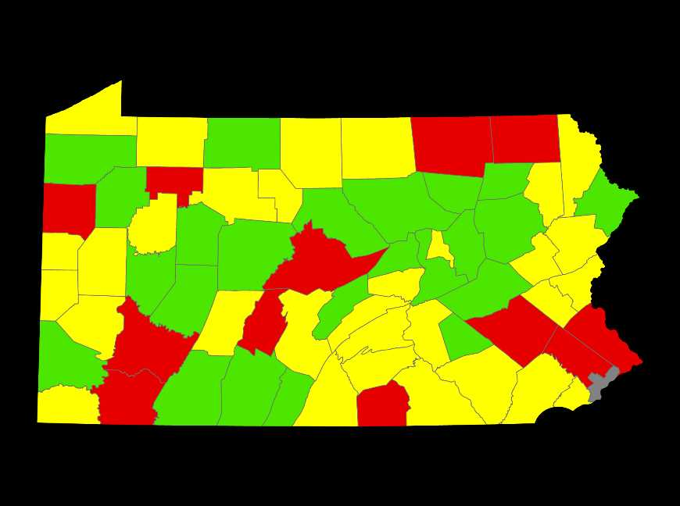
DGLVR Program
Spending Update
5-Year Spending Status – LVR
As of 3/20/2024

Slide 77
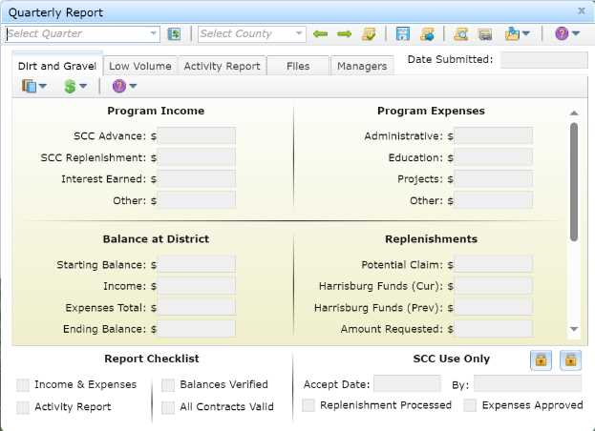
DGLVR Program
Spending Update
Question:
How do I make sure my spending is counted towards the spending requirement?
Answer:
Enter admin, edu, and project expenses in the GIS by 6/24/2024 (and don’t forget to click save!)

Slide 78
DGLVR Program
Spending Update
Question:
What if my expenses won’t be ready to enter in GIS by 6/24/2024?
Answer:
Contact Ken or the SCC to discuss a plan

Slide 79
DGLVR Program
Spending Update
Question:
What if I don’t know how much money I need to spend or how to spend it?
Answer:
Review GIS
Review past webinars
Reach out to Ken or the SCC for assistance

Slide 80
DGLVR Program
Spending Update
Question:
What if I know I’m not going to meet my spending requirements?
Answer:
Reach out to Ken or the SCC to let us know.

