Slide 1
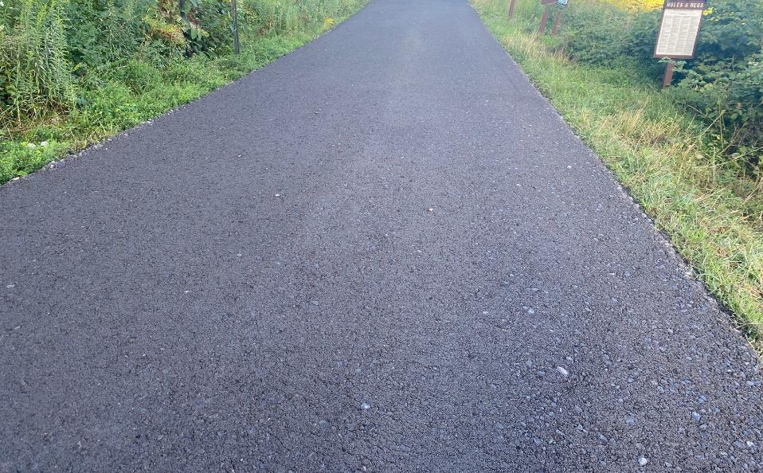
DGLVR Workgroup
Proposed Driving Surface Aggregate Specification Changes
2/2/23
If you are reading this, then you are successfully seeing the webinar video. Webinar audio should be automatic through your computer, and options can be accessed in the “audio options” button on the bottom left. If you are having audio issues, or are in a location where listening via phone is preferable, audio is also available on the CDGRS conference line at: 312-626-6799
For technical assistance, call: 814-865-5355

Slide 2
DGLVR
DSA Specification Changes
Background
DSA is only approved unbound surface aggregate for use with DGLVR funds
Specification is designed for maximum compaction density.
Resist erosion
Lengthen maintenance cycles
Less sediment runoff
Other common aggregates
PennDOT 2A: “cleaner”, minimal fines designed for drainage
PennDOT 2RC: very wide spec that can contain dirt and organics
2A

Slide 3
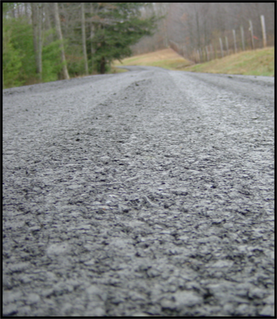
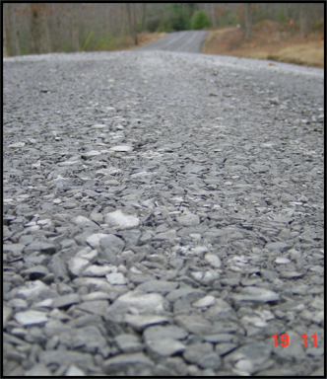
DGLVR
DSA Specification Changes
DSA
2A
 | 2” | 1.5” | ¾” | ¼” | 1/16” | “fines”
DSA |  | 100 | 65-97 | 30-65 | 15-30 | 10-15*
2A | 100 |  | 52-100 | 24-50 | 10-30 | 0-10

Slide 4
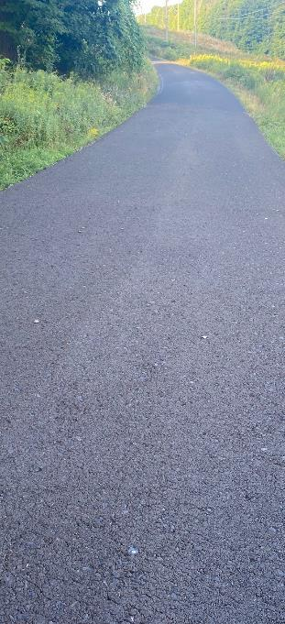
DGLVR
DSA Specification Changes
DSA developed in 2000, modified over the years
Recent History
20015-18: implemented Plasticity index to limit clay content
2019: Increased max fine content for non-plastic aggregate
2022: reduced paver requirement to jobs over 500 tons

Slide 5
DGLVR
DSA Specification Changes
Current Driving Surface Aggregate Specification
% passing by weight
Passing Sieve | Lower % | Higher %
1½ inch | 100 | -
³/4 inch | 65 | 97
#4 (¹/4 ") | 30 | 65
#16 (¹/16 ") | 15 | 30
#200(¹/200 ") | 10 | 15*
* Up to 17 % fines if PI <2

Slide 6
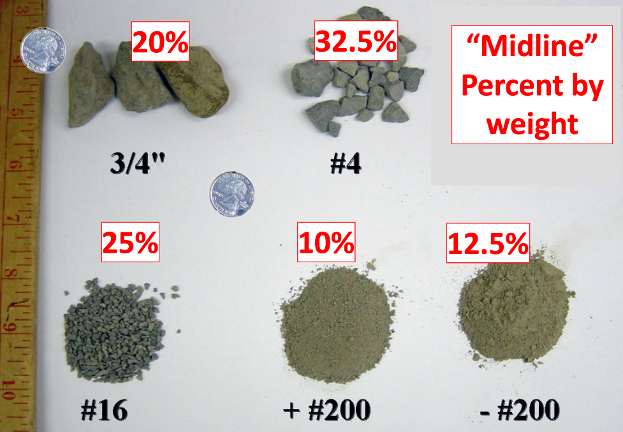
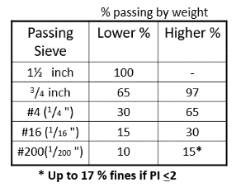
DGLVR
DSA Specification Changes
2020 Driving Surface Aggregate Specification
% passing by weight
Passing Sieve | Lower % | Higher %
1½ inch | 100 | -
³/4 inch | 65 | 97
#4 (¹/4 ") | 30 | 65
#16 (¹/16 ") | 15 | 30
#200(¹/200 ") | 10 | 15*
* Up to 17 % fines if PI <2

Slide 7
DGLVR
DSA Specification Changes
Proposed Driving Surface Aggregate Change
Proposing to increase #200 sieve to 11%
% passing by weight
Passing Sieve | Lower % | Higher %
1½ inch | 100 | -
³/4 inch | 65 | 97
#4 (¹/4 ") | 30 | 65
#16 (¹/16 ") | 15 | 30
#200(¹/200 ") | 10 11 | 15*
* Up to 17 % fines if PI <2

Slide 8
DGLVR
DSA Specification Changes
Question:
Why are we proposing the change to 11%?
Answer:
In 2020 we tested 52 DSA piles
15 failed
20% of samples had #200 sieves that were ≤11%
17% of samples has #200 sieves that were <11%
In 2021 we tested 60 DSA piles
5 failed
23% of samples had #200 sieves that were ≤11%
19% of samples has #200 sieves that were <11%

Slide 9
DGLVR
DSA Specification Changes
Question:
Why are we proposing the change to 11%?
Answer:
In 2022 we tested 47 DSA piles
7 failed
38% of samples had #200 sieves that were ≤11%
33% of samples has #200 sieves that were <11%
Number of samples with low #200 results
almost doubled in 2022!

Slide 10
DGLVR
DSA Specification Changes
Percentage of passing DSA Samples with <11% fines
2022
38%
2020
20%
2021
23%
Samples <11% in fines

Slide 11
DGLVR
DSA Specification Changes
Why are projects with #200 sieves <11% an issue?
Most DSA issues in 2022 that were material-related (not placement) were due to low fines (10-11%).
Raveling during and immediately after placement
Grading and re-compaction required soon after new placement
Multiple projects required remediation immediately after placement
Time & Money…
We can’t reject material that meets spec, even 10.0%.

Slide 12
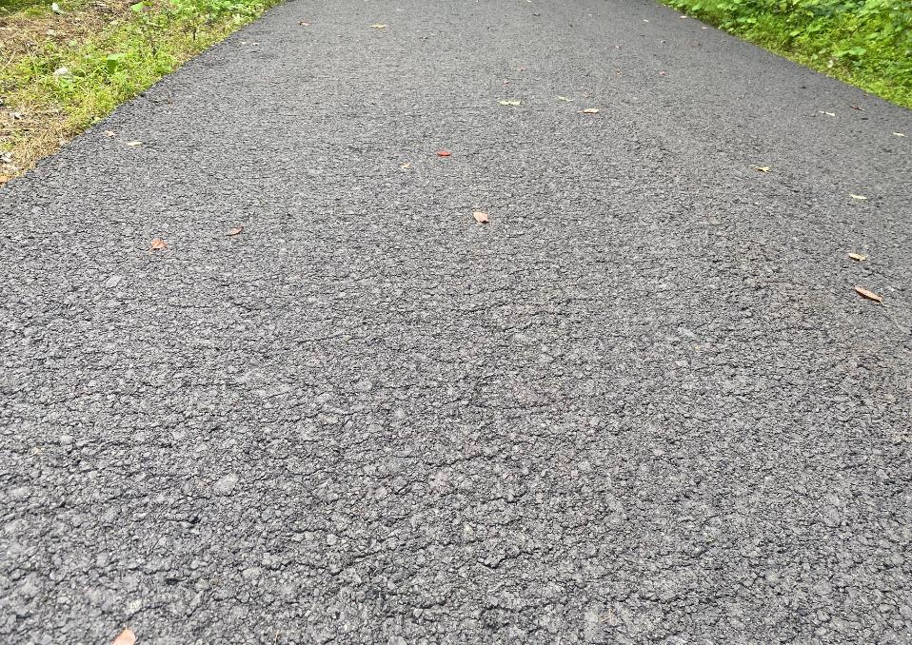
DGLVR
DSA Specification Changes
Road #1:
10.4% #200 Sieve
Immediately after placement & compaction
Most DSA issues in 2022 that were material-related (not placement) were due to low fine content (10-11%).
We can’t reject material that meets spec, even 10.0%.

Slide 13
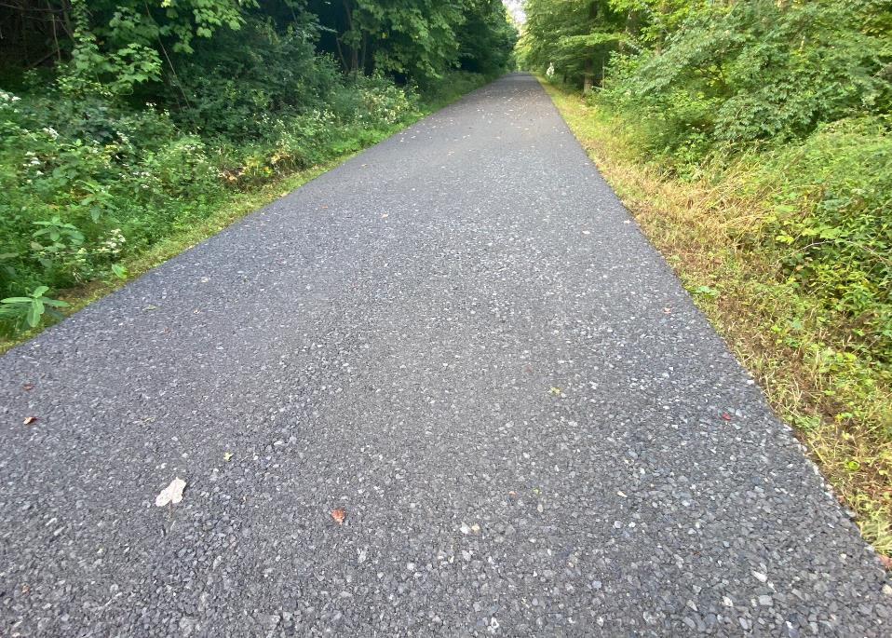
DGLVR
DSA Specification Changes
Road #1:
10.4% #200 Sieve
Immediately after placement & compaction

Slide 14
DGLVR
DSA Specification Changes
Take a closer look…

Slide 15
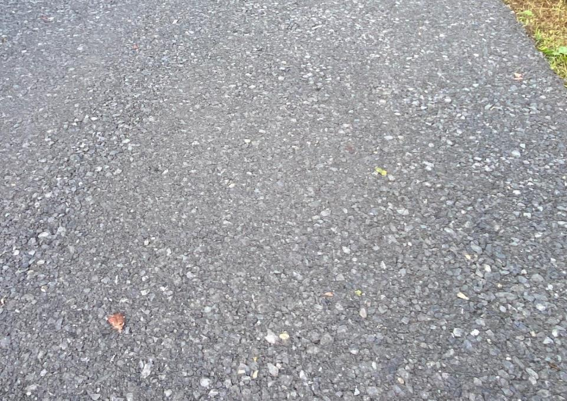
DGLVR
DSA Specification Changes
Lack of fines
Loose aggregate

Slide 16
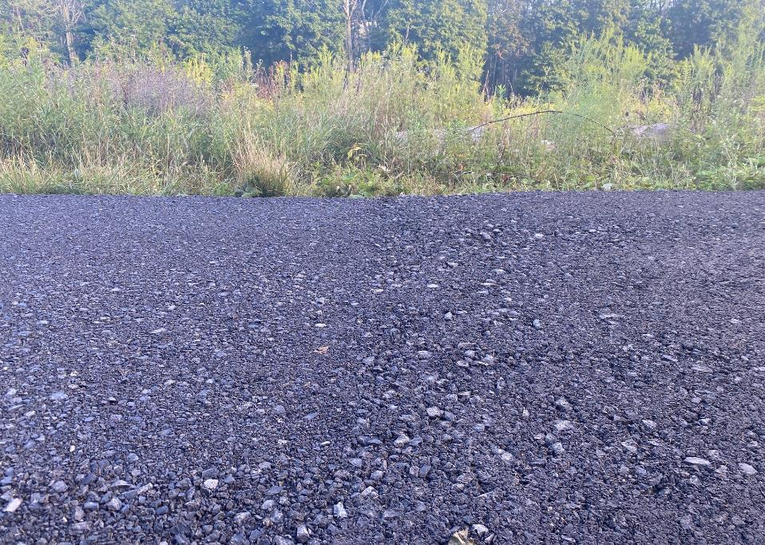
DGLVR
DSA Specification Changes
Road #1:
10.4% #200 Sieve
Immediately after placement & compaction
Lack of fines
Loose aggregate

Slide 17
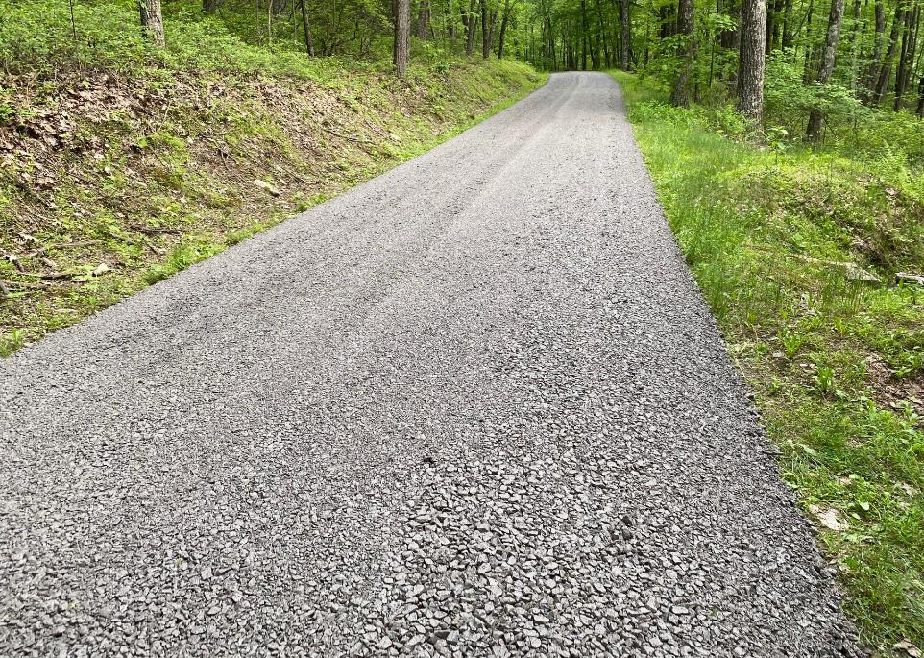
DGLVR
DSA Specification Changes
Road #2:
Low Moisture & Fines
Immediately after placement & compaction

Slide 18
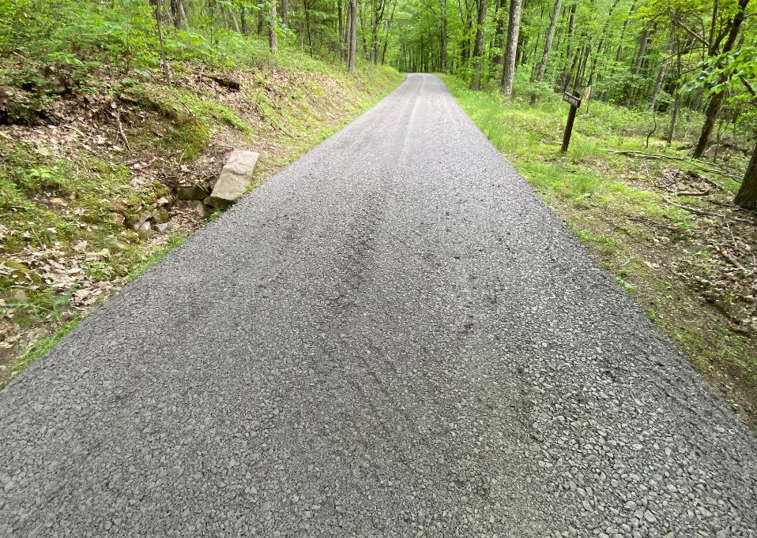
DGLVR
DSA Specification Changes
Road #2:
Low Moisture & Fines
Immediately after placement & compaction

Slide 19
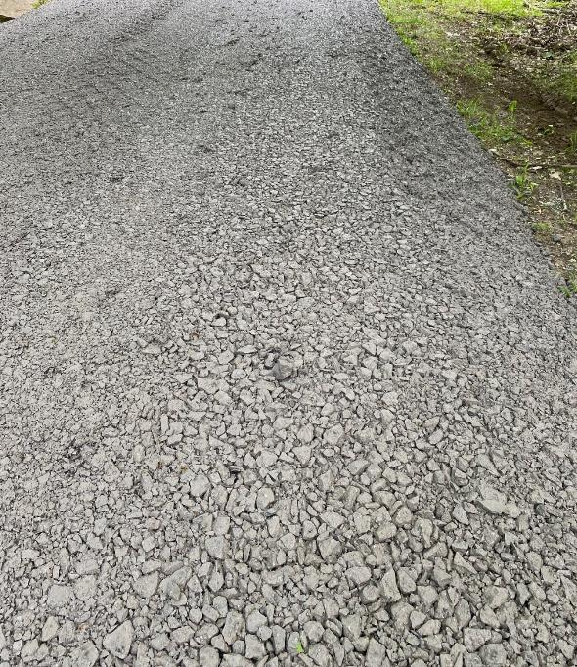
DGLVR
DSA Specification Changes
Road #2:
Low Moisture & Fines
Immediately after placement & compaction

Slide 20
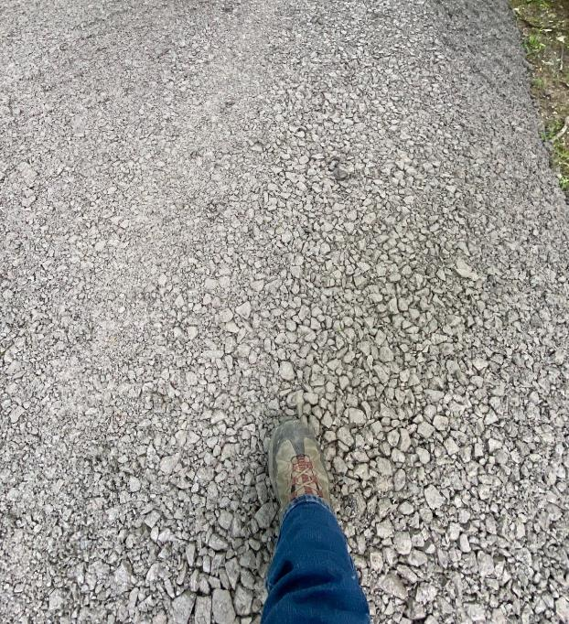
DGLVR
DSA Specification Changes
Road #2:
Low Moisture & Fines
Immediately after placement & compaction

Slide 21
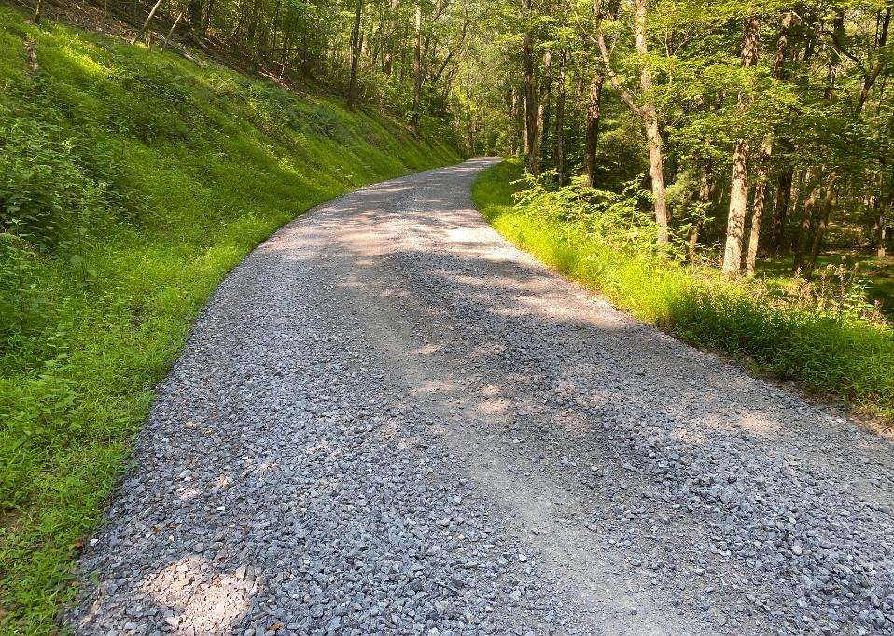
DGLVR
DSA Specification Changes
Road #2:
Low Moisture & Fines
3 months after placement

Slide 22
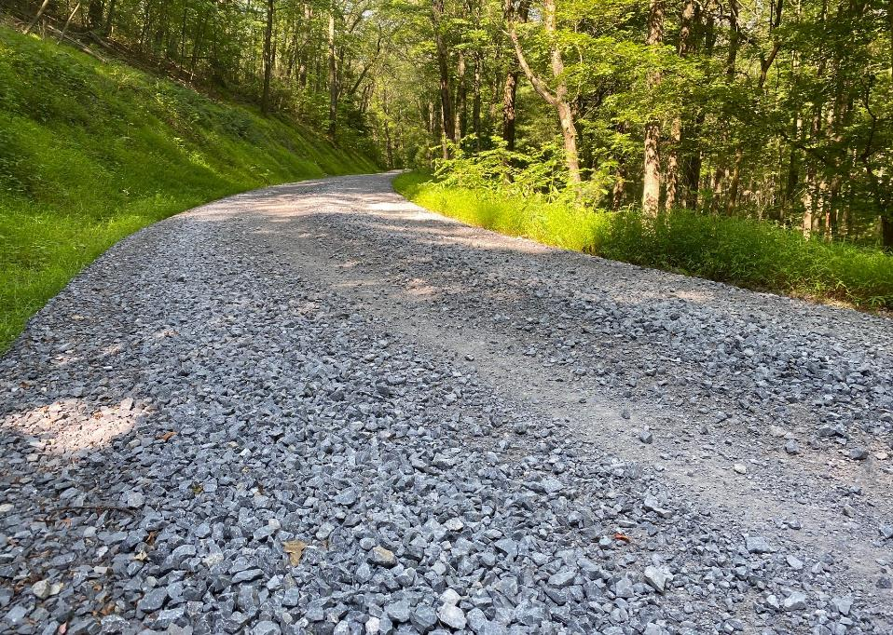
DGLVR
DSA Specification Changes
Road #2:
11% #200 Sieve
Low Moisture & Fines
3 months after placement

Slide 23
DGLVR
DSA Specification Changes
Proposed 2023 Driving Surface
Aggregate Specification
Proposing to increase #200 sieve to 11%
% passing by weight
Passing Sieve | Lower % | Higher %
1½ inch | 100 | -
³/4 inch | 65 | 97
#4 (¹/4 ") | 30 | 65
#16 (¹/16 ") | 15 | 30
#200(¹/200 ") | 11 | 15*
* Up to 17 % fines if PI <2

Slide 24
DGLVR
DSA Specification Changes
Other DSA Specifications
DCNR Currently has their own DSA specification
PennDOT currently has their own DSA specification
The three specs do not all match!
Why? Changes were made to the SCC spec that were never reflected in other specs.

Slide 25
DGLVR
DSA Specification Changes
DCNR Bureau of Forestry
Match SCC specification
Increase #200 sieve to 11%
Change LA Abrasion to 40%
Minus #200 composition word change - “Lime kiln dust and cement kiln dust may be added to DSA to account for up to 50% of the fines passing the #200 sieve”.
PennDOT
Meeting with PennDOT to update spec to match SCC specification.
Goal is to have the DSA specification be the same for all 3 entities!

Slide 26
DGLVR
DSA Specification Changes
Next Steps?
Thoughts / Questions from CDs?
Talking with PA Aggregate & Concrete Association in February for supplier input.
Take proposed change to SCC for approval
If approved, determine acceptable date for implementation.

Slide 27
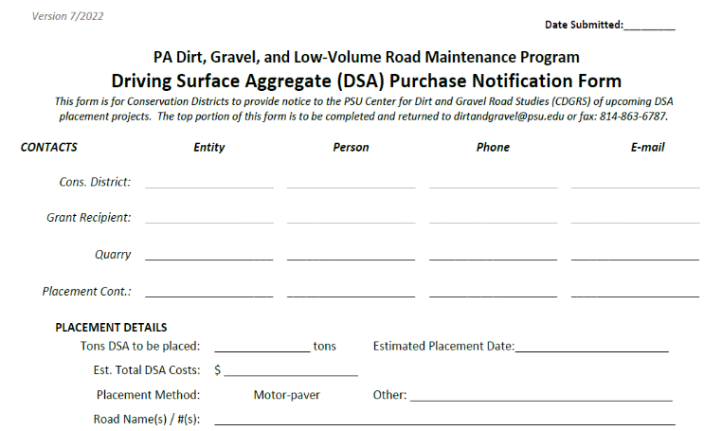
DGLVR
DSA Specification Changes
DSA Notification Form
Make sure you are using the most recent form!
Dated 7/2022
Please fill in the cost of the DSA
Used to track $/ton

