Slide 1
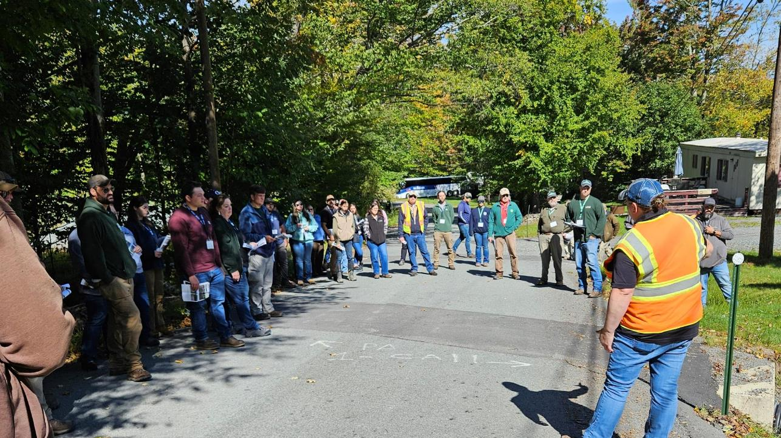
Dirt Gravel and Low Volume Road Program
WEBINAR
12/7/23
Starts 9am
DGLVR Education Events Overview:
2023 Summary and 2024 Planning
CDGRS
Steve Bloser
smb201@psu.edu
SCC
Sherri Law
shlaw@pa.gov
Andy Mickey
anmickey@pa.gov
If you are reading this, then you are successfully seeing the webinar video. Webinar audio should be automatic through your computer (or click “join audio”), and options can be accessed in the “audio options” button on the bottom left. If your computer audio is not working, you can listen on your phone by dialing 312-626-6799.

Slide 2
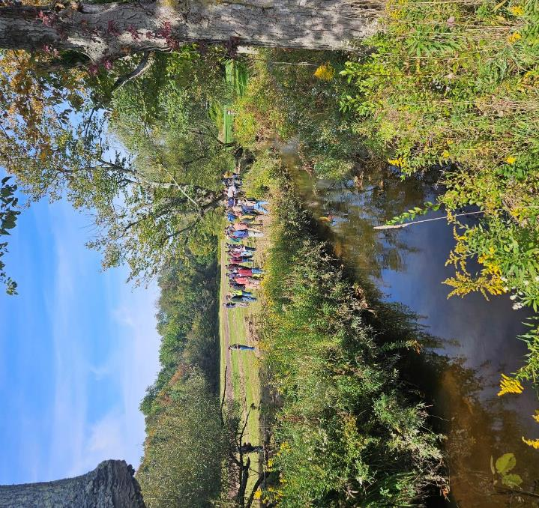
2024 DGLVR Education Update
Purpose
Provide overview of current direction with DGLVR education planning (advisory workgroup meeting held 11/30)
Allow input and feedback from CDs

Slide 3
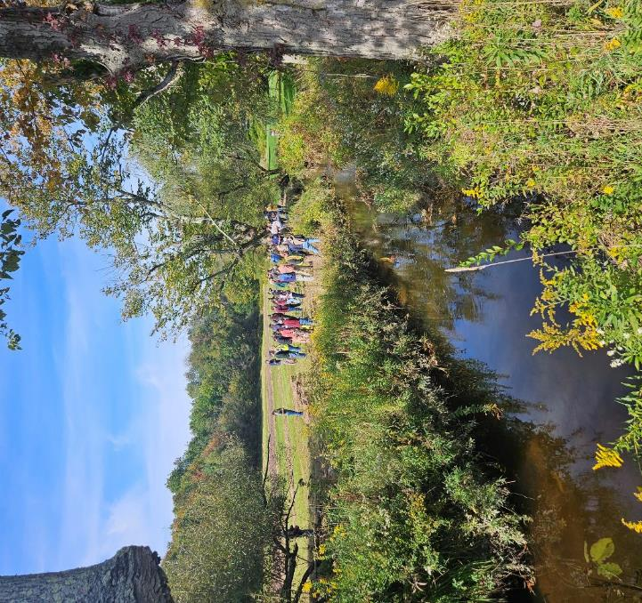
2024 DGLVR Education Update
ESM Training
Webinars
Stream Crossing Trainings
Workshops
Admin and Financial Trainings
Boot Camp
Regional Roundtables
Course Management System

Slide 4
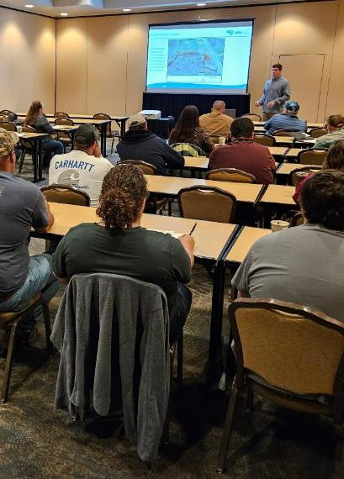
ESM Training
Base 2-day in-person training for DGLVR eligibility
Pre-COVID:
12 trainings annually, ~750 annual attendance
2023:
12 In-person trainings, 700 attendees
2024:
12 in-person two-day trainings being scheduled
Most trainings already booked, will announce soon.
Continue 1-day recertification as part of annual workshop.
www.dirtandgravelroads.org

Slide 5
ESM Training
Current 2024 Plan TENTATIVE – ANNOUNCEMENT OUT SOON
Cambria Co. – March 20 – 21, 2024 – Ace’s Banquets and Catering - Johnstown
Schuylkill Co. – April 2 – 3, 2024 – Fountain Springs County Inn - Ashland
Armstrong Co. – April 24 – 25, 2024 Kittanning Country Club - Kittanning
McKean Co. – May 15 – 16, 2024 – Veteran Memorial Social Hall – Port Allegheny
Wayne Co. – June 5 – 6, 2024 – Park Street Complex - Honesdale
Clinton Co. – July 10 – 11, 2024 – Lock Haven University – Lock Haven
Beaver Co. – July 31 – August 1, 2024 – Beaver Station Cultural & Event Center - Beaver
Perry Co. – August 13 & 14, 2024 –Central Penn College - Summerdale
Crawford Co. – September 11 – 12, 2024 – Cross Creek Resort – Titusville
Bradford Co. - September 25 – 26, 2024 – TBA
Bedford Co. – October 23 – 24, 2024 – Forbes Road Conference Center – Breezewood
Lancaster Co. – November 6 – 7, 2024 – Double Trees Resort by Hilton – Lancaster
www.dirtandgravelroads.org

Slide 6
2024 DGLVR Education Update
ESM Training
Webinars
Stream Crossing Trainings
Workshops
Admin and Financial Trainings
Boot Camp
Regional Roundtables
Course Management System

Slide 7
Winter Webinars
Winter Webinar Series
Thursdays at 9am, ~30-45 minutes each
Will be recorded
Schedule
12/07 Winter planning and education update
12/14 CD 5-year agreements, spending and Annual Summary Report Refresher
12/21 no webinar
12/29 no webinar
1/5 Online Longitudinal Profile Tool
1/11 2023 “Project Showcase”: examples of successful projects
1/18 TBD
1/25 TBD
Webinar Subject Poll at End
www.dirtandgravelroads.org

Slide 8
2024 DGLVR Education Update
ESM Training
Webinars
Stream Crossing Trainings
Workshops
Admin and Financial Trainings
Boot Camp
Regional Roundtables
Course Management System

Slide 9
Stream Crossing Replacement Trainings
OLD Rough Training Agenda (over 2 weeks)
1 (virtual): Intro and site assessment
2 (in person): Site assessment, long pro, excel form
3 (virtual): Developing recom., grant estimation
4 (virtual): RFP, pre-design meeting, plan reviews
5 (virtual): Bidding, site showing
6 (in person): Pre-con meeting, project oversight, construction inspection
Stream Crossing Trainings : CDs
Multi-day hybrid trainings, ~25 hours total over 2 weeks
2022: 6 trainings and 78 attendees
2023: 3 trainings and 31 attendees (one canceled)
2024: 3 trainings planned
Potential Format Change…………
www.dirtandgravelroads.org

Slide 10
Stream Crossing Replacement Trainings
Proposed CD Stream Training for 2024
Content would be updated but similar
More in-person, condense to one week
~3 hours virtual or recorded pre-req: Intro and site assessment
~2.5 day in person: Tue-Wed-Thr
Likely hold in State College, spread through year
Still in initial planning, format not final.
OLD Rough Training Agenda (over 2 weeks)
1 (virtual): Intro and site assessment
2 (in person): Site assessment, long pro, excel form
3 (virtual): Developing recom., grant estimation
4 (virtual): RFP, pre-design meeting, plan reviews
5 (virtual): Bidding, site showing
6 (in person): Pre-con meeting, project oversight, construction inspection
Poll: How many staff would you send?
www.dirtandgravelroads.org

Slide 11
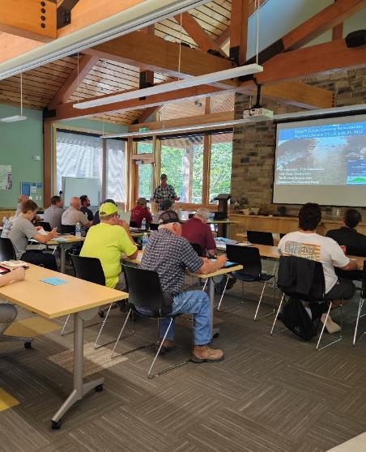
Stream Crossing Replacement Trainings
Stream Crossing Trainings: DEP
Coordinating closely with DEP Central Office
Developed 1.5 day training (in person)
Audience: DEP Permit Review Staff
2023: 2 trainings held, 60 attendees
2024: 3 trainings already scheduled for April-May, (capacity of 90)
www.dirtandgravelroads.org

Slide 12
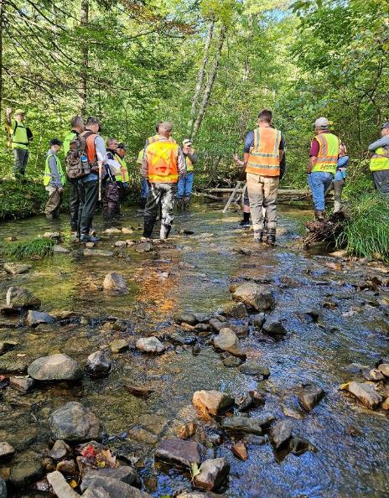
Stream Crossing Replacement Trainings
Stream Crossing Trainings: Engineers
Developed 1.5 day training (1 day in person)
Audience: Engineers
2023: 6 trainings held, 118 attendees
2024: Planning for 4 additional regional trainings
www.dirtandgravelroads.org

Slide 13
2024 DGLVR Education Update
ESM Training
Webinars
Stream Crossing Trainings
Workshops
Admin and Financial Trainings
Boot Camp
Regional Roundtables
Course Management System

Slide 14
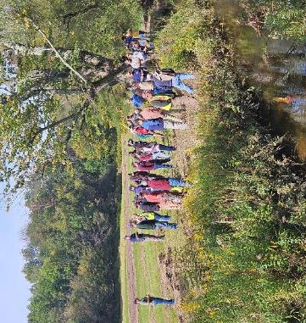
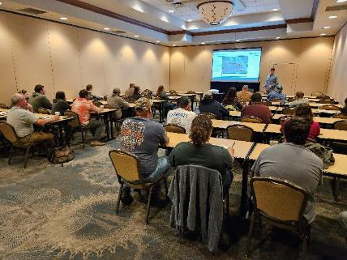
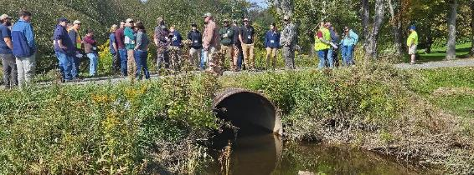
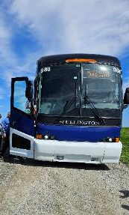
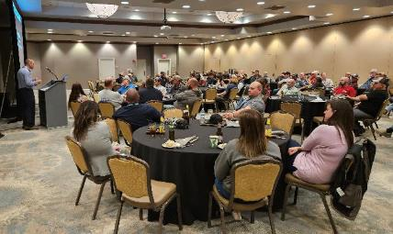
Annual Workshop
DGLVR Workshop
2023 (Scranton)
40/66 CDs represented
20 DCNR
~110 attended full workshop
25 for municipality day
Expanded back to ~2.5 days with multiple optional classes on first day

Slide 15
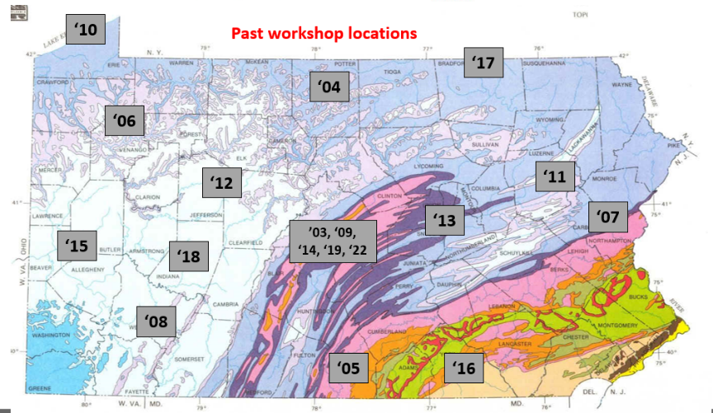
Annual Workshop
DGLVR Workshop
2024 (tentative)
Dubois
October 8-10
After “DSA” season
After trout restrictions kick in
‘23
Poll: On moving workshop to Oct 8-10

Slide 16
2024 DGLVR Education Update
ESM Training
Webinars
Stream Crossing Trainings
Workshops
Admin and Financial Trainings
Boot Camp
Regional Roundtables
Course Management System

Slide 17
Administrative and Financial Training
Administrative Training
Required 1-day training for all CD technicians administering DGLVR Program
Follows Policy Manual
2023
4 trainings held, 65 attendees
Held on a “semi-on-demand basis”
2024 Plan
Schedule 5 regionally
Pair with NEW Financial Training
www.dirtandgravelroads.org

Slide 18
Administrative and Financial Training
Administrative Training: on Policy and running DGLVR Program
SCC recognized a need for a separate DGLVR FINANCIAL Training
Financial Training:
Aimed at “bookkeepers” / financial and budget personnel
Will cover financial related policy
Some technicians may want both, some may just want “admin”
Financial training is optional
Can likely remove some financial sections from admin training.
www.dirtandgravelroads.org

Slide 19
Administrative and Financial Training
Administrative and Financial Training – Back to Back:
Can attend one or both in any region
Scheduling regionally in advance
Current Tentative Schedule
First day Admin, Second Day Financial
March 13-14, 2024 - Berks County Conservation District Office
May 21-22, 2024 - Westmoreland County Conservation District Office
July 23-24, 2024 - Centre County Area
October 15-16, 2024 - Northeast Region
December 3-4, 2024 - Northwest Region
www.dirtandgravelroads.org

Slide 20
2024 DGLVR Education Update
ESM Training
Webinars
Stream Crossing Trainings
Workshops
Admin and Financial Trainings
ESM Boot Camp
Regional Roundtables
Course Management System

Slide 21
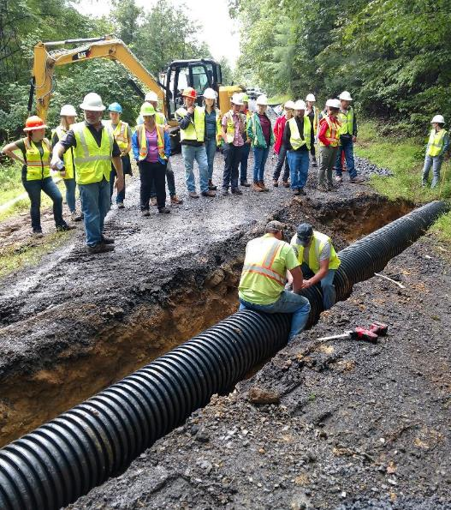
ESM Boot Camp
ESM Boot Camp
Not held since COVID
What is the Boot Camp?
Designed for new hires at CDs
~3 day in-person course
Mix of class and field
Construction basics
Active small drainage project
Diagnostic and site plan development
www.dirtandgravelroads.org

Slide 22
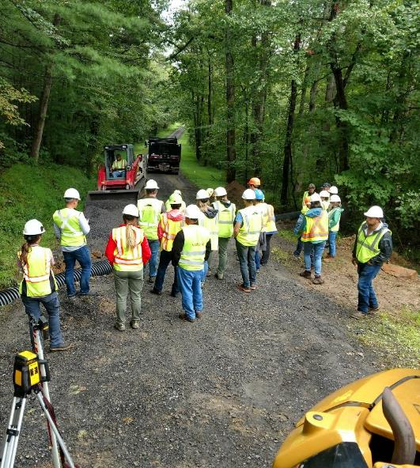
ESM Boot Camp
ESM Boot Camp
Current plan
Hold 1 (potentially 2) in State College in 2024
Poll: How many staff would you send?
www.dirtandgravelroads.org

Slide 23
2024 DGLVR Education Update
ESM Training
Webinars
Stream Crossing Trainings
Workshops
Admin and Financial Trainings
Boot Camp
Regional Roundtables
Course Management System

Slide 24
DGLVR Regional Roundtables
DGLVR Regional Roundtables
Regional ½ day meetings to promote discussion between CDs and with CDGRS/Program
Minimal presentation from CDGRS/Program. More discussion: sharing experiences, projects, ideas, advice.
Not a one-size fits all agenda, will be guided by CDs.
Some regions may wish to continue and repeat them semi annually or annually.
Initial planning for 5 across PA
Likely late January through March
Look for announcement soon
www.dirtandgravelroads.org

Slide 25
2024 DGLVR Education Update
ESM Training
Webinars
Stream Crossing Trainings
Workshops
Admin and Financial Trainings
Boot Camp
Regional Roundtables
Course Management System

Slide 26
Course Management System
CDGRS New Course Management System
New system debuted late last year for registration for ESM and several other trainings.
All future CDGRS training registration will be through new system
System allows users to access certification information (instead of a 100 page PDF list that we have to update after each training)
DEMO
www.dirtandgravelroads.org

Slide 27
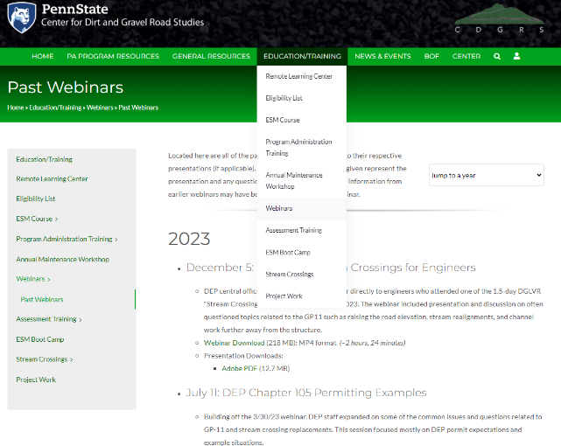
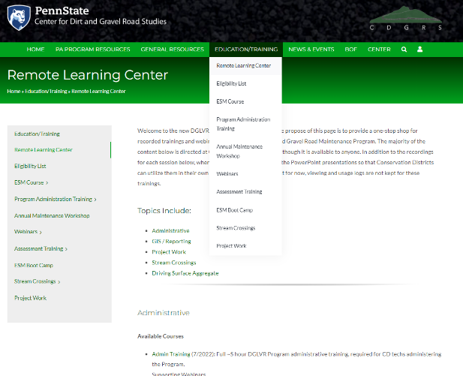
Education Efforts
Past Webinars: 100+ Remote Learning Center: 37
www.dirtandgravelroads.org

Slide 28
Education Efforts
Winter Technical Assistance
THIS IS A GREAT TIME FOR TECHNICAL ASSISTANCE!!
Take advantage of the (relatively) warm and snow free days!
With spending deadlines, next spring promises to be very busy!
smb201@psu.edu
www.dirtandgravelroads.org

Slide 29
Education Efforts
Survey
Thank you for feedback today.
Since Zoom polls are limited, and not everyone is on today, planning a larger survey to go out to CDs soon.
E-mails
Please notify Amy and Ken of e-mail or contact changes.
Poll: Webinar Topics
www.dirtandgravelroads.org

