Slide 1
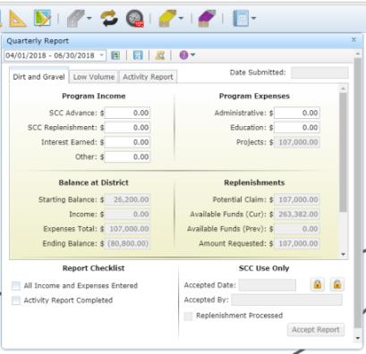
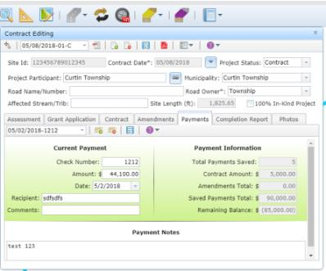
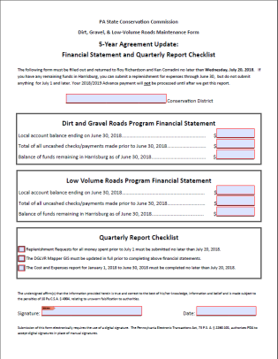
Dirt Gravel and Low Volume Road Program
WEBINAR
7/6/2023
Starts 9am
End of FY Guidance and Discussion
SCC
Sherri Law
shlaw@pa.gov
Roy Richardson
rrichardso@pa.gov
CDGRS
Ken Corradini
kjc139@psu.edu
If you are reading this, then you are successfully seeing the webinar video. Webinar audio should be automatic through your computer (or click “join audio”), and options can be accessed in the “audio options” button on the bottom left. If your computer audio is not working, you can listen on your phone by dialing 312-626-6799.

Slide 2
DGLVR Program
5-Year Agreements & Spending
DGLVR 5-Year Agreements (between SCC and CDs)
Agreement that establishes DGLVR Program in individual CDs, allowing funding transfer to CDs.
66 CDs currently have agreement
New Agreement Starts 7/1/2023
All funding from previous agreement must be spent out by 6/30/24

Slide 3
DGLVR Program
5-Year Agreements & Spending
2018 2019 2020 2021 2022 2023 2024 2025 2025 2027 2028
Previous 5-year
today
Previous 5-year:
Began 7/1/2018 & ended 6/30/2023

Slide 4
DGLVR Program
5-Year Agreements & Spending
2018 2019 2020 2021 2022 2023 2024 2025 2025 2027 2028
Previous 5-year
Extra Year
today
Previous 5-year:
Began 7/1/2018 & ended 6/30/2023
Extra year written into contract to spend funds. All funds must be spent by 6/30/2024.

Slide 5
DGLVR Program
5-Year Agreements & Spending
2018 2019 2020 2021 2022 2023 2024 2025 2025 2027 2028
Previous 5-year
Extra Year
New 5-year
today
Previous 5-year:
Began 7/1/2018 & ended 6/30/2023
Extra year written into contract to spend funds. All funds must be spent by 6/30/2024.
New Agreement begins 7/1/2023

Slide 6
DGLVR Program
5-Year Agreements & Spending
ALL FUNDS: funds in Harrisburg, AND in Conservation District Accounts
Current 5-year
1-year Extension
today
What this means:
6/30/2024: ALL funds from FY 18-19 through FY 22-23 must be SPENT.

Slide 7
DGLVR Program
5-Year Agreements & Spending
Spending Status as of 7/6/2023
Committed All:
DGR: 14 ($16.6M)
LVR: 10 ($6.1M)
Not Committed All:
DGR: 51 ($5.2M)
LVR: 56 ($3.6M)
Remaining in Harrisburg:
DGR: $160K
LVR: $261K

Slide 8
DGLVR Program
5-Year Agreements & Spending
Question:
What do you consider “spent”?
Answer:
Spent: when DGLVR Funds leave your Program account
An admin/edu expense has been paid with Program funds and reported in quarterly report
A check has been written to the grant recipient and entered in GIS
Advances, partial payments, final payments

Slide 9
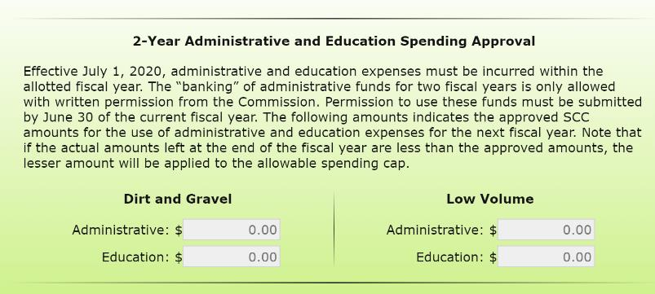
DGLVR Program
5-Year Agreements & Spending

Slide 10
DGLVR Program
5-Year Agreements & Spending
Reminders about project payments:
Advance:
Funds paid from conservation district to grant recipient before any project work is done
Up to 50% of contracted grant amount
Final Payment:
Must be at least 30% of the contract
Can only be made after project completion
Construction completed to DGLVR requirements and district satisfaction
Completion report properly filled out and signed by district and grant recipient
All required paperwork received: invoices, prevailing wage, off ROW permission, evidence of permits, etc.

Slide 11
DGLVR Program
5-Year Agreements & Spending
Reminders about project payments:
Partial payment:
Payment for construction completed before a project is 100% complete
Conservation district must have receipts for any advance payments PLUS the requested partial payment
Cannot exceed 70% of total grant amount

Slide 12
DGLVR Program
5-Year Agreements & Spending
How to spend money:
Admin and education expenses paid for between 7/1/2023 and 6/30/2024
Do simple projects
Why? They can be completed by 6/30/2024
Note that advances & partial payments count towards spending, but are rarely adequate to meet spending requirements
Call Roy, Ken, and Sherri
Will happily do a budget analysis with you ☺

Slide 13
DGLVR Program
5-Year Agreements & Spending
Things not to do:
Additional partial payments before the advance is spent is not allowed by policy
It is not advisable to provide additional funds to a project that will not be done by 6/30/2024
It is not advisable to contract a new stream crossing now to try to spend funds by 6/30/2024

Slide 14
DGLVR Program
5-Year Agreements & Spending
Things not to do:
Additional partial payments before the advance is spent is not allowed by policy
If your schedule of payments allows you to pay up to 70%, then you can pay an additional 20% of the contract value (original contract + amendments)

Slide 15
DGLVR Program
5-Year Agreements & Spending
Example schedule of payments:
$100,000 total contract amount
$50,000 is advanced
District receives receipts for $20,000 in materials costs.
Can you provide another payment for $20,000?
NO!
Because the grant recipient still has $30,000 of the original advance
An additional payment at this point would essentially be another advance, which is not allowed

Slide 16
DGLVR Program
5-Year Agreements & Spending
Example schedule of payments:
$100,000 total contract amount
$50,000 is advanced
District receives receipts for $70,000 in materials costs.
Can you provide another payment for $20,000?
YES!
Because the grant recipient has spent the original advance, plus an additional $20,000

Slide 17
DGLVR Program
5-Year Agreements & Spending
Example schedule of payments:
$100,000 total contract amount
$50,000 is advanced
District receives receipts for $80,000 in materials.
Can you provide another payment for $30,000?
NO!
Because you have to retain at least 30% of the contract for final payment
You can make a partial payment of $20,000.
The other $10,000 is part of the final payment.

Slide 18
DGLVR Program
5-Year Agreements & Spending
Things not to do:
It is not advisable to provide additional funds to a project that will not be done by 6/30/2024
This ties up 50% of the amount as funds that cannot be spent by 6/30/2024

Slide 19
DGLVR Program
5-Year Agreements & Spending
Example:
Existing $100,000 contract ($50,000 advance)
Won’t be completed by 6/30/2024
Have $50,000 left to spend by 6/30/2024
Could I provide a $50,000 amendment to the contract to meet my 6/30/2024 spending requirement?
NO
Why? Because you can only give an additional $25,000 advance
Also, because the contract won’t be completed by 6/30/2024, there is no way to spend the other $25,000

Slide 20
DGLVR Program
5-Year Agreements & Spending
Don’t forget to call us to discuss your specific situation

Slide 21
DGLVR Program
5-Year Agreements & Spending
Things not to do:
It is not advisable to contract a new stream crossing now to try to spend funds by 6/30/2024
Very likely will not be able to be complete
Also treat other complex, engineered/permitted projects the same way (land slides, etc.)
Note that if your spending requirement can be met with other spending (including the advance for the stream crossing): it can be okay to sign that contract.

Slide 22
DGLVR Program
5-Year Agreements & Spending
Spending “old” vs “new” funds
Note that ALL DGLVR funds spent between 7/1/2023-6/30/2024 will count towards spending requirements
Including “new” funds from 2023-24 allocation

Slide 23
DGLVR Program
5-Year Agreements & Spending
Call Ken, Sherri, or Roy for assistance in determining how to meet your spending requirement

Slide 24
DGLVR Program
5-Year Agreements & Spending
Question:
What if funds are not spent by 6/30/24?
Answer:
Per conditions of the existing 5-year agreement (section 1.3): “…the funds will revert back to the control of the Commission for future apportionments, or the District may, at the discretion of the Commission, be ineligible for future allocations, or the amount of such funds may be deducted from any future apportionment to the District.”

Slide 25
DGLVR Program
5-Year Agreements & Spending
Question:
How do I know how much I need to spend to meet my spending requirements?
Answer:
This information is available in the GIS.

Slide 26
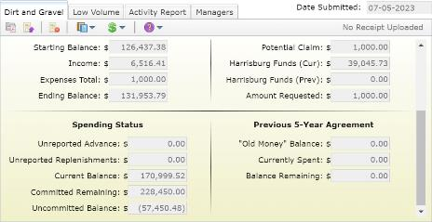
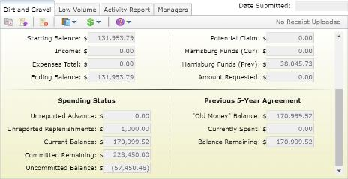
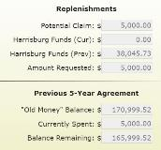
DGLVR Program
5-Year Agreements & Spending
What happens when the April – June, 2023 Quarter is Accepted?
The Current Balance will be copied to the “Old Money” Balance
All remaining funds from the old agreement that are still in Harrisburg will be shifted to the previous agreement.
April – June Quarter
All expenses, which are equivalent to the Potential Claim will also count towards reducing your “Old Money” Balance to zero.
July - September Quarter

Slide 27
DGLVR Program
5-Year Agreements & Spending
Question:
What happens next?
Answer:
The SCC will begin accepting April-June 2023 quarterly reports
Once your QR is accepted, new numbers will appear in the July-Sept 2023 quarterly report:
Location where you track 5-year spending moves
New allocations will appear in the quarterly report once the funds are encumbered

Slide 28
DGLVR Program
5-Year Agreements & Spending
Question:
When do I get my advance?
Answer:
After a while:
Funds need to be encumbered first
State budget needs to pass
SCC will not process advances until the last quarterly report in the 5-year agreement is accepted
It is especially important that account balances match at the end of the 5-year agreement

Slide 29
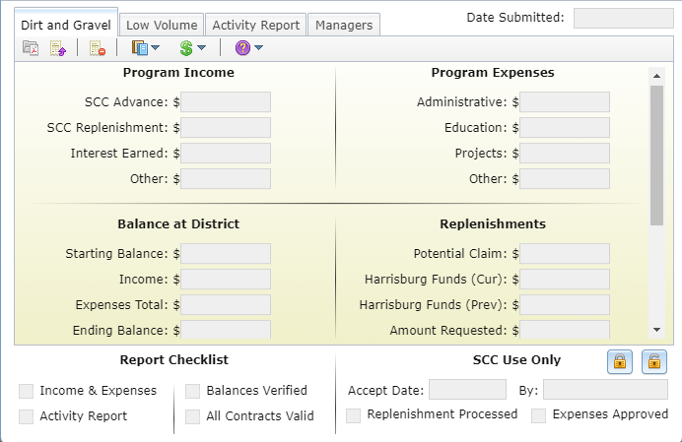
DGLVR Program
5-Year Agreements & Spending
If there are any inconsistencies between your local and GIS accounts, CALL US IMMEDIATELY

