Slide 1
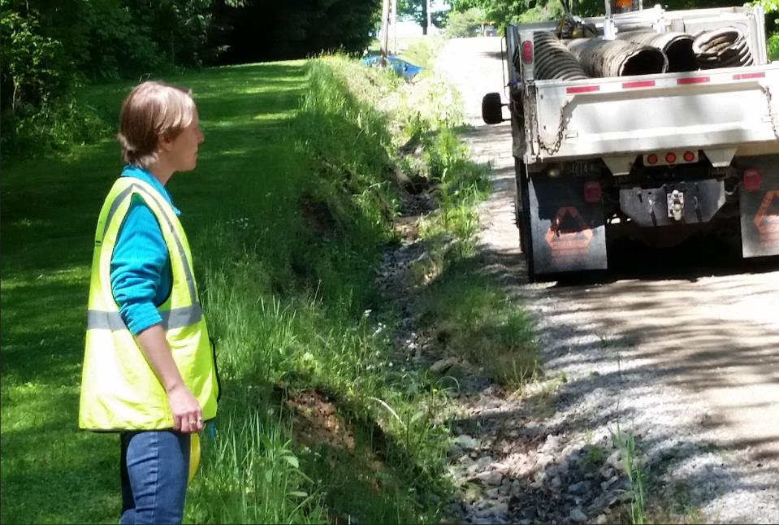
Dirt Gravel and Low Volume Road Program
WEBINAR
2/16/23
Starts 9am
Estimating Quantities and Costs
Presenters:
Tim Ziegler
PSU Center for Dirt & Gravel Road Studies
Shaun McAdams
PSU Center for Dirt & Gravel Road Studies
If you are reading this, then you are successfully seeing the webinar video. Webinar audio should be automatic through your computer (or click “join audio”), and options can be accessed in the “audio options” button on the bottom left. If your computer audio is not working, you can listen on your phone by dialing 646-876-9923.

Slide 2
Estimating Quantities & Costs
Purpose: To share ideas for estimating materials, to generate projected costs for DGLVR projects
Recommended procedure:
Determine road plan and the practices included
Determine needed quantities for each practice
Itemize and combine quantities for the plan
We will cover:
Material quantities for common ESM practices
Commonly overlooked items

Slide 3
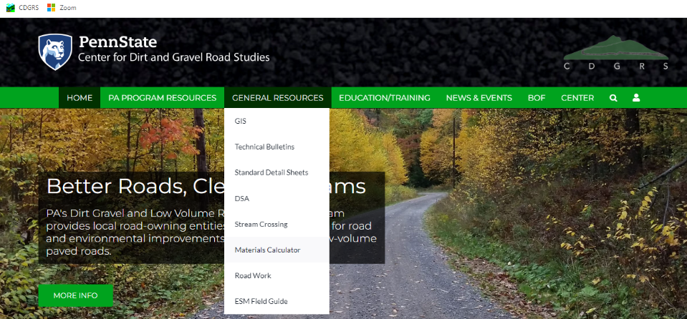
Estimating Quantities & Costs
DGLVR Materials Calculator

Slide 4
Estimating Quantities & Costs
Estimating material quantities for ESM practices:
Road Fill/Road Base
Crosspipe/Storm Sewer Installation
Subsurface Drainage
Driving Surface Aggregate
Stream Crossing Replacement

Slide 5
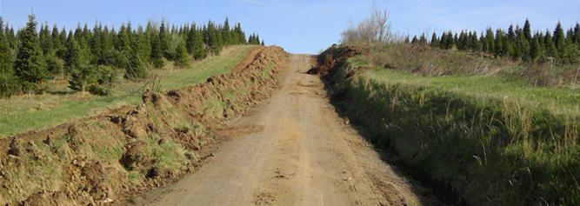
Estimating Quantities & Costs
Estimating material quantities for ESM practices:
Road Fill/Road Base

Slide 6
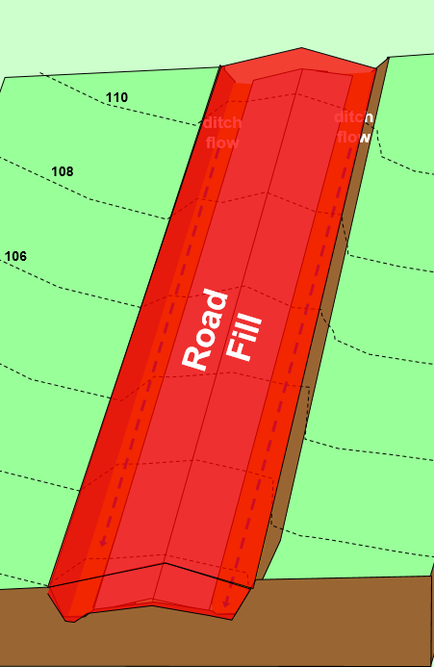
Estimating Quantities & Costs
Data to collect in the field for road fill estimates
Measure Fill Length at road centerline

Slide 7
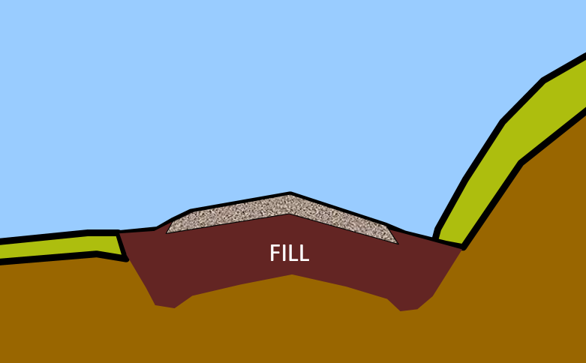
Estimating Quantities & Costs
Data to collect in the field for road fill estimates
Measure Fill Width at the top of bank

Slide 8
Estimating Quantities & Costs
Data to collect in the field for road fill estimates
Measure Fill Depth at road shoulder

Slide 9
Estimating Quantities & Costs
Estimating material quantities for ESM practices:
Full Fill Option (for sectional fill break into segments)
Length x Width x Depth in feet = cubic feet of compacted material required (in place)
Cubic feet ÷ 27 = cubic yards required (in place)
Cubic yards x 1.33 = cubic yards of
uncompacted material required (as shipped)
Cubic yards of uncompacted material x 1.5 =
tonnage of material required (as shipped)
Measure on road shoulder

Slide 10
Estimating Quantities & Costs
Estimating material quantities for ESM practices:
Example fill calculation
1,400’ long project: 900’ needs 2.5’ of fill and 500’ needs 1’ of fill
Calculate for 2.5’ fill segment:
900’ L x 25’ W x 30”(2.5’) D = 56,250 ft³
56,250 ft³ ÷ 27 = 2,083 yd³ compacted fill
2,083 yd³ x 1.33 = 2,770 yd³ loose fill required
2,770 yd³ x 1.5 = 4155 tons required for 900’
But, there is a simpler way to do this…..
Measure on road shoulder

Slide 11
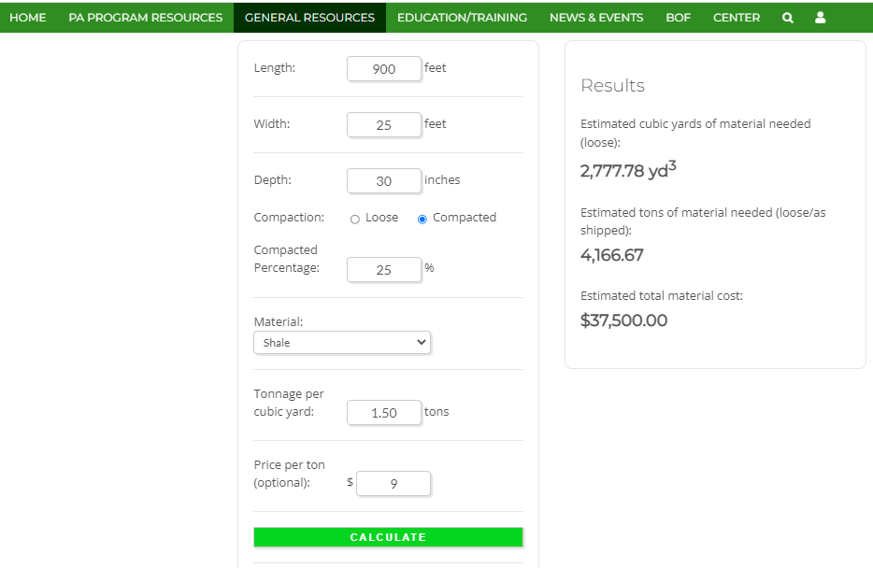
Estimating Quantities & Costs
Example Road Fill
900’ long
25’ wide
30” deep
shale
$ 9/ton
For the 2.5’ fill stretch

Slide 12
Estimating Quantities & Costs
Estimating material quantities for ESM practices:
Example fill calculation
1,400’ long project: 900’ needs 2.5’ of fill and 500’ needs 1’ of fill
Calculate for 1’ fill segment:
500’ L x 25’ W x 12”(1’) D = 12,500 ft³
12,500 ft³ ÷ 27 = 463 yd³ compacted fill
463 yd³ x 1.33 = 616 yd³ loose fill required
616 yd³ x 1.5 = 924 tons required for 500’
Measure on road shoulder

Slide 13
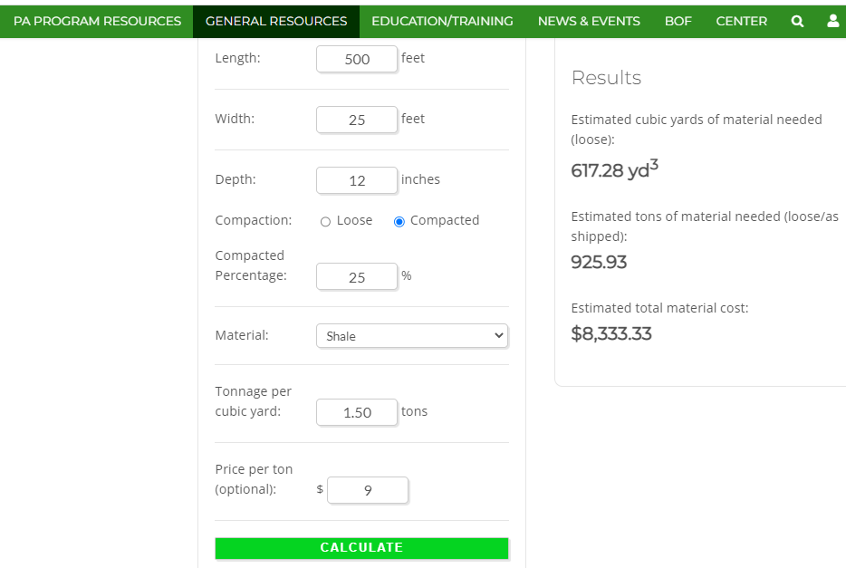
Estimating Quantities & Costs
Example Road Fill
500’ long
25’ wide
12” deep
shale
$ 9/ton
For the 1’ fill stretch

Slide 14
Estimating Quantities & Costs
Estimating material quantities for ESM practices:
Example fill calculation
Add together segments for entire project:
900’ at 30”(2.5’) D = 4,167 tons or 2,778 yd³
500’ at 12”(1’) D = 926 tons or 617 yd³
Total fill amount required for project (as shipped):
5,093 tons or 3,395 yd³
Measure on road shoulder

Slide 15
Estimating Quantities & Costs
Estimating material quantities for ESM practices:
Good things to know -
A tri-axle truck hauls ~14 yd³ or 21 tons of fill
The previous example will require approx. 243 tri-axle truck deliveries to the project site
Shale/bank-run often priced by the truck load (use total yd³ ÷ 14 to figure truck loads)
Don’t discount total fill volume for pipes, French Mattresses, underdrains, etc.
Measure on road shoulder

Slide 16
Estimating Quantities & Costs
Estimating material quantities for ESM practices:
Fill for Base Enhancement
Calculated the same as Full Fill Option, but…
fill width is the road width, including shoulders, not bank to bank.
Measure on road shoulder

Slide 17
Estimating Quantities & Costs
Estimating material quantities for ESM practices:
Road Fill/Road Base
Crosspipe/Storm Sewer Installation
Subsurface Drainage
Driving Surface Aggregate
Stream Crossing Replacement

Slide 18
Estimating Quantities & Costs
Data to collect in the field for pipe estimates
Crosspipe/Storm Sewer Information
Collect Info for:
Length of pipe needed by pipe diameter
Each pipe length can vary by desired inlet and outlet locations (keep lengths to 10’ intervals)
Number of drop inlets/junction boxes needed
Need for and size of outlet protection
If pipes will be shallow or standard installation
- Shallow crosspipes need more fill per pipe
Measure on road shoulder

Slide 19
Estimating Quantities & Costs
Estimating material quantities for ESM practices:
Crosspipe/Storm Sewer Pipe Quantity
For quantity of pipe:
Take the total length of each diameter pipe needed ÷ 20 = # of sticks for each diameter
For collared pipe, the number of joints = number of collars needed
Consider pipe angle when calculating the length of pipe needed. Round individual pipe lengths to nearest 10’. Half sticks are usable, smaller are not.
Measure on road shoulder

Slide 20
Estimating Quantities & Costs
Estimating material quantities for ESM practices:
Crosspipe bedding and cover needs
For typical 15” and 18” pipes:
Combine total length of 15” and 18” pipe = total length of trench in feet
Default to 3.5’ width for pipe trench
Use 3’ for trench depth to ensure minimum 12” pipe cover
Total trench length x 3.5 x 3 = the volume of pipe backfill needed (solve for tons as with road fill or use Materials Calculator)…
Measure on road shoulder

Slide 21
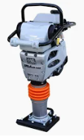
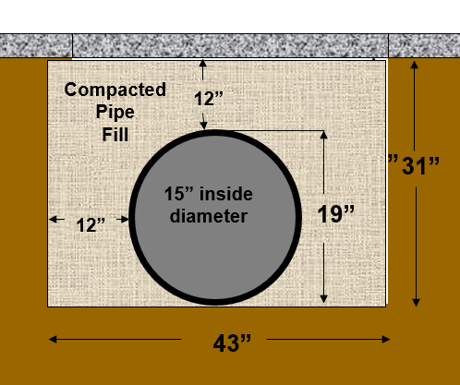
Estimating Quantities & Costs
Estimating material quantities for ESM practices:
Crosspipe bedding and cover needs
Why this wide and deep you ask?
Jumping Jack has 8” wide foot
15” pipe has 19” ID
18” pipe has 22” ID
Crush protection for pipes prior to surfacing
Measure on road shoulder

Slide 22
Estimating Quantities & Costs
Estimating material quantities for ESM practices:
Crosspipe bedding and cover needs
Do not discount for the volume displaced by the pipe. Any extra fill will help to smooth in trench edges.
Measure on road shoulder

Slide 23
Estimating Quantities & Costs
Estimating material quantities for ESM practices:
Crosspipe bedding and cover needs
Thumb rule for pipe bedding on standard crosspipes:
Calculate for uncompacted material
240’ of 15” pipe in plan x
3.5’ wide trench x 3’ deep trench = 2,520 ft³ ÷ 27 = 93 yd³ x 1.5 (basic conversion factor) = approx. 140 tons
(approx. 6.5 tri-axle loads)
OR
1/2 tri-axle load of fill for each 20’ stick of 15” or 18” pipe used is close enough for small jobs and government work.
Measure on road shoulder

Slide 24
Estimating Quantities & Costs
Estimating material quantities for ESM practices:
Specific to Replacement Crosspipes and Storm Sewer bedding
Storm sewers and existing deep pipe installations may require greater fill volumes, depending on depth and municipal regulations.
Take field measurements to accurately account for the fill needs of these structures.
Do not discount for the volume displaced by the pipe.
+++
Measure on road shoulder

Slide 25
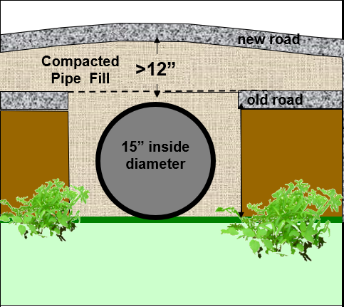
Estimating Quantities & Costs
Estimating material quantities for ESM practices:
Specific to Shallow Crosspipes with associated grade breaks
Shallow pipes gain cover by importing material and raising the road over the pipe.
The actual amount of needed fill will depend on road width and the taper into the road surface in each direction. This should be determined in the field. But a thumb rule of
Two tri-axle loads of aggregate for each shallow crosspipe
works well for estimating.
Measure on road shoulder

Slide 26
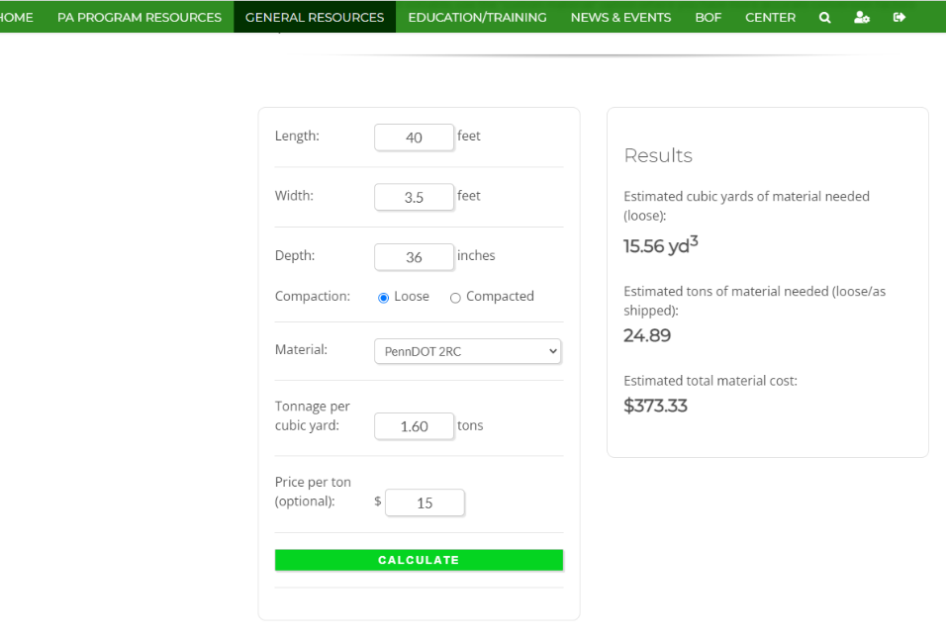
Estimating Quantities & Costs
Example Pipe Bedding
40’ long
3.5’ wide
36” deep
2RC
$15/ton
If you like math, you can use your hand calculator. Or…
You can use the Materials Calculator
For small jobs with ≤ 10 pipes, the thumb rule of ½ truckload per 20’ stick will get you close for standard pipe installations

Slide 27
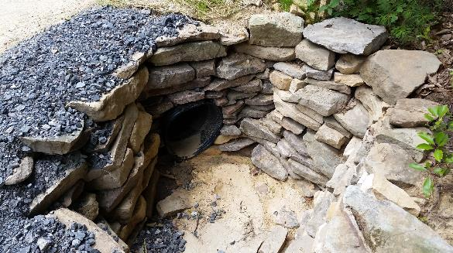
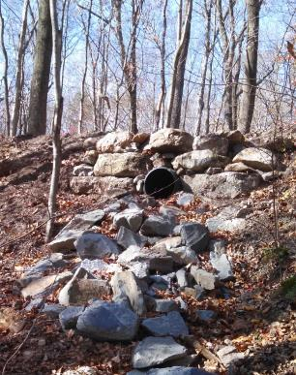
Estimating Quantities & Costs
Estimating material quantities for ESM practices:
Crosspipe/Storm Sewer inlet/outlet protection
Headwalls, endwalls, bank walls and scour aprons:
Measure on road shoulder

Slide 28
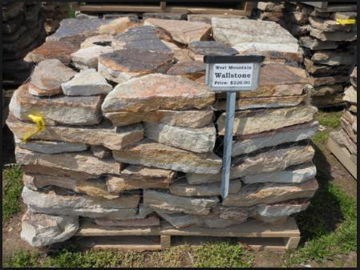
Estimating Quantities & Costs
Estimating material quantities for ESM practices:
Crosspipe/Storm Sewer headwalls/bank walls
A typical pallet of wall stone is one cubic yard and weighs 1 ½ tons.
Four typical pipe walls can be built out of each pallet of wall stone.
The rule above is for 15” & 18” crosspipes. Larger drainpipes and stream culverts need more stone.
Measure on road shoulder

Slide 29
Estimating Quantities & Costs
Estimating material quantities for ESM practices:
Crosspipe/Storm Sewer precast inlets & outlets
If you use drop inlets on crosspipes, you must still account for endwalls.
Figure inlet numbers and any needed junctions.
Note that inlet grates are sold separately.
Headwalls and endwalls constructed of materials other than natural stone (i.e., pre-cast blocks, poured in-place concrete, pre-cast headwalls, etc.) require site specific estimates. Consult local suppliers.
Measure on road shoulder

Slide 30
Estimating Quantities & Costs
Estimating material quantities for ESM practices:
Crosspipe/Storm Sewer outlet scour protection
The need for scour protection aprons is typically a judgement call based on anticipated flow, soil stability, and steepness at the outlet.
The size of the apron is also a judgement call.
R-4 & R-5 riprap over geofabric is commonly used.
For tons of rip-rap required multiply the apron length x width x depth (1.5’ for R-4 and 2’ for R-5) ÷ 27 to get yd³ x 1.4 = tons to order. Or plug figures into the Materials Calculator…
Measure on road shoulder

Slide 31
Estimating Quantities & Costs
Estimating material quantities for ESM practices:
Road Fill/Road Base
Crosspipe/Storm Sewer Installation
Subsurface Drainage
Driving Surface Aggregate
Stream Crossing Replacement

Slide 32
Estimating Quantities & Costs
Field data to get for subsurface drainage practices
Length, width, and depth of the underdrain or French Mattress.
The above is determined by site conditions:
For underdrain ask what is peak flow anticipated, consider number of outlets and physical site constrictions
For Mattresses account for desired road width, road elevation, base stability, embedded pipes
Measure on road shoulder

Slide 33
Estimating Quantities & Costs
Estimating material quantities for ESM practices:
Underdrain design/estimating considerations
Perforated flexible pipe is available in rolls or more rigid sections in different diameters. Estimate required amount by the linear foot.
AASHTO 1 stone recommended for subsurface drainage applications.
Non-woven separation fabric is recommended for subsurface drainage applications.
Separation fabric for constructed underdrain requires a double layer on the top.
Measure on road shoulder

Slide 34
Estimating Quantities & Costs
Estimating material quantities for ESM practices:
Underdrain design/estimating considerations
Example of underdrain material estimation:
Factor a minimum of 1’ of cover over underdrain
(R-4 or AASHTO 1 often recommended)
Length’ x 2X the UD Width’ x 1’ ÷ 27 x 1.4 = ~tons
Calculate rock needs per method for crosspipe fill
(disregard the pipe displacement)
Measure on road shoulder
Determine geotextile needs by:
Length x 3X Width x 2X Depth = ft² required
(5,400 ft² or 600 yd² per roll)
Determine pipe diameter desired and length required

Slide 35
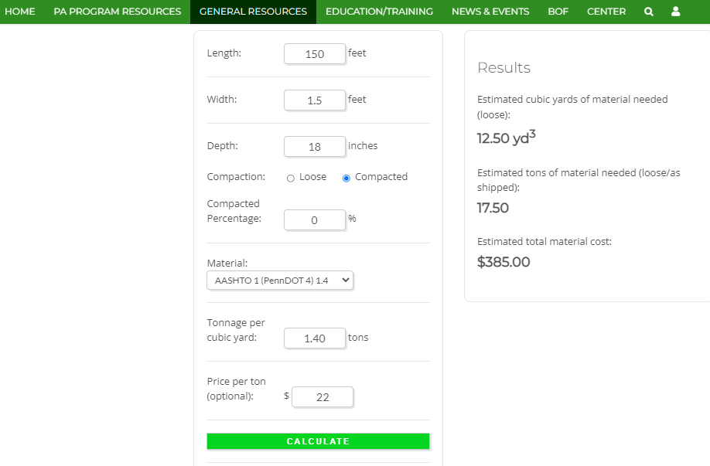
Estimating Quantities & Costs
Example Underdrain
150’ long
1.5’ wide
18” deep
AASHTO #1
$22/ton

Slide 36
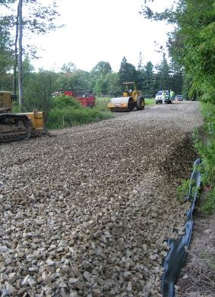
Estimating Quantities & Costs
Estimating material quantities for ESM practices:
French Mattress estimating considerations
Example of French Mattress material estimation:
Remember to factor in 1’ of compacted cover over Mattress. Don’t cover inlet/outlet of mattress.
Calculate rock needs by:
Length’ x Width’ x Depth’ = ft³ ÷ 27 = yd³ required
X 1.4 = tonnage required
Measure on road shoulder
Determine geotextile needs by:
2X Length’ x 2X Width’ (accounts for top and bottom) x 2X Depth’ (accounts for each end) + 2X Length’ if linear overlap is required, and 1X Width’ for each lateral overlap required = ft² required
(*rolls come in 12.5’ x 432’, 15’ x 360’, 17.5 x 308’)
Determine length of mattress (specified linear distance in the road)

Slide 37
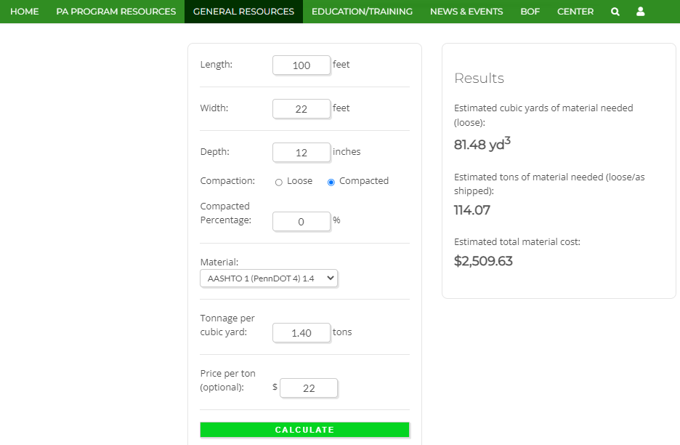
Estimating Quantities & Costs
Example French Mattress
100’ long
22’ wide
12” deep
AASHTO #1
$22/ton

Slide 38
Estimating Quantities & Costs
Estimating material quantities for ESM practices:
Road Fill/Road Base
Crosspipe/Storm Sewer Installation
Subsurface Drainage
Driving Surface Aggregate
Stream Crossing Replacement

Slide 39
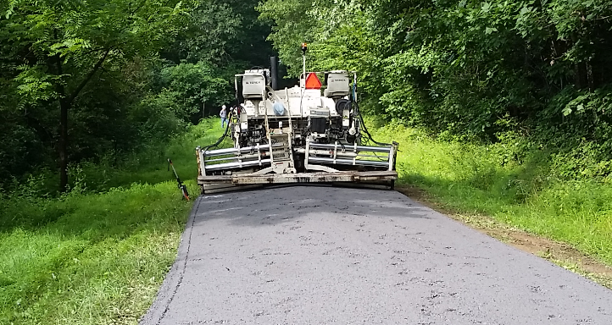
Estimating Quantities & Costs
Estimating material quantities for ESM practices:
Driving Surface Aggregate
Measure on road shoulder
DSA estimates are generally calculated on a cost per ton in-place. This figure includes the cost of material, hauling to site, paver placement, compaction, and traffic control.

Slide 40
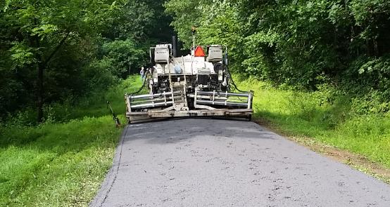
Estimating Quantities & Costs
Estimating material quantities for ESM practices:
Driving Surface Aggregate
Measure on road shoulder
DSA Tonnage Estimation
4 ½” compacted lift (6” loose): L’ x W’ x .030 = tons
6” compacted lift (8” loose) use: L’ x W’ x .040 = tons

Slide 41
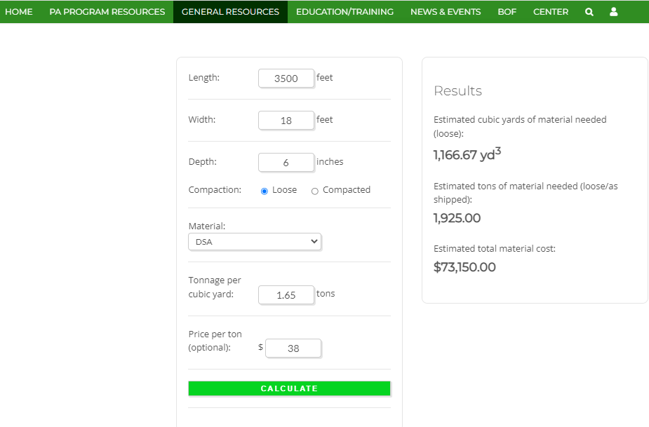
Estimating Quantities & Costs
Example DSA
3,500’ long
18’ wide
6” deep (loose)
DSA
$38/ton

Slide 42
Estimating Quantities & Costs
Estimating material quantities for ESM practices:
DSA pre-placement considerations
Road base preparation is often overlooked on jobs with DSA placement. The road base must be graded to reflect the finished road shape desired. This may require supplemental road base material to be included in the plan.
Anytime a grant application includes only DSA, further investigation is warranted. Few project sites won’t benefit from drainage, base improvements, and other ESMs prior to DSA paving.
“You’ve got to bake the cake before you can ice it!”
Measure on road shoulder

Slide 43
Estimating Quantities & Costs
Estimating material quantities for ESM practices:
Road Fill/Road Base
Crosspipe/Storm Sewer Installation
Subsurface Drainage
Driving Surface Aggregate
Stream Crossing Replacement

Slide 44
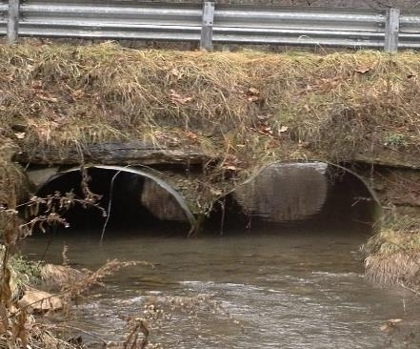
Estimating Quantities & Costs
Estimating material quantities for ESM practices:
Stream Crossing Replacement
Comprehensive Projects:
Replacement Structure
Structure
Foundation (Bedding)
Footings (if bottomless)
Backfill
Instream Restoration
Streambed material
Grade Control features
Bank Margins
Bank Stabilization
Roadway
Road base
Surfacing
Drainage, etc.
Measure on road shoulder

Slide 45
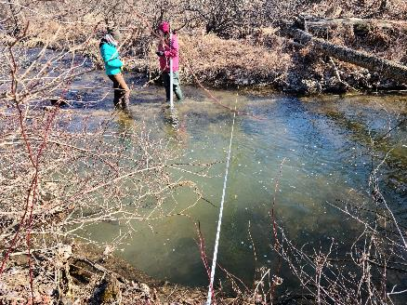
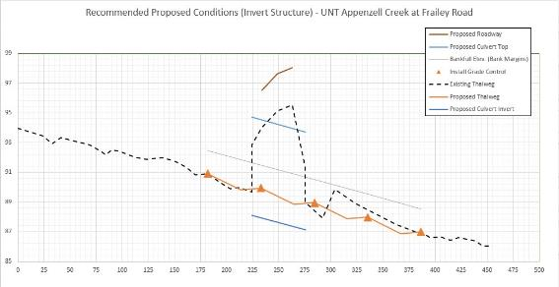
Estimating Quantities & Costs
Estimating material quantities for ESM practices:
Stream Crossing Replacement
The Site Assessment Tool is your most valuable resource!

Slide 46
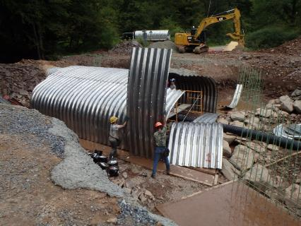
Estimating Quantities & Costs
Estimating material quantities for ESM practices:
Stream Crossing Structure
First must allow for:
bankfull channel width
properly-sized (stable) bank margins
adequate bury depth
Q100 / 80% rule.
After these are met:
cannot be less than 125% bankfull width at bank margin elevation.
Use Site Assessment Tool to predict a suitable structure size
With Your Applicant:
Discuss pros / cons of invert vs. bottomless vs. bridge options
Agree on a preferred structure type and size for the grant application
Slope >4.0% or width >20' is bottomless
Measure on road shoulder

Slide 47
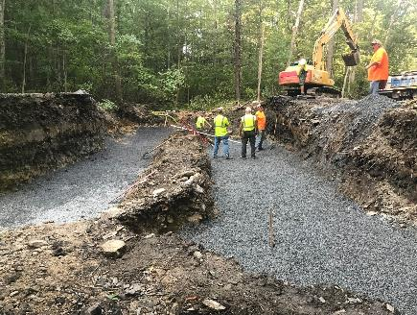
Estimating Quantities & Costs
Estimating material quantities for ESM practices:
Stream Crossing Structure
Cost estimate
Use a recent quote – similar type/size
($ per linear foot)
Contact the vendor
Lane Enterprises
Contech Engineered Solutions
Full invert structure – only need a quote for the structure (delivered)
Bottomless structure – need a quote for the structure and for footings
Pre-cast
Pour-in-place
Express footer
Contact a local concrete supplier for pricing
Structure vendor or applicant may be able to help
Measure on road shoulder

Slide 48
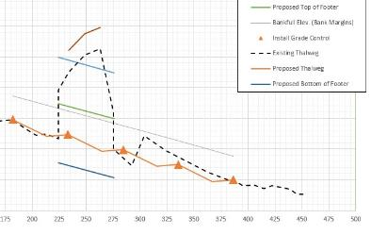
Estimating Quantities & Costs
Estimating material quantities for ESM practices:
Stream Crossing Structure - Footings
Use the Site Assessment Tool!
On "Bottomless Recommendations" tab:
Provides footer height
Assume a footer width (Width)
Use Proposed Structure Length (Length)
Volume = H x W x L
Measure on road shoulder

Slide 49
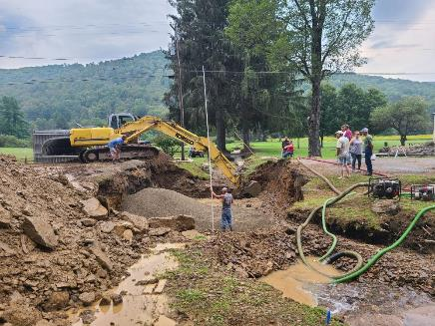
Estimating Quantities & Costs
Estimating material quantities for ESM practices:
Stream Crossing Structure – Foundation / Bedding
Typically a 2”-minus stone
2A Modified, or 2RC (where available)
For a full invert structure
Width = Structure width + 6’ (3’ on each side)
Length = Structure length
Depth = 6” (0.5’)
Use the materials calculator to determine volume (W x L x D)
For bottomless structure
Width = 3’ (assumed for base of footing)
Length = Structure length
Depth = 8” (0.67’)
Volume x 2 (two footings)
Measure on road shoulder

Slide 50
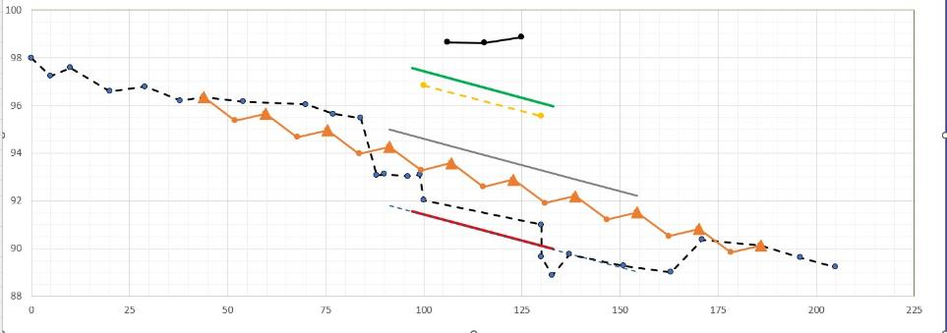
Estimating Quantities & Costs
Estimating material quantities for ESM practices:
Stream Crossing Structure – Streambed Material
How Much Material Do I Need?
Use the Site Assessment Tool (either of the Recommendations graphs)
Determine length of reconstructed reach
If depths vary significantly, break the reconstructed reach into segments (Length)
Estimate an average depth of fill required for each segment (Depth)
Segment 2
ST 130 to 170 (40’)
~ 2.0’ fill
Measure on road shoulder
Segment 1
ST 44 to 88 (44’)
~ 0.5’ cut
Segment 2
ST 88 to 130 (42’)
~ 1.0’ fill

Slide 51
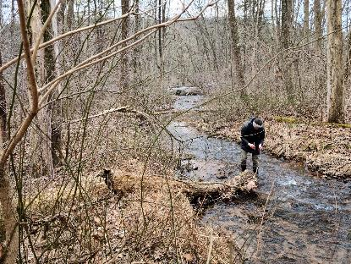
Estimating Quantities & Costs
Estimating material quantities for ESM practices:
Stream Crossing Structure – Streambed Material
How Much Material Do I Need?
Assume channel will be reconstructed to the bankfull width (Width)
Use (Length) and average fill (Depth) from each segment
Remember the Scour Pool cross-section
Use the materials calculator (V = W x L x D)
What Material Do I Need?
Pebble counts give the most reliable basis
Usually a 3-part mix, in equal parts
Reference Reach
Largest material size
Material size moveable at bankfull flow
Finer materials
May be able to use fines from excavated onsite (“project reach” pebble count)
Measure on road shoulder

Slide 52
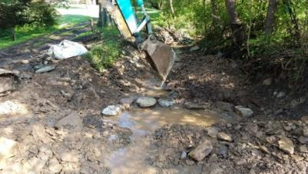
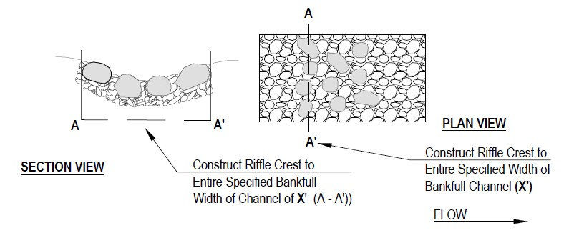
Estimating Quantities & Costs
Estimating material quantities for ESM practices:
Stream Crossing Structure – Grade Controls
What Material Do I Need?
Measure largest grade control rock in reference reach
Use this as a basis for estimating
Engineer will determine actual size in design
(Length) and (Depth) of rock sill
Length
Depth
Measure on road shoulder

Slide 53
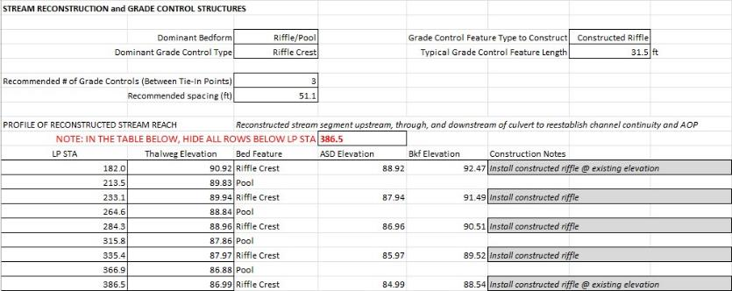
Estimating Quantities & Costs
Estimating material quantities for ESM practices:
Stream Crossing Structure – Grade Controls
How Much Material Do I Need?
Use the Site Assessment Tool!
Grade control (Length)
Assume constructed to bankfull (Width)
(Depth) from largest Grade Control rock in reference reach
Use materials calculator to determine volume for each sill (V = W x L x D)
Measure on road shoulder

Slide 54
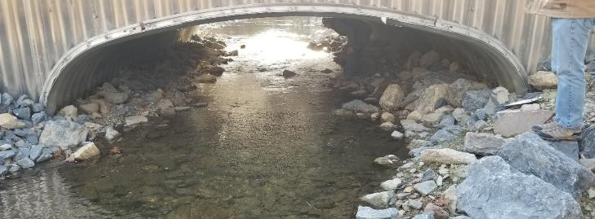
Estimating Quantities & Costs
Estimating material quantities for ESM practices:
Stream Crossing Structure – Bank Margins
What Material Do I Need?
Same as for grade control features…
Measure largest grade control rock in reference reach
Use this as a basis for estimating
Engineer will determine actual size in design
How Much Material Do I Need?
Use the Site Assessment Tool!
Bank Margin width
Bank Margin height above invert or bottom of footer
Length of replacement structure
(may need additional length to tie into existing banks)
Measure on road shoulder

Slide 55
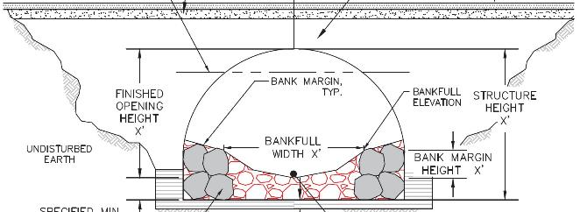
Estimating Quantities & Costs
Estimating material quantities for ESM practices:
Stream Crossing Structure – Backfill / Road Base
How big is the road cut?
Figure the area of a trapezoid
Depth = road elevation – invert of Bottom of Footer Elev.
Bottom width = structure width +6’ (3’ each side)
Assume side slopes 1:1
Calculate top width
Length = structure length
How much backfill?
Use structure “Area” from vendor’s brochure
Cut “area” – structure “area” = backfill quantity needed
Measure on road shoulder

Slide 56
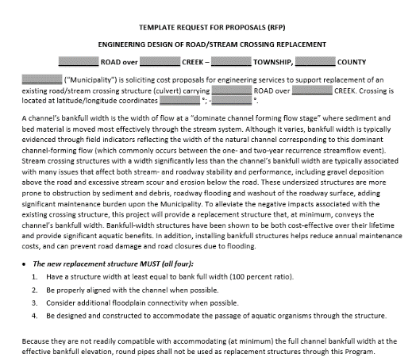
Estimating Quantities & Costs
Estimating material quantities for ESM practices:
Stream Crossing Replacements
Use actual installation costs for recent jobs in your region and collect quotes and cost estimates from manufacturers/suppliers.
Use the RFP for enigineering quotes.
Measure on road shoulder

Slide 57
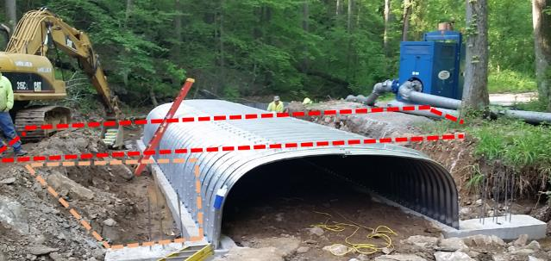
Estimating Quantities & Costs
Estimating material quantities for ESM practices:
Stream Crossing Replacements
Remember stream diversion needs.
Include required cover for selected structure and taper of fill each direction.
Measure on road shoulder
Ensure actual extent of excavation and backfill are accounted for.
How will the job be broken down?
Who is responsible for what?
What materials and services were quoted?
Make sure that you know the breakdown and don’t overlook the basics

Slide 58
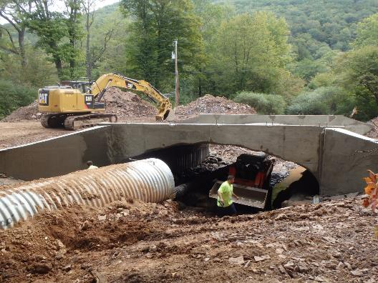
Estimating Quantities & Costs
Estimating material quantities for ESM practices:
Stream Crossing Replacements
Be sure to include ancillary structures to the crossing structure, including:
Headwalls
wing walls
bank stabilization structures
Measure on road shoulder
… and how it’s going to get done
Labor & equipment

Slide 59
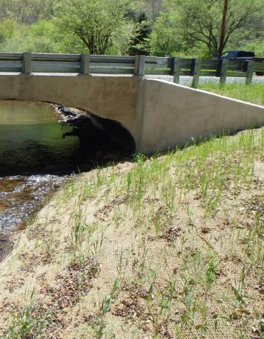
Estimating Quantities & Costs
Estimating material quantities for ESM practices:
Stream Crossing Replacements
Don’t forget E&S Requirements!
Measure on road shoulder

Slide 60
Estimating Quantities & Costs
In conclusion:
Determine plan and practices. Then determine material needs for each practice. Combine the itemized quantities for a total plan estimate.
This will help you:
Determine accuracy of grant applications
Compare bids and recognize bid miscalculations
Monitor material usage, overruns, and potential misappropriation of grant funds
Correlate material amounts with total project costs to estimate contractor costs.

Slide 61
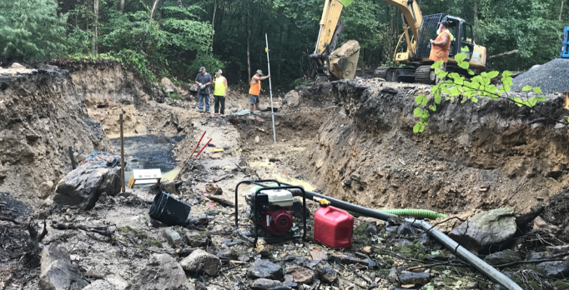
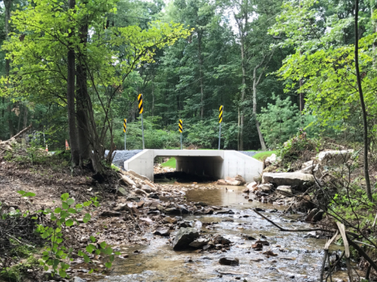
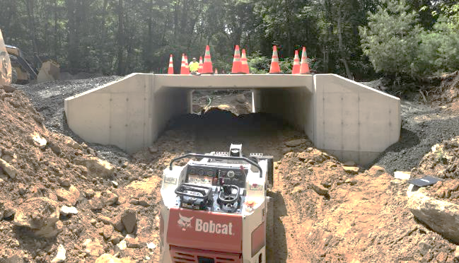
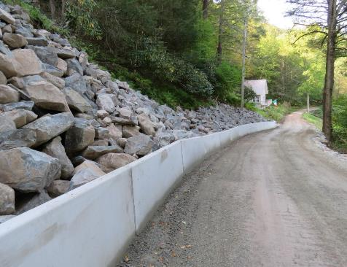
Estimating Quantities & Costs
From beginning to end,
What’s it going to take?

Slide 62
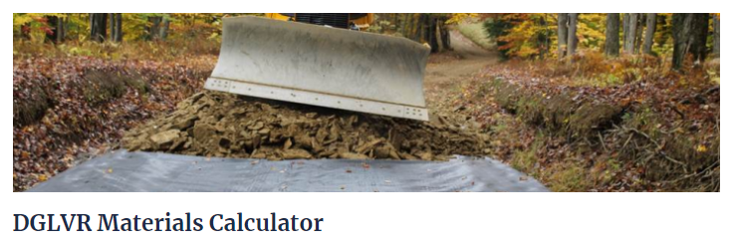
Estimating Quantities & Costs
For DGLVR Projects
Reference sites for estimating material needs:
https://www.dirtandgravel.psu.edu/general-resources/dglvr-materials-calculator
https://www.calculatorsoup.com/calculators/construction/roadway.php

