Slide 1
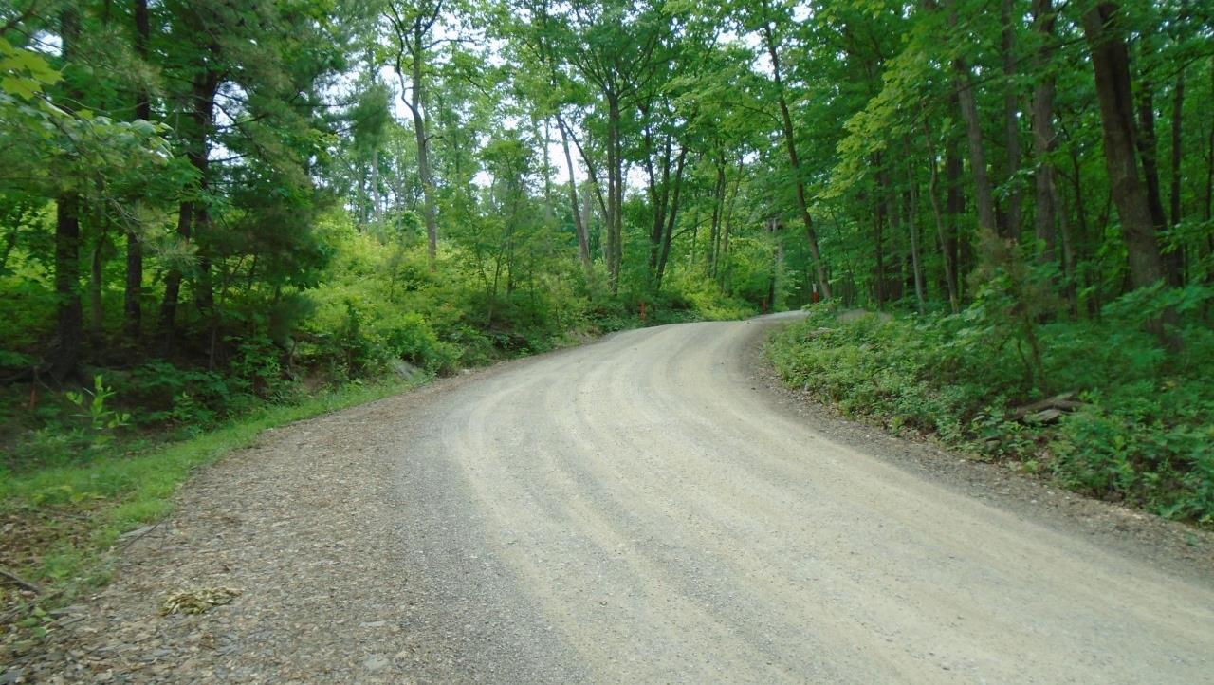
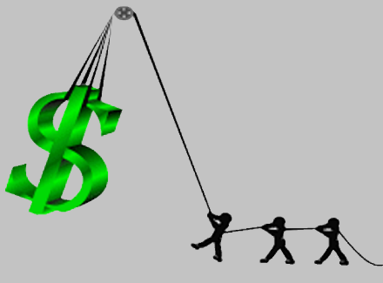


Dirt Gravel and Low Volume Road Program
WEBINAR
3/9/23, 9am
Using DGLVR to Leverage Other Funding
CDGRS
Steve Bloser: smb201@psu.edu
Maria Dreese: maa241@psu.edu
Eric Chase ech111@psu.edu
SCC
Justin Challenger, jchallenge@pa.gov
CDs
Riley Kinney, Allegheny
rkinney@accdpa.org
Alicia Ramsey, Clarion
ramseyccd@gmail.com
Erica Tomlinson, Tioga
etomlinson@tiogacountypa.us
OTHERS WELCOME TO SHARE
If you have experience to share in combining funds, feel free. Enter it into the Q&A, or we will ask if anyone wants to unmute and join the conversation near the end of the session.
If you are reading this, then you are successfully seeing the webinar video. Webinar audio should be automatic through your computer (or click “join audio”), and options can be accessed in the “audio options” button on the bottom left. If your computer audio is not working, you can listen on your phone by dialing 646-876-9923.

Slide 2
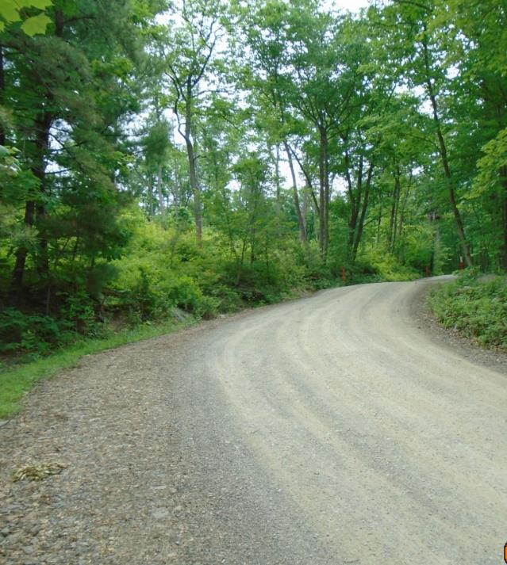



Leveraging Other Funding
Introduction
CD Examples
  Allegheny
  Clarion
  Tioga
CDGRS Examples
Other Examples from attendees?
Potential ACAP/DGLVR partnerships.
Discussion / Questions
If you have experience to share in combining funds, feel free. Enter it into the Q&A, or we will ask if anyone wants to unmute and join the conversation near the end of the session.

Slide 3


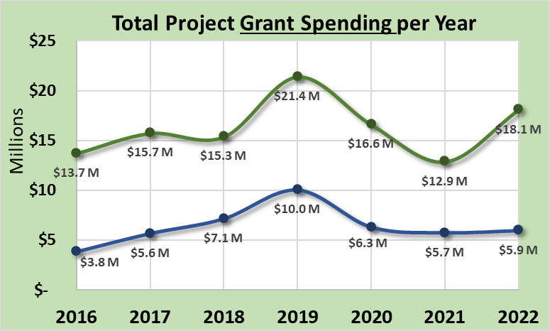
Leveraging Other Funding: Introduction
CDs spending annually through DGLVR
  ~$25M on Projects
  ~$2.5M on admin/edu expenses
Dirt and Gravel
Paved Low-Volume

Slide 4
Leveraging Other Funding: Introduction
CDs spending annually through DGLVR
  ~$25M on Projects
  ~$2.5M on admin/edu expenses
Dirt and Gravel
How much of this funding is used as match with other funding?
  ???? Less than 5% ???
Paved Low-Volume

Slide 5
Leveraging Other Funding: Introduction
CDs spending annually through DGLVR
  ~$25M on Projects
  ~$2.5M on admin/edu expenses
Dirt and Gravel
How much of this funding is used as match with other funding?
  ???? Less than 5% ???
Paved Low-Volume
Purpose Today: Provide examples and ideas to encourage the use of DGLVR funding to partner with and leverage funding from additional sources.

Slide 6
Leveraging Other Funding: Introduction
Why not use money the DGLVR Program is already spending to get additional funding and complete additional (or larger) projects.
Most federal grants require a non-federal match.

Slide 7
Leveraging Other Funding
Introduction
  Potential Funding Sources
  Considerations When Mixing Funds

Slide 8
Leveraging Other Funding: Introduction
Potential Other Sources of Funding
  NFWF
National Fish and Wildlife Foundation
Federal Funding
70+ grant programs
Wide variety of initiatives and priorities
Significant funding but competitive
Require non-federal match (“strive for 200%” match)

Slide 9
Leveraging Other Funding: Introduction
Potential Other Sources of Funding
  NFWF
  USFWS
US Fish and Wildlife Service
Federal Funding
Wide variety of initiatives and priorities
Require non-federal match

Slide 10
Leveraging Other Funding: Introduction
Potential Other Sources of Funding
  NFWF
  USFWS
  Pittman-Robertson
Pittman-Robertson
Federal Funding
For “wildlife restoration”
Common on Game Commission lands

Slide 11
Leveraging Other Funding: Introduction
Potential Other Sources of Funding
  NFWF
  USFWS
  Pittman-Robertson
  CIG
Conservation Innovation Grants
Federal Funding (USDA-NRCS)
Conservation Innovation Grants (CIG) is a competitive program that supports the development of new tools, approaches, practices, and technologies to further natural resource conservation on private lands.
Will provide example today.

Slide 12
Leveraging Other Funding: Introduction
Potential Other Sources of Funding
  NFWF
  USFWS
  Pittman-Robertson
  CIG
  Multimodal Transportation
  Multimodal Transportation
  State Funding (PennDOT)
  The program is intended to provide financial assistance to municipalities, councils of governments, businesses, economic development organizations, public transportation agencies, and ports and rail freight entities to improve transportation assets that enhance communities, pedestrian safety, and transit revitalization.
  Will provide example today.

Slide 13
Leveraging Other Funding: Introduction
Potential Other Sources of Funding
  NFWF
  USFWS
  Pittman-Robertson
  CIG
  Multimodal Transportation
  Growing Greener Plus
  Growing Greener Plus
  State Funding
  Growing Greener Watershed Restoration and Protection
  15% match requirement

Slide 14
Leveraging Other Funding: Introduction
Potential Other Sources of Funding
  NFWF
  USFWS
  Pittman-Robertson
  CIG
  Multimodal Transportation
  Growing Greener Plus
  Liquid Fuels
  PA Liquid Fuels
  State Funding
  NOT GRANT BASED
  PA Municipalities receive funding based on road miles and population
  Liquid Fuels are the basis of municipalities “normal road maintenance” budget
  Potential for conflicts with PennDOT Standards (will discuss example today)

Slide 15
Leveraging Other Funding: Introduction
Potential Other Sources of Funding
  NFWF
  USFWS
  Pittman-Robertson
  CIG
  Multimodal Transportation
  Growing Greener Plus
  Liquid Fuels
  Other Local / Regional Sources
This list is far from all-inclusive
  Liquid Fuels: Grants from County to Municipalities
  Northwest Greenways Block Grant (PA)
  PENNVEST
  Department of Community and Economic Development
  Eastern Brooktrout Joint Venture
  Coldwater Heritage Partnership
  Chesapeake Bay Commission
  Great Lakes Basin Commission
  Western Pa Conservancy
  Susq River Basin Commission

Slide 16
Leveraging Other Funding: Introduction
Potential Other Sources of Funding
  NFWF
  USFWS
  Pittman-Robertson
  CIG
  Multimodal Transportation
  Growing Greener Plus
  Liquid Fuels
  Other Local / Regional Sources
  ACAP
  Agricultural Conservation Assistance Program
  State Funding
  will discuss today

Slide 17
Leveraging Other Funding: Introduction
Potential Other Sources of Funding
  NFWF
  USFWS
  Pittman-Robertson
  CIG
  Multimodal Transportation
  Growing Greener Plus
  Liquid Fuels
  Other Local / Regional Sources
  ACAP
You don’t have to go it alone!
Find a partner!
Many other entities don’t have their own funding but are good at partnering and finding grants!
The Applicant!
Trout Unlimited
Western PA Conservancy
Watershed Groups
COGs
PGC/DCNR/PAFBC/etc.

Slide 18
Leveraging Other Funding
Introduction
  Potential Funding Sources
  Considerations When Mixing Funds

Slide 19
Leveraging Other Funding: Introduction
Considerations When Mixing Funds
  Priorities of other sources?
What are their funding priorities?
Need to “spin” your project to show benefit to other sources.
The same stream crossing replacement will be written very differently for Growing Greener Plus –vs- Multimodal funds –vs- DCED

Slide 20
Leveraging Other Funding: Introduction
Considerations When Mixing Funds
  Priorities of other sources?
  Deadlines for other sources?
When are grants due?
When are DGLVR applications due?
Who is going to write the other grant?
Planning and spending requirements in DGLVR.
Planning and coordination will likely add time, plan ahead and don’t “tie up” DGLVR funding.

Slide 21
Leveraging Other Funding: Introduction
Considerations When Mixing Funds
  Priorities of other sources?
  Deadlines for other sources?
  Labor Rates: Federal Funds
Federal: Davis Bacon
State: Prevailing Wage
PA will accept Davis Bacon guidelines
Threshold is $2,000 contracts, not $25,000
Separate federal wage determination website.

Slide 22
Leveraging Other Funding: Introduction
Considerations When Mixing Funds
  Priorities of other sources?
  Deadlines for other sources?
  Labor Rates: Federal Funds
  Conflicting Standards or Goals?
Sometimes you can mix, sometimes you can’t!
If standards from other funding sources conflict with DGLVR standards, can’t combine funds!
For example, Liquid Fuels must meet PennDOT Standards, which may conflict with Program requirements.
  Stream crossings
  Use of polluting products

Slide 23
Leveraging Other Funding: Introduction
Considerations When Mixing Funds
  Priorities of other sources?
  Deadlines for other sources?
  Labor Rates: Federal Funds
  Conflicting Standards or Goals?
  Match with admin/ staff time, not just projects?
Technical assistance and/or education may be a suitable match for some grants.
What are you already doing for DGLVR (or other programs) that may be of value to others?
  Environmental education for road owners
  Technical assistance
  Project oversight

Slide 24
Leveraging Other Funding
Introduction
CD Examples
  Allegheny
  Clarion
  Tioga
CDGRS Examples
Other Examples from attendees?
Potential ACAP/DGLVR partnerships.
Discussion / Questions
Note we will be focusing on collaborations and funding today, not on project details.

Slide 25
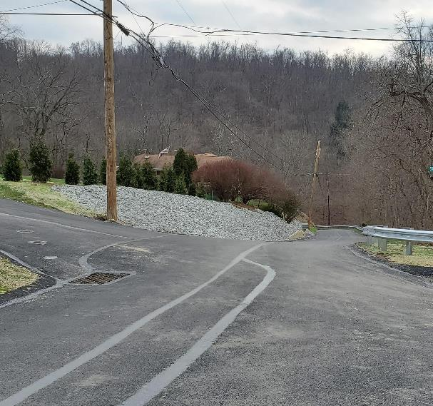

Leveraging Other Funding: Examples
Allegheny County Conservation District
Fuehrer Road, Lincoln Township
DGLVR + Multimodal + Allegheny County
+ Utility company
DGLVR: upslope drainage improvements.
3 basins, stepped stormwater system to filter
Multimodal: Landslide mitigation
County: Road Relocation
PA American Water: Paving
Landslide restricted road to 1-lane
Borough approached CD in 2018
Estimated costs exceeded LVR budget, borough sought additional funds
Road relocated slightly due to slope instabilities.
Water and gas line work already planned, coordinated project with utility and they paid for repaving
Funding Breakdown
DGLVR: $69,000
Cty: $150,000
Multimodal: $155,000
Am Water: ~$25,000
TOTAL: ~$400,000
Notes:
Fuehrer Road is a dead-end street in Lincoln Borough in Allegheny County. In 2018, the Borough approached ACCD to inquire about a grant to repair the landslide that had restricted the road to one lane. Local concerns regarding safety and access to the cluster of homes at the top of the road were top of mind for Borough staff as many residents required access to ambulances and medical staff as well as typical vehicles like delivery trucks, waste management services, and the school bus. In 2019 Lincoln Borough was awarded an LVR grant that would focus on landslide mitigation. The estimated cost of repair for the road exceeded the capacity of the LVR funds and so the Borough sought to supplement funding to cover additional costs and mitigate additional slide impacted areas.
Once all of the funding sources were collected, the total amount from each funding source was:
CITF: $150,000
Multi Modal: $155,444
LVR: $69,000
PA American Water: Paving
For a total project value of $400,000. ACCD typically receives around $215,000 to fund Low Volume Road projects per year.
Fuehrer Road was scheduled to have water and gas line replacement projects that coincided with the project timeline of the landslide repair, so the Borough Secretary was able to coordinate with the utilities to have them replace the lines at the same time as our project was under construction. This allowed us to use the curb-to-curb paving policy for the utility company to cover partial paving costs on both Fuehrer and the adjacent alley near the project site.
During this time ACCD experienced a number of staff transitions as well as a significant amount of back and forth on the final project scope and design selections. After struggling to find the most cost-effective way to keep the road open during construction, repair the slide impacted area in a way that would not restrict traffic, and prevent further deterioration of the hillside, ACCD pivoted the use of their funding to address the upslope drainage for the project and leverage the other grant sources to relocate the road away from the unstable hillside. Three geotechnical reports were completed as part of the project, all of which indicated there was not stable material to reconstruct the road over the original location without significant excavation that would have far exceeded the multi-grant budget. Addressing the drainage for the road was a better fit for the DGLVR program goals and the available budget for the project. Luckily, the additional grant sources were open to adjusting the project plan so that we could best accommodate site specific conditions and make lasting improvements on the road.
The final scope of work included:
LVR – installation of 3 catch basins that would capture upslope water and discharge the stormwater down a stepped manhole system that outlets at the bottom of the hillside. The water is able to filter through a rip rap apron and some additional vegetation.
Multi Modal – road relocation (partial paving). Because of the unstable slopes, Fuehrer Road was shifted away from the slide impacted area. This required the removal of some trees on residential property and stabilizing that area with rip rap (pictured above)
CITF – slide stabilization (partial paving). The slide impacted area was stabilized with shotcrete. Additional drainage work was included in the lower portion of the road to ensure water from the top of the hill did not continue to erode other smaller instabilities on the road.

Slide 26
Leveraging Other Funding
Introduction
CD Examples
  Allegheny
  Clarion
  Tioga
CDGRS Examples
Other Examples from attendees?
Potential ACAP/DGLVR partnerships.
Discussion / Questions

Slide 27
Leveraging Other Funding: Examples
Clarion County Conservation District - Project 1 of 3
Old State/Asbury Road, Clarion and Millcreek Township
DGLVR + Multimodal + County
Completed 2019
24’ W x 10' H x 24’ L
aluminum box with invert
DGLVR $: E&S controls (including
restoration), guide rail, backfill
material (2A), grade control material
(R-8s and R-4s) and portion of
engineering
Multimodal, County, municipality:
all other costs
Funding Breakdown
DGLVR: $50,600
Multimodal: $157,500
County: $20,000
Twp: $912
TOTAL: $229,012
Note: Predates current
policy/standard

Slide 28
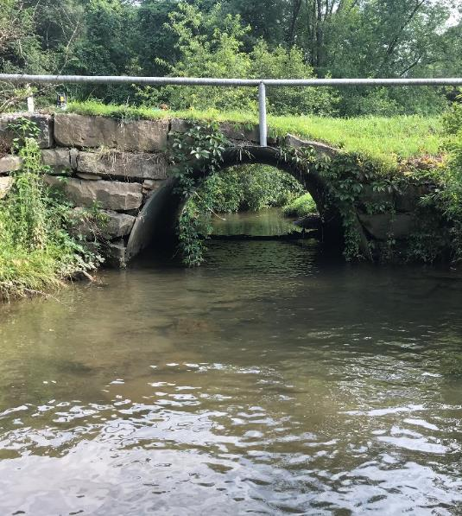
Leveraging Other Funding: Examples
Clarion County Conservation District - Project 2 of 3
Smith Road, Porter Township
DGLVR + Liquid Fuels + County
Underway
Bottomless structural plate arch (27’ W x 6’ H x ~30’ L)
DGLVR: in stream restoration, footers,
E&S controls, a portion of engineering
County Aid: (portion of) the replacement structure
Municipal in-kind: E&S controls, remainder of
structure, labor & equipment, remainder of
engineering + geotechnical design
County + Liquid Fuels $ mean that PennDOT
standards and CDGRS policy must be met. Project
has been in the ‘design’ phase for ~14 months.
Funding Breakdown
DGLVR: $50,000
County: $61,600
Twp: $54,400 (Liq Fuel)
TOTAL: $116,000
-----ALL ESTIMATED------

Slide 29
Leveraging Other Funding: Examples
Clarion County Conservation District - Project 3 of 3
Greer Road, Elk Township
Grant just awarded 2/2023
DGLVR + TU(local) + Northwest
Greenways Block Grant (NWGBG)
In-stream structures plus
streambank stabilization practices
DGLVR: oversight and portion
of construction costs
TU: portion of construction costs
NWGBG: materials and portion
of construction cost
Municipal in-kind: labor and equipment
to assist with construction
Funding Breakdown
DGLVR: $5,000
TU (local): $7,500
NWGBG: $17,500
TOTAL: $30,000
-----ALL ESTIMATED------

Slide 30
Leveraging Other Funding
Introduction
CD Examples
  Allegheny
  Clarion
  Tioga
CDGRS Examples
Other Examples from attendees?
Potential ACAP/DGLVR partnerships.
Discussion / Questions

Slide 31
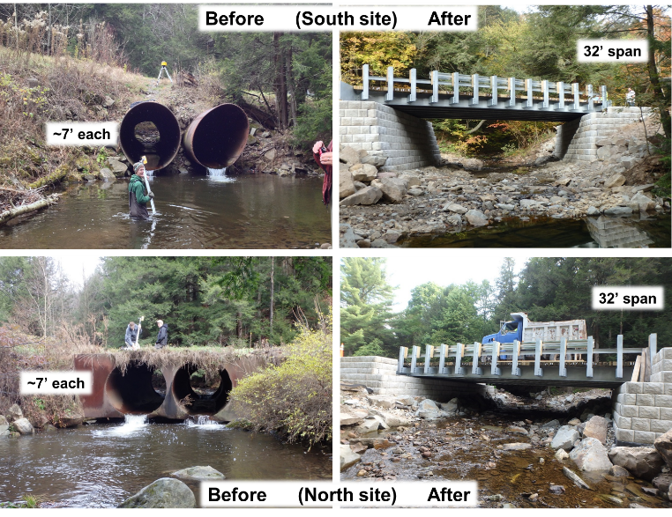
Leveraging Other Funding: Examples
Tioga County Conservation District
Salt Spring Run, Liberty Township
DGLVR + several others
Completed 2017
Two large (~32’) GRS bridges
Opened 11+ miles of trout
habitat
Funding Breakdown
DGLVR: $258,700
USFW: $50,000
NFWF: $200,000
Shell: $30,000
Twp: $18,000
TOTAL: $556,700

Slide 32
Leveraging Other Funding
Introduction
CD Examples
  Allegheny
  Clarion
  Tioga
CDGRS Examples
Other Examples from attendees?
Potential ACAP/DGLVR partnerships.
Discussion / Questions

Slide 33
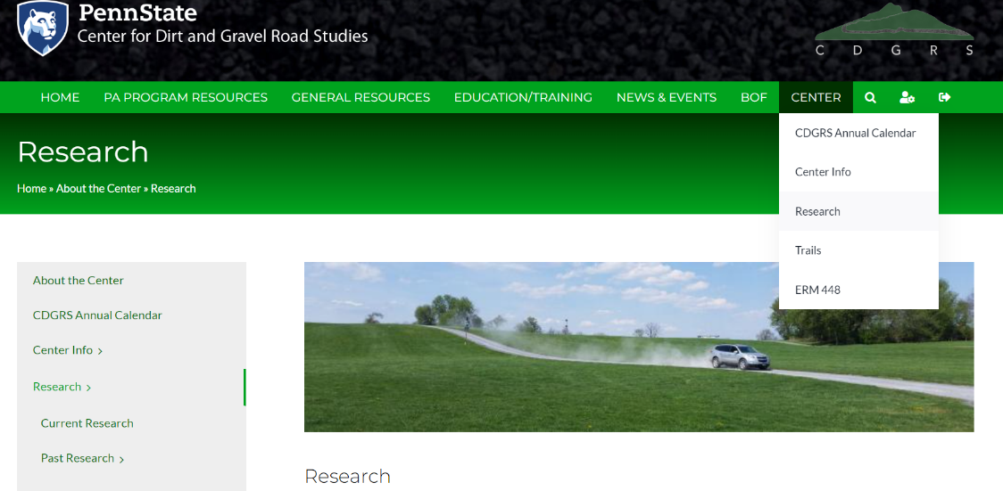
Leveraging Other Funding: Introduction
Note: today is about potential collaborations, not about details of projects and results of research.

Slide 34
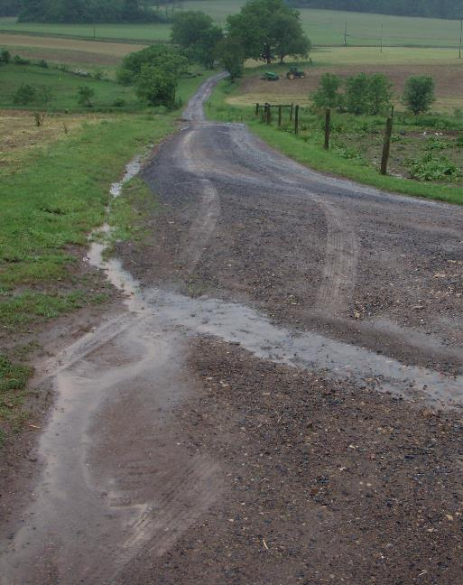
Leveraging Other Funding: Introduction
CDGRS Examples
CIG – Mifflin Farm Lanes
Purpose:
  ESM practices on farm lanes
  Quantify sediment reductions
  Provide training for farmers
Partnerships:
  Conservation Innovation Grant
  Mifflin County CD
  Paired w/ DGLVR funding on adjacent public roads

Slide 35
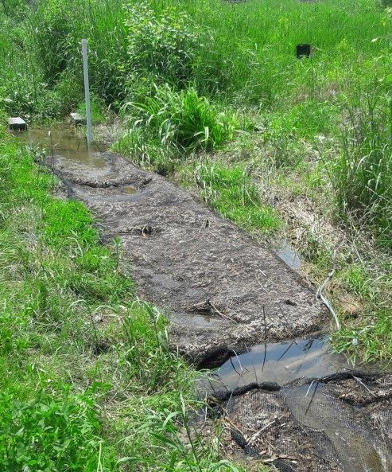
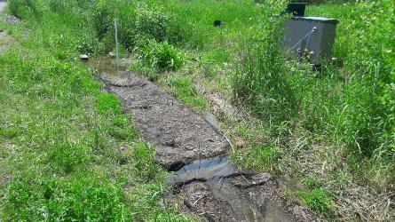
Leveraging Other Funding: Introduction
CDGRS Examples
CIG – Mifflin Farm Lanes
CIG – Bradford Roadside Bioreactor
Purpose:
  Roadside treatment of ag runoff
  Quantify sediment / nutrient reductions
  Provide training for farmers
Partnerships:
  USDA Conservation Innovation Grant
  Bradford County CD Project
  DGLVR funds for practices within ROW
Funding Breakdown
Center Demo: $60,000
Bradford Project: $140,000
Personnel: $55,000
USDA: $228,000
TOTAL: $483,000

Slide 36
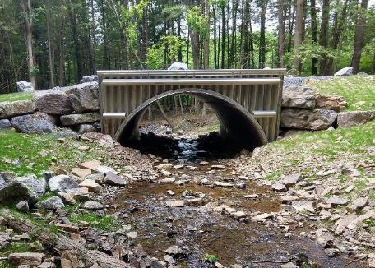
Leveraging Other Funding: Introduction
CDGRS Examples
CIG – Mifflin Farm Lanes
CIG – Bradford Roadside Bioreactor
TU – Tech Assist Match
  CDGRS already providing technical assistance statewide.
  Used some of that time in “focus watersheds” as educational match for TU.
  TU was able to get NFWF grant for NAACC surveys, culvert design work, demo days, and more.

Slide 37
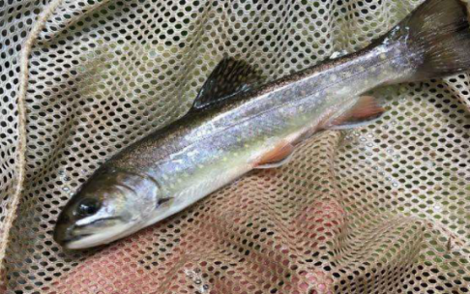
Leveraging Other Funding: Introduction
CDGRS Examples
CIG – Mifflin Farm Lanes
CIG – Bradford Roadside Bioreactor
TU – Tech Assist Match
TU – CD Project Match
  CDs already funding stream crossing replacements.
  Identified projects that would lead to trout habitat reconnection.
  TU used projects as match in several NFWF grants.

Slide 38
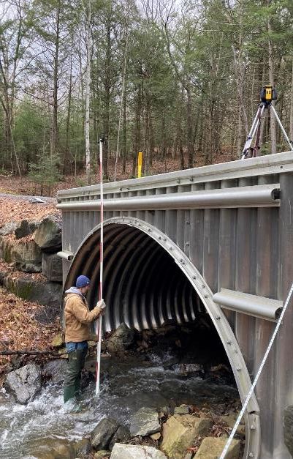
Leveraging Other Funding: Introduction
CDGRS Examples
CIG – Mifflin Farm Lanes
CIG – Bradford Roadside Bioreactor
TU – Tech Assist Match
TU – CD Project Match
WPC – CD Project Match & Center Training
  WPC used match funds to secure 2023 NFWF grant.
  CDs already funding stream crossing replacements.
  Center already providing training and technical assistance.
  Identifies projects with high priority to enhance habitat.
  Funds AOP and Restoration coordinator position at WPC.

Slide 39
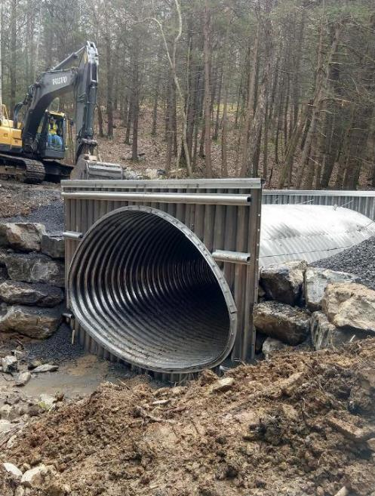
Leveraging Other Funding: Introduction
CDGRS Examples
CIG – Mifflin Farm Lanes
CIG – Bradford Roadside Bioreactor
TU – Tech Assist Match
TU – CD Project Match
WPC – CD Project Match & Center Training
Shavers Creek Stream Crossing
  DGLVR (CDGRS/SCC Demo) funds for structure
  PSU funded $500K+ in additional road improvements (mostly taking advice on ESM practices)
  Juniata College did stream monitoring

Slide 40
Leveraging Other Funding: Introduction
Note: today is about potential collaborations, not about details of projects and results of research.

Slide 41
Leveraging Other Funding
Introduction
CD Examples
  Allegheny
  Clarion
  Tioga
CDGRS Examples
Other Examples from attendees?
Potential ACAP/DGLVR partnerships.
Discussion / Questions

Slide 42
Leveraging Other Funding: Anyone else?
Combining DGLVR and/or using to leverage other funds
Other CDs have experience they would like to share?
“Raise hand” and we can unmute you

Slide 43
Leveraging Other Funding
Introduction
CD Examples
  Allegheny
  Clarion
  Tioga
CDGRS Examples
Other Examples from attendees?
Potential ACAP/DGLVR partnerships.
Discussion / Questions

Slide 44
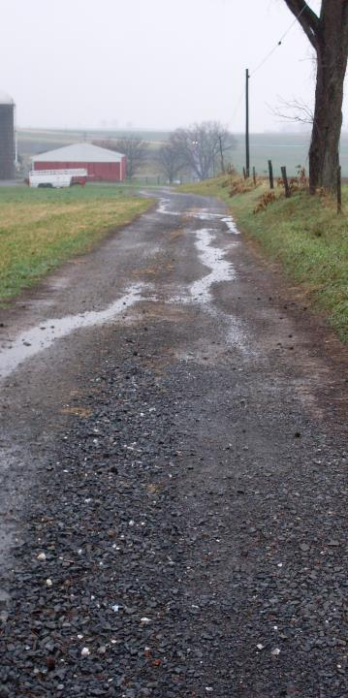
Leveraging Other Funding: DGLVR and ACAP?
Combining DGLVR and ACAP?
ACAP:
  Applicants are farms / ag operations.
  Separate contract with farm owner
  For BMPs that reduce sediment, nitrogen, or phosphorus on ag operations.
  Has to be in a manure management plan, nutrient management plan, ag E&S plan, or conservation plan.

Slide 45
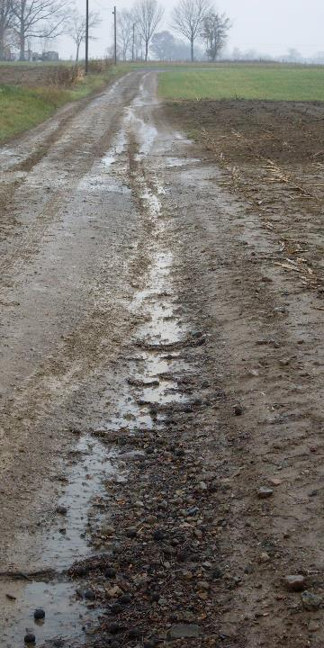
Leveraging Other Funding: DGLVR and ACAP?
Combining DGLVR and ACAP?
ACAP:
  Applicants are farms / ag operations.
  Separate contract with farm owner
  For BMPs that reduce sediment, nitrogen, or phosphorus on ag operations.
  Has to be in a manure management plan, nutrient management plan, ag E&S plan, or conservation plan.
Most likely use of combining funds:
  Improving farm lanes that impact roadways. Can fund DGLVR ESM practices to fix the farm lane / reduce pollution.
  Reducing impacts to road from other “off row” water and sediment sources
      Field and barnyard runoff
      Diversions and swales
      Streambank stabilization
ACAP/DGLVR partner projects:
Maybe its own webinar in the future?

Slide 46
Leveraging Other Funding
Introduction
CD Examples
  Allegheny
  Clarion
  Tioga
CDGRS Examples
Other Examples from attendees?
Potential ACAP/DGLVR partnerships.
Discussion / Questions

Slide 47

Using DGLVR to Leverage Other Funding
CDGRS
Steve Bloser: smb201@psu.edu
Maria Dreese: maa241@psu.edu
Eric Chase ech111@psu.edu
SCC
Justin Challenger, jchallenge@pa.gov
CDs
Riley Kinney, Allegheny
rkinney@accdpa.org
Alicia Ramsey, Clarion
ramseyccd@gmail.com
Erica Tomlinson, Tioga
etomlinson@tiogacountypa.us
OTHERS WELCOME TO SHARE
Summary: Take something you need to do anyway, like fund DGLVR Projects… and use that spending as match to obtain additional funding.

