Slide 1
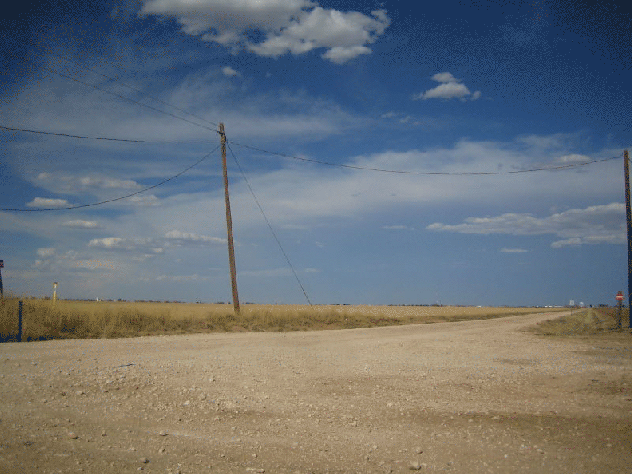
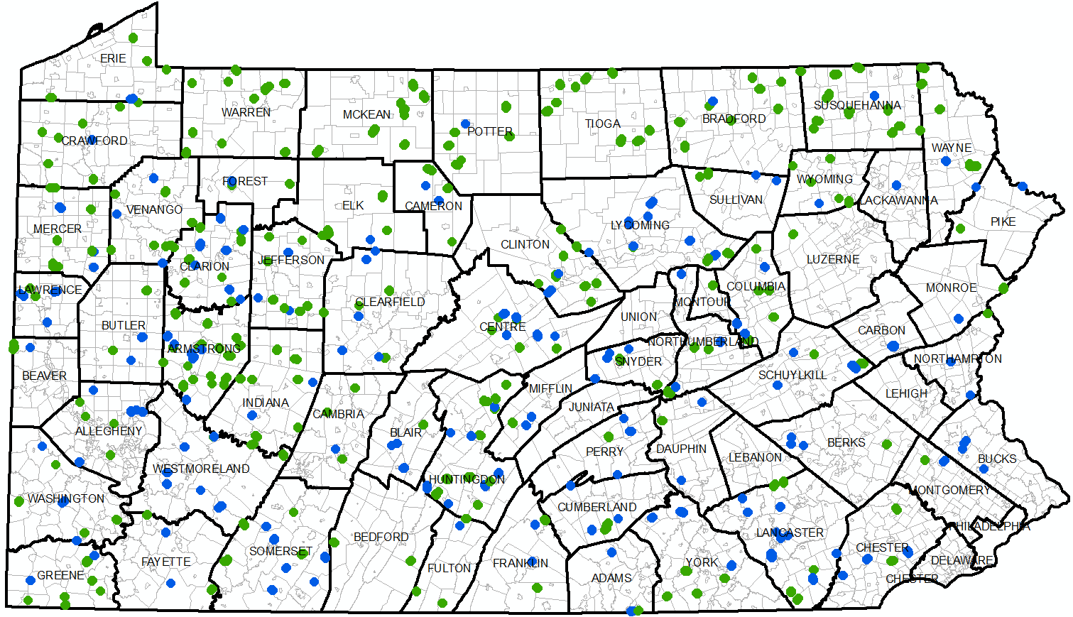
DGLVR Webinar
GIS Analysis
for CDs
3/7/2019
Starts at 9am
We would like to show actual data today. Are there any (preferably small Program) counties willing to volunteer the use of their data for this webinar? (volunteer using chat or question box)
If you are reading this, then you are successfully seeing the webinar video. Webinar audio should be automatic through your computer, and options can be accessed in the “audio options” button on the bottom left. If you are having audio issues, or are in a location where listening via phone is preferable, audio is also available on the CDGRS conference line at:
866-823-7699.
For technical assistance, call: 814-865-5355

Slide 2
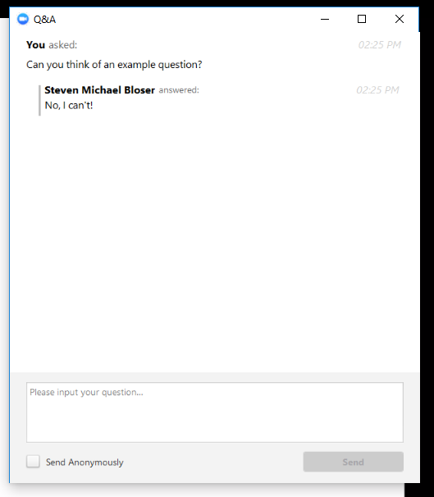
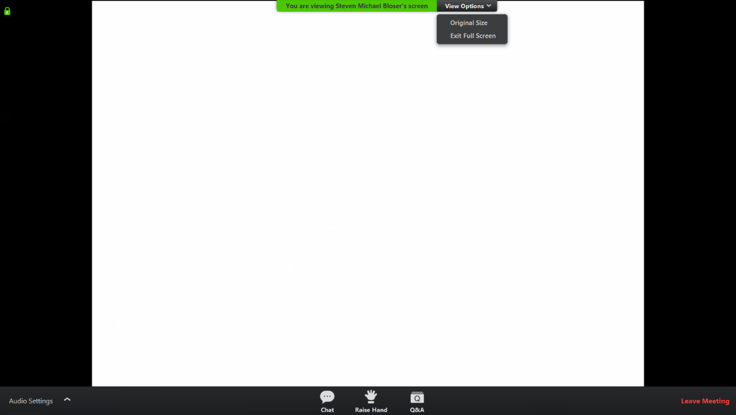
Q&A
Note you can ask a question anonymously
Q&A
For audio via phone: 866-823-7699
For technical assistance: 814-865-5355
Slide #

Slide 3
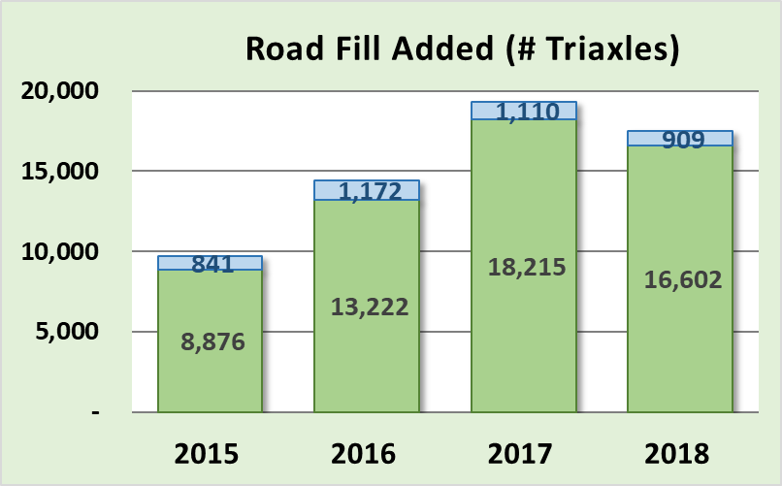
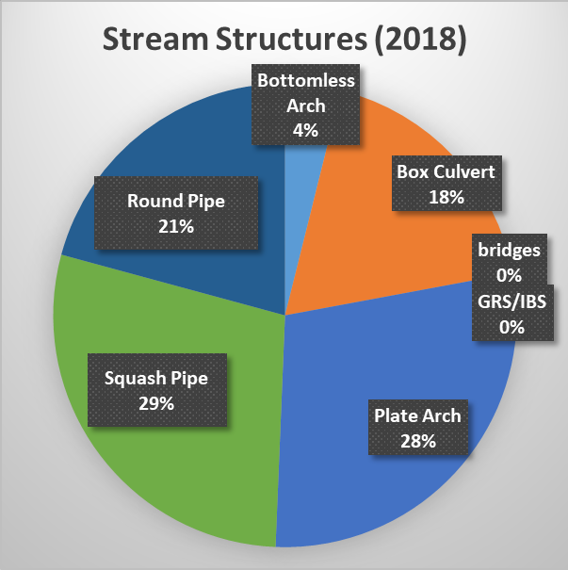
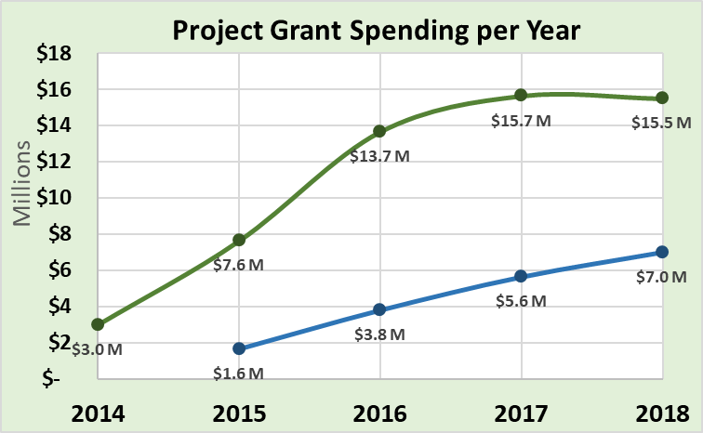
CD GIS Analysis
Purpose:
Demonstrate some of the data mining and analysis potential that already exists in your GIS
Help you to pull useful data out for your county, district board, or QAB

Slide 4
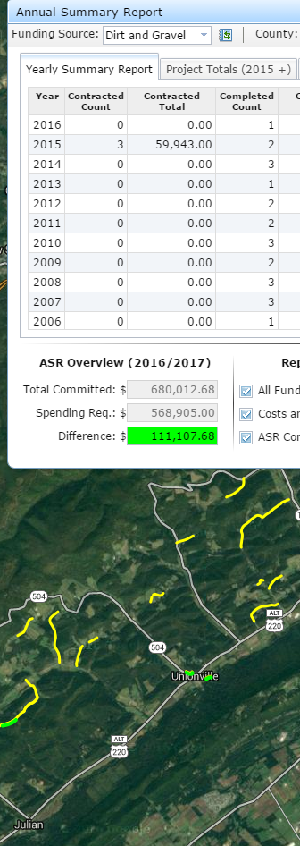
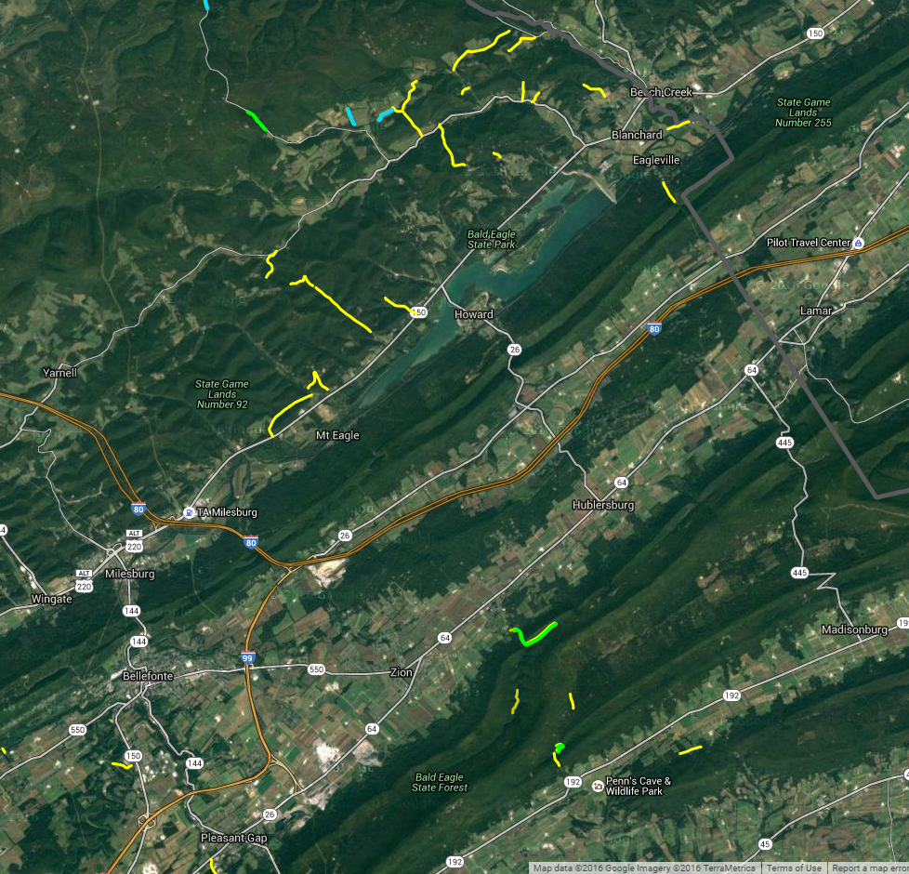
CD GIS Analysis
Internal to GIS
need GIS account to access
Data Exported to Excel
Audio also available via phone: 866-823-7699
For assistance, call: 814-865-5355

Slide 5
CD GIS Analysis
Please note:
This is a webinar, not a training.
Don’t try to follow along, purpose is to provide an overview.
Will be recorded so you can view again if needed.
Are there any counties willing to volunteer the use of their data for the webinar? (use chat or question box)

