Slide 1
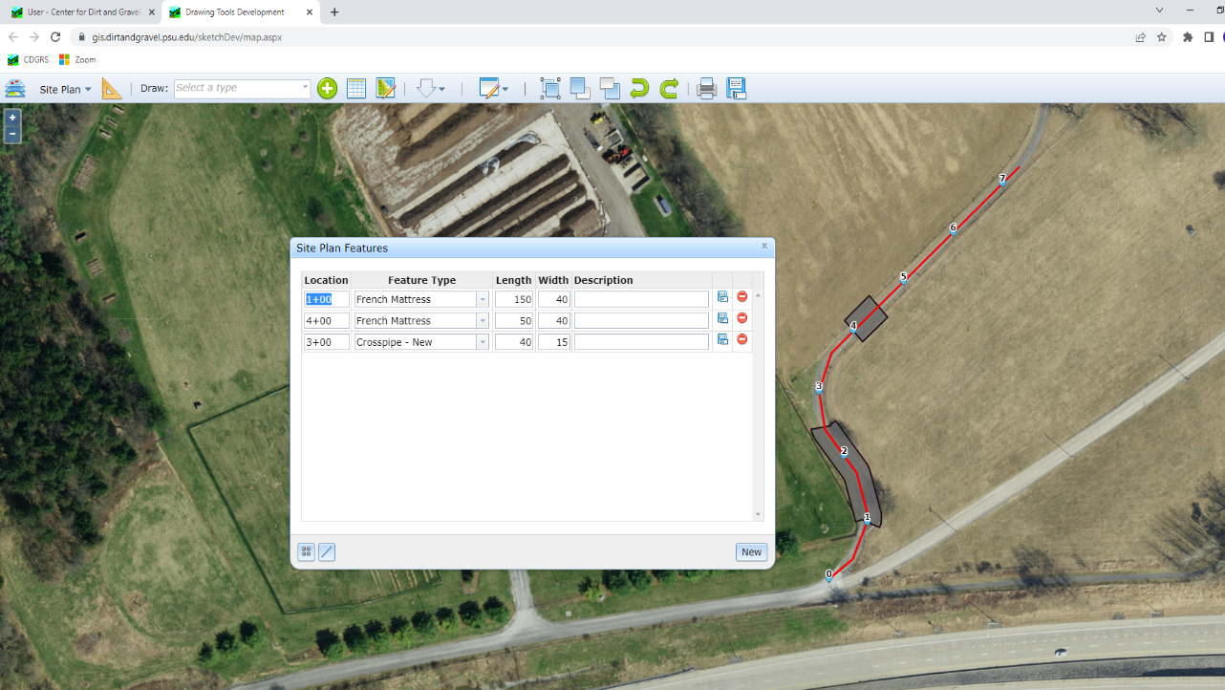
Dirt Gravel and Low Volume Road Program
WEBINAR
12/22/22
Starts 9am
GIS Project Sketches
CDGRS
Steve Bloser
smb201@psu.edu
Ken Corradini
kjc139@psu.edu
If you are reading this, then you are successfully seeing the webinar video. Webinar audio should be automatic through your computer (or click “join audio”), and options can be accessed in the “audio options” button on the bottom left. If your computer audio is not working, you can listen on your phone by dialing 312-626-6799.

Slide 2
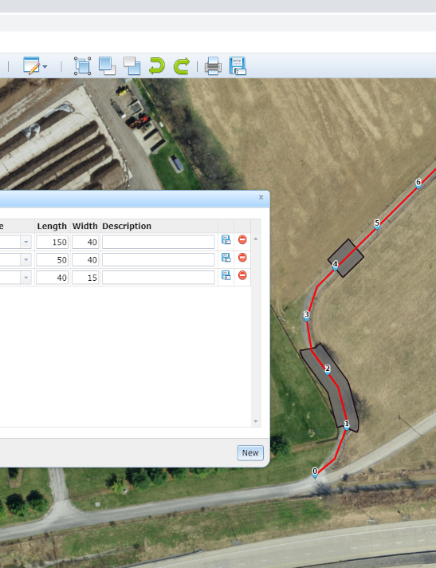
GIS Project Sketches
Purpose
Provide an overview and update on incorporating project sketch capability into DGLVR GIS
Allow input and feedback from CDs

Slide 3
GIS Project Sketches
Background and Status
Demonstration
Moving Forward

Slide 4
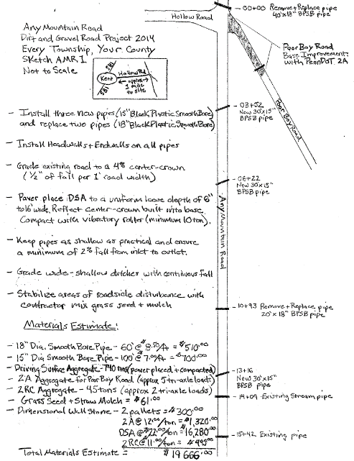
GIS Project Sketches
Project Sketches
Show location of project deliverables such as pipes, turnouts, DSA, etc.
Required as part of workplan, become part of contract.
Most still done by hand:
Some fancy…
www.dirtandgravelroads.org

Slide 5
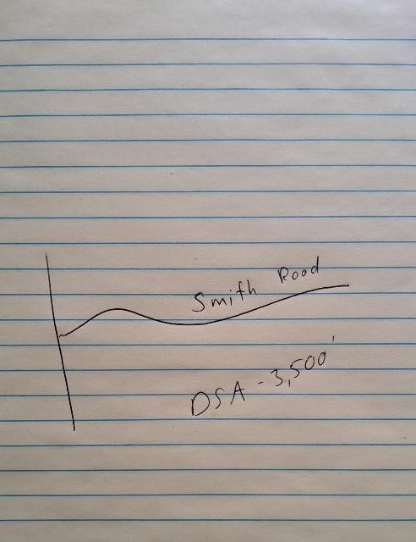
GIS Project Sketches
Project Sketches
Show location of project deliverables such as pipes, turnouts, DSA, etc.
Required as part of workplan, become part of contract.
Most still done by hand:
Some fancy…
Some not…
www.dirtandgravelroads.org

Slide 6
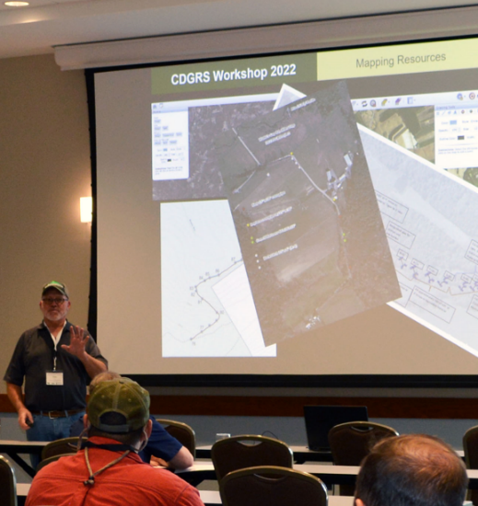
GIS Project Sketches
2022 Workshop Session
Several Counties and CDGRS staff shared tools they use to create workplans
Aerial images, text and graphics in word/ppt
Other software
Good discussion and feedback on possibilities to incorporate into DGLVR GIS system
www.dirtandgravelroads.org

Slide 7
GIS Project Sketches
Since Workshop
CDGRS has been working with programmer to develop project sketch capability
Draw on map to scale
Include stationing
Standardized practices (pipe, mattress, etc)
Can print and attach to grant app
www.dirtandgravelroads.org

Slide 8
GIS Project Sketches
Demonstration Today
Basics are working.
Still rough and in test mode:
Not available to CDs yet
There will likely be glitches during demo.
Will be looking for feedback, ideas, and eventually a few “testers”.
DEMO
www.dirtandgravelroads.org

Slide 9
GIS Project Sketches
Background and Status
Demonstration
Moving Forward

Slide 10
GIS Project Sketches
Background and Status
Demonstration
Moving Forward

Slide 11
GIS Project Sketches
Moving Forward
Use of GIS project sketch will not be required, but available as a tool.
Can print out plans, attach to grant application.
Plans can be saved and “tweaked” to create “as-builts” or reflect project changes.
Will eventually be available to applicants (via public viewer).
www.dirtandgravelroads.org

Slide 12
GIS Project Sketches
Moving Forward
Still in development mode. Potential Timeline:
January: complete initial programming, look for CD “testers”
February: continue testing and programming
March: Potentially “go live” for all CDs to use
www.dirtandgravelroads.org

Slide 13
GIS Project Sketches
Poll Question
Polls are limited to multiple choice, so Please put in the Chat:
Any recommendations or comments based on the demo you saw
Your name and e-mail if you would like to help with testing in January. -Only volunteer if you will actually have the time to put into it.
www.dirtandgravelroads.org

