Slide 1
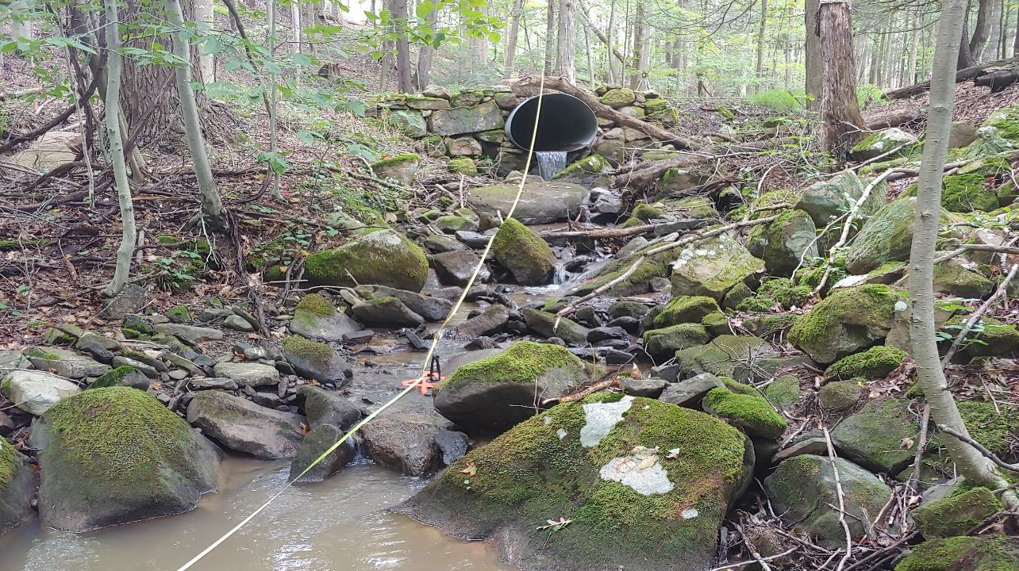


Dirt Gravel and Low Volume Road Program
WEBINAR
1/4/24
Starts 9am
Geomorphic Assessment Tool
Shaun McAdams
spm140@psu.edu
Eric Chase
ehc111@psu.edu
If you are reading this, then you are successfully seeing the webinar video. Webinar audio should be automatic through your computer (or click “join audio”), and options can be accessed in the “audio options” button on the bottom left. If your computer audio is not working, you can listen on your phone by dialing 312-626-6799.

Slide 2

Geomorphic Assessment Online Tool
Basics
Online geomorphic assessment tool for LongPro surveys
Based off current geomorphic assessment Excel spreadsheet
Real time error checking
Individual county login Entity and Pin
County assessments stored in one location
Accessible by CDGRS staff remotely

Slide 3

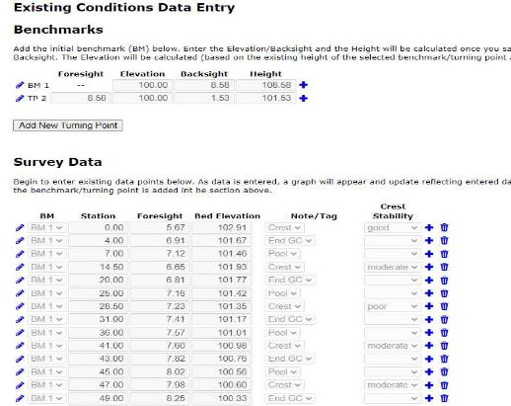
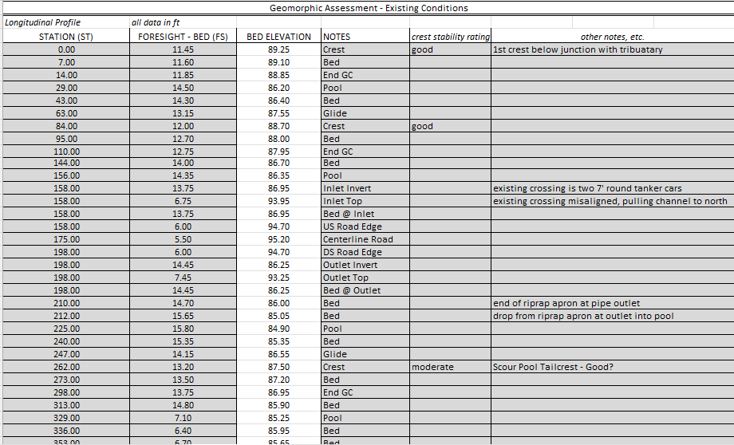
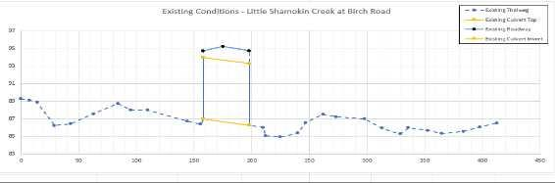
Survey Data Entry

Slide 4
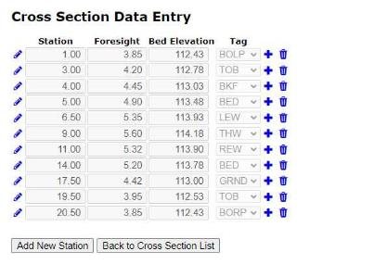
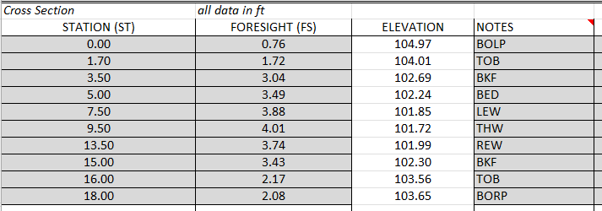
Cross Section Data Entry

Slide 5
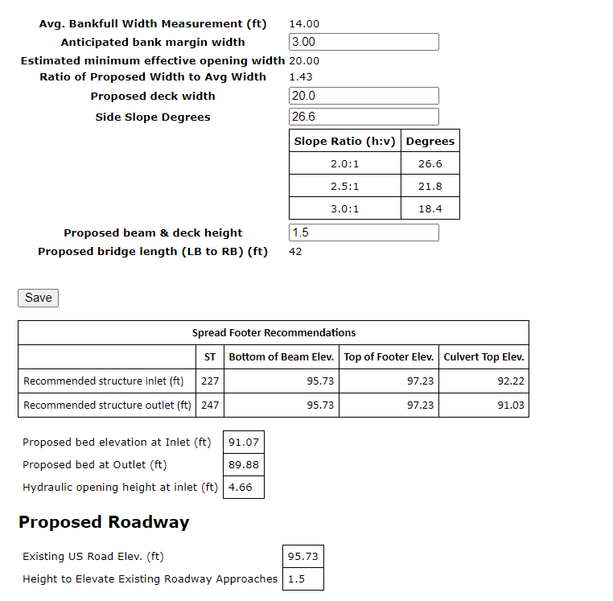
Proposed Conditions Analysis

Slide 6
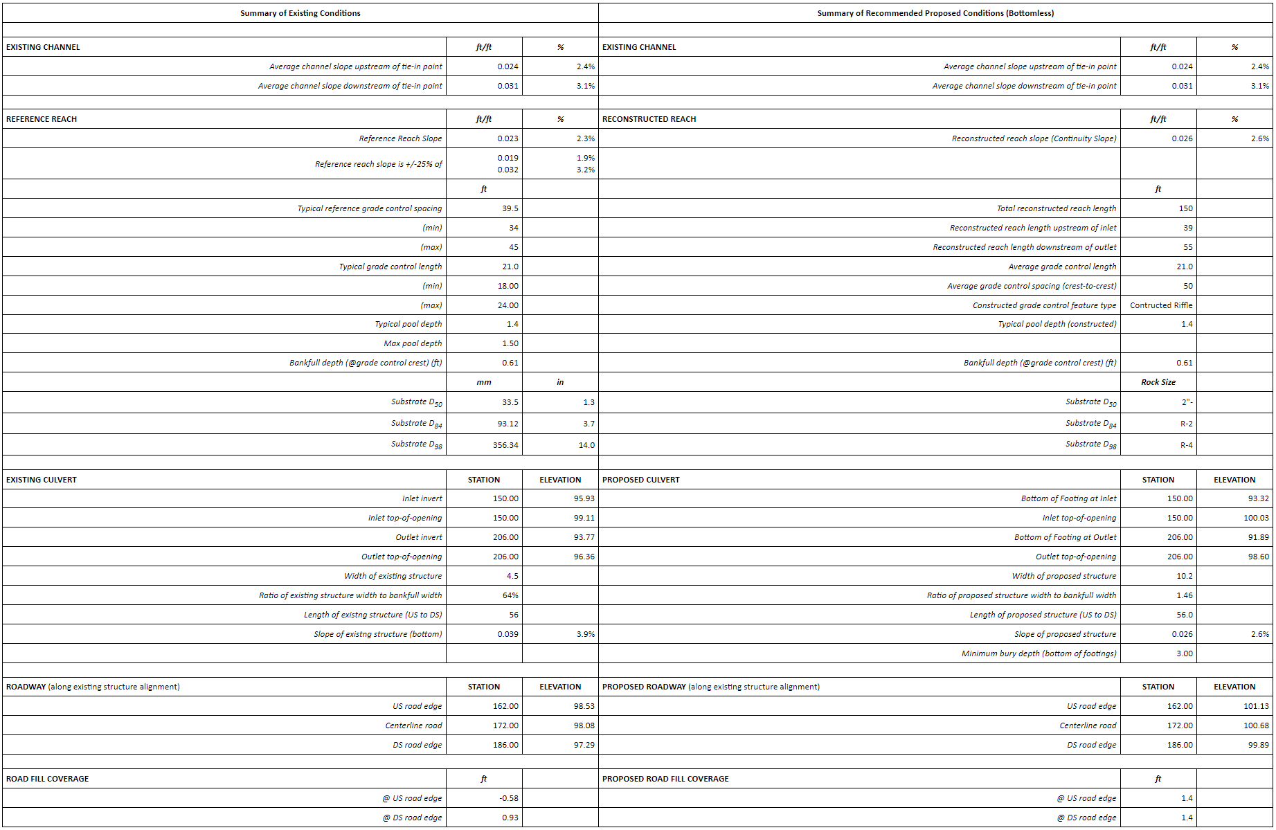
Summary of Existing and Proposed Conditions

Slide 7
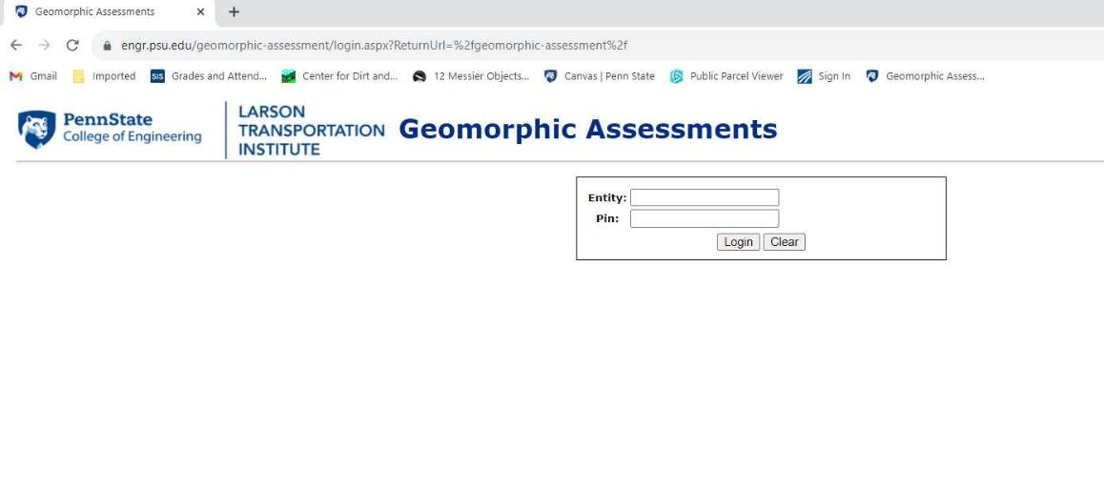
https://www.engr.psu.edu/geomorphic-assessment/

Slide 8
DGLVR Geomorphic Assessment Tool – Questions??
Shaun McAdams
spm140@psu.edu
Eric Chase
ehc111@psu.edu

