Slide 1
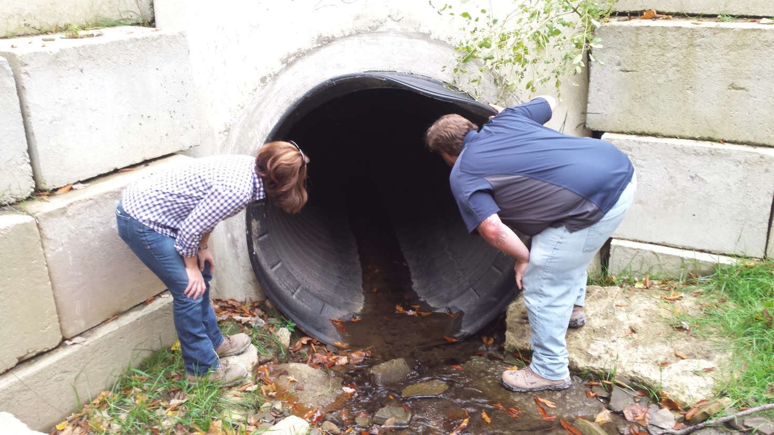
Project Hard Files
Toggle Fullscreen mode with
this button above
Files to Download
Use Chat box to ask Questions
http://metrocount.com
If you are reading this, then you are successfully seeing the webinar video. In addition to audio on the webinar, we have opened a phone conference line to allow attendees to listen and ask questions directly: 866-823-7699. Please use either the webinar audio or conference line, but not both (will produce feedback).
7/7/16
Starts at 9am
Audio also available via phone: 866-823-7699
For assistance, call: 814-865-5355

Slide 2
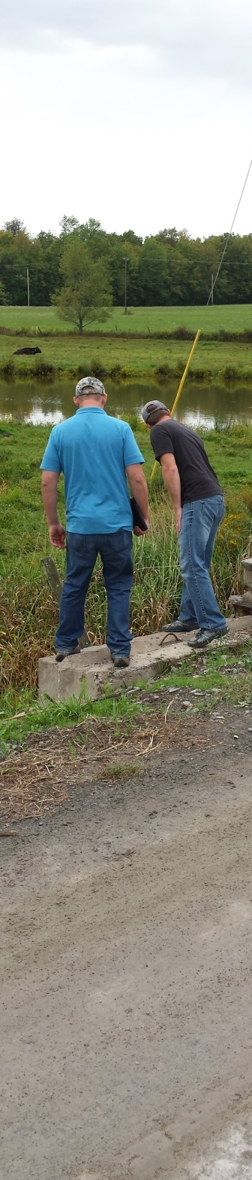
Project Hard Files Webinar
Purpose
Required Documents
Required (if applicable) Documents
Recommended Documents

Slide 3
Project Hard File Webinar
Overview and Purpose
Purpose
  Administrative lessons learned during the QAQC process
  Common misconceptions found during QAQC’s
  What information is required to be kept in a contract file?

Slide 4
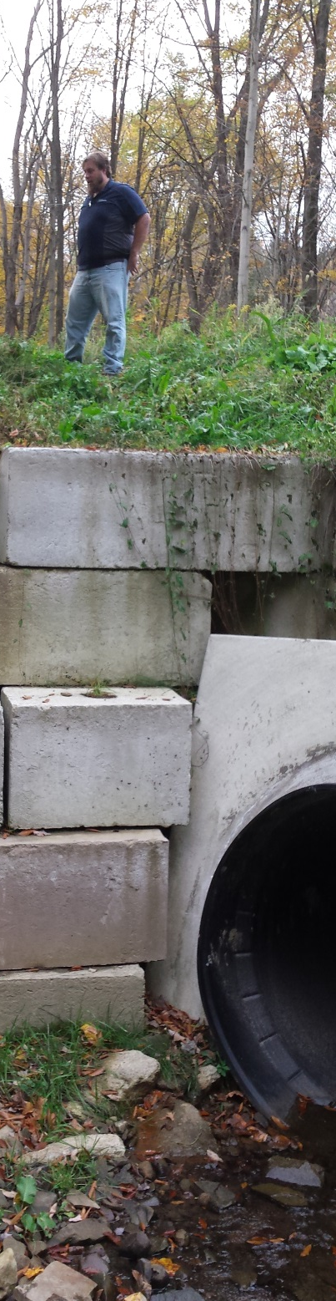
Project Hard Files Webinar
Purpose
Required Documents
Required (if applicable) Documents
Recommended Documents

Slide 5
Project Hard File Webinar
Overview and Purpose
Where can I find these documents??
http://www.dirtandgravel.psu.edu/pa-program-resources/program-specific-resources/blank-forms
-Webinar will follow “contract file checklist”.

Slide 6
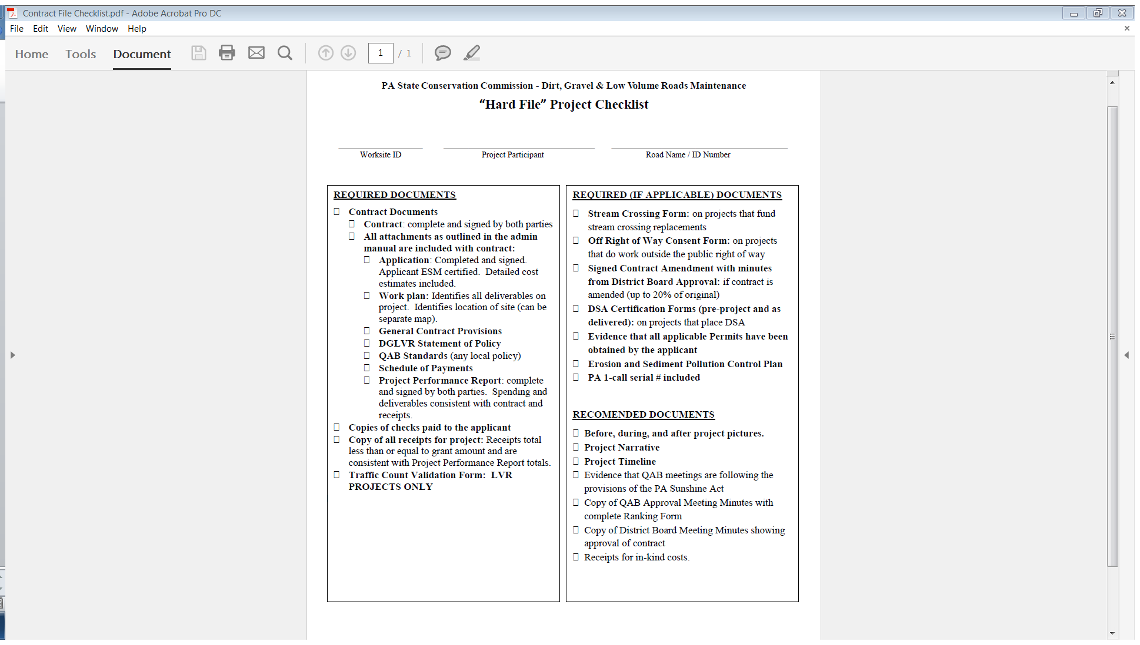
Project Hard File Webinar
Overview and Purpose

Slide 10
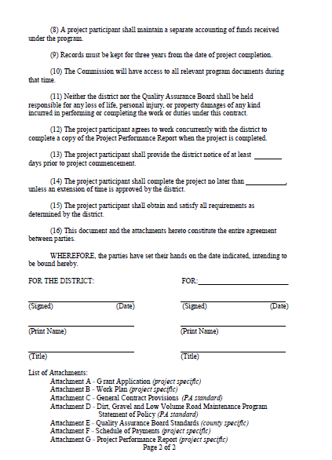

Slide 11
Project Hard File Webinar
Additional Contract Considerations
  Contract must be signed with the road owning entity
  Ensure contract amount matches the application
  Must be signed and dated by both the District and the Project Participant
  Any changes to the standard contract must be approved by the Districts solicitor and a copy sent to the SCC

Slide 14


Slide 18
Project Hard File Webinar
Attachment A – Grant Application
  Important that the amount of funding they request in a grant application matches that amount that is contracted.
  Remember, the application is attached to the contract. The application is what they are required to do, and outlines the amount of money they are requesting.
  Applicant may amend their application if needed after they submit.

Slide 19
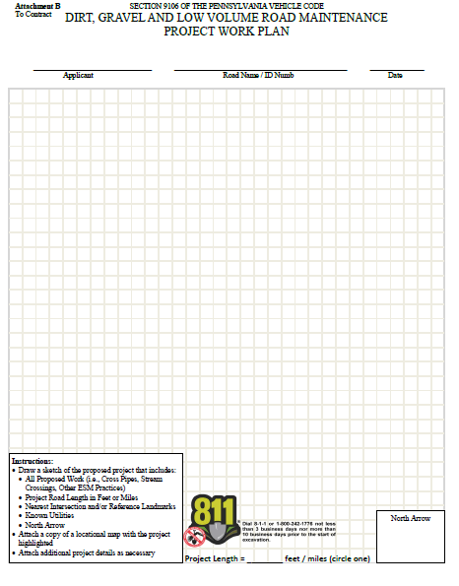
Attachment B – Workplan

Slide 21
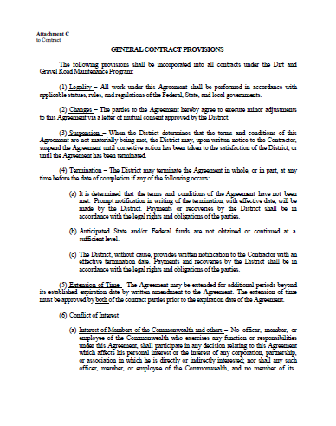
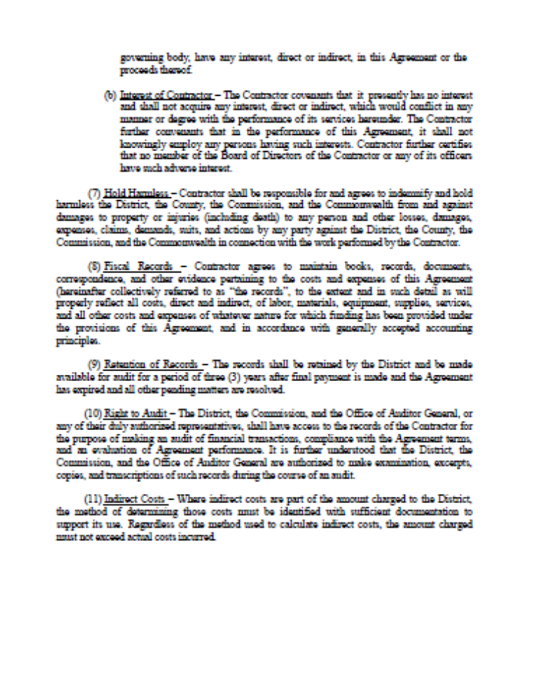
Project Hard File Webinar
Attachment C – General Contract Provisions
***Admin manual appendix G-8

Slide 22
Project Hard File Webinar
Attachment D
SCC Statement of Policy
*Admin Manual Appendix B-3

Slide 23
Project Hard File Webinar
Attachment E – Local QAB Policy
  Every QAB is required to have a written policy or standards
  Must include 5 items
      Equal Access
      Conflict of Interest
      Project Ranking
      Incentives for training
      Non-pollution standards
  See page 35 of Administrative Manual for more information

Slide 24
Attachment F – Schedule of Payments
50 % Maximum
30% Minimum

Slide 26
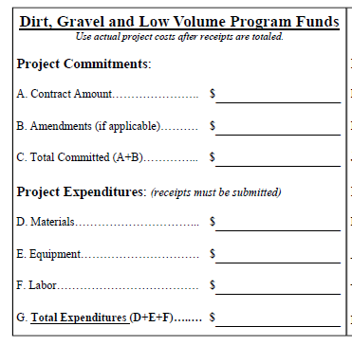
Project Hard File Webinar
Must match contract
Must have amendment form, max 20% of original contract
Project Expenditures: What was actually spent on the project? These amounts must be accounted for with receipts.

Slide 27
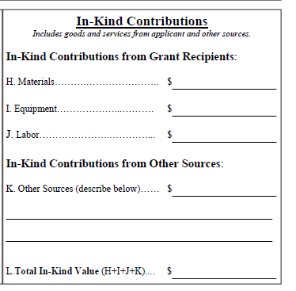
Project Hard File Webinar
Recommended to keep receipts for in-kind contributions
Additional funding sources like growing greener, 319, etc.

Slide 28
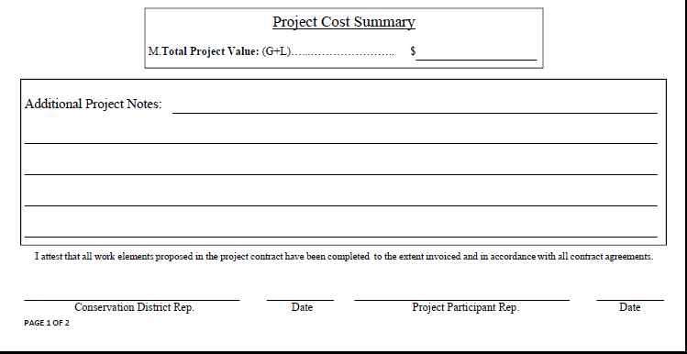
Project Hard File Webinar
Project Cost Summary: Total of Expenditures and In-Kind contributions
Ensure that both the District and the Project Participant sign and date the Project Completion Report

Slide 32
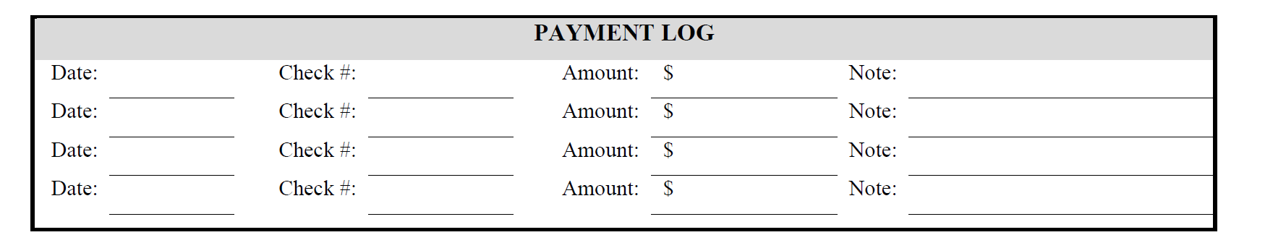
Project Hard File Webinar
Checks paid to the applicant
Evidence of payments to project participant
Maximum of 50% upfront
Hold minimum of 30% until project completion
Can be included on the project timeline form

Slide 33
Project Hard File Webinar
Copy of all receipts for project
Must total to a minimum of the project expenditures
Receipts must show the amount paid, to who it was paid, and what it was paid for.
Recommended to keep in-kind receipts

Slide 36
Project Hard File Webinar
Traffic Count Form
Must be under 500 cars per day
Must be signed and dated
Must be completed March 1st through Thanksgiving, Tuesday through Thursday, not day before or after holiday
Level 1: must be 3pm to 6 pm Tuesday through Thursday.

Slide 37
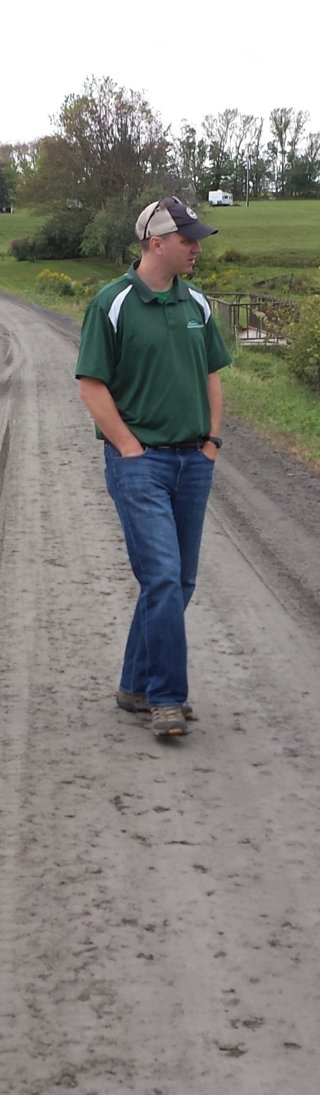
Project Hard Files Webinar
Purpose
Required Documents
Required (if applicable) Documents
Recommended Documents

Slide 38


Slide 41
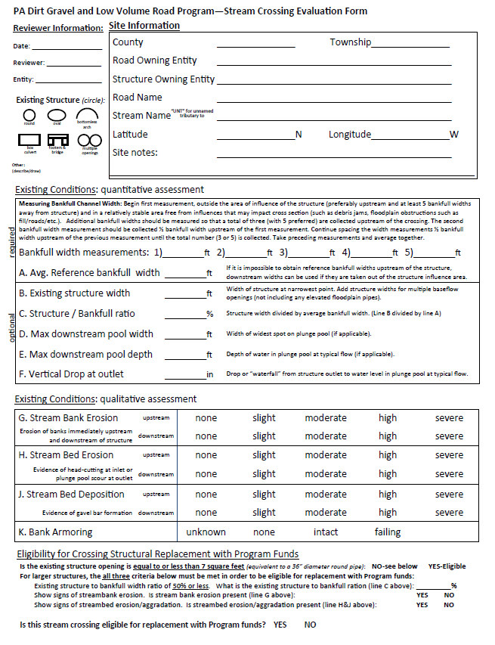
Project Hard File Webinar
Details in manual, and future Webinar topic.
Photo documentation
Recommended!
Site Info
Site Evaluation: width considerations
Site Evaluation: erosion considerations
Appendix M
in manual
Eligibility Determination

Slide 42
Project Hard File Webinar
Stream Crossing Policy Reminder
All replacement structures must be a minimum of 100% bankfull width, regardless of original size
All replacements must be a single structure. No multiple pipes permitted.
Field trip at annual conference: measuring bankfull, policy discussion.

Slide 43
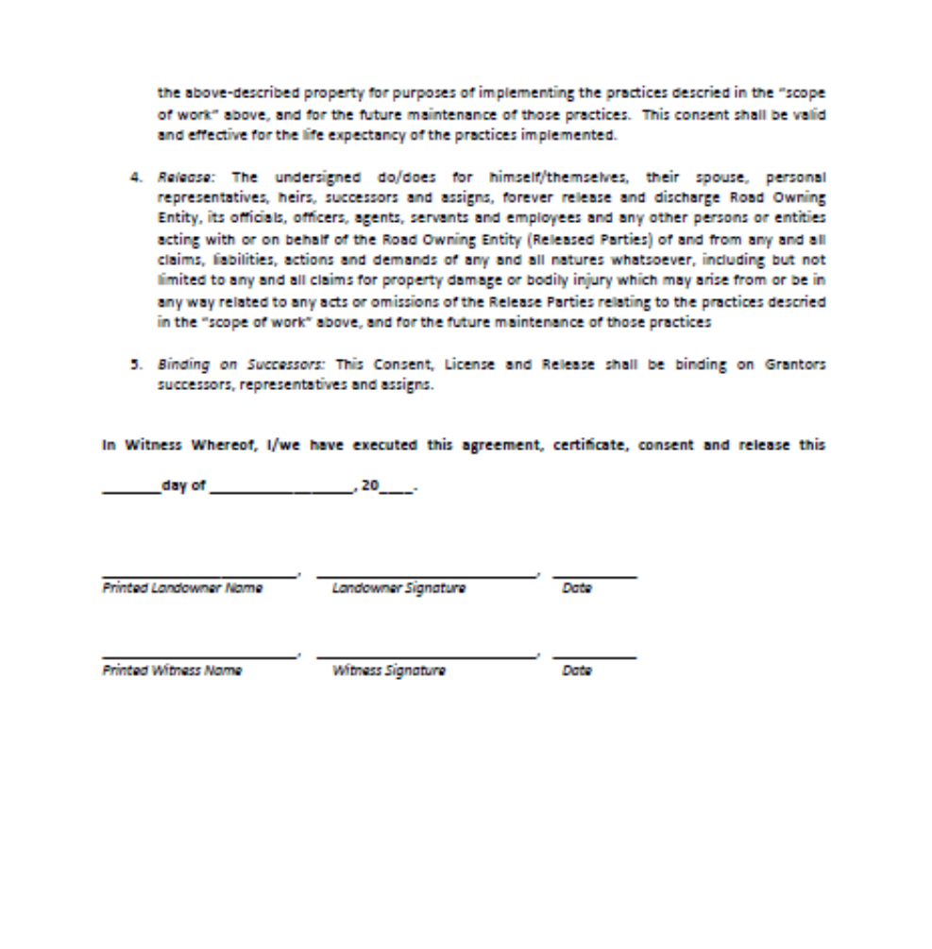
Project Hard File Webinar
Off Right of Way Consent Form

Slide 44
Project Hard File Webinar
Contract Amendment Form
Required in order to amend a contract
Multiple amendments allowed, but no more than 20% of original contract
Cost overruns or time extensions
Must be approved by District Board

Slide 45
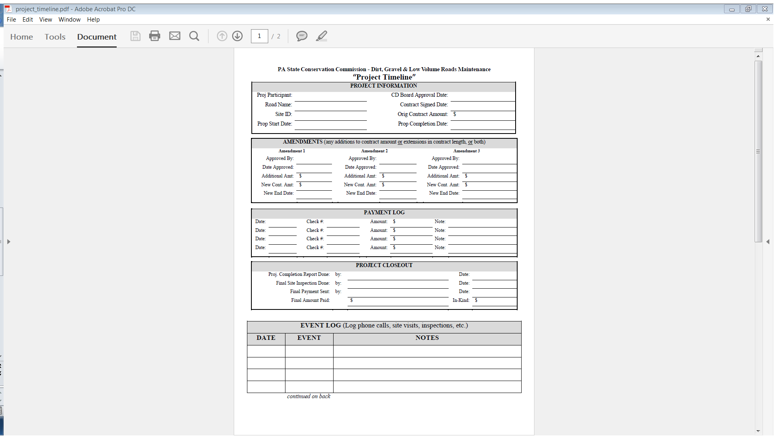
Project Hard File Webinar
Can also be tracked on the Project Timeline , but still need to have a completed contract amendment form

Slide 46
Project Hard File Webinar
DSA Certification
Certification form required with the first load of DSA delivered to the job site
New DSA spec requires DSA to be tested by independent, third party lab
Contact Eric Nevel (DSA Clearinghouse) at the Center for Dirt and Gravel Roads for assistance

Slide 47
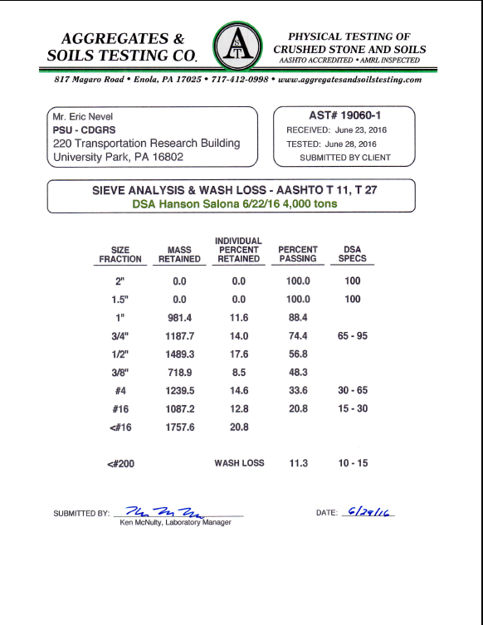
Project Hard File Webinar

Slide 48
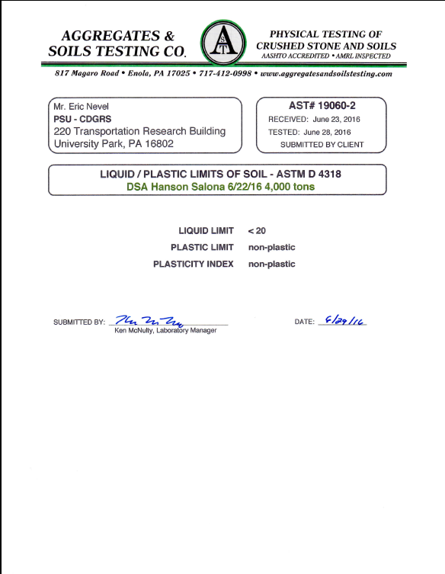
Project Hard File Webinar

Slide 49
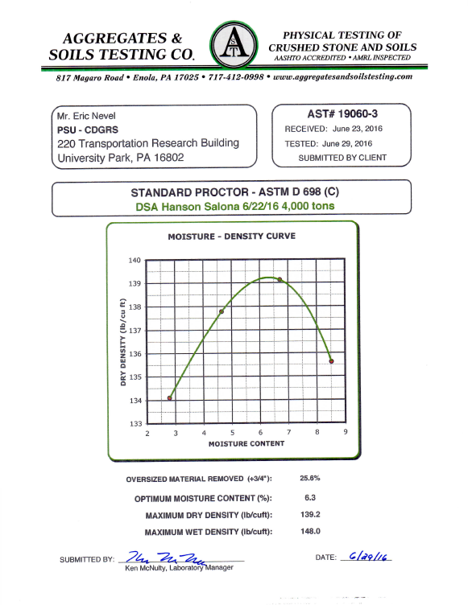
Project Hard File Webinar

Slide 50
Project Hard File Webinar
Permits and Plans
Contracts may be signed prior to obtaining permits and plans. However:
All permits and plans must be obtained prior to start of work or advancing of funds

Slide 51
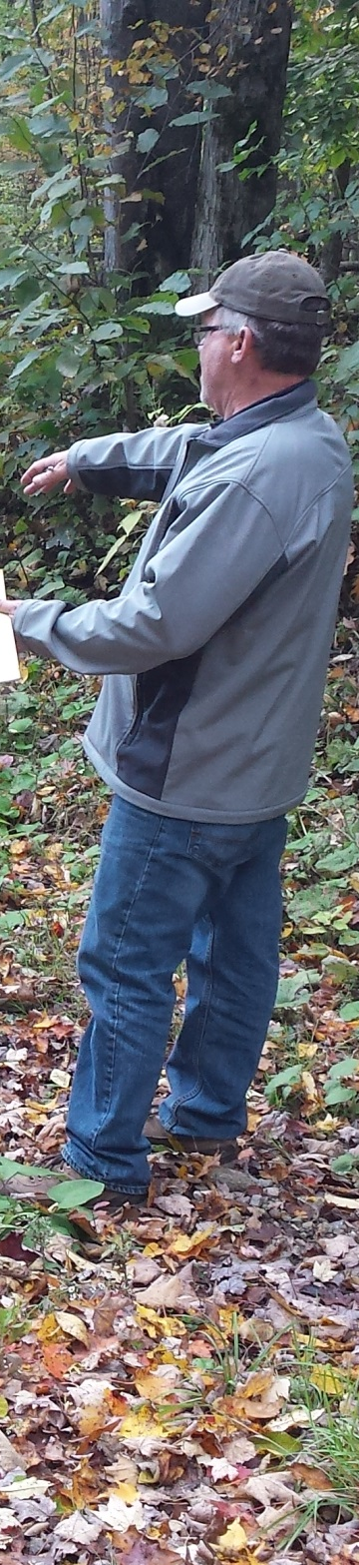
Project Hard Files Webinar
Purpose
Required Documents
Required (if applicable) Documents
Recommended Documents

Slide 54
Project Hard File Webinar
Before, During, and After Photos:
Photo Points
  Find a spot that is out of the way of the project
  Drive a metal stake into the ground
  Take photos from top of the stake whenever possible
  Makes a huge difference in having photos from the same vantage point

Slide 55
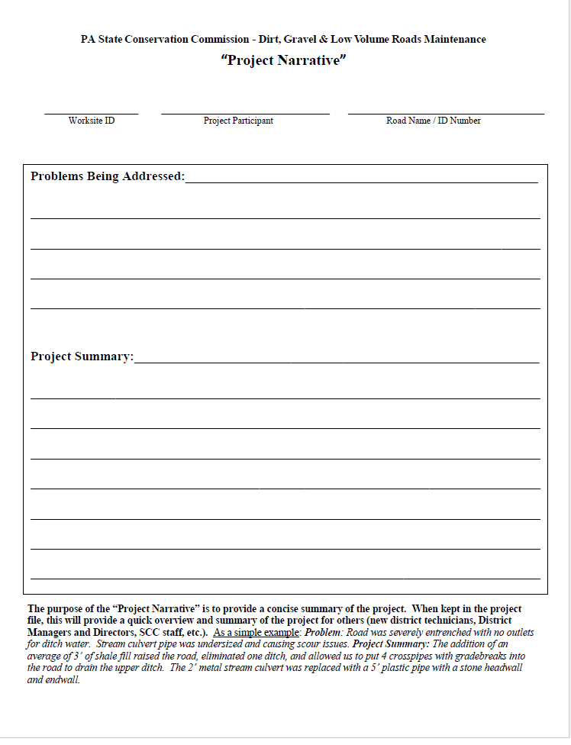

Slide 58
QUESTIONS?

