Slide 1
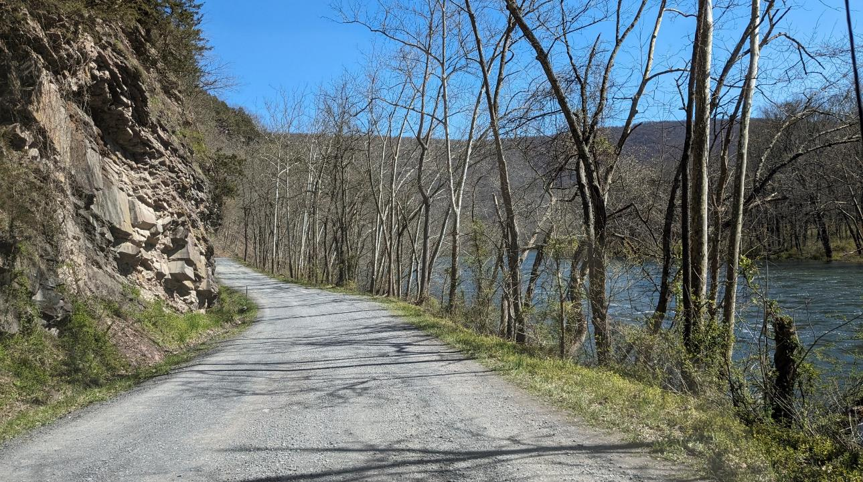
Dirt Gravel and Low Volume Road Program
WEBINAR
4/25/24, 9am
Keeping Up with Spending Requirements
SCC
Sherri Law
Roy Richardson
Andy Mickey
CDGRS
Ken Corradini
Steve Bloser
If you are reading this, then you are successfully seeing the webinar video. Webinar audio should be automatic through your computer (or click “join audio”), and options can be accessed in the “audio options” button on the bottom left. If your computer audio is not working, you can listen on your phone by dialing 646-876-9923.

Slide 2
Introduction
Conservation districts receive DGR and LVR funds annually
These funds must be spent within certain timeframes
Purpose of webinar:
Explain the spending requirements and provides guidance on how to meet them.
ADVICE
AHEAD
Image from https://blog.centerpointgroup.com/how-to-save-millions-in-indirect-spend

Slide 3
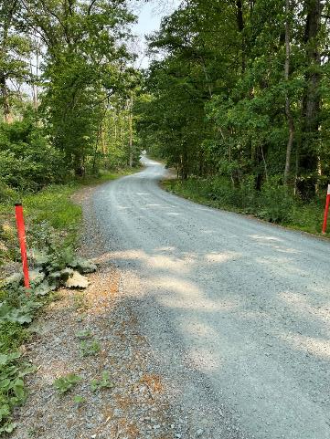
Outline
Quick review of spending basics
Explain the 3 spending requirements
2-year (total allocation)
1-year (admin & edu)
End of Five-year agreement
Tips for keeping up with spending requirements
Budgeting and determining how much funding is available for new projects/expenses
Update on 5-year spending

Slide 4
Outline
Quick review of spending basics
Explain the 3 spending requirements
2-year (total allocation)
1-year (admin & edu)
End of Five-year agreement
Tips for keeping up with spending requirements
Budgeting and determining how much funding is available for new projects/expenses
Update on 5-year spending

Slide 5
Spending Basics
The DGLVR Program follows the state fiscal year
July 1 – June 30
July = month 1

Slide 6
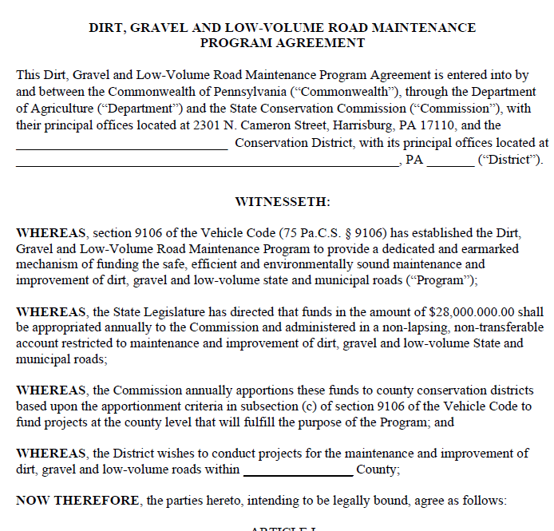
Spending Basics
Conservation districts enter into a 5-year agreement with the State Conservation Commission (SCC).
Allows the CD to run the DGLVR Program locally and receive annual allocations with limited annual paperwork.
Currently, we’re in year 1 of the new Five-Year Agreement (2023-2028)

Slide 7
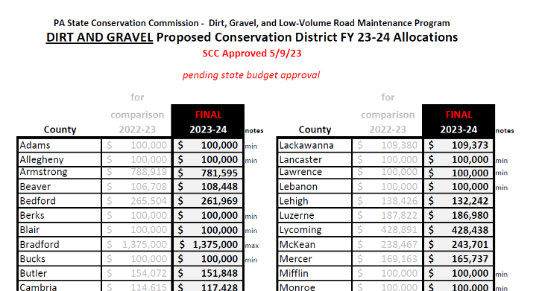
Spending Basics
Annual allocations are typically determined in May each year, pending approval of the state budget 7/1
Could be June or July some years as needed

Slide 8
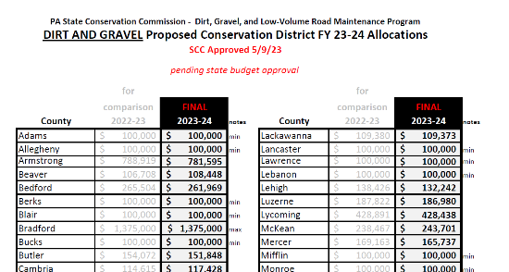
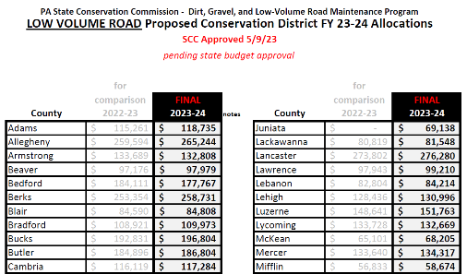
Spending Basics
CDs receive 2 separate allocations each year:
Dirt and Gravel Road funds (DGR) and Low Volume Road Funds (LVR)
Spending requirements are calculated and tracked separately for each allocation

Slide 9
Outline
Quick review of spending basics
Explain the 3 spending requirements
2-year (total allocation)
1-year (admin & edu)
End of Five-year agreement
Tips for keeping up with spending requirements
Budgeting and determining how much funding is available for new projects/expenses
Update on 5-year spending

Slide 10
3.4.2-7 CD Spending Categories
Chap 3. CD Role
DGR (or LVR) Allocation
Must be spent in 2 years
Districts are required to spend their entire allocation within two years of state budget approval in order to be eligible for future allocations.
100% can be used for Projects

Slide 11
3.4.2-7 CD Spending Categories
Chap 3. CD Role
DGR (or LVR) Allocation
Available in the first year of an allocation
2. Admin and edu funds must be spent within one year.
Max 10% can be Admin
Max 10% can be Edu
Minimum 80% Project funds

Slide 12
3.4.2-7 CD Spending Categories
Chap 3. CD Role
Can use less than
10% of allocation for admin and 10% of allocation for edu
DGR (or LVR) Allocation
2. Admin and edu funds must be spent within one year.
Admin
Edu
Minimum 80% Project funds
Notes:
Every county is different, but statewide, CDs spent 7% of their allocations on admin expenses and 3% of their allocations on edu expenses.

Slide 13
3.4.2-7 CD Spending Categories
Chap 3. CD Role
Unused admin & edu allowance become project funds
DGR (or LVR) Allocation
2. Admin and edu funds must be spent within one year.
Admin
Edu
Minimum 80% Project funds

Slide 14
3.4.2-7 CD Spending Categories
Chap 3. CD Role
DGR (or LVR) Allocation
All funds must be spent in 2 years
Admin
Edu
Minimum 80% Project funds

Slide 15
Spending Requirements
What does this look like in the real world?
January
January
July
2021 2022 2023 2024 2025 2026

Slide 16
Spending Requirements
PA Fiscal Year runs July 1 – June 30
2021 2022 2023 2024 2025 2026
FY 2021-22
FY 2022-23
FY 2023-24

Slide 17
Spending Requirements
Total allocation must be spent in 2 years
Can spend funds on admin/edu expenses in 1st fiscal year
2021 2022 2023 2024 2025 2026
FY 2021-22 funds
Admin/Edu
FY 2022-23 funds
Admin/Edu
FY 2023-24 funds
Admin/Edu

Slide 18
Spending Requirements
Annual allocations + 2 year spending requirement = overlapping financial tracking
2021 2022 2023 2024 2025 2026
FY 2021-22 funds
Admin/Edu
FY 2022-23 funds
Admin/Edu
FY 2023-24 funds
Admin/Edu
today

Slide 19
Spending Requirements
SCC assesses 2-year spending requirements 9 months after the requirement
2021 2022 2023 2024 2025 2026
FY 2020-21 funds
3/31/2023: check to see if districts met 6/30/2022 spending requirement
FY 2021-22 funds
FY 2022-23 funds
FY 2023-24 funds
Actual 2-year spending requirement
When we check the 2-year spending requirement

Slide 20
Spending Requirements
3 spending requirements:
Entire allocation must be spent within two years.
Admin and edu funds must be spent within one year.
All funds under a 5-year agreement must be spent by 12 months after the end of the agreement.
For the 2018-2023 agreement, funds must be spent by 6/30/2024.

Slide 21
Spending Requirements
Five Year Agreement
Provides 6 years to spend 5 year’s DGLVR allocations
Extra year maintains 2-year spending requirement
2019 2020 2021 2022 2023 2024
FY 2018-19 funds
FY 2019-20 funds
FY 2020-22 funds
FY 2021-22 funds
FY 2022-23 funds
FY 2023-24 funds

Slide 22
Outline
Quick review of spending basics
Explain the 3 spending requirements
2-year (total allocation)
1-year (admin & edu)
End of Five-year agreement
Tips for keeping up with spending requirements
Budgeting and determining how much funding is available for new projects/expenses
Update on 5-year spending

Slide 23
Keeping up with Spending Requirements
How do districts get in trouble with spending requirements?
Timing

Slide 24
Keeping up with Spending Requirements
Each 2-year spending period only spans 1 continuous construction season
July 1
2021 2022 2023 2024 2025 2026
FY 2022-23 funds
FY 2023-24 funds
FY 2024-25 funds

Slide 25
Keeping up with Spending Requirements
How districts get in trouble with spending: Timing
Jan-June: difficult to get construction started in the few spring months
July 1
2021 2022 2023 2024 2025 2026
FY 2022-23 funds
FY 2023-24 funds
July-Dec: difficult to prepare, start, and complete a project before it gets too cold
FY 2024-25 funds

Slide 26
Keeping up with Spending Requirements
How districts get in trouble with spending
Relying on advances to meet spending requirements
It’s better to rely on completing projects and only rely on advances as a last resort to meet spending
$140k project has 50% advanced and won’t be complete by the spending requirement

Slide 27
Keeping up with Spending Requirements
How districts get in trouble with spending
Relying on advances to meet spending requirements
It’s better to rely on completing projects and only rely on advances as a last resort to meet spending
There isn’t enough funding available to meet the spending requirement

Slide 28
Keeping up with Spending Requirements
How districts get in trouble with spending
Staff turnover
Projects get delayed when new staff take over at the CD
Be cautious of the types of projects being funded
More on this later

Slide 29
Keeping up with Spending Requirements
How to keep up with spending requirements?
Run an annual grant program

Slide 30
Keeping up with Spending Requirements
Prepare projects the calendar year before they go to construction
Be ready to contract projects with 2024-25 funds as soon as the 2024-25 FY starts
Work proactively, not reactively!
2021 2022 2023 2024 2025 2026
FY 2022-23 funds
FY 2023-24 funds
July 1
Use 2024 to prepare for projects that will be constructed in 2025
FY 2024-25 funds
Notes:
Have grant applications ranked and ready for QAB recommendation with the intent of using those applications to commit the upcoming allocation immediately.

Slide 31
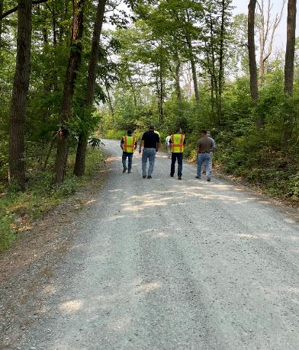
Keeping up with Spending Requirements
Things to do in 2024 to be able to construct projects in 2025 with FY 2024-25 funds:
Education and outreach to potential applicants
pre-app meetings
application due date
Revise applications as needed
Rank applications / QAB meeting
Revise applications as needed
CD Board approval
Create contract in GIS
Have grant recipient sign contract

Slide 32
Keeping up with Spending Requirements
Things to do in 2024 to be able to construct projects in 2025 with FY 2024-25 funds:
Education and outreach to potential applicants
pre-app meetings
application due date
Revise applications as needed
Rank applications / QAB meeting
Revise applications as needed
CD Board approval
Create contract in GIS
Have grant recipient sign contract
Can start these BEFORE 7/1
If you’re interested in doing these steps before you receive the next allocation, reach out to Ken or SCC to discuss

Slide 33
Expedite the Project Timeline
Sample Timeline
Summer/Fall 2023 – Complete pre-application meetings
Winter 2024 – Accept applications
Spring 2024 – Rank project applications
June/July 2024
Once new allocation amount is known, hold QAB meeting and recommend projects for funding
Approve projects at District Board meeting
Contract the new projects
July 2024 – October 2025 – Complete Construction
November/December 2025 – Close out project including reimbursement to project participant

Slide 34
Expedite the Project Timeline
Sample Timeline – stream crossing
Summer/Fall 2023 – Complete pre-application meetings
Winter 2024 – Accept applications
Spring 2024 – Rank project applications
June/July 2024
Once new allocation amount is known, hold QAB meeting and recommend projects for funding
Approve projects at District Board meeting
Contract the new projects
Site assessment required before QAB recommends a stream crossing for funding
(includes long pro, cross section, pebble count and any additional geomorphic assessment)
Have the pre-design meeting immediately after contracting so the engineer’s assessment and design can begin

Slide 35
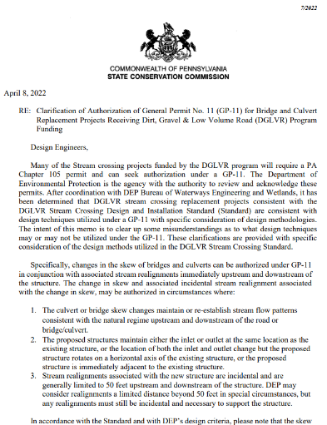
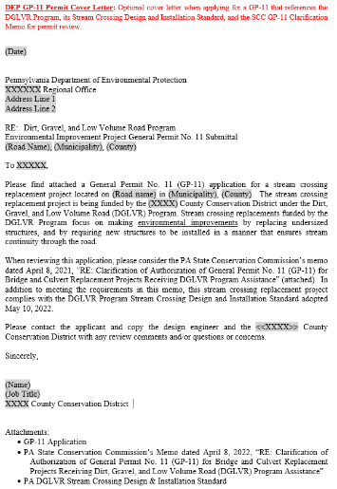
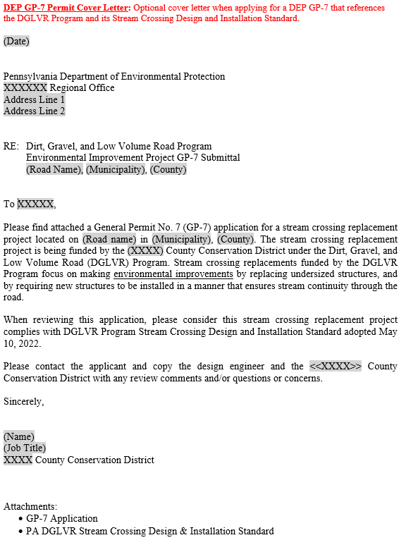
Expedite the Project Timeline
Sample Timeline – stream crossing (continued)
Late summer/early fall 2024 - Review and revise the draft design
Oct/Nov 2024 - Submit the permit application w/GP-7 or GP-11 cover letter

Slide 36
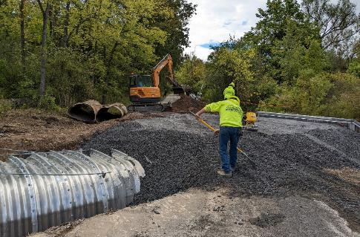
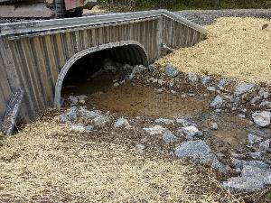
Expedite the Project Timeline
Sample Timeline – stream crossing (continued)
Winter 2024/25 – review revised permit application before it’s resubmitted (if applicable)
January/February 2025 – Receive permit authorization
February/March 2025 – Review bid documents & bid project construction (if applicable), order structure
Summer 2025 – Construct the project

Slide 37
Keeping up with Spending Requirements
How to stay on track with spending requirements
Run an annual grant program
Be up front with program participants about the required timelines
Fund projects that can be completed in the allotted time
Fund a variety of project types

Slide 38
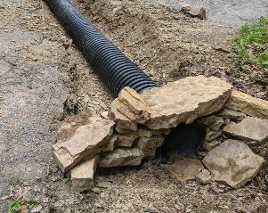
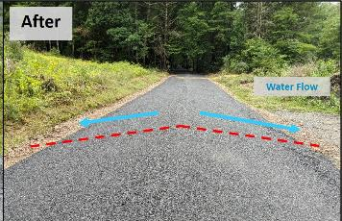
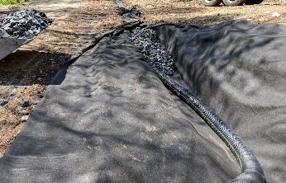
Keeping up with Spending Requirements
Projects that can typically be done quickly:
“traditional” drainage and road base improvements
New cross pipes
New turnouts
Raise an entrenched road to achieve sheet flow
Good crown and cross slope
Grade breaks
Address groundwater saturation with underdrain and French mattress
Driving Surface Aggregate

Slide 39
Keeping up with Spending Requirements
What might make a project take longer to complete?
Any project with additional steps, typically:
Engineering
Permitting
Formal, competitive bidding (materials or hiring a construction contractor)
Keep in mind, each of these steps may have some “back and forth”
Asking the engineer to update the design to meet DGLVR policy
Permit reviewers requiring changes to the permit application
No bidders or bids coming in to too high

Slide 40
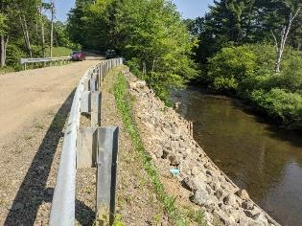
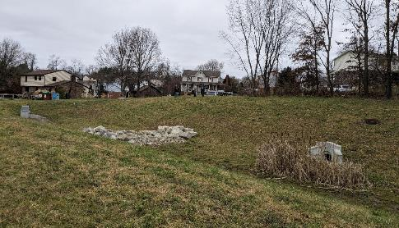
Keeping up with Spending Requirements
What kind of projects often require additional steps?
In-stream work
Stream crossing replacement
Stream bank stabilization
Slide repairs
Some storm water management practices
Storm sewer, infiltration, detention
Sometimes, traditional drainage practices
Depends on site conditions and road owner
preferences

Slide 41
Keeping up with Spending Requirements
Does this mean I should never fund these types of projects? (stream projects, landslides, engineered stormwater management, etc.)
No!
It means, don’t only fund these projects.
Have discussions with Center and SCC to see what kind of projects are right for your situation.
In general, fund a variety of types of projects:
Some might be done in less than 2 years
Some might be done in more than 2 years
If you budget correctly, you can complete a project that takes more than 2 years and still meet the 2-year spending requirement

Slide 42
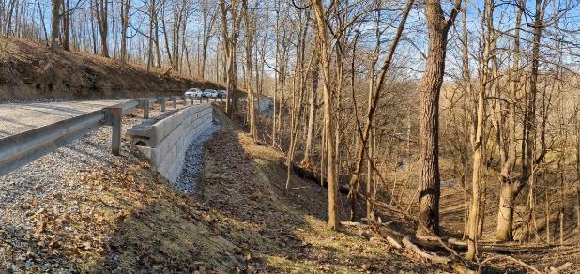
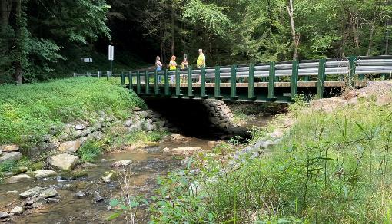
Keeping up with Spending Requirements
If the only applications you receive are for complex projects, consider additional outreach and education
Highlight the benefits of drainage projects
Share example pictures of drainage projects
Consider local policy to limit the number of complex projects (stream crossings, large slide repairs, etc.)
Reach out to Center and SCC for assistance

Slide 43
Keeping up with Spending Requirements
Tips to speed up projects:
Clear communication
Discuss DGLVR requirements frequently with grant recipients and other project participants (engineer, permit reviewer, contractor)
In person, on the phone, in writing
pre-application meeting
pre-design meetings
Pre-bid site showing
Pre-construction meeting
Frequent construction inspections
Provide key info in writing (emails, tech bulletins, etc.)
Check out checklists for each of these meetings on the “Blank Forms” webpage!
https://dirtandgravel.psu.edu/pa-program-resources/program-specific-resources/blank-forms/

Slide 44
Keeping up with Spending Requirements
How to stay on track with spending requirements
Run an annual grant program
Be up front with program participants about the required timelines
Fund projects that can be completed in the allotted time
Fund a variety of project types
Make sure you know how much money you need to spend (use GIS)
Budget well so you don’t have extra money leftover
If anything comes in underbudget, reallocate that funding ASAP

Slide 45
Keeping up with Spending Requirements
How to figure out spending requirements?
GIS
2-year spending is tracked in Annual Summary Report (ASR)
At the end of the 5-year agreement, don’t look at the ASR for spending
Additional webinars will be held to provide more detail
Call Ken or Sherri for assistance!
Photo from: https://www.iconfinder.com/icons/5399714/call_customer_handphone_happy_icon

Slide 46
Outline
Quick review of spending basics
Explain the 3 spending requirements
2-year (total allocation)
1-year (admin & edu)
End of Five-year agreement
Tips for keeping up with spending requirements
Budgeting and determining how much funding is available for new projects/expenses
Update on 5-year spending

Slide 47
Budgeting
How to budget DGLVR funds
annually
Because CDs receive new DGLVR funds every year
Because CDs have 1 year to spend admin/edu funds
Helps CDs stay on track to meet spending requirements

Slide 48
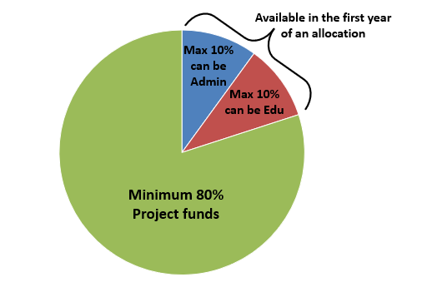
Budgeting
How to budget DGLVR funds
Total allocation = admin funds + edu funds + project funds
Project funds = total allocation – admin funds – edu funds

Slide 49
Budgeting
Project funds = total allocation – admin funds – edu funds
Should show the same balance at the end of each quarter!
Figure out how much of your allocation you need for admin/edu expenses for the fiscal year
Subtract this from your allocation
The remaining amount should be allocated to projects
Don’t forget to check the GIS and your DGR & LVR bank accounts to see if you have any other funds available for projects.
Unspent admin/edu
Projects that came in under budget
Interest
Other?

Slide 50
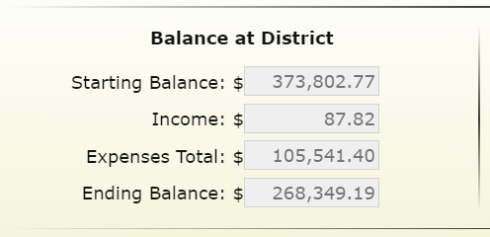
Budgeting
Why does it matter if bank account and GIS balances match?
If they don’t match, you don’t know how much money you have ☹

Slide 51
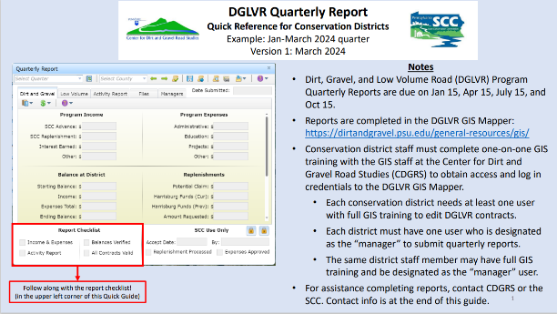
Budgeting
What to do when bank account and GIS balances don’t match?
Update the GIS quarterly report income and expenses and click “save”
View the Quarterly Report Quick Guide section on account balances
https://dirtandgravel.psu.edu/education-training/program-administration/
Attend Financial Training
Call Ken and the SCC

Slide 52
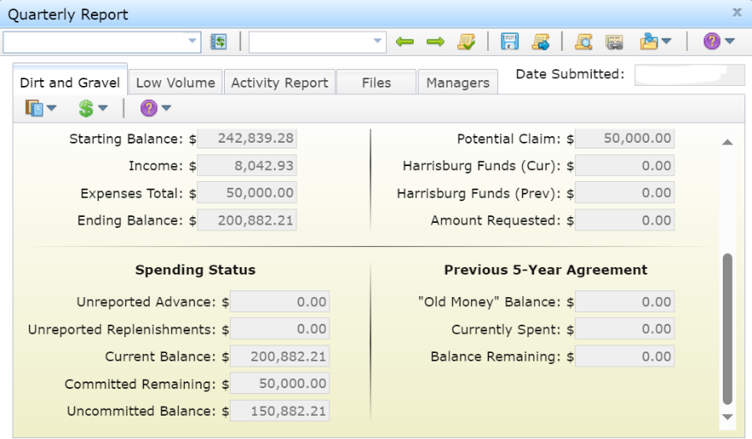
Budgeting
The “Uncommitted Balance” in GIS is NOT automatically all available for new projects!
This number shows all funds available for any future expense, including:
Admin
Edu
Amendments
New projects

Slide 53
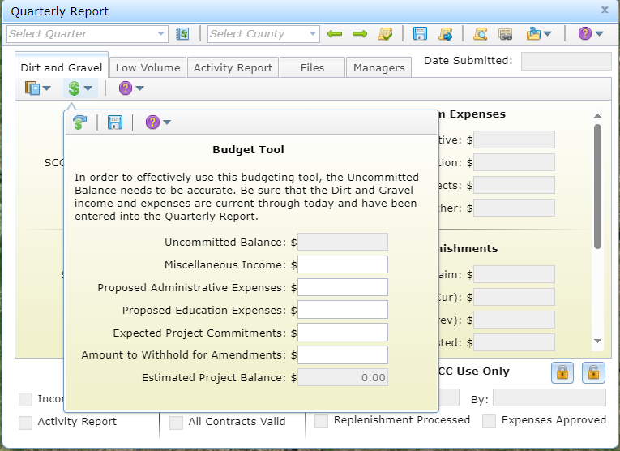
Slide from “FY 2022-23 Updates” webinar
Quarterly Reports: Budget Tool
Helps with simple budgeting
Resets after each quarter but has a tool to import the previous quarter’s values
Important to have the income and expenses current in the QR in order for the budget to be accurate

Slide 54
Budgeting
How to budget DGLVR funds
Use budgeting tool in quarterly report
Revisit regularly or at least once a year
Reach out to SCC for assistance
More detail in the DGLVR Financial Training
Register online here: https://dirtandgravel.psu.edu/education-training/program-administration/financial-training-registration/
May 22 (Westmoreland County)
July 24 (Centre County)
October 17 (Luzerne County)
December 4 (Venango County)

Slide 55
Outline
Quick review of spending basics
Explain the 3 spending requirements
2-year (total allocation)
1-year (admin & edu)
End of Five-year agreement
Tips for keeping up with spending requirements
Budgeting and determining how much funding is available for new projects/expenses
Update on 5-year spending

Slide 56
Update on 5-year spending
All funding from agreement must be spent out by 6/30/2024
Current CD Status as of 4/25/2024
Spent everything: 30 DGR, 32 LVR
Committed everything: 26 DGR, 24 LVR
Not committed: 8 DGR, 10 LVR

Slide 57
Update on 5-year spending
Dirt and Gravel
Committed: $3,236,708.49
Not Committed: $183,916.76
Low Volume
Committed: $1,917,259.79
Not Committed: $486,087.44
Total that still needs to be spent
DGR: $3,420,625.25
LVR: $2,403,347.23
Total: $5,823,972.48

Slide 58
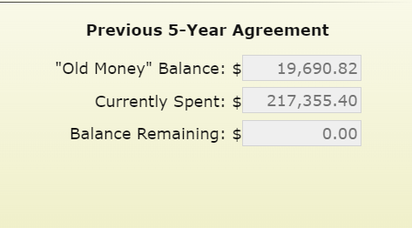
Update on 5-year spending
If you are Green in both DGR and LVR, great job!
You have a “balance remaining” of $0
You have spent all DGR and/or LVR funds from the previous 5-Year Agreement.

Slide 59
Update on 5-year spending
If you are Yellow in DGR and/or LVR:
You have a “balance remaining” and it is greater than the committed remaining

Slide 60
Update on 5-year spending
If you are Red in DGR and/or LVR
You have a “balance remaining” and it is greater than the committed remaining

Slide 61
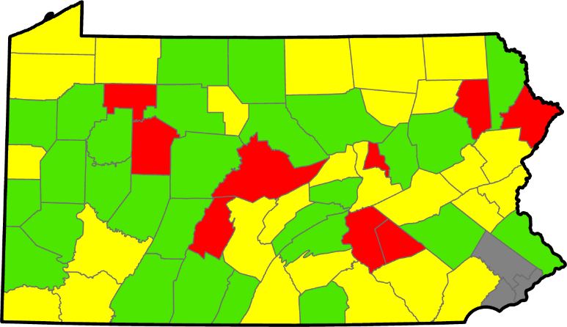
Update on 5-year spending
5-Year Spending Status – DGR
As of 4/25/2024

Slide 62
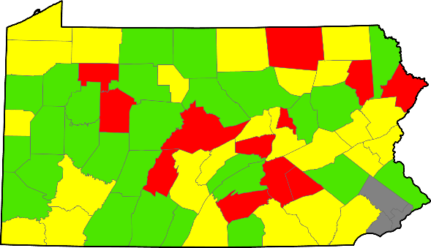
Update on 5-year spending
5-Year Spending Status – DGR
3/19/2024
4/25/2024

Slide 63
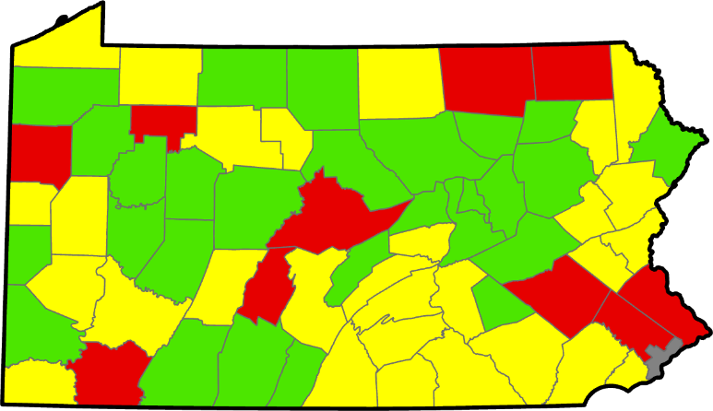
Update on 5-year spending
5-Year Spending Status – LVR
As of 4/25/2024

Slide 64
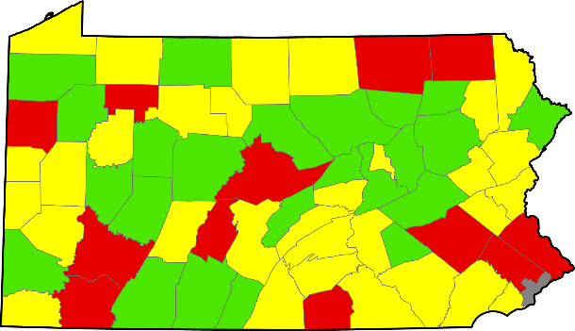
Update on 5-year spending
5-Year Spending Status – LVR
3/19/2024
4/25/2024

Slide 65
Update on 5-year spending
What do you consider “spent”?
For DGLVR Program: when DGLVR Funds leave your Program account
An admin/edu expense has been paid with Program funds and reported in quarterly report
A check has been written to the grant recipient and entered in GIS
Advances, partial payments, final payments

Slide 66
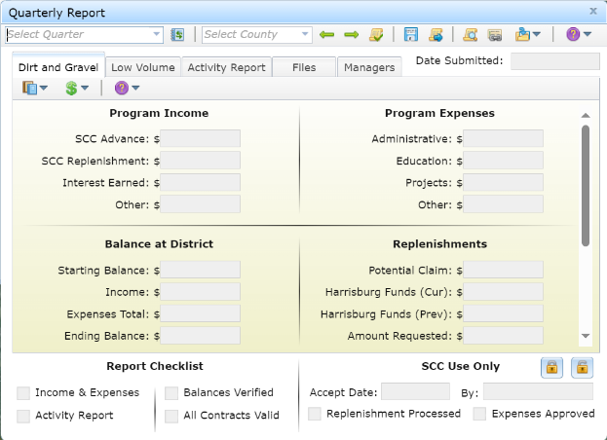
Update on 5-year spending
Question: How do I make sure my spending is counted towards the spending requirement?
Answer: Enter admin, edu, and project expenses in the GIS by 6/24/2024 (and don’t forget to click save!)

Slide 67
Update on 5-year spending
Question:
What if my expenses won’t be ready to enter in GIS by 6/24/2024?
Answer:
Contact Ken or the SCC to discuss a plan

Slide 68
Update on 5-year spending
Question:
What if I know I’m not going to meet my spending requirements?
Answer:
Reach out to Ken or the SCC to let us know.

Slide 69
Keeping up with Spending Requirements
Take Home:
Think about Timing
(Run an annual program)
When funding complex projects:
Consider limiting the number of them funded at once
Consider spending deadlines and how long money may be “tied up” in a project

